Slide 1
EUGridPMA
Status and Current Trends and some technical topics
November 2013
La Plata, AR
David Groep, Nikhef & EUGridPMA

Slide 2
EUGridPMA Topics
EUGridPMA (membership) status
Risk Assessment Team
IPv6 readiness and fetch-crl
SHA-2 time line
CA readiness for SHA-2 and 2048+ bit keys
OCSP support documents and guidelines
GFD.125bis
Private Key Protection Guidelines v1.2
IGTF Test Suite
On on-line CAs and FIPS 140-2 level3 HSMs
IOTA AP and RP Questionnaire

Slide 3
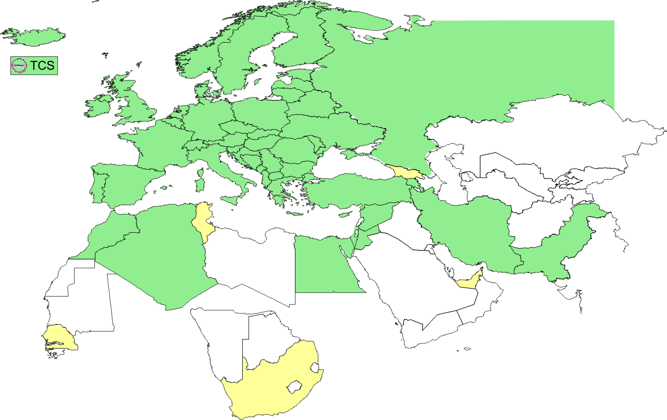
Geographical coverage of the EUGridPMA
25 of 27 EU member states (all except LU, MT)
+ AM, CH, DZ, EG, HR, IL, IR, IS, JO, MA, MD, ME, MK, NO, PK, RO,
RS, RU, SY, TR, UA, CERN (int), DoEGrids(US)* + TCS (EU)
Pending or in progress
ZA, SN, TN, AE, GE

Slide 4
Membership and other changes
Responsiveness challenges for some members
  JUNET CA – proposed for suspension
  HIAST CA – keeps running! (albeit with some connectivity issues)
Upcoming changes
  More countries are moving towards TCS (IUCC, BE, …)
  TCS tender – aim for start end of 2014 with selected new partner
  … pre-ITT market consultation on-going
  New CA in Georgia (Tblisi)
Self-audit review
  Kaspars Krampis as dedicated review process coordinator
  Self-audits progressing on schedule for most CAs
  biggest challenge in getting peer reviewers to actually review

Slide 5
RAT challange
Ursula Epting to conduct early June against all CAs
Timeline taking into account time zones
  4th June, Announcement of the test
  18th June, 10.20 h, Start of the test
  20th June, 14.50 h, Reminder for not replying CA's
  21th June, 10.20 h, End of the test
Request for
  Acknowledge receipt
  for each trust anchor

Slide 6
Results (2)
Furthermore 4 CA's replied later, after the official deadline
So in the very end 13 % did not reply at all.
This comes down to 11 CA's (with 'one CA' as 'one structure')

Slide 7
Resulting actions proposed
24% late (longer than 24hr), 13% non-response
Some non-response reasons clarified quickly
  Incorrect email address in distribution – fixed
  Already in decommissioning mode
  Being located in conflict areas, at times near FEBA
For others, it correlates with known behaviour ☹
Re-challenge non- and late-responders again
  After 1.55 distribution release fixing mail contacts
  ~ December 2013
For some require in-person self-audit remediation

Slide 8
IPv6 status
FZU runs a continuous v6 CRL monitor
http://www.particle.cz/farm/admin/IPv6EuGridPMACrlChecker/
(needs to be updated with new distribution URLs)
22 CAs offer working v6 CRL
  but there are also 4 CAs that give an AAAA record but where the GET fails …
  Still 72 endpoints to go (but they go in bulk)
  dist.eugridpma.info can act as v6 source-of-last-resort
fetch-crlv3 v3.0.10 has an explicit mode to force-enable IPv6 also for older perl versions
  Added option "--inet6glue" and "inet6glue" config setting to load the Net::INET6Glue perl module (if it is available) to use IPv6 connections in LWP to download CRLs

Slide 9
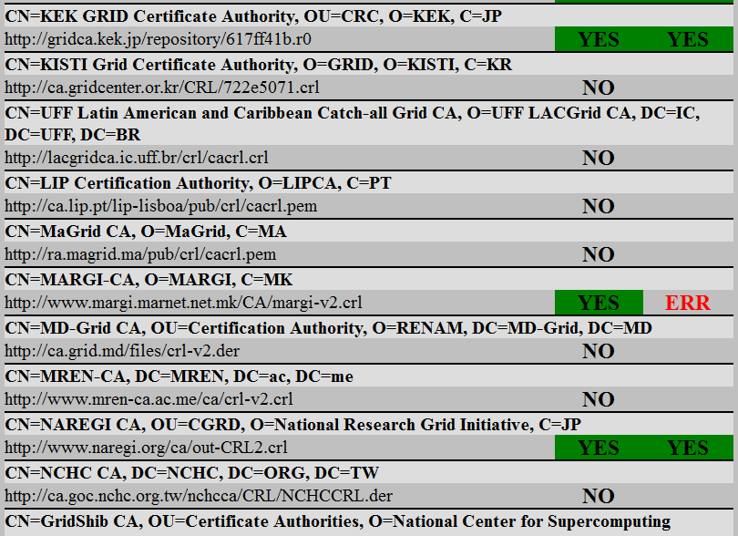
http://www.particle.cz/farm/admin/IPv6EuGridPMACrlChecker/

Slide 10
Upcoming meetings

Slide 11
EUGridPMA Agenda
30th PMA meeting (+SCI?)
Abingdon, UK, 13-15/16 January 2014
http://www.eugridpma.org/meetings/2014-01/
31th PMA meeting
Tartu, EE, 13-14 May 2014 (alt: 27-28 May)
TNC2014: 19-23 May 2014, Dublin, IE
32nd PMA meeting
Belgrade, RS, 8-10 September 2014

Slide 12
Ongoing work items
SHA-2
HSMs
OCSP and OGF CAOPS-WG
PKP Guidelines, Test Suite, IPv6, RAT

Slide 13
SHA-2
Time line
Status

Slide 14
SHA-2 time line minor deferment
Now
  CA certificates in the IGTF distribution and CRLs at official distribution points should use SHA-1
  CAs should issue SHA-1 end entity certificates on request
  CAs may issue SHA-2 (SHA-256 or SHA-512) end entity certificates on request. CAs may publish SHA-2 (SHA-256 or SHA-512) CRLs at alternate distribution point URLs
1st DECEMBER 2013
  CAs should begin to phase out issuance of SHA-1 end entity certificates
  CAs should issue SHA-2 (SHA-256 or SHA-512) end entity certificates by default
1st April 2014
  New CA certificates should use SHA-2 (SHA-512)
  Existing intermediate CA certificates should be re-issued using SHA-2 (SHA-512)
  Existing root CA certificates may continue to use SHA-1
1st October 2014
  CAs may begin to publish SHA-2 (SHA-256 or SHA-512) CRLs at their official distribution points.
1st February 2014 (‘sunset date’)
  All issued SHA-1 end entity certificates should be expired or revoked.
In case of new SHA-1 vulnerabilities, the above schedule may be revised.

Slide 15
SHA-2 readiness
For SHA-2 there are still a few CAs not ready
a few can do either SHA-2 OR SHA-1 but not both
  so they need to wait for software to be SHA-2-ready
  and then change everything at once
A select few can do SHA-2 but their time line is not driven solely by us (i.e. some commercials)
  Their time line is driven by the largest customer base
  All can so SHA-2 (since non-grid customers do request SHA-2-only PKIs)
  it is because of these that RPs have to be ready, because when directives come from CABforum they will change, and do it irrespective of our time table!
Keep in mind hardware issues, e.g. the
old Alladin eTokens (32k) do not support SHA-2

Slide 16
HSMs at level 3 for on-line CAs
“Inspired by the idea of NIIF for buidling an on-line CA based on a low-power Raspberry Pi and a level-3 HSM in USB format, a discussion emerged on whether it is possible to have enough compensatory controls around a level-2 HSM to make the risk comparable to the current off-line CA or level-3. It is not entirely clear which elements of level-3 improve the risk resilience when compared to an off-line classic CA.”
We think it is worthwhile doing the risk analysis compared to the off-line classic CA, and if the risk is comparable allow the use of L2 HSM or eTokens in conjunction with compensatory controls like a safe. We propose to discuss this with the TAGPMA and APGridPMA and have a discussion at the IGTF All Hands in La Plata (October 2013).

Slide 17
IGTF Test Suite
Software developers want to do real-life testing!
Actions to get to a comprehensive suite
each CA to send a URL to or a sample of end-entity certs, at least personal cert and server cert, and depending on the CA also a robot cert and/or a 'service' ("blah/") cert
each CA to indicate some edge cases for their CA (use of colons, dashes, weird characters) and parameter space of the subject naming
known troublesome certs should be included
requirements developed on the Wiki
  https://wiki.eugridpma.org/Main/IGTFTestSuite
  now has some samples and conditions

Slide 18
Identifier Only Profile
IOTA AP background
RP requirements
Questionnaire

Slide 19
New Authentication Profile
The AP is currently being drafted
  https://wiki.eugridpma.org/Main/IOTASecuredInfraAP
  Usefulness for RP is unclear, even for PRACE
  Unclear how to distinguish users on resources that are part of two RP infrastructures
  (one with and one without IOTA)
Many things to be decided
  Need for HSM FIPS 140-2 level 3 or 2?
  What audit requirements needed?
  Real or pseudonymous naming
Distribution would be through separate ‘bundle’
  Next to ‘classic’, ‘mics’, ‘slcs’, and ‘experimental’
  Note there never was an ‘all’ bundle for this very reason
  RPs will have to make an explicit choice to accept this

Slide 20
So, is the IOTA profile acceptable for PRACE ?
Yes, as long as PRACE and the joining organization can organize themselves to meet the traceability requirement :
  User should never access the PRACE environment anonymously.
  An execution site (site providing computing resources to PRACE users) should have an immediate access to the user details. This can be achieved with a distributed database like the PRACE LDAP.
A prerequisite would be that all partners have solid procedures to register users.
  An internal meeting will be organized to define more clearly the criteria of these procedures.

Slide 21
This profile may be accepted by PRACE if we are convinced that for every internal registered user we have enough information to trace that user.
(the next two slides quote parts form the profile which make clear why we need the above requirement)
Users from other infrastructures can only be accepted if that infrastructure has the same requirement for traceability of the user and can provide us with this information if asked for (in agreed situations).

Slide 22
Basic Premises
Subject names must be globally unique
Subject names must be persistent (for the life time of the authority)
It’s about people and robots
Naming of IOTA subjects must be different from other profiles

Slide 23
IOTA Questions for RPs
Do the RPs/RCs need the ‘real name’ of the person the certificate subject?
  Is it enough to be able to ask another entity to give you the name (e.g. the VO, community, other site or central LDAP)?
  What assurance level do you expect from this 3rd party?
  Do you need this information up-front (before or at use time)?
  Do you need this information at end (e.g. for accounting)?
  or It is sufficient to be able to ask an entity to contact the user on your behalf (like a privacy service)?
  Should pseudonyms be clearly identifiable (e.g. if they look like a name they should be the real name)?
  The email use case will not work: since emailAddress must be embedded in the SAN, but the mail will be pseudonymous as well

Slide 24
IOTA AP
Vetting assurance level and responsibility
  Given that the name may be a pseudonym and is weakly verified, do you (RP, community) have the mechanisms in place to strongly identify the real user?
  Should we enforce obfuscated naming for all subjects?
  How will you (RP, VO) deal with ‘identity spoofing’?
  How do you currently enrol users in the community? Do you use or rely on the commonName of the subject for adding people to your databases (or get a ‘warm fuzzy’ feeling in association with e.g. unsigned email)?
Tracability by the VO
  Are you set up to provide traceability for your users?
  Do you have means and procedures for incident response and mitigation?

Slide 25
Auditability, traceability
Access to the user information by RPs
  Do you insist that the collection of this data is verifiable?
  Should the chain of processes be documented?
  Should the chain of processes be audited periodically (expensive!)?
  Should the chain be auditable? Or contract/sanction-based?
  A user may and will have many credentials and changing names: does this pose issues?
  Do you expect e.g. the community to provide a real name up-front with every access request (e.g. in a VOMS generic attribute)?
Do the RPs (RCs) need to be able to independently trace the user without involving the user community?
  Can a registration mechanism, retrievable or callable by the RP, satisfy this requirement (e.g. like the EGEE CIC portal having an ability to send email to the owner of a DN)
Do the RPs need to be able to trace without involving the CA?
  Which are the ‘emergency cases’ where they expect CA involvement in tracing or contacting subscribers?

Slide 26
Incident response
Do RPs/RCs expect the CA to be involved in incident response?
  What is an incident where you expect CA involvement?
  What is the level of involvement?
  Do you see a classification of incidents?
  If there are up-stream IdPs, are you ‘happy’ with just the CA response even if upstream does not participate?
  Do you expect more than pure credential revocation in case of demonstrable credential compromise?
  Do you see the CA more than a fall back to point to in case LEA comes after you?
  Do you expect/prefer suspension possibilities? Do you have this capability at the RP level (through authorization)?
Can you get by with just your own response capability?

Slide 27
Next Steps
How to approach RPs?
Interplay in mixed infrastructures
Reconciliation of PRACE and CILogon input?
  Incident response
  Tracability of issuance
  Codification of ‘best practices’
…

