Slide 1



European IGTF+ update
David Groep
davidg@nikhef.nl
Enabling Communities, Trust, Identity,
and Security from the EUGridPMA+
part of the work programme of GEANT 5-1 EnCo, and AARC TREE, co-fundied by the European Union
co-supported by Nikhef and the Dutch
National e-Infrastructure coordinated by SURF

Slide 2
Meanwhile in the EUGridPMA+ …
EUGridPMA State of the Fabric
  constituency and developments
  IGTF distribution updates and packaging
  S/MIME baseline in CABF: separating authentication and email in TCS
AARC (Authentication and Authorisation for Research Collaboration)
and its Technical Revision for Enhanced Effectiveness (AARC TREE)
  Evolving AARC and the AARC Blueprint Architecture “BPA 2025”
  Attribute Authority Operations self-assessment for secure and trusted BPA proxies
  Policy Development Kit: supporting community structuring and a secure baseline
  Notice management for AUP and data protection
  novel (OpenID) federation models – disambiguating trust and technical translations
https://www.eugridpma.org/ for all details and meeting minutes!

Slide 3
EMEA area membership evolution
Europe⁺: GEANT TCS, and CZ, DE, DK(+FI+IS+NO+SE), FR, GR, HR, NL, PL, RO, SI, SK; AM, MD, ME, MK, RS, RU, TR, UA, UK
Middle East: IR, PK
Africa: DZ, KE, MA
CERN, RCauth.eu

Slide 4
Membership and other changes
Identity providers: both reduction and growth
  migration to GEANT TCS continues
  https://wiki.geant.org/display/TCSNT/TCS+Participants+Sectigo
  CERN joining TCS via Renater (FR)
  Discontinued: -GE, -BY, -PT, -AE
  Suspended: -KE
Self-audit review
  Cosmin Nistor will update us in a moment
  real-time interaction between authority and reviewers helps, but …
.ch is now served by eMudhra – confirmed since September 2024

Slide 5
Distribution signing key update
error: Verifying a signature using certificate
D12E922822BE64D50146188BC32D99C83CDBBC71
(EUGridPMA Distribution Signing Key 3 <info@eugridpma.org>):
Key C32D99C83CDBBC71 invalid: not signing capable
In Fedora Core 38+ (and thus later in its derivatives, and maybe soon in Debian), RSA 1024 package signing no longer supported by default
(work-around with bespoke crypto-policies possible, not recommended)

Slide 6
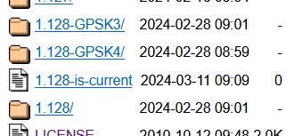
Distribution signing key update
In future releases we move
to a new GPG package key
RSA-2048
called GPG-KEY-EUGridPMA-RPM-4
distributed with 1.122+ releases
Retrieve new public key file from
https://dl.igtf.net/distribution/GPG-KEY-EUGridPMA-RPM-4
or from the public key servers: rsa/2048 dated 2023-07-29T12:06:23Z
fingerprint: 565f 4528 ead3 f537 27b5 a2e9 b055 0056 7634 1f1a

Slide 7
S/MIME Baseline Requirements
CA/B Forum developments

Slide 8
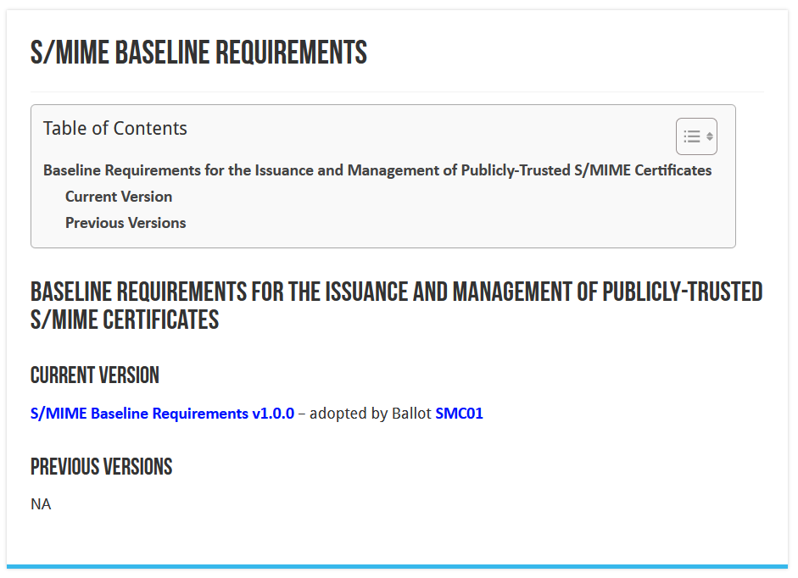
CA/BROWSER Forum
continuously updated

Slide 9
What TCS did
Have S/MIME personal certs, organization-verified, continue to be publicly trusted
  sponsor-validated (multi-purpose) BR-compliant (for ‘humans’) or org-validated (‘robot email’)
  we define all TCS members as Enterprise RAs (clarified in Ballot SMC-03
  does require all orgs to be revalidated using a Government Information Source or LEI (3.2.3.2.1)
  their subject name will be filled with the required fields (such as LEI, jurisdiction, address)
  the /clientgeant SAML endpoint (the only way for personal certs!) auo-upgrades Validation to “High”
Move the client authentication trust to a ‘private CA’ (non-public trust anchor), retaining exactly the same subject DNs, just a different ICA issuerDN and Root
  Add some additional ICAs and non-public Roots to the IGTF distribution
  so for IGTF RPs the change is minimal and transparent
  Inform relying parties, also outside of the IGTF, that client trust will become a specific decision. This is probably good, also for OpenVPN services, web access (.htpasswd), &c. The IGTF RPs are not impacted, others likely will be.

Slide 10
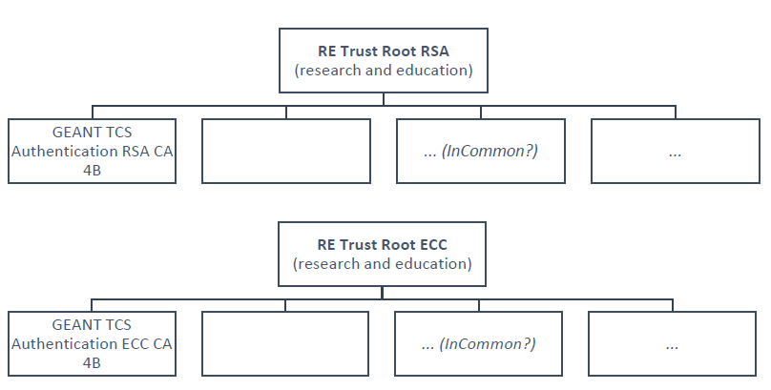
The new TCS Private hierarchies
Two new “RE Trust Roots” (RSA+ECC)
the cost is (apparently) there
can be re-used in R&E
GEANT TCS Authentication RSA/ECC CA 4B issuing subordinate CA
move all authentication use cases here
clarify that this is wider than ‘just e-science’: web site auth, IdP login, any client auth, network login, …
minimize disruption (at least in theory)

Slide 11
User awareness
This is a change in communications and documentation as well,
not only a set of technical changes
In request systems, have to clearly distinguish for users
which product to order. For example:
  “Personal” stays the same, but is called now “Email signing and Encryption”
  renaming “IGTF MICS Personal” to “Personal Authentication” and explain
  renaming “IGTF MICS Robot Personal” to “Personal Automated Authentication”
  forking “IGTF Classic Robot Email”
    Authentication-only (IGTF) profile “Classic Robot Email”
    Email signing profile “Organisation-validated S/MIME signing” (i.e. team-based or role-based)

Slide 12
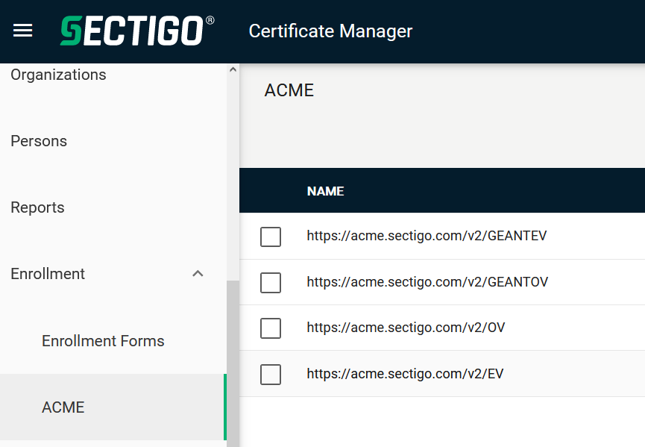
Other CABF things to keep in mind
Server SSL BR has already been updated
  the provision for using DC prefixing has been retained
But expect shorter validity periods in the future
  start preparing for 90-day max in your service deployment automation systems
  increased use of automation (ACME OV using client ID+secret, or use of APIs)
[root@hekel ~]# certbot certonly \
--standalone --non-interactive --agree-tos --email davidg@nikhef.nl \
--server https://acme.sectigo.com/v2/GEANTOV \
--eab-kid DUniqueID_forthisclient --eab-hmac-key mv_v3ryl0n9s3cr3tK3y \
--domain hekel.nikhef.nl --cert-name OVGEANTcert

Slide 13
The Challenge of Self-Signed Roots in RedHat
RedHat’s and Firefox’s idea of what trust means for self-signed objects in an explicit trust store …

Slide 14
Although it conceptually makes no sense …
While all intermediate and end-entity certificate now use secure hash algorithms,
some operating system distros are deprecating sha1 also for self-signed root certs
FF103+
RHEL9+ (and its rebuilds)
Impacts both joint-trust and igtf-only trust, but for web-trust clients it is taken care of
by specific bespoke software configuration (RHEL’s OpenSSL trust flags, or the Firefox built-ins)
For other cases, there is – for now – a policy override:
update-crypto-policies --set DEFAULT:SHA1
update-crypto-policies --set LEGACY
A blunt mitigation for the actual issue, as it allows for other sha1 purposes
which is ‘fine’ for the IGTF fabric, but not in general

Slide 15
The OSG experiment
OSG shipped the dual-blob mode that mimicks the bespoke OS config
  using equivalent of https://www.nikhef.nl/~davidg/tmp/make-trusted.sh
  first a “BEGIN TRUSTED CERTIFICATE”,
  then in the same file “BEGIN CERTIFICATE”
However, it broke ☹
  CANL-Java, extending BouncyCastle, cannot process this blob
  and will balk even if it does not recognise it and should just ignore it
  (https://stackoverflow.com/questions/55550299/java-can-not-load-begin-trusted-certificate-format-certificate)
  open as a dCache Feature Enhancement on CANL Java (by Paul Millar)
will not be fixed overnight, of course … and we may find other issues thereafter

Slide 16
Yet maybe …
On 2023-12-20 13:25, Guido Pineda (SURF NL) wrote:
> I am using fetch-crl version 3.0.22.
> We have a total of 89 trust anchors configured on our /etc/grid-security directory.
> I have tested fetch-crl with different versions of OpenSSL and here are the
> outcomes:
> For versions 1.1.1k and versions 3.2.0, the amount of errors when trying to verify
> the CRL's is only one [which was explainable]
> However, when using OpenSSL version 3.0.7, we get 10 errors
Due to self-compiling OpenSSL? And does that then ignore the RH crypt-policies?

Slide 17
It cannot be solved without changes to RP software
asking for ‘a SHA-1 free IGTF distribution’ is not helpful
  unless you at the same time also remove all SHA-1 from the public web trust stores
dual-blob solution might the the best option, but it needs CANL-Java fixes
  for the large authorities, e.g. DigiCert Assured ID Root from 2006, re-issuing with the same key and different digest will cause unfathomable confusion in browsers
  migrating to another (SHA-2 rooted) signing hierarchy will take at least 395 days, may be a lot of engineering on the RP and CA side, or require new contracts
root cause is RH and FF not understanding what a self-signed trust anchor is,
but that will not help us in the short term ☹

Slide 18
Reissuance of roots – state and progress
Just to make the problem appear smaller, some issuers are migrating anyway
Current list of SHA-1 self-signed trust anchors:
ASGCCA-2007 ArmeSFo
DZeScience DigiCertAssuredIDRootCA-Root
IHEP-2013 (to change <1yr)
KEK CESNET-CA-Root
MARGI RDIG
RomanianGRID SRCE
SiGNET-CA TRGrid
seegrid-ca-2013
Changed by now: GridCanada, CILogon basic/silver/OpenID, UKeScienceRoot-2007
Removed: DigiCertGridCA-*, DFN-GridGermany, CNIC, BYGCA , LIPCA
Pending withdrawal:

Slide 19
Federated T&I and AARC
Authentication and Authorisation for Research Collaboration (AARC) & Enabling Communities (EnCo)

Slide 20
Federated T&I and AARC
Federated T&I and AARC
EUGridPMA+ is also the place for the AARC Policy Community & EnCo:
AARC Policy Development Kit:
supporting community structuring, security baseline, trust proxies
notice management for AUP and data protection in proxies
novel (OpenID) federation models – disambiguating trust and translation
but also federated access to ‘SSH’ non-web services, and ssh-ca
https://www.eugridpma.org/meetings/2024-09/The-Copenhagen-60th-EUGridPMA+-Meeting-Summary.pdf

Slide 21
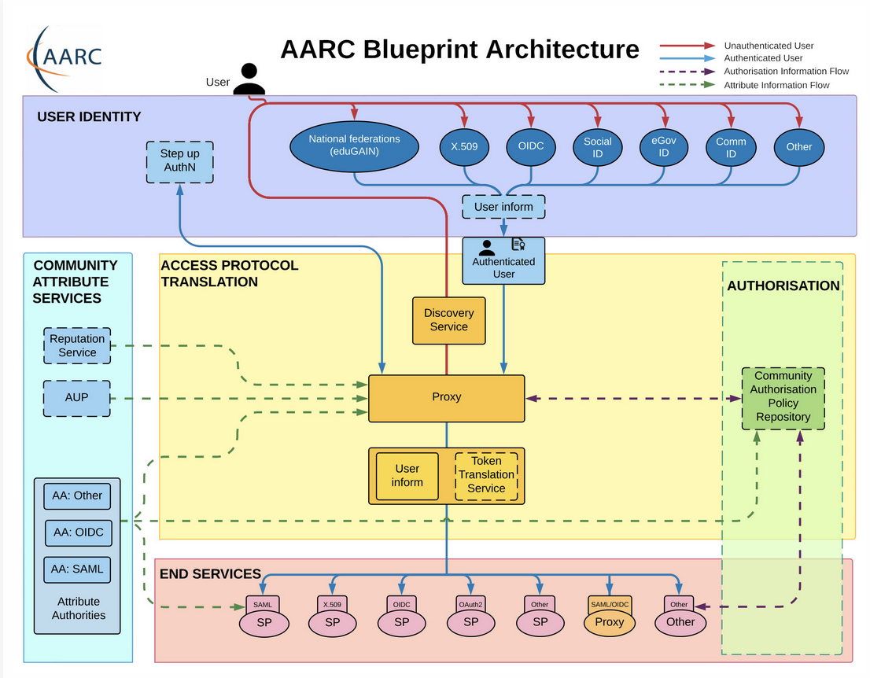
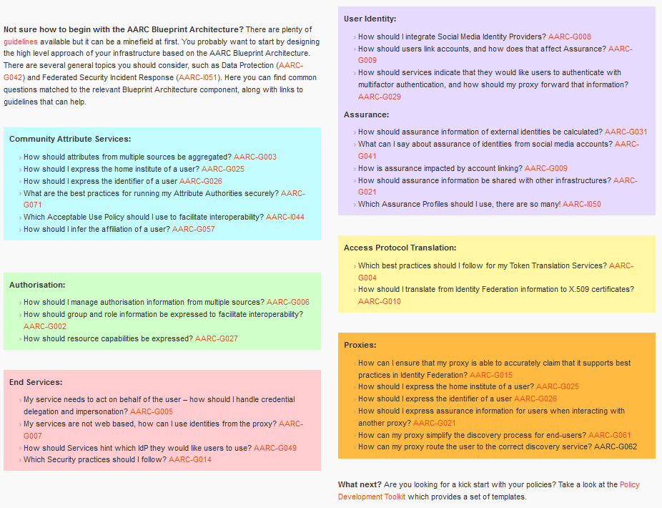
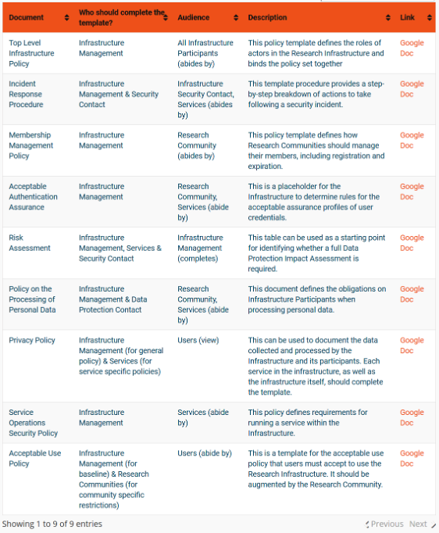

Interoperability – more than just the nice colours
https://aarc-community.org/guidelines/

Slide 22
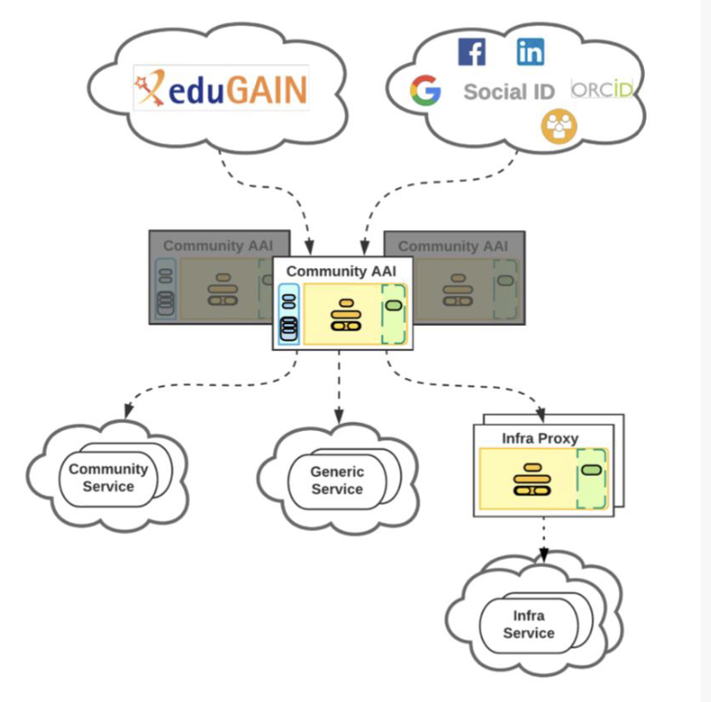
The Community AAI and the Infrastructure Proxy – structuring elements
Community AAI
The purpose of the Community AAI is to streamline researchers’ access to services, both those provided by their own infrastructure as well as the services provided by infrastructures that are shared with other communities.
Infrastructure Proxy
The Infrastructure Proxy, enables Infrastructures with a large number of resources, to provide them through a single integration point, where the Infrastructure can maintain centrally all the relevant Policies and business logic for making available these resources to multiple communities

Slide 23
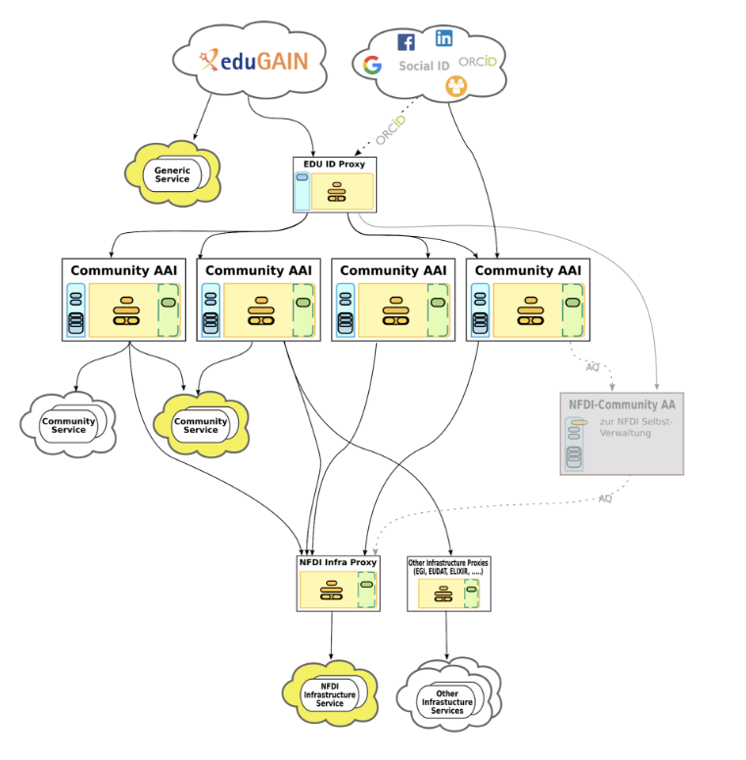
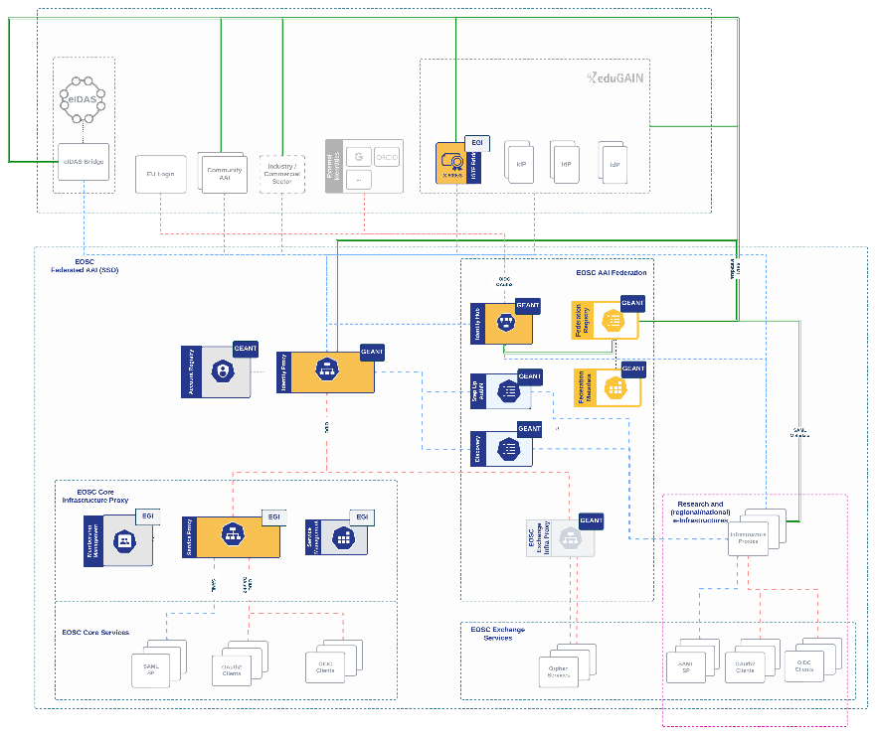
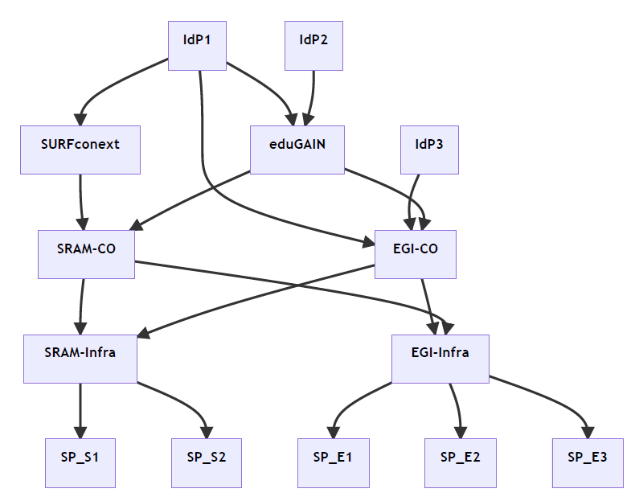
Our federated world is growing more complex
Images: SURF SSRAM and EGI by Maarten Kremers, NDFI AAI (Marcus Hardt), EOSC AAI for the EOSC Core and Exchange Federation for the EOSC European Node by Christos Kanellopoulos, Nicolas Liampotis, David Groep (June 2023 version)

Slide 24
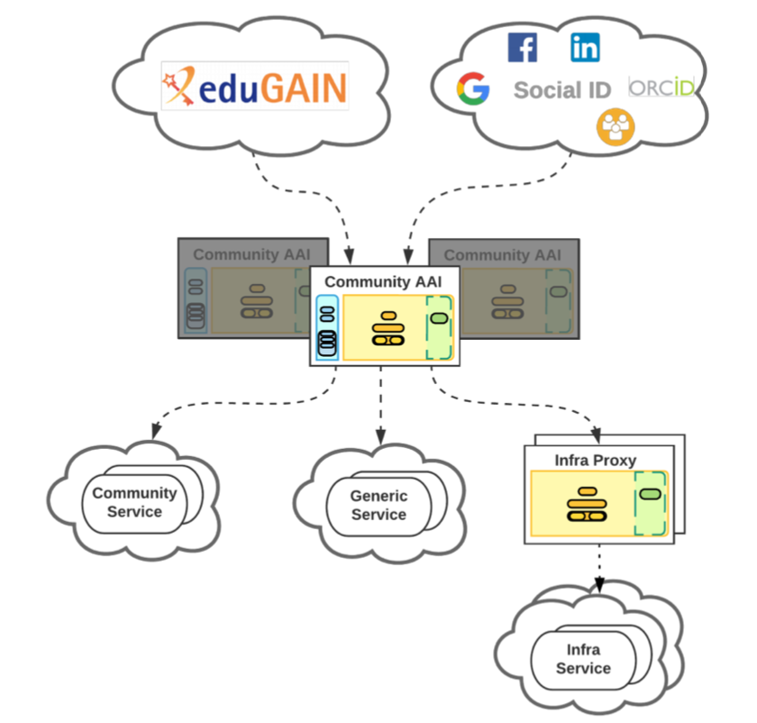
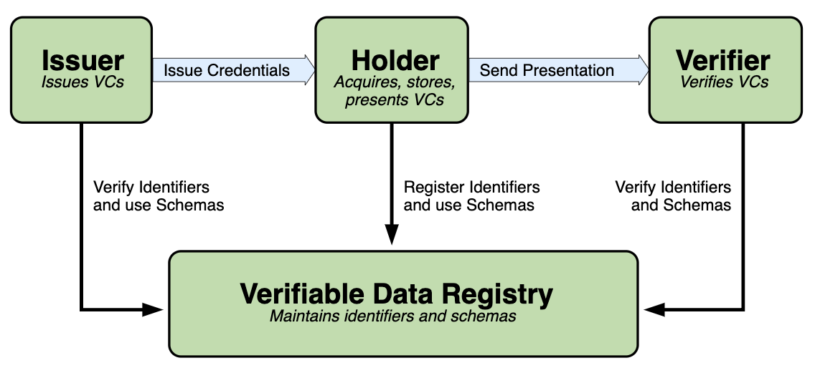
AARC-TREE: Evolved BPA for more complex (and the simpler) worlds
Guidelines for expression of community user attributes
reduce inconsistencies between implementations
improve interoperability & end-user usability across research community communities and infrastructures
Extend AARC BPA
improve scalability
leverage emerging standards
like OpenID Federation
Authorisation guidelines
best practises to enable efficient &
effective sharing of federated resources
2025
Decentralised identities
guidance for digital wallets linked to BPA

Slide 25
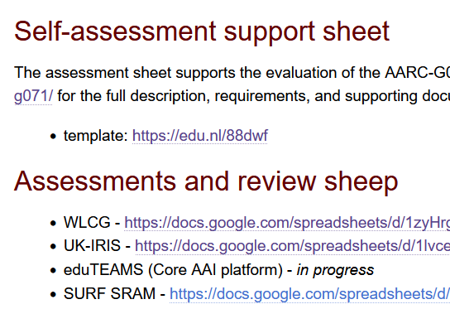
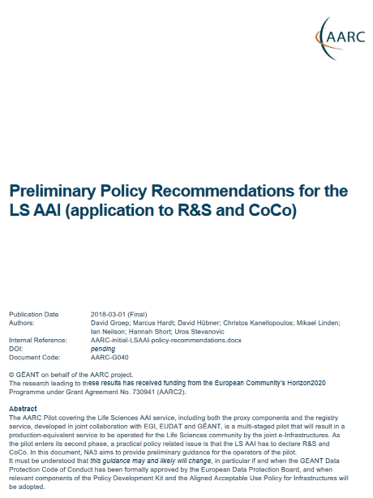

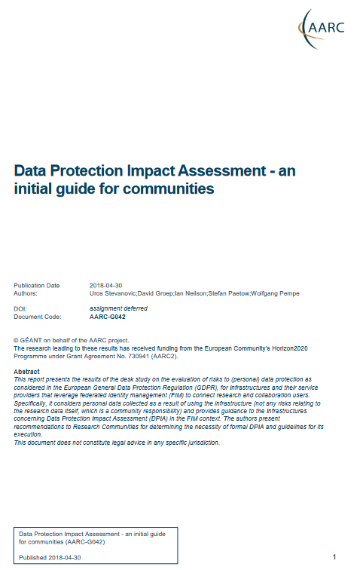

Policy and good practice underpinning the AARC Blueprint BPA
Infrastructure alignment and policy harmonisation: helping out the proxy
Operational Trust for Community and Infrastructure BPA Proxies
Increase acceptance of research proxies by identity providers through common baselines
Review infrastructure models for coordinated AUP, T&C, and privacy notices, improving
cross-infrastructure user experience (users need to click only once)
User-centric trust alignment and policy harmonization: helping out the community
Lightweight community management policy template
Guideline on cross-sectoral trust in novel federated access models
Assurance in research services through (eIDAS) public identity assertion
Anchored in the researcher user communities by co-creation with FIM4R

Slide 26

Attribute Authority operational security
AARC-G071
IGTF AAOPS (https://www.eugridpma.org/guidelines/aaops/)

Slide 27
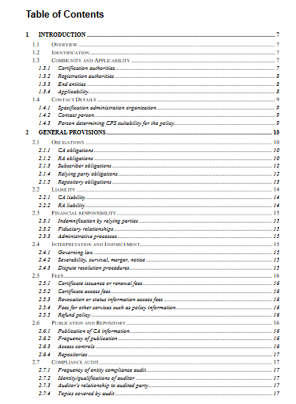
Taking proper care of trust sources
Protections for (IGTF) identity providers are known and documented
RFC3647
IGTF Guidelines
Technical profiles
The AAI relies also on other attribute sources, and on the hubs & AARC Proxies
only generic guidance
proxies fully hide ID source

Slide 28
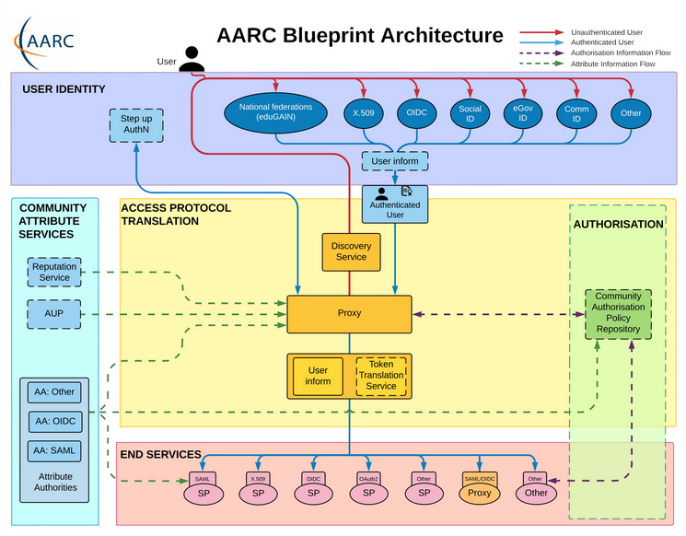
Operational guideline landscape for - proxy or source - AAI components
Authentication/identity sources
Sirtfi
(eduGAIN) baselining, RAF
IGTF AP Profiles
NIST SP800-63
eduGAIN sec. team workflow
RFC6238/4226
FIPS140
NISTSP800-53
Ephemeral credentials
trusted credential stores
protection at rest
Service provider operations
ISO27k
Sirtfi
Infrastructure response plans

Slide 29
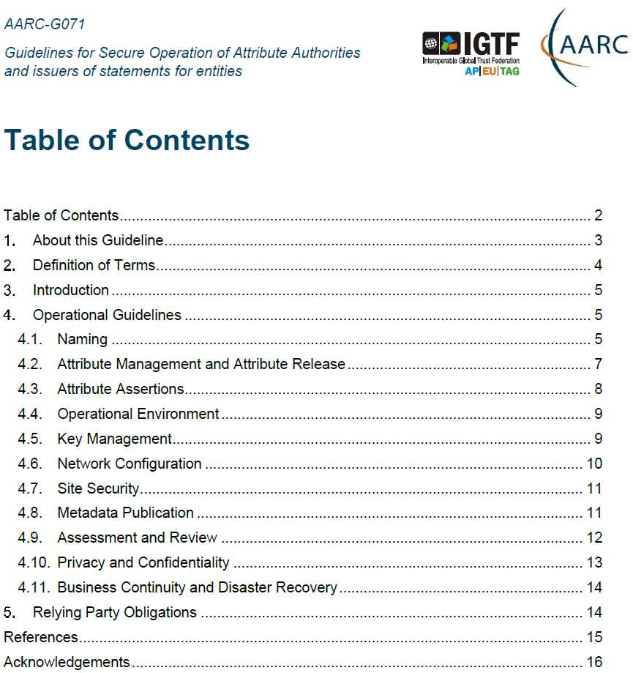
Trust and security in the BPA beyond IdPs and SPs
Community management and attribute authorities
integrity of membership
traceability
site and service security
protection on the network
assertion integrity
AARC-G071: Structured around concept of
“AA Operators” operating “Attribute Authorities”
(technological entities or proxies),
on behalf of, one or more, Communities,
that are trusted by Relying Parties

Slide 30
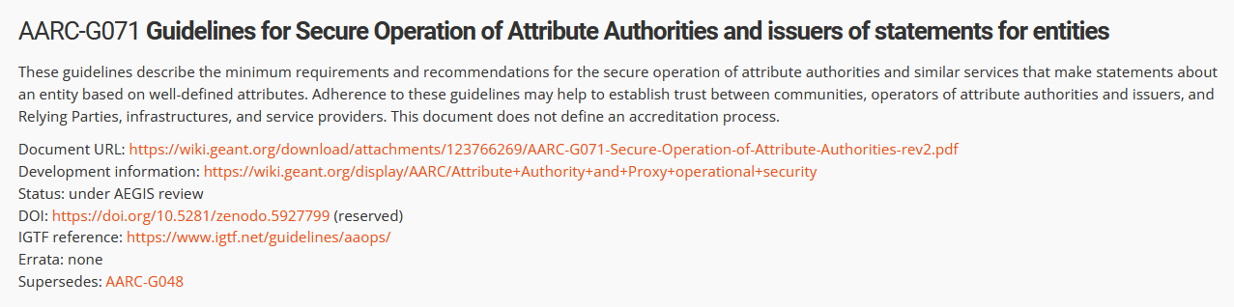
Implementing the AA Operations Security guidelines
Major RPs and Infrastructures reviewed it based on current use cases and models
Guideline aimed at both Infrastructure and Community use cases
Useful input to e.g. ‘EOSC’ connected proxies as a good practice guideline
Assessment or review process is separate – could be IGTF or an RP consortium,
but does state what needs to be logged and saved to do a (self) assessment
https://aarc-community.org/guidelines/aarc-g071/

Slide 31

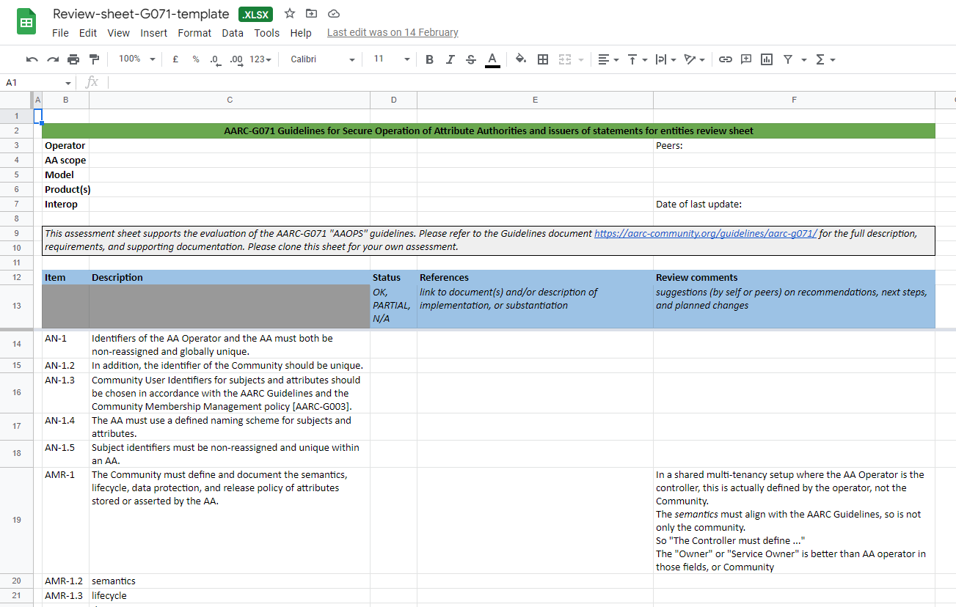
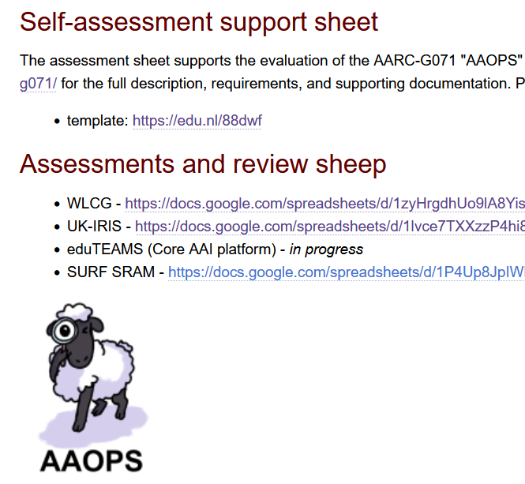
G071 self-assessment process
https://edu.nl/88dwf
Self-assessment by WLCG, UK-IRIS, eduTEAMS, EGI CheckIn, SURF SRAM
mutual review also improves G071 guideline itself

Slide 32
Notice Management by Proxies
AARC-G083

Slide 33
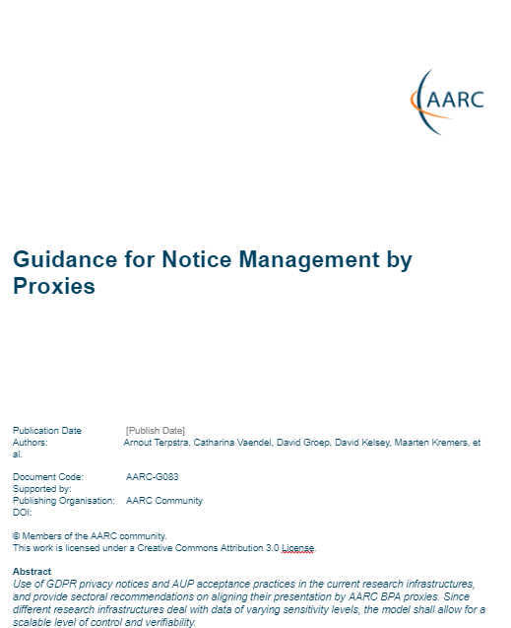
With fewer clicks to more resources: AARC-G083
Users should not click the same policy at many different places
Services should not require the user clicking (policy) acceptance, since this will interrupt workflows
Target audience for this guideline
both community and infra proxies and hybrids
notices for the proxies themselves: so privacy notes
personal data related to use of the infrastructure
for the notices by services that are mediated by the proxy, and thereby also allow for specific protection on (personal) research data
https://wiki.geant.org/display/AARC/AARC-G083+-+Guidance+for+Notice+Management+by+Proxies

Slide 34
Growing AARC Policy Harmonisation
https://wiki.geant.org/display/AARC/AARC+Policy+Harmonisation

Slide 35
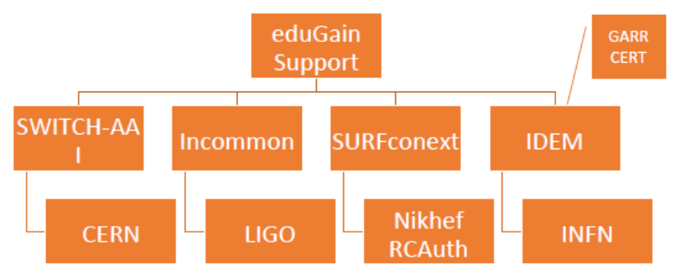
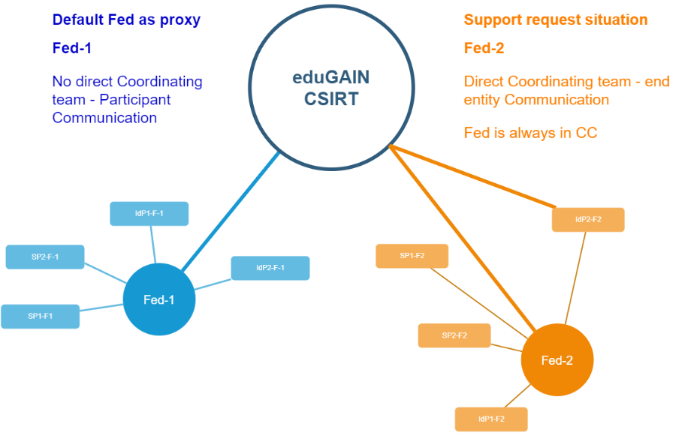
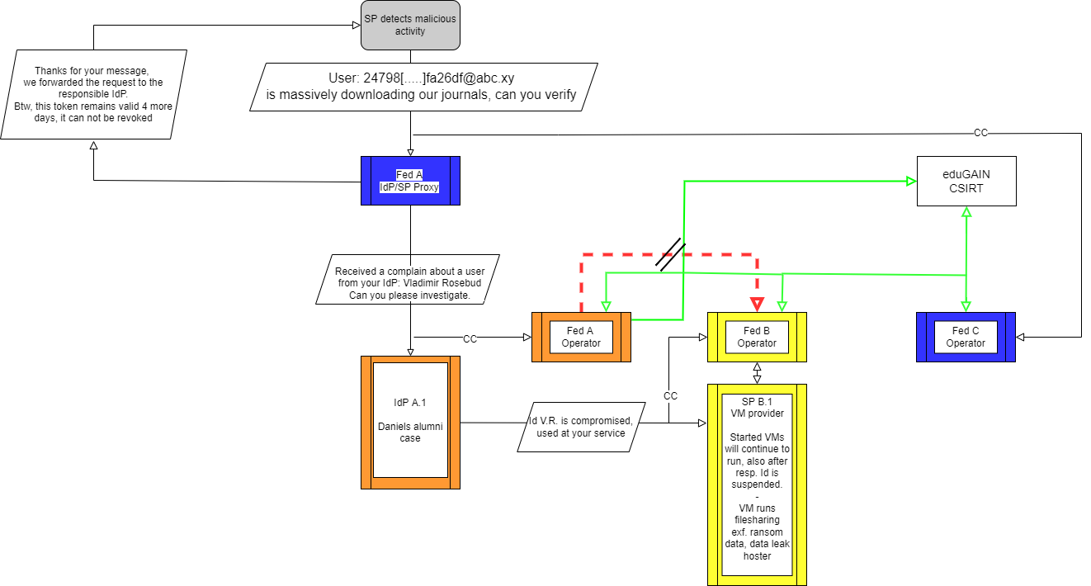

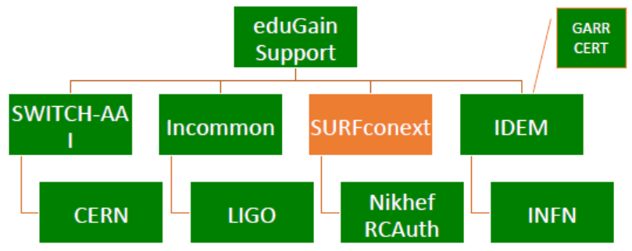




Response and traceability across IdP-SP Proxies and the limits of Sirtfi
Srtfi v1
Guidelines for a joint operational trust baseline for membership management and proxy components,
supplemented by policy guidance for sectoral federations with more specific policies where needed
‘How can we convey the trust in what is in and behind the proxy?’
‘How to provide timely traceability between services and identities through the proxy?’
Based on requirements from FIM4R, WISE, and the proxy operators in AEGIS.
|
|CSIRT
joint work with GN5 EnCo and eduGAIN CSIRT
images: AARC Sirtfi v1 exercise (Hannah Short), eduGAIN security TTX (Sven Gabriel, eduGAIN CSIRT)

Slide 36
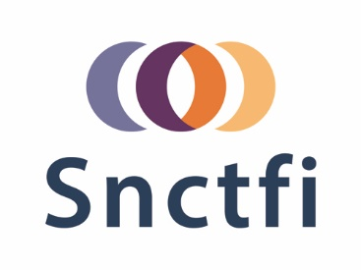
Can we build on a trusted baseline and expectations to increase acceptance of research infrastructure proxies with R&E identity providers
Even though affiliation is the most relevant attribute from home IdPs, …
still need assurance statements and REFEDS Assurance Framework attribute freshness
unless ‘well hidden’, proxies are met with scepticism by IdPs to release personalised to R&S
do Entity Categories ‘traverse’ proxies? and can proxy ops rely on their ‘downstreams’?
a common baseline that proxies can endorse and manage for their connected services helps
review and enhance effectiveness of Snctfi ‘revamped’
the set of guidelines that describe a (self-) accessible baseline
for a set of service providers behind an AARC BPA Proxy
and thereby encourage trust in the proxies and their connected services

Slide 37
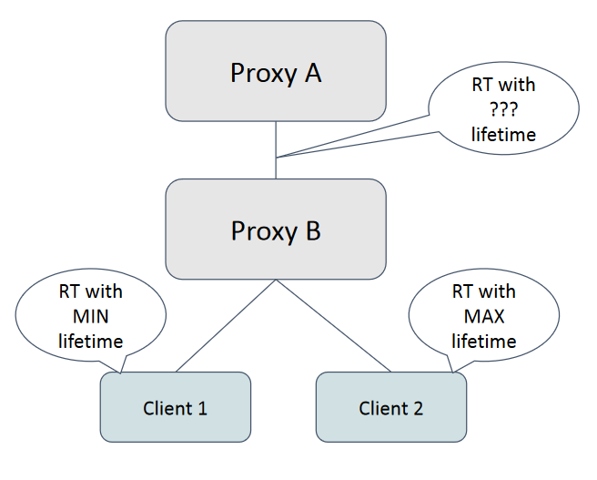
Token life times: both technical and policy elements in AARC G081
While for Refresh Tokens the validity period can be long … a risk-based approach is needed
Access and ID tokens may come in form that can be validated ‘off-line’
For opsec, there should be no long-lived credentials that can’t be invalidated
But what is ‘long-lived’?
If revocation is needed – what issues does that cause?
What trust can proxies have in their downstream (or upstream)?
What about token change flows (even if less likely)?
Limited differentiation of life times,
with SHOULD defaults and MUST upper and lower bounds

Slide 38
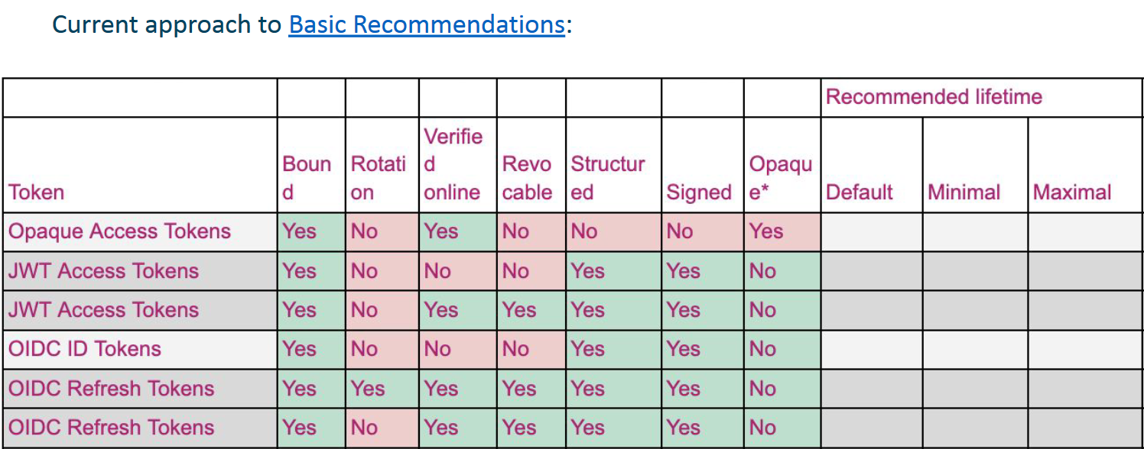
G081
Canonical GFD.32 guidance still appears appropriate
1Ms and ~1 year
a capability to invalidate (off-line) tokens on an opsec incident should be < 6 hrs,
the acceptable value for emergency suspension in e.g. the WLCG operational infrastructure
https://docs.google.com/presentation/d/1P_ZDUWTX0py8kXTgWHMCCfO2f_9uzsE0/edit#

Slide 39
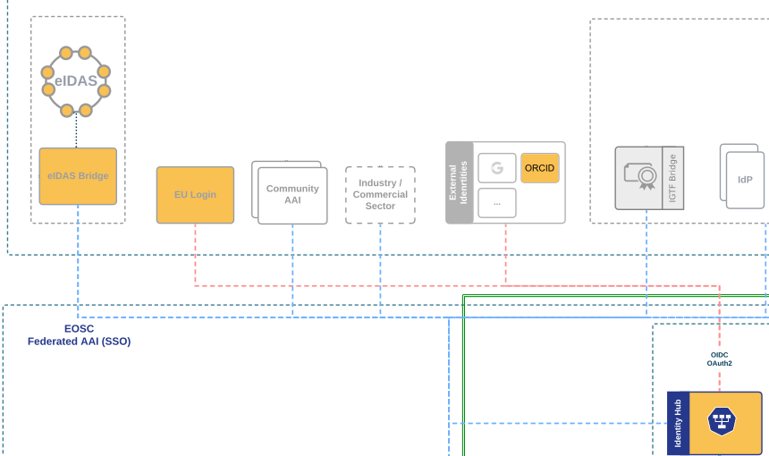
We’ll see more diverse sources of identity & assurance anyway
Most reliable (and most ‘available’) source of assurance may be the European government identity ecosystem.
Step-up to at least substantial level can now readily be done ‘at home’ by users
through their national eID schemes
Joint work on eIDAS, Erasmus Student Mobility,
and more makes this more accessible
Better attainable than relying on home institutions?
… but:
what to do with non-European users?
how to link the identities together

Slide 40
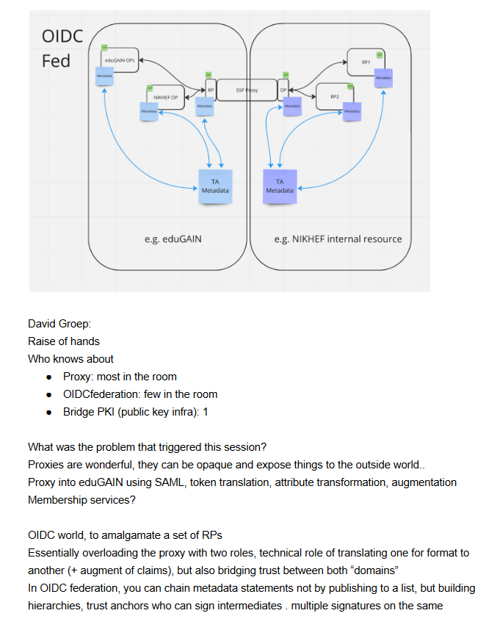
New trust models – what is the role of the proxy in OIDCFed? And Wallets?
In today’s BPA proxy links both sides by being
opaque, both for attributes as well as for trust
does it have to be that way?
separate claims/attribute transformation from trust bridging?
can OIDCfed structure convey trust transparently? Should it?
can we then be more flexible? or will it just confuse everyone?
easier to bridge trust across sectors this way?
e.g. linking .edu, .gov, and private sector federations?
how do wallets change the trust flow? Also with composite VCs?

Slide 41
All about enabling research: FIM4R & communities are a key factor
Also in AARC-TREE we target a “co-creation process”
support FIM4R to increase the reach of workshops in the next 2 years
community review, ideas, and input on both policy and architecture
start from the high-level requirements and broad community input
whatever we build must be usable and available by researcher communities first of all, and align to interoperability standard and open, collaborative research goals
Really a global activity: we want to engage
everyone, in AARC TREE and beyond

Slide 42

Building OUR global trust fabric
Questions?
David Groep davidg@nikhef.nl
https://www.nikhef.nl/~davidg/presentations/
https://orcid.org/0000-0003-1026-6606

Slide 43

this work is co-supported by the Trust and Identity work package of the GEANT project (GN5-1)
in collaboration with many, many people in the AARC+ Community, including Christos Kanellopoulos, Nicolas Liampotis, Licia Florio, Hannah Short, Maarten Kremers, Niels van Dijk, David Crooks, Dave Kelsey, Ian Neilson, Mischa Sallé, Slavek Licehammer, Catharina Vaendel, Liam Atherton, Arnout Terpstra, Jens Jensen, and so many others!
davidg@nikhef.nl

