Slide 1


European IGTF update
David Groep
davidg@nikhef.nl
Enabling Communities, Trust, Identity,
and Security from the EUGridPMA+
part of the work programme of
GEANT 5-1 EnCo, and AARC TREE
the work has received co-funding
from the European Union
co-supported by Nikhef and the Dutch
National e-Infrastructure coordinated by SURF

Slide 2

Meanwhile in the EUGridPMA+ …
EUGridPMA and IGTF distribution matters
  constituency and developments
  GPG Package Signing Key updates
S/MIME baseline in CABF: separating authentication and email in TCS
Attribute Authority Operations “AAOPS” self-assessment
Root migration update for EL9+
https://www.eugridpma.org/ for all details and meeting minutes!

Slide 3
EMEA area membership evolution
Europe⁺: GEANT TCS, and CZ, DE, DK(+FI+IS+NO+SE), FR, GR, HR, HU, NL, PL, PT, RO, SI, SK; AM, GE, MD, ME, MK, RS, RU, TR, UA, UK
Middle East: IR, PK
Africa: DZ, KE, MA
CERN, RCauth.eu
the Swiss moved from the
imploded DigitalTrust to eMudhra
(via a legacy DutchGrid transition)
Emphasis on collaboration
across the whole T&I space

Slide 4
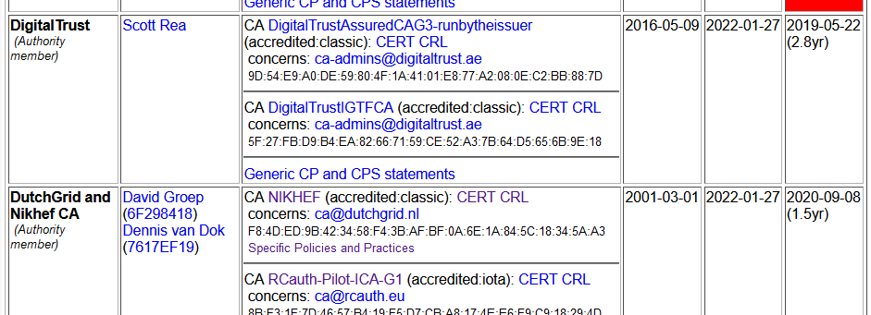
Membership and other changes
Identity providers: both reduction and growth
  migration to GEANT TCS continues: +DE
  https://wiki.geant.org/display/TCSNT/TCS+Participants+Sectigo
  CERN joining TCS via Renater (FR)
Self-audit review
  Cosmin Nistor as review coordinator
  new self-audit model: real-time interaction
  between authority and reviewers helps!
Next meeting in Abingdon, UK (RAL @Coseners House) May 29-30, 2024
joint with GN5-1 and the AARC TREE Policy & Community

Slide 5
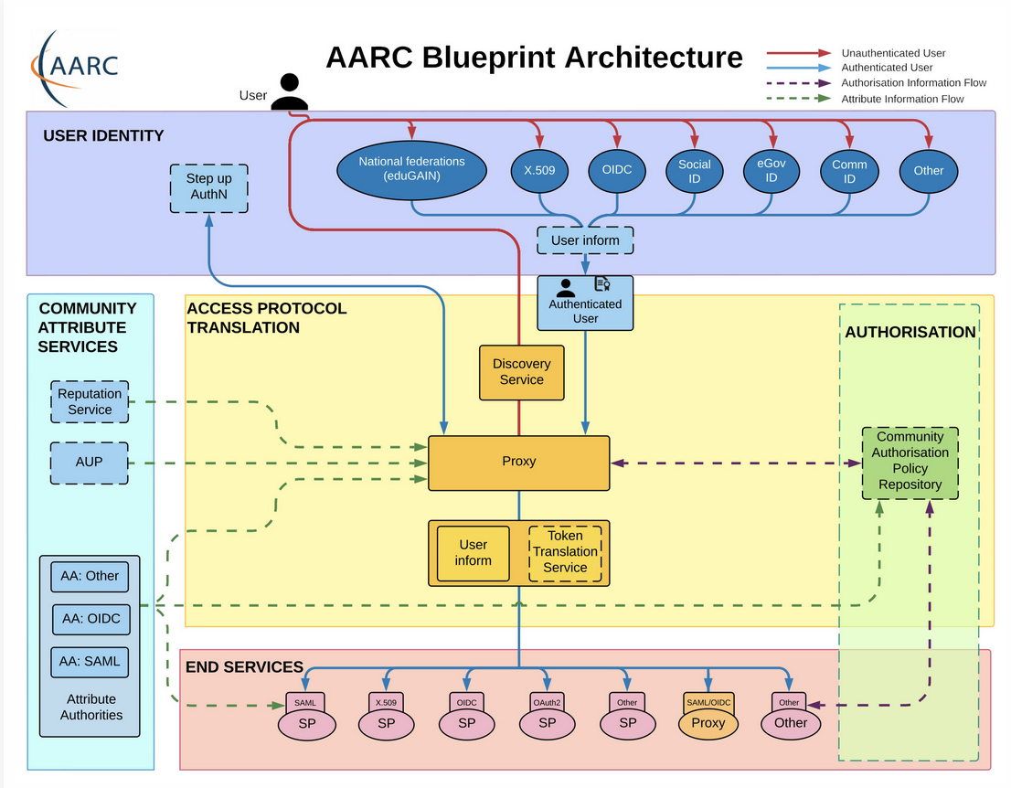
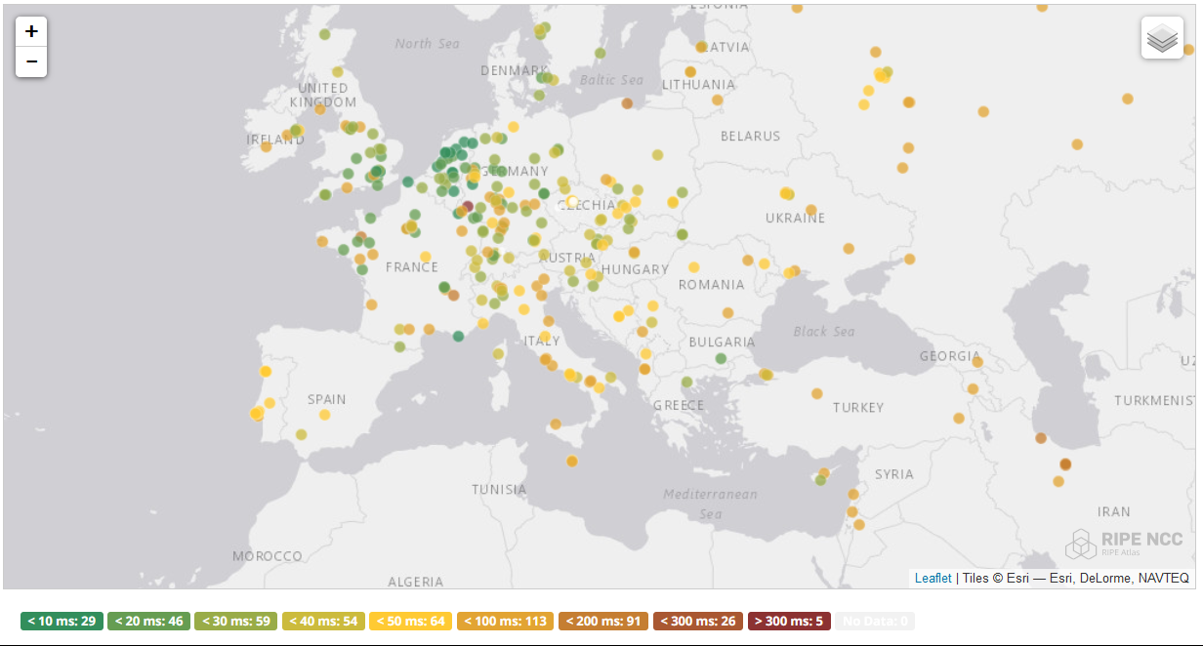
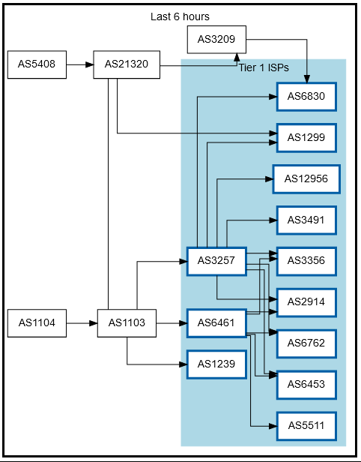
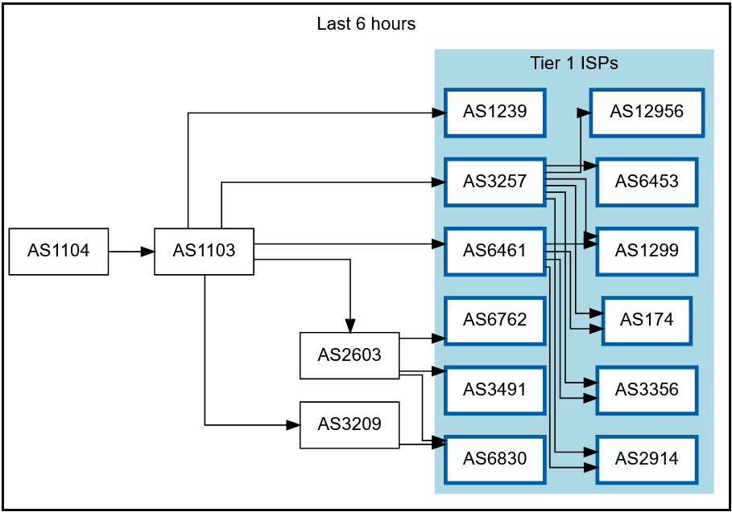
RCauth.eu – the ubiquitous federated IOTA
IGTF accredited IOTA (DOGWOOD) CA
  Online credential translation, connected to eduGAIN for all R&S+Sirtfi IdP
  Inspired by & leveraging CILogon delegation service
Now EOSC Future implemented High Availability setup across 3 sites: GRNET, Nikhef/SURF, STFC/RAL
map: RIPE NCC RIPE Atlas - 500 probes, distributed across Europe (https://atlas.ripe.net/measurements/50949024/)

Slide 6
Federated T&I and AARC
Federated T&I and AARC
EUGridPMA+ is also the gathering place for the AARC Policy Community,
everything from
federated access to ‘SSH’ non-web services
RP trust resource evolution
OpenID Connect Federation models
Enabling Communities
https://www.eugridpma.org/meetings/2024-01/The-Copenhagen-60th-EUGridPMA+-Meeting-Summary.pdf
https://www.eugridpma.org/meetings/2024-01/The-Copenhagen-60th-EUGridPMA+-Meeting-Summary.pdf

Slide 7
Distribution signing key update
error: Verifying a signature using certificate
D12E922822BE64D50146188BC32D99C83CDBBC71
(EUGridPMA Distribution Signing Key 3 <info@eugridpma.org>):
Key C32D99C83CDBBC71 invalid: not signing capable
In Fedora Core 38+ (and thus later in its derivatives, and maybe soon in Debian), RSA 1024 package signing no longer supported by default
(work-around with bespoke crypto-policies possible, not recommended)

Slide 8
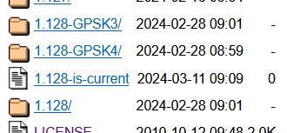
Distribution signing key update
In future releases we move
to a new GPG package key
RSA-2048
called GPG-KEY-EUGridPMA-RPM-4
distributed with 1.122+ releases
Retrieve new public key file from
https://dl.igtf.net/distribution/GPG-KEY-EUGridPMA-RPM-4
or from the public key servers: rsa/2048 dated 2023-07-29T12:06:23Z
fingerprint: 565f 4528 ead3 f537 27b5 a2e9 b055 0056 7634 1f1a

Slide 9
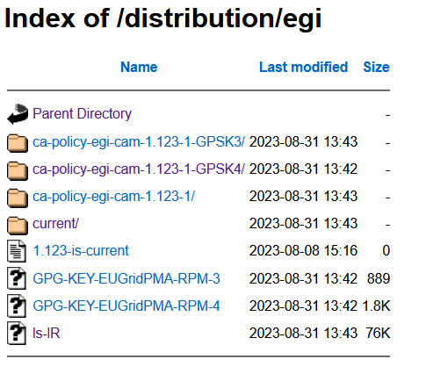
Specific downstream distribution (like EGI) follow
EGI uses the same signing key, since – for now – the packaging is integrated and co-supported by EGI
Plan is to move on the next major change, but not before Q2 2024
RHEL SHA-1 Root issue may be a good time to also make this change the default?

Slide 10
S/MIME Baseline Requirements
CA/B Forum developments

Slide 11
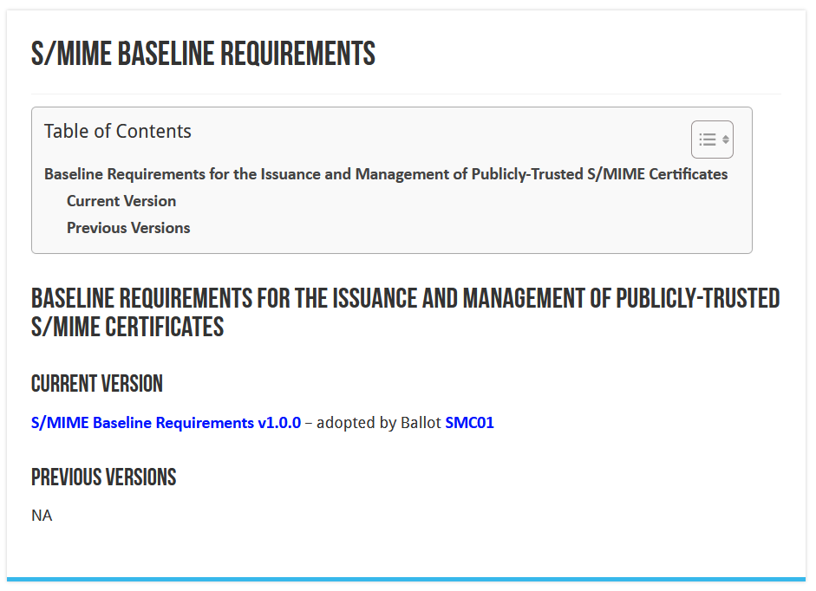
CA/BROWSER Forum

Slide 12
Different ‘profiles’ and validation types
Strict
  825-days (2yr), limited RDN attributes allowed
  intended only for S/MIME
Multi-purpose
  825 days (2yr), slightly more eKUs allowed
  crossover use cases between document signing and secure erossover use cases between document signing and secure emailmail
Legacy
  1185 days (3yr)
  transitional profile (likely to be phased out in the end)
  bit more freedom in subject, still allows DC naming, but otherwise not much more than MP
mailbox-validated
  just the rfc822name (only!)
organization-validated
  includes only Organizational (Legal Entity) attributes in the Subject
sponsor-validated
  Combines Individual (Natural Person) attributes and organizationName (associated Legal Entity) attribute
individual-validated
  Includes only Individual (Natural Person) attributes in the Subject

Slide 13
What TCS did
Have S/MIME personal certs, organization-verified, continue to be publicly trusted
  sponsor-validated (multi-purpose) BR-compliant (for ‘humans’) or org-validated (‘robot email’)
  we define all TCS members as Enterprise RAs (clarified in Ballot SMC-03
  does require all orgs to be revalidated using a Government Information Source or LEI (3.2.3.2.1)
  their subject name will be filled with the required fields (such as LEI, jurisdiction, address)
  the /clientgeant SAML endpoint (the only way for personal certs!) auo-upgrades Validation to “High”
Move the client authentication trust to a ‘private CA’ (non-public trust anchor), retaining exactly the same subject DNs, just a different ICA issuerDN and Root
  Add some additional ICAs and non-public Roots to the IGTF distribution
  so for IGTF RPs the change is minimal and transparent
  Inform relying parties, also outside of the IGTF, that client trust will become a specific decision. This is probably good, also for OpenVPN services, web access (.htpasswd), &c. The IGTF RPs are not impacted, others likely will be.

Slide 14
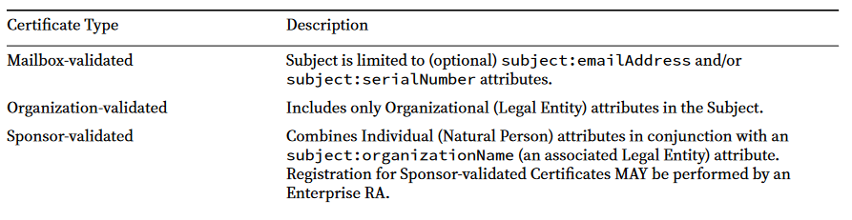
Sponsor validated
Sponsor‐validated:
‘Refers to a Certificate Subject which combines Individual (Natural Person) attributes in conjunction with an subject:organizationName (an associated Legal Entity) attribute. Registration for Sponsor‐validated Certificates MAY be performed by an Enterprise RA where the subject:organizationName is either that of the delegated enterprise, or an Affiliate of the delegated enterprise, or that the delegated enterprise is an agent of the named Subject Organization.’

Slide 15
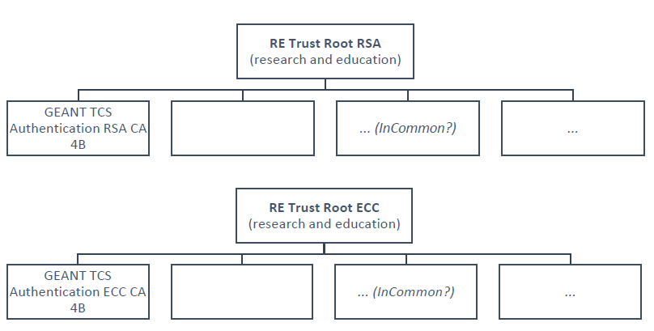
The new TCS Private hierarchies
Two new “RE Trust Roots” (RSA+ECC)
the cost is (apparently) there
can be re-used in R&E
GEANT TCS Authentication RSA/ECC CA 4B issuing subordinate CA
move all authentication use cases here
clarify that this is wider than ‘just e-science’: web site auth, IdP login, any client auth, network login, …
minimize disruption (at least in theory)

Slide 16
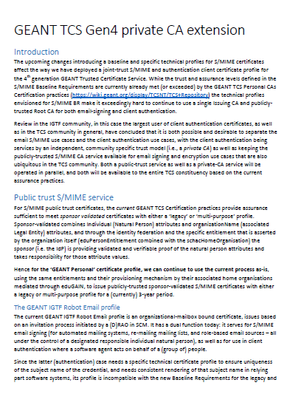
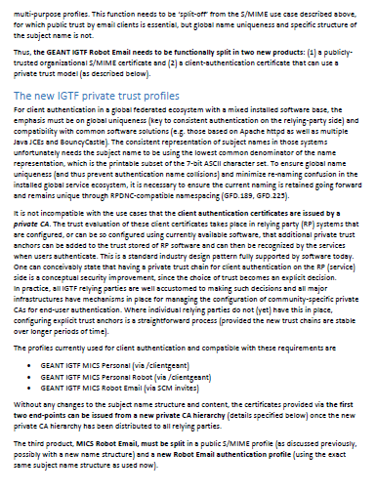
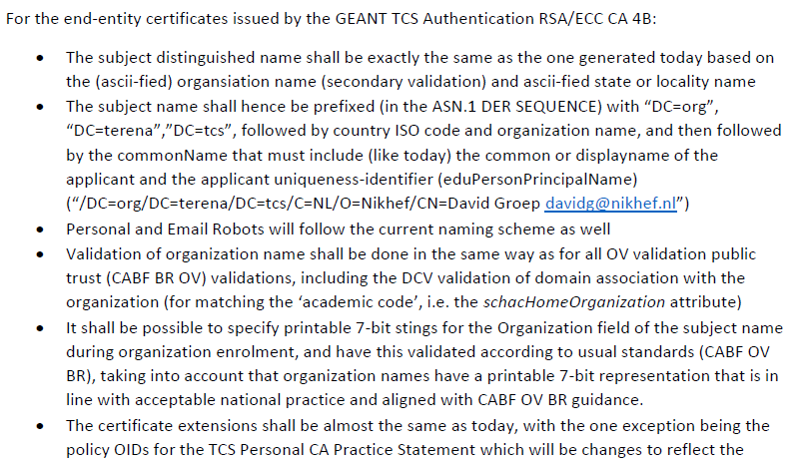
The guidance doc for TCS …
https://www.nikhef.nl/~davidg/tcsg4/TCS-Personal-CPS-2.2/GEANT-TCSG4-private-CA-extension-20230712.pdf

Slide 17
User awareness
This is a change in communications and documentation as well,
not only a set of technical changes
In request systems, have to clearly distinguish for users
which product to order. For example:
  “Personal” stays the same, but is called now “Email signing and Encryption”
  renaming “IGTF MICS Personal” to “Personal Authentication” and explain
  renaming “IGTF MICS Robot Personal” to “Personal Automated Authentication”
  forking “IGTF Classic Robot Email”
    Authentication-only (IGTF) profile “Classic Robot Email”
    Email signing profile “Organisation-validated S/MIME signing” (i.e. team-based or role-based)

Slide 18
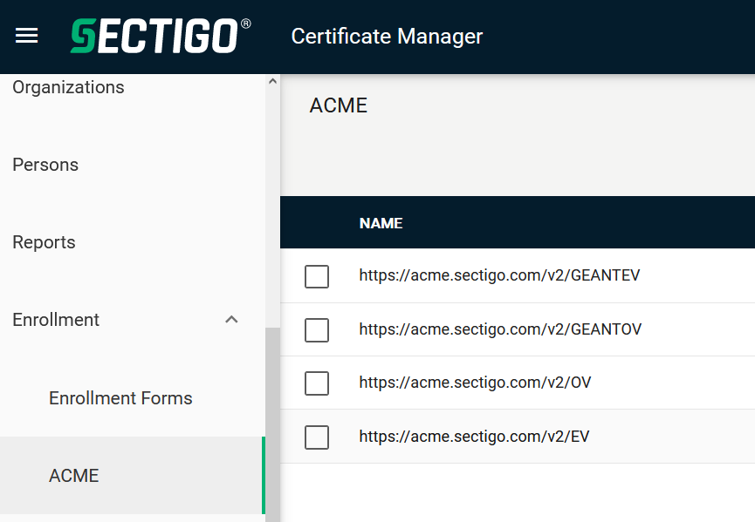
Other CABF things to keep in mind
Server SSL BR has already been updated
  the provision for using DC prefixing has been retained
But expect shorter validity periods in the future
  start preparing for 90-day max in your service deployment automation systems
  increased use of automation (ACME OV using client ID+secret)
[root@hekel ~]# certbot certonly \
--standalone --non-interactive --agree-tos --email davidg@nikhef.nl \
--server https://acme.sectigo.com/v2/GEANTOV \
--eab-kid DUniqueID_forthisclient --eab-hmac-key mv_v3ryl0n9s3cr3tK3y \
--domain hekel.nikhef.nl --cert-name OVGEANTcert

Slide 19

Attribute Authority operational security
AARC-G071
IGTF AAOPS (https://www.eugridpma.org/guidelines/aaops/)

Slide 20
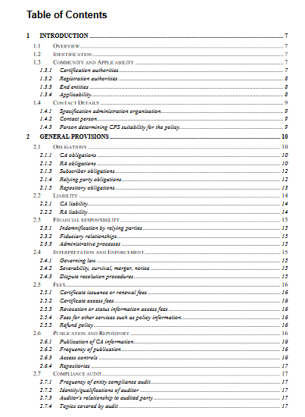
Taking proper care of trust sources
The AAI relies also on other attribute sources, and on the hubs & AARC Proxies
only generic guidance
proxies fully hide ID source
Protections for (IGTF) identity providers are known and documented
RFC3647
IGTF Guidelines
Technical profiles

Slide 21
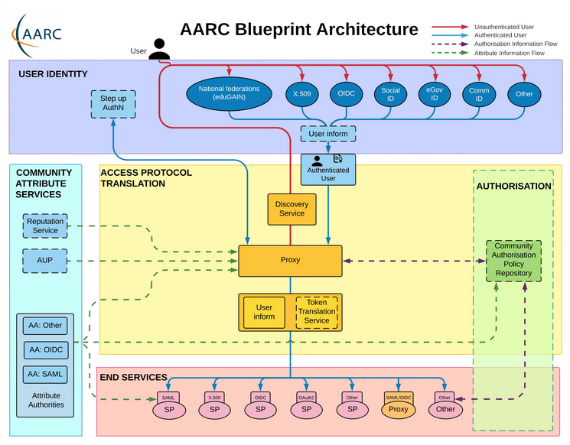
Operational guideline landscape for - proxy or source - AAI components
Authentication/identity sources
Sirtfi
(eduGAIN) baselining, RAF
IGTF AP Profiles
NIST SP800-63
eduGAIN sec. team workflow
RFC6238/4226
FIPS140
NISTSP800-53
Ephemeral credentials
trusted credential stores
protection at rest
Service provider operations
ISO27k
Sirtfi
Infrastructure response plans

Slide 22
Operational security focus in the BPA: beyond just the IdPs
Community membership management directories and attribute authorities
integrity of membership
identification, naming and traceability
site and service security
protection on the network
assertion integrity
Community membership management directories and attribute authorities
integrity of membership
identification, naming and traceability
site and service security
protection on the network
assertion integrity
Guidelines for Secure Operation of Attribute Authorities and other issuers of access-granting statements
(AARC-I048, in collaboration with IGTF AAOPS)

Slide 23
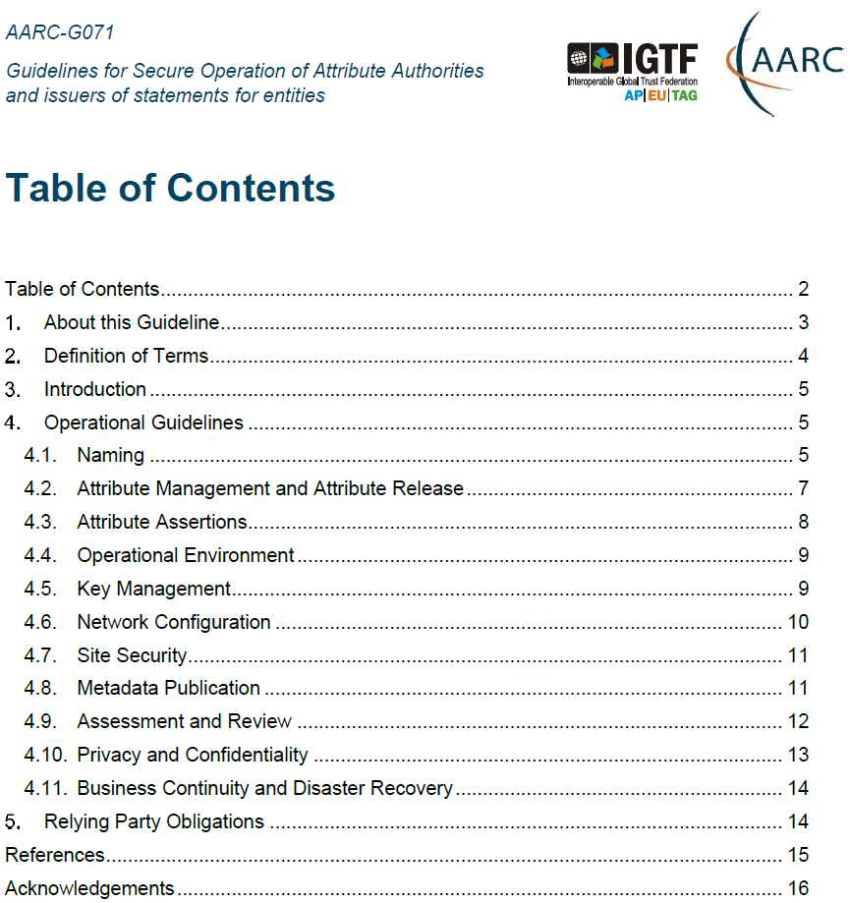
AARC-G071: keeping users & communities protected, moving across models
Structured around concept of “AA Operators”,
operating “Attribute Authorities”
(technological entities or proxies),
on behalf of, one or more, Communities, that are
trusted by Relying Parties
formerly AARC-G048bis
https://www.igtf.net/guidelines/aaops/
https://aarc-community.org/guidelines/aarc-g071/
Notes:
And dwells also on naming since that is the unique hook for the service providers to actually track back persistently to the proper community as well as operator …

Slide 24
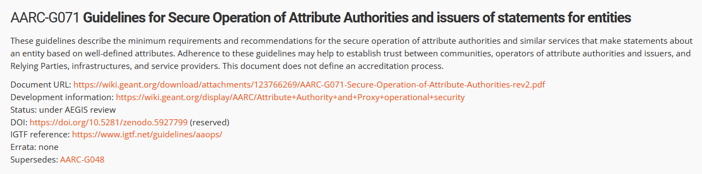
Implementation of the AA Operations (“AAI proxy”) Security guidelines
Major RPs and Infrastructures reviewed it based on current use cases and models
Guideline aimed at both Infrastructure and Community use cases
Useful input to e.g. ‘EOSC’ connected proxies as a good practice guideline
Assessment or review process is separate – could be IGTF or an RP consortium,
but does state what needs to be logged and saved to do a (self) assessment
https://aarc-community.org/guidelines/aarc-g071/

Slide 25
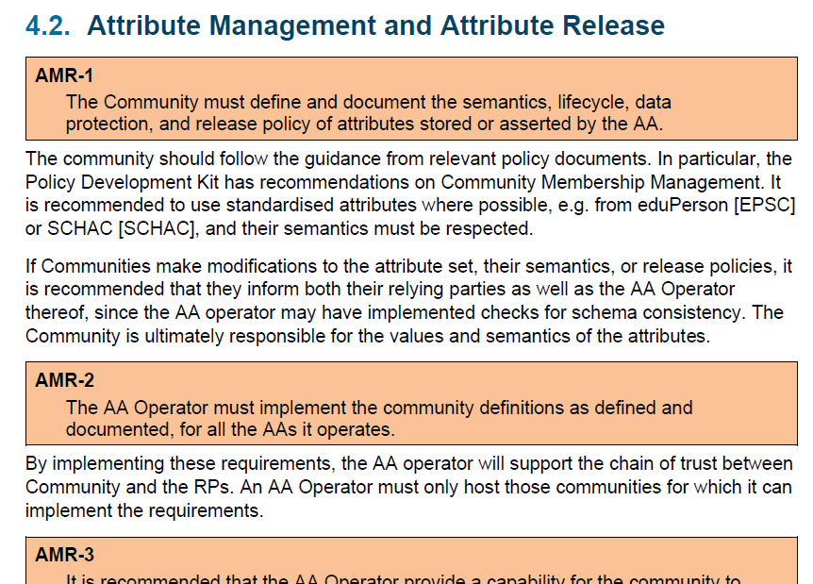
Deployment guidance included …

Slide 26

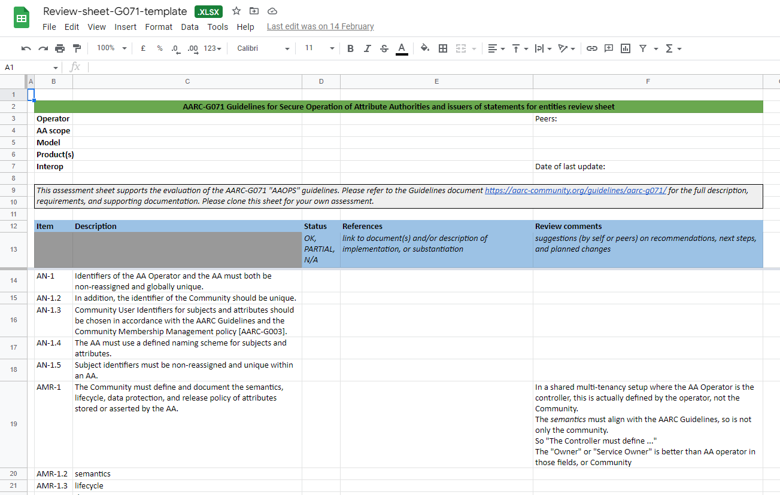
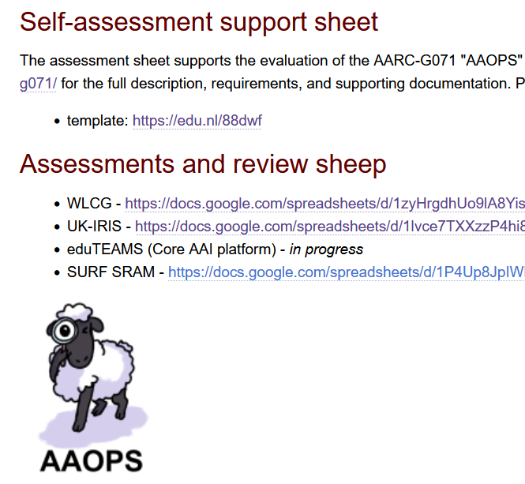
G071 self-assessment process
https://edu.nl/88dwf
Self-assessment by WLCG, UK-IRIS, eduTEAMS, and SRAM
mutual review also improves G071 guideline itself

Slide 27
The challenge of self-signed roots and FF & RedHat’ s idea of what self-signed means …

Slide 28
Although it conceptually makes no sense …
We know SHA-1 is no longer secure – and all EECs and ICAs moved away – when used as a secure hash algorithm. But …
now, some projects and distros are (uselessly!) deprecating SHA-1
also for self-signed (root) certificates
This affects at least
  FF103+
  RHEL9+ (and rebuilds)
yet … in the cases we could find only for CA certs
that are not in the WebPKI (and distro) public trust list
This impacts both joint-trust and igtf-only trust when installed in a non-system location. But thy system locations are different is not obvious from the doc …

Slide 29
Rocky9+, AlmaLinux9+, RHEL9+ and
With RHEL9 also deprecating SHA-1, but at the same time
still having self-signed SHA-1 based root certs in the ca-certificates
package, depends on a RedHat/OSSL proprietary set of ‘bonus bits’ appended to the end of the ASN.1 certificate blob.
For the others, there is – for now – a policy override:
update-crypto-policies --set DEFAULT:SHA1
update-crypto-policies --set LEGACY
even if that is a rather course-grained and blunt tool

Slide 30
The ca-certificates package in RH9
Interestingly, EL9 does ship with a lot of SHA-1 root CAs in
ca-certificates-2022.2.54-90.2.el9.noarch.rpm
and the p11-kit sources thereof (and thus e.g. /etc/pki/tls/certs/ca-bundle.crt)
contain SHA-1 self-signed roots that do work on EL9.
this relies on the OSSL proprietary ‘trust bytes’ in a BEGIN TRUSTED CERTIFICATE blob
such blobs allow SHA-1 for self-signed roots, but are not standarised
Yet the ‘simple’ solution, to ship both the EL/OSSL proprietary ‘trust’ bytes as well as a regular PEM formatted root does not work (thanks to Brian Lin for testing that!)

Slide 31
The OSG experiment
OSG shipped the dual-blob mode for a few days
using something like https://www.nikhef.nl/~davidg/tmp/make-trusted.sh
first a “BEGIN TRUSTED CERTIFICATE”,
then in the same file “BEGIN CERTIFICATE”
However, it broke:
CANL-Java, extending BouncyCastle, cannot process this blob and will balk even if it does not recognise it
(https://stackoverflow.com/questions/55550299/java-can-not-load-begin-trusted-certificate-format-certificate)
open as a dCache Feature Enhancement on CANL Java by Paul Millar
will not be fixed overnight, of course. And we my find other issues thereafter

Slide 32
But … maybe …
On 2023-12-20 13:25, Guido Pineda wrote:
> I am using fetch-crl version 3.0.22.
> We have a total of 89 trust anchors configured on our /etc/grid-security directory.
> I have tested fetch-crl with different versions of OpenSSL and here are the
> outcomes:
> For versions 1.1.1k and versions 3.2.0, the amount of errors when trying to verify
> the CRL's is only one [which was explainable]
> However, when using OpenSSL version 3.0.7, we get 10 errors
Due to self-compiling OpenSSL and does that ignore the RH crypt-policies?

Slide 33
Mitigations?
Still,
if you still have a SHA-1 root
and you are able to re-issue with the same key (and new serial)
and your EECs do not have dirname+serial in their AKI
your CAs should probably re-issuing its root because that is easier.
But for the large ones, esp. the DigiCert Assured ID Root from 2006 for instance, that will be hard.
And migrating to another (SHA-2 rooted) signing hierarchy will take at least 395 days ... and a lot of engineering on the RP and CA side
The root cause is with RH not understanding what a self-signed trust
anchor is, but that will not help us in the short term.

Slide 34
Reissuance of roots – state and progress
ASGCCA-2007 ArmeSFo
BYGCA CESNET-CA-Root
DZeScience DigiCertAssuredIDRootCA-Root
DigiCertGridRootCA-Root IHEP-2013
KEK LIPCA
MARGI
RDIG RomanianGRID
SRCE SiGNET-CA
TRGrid seegrid-ca-2013
Fixed by now: GridCanada, CILogon basic/silver/OpenID, UKeScienceRoot-2007
Removed: DigiCertGridCA-1-Classic, DigiCertGridTrustCA-Classic, DFN-GridGermany, CNIC
Will be discontinued soon: LIPCA

Slide 35

Building OUR global trust fabric
Questions?
David Groep davidg@nikhef.nl
https://www.nikhef.nl/~davidg/presentations/
https://orcid.org/0000-0003-1026-6606

Slide 36

this work is co-supported by the Trust and Identity work package of the GEANT project (GN5-1)
in collaboration with many, many people in the AARC+ Community, including Christos Kanellopoulos, Nicolas Liampotis, Licia Florio,
Hannah Short, Maarten Kremers, Niels van Dijk, David Crooks, Dave Kelsey, Ian Neilson, Mischa Sallé, Jens Jensen, and so many others!
davidg@nikhef.nl

