Slide 1


IGTF Fabric Updates
David Groep
davidg@nikhef.nl
status of our authorities and trust fabric news
May 2025
part of the work programme of
GEANT 5-1 EnCo, and AARC TREE
the work has received co-funding
from the European Union
co-supported by Nikhef and the Dutch
National e-Infrastructure coordinated by SURF

Slide 2
Meanwhile in Europe …
EUGridPMA and IGTF distribution matters
  constituency and developments
Package signing and SHA confusion
Root migration update for EL9+ (or: why people bother the fetch-crl devs)

Slide 3
EMEA area membership evolution
Europe⁺: GEANT TCS, and CZ, DE, DK(+FI+IS+NO+SE), GR, HR, NL, PL, RO, SI, SK; AM, MD, ME, MK, RS, RU, TR, UA, UK
Middle East: IR, PK
Africa: DZ, KE, MA
CERN, RCauth.eu

Slide 4
Membership and other changes
Identity providers: both reduction and growth
  migration to GEANT TCS continues
  https://wiki.geant.org/display/TCSNT/TCS+Participants+Sectigo
  Discontinued recently: -FR
  CERN joined TCS also via Renater (FR)
  Suspended: -KE, -MK
Self-audit review
  Cosmin Nistor tracks the status on the PMA Wiki
  real-time interaction between authority and reviewers helps, but …

Slide 5
Updates in 1.135
Changes from 1.134 to 1.135
---------------------------
(05 May 2025)
NOTE: the _default_ package signing key has changed to the 4th generation
for increased security and compatibility. The new key is a 2048 bit
RSA with fingerprint 565F4528EAD3F53727B5A2E9B055005676341F1A.
The GPG public key file can be retrieved from
https://dl.igtf.net/distribution/current/GPG-KEY-EUGridPMA-RPM-4
and imported on rpm-based distributions with 'rpmkeys --import <file>'
or on Debian (apt) based systems set in Signed-By in sources.list or
added as a file in /etc/apt/trusted.gpg.d/

Slide 6
Distribution signing key update
error: Verifying a signature using certificate
D12E922822BE64D50146188BC32D99C83CDBBC71
(EUGridPMA Distribution Signing Key 3 <info@eugridpma.org>):
Key C32D99C83CDBBC71 invalid: not signing capable
In Fedora Core 38+ (and thus later in its derivatives, and maybe soon in Debian), RSA 1024 package signing no longer supported by default
(work-around with bespoke crypto-policies possible, not recommended)

Slide 7
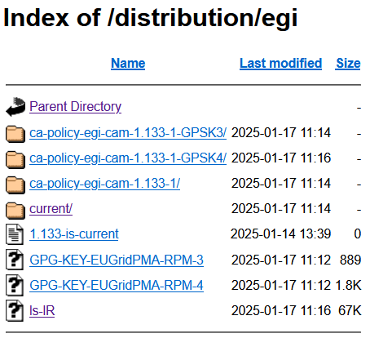
Distribution key update
In 1.135 we move the default
to a new GPG package key
RSA-2048
called GPG-KEY-EUGridPMA-RPM-4
distributed with 1.122+ releases
Retrieve new public key file from
https://dl.igtf.net/distribution/GPG-KEY-EUGridPMA-RPM-4
or from the public key servers: rsa/2048 dated 2023-07-29T12:06:23Z
fingerprint: 565f 4528 ead3 f537 27b5 a2e9 b055 0056 7634 1f1a

Slide 8

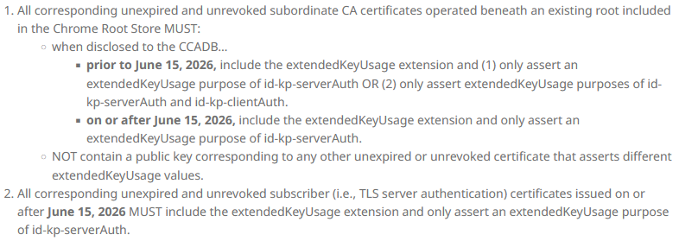
Other things to keep in mind, beyond CABF …
The pubic end to abusing server certs for client auth? Yeah!
  https://googlechrome.github.io/chromerootprogram/ section 3.2
  and it is to be strictly true from early 2027 onwards:
will this solve part of LE issue?
almost seems triggered by the DCVOTA profile ☺

Slide 9
The challenge of self-signed roots and FF & RedHat’ s idea of what self-signed means …

Slide 10
Rocky9+, AlmaLinux9+, RHEL9+ and
With RHEL9 also deprecating SHA-1, but at the same time
still having self-signed SHA-1 based root certs in the ca-certificates
package, depends on a RedHat/OSSL proprietary set of ‘bonus bits’ appended to the end of the ASN.1 certificate blob.
For the others, there is – for now – a policy override:
update-crypto-policies --set DEFAULT:SHA1
update-crypto-policies --set LEGACY
even if that is a rather course-grained and blunt tool

Slide 11
Reissuance of legacy roots – state and progress
ASGCCA-2007 ArmeSFo
CESNET-CA-Root
DZeScience DigiCertAssuredIDRootCA-Root
DigiCertGridRootCA-Root IHEP-2013
KEK
MARGI
RomanianGRID
SRCE SiGNET-CA
TRGrid seegrid-ca-2013
Fixed by ‘now’: RDIG, GridCanada, CILogon basic/silver/OpenID, UKeScienceRoot-2007
Removed: DigiCertGridCA-*, DFN-GridGermany, CNIC, BYGCA , LIPCA, MARGI (suspended)
Pending withdrawal:

Slide 12

Building OUR global trust fabric
Questions?
David Groep davidg@nikhef.nl
https://www.nikhef.nl/~davidg/presentations/
https://orcid.org/0000-0003-1026-6606

