Slide 1
RATCC4 and the SCCCJWG
January 2020
Prague 48th meeting
David Groep, Nikhef & EUGridPMA

Slide 2
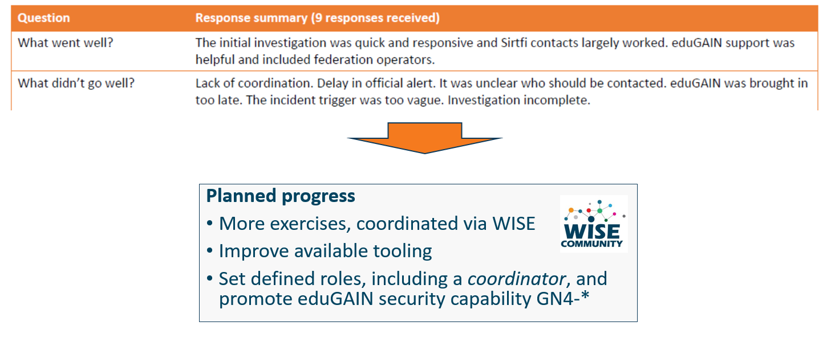
Communications Challenges
Based on Sirtfi incident role play of AARC in eduGAIN:
testing communications channels identified as high-prio target
Initial model might be along the IGTF RAT CC challenges – can be extended later

Slide 3
Proper OpSec needs to be exercized!
Like the IGTF RAT Communications Challenges, and TF-CSIRT processes, opsec really needs to be exercised often and in-depth to ensure readiness
Logical candidates that could all run the test against IdPs, CAs, SPs, RPs …
… and ‘legitimately’ claim an interest in their results
eduGAIN
IGTF
GEANT.org
EOSC-HUB ops, or EGI CSIRT
each of the e-Infrastructures XSEDE, EGI, EUDAT, PRACE, HPCI, …
every research infra with an interest: WLCG, LSAAI, BBMRI, ELIXIR, …
any institution (or person) with access to https://mds.edugain.org/
so soon: all the email in the world will be about Sirtfi Incident Response tests??

Slide 4
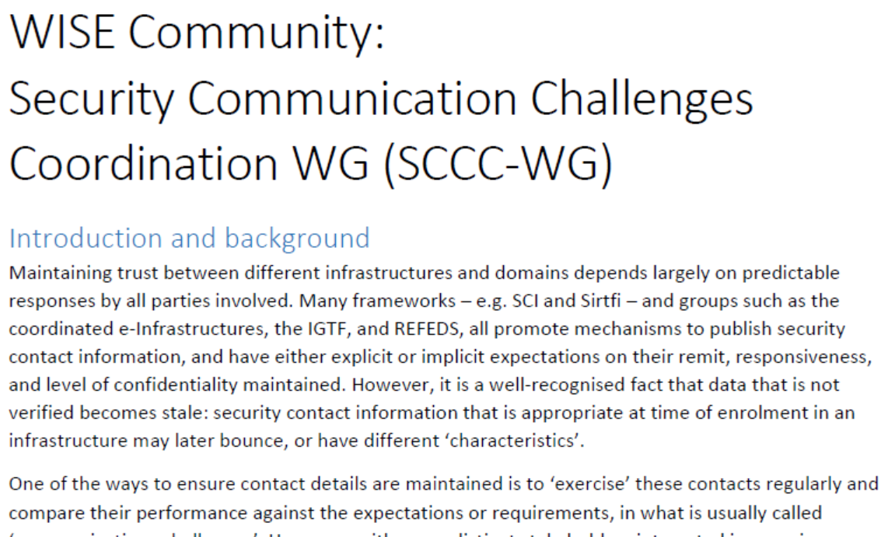
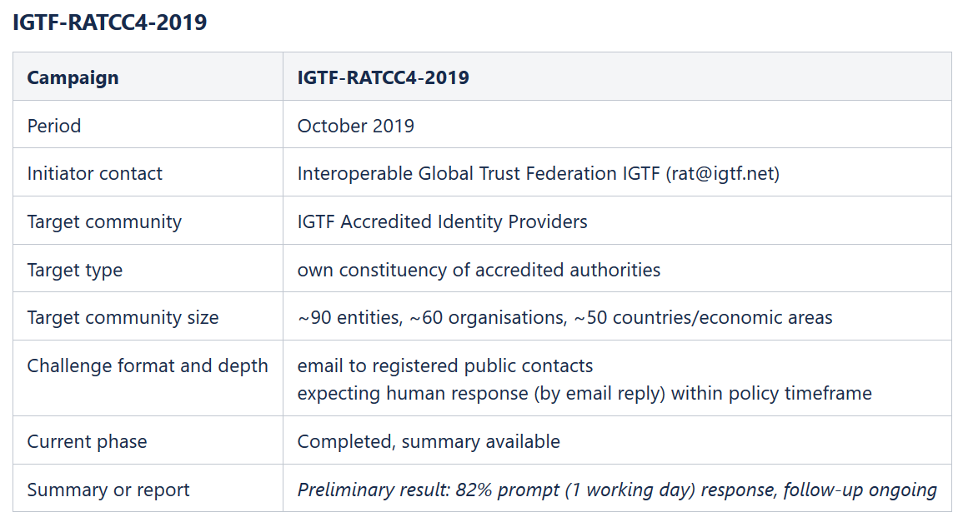
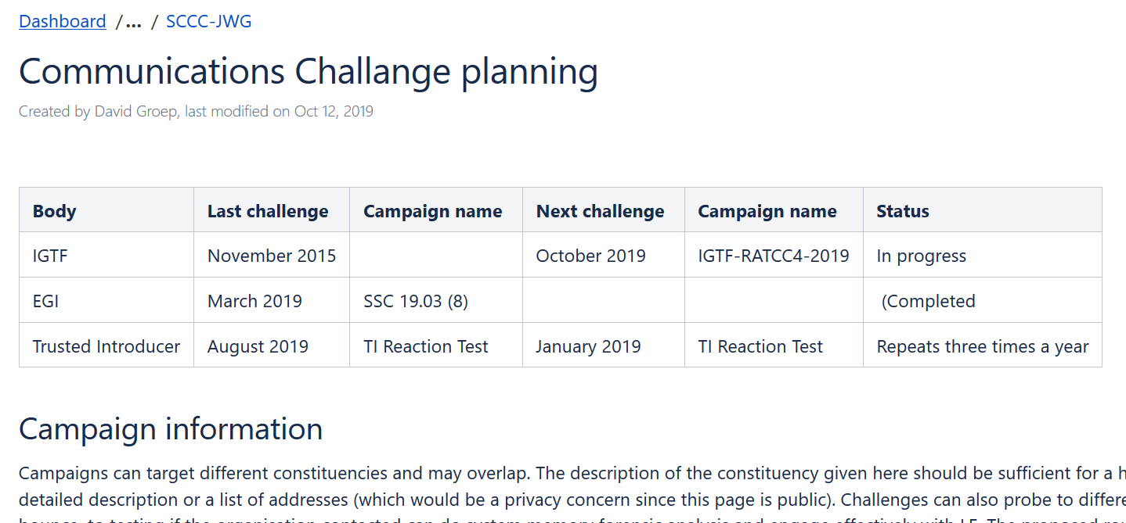
WISE SCCC-WG – participate!
WISE, SIGISM, REFEDS, TI joint working group
see wise-community.org and join!
https://wiki.geant.org/display/WISE/SCCC-JWG

Slide 5
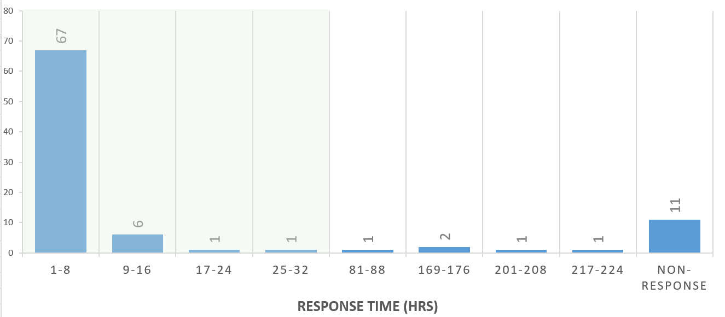
IGTF RATCC4 Results
In total there are 91 trust anchors (root, intermediate, and issuing authorities) currently in the accredited bundle,
managed by 60 organisations.
Of the 60 organisations, 49 responded within one working day (82%), representing (incidentally) also 82% of the trust anchors.
Within a few days more, 3 additional ones came in, and 4 more responded after a reminder.
In total, 90% of the organisations responded to the challenge, representing 88% of the trust anchors.

