Slide 1
OIDCfed and the IGTF MDSS
January 2020
Prague 48th meeting
David Groep, Nikhef & EUGridPMA

Slide 2
oidcfed.igtf.net
And now for something completely different …

Slide 3
OIDC Federation use cases for communities
Why did we embark on OIDC Fed for global e-Science?
EOSC-HUB registration of clients
goal for EGI and EUDAT is a scalable and trusted form of OIDC usage.
Today < O(50) clients; next year maybe O(100-1000)?
cloud-based services (containers, microservices) could push that to millions
CILogon (and XSEDE) use cases see need for a set of policies and practices
that support a 'trust anchor distribution'-like service targeting OIDC OPs and RPs
and where RPs that are ‘in the community’ can be identified as such
ELIXIR (and the Life Sciences) AAI expect growth in # OIDC RPs as AAI extends beyond just ELIXIR and into other biomedical RIs – potentially dynamically created
All of these need a policy framework, on both the (infrastructure) OPs and on the RPs
This is the community that traditionally also relied on the IGTF trust anchor distribution

Slide 4
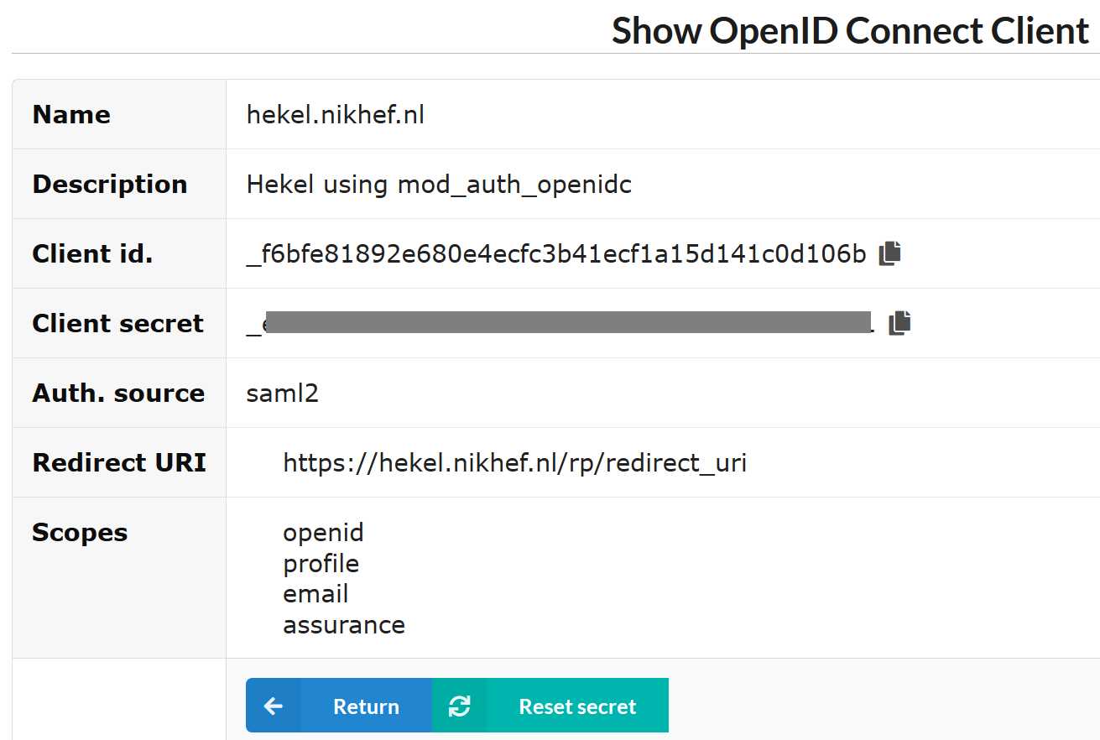
And registering clients does not scale…
configuration of a (test) client on the Nikhef institutional OP sso.nikhef.nl

Slide 5
OIDC Fed ‘policy’
IGTF “RP oriented” OIDC Fed can leverage existing framework
connect RPs from infrastructures that are IGTF members
(EGI, HPCI, OSG, WLCG, GEANT, PRAGMA, PRACE, XSEDE, …)
and new IGTF RP members can join of course!
Accreditation process and membership guidelines in place
OPs in the federation (RI/EI IdP-SP-Proxies) use IGTF APs
and Snctfi framework where needed
RPs in the federation become the responsibility of their member representatives
regional (‘national’) RP groups via their existing authority member
for RP trust (more than today) re-use Sirtfi, WISE, and trust groups

Slide 6
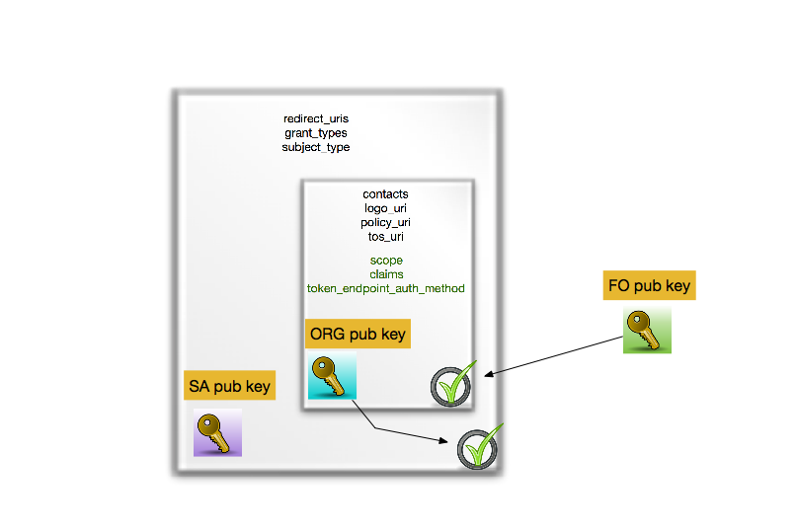
OIDCfed is basically signing a tree of entities with extensions
we kind-of know building trees and meshed of signed entities work – is this ‘just recast it JSON’ ?

Slide 7
Or can we do without a single one to rule them all?
today the RIs and EIs trust the IGTF trust anchors and
may (but do rarely) add their own
Can the ‘federation’ be the community and import a commonly trusted set?
Can the IGTF allow devolved registration provided that the trusted organisations implement the same policy controls Snctfi and the proper Assurance Profiles?

Slide 8
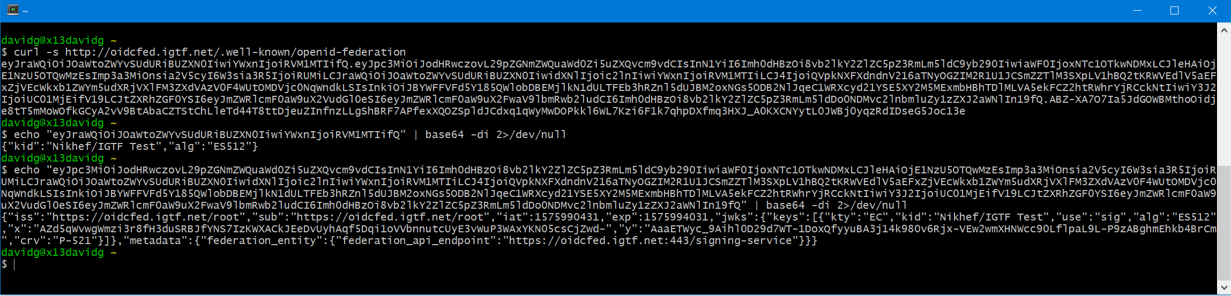
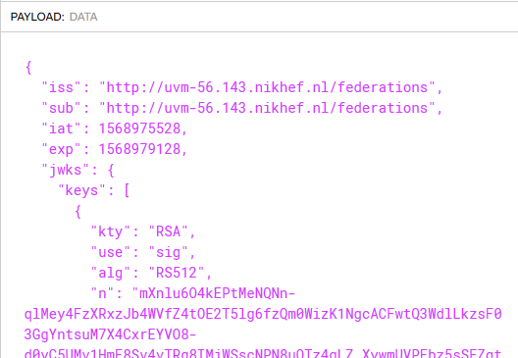
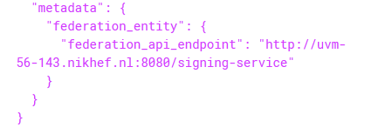
and this works now: oidcfed.igtf.net
translating with jwt.io into

