Slide 1
Dutch National Technology Strategy
ESPP-NL Technology Day
David Groep
January 2025

Slide 2
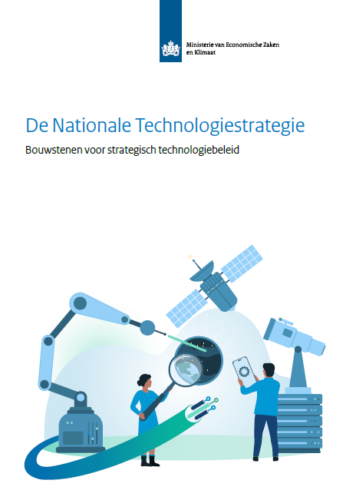
Dutch National Technology Strategy
With international competition and strategic emphasis abroad on key technologies, Dutch government developed the “Nationale Technologie Strategie” with those techs that:
increase significantly national earning power
are crucial for societal developments
are important for national (economic) security
enable (continued) Dutch technological leadership
There are actually two versions: one (Jan 19th, 2024) missing Cybersecurity, and one (June 6th) with CyberSec and some formatting changes! So beware which one you pick – I chose the latest one
https://www.rijksoverheid.nl/documenten/rapporten/2024/06/07/nationale-technologiestrategie

Slide 3
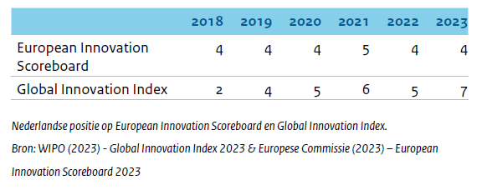
The political context of the National Tech Strategy
The Netherlands are good in developing technologies “and want to stay that way”
a strategy by the ministry of Economic Affairs, so not OCW
input from (tech) industry, knowledge institutions, and societal organisations
urgency provided by geo-political and economic context
both in Europe and globally
national security (mainly non-kinetic conflict) considered in all roadmaps and actions
“partner, competitor, system rival” (for .cn) reducing risks of negative impact on national security in technology competition by prioritising strategic technologies
aligned with EU strategy plans, but with specific Dutch emphasis (as there are competitors within the EU as well)

Slide 4
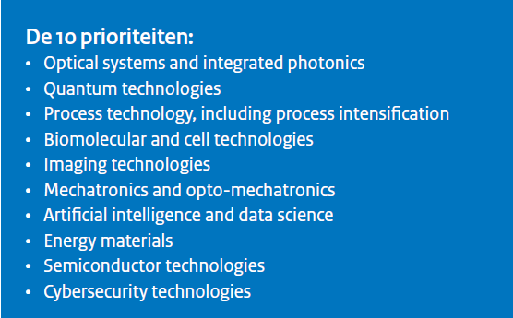
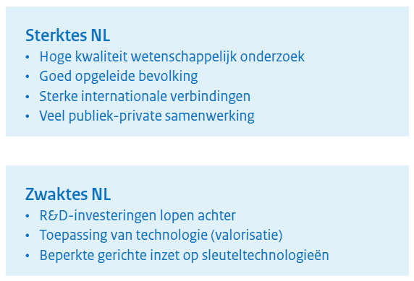
Having a look at the technologies ‘that will see investment’
10 priorities correspond to 44 key technologies

Slide 5
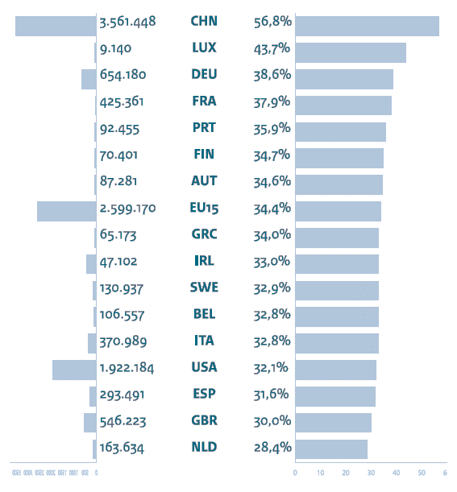
Closing the priorities gap
#key technology papers
in
% key tech papers/all
from the Natl. Tech Strategy Agenda, pg. 11

Slide 6
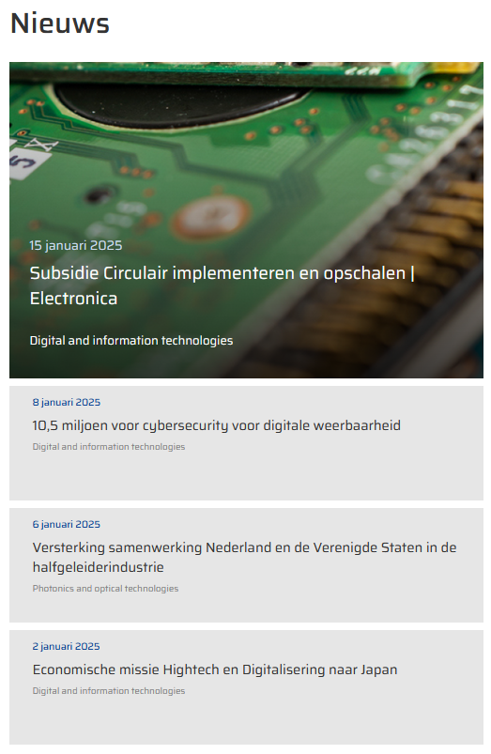
Implementation mechanisms
Top-sector missions for the future (Energietransitie, Circulaire Economie, Landbouw-Water-Voedsel, Gezondheid & Zorg, Veiligheid) continue to play important role, but now ‘re-align’:
Key Technologies 2024-2027 is an underpinning Knowledge and Innovation Agenda (KIA) alongside Digitalisation and Societal Earning Power
High Tech Systems and Materials top-sector identified “Key Technologies as an urgent transition”
expect investment & innovation policy to align during next decade
https://www.topsectoren.nl/missiesvoordetoekomst; https://www.kia-st.nl/; https://hollandhightech.nl/innovatie/urgente-transities/sleuteltechnologieen

Slide 7
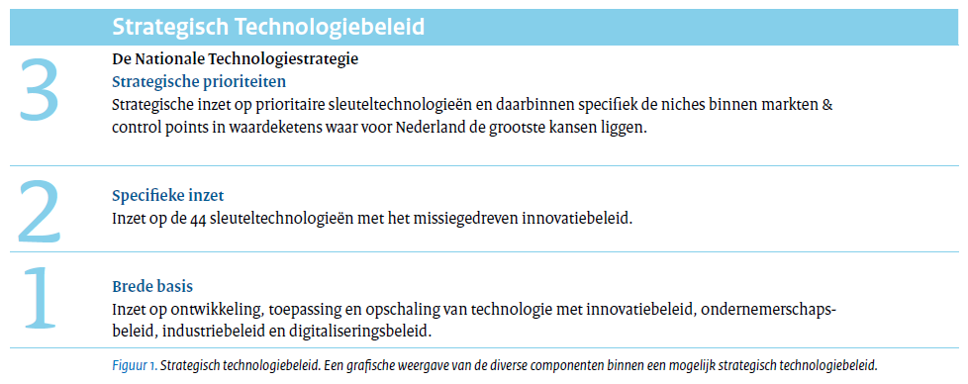
Not all technologies are created equal
‘Each of the 44 key technologies are important for mission-driven innovation policy’
‘Broad basis: target development, application and scale-up of technology by means of innovation, entrepreneurial, and industry policy’
but when you have a closer look, of course …
NL holds ‘control points’, i.e. crucial tech in the international value chain, and wants to acquire more of these also others (US, UK) prioritise controls points within their strategic technologies portfolio

Slide 8
Control-point technologies
Next to existing control points (e.g. optical systems, and semicon) strategy identifies
Quantum “Nederland is een gidsland met control points in internationale waardeketens voor alle drie de beschreven technologiegebieden, met spelers die concurreren op internationaal niveau.” – targeting specific niches for the control points “rekening gehouden met de lokale economische omstandigheden, niet enkel de wetenschappelijke kwaliteit.”
Imaging “the combination of semicon and quantum (optics, opto-mechatronics, acoustics) is unique for quality assurance. This can become a control point for the semicon industry”
Energy materials existing NGF programme targets specific elements of the battery value chain; next gen cells, stationary load-balancing batteries, HGV batteries

Slide 9
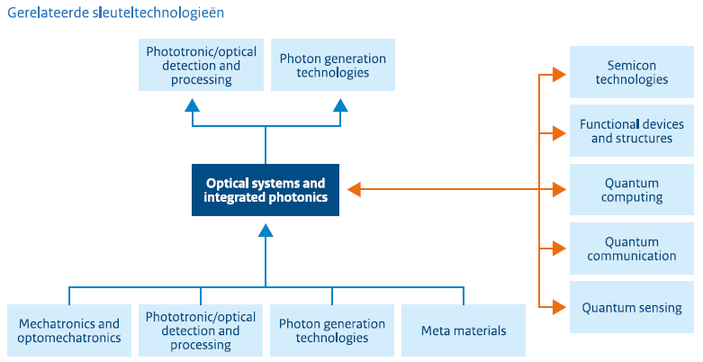
Optical systems and photonics “in 2035 NL is the world leader and we outcompete the rest”
Optical systems
industrial scale achieved, but there are some new low-TRL developments
widely applicable, but NL emphasis on complex systems
Integrated photonics
mostly niche applications (apart from datacom)
sensing in datacom (strategic!) and in agro/bio sectors
low TRL for things like wafer-scale
Existing partners dominate (PhotonicsNL, Optics Netherlands and PhotonDelta, plus HTSM)

Slide 10
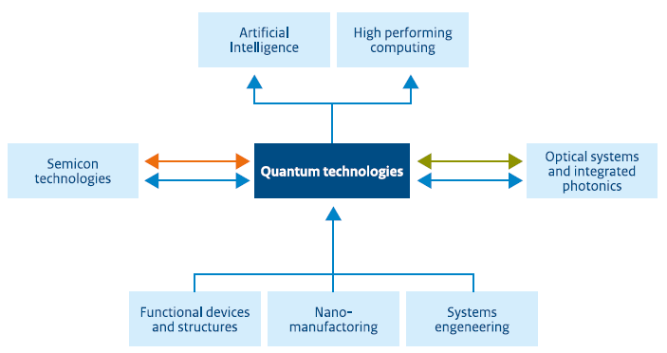
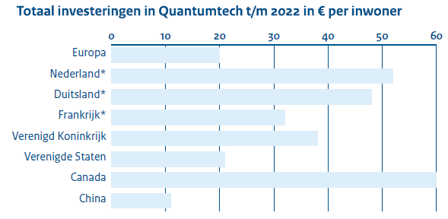
Quantum “In 2035 the Dutch Quantum ecosystem is world-class with the Dutch leading with controlpoints for all three areas”
Quantum Computing
Quantum Communications
Quantum Sensing
Clear focus on ‘Dutch’ quantum tech: “Quantumtoepassingen zullen in toenemende mate kennis uit semicon technologies gebruiken voor het ontwerp van chips en systemen.”
Recognition that it will be European as there’s lack of large tech and venture capital - should align well for NL linking to a European strategy (with the EU QT Flagship)

Slide 11
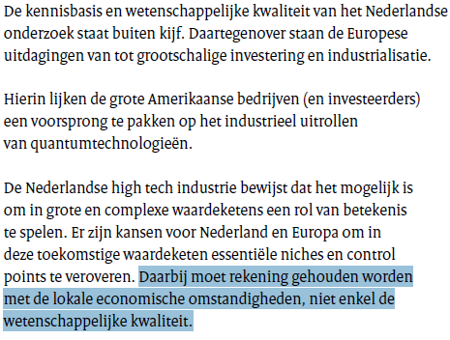
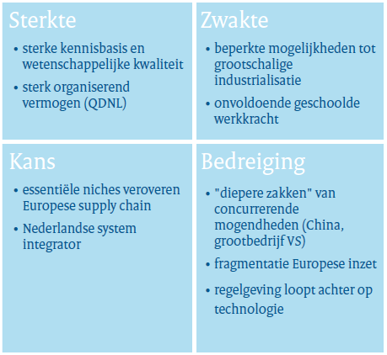
Research and test facility emphasis strengthens existing hubs (QuTech, NanoLabNL, QuSoft)
Quantum SWOT for NL

Slide 12
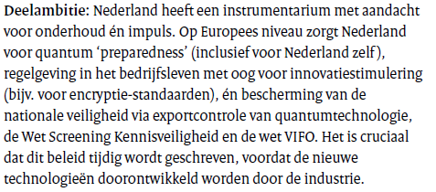
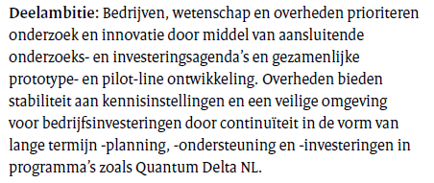
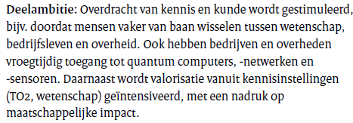
Quantum Quotes

Slide 13
For these key techs, maybe less overlap (but who knows)?
Process technology including process intensification (bio-mass and waste energy conversion, pyrolyse plants, syngas, ethanol fermentation)
Biomolecular and cell technologies (precision health, sustainable agro and non-food bioproduction)
Energy materials (batteries, electrolysers, heat storage)

Slide 14
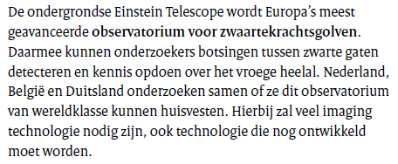
But … Imaging?
“Imaging is the generation, duplication, analysis and visualisation of images” … with “applications in medicine, semicon, security, agriculture, industry, traffic and aerospace.”
And it’s very nice of course, but why here?
listed alongside medical, defence, semicon, agro, industry and traffic imaging on pg. 56 as significant application area for new imaging techniques

Slide 15
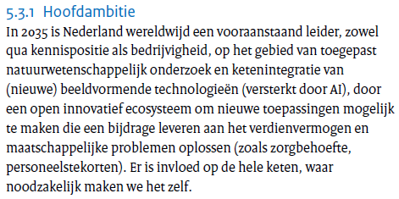
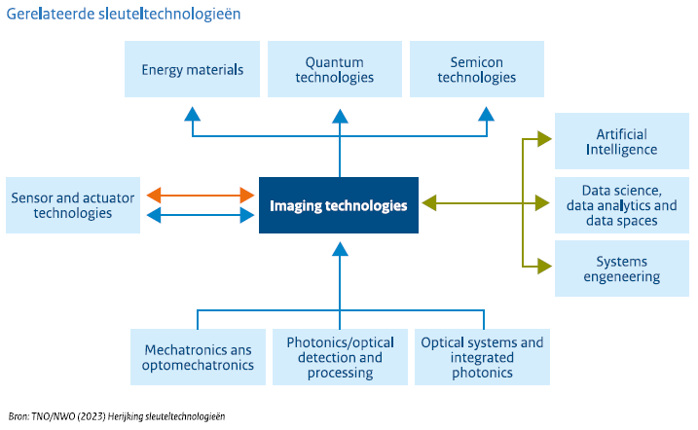
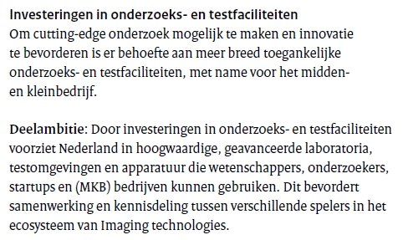
Some imaging considerations as a counterbalance

Slide 16
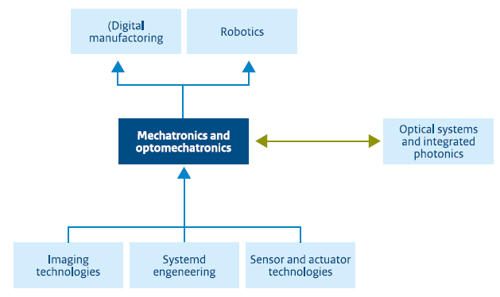
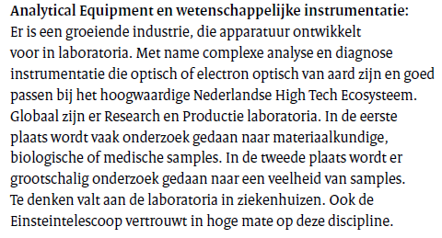
Mechatronics en Optomechatronics “the Netherlands has further strengthened its leadership position” “delivering open strategic autonomy”
Here ET is mentioned, and makes perfect sense

Slide 17
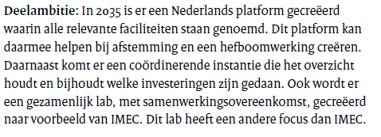
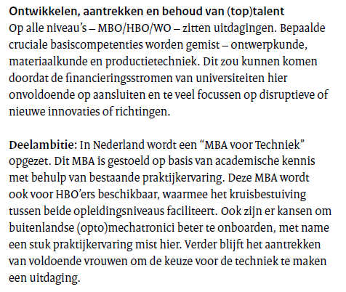
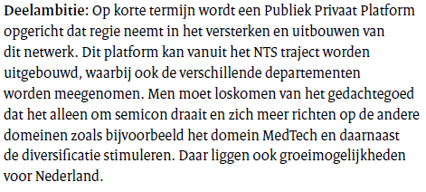
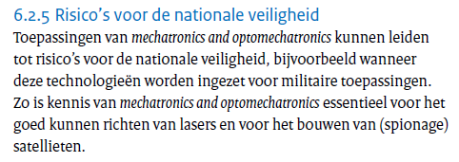
Mechatronics en Optomechatronics

Slide 18
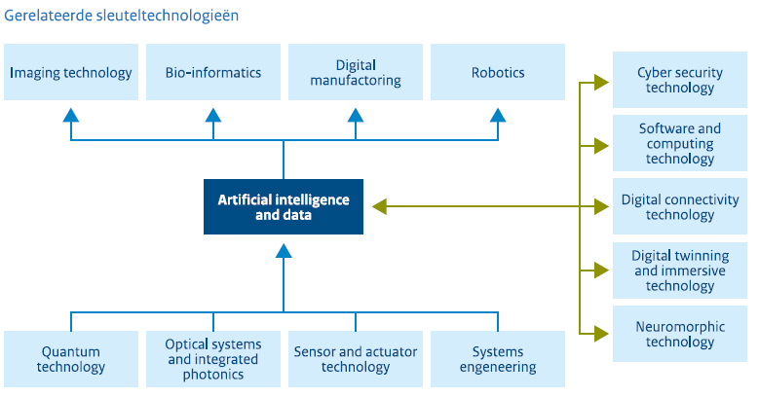
Artificial Intelligence and data “the Netherlands has the capacity to work with AI and data, leading to innovation and accelerating societal transitions”
note this was not designated as a control-point technology
entire focus of this topic is on decentralised learning, federated models, and sharing in data spaces
it is recognised that NL has prominent scientific position, but failed (fails) in large-scale AI and data analytics … just like the rest of Europe!

Slide 19
AI and data – identified barriers
Challenges
lack of sufficient compute capacity and dependence on foreign infrastructure (and that is likely to remain so)
lack of access to data: and that is not always lack of will: also regulatory barriers
lack of access to capital, both public and private
limited uptake by companies of AI innovations, apart from a select few
climate for attracting talent is deteriorating (fiscal, immigration)
Within Europe, NL is actually quite OK (as: on the Digital Economy and Society Index)
above average on human capital, connectivity, integration of digital technologies, and digital public services
broad presence of AI research in universities and HBO, and good collaboration between AI (data) research groups and SSH groups
strong public-private partnerships (Commit, Commit2Data, AI Coalition)

Slide 20
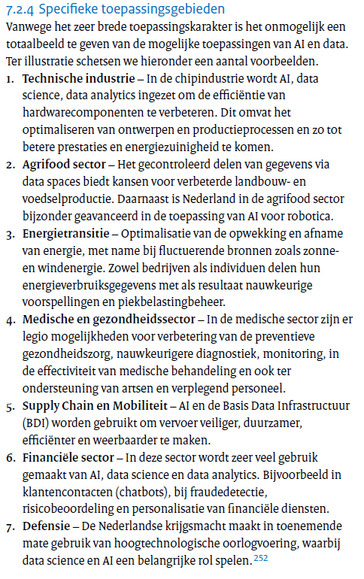
Identified application areas don’t help us
But some other elements might – in the longer future
the other aspects are not directly helpful to us, although some aspects may (indirectly) harm us
imitations by the EU AI Act may push talent away from EU
‘federated learning’ does not provide much advantages for HEP
the ‘data’ aspect here is not on volume, but on access

Slide 21
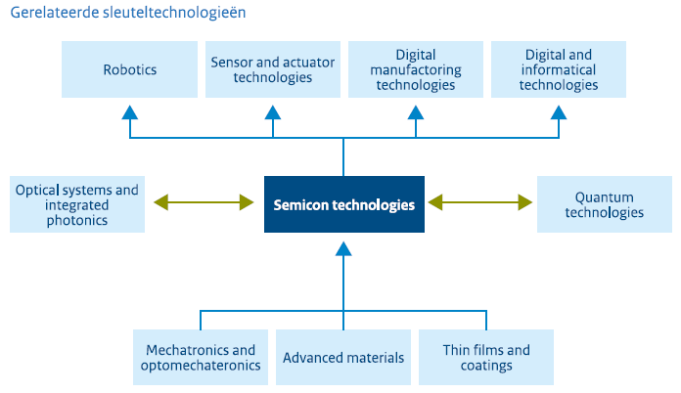
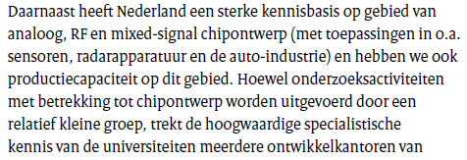
Semiconductor technologies “in 2035, the Netherlands holds signature sustainable positions in chip design, production equipment, materials, and packaging. With pride.”
We know that, so the let’s look inside:

Slide 22
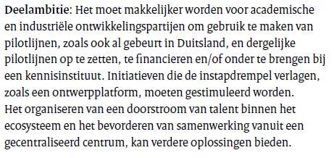
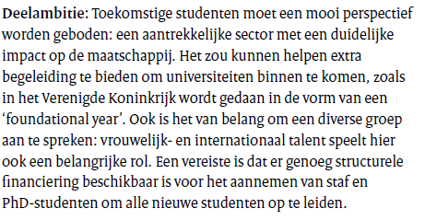
Ambitions semicon

Slide 23
Ambitions semicon

Slide 24
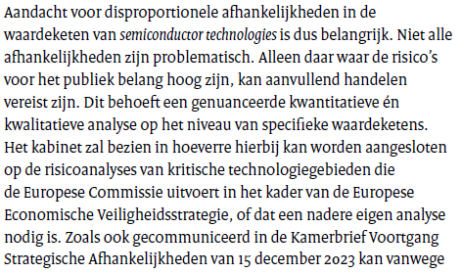
But there’s a caveat

Slide 25
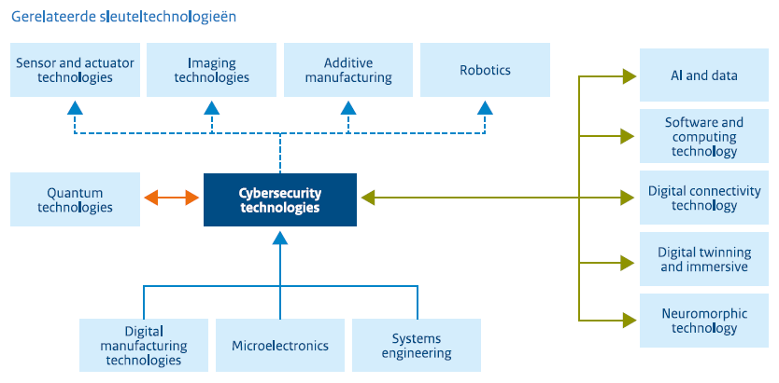
Cybersecurity Technologies
“by 2035 a competitive cybersecurity market with enough talent, through a multi-disciplinary approach … protecting infrastructure, IT, OT, with post-quantum, automation, defence using AI”
Remember this was a late addition … it shows a bit in the text …

Slide 26
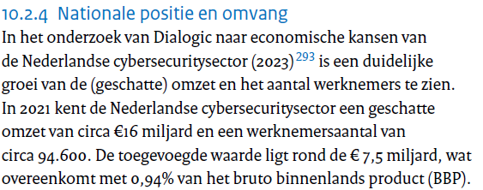
The strategy is a bit creative here with the data
There are new drivers now:
NIS2
Cyber Resilience Act
Cyber Security Act
ongoing growth of threats
??
From underlying Dialogic rapport: significant growth from 2010 to 2015 in #employees, but that is also affected by a change of methodology. Other indicators show a steady but not spectacular change https://dialogic.nl/wp-content/uploads/2023/06/economische-kansen-van-de-cybersecuritysector-7.pdf

Slide 27
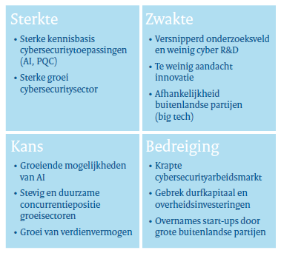
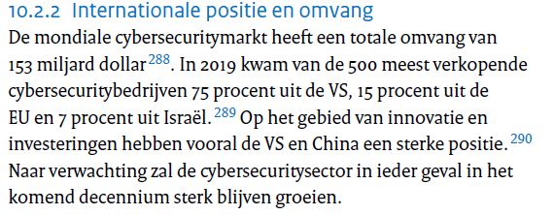
But its (again) not a control-point technology

Slide 28
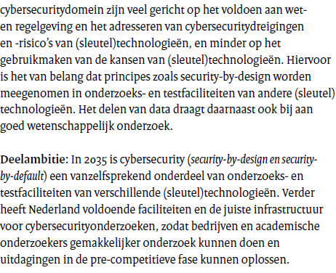
But the cybersec strategy will have broad impact

Slide 29
So where are our best chances? What should the strategy say?
Reflecting on the relevant areas to ensure we can leverage NL investments and synergy in
optical/photonics, quantum, (opto)mechatronics, AI & datascience, and semicon
… and we may leverage cybersecurity in some way, plus have a look at imaging
The strategy should increase the focus on and strengthen
semiconductor-based development
quantum technologies (quantum sensing as well as quantum computing)
integrated photonics in future detectors
and leverage the potential of
build on the (opto)mechatronics basis
fiber sensing through integrated photonics (?)

Slide 31
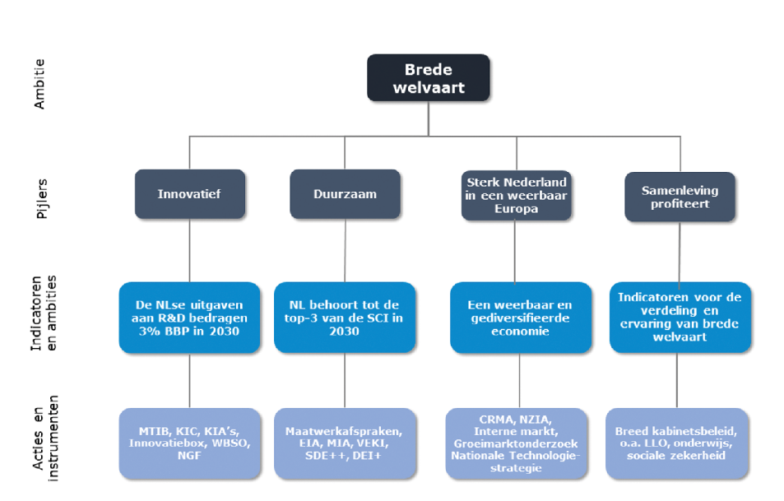
The NTS as part of a larger picture
https://zoek.officielebekendmakingen.nl/kst-33009-131, published 27-07-2023

Slide 32
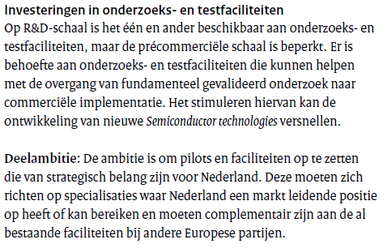
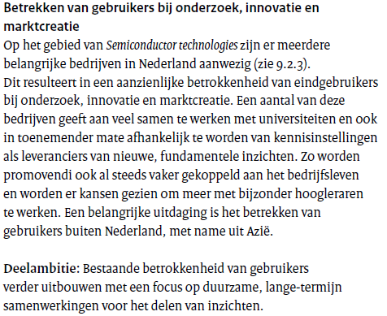
Ambitions semicon

