Slide 1
EOSC Future Security Operations and Policy
June 2021 EUGridPMA IGTF meeting

Slide 2


A challenging landscape
Entities of all kinds – diversity in the EOSC range
from data sets to storage to computing to publications & digital objects
An open ecosystem – rules of participation will favour low barrier to
entry regarding operational maturity, service management quality, &c
A diverse ecosystem – providers will come from e-Infrastructures,
from member states, from research infrastructures, and private sector
An interdependent ecosystem – aiming for composability
and collective service design through an open, core AAI federation

Slide 3
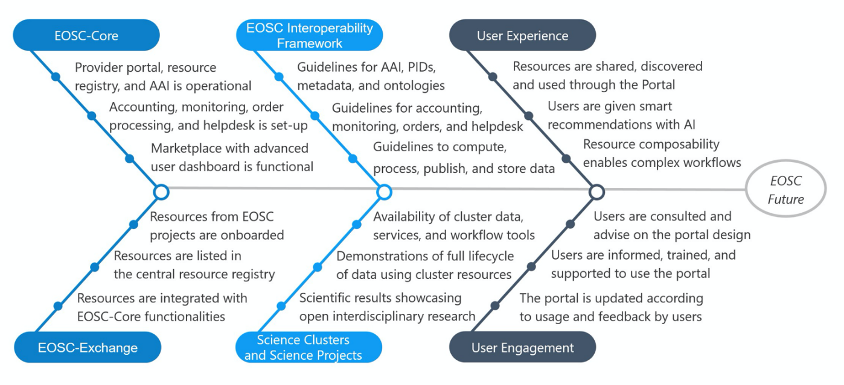
Mission of EOSC Future …

Slide 4
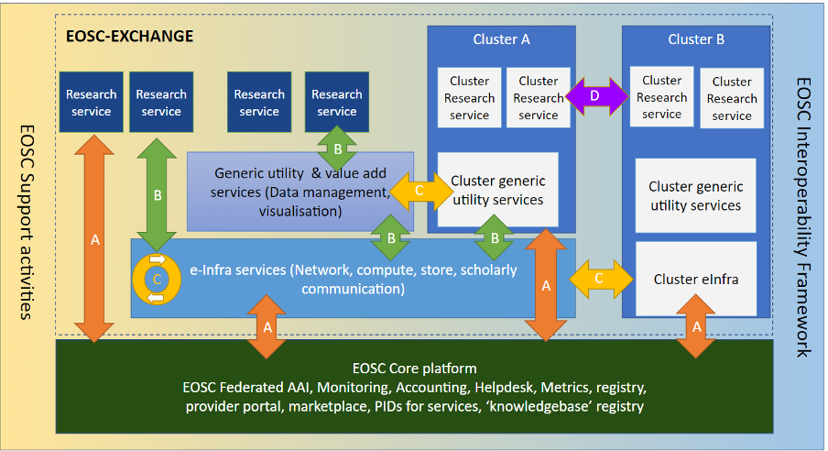

Slide 5
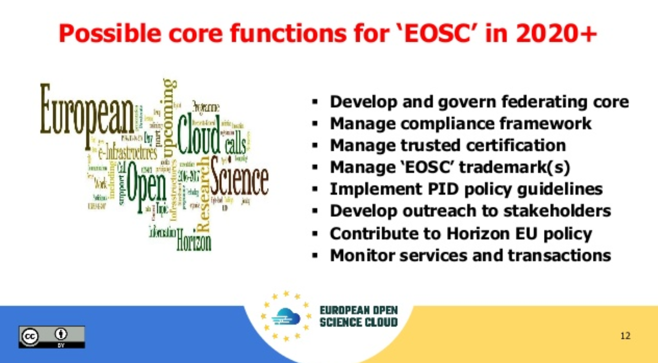
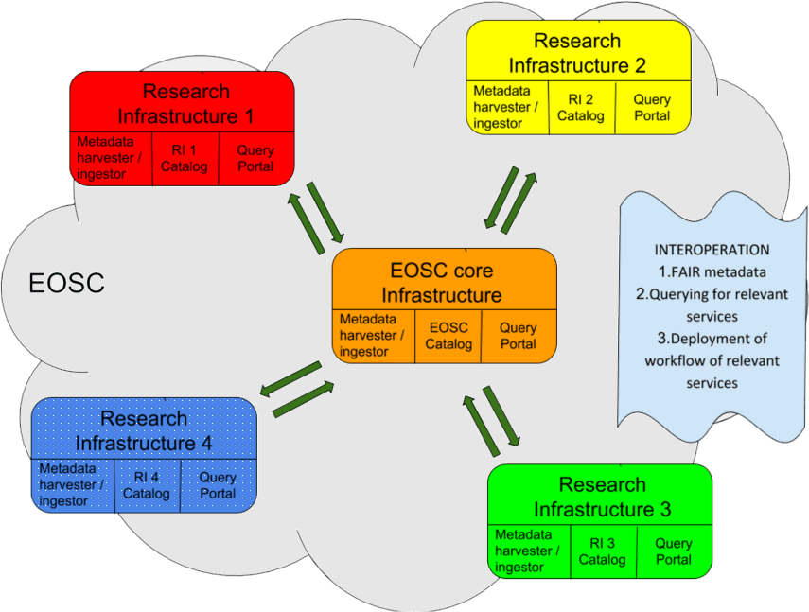
Operating core services and ‘exchange’
IT service management for the (core) services
Portal operation, with a demand and supply side
AAI federation - authentication and authorization
based on the ‘AARC BPA’ and federation concepts
operational security capabilities, trust policy,
and security risk structuring
Sustainability and Architecture WGs set criteria for inclusion of additional services
Architecture WG and its taskforces set interoperability standards

Slide 6
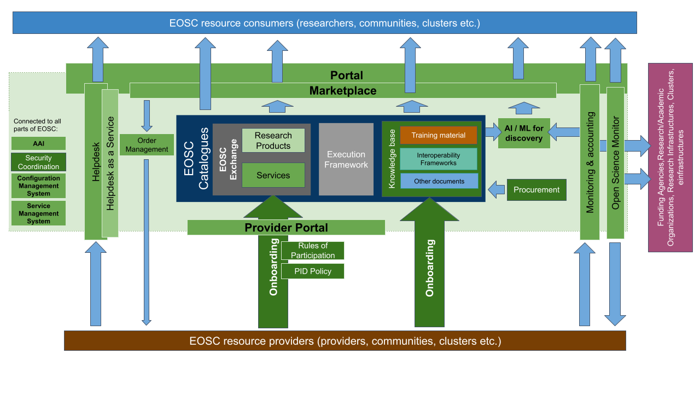
Components Integrated by EOSC Future
from “PartB”, 24_03_2021_EOSC_Future_master_file

Slide 7
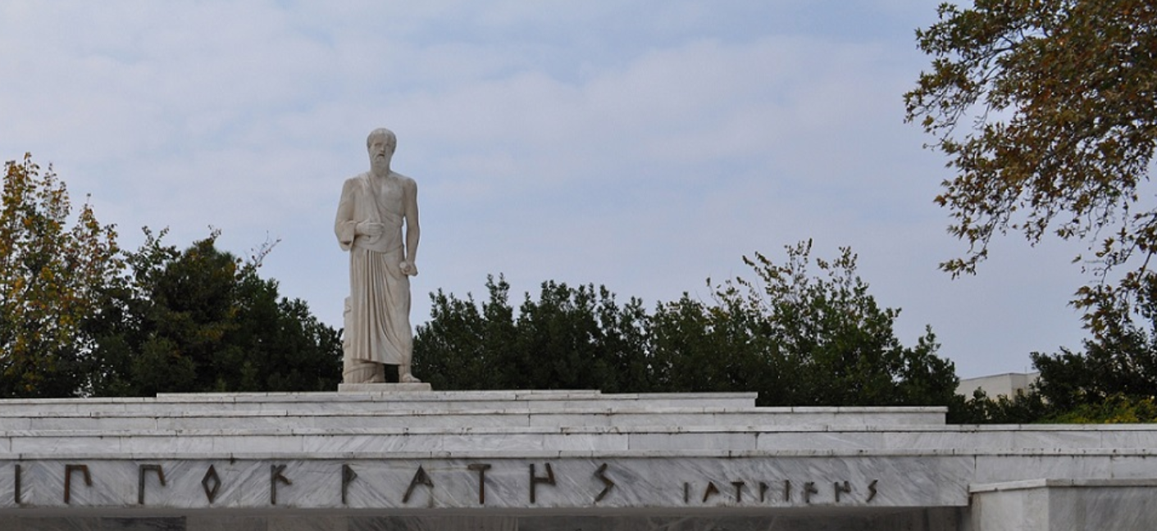
Start with the basics for ‘EOSC at large’
A service provider should
do no harm to interests & assets of users
not expose other service providers
in the EOSC ecosystem to enlarged risk
as a result of their participation in EOSC
be transparent about its infosec maturity and risk to its customers and suppliers
From promoting and monitoring provider specific capabilities
to managing core risk
this means some minimum requirements in the Rules of Participation
and a response capability in the core that protects ecosystem integrity

Slide 8
EOSC Security Operations & Policy
Risk-centric self-assessment framework
Baselining security policies & common assurance
An incident coordination hub and a trust posture
Actionable operational response to incidents
AARC, REFEDS, IGTF, PDK & practical implementation measures
EOSC core expertise to support resolution of cross-provider issues
spanning providers and core, based on experience & exercises
based on federated InfoSec guidance including WISE SCI
Fostering trust through a known skills programme
so that your peers may have confidence in service provider abilities
DanielK - WP10 →

Slide 9
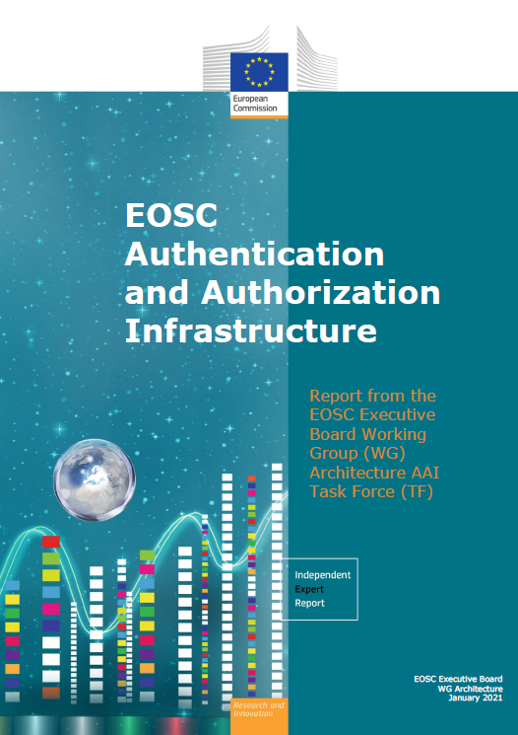
The EOSC AAI /Federation
In order to outline a globally viable, scalable and secure EOSC AAI, the group defined the following three core principles, on which to base their work:
User experience is the only touchstone.
All trust flows from communities.
There is no centre in a distributed system.
“The human element was the starting point of our exploration. We believe that providing a good user experience and making use of the existing trust relations that users already have within their research communities are the key factors for delivering a successful EOSC AAI.” [Klaas Wieringa, EOSC AAI TF chair]
doi:10.2777/8702 – ISBN 978-92-76-28113-9

Slide 10
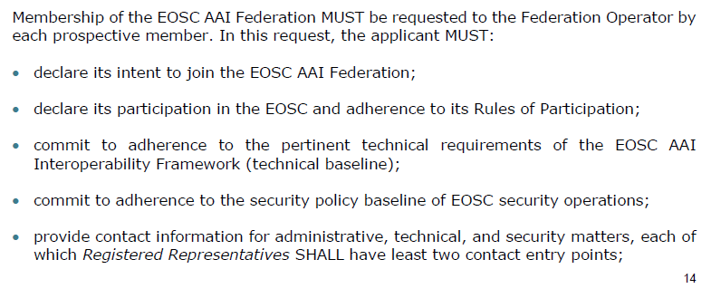
Why is the EOSC AAI important here?
… the new ‘EOSC’ federation gets policies and a base line at ‘onboarding’ time
leveraging existing trust frameworks
not repeat earlier mistakes: so implement a baseline at the start

Slide 11
Planning security activities for the EOSC
Information security risk assessment framework based on SCI and a maturity model – targeting connected services as well as data, and correlated risks
Coordinate security policies for a baseline aligned with the Rules of Participation of the EOSC, and the EOSC AAI federation – ensuring transparency for the ‘risk appetite’ of the participants
Mechanisms for coordination and resolution of incidents through Information Security Management (ISM) processes – leveraging WISE community and Sirtfi, and enabling the (tested) framework for information sharing
Security operations and incident response capabilities related to or affecting the EOSC Core (in relatively broad sense) - with content and service providers

Slide 12
Risk Assessment
base on WISE Risk Assessment for WISE (RAW-WG) assessment template
moves beyond single-domain framework
specifically challenging if you cannot enumerate your assets?
EOSC-specialised maturity model and (self-)assessments
assessment of risk of combined and composite services

Slide 13
Security policy baseline and trust
needs to preserve the risk appetite of the participants involved
trust should be transparent, comparably formulated,
and address existing and emergent usage patterns
taking in EOSC Rules of Participation WG, governance activities, and WISE
security policy baseline to be incorporated into EOSC AAI Federation participation policy and incorporate secure service operations guidelines
evolving trust ‘mapping’ framework of WISE SCI by explicitly incorporating federative aspects
effective peer-reviewed self-assessment of information security maturity

Slide 14
Coordination framework and operational sharing process
incidents are not limited to just one participant, so their mitigation, containment, and ultimate resolution requires a collective response
leverage, enhance mechanisms developed in WISE and REFEDS
procedures for collaborating and sharing of the so-called ‘Indicators of Compromise’ (IoCs)
since incidents do not stop at the EOSC edge, needs engagement
with whole constituency: EOSC Core, Exchange, providers, community
concrete processes that enable collaboration during actual response
periodically exercised!

Slide 15
Remediation of Core incidents and coordinated security response
interdependency of services requires exchange of information and a coherent and simultaneous response to incidents both across services as well as inside each individual service
coordinating response for incidents affecting the EOSC
remediation of incidents in the Portal, Core Services, and key infrastructure elements
effective remediation of incidents in the EOSC at large also depends on
subsidiarity and participation of service providers and Infra’s

Slide 16
‘whatever it will become, EOSC will shape the research area – and its resilience and security’

