Slide 1
The EOSC Security Baseline
EOSC Future TCB, August 2022

Slide 2
Keeping the EOSC secure
“ensure confidentiality, integrity and availability”
“protecting data and services from threats and vulnerabilities”
In our heterogeneous EOSC at large, founded on subsidiarity, this translates to
primum non nocere: do no harm to interests & assets of others, including users
not expose other service providers in the EOSC ecosystem to enlarged risk
as a result of their participation in EOSC
be transparent about infosec maturity and risk to its customers and suppliers
baselining is a true & tried approach to improve collective security posture

Slide 3
Applicability of ISM policies and processes
EOSC ISM differentiates between Core and Exchange
both are in scope for all security policies
Core: mandatory adherence (and pro-active support from the security team)
Exchange: based on Interoperability Framework (& ‘RFC2119-RECOMMENDED’)
Participants are autonomous
but subscribe to shared commitment of maintaining trustworthy & secure EOSC
With everyone expected to participate in incident response and ‘drills’
for the Core services, expert forensics support is provided for if desired
in the Exchange, coordination and liaison are the primary tasks of the CSIRT
but the EOSC CSIRT will of course help where it can!

Slide 4
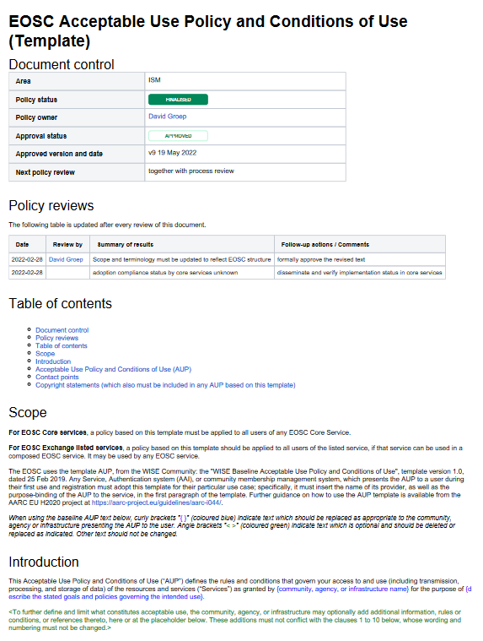
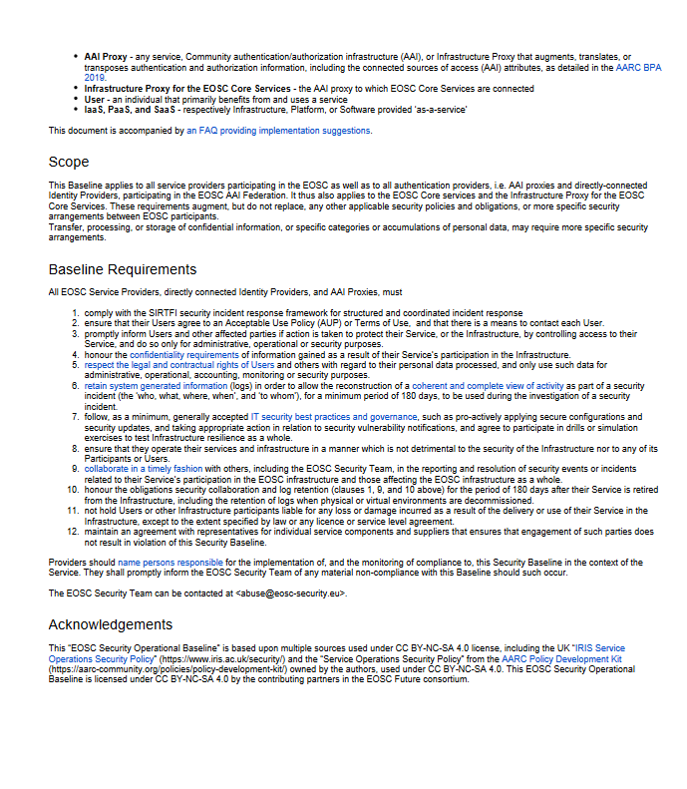
Policy – a baselining approach for AUP and Operations
Common AUP (based on WISE AUP) – required for core services to ensure consistency, strongly recommended for all services and for community AAI proxies
EOSC Security Operational Baseline
a mere 12 points that make you a trustworthy provider organisation towards your peers and the EOSC

Slide 5

EOSC Security Operational Baseline
Co-development of EOSC Future & AARC Policy Community
version based on the AARC Policy Development Kit
specifically geared towards the more heterogeneous EOSC ecosystem
mindful of urgent need for collective and coherent response
EOSC consultation, together with AEGIS, AARC, and GEANT EnCo
Baseline complemented by an ‘FAQ’ with guidance and references,
but it defined no new standards: ‘there is enough good stuff out there’
leverages REFEDS Sirtfi framework
connects to the EOSC Core Security Team
part of the EOSC SMS and Core Participation Agreement
Joint input to the new WISE AARC Service Operational Policy work in SCI

Slide 6
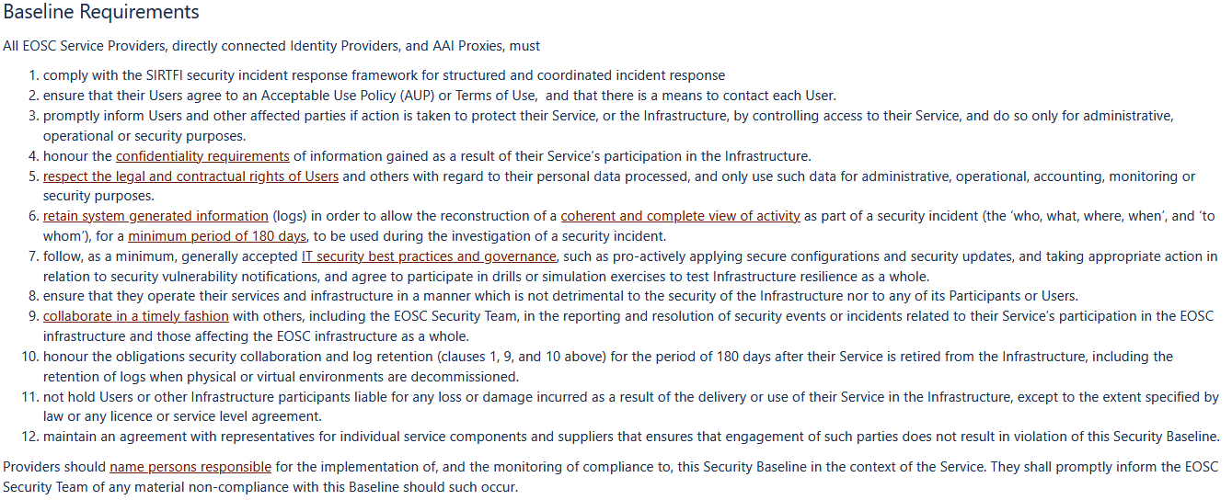
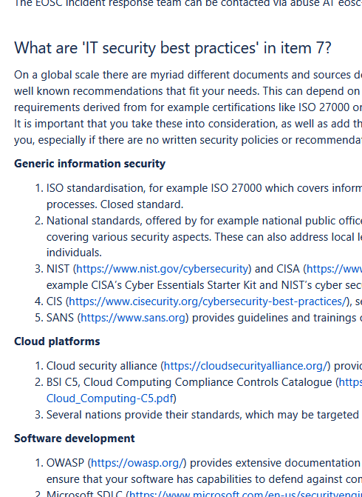
EOSCSMS – EOSC Security Operational Baseline & FAQ
https://wiki.eoscfuture.eu/display/EOSCSMS/EOSC+Security+Operational+Baseline

Slide 7

Discussion time!
Thanks to the EOSC Future WP7.5 collaborators: Alf Moens, Daniel Kouřil, Baptise Grenier, David Crooks, David Groep, David Kelsey, Ian Neilson, Linda Cornwall, Matt Viljoen, Pinja Koskinen, Ralph Niederberger, Romain Wartel, Sven Gabriel, and Urpo Kaila.
eoscfuture.eu

