Slide 1
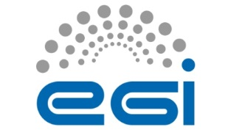




Differentiated and Collaborative Assurance
profiling the identity management landscape for diversifying e-Infrastructure services
ISGC2014
David Groep
This work is supported by EGI-InSPIRE under NA2 for Global Task O-E-15 and by the Dutch National e-Infrastructure coordinated by SURFsara
davidg@nikhef.nl, orcid.org/0000-0003-1026-6606 http://dx.doi.org/10.6084/m9.figshare.XXXXXX

Slide 2
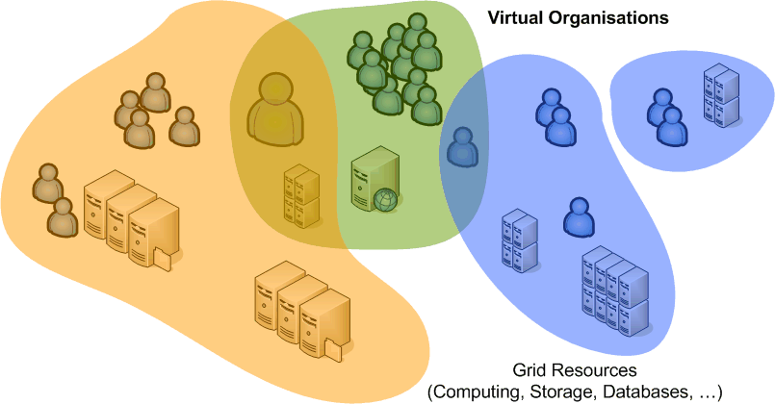
Why Do We Trust?
Reduce over-all burden
by adhering
to common policy criteria
Goals
single registration for access to many resources
with multiple sources of ‘interesting’ trust assertions:
user, institute, trusted third parties, communities
to provide
basis for access control by resources providers
in a secure, operationally stable, and available way

Slide 3
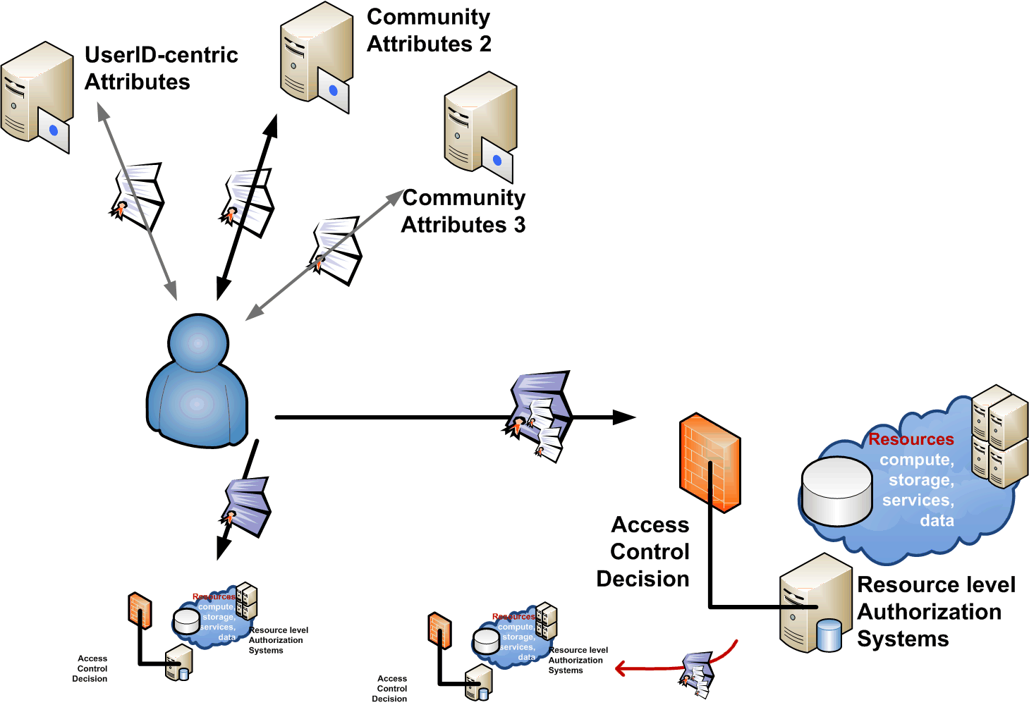
Participants
Many participants contribute to access control with trustworthy
identity and attributes
decision rests with the resource
… service, site, &c …

Slide 4




Requirements to fulfil
Privacy and data
protection
important ‘unalienable
right’ for research
correlation of PII among
service providers could allow profiling
exchange of PII often fraught with issues
Access Control Attribute handle
unique binding
never re-assigned
Measurement and
Accounting
publication metrics
usage metering, billing
auditing and compliance monitoring
Regulatory compliance
need to know who you let in beforehand
Incident Response
long-term* traceable
independent from
short-lived community
must be revocable
correlate with other information sources
banning and containment handle
identity lives
in a policy ecosystem
to protect all participants
commensurate to their risk level

Slide 5
Whom do we ~ trust?
resource owners
grant access based on
both ID authorities directly
and community membership
which is based on the ID
local knowledge
(usually) overrides
anything else ☺
TTPs are typically IGTF
classic, MICS and SLCS
community today often either
uses identity from identity authorities (e.g. most EGI VOs)
might also be a merger of local user knowledge (e.g. PRACE)

Slide 6
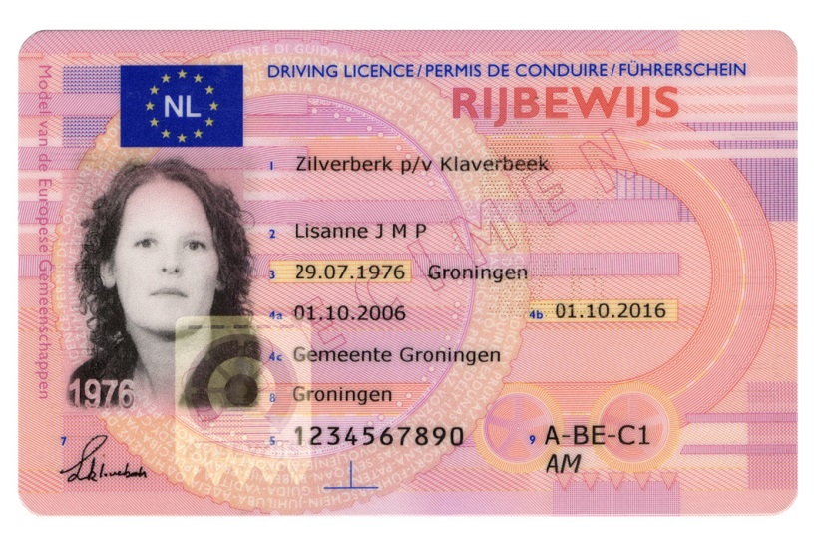
Trusted Identity?
As resource owners in what identity do we trust?
It has a ‘name’
Some sort of integrity protection (crypto)
An assurer, who says the above is correct
but ‘correct’ can mean different things and
also ‘integrity protection’ can be different
Name
Assurer name
‘Crypto’ - a watermark

Slide 7
Identity authorities in current e-Infrastructure
Most common levels IGTF Classic, MICS, SLCS
Name is ‘reasonable representation’
verified against an official document (via a federated ID, in-person meeting, local representative, or notary)
Crypto is usually RSA digital signatures
Signed by a limited set of authorities,
peer-reviewed and namespace-coordinated
IGTF’s Classic, MICS and SLCS give
‘roughly equivalent’ assurance level
Interoperable Global Trust Federation – www.igtf.net

Slide 8
Risk
‘risk envelope’
Subject (ID/LoA) based
Defined identity assurance level
Includes Community-given LoA
For given actions, resources, and acceptable residual risk,
required ID assurance is a given
Action (app) based
More constraint actions can
lower need for identity LoA
(J)SPG VO Portal policy
did just that: 4 levels of actions
Resource (value) based
e.g. access to wireless network does not pose huge risks,
so can live with a lower identity LoA (eduroam)

Slide 9
Beyond a single level for Identity?
Distributed IT infrastructures get more diverse
Portals and SAAS
Read-only data access, or transient data
More (data) sharing
between pre-trusted individuals or small groups
Pre-vetted infrastructures (XSEDE, wLCG)
Does a single level still suffice, or
can we redistribute the responsibilities?

Slide 10





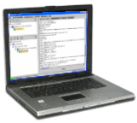



Example: user registration in PRACE
user
DB
user
DB
site A
site B
allowed
User
Review DB
Project attributes
LDAP
authz
user
DB
site C
Graphic: Vincent Rabbailler (IDRIS and PRACE) EUGridPMA Budapest 2013

Slide 11
IGTF Assurance Process
Type and sensitivity of e-Infrastructure services
drives the level of assurance required
Security and assurance level set to be commensurate
  not overly high for ‘commodity’ resources
  not too low, as resource owners/providers otherwise
  start implementing additional controls
  on top of and over the common criteria
  defined in collaboration with resource providers
  using transparency and a peer review processes
  leveraging our own community organisation mechanisms

Slide 12
Trust Element Distribution
Technical elements
integrity of the roots of trust
integrity of issuance process
process incident response
revocation capabilities
key management
credential management
incident response
Identity elements
identifier management
re-binding and revocation
binding to entities
traceability of entities
emergency communications
regular communications
‘rich’ attribute assertions
correlating identifiers
access control
IGTF Classic elements
RP, Community elements
Verifiability & Response, mitigation, recovery

Slide 13
Trust in the assertions by resource and service providers is key
Until now, our e-Infrastructure used a single ‘level’
  there are also well-known ‘government’ standards for LoA
  in the USA: OMB M-04-04 & NIST SP800-63,
  generalised: Kantara
  there is rough but not 1:1 correspondence between balanced needs of the providers and users and the Kantara LoA levels
For your interest: Kantara Assurance Levels
http://kantarainitiative.org/confluence/download/attachments/38371432/Kantara+IAF-1400-Service+Assessment+Criteria.pdf

Slide 14
Differentiated LoA -
Collaborative identity vetting
Cater for those use cases where
  the relying parties (VOs) already collect identity data
  this relying party data is authoritative and provides traceability
  the ‘identity’ component of the credential is not used
through an authentication service that provides only
  persistent, non-reused identifiers
  traceability only at time of issuance
  naming be real, pseudonymous, or set by-the-user-and-usually-OK
  retains good security for issuance processes and systems
and where the RP will have to take care of
  all ‘named’ identity vetting, naming and contact details
  subscribers changing name (often) when traceability is lost

Slide 15
A new Identity Assurance Level
Identity elements
identifier management
re-binding and revocation
binding to entities
traceability of entities
emergency communications
regular communications
‘rich’ attribute assertions
correlating identifiers
access control

Slide 16
IGTF Trust Structure
Common criteria and model
  globally unique and persistent identifier provisioning
  not fully normative, but based on minimum requirements
Trust is technology agnostic
  technology and assurance ‘profiles’ in the same trust fabric
  ‘classic’ traditional public key infrastructure with
  near-realtime identity betting
  ‘MICS’ dynamic ID provisioning leveraging federations
  ‘SLCS’ on-demand short-lived token generation
  a basis for ‘arbitrary token’ services
  and now a new profile …
  … IOTA – Identifier-Only Trust Assurance
For your interest: IGTF Authentication Profiles http://ww.igtf.net/

Slide 17
IGTF and other assurance levels
my own personal classification of identity LoAs

Slide 18
IOTA: what do you get?
Name is unique, but not ‘standard’ globally
  Some WebSSO federations on purpose don’t have one
  But you get a name, probably OK, maybe user-chosen
Incident response participation by the CA
  a contact address for the home organisation
  and likely from the federation, maybe from the ‘UHO’
A up-to-13-months valid certificate
  Can keep same name later if there is an ID record
  But: name will change if the user moves institution
A well-secured issuing process
For now, you’ll get these mostly as certificates, but
the level is technology agnostic
and can be applied to X.509, OpenID Connect, WebSSO federations with SAML, &c

Slide 19
IOTA: what do you gain?
Prevent duplication of effort
  Should be easier for end-users to get
  They should feel ‘happier’
  Less end-user support (for eligible users)
More quick turn-around time registering
  Experience like TCS (MICS) or on-line Cas
  But for many more users (e.g. InCommon Basic)
More flexibility assigning services to trust levels

Slide 20
Differentiated ⇨ Really Different!
Identity assurance only as strong as back-end
usually R&E federations (eduGAIN, InCommon)
some are really weak on assurance, auditing and traceability, have user-editable content – or just decline incident response on purpose
not many of these are setup to deal with OpSec!
expect content of the IOTA credentials to be
somewhat better than facebook, twitter or gmail
But then they are much easier to get for users …

Slide 21
Know your own users
… and since you know your users anyway
Link IOTA credentials to
pre-existing users you know yourself
IOTA subject are persistent, unique and never re-issued to anyone else (so are good identifiers)
… or it’s a ‘lower value resource’ to mitigate risk

Slide 22
In Quasi-legalise …
It remains critical that RPs acknowledge that the information contained in IOTA credentials in itself is insufficient to trace individuals, and that any traceability and contact requirements rest with the infrastructures (or collectives of users).
Mixing IOTA-capable and more loosely managed assurance levels within the same service requires distinguishing capabilities and policy evaluation on the receiving end that can take combined decisions on authentication credential strength and community membership or attribute information, and it must be noted that most software in current production use is not capable of making this distinction.
Assurance levels must not be mixed unless a risk assessment has been done.

Slide 23
Think before you Do
‘interesting’ interplay in mixed infrastructures
  It is not supported in software to distinguish users on resources that are part of two RP infrastructures with multiple VOs, i.e., one with and one without IOTA
“For a Resource Provider participating in multiple infrastructures, the minimum acceptable LoA should be the lowest one that the resource provider is willing to accept for all its users and
supported communities”
So if you participate in a controlled infra with managed user database and one which has ‘loose’ registration procedures, you should stay at Classic, MICS & SLCS!

Slide 24
Summary
IOTA opens new possibilities for easier access
Fits really well with current federations
  An InCommon Basic IOTA CA is coming
  Policy allows for a single service in e.g. eduGAIN
a ‘WYSIWYG’ authority: the name is never
re-used, but it may not be who you think it is!
Prevents duplication of effort and encourages more users, if you use it with your own user registration system
… but read the fine-print before first use:
https://www.igtf.net/ap/iota

Slide 25



