Slide 1


Developments in the IGTF and EUGridPMA – an update
enabling an interoperable
global trust federation
David Groep
davidg@nikhef.nl
part of the work programme of EOSC-Hub and GEANT 4-3
the work has received co-funding from the Horizon 2020 programme of the European Union
co-supported by Nikhef and the Dutch
National e-Infrastructure coordinated by SURF

Slide 2
For today …
EUGridPMA membership and updates
IGTF Relying Parties in OIDC and OIDCfed
GEANT TCS Generation 4 implementation
Assurance Profiles
Attribute Authority operations AARC G048
Communications Challenges: RATCC4 and the SCCC-JWG

Slide 3
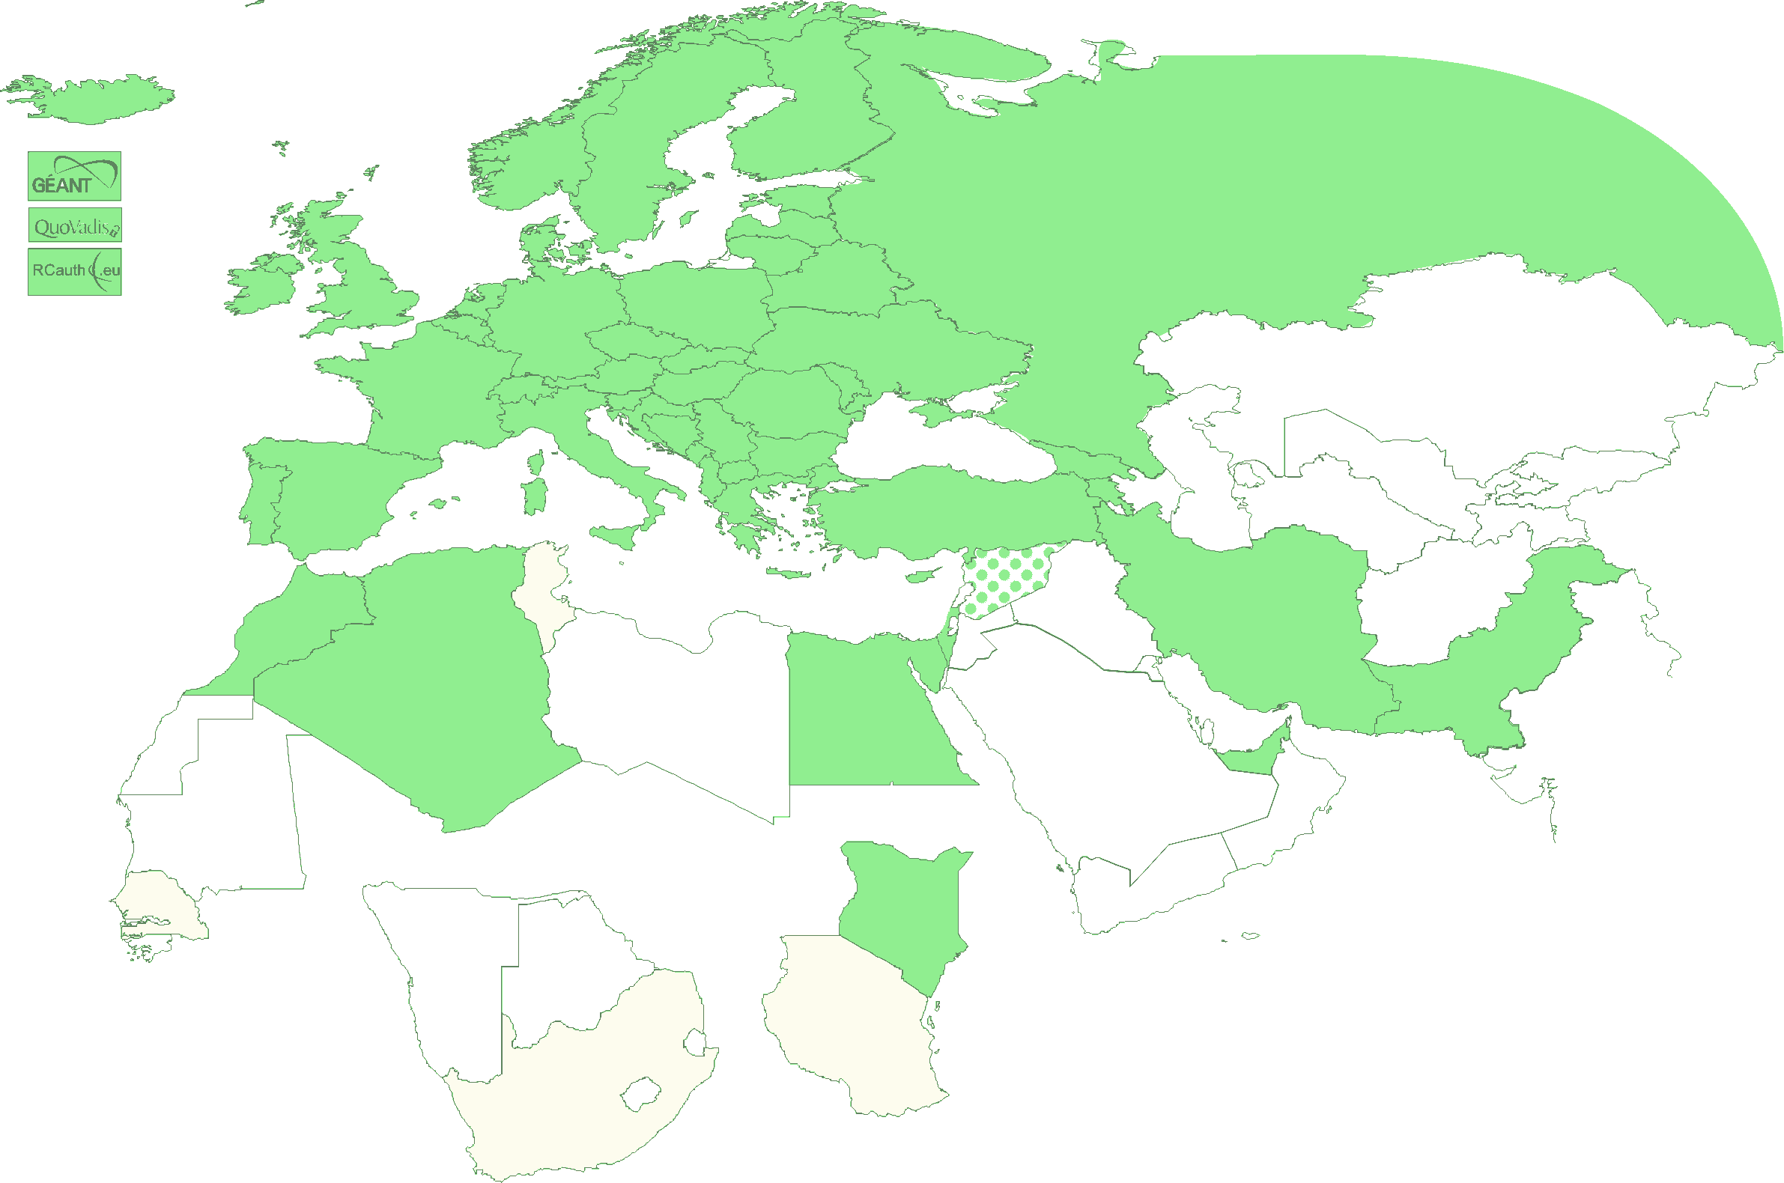
EUGridPMA – membership and evolution
Europe: CZ, DE, DK, ES, FI, FR, GR, HR, HU, IT, NL, PL, PT, RO, SE, SI, SK;
AM, GE, IS, MD, ME, MK, NO, RS, RU, TR, UA, UK and
the GEANT TCS
Middle East: AE, IR, PK
Africa: DZ, EG, KE, MA
CERN, RCauth.eu,
QuoVadis (BM), DigitalTrust (AE)

Slide 4
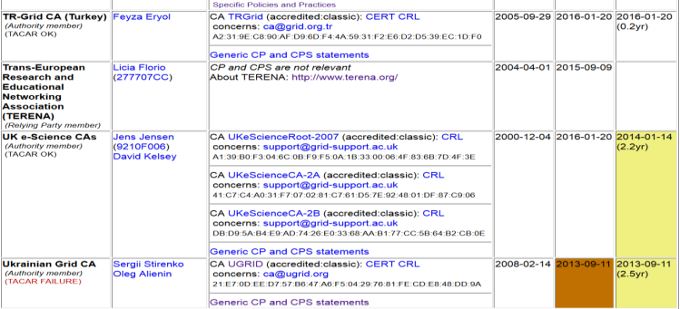
Membership and other changes
Responsiveness challenges for some members
  PLEASE take care to renew your trust anchors in time, as well as your CRLs
  EG-EUN now temporarily withdrawn for availability reasons
Identity providers: both reduction and growth
  RCauth.eu distributed operations (GRNET, STFC, Nikhef)
  using a shared key (and some smart border-guard-proof distribution)
  AustrianGrid discontinued, INFN CA by 2021
Self-audit review
  Cosmin Nistor as review coordinator
  Self-audits on schedule for most CAs

Slide 5
Supporting Relying pArties in OIDC
OIDC Federation

Slide 6
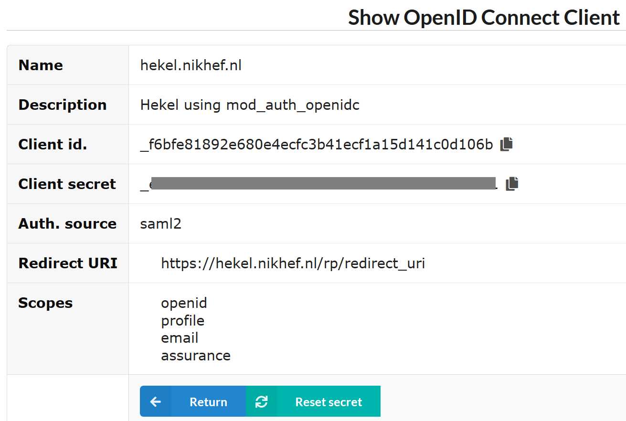
OpenID Connect: registering clients does not scale…
configuration of a (test) client on the Nikhef institutional OP sso.nikhef.nl

Slide 7
OIDC Federation use cases for communities
Why did we embark on OIDC Fed for global e-Science?
EOSC-HUB registration of clients
goal for EGI and EUDAT is a scalable and trusted form of OIDC usage.
Today < O(50) clients; next year maybe O(100-1000)?
cloud-based services (containers, microservices) could push that to millions
CILogon (and XSEDE) use cases see need for a set of policies and practices
that support a 'trust anchor distribution'-like service targeting OIDC OPs and RPs
and where RPs that are ‘in the community’ can be identified as such
ELIXIR (and the Life Sciences) AAI expect growth in # OIDC RPs as AAI extends beyond just ELIXIR and into other biomedical RIs – potentially dynamically created
All of these need a policy framework, on both the (infrastructure) OPs and on the RPs
This is the community that traditionally also relied on the IGTF trust anchor distribution

Slide 8
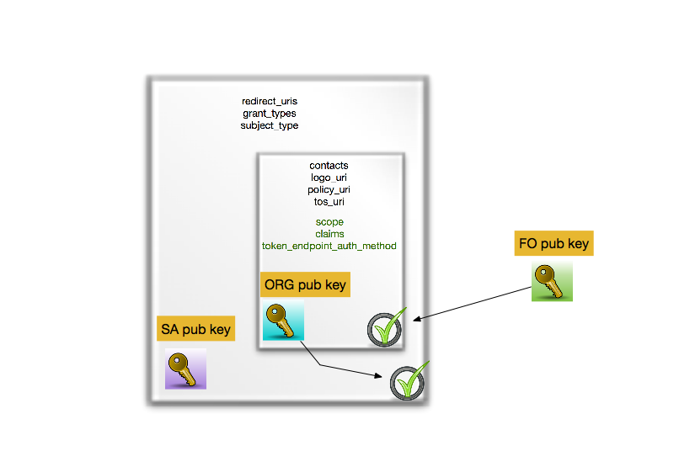
OIDCfed is basically signing a tree of entities with extensions
we kind-of know building trees and meshed of signed entities work – is this ‘just recast it JSON’ ?

Slide 9
Or can we do without a single one to rule them all?
today the RIs and EIs trust the IGTF trust anchors and
may (but do rarely) add their own
Can the ‘federation’ be the community and import a commonly trusted set?
Can the IGTF allow devolved registration provided that the trusted organisations implement the same policy controls Snctfi and the proper Assurance Profiles?

Slide 10
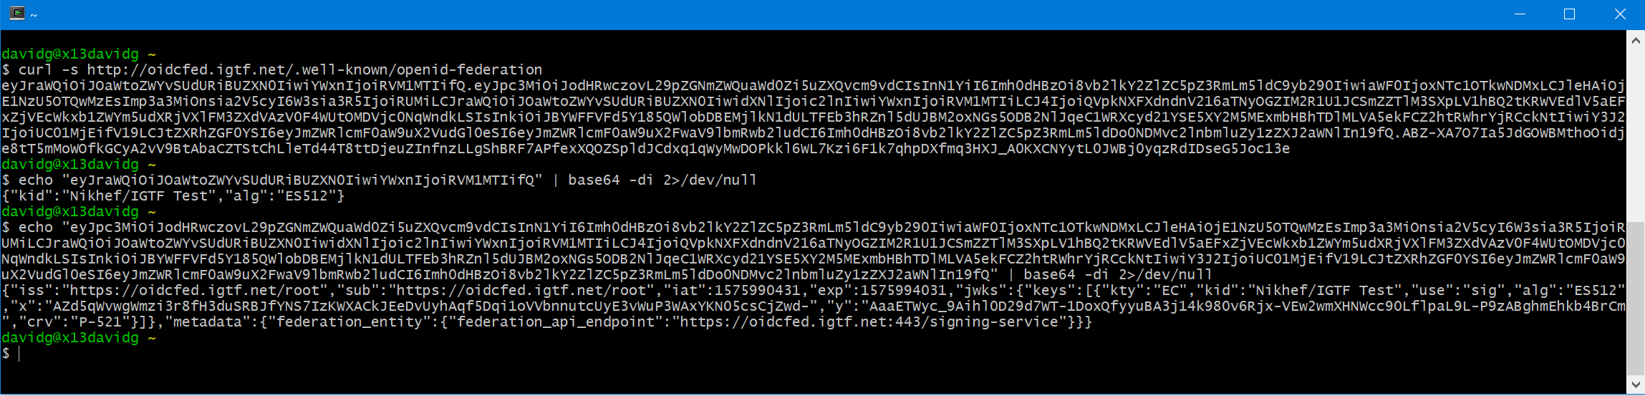
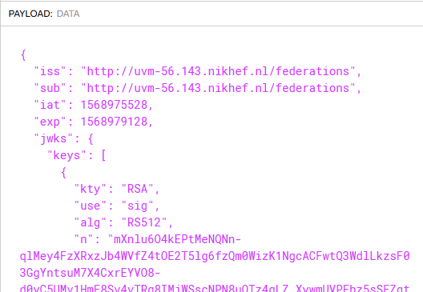
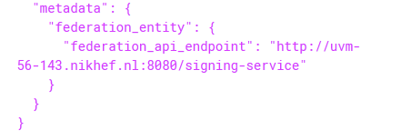
and this works now: oidcfed.igtf.net
Ask Jouke for all details
translating with jwt.io into

Slide 11

GEANT TCS service update
Generation 4 Trusted Certificate Service – issuing provider update

Slide 12
15 years of TCS service
based on a concept by Jan Meijer back in 2004
driven primarily by the NREN constituency, but with the eScience use cases very much in mind
NREN (GEANT constituency) requirements on public trust, today esp. EV, but also eIDAS
in a way that scales to 45 countries and ~100k active certificates today, increasing steadily
and also ~10000 organisations, most of which cannot deal with certificates … or with much change
now going to its 4th iteration: GlobalSign, Comodo, DigiCert, … and now Sectigo again
1st CfP
SCS G1 (GlobalSign)
2nd CFP and start of TCS eScience with Comodo
TCS G4 CfP
2004
2005
2006
2009
2015
2019
2020
TF-EMC2
concept
Commissioning started
TCS G3 with DigiCert and eduGAIN

Slide 13
TCS constituency
service is ultimately driven by the GEANT members: 45 national R&E network organisations
wide range of inputs: some countries adore Qualified Certificated and eIDAS, others don’t care
some countries really need a native-language interface (like .fr, .es, …), others don’t care (.nl, .se)
stakeholders regard EV as mandatory, and many stakeholders pushed for ultimate stability – since the subscribers have actually no knowledge of PKI, nor of validation, and certainly not about chaining
eScience use cases are important for many, but certainly not the only driving factor in the game
Result of the formal 3-round consultation sessions with the NRENs (22 / 40 participated, April 2019)
one set of knock-out minimum requirements (which then cannot be materially changed any more)
a long list of ‘quality’ criteria, with a strong focus on compliance (CABF), public trust continuity,
all manner of interfaces to the service, and personnel & contract management

Slide 14
Certificate profiles
OV TLS Server | BR OV validated multi-domain with mixed SANs
OV TLS wild | BR OV validated multi-domain with mixed SANs combining both wildcard and non-wildcard domain names
EV TLS | BR EV validated multi-domain with mixed SANs
Personal webClientAuth and S/MIME | End-user personal certificate recognised by the major MUAs suitable for identifying the users real name
Personal webClientAuth IGTF and S/MIME | End-user personal certificate adhering to IGTF profile (using IA5String representation of the name with unique prefix /DC=org/DC=terena/DC=tcs/...), suitable both for authentication, and also including validated name and email address
Personal Robot webClientAuth IGTF and S/MIME | End-user personal software agent certificate adhering to IGTF profile (like above) and Robot Profile, suitable both for authentication, and also including validated name and email address
Robot Email webClientAuth IGTF and S/MIME | E-mail validated software agent certificate adhering to IGTF profile (like above) and Robot Profile, suitable both for authentication, and also including validated email address
IGTF OV TLS Server | BR OV validated multi-domain with mixed SANs including unique prefix "/DC=org/DC=terena/DC=tcs/..."
Document Signing | Adobe AATL compliant signing certificate
Code Signing | Conventional code signing certificate recognised by Oracle, MSFT, &c
EV Code Signing | BR EV Code Signing certificate recognised by MSFT &c

Slide 15
TCS is a GEANT service – with the TCS PMA defining the profiles and policy
TCS PMA drawn from the wider GEANT community (NRENs as well as individual orgs)
Current PMA members … some of whom you will have seen
  Teun Nijssen (SURF, NL)
  Dominique Launay (Renater, FR)
  Kurt Bauer (ACONET, AT)
  Kent Engström (SUNET, SE)
  David Groep (Nikhef, NL)
  Nicole Harris (GEANT)
  Sigita Jurkynaite (GEANT)
GEANT service manager is nowadays Sigita Jurkynaite

Slide 16
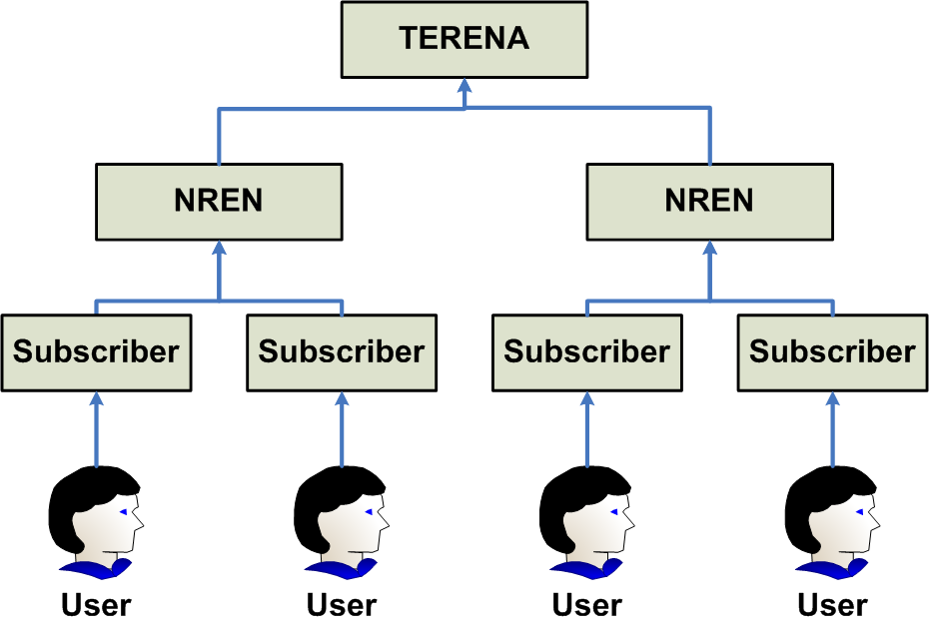

The basic structure remains the same … again!
image source: Jan Meijer, 2008

Slide 17
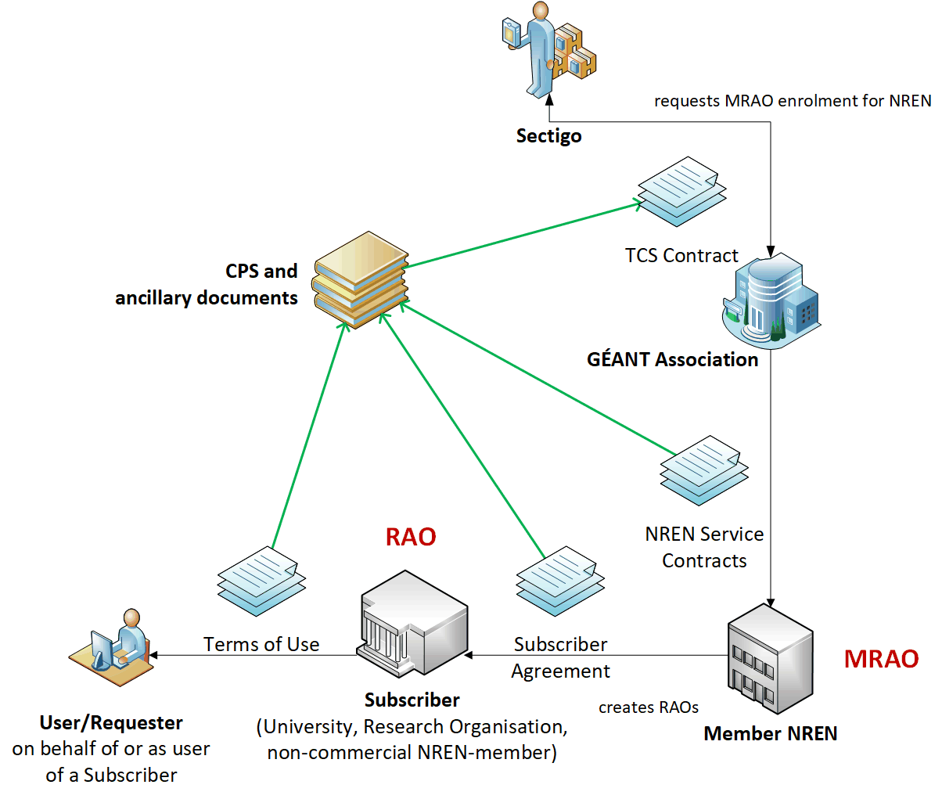
TCS G4

Slide 18
Assurance levels
Host certs all meet CABF OV requirements, which actually exceed ‘IGTF Classic’ a bit
OV validation requires DCV, which is stronger than the RA checks minimally required
the IGTF+public trust combination is getting more important for S3/cloud like deployments
User and personal robot certs
SAML process, and the eligibility checking by the subscribers (organisations), remains the same
urn:mace:terena.org:tcs:personal-user in attribute eduPersonEntitlement
real name of the person – by the subscriber agreement and CP/CPS this goes beyond R&S assurance
manual side-process may remain just like today, based on data entry by the ‘RAO/DRAO’ in SCM
as per https://wiki.geant.org/display/TCSNT/Documentation ‘non-SAML issuance model process’
the CP/CPS requirements though the Subscriber Agreement meet IGTF BIRCH
and this time we will put the _right_ OIDs in the policy extension …
All stuff audited already for CABF/WebTrust things (SSL certs) and similarly for the ‘S/MIME’ use cases

Slide 19
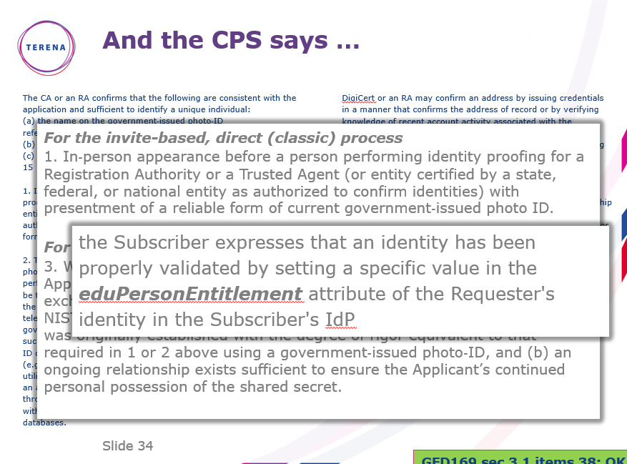

Slide 20
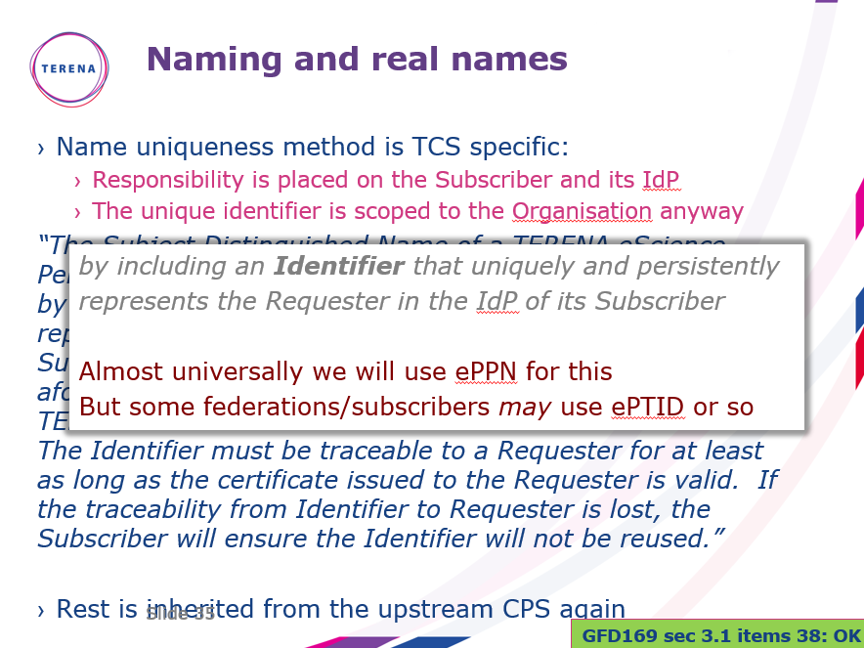

Slide 21
We have been there before … but not quite
The TCS G2 had essentially the same back-end provider (then called Comodo)
which we accredited in 2010 (hosts) and 2012 (personal)
but where personal certs were issued off a central TERENA-managed service (‘Confusa’)
This now all moves to the selected provider
of course we are slightly different from the InCommon use case
… which only does server certs via SAML and not personal or S/MIME
we require the personal issuance based on SAML to be hosted at the provider as well
maybe one-per-NREN, and not a single global instance for all of TCS, but
still this requires multi-lateral federation
Sectigo now working on an implementation (fall-back scenarios are under study, though …)

Slide 22
Phasing is tight
contract final as of the last days in December 2019
Jan 6th 2020 started early-commissioning phase
  challenges in this phase include both the new web-management interface, but also getting the enrolment and provisioning flow right
  there are a lot of orgs and domains to go through, with some interesting DBA vs. legal names
  certificate profile definition (e.g. making sure Robots work even if they are not in the InCommon scheme)
subsequent phases in February & March
  multi-lateral eduGAIN SAML meta-data parsing (done for SCM-managed login)
  client cert portal based on SAML attributes, auto-provisioning security (pending …)
  confirmation of exact profiles and all relevant controls re-implemented in new system + API
  all dedicated intermediates for the (small number of) chains available for distribution (awaiting EEC profiles)
  translation of interfaces and messages to all relevant languages
End of March: commissioning complete and ready for large-scale roll-out
End of April: all subscribers on-boarded, trained, and ready is issue
End of September 2023: last TCS G3 certificates will expire (for IGTF: end of July 2021)

Slide 23
Main relevant items for the IGTF trust
subscriber validation for host/server certs as well as the model for personal/robot remains the same
the contractual obligations and adherence to the TCS CP/CPS remains the same
and the TCS CP/CPS is already today written as an incremental one, so need not change except for the same of the new upstream provider:
“No further stipulations beyond those set forth by the CA Operator.”
now on top of Sectigo’s CP/CPS 5.1.5 (https://sectigo.com/uploads/files/Sectigo-CPS-v5.1.5.pdf)
see also https://sectigo.com/uploads/files/Certificate-Subscriber-Agreement-v2.2-click.pdf
it is a new hierarchy, but it shares some of the HLCAs with the InCommon IGTF Server CA
we will aim to keep the current prefix /DC=org/DC=terena/DC=tcs the same
issuer names will change (since these show visibly in the UX), and without É (E-acute) in there
will need to distribute the new chains in March
updates to the CP/CPS under review by Reimer and Scott in EUGridPMA

Slide 24
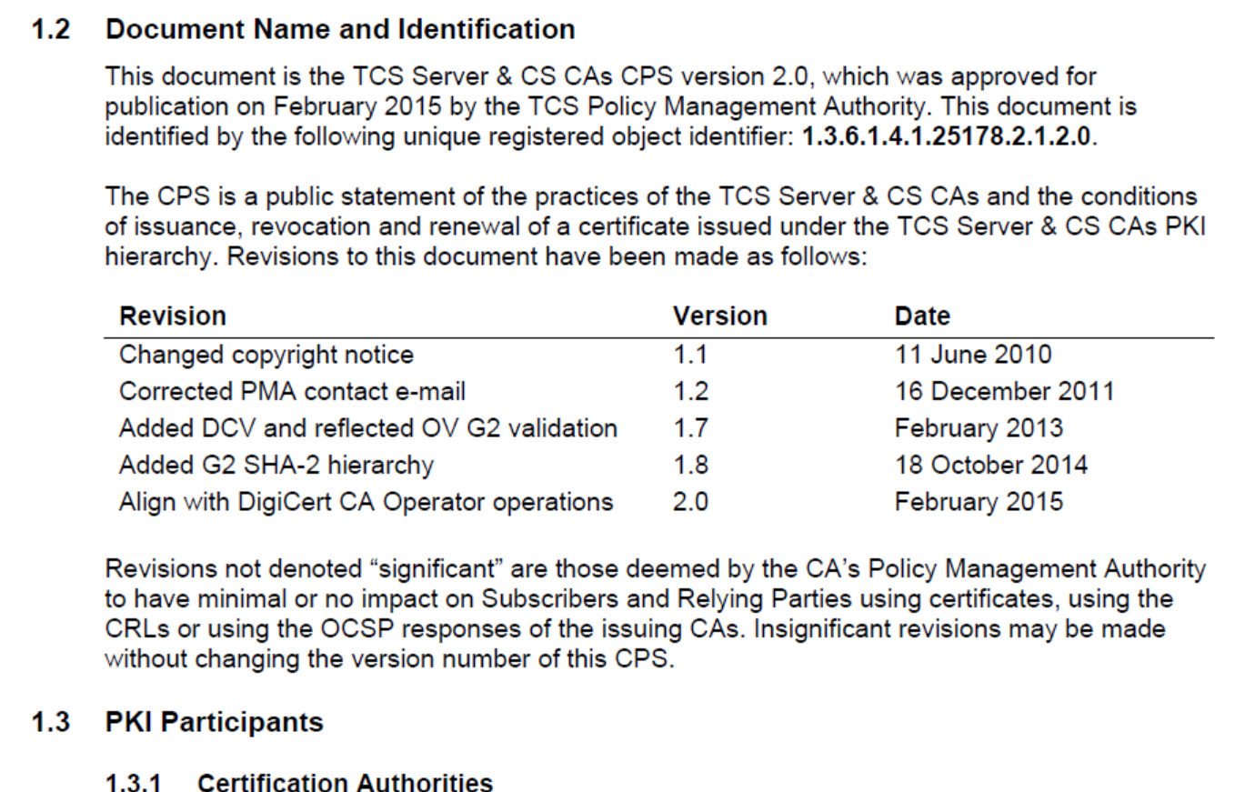

Slide 25
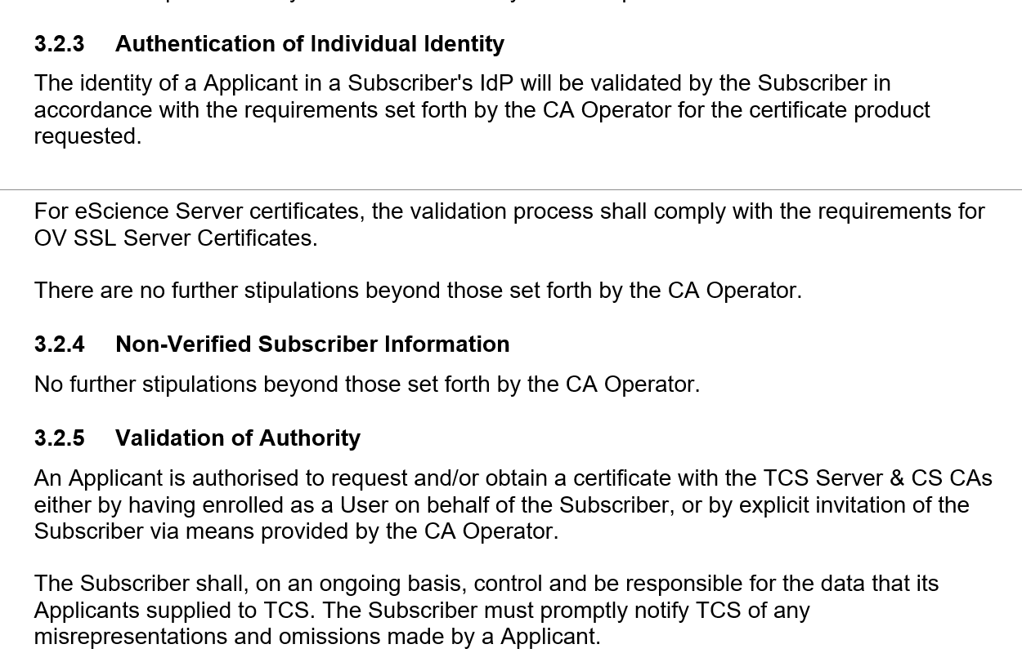

Slide 26
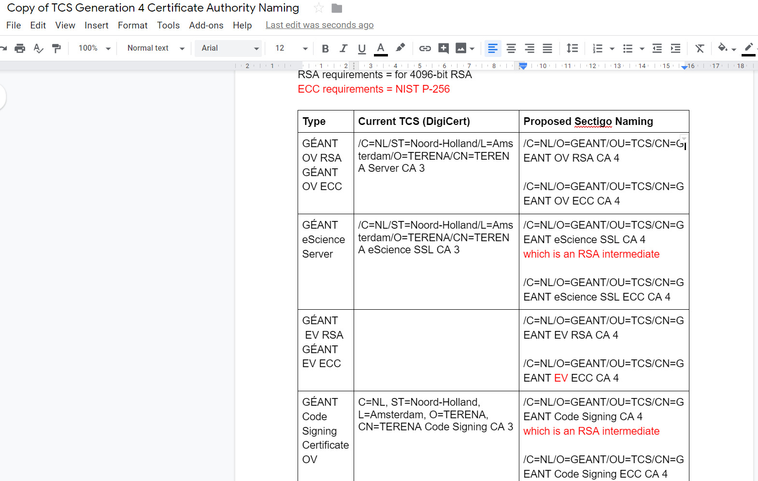
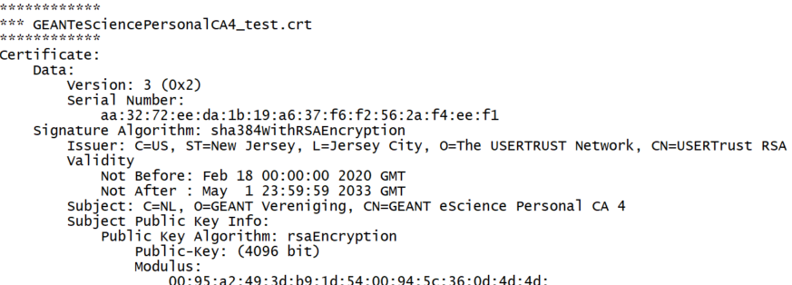

Slide 27
Authentication Assurance profiles
REFEDS RAF, SFA and MFA
Peer-reviewed assessment process

Slide 28
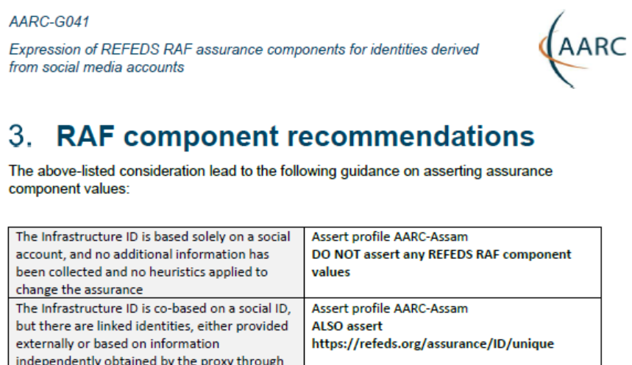
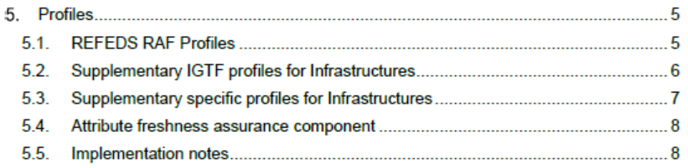
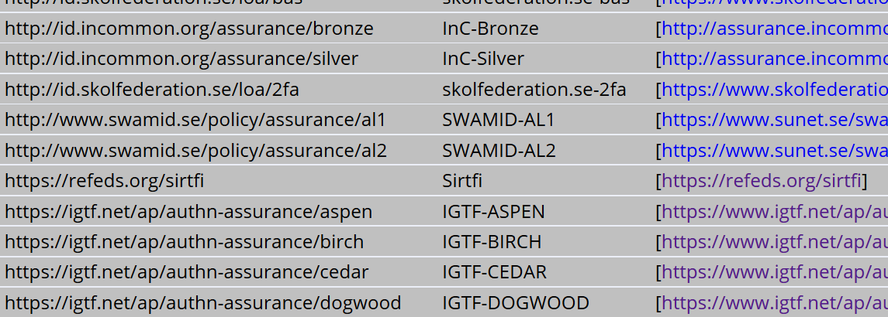
Assurance – standard profiles and ‘untangling spaghetti’
REFEDS RAF profiles (feasible assurance from all over R&E federations – as far as we can!)
inter-infrastructure profiles and relying-party oriented profiles (IGTF BIRCH, DOGWOOD)
how to express social media assurance, for citizen science and in support of account linking
AARC-G021
inter-infrastructure adoption
https://www.iana.org/assignments/loa-profiles/

Slide 29
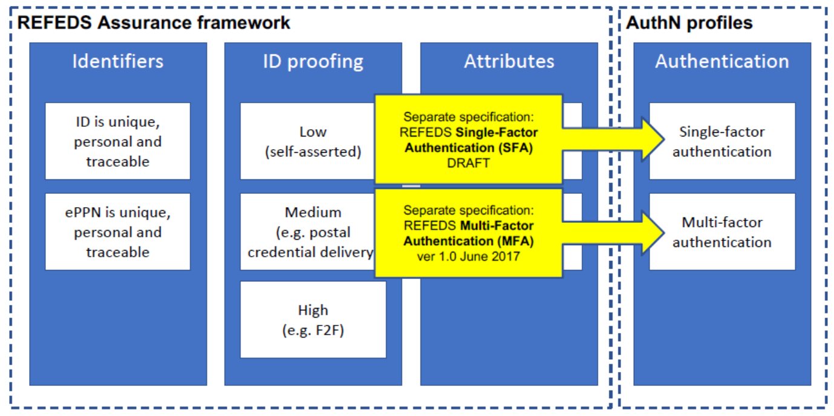
Differentiated Assurance Profile – in eduGAIN and REFEDS
Specific definitive guidance to IdPs and federations
Logical grouping and profiles
for the Infrastructures
Uniqueness: at least ePUID or NameID
ID proofing: ‘low’ (good for local use),
‘medium’ (Kantara LoA2, IGTF BIRCH, eIDAS low),
or ‘high’ (Kantara LoA3, eIDAS substantial)
Authenticator: in REFEDS separate profiles,
single (SFA) and multi-factor (MFA) authenticator
Freshness: better than 1 month
All assurance profiles assume
organizational-level authority, also used by the IdP for ‘real work’, good security practices
http://refeds.org/assurance, https://refeds.org/profile/sfa, and https://refeds.org/profile/mfa

Slide 30
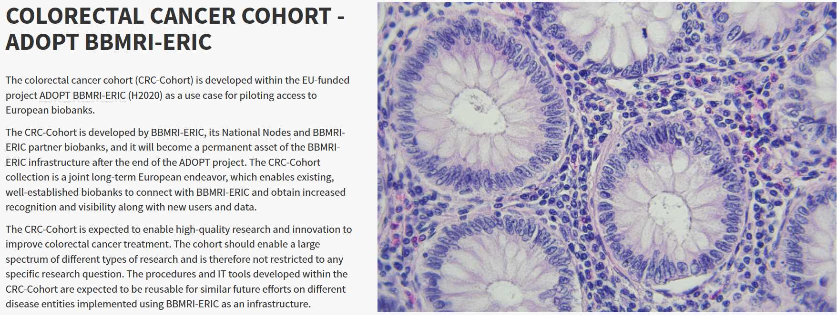
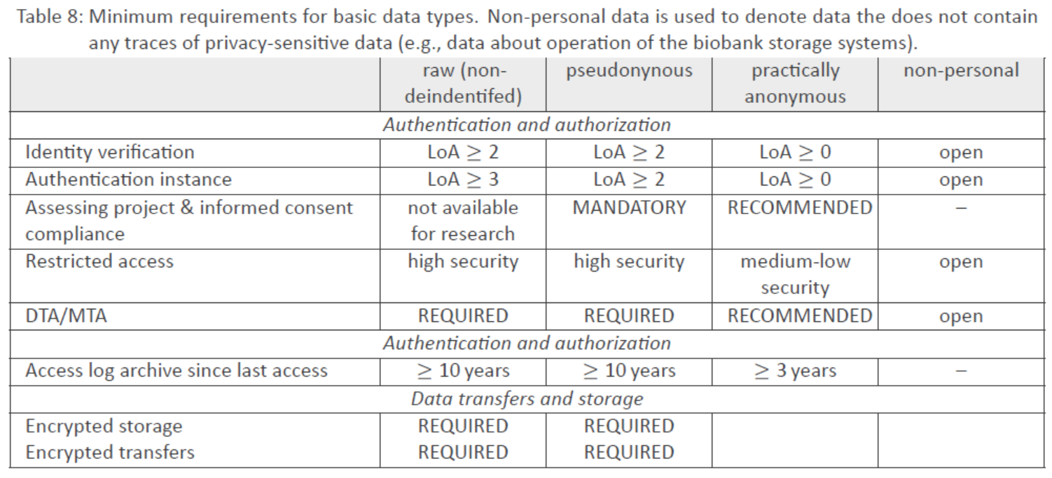
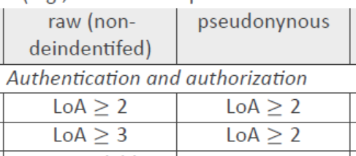
e-Infra & Research Infra: high-assurance use cases – does it stand the test?
Two representative use cases from the AARC Pilots
Sensitive data – assurance must stand up to scrutiny, and seen in conjunction with other standards
Retrieval of data from medical data repository
BBMRI-ERIC Colorectal Cancer Cohort study data
Processing personal data on secure computing infrastructures
BioBankCloud, TSD Trusted Sensitive Data, MOSLER platform

Slide 31
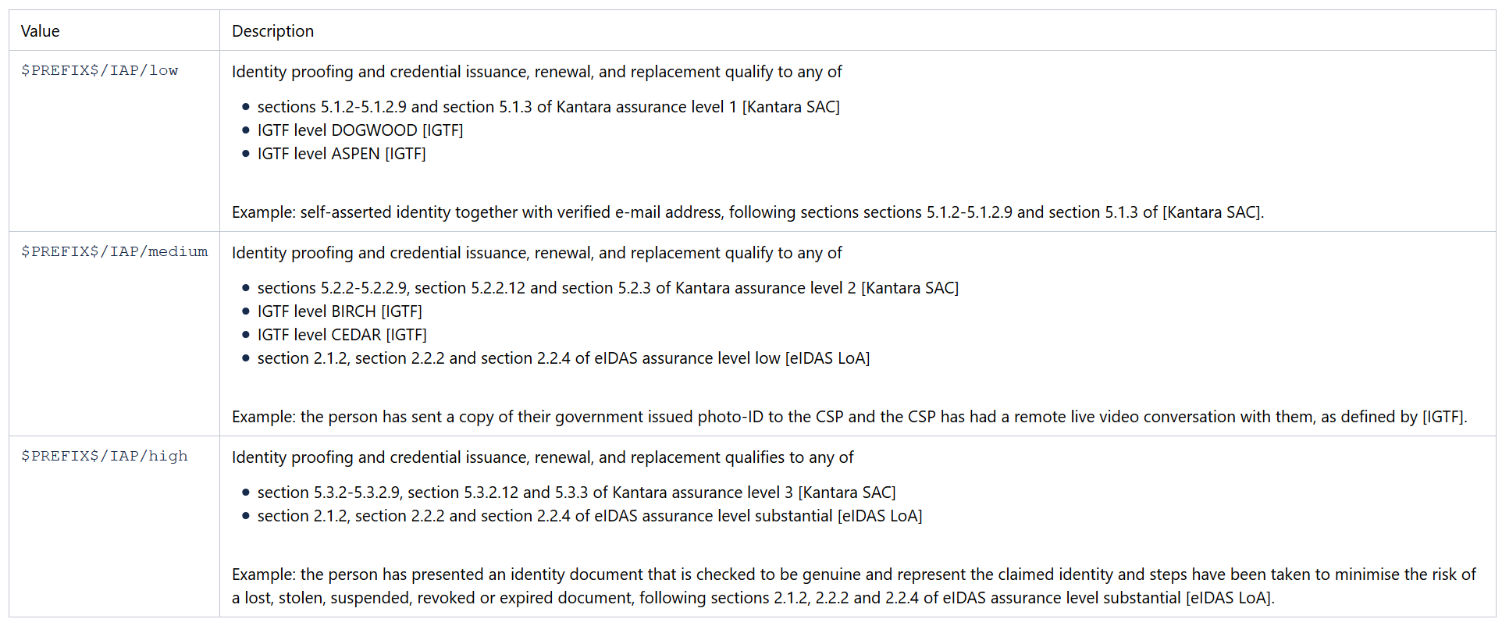
REFEDS RAF Assurance in relation to Kantara, eIDAS, and IGTF profiles

Slide 32

Untangling Assurance Spaghetti:
Comparison Guide to Identity Assurance Mappings for Infrastructures
https://aarc-project.eu/guidelines/aarc-i050/

Slide 33
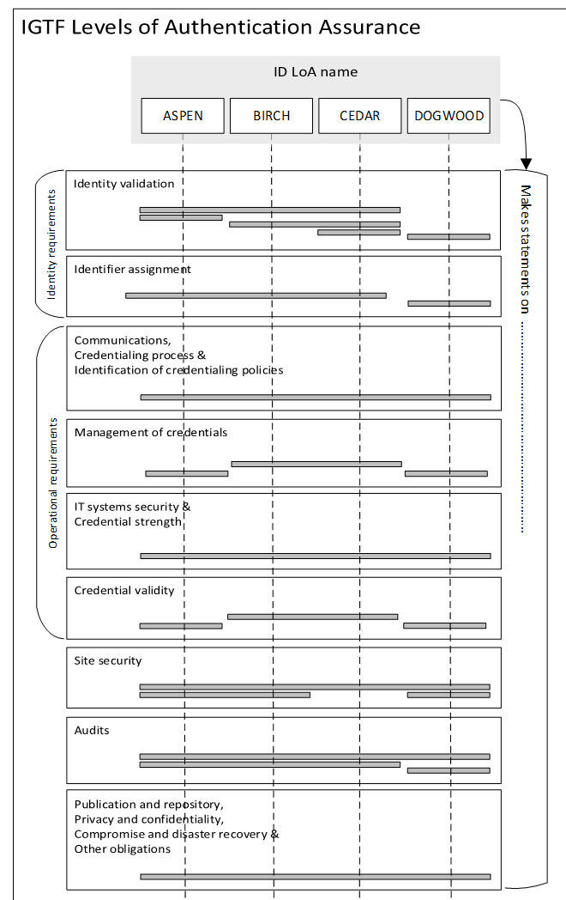
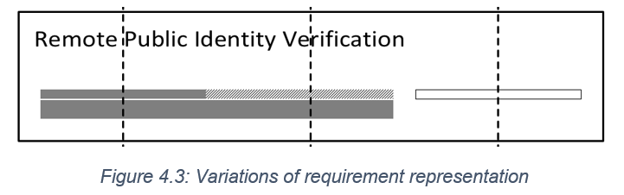
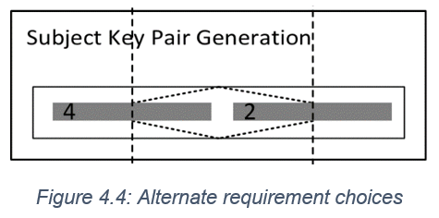
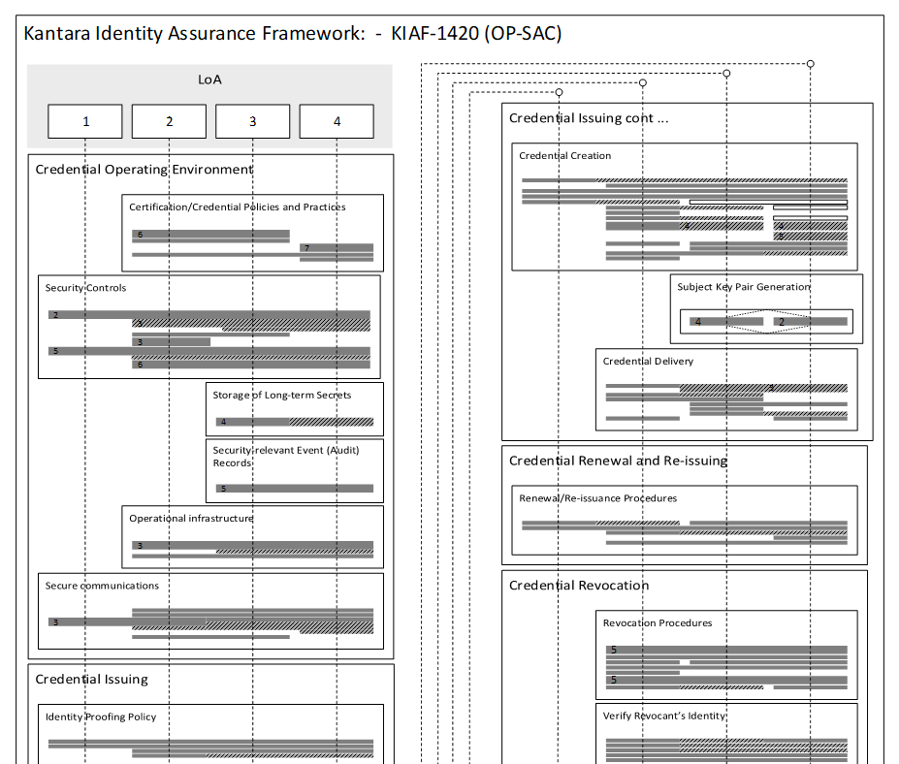
Interpreting the graphs
on context and missing ‘breadcrumbs’
components vs. profiles
implicit trust vs. completeness

Slide 34
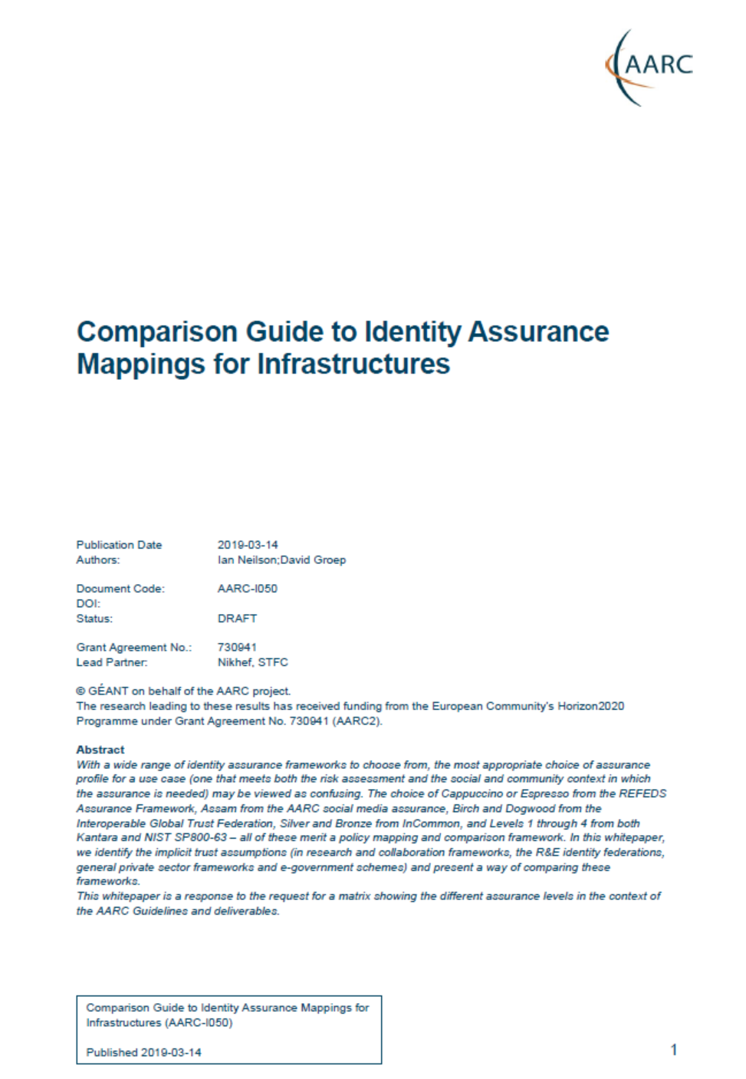
About the mapping exercise – the AARC-I050 white paper
Answering the questions
why are there so many Assurance Frameworks
why are the academic and research ones different
why is there more than one for each
how do they compare? what are the unique features
We attempted to answer your request … at TIIME and in AARC-I050!
addressing different audiences:
IdP feasibility vs SP minimal requirements
orthogonality vs component-suite approach (profiles)
completeness vs community-focused:
leveraging common understanding,
… and forgetting the grains of rice on how we got there
aarc-community.org/guidelines/aarc-i050 – https://doi.org/10.5281/zenodo.3627593

Slide 35
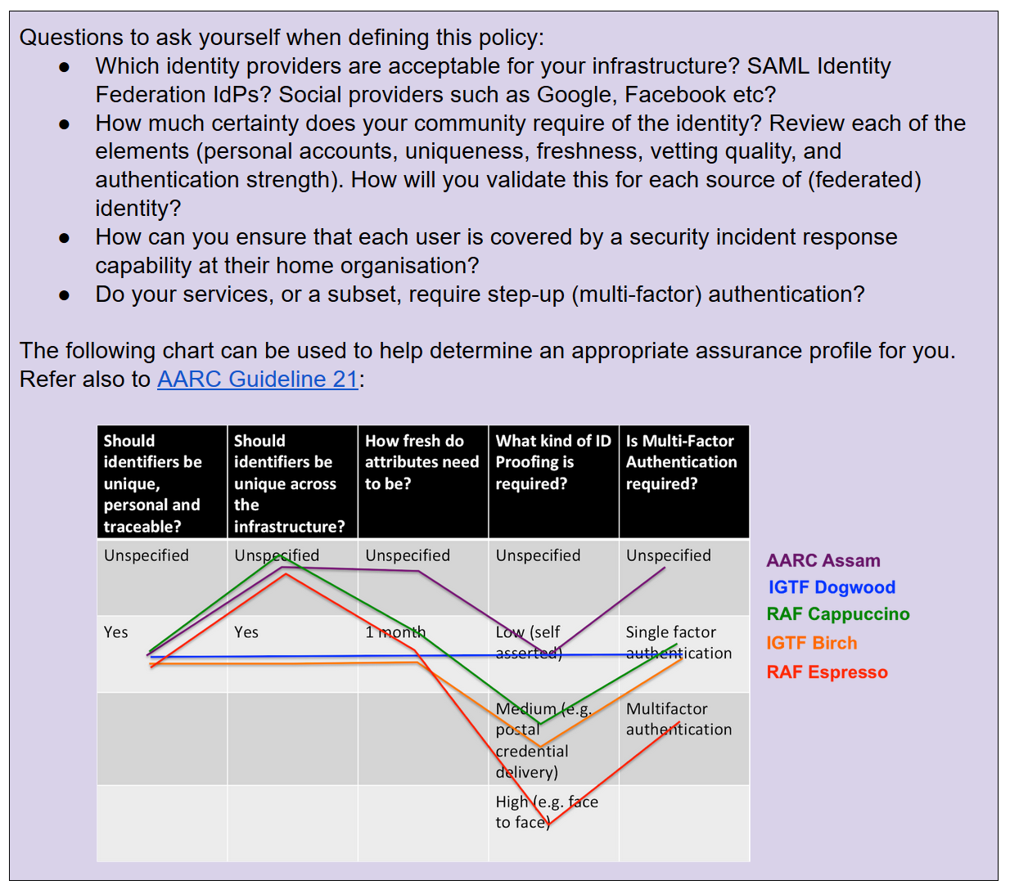
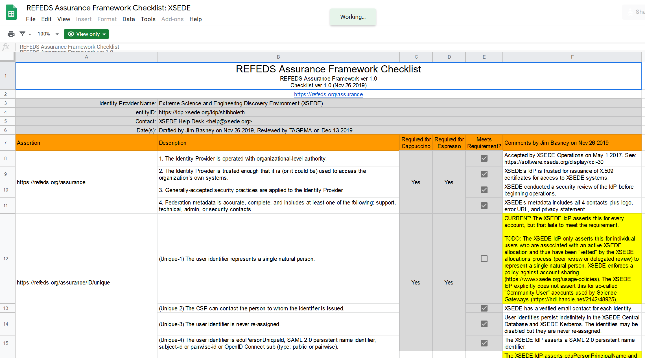
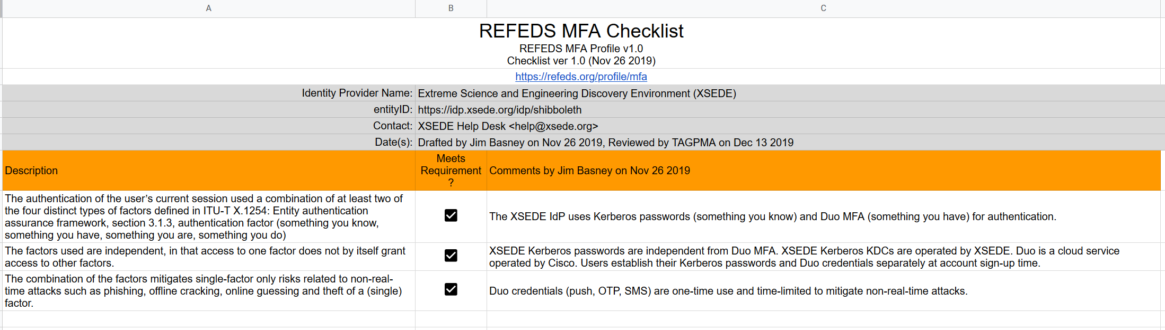
Conveying Assurance and Profiles in practice – at the IGTF: XSEDE & FNAL

Slide 36
Attribute Authority Operations
Guidelines for running a secure membership and group management service

Slide 37
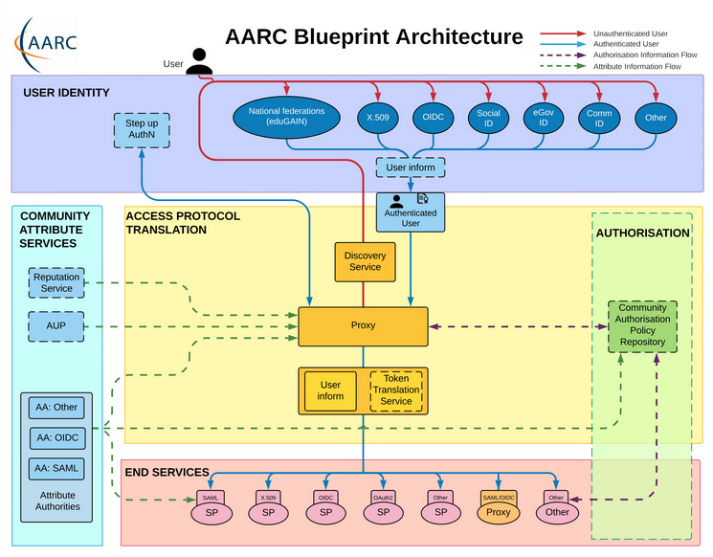
Operational guideline landscape for - proxy or source - AAI components
Authentication/identity sources
Sirtfi
(eduGAIN) baselining
IGTF AP Profiles
NIST SP800-63
eduGAIN sec. team workflow
MFA
RFC6238/4226
FIPS140
NISTSP800-53
Ephemeral credentials
trusted credential stores
protection at rest
Service provider operations
ISO27k
Sirtfi
Infrastructure response plans

Slide 38
Operational security in the BPA: beyond just IdPs
Community membership management directories and attribute authorities
integrity of membership
identification, naming and traceability
site and service security
protection on the network
assertion integrity
Guidelines for Secure Operation of Attribute Authorities and other issuers of access-granting statements
(AARC-I048, in collaboration with IGTF AAOPS)

Slide 39
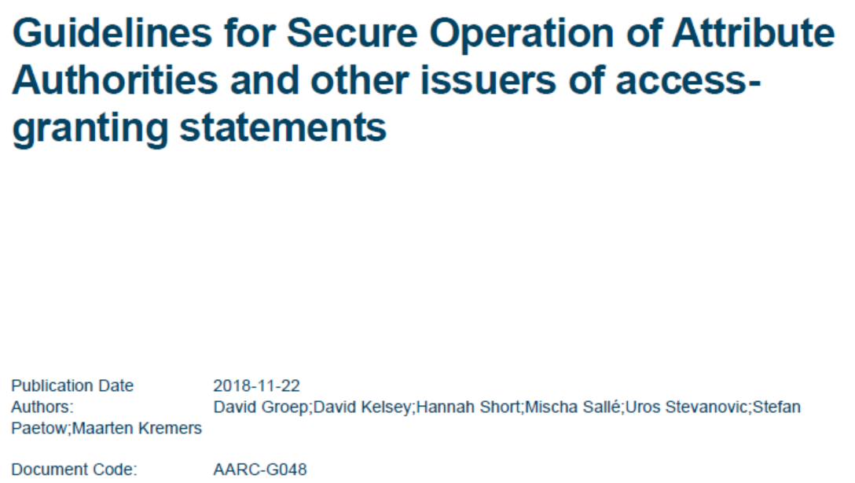
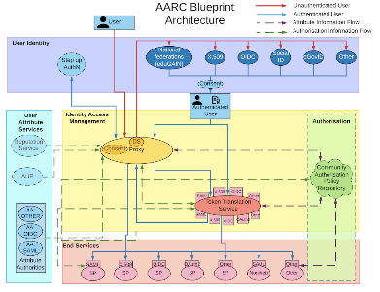
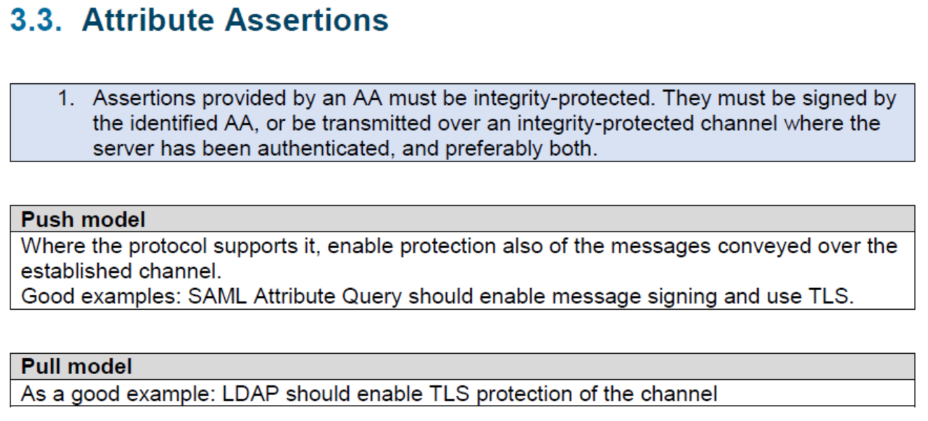
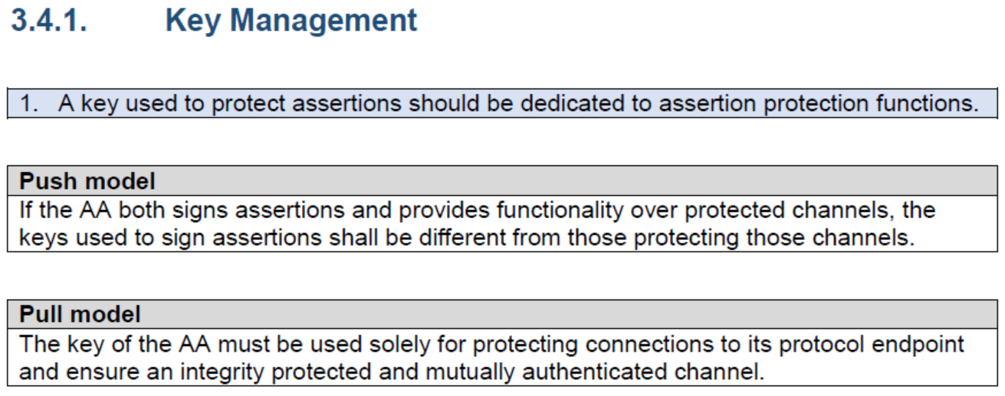
AARC-G048: keeping users & communities protected, moving across models
trusted delegation of response from communities to operators,
and from services to communities in recognizing their assertions
Structured around concept of “AA Operators”,
operating “Attribute Authorities” (technological entities),
on behalf of, one or more, Communities
`
https://www.igtf.net/guidelines/aaops/
https://aarc-community.org/guidelines/aarc-g048/
Notes:
And dwells also on naming since that is the unique hook for the service providers to actually track back persistently to the proper community as well as operator …

Slide 40
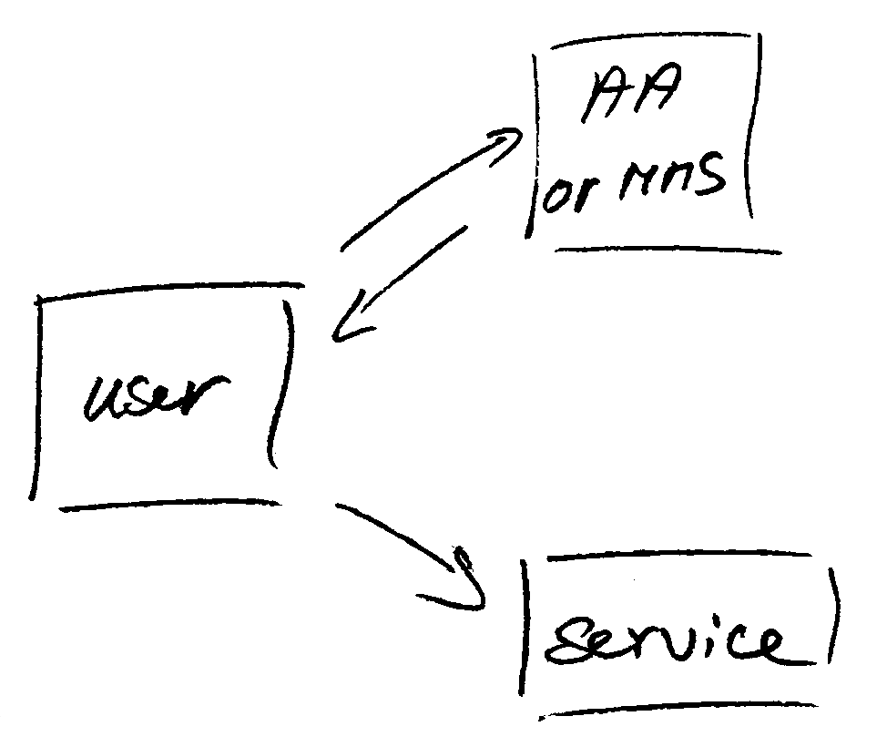
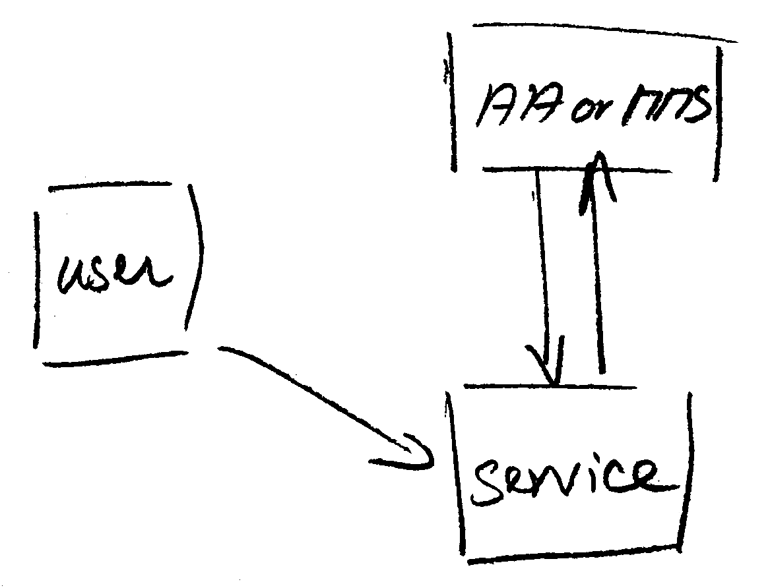
Protecting the community membership data and its proxy
Intentionally targeted broader than just BPA-style communities, since operational security spans data centres and infrastructures using other forms of AA membership management
PRACE: ‘pull model’ directory-based communities
BPA: encourages ‘push model’ attribute-carrying service requests
push model – the common BPA method
(e.g. SAML AttributeStatement, VOMS AC)
pull model – common when using directories
(e.g. LDAP in PRACE, GUMS in OSG)
push and pull model diagrams as per RFC2904 – the 3rd (agent) model is uncommon in research/collaboration scenarios except for provisioning

Slide 41
When the AA is managed (and in a data centre) …
Many of the recommendations are already implemented ‘implicitly’
because common software implements it: e.g. signing SAML assertions and JWTs
because a good data centre already has network monitoring and central logging in place
because you signed up to Sirtfi (didn’t you?) – so you collaborate in incident response
because you have trained IT operations personnel looking after the service
And some are intuitive best practice
like assigning a unique and lasting name to a group
because implemented controls follow ought to be those that have been documented

Slide 42
Forward looking and specific requirements
Some controls are specific to AA operations and protect against current and future threats:
minimum signing key length so that the community is not broken in the next few years (at least 112-bit symmetric, i.e. >=2048 bit RSA keys)
protect the key from data breaches, compromise, ransomware, and exfiltration by using HSM Hardware Security Modules or equivalent controls (and the HSMs you need are not that expensive, or you can even rent them in AWS…)
Or deal with commensurate incident response (you don’t want just a big red button):
re-issuance of attribute statement must be based on fresh data
release them only in accordance with the community’s policy and maximum life time
require appropriate client authentication before releasing attributes to prevent data breaches
for non-revocable tokens (like OAuth Access Tokens or PKIX 3820 proxies),
limit life time <24hrs (for OIDC, these are anyway typically 15 minutes)

Slide 43
G048 AA Ops guidelines and AA hosting
Guideline was written with both physical and virtual deployment in mind
“An AA may be run in a virtual environment that has security requirements the same or better than required for the AA, and for all services running in this environment, and it must not leave this security context. Any virtualization techniques employed (including the hosting environment) must not degrade the context as compared to any secured physical setup. Only AA Operator designated personnel should have control over the virtualisation and security context of the AA.”
if you can host it on-prem, the easiest solution is to host it on your security-service VM infrastructure (e.g. alongside your IdP, your AD, or your master LDAP servers) to limit guest compromise)
If you run it in a cloud provider, select a provider that offers proper security and network controls, implement account role separation, and deploy the offered protections. E.g. in AWS you have a lot of controls available to do so. But Azure &co hve the same. – and rent a netHSM

Slide 44
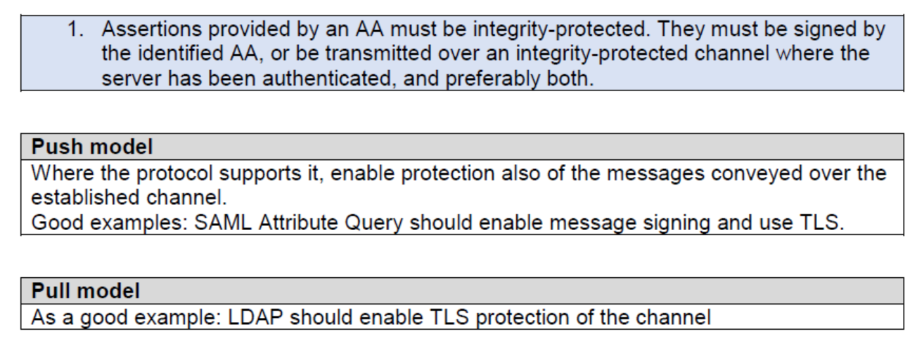
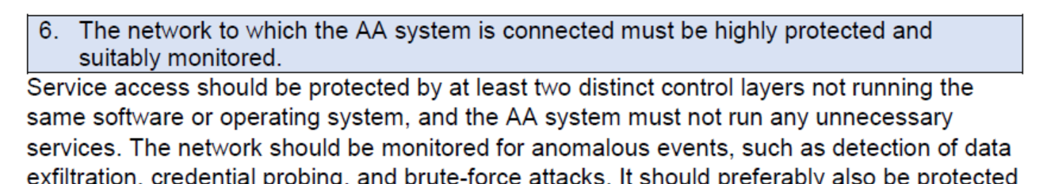
Deployment guidance included …

Slide 45
SCCC JWG
Security Communications Challenge Coordination Joint Working Group –
IGTF, WISE-Community, GEANT SIG-ISM, Trusted Introducer / TF-CSIRT, REFEDS

Slide 46
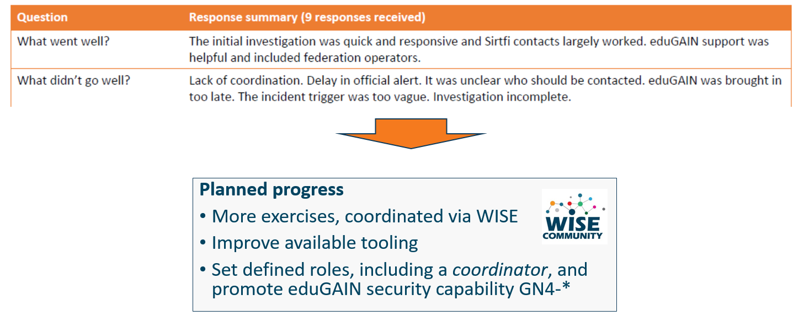
Communications Challenges
Based on Sirtfi incident role play of AARC in eduGAIN:
testing communications channels identified as high-prio target
Initial model might be along the IGTF RAT CC challenges – can be extended later

Slide 47
Proper OpSec needs to be exercized!
Like the IGTF RAT Communications Challenges, and TF-CSIRT processes, opsec really needs to be exercised often and in-depth to ensure readiness
Logical candidates that could all run the test against IdPs, CAs, SPs, RPs …
… and ‘legitimately’ claim an interest in their results
eduGAIN
IGTF
GEANT.org
EOSC-HUB ops, or EGI CSIRT
each of the e-Infrastructures XSEDE, EGI, EUDAT, PRACE, HPCI, …
every research infra with an interest: WLCG, LSAAI, BBMRI, ELIXIR, …
any institution (or person) with access to https://mds.edugain.org/
so soon: all the email in the world will be about Sirtfi Incident Response tests??

Slide 48
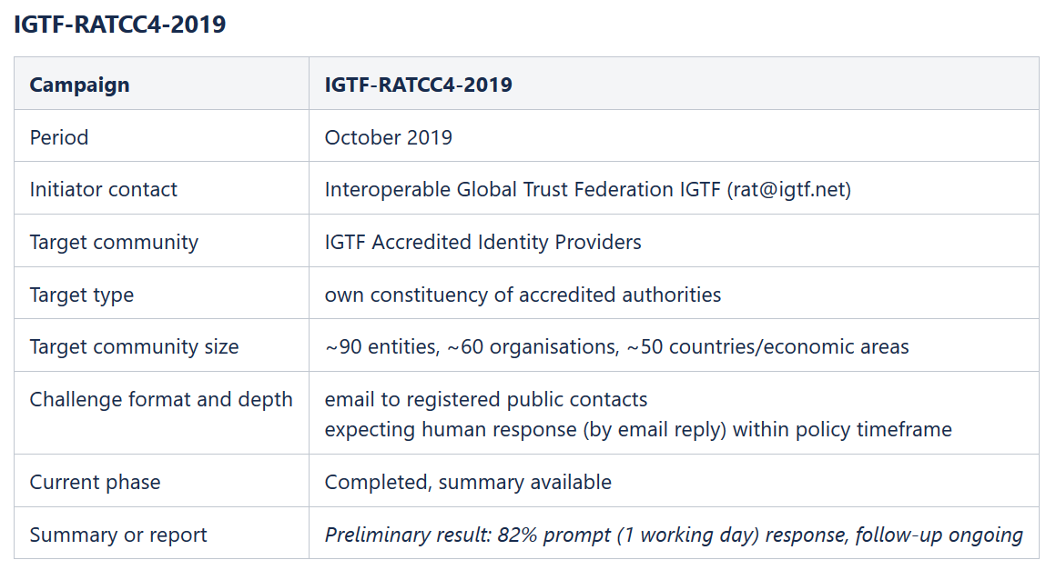
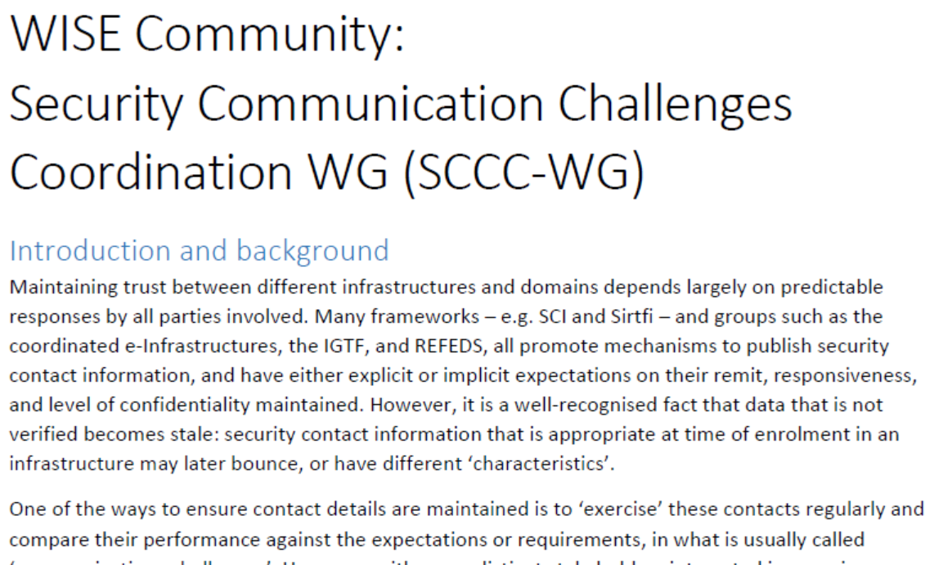
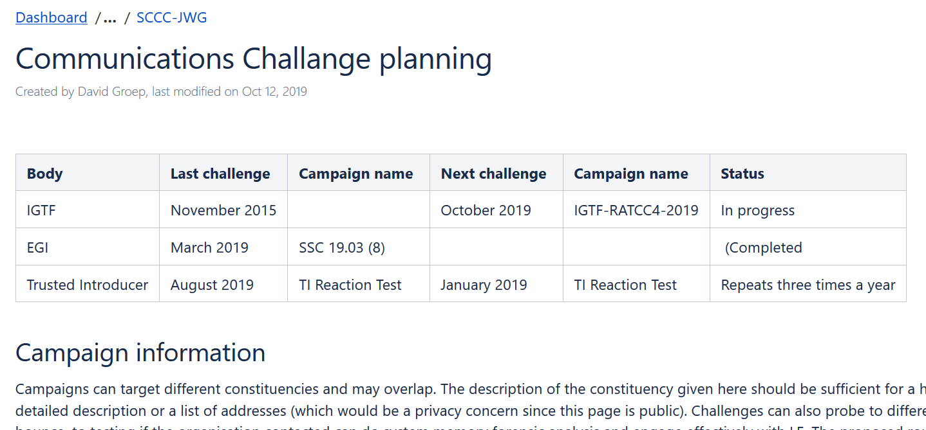
WISE SCCC-WG – participate!
WISE, SIGISM, REFEDS, TI joint working group
see wise-community.org and join!
https://wiki.geant.org/display/WISE/SCCC-JWG

Slide 49
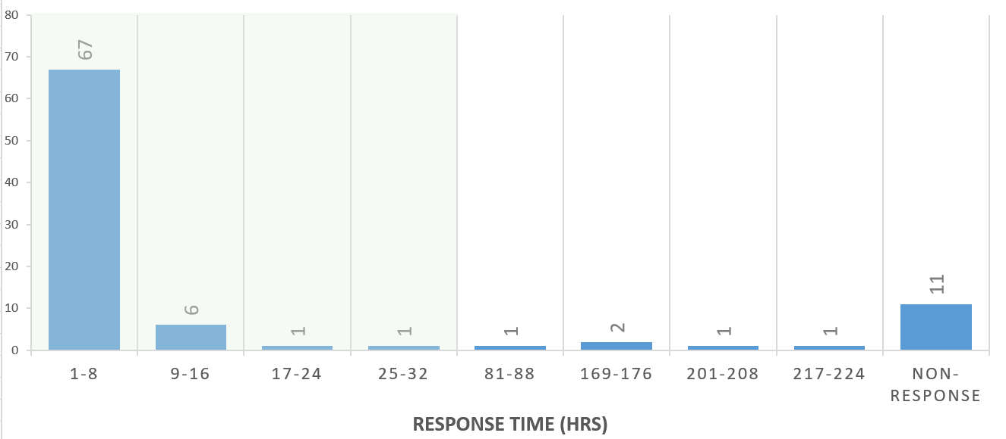
IGTF RATCC4 Results
In total there are 91 trust anchors (root, intermediate, and issuing authorities) currently in the accredited bundle,
managed by 60 organisations.
Of the 60 organisations, 49 responded within one working day (82%), representing (incidentally) also 82% of the trust anchors.
Within a few days more, 3 additional ones came in, and 4 more responded after a reminder.
In total, 90% of the organisations responded to the challenge, representing 88% of the trust anchors.

Slide 50
Specific IGTF actions following RATCC4
DigiCert contact was updated and verified
BYGCA (.by) is migrating operations to new entity
INFN will discontinue its CA by January 2021 (and move to TCS)
TSU GRENA communications ongoing
SDG, CNIC information updated

Slide 51
Building a global trust fabric
Questions?

