Slide 1
Combined Assurance and the RPS

Slide 2
The ‘Combined Assurance Model’: ID vetting
Both IGTF and REFEDS RAF
define ‘low assurance’ proofing:
basically ‘identifier-only’
Stepping up to ‘medium’ assurance requires adding a
controlled identity vetting process
Who runs that process is selectable!

Slide 3
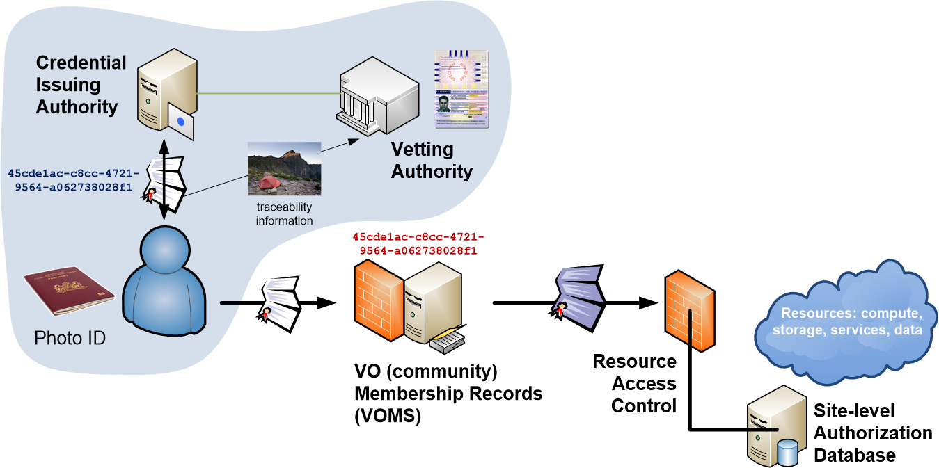
Responsibility model I: Trusted Third Party

Slide 4
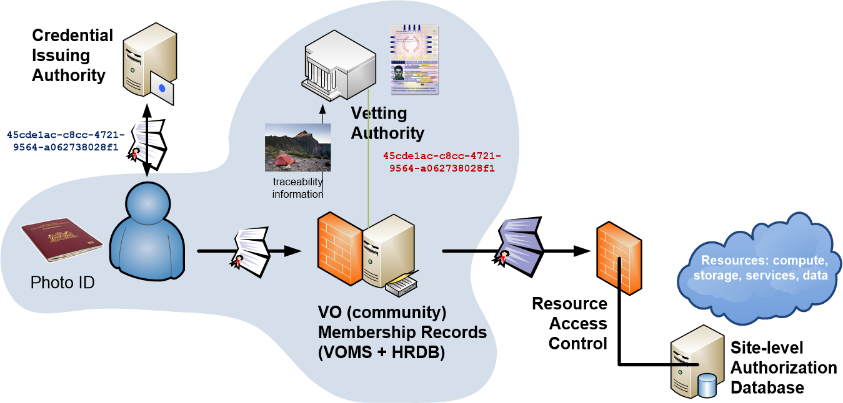
Responsibility model II: Collab. AssurancE

Slide 5
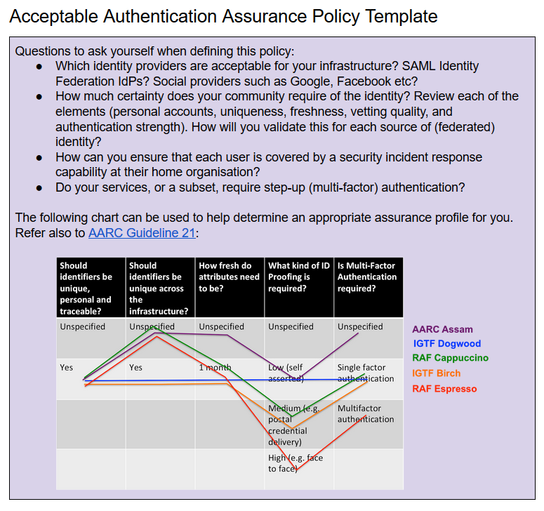
SPG Acceptable AuthN Assurance
Policy Development Kit: Acceptable Authentication Assurance defines the target level based on risk assessment
How to get to the target level is a process and required procedures

Slide 6
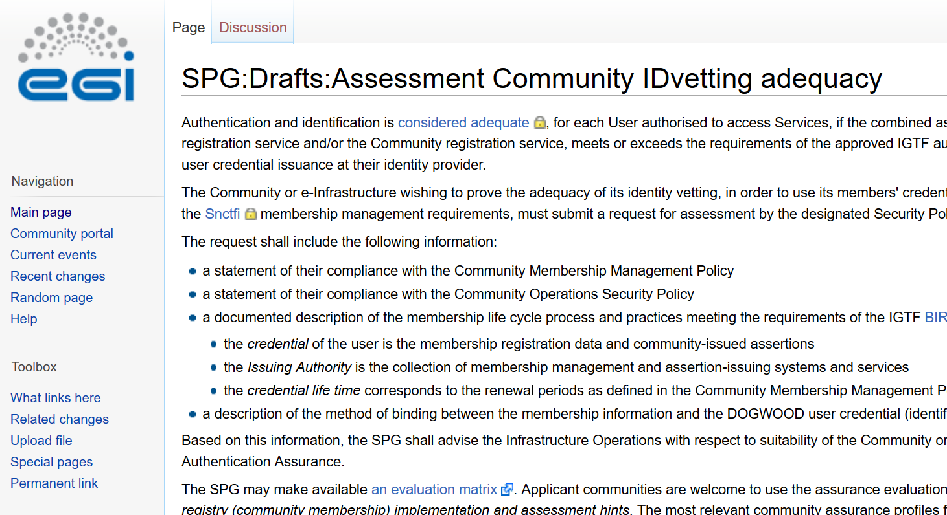
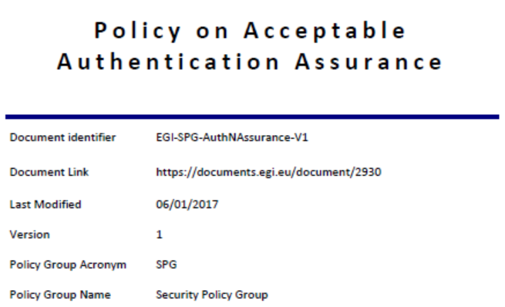
EGI SPG procedure – assessment matrix

Slide 7
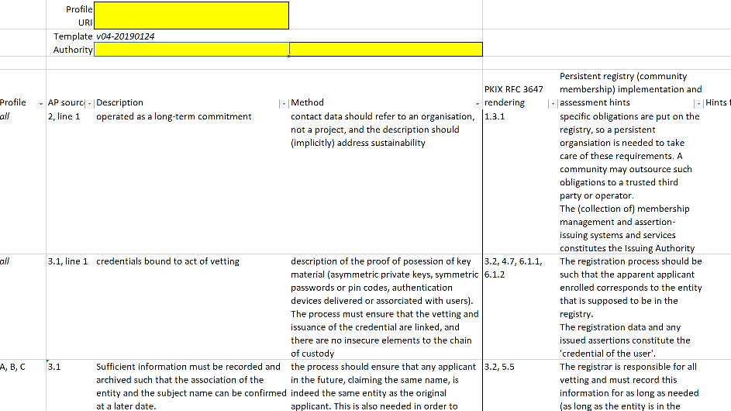
A common assessment model on ID vetting
for ID providers and for communities
https://wiki.eugridpma.org/Main/AssuranceAssessment

Slide 8
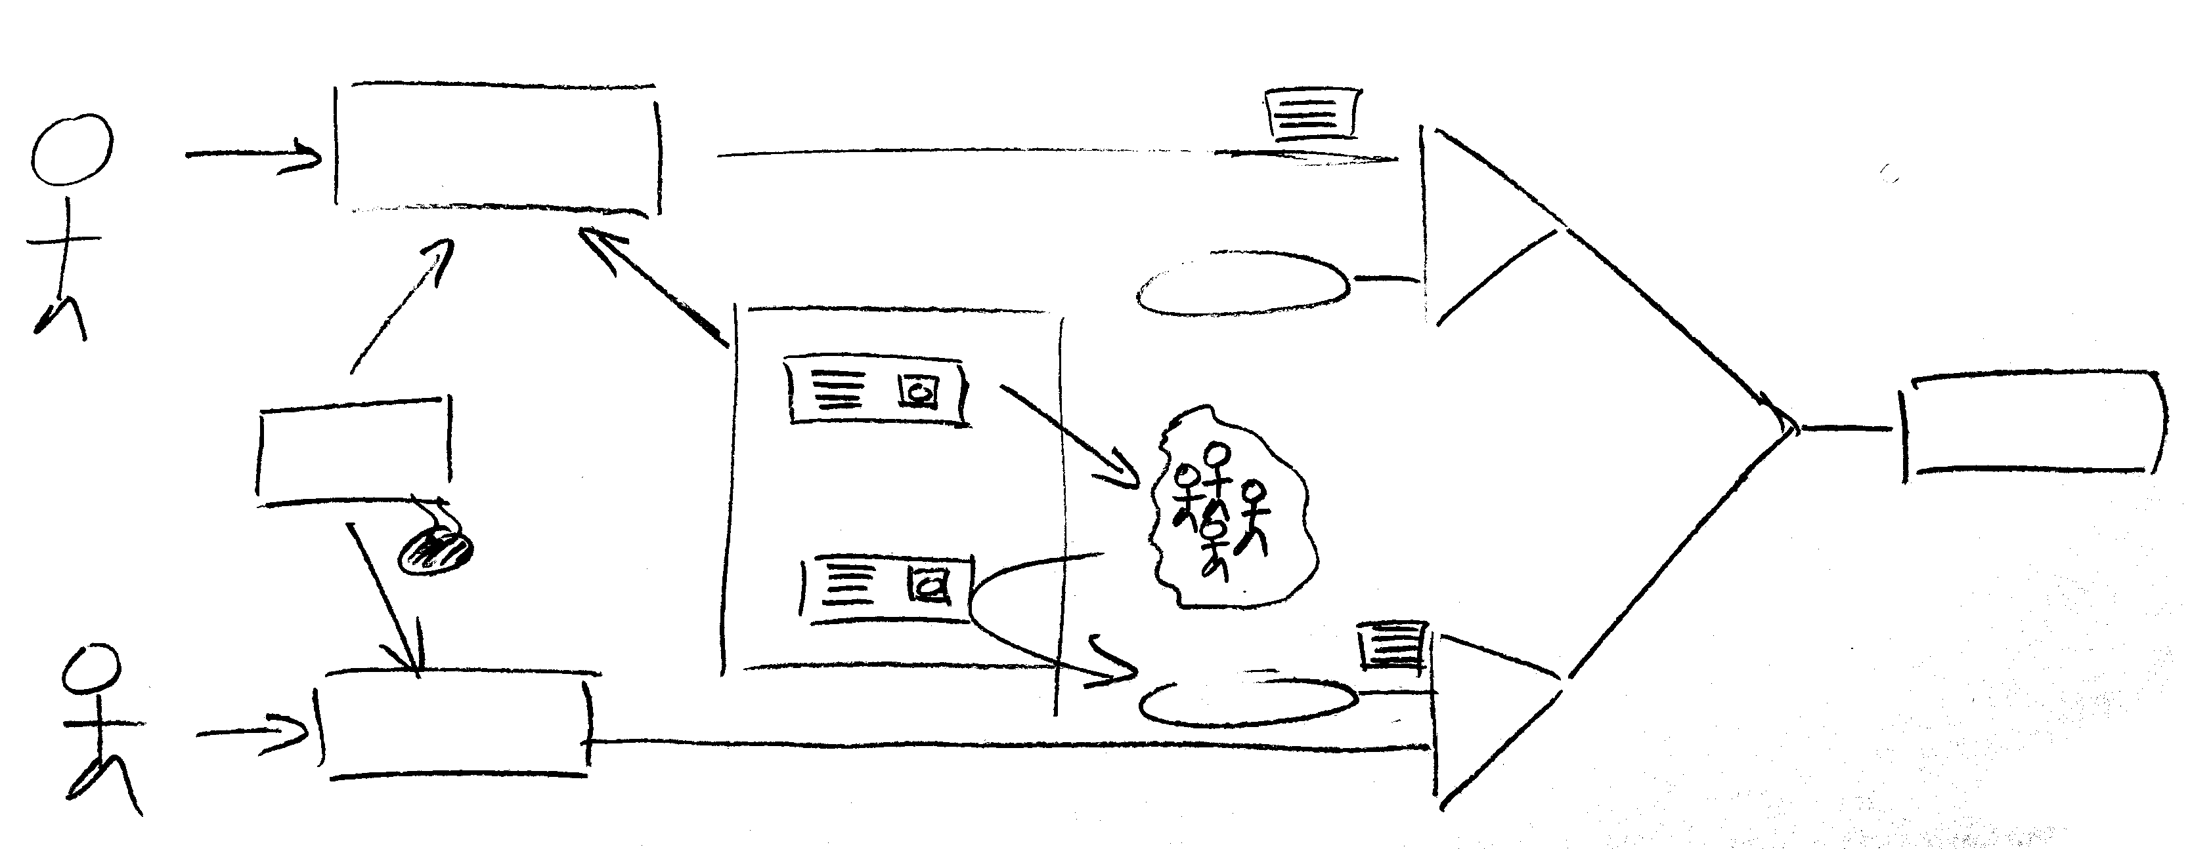
But the model extends back to CAs …
identity sent to service based on CILogon Silver using Cappucino
ID proven?
BIRCH
ID vetting
AA-
national
community
management
service
ident#
community-
based
ID proven?
AA++
identity sent to service based on CILogon Basic using DOGWOOD and ID vetting by LIGO LSC
DOGWOOD

Slide 9
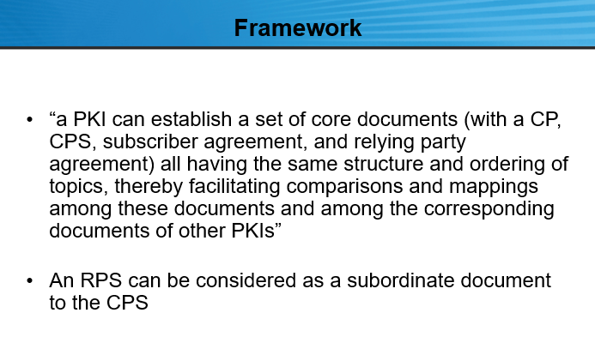
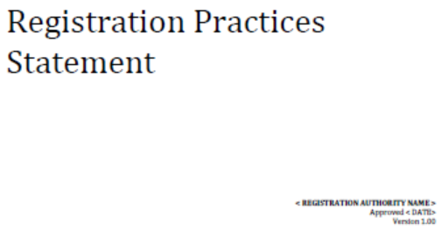
What is needed is … the RPS!
Scott Rea, in the 33rd EUGridPMA Berlin meeting:
reference RPS targets
BIRCH/CEDAR assurance
http://wiki.eugridpma.org/Main/RPS

Slide 10
Alignment and community guidance
How to help communities implement community-level ID vetting?
How to engender trust for their service providers?
The ‘increment’ for communities to Cappucino (or igtf-birch)
documented by way of a prefilled RPS as part of the PDK?
Verified using the standard assessment sheet?

Slide 11
What helps the community best?

