Slide 1
Collaborative e-infrastructures
urn:doi:10.60953/bf3e2015-85a9-41cd-8819-e1f7fd4a1711 R8/18/1748
computing and networks for research
crossing country borders with ease
David Groep
Italian Cultural Institute
Amsterdam
May 2025

Slide 2

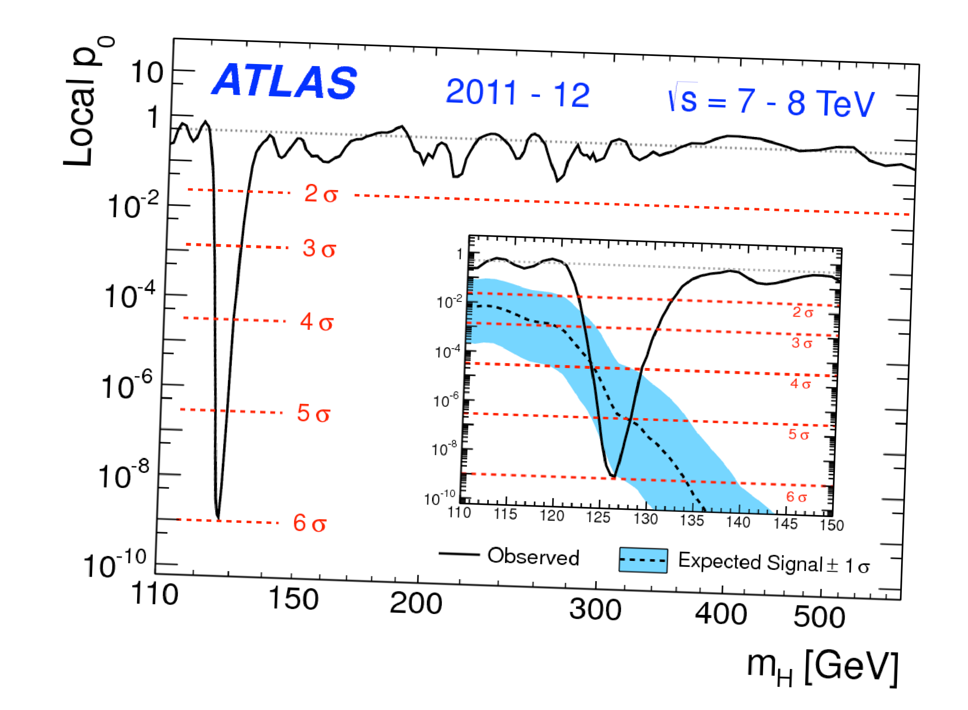
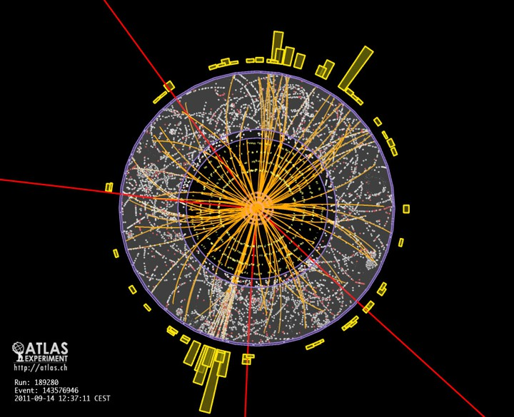
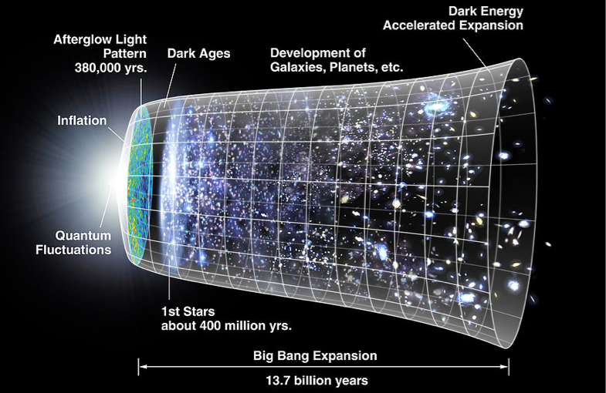
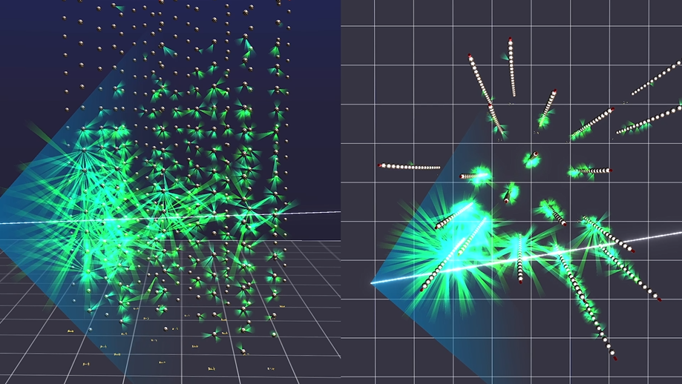
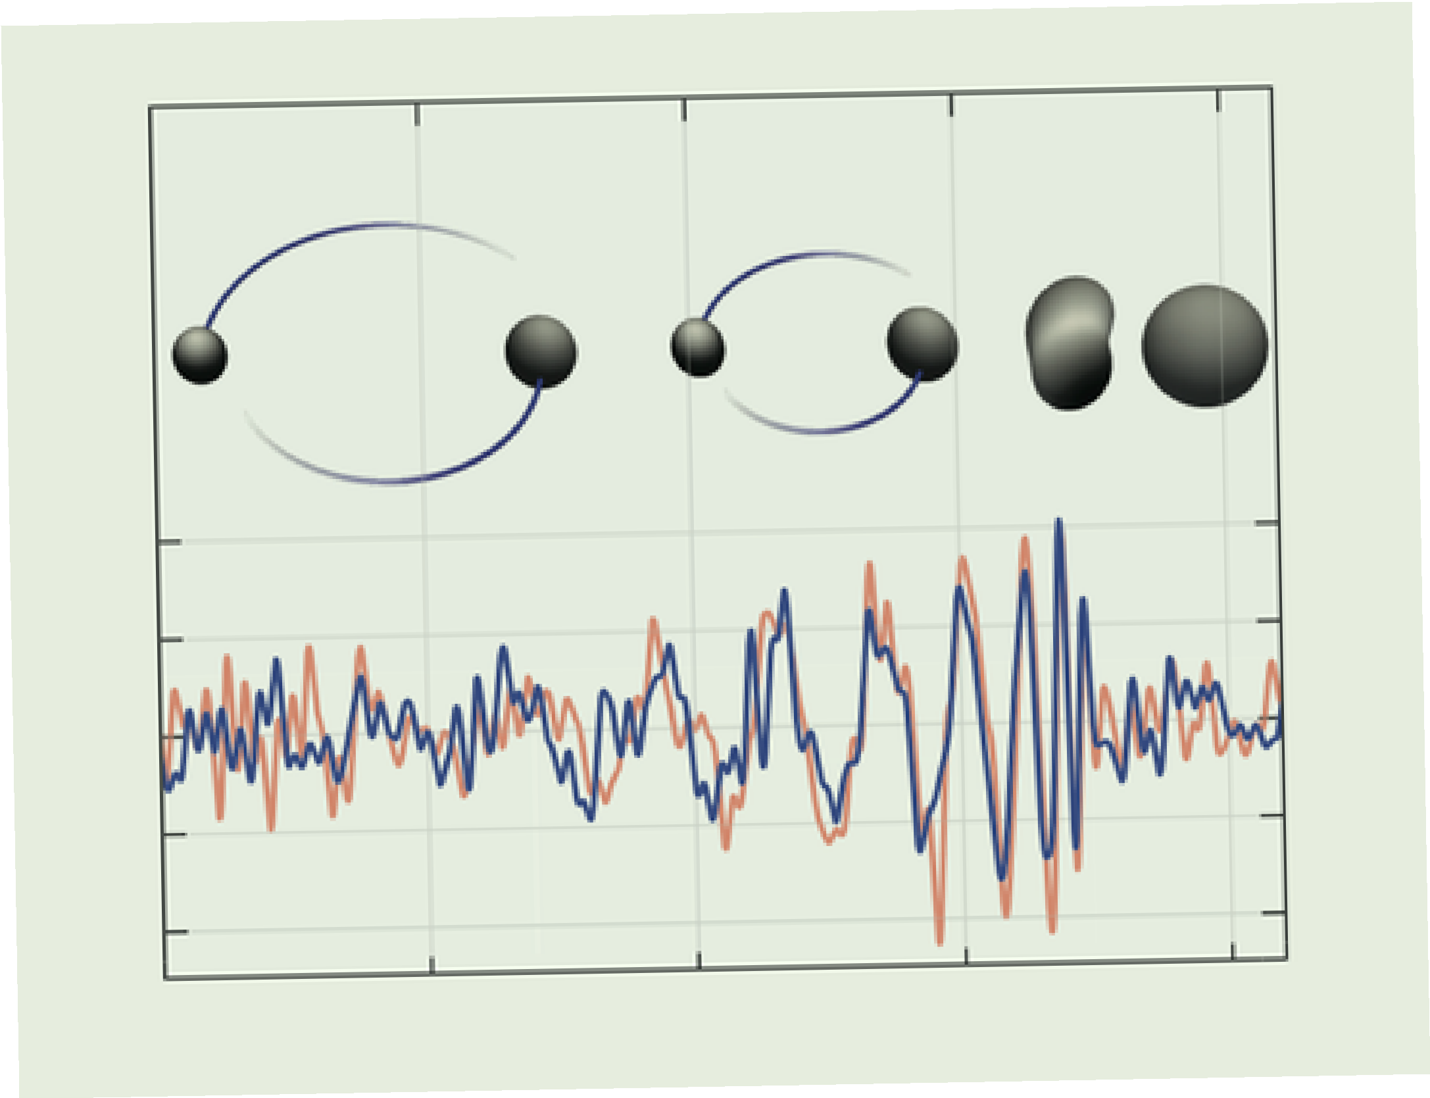
A few words on Nikhef and
sub-atomic physics as a global endeavour
Highest energy ν from KM3-230213A
Discovery of Higgs particle
We probe our world, made of particles and fields,
with collider physics, primarily at CERN
astroparticle physics:
particles, radiation, and ripples coming from the universe
Discovery of Gravitational Waves
images: atlas.cern.ch, CERN, LIGO-Virgo Collaboration

Slide 3
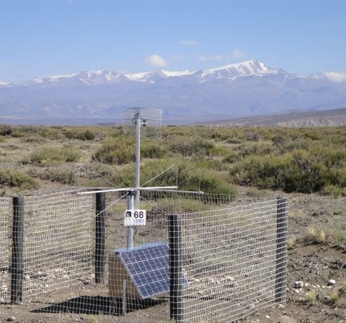
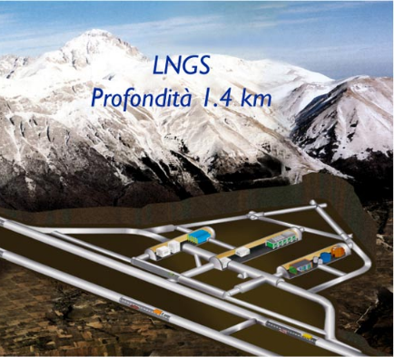
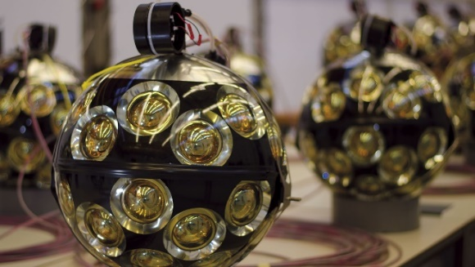
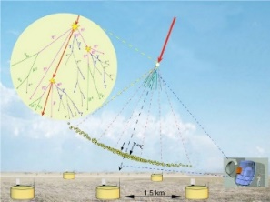
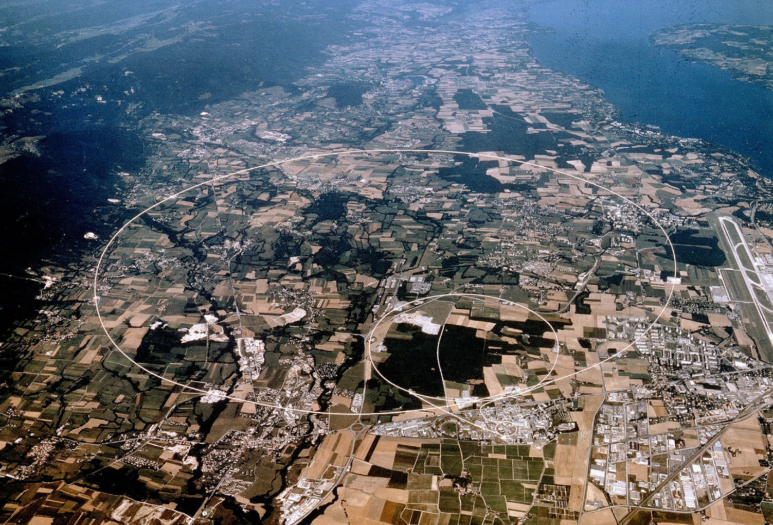
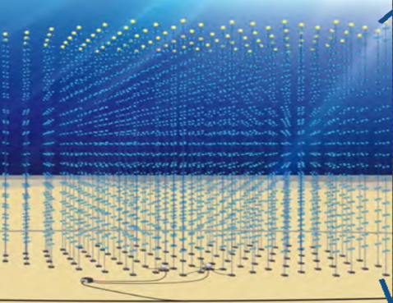
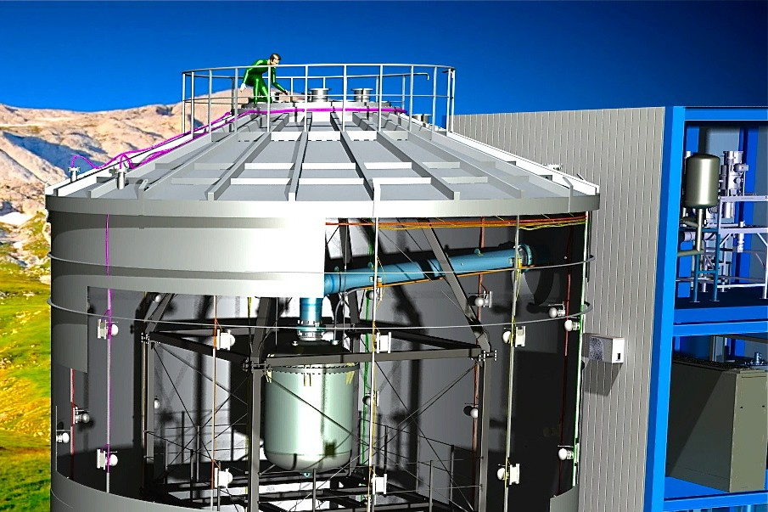


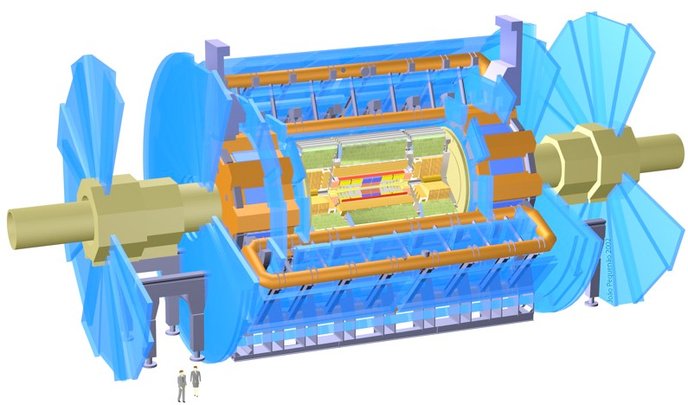
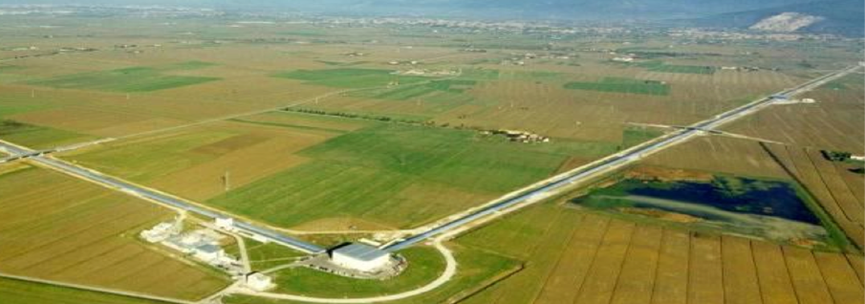
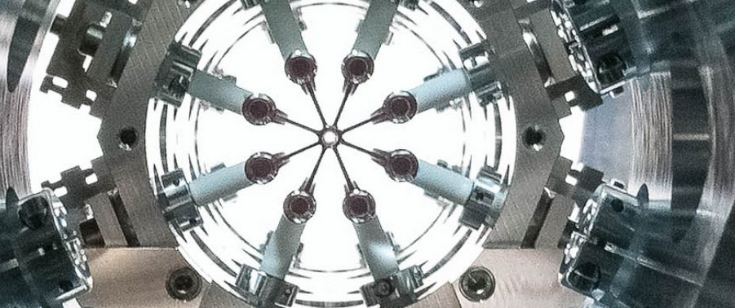
… and almost all beyond the Netherlands
Pierre Auger - UHECR
LHC collaborations
XENONnT - Dark Matter
Gravitational Waves
at Virgo
KM3NeT - neutrino telescope
EEDM: the
only one in NL …
images: Pierre Auger collaboration, Virgo collaboration, Xenon-nT collaboration, KM3NeT collaboration, INFN, LNGS, Nikhef

Slide 4
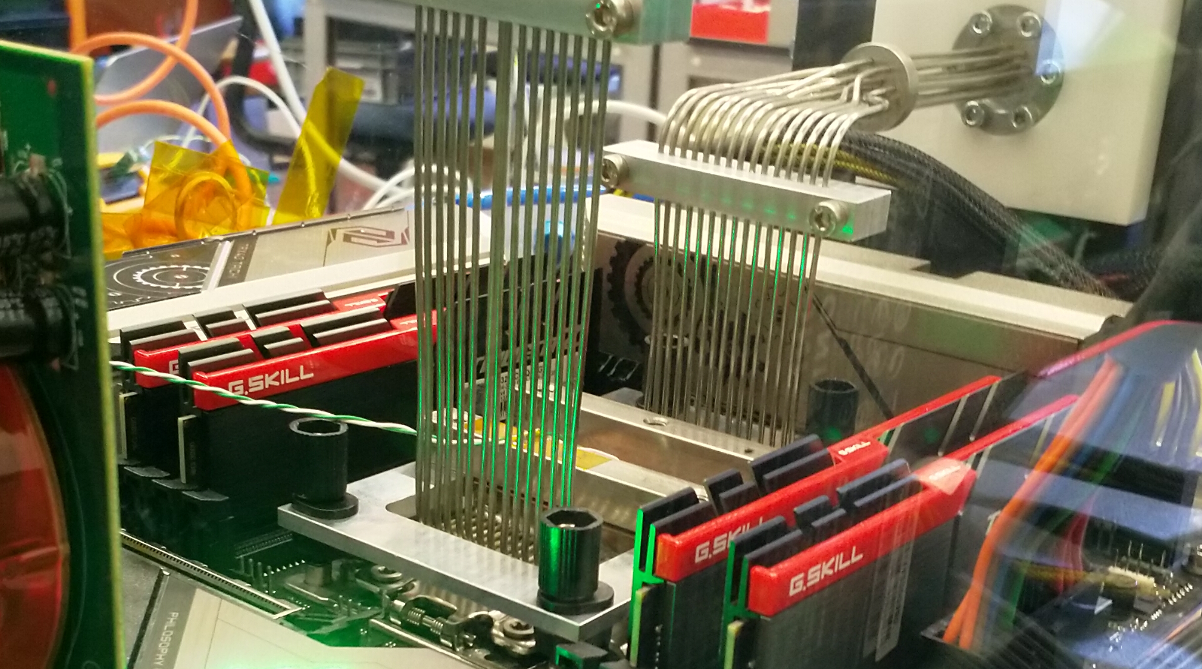
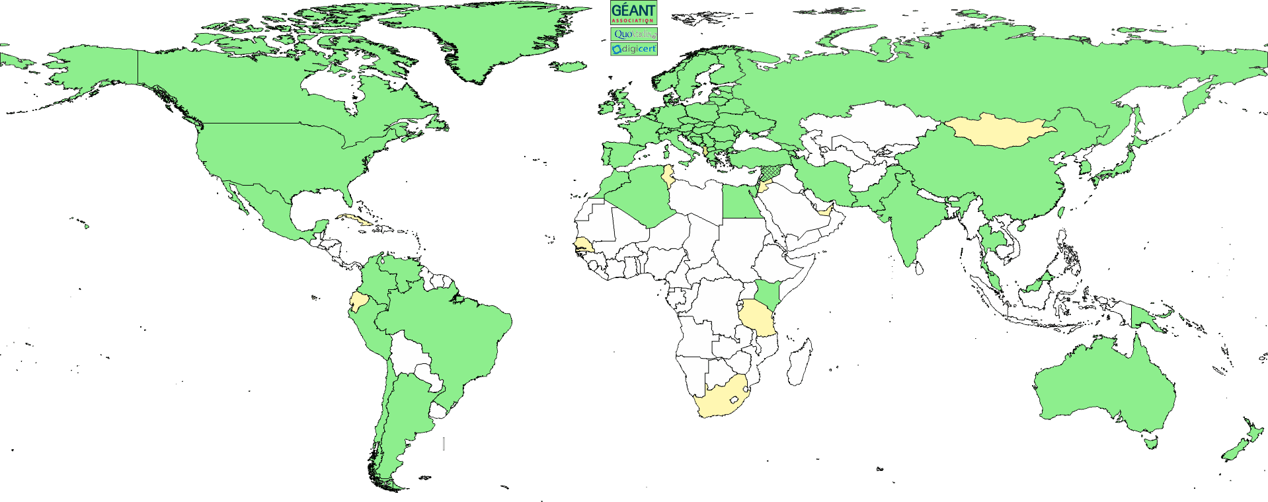
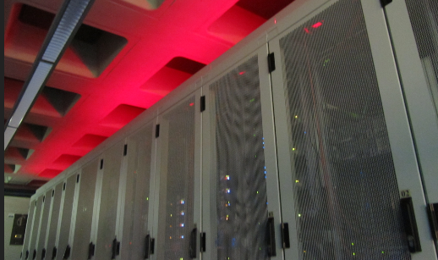

ICT Infrastructure research for Research Infrastructure at Nikhef
Algorithmic design patterns and software
scientific software (GPU) acceleration, ML tracking,
application architecture
software design patterns for workflow & data orchestration, and (energy) efficiency
Infrastructure for
trusted collaboration
trust and identity for
enabling communities
managing complexity of collaboration mechanisms
securing the infrastructure
of our open science cloud
Infrastructure, network
and systems R&D
building ‘research IT facilities’
co-design & development
data throughput innovation
research on IT infrastructure

Slide 5
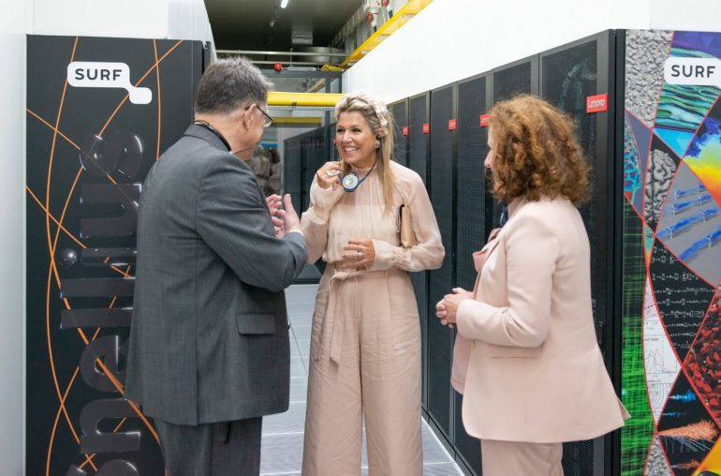
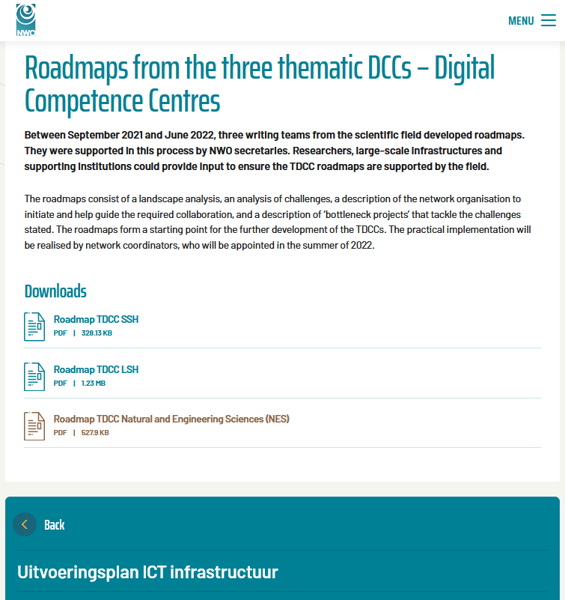



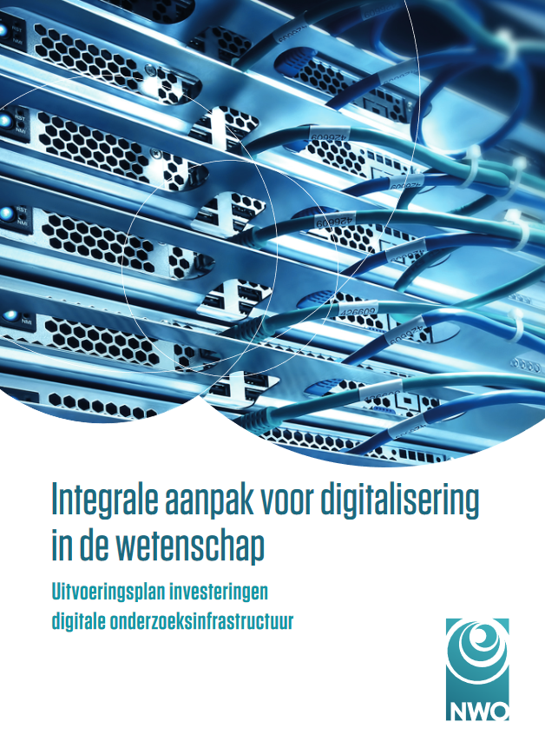




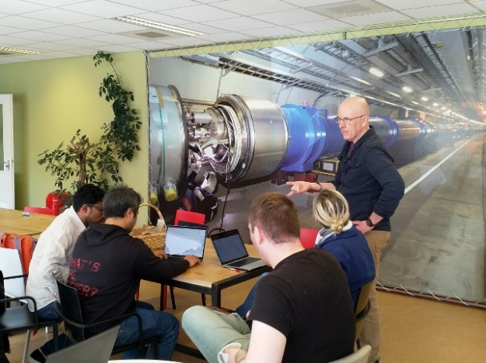
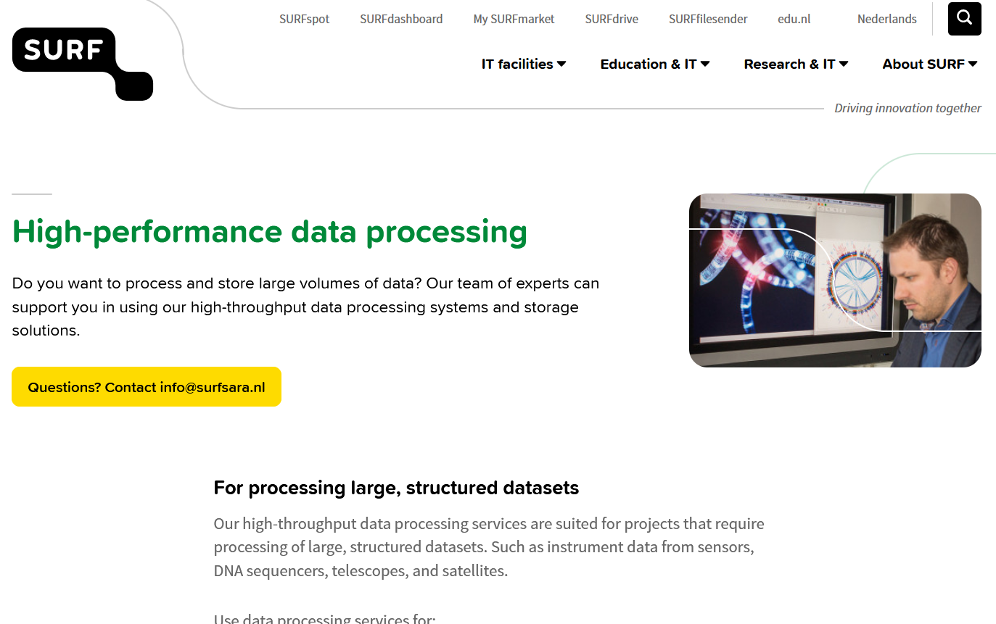
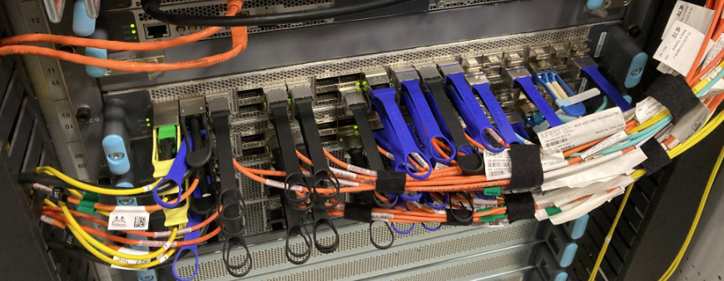
ICT infrastructure for research as research infrastructure
hardware, software, services, competences and people
Thematic (domain-specific) DCCs
National coordination per domain, international collaboration, brokering domain expertise, collections, tools, FAIR-standards, training
Cross-domain & large-scale IT infrastructure
Generic infra & expertise for data & software stewardship
Connecting to international
e-infrastructures
TDCC-SSH
TDCC-LSH
TDCC-NES
Local DCC
Local DCC
Supporting local needs within constraints of
local infrastructure, budgets & policy
Institutional & domain data stewards, data science centres
Images: ATLAS Rucio volume, (from rucio.cern.ch); optical network: NDPF ‘deel’; User meeting Stoomboot Office Hours (both Nikhef)); Snellius opening visit; HPDC service page (both SURF); TDCC image by Ruben Kok, LSH TDCC and DTL
Notes:
** Alle dingen in verhouding tot elkaar
** de “mensen” komen terug in de DCC slides
Message: Infrastructure is more than the computing or storage hardware, although we do need capacity as well of course. What makes it ‘ICT infrastructure for research’ includes also the network that connects us to our peers and the world, the software that makes it work together, it needs design and architecture to turn disparate pieces of iron into a service, and you need the experts to embed ICT into the research process – which is much more than a ‘helpdesk’, but a joint adventure into research computing.

Slide 6
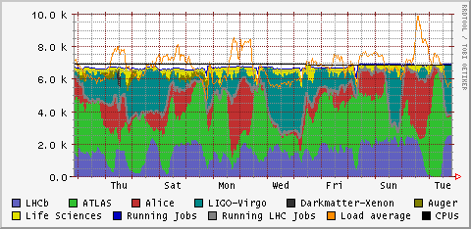
HTC/HPC infrastructure: federated joint processing in NL
One of the processing sites of the joint federated infrastructure
Multi-domain e-Infrastructure
ENMR: structural biochemistry
Project MinE: ALS (health)
Xenon: direct DM searches
TROPOMI: earth observation
DUNE:
long baseline neutrinos
LIGO-Virgo:
Gravitational waves
Alice, ATLAS, LHCb
LHC (NL) experiments
Cumulative cores per community on the Nikhef
NDPF part of the DNI federated HTC Tier-1 infra
day (arbitrary 2 weeks)
Graphic: NDPF DNI compute service coordinated by SURF
Notes:
De nationale e-Infra is een plaats waar veel communities samen schaalvoordeel kunnen halen. Het combineren van domeinen krijgt de utilisatie naar ~95%, zodat de infrastructuur extreme efficient is. Ook voor energiegebruik, trouwens …
(dit plaatje kan nog vervangen worden door eentje van GINA)

Slide 7
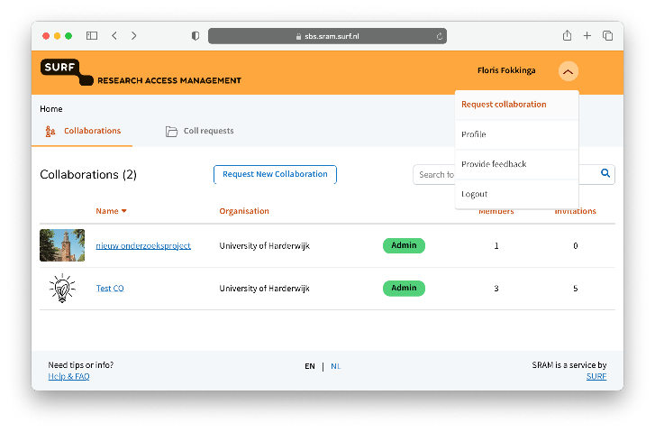
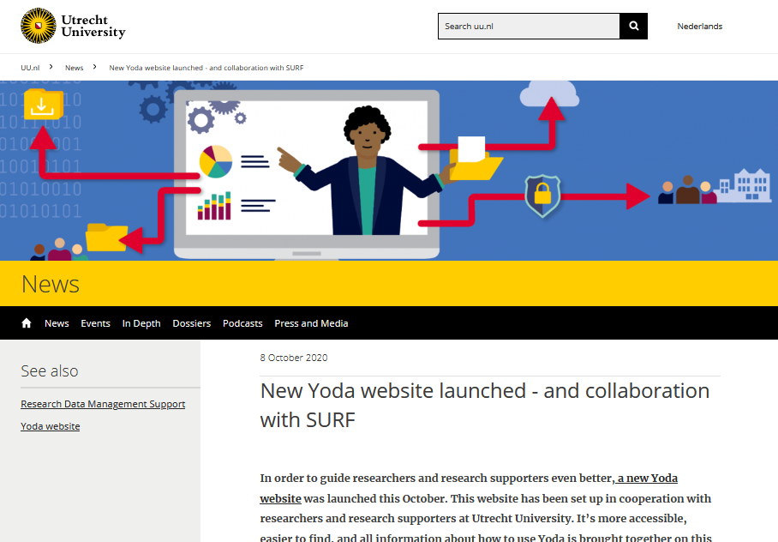
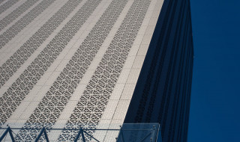
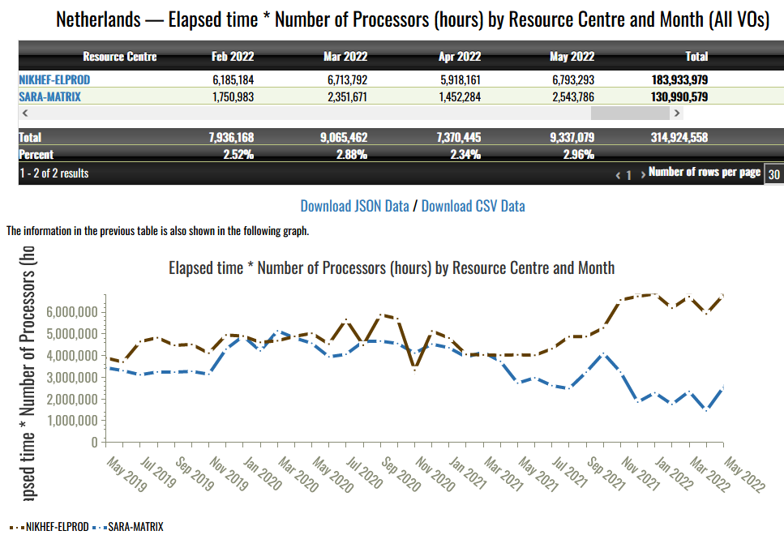
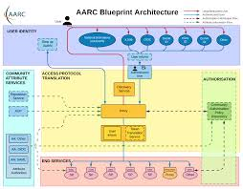
SURF as linking pin between research and e-infrastructure
National ‘Tier-1’ federated computing with
heterogeneous HTC/HPC, Quantum, AI/ML capacity
Secure Supercomputing for (social) sciences
Federating institutional HPC facilities
Data archiving and large FAIR repository services
Stimulating - with NWO - ‘digital competences’
for researchers via the NL eScienceCenter
trust, identity, and AAI research federation
as a transnational effort – like research itself
Images: EGI accounting (https://accounting.egi.eu/) for NL, all federated communities, 2020-2022, SURF: Amsterdam Data Tower
Yoda: Utrecht University and SURF, https://www.uu.nl/en/news/new-yoda-website-launched-and-collaboration-with-surf; SRAM: SURF Wiki;
Notes:
infrastructure is a prerequisite for keeping data ‘alive’
and it’s all about collaboration and doing that in national infrastructure ‘coordinated by SURF’ is the most effective way of preventing lock-in (to cloud vendors, countries, or … again publishers! – think of Mendelay, PURE, &c …)
DNI national federated HTC infrastructure
Yoda
T2 network
DCC network

Slide 8
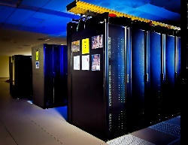
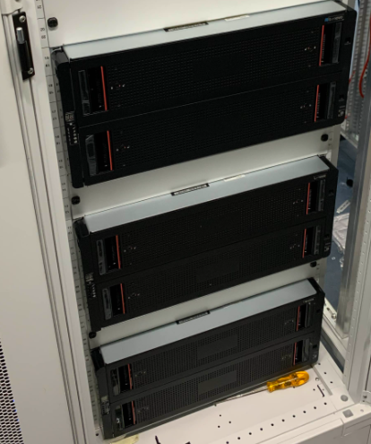
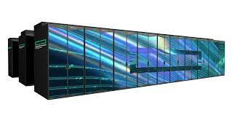
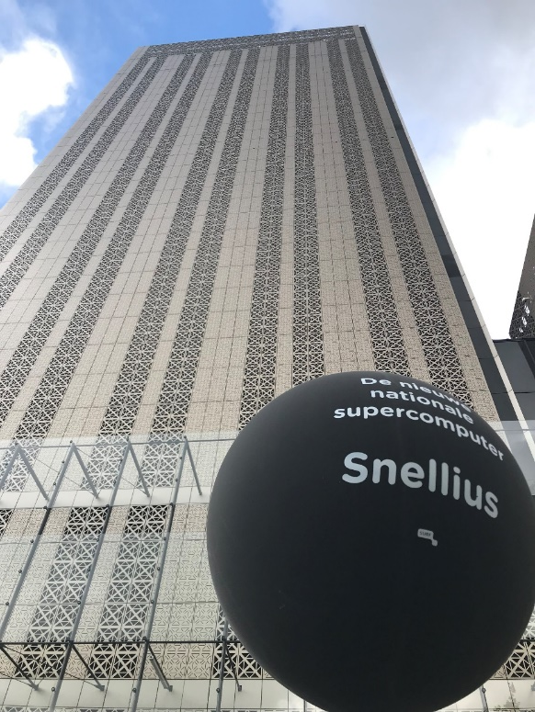
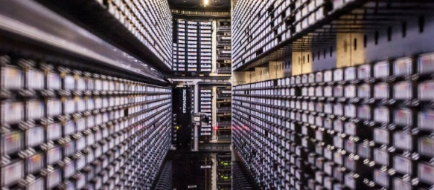


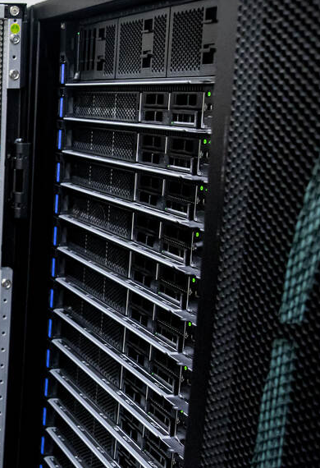


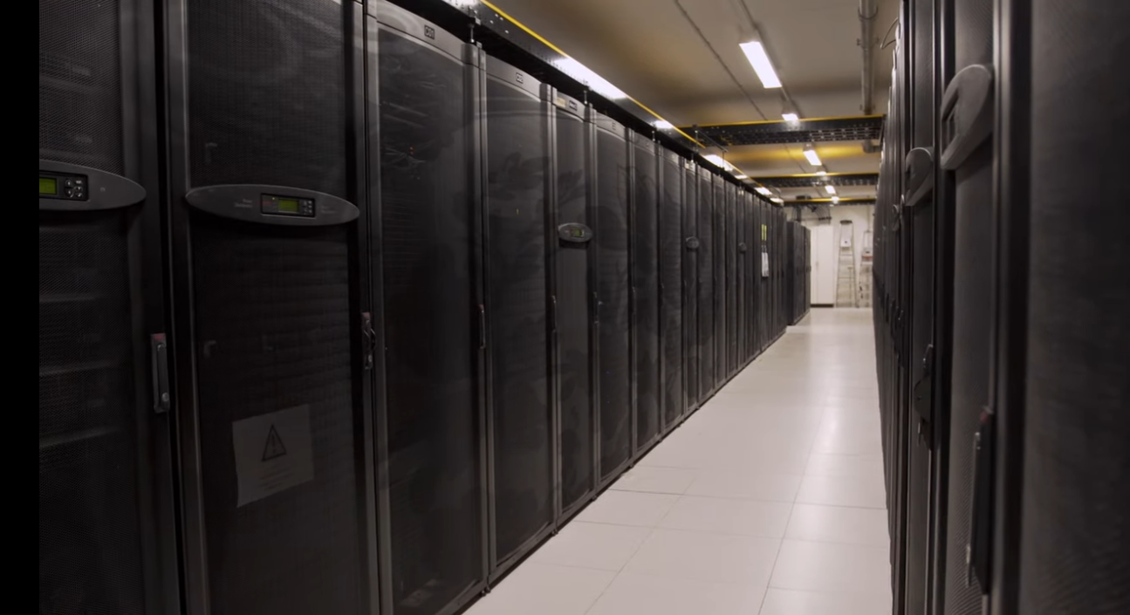
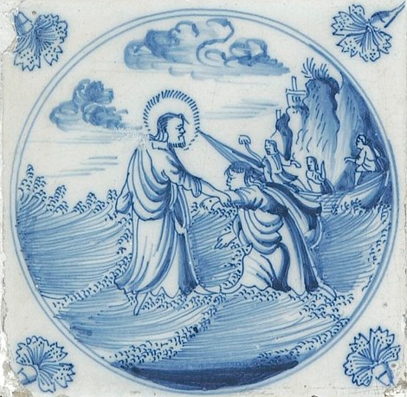
Scalable HPC: from local “Tier-2” to European “Tier-0”
Nikhef “Stoomboot”
Analysis Facility
with local expertise
to enable exploitation
of European and
global resources
ALICE, Leiden
DelftBlue, TUD
…
SURF National Infrastructure
foundation as well as stepping stone
Photos: Nikhef NDPF, DelftBlue/TUDelft, SURF Data Repository, Snellius, SURF @ DigitalRealty
Steamship: Michael on Unsplash (https://unsplash.com/photos/944sDSMQ778), Tile: Nationaal Museum van Wereldculturen
Notes:
** KEY SLIDE
** ook EOSC expliciet noemen
de flow van instellingen naar T1 T0 vereist deelname instellingen – ook in volgende slide
HPC strategie
- opschaling T2T1T0
- Nederland goede positive, maar HPC is nodig, en kost wel geld …
- daar moeten ‘we’ iets van vinden
- en keuzes maken

Slide 9
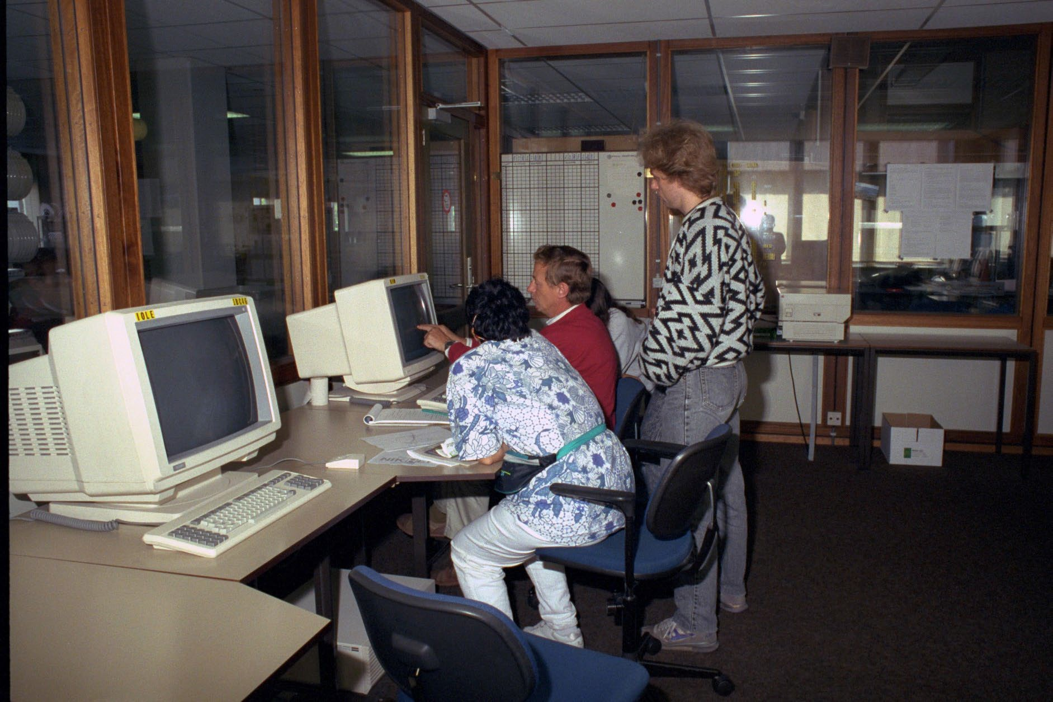

Collaboration has long since outgrown the one terminal
With one system using several racks
and with just a few people hunched over them
Nikhef room H1.37 – terminal stations on the raised data floor of the computer room (H1.40, behind the glass-panel walls)

Slide 10
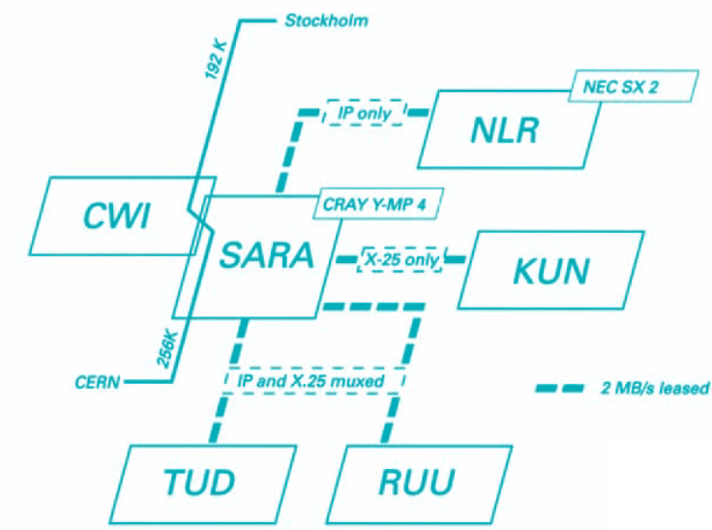
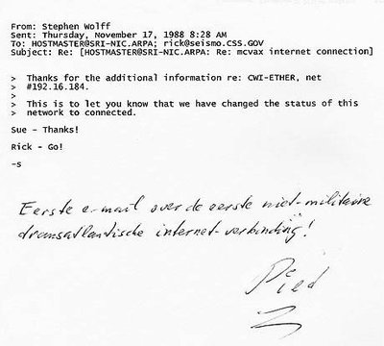
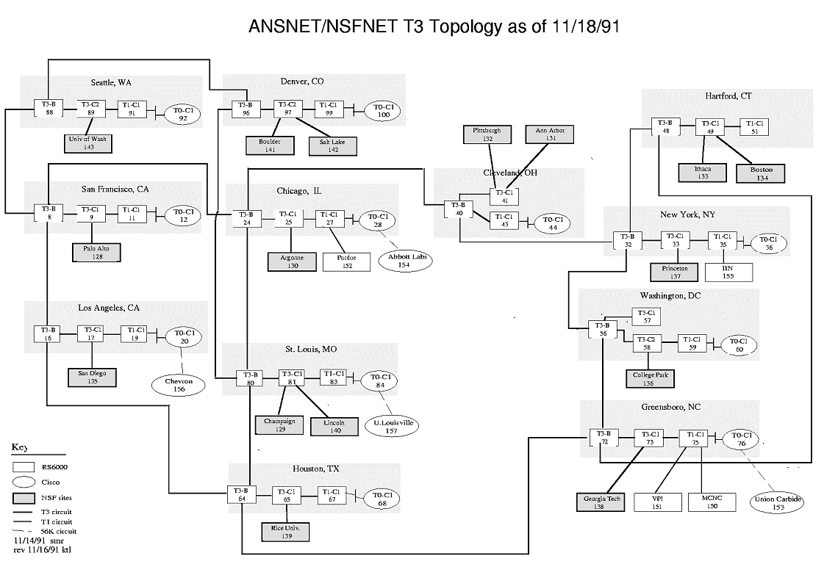
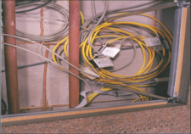
Networking is the mainstay: be it for computers … or for people
See https://personalpages.manchester.ac.uk/staff/m.dodge/cybergeography/atlas/historical.html for more historic maps ;
right-hand image: SURFnet2, 1990, first email to MCVAX at CWI from https://www.cwi.nl/en/news/cwi-celebrates-25-years-of-open-internet-in-europe-in-november/
(Piet Beertema, CWI, 1988); International Backbone Router Local Area Network “IBR-LAN” at Nikhef, room H1.40 as seen in 1996.

Slide 11
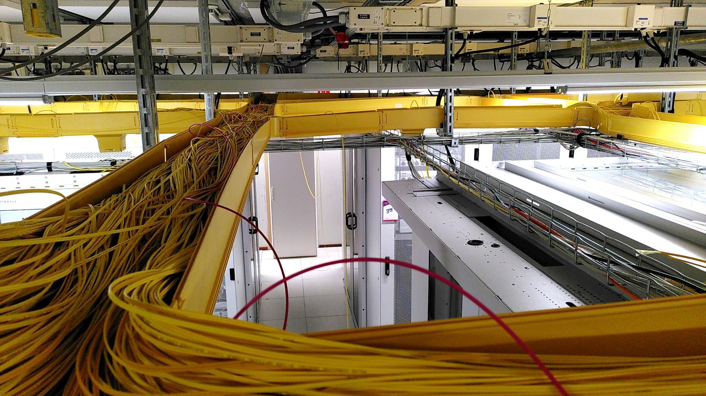
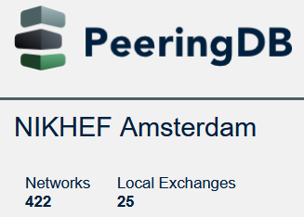
The only constant element is the yellow colour … and IP
Nikhef Housing has grown a bit since
        connectivity data centre
        focussing on global networking
        Nikhef science data centre
        federated in the SURF
        national Tier-1 facilities
        focus on throughput
        compute & storage
https://www.nikhefhousing.nl/ PeeringDB data: https://www.peeringdb.com/fac/18 (May 18, 2025)

Slide 12
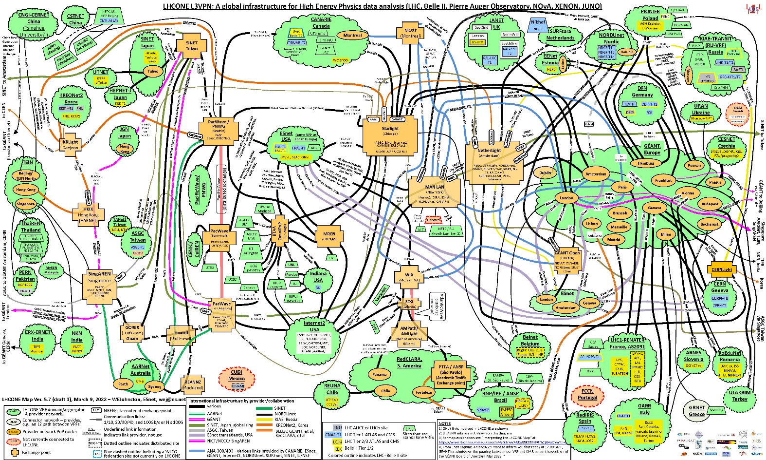
Networking together – globally connected research
Graphic: Bill Johnston, ESnet, for LHCone
Notes:
** netwerken voor data – Nederland sterk, moeten we wel blijven – ZEEKABELS
Historisch sterk in netwerken en verbondenheid: Netherlight, optical networks, connectivity-oriented network hubs
Nederland heeft ook hier een unieke positie!
En de bundeling van e-Infra (network, compute, storage, services) in een gezamenlijk ecosystem is behoorlijk uniek in de wereld – maar dan moeten we die positive wel ‘uitnutten’ ☺

Slide 13
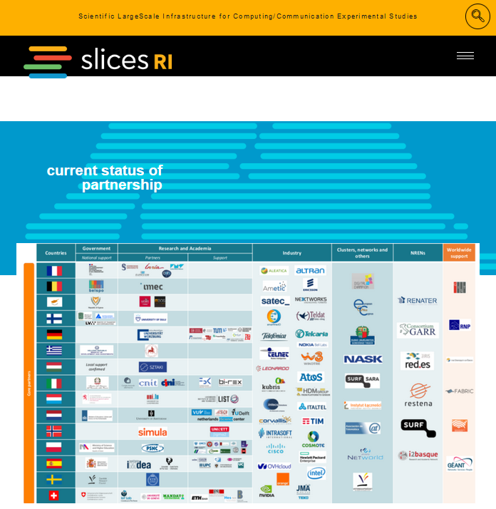
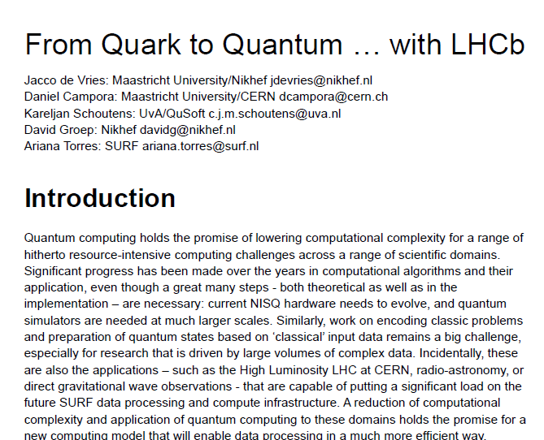
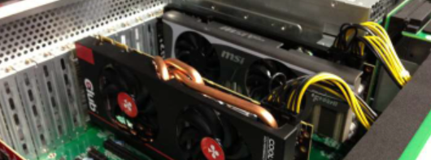
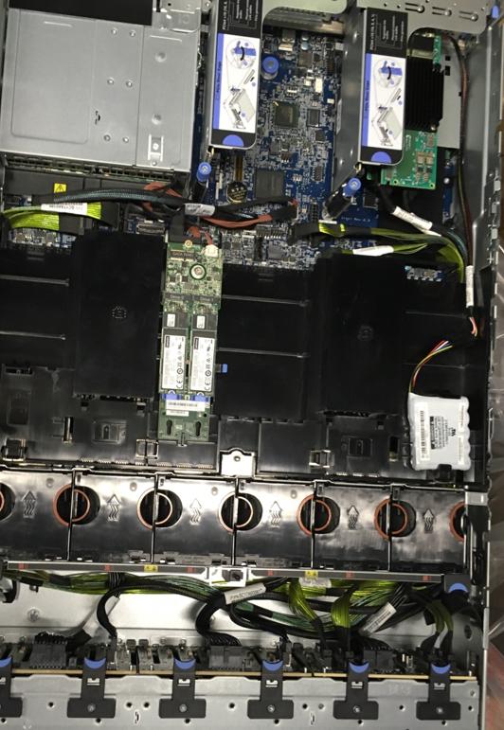



Riding the infrastructure innovation chain together
Computing Sciences
Research
Operational Research
(near-term, NextGen storage,
800G+ network, QC & simulators)
Operational innovation (procurement, systems vendor co-engineering)
scaling and validation with applications
Images: SLICES-RI, CompSysNL, UM & SURF QC, SURF SOIL BDRI,
NationaleSpeeltuin.nl @Nikhef
Notes:
In de innovatieketen is SURF een stabiele continue factor. De betrokkenheid van SURF in het hele traject, b.v. vanuit SLICES-NL en samenwerking met CS groepen, via het innovatieprogramma voor (efficient en effectief) gebruik van faciliteiten en het onderzoek naar matching tussen technologie en applicaties, tot aan het operationeel onderzoek zodat SURF en haar partners _zelf_ de expterside hebben om infrastructure te bouwen. Niets zou erger zijn dan zelfs de kennis over wat je wilt te moeten inhuren. Doordat SURF dit, met haar partners, wel kan, krijgt Nederland een unieke positive.
Daarvoor is het wel van belang dat ICT alsresearch instrument gezien wordt, en NIET als facilitair of een veredeld ERP system.
De erkenning van ICT als essentieel als onderzoeksinstrument is nog lang niet voltooid – nog te veel instellen in Nederland zien ICT (en dus ook hun representative richting SURF) als een kostenpost. Dit is een structuurprobleem waarook de instellingen (en hun CSCs) aan zullen moeten wennen.
matching de infra op research – samenwerking tussen infra expertise bij SURF en domein expertise
co-innovatie is sterk punt SURF: SOIL, BDSI (‘nationale speeltuin’), maar ook op diensten (Yoda), en ‘stressen’ van next-gen infra research (Quantum simulators, QC – short term & long term)

Slide 14




SURF Experimental Technologies Platform &
Nikhef Nationale Speeltuin
https://servicedesk.surf.nl/wiki/display/WIKI/Experimental+Technologies+Platform and https://www.surf.nl/en/etp; https://nationalespeeltuin.nl; https://www.nikhef.nl/pdp/doc/facility

Slide 15







And since speed does matter …
1.02 Bpps
Image: Minister of Economic Affairs M. Adriaansens launched the Innovation Hub with Nikhef, SURF, Nokia and NL-ix, January 2023. Composite image from https://www.surf.nl/nieuws/minister-adriaansens-lanceert-testomgeving-voor-supersnelle-netwerktechnologie

Slide 16





Our science data flows are somebody else’s DDoS attack
Image sources: belastingdienst.nl, rws.nl, nu.nl, werkentegennederland.nl

Slide 17

Because, even if we can speed up one system …
LCO2 cooling of an AMD Ryzen Threadripper 3970X [56.38 °C] at 4600.1MHz processor (~1.25x nominal speed) sustained over all cores simultaneously, using the Nikhef LCO2 test bench system (https://hwbot.org/submission/4539341) - (Krista de Roo en Tristan Suerink)
Notes:
Leuk, maar niet de oplossing voor ons ICT samenwerkingsprobleem!

Slide 18
… it is not always the most scalable solution!
7m
Nikhef 2PA LCO2 cooling setup. Image from Bart Verlaat, Auke-Pieter Colijn CO2 Cooling Developments for HEP Detectors https://doi.org/10.22323/1.095.0031

Slide 19
Molto grazie

