Slide 1
Classic X.509 secured profile version 4.2
Proposed Changes
David Groep, Apr 20th, 2009

Slide 2
Updates
Propose to change the Classic AP
  Improved wording
  RobotReady™
  Accommodate GFD.125
  Better CRL handling
  Realistic re-keying
See also
http://www.eugridpma.org/guidelines/
IGTF-AP-classis-difference-4-1-to-4-2.pdf [sic]

Slide 3
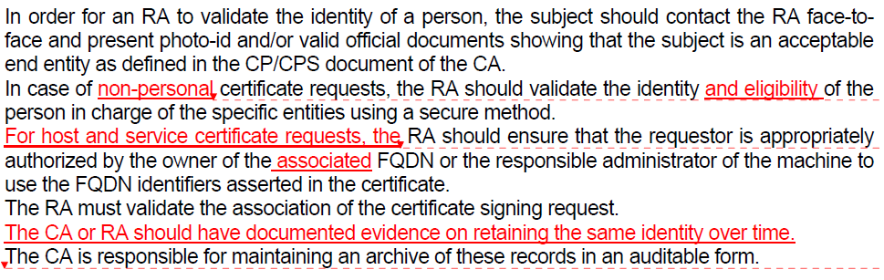
Identity vetting rules
Updates to better reflect
existence of robot certificates
And put down the (formerly implicit) documentation expectation on identity

Slide 4
Wording improvements on CA/RA
New wording to accommodate CP/CPS-es with a secure but novel method for securing CA-RA communications
Updates on the rekeying and renewal section
  Better wording and expression of intent

Slide 5
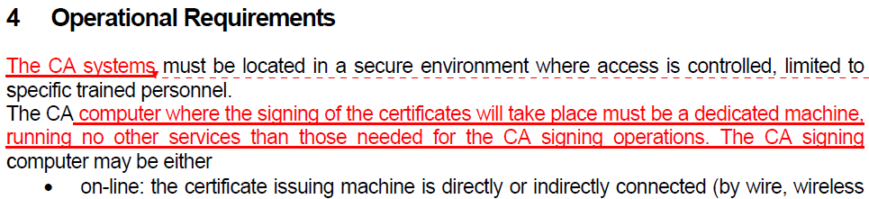
The CA issuing system
Improved wording on issuing system

Slide 6
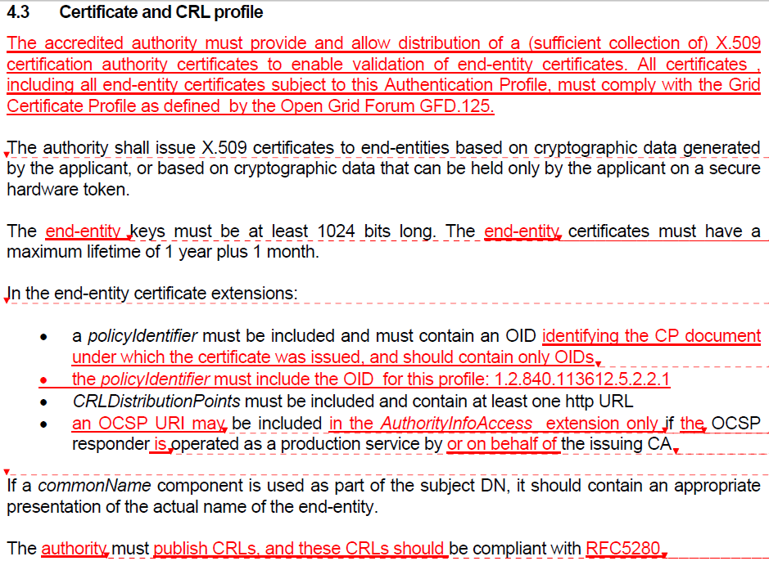
Certificate Profile – GFD.125 cleanup
Cleanup after accepting GFD.125

Slide 7
Certificate Profile - OIDs
New text makes it explicit that the
OID of the profile MUST be included
in the certificates issued under this profile
Also, add relevant 1SCP OID
This will enable relying parties to make judgements based on the OIDs
… and will get us out of the chicken-and-egg mess

Slide 8
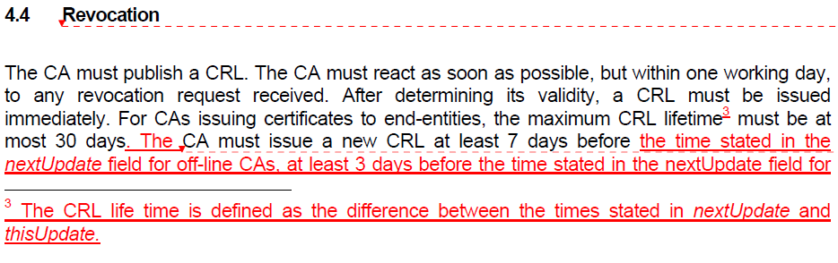
Revocation
Accommodate on-line CAs that can auto-reissue a CRL frequently, and make up for too-short CRLs

Slide 9
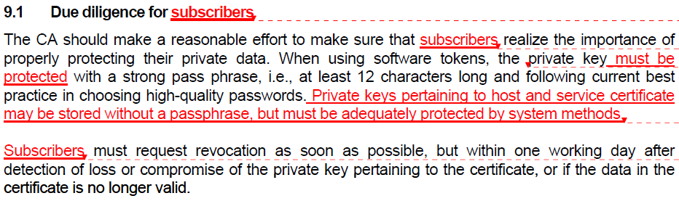
Subscriber due diligence
Improved wording

Slide 10
Implementation
EUGridPMA has standing guidelines to
implement changes in the profile within 6 mo
Can you live with them?
We’re still short of the associated 1SCPs
  Entity descriptions (person, robot, host/service)
  Private key protection other than secure token
  Robot Certificate profile set

