Slide 1
CVE-2008-0166, lessons learned and actions
David Groep, Nov 7nd, 2008

Slide 2
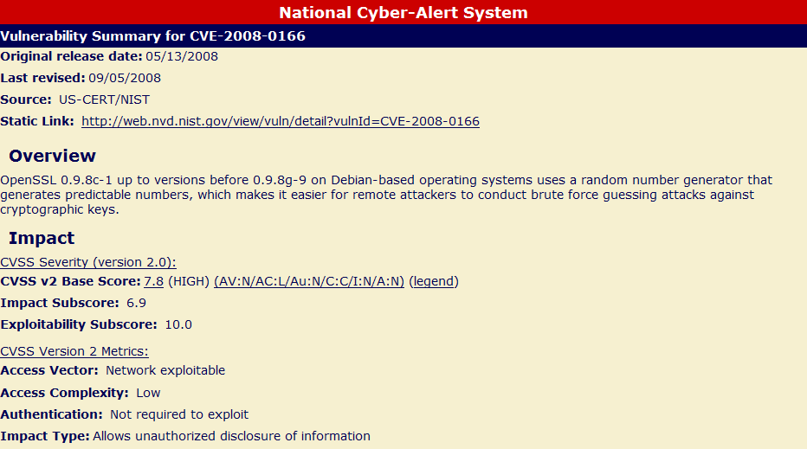
CVE-2008-0166

Slide 3
Approx time line
Released: Tue, May 13
  (CVE number reserved: Jan 15, 2008!)
  Picked up by Roberto Cecchini same day
Tue May 13
  ‘informal’ request for assessment sent to PMA members
  several CAs start revoking affected end-entity certs
Wed May 14
  Bulk checking tool distributed to the PMA lists
  PMA itself checked IGTF distribution
  Affected CA root certs identified and re-generated
Fri May 16
  Updates IGTF distribution with updated CA
  Release coordinated with OSCT EGEE/LCG public advisory
  Still limited (~50%) CA response on affected EE certs

Slide 4
The week after
Mon, May 19
  31 responses received and appropriate action taken
  Still 10 CAs did not respond at all
Tue, May 20
  Sent ‘final’ warning to personal addresses
  End of day: 36 responses received, 4 pending
  One pleaded extension of checking till Friday …
Wed, May 21
  For those CAs that have a EE list retrievable, did checking myself
  For selected CAs, bypassed CA and contact Ees
  Publication of list of keypairs escalates the issue
Thu, May 22 – …

Slide 5
What did we learn?
Requests for action from PMA should be univocal and clear in what action is required
CA contact addresses are ill-watched
  And people behind the addresses are not always the same people as those technically operating the CA
  Response can take N mails and still wait for a week
  Response to all mails is even more important than action
The RPs need an IGTF-wide response
CA suspension can be done
  But is very upsetting and must never be done lightly
  And needs couple of key people to share responsibility
The PMA structure was not ROBAB proof

Slide 6
Implemented structure and process
For public vulnerabilities only
  Communicate to relying parties that the PMA is aware
  Publish this statement on-line and send to the PMA announce list(s) - with URL for updated information
A IGTF wide Risk Assessment Team assesses issue
  Jim Basney, Jens Jensen, Willy Weisz, Yoshio Tanaka, Jinny Chien, David Groep, Vinod Rebello
  (igtf-rat@eugridpma.org)
  Define expected time for responses from Cas
  Interacts with RAT and CSIRT teams from RPs

Slide 7
Response
Send query to all CAs
  Initial address taken from .info file
  Signed email, but not encrypted
  Define expected response
  For urgent issues, use per-CA escalation procedure
CA response
  All Cas are expected to send an ACK next business day
  Full response before RAT-established dead line
  CAs can of course ask for extension
  but need to keep responding to RAT requests any time!
Escalation
  per-PMA core team (for EUGridPMA: DaveK, UrsulaE, Jan Jona J, DavidG) agrees what happens in case of serious malfunction – if rapid action is indeed needed

Slide 8
CA actions requested
Respond to all RAT emails!
  Check that email address in your meta-data is OK
  And there is somebody watching
Deposit your escalation procedure
  For example: do you want the RAT to phone you?
  1: send email to this personal address
  if no response: 2: call me at the office on number XX
  if no response: 3: call me at home on number YY
  if no response: 4: call ZZ at number AA
  This information is kept private and encrypted by the RAT members (incl. the PMA chairs)
  And never used otherwise…
Act within the RAT time line

Slide 9
ROBAB
PMA operations were too concentrated
  Shared control passwords to more people
  For EUGridPMA also AndersW can now do everything
    web sites hosting machine access
    domain name management (.org+.info)
    email forwarding configuration
    CVS management
  Enable all chairs to sign the IGTF distribution with the SAME key
    Securely distributed to MikeH, YoshioT, AndersW
  Replication of key web sites
  (already did that for the IGTF distribution itself)

Slide 10
RAT
See Jim’s presentation …

