Slide 1
CS lab: a fieldlab for fieldlabs The DACS FSE Computing Sciences Lab as a Fieldlab Demonstrator
Concepts, capabilities, connections
David Groep,
January 2025

Slide 2
‘Wereldwijd verbonden vanuit stevige basis in Euregio’
Research and education are inherently collaborative, and ‘services exist’ and are being used .. whether we know about them or not:
European Open Science Cloud, ‘ESFRI’ research infrastructures, Erasmus Without Papers, EU Identity Wallets, SURF-NWO Rekentijd & Snellius, EOSC EU Node ‘free VMs for all faculty’
Images: UM Strategic Programme 2022-2026, SURF ETP slide captures: www.nikhef.nl/~davidg/p/ for UM-CI office & LsIT course

Slide 3
Translating ‘wereldwijd verbonden’ education & research as a technical systems and network design
‘we can use existing services from outside’: AAI interoperability, network connectivity and bandwidth, and devolution of concerns and work to research infrastructures (ESFRI&GWI)
‘we can contribute in collaborations in education and research’: we can offer services, support pan-European student mobility in our programme, and provide innovative lab environments that attract students and make our programmes unique
‘we teach and train our students to understand, design, build, study, work with, and experiment with interconnected services and systems that are globally connected’
Of course we should do that in a safe, scalable, and transparent way, and at the same time build and use our own science and engineering R&E concepts in an agile way
With a view towards the future … a decadal vision of common reference platform model, usable for DACS & FSE, GWFP/LHCb, ET, … for FASTER 4D-imaging, … for other faculties and UM-wide?

Slide 4
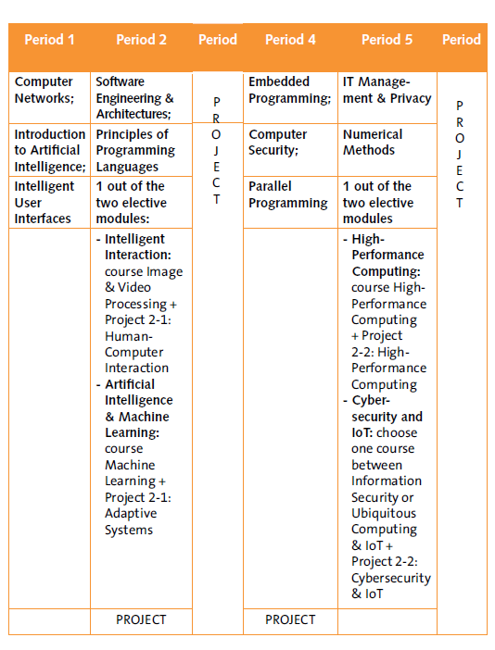
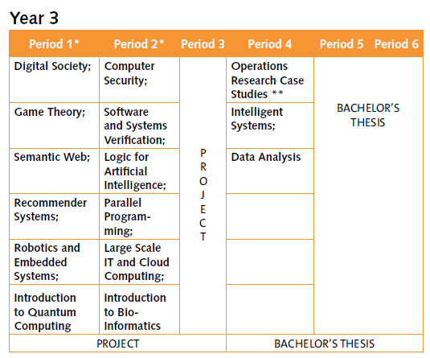
Why the CS lab?
Initially triggered by ‘basic’ short-term needs
new Bachelor Computer Science, with strong engineering component (esp. in Y2 & Y3)
Large-scale IT and robotics, also in DSAI Year-3
But with wide use for {master, PhD} thesis work and cross-discipline and cross-organisation research as well:
HPC simulation and modelling , ML models, LLM applications, and collaborating with research output ‘as a service’
science and engineering beyond DACS: ET pathfinder & LHCb for GWFP, the MSP programme, …
data science in other faculties: need for ‘student sandboxes’
large multi-modal 4D imaging (e.g. for NWO ENW XL FASTER with Ron Heeren), and EU Horizon and Euregio collaborations
https://curriculum.maastrichtuniversity.nl/sites/default/files/dacs_-_study_guide_2024-2025.pdf

Slide 5
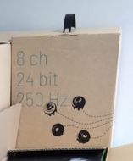
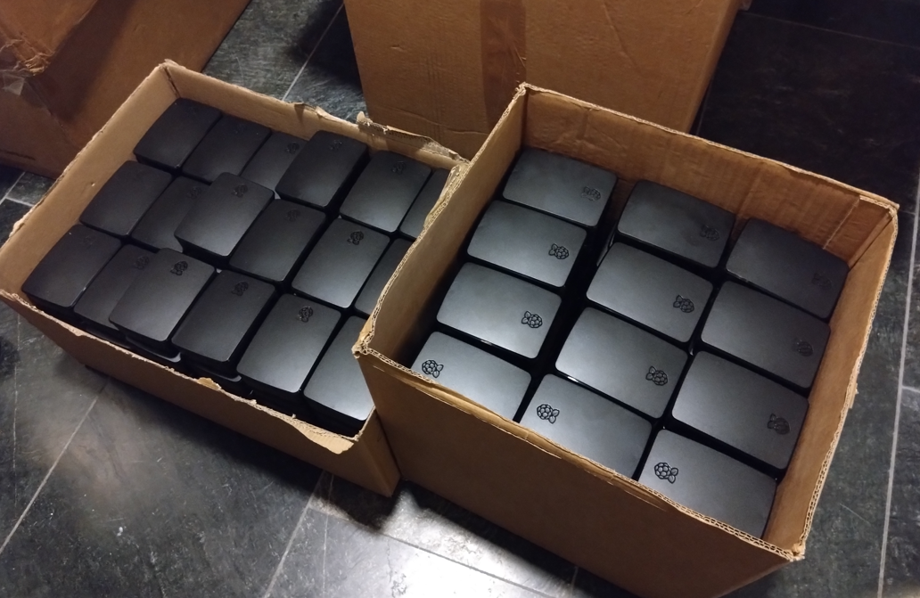
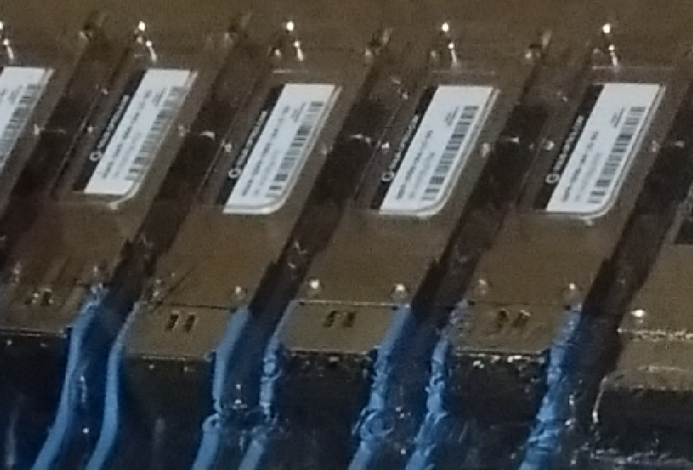
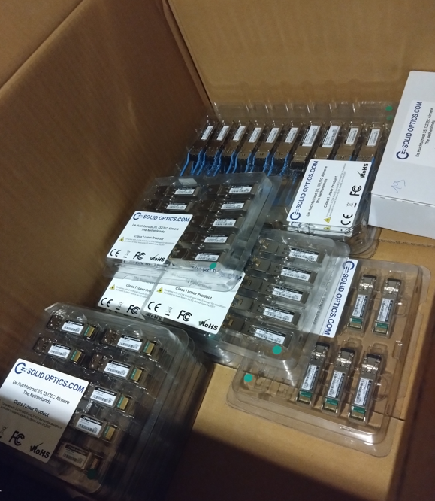
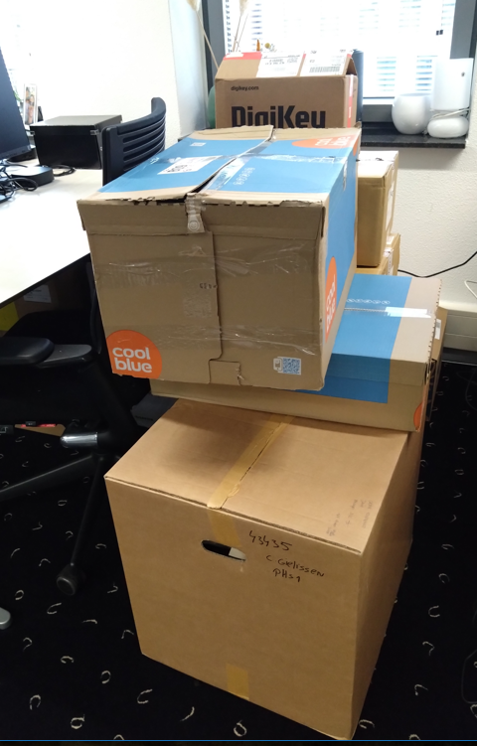
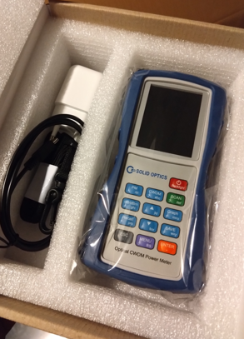
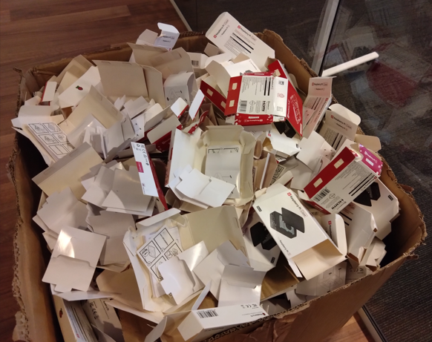
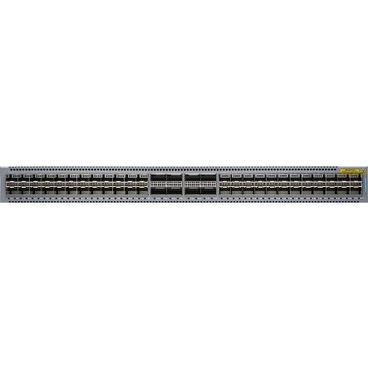
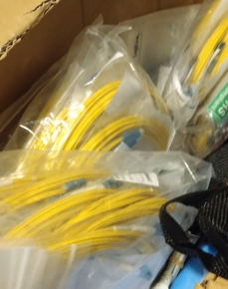
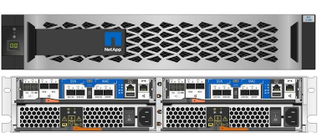
Suddenly … CSlab
And then there was Sectorplan 1 … whose funds needed to be spent in 2024

Slide 6
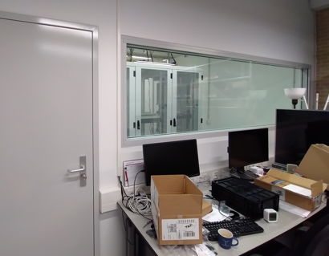
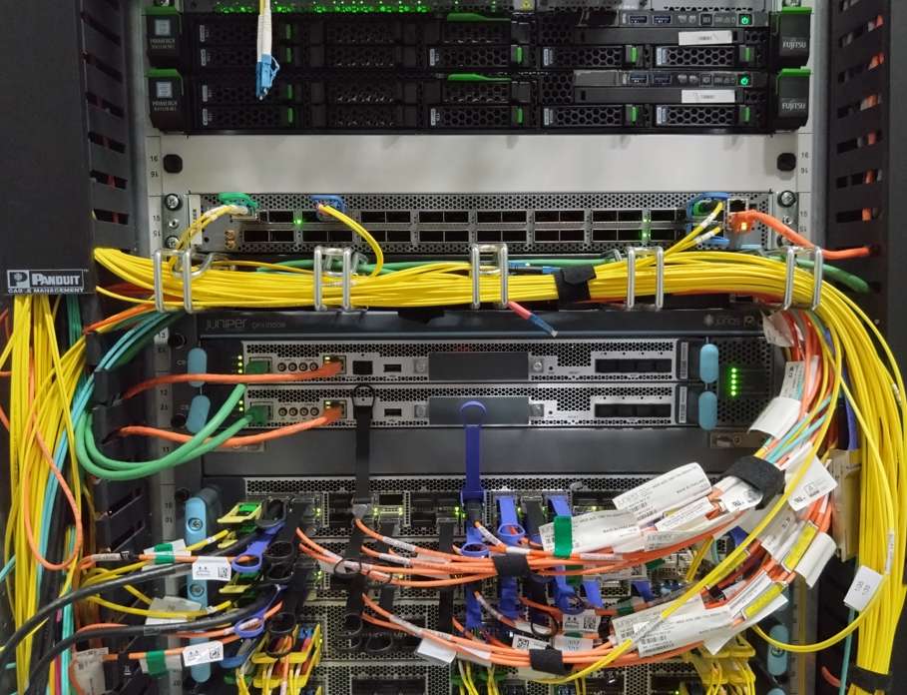
Technical inspiration
DACS CS-Lab concept for today focusses on systems, networks, and course/project labs
those act a foundation for more specific lab settings: robotics, XR, security
focus on education labs, but equally applicable to research networks
design around micro-segmented networks and inter-subnet controls
so you could build multiple labs on a partly-shared infrastructure
leveraging the ESnet (US DoE) ‘ScienceDMZ’ concept, and
the UvA Security and Network Engineering master lab ( ‘every student a machine on the public internet and they are entirely responsible for this box’)
with inspiration from SURF Experimental Technologies Platform and Nikhef open innovation lab
for CS and engineering education (extensible to research), and not targeting enterprise services, nor for now sensitive data services

Slide 7
‘ScienceDMZ’
Predicable performance and data access for research
‘where research services, data, and researchers meet’
lossless transfers and latency hiding
elements horizontally scalable
security zoning/segmentation protects services and data
outside enterprise perimeter
for a different type of traffic: science data transfers rather than eyeball networks
Image and ‘ScienceDMZ’ concept promulgated by ESnet (see fasterdata.es.net), Eli Dart

Slide 8
From Eli Dart (ESnet), “The Strategic Future of the Science DMZ”, TNC23, https://indico.geant.org/event/2/contributions/186/attachments/168/

Slide 9
Eli Dart, The Science DMZ Design Pattern, NASA talk, https://edu.nl/a7efv

Slide 10
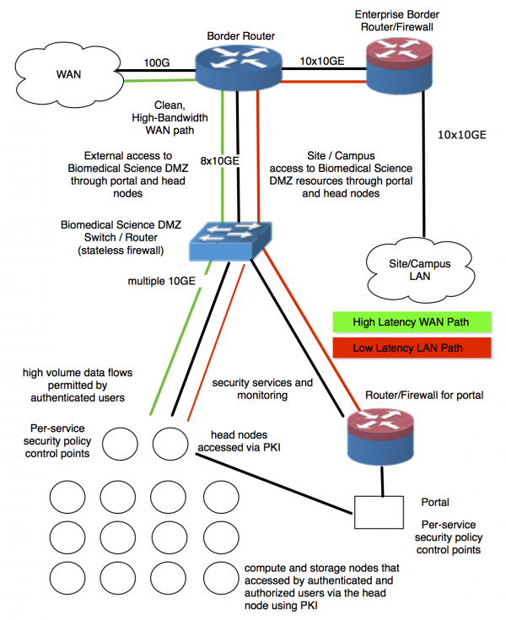
Labs as a design pattern …
See https://doi.org/10.3233/SPR-140382 and Eli Dart’s NASA talk: https://edu.nl/a7efv for a quick read or glance
Right: components in a medical sciences DMZ from https://crd.lbl.gov/news-and-publications/news/2017/esnets-science-dmz-design-could-help-transfer-protect-medical-research-data/

Slide 11
And once you have multiple FieldLabs
Slides: Eli Dart, ESnet (2017) https://smd-prod.s3.amazonaws.com/science-red/s3fs-public/atoms/files/3-2-Science%20DMZ%20Design%20Pattern%20-%20ESNet%20-%20Eli%20Dart.pdf

Slide 12
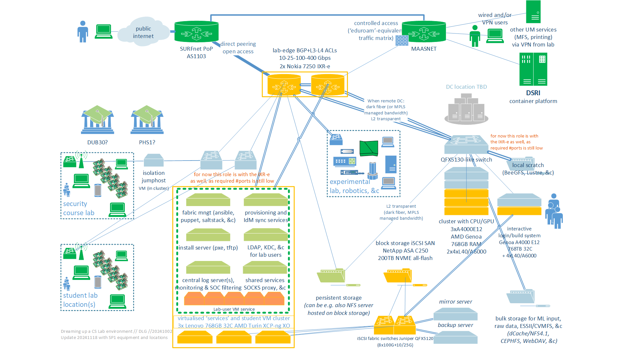
Dreaming up a CS lab environment in a ScienceDMZ
SOLL and IST (yellow, green) state of the CSlab foundation

Slide 13
CS Lab – the 2024 foundation (20 December 2024)
Virtualised base infrastructure: fabric management, logging, IAM bridging (to SURF SRAM or locally with a SAML SP), proxy and gateway services for sub-labs, ~300+ student sandbox VMs, XCP-ng & XenOrchestra managed with SAML or OIDC auth
3x SR635v3 (each: 786GB RAM, 2x25G data network, 2x25G iSCSI, 64 logical cores 9355P)
Storage back-end service: block storage for VMs (supporting NFSv4 via VM with linux)
NetApp C250 with 200 TByte net NVME all-flash capacity, 4x100G iSCSI
HPC starter cluster: AI/ML courses, reasoning, HPC modelling, interactive & batch
4x ASUS ESC4000A (each: 3.25GHz 64 logical core EPYC 9355P, 768 GB RAM, 2x16TB NVME, 2x25G data network), 3 of these systems have 4 Nvidia L40 GPUs each (so 12 GPUs in total)
one node as the ‘interactive’ validation and compilation node (scheduling will be in a VM)
Network: access gateway for standard edge connectivity (BGP, MPLS, 802.1q, EVPN, L3/L4 ingress and egress ACLs and policers) and iSCSI SAN fabric switches (25/100G)
pair of Nokia 7250 IXR-e, each: 2xQSFP28 100G, 8xSFP28 25G, 24xSFP+ 10G (or 1G)
pair of Juniper QFX 5120’s, each: 8xQSFP28 100G, 28xSFP28 25/10/1G

Slide 14
A lab for fieldlabs
It is also a technology lab & computing sciences engineering innovation lab
networking from commonly used protocols like evpn-vpls/mpls to high-speed udp science data transport or alternative tcp stacks, or segment routing and connecting to LHCone at 400Gbps to 1.6Tbps?
storage, compute, acceleration, cluster computing, virtualisation, orchestration, automation, AuthN & AuthZ infrastructures and IAM, …
power usage, application efficiency, divergence of 2019/424 to actual usage?
‘Lab’ aspect need not to stop at layer-7
ITSRM, SMS & FitSM/ISO20k/ITIL, … to federated services and Tier-2/1/0 scaleout
red-teaming in resilience exercises with SURF/NMDDoS – or for ourselves?

Slide 15
A collaborative demonstrator
The Fieldlab & ScienceDMZ concepts are readily generalizable
both a technology lab (networking, computing, storage, IoT, security)
as well as a infrastructure and systems lab for SMS and ITSRM concepts
So let’s try and use this for an integrated approach already now for the CSLab
linked to current and evolving ICT at UM as a whole
ITSRM for the CSLab in line with UM IT security risk management e.g. Lab ISO27k5 ITSRM doc leverages and supports the UM risk assessment
look at this also as a playground for new IT service mngt ideas and experiments – this is a ‘harmless’ lab with forgiving users and local flexibility ☺

Slide 16
The most important ingredients …
Creativity
Flexibility
Desire to experiment
CSLab equipment and configuration is a usual high availability design, but
can, may, and should be used for experiments – it is not our national critical infra ☺
a common playground for students, researchers, and ICT engineers
diversity in equipment, components, client devices, IoT stuff, and tools is intentional for experimentation
overprovisioning is intentional, as lab can consolidate ‘loose’ things and ‘lone’ systems
Other labs may have a different scope and purpose, but all share the top-3 elements …

Slide 17
Collaboration … because it’s absolutely needed
Although FSE will take care of hardware, systems management, networking, &c, in our interactions with ‘the world’, UM must appear as a coherent whole
interaction with SURF on connectivity, Internet number resources, SURF Access even though FSE DACS can initiate and prepare SURF staff for the requests, SURF really wants these to come from our institutional contact persons
incident response coordination & Sirtfi
network transport across campus building locations
housing and secured access, power and PDUs, compliance BaL 3.7.3 & 5.4.1 (5.4.1a)

Slide 18
Collaboration … because it’s just better together
Identity and Access Management, for linking lab services to UM identity & eduGAIN an experiment: CSLab end-users shall not have any lab-specific re-usable credentials, use only SAML, OIDC, or Wallet VCs to authenticate, or ssh pubkeys for login/access
release of attributes and provisioning interfaces for some lab services like: which students are in which course, and hence need to be granted access to which parts of the lab?
prevent duplication of SMS support that the CSLab needs but can be usefully shared
Can we re-use elements, structure, and templates of an SMS that is already in place?
If need to construct (part of) our own SMS (which takes time) can we do it such that it is generally useful?

Slide 19
Collaboration … because we’re all human
coordinating shared data center facilities
alignment on identifiers because it prevents confusion in human communication and for systems communications as well in some cases…
joint access to documentation and SMS information
process for Q’s sent by accident to central helpdesk that should have gone to the lab?
mechanism for periodic technical meetings & chat, since working together is nice, … and because we all forget to ask for the right stuff sometimes!

Slide 20
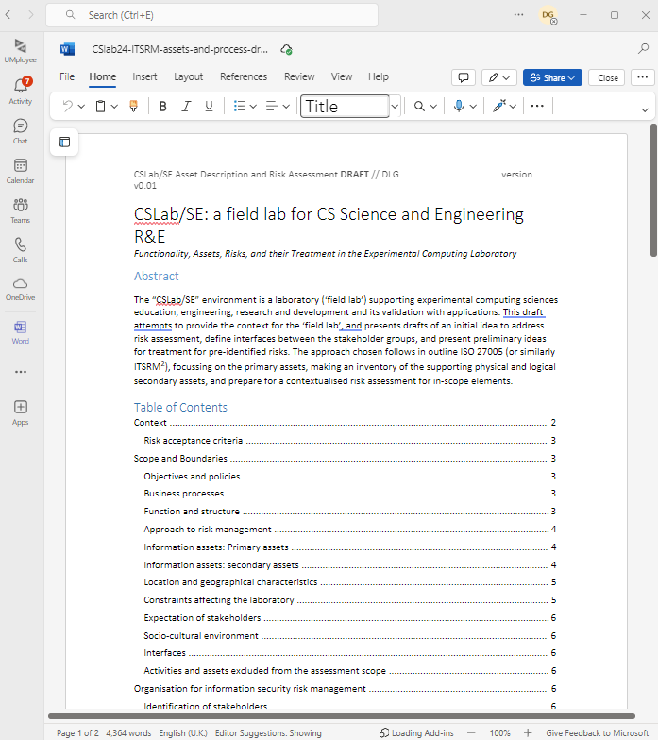
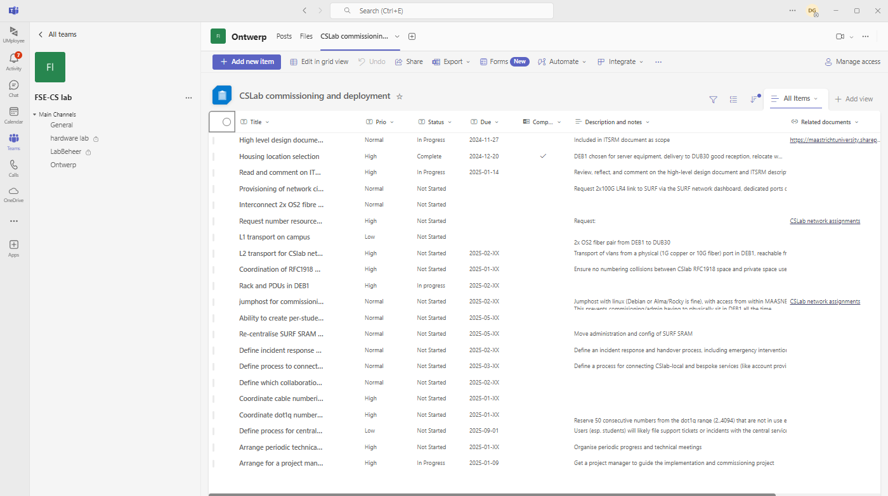
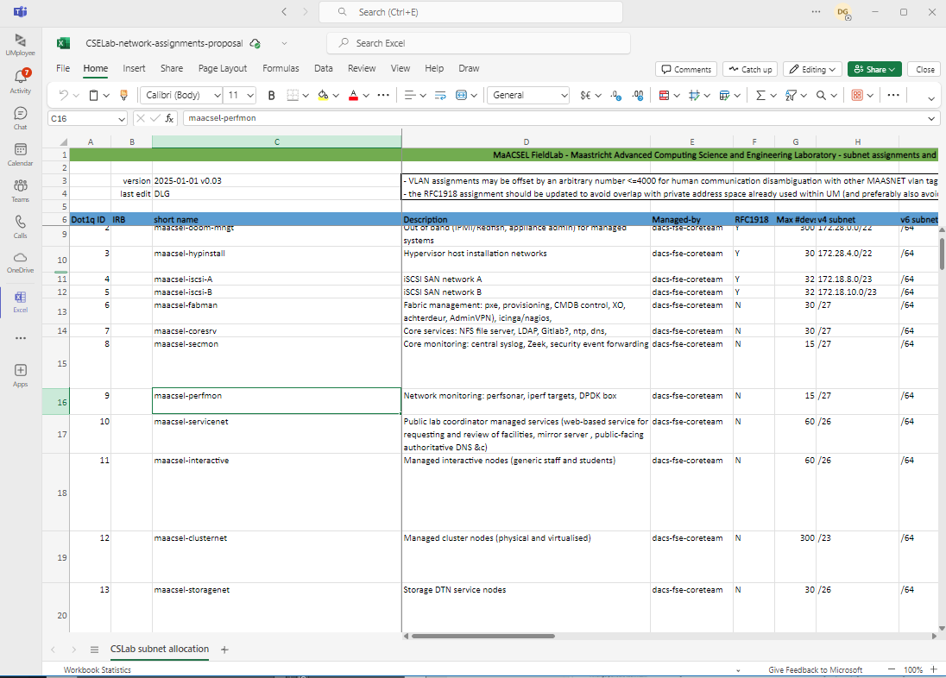
Collaboration - practically

Slide 21
More discussion time …

Slide 22
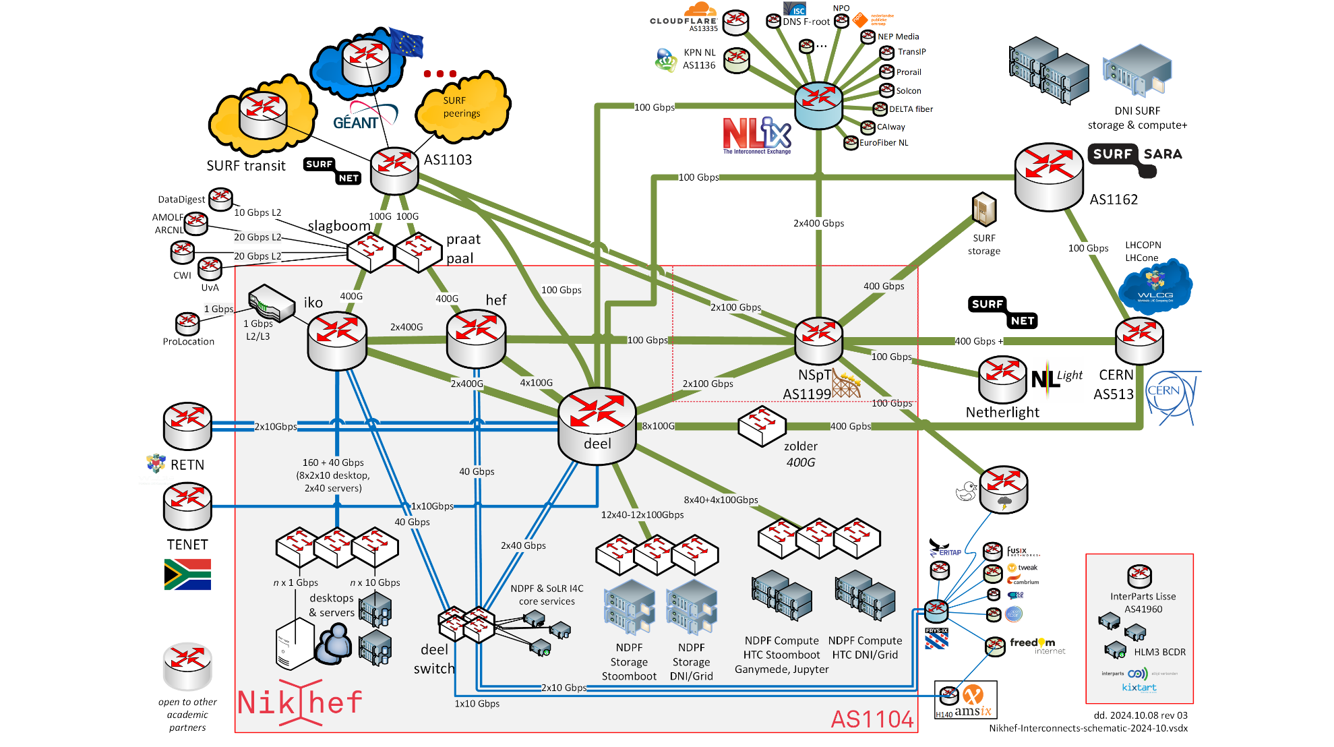
AS1104
a pretty standard research lab network
https://www.nikhef.nl/pdp/doc/facility

Slide 23
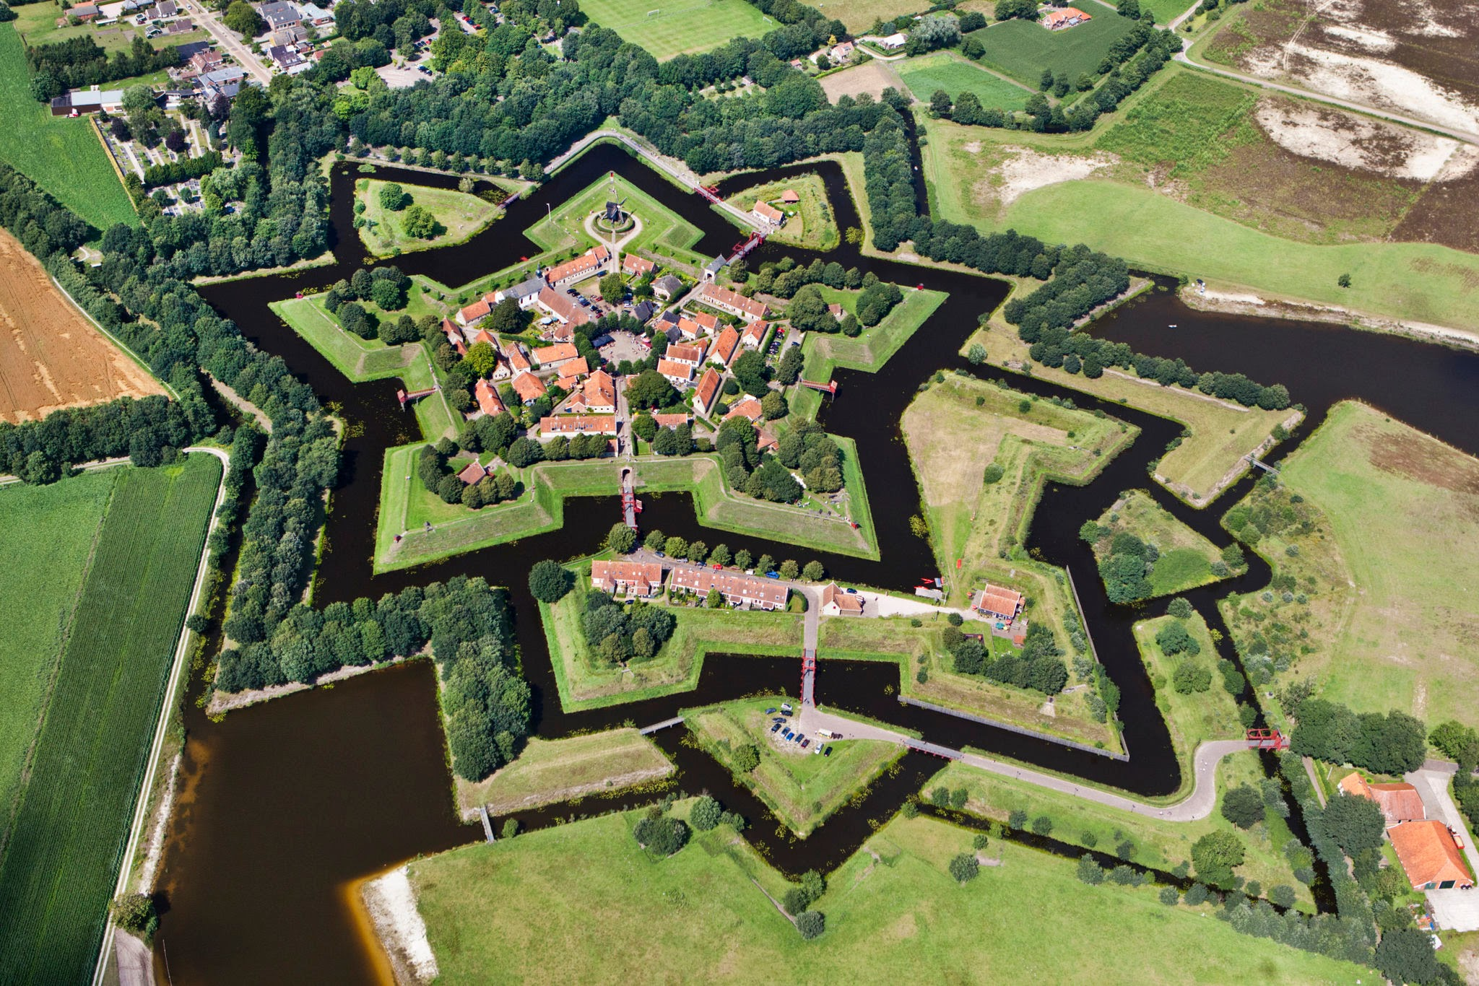
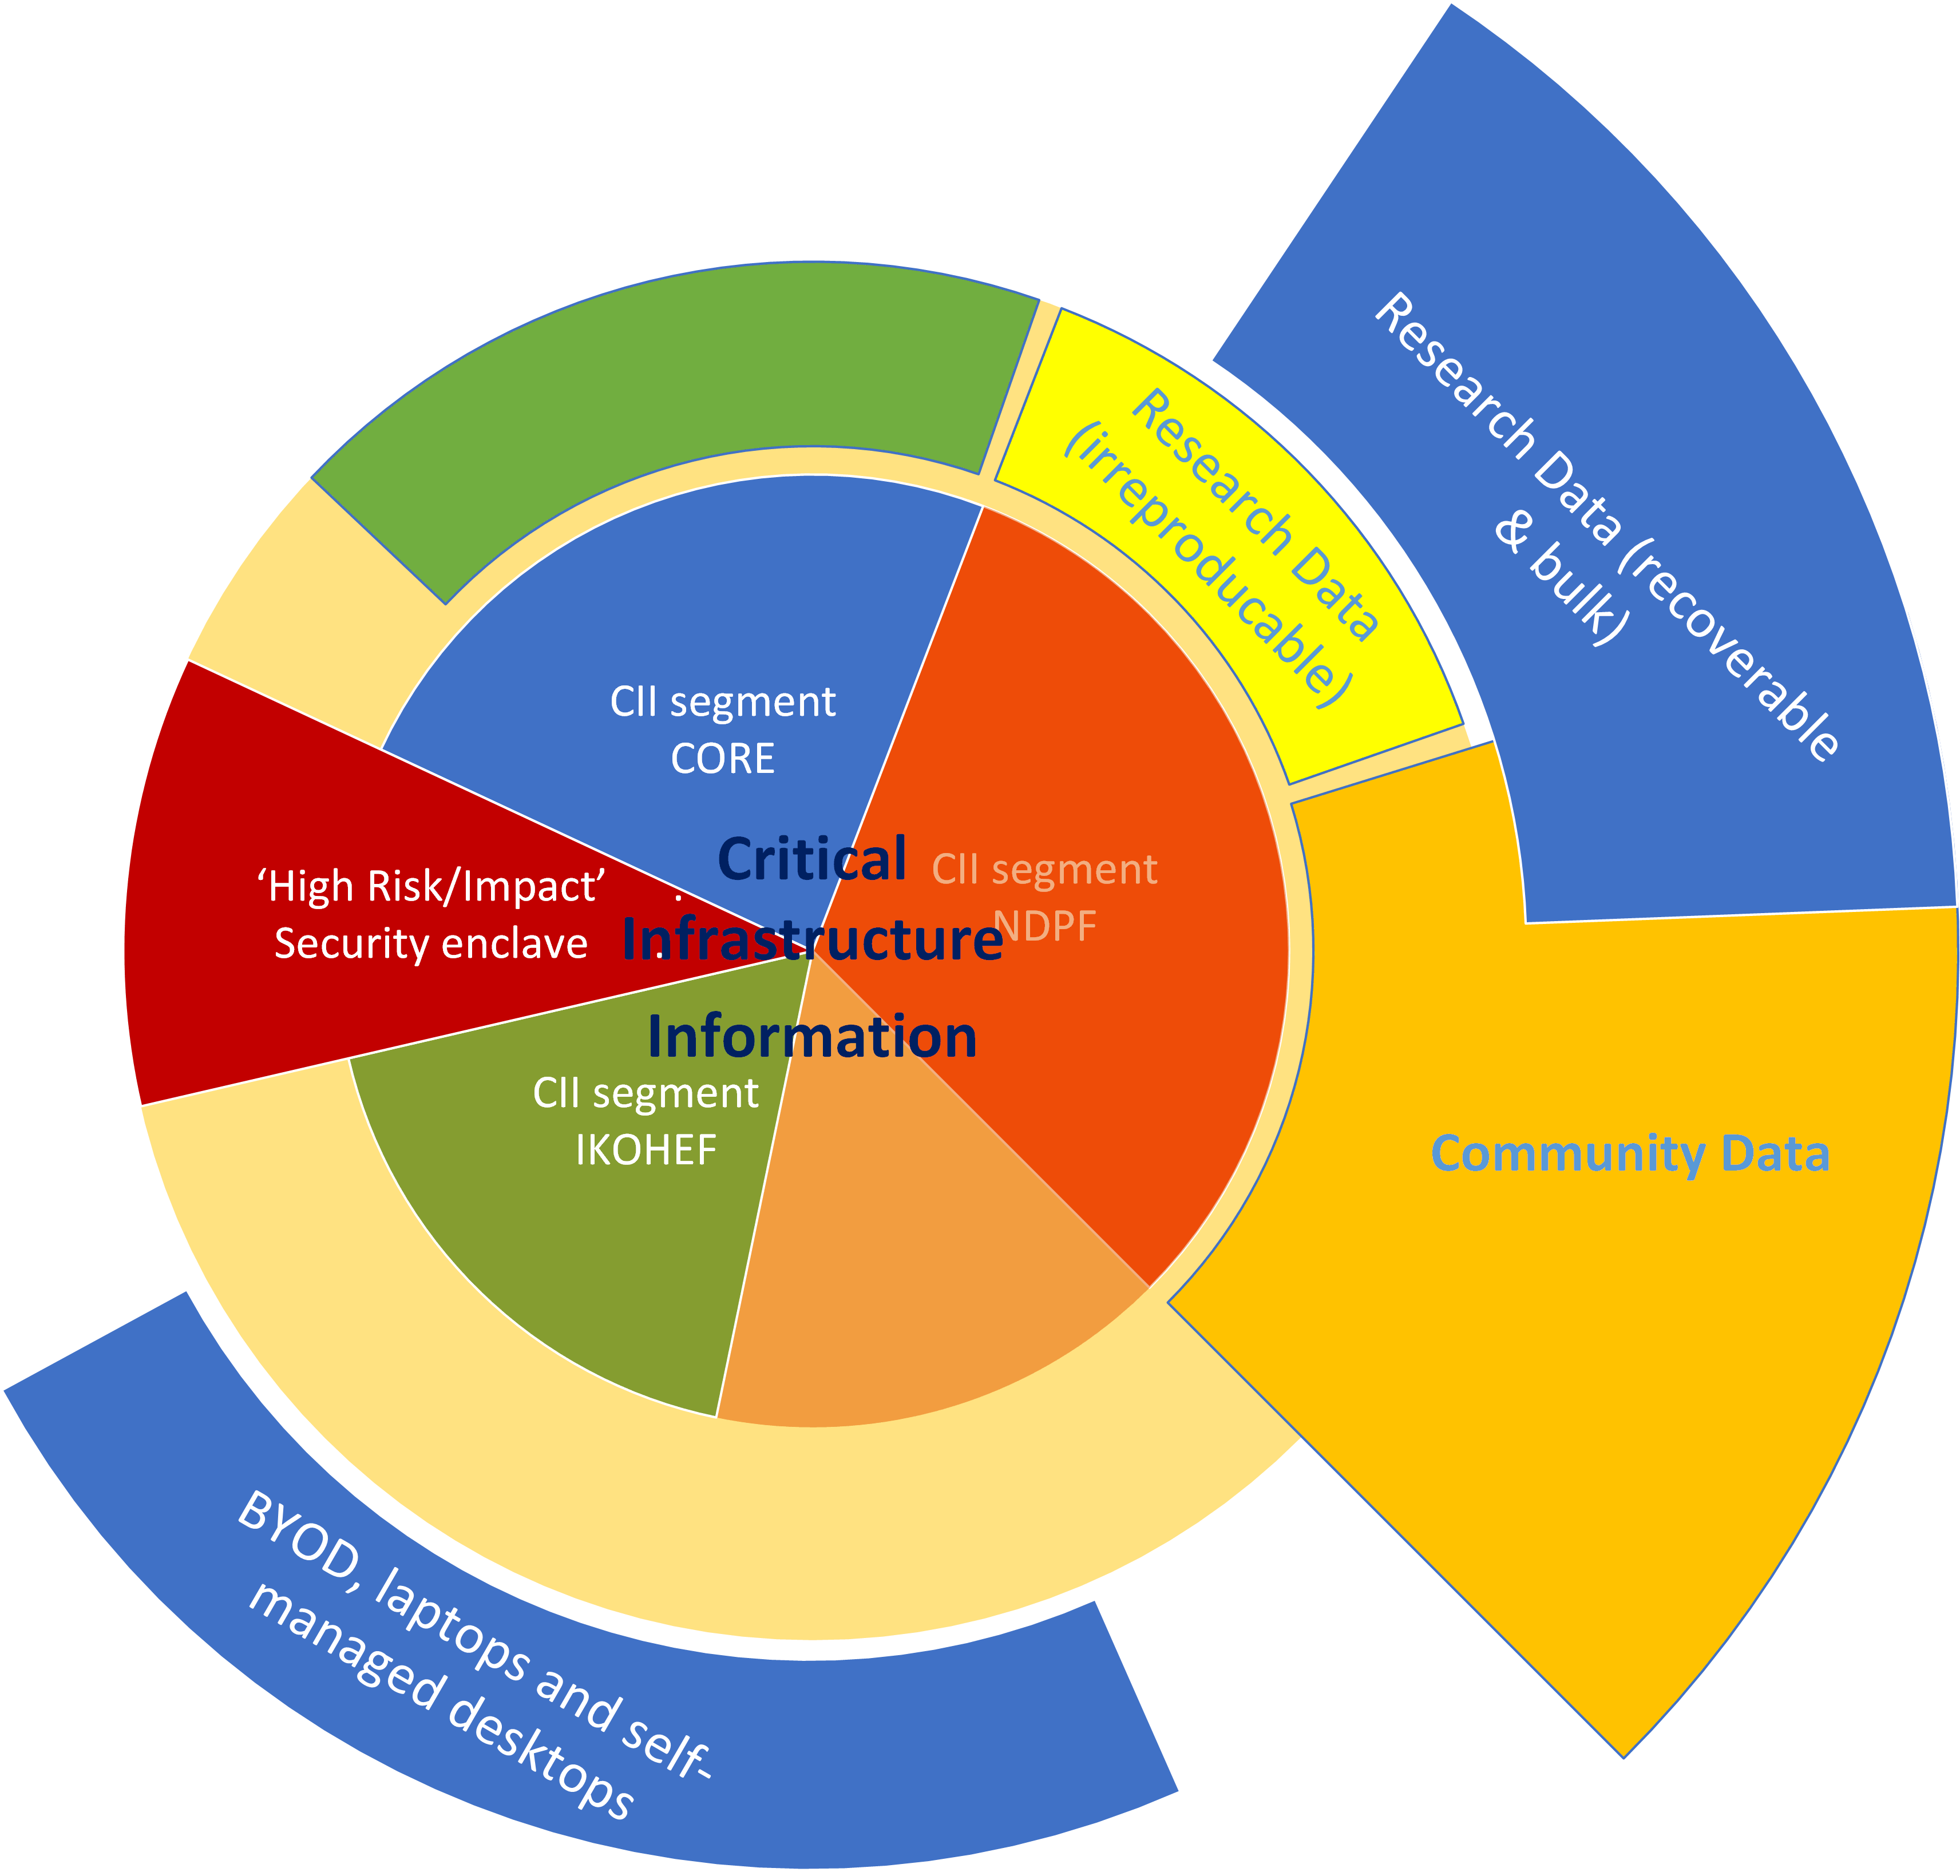
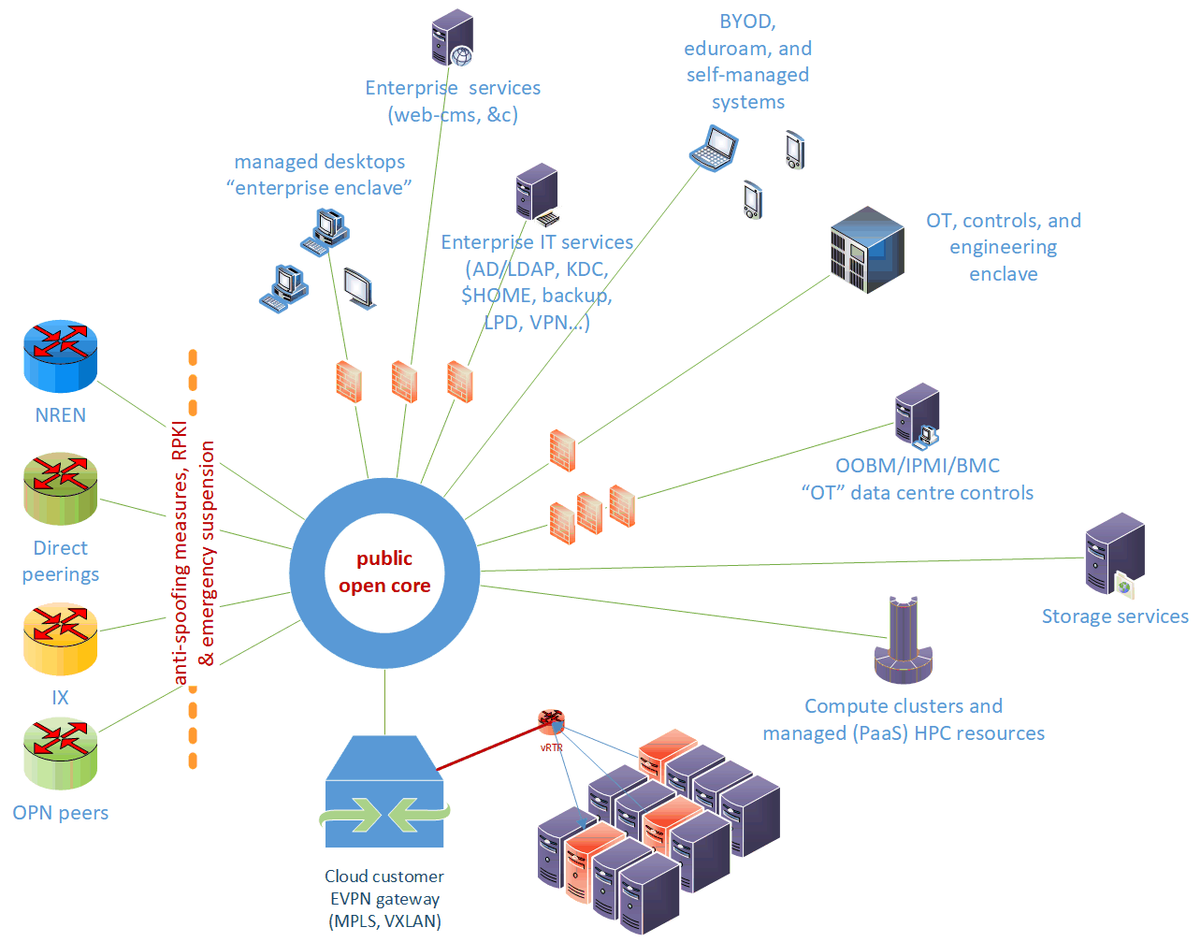
Network structure design: logical and topological view segmentation: a research network with office enclaves
achtergrondbeeld: Vesting Bourtange

Slide 24
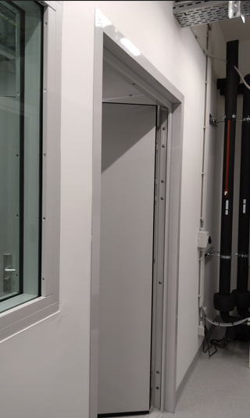
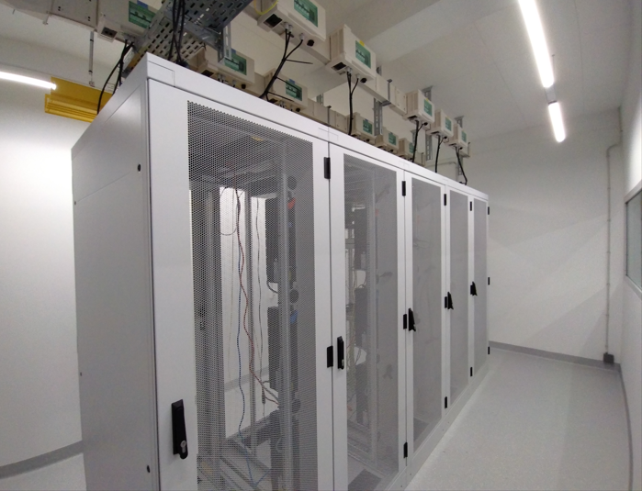
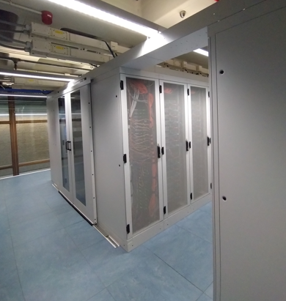
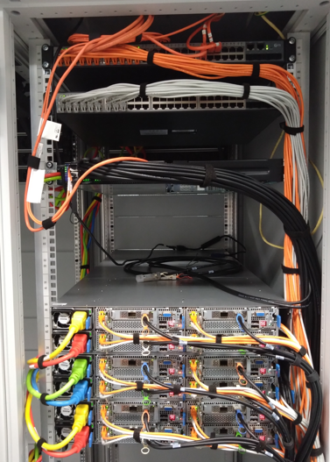
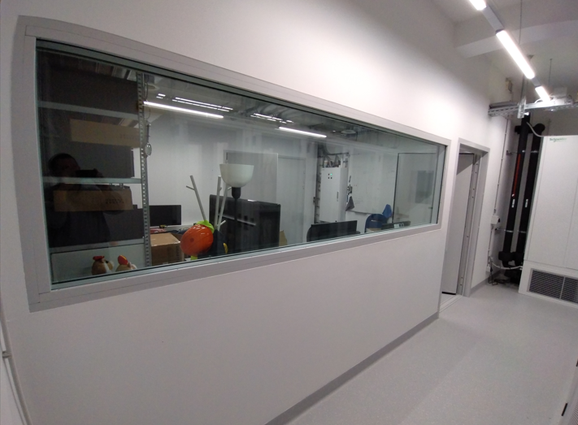
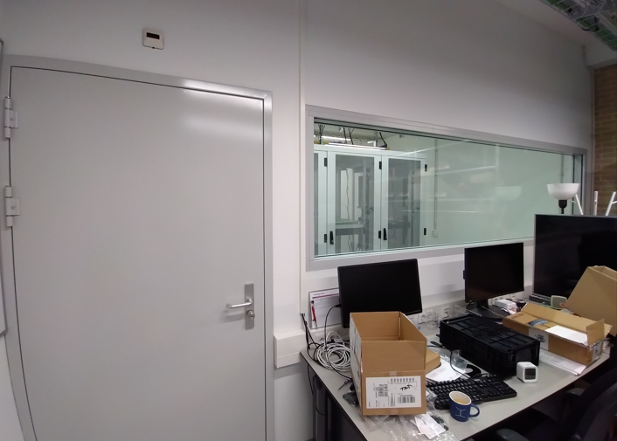
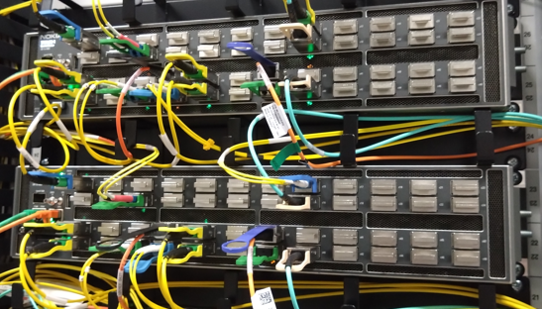
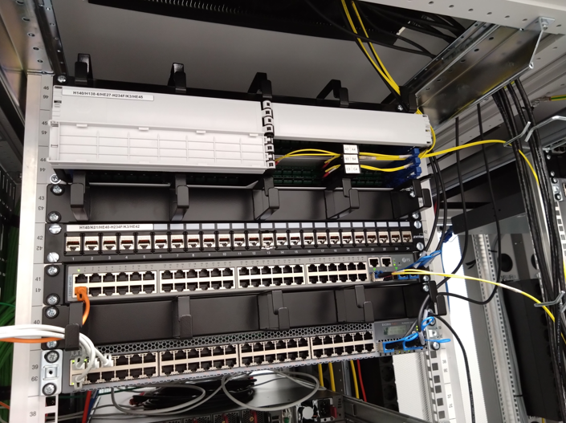
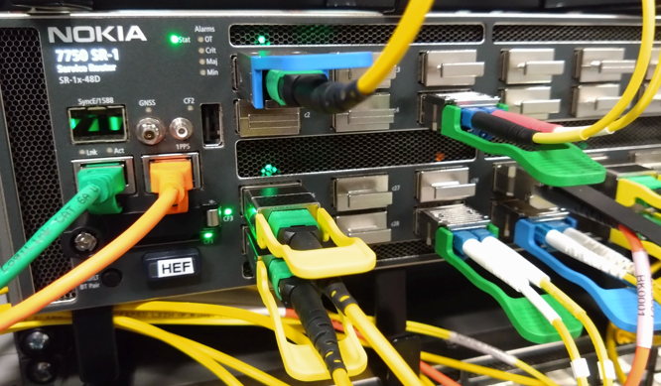
Labs and more labs!
Nikhef SP105: H234b (L) and H234f (R)

Slide 25
Subset of Eli Dart’s ScienceDMZ slides
Eli Dart’s NASA talk (2016): https://edu.nl/a7efv
See also https://doi.org/10.3233/SPR-140382

