Slide 1
Building highly-available stateful services using IP anycast
RCauth.eu at Nikhef, GRNET, and STFC
David Groep
Dennis van Dok
October 2022

Slide 2
Why go here?
Creating a PKIX credential translation service for the AARC BPA
with high-availability, scalability, and pan-European redundancy
“provide a highly-available credential bridging services (RCauth.eu)”
And at the same time
demonstrate that also stateful services can be effectively anycasted
find minimum viable anycast environment still having global properties
provide a reference HA architecture for EOSC core services
dispel arguments that building IP anycasted services is complex

Slide 3
The RCauth.eu service

Slide 4
AAI evolution of Research and e-Infrastructures
Most infrastructures move to community proxies, with credential translation
  less credentials to manage, appearing ‘simpler’ to the user
  support both augmenting attributes as well as credential translation
but since non-web access remains challenging for ‘SAML’ federations
  SAML->OIDC, SAML->X509, X509->OIDC, X509->SAML, OIDC->X509, …
  does not require major technical changes in existing R&E federations
  allows community-centric identifiers

Slide 5
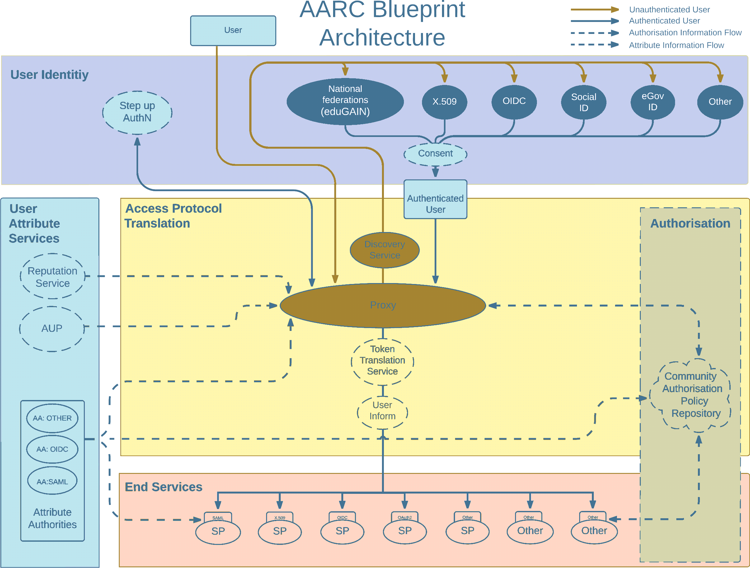
AARC Blueprint Architecture
AARC-G045 – https://aarc-community.org/guidelines/aarc-g045/

Slide 6

One element: RCauth.eu – a ubiquitous federated IOTA CA
Credential translation from (SAML) federation to X.509
IGTF accredited IOTA (DOGWOOD class) CA
  online credential conversion based on basic assurance
  connected to eduGAIN (R&S+Sirtfi) plus direct,
  e.g. EGI Check-in and eduTEAMS
  support credential management systems for portals (MasterPortal)
Inspired by and leveraging the delegation service from CILogon
For CILogon, Jim Basney et al, NCSA/UIUC for NFS – see https://cilogon.org/

Slide 7
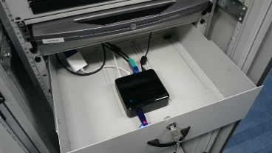
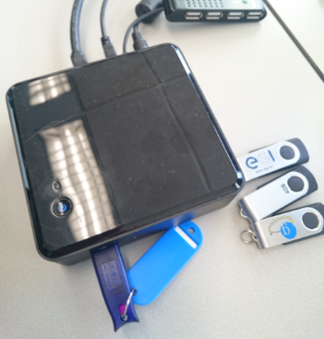
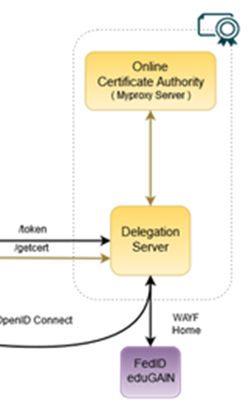
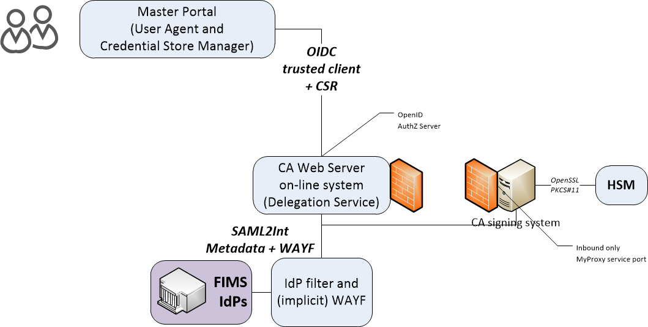

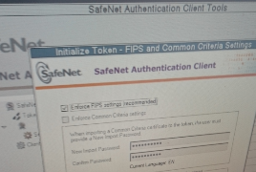
Building the first RCauth – at a single site
well protected, but at a single site
subject to failure (e.g. natural disasters)

Slide 8
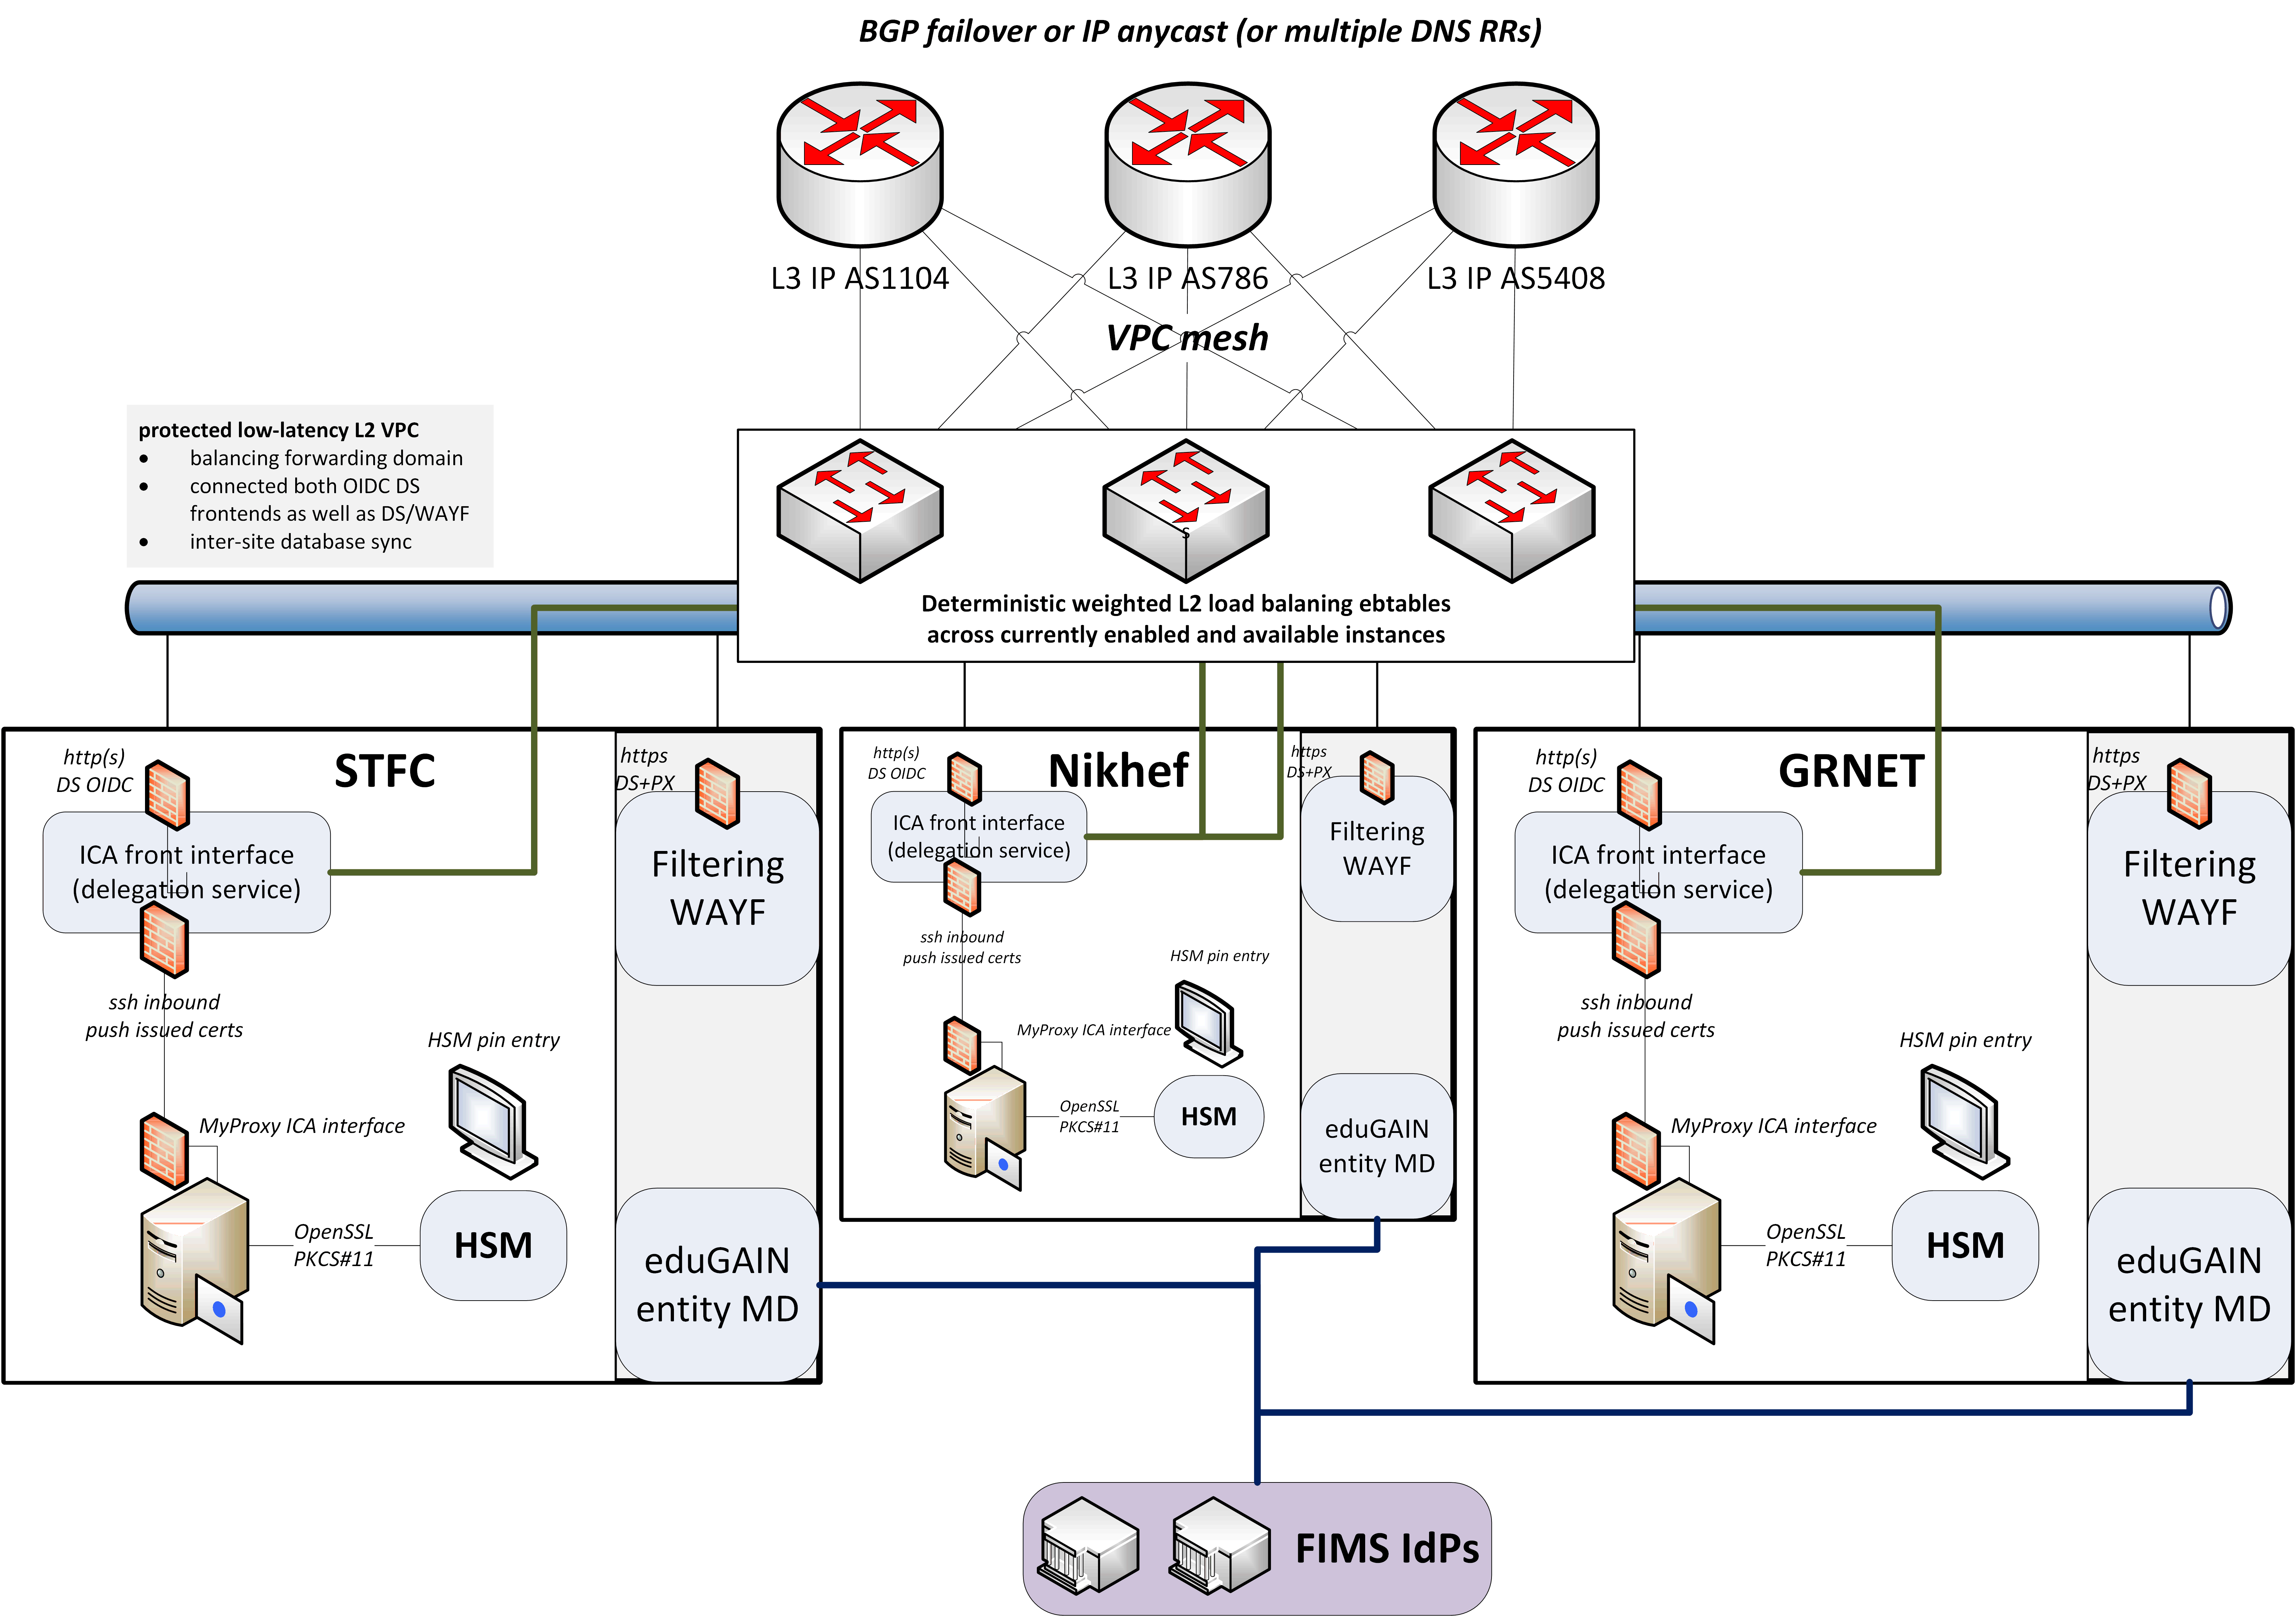
Since we do not like SPOFs …
Implement a High Availability setup across 3 sites
Supported by EOSC Hub and EOSC Future

Slide 9
towards a pan-European distributed service

Slide 10
Distributed RCauth service
HA proxy
DS
DB
VPN
client
VPN server
STFC
GRNET
Nikhef
HA proxy
DS
DB
VPN client
VPN server
HA proxy
DS
DB
VPN client
VPN server
selected imagery: Mischa Sallé, Jens Jensen, Nicolas Liampotis

Slide 11
A transparent multi-site setup?
HA proxy
HA proxy
Need a way to send users to “closest” working service
Each HA proxy forward mainly to its own DS
If a HA loses its backend DS, it can still route to the other DS’es
HA proxy
selected imagery: Mischa Sallé, Jens Jensen, Nicolas Liampotis

Slide 12
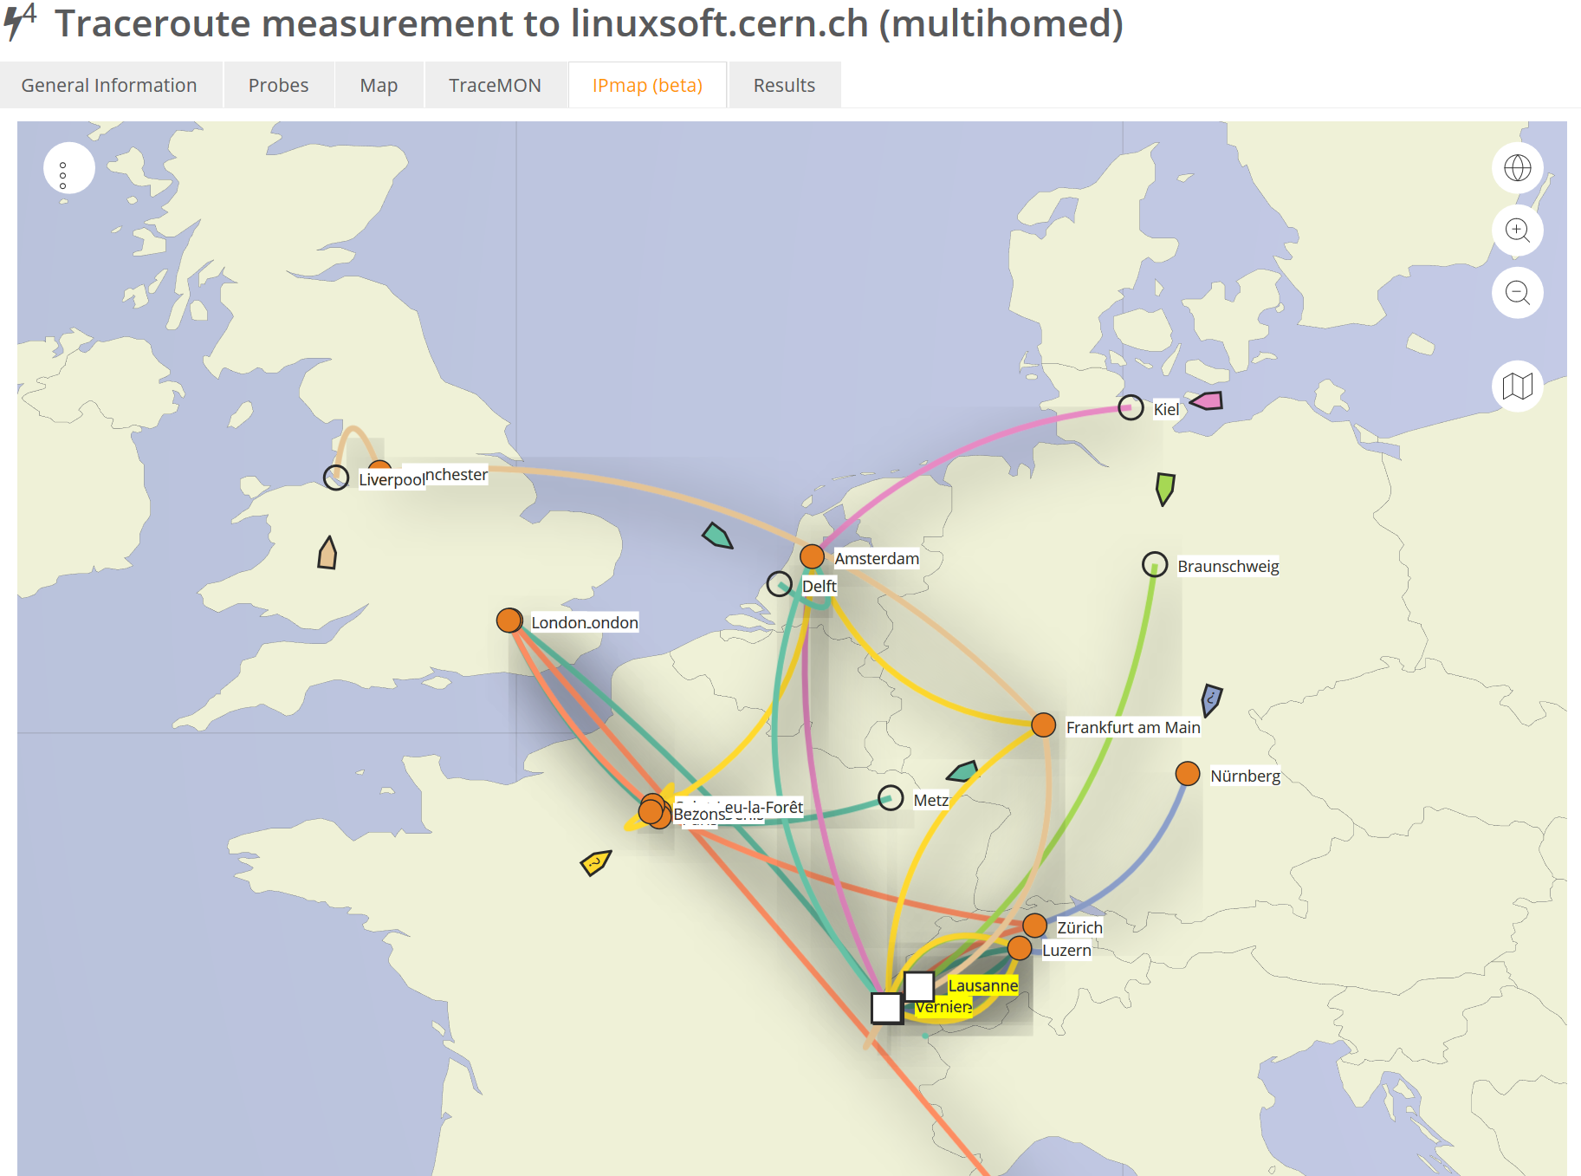

Intermezzo – BGP routing principles
Data: TraceMON IPmap
from RIPE NCC Atlas
atlas.ripe.net
measurement 9249079

Slide 13
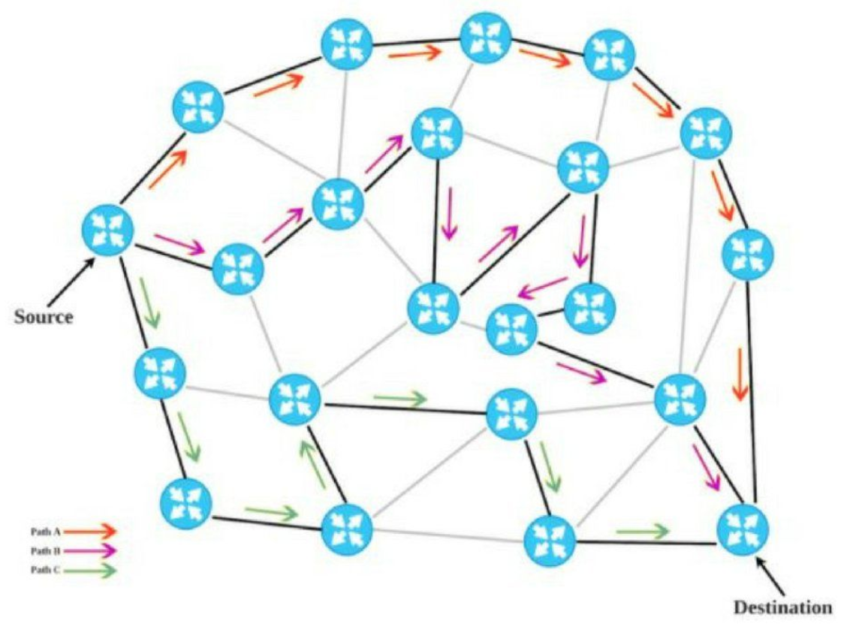



A labyrinthine network?
I am IP Max, AS51530,
and like to take Swiss things
I AM CERN, AS513 …
and want to talk to
e.g. 145.116.216.1
I am LibertyGlobal, AS9141, and
for a stiff price will take you anywhere
I AM Sunrise CH, AS6730,
and will bring you
somewhere – I hope
I am KPN, AS286,
and will bring your
somewhere near
188.184.38.9
I am SURF Amsterdam, AS1162,
and I can talk directly AS1104!
I’m GEANT, AS20965, and I can
get you to AS1104, but via AS1103
I AM Nikhef, AS1104!
I am SURFnet, AS1103,
and can bring you to AS1104
145.116.216.0/24
“segment routing” background image by David Penaloza, Cisco; content: only artificial routing example shown

Slide 14
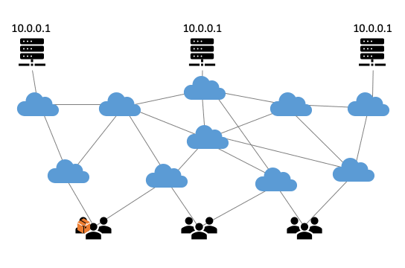
Anycast: when the same place exists many times
So we used
3 (now: 2) sites
one VM at each site
exposing 145.116.216.1
smallest v4 subnet (/24)
bird + a service probe
each site’s own ASN
some IRR DB editing
v6 is similar, with a /48
and some monitoring
routing image: SIDNlabs - https://www.sidnlabs.nl/en/news-and-blogs/the-bgp-tuner-intuitive-management-applied-to-dns-anycast-infrastructure

Slide 15
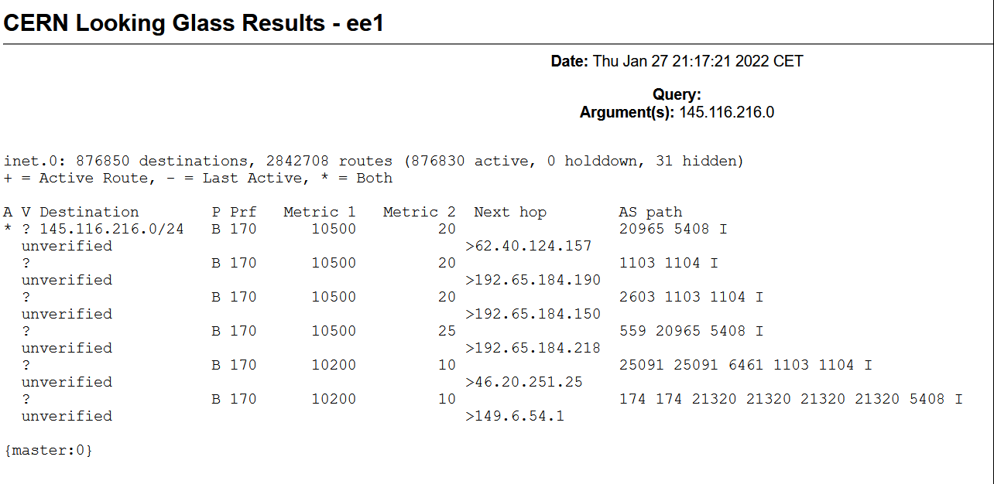
Same address, two paths
assigned 2a07:8504:1a0::/48 and 145.116.216.0/24 to RCauth anycast

Slide 16
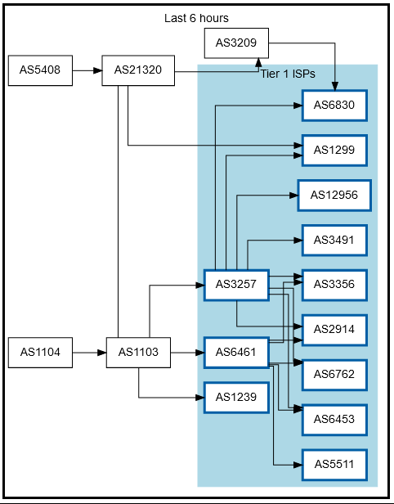
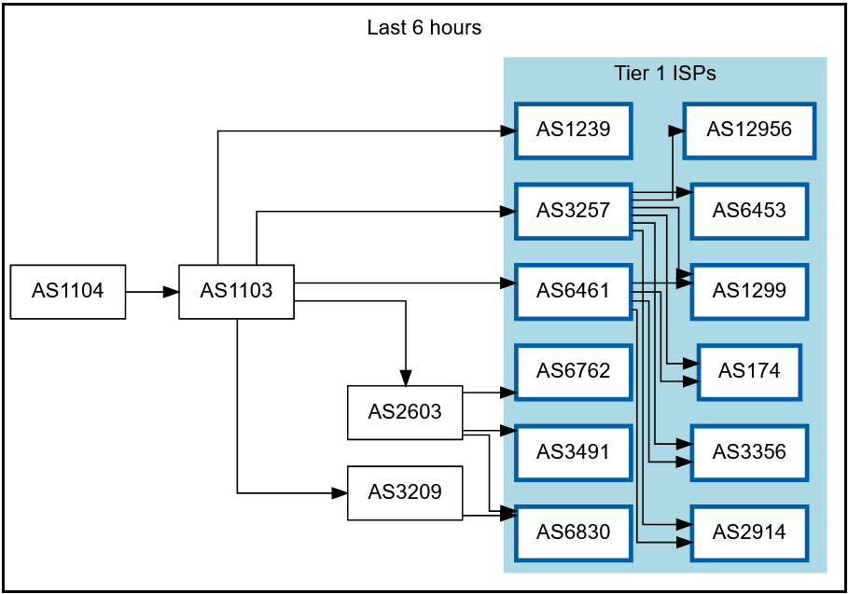
Getting 2a07:8504:1a0::/48 and
145.116.216.0/24 out there
route maps: bgp.tools for 145.116.216.0/24 – IPv6 would be similar

Slide 17
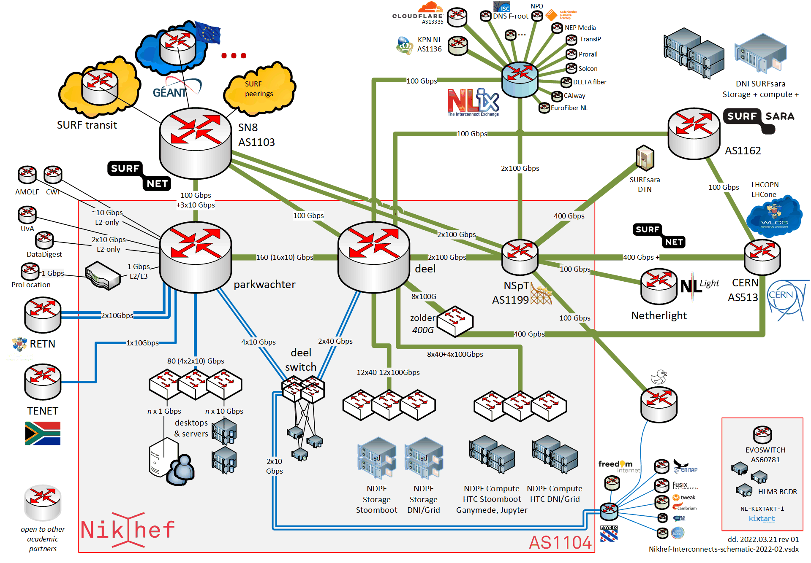
Shortest path, also when mixing with the default-free zone
[root@kwark ~]# traceroute -IA 145.116.216.1
traceroute to 145.116.216.1 (145.116.216.1), 30 hops max, 60 byte packets
1 cmbr.connected.by.freedominter.net
(185.93.175.234) [AS206238]
2 connected.by.freedom.nl
(185.93.175.240) [AS206238]
3 et-0-0-0-1002.core1.fi001.nl.freedomnet.nl
(185.93.175.208) [AS206238]
4 as1104.frys-ix.net (185.1.203.66) [*]
5 parkwachter.nikhef.nl
(192.16.186.141) [AS1104]
6 gw-anyc-01.rcauth.eu
(145.116.216.1) [AS786/AS5408/AS1104]
rcauth.eu HA proxy

Slide 18
Prerequisites are relatively simple
an IPv6 /48 block (and a legacy IPv4 /24 netblock)
your own, or a friendly, Autonomous System Number (AS)
a set of IRR route objects, and either none, or a correct RPKI VRP
(easily done in your local RIR registry: APNIC, RIPE, ARIN, AfriNIC, LACNIC)
bird, or quagga, with a monitoring plugin (to flap the route in case of downtime)
But you don’t per-se need
a unique AS just for this anycast activity (it works equally well without it)
a balanced AS path length (unless you want load balancing as well as redundancy)
your own AS (if you have a friendly AS willing to re-announce your specific route)

Slide 19
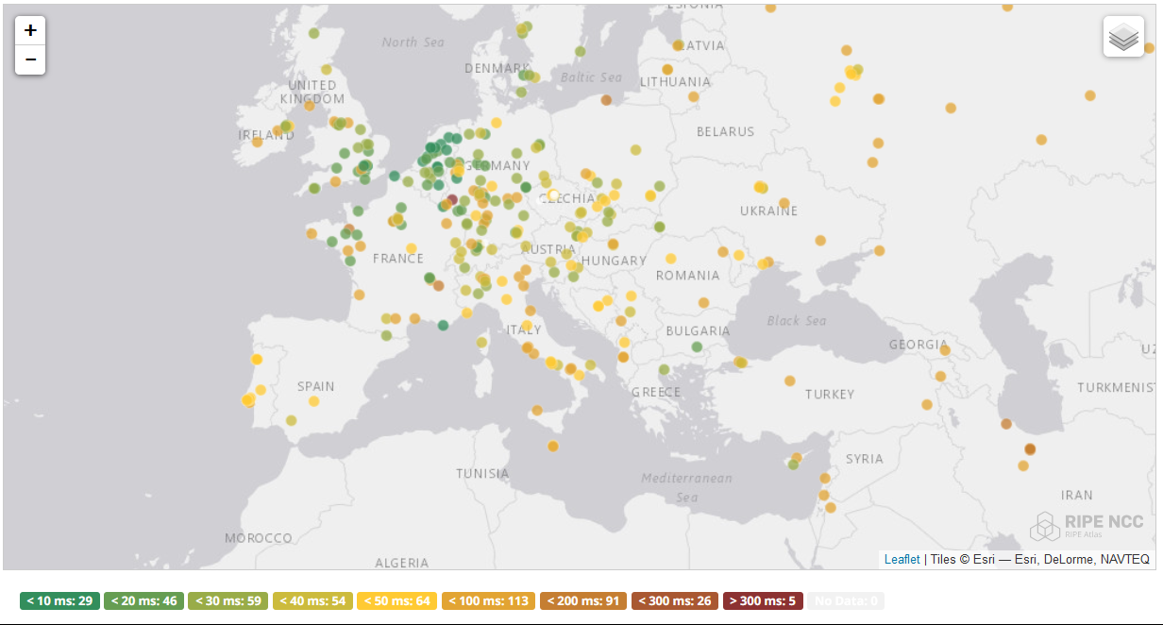
And you get reasonable load balancing
map: RIPE NCC RIPE Atlas- 500 probes, zoomed in on Europe

Slide 20
Other HA options
Local HA with an HA proxy and pacemaker/CRM failover works on the local network – and can be meshed with two signing systems
this is the local Nikhef RCauth instance setup
DNS-based fast-failover – the method used for InAcademia
automatic updating of DNS a distributed set of servers, auto-updating each other
But does require that the DNS domain level operator remains available, since you need *very* short TTLs (and of course your ccTLD/gTLD as well)
Add a dedicated HA link for the back-end databases
e.g. multiple redundant circuits over an MPLS cloud

Slide 21
The hard challenge: when is a service actually ‘up’?
STFC has a delegation service and issuance system,
but for now traffic is sent through Nikhef. But it is part of the gallera cluster
Nikhef has an internally-redundant DS+issuance system (4 boxes), and if either of these is down, the ‘service’ at Nikhef is still ‘up’
With a galera cluster with 3 nodes, when the links are severed, on reconnection it cannot form a majority quota unless all come up at the same time. A tie-breaker would be needed, but where?
And: now operational monitoring and SLA monitoring are different …

Slide 22

Still here? Thanks!
This work has also been co-supported by projects that have
received funding from the European Union’s Horizon research and
innovation programmes under Grant Agreement No. 856726 (GN4-3),
101017536 (EOSC Future), 777536 (EOSC-hub), 730941 (AARC2).
In collaboration with Mischa Sallé and
Tristan Suerink (Nikhef), Nicolas Liampotis and Kyriakos Gkinis (GRNET), and Jens Jensen (STFC RAL)

