Slide 1
Building highly-available stateful services using IP anycast
RCauth.eu at Nikhef, GRNET, and STFC
David Groep
B@UM meeting
April 2022

Slide 2
Why go here?
Creating a PKIX credential translation service for the AARC BPA
with high-availability, scalability, and pan-European redundancy
“provide a highly-available credential bridging services (RCauth.eu)”
And at the same time
demonstrate that also stateful services can be effectively anycasted
find minimum viable anycast environment still having global properties
provide a reference HA architecture for EOSC core services
dispel arguments that building IP anycasted services is complex

Slide 3
The RCauth.eu service

Slide 4

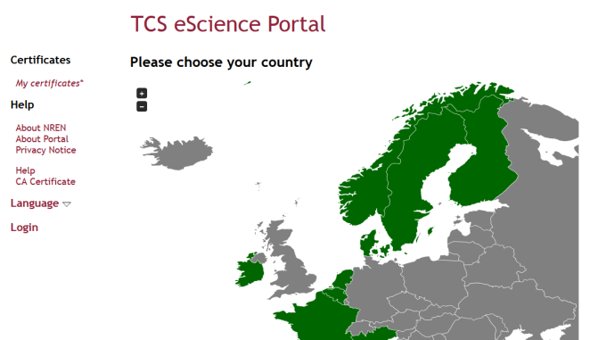
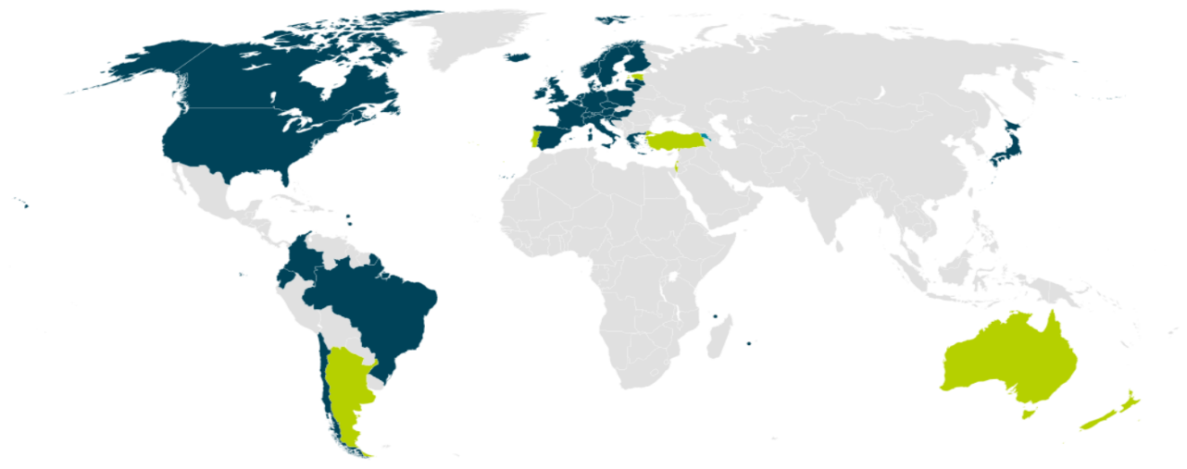


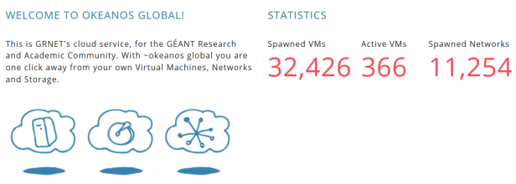

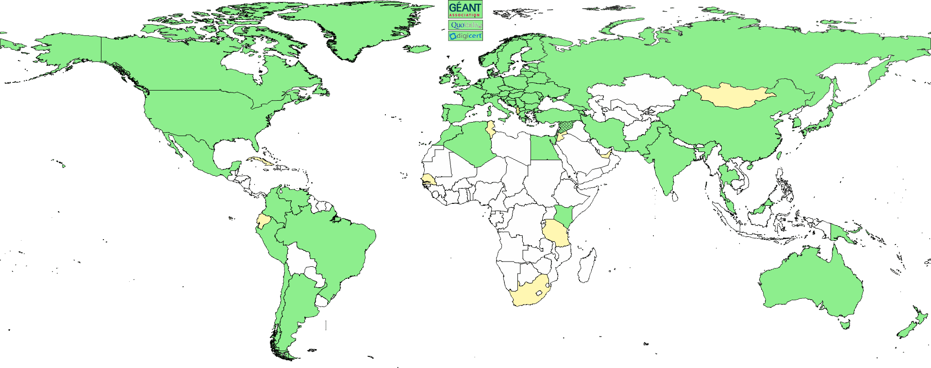
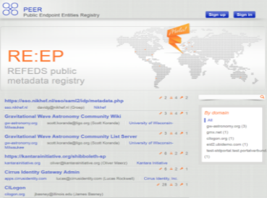
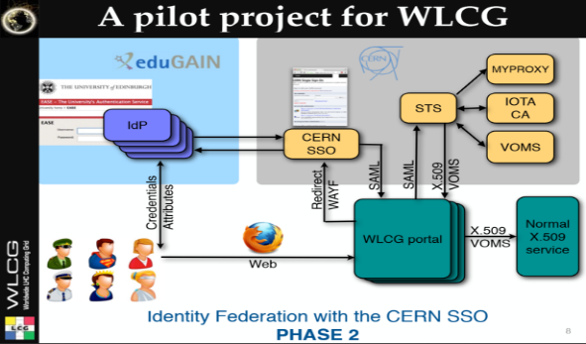
We live in a federated world …
We live in a federated world
wLCG FIM4R pilot
background: eduGAIN connected federations as of November 2014, and others – Brook Schofield, TERENA

Slide 5
AAI evolution of Research and e-Infrastructures
Most infrastructures move to community proxies
  Less credentials to manage, appearing ‘simpler’ to the user
  support both augmenting attributes as well as credential translation
  but non-web access remains challenging for ‘SAML’ federations
EEPKI + RFC3820 did solve both the CLI and delegation use case nicely!
  OIDC + OAuth2 can do the same, provided clients gets better, SAML ECP? no…
Bridging and translation
  SAML->OIDC, SAML->X509, X509->OIDC, X509->SAML, OIDC->X509, …
Does not require major technical changes in existing R&E federations
Allows community-centric identifiers

Slide 6
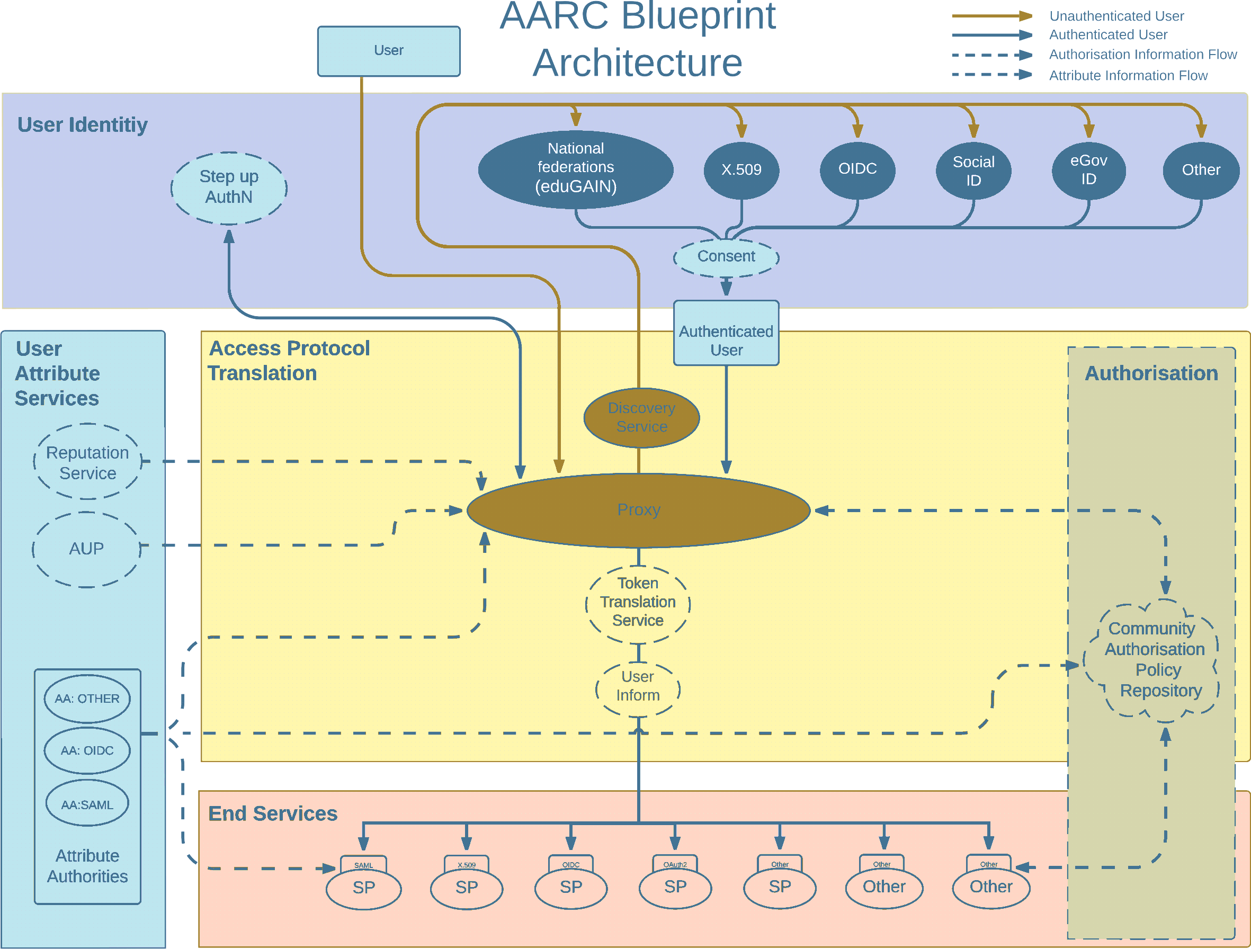
AARC Blueprint Architecture
AARC-G045 – https://aarc-community.org/guidelines/aarc-g045/

Slide 7
A *-to-X509 Token Translations Service for Europe
Ability to serve a large pan-European user base without national restrictions
  without having to rely on specific national participation exclusively for this service
  serve needs of cross-national communities that have large but sparse user base
Use existing resources and e-Infrastructure services
  without the needs for security model changes at the resource centre or national level
Allow integration of this system in science gateways and portals with minimal effort
  only light-weight industry-standard protocols
Permit the use of the VOMS community membership service
  attributes for group and role management in attribute certificates
  also for portals and science gateways access the e-Infrastructure
Concentrate service elements that require significant operational expertise
  not burden research communities with care for security-sensitive service components
  keep a secure credential management model
  coordinate compliance and accreditation

Slide 8

RCauth.eu – a ubiquitous federated IOTA
RCauth is an IGTF accredited IOTA (DOGWOOD class) CA
  Online credential conversion
  Connected to eduGAIN (R&S+Sirtfi) plus direct,
  e.g. EGI Check-in and eduTEAMS
Inspired by and leveraging the delegation service from CILogon
For CILogon, Jim Basney et al, NCSA/UIUC for NFS – see https://cilogon.org/

Slide 9
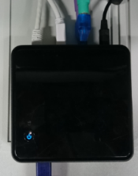




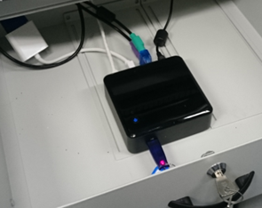






Long ago, in a drawer, far far away
R&S
delegation
filtering
WAYF
server

Slide 10
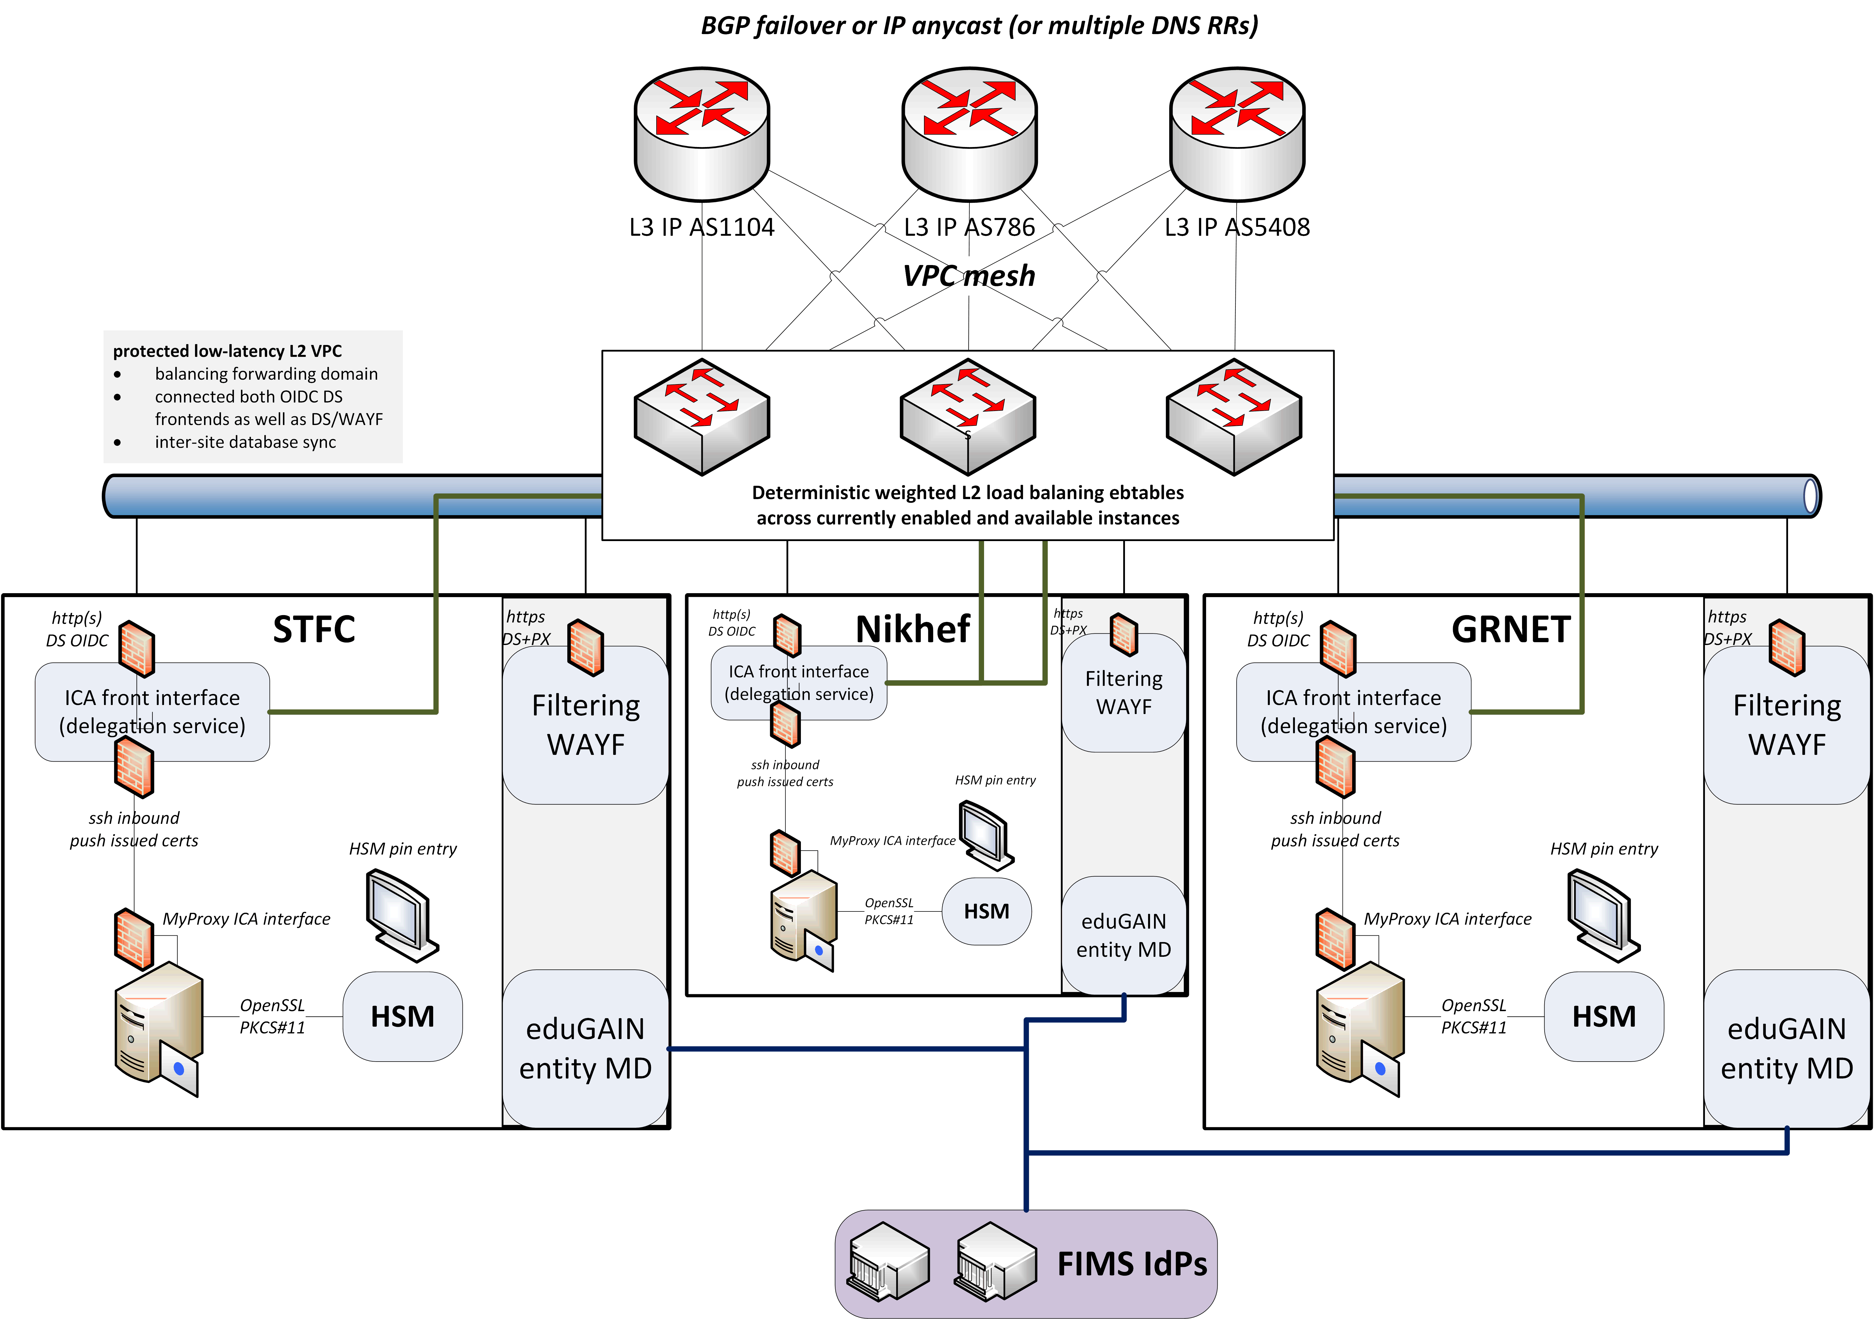
Since we do not like SPOFs …
Implement a High Availability setup across 3 sites
Supported by EOSC Hub and EOSC Future

Slide 11
towards a pan-European distributed service

Slide 12
Distributed RCauth service
HA proxy
DS
DB
VPN
client
VPN server
STFC
GRNET
Nikhef
HA proxy
DS
DB
VPN client
VPN server
HA proxy
DS
DB
VPN client
VPN server
selected imagery: Mischa Sallé, Jens Jensen, Nicolas Liampotis

Slide 13
A transparent multi-site setup?
HA proxy
HA proxy
Need a way to send users to “closest” working service
Each HA proxy forward mainly to its own DS
If a HA loses its backend DS, it can still route to the other DS’es
HA proxy
selected imagery: Mischa Sallé, Jens Jensen, Nicolas Liampotis

Slide 14
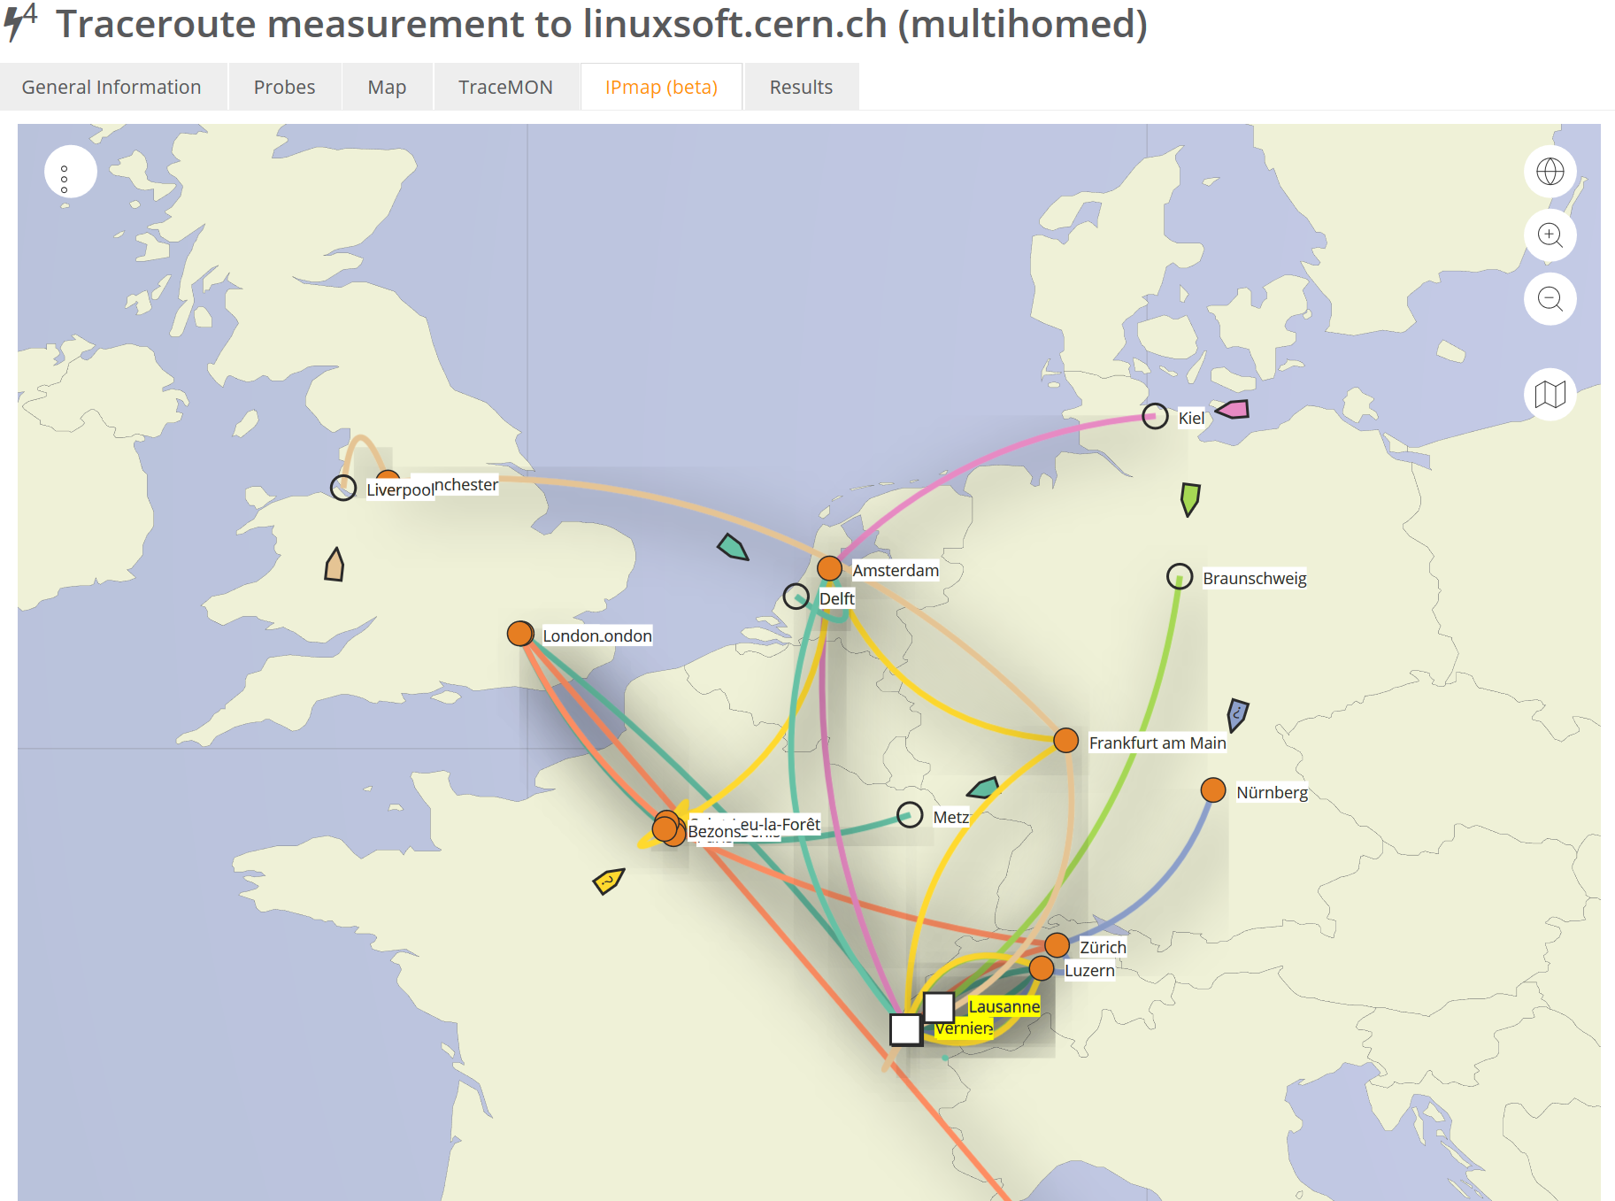

Intermezzo – BGP routing principles
Data: TraceMON IPmap
from RIPE NCC Atlas
atlas.ripe.net
measurement 9249079

Slide 15
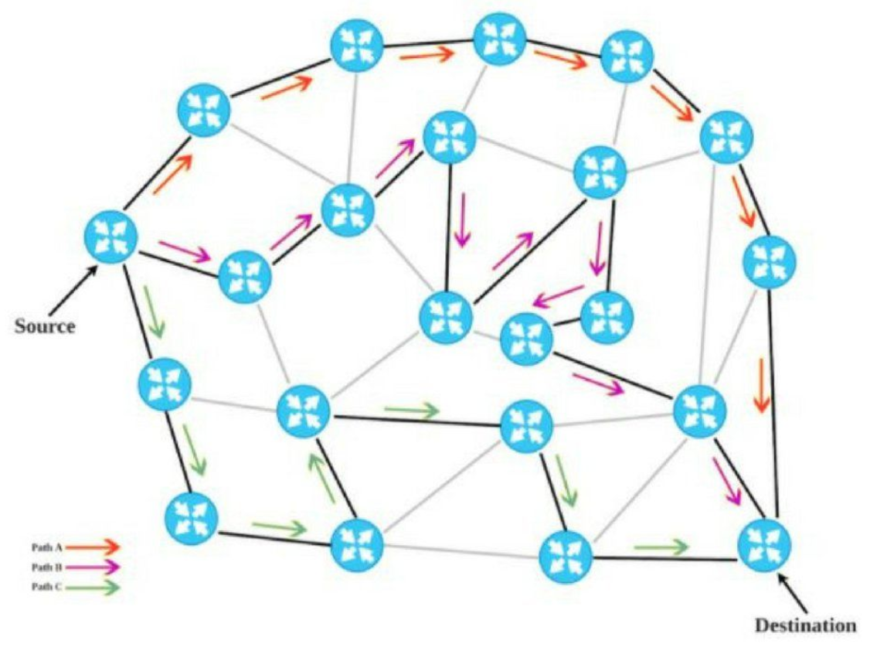



A labyrinthine network
I AM AortaNet, AS6830,
(but secretly LibertyGlobal again)
I AM CERN, AS513 …
and want to talk to
194.171.96.128/25
I AM LibertyGlobal, AS9141,
FOR A STIFF PRICE TAKES YOU ANYWHERE
I AM Sunrise CH, AS6730,
AND WILL BRING YOU SOMEWHERE
I AM KPN, AS286, AND WILL
BRING YOU SOMEWHERE NEAR
188.184.38.9
I AM SURFSARA, AS1162,
AND DIRECTLY TALK TO AS1104!
I AM GEANT, AS20965,
CAN GET YOU TO AS1104 via 1103
Ik ben Nikhef, AS1104!
I AM SURFnet, AS1103,
and can bring you to AS1104
194.171.96.128/25
“segment routing”
image by David Penaloza, CISCO

Slide 16
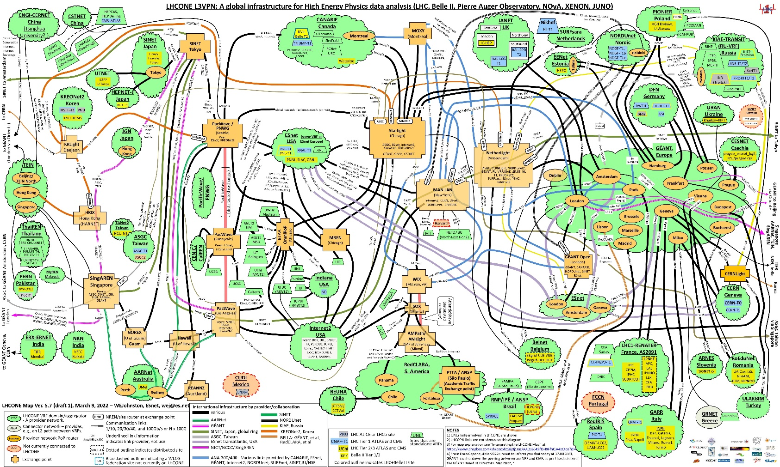
LHCone
Image: Bill Johnston, ESnet, for the LHCOPN/LHCone collaborations

Slide 17
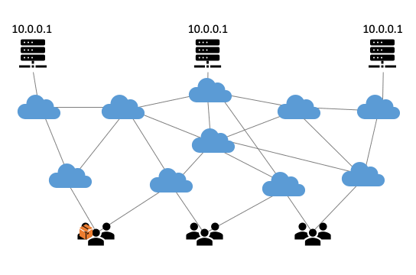
Anycast: when the same place exists many times
So we used
3 (now: 2) sites
one VM at each site
exposing 145.116.216.1
smallest v4 subnet (/24)
bird + a service probe
each site’s own ASN
some IRR DB editing
v6 is similar, with a /48
and some monitoring
routing image: SIDNlabs - https://www.sidnlabs.nl/en/news-and-blogs/the-bgp-tuner-intuitive-management-applied-to-dns-anycast-infrastructure

Slide 18
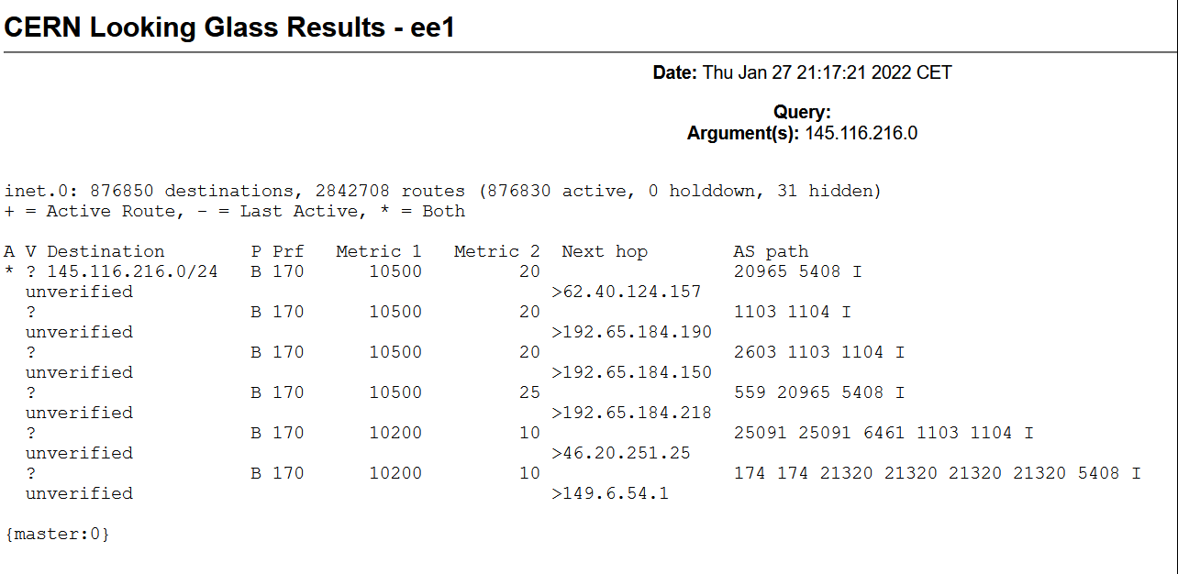
Same address, two paths

Slide 19
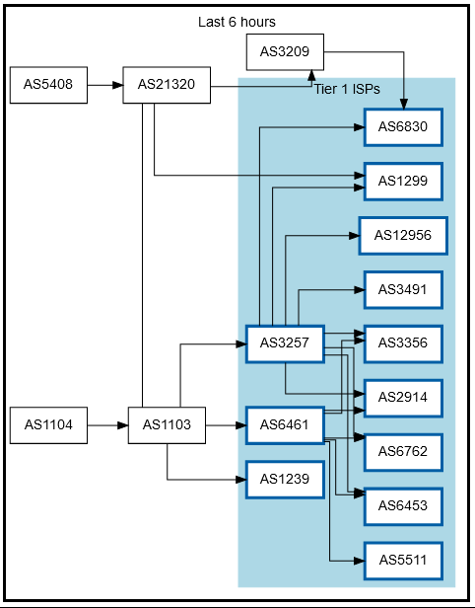
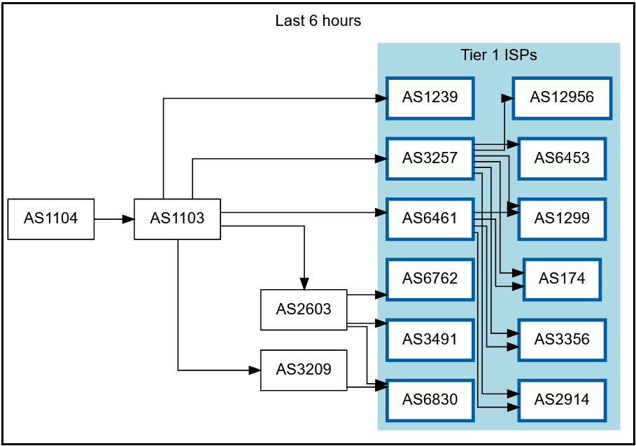
Getting 145.116.216.0/24 out there
route maps: bgp.tools for 145.116.216.0/24 – IPv6 would be similar

Slide 20
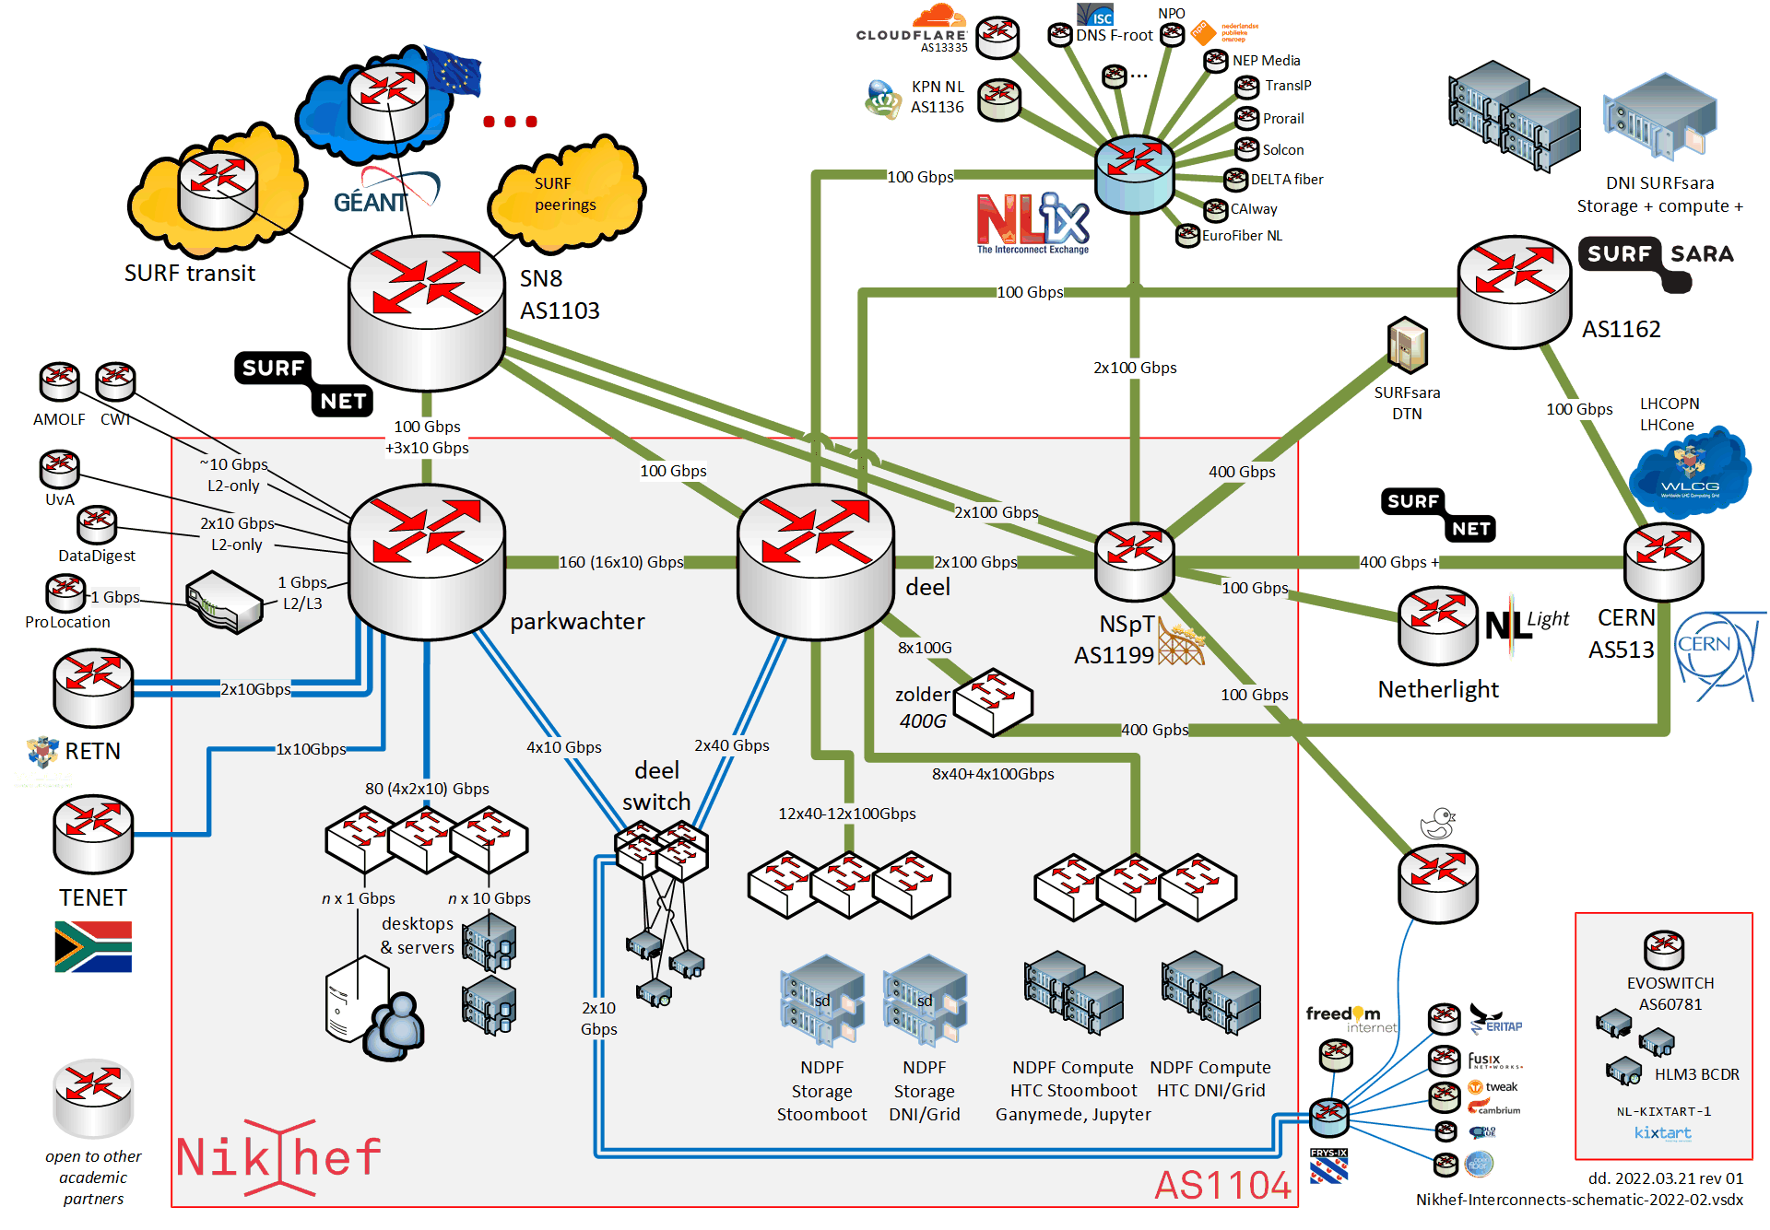
Shortest path, also when mixing with the default-free zone
[root@kwark ~]# traceroute -IA 145.116.216.1
traceroute to 145.116.216.1 (145.116.216.1), 30 hops max, 60 byte packets
1 cmbr.connected.by.freedominter.net
(185.93.175.234) [AS206238]
2 connected.by.freedom.nl
(185.93.175.240) [AS206238]
3 et-0-0-0-1002.core1.fi001.nl.freedomnet.nl
(185.93.175.208) [AS206238]
4 as1104.frys-ix.net (185.1.203.66) [*]
5 parkwachter.nikhef.nl
(192.16.186.141) [AS1104]
6 gw-anyc-01.rcauth.eu
(145.116.216.1) [AS786/AS5408/AS1104]
rcauth.eu HA proxy

Slide 21
Prerequisites are relatively simple
an IPv4 /24 netblock (and, or) an IPv6 /48
your own, or a friendly AS
a set of IRR route objects, and either none, or a correct RPKI VRP
(easily done in your local RIR registry: APNIC, RIPE, ARIN, AfriNIC, LACNIC)
bird, or quagga, with a monitoring plugin (to flap the route in case of downtime)
But you don’t per-se need:
a unique AS just for this anycast activity (it works equally well without it)
a balanced AS path length (unless you want load balancing as well as redundancy)
your own AS (if you have a friendly AS willing to re-announce your specific route)

Slide 22
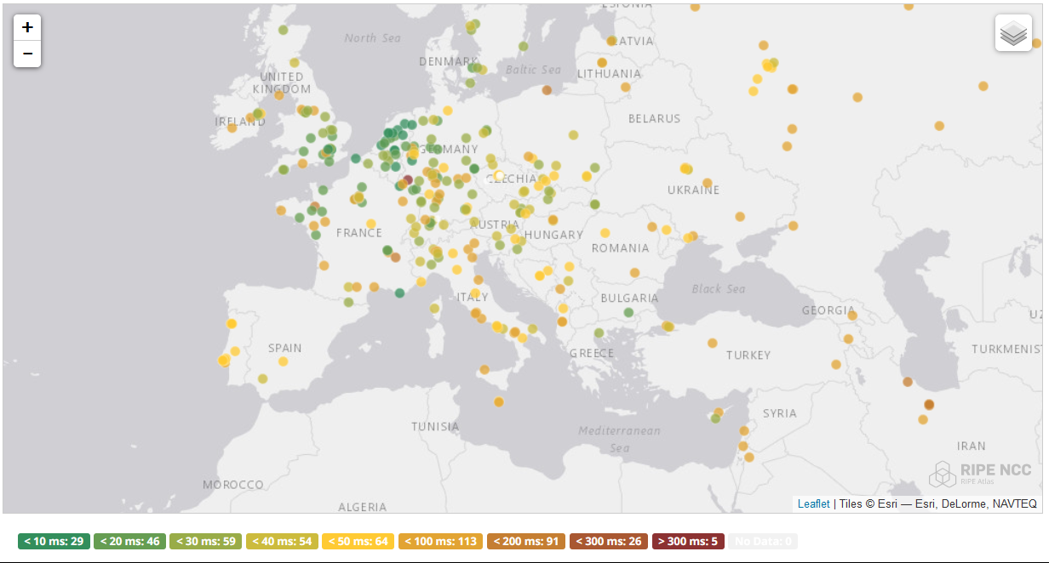
And you get reasonable load balancing
map: RIPE NCC RIPE Atlas- 500 probes, zoomed in on Europe

Slide 23
Other HA options
Local HA with an HA proxy and pacemaker/CRM failover works on the local network – and can be meshed with two signing systems
this is the local Nikhef RCauth instance setup
DNS-based fast-failover – the method used for InAcademia
automatic updating of DNS a distributed set of servers, auto-updating each other
But does require that the DNS domain level operator remains available, since you need *very* short TTLs (and of course your ccTLD/gTLD as well)
Add a dedicated HA link for the back-end databases
e.g. multiple redundant circuits over an MPLS cloud

Slide 24

Still here? Thanks!
This work has also been co-supported by projects that have
received funding from the European Union’s Horizon research and
innovation programmes under Grant Agreement No. 856726 (GN4-3),
101017536 (EOSC Future), 777536 (EOSC-hub), 730941 (AARC2).
In collaboration with Mischa Sallé and
Tristan Suerink (Nikhef), Nicolas Liampotis and Kyriakos Gkinis (GRNET), and Jens Jensen (STFC RAL)

