Slide 1

Bring the WLCG federation Home
Extending your trust options beyond bottom-up identity
by collaborating with global Research and Scholarship
With support from the Authentication and Authorization
for Research and Collaboration project
Trust Anchor Distribution evolution supported by EGI ENGAGE

Slide 2
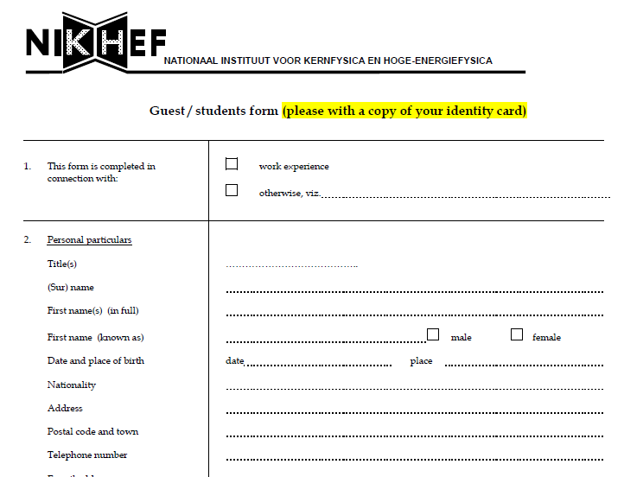
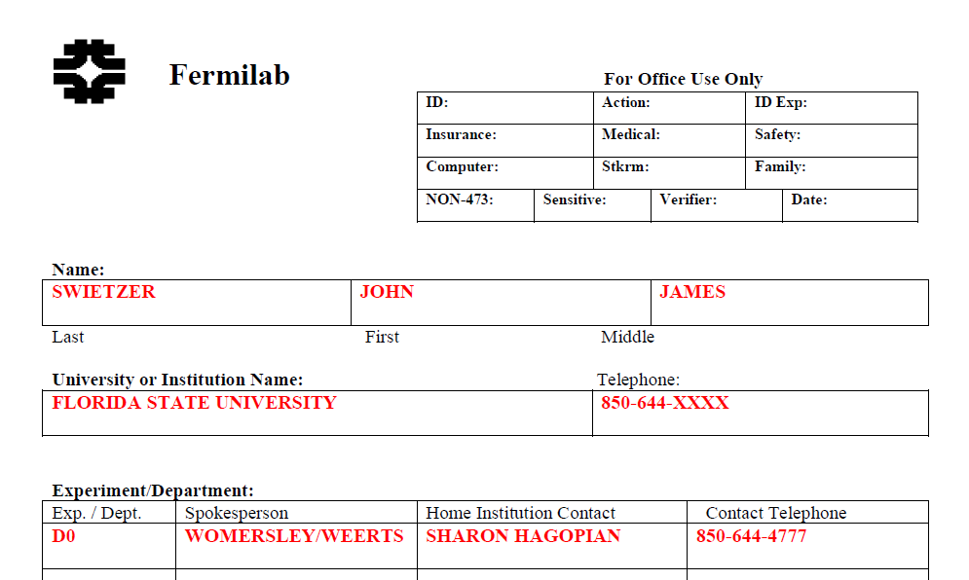
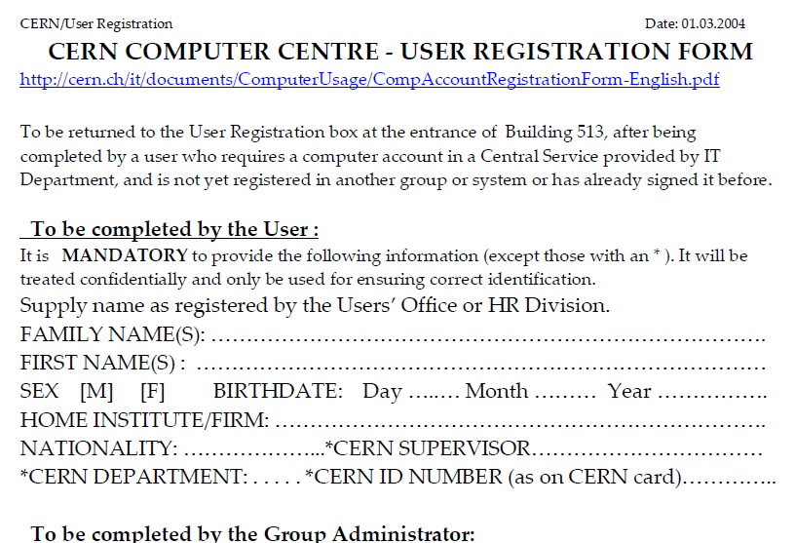
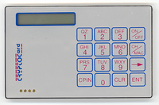
You all remember the bad old days …

Slide 3
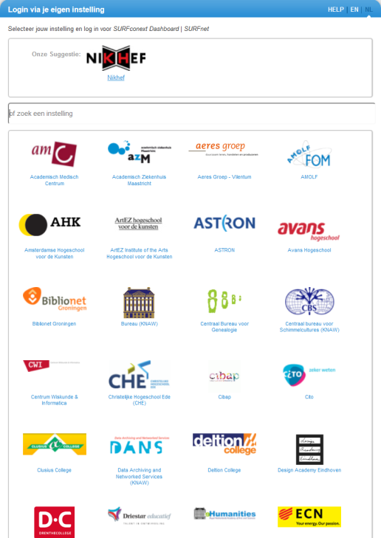
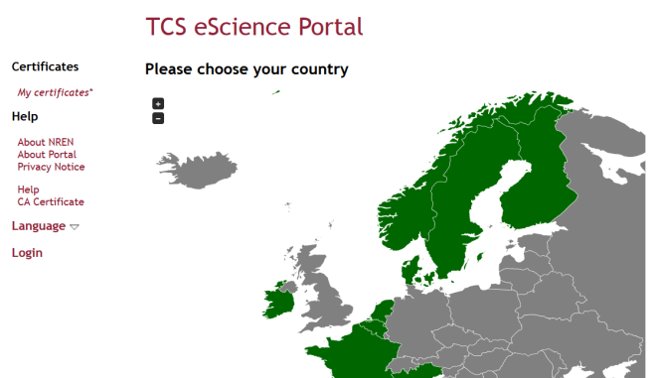
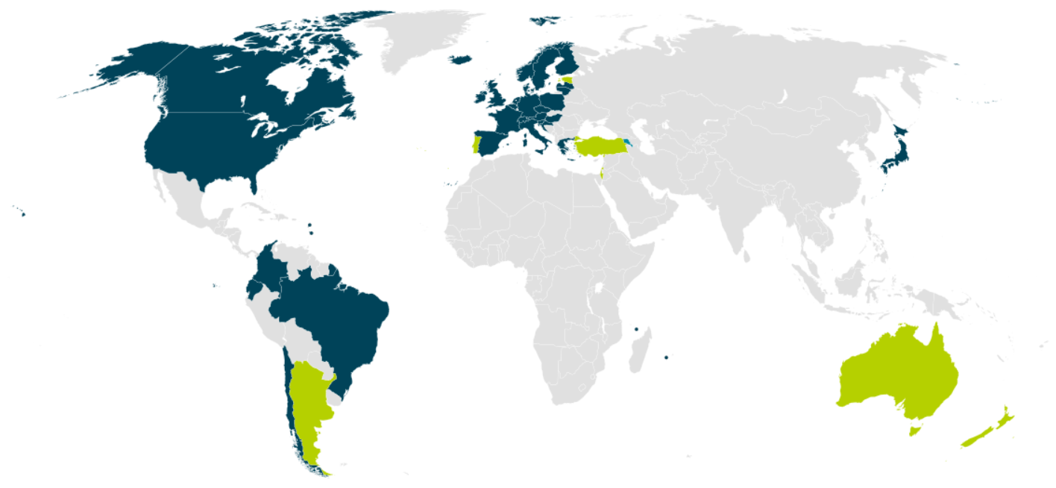


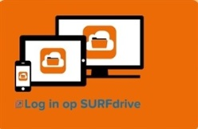
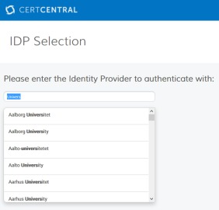
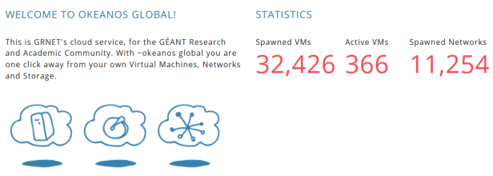

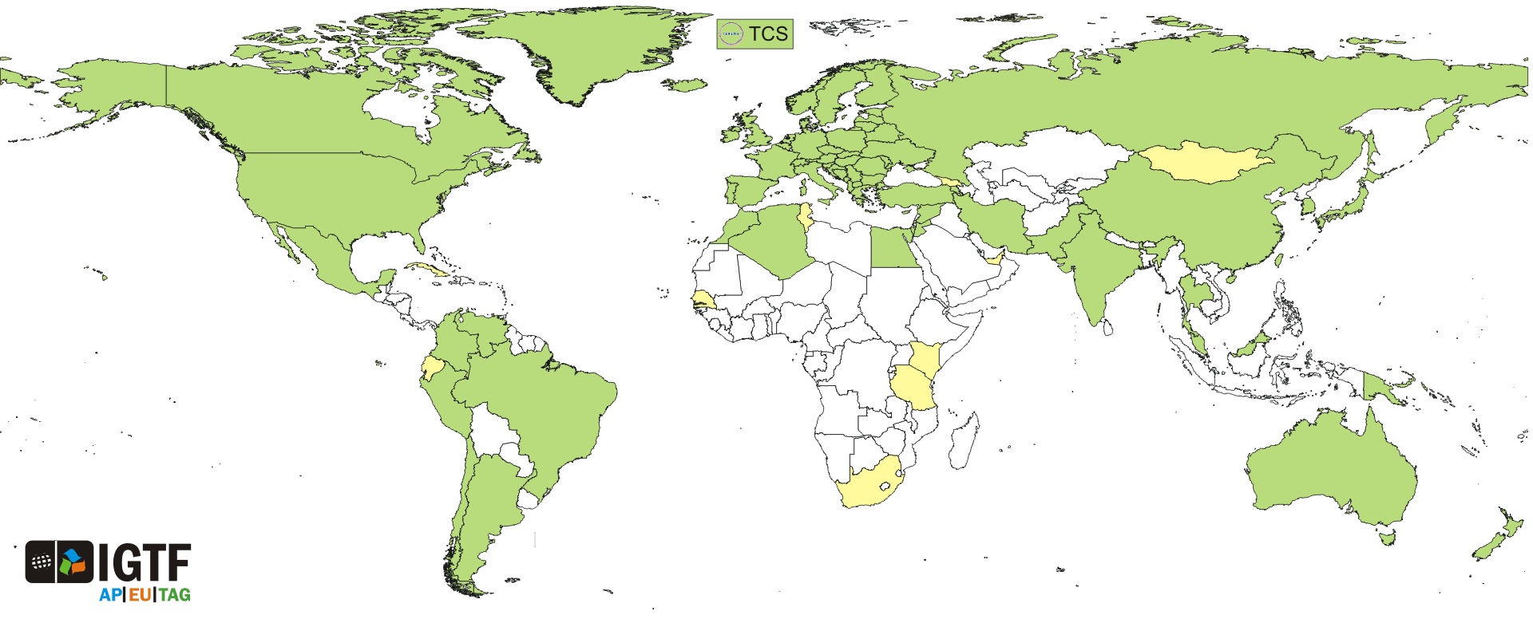
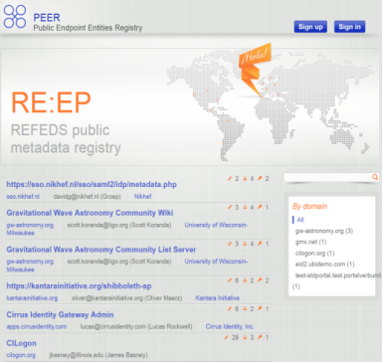
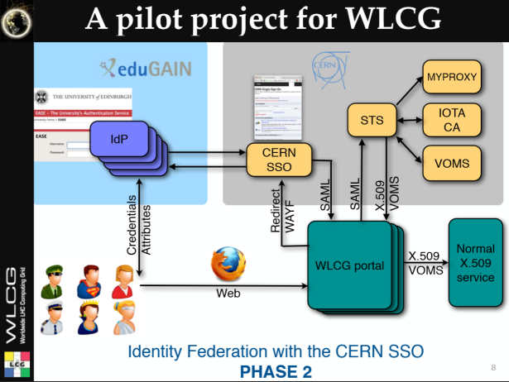

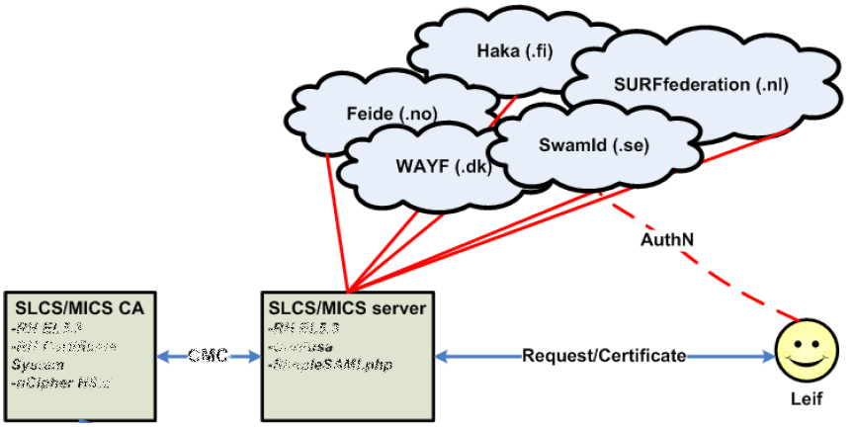
And now we have this!
WLCG FIM4R pilot
background: eduGAIN connected federations as of November 2014 – Brooke Schofield, TERENA

Slide 4
Evolution of Trust – from 1995 to 2020?
Every institute trusts only its own database
  you can trace everyone, but you get to manage all the accounts
  passwords are all over - and users pick the same everywhere
Distributed global trust – independent third parties
  identification and identity vetting by CAs, a limited number
  but accessible to all users everywhere on their own inititiative
Easing trust building – mixing assurance from different places
  extend identification by also leveraging your home organisation
www.igtf.net/ap/iota

Slide 5
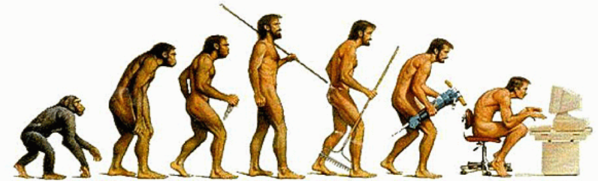
Evolving for 2020!
Getting to distributed global trust
for open innovation, open science, open to the world
  how far can we push federated authentication?
  A single account for all your services, single sign-on for everything:
  from data analysis to wikis, and from file sending, and date picking to expense claims
But … institutions vary a lot
is your home university ready to identify you to the world?
does it even want to tell WLCG who you are?
ready to help you already today? Or does it need work?
is it ready to help the others, sites and operators,
in case of incidents?
www.refeds.org, FIM4R https://cdsweb.cern.ch/record/1442597

Slide 6
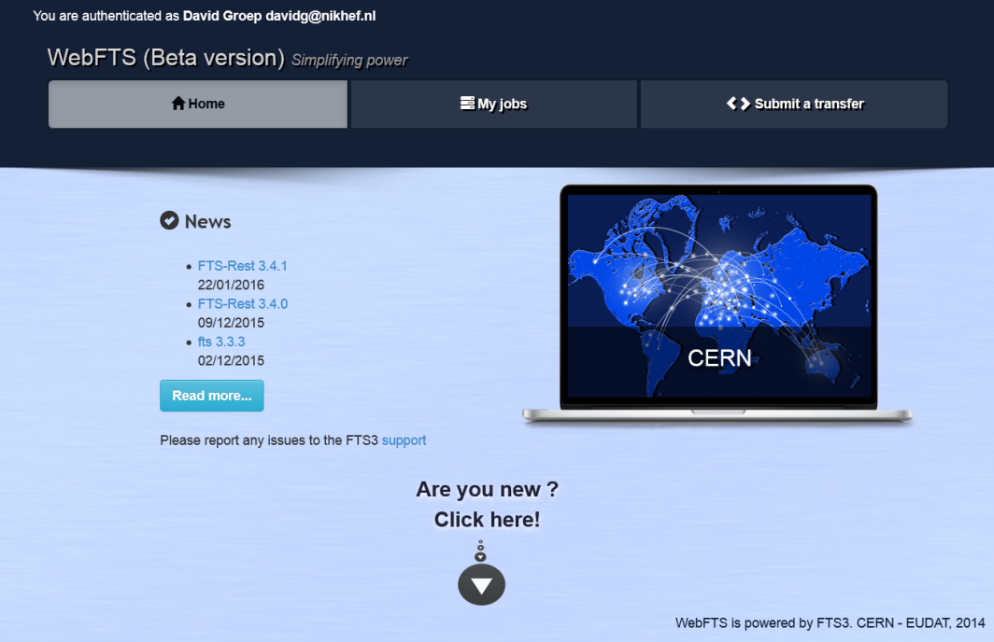
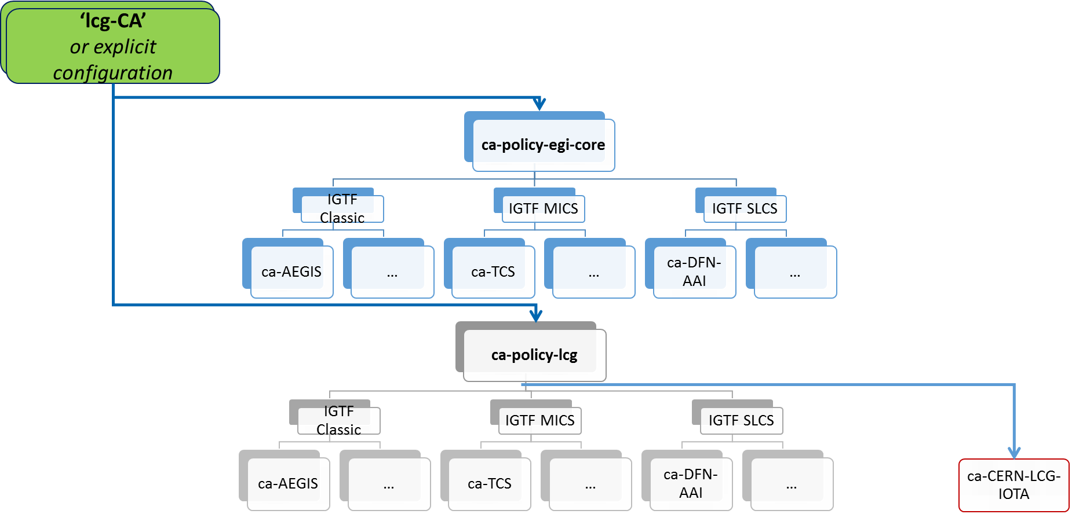
#1: Leverage the CERN User Office
Your trusty CA distribution as of next month:
now with the CERN LCG IOTA CA
supporting the WebFTS pilot
https://webfts.cern.ch

Slide 7
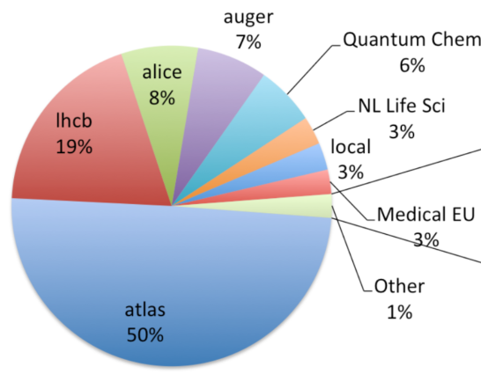
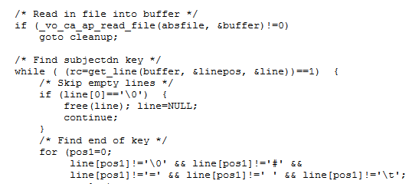
More than a pilot – a new way of life!
wLCG leverages major open science infrastructures
it must work alongside more dynamic communities
on the same infrastructure without separating services
besides the ‘CERN LCG IOTA CA’ there will be more
generic identity providers from all over the world
services must be able to trust just-a-unique-name CAs
for only highly-managed VOs like LCG, but not for other VOs
This needs a decision in software – on CA+VO combination
this software is getting there for many areas
you all should encourage software providers to implement
and deploy such new software in production ASAP
http://www.nikhef.nl/grid/tmp/WLCG-CERN-IOTA-statement-MB-20151028.pdf

Slide 8
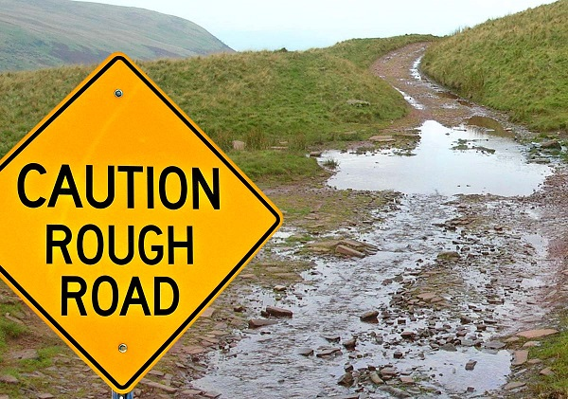

Open Science, Open to the World? Ready?
Old innovations now just seem a given: think of eduroam™
On the way…it may be bumpy!
Federated access means you’ll
rely on your institute a lot more
Some things become easier (web)
others more complicated (CLI)
Meanwhile, there’ll be lot of
bridging and new things to learn
But: aligning with the world will bring usability benefits,
and enable scenarios that
for next years’ students will be their ‘natural habitat’!
www.aarc-project.eu

Slide 9
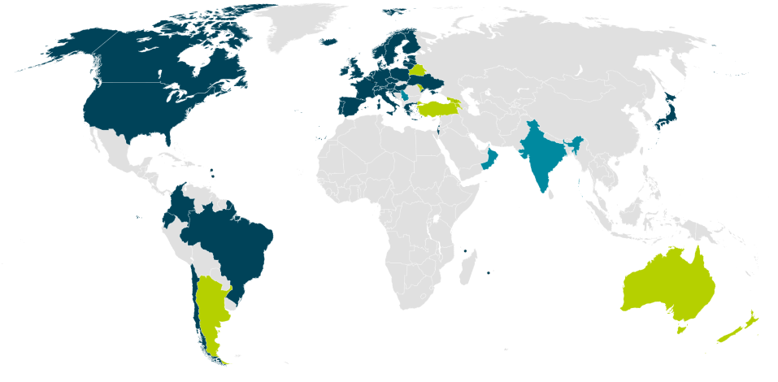

But What Should I Do??
Ask your home organisation to join or opt-in to eduGAIN
still no federation? In an eduGAIN country? Ask your local IT to join the national federation,
or set up identity management!
Ask them to release attributes
there’s a basic set that is needed,
called “Research and Scholarship”
they should join that scheme
Ask them to collaborate in incident response
and tell us so by joining the SirTFi programme – it’s self-asserted, and we will trust them if they say so – but it means that sites and response teams know they’re able to act OK
https://refeds.org/category/research-and-scholarship, https://wiki.refeds.org/display/GROUPS/SIRTFI

