Slide 1
Grid Computing: enabling scientific collaboration in Europe and beyond
David Groep
Nikhef
Belnet Networking Conference
Brussels, 28th November 2008 partially based on Bob Jones’ general EGEE presentation

Slide 2
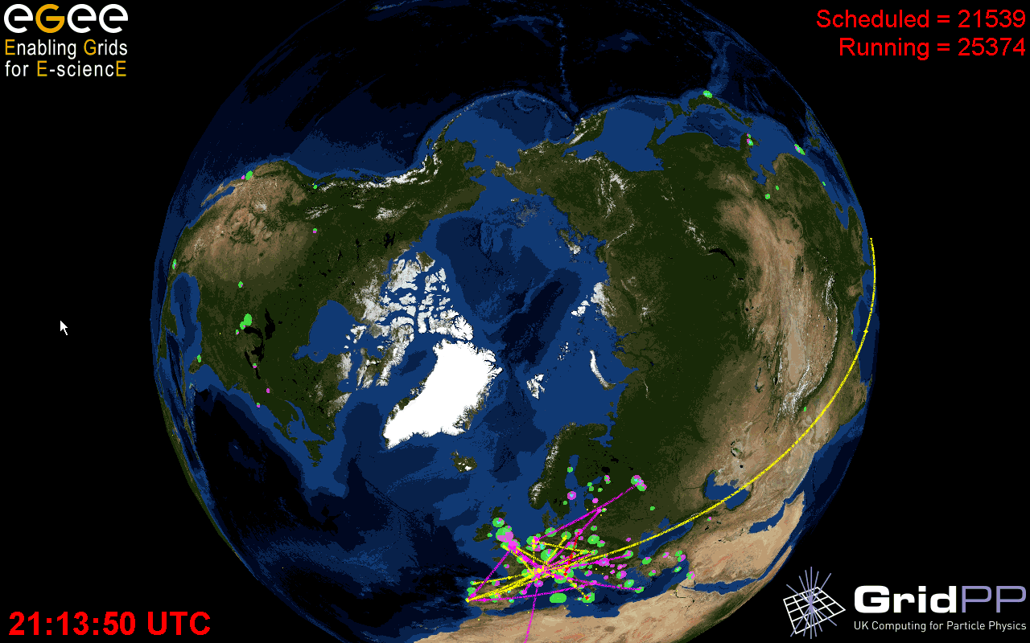
An Infrastructure for Research
Building on top of the network …
… an infrastructure to enable collaboration …
… that spans Europe and the world …
… to deal with our growing research challenges
Graphics: Real Time Monitor, Gidon Moont, Imperial College London, http://gridportal.hep.ph.ic.ac.uk/rtm/

Slide 3
Why do we need it?
Collected data in research and industry grows exponentially
The Bible | 5 | MByte
X-ray image | 5 | MByte/image
Functional MRI | 1 | GByte/day
Bio-informatics databases | 500 | GByte each
Refereed journal papers | 1 | TByte/yr
Satellite world imagery | 5 | TByte/yr
US LoC contents | 20 | TByte
Internet Archive 1996-2002 | 100 | TByte
Particle Physics today | 5 | PByte/yr
LHC era physics, Astronomy, ... | 20 | PByte/yr
And the size of the scientific collaborations grows even faster ...
with today ‘Web 2.0’ techniques penetrating research, like MyExperiment

Slide 4
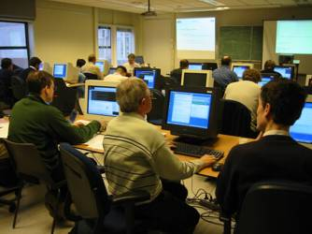
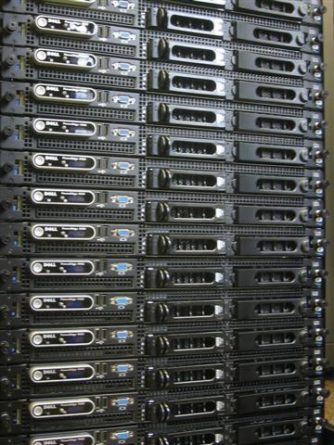
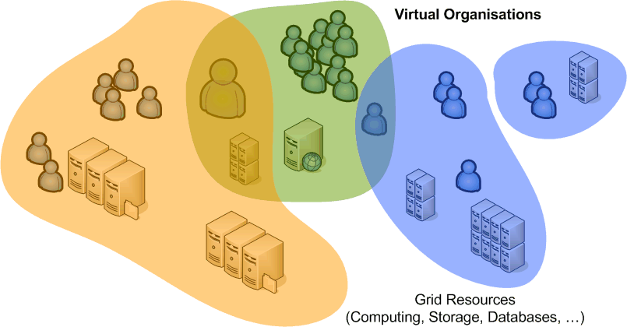
What is Grid?
Cycle scavenging
harvest idle compute power
improve RoI on desktops
Cluster computing and storage
What-if scenarios
Physics event analysis
Improve Data Centre Utilization
About interlinking global communities
more than one organisation
more than one application
more than one …
Based on
open protocols
collective service
In an usable, persistent manner

Slide 5

Grid Infrastructure
To bring about ICT-enhanced research – and sustain it –
requires a persistent infrastructure, based on standards
Hardware infrastructure
Networks, clusters, supercomputers, databases, mass storage, visualisation, ...
Trust and ‘federated’ infrastructure
authentication, authorization, accounting, billing and settlement, policy agreements
Software infrastructure
execution services, workflow, resource information systems, database access, storage management, meta-data
Application infrastructure
user support, training, integration in domain specific software, ...

Slide 6
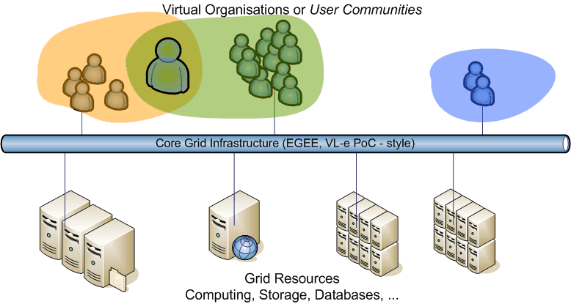
A Grid Network
Europe, through its national grids and coordination,
is building a multi-disciplinary grid for research
Based on the high-bandwidth network
As a sustainable, ‘always-on’, standards-based service

Slide 7
How e-Infrastructures help e-Science
e-Infrastructures provide easier access for
  Small research groups
  Scientists from many different fields
  Remote and still developing countries
… to new technologies
  Produce, store and search massive
  amounts of data
  Transparent access to millions of files
  across different administrative domains
  Low cost access to resources
    Mobilise large amounts of CPU & storage
    on short notice (PC clusters)
  High-end facilities (supercomputers)
And help to find new ways to collaborate
  Eases distributed collaborations & provides
  new ways of community building
  Develops applications using distributed
  complex workflows
  Gives easier access to higher education
KNOWLEDGE .
INFRASTRUCTURE
GRID .
INFRASTRUCTURE
NETWORK .
INFRASTRUCTURE

Slide 8
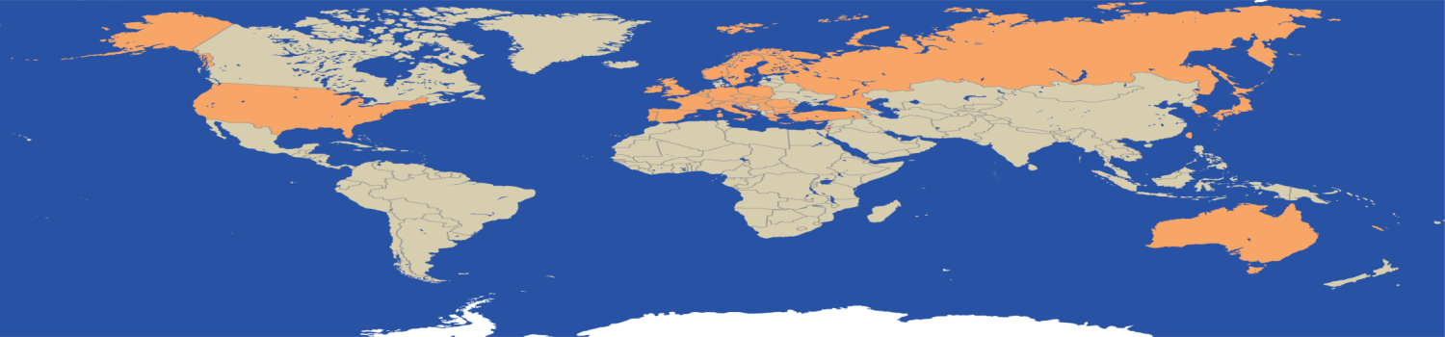
EGEE-III
Flagship Grid infrastructure project co-funded by the European Commission
Main Objectives
  Expand/optimise existing EGEE infrastructure, include more resources and user communities
  Prepare migration from a project-based model to a sustainable federated infrastructure based on National Grid Initiatives
Duration: 2 years
Consortium: ~140 organisations across 33 countries
EC co-funding: 32Million €
Notes:
8

Slide 9
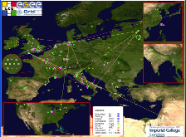

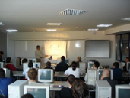

EGEE – What do we deliver?
Infrastructure operation
  Sites distributed across many countries
    Large quantity of CPUs and storage
    Continuous monitoring of grid services & automated site configuration/management
    Support multiple Virtual Organisations from diverse research disciplines
Middleware
  Production quality middleware distributed under business friendly open source licence
    Implements a service-oriented architecture that virtualises resources
    Adheres to recommendations on web service inter-operability and evolving towards emerging standards
User Support - Managed process from first contact through to production usage
  Training
  Expertise in grid-enabling applications
  Online helpdesk
  Networking events (User Forum, Conferences etc.)

Slide 10
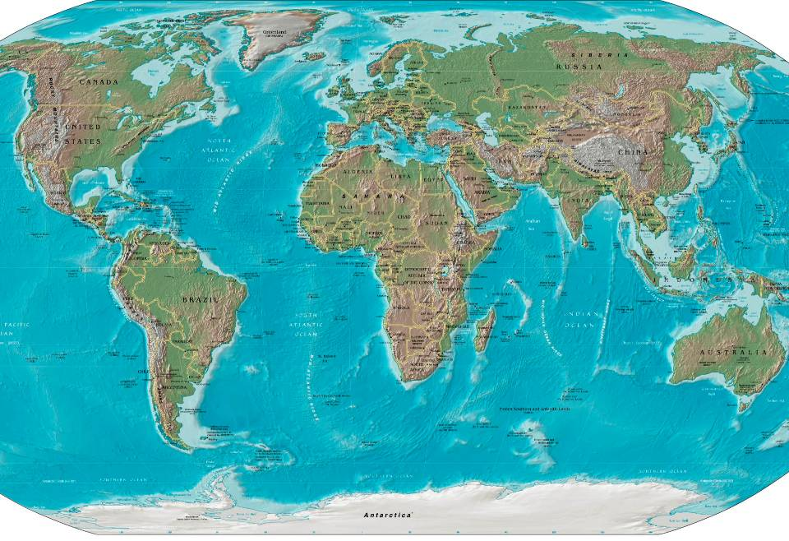
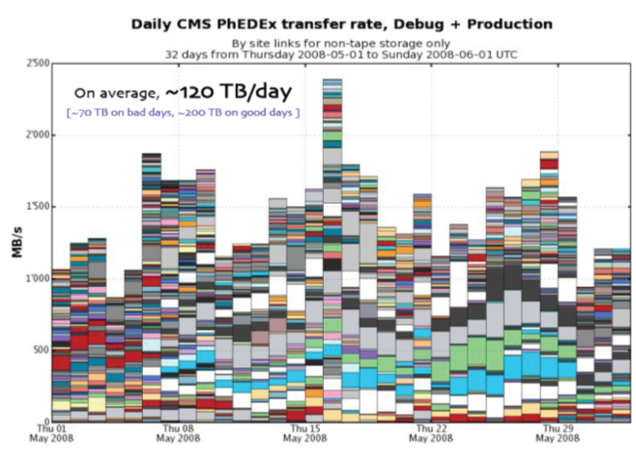
EGEE Achievements - Infrastructure
EGEE Production Grid Infrastructure
Steady growth over the lifetime of the project
Improved reliability
How can we reduce the effort required to operate this expanding infrastructure?
How can we accommodate more diverse resources?
What ‘credit’ can a site receive for contributing resources?

Slide 11


Grid Middleware
Applications
Applications access both Higher-level Grid Services and Foundation Grid Middleware
  Application code
  Frameworks
  Community Portals
VOs complement gLite with other high-level services via the RESPECT programme
  Rec. External Software Pkgs. for the EGEE Community
  Identify useful, 3rd-party software that works with gLite
  Make users aware of that software to avoid duplicated efforts
Higher-Level Grid Services
Workload Management
Replica Management
Visualization
Workflow
Grid Economies
...
Foundation Grid Middleware
Security model and infrastructure
Compute (CE) and Storage Elements (SE)
Accounting
Information and Monitoring

Slide 12
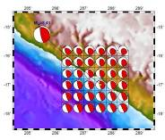


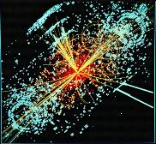

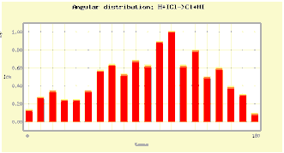
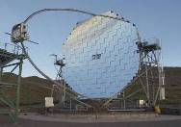
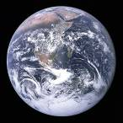
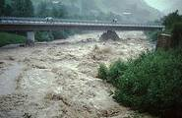
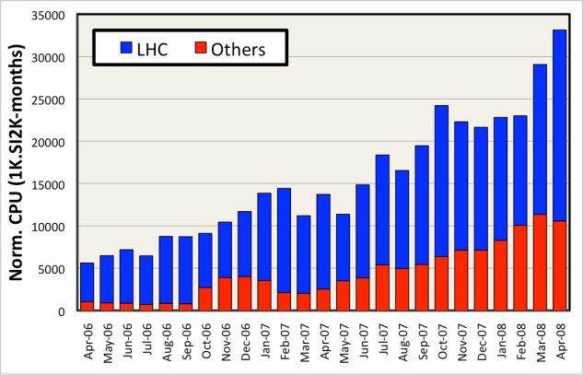
EGEE Achievements - Applications
>270 VOs from several scientific domains
  Astronomy & Astrophysics
  Civil Protection
  Computational Chemistry
  Comp. Fluid Dynamics
  Computer Science/Tools
  Condensed Matter Physics
  Earth Sciences
  Fusion
  High Energy Physics
  Life Sciences
Further applications
under evaluation
How do we match the expectations of the growing user communities?
  Will we have enough computing resources to satisfy their needs?
Applications have moved from
testing to routine and daily usage
~80-95% efficiency

Slide 13
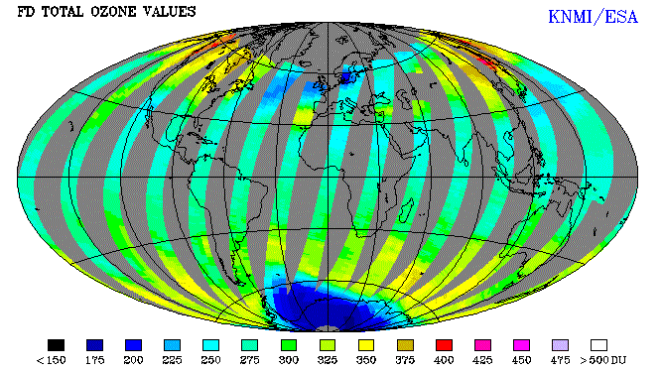
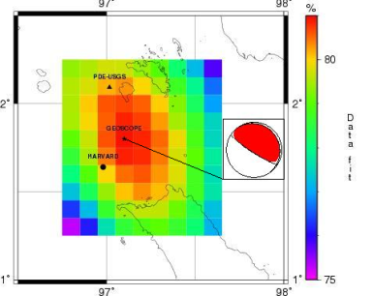
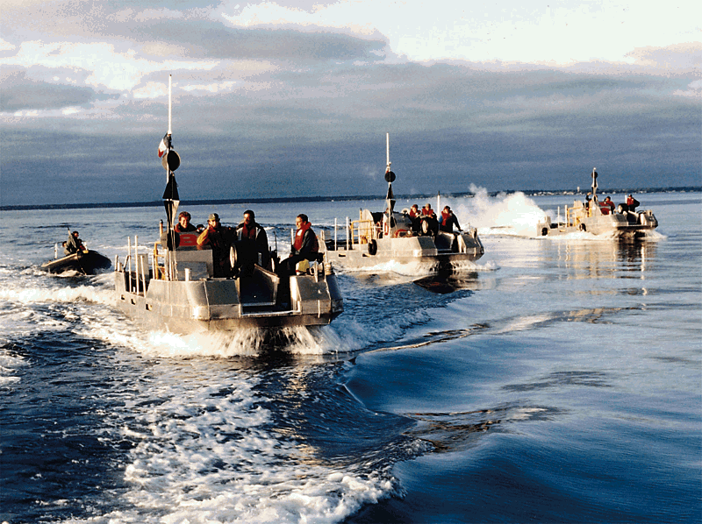
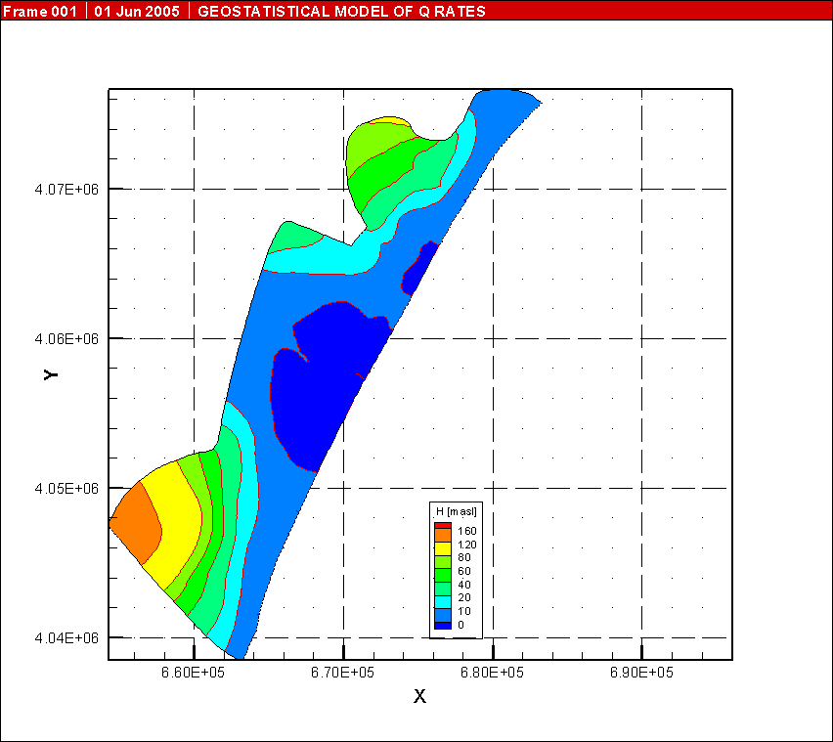
Earth Science
Flood of a Danube river-Cascade of models (meteorology,hydraulic ,hydrodynamic….) UISAV(SK)
ESA, UTV(IT), KNMI(NL), IPSL(FR)- Production and validation of 7 years of Ozone profiles from GOME
Rapid Earthquake analysis (mechanism and epicenter) 50- 100CPUs IPGP(FR)
Geocluster for Academy and industry CGG(FR)
Data mining Meteorology & Space Weather (GCRAS, RU)
DKRZ(DE)- Data access studies, climate impacts on agriculture
Specfem3D: Seismic application. Benchmark for MPI (2 to 2000 CPUs) (IPGP,FR)
Modelling seawater intrusion in costal aquifer (SWIMED) CRS4(IT),INAT(TU),Univ.Neuchâtel(CH)
Air Pollution model- BAS(BG)
Mars atmosphere CETP
( FR)
RISGE - OGF22

Slide 14
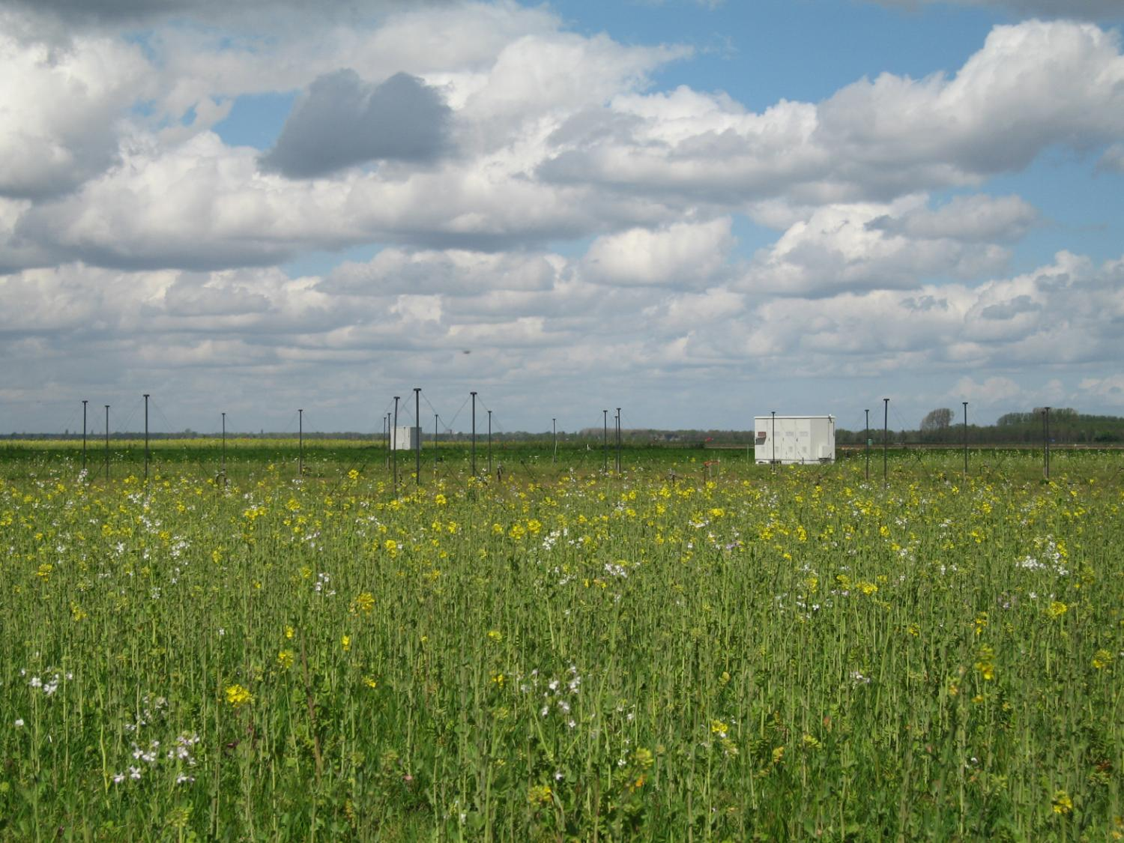
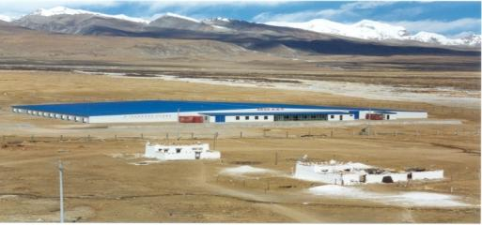
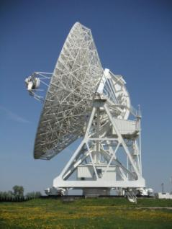
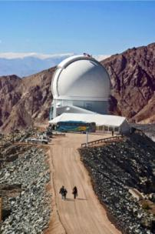
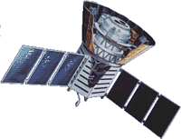
Astronomy & Astrophysics
LOFAR large distributed radio telescope
AUGER & ARGO Cosmic Ray Observatories
Notes:
LOFAR is the LOw Frequency ARray for radio astronomy.
LOFAR started as a new and innovative effort to force a breakthrough in sensitivity for astronomical observations at radio-frequencies below 250 MHz. The basic technology of radio telescopes had not changed since the 1960's: large mechanical dish antennas collect signals before a receiver detects and analyses them. Half the cost of these telescopes lies in the steel and moving structure. A telescope 100x larger than existing instruments would therefore be unaffordable. New technology was required to make the next step in sensitivity needed to unravel the secrets of the early universe and the physical processes in the centers of active galactic nuclei.
LOFAR is the first telescope of this new sort, using an array of simple omni-directional antennas instead of mechanical signal processing with a dish antenna. The electronic signals from the antennas are digitised, transported to a central digital processor, and combined in software to emulate a conventional antenna. The cost is dominated by the cost of electronics and will follow Moore's law, becoming cheaper with time and allowing increasingly large telescopes to be built. So LOFAR is an IT-telescope. The antennas are simple enough but there are a lot of them - 25000 in the full LOFAR design. To make radio pictures of the sky with adequate sharpness, these antennas are to be arranged in clusters that are spread out over an area of ultimately 350 km in diameter. (In phase 1 that is currently funded 15000 antenna's and maximum baselines of 100 km will be built). Data transport requirements are in the range of many Tera-bits/sec and the processing power needed is tens of Tera-FLOPS.
It was soon realised that LOFAR could be turned into a more generic Wide Area Sensor Network. Sensors for geophysical research and studies in precision agriculture have been incorporated in LOFAR already. Several more applications are being considered, given the increasing interest in sensor networks that “bring the environment on-line.”
The capabilities of LOFAR can be increased dramatically by broadening the scope to a European level, thus creating a European Sensor Network.
The European Gèant network is already being used to connect existing radio telescopes in the EVN program. It would be a natural next step to create a Europe-wide sensor grid for astronomy by adding LOFAR stations to these sites. As a European Sensor Grid, LOFAR could provide essential ground-based information complementary to earth-observation satellites, and would thus form an important contribution to the European Global Monitoring for the Environment and Security (GMES) program.
LOFAR contains 25.000 small antennas in the North of the
Netherlands and a part of Germany.
– LOFAR is essentially a software telescope.
• LOFAR and EGEE
– pave the path for connecting the LOFAR near-line and off-line
astronomical data reduction system to the EGEE infrastructure in
order to enable distributed computing and storage for a distributed
LOFAR community;
– enabling the astronomy VOs LOFAR and Omegac.
The Pierre Auger Cosmic Ray Observatory
is studying ultra-high energy cosmic rays, the most energetic and rarest of particles in the universe. When these particles strike the earth's atmosphere, they produce extensive air showers made of billions of secondary particles. While much progress has been made in nearly a century of research in understanding cosmic rays with low to moderate energies, those with extremely high energies remain mysterious. Results from the Pierre Auger Observatory made a lasting impression on the scientific community in 2007. The announcement by the Pierre Auger Collaboration that active galactic nuclei were the most likely source for the highest-energy cosmic rays that hit the earth made the list of breakthroughs and top science stories for several science media organizations.
The Auger Observatory will have two sites, one in the southern hemisphere and one in the north. This allows scientists to view ultra-high energy cosmic rays over the entire sky. The southern site near the city of Malargüe in Mendoza province, Argentina has been completed in 2007. The northern site is planned for southeast Colorado, USA, near the city of Lamar.
The Auger Observatory is located in a remote region far from academic or research Institutions.
The AUGERACCESS project has been designed to improve the communications link between the Auger Observatory and the CLARA network in Argentina and hence to international networks. Over 7 Tbytes of data per year are created at the Observatory site and the desired transmission rate greatly exceeds the available transmission capacity between the Observatory and the city of Mendoza, about 400 km to the north. At present some of the data must be put on disk and hand-carried to Mendoza. This makes monitoring of the status of instruments at the Observatory extremely difficult. A link of at least 10 Mbps is required.
The existing on-line software will be re-written and extended to use state-of-art Grid services to make the required remote monitoring and control access possible. In our opinion this is a natural extension of the Grid concept to remote and secure management of facilities. Interactive communication between the European Institutions and the Auger Observatory requires a reliable high bandwidth connection.
The grid is also used for offline simulations and processing of the data acquired from the Auger Observatory.
------------
The aim of the ARGO-YBJ (Astrophysical Radiation with Ground-based Observatory at YangBaJing) experiment is to study cosmic rays, mainly cosmic gamma-radiation, at an energy threshold of ~100 GeV, by means of the detection of small size air showers. This goal will be achieved by operating a full coverage array in the Yangbajing Laboratory (Tibet, P.R. China) at 4300 m a.s.l. The central array of the ARGO detector at the YangBaJing Cosmic Ray Laboratory (4300 m a.s.l., Tibet, P.R. China) has been put into operation for physics runs. It is made of 130 identical sub-units of 12 RPCs each (.cluster.) covering a surface of about 5800 m
2 with 92% active area.
ARGO was completed in spring 2007 and processing of it data is performed on the grid.
http://ieeexplore.ieee.org/iel5/23/4448435/04448452.pdf?tp=&isnumber=&arnumber=4448452

Slide 15
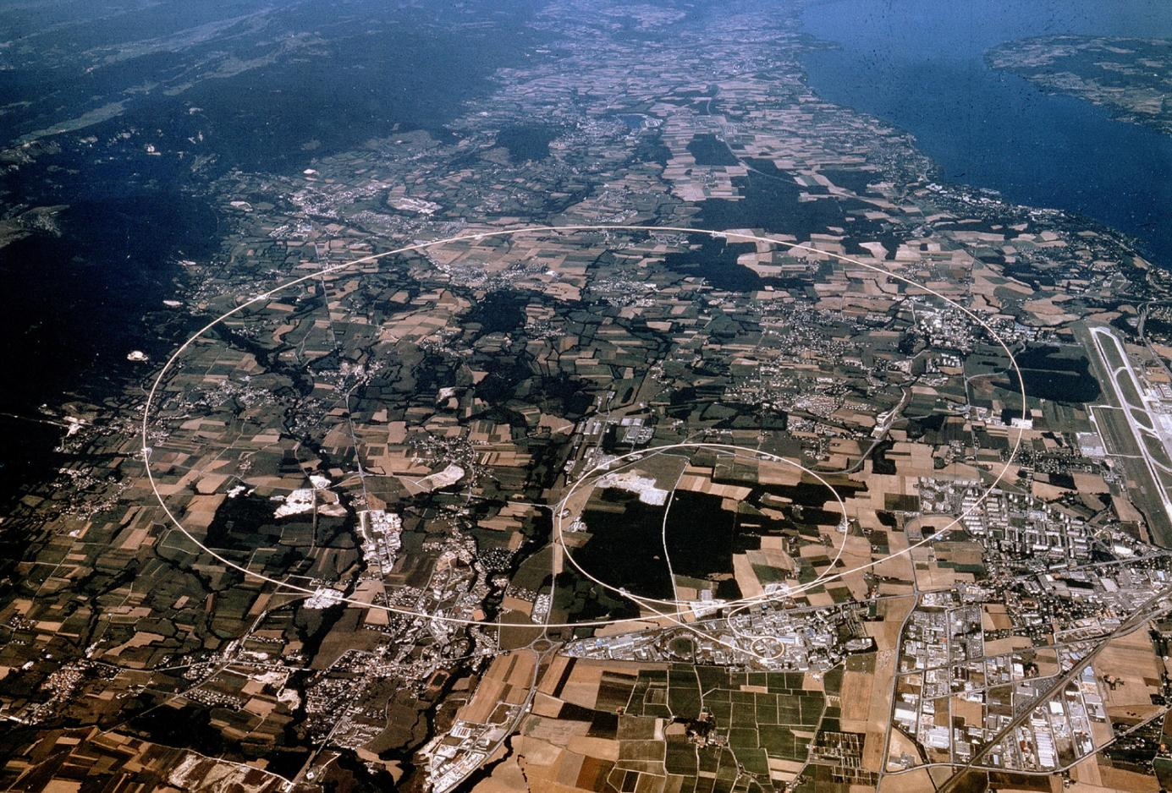
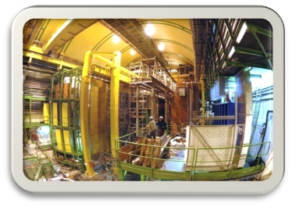
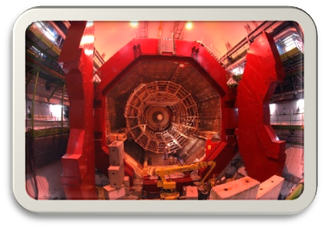
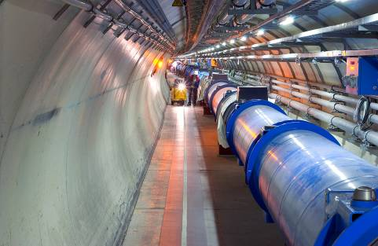
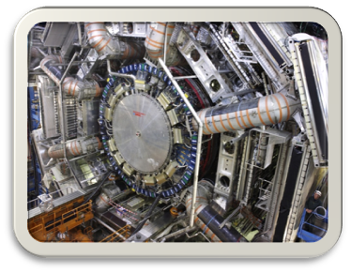
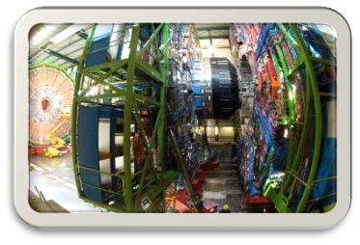
CERN’s Large Hadron Collider
Large Hadron Collider
27 km circumference
Lake Geneva
CMS
LHCb
ALICE
ATLAS

Slide 16
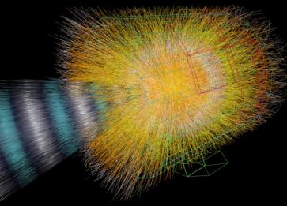
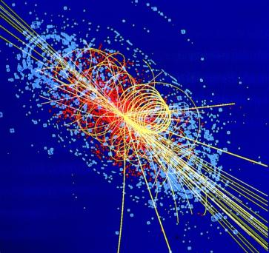
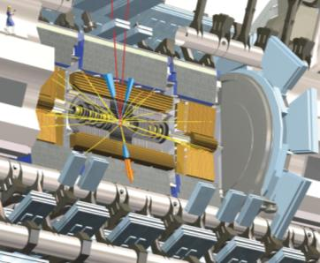
The LHC Computing Challenge
The scale and complexity of the data
  ➔ 15 PetaBytes of new data each year
The computing capacity to support 7,000 researchers all actively analysing the data
  ➔ 60’000 of (today's) fastest CPUs
The way in which the data is accessed will depend on the
physics that emerges
Notes:
When we first started designing a computing system to analyze the vast amounts of data that we knew would be coming from the LHC, we were faced with three major challenges: (1) the scale and complexity of the data, (2) the size of the computing facility that would be needed to analyse it, and (3) the need for a service that can evolve rapidly as new discoveries change the way in which the data is accessed.
The volume of data produced at the LHC will be hundreds of times greater than in previous accelerators. This is because the detectors of the experiments have many more sensors, the “events” that they record at the LHC’s energy scale are much more complex, and the rate at which interesting collisions occur is much higher. Altogether, we expect that 15 PetaBytes of new data – 15 Million GigaBytes, or enough data to fill 20 million CDs - will be generated each year, and all of this must be carefully managed and made readily accessible to all of the users.
With 7,000 LHC physicists actively analysing the data, a lot of computing power is also needed. We are planning for about 100,000 processors and about 45 PetaBytes of disk storage just for the first full year of running.
Because this is a research programme – involving a new energy level, new detectors, and new physics – we do not know exactly how much capacity will be required, nor do we know how the data will be accessed.
What we did know when designing the computing system was that it would have to be very flexible – able to develop smoothly over a period of at least ten years, during which we would be continually adding capacity, improving performance, and absorbing new computing technologies, while striving always to maintain excellent access to the data.

Slide 17
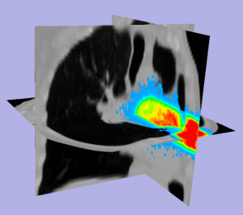
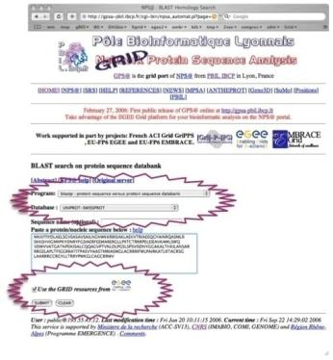
Life Sciences
Medical Imaging - ThIS (Therapeutic Irradiation Simulator)
Monte-Carlo simulation of irradiations of living tissues with photons, protons or light ions beams for cancer therapy
Bioinformatics - Grid Protein Sequence Analysis
Notes:
The medical imaging sector targets the computerised analysis of digital medical images. It includes medical data federation, compute-intensive medical procedures, processing large data sets and statistical studies over large populations.
http://en.wikipedia.org/wiki/Radiation_therapy
The bioinformatics domain studies genes, proteins, and other components of living organisms. These include studies of systems biology on the grid, molecular level oncology, genome wide association studies of diseases, protein and DNA binding in the cell nucleus and complete genome comparisons
From paper “Trends in life science grid: from computing grid to knowledge grid.” Genomic Sciences Center, RIKEN, Yokohama, Japan. konagaya@gsc.riken.jp
(Dec’’2006): http://www.ncbi.nlm.nih.gov/pubmed/17254294
Bioinformatics applications often have to deal with thousands of relatively small independent tasks, each of which costs at most seconds or minutes for computation.
…
…
"Parameter Mining" is an alternative approach to genetic algorithms for the parameter estimation of mathematical models [26]. It uses two-dimensional geometrical patterns representing parameter-parameter dependencies (PPD) in differential equations, obtained by calculating moment parameters, such as area under the curve (AUC), mean residence time (MRT), and variance of residence time (VRT). Each two-dimensional pattern requires 25*21 measurement points to cover (10 to 6)*(10 to 5) parameter ranges, and 370 Gigabytes and 71 single cpu days are required for calculation of 256 geometrical patterns with 2,150,400 simulation in total. This CPU and data-intensive approach enables more precise mapping of biological experimental data on appropriate locations in geometrical patterns with a bird's eye view.
…
Sequence analysis, such as homology searches, genome comparisons and genome-wide analyses, are typical examples of time-consuming high-throughput symbolic processing applications in bioinformatics. Although the human genome sequence project has been concluded, there is still strong demand for high-performance sequence analysis due to the emergence of metagenomic projects and human resequencing projects as well as genome sequencing projects on mammalian and other species [27]. Sequencing data are expected to increase more rapidly as high-throughput DNA sequencing technologies become popular and economical. Unlike numerical processing, bioinformatics symbolic processing often requires large databases such as DNA and protein sequence databases. Sharing and updating of biological databases on the grid are of key importance in high-throughput symbolic processing such as homology searches, genome comparison and genome-wide scan analyses.
…
The Genome Analysis and Database Update system (GADU) provides an automated, scalable, high-throughput computational workflow engine that executes bioinformatics tools (BLAST, BLOCKS, PFam, Chisel and InterPro) with public databases (NCBI RefSeq, PIR, InterPro and KEGG) on multiple Grids of different architectures and environment, a collective member of more than 18,000 CPUs contributed by more than 60 institutions [31].
…
BLAST is a typical example of high-throughput symbolic processing in homology searches. Many GRID BLAST implementations have been developed and reported [30-35]. The characteristics of Grid Blast are summarized as follows: (1) prestaging of sequence databases to minimize the runtime overhead of transferal of large sequence databases, which often reach several Gigabytes in size, (2) databases update which keeps data consistency on the data-grid, (3) dynamic load balancing of query sequences to avoid unexpected slow responses, especially when dealing with thousands of query sequences in heterogeneous computation pools including PC-clusters and desktop computers, and (4) assembling of the results from distributed jobs.
…
Genome comparison is one of the most promising life science applications for grid computing. "The computation will be left behind a tidal wave of genomic data, unless an expandable and flexible large scale computing facility is established" described Sugawara, when investigating horizontal gene transfer among 354,606 ORFs extracted from more than 100 microbial genomes using 229 CPUs located in five institutions in 2003 [36]. It should be noted the number of pair-wise sequence comparison increases in proportion to the square of the number of genome sequences. Grid is one of feasible information technologies that can provide huge computation power necessary for this purpose.
Genome-wide scan analysis becomes more and more important but time-consuming in nature. Recent disccovery of RNA world reveals the importance of finding highly conserved regions in genome sequences for non-coding genes and microRNA binding regions as well as coding-genes and binding factor regions. SNP-based population genetics and copy number analysis on genome sequence variations are also important applications for a life science grid in near future. Gridification of sequence analysis tools are urgent issues to deal with ever–expanding genome sequences [37,38].
…
Bioinformatics workflow tools are necessary for end-users to make use bioinformatics web/grid services. Taverna is one such example which provides a workflow language and graphical user interface to facilitate the easy building, running and editing of workflows allowing the integration of resources that are published as Web services [42]. However, the quest for resources becomes a very demanding and time-consuming activity, so that a dynamic semantic indexing system of bioinformatics services becomes essential [43]. Searching functionally similar bioinformatics workflows is also important for the recyclable use of bioinformatics workflows [44]. In addition, automatic generation of bioinformatics is possible if bioinformatics ontology that defines input-output data specification and functional specification is established [45]. A workflow management system is also helpful for deploying grid applications because it enables to encapsulate architectural differences of heterogeneous grid resources from application users [46-48]. Agents society is another approach to integrate insilico experiments, resource discovery and biological system simulation [49].
…
Many bioinformatics databases are public and freely available, but it is often the case that access to the data needs to be strictly controlled in distributed collaborative research. A secure framework is needed to access clinical data that exists across regional, national and international boundaries for clinical trials and unbiased evaluations of their outcome [50]. Although Public Key Infrastructures (PKI) is the predominant method for enforcing authentication in a grid community, the Virtual Organization for Trials and Epidemiological Studies (VOTES) project adopted the Internet2 Shibboleth technology to allow a "single sign-on" authentication step between the grid/data servers and the local database resources [35,50,51].

Slide 18
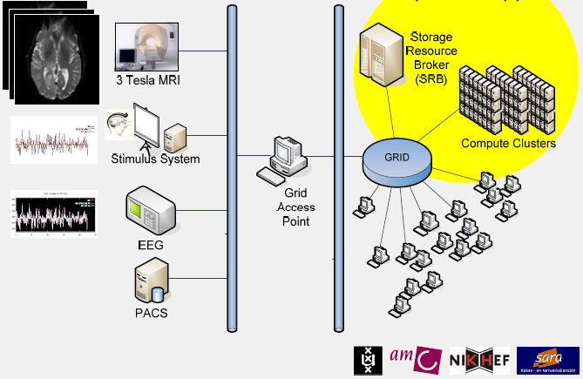
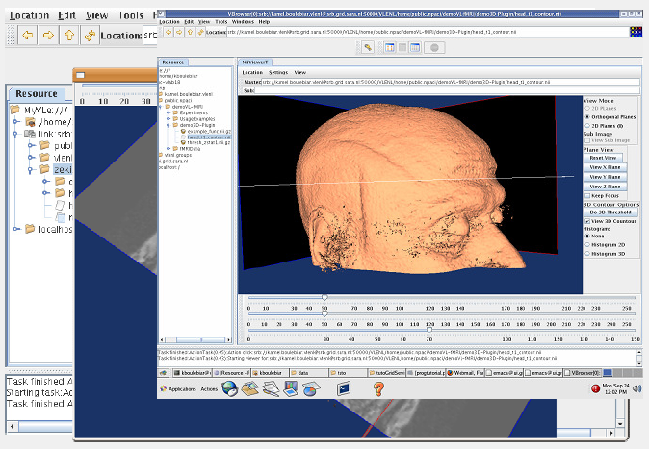
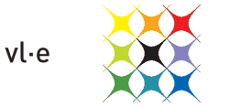
Functional MRI analysis
VL-e Medical Applications on the EGEE Infrastructure
Research work by:
Silvia Olabarriaga (AMC, UvA)
Tristan Glatard (IvI,UvA)
Abdullah Ozsoy (IvI,UvA)
Storage of fMRI research data
for sharing between groups and
processing of image alignments

Slide 19
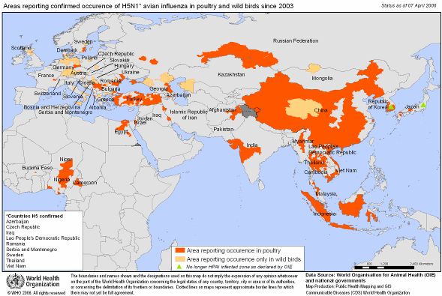

In silico drug discovery
Diseases such as HIV/AIDS, SRAS, Bird Flu, Malaria etc. are a threat to public health due to world wide exchanges and circulation of persons
Grids open new perspectives to in silico drug discovery
  Reduced cost and adding an accelerating factor in the search for new drugs
International collaboration is required for:
Early detection
Epidemiological watch
Prevention
Search for new drugs
Search for vaccines
Avian influenza:
bird casualties
Notes:
The acronym WISDOM, for Wide In Silico Docking On Malaria, comes from the first screening experiment at a large scale against malaria and is now used as a generic name for the initiative.
The WISDOM initiative runs large-scale computations for the in-silico drug discovery against emerging and neglected diseases. These virtual screening calculations determine how well certain drugs attach to specific sites on the target virus – those which dock are more likely to be active against the virus. It has been successfully deployed against malaria and avian influenza, with exciting results confirmed in vitro.
From paper “Trends in life science grid: from computing grid to knowledge grid.” Genomic Sciences Center, RIKEN, Yokohama, Japan. konagaya@gsc.riken.jp
(Dec’’2006): http://www.ncbi.nlm.nih.gov/pubmed/17254294
One of the best examples of life science high-throughput computing is the WISDOM high-throughput docking project in the Enabling Grids for E-sciencE (EGEE) project. It achieved over 46 million docking simulations, using 1700 computers distributed in 15 countries in about 6 weeks. The equivalent of 80 years on a single machine was used to find new inhibitors for a family of proteins produced by Plasmodium falciparum from 11 July 2005 to 19 August 2005 [19].
DIANE is an enhanced version of WISDOM with a light-weight framework. It was used to search for potential drugs for the predicted variants of the avian flu virus (H5N1), and produced two millions docking complexes with a size of 600 gigabytes using 2000 grid worker nodes distributed in 17 countries [20]

Slide 20
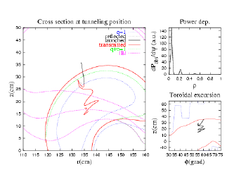
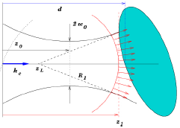
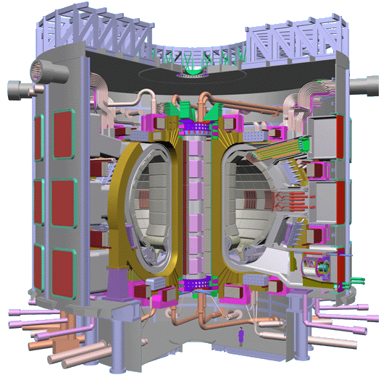
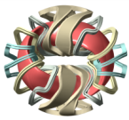
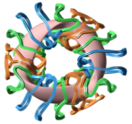
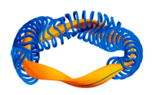
Fusion
Commercial exploitation of fusion energy still needs to solve several outstanding problems requiring exceptional computing facilities including supercomputers and cluster-based grids
Ion Kinetic Transport
Massive Ray Tracing
Stellarator Optimization
Interworking course-grained clusters and MPP systems across both the EGEE and DEISA grids
Notes:
Commercial exploitation of fusion energy still needs to solve several outstanding problems, some of which require a strong computing capacity. The International Thermonuclear Experimental Reactor (ITER), a joint international research and development project, aims to demonstrate the scientific and technical feasibility of fusion power and could potentially produce 500 MW of power by 2016. The exploitation of ITER requires a modelling capability that is at the limit of the present state of the art. Therefore, computing grids and high performance computers are basic tools for fusion research.
From EGEE-II DNA4.2.2:
The Ion Kinetic Transport application (or code ISDEP, Integrator of Stochastic Differential Equations
in Plasmas) has been run in stellarator geometry and is now in process of improvement. The new
major capability of the application is the introduction of self-consistent transport calculations with the
capability of updating the background plasma, hence performing quasi-linear calculations (the number
of CPU hours for this type of calculations is 15000). Several new features are under consideration,
being an important one to use ISDEP for tokamak configuration and, in particular, for ITER tokamak.
ISDEP code has been also used to perform divertor studies in magnetic confinement devices. The
strike points of the ions against the vacuum chamber are estimated and it is possible to develop
strategies to minimize such strikes.
The MaRaTra application is used to study plasma heating by a microwave beam simulated by a huge
number of rays. This application is useful especially for estimating the properties of Electron
Bernstein Waves, which present a quasi-electrostatic polarization and cannot be simulated with the
usual number of rays. MaRaTra can be used also to optimize the microwave launching position and
characteristics, as has been done in TJ-II stellarator. One important feature of this application is that no
result can be lost, since the beam structure must be kept. In order to guarantee this fact, the
metascheduler GridWay is used to launch the application and to pick the results, organizing the
workflow.
Another embarrassingly parallel application is the simulation of the Electrostatic Residual Ion dump
(ERID) of the Neutral Beam Injector (NBI) of ITER. The goal of these calculations is to elucidate if
the ERID or the Magnetic RID concept will be finally chosen for the NBI if ITER. So these
simulations have a direct impact on ITER design.
Stellarator Optimization Application is based on a standard fusion code, VMEC that is used to
estimate the equilibrium magnetic configuration. The Stellarator Optimization is needed to find the
magnetic configuration that is optimum with respect to a certain criterion that is described by a target
function. This application works by choosing the best configuration by using a genetic algorithm,
which imposes especial demands on the application working.
More applications are in the process of being ported, like a linear version of a turbulence gyrokinetic
code (GYSELA) or one for designing plasma diagnostics.
One important recent novelty is the possibility of using the KEPLER workflow orchestration to
organize complex workflows in the grid, among the above described or other applications.
As a result of these activities the project EUFORIA has been launched. This project is envisaged for
bringing fusion community to both high performance computers and computing grids. This project
will enable more plasma physicists to use the grid for their customary activities.
Grid demos for ITER (2003): http://www.fusiongrid.org/about/events/iter-grid-agenda-2003.pdf
DEISA/EGEE interaction scenario for fusion from OMII-Europe: http://wwwiscampos.ifca.es/users/iscampos/docs/EUFORIA/2008-04-22_OMII-EU_FactSheet_EUFORIA_InteropUseCase_v1.pdf
From DEISA digest (http://www.deisa.eu/press/Media/DEISA-Digest.pdf):
“Fusion energy is one of the rare alternatives for solving
the world’s energy problem.
It has been estimated that
the world’s energy
consumption will double or triple by the
end of the century. Even if the Western
world can achieve the goals set for
saving energy, it will not be able to
compensate for the growing energy
needs of the current developing
countries.
Fusion energy has several
advantages over nuclear fission power
or fossil fuels. Fusion energy has minor
effects on the environment, it does not
generate long-term radioactive waste
and the resources are abundant, evenly
dispersed around Earth.
“Nuclear fusion is a very
challenging research field. At the
moment, it involves three main
problems: heating, confinement and
materials’ durability. Our research deals
with the confinement of fusion plasma”,
says Timo Kiviniemi who works at the
Laboratory of Advanced Energy
Systems at Helsinki University of
Technology.
To release significant amounts
of energy in a fusion reaction under
terrestrial conditions requires a
temperature of over 100 million ◦C.
Attaining such extreme temperatures
requires efficient heating of plasma
with minimized thermal losses.
The best performance has been attained
by using tokamak-type test reactors,
where plasma is floated with the help of
strong magnets in the chamber to form
a toroidal (doughnut-shape) ring. The
magnetic field confines the plasma by
preventing charged particles from
escaping; it also keeps plasma detached
from the chamber walls, which reduces
thermal loss and stress on the reactor
wall structures. There are several
experimental devices being tested in
Europe and they continuously produce
basic information needed to advance
fusion research.
…
The key feature of European fusion
research is exact coordination, which
has made it possible to allocate the
available research resources efficiently
to essential areas of research. The
fusion plasma research at Helsinki
University of Technology is also part
of the carefully coordinated program.
The national program in Finland is
coordinated by the Finnish Funding
Agency for Technology and Innovation
(Tekes) and the program is strongly
integrated to the European fusion
program.
The ITER tokamak being built in
France will not be connected to the
mains network yet. It will be used as
a research instrument to demonstrate,
among other things, that the power
plant can actually generate more energy
than it consumes.
“This has never been proved with
any device before. However, it has been
observed that the ratio improves with
the size of the device”, says Kiviniemi.
He estimates that in the future, the
energy volumes generated by the fusion
power plants then in commercial use
will roughly match the capacities of the
largest currently used power plants,
about 1000 megawatts.
“The political decision-making
process on the ITER reactor has taken
an eternity. Had more money been
available for fusion research, the reactor
could have been built earlier”, says
Kiviniemi.
“However, I am convinced that
fusion reactors will be used for energy
production. Certainly, fusion energy will
be expensive at the beginning, but as
soon as the technology has been
improved, the prices will come down.
As other fuel resources become
depleted, their price will go up and
make fusion energy quite competitive”,
says Kiviniemi

Slide 21

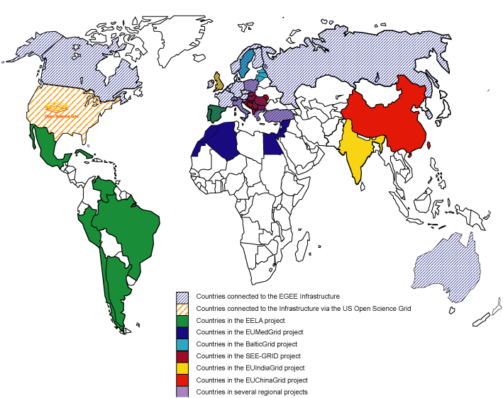





Collaborating e-Infrastructures

Slide 22

Global Trust
Why would I trust you? How do I know who you are?
‘digital signatures and certificates used as digital identities’
For the Grid a truly global identity is needed
–– so we built the International Grid Trust Federation
  supported by the EU and e-IRG policy makers
  with over 80 member Authorities a global PKI
New generation of CAs
leverages national
HE federations
  SWITCH AAI SLCS
  DFN
  Joint Northern SLCS
  (NO,DK,SE,FU,NL)

Slide 23
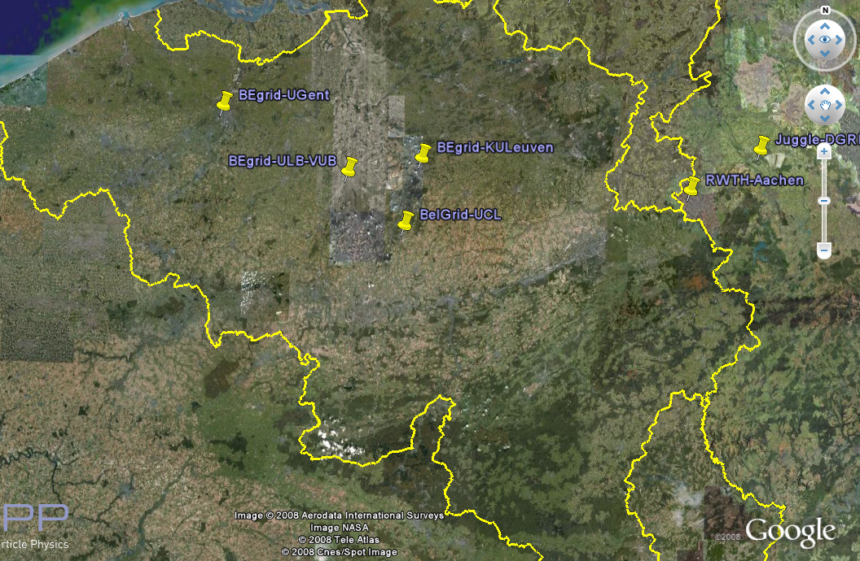
Belgium & EGEE
Active sites throughout the country
(including also some non-EGEE listed systems)
Cross-authorization for BE and NL virtual organisations
Responsible for dissemination, training, and direct user support
in the Benelux Federation of EGEE
... but Grid use is not linked to being at a grid site!

Slide 24
Connecting to the Grid?
‘If you belong to the Belgian Research World then you most probably qualify to make use of the BEgrid services’
http://www.begrid.be/
In 4 easy steps:
Go to the BEGrid or EGEE web site
  Ask the Benelux Regional Helpdesk
  Follow an EGEE training course
  at http://www.eu-egee.org/
Get a globally trusted certificate to identify you
  BELNET CA is IGTF accredited
  Trusted by all production grids in the world
Join (or set up) a Virtual Organisation
  BEtest will get you started
Use the grid to accelerate your research

Slide 25
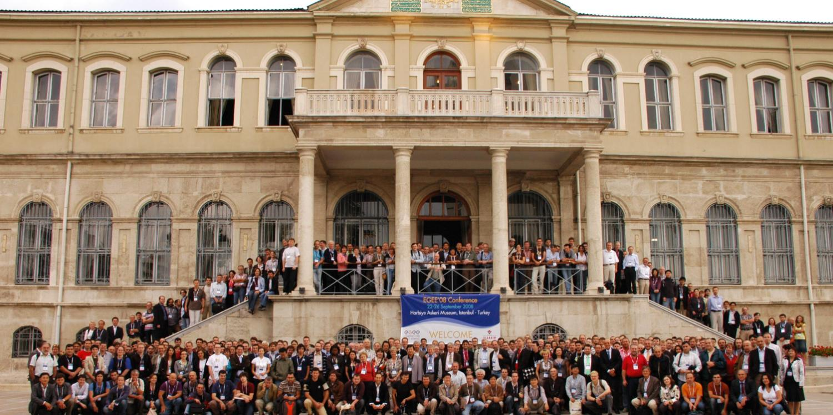
EGEE’08 Istanbul
545 participants from 48 countries

Slide 26
European Grid Initiative
Goal:
Long-term sustainability of grid infrastructures in Europe
Approach:
Establishment of a new federated model bringing together NGIs to build the EGI Organisation
EGI Organisation:
Coordination and operation of a common multi-national, multi-disciplinary Grid infrastructure
  To enable and support international Grid-based collaboration
  To provide support and added value to NGIs
  To liaise with corresponding infrastructures outside Europe

Slide 27

European Grid Initiative timeline
Must be no gap in the support of the production grid

Slide 28





EGI Design Study proposal approved by the European Commission (started 1st September’07)
Supported by 35+ National Grid Initiatives (NGIs)
    http://web.eu-egi.eu/partners/ngi/
2 year project to prepare the setup and operation of a new organizational model for a sustainable pan-European grid infrastructure
Draft EGI Blueprint produced:
Blueprint Proposal http://www.eu-egi.eu/blueprint.pdf
Functions Description http://www.eu-egi.eu/functions.pdf
http://www.eu-egi.org

Slide 29
Summary
EGEE operates the world’s largest multi-disciplinary production grid infrastructure for scientific research
Grids are all about sharing and collaborating – it is a means of working with groups around the world, to share data, results and software packages
A third phase of EGEE (2008-2010) has started
EGEE is open to collaborating with all countries and user communities
A long-term plan exists for a sustainable infrastructure
Notes:
29

Slide 30




Connecting & Catalysing User Groups for Best Practices & Standardisation
OGF25/EGEE User Forum,
2-6 March 2009, Catania, Italy
Hosted by INFN
Multi-disciplinary infrastructures
Scientific applications
Distributed Computing
Business
Innovation & Sustainability
Interoperation & Interoperability

