Slide 1
Of AARC TREEs and colourful pictures
Enhanced effectiveness for AARC in FIM for Research
David Groep
Nikhef & Maastricht University
for the AARC TREE Collaboration
FIM4R at Internet2 TechEx
December 2024

Slide 2


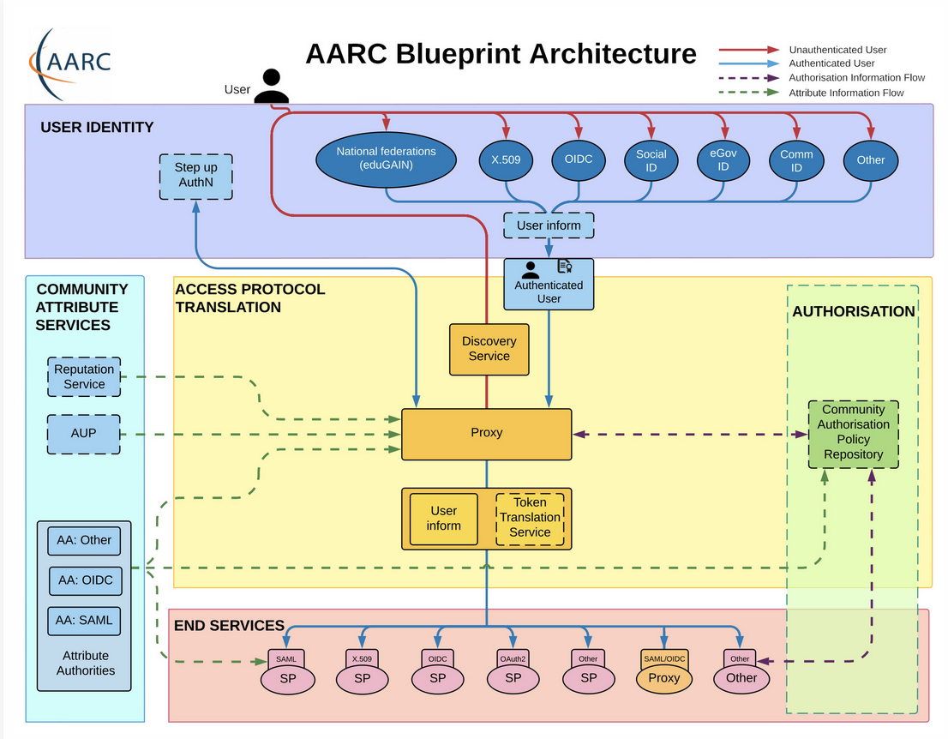








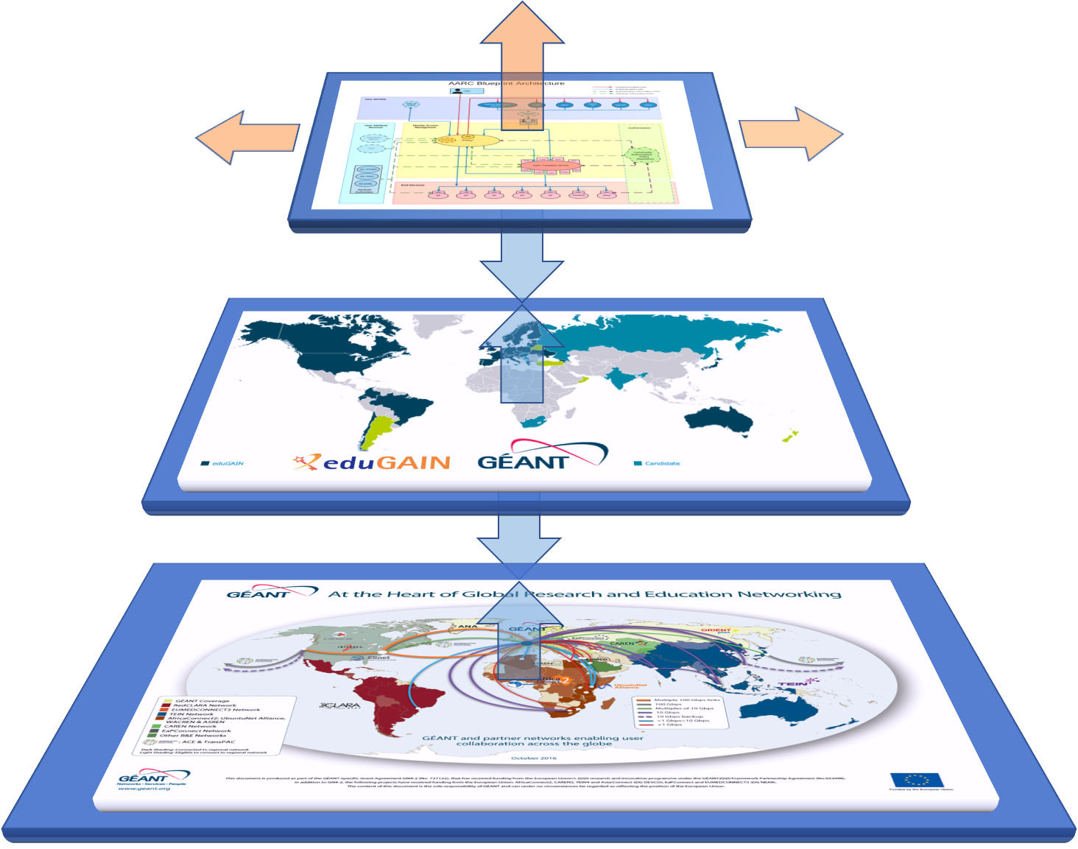
AARC Blueprint Architecture: many communities and collaboration, and full of fancy colourful pictures and stuff
…

Slide 3
What is the AARC BPA?
The Authentication and Authorization For Research and Collaborations BluePrint Architecture provides a set of building blocks for software architects and technical decision makers who are designing and implementing access management solutions for international research collaborations. By design the AARC BPA is technology agnostic and provides an architectural design for those the deploy AAIs.

Slide 4
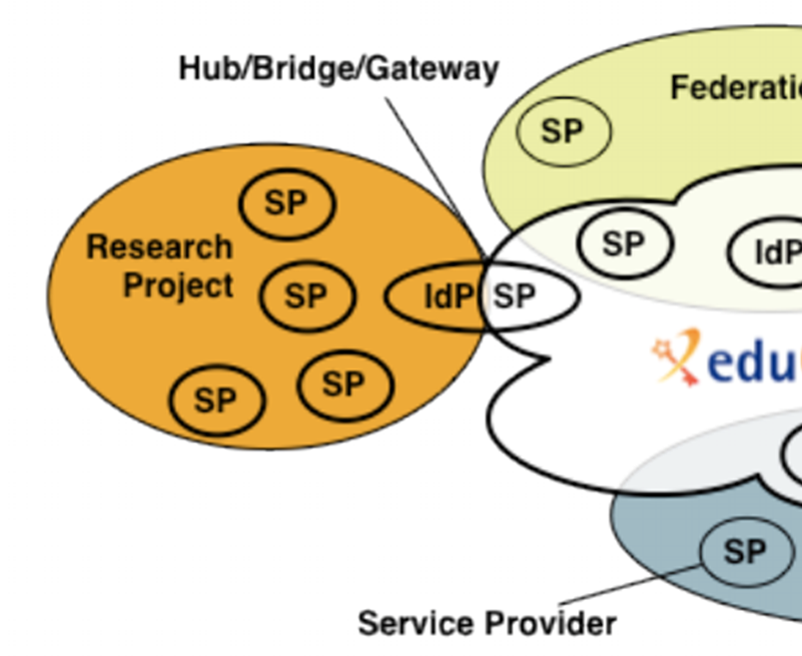
The AARC BPA: the IdP-SP proxy to enable federated access for research
Access services using identities from users’ Home Organizations, but hide complexity of multiple IdPs, federations, AA technologies
One persistent identity across all the community’s services through account linking
Access services based on role(s) users have in the collaboration.
For both web and non-web resources
Integration of guest identity solutions
Support for stronger authentication assurance mechanisms
Graphics: Ann Harding and Lukas Hammerle (SWITCH )– from a long time ago now!
Authentication and Authorization for Research Collaboration – https://aarc-community.org/

Slide 5
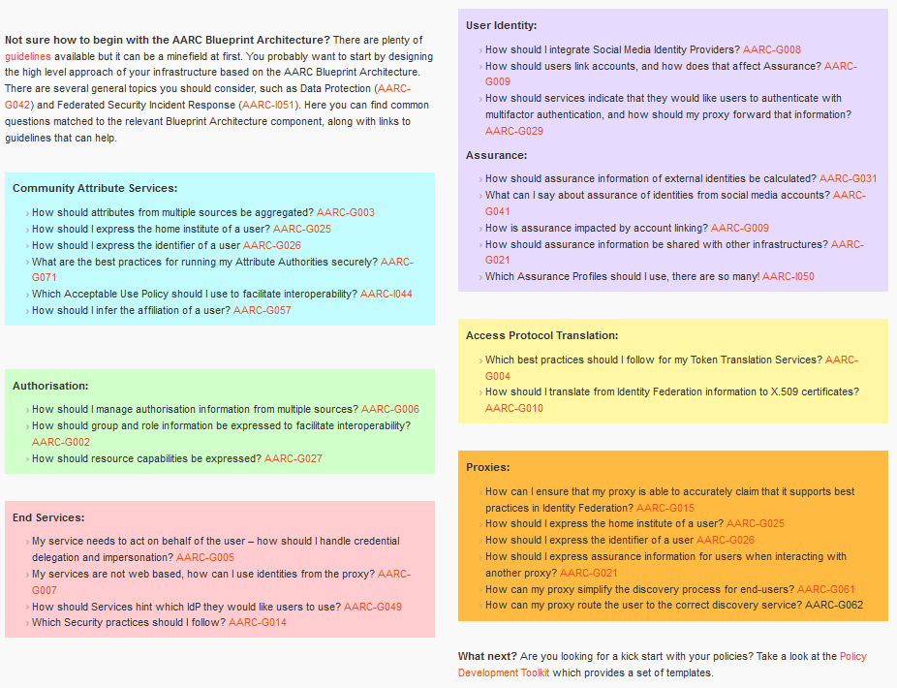
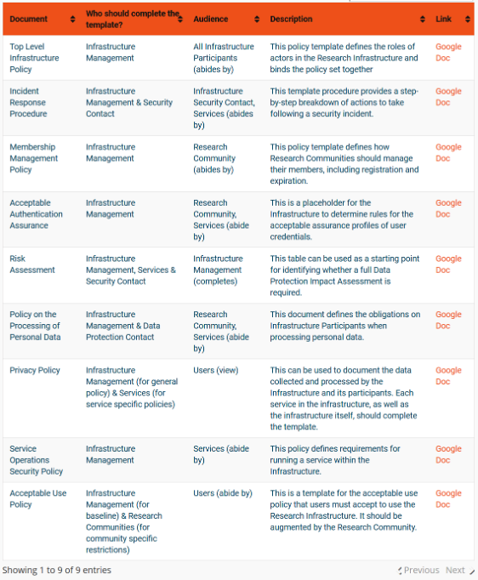

Interoperability – more than just the nice colours
https://aarc-community.org/guidelines/

Slide 6
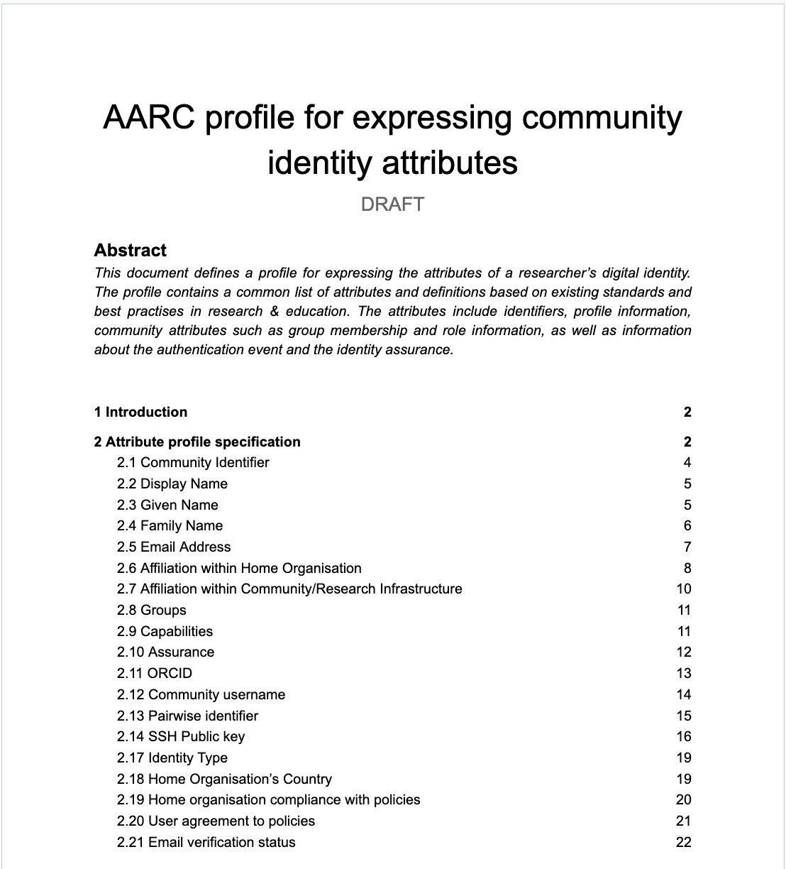
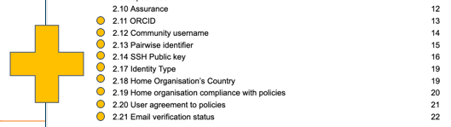
Example: how to express community identity attributes?
AARC-G056
“How to express the identifier of a user?”
→ AARC-G026
“How to express the groups and roles of a user?”
→ AARC-G069 (was AARC-G002)
“How to express resource capabilities of a user?”
→ AARC-G027
“How to express the home institute of a user?”
→ AARC-G025
How to express user assurance information
when interacting with another proxy?”
→ RAF & AARC-G021

Slide 7
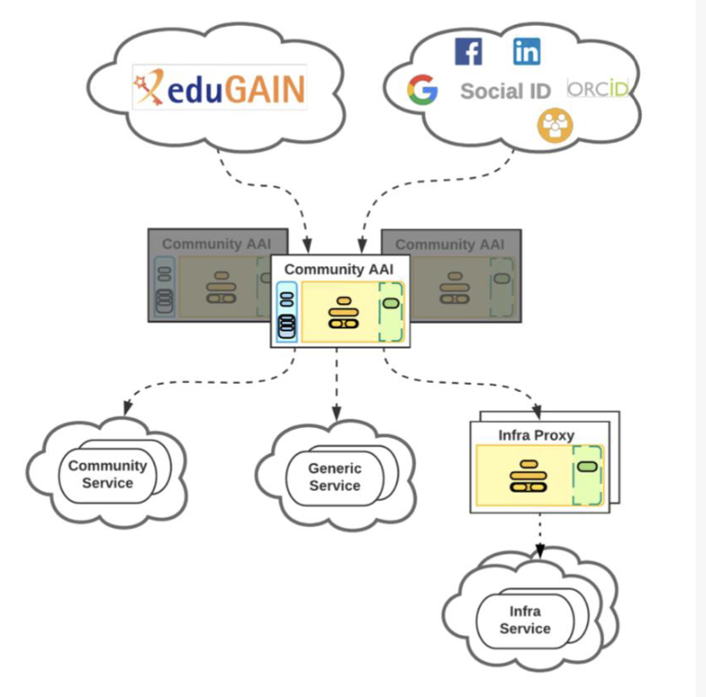
The Community AAI and the Infrastructure Proxy – structuring elements
Community AAI
The purpose of the Community AAI is to streamline researchers’ access to services, both those provided by their own infrastructure as well as the services provided by infrastructures that are shared with other communities.
Infrastructure Proxy
The Infrastructure Proxy, enables Infrastructures with a large number of resources, to provide them through a single integration point, where the Infrastructure can maintain centrally all the relevant Policies and business logic for making available these resources to multiple communities

Slide 8

AARC TREE: new EU funding to enhance the impact of AARC

Slide 9

AARC Technical Revision to Enhance Effectiveness
Recommendations for a common long-term strategy for AAI services
AARC TREE Project Main Facts
Start date: March 2024
Duration: 24 M
22 Partners
NDN (Licia ☺) is the coordinator
Updated
AARC BPA
Updated interoperability framework
We want to make AARC3
a global activity to engage
everyone interested
in the evolution of AARC BPA
Bring RIs,
e-Infrastructures and relevant stakeholders together

Slide 10
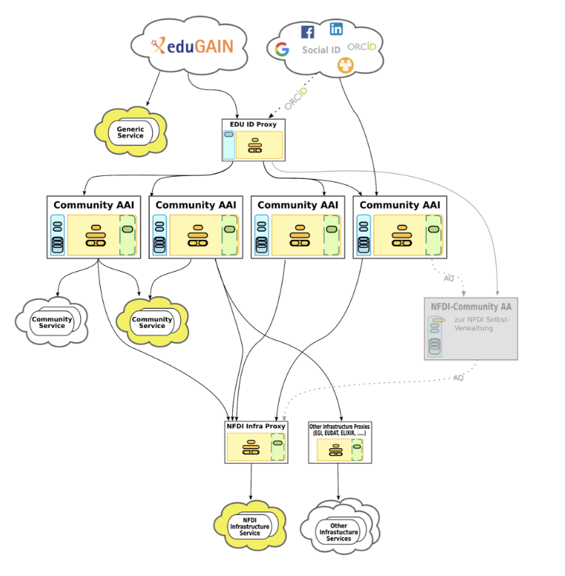
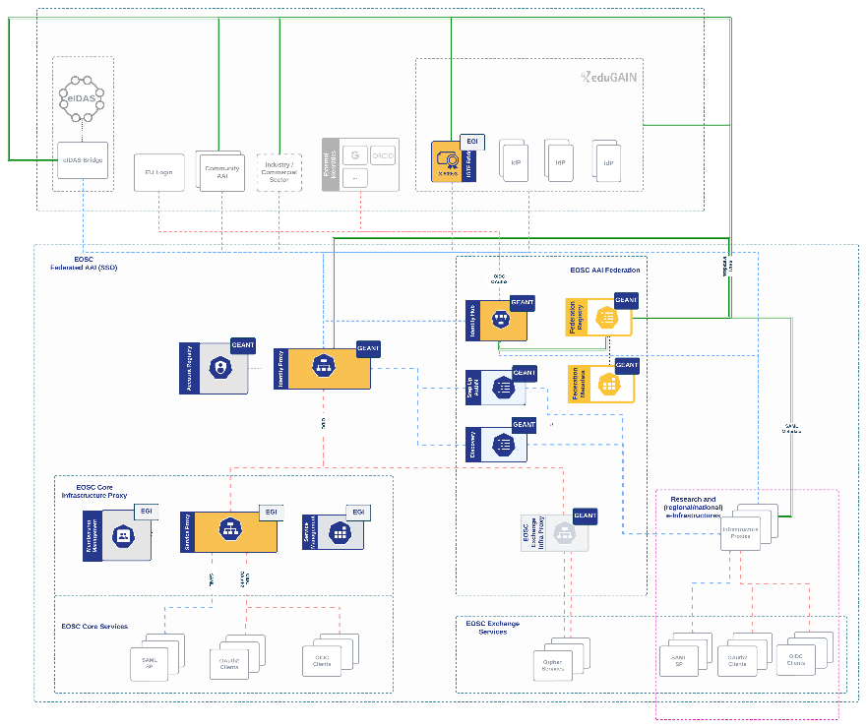
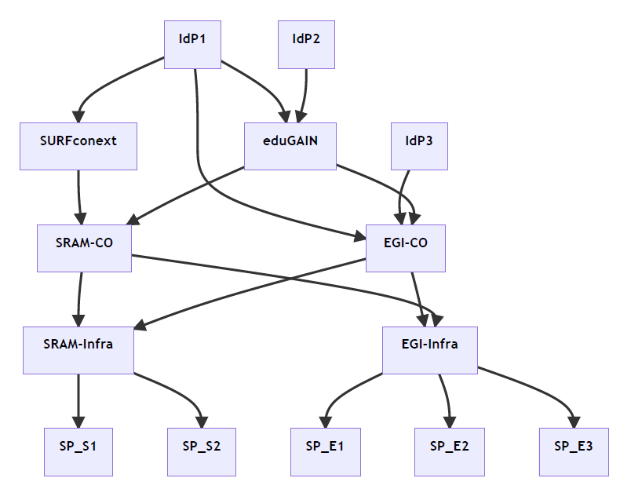
Our federated world is growing more complex
Images: SURF SSRAM and EGI by Maarten Kremers, NDFI AAI (Marcus Hardt), EOSC AAI for the EOSC Core and Exchange Federation for the EOSC European Node by Christos Kanellopoulos, Nicolas Liampotis, David Groep (June 2023 version)

Slide 11
AARC TREE main goal is to increase the (global) impact
Landscape analysis of AARC BPA adoption
due in December 2024
Use-Case Collection and Analysis
due in February 2025
Survey of the RIs and eInfras in AARC TREE and beyond - The survey focused only on the AARC Guidelines that are endorsed by AEGIS

Slide 12
AARC TREE main goal is to increase the (global) impact
Landscape analysis of AARC BPA adoption
due in December 2024
Use-Case Collection and Analysis
due in February 2025
If you have not been contacted and you feel you should provide your inputs please get in touch!!!
Survey of the RIs and eInfras in AARC TREE and beyond - The survey focused only on the AARC Guidelines that are endorsed by AEGIS
Survey of the RIs and eInfras in AARC TREE and beyond
marina@sunet.se mohacsi.janos@kifu.gov.hu

Slide 13
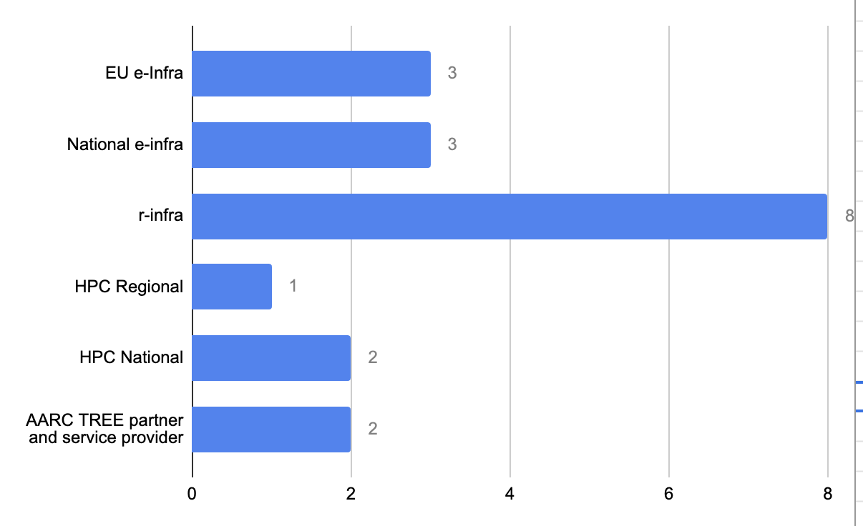
Where are AARC guidelines used today …
… and what can we learn from current implementations to ease it for new communities?
We think that this group should not be considered in the survey - we found institutional SP proxies to be too bespoke

Slide 14
Survey findings
Most implemented guidelines are in the area of Community Attribute Services and Authorisation
G061 and G062 guidelines which are about implementation of the discovery services and signaling about the end-user service seem to be not prioritised or relevant
Guidelines that overlap with Community Attribute Services and Assurance are well adopted
Least adopted guideline is the one in the End user service area that is
related to IdP hinting for discovery services

Slide 15
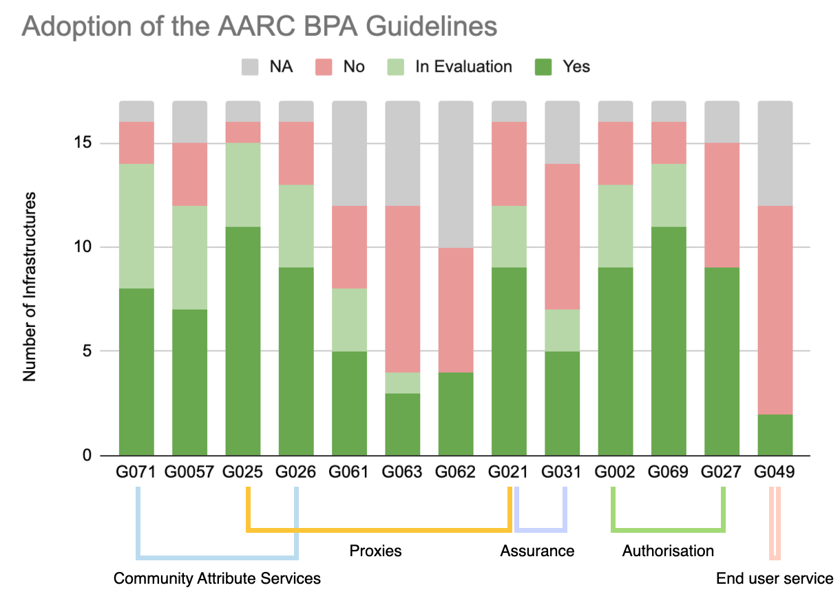
Adoption of Guidelines among interviewed Research and e-Infrastructures

Slide 16
So how to evolve the guidelines?
Use the experience of the RI and e-Infrastructures that have
deployed most of the guidelines to support the adoption for others
People often do not know where to start from - Too many guidelines and
not always clear how to deploy them. We need to identify the must use guidelines
Not all guidelines are fully tested in operational environments.
Exploring if those that roll out the guidelines can provide some how-to (‘validation’)

Slide 17

AARC BPA Guidelines – evolving interoperability with new guidance
Architecture
Protocols and profiles
Attribute specs and transport
Communications and interfaces
Policy
ISM interoperatability
Policy development kit
Trust mechanisms and federation
Validation and adoption

Slide 18
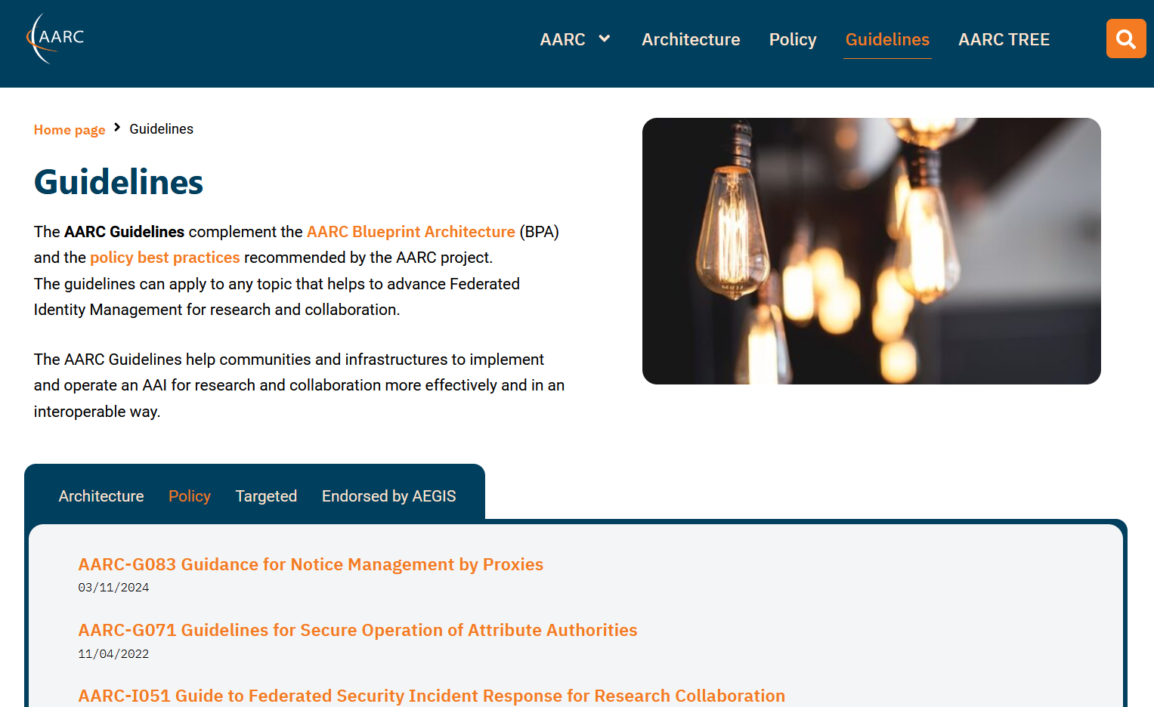
A common suite of architecture and policy guidelines
https://aarc-community.org/guidelines/

Slide 19
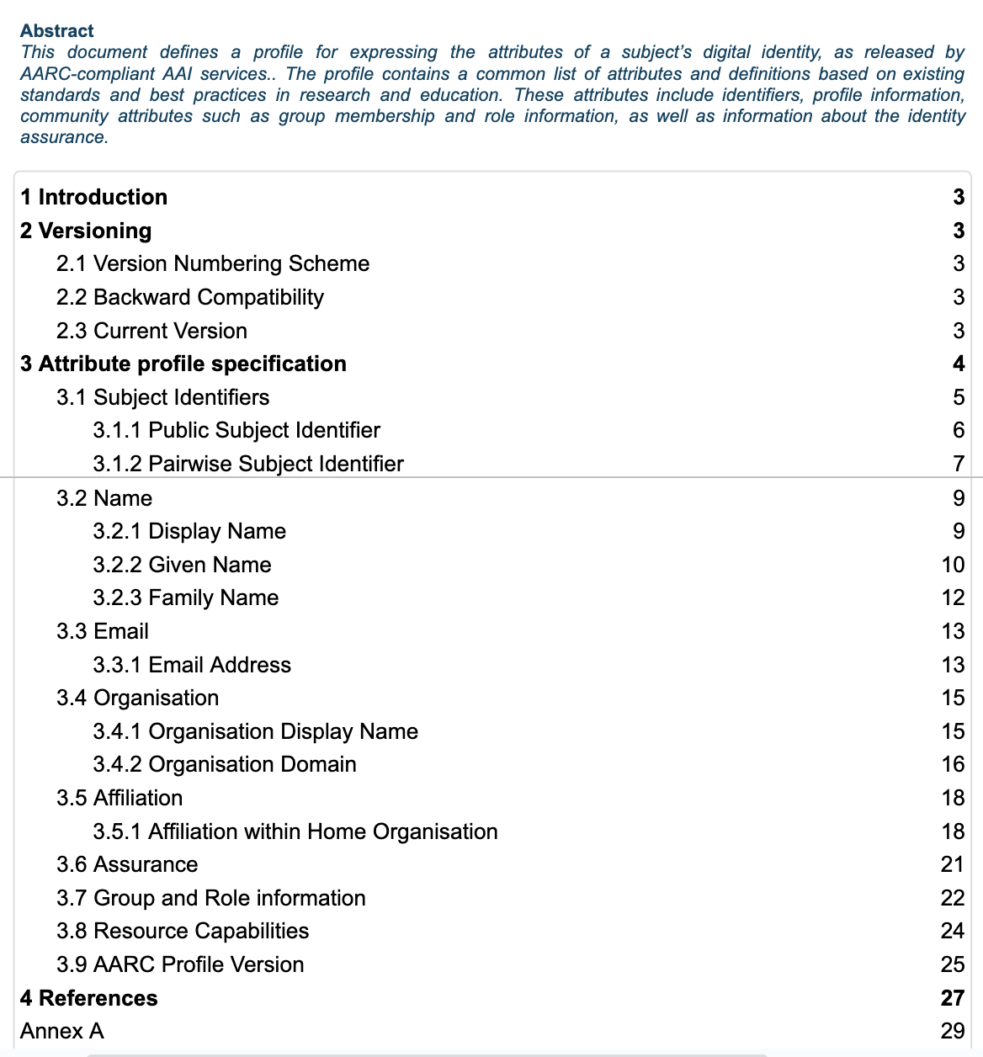
Development: interoperable Attribute Profile beyond Personalised (G056)
Purpose: Defines how AARC-compliant AAI services express the attributes of a subject's digital identity.
Builds upon the REFEDS Personalized Access entity category
  Attributes include: Organisation, user identifier, name, email address, affiliation, and assurance.
Adds community-related attributes such as group memberships, roles, and resource capabilities.

Slide 20
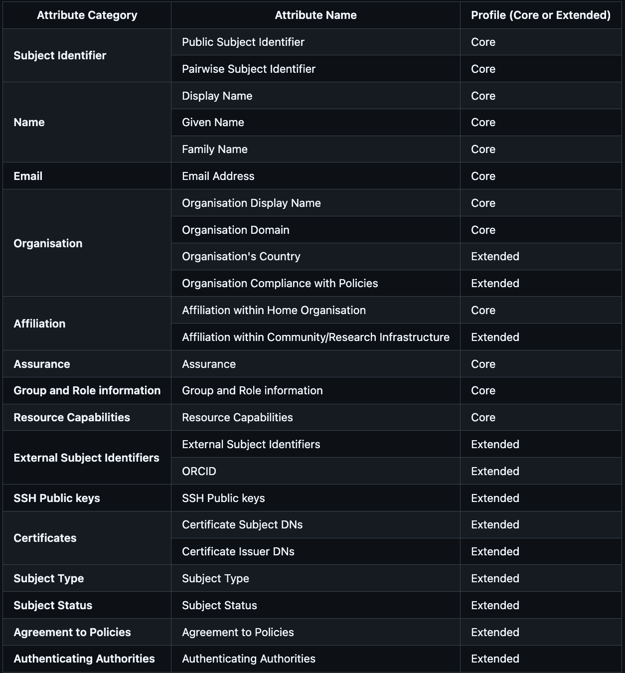
AARC-G056 enables workflows across infrastructures
– if you get the attributes, in the right place, and know what they mean
Distinguishes between the following profiles
Core - Considered essential for basic functionality.
Extended - Its inclusion provides additional information about the subject but is not mandatory.
but also discussed their rendering in SAML, OIDC, SCIM, and
whether it should be voPerson-based, or add/replace with sub claims and subject-id
discussions you can help shape!
https://github.com/aarc-community/architecture-guidelines/issues/15

Slide 21
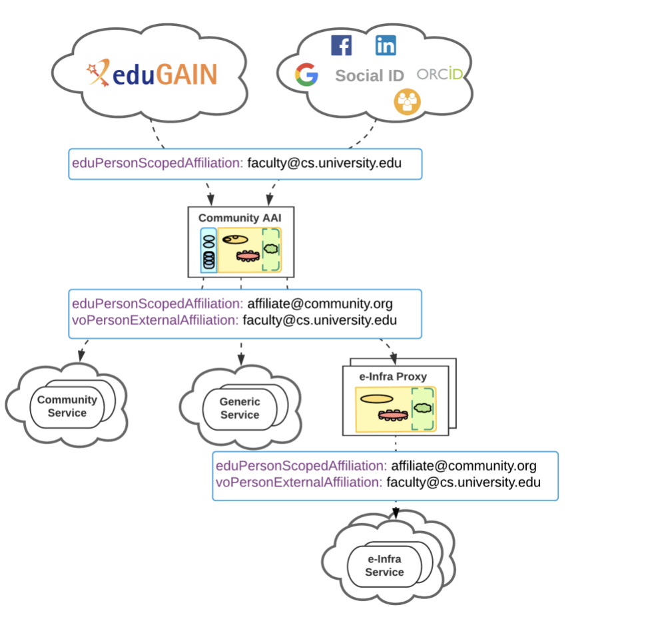
Authorisation and affiliation in community use cases
Problem
How to communicate affiliation of a user with the community
Guidelines
AARC-G025 - Guidelines for expressing affiliation information
AARC-G057 - Inferring and constructing voPersonExternalAffiliation

Slide 22
AARC-I058 Methods for Establishing Trust between OAuth 2.0 Proxies
Informational guideline rather than a normative one: encourage alignment!
How to establish trust across proxies in different domains? OpenID Federation or …
Trust Authority
R&E AAI Fed
(Domain C)
SP-IdP-Proxy
(Domain A)
No direct trust relationship
SP-IdP-Proxy
(Domain B)
https://docs.google.com/document/d/18bvC63O3wti8nw5lhgUbBVMtDG9ggqpe5ad8Om9voBo/edit

Slide 23
Comparing federation approaches in AARC-I058
Metric \ Approach | 1 Shared list of entity IDs | 2 Shared list of entity statements | 3 Shared list of entity statements via extended listing | 4 Targeted entity statement resolution | 5 Shared list of entity IDs with OID-Fed metadata | 6 OID-Fed entity discovery
Metadata format | OIDC / OAuth2, no federation metadata (e.g. security contact info) | OID-Fed | OID-Fed | OID-Fed | OID-Fed | OID-Fed
Publish/update metadata | non-standard | non-standard | non-standard | non-standard | OID-Fed well-known endpoint | OID-Fed well-known endpoint
Retrieve metadata | OIDC Discovery | Custom resolve endpoint for aggregated response | OID-Fed extended_list | OID-Fed resolve endpoint | OID-Fed well-known endpoint | OID-Fed (resolve trust chain & metadata)
Support for federation policies | Distributing Trust Mark specific lists | Trust Marks | Trust Marks | Trust Marks | Trust Mark specific lists / Trust Marks signed by list providers | Full flexibility: Trust Marks, metadata policies

Slide 24
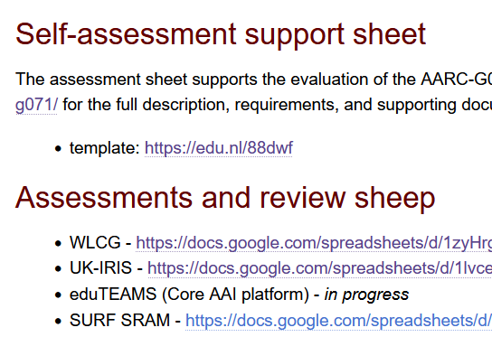


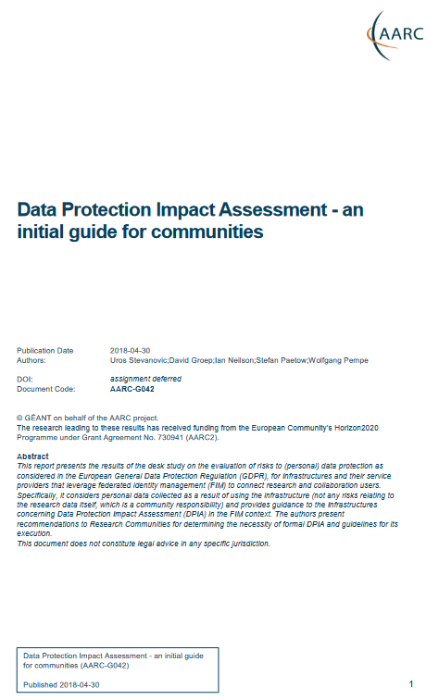

Policy and good practice underpinning the AARC Blueprint BPA
Infrastructure alignment and policy harmonisation: helping out the proxy
Operational Trust for Community and Infrastructure BPA Proxies
Increase acceptance of research proxies by identity providers through common baselines
Review infrastructure models for coordinated AUP, T&C, and privacy notices, improving
cross-infrastructure user experience (users need to click only once)
User-centric trust alignment and policy harmonization: helping out the community
Lightweight community management policy template
Guideline on cross-sectoral trust in novel federated access models
Assurance in research services through (eIDAS) public identity assertion

Slide 25
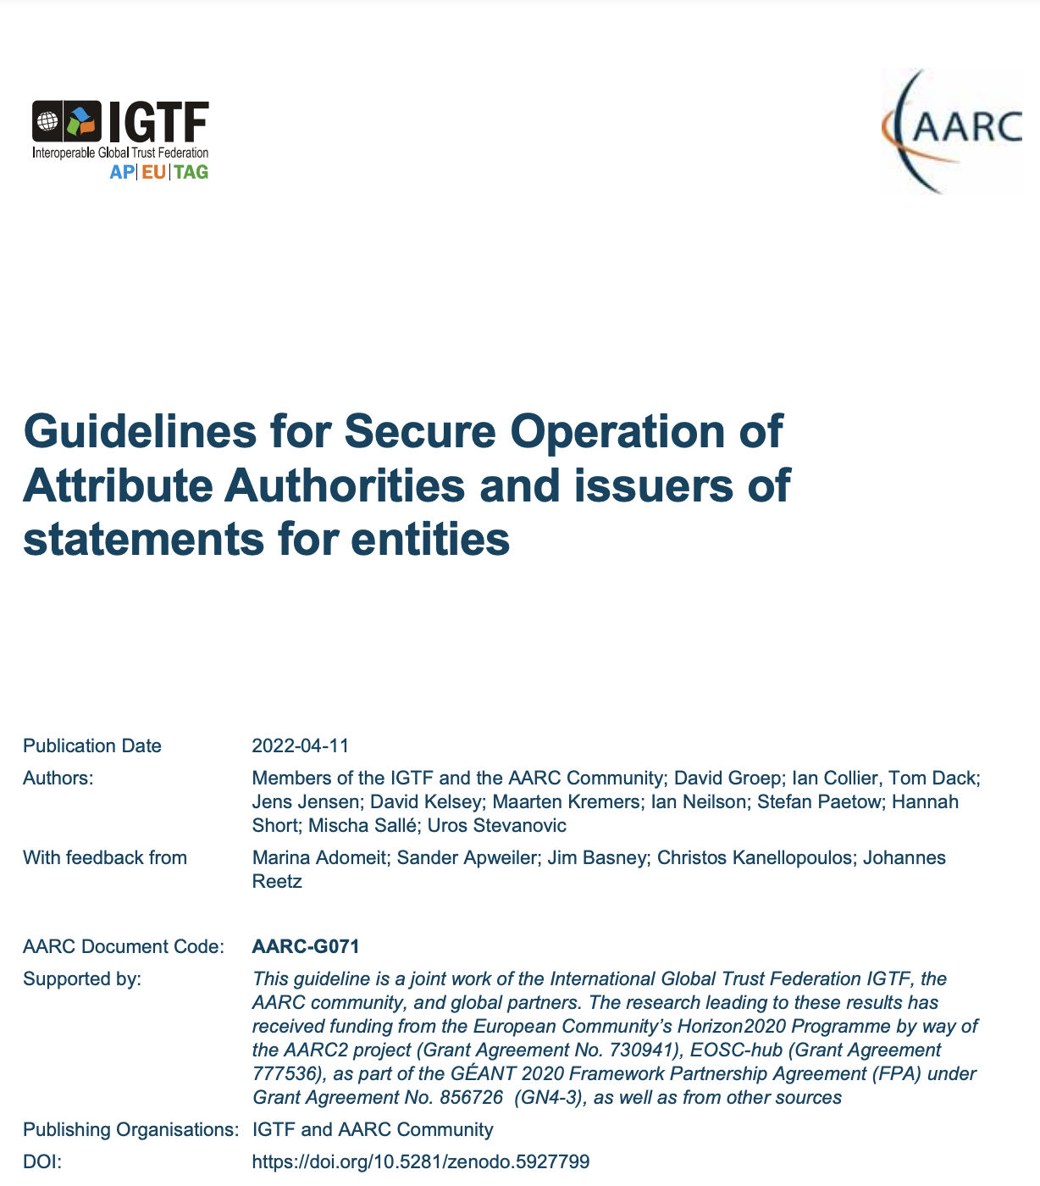
How to establish secure operation for your (AARC BPA) proxy?
The Challenge
How to securely operate proxies, attribute authorities and issuers of statements for entities?
Guideline
AARC-G071 Guidelines for Secure Operation of Attribute Authorities
Summary
Operational security processes and procedures
Requirements on traceability, auditability, and logging
Requirements on the secure operation
Requirements on securing the interactions

Slide 26
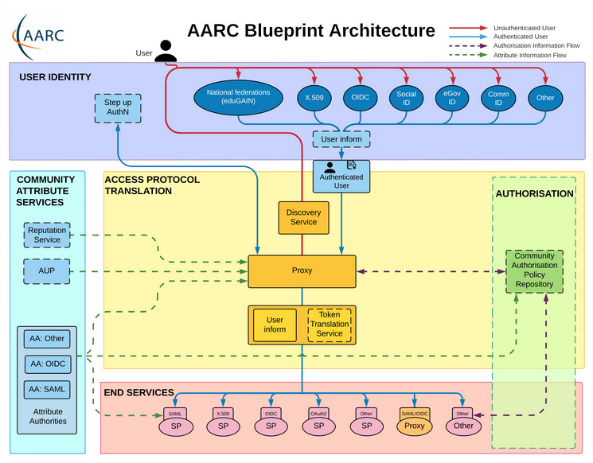
Operational security focus in the BPA: beyond just the IdPs
Community membership management directories and attribute authorities
integrity of membership
identification, naming and traceability
site and service security
protection on the network
assertion integrity
Community membership management directories and attribute authorities
integrity of membership
identification, naming and traceability
site and service security
protection on the network
assertion integrity
Guidelines for Secure Operation of Attribute Authorities and other issuers of access-granting statements
(AARC-I048, in collaboration with IGTF AAOPS)

Slide 27
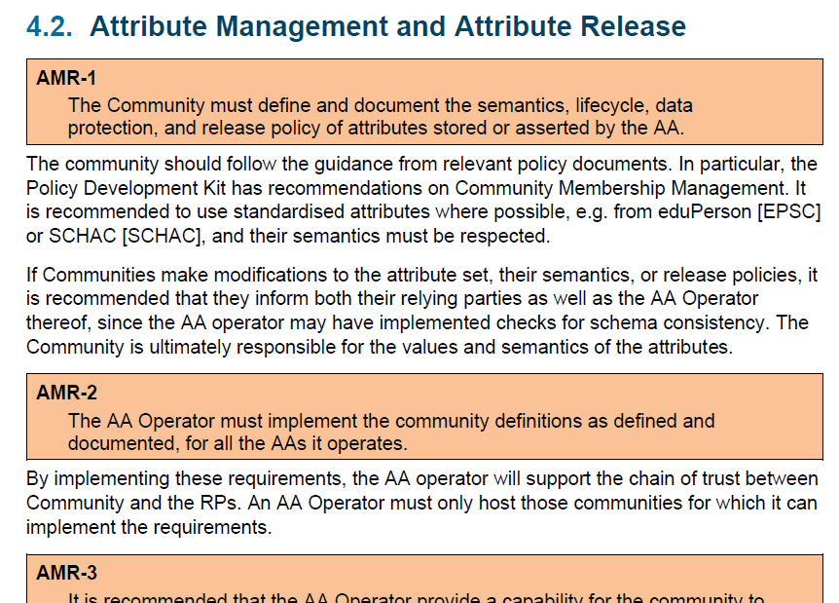
Deployment guidance included …

Slide 28
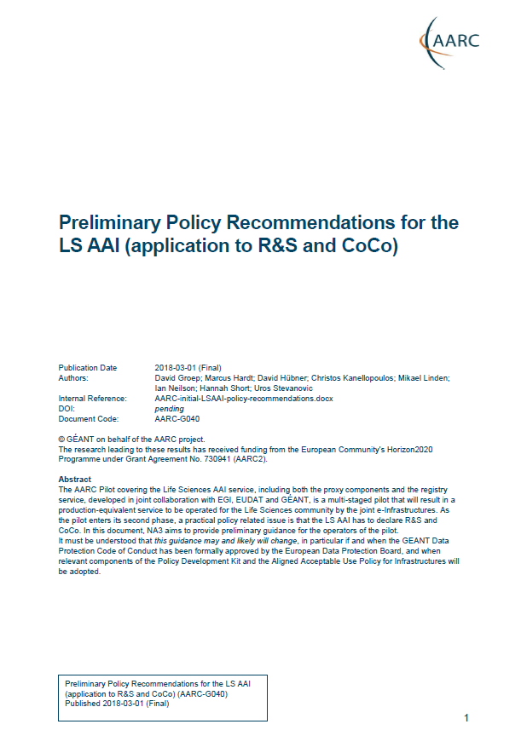
Proxies have more challenges as well: AUPs, T&Cs, Privacy notices, …
For large ‘multi-tenant’ proxies
some subset users in some communities use a set of services –
how to present their Terms and Conditions and their privacy policies, so that users
  only see the T&Cs and notices for services they will access
  this does not to need to be manually configured for each community
  is automatically updated when services join
For community and dedicated proxies
when new (sensitive) services join, who needs to see the new T&Cs?
can we communicate existing acceptance of T&Cs to downstream services?
What is an acceptable user experience in clicking through agreements?
What is effective in exploiting the WISE Baseline AUP? What do researchers need?
‘with fewer clicks to more resources’
beyond AARC-G040

Slide 29
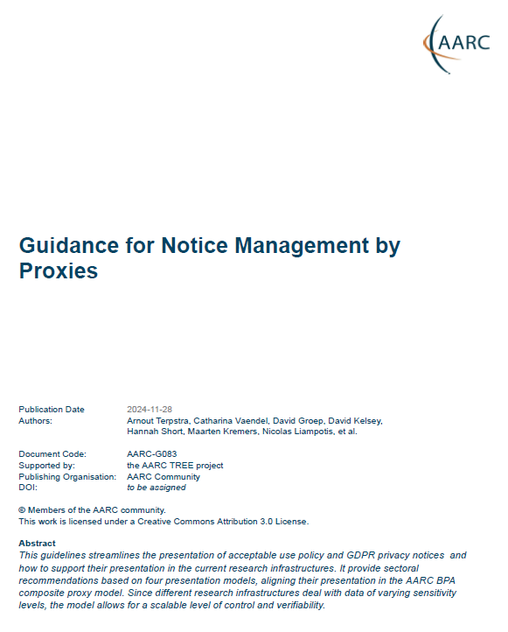
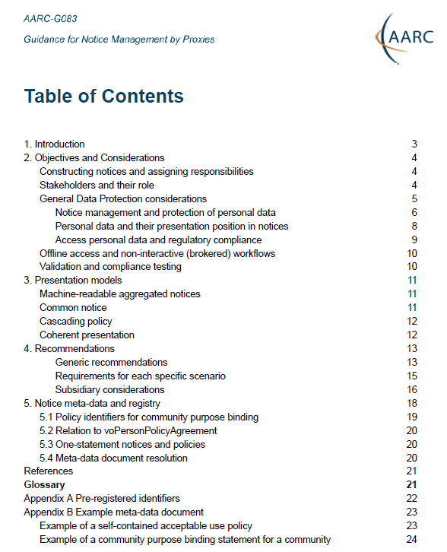
AARC G082 Notice Management by Proxies
Four presentation models. In order of preference
machine-readable aggregated notice
common notice (single common authority domain)
cascading notices (assume responsibility for underlings)
coherent presentation (you show what you need, but not more)
Generic recommendations
use the WISE Baseline AUP composition model, record what and when
user confirmed acceptance, and be able to confirm this downstream
plus a machine-actionable model to
construct notices based on a hierarchy of proxies
sufficient to build you a comprehensive WISE Baseline AUP
and a set of privacy notices (for those GDPR encumbered)
plus a namespace inspired by RFC6711’s LoA registry
https://aarc-community.org/guidelines/aarc-g083/

Slide 30
Automatically constructing notices? Will that work? We can at least try!
{ "id": "urn:doi:10.60953/68611c23-ccc7-4199-96fe-74a7e6021815", "aut": "https://www.nikhef.nl/", "aut_name": "Nikhef", "valid_from": 1649023200, "ttl": 604800, "contacts": [ "helldesk@nikhef.nl", "information-security@nikhef.nl" ], "security_contacts": [ "abuse@nikhef.nl" ], "privacy_contacts": [ "privacy@nikhef.nl" ], "policy_class": "acceptable-use", "notice_refresh_period": 34214400, "includes_policy_uris": [ "https://documents.egi.eu/document/2623" ], "policy_uri": "https://www.nikhef.nl/aup/", "description#nl_NL": "Deze Gebruiksvoorwaarden betreffen het gebruik van netwerk en computers bij Nikhef. Iedere gebruiker van deze middelen of diensten wordt geacht op hoogte te zijn van deze voorwaarden en deze na te leven.", "description": "This Acceptable Use Policy governs the use of the Nikhef networking and computer services; all users of these services are expected to understand and comply to these rules." }
{ "id": "https://operations-portal.egi.eu/vo/view/voname/xenon.biggrid.nl", "aut": "https://xenonexperiment.org/", "aut_name": "Xenon-nT collaboration", "valid_from": 1311890400, "ttl": 31557600, "contacts": [ "grid.support@nikhef.nl", ], "security_contacts": [ "vo-xenon-admins@biggrid.nl" ], "policy_class": "purpose", "augments_policy_uris": [ "https://wise-community.org/wise-baseline-aup/v1/" ], "policy_uri": "https://operations-portal.egi.eu/vo/view/voname/xenon.biggrid.nl", "description": "detector construction and experiment analysis for the search of dark matter using Xenon detectors" }

Slide 31
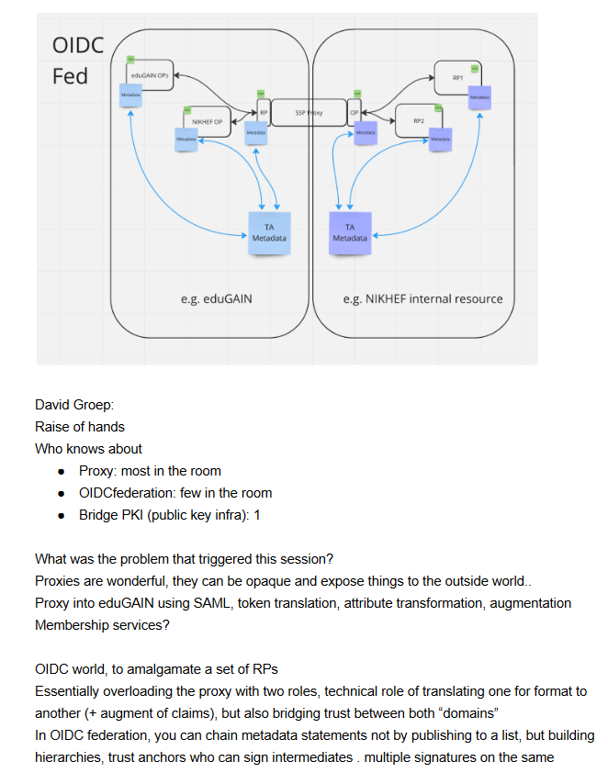
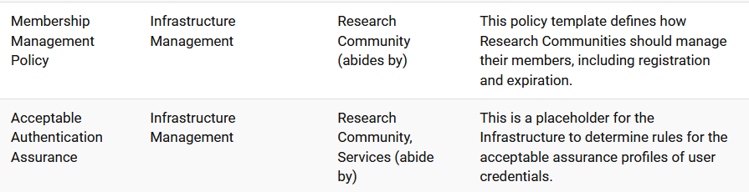
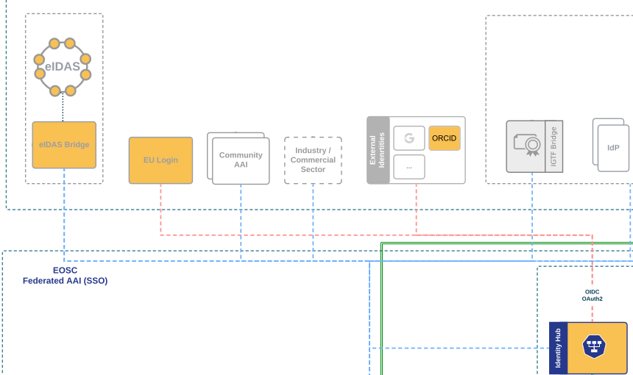
Next: helping out the community: policy toolkit for communities & trust
“small to mid-sized communities do not have the resources to maintain a bespoke community management policy”
this leaves communities and SP operators unclear about trust assurance level of members
Today’s BPA proxy links attributes as well as trust
And what about assurance: we’ll have more, and maybe more reliable, sources of assurance in the near term?

Slide 32


Right now in AARC TREE:
Time to engage ?
Use Cases Collection and Analysis
with the large ESFRI RIs, clusters, FIM4R communities, and EOSC national nodes to validate BPA effectiveness and act as a flywheel to increase its application
Compendium & Recommendations
Have the validators and use cases have a broader impact by promoting them as ‘community good practice’ examples – and telling the world about it.

Slide 33
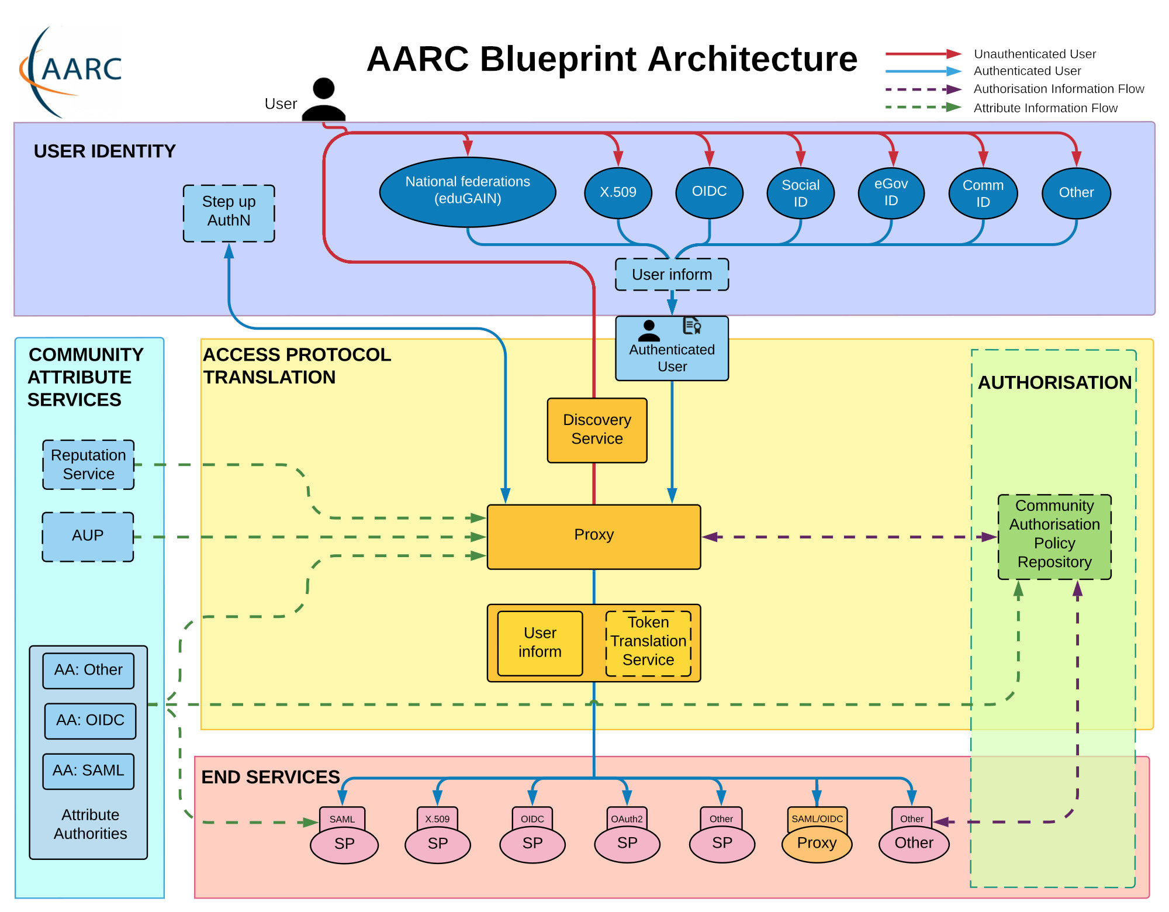
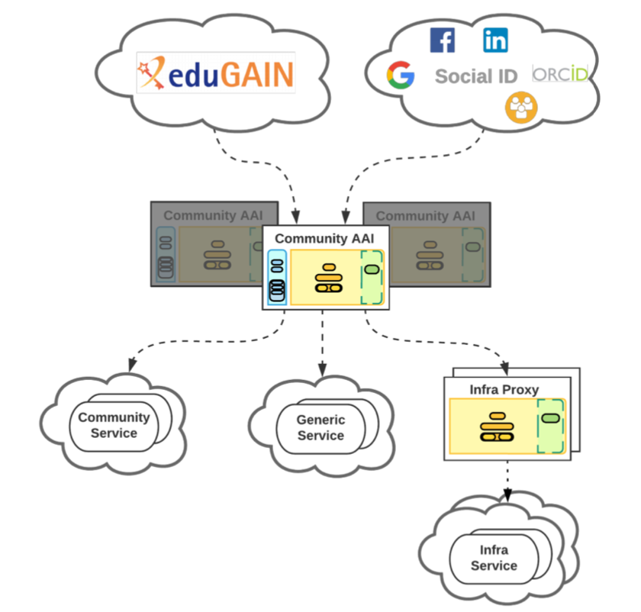
AARC Blueprint Architecture ‘BPA2025’
AARC BPA 2019
AuthZ for Federated Resources
Decentralised Identities & Wallets
OpenID Federations
AARC BPA 2025

Slide 34

AARC Community - open for all
AARC Engagement Group for Infrastructures
The forum of e/r-Infras that operate an AARC BPA complaint AAI.
It’s a closed group on purpose as we want to get feedback from the hands on group.
They approve the AARC guidelines.
Technical WG
Led by Nicolas and Christos
Where technical guidelines are discussed
Anybody can join the discussion:
https://lists.geant.org/sympa/info/aarc-architecture
Policy WG
Led by Dave and David
Supported by EnCo and IGTF
Anybody can join the discussion: policy@aarc-community.org
https://lists.geant.org/sympa/info/aarc-na3

Slide 35
Thanks to the AARC Community, including folk from whom we re-used graphics and material in this overview. In random order: Licia Florio, Nicolas Liampotis, Christos Kanellopoulos, Marina Adomeit, Janos Mohacsi, Ilaria Fava, Slavek Licehammer, Dave Kelsey, Ian Neilson, Marcus Hardt, Mischa Salle, Hannah Short, Catharina Vaendel, Arnout Terpstra, and Maarten Kremers.

