Slide 1
Frameworks for harmonized policies and practices
The Story So Far …
David Groep
Activity Coordinator
Dutch National Institute for sub-atomic Physics Nikhef
DI4R 2018
November 2017

Slide 2
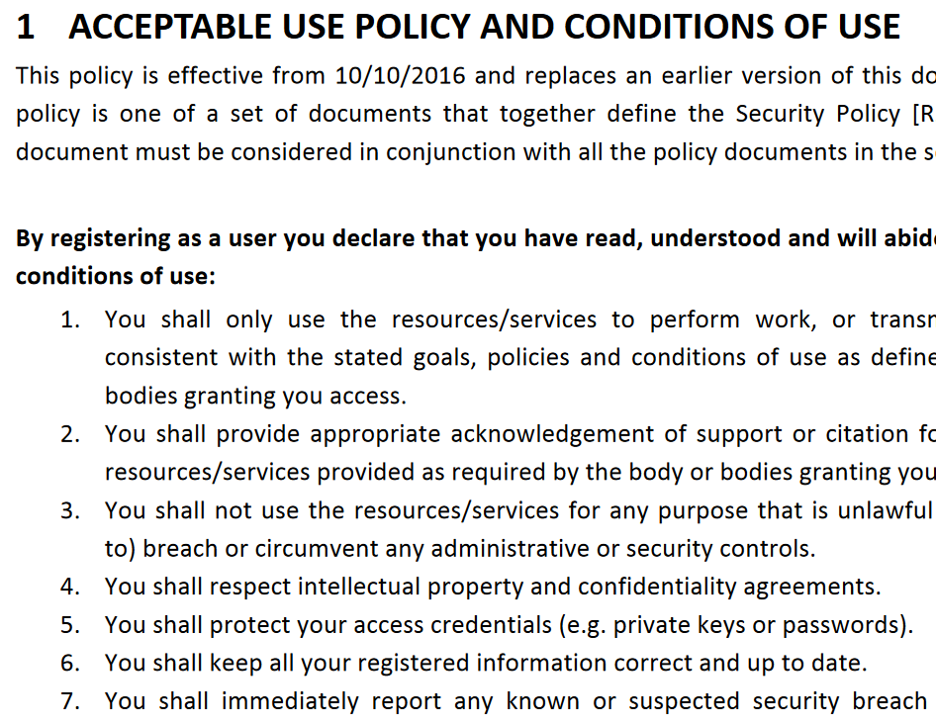
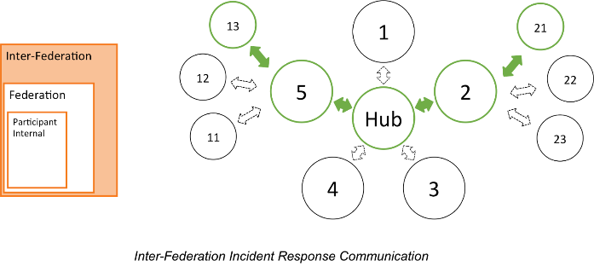
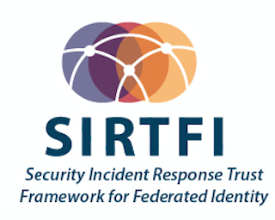


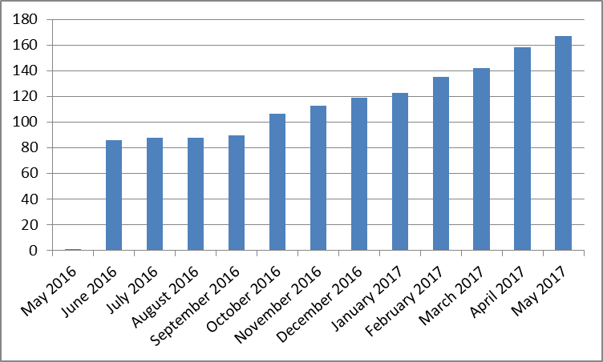
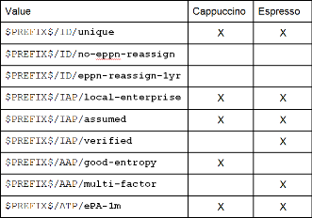
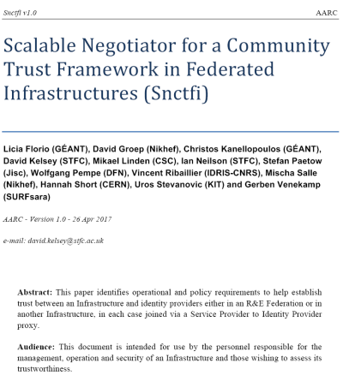
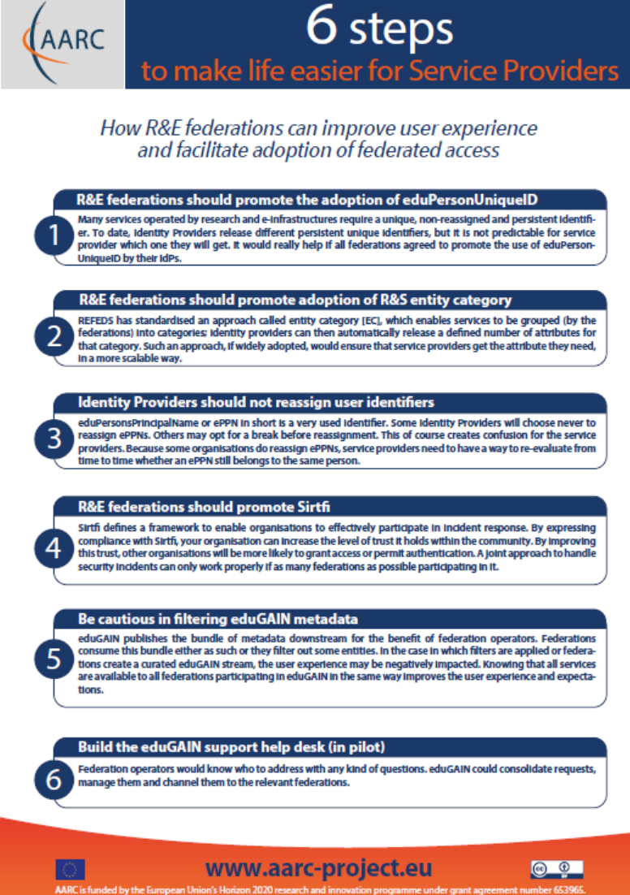

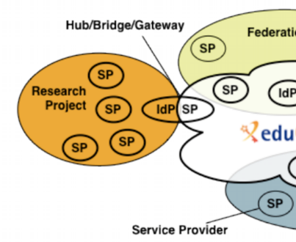
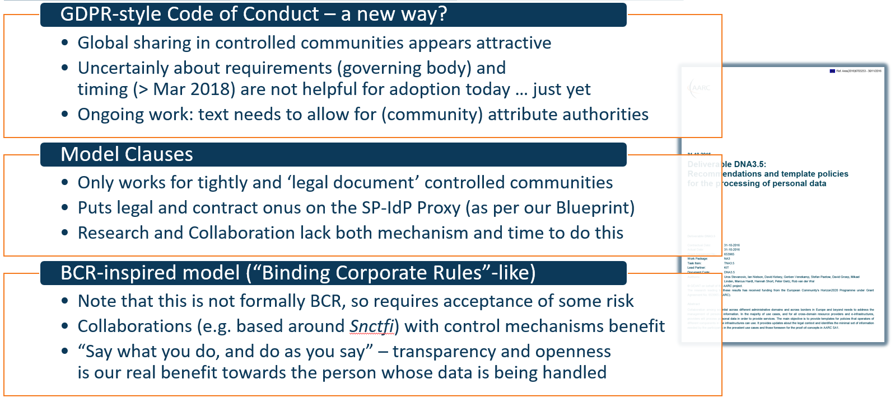
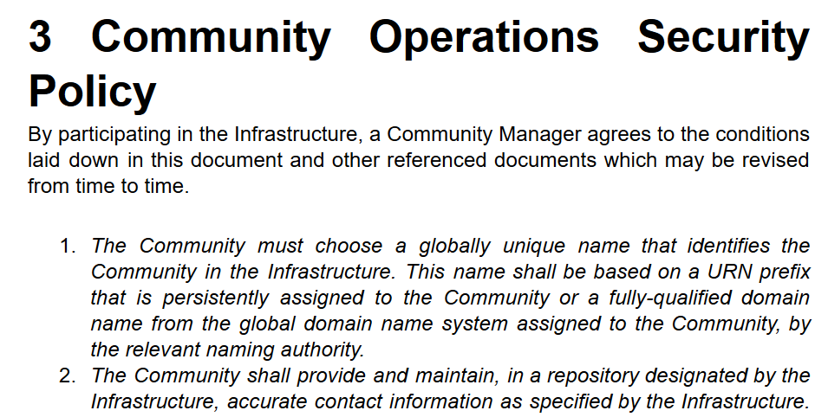
Touring the policy space in AARC
supporting Researcher
Community Assurance
‘low-risk’ use cases
few unalienable expectations by research and collaborative services
generic
e-Infrastructure services
access to common compute and data services that do not hold sensitive personal data
protection of sensitive
resources
access to data of real people, where positive ID of researchers and 2-factor authentication is needed
Operational Security
Baseline Assurance
known individual
Persistent identifiers
Documented vetting
Password authenticator
Fresh status attribute
Self-assessment
Slice includes:
assumed ID vetting
‘Kantara LoA2’, ‘eIDAS low’, or ‘IGTF BIRCH’
Good entropy passwords
Affiliation freshness
better than 1 month
Slice includes:
Verified ID vetting
‘eIDAS substantial’, ‘Kantara LoA3’
Multi-factor authenticator
bulk
model
167 entities
Supporting Infrastructures work as a coherent system
Harmonising support for practices for communties
2

Slide 3

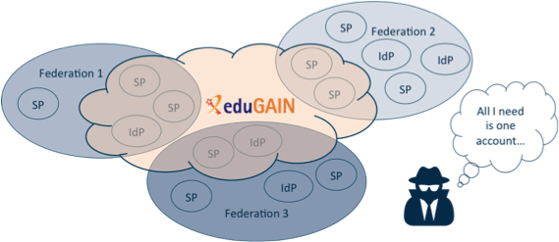

Security Incident Response in the Federated World
All | 4327
IdPs | 2570
SPs | 1763
How could we determine the scale of the incident?
  Do useful logs exist? Could logs be shared?
Taking responsibility for resolving an incident
How could we alert the identity providers
and service providers involved?
Enable information to be shared confidentially
Today:
293 IdPs support R&S
188 IdPs from 18 feds support Sirtfi
63 IdPs (from 17 feds) support both …
Security Incident Response Trust Framework
for Federated Identity
Sirtfi – based on Security for Collaborating Infrastructures (SCI) & FIM4R Recommendations
see http://refeds.org/sirtfi

Slide 4

A Security Incident Response Trust Framework – Sirtfi summary
Operational Security
Incident Response
Traceability
Require that a security incident response capability exists with sufficient authority
to mitigate, contain the spread of, and remediate the effects of an incident.
Assure confidentiality of information exchanged
Identify trusted contacts
Guarantee a response during collaboration
Participant Responsibilities
Improve the usefulness of logs
Ensure logs are kept in accordance with policy
Confirm that end users are aware of an appropriate AUP
see http://refeds.org/sirtfi

Slide 5
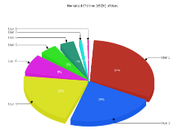
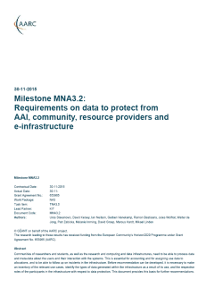
Permissing usage accounting across collective services
Data collection necessary for ‘legitimate interests’ for Research and e-Infra
Justification of global resource use, with infrastructures collecting data collaboratively
Operational purposes: fault finding, researcher support, Incident response
Global view needed for accounting data
Policy coherency as enabler – model policies
Security Incident Response – data exchange
exchange of personal data is imperative – both for EIs and Research Collaboration funding
put in place policies on retention, permissible use, secure exchange, purpose limitation
add as permissible purpose, but leave its scope to Sirtfi and existing forums
‘binding’ - in the sense that a party can only remain in the club if it’s compliant
policy suite identified by Security for Collaborating Infrastructures (SCI) group
roles are defined to limit access to personally identifiable data

Slide 6
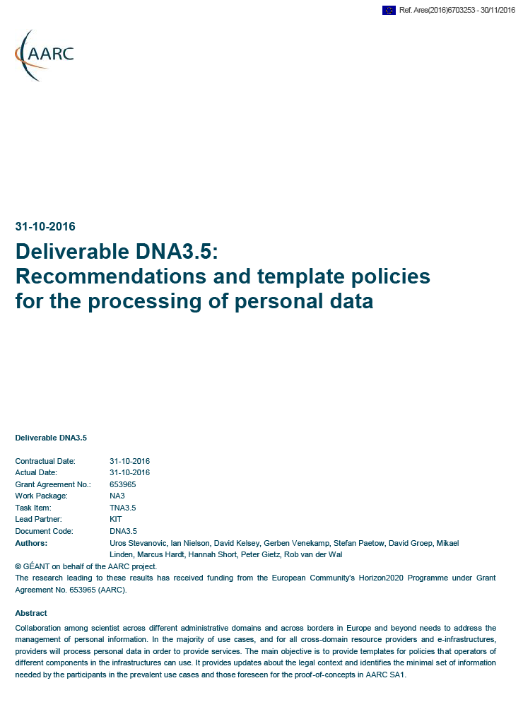
Three community models – three Recommendations?
GDPR-style Code of Conduct – a new way from May 2018
Model Clauses
BCR-inspired model (“Binding Corporate Rules”-like)
Global sharing in controlled communities appears attractive
Only works for tightly and ‘legal document’ controlled communities
Note that this is not formally BCR, so requires acceptance of some risk
Uncertainly about requirements (governing body) and
timing (> Mar 2018) are not helpful for adoption today … just yet
Ongoing work: text needs to allow for (community) attribute authorities
Puts legal and contract onus on the SP-IdP Proxy (as per our Blueprint)
Research and Collaboration lack both mechanism and time to do this
Collaborations (e.g. based around Snctfi) with control mechanisms benefit
“Say what you do, and do as you say” – transparency and openness
is our real benefit towards the person whose data is being handled

Slide 7
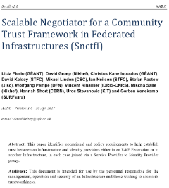
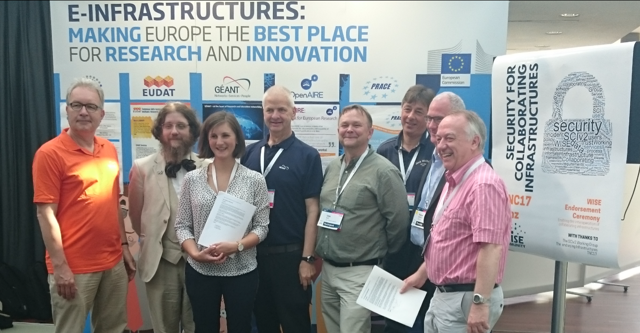
Proxying not just AAI flow, but policy & practice as well
✓
allow SPIdP Proxies to assert ‘qualities’, categories, based on assessable common trust
✓
Develop recommendations and framework for a infrastructure
coherent policy set
✓
Snctfi
Scalable Negotiator for a Community Trust Framework in Federated Infrastructures
Derived from SCI, the framework on Security for Collaboration among Infrastructures
Infrastructures would assert existing categories to IdPs: REFEDS R&S, Sirtfi, DPCoCo, …
see http://igtf.net/snctfi

Slide 8
Ease the flow across infrastructures – targeting users & communities!
˃
Identify and support commonality between acceptable use policies (AUPs)
So that a user that signed one of them need not be bothered again – and still move across silos
Generic e-Infrastructures have a similar, but slightly diverged, AUP based on the Taipei Accord
Realign the Taipei Accord concepts, and add a layered approach to support communities
˃
Support user communities implementing the gaps in Snctfi
Reference practices for communities setting up their AAI
With the central role of the community, you gain control and responsibilities
˃
Commonly agreed suite of Authentication Assurance Profiles
Common Profiles accepted and deployed for all target groups
Making the baseline a real baseline, and Cappuccino a common occurrence
Align assurance between the generic e-Infrastructures to permit use to flow
Stronger assurance for access to biomedical and human-related data

Slide 9

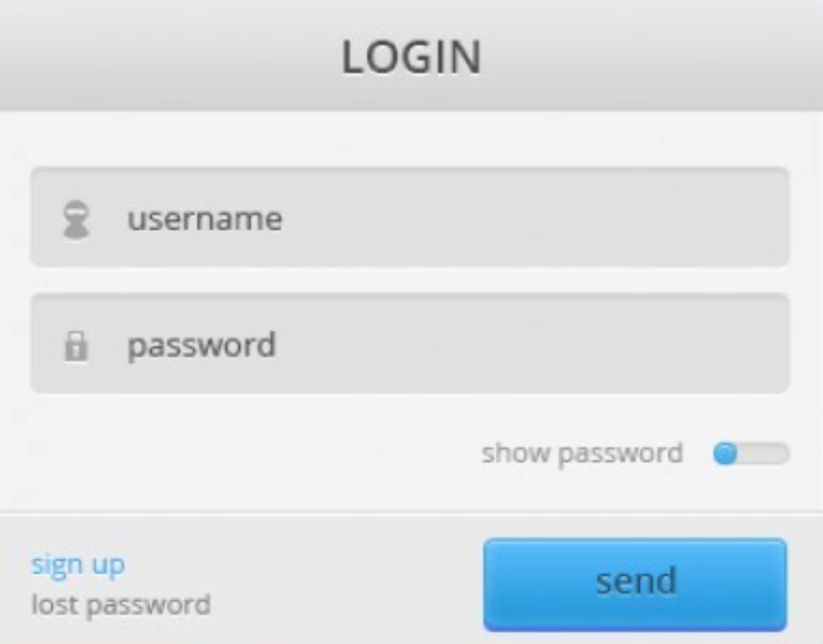

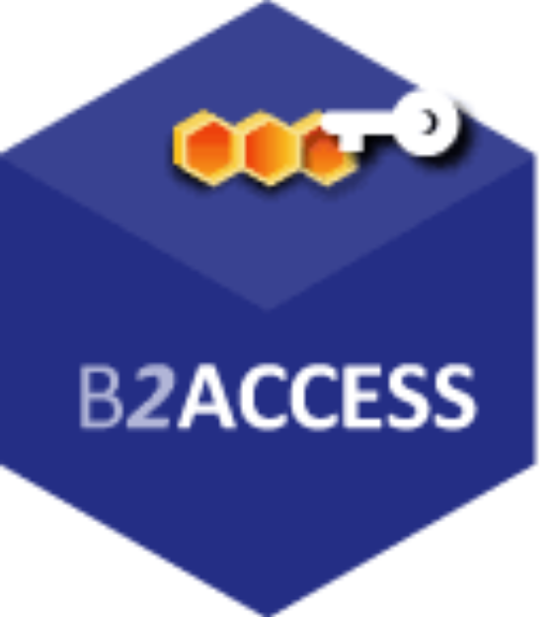




Everything meshed together … look for your favourite loop …
…
…
and many more hubs and bridges, apologies if your logo is not here …

Slide 10
Snctfi infrastructure requirements, a summary
Operational Security
User Responsibilities
Protection and Processing of Personal Data
State common security requirements: AAI, security, incident and vulnerability handling
Awareness: users and communities need to know there are policies
Have a data protection policy that binds the infrastructure together, e.g. AARCs recommendations or DP CoCo
Ensure constituents comply: through MoUs, SLA, OLA, policies, or even contracts, &c
Have an AUP covering the usual
Community registration and membership should be managed
Have a way of identifying both individuals and communities
Define the common aims and purposes (that really helps for data protection …)
Make sure every ‘back-end’ provider has a visible and accessible Privacy Policy
https://igtf.net/snctfi

Slide 11
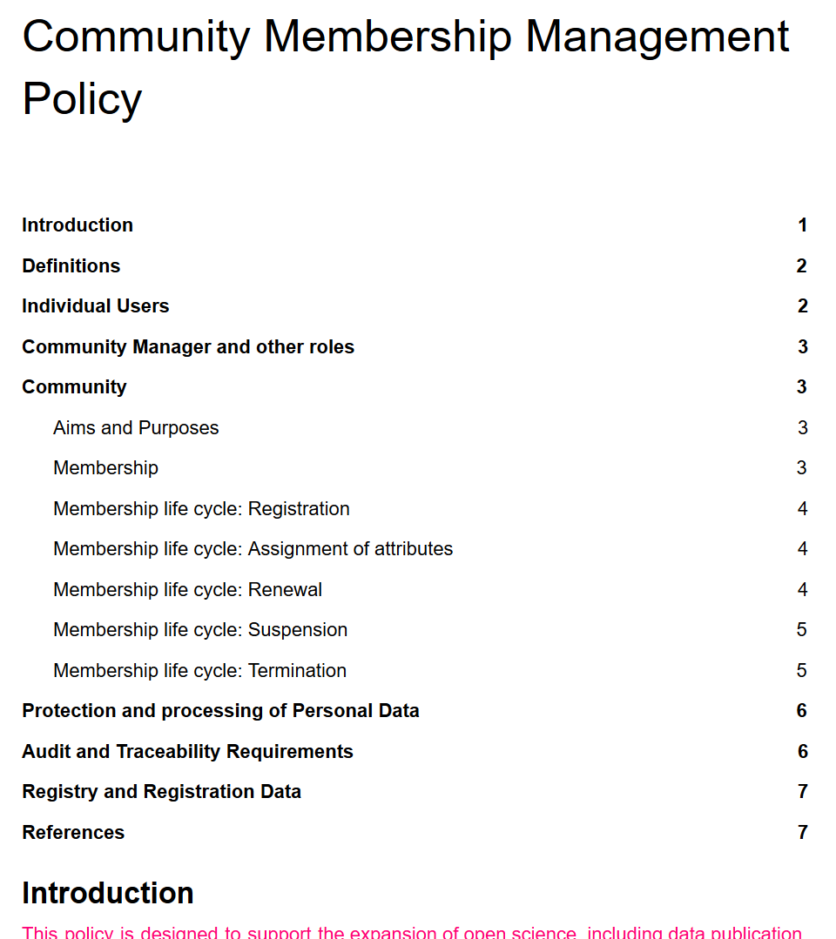
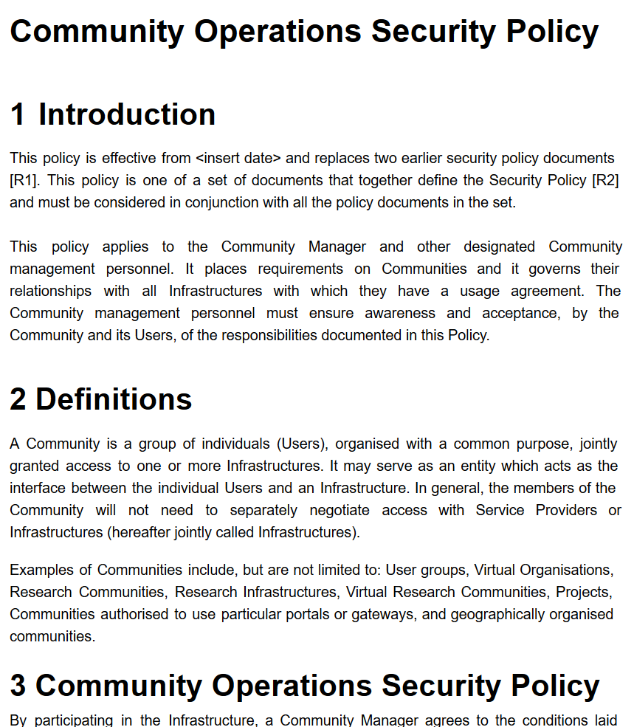
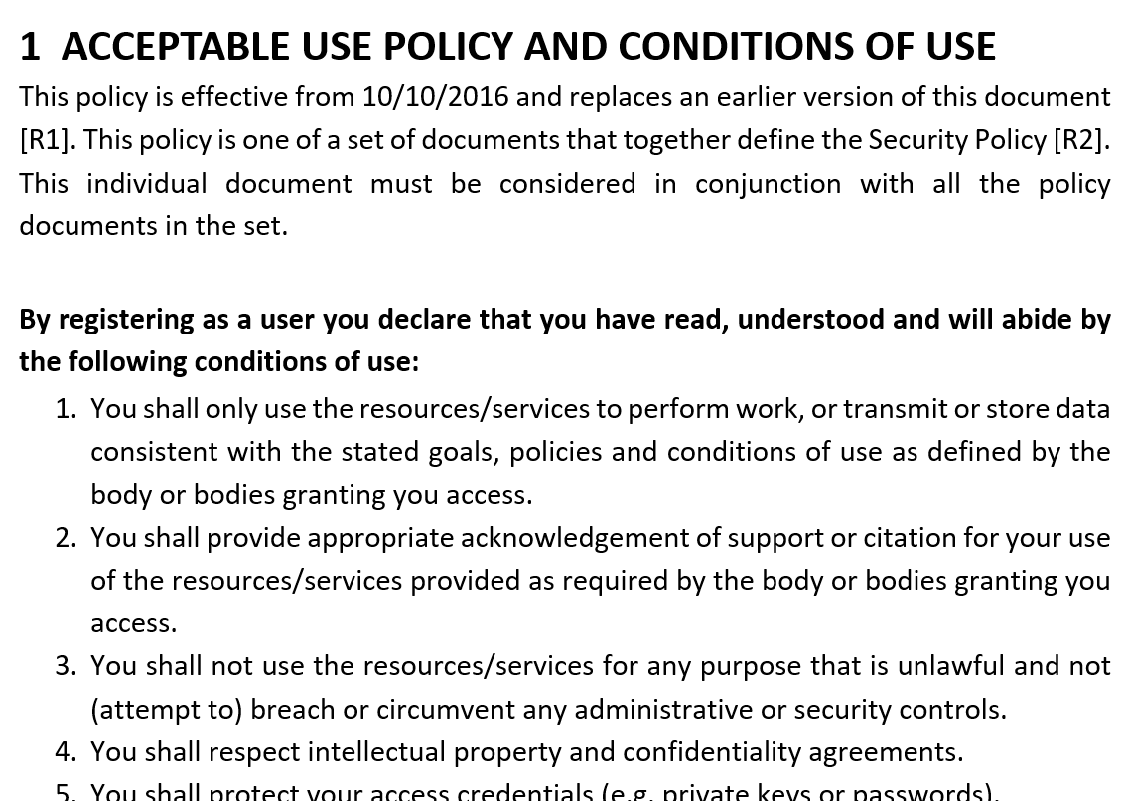
Evolving the Policy Development Kit for communities around Snctfi
…
https://wiki.geant.org/display/AARC/Policy+Engagement+and+Coordination

Slide 12
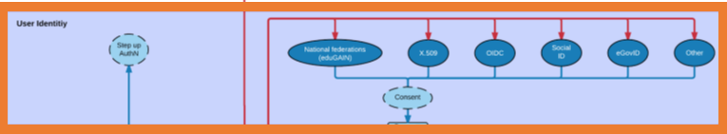
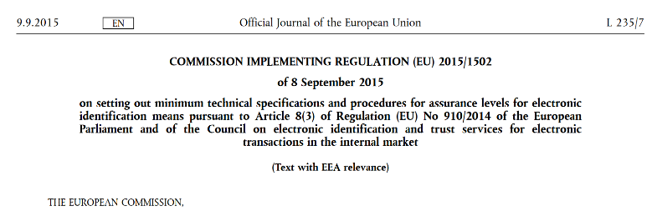
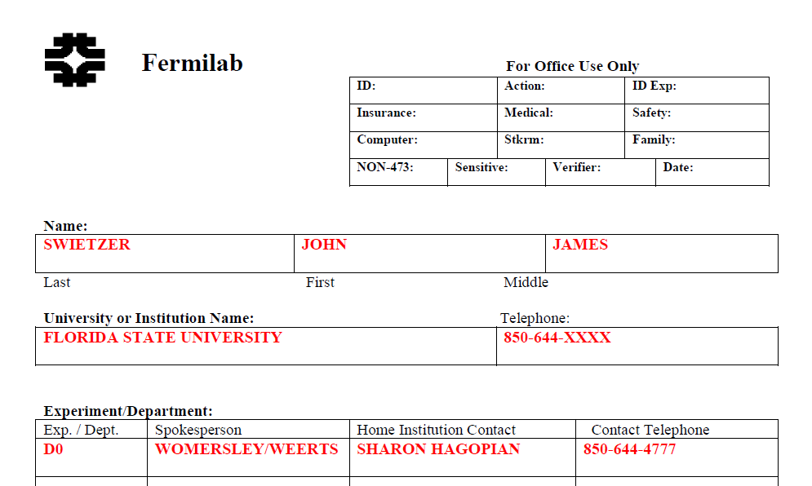
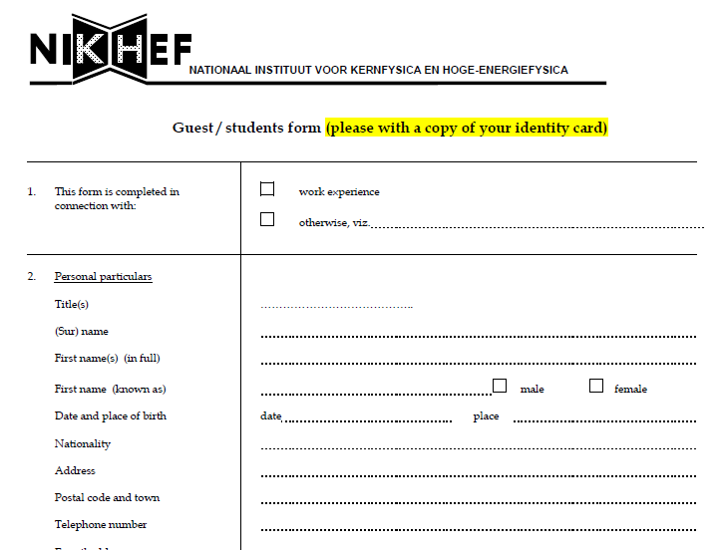
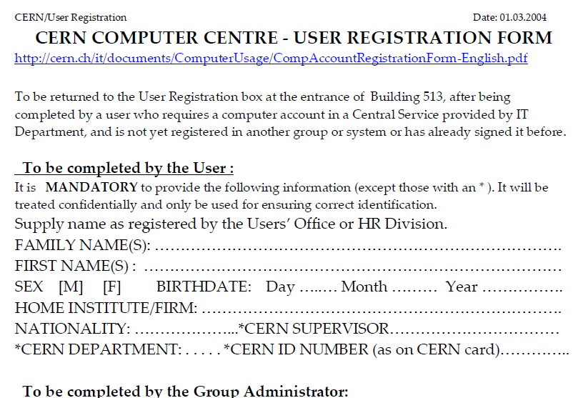
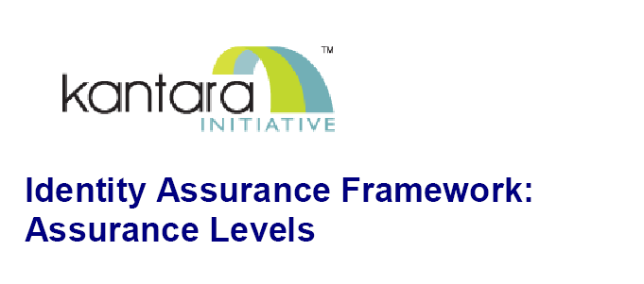
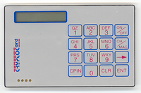
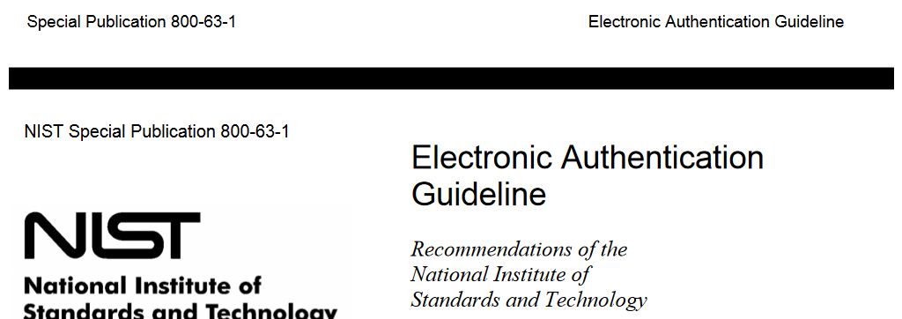
Trusting the User’s Authentication
Many layered models (3-4 layers)
but: specific levels don’t match needs
of Research- and e-Infrastructures:
Specific combination
‘authenticator’ and ‘vetting’ assurance
doesn’t match research risk profiles
Disregards existing trust model
between federated R&E organisations
Cannot accommodate
distributed responsibilities
As a result, in R&E federation there was
in practice hardly any
documented and agreed assurance level
Beyond uncontrolled identifiers:
baseline assurance for research use cases
12

Slide 13



Differentiated assurance from an Infrastructure viewpoint
‘low-risk’ use cases
few unalienable expectations by research and collaborative services
generic
e-Infrastructure services
access to common compute and data services that do not hold sensitive personal data
protection of sensitive
resources
access to data of real people, where positive ID of researchers and 2-factor authentication is needed
Minimal Assurance
known individual
Persistent identifiers
Documented vetting
Password authenticator
Fresh status attribute
Self-assessment
Slice includes:
assumed ID vetting
‘Kantara LoA2’, ‘eIDAS low’, or ‘IGTF BIRCH’
Good entropy passwords
Affiliation freshness
better than 1 month
Slice includes:
Verified ID vetting
‘eIDAS substantial’, ‘Kantara LoA3’
Multi-factor authenticator
see https://wiki.refeds.org/display/GROUPS/Assurance+Working+Group

Slide 14


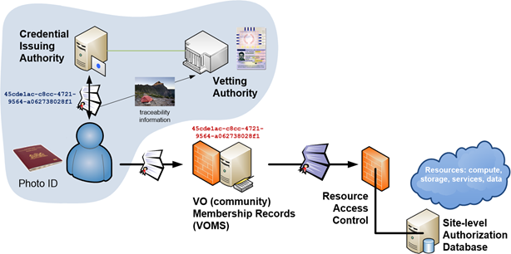
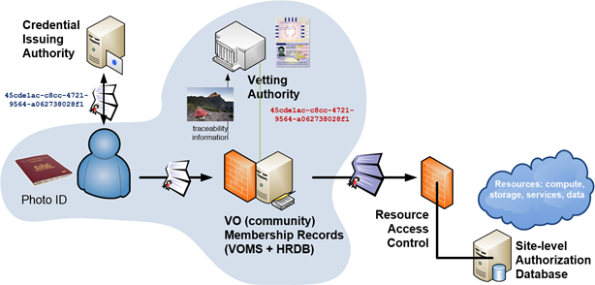
Using Assurance in practice: mixing your favourite drink
Identifiers ID proofing Authentication Attributes
ID is unique, personal and traceable
Good enough for institution’s local systems
Good entropy passwords
Accurate and fresh affiliation information
ePPN is unique, personal and traceable
Assumed
(e.g. postal credential delivery)
Multi-factor authentication
Verified
(e.g. F2F)
Assurance can come from a single source …
… or be a combined/collabative assurance
by identifier source and vetting attributes
See also the JRA1 Series Guidelines (1.1A)
see also http://igtf.net/ap/loa and https://www.iana.org/assignments/loa-profiles

Slide 15


Engagement and global alignment
✓
Use pre-existing groups and communities to develop policies and harmonise practices
and thus avoid each infrastructure becoming yet another island
Develop
Adopt
Through
WISE and SCI
REFEDS
IGTF
(FIM4R)
… and all willing policy & CSIRT groups
In your Infrastructure, IdP, and Federation
Persistent, non-reassigned identifiers
Incident Response capabilities & Sirtfi NG
Protected personal data sharing
Snctfi conformant policy models
Self-assessment and peer review methods
work with us
by collaborating in these groups
help collaboration progress
by adopting results

Slide 16
davidg@nikhef.nl

