Slide 1

The AARC Policy Development Kit

Slide 2

go.nikhef.nl/aarc2na3py2
WP3: Policy and Best Practice Harmonisation
the policy side of AARC
David Groep
AARC2 Y2 EC Review
June, 2019
Lëtzebuerg, LU
0.4

Slide 3
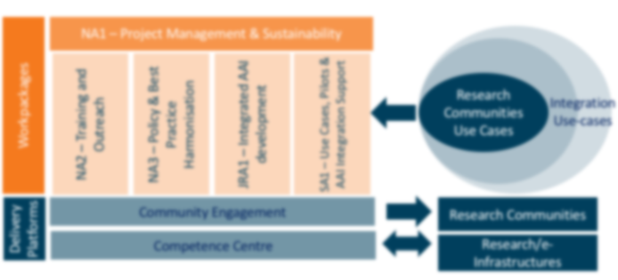

WP3: Policy and Best Practice Harmonisation

Slide 4
Agenda “NA3” Policy and Best Practice Harmonisation
Organisation
Team and partners
Objectives
Achievements
Operational Security and Incident Response
Service-centric activities
Beyond
the project
Leveraging persistent structures for sustainability
e-Infrastructure support and collaboration
Use of Resources
Researcher-centric activities
Engagement and consultation

Slide 5
Policy and best practice activity high-level objectives from our DoW
✓
“Minimise the number of divergent AAI policies and
empower identity providers, service providers and research communities
to identify interoperable policies”
✓
Define a reference framework to enable different parties to compare policies and assess policy compatibility
✓
Create (baseline) policy requirements,
driven by the explicit needs of the research communities
✓
Identify all necessary policy elements and
develop guidelines and assessment models to support communities
in establishing, adopting, or evolving their own policies

Slide 6













Activity Structure
  T1
  T2
  T3
  T4
Activity Lead
Incident Response Trust
Service-centric
Policy Support
Researcher-
centric Support
Enagement & Development
  David Groep
  Nikhef (NWO-I)
  Hannah Short
  CERN
  Uros Stevanovic
  KIT
  Ian Neilson
  STFC RAL
  David Kelsey
  STFC-RAL
Partners
in collaboration with:

Slide 7
Resources (1 May 2017 – 30 April 2018 – 30 April 2019) and deliveries
Cumulative: Total: | 47 PM foreseen approx. 2 FTE average | > 38 PM used of which 26 PM used in PY1 > 81% of forecast personnel resources
✓
3 of 3 deliverables in PY2 DNA3.2 – Report on Security Incident Response DNA3.3 – Accounting and Traceability in Multi-Domain Service Provider Environments DNA3.4 – Recommendations for e-Researcher-Centric Policies and Assurance
With many other documents and results 7 Guidelines and Informational documents (topical white papers) in AARC2 … the Policy Development Kit, WISE Baseline AUP implementation guide, guidance on using DPCoCo in proxies, REFEDS Assurance Pilot, secure attribute authority operations, FIM4R community engagement, eduGAIN Sirtfi communications challenge, reference incident response process, X-infrastructure assurance expression, social-ID assurance guide, Data Protection Impact Assessment hints, untangling spaghetti …

Slide 8
Deliverable submission status
✓
Report on the coordination of accounting data sharing amongst Infrastructures (initial): DNA3.1
Initial phase in PY1 focussed on giving guidance to the community on GDPR DPIA
✓
Report on Security Incident Response (in FIM): DNA3.2 / D3.1
Operational security processes for R&E federations and protection of (BPA) proxies
Sirtfi readiness, and how trust groups can support federated incident response
✓
Accounting and Traceability in Multi-Domain Service Provider Environments: DNA3.3 / D3.2
Supporting proxies and infrastructures in service delivery with privacy guidance on traceability and accounting, policy suites, and frameworks to interwork at a global level for research infras
✓
Recommendations for e-Researcher-Centric Policies and Assurance: DNA3.4 / D3.3
Complementing policies centering on research communities and involving end-researchers: assurance sourced from R&E federations and peer infrastructures, a global common Baseline AUP to prevent interrupting research workflows, and engaging through the FIM4R v2 process
all substantially delivered on time, proviso some upload challenges to the portal

Slide 9
The evolved role for policy and best practices in AARC2
AARC2’s stronger use case driven & community focus
Policy Development Kit
Consultancy role for communities & infrastructures
work items address policy aspects of the architecture & implementation, e.g.,
  AARC-G041 Assurance derived from social media
  AARC-G048 Secure Operation of Attribute Authorities …
address pilots in SA1, communities, or Infrastructures, e.g.
  AARC-G040 Policy Recommendations for the LS AAI (application to R&S and CoCo)
  AARC-I044 Implementers Guide to the WISE Baseline Acceptable Use Policy
& ever closer collaboration with infrastructures in applying this harmonization
by construction NA3 work ‘homed’ in sustained forums: WISE, IGTF, REFEDS, FIM4R

Slide 10
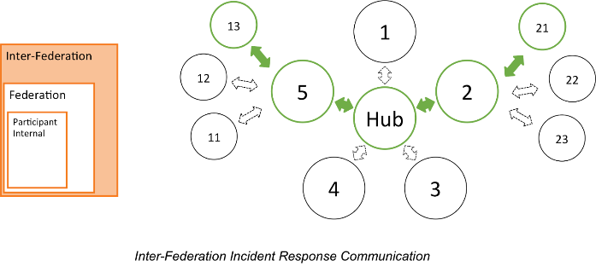
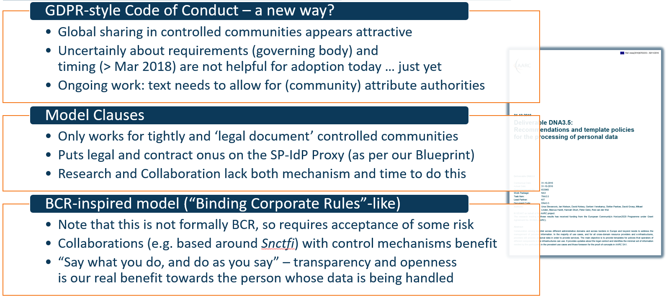
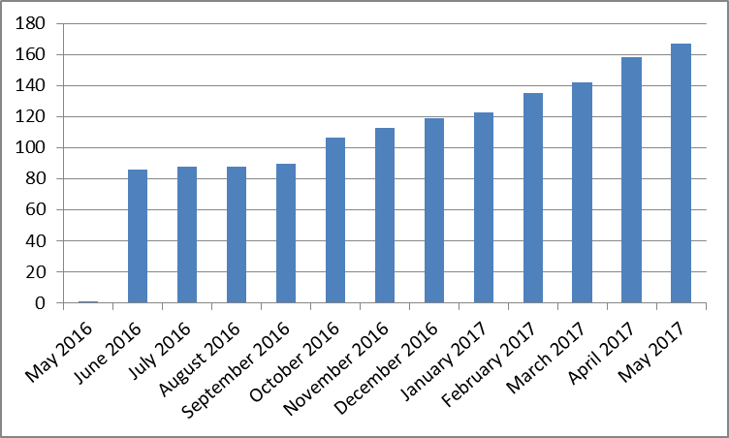
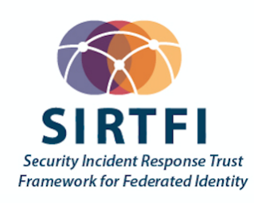
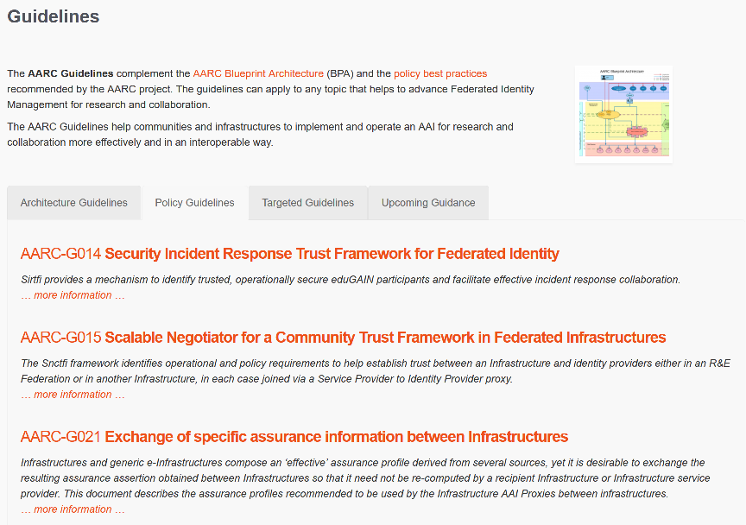


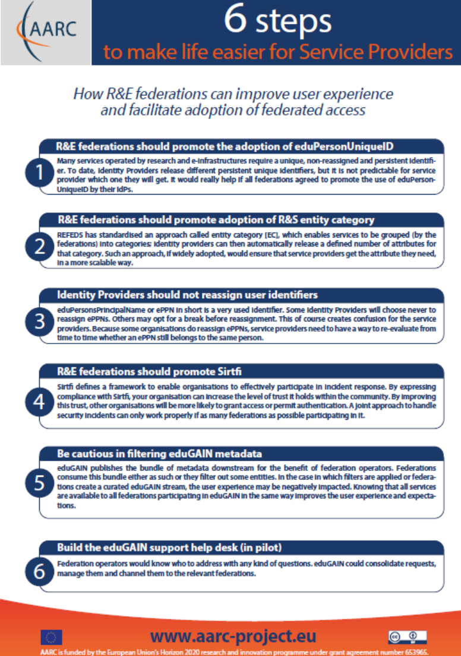
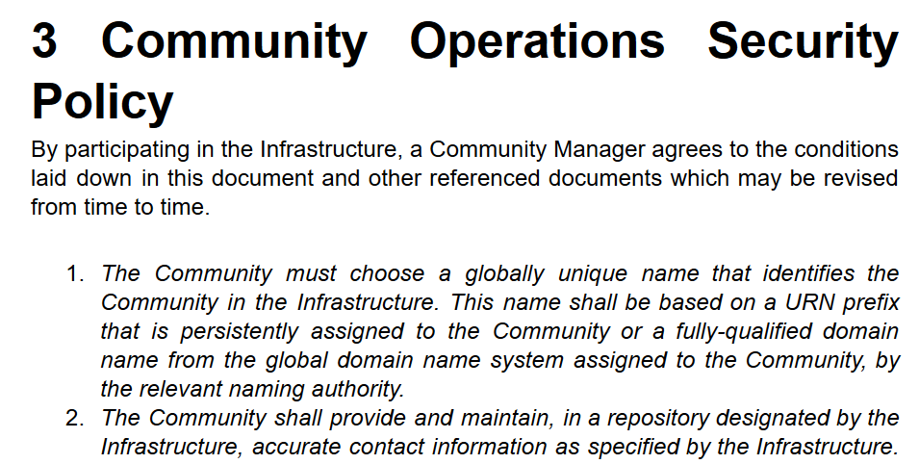
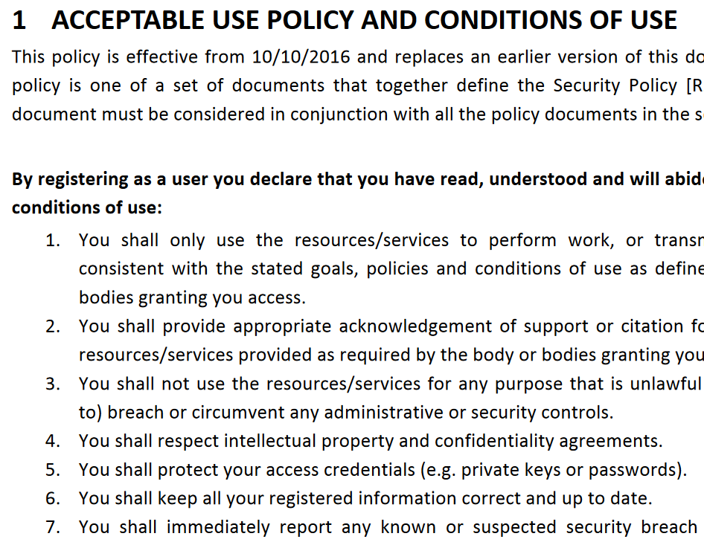
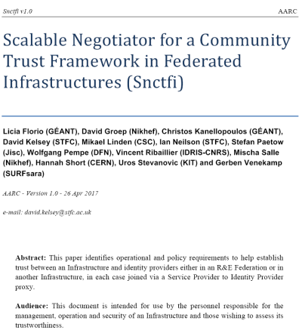
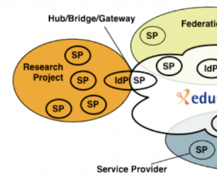


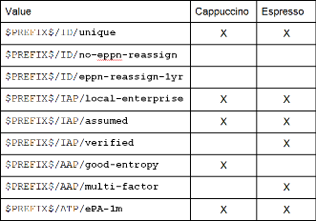
A tour of the policy space in AARC2
T1 Operational Security
for FIM Communities
167 entities
T2 supporting policies
for Infrastructures
bulk
model
T3 support for
Researchers & Community
‘low-risk’ use cases
few unalienable expectations by research and collaborative services
generic
e-Infrastructure services
access to common compute and data services that do not hold sensitive personal data
protection of sensitive
resources
access to data of real people, where positive ID of researchers and 2-factor authentication is needed
T4 Engagement
and Coordination
Baseline Assurance
known individual
Persistent identifiers
Documented vetting
Password authenticator
Fresh status attribute
Self-assessment
Slice includes:
assumed ID vetting
‘Kantara LoA2’, ‘eIDAS low’, or ‘IGTF BIRCH’
Good entropy passwords
Affiliation freshness
better than 1 month
Slice includes:
Verified ID vetting
‘eIDAS substantial’, ‘Kantara LoA3’
Multi-factor authenticator
10

Slide 11
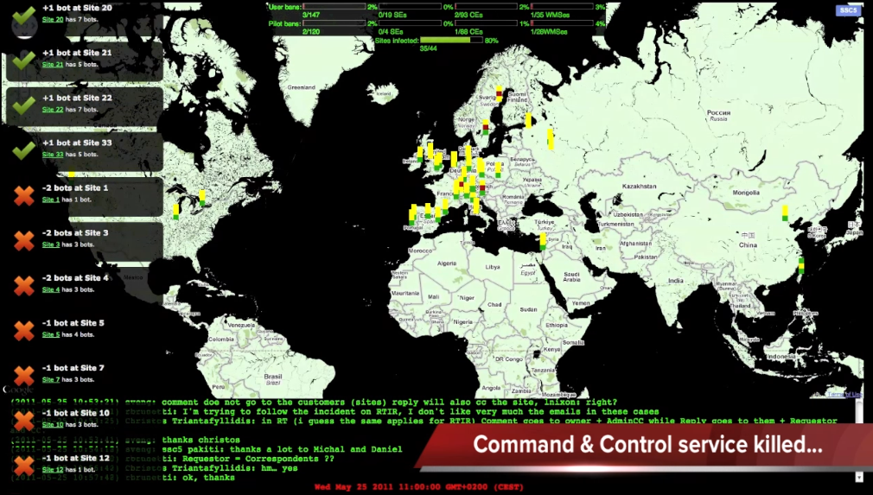
Policy and Best Practices Harmonisation
Security Incident Response Trust Framework
SCCC: Security Service Challenge Coordination
Attribute Authority Security, in the BPA model and beyond
Task 1
Operational Security and Incident Response

Slide 12
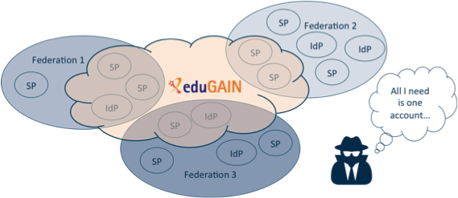
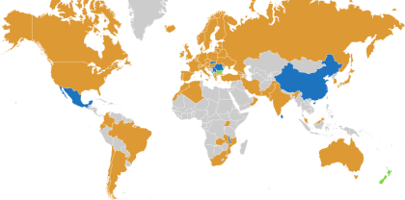














Security Incident Response in the Federated World
AARC-1 Refresher
many countries & economic regions with an R&E identity federation
full of valuable resources
(data, network, services)
Could we ensure that information is shared confidentially, and reputations protected?
Security Incident Response Trust Framework for Federated Identity
Sirtfi – based on Security for Collaborating Infrastructures (SCI) & FIM4R Recommendations

Slide 13

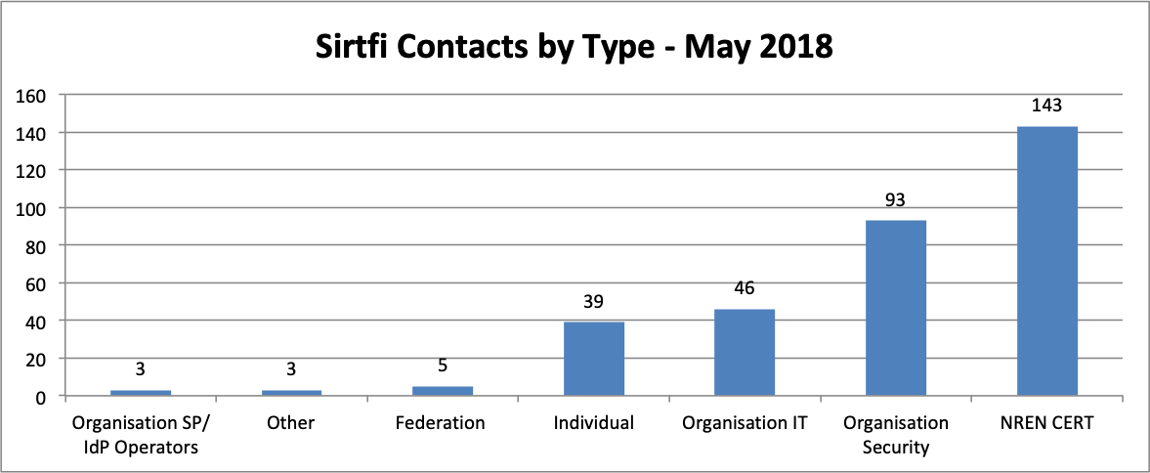
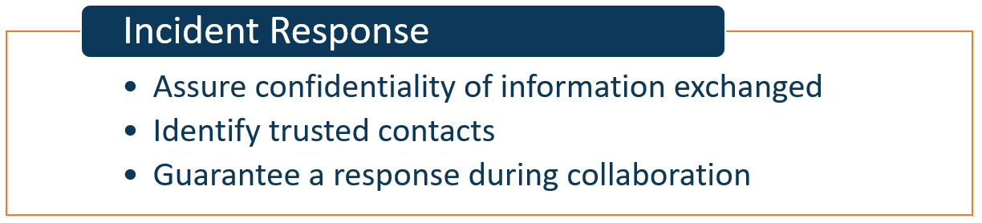
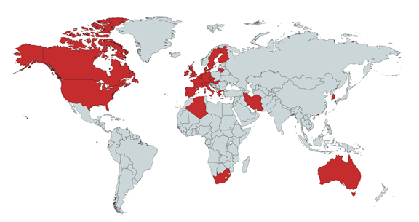
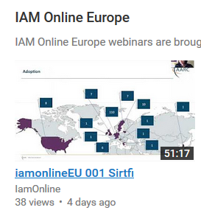
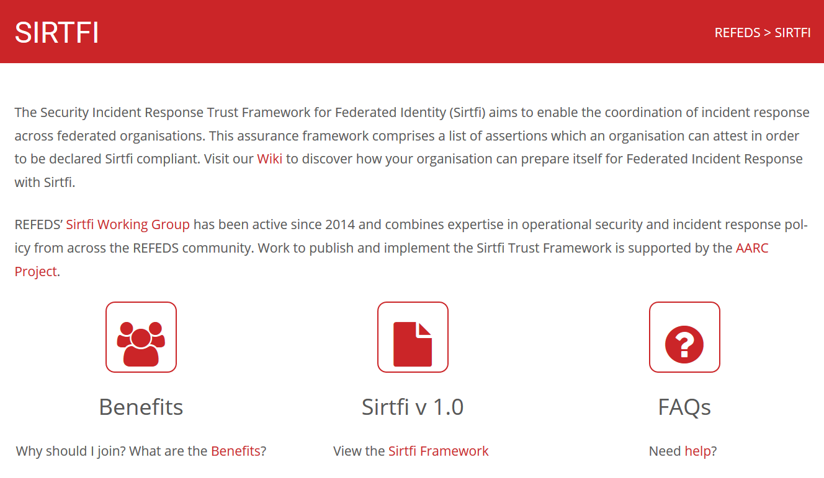
Sirtfi is there today – 575 parties (420 IdPs) joined, in 28 federations
https://refeds.org/SIRTFI
countries with at least one Sirtfi entity
graphics source: AARC2 DNA3.2 Report on Incident Response in FIM; data: technical.edugain.org

Slide 14
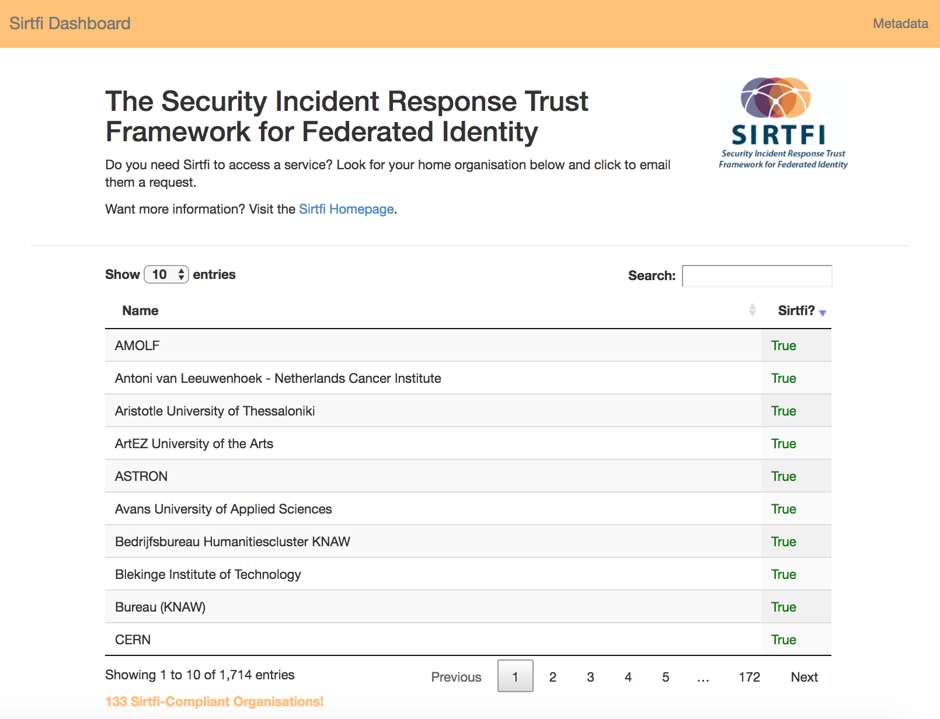
The sociology of checking Sirtfi enablement …
Sirtfi ‘encouragement’
the tool certainly raises attention ☺
lack-of-Sirtfi (and R&S) is non-trivial to
diagnose – other causes may interfere
Sirtfi+ registry
enabling more entities to express Sirtfi
sharing implicit trust between communities?
tool requirement
http://sirtfi.cern.ch/
graphics source: Hannah Short, CERN

Slide 15
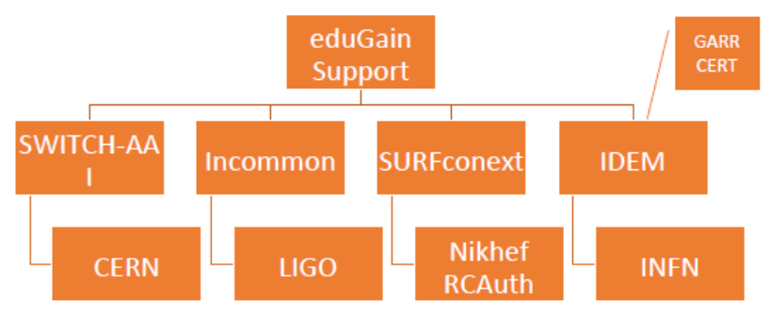
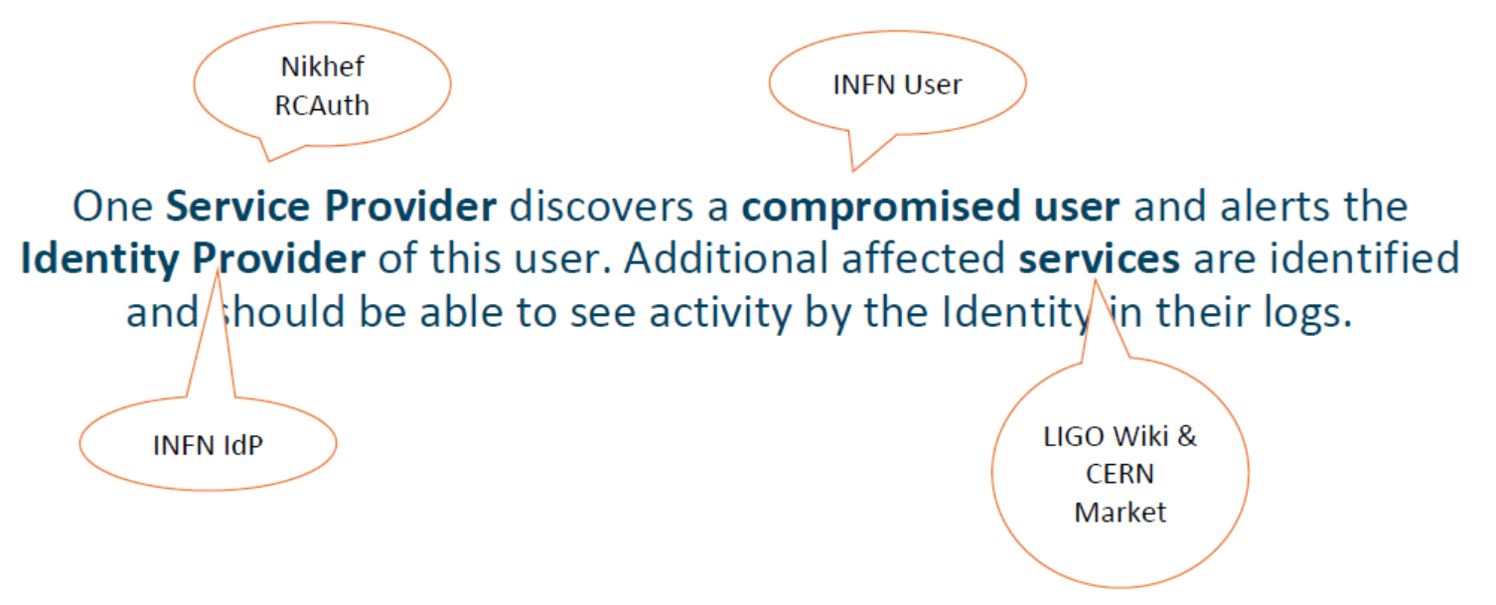


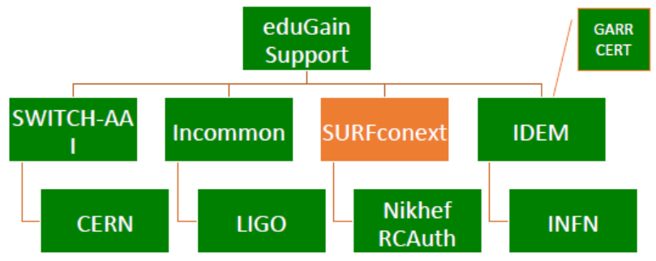



Testing incident response coordination
As seen in PY1
Can we coordinate our collective R&E response?
Communication guidelines to help timely resolution?
Two ‘challenges’: March 2018 and December 2018
parties involved in response challenge
Report-outs see https://wiki.geant.org/display/AARC/Sirtfi+Communications+Challenges%2C+AARC2-TNA3.1

Slide 16
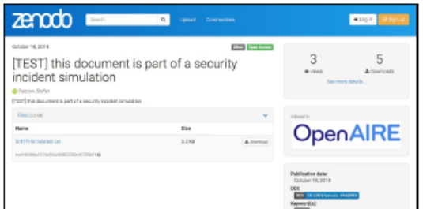
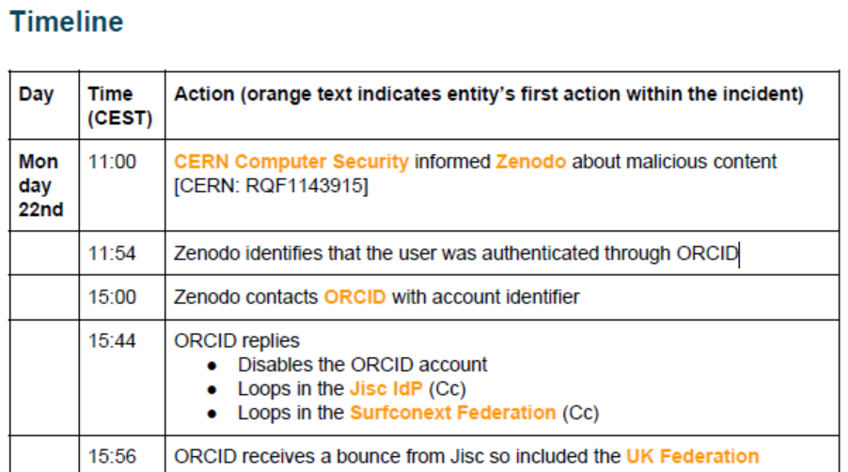
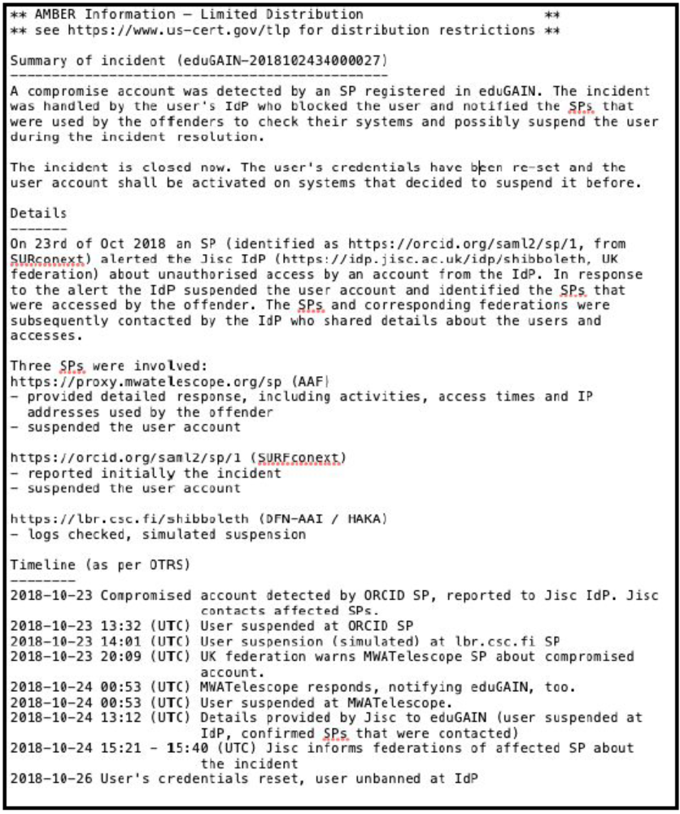
2nd challenge, December 2018: using the draft response templates
Malicious content hosted on Zenodo, uploaded with an ORCID account
time delay between ‘malicious act’ and request for investigation (+3 days)
spread over all time zones (.au, .ch, .nl, .uk, .us,
new set of participant IdPs and federations
initial mitigation within 4 hrs, but eduGAIN support desk gets it only on the 3rd day …
contact with affected user effective and appreciated
TLP classification not used throughout, some entities initially missed
https://wiki.geant.org/display/AARC/Sirtfi+Communications+Challenges%2C+AARC2-TNA3.1

Slide 17
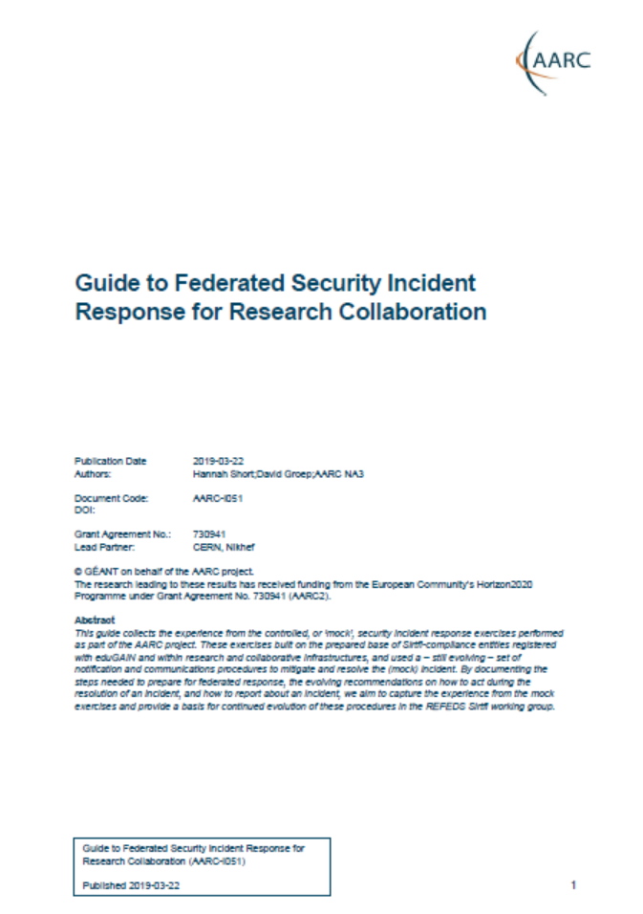
Preparing the ground for REFEDS Sirtfi procedures: AARC-I051
Acknowledging that only reviewers read deliverables, response process from DNA3.2 issued as …
AARC-I051 Guide to Federated Security Incident Response for Research Collaboration
Be Prepared
Federated Entities Should Support Sirtfi
Community Proxies Should Adopt Interoperable Policies & Procedures
Federations and Interfederations Should Adopt Common Procedures
Leverage Templated Emails
Establish Secure Communication Channels in Advance
Act
Scope
Goals
Responsibilities
Procedures: for IdPs & SPs, for coordinators, for eduGAIN
Report and Share
informational document and not a guideline since Sirtfi WG still needs
to get global endorsement, yet we need practical guidance right now!
https://aarc-project.eu/guidelines/aarc-i051/

Slide 18
Operational security focus in the BPA: beyond just the IdPs
Community membership management directories and attribute authorities
integrity of membership
identification, naming and traceability
site and service security
protection on the network
assertion integrity
Store and manage ephemeral user credentials
trusted credential stores
protection at rest
IGTF Guidelines on
Trusted Credential Stores
(pre-existing)
Guidelines for Secure Operation of Attribute Authorities and other issuers of access-granting statements
(AARC-I048, in collaboration with IGTF AAOPS)

Slide 19
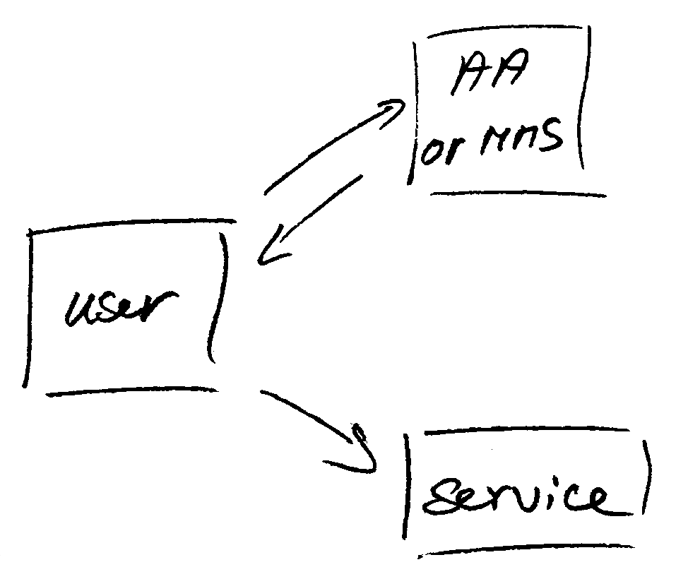
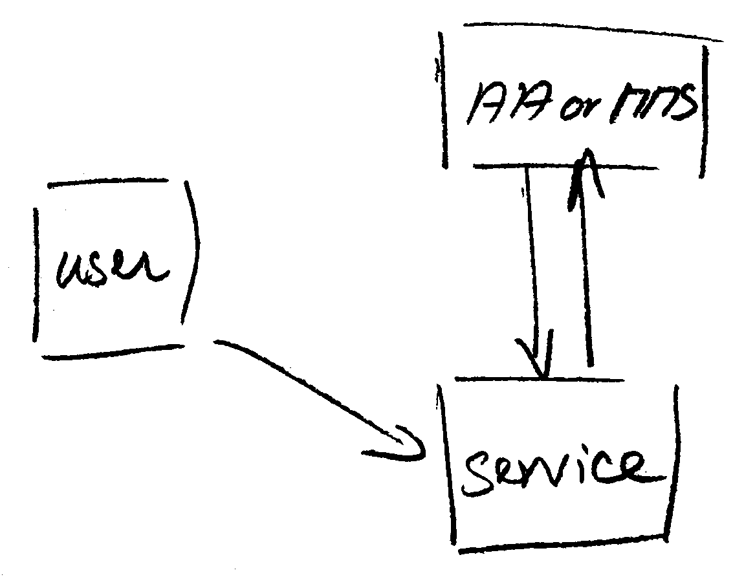
Protecting the community membership data and its proxy
Intentionally targeted broader than just BPA-style communities, since operational security spans data centres and infrastructures using other forms of AA membership management
PRACE: ‘pull model’ directory-based communities
BPA: encourages ‘push model’ attribute-carrying service requests
push model – the common BPA method
(e.g. SAML AttributeStatement, VOMS AC)
pull model – common when using directories
(e.g. LDAP in PRACE, GUMS in OSG)
push and pull model diagrams as per RFC2904 – the 3rd (agent) model is uncommon in research/collaboration scenarios except for provisioning

Slide 20
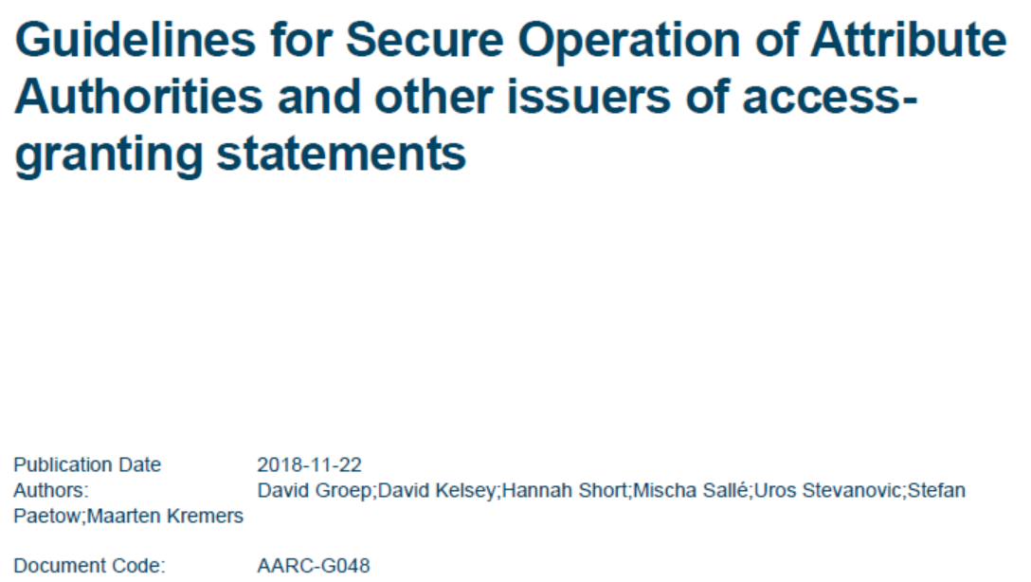
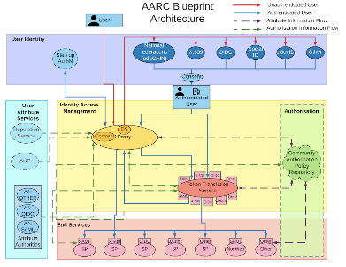
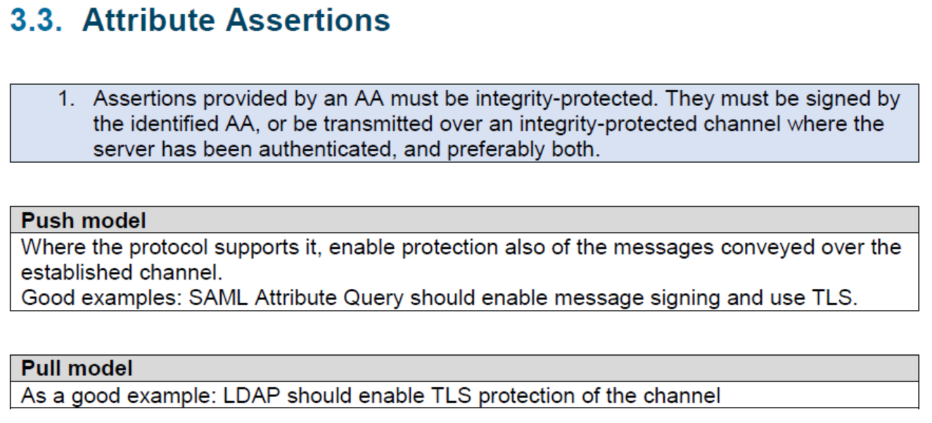
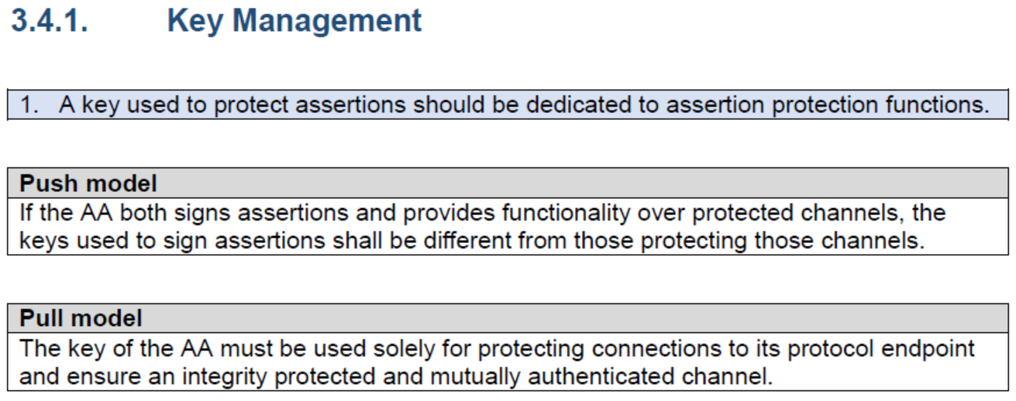
AARC-G048: keeping users & communities protected, moving across models
trusted delegation of response from communities to operators,
and from services to communities in recognizing their assertions
Structured around concept of “AA Operators”,
operating “Attribute Authorities” (technological entities),
on behalf of, one or more, Communities
`
https://www.igtf.net/guidelines/aaops/
Notes:
And dwells also on naming since that is the unique hook for the service providers to actually track back persistently to the proper community as well as operator …

Slide 21
Main achievements in Operational Security
Sirtfi framework adoption and promotion | ➔ | Sirtfi checking tool, and the Sirtfi+ Registry Much increased awareness (and some beneficial annoyance as well)
Sirtfi incident exercises and training | ➔ | Improved incident response in eduGAIN Response guidelines on readiness and action
Communications challenge coordination | ➔ | Commitment beyond WISE or Sirtfi for challenge coordination in SIGISM & REFEDS
Attribute Authority Operations guidance | ➔ | Better protected community management in the provisioning of data form BPA proxies
After AARC | WISE Security Communication Challenge Coordination JWG
 | REFEDS Sirtfi, eduGAIN Security Capability, EGI CSIRT, EOSChub ISM, and the IGTF

Slide 22

Policy and Best Practices Harmonisation
Snctfi contributions to the Policy Development Kit
Data Minimisation at the proxy for access to services
Security for Collaboration among Infrastructures SCI:
assessment and peer review methodology
Task 2
Service Centric Policies

Slide 23

A policy framework for service providers groups and proxies in the BPA
Snctfi
Scalable Negotiator for a Community Trust Framework in Federated Infrastructures
derived from SCIv2: framework on Security for Collaboration in Infrastructures via WISE
reference policies supporting Snctfi fulfilment in the Policy Development Kit
graphic IdP-SP bridge: Lukas Hammerle and Ann Harding, SWITCH

Slide 24
Filling the framework: generic and community-targeted guidance
aarc-project.eu/guidelines
Snctfi covers both
service-centric and some researcher-centric policies

Slide 25
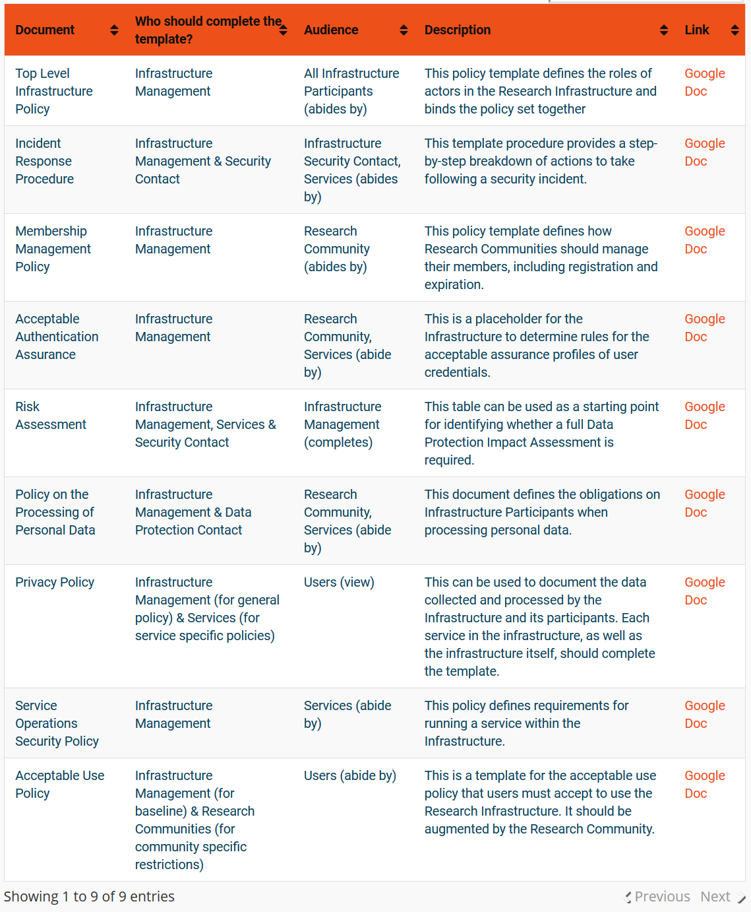
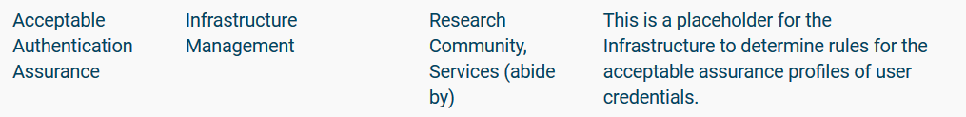

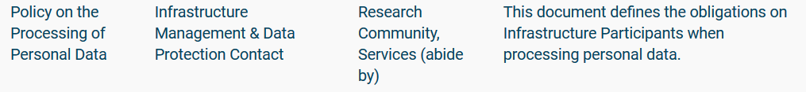
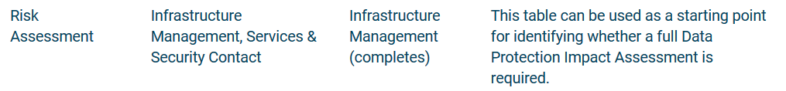
Service-centric policies – key elements to our ‘PDK’
more on the Policy Development Kit when we get to task 4!
https://aarc-project.eu/policies/policy-development-kit/

Slide 26
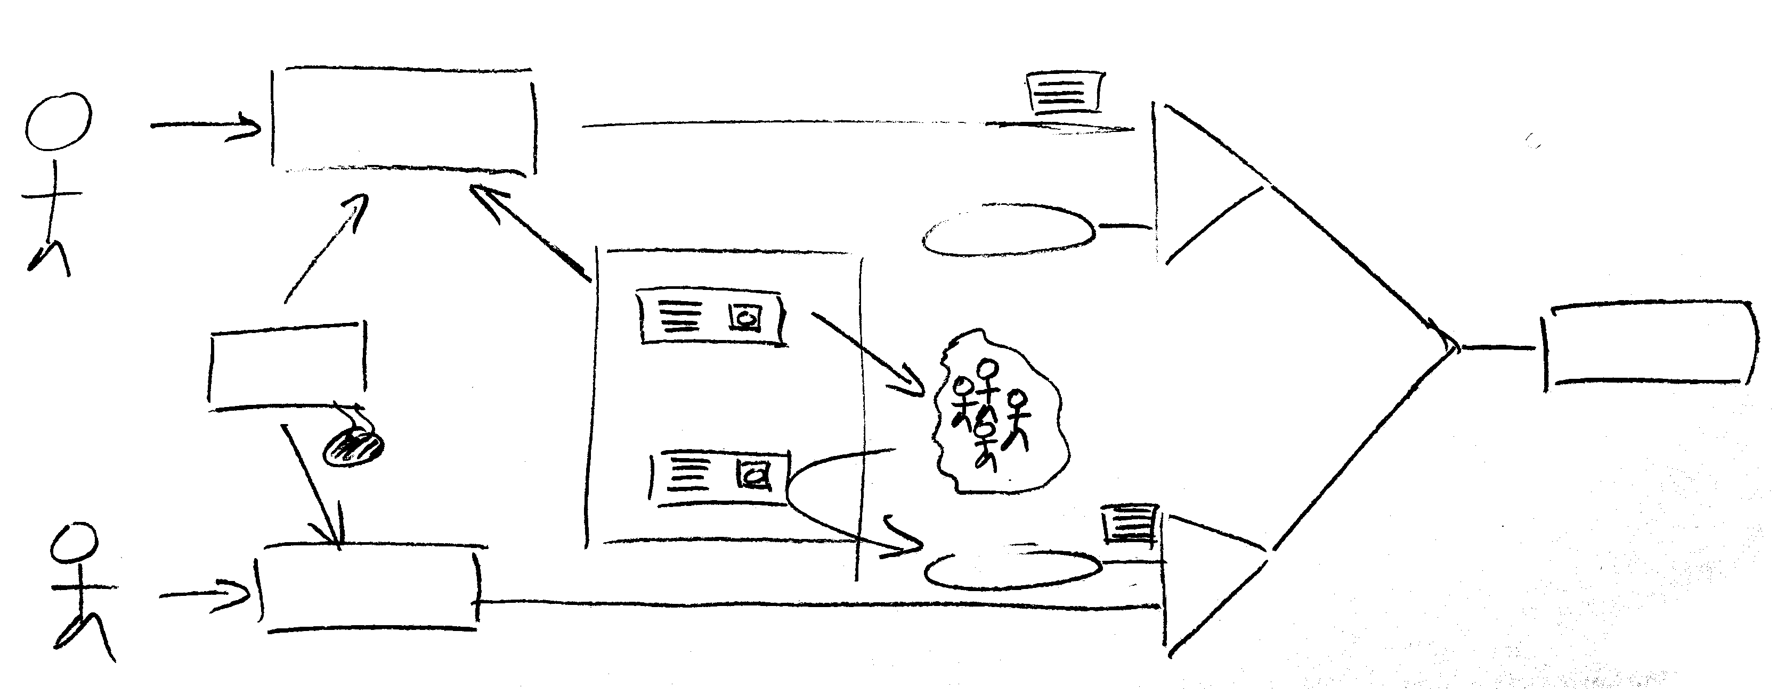
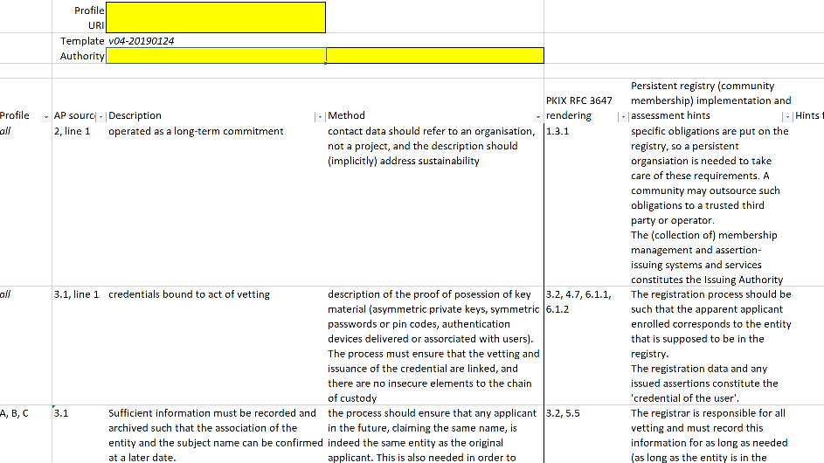
Example: Acceptable Authentication Assurance
– enabling flexible user communities by mapping assurance elements
ID proven?
BIRCH
ID vetting
AA-
national
community
management
service
ident#
community-
based
ID proven?
AA++
DOGWOOD
Identity vetting can be done
when credentialing the user
on enrolling the user in a community
e.g. LIGO LSC always does researcher vetting, and Assurance Policy accommodates linkage in either place – still meeting SP trust needs

Slide 27
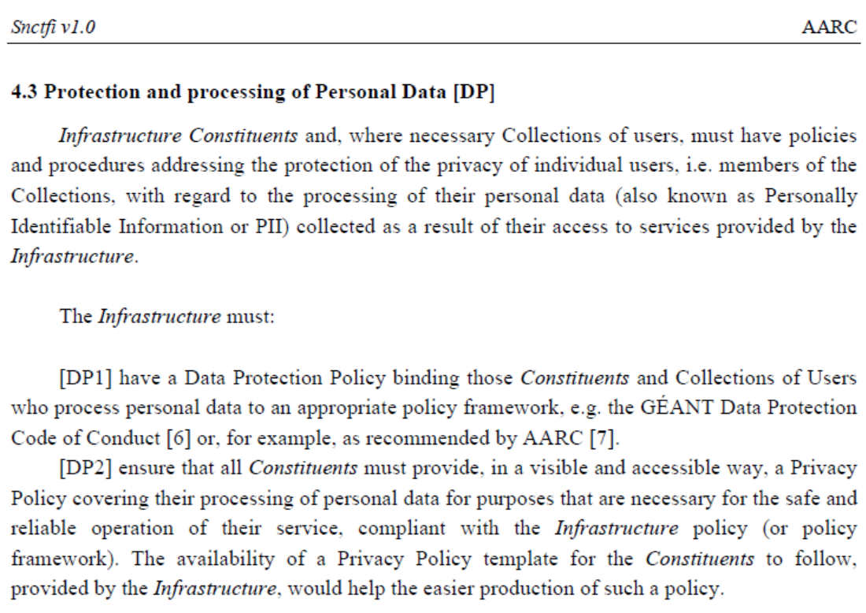
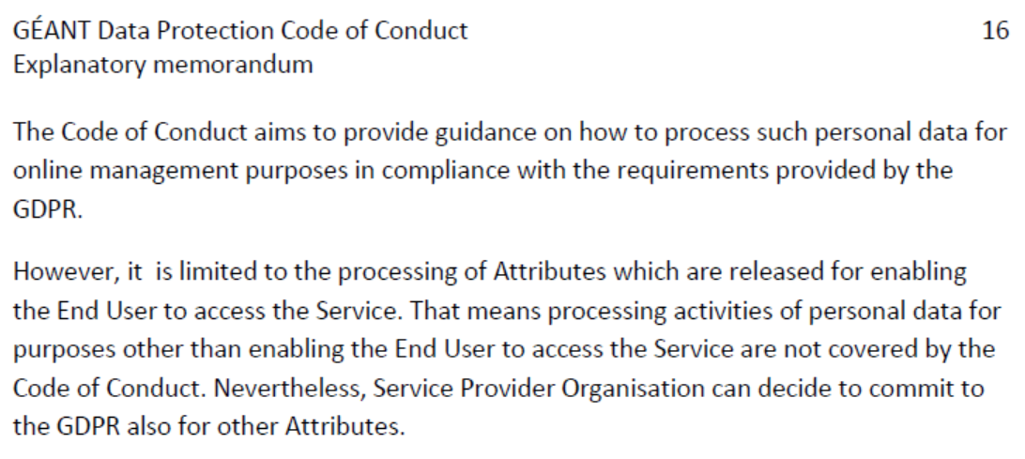
GDPR for BPA and multi-BPA proxy scenarios
Snctfi and DPCoCo jointly provide the transitive trust model
Common attributes ‘enabling End User to access the Service(s)’ behind a BPA proxy (and its omnidirectional attributes) in Snctfi
is scoped to enable access – in conjunction with DPCoCo
allows release of attributes by IdPs and MMS services
DNA3.3 (D3.2) Accounting and Traceability in Multi-Domain Service Provider Environments
in fact collecting service-centric policy support also for the BPA proxy privacy implications
GN4 project work on DPCoCo: https://wiki.refeds.org/display/CODE/Code+of+Conduct+ver+2.0+project and SCI v2

Slide 28
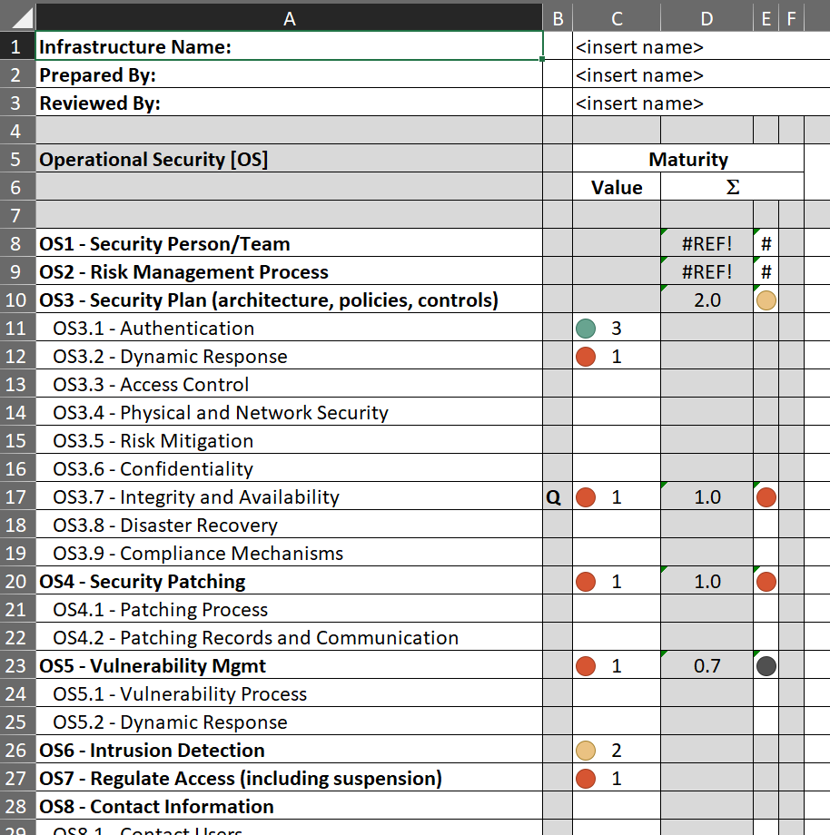
SCIv2 assessment and peer review – do you want to work with your peer?
SCIv2 proposed assessment model
Level 0: Not implemented for critical services;
Level 1: Implemented for all critical services, but not documented;
Level 2: Implemented and documented for all critical services;
Level 3: Implemented, documented & reviewed by a collaborating
Infrastructure or by an independent external body;
“Justifiable exclusion”: feature not relevant for infrastructure.
Conclusions
self-assessment feasible, SCI model emphasises proper elements for federated access
peer-review extends trust across similar organisations
transparency needed:
infrastructures weigh sub-elements differently!
(no global consensus yet on any weighting method …)
https://wiki.geant.org/display/WISE/SCIV2-WG+documents
http://wise-community.org/sci/

Slide 29
Main achievements in Service-Centric Policy
Policy templates and guidance for infrastructures and services | ➔ | Increased interoperability by adoption of Snctfi
Guidance in data protection in proxies for infrastructures for research | ➔ | Ease attribute release by communities in BPA scenarios
SCIv2 Assessment Security Collaboration among Infrastructures | ➔ | Developed assessment model and gained adoption in global WISE-community
Assessment model based on peer review | ➔ | Increased trust between infrastructures for a broader community at lower cost
After AARC | AEGIS (and WISE SCI WG & IGTF): supporting interworking infrastructures
 | GN4-3 EnCo: support communities in data protection & policy development kit

Slide 30
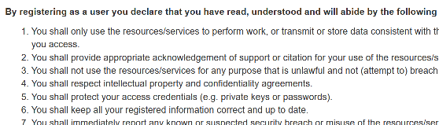
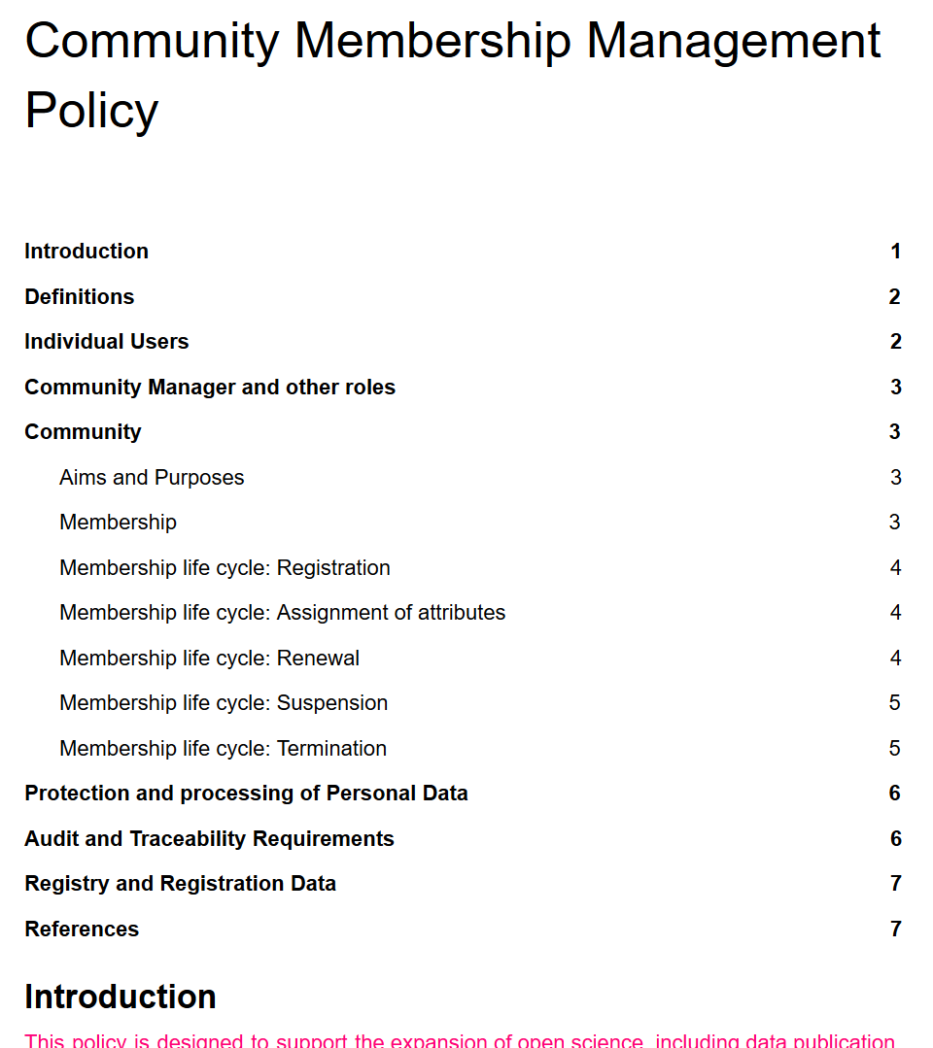
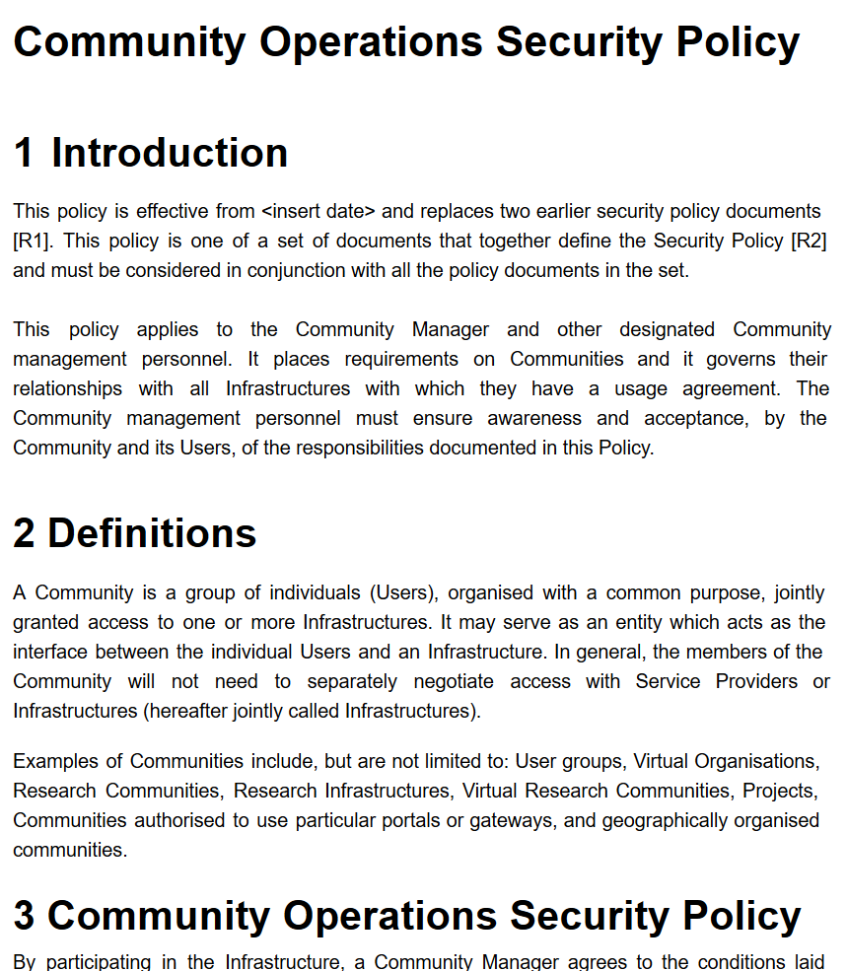


Policy and Best Practices Harmonisation
Identity Assurance and Assurance Framework Mapping
Baseline Acceptable Use Policy and WISE
Policies for the Development Kit
Task 3
e-Researcher Centric Policies

Slide 31
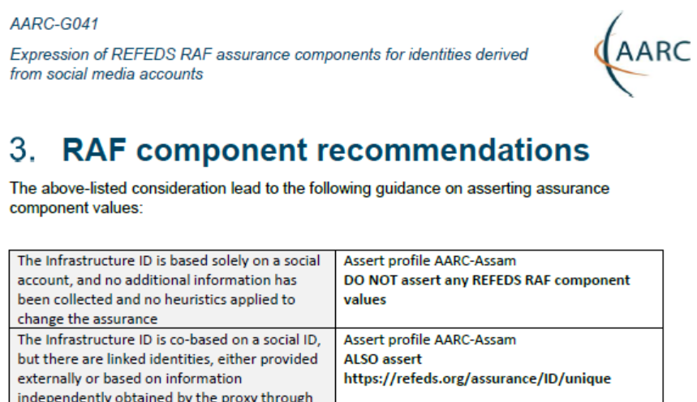
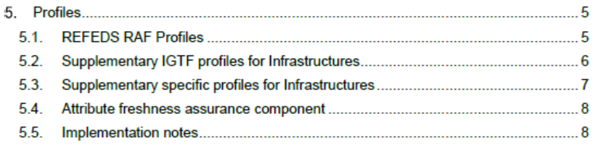
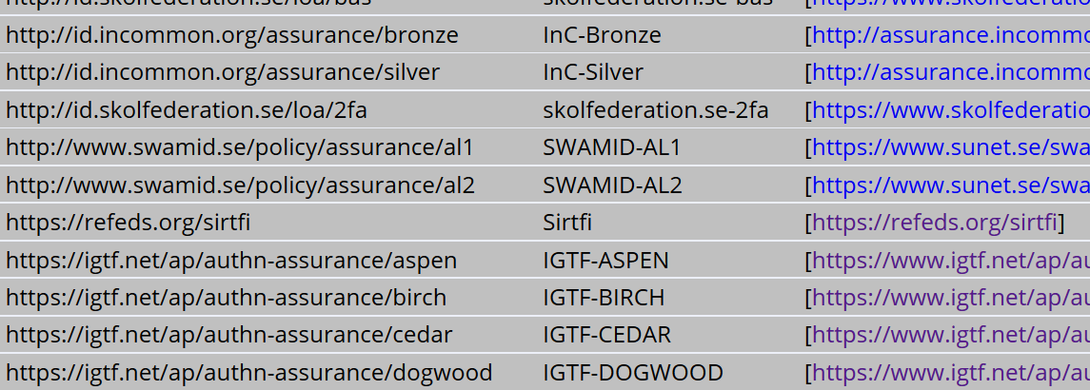
Assurance – standard profiles and ‘untangling spaghetti’
REFEDS RAF profiles (feasible assurance from all over R&E federations – as far as we can!)
inter-infrastructure profiles and relying-party oriented profiles (IGTF BIRCH, DOGWOOD)
how to express social media assurance, for citizen science and in support of account linking
AARC-G021
inter-infrastructure adoption
https://www.iana.org/assignments/loa-profiles/

Slide 32
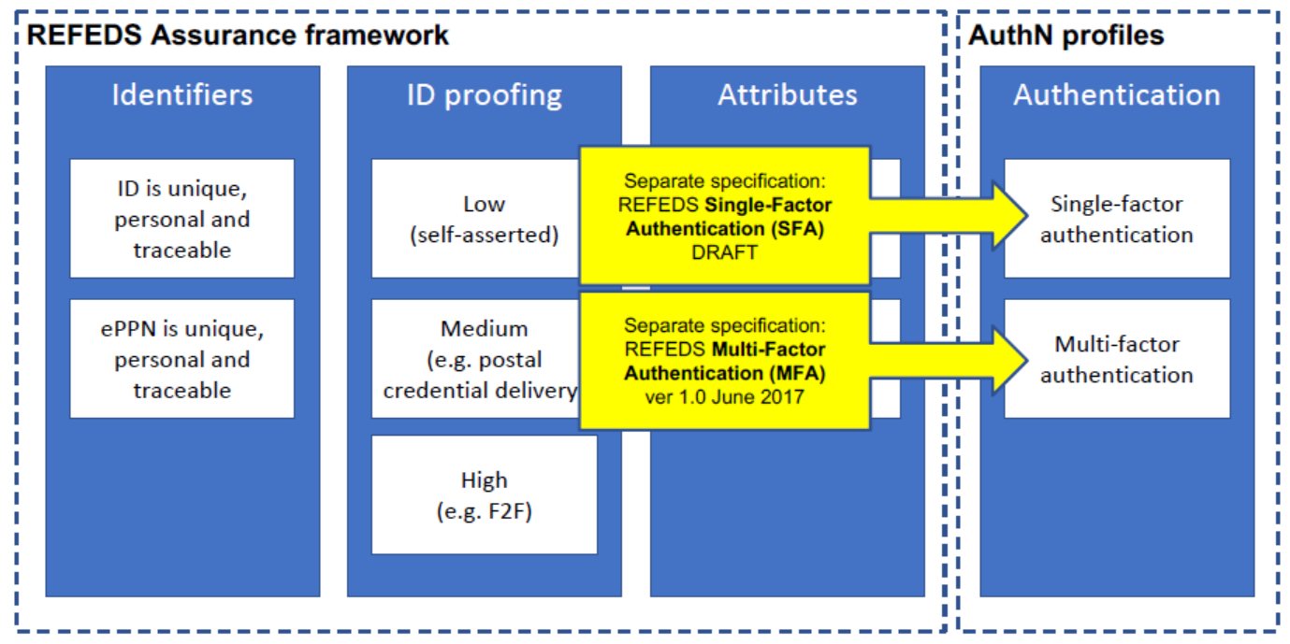
Differentiated Assurance Profile – in eduGAIN and REFEDS
AARC-1 Refresher
Specific definitive guidance to IdPs and federations
Logical grouping and profiles
for the Infrastructures
Uniqueness: at least ePUID or NameID
ID proofing: ‘low’ (good for local use),
‘medium’ (Kantara LoA2, IGTF BIRCH, eIDAS low),
or ‘high’ (Kantara LoA3, eIDAS substantial)
Authenticator: in REFEDS separate profiles,
single (SFA) and multi-factor (MFA) authenticator
Freshness: better than 1 month
All assurance profiles assume
organizational-level authority, also used by the IdP for ‘real work’, good security practices
http://refeds.org/assurance, https://refeds.org/profile/sfa, and https://refeds.org/profile/mfa

Slide 33



e-Infra & Research Infra: high-assurance use cases – does it stand the test?
Two representative use cases from the AARC Pilots
Sensitive data – assurance must stand up to scrutiny, and seen in conjunction with other standards
Retrieval of data from medical data repository
BBMRI-ERIC Colorectal Cancer Cohort study data
Processing personal data on secure computing infrastructures
BioBankCloud, TSD Trusted Sensitive Data, MOSLER platform

Slide 34

REFEDS RAF Assurance in relation to Kantara, eIDAS, and IGTF profiles

Slide 35

Untangling Assurance Spaghetti:
Comparison Guide to Identity Assurance Mappings for Infrastructures
https://aarc-project.eu/guidelines/aarc-i050/

Slide 36




Interpreting the graphs
on context and missing ‘breadcrumbs’
components vs. profiles
implicit trust vs. completeness

Slide 37

About the mapping exercise – the AARC-I050 white paper
Answering the questions
why are there so many Assurance Frameworks
why are the academic and research ones different
why is there more than one for each
how do they compare? what are the unique features
We attempted to answer your request … at TIIME and in AARC-I050!
addressing different audiences:
IdP feasibility vs SP minimal requirements
orthogonality vs component-suite approach (profiles)
completeness vs community-focused:
leveraging common understanding,
… and forgetting the grains of rice on how we got there

Slide 38

Divergence and convergence – the AUP Alignment Study
As seen in PY1
Image: Mozes en de tafelen der Wet, Rembrandt van Rijn, 1659

Slide 39
Scaling Acceptable Use Policy and data release
impractical to present user ‘click-through’ screens on each individual service
Community conditions
Community specific terms & conditions
Community specific terms & conditions
RI Cluster-specific terms & conditions
Common baseline AUP
for e-Infrastructures and Research Communities
WISE Baseline Acceptable Use Policy and Conditions of Use
Also picked up by e.g. SURF SCZ,
eduTEAMS, CheckIn, Vorarlberg, …
https://wiki.geant.org/display/WISE/Baseline+Acceptable+Use+Policy+and+Conditions+of+Use

Slide 40

Baseline AUP at WISE SCI
shown only once to user during registration
information on expected behaviour and restrictions
can optionally be augmented with
additional community or infrastructure specific clauses
but numbered clauses should not be changed
registration point may be operated directly by research community or by third party on community's behalf
Other information shown to user during registration
Privacy Notice – information about processing & user rights
Service Level Agreements – information about what user
can expect from the service in terms of ‘quality’
Terms of Service – optional, with the ‘benefits’ to the user
https://wiki.geant.org/display/WISE/Baseline+Acceptable+Use+Policy+and+Conditions+of+Use

Slide 41


WISE Baseline AUP – and how to apply it for your Infrastructure
AARC-I044
Includes the final WISE Baseline AUP text
for both ‘community-first’ and ‘user-first’
MMS services (attribute authorities)
examples make it concrete
Quick take-up by e-Infras
(both global and national)
https://aarc-community.org/guidelines/aarc-i044/

Slide 42

Examples in action: SURF Science Collaboration Zone, eduTEAMS, …

Slide 43


Implementing Snctfi in community policies
Relevant to communities
and e-Infrastructures both
what are the requisite policy elements
and processes you need to define to manage a structured community?
which of these are required to access general-purpose e-Infrastructures?
which roles and responsibilities lie
with the community ‘management’
so that the BPA proxy model will scale out?
in collaboration with EGI, GEANT, EOSC-Hub, EUDAT, WLCG, PRACE, HBP, and SURF

Slide 44
Main achievements in Researcher-Centric Policy
Interoperable authentication assurance across federations also for high-assurance use cases | ➔ | REFEDS RAF adoption shown to work & e.g. adopted in lieu of complex frameworks by CILogon Silver
‘I050’ white paper on assurance frameworks | ➔ | Untangled some assurance spaghetti
WISE Baseline Acceptable Use Policy | ➔ | Directly supported eduTEAMS and CheckIn, adopted in other places, both nationally and thematically
Snctfi-compatible community policies | ➔ | Fill the need of research communities for a complete Policy Development Kit
After AARC | WISE and REFEDS committed to supporting research communities in development
 | EOSCH ISM and GN43-EnCo: support communities in policy adoption and design

Slide 45

Policy and Best Practices Harmonisation
Policy Development Kit
FIM4R version 2
WISE SCI and SCCC-JWG
Task 4
Policy Development Engagement and Coordination

Slide 46



Policy Development Kit
Bring together a consistent suite
based on e-Infrastructure best practices
in particular EGI, WLCG, and the JSPG
cover all of the Snctfi requirements
https://igtf.net/snctfi
https://aarc-community.org/policies/policy-development-kit/

Slide 47


Policy Development Kit
introduction video – training – 9 reference templates – continued improvement
joint work
with peers in
https://aarc-project.eu/policies/policy-development-kit/

Slide 48





Templates and guidance on how to implement
…

Slide 49


Adoption – by new (national) proxies, and: PDK seen as a ‘neutral go-to’
And much more (do we want a list?):
PDK adoption: by HDF, WLCG
MMS services adopting AUP
LSAAI R&S+DPCoCo
EOSC-HUB and WLCG
policy framework revision
AUP by many (even by a FH)
FIM4R impact
…
Policy Development Kit showing up without me prompting
in a Dutch collaborative science presentation …
(slides: Raoul Teeuwen, January 2019)

Slide 50


Bringing Infrastructures Together – the WISE road
Coordinating Information Security
for e-Infrastructures
More than just the home of SCI
Broad collaboration: steering group with
EGI, GEANT, EUDAT, PRACE, XSEDE, OSG, TrustedCI, HBP, WLCG, LIGO, SURF, CERN, CSC, JSC, & Nikhef.

Slide 51
Example of WISE coordination – evolving the Sirtfi challenges
The first Sirtfi challenges were run ‘by AARC’ to establish the guidelines
But: many ‘logical’ candidates that could all run the test
… and all have an interest in knowing the result so to establish trust!
eduGAIN
GEANT.org
any EOSC-HUB and e-Infrastructure CSIRT teams
the IGTF (as it leverages federated identity in RCauth, TCS, CILogon)
each of the e-Infrastructures XSEDE, EGI, EUDAT, PRACE, OSG, HPCI, …
every research infra with an interest: WLCG, LSAAI, BBMRI, ELIXIR, …
and any institution (or person) with access to https://mds.edugain.org/ can run them, of course!
‘so in a short while, all the email in the world will be on Sirtfi Incident Response tests??’

Slide 52




Challenge elements – what is valued or expected might differ …
A single test and challenge can answer one or more of these questions
ability to
take action
confidentiality
timeliness
investigative capability
when data available: infrastructure can set its own level of expectancy and gives deep trust
assessment supported with community controls (suspension) gives a baseline compliance
Communications challenges build ‘confidence’ and trust – an important social aspect!
different tests bring complementary results: responsiveness vs. ability act , or do forensics
unless you run the test yourself, you may not be growing more trust in the entities tested
for a ‘warm and fuzzy feeling of trust’, share results: but this is sociologically still challenging …

Slide 53

Continued engagement and coordination: WISE SCCC JOINT WG
WISE
SIG-ISM
REFEDS
IGTF
https://wiki.geant.org/display/WISE/SCCC-JWG

Slide 54
Main achievements in Policy Development Coordination
Policy Development Kit | ➔ | Lasting resource for both emerging and established communities
 | ➔ | Supports alignment also of e-Infrastructures
 | ➔ | Continuous evolution happening in practice: security policy for WLCG, LIGO, and EOSCH
WISE and SCCC JWG coordination (SIG-ISM, REFEDS, EOSCH-ISM) | ➔ | AARC brought together security coordination and articulated need across many domains
After AARC | WISE: new working groups like the SCCC JWG, and evolution in SCI
 | FIM4R, GN4-3 EnCo, EOSCHUB-WP44, AEGIS, REFEDS, GN4-EOSCH-CA!

Slide 55




WISE SCI and SCCC
IGTF
REFEDS
SIG-ISM
FIM4R
aarc-community.org
Beyond AARC
The Community Beyond the Project

Slide 56

Beyond the end of the world … oh well, of AARC
Sirtfi & the Registry
Communications Challenges
Attribute Authority operations
SCI evolution and its assessment to support trust
Acceptable Use Policy
Assurance profiles: adoption & suitability in high-risk cases
Policy Development Kit evolution
Data Protection guidance for global research collaboration
WISE-community
IGTF
REFEDS
AEGIS
FIM4R
Collaboration EOSCH-GN4
national, domain and community groups

Slide 57

AARC Community – towards EOSChub, GEANT4-3, and the Research Infra’s
https://wiki.geant.org/display/gn43wp5/eScience+Global+Engagement

Slide 58
aarc-community.org/policies
wiki.geant.org/display/AARC/AARC+Policy+Harmonisation
davidg@nikhef.nl

Slide 59
FIM4R

Slide 60


FIM4R version 2
https://doi.org/10.5281/zenodo.1296031

Slide 61


FIM4R reinvigoration, supported by AARC
Based on the requirements collected, we know where we want to go:
an interoperable infrastructure that:
solves current issues
is as invisible to the researcher as possible
All depends upon the substantial participation and cooperation of several groups
In our recommendations we specifically address each of these groups
Each recommendation is expected to have broad positive impact on the viability and value of FIM for research collaborations
AARC2

Slide 62

FIM4R at RDA

Slide 63
Towards the future: homing the AARC activities

Slide 64
Where do you want to go today? Operational security and WISE
Sirtfi
Continue its evolution in the REFEDS WG with Sirtfi+ and the Registry
Guidance on incident response + implicit & explicit expectations where it involves federation
actual incident response plus readiness challenges on federated ID side
go with the new eduGAIN security capability
Communications challenges for security that involve also the Infrastructures
WISE, specifically the new SCCC JWG
needs some love and care from all Infrastructures, commitment from REFEDS, WISE, SIGISM
Specific challenges remain in their infrastructure, coordinated through SCCC-JWG
like the IGTF RAT CC, EGI CSIRT SSC’s

Slide 65
Where do you want to go today? Service providers and Infrastructures
Data Protection and GDPR – service centric policy support
more than TF-DPR and the special interest group is needed
risk-assessment methodology for infrastructures and communities
consultancy role for new communities to enable use of the infrastructures -> mailing list?
joint GN4-3 + EOSC-HUB + WLCG effort, homed (for lack of anything else) in AEGIS?
SCI Assessment
WISE SCI WG, with assessment in the IGTF
support through EOSC-HUB InfoSec and GN4-3 Enabling Communities
but obviously also from PRACE, XSEDE, GridPP, SURF, &c
Tuning the policy development kit
the WISE SCI WG will coordinate, but the effort should come from somewhere
support from GN4-3 and EGI and EUDAT, as requested by FIM4R
other sources have been very successful as well: HDF, GridPP, and SURF

Slide 66
Where do you want to go today? Research-centric federation harmonisation
Assurance Profiles – from federations to Infrastructures, and between R/E infrastructures
the ‘feasible’ assurance and alignment with IdPs and federations belongs in REFEDS RAF
assurance requirements of, and exchange of assurance between, infrastructures: in IGTF
AUP and Terms of Use
the home is WISE SCI, but it needs care and nourishment from EOSCHUB and GN4-3
extends beyond just EOSCH & GN4-3, and involves e.g. also eduTEAMS, CheckIn, B2ACCESS
For the rest and new things needed, leverage GN-EOSCH collaboration agreement & AEGIS?
one-on-one consulting with communities highly appreciated also beyond AEGIS,
but must be and be seen as neutral – we keep the forum of ‘AARC-Community’
ongoing discussions on how to engage FIM4R effectively

