Slide 1
Policy in harmony: our best practice
A Kit List for Communities
David Groep
NA3 Coordinator
Dutch National Institute for Subatomic Physics Nikhef
AARC2 AHM3 Athens meeting
April 2018

Slide 2
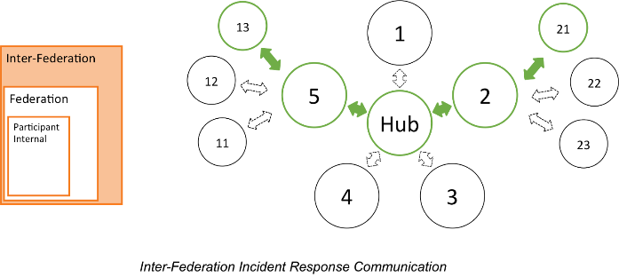
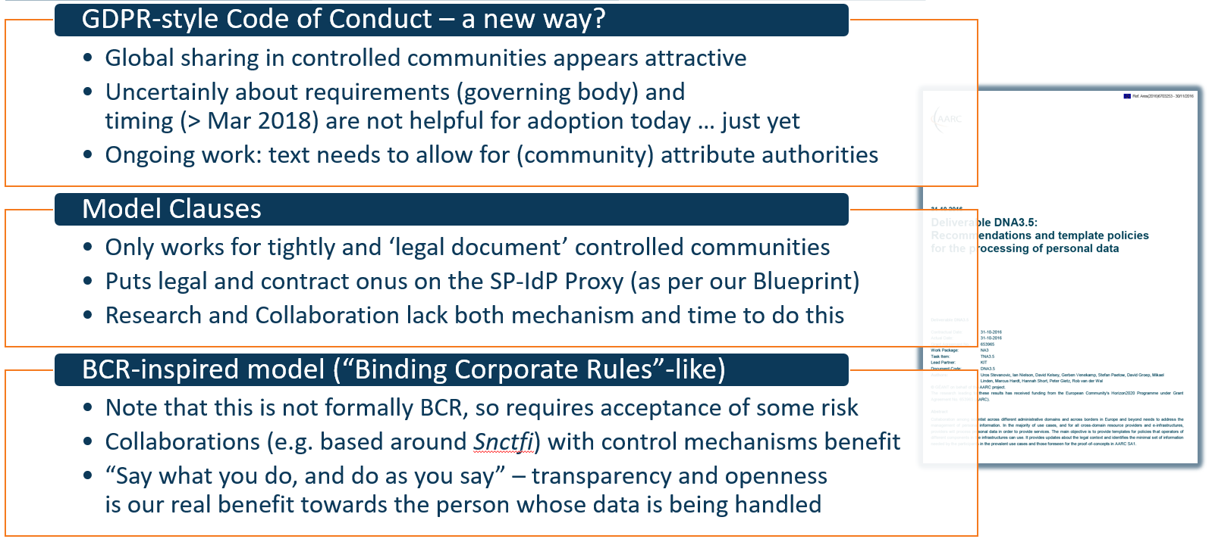
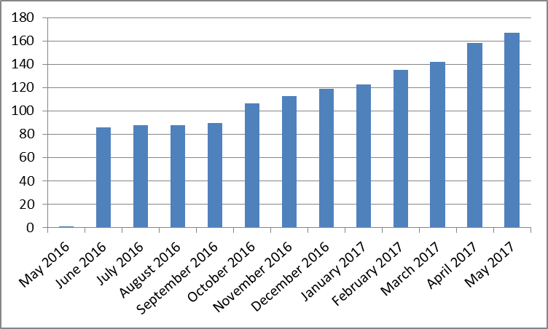
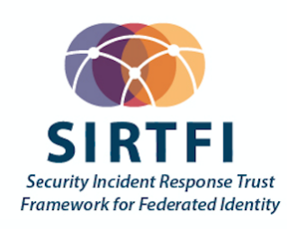
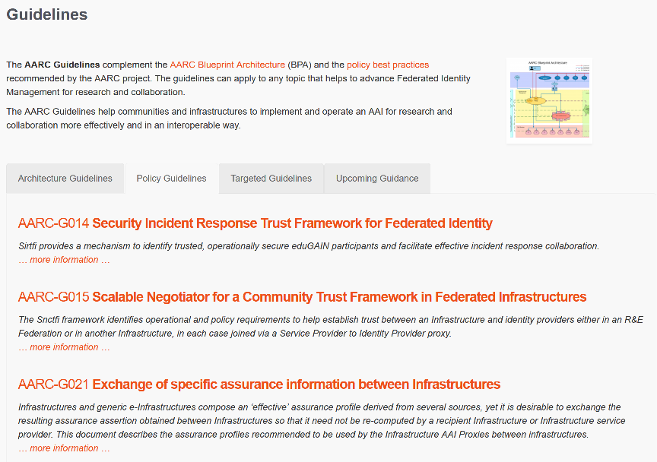

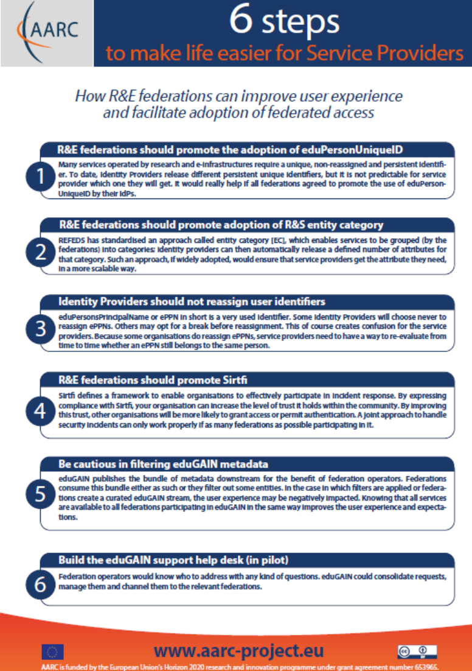
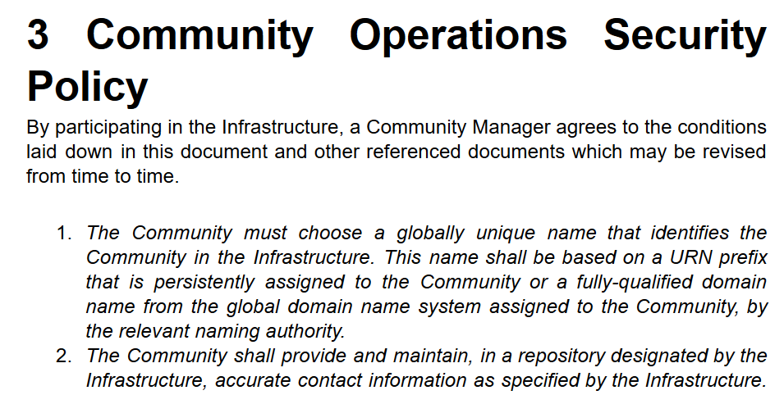
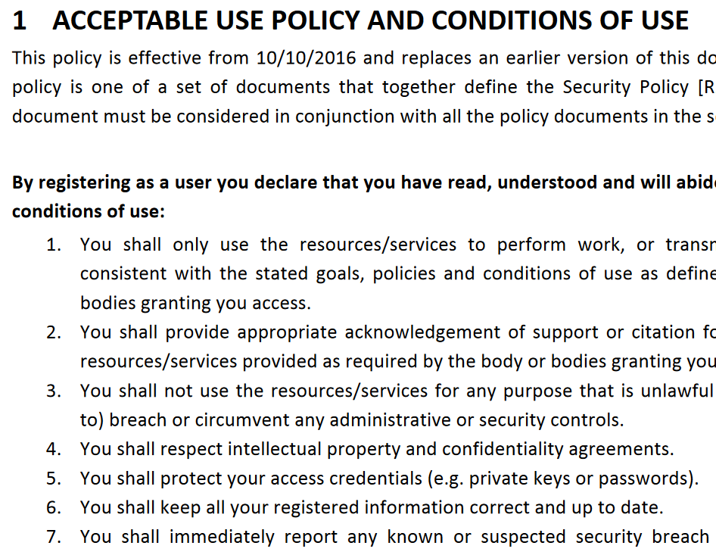
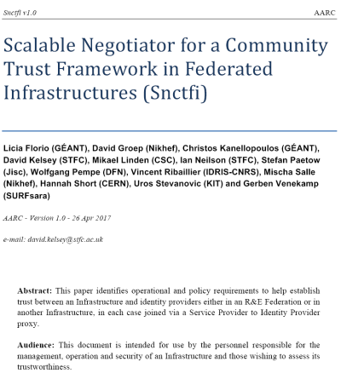
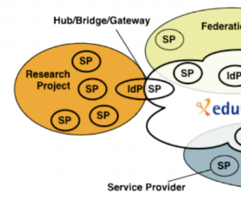


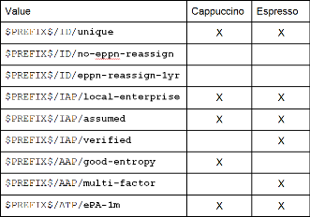
A tour of the policy space in AARC2
Operational Security
for FIM Communities
167 entities
supporting policies
for Infrastructures
bulk
model
support for
Researchers & Community
‘low-risk’ use cases
few unalienable expectations by research and collaborative services
generic
e-Infrastructure services
access to common compute and data services that do not hold sensitive personal data
protection of sensitive
resources
access to data of real people, where positive ID of researchers and 2-factor authentication is needed
Engagement and Harmonisation
Baseline Assurance
known individual
Persistent identifiers
Documented vetting
Password authenticator
Fresh status attribute
Self-assessment
Slice includes:
assumed ID vetting
‘Kantara LoA2’, ‘eIDAS low’, or ‘IGTF BIRCH’
Good entropy passwords
Affiliation freshness
better than 1 month
Slice includes:
Verified ID vetting
‘eIDAS substantial’, ‘Kantara LoA3’
Multi-factor authenticator
2

Slide 3

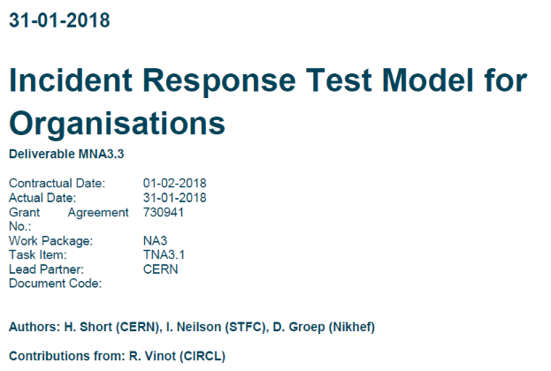
Improving operational security readiness for FIM (“T1”)
Define & test model for organizations (IdP) to share info on account compromises
Attribute authority operations (security) practices
Access control, integrity and availability of IdP-SP-Proxies
Detect, connect, mitigate
243 IdPs now support Sirtfi
and 65 SPs and proxies
What happens when you try the model?
How does this work when you involve community AAs?
How can Sirtfi protect the communities and proxies?
Hannah Short: before coffee

Slide 4
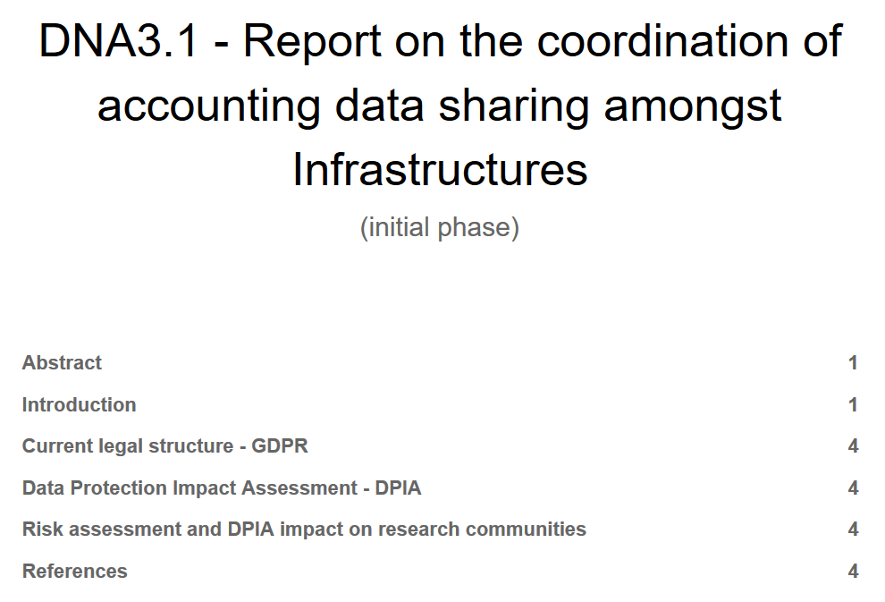
Service-centric policy support: ‘helping out’ the Infrastructures (“T2”)
Develop traceability and accounting data-collection policy framework based on SCI
  e.g. why SCI & peer review may more appropriate than trying 27k and audits for Infrastructures?
  construct (‘service’ part of) a Policy Development Kit for Infrastructures
Impact of GDPR and risk assessment guidance
Protection of aggregations of accounting
data by (user) communities
Policy recommendations accompanying
technical ‘JRA1’ recommendations
Uros Stevanovic: after coffee

Slide 5
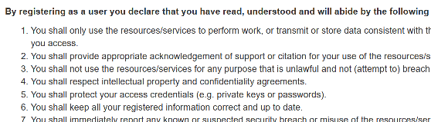
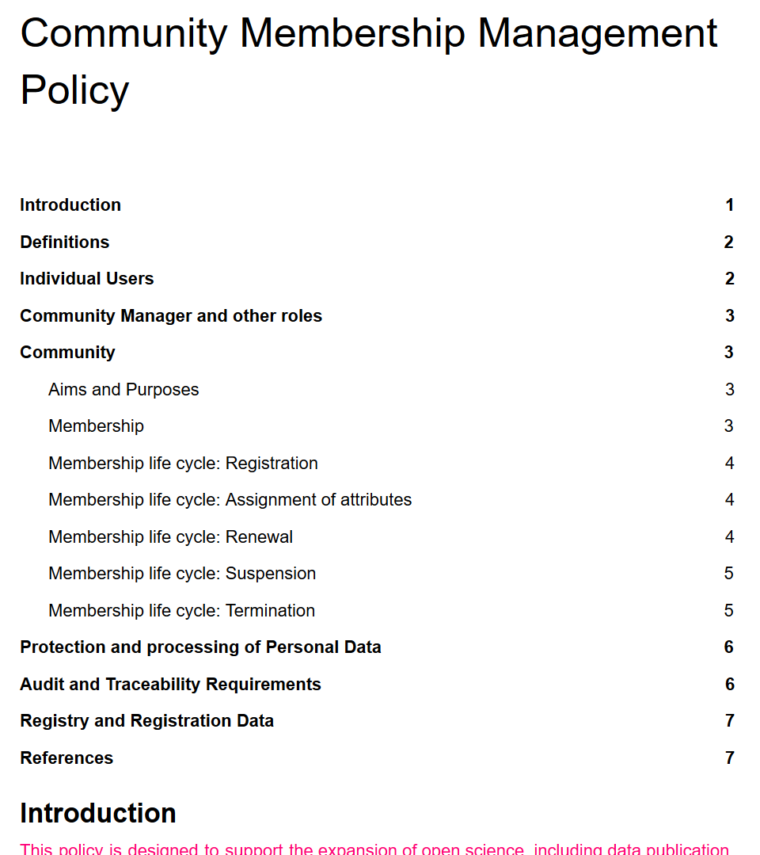
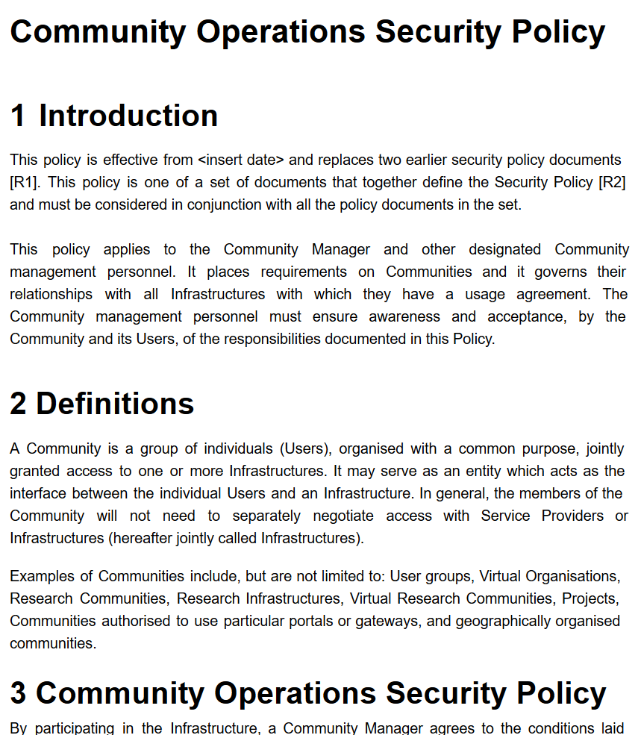
Researcher-centric policy support (“T3”)
Recommendations for baseline “policy profiles” for FIM Communities & Infrastructures
for users, communities, identity providers: reducing “policy silos” hindering interoperation
commonality between acceptable use policies
through assurance profiles
support community management, also to
ease use of the generic e-Infrastructures
can you support trustworthy community
operations? How should a community
collaborate in the Infra ecosystem, now
that we have very ‘powerful’ communities?
Mikael & Jule: Assurance after Coffees
Ian Neilson: after coffee

Slide 6
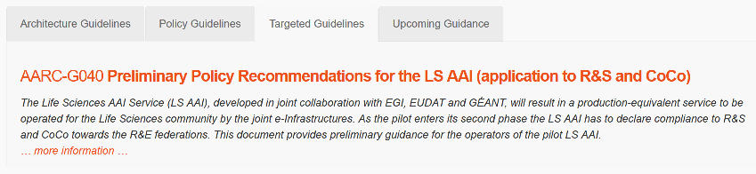
Policy guidance: generic and community-targeted

Slide 7

Engagement and coordination with the global FIM community (“T4”)
Develop
Adopt
Through
WISE/SCI
REFEDS
IGTF
… and all willing policy & CSIRT groups
In your Community, use
Persistent, non-reassigned identifiers
Snctfi
Trusted Community Attributes
Self-assessment and
peer review methods
Snctfi
Scalable Negotiator for a Community Trust Framework in Federated Infrastructures
AEGIS
AARC Engagement & FIM4R
help us progress by adopting results
Derived from SCI, the framework on
Security for Collaboration among Infrastructures
Structure for the wider policy development kit
assessment of SCIv2
Dave Kelsey: FIM4R before coffee

Slide 8
We will need your input today … and thereafter!
Operational Security and Incident Response
Beyond Sirtfi, involving the proxies and proxy operators: we need volunteers to try (& ‘buy’)
Cross-domain trust groups spanning Infrastructures & eduGAIN Support Desk to aid resolution
Service-centric policies
Community Risk Assessment, GDPR, and TF-DPR impact on accounting (and your use cases!)
Policy framework: what do you need in a policy development kit for Infrastructures?
e-Researcher-Centric Policies
Assurance profiles: exchanging information between Infrastructures and the ‘Snctfi’ scenario
Align practices for community policies, and a baseline AUP
Policy Development Engagement and Coordination
Policy development and engagement ‘kit’ – via existing groups, and trainings, WISE, IGTF, and FIM4R
Targeted guidance for (AARC) use cases and communities – ‘/guidelines’

Slide 9
Best Practice session
10:00-11:00 | 10.00 Introduction to the NA3 activities (DavidG) 10.15 Operational Security: the Sirtfi Challenge (Hannah) 10.35 FIM4R and the FIM4R Paper (DaveK)
11:00-11:30 | Break
11:30- 13:00 | 11.30 REFEDS Assurance evolution (Mikael, Jule) 11.45 Data Protection and Risk Assessment for communities (Uros) and input from the AARC use cases (Uros) 12.15 Acceptable Use Policy alignment study and towards a basic AUP (IanN) 12.35 Policy Development Kit: supporting communities with template policies (Hannah, Uros)

Slide 10
davidg@nikhef.nl

