Slide 1
AARC TREE: Enhancing our Research Collaborations
even better research with secure collaborative authentication & authorization
David Groep
AARC Community policy lead, for the AARC Collaboration
Nikhef Physics Data Processing programme and UM Dept. Advanced Computing Sciences
GÉANT Security Days 2024
Prague, April 2024

Slide 2
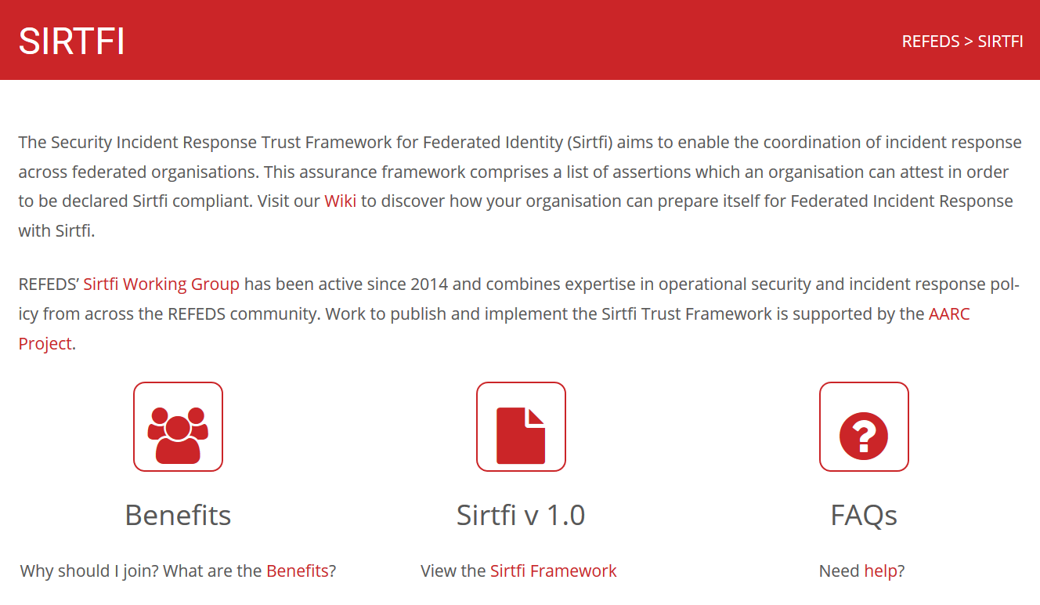
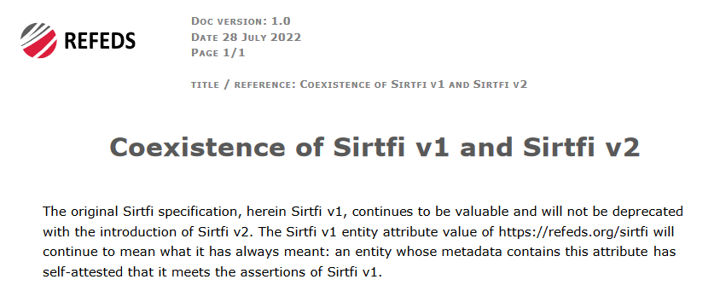
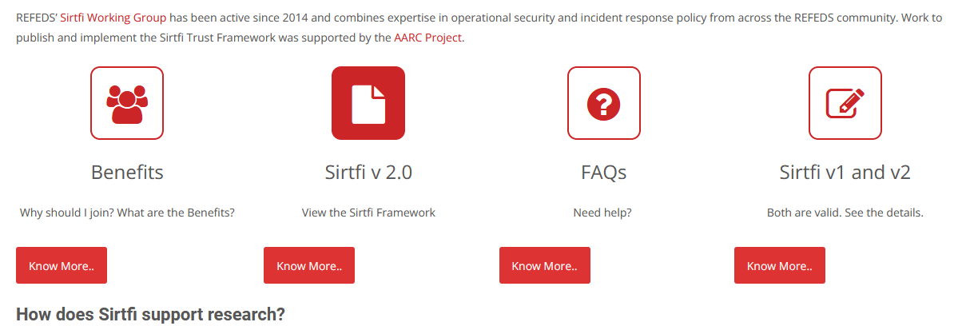


Probably most well-known AARC result to this audience …
Security Incident Response Trust Framework for Federated Identity
https://refeds.org/SIRTFI

Slide 3



































But that is only part of a much larger, federated, story …
slide inspiration: Licia Florio, NORDUNET

Slide 4
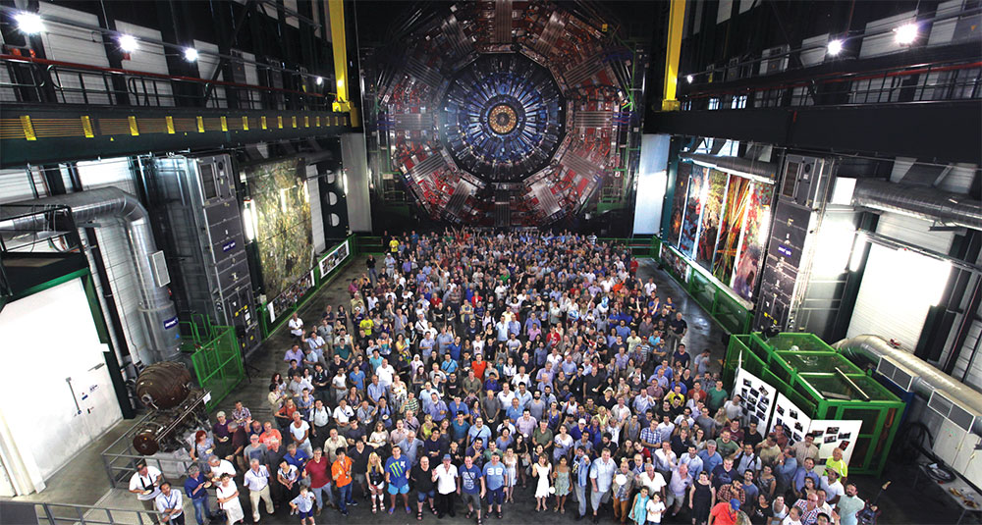


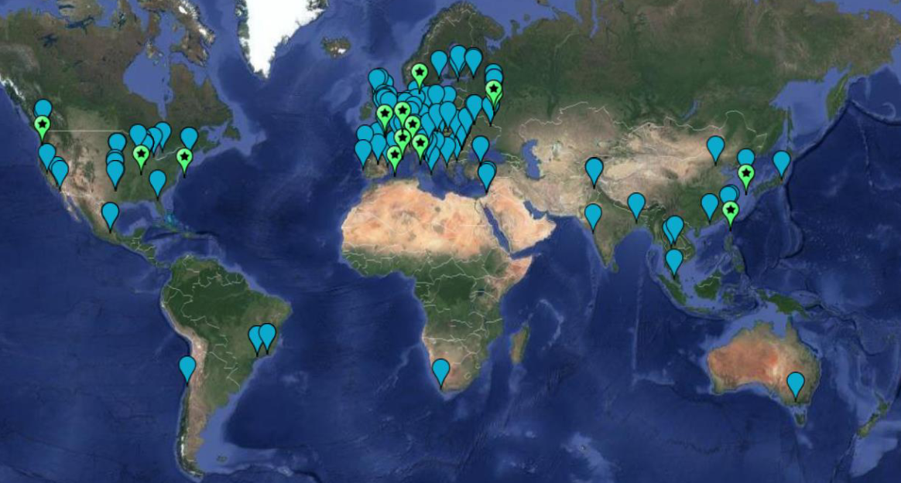
Research Collaboration: an inherently-cross-domain issue .. and solution
Example from the LHC Computing infrastructure WLCG
170 sites
~50 countries & regions
~20000 users
just how many interactions ??
AuthN & AuthZ, as well as security & compliance should align with collaboration structures, and be outward facing: open, scalable, and multi-domain
people photo: a small part of the CMS collaboration in 2017, Credit: CMS-PHO-PUBLIC-2017-004-3; site map: WLCG sites from Maarten Litmaath (CERN) 2021

Slide 5
Federated Identity Management and global collaboration
Access services using identities from their Home Organizations,
but hide complexity of multiple IdPs, federations, AA technologies
with one persistent identity
across all the community’s services through account linking
Access services based on role(s) users have in the collaboration. linking not known to your “SP” services, the IdPs – or to eduGAIN
for both web and non-web resources
Integration of guest identity solutions
support for stronger authentication assurance mechanisms
Authentication and Authorization for Research Collaboration – AARC (Licia Florio et al.) – https://aarc-community.org/

Slide 6
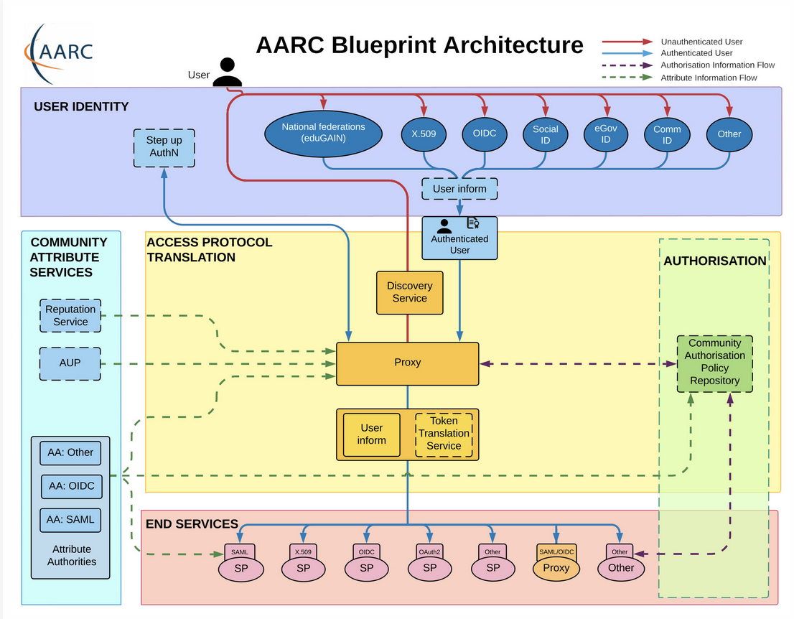









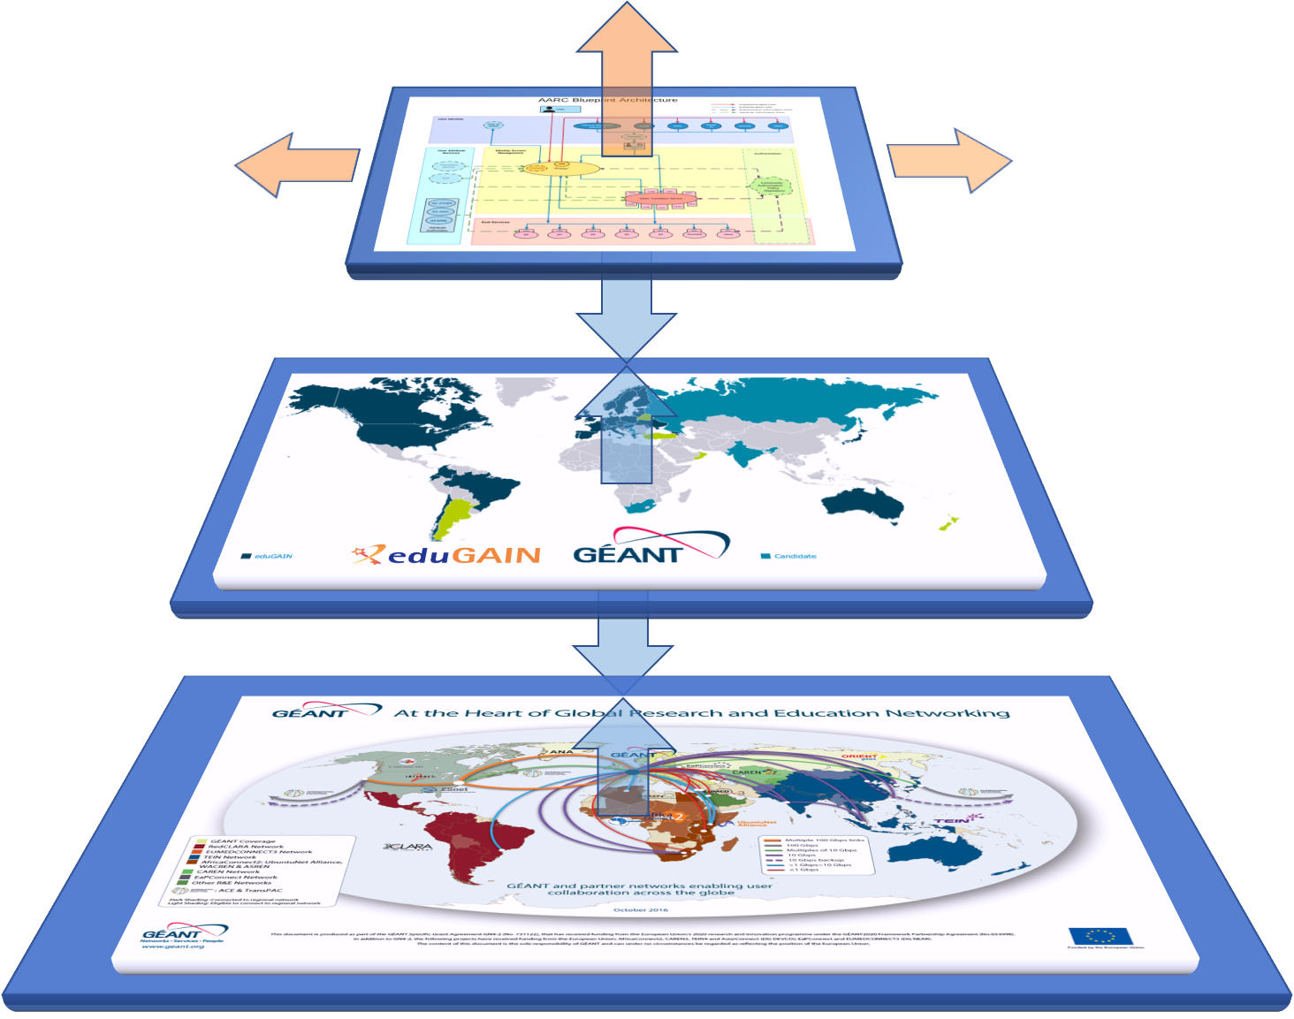
AARC – ‘just eduGAIN is not enough’

Slide 7
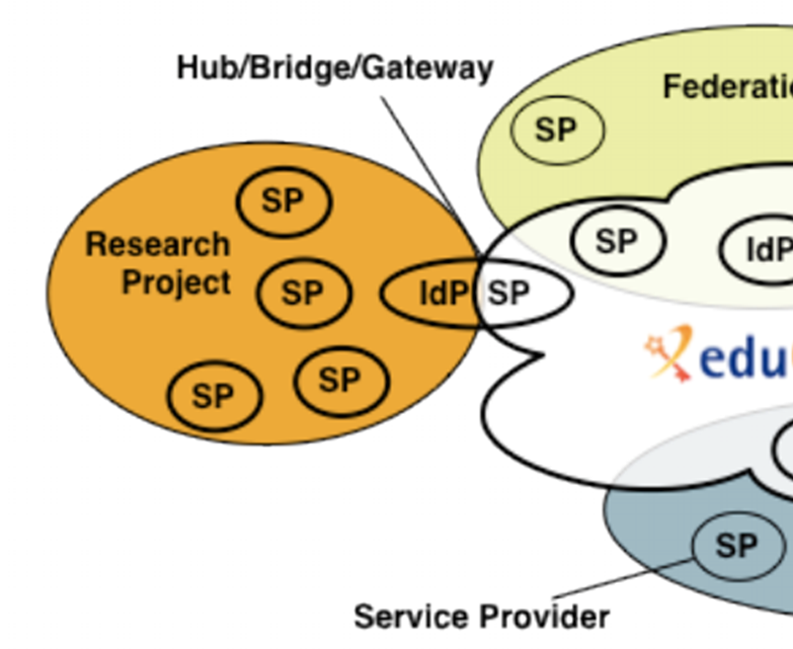
The IdP-SP proxy: a First-class Citizen
Graphics: Ann Harding and Lukas Hammerle, GEANT and SWITCH – from a long time ago now!

Slide 8
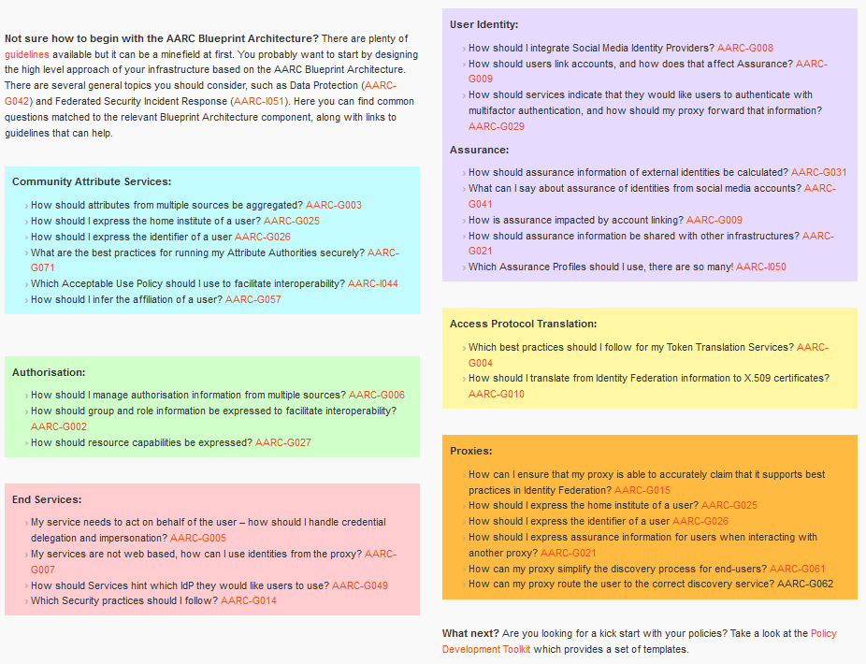
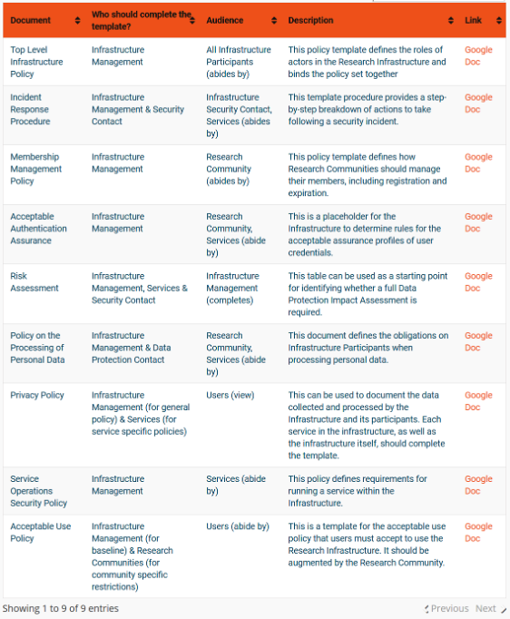

Interoperability – more than just the nice colours
https://aarc-community.org/guidelines/

Slide 9
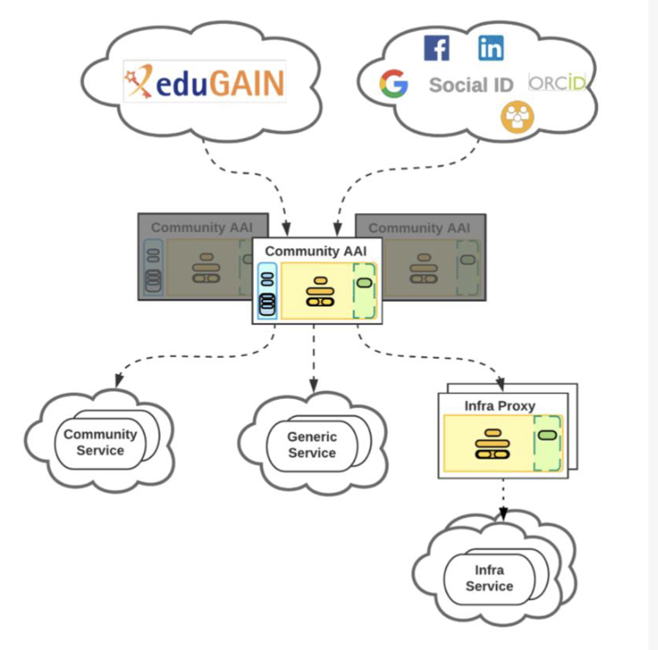
The Community AAI and the Infrastructure Proxy – structuring elements
Community AAI
The purpose of the Community AAI is to streamline researchers’ access to services, both those provided by their own infrastructure as well as the services provided by infrastructures that are shared with other communities.
Infrastructure Proxy
The Infrastructure Proxy, enables Infrastructures with a large number of resources, to provide them through a single integration point, where the Infrastructure can maintain centrally all the relevant Policies and business logic for making available these resources to multiple communities

Slide 10
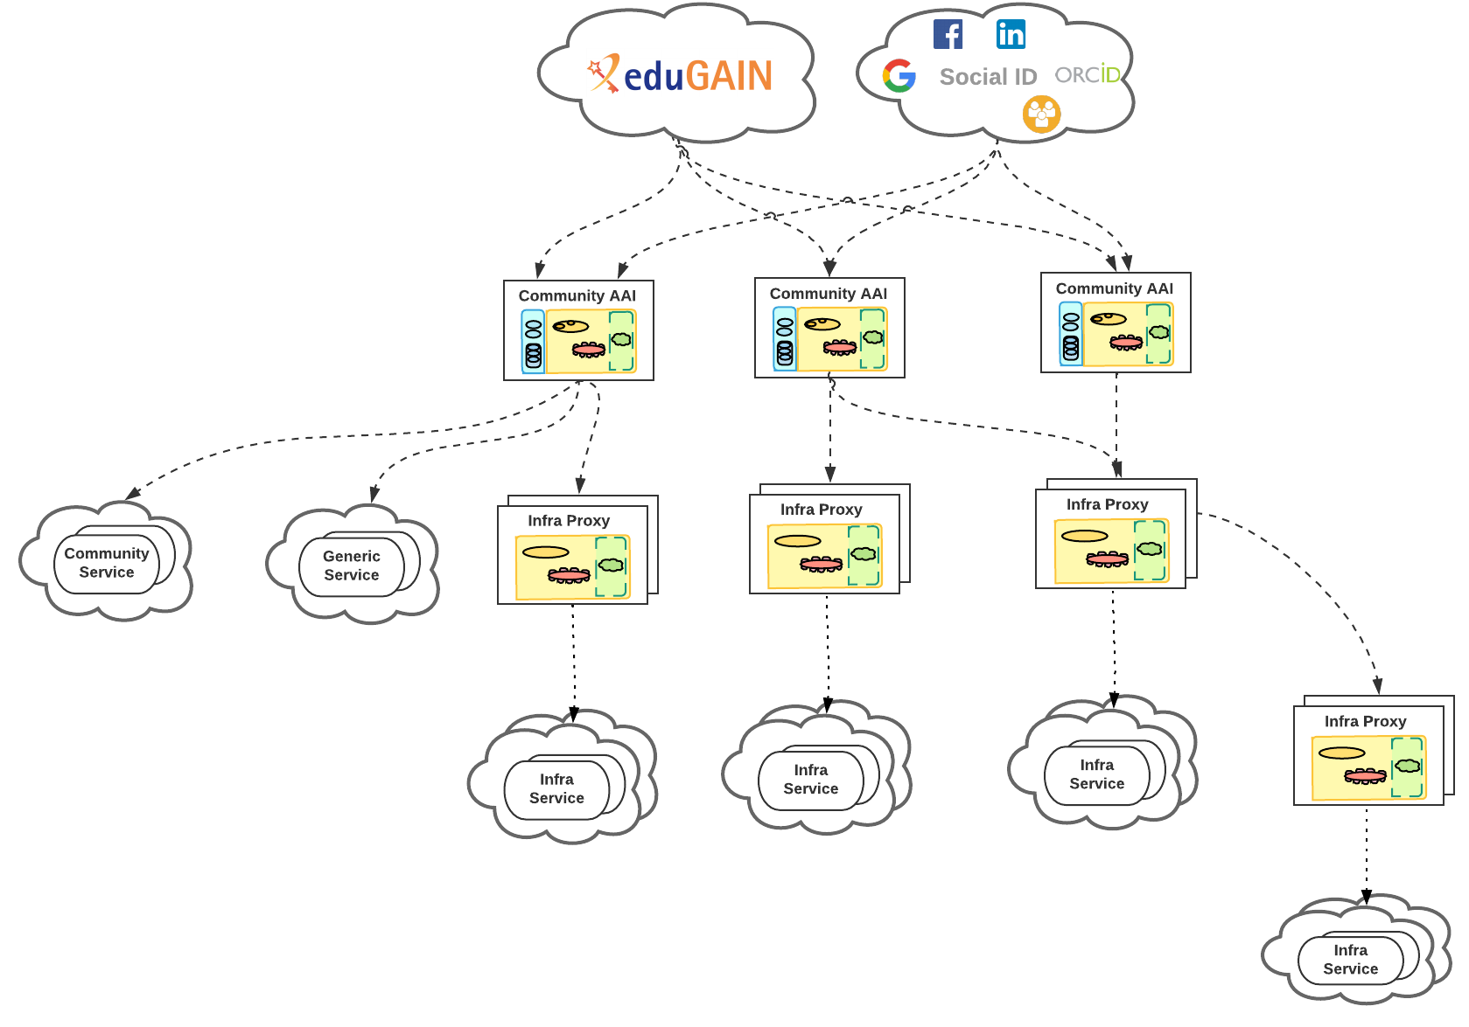
But it’s getting more complex …
… it’s time for a Technical Revision to Enhance Effectiveness!

Slide 11

AARC TREE Main Facts: Expected results
Updated AARC BPA
Recommendations for a common long-term strategy for AAI services
Updated interoperability framework

Slide 12

The AARC TREE in the Trust and Identity Landscape
AARC Engagement Group for Infrastructures
The forum of e/r-Infras that operate an AARC BPA complaint AAI.
It’s a closed group on purpose as we want to get feedback from the hands on group.
They approve the AARC guidelines.
Technical WG
Led by Nicolas and Christos
Where technical guidelines are discussed
Anybody can join the discussion:
https://lists.geant.org/sympa/info/aarc-architecture
Policy WG
Led by Dave and David
Supported by EnCo and IGTF
Anybody can join the discussion: policy@aarc-community.org
https://lists.geant.org/sympa/info/aarc-na3

Slide 13
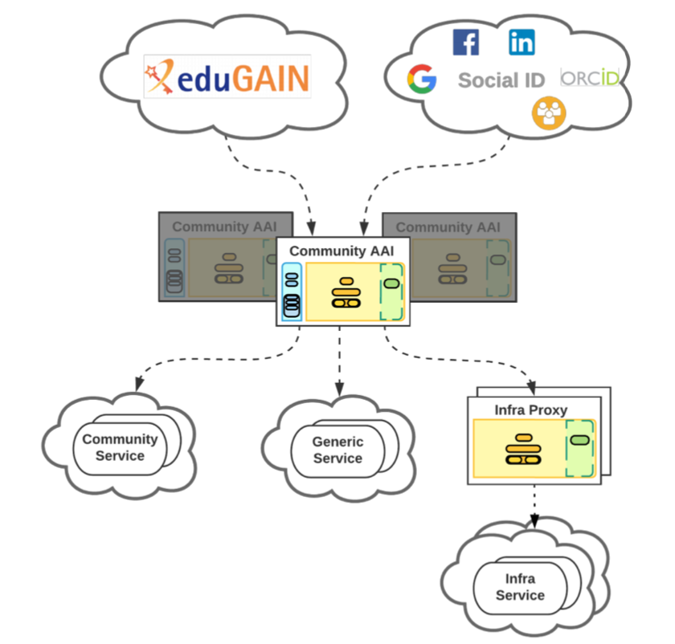
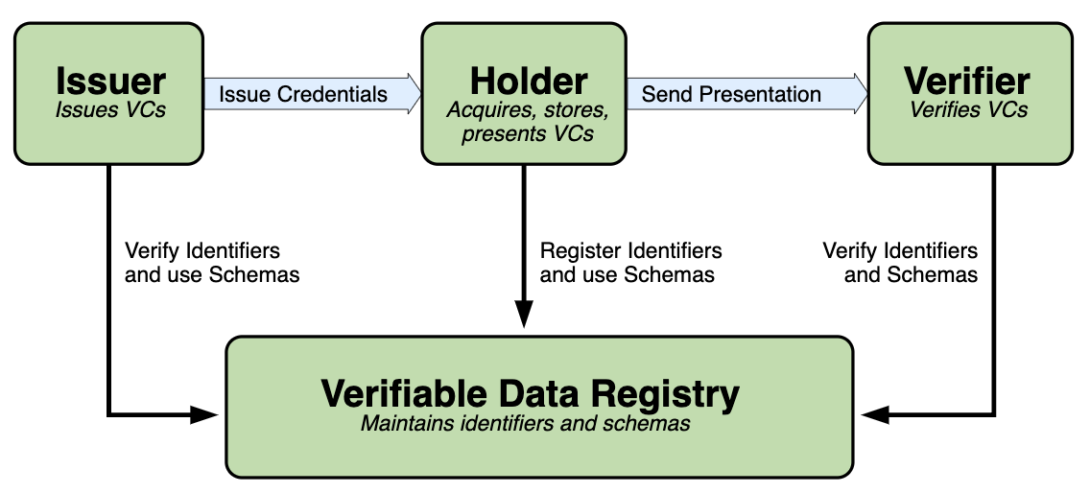
Evolve the BPA to address the more complex (and the simpler) worlds
Guidelines for expression of community user attributes
reduce inconsistencies between implementations
improve interoperability & end-user usability across research community communities and infrastructures
Extend AARC BPA
improve scalability
leverage emerging standards
like OpenID Federation
Authorisation guidelines
best practises to enable efficient &
effective sharing of federated resources
2025
Decentralised identities
guidance for digital wallets linked to BPA

Slide 14
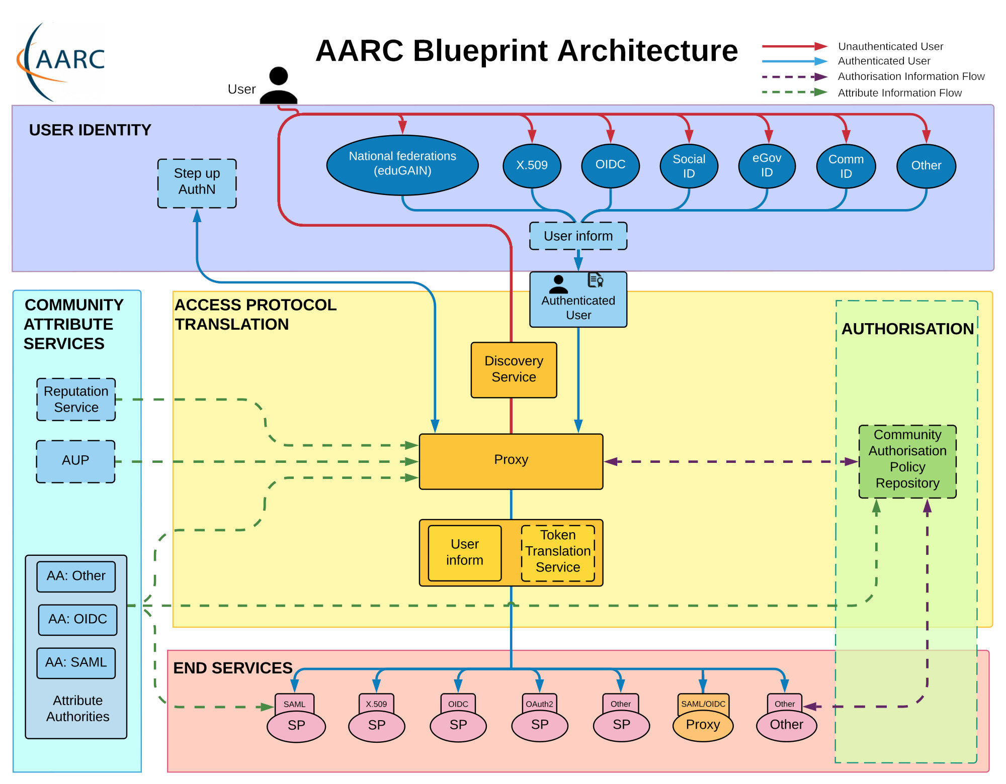
AARC Blueprint Architecture ‘BPA2025’
AARC BPA 2019
AuthZ for Federated Resources
Decentralised Identities & Wallets
OpenID Federations
AARC BPA 2025

Slide 15
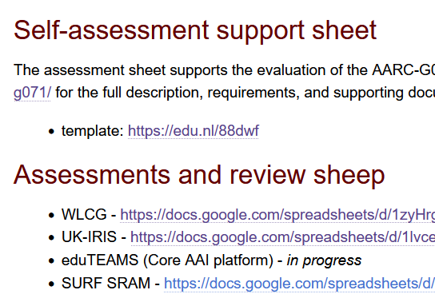
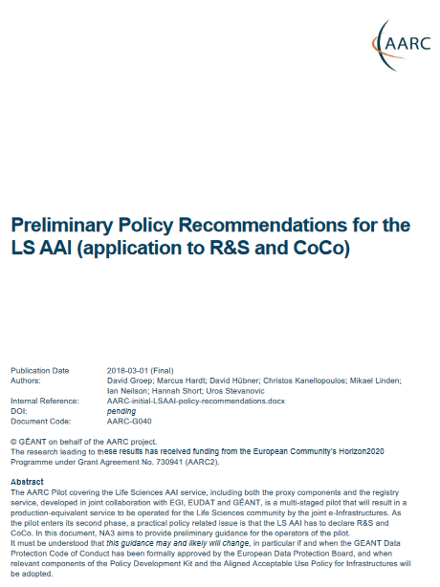

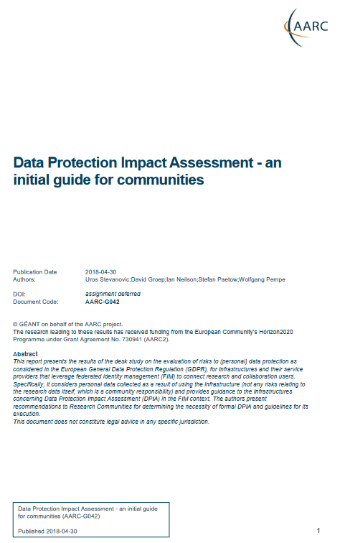

Policy and good practice underpinning the AARC Blueprint BPA
Infrastructure alignment and policy harmonisation: helping out the proxy
Operational Trust for Community and Infrastructure BPA Proxies
Increase acceptance of research proxies by identity providers through common baselines
Review infrastructure models for coordinated AUP, T&C, and privacy notices, improving
cross-infrastructure user experience (users need to click only once)
User-centric trust alignment and policy harmonization: helping out the community
Lightweight community management policy template
Guideline on cross-sectoral trust in novel federated access models
Assurance in research services through (eIDAS) public identity assertion
Anchored in the researcher user communities by co-creation with FIM4R

Slide 16
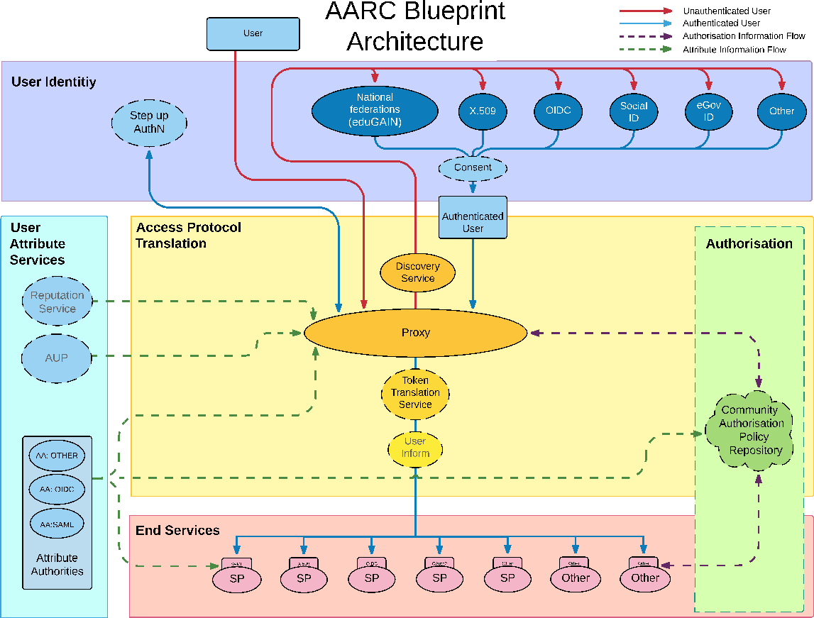
AARC G071 is there to help, but do we ‘get the trust across’?
Membership management service, attribute authorities, and proxy/token translator
integrity of membership
identification, traceability
site and service security
network protections
assertion integrity
> Trust marks and expression
Community membership management directories and attribute authorities
integrity of membership
identification, naming and traceability
site and service security
protection on the network
assertion integrity
But when proxies are proxying proxies, can we proxy the trust?
Agree to a
common baseline
… an approach that was successful previously!
See https://www.igtf.net/guidelines/aaops/ and https://aarc-community.org/guidelines/aarc-g071/

Slide 17
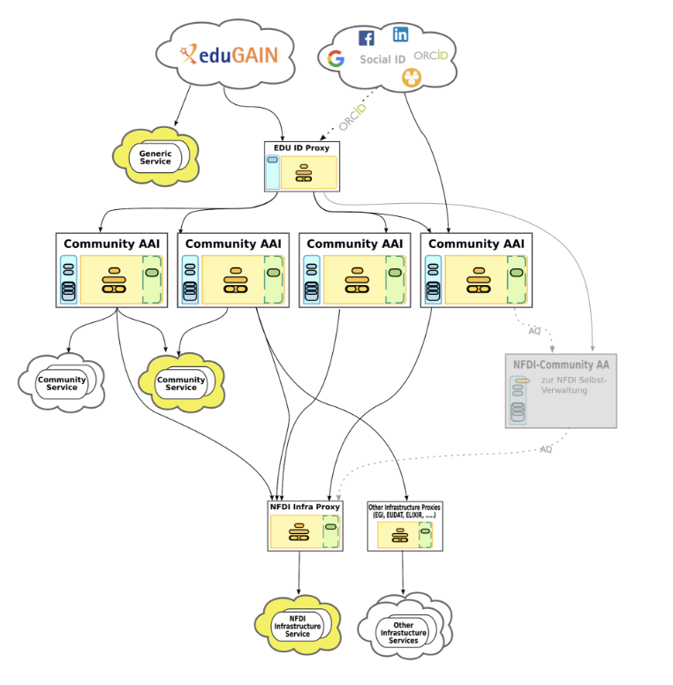
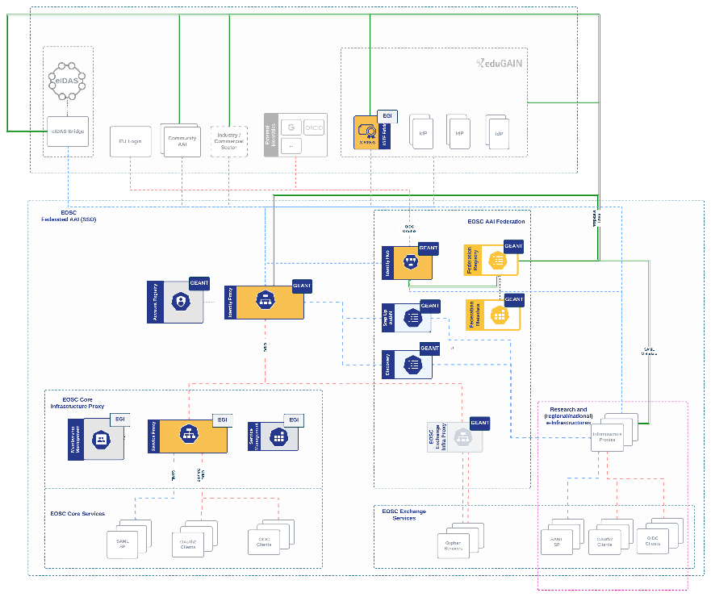
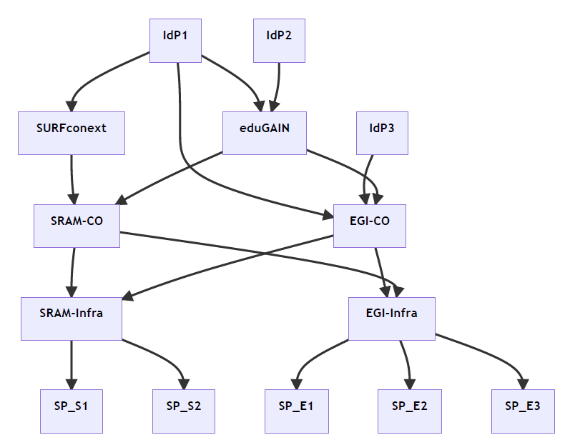
Our federated world is growing more complex
Images: SURF SSRAM and EGI by Maarten Kremers, NDFI AAI (Marcus Hardt), EOSC AAI for the EOSC Core and Exchange Federation for the EOSC European Node by Christos Kanellopoulos, Nicolas Liampotis, David Groep (June 2023 version)

Slide 18
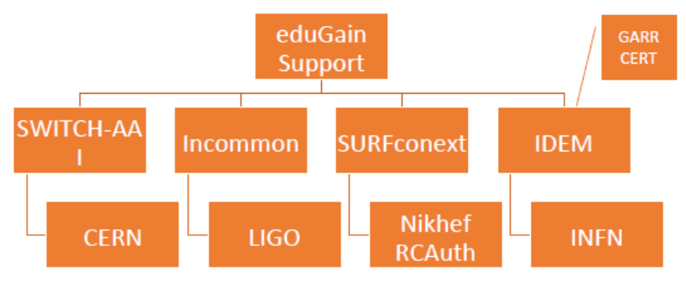
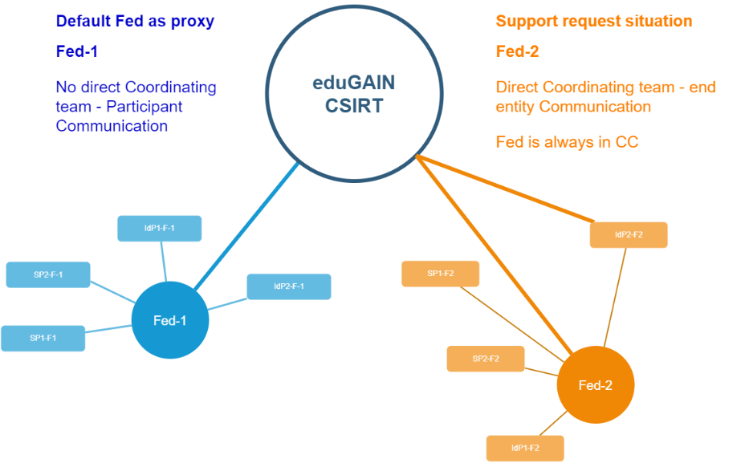
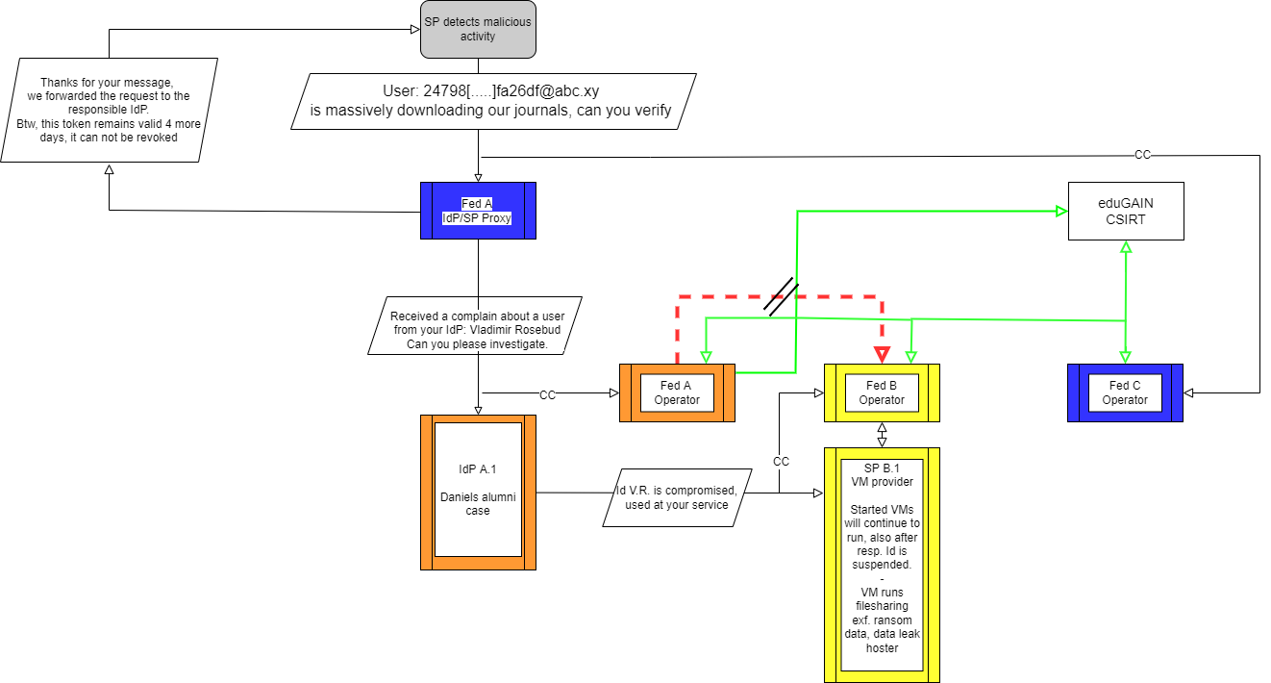
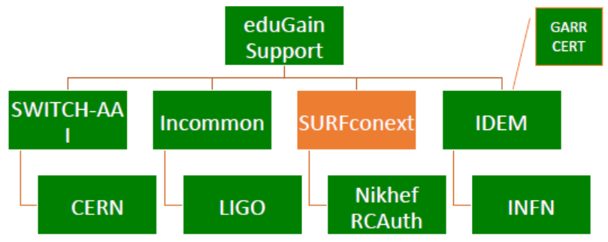



Response and traceability across IdP-SP Proxies and the limits of Sirtfi
Srtfi v1
Guidelines for a joint operational trust baseline for membership management and proxy components,
supplemented by policy guidance for sectoral federations with more specific policies where needed
‘How can we convey the trust in what is in and behind the proxy?’
‘How to provide timely traceability between services and identities through the proxy?’
Based on requirements from FIM4R, WISE, and the proxy operators in AEGIS.
|
|CSIRT
joint work with GN5-1 EnCo and eduGAIN CSIRT
images: AARC Sirtfi v1 exercise (Hannah Short), eduGAIN security TTX (Sven Gabriel, eduGAIN CSIRT)

Slide 19
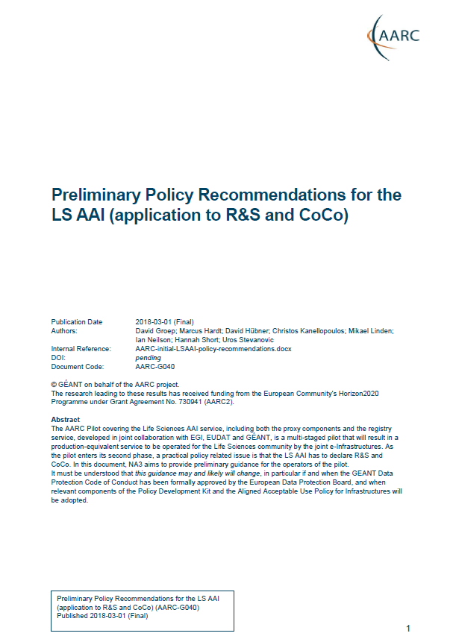
Proxies have their own challenges as well: AUPs, T&Cs, Privacy notices, …
For large ‘multi-tenant’ proxies
some subset users in some communities use a set of services –
how to present their Terms and Conditions and their privacy policies, so that users
  only see the T&Cs and notices for services they will access
  this does not to need to be manually configured for each community
  is automatically updated when services join
For community and dedicated proxies
when new (sensitive) services join, who needs to see the new T&Cs?
can we communicate existing acceptance of T&Cs to downstream services?
What is an acceptable user experience in clicking through agreements?
What is effective in exploiting the WISE Baseline AUP? What do researchers need?
‘with fewer clicks to more resources’
beyond AARC-G040

Slide 20
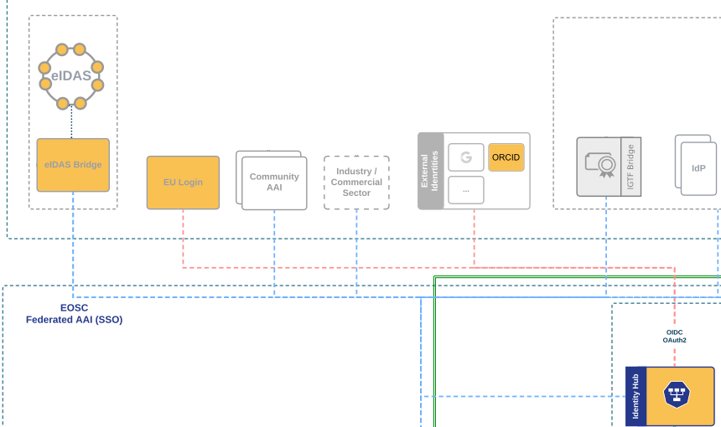
And .. we’ll be seeing more, and diverse, sources of identity assurance
An ‘available’ persistent source of assurance may be the (European) government-ID ecosystem
step-up to at least substantial level can now readily be done ‘at home’ by many users
through their national eID schemes
Joint work on eIDAS, Erasmus Student Mobility,
and more makes this more accessible
step-up-as-a-service as a fall-back (like in .se)
better attainable than relying on home institutions?
… but:
what to do with non-European users?
how to link the identities together

Slide 21
All about enabling research: FIM4R & communities are a key factor
Also in AARC-TREE we target a “co-creation process”
support FIM4R to increase the reach of workshops in the next 2 years
community review, ideas, and input on both policy and architecture
start from the high-level requirements and broad community input
whatever we build must be usable and available by researcher communities first of all, and align to interoperability standard and open, collaborative research goals
Really a global activity: we want to engage
everyone, in AARC TREE and beyond

Slide 22
Compendium and Recommendations
Key result in the ‘2nd year’ (April 2025 - February 2026) is the Compendium
'compendium of AARC best practices’ with recommendations for a common long-term strategy for AAI services in pan-European Research Infrastructures in Europe
based on the use case input and researcher requirements
promotes coherent and interoperable architecture and policy
iterate and validate with the infrastructures at large
describe the road that collaborative research infrastructure AAI will take!

Slide 23

Let’s climb the AARC TREE together: work with us on our joint security challenges!
Image generated by Adobe Firefly 2 with the text prompt
“image of a broad-leaved lemon tree with a person sitting below it leaning against the trunk in the sunshade”

Slide 24
Thanks to the AARC Community, including folk from whom I re-used graphics and material in this overview. In random order: Licia Florio, Nicolas Liampotis, Christos Kanellopoulos, Marina Adomeit, Janos Mohacsi, Ilaria Fava, Slavek Licehammer, Dave Kelsey, Ian Neilson, Marcus Hardt, Mischa Salle, Hannah Short, and Maarten Kremers.
davidg@nikhef.nl

Slide 25
What will AARC TREE bring?
Capture and analyse new authentication and authorisation interoperability requirements (that support integration use-cases across the thematic area) and provide a landscape analysis of AAIs services (including gaps) in the RIs represented in AARC TREE
Expand the number of research communities that can implement the AARC BPA and/or the AARC guidelines, by providing a validation environment and toolkits. At the same time support existing AARC communities in adopting new guidelines
Define and validate new technical and policy guidelines for the AARC BPA that address RIs use-cases. This will improve the integration of RIs across thematic areas and increase the ability of RIs to support emerging needs
Bring RIs, e-Infrastructures and relevant stakeholders together to align strategies to integrate new technologies, better interoperate and share resources across thematic areas and produce a compendium and recommendations for different stakeholders

Slide 26
Dedicated work package to collect requirements from (new) communities
  Conduct an AARC BPA adoption survey among the RIs,
  online survey accompanied by the arranged conversations with the individual RIs
  Collect information on current deployment of AARC BPA AAIs and adoption of guidelines
Result: Landscape analysis of AARC BPA adoption (around December 2024)
Landscape analysis of AARC BPA adoption
  Design and create survey (including technology and policy questions)
  based on FIM4Rv2 paper, Evolution, EOSC AAI TF requirements
  Engage FIM4R, AEGIS, EOSC AAI TF, National Ris, EU data spaces to capture requirements
  Discus with our ESFRIs to get expectations & requirements via consultations, workshops etc
Result: Use cases requirements described in a white paper (target Q1 2025)
Use cases requirements & consultations
Handover to Compendium

