Slide 1
Coordination policies in a multi proxy set-up
Building Trust across a Landscape of AARC BPA Proxies
David Groep
AARC Policy Area Coordinator
Nikhef Physics Data Processing programme and UM Dept. Advanced Computing Sciences
FIM4R 18
January 2023

Slide 2
Arguably the best known picture from our AARC community

Slide 3
Beyond a single BPA proxy – complexities in composite infrastructure
EOSC AAI was one of the triggers to extend the BPA
but is and will not be the only one!
2019 “BPA Reloaded” (AARC-G045) lead us
to composite proxy architectures
and as we see the need grow for
multiple instances of community and e-Infra proxies
to work together, we end up with …
… a federation of proxies ?! ☺
AARC G045 https://aarc-community.org/guidelines/aarc-g045/
and EOSC AAI Task Force report – ISBN 978-92-76-28113-9, DOI:10.2777/8702

Slide 4
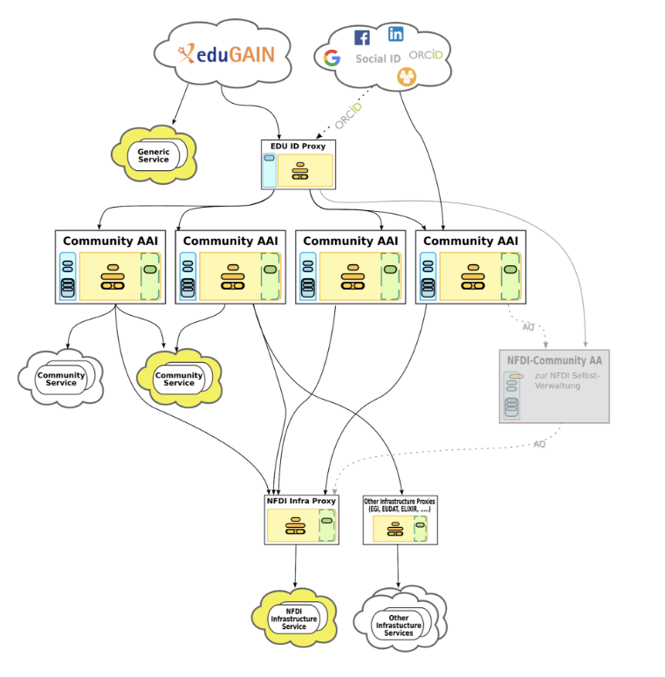
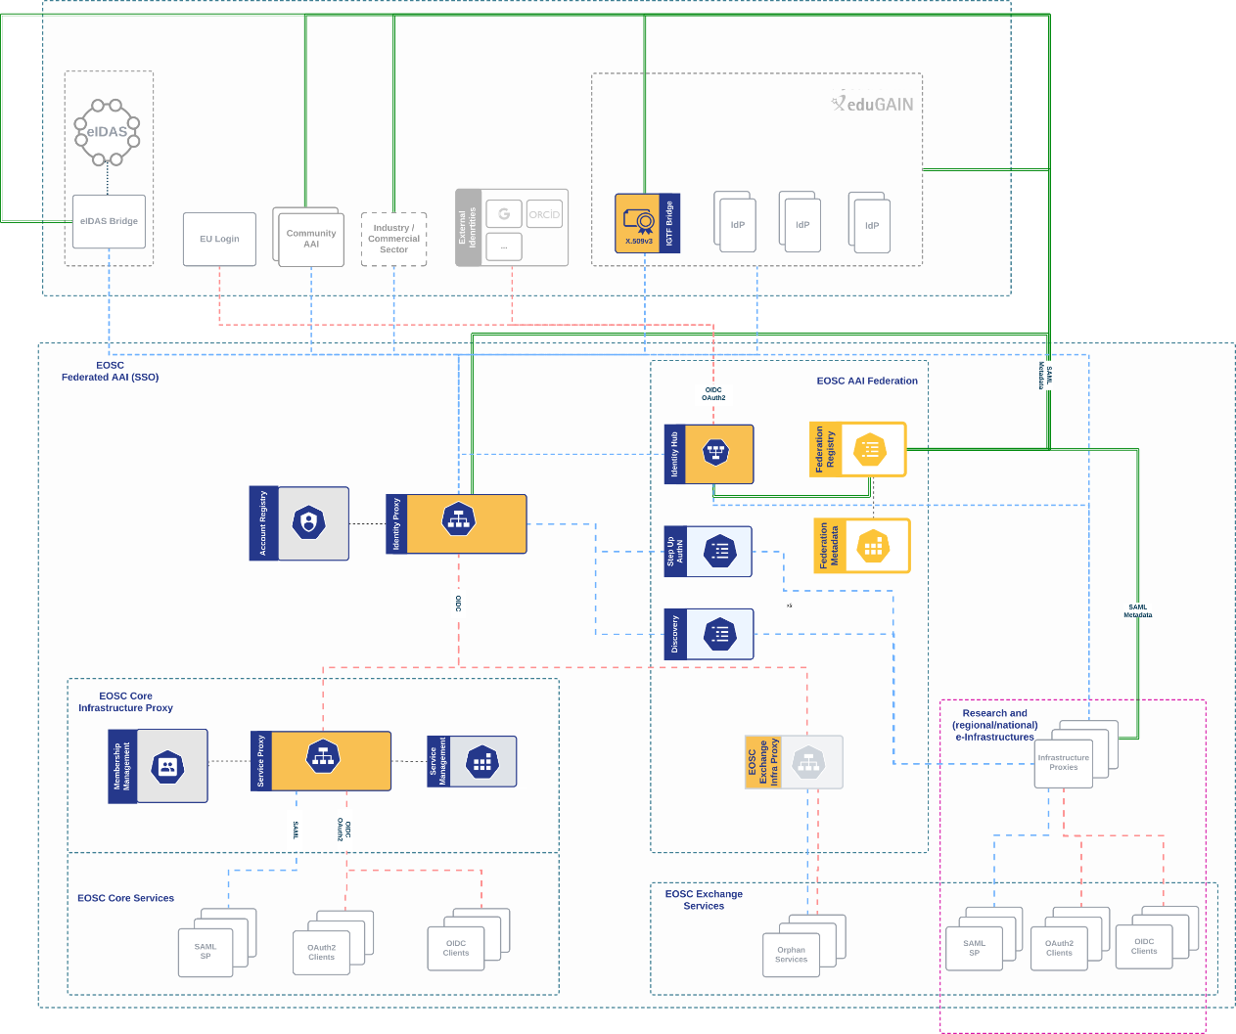
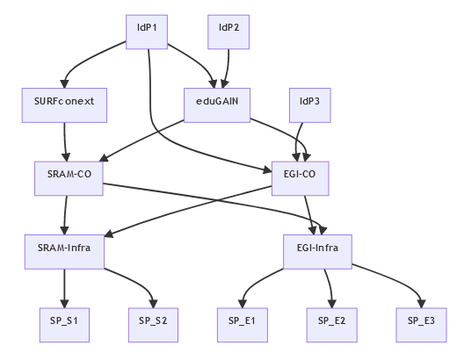
Composite proxies and more proxies!
Image (right): EOSC AAI for the EOSC Core and Exchange Federation for the EOSC European Node by Christos Kanellopoulos, Nicolas Liampotis, David Groep (June 2023)
Centre: SURF SRAM, as described by Maarten Kremers (EUGridPMA59 notes) Image (left): Marcus Hardt for the NFDI AAI

Slide 5
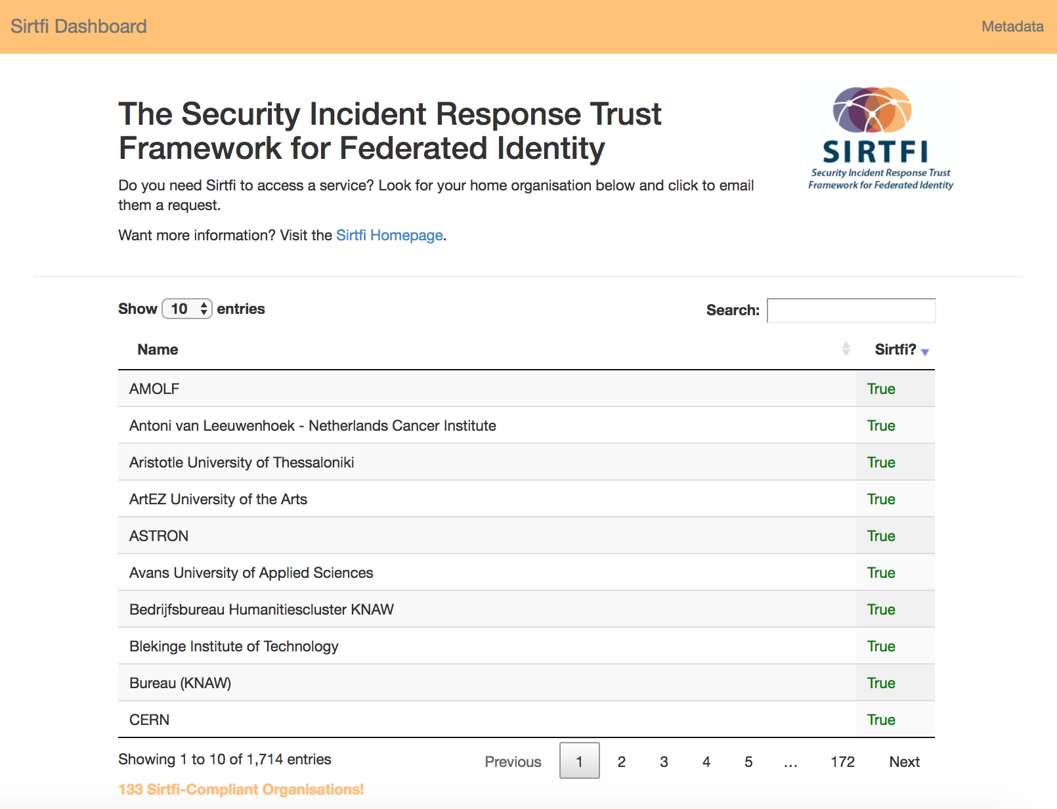
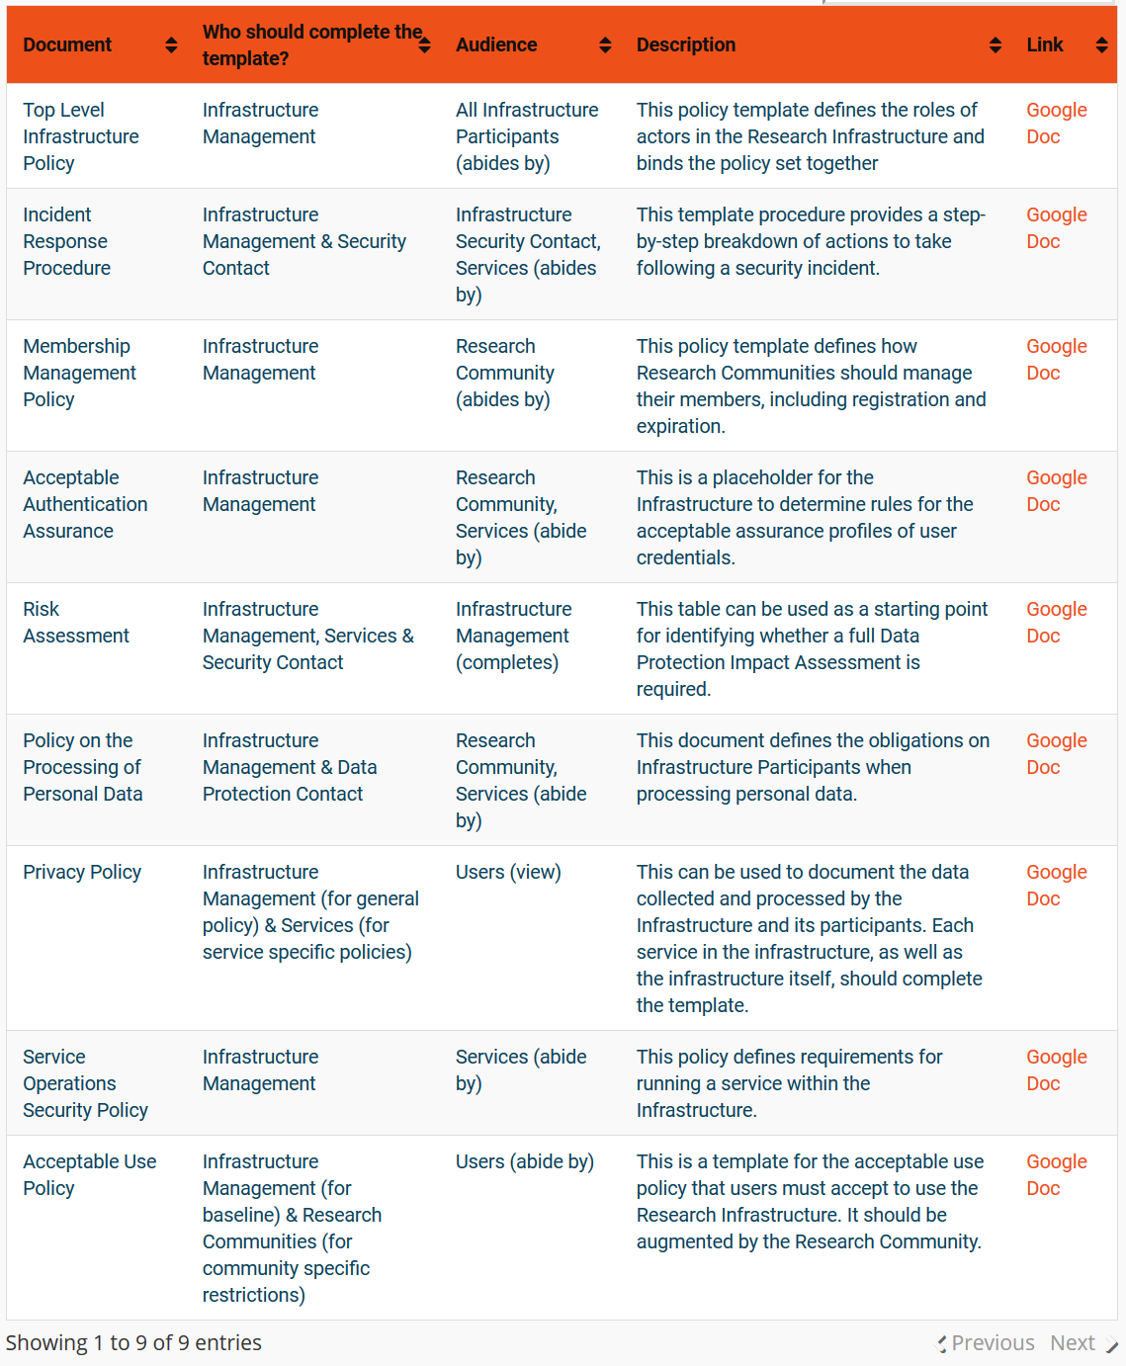
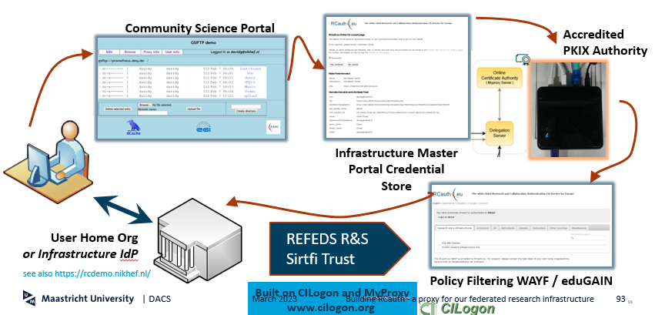
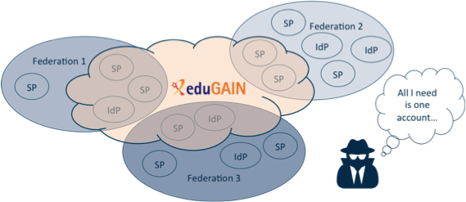
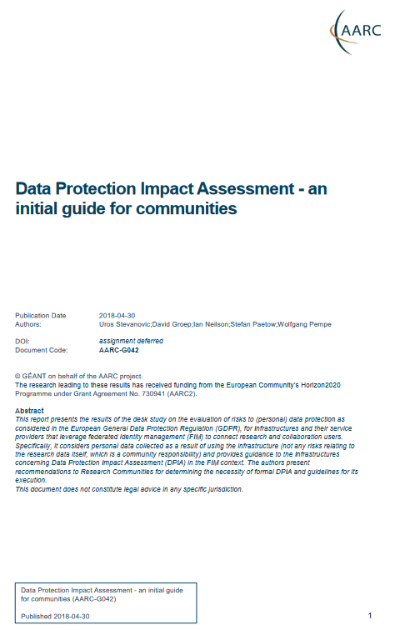


And an AARC beyond Sirtfi, RCauth, and the Policy Development Kit?
Current PDK is targeted at large and structured communities – and quite complex
https://aarc-community.org/policy

Slide 6
Effort in AARC TREE to address issues and explore policy needs
AARC-TREE topics are scoped (and effort assigned to each), with
results defined in terms of how guidelines support proxy use cases and communities
Participatory model, with FIM4R, AEGIS, and community management authorities
What is needed for operational trust in terms of, e.g., ‘baseline requirements’?
Let’s look at some we identified when writing AARC-TREE …

Slide 7
New good practices … and there are more and different policy needs now
Infrastructure alignment and policy harmonisation: helping out the proxy
Operational Trust for Community and Infrastructure BPA Proxies
Snctfi - increasing acceptance of research infrastructure proxies with R&E identity providers and sources of authentication
Review infrastructure models for coordinated AUP, T&C, and privacy notices, improving
cross-infrastructure user experience
User-centric trust alignment and policy harmonization: helping out the community
Lightweight community management policy template
Guideline on cross-sectoral trust in novel federated access models
Assurance in research services through (eIDAS) public identity assertion
FIM4R policy workshop series on validation of the restructured policy framework
(together with the new ‘BPA’)

Slide 8
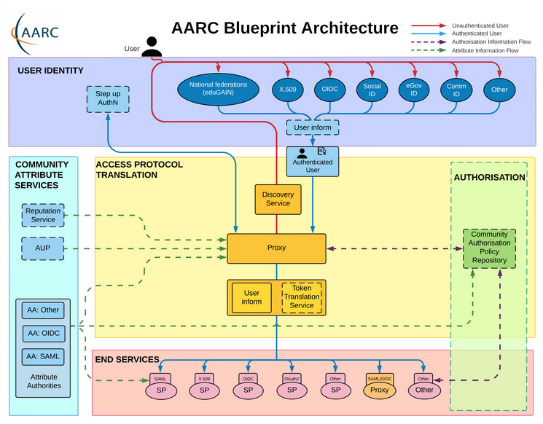
“Operational Trust Framework for Community & Infrastructure Proxies”
In the authentication and service management space there are well-recognised operational security systems available …
Authentication/identity sources
Sirtfi and (eduGAIN) baselining
REFEDS Assurance Framework
IGTF AP Profiles
NIST SP800-63
eduGAIN Security Handbook
RFC6238/4226
FIPS140-2
NISTSP800-53
Service provider operations
ISO27k
Sirtfi
Infrastructure response plans
but proxies themselves are (far more!) valuable.
How are these to be protected?
Can we learn from each other as these are proliferating?

Slide 9
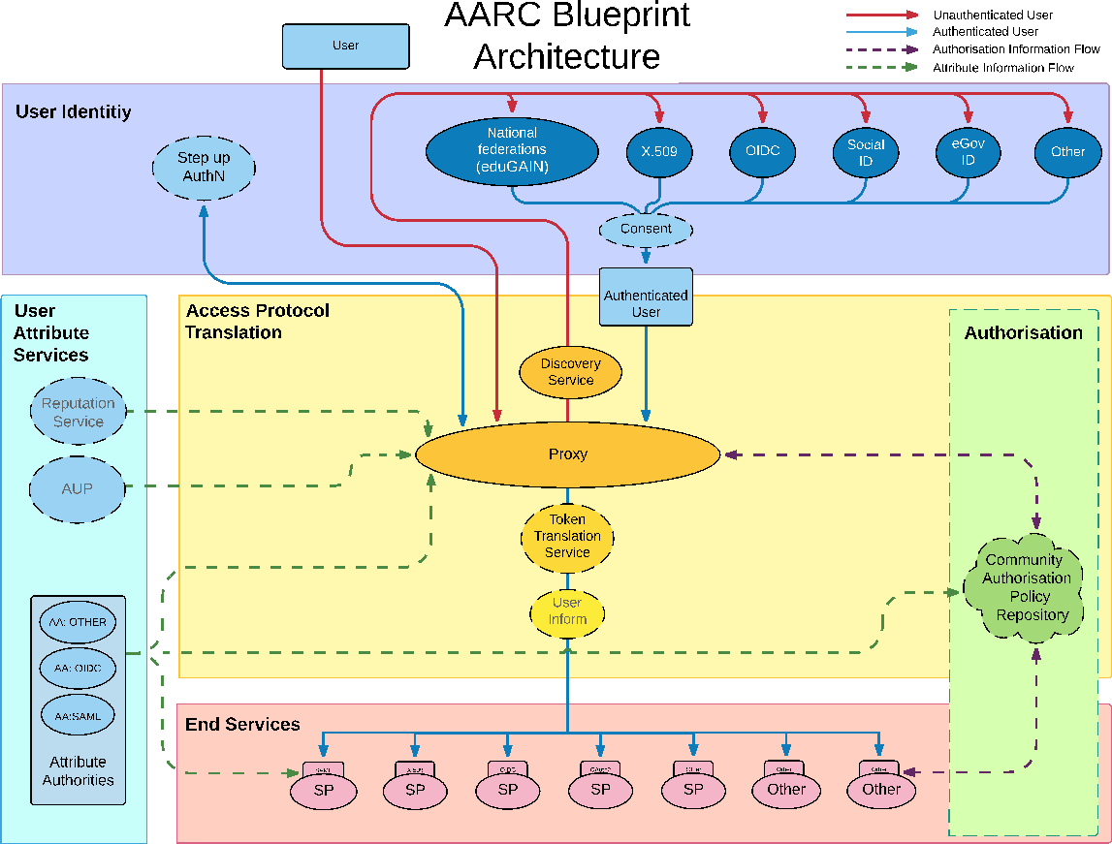
AARC G071 is there to help, but do we ‘get the trust across’?
Community membership management directories and attribute authorities
integrity of membership
identification, naming and traceability
site and service security
protection on the network
assertion integrity
Community membership management directories and attribute authorities
integrity of membership
identification, traceability
site and service security
network protections
assertion integrity
> Trust marks and expression
But when proxies are proxying proxies, can we proxy the trust?
Agree to a common baseline – that was successful before!
… set of (one or more) guidelines that represent a widely agreed and jointly-developed
operational trust baseline for infrastructure membership management and proxy components.
Supplemented by policy guidance on how to connect sectoral federations with more specific policies.
Driven by your (FIM4R, WISE, EOSC, …) feedback, and those of current proxy operators (in AEGIS).
See https://www.igtf.net/guidelines/aaops/ and https://aarc-community.org/guidelines/aarc-g071/

Slide 10
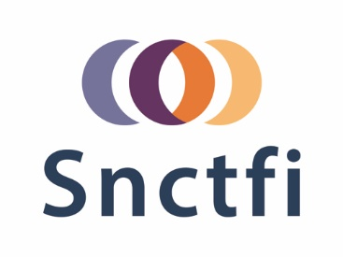
Can we build on trusted ‘AAOPS’ to increase acceptance of research infrastructure proxies with R&E identity providers
May never get ‘interesting attributes’ apart from affiliation from home IdPs, but …
still need assurance statements and REFEDS Assurance Framework attribute freshness
unless ‘well hidden’, proxies are met with scepticism by IdPs to release personalised to R&S
and do Entity Categories ‘traverse’ proxies? and can proxy ops rely on their ‘downstreams’?
review and enhance effectiveness of Snctfi
the set of guidelines that describe a (self-) accessible framework of policies that bind a set of service providers behind an AARC BPA Proxy
and thereby encourage trust in the proxies and their connected services

Slide 11
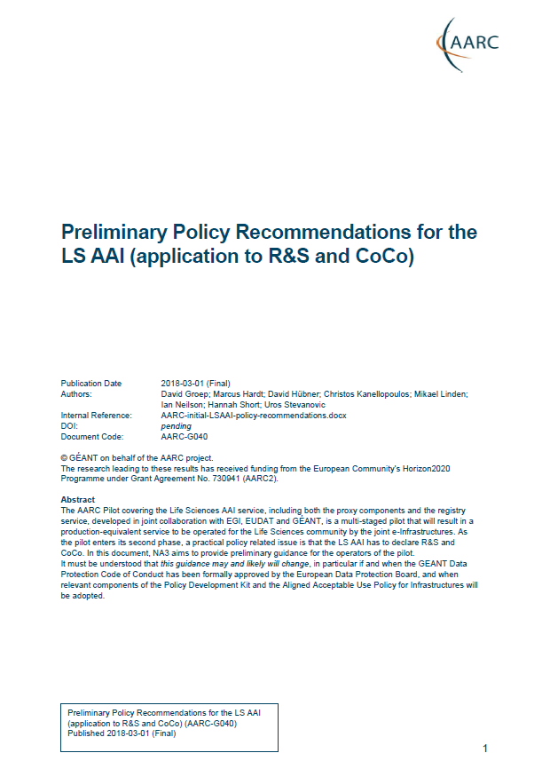
Proxies have their own challenges as well: AUPs, T&Cs, Privacy notices, …
For large ‘multi-tenant’ proxies:
some subset users in some communities use a set of services – how to I
present their Terms and Conditions, and their privacy policies, so that the users
  only see the T&Cs and notices for services they will access
  this does not to need to be manually configured for each community
  is automatically updated when services join
as well as for community and dedicated proxies:
when new (sensitive) services join, who needs to see the new T&Cs?
can we communicate acceptance of T&Cs to services even if ‘we’ are small and ‘they’ are large?
What is an acceptable user experience in clicking through agreements?
What is most effective in exploiting the WISE Baseline AUP? What do you need?
With Fewer Clicks to More Resources!
beyond AARC-G040

Slide 12
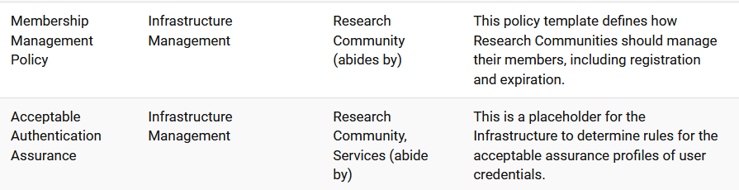
Helping out the community – a simpler policy toolkit for communities
What we heard through the grapevine (and at TechEx 2022 …) :
“small to mid-sized communities do not have the resources to maintain a bespoke community management policy”
Leaves both communities and operators of membership management services unclear about trust assurance level of members - current templates in toolkit too complex and prescriptive
community consultation on the ‘minimum viable community management’ – we are here!
template and implementation guidance (FAQ) on community lifecycle management
how to implement the community management in the (EOSC) AAI services

Slide 13
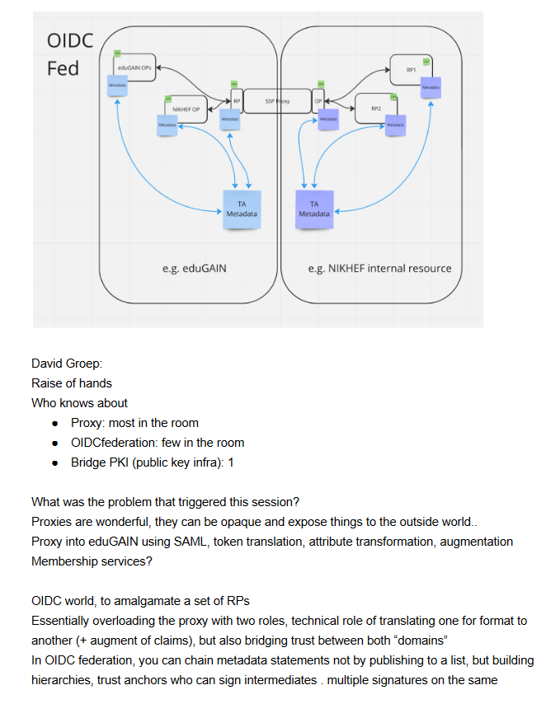
New trust models – what is the role of the proxy in OIDCFed?
In today’s BPA proxy links both sides by being
opaque, both for attributes as well as for trust
does it have to be that way?
separate claims/attribute transformation from trust bridging?
can OIDCfed structure convey trust transparently? Should it?
can we then be more flexible? or will it just confuse everyone?
easier to bridge trust across sectors this way?
e.g. linking .edu, .gov, and private sector federations?
ACAMP at TechEx23 – and TIIME?

Slide 14
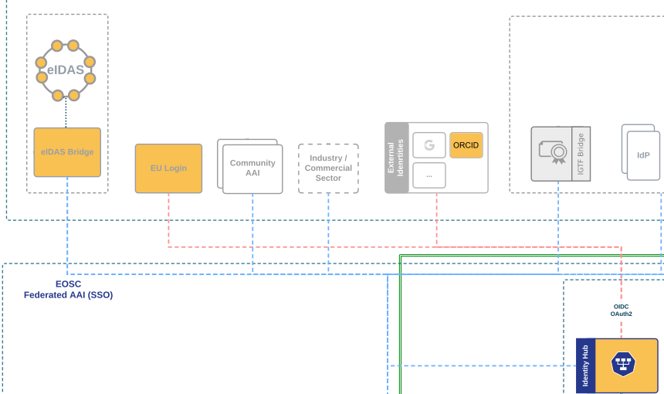
We’ll see more diverse sources of identity & assurance anyway
Most reliable (and most ‘available’) source of assurance may be the European government identity ecosystem.
Step-up to at least substantial level can now readily be done ‘at home’ by users
through their national eID schemes
Joint work on eIDAS, Erasmus Student Mobility,
and more makes this more accessible
Better attainable than relying on home institutions?
… but:
what to do with non-European users?
how to link the identities together

Slide 15
All About You – FIM4R and communities are the driving factor
Also in AARC-TREE we really need a “co-creation process” with you, our FIM4R communities
we have resources to help run a couple of workshops in the next 2 years
we need your critical review and your ideas and input on both policy and architecture
start from the high-level requirements and some broad community input
May AARC-TREE be helpful to you … with your input and brain dumps!

Slide 16
davidg@nikhef.nl

Slide 17

this work is co-supported by the Trust and Identity work package of the GEANT project (GN5-1)
in collaboration with many, many people in the AARC+ Community!
davidg@nikhef.nl

