Slide 1
AARC Symposium – policy and good practice
David Groep
AARC Policy Lead
Nikhef Physics Data Processing programme and UM FSE Dept. Advanced Computing Sciences
AARC Symposium
Amsterdam, February 2026

Slide 2
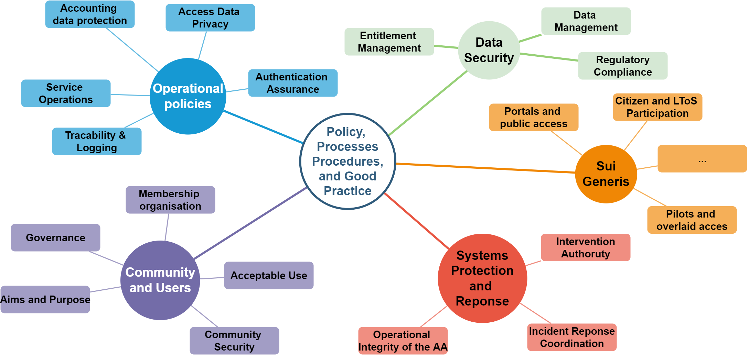
A world of good practice to implement, and policies to share

Slide 3
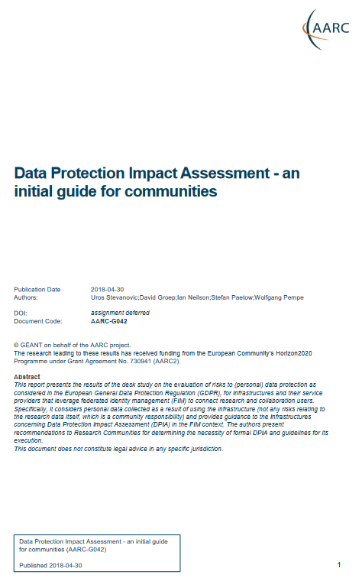


Two-pronged approach for policy and good practice for AARC BPA 2025⁺
Infrastructure alignment and policy harmonisation: ‘helping out the proxy’
Operational Trust for Community and Infrastructure BPA Proxies
Increase acceptance of research proxies by identity providers through common baselines
Review infrastructure models for coordinated AUP, T&C, and privacy notices, improving cross-infrastructure user experience (users need to click only once)
User-centric trust alignment and policy harmonization: ‘helping out the community’
Lightweight community management policy template
Guideline on cross-sectoral trust in novel federated access models
Assurance in research services through (eIDAS) public identity assertion
Anchored in the researcher user communities by co-creation with FIM4R

Slide 4
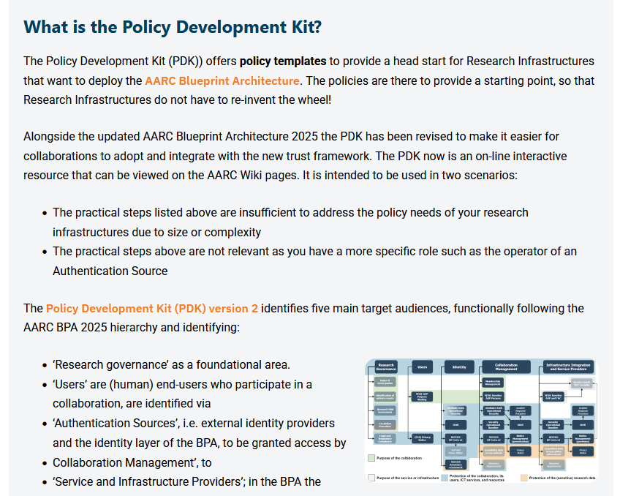

Developing the Trust framework, guidelines and best practice for BPA proxies and interaction with research services
minimise the number of divergent policies empower identity providers, service providers, user communities to rely on interoperable policies
From the AARC2 infrastructure-oriented Policy Development Kit to
a simpler and deployment-oriented Policy, Process, and Procedure Development Kit version 2
comprehensive review of existing policy suite to reduce complexity
input from national research infrastructures and EOSC nodes, but not only in Europe but e.g. also Australia
leverage the works we co-created with REFEDS and EOSC
https://aarc-community.org/policies/policy-development-kit/

Slide 5
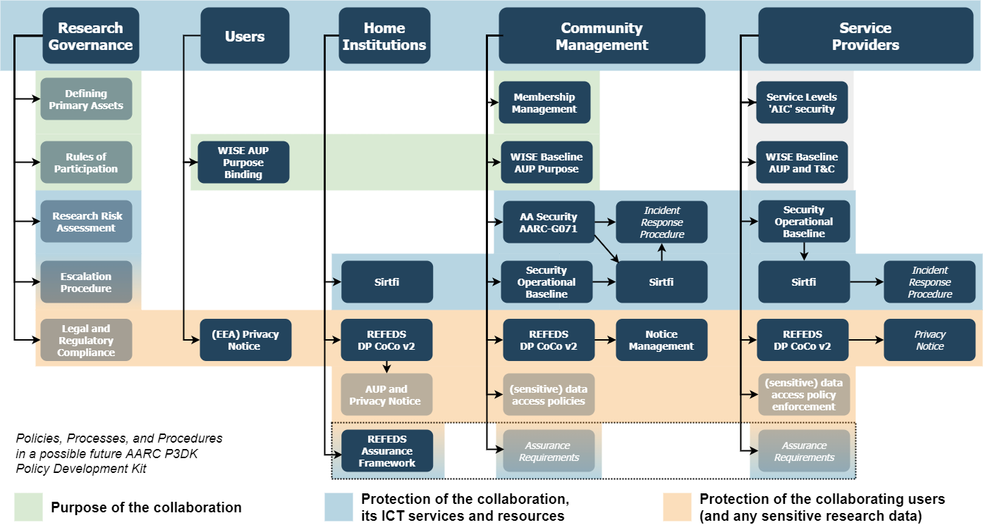
Building the trust framework: development of the new full PDK structure
AARC-I082

Slide 6
Today specialised AAI platform providers have established themselves
AARC-I082
Previous PDK policies targeted primarily at infrastructure AAIs and at operators of the few multi-community AAIs
BPA2025 identifies platform layers, and AAI platform operators serving many collaborations and infrastructures with a common layer are a key player today
A ‘trusted proxy operator’ can now be either self-hosted or used ‘as a service’
This has changed the policy landscape: the more complex policy implementations can now be ‘sourced’ from trusted providers

Slide 7

AAI infrastructure providers for communities: a new ‘Snctfi’ trust mark
AARC-I082
review and enhance effectiveness of Snctfi ‘revamped’
the set of guidelines that describe a (self-) assessable baseline for the proxy operator a set of service providers behind an AARC BPA Proxy

Slide 8
More importantly: AARC Guidelines series as a pathways to policy sustainability and impact
AARC-I082 Trust framework for proxies and Snctfi research services landscape analysis and structure
AARC-G083 Guidance for Notice Management by Proxies reducing user frustration by streamlining
AARC-G084 Security Operational Baseline trusted and secure infrastructure and incident response
AARC-I085 eID Assurance Model Assessment investigates capabilities for leveraging national eID
AARC-I086 Membership Management Policy Development at light-weight and infrastructure-level
AARC-PDK Policy Development Kit an interactive resource for jumpstarting collaboration
Cross-cutting guidelines
AARC-G080 Blueprint Architecture 2025 as the conceptual foundation
AARC-G081 Recommendations for Token Lifetimes balancing usage patterns and security
Adoption stimuli through the Policy Development Kit version 2 for
AARC-G071 ‘Attribute Authority and Proxy Operations’, AARC-I044 ‘Baseline AUP implementation’ AARC-I051 and SIRTFI federated incident response, REFEDS DPCoCo v2, AARC-G042 ‘DPIA’ for research collaborations, REFEDS Assurance Framework
https://aarc-community.org/guidelines/; PDK: https://aarc-community.org/policy/policy-development-kit/

Slide 9
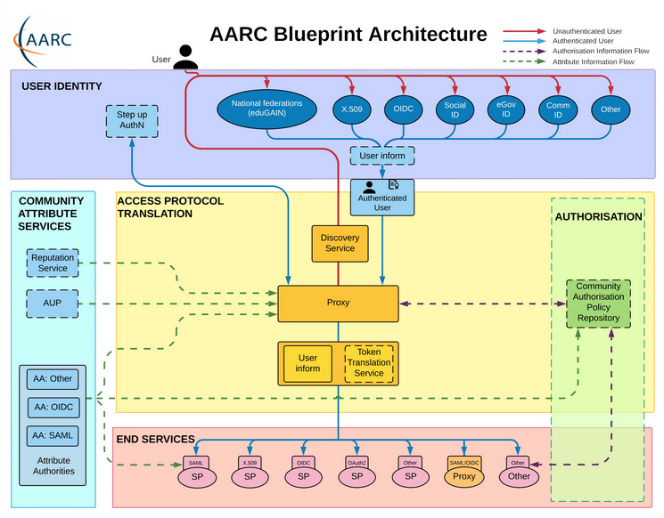
Practices we already have, practices we need to harmonise
AARC-G071
Authentication/identity sources
NIST SP800-63
FIPS140
ISO 27001
IGTF AP Profiles
REFEDS MFA
REFEDS Assurance Framework
so … what about standards for the Community Attribute Authority (AA) or for operation of the Proxy?
Service provider operations
ISO27k
NIS2
ITSRM2
while for identity sources and for services there is extensive normalisation, our AARC BPA ‘proxy’ did not …

Slide 10
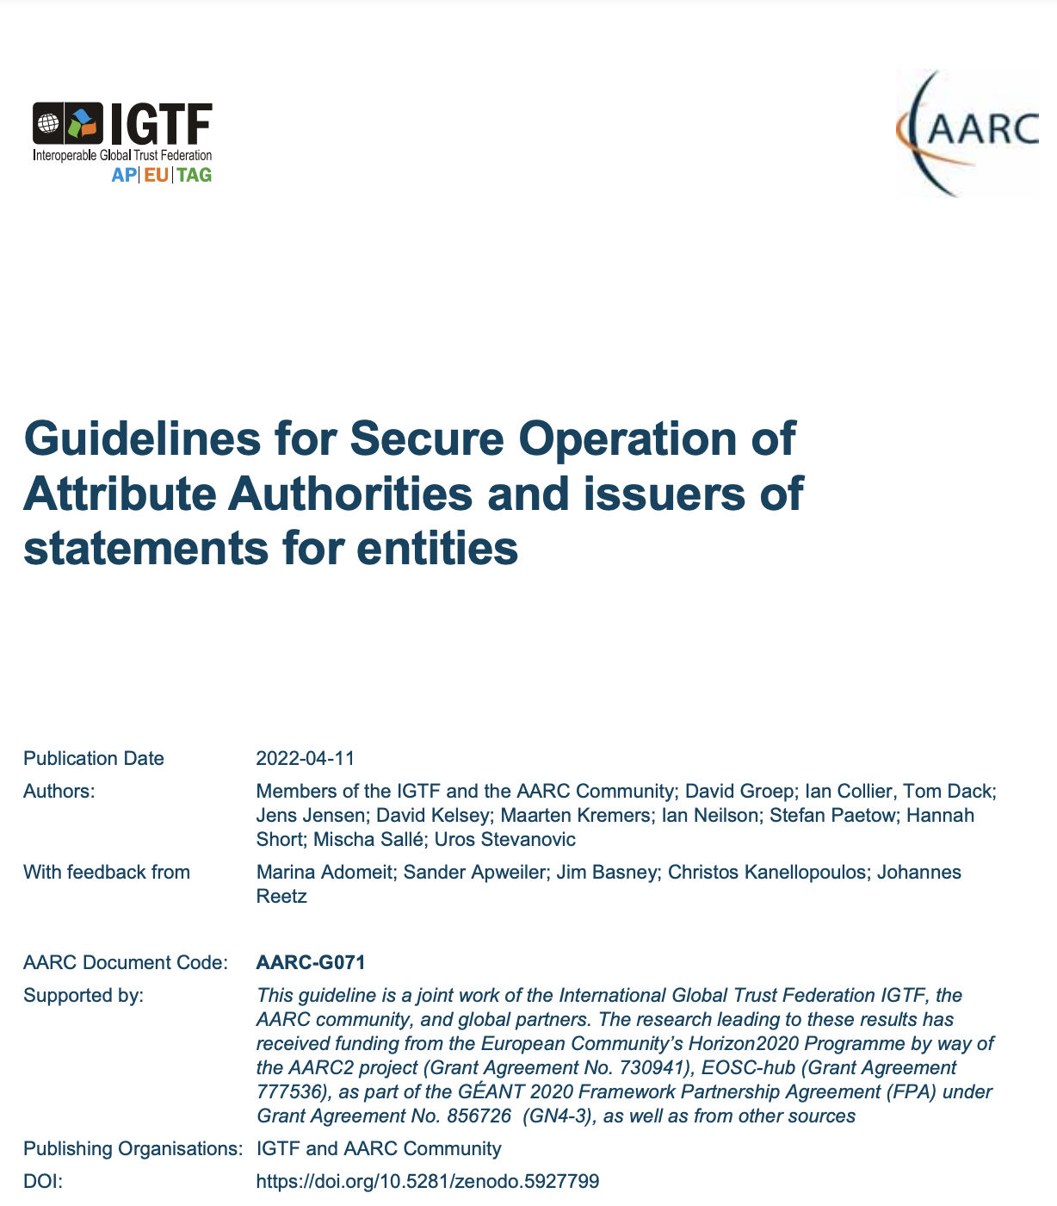
How to establish secure operation for your (AARC BPA) proxy?
AARC-G071
The Challenge
How to securely operate proxies, attribute authorities and issuers of statements for entities?
Guideline
AARC-G071 Guidelines for Secure Operation of Attribute Authorities
Summary
Operational security processes and procedures
Requirements on traceability, auditability, and logging
Requirements on the secure operation
Requirements on securing the interactions

Slide 11
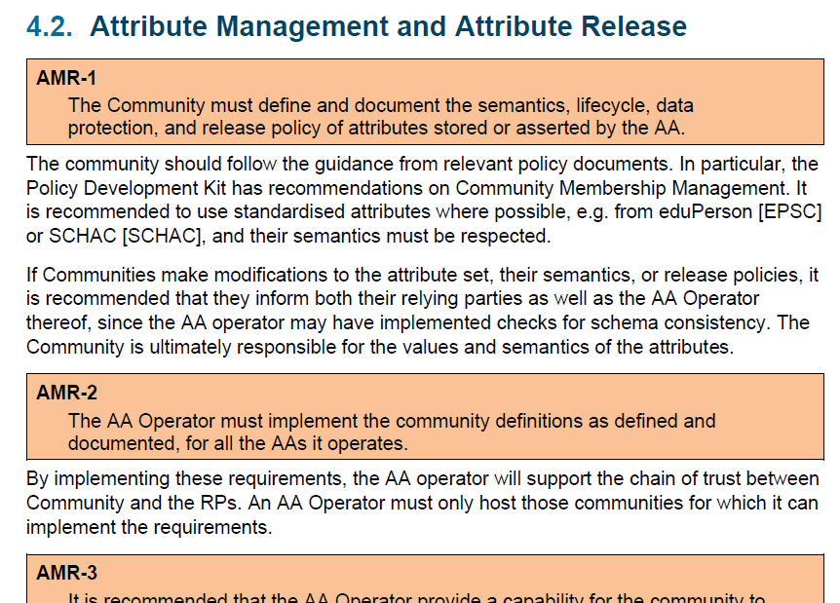
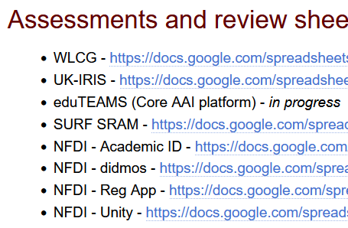

Deployment guidance, self-assessment, and peer feed-back
AARC-G071
http://wiki.eugridpma.org/Main/AAOperationsGuidelines

Slide 12
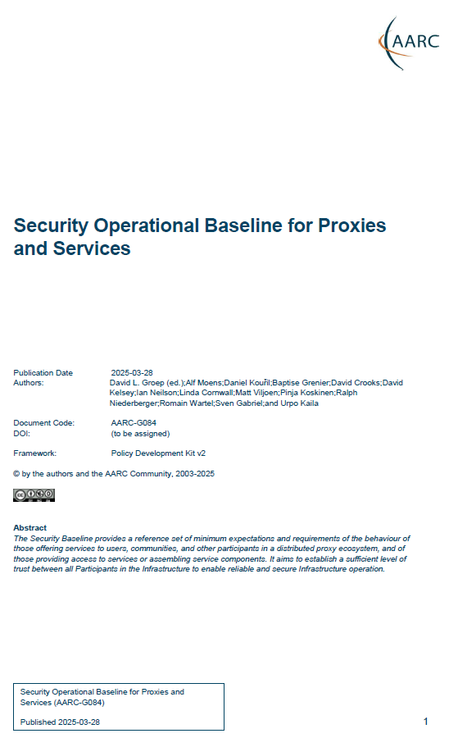
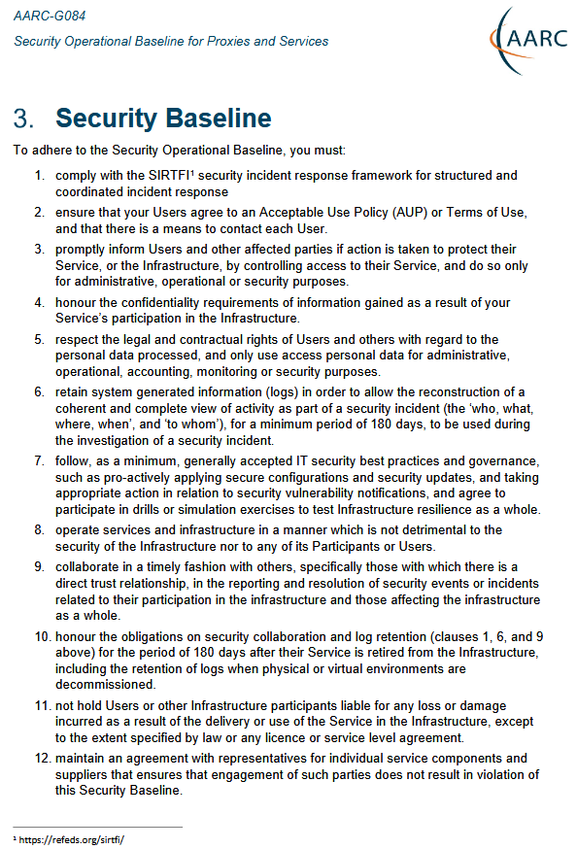
Proxy Operations: Information Security and Security Operational Baseline
AARC-G084
‘address information security for disciplines and infrastructures - some of which process sensitive data’
Service Security Policy from AARC PDK v1 was successful but diverged in several directions:
national implementations and specialisations
included in EOSC Interoperability Framework as ‘Security Operational Baseline’
The new PDK in AARC TREE converges on a common Baseline - with guidance and FAQ
Included in the EOSC AAI WG Federation 2025
AARC-G084 https://doi.org/10.5281/zenodo.7396724

Slide 13
The 12 points of AARC-G084
AARC-G084
comply with the SIRTFI security incident response framework for structured and coordinated incident response [ref to SIRTFI]
ensure that your Users agree to an Acceptable Use Policy (AUP) or Terms of Use, and that there is a means to contact each User.
promptly inform Users and other affected parties if action is taken to protect their Service, or the Infrastructure, by controlling access to their Service, and do so only for administrative, operational or security purposes.
honour the confidentiality requirements of information gained as a result of your Service’s participation in the Infrastructure.
respect the legal and contractual rights of Users and others with regard to the personal data processed, and only use access personal data for administrative, operational, accounting, monitoring or security purposes.
retain system generated information (logs) in order to allow the reconstruction of a coherent and complete view of activity as part of a security incident (the ‘who, what, where, when’, and ‘to whom’), for a minimum period of 180 days, to be used during the investigation of a security incident.
follow, as a minimum, generally accepted IT security best practices and governance, such as pro-actively applying secure configurations and security updates, and taking appropriate action in relation to security vulnerability notifications, and agree to participate in drills or simulation exercises to test Infrastructure resilience as a whole.
operate services and infrastructure in a manner which is not detrimental to the security of the Infrastructure nor to any of its Participants or Users.
collaborate in a timely fashion with others, specifically those with which there is a direct trust relationship, in the reporting and resolution of security events or incidents related to their participation in the infrastructure and those affecting the infrastructure as a whole.
honour the obligations on security collaboration and log retention (clauses 1, 6, and 9 above) for the period of 180 days after their Service is retired from the Infrastructure, including the retention of logs when physical or virtual environments are decommissioned.
not hold Users or other Infrastructure participants liable for any loss or damage incurred as a result of the delivery or use of the Service in the Infrastructure, except to the extent specified by law or any licence or service level agreement.
maintain an agreement with representatives for individual service components and suppliers that ensures that engagement of such parties does not result in violation of this Security Baseline

Slide 14
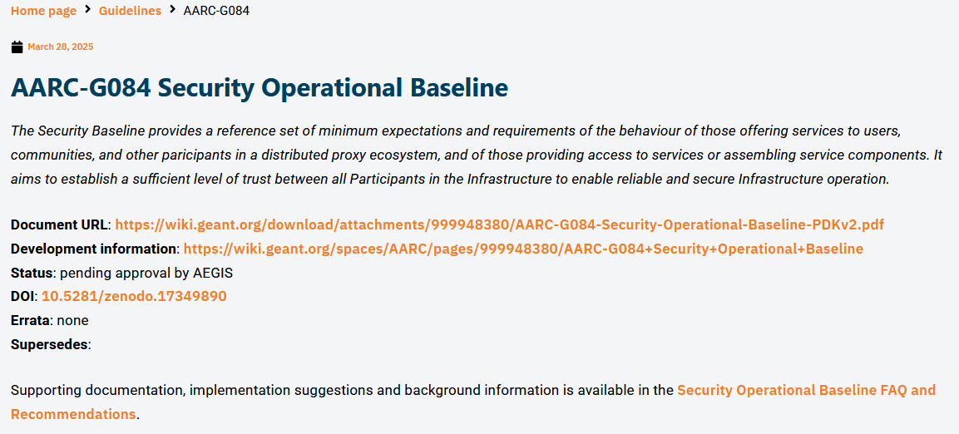
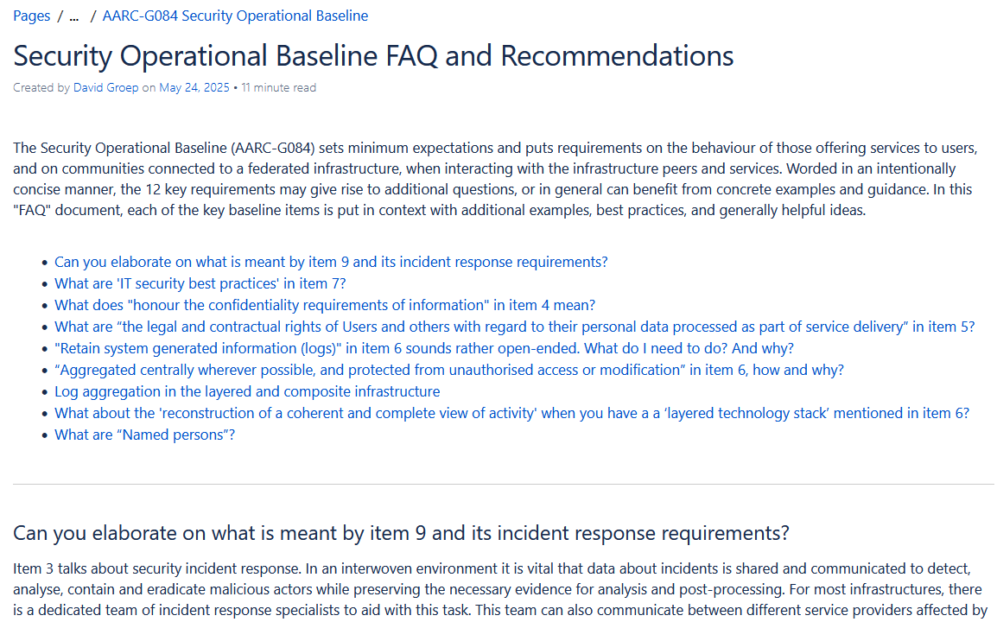
FAQ and implementation guidance
AARC-G084
https://wiki.geant.org/spaces/AARC/pages/1049624759/view

Slide 15
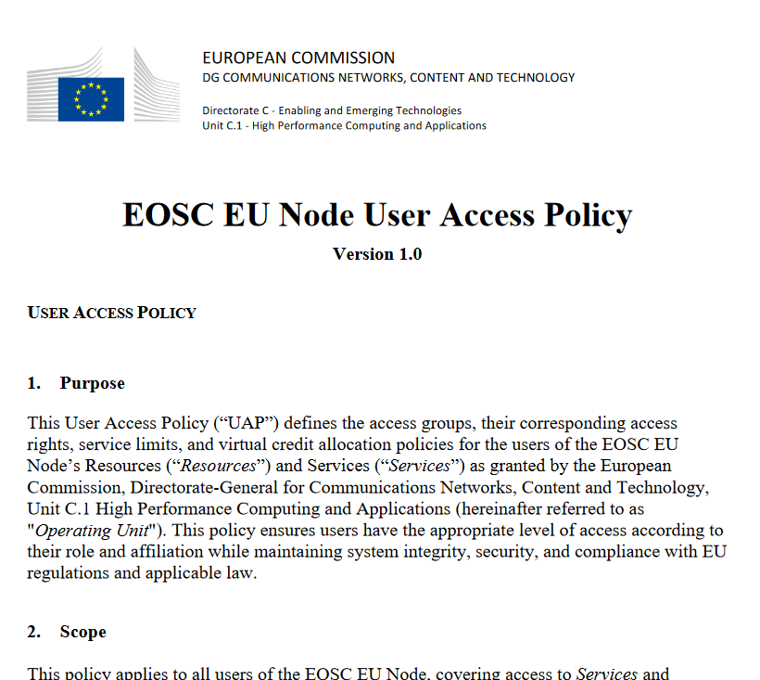
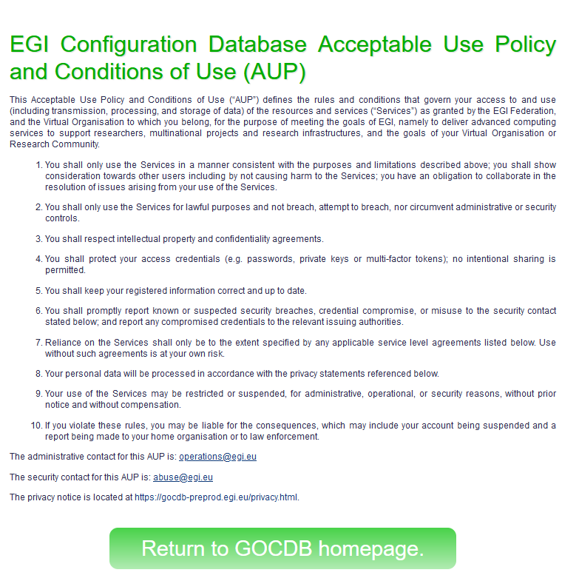
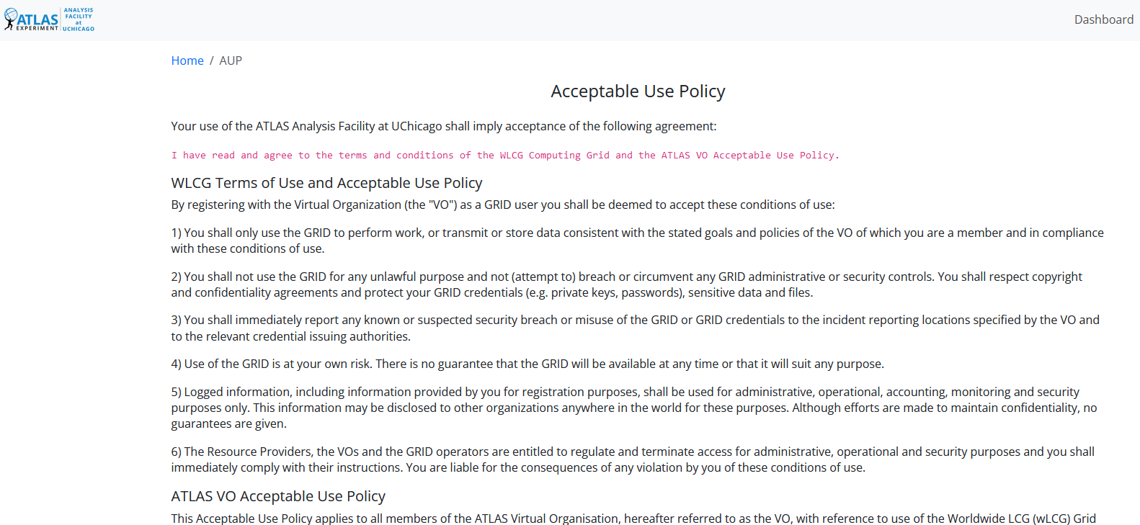
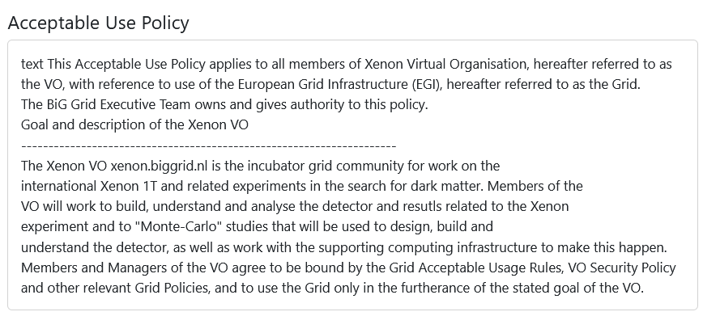
With fewer clicks to more resources – while keeping the user informed
AARC-G083
reference models for acceptable use policy and privacy notice collection to improve cross-infrastructure user experience

Slide 16
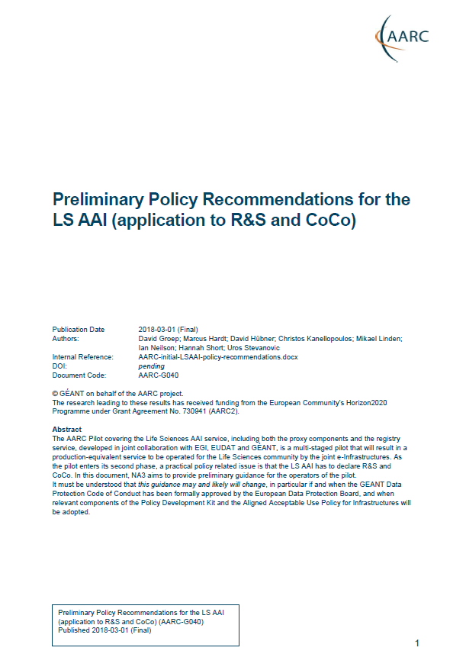
Proxies have their ‘experience challenges’: AUPs, T&Cs, Privacy notices, …
AARC-G083
For large ‘multi-tenant’ proxies
some subset users in some communities use a set of services – how to I present their Terms and Conditions, and their privacy policies, so that the users
only see the T&Cs and notices for services they will access
this does not to need to be manually configured for each community
is automatically updated when services join
as well as for community and dedicated proxies
when new (sensitive) services join, who actually needs to see the new T&Cs?
can we communicate acceptance of T&Cs to services even if ‘we’ are small and ‘they’ are large?
What is an acceptable user experience in clicking through agreements? What is most effective in exploiting the WISE Baseline AUP? What do you need?
With Fewer Clicks to More Resources!
beyond bespoke guidance

Slide 17
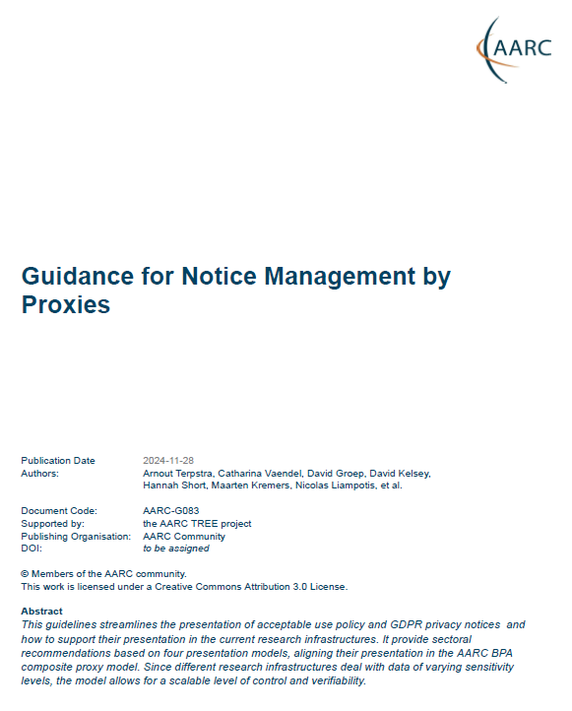
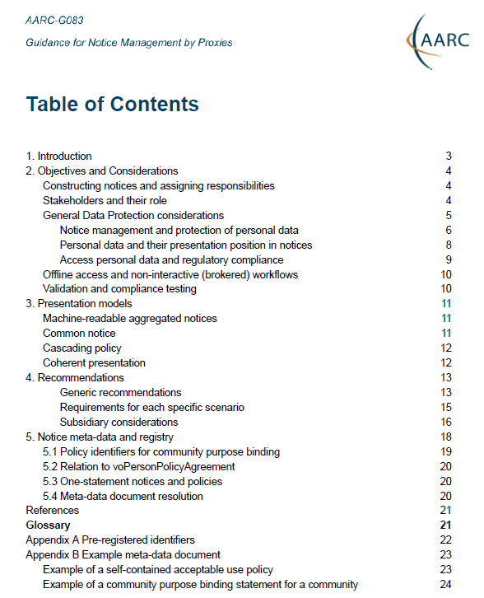
New AARC guidance on Notice Management by Proxies
AARC-G083
Four presentation models In order of preference
machine-readable aggregated notice
common notice (single common authority domain)
cascading notices (assume responsibility for underlings)
coherent presentation: you show what you need (but not more)
Recommend WISE Baseline AUP plus model to construct notices and communicate acceptance based on the AARC ID-community-infra hierarchy of proxies
sufficient to build you a comprehensive WISE Baseline AUP
and a set of privacy notices (for those GDPR encumbered)
plus a namespace inspired by RFC6711’s LoA registry

Slide 18
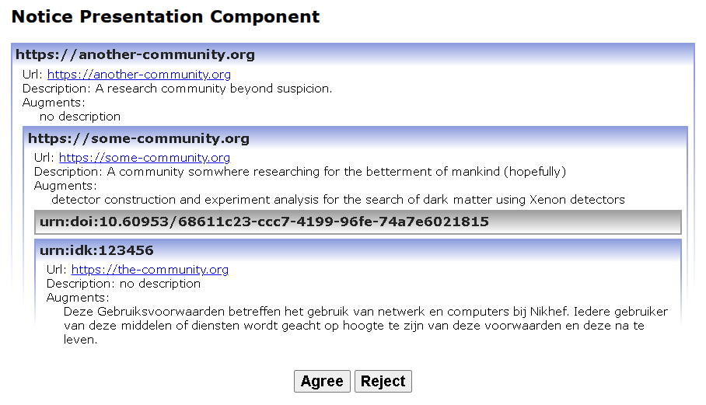
Notice presentation (PoC example implementation from the Validator)
AARC-G083

Slide 19
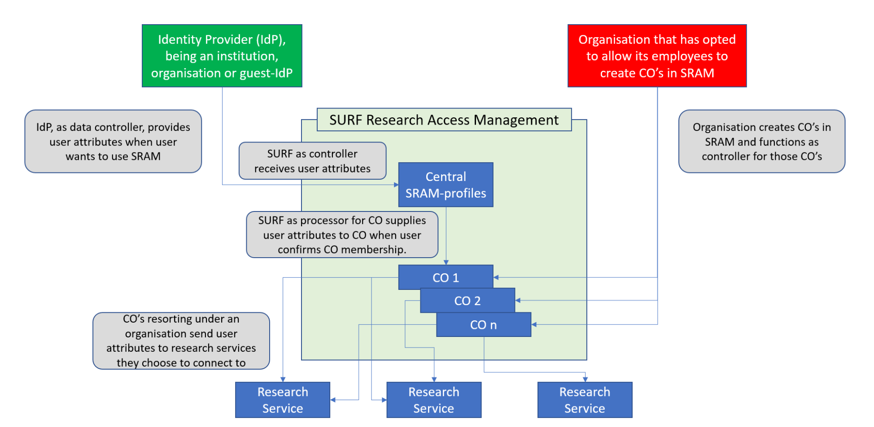
Helping out the community – a simpler policy toolkit for communities
AARC-I086
provide a revised policy development kit for mid-sized communities using the research infrastructures
Requirement from the AAI operators in FIM4R and BPA operators:
“small to mid-sized communities do not have the resources to maintain a bespoke community management policy”
But both communities and operators of membership management services are today unclear about trust assurance level of members: current templates in toolkit too complex and prescriptive
develop ‘minimum viable community management’ for most small and mid-sized use cases
give template and implementation guidance (FAQ) on community lifecycle management
leverage complement of PDK practices that communities can ‘source’ from trusted providers
where is the community here?!

Slide 20
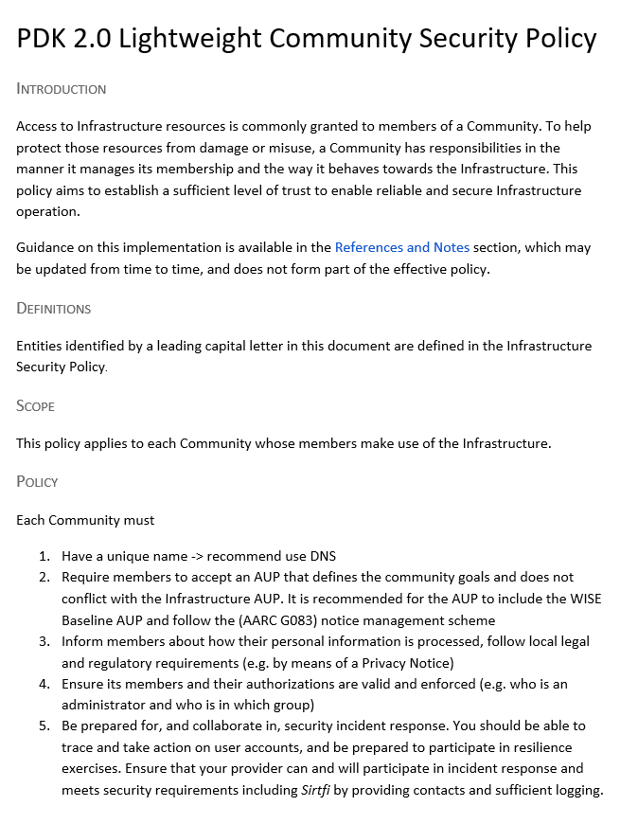
I086: Simplified Community Management policy – down to five items!
AARC-I086
Each Community must
Have a unique name (we recommend use DNS domain names)
Require members to accept an AUP that defines the community goals and does not conflict with the Infrastructure AUP. It is recommended for the AUP to include the WISE Baseline AUP and follow the (AARC G083) notice management scheme
Inform members about how their personal information is processed, follow local legal and regulatory requirements (e.g. by means of a Privacy Notice)
Ensure its members and their authorizations are valid and enforced (e.g. who is an administrator and who is in which group)
Be prepared for, and collaborate in, security incident response. You should be able to trace and take action on user accounts, and be prepared to participate in resilience exercises. Ensure that your provider can and will participate in incident response and meets security requirements including Sirtfi by providing contacts and sufficient logging.
https://aarc-community.org/guidelines/aarc-i086/

Slide 21
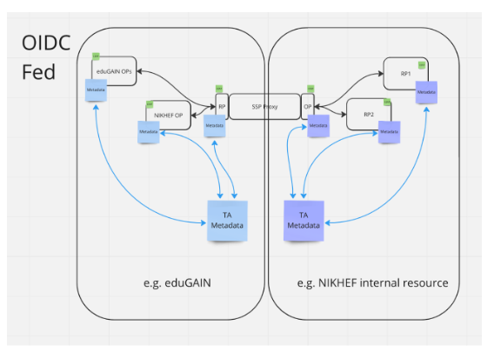
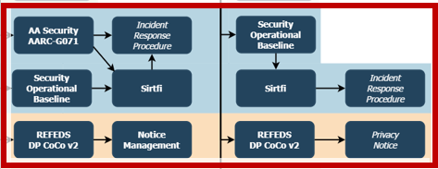
Build trusted baseline expectations to increase reach of RI proxies … with R&E identity providers … and with new sources of information
‘guidelines on cross-sectoral trust in novel federated access models’
Service and data providers need unique identifier and affiliation, with name and email, and ‘fresh’ assurance from home IdPs, but:
proxies have met with scepticism by IdPs: lack of even basic personalised and R&S attribute release
how do these trust qualities ‘traverse’ proxies?
how do operators rely on adherence to guidelines by their ‘downstream’ providers?
Position of the proxy makes trust bidirectional, and platform operators are facilitating this trust today

Slide 22
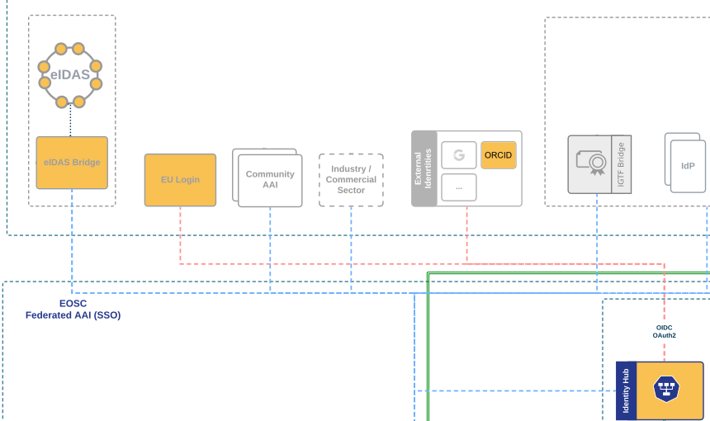
More diverse sources of researcher identity & assurance with eID wallets
AARC-I085
Most reliable (and most ‘available’) source of assurance could be government identity!
Step-up can now readily be done ‘at home’ by users through their national eID schemes
eID wallets could solve the blockage by home IdPs to release assurance
… but their applicability to research and education use cases remains limited:
eIDAS 1.0 suffers from inconsistent national uptake, asymmetrical cross-border connectivity, and protocol incompatibilities
eIDAS 2 at this point in time, has incomplete roll-out, national implementations vary widely, and support for non-governmental use cases remains immature
non-European users in Europe and international linking are not addressed at all today
Verifiable Credentials and digital wallets offer a complementary path forward, but lack of ecosystem maturity, lack of common standards, and adoption are (too) far in the future …

Slide 23
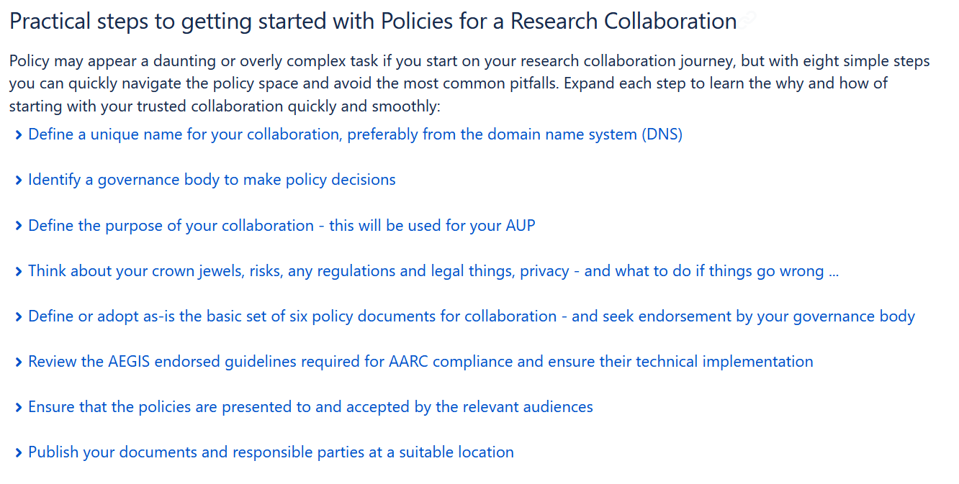
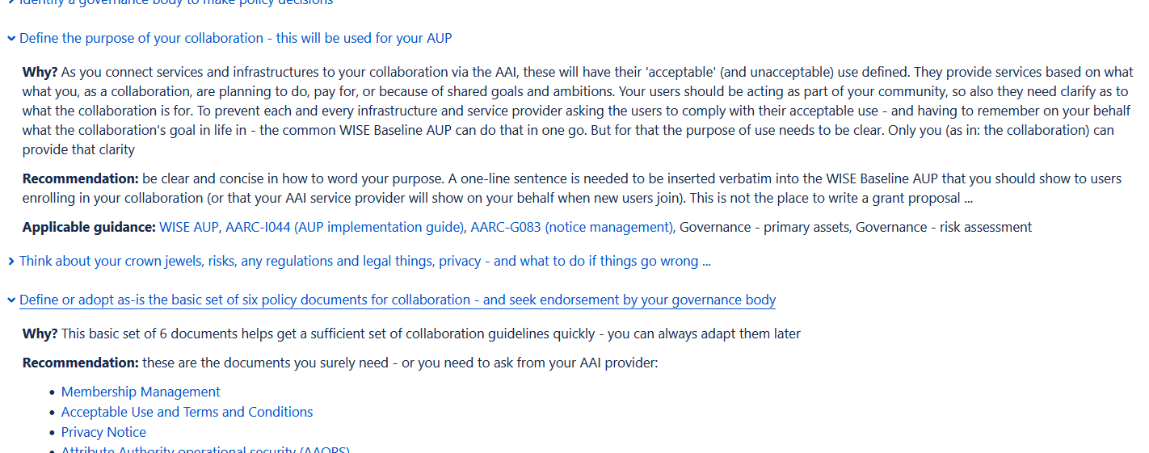
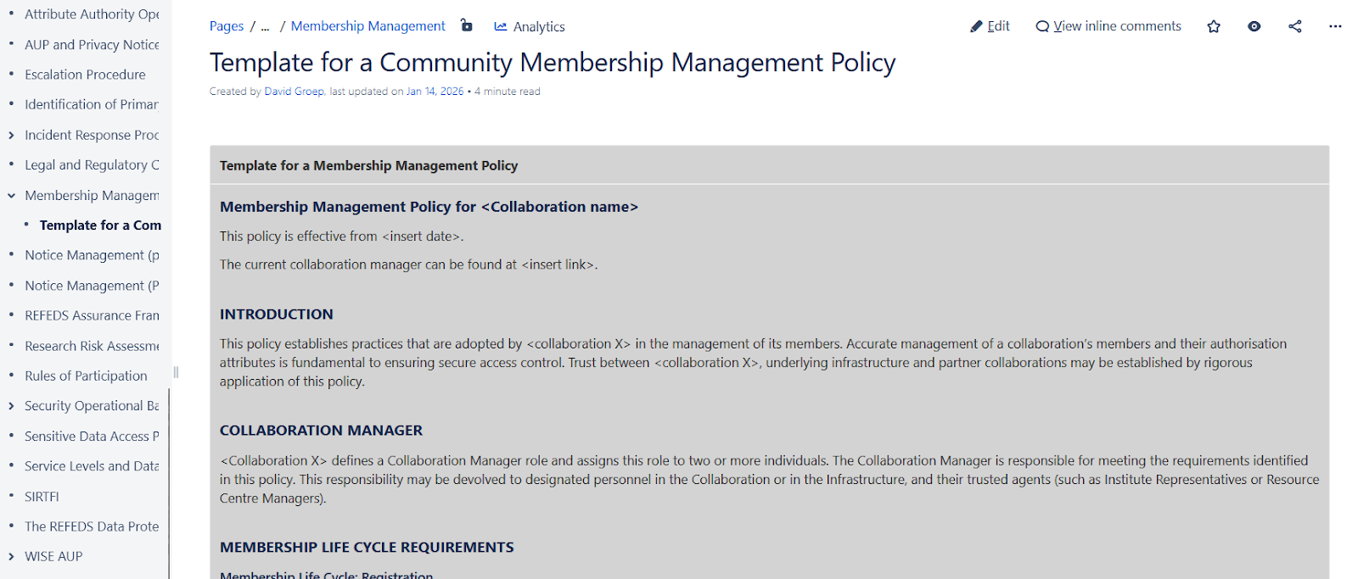
Bringing it together: the Policy Development Kit
AARC TREE D2.2
AARC PDK
PDK v2 has guidelines and explanations, hints, and accessible recommendations
https://aarc-community.org/policies/policy-development-kit/

Slide 24
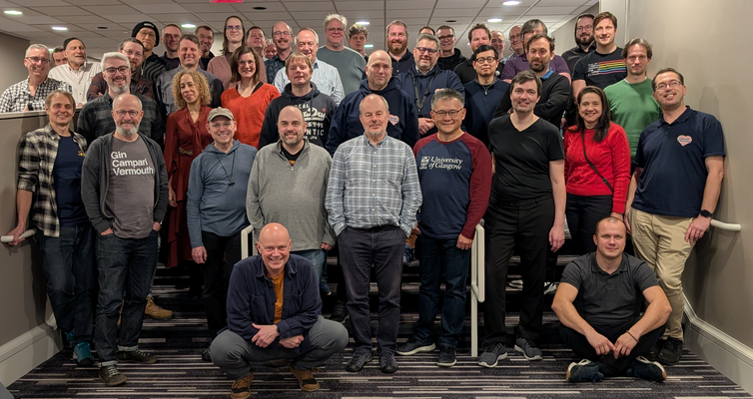
In the end, it’s all about enabling research: FIM4R & collaboration are our driving factors
The AARC Community uses a “co-creation process” through FIM4R
Research community requirements and reflection
Global forum with strong European focus
Enhanced by strategic co-location with trust and identity events
Impact on accessibility of the AAI infrastructure for user communities
by identifying inconsistencies in access management and policy, and
co-creating the architecture & getting researcher reflection early for proposed solutions
‘Copenhagen, Boston, Reading, Denver, Amsterdam, …’

Slide 25

The AARC Policy Tree …
Everyone will sit under their AARC TREE, and no one will make them afraid

Slide 26
davidg@nikhef.nl

