Slide 1
Sustainability for the AARC CILogin-like TTS Pilot
Mapping component distribution and costing models for the CILogon-like TTS Pilot considering scalability and usability
in the European e-Infrastructure landscape
David Groep
NA3 coordinator
Nikhef PDP (Advanced Computing Research) group
AARC 3rd AHM meeting
May 25th, 2016

Slide 2
CILogon-like TTS Pilot - aims
Ability to serve a large pan-European user base without national restrictions
  without having to rely on specific national participation exclusively for this service
  serving the needs of cross-national user communities that have a large but sparsely distributed user base
Use existing resources and e-Infrastructure services
  without the needs for security model changes at the resource centre or national level
Allow integration of this system in science gateways and portals with minimal effort
  only light-weight industry-standard protocols, limit security expertise (and exposure)
Permit the use of the VOMS community membership service
  attributes for group and role management in attribute certificates
  also for portals and science gateways access the e-Infrastructure
Concentrate service elements that require significant operational expertise
  not burden research communities with the need to care for security-sensitive service components
  keep a secure credential management model
  coordinate compliance and accreditation – and help meet EU privacy stuff in just one place to ease adoption
Optional elements: ability to obtain CLI tokens (via ssh agent or even U/P); implicit AuthZ

Slide 3
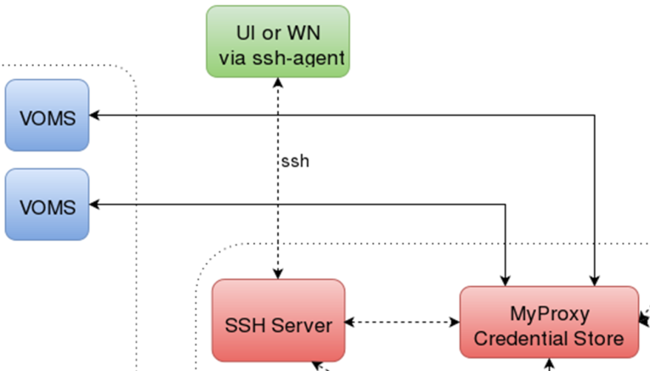
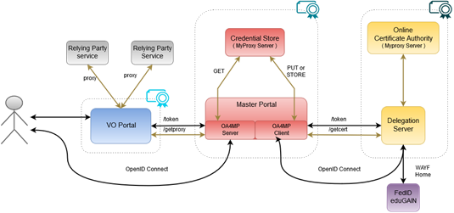
CILogon-like TTS Pilot - distributable elements

Slide 4
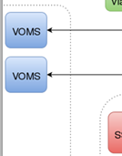
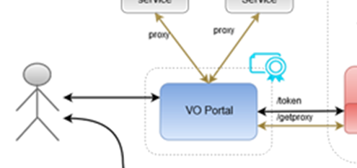
Blue: VO services and resources
Are around today, either self-managed or hosted, in most communities
Science gateways, portals, e.g. HADDOCK, Galaxy, generic (LifeRay), WebFTS, …
Omnipresent (and has unfortunately proven to be an easily compromised target,
especially when end-user instantiated in a cloud environment)
Will have to get credentials from the MPs, but should be able to
do so only for authenticated users
Downtime will impact its’ own users, but there will be
many of these (same service by different sites?)
VO management impact high (VOMS but usually hosted)
Considerations:
Ease of deployment, trust by MPs and end-users, usability, containment of incidents

Slide 5
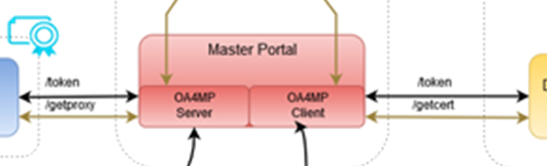
Red: the Master Portal (MP) and Credential Repository
Needs to be a trusted element (to permit credential storage by the TTS)
Requires some operational and security expertise (managed data centre, locked racks, access controls, ability to designate infrastructure for security operations, trained staff)
Connects to (many) workflow-specific VO portals
Connects to a (single, we hope!) Delegation Service/TTS-CA
The credential repository is a highly valuable resource for attackers
Similarly, a downtime of the MP/Credential Repo disables resource access for connected VO portals – so it can (and usually will) be a SPoF
Considerations:
scalability, A/R, trust by the VO portals

Slide 6
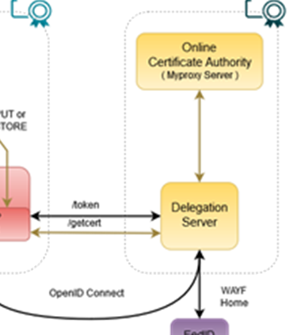
Yellow: the Token Translator/OA4MP/CA service
Is a highly trusted element:security and policy expertise, ability to maintain accreditation
Needs operational and technical capabilities: hardware security modules,
managed data centres, off-line and on-line secure areas, ROBAB-proof trained
personnel, ability to designate infrastructure for security operations
Connects to (a few, we hope) Master Portals (MPs)
Connects (many, we hope scalably) federations, IdPs and (few) SP-IdP-Proxies
May have to present a WAYF, if the VO portal does not pass IdP entityID
Needs to be a trusted element for Relying Parties (resource owners), users, and federations
Is an extremely valuable source for attackers, and again downtime impacts all connected MPs, and (with delay) impact all VO portals anywhere
Considerations:
trust, recoverability, A/R, compliance, need to conclude specific agreements with MPs

Slide 7
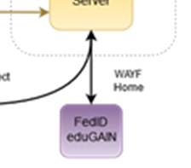
Purple: connected federations and IdPs (proxies)
In the generic case (conventionsl R&E federations) limited control possible
RI/eI proxy IdPs will provide more specific capabilities (uniqueness, user management ability)
Connects to many services, of which the DS/TTS is just one
Build on common technology (keep with SAML, no OIDC here)
Shared policy compliance: REFEDS R&S, Sirtfi
Negotiate non-scaleably only when needed (but a TTS must serve all users to prevent fragmentation!)
Cope with heterogeneity (i.e.: use a ‘filtering WAYF/entity filter proxy’)
Considerations:
Trust, scalability, non-intrusiveness, service-specific filtering

Slide 8
Some appeal?
Pilot appears to be appealing to RIs and e-Infrastructures
ELIXIR instance (demo) managed under SA1 on CESNET resources for EBI
EGI AAI evolution (demo) managed under ENGAGE JRA1 on GRNET resources for EGI.eu
Continuing discussions on alignment with WLCG … (who already have a nice setup anyway ;-)
Effect: expressions on interest received to host ‘the service’ (whatever that is) from many

Slide 9
Where are we now?
Several pre-production instances deployed, for EGI and ELIXIR (all managed by Nikhef)
A ‘production demonstrator’ instance of the TTS set up in conceptually the ‘right way’:
  Dedicated servers, secure environment, FIPS 140 level 3 approved HSM, anchored in a stable way
  Policy and practices accredited (under the ‘unique-identifier-only’ profile) at the IGTF – which is good enough for some infrastuctures, and is expected to be good enough in EGI in combination with managed communities
  Scalable negotiation model based on Sirtfi and REFEDS R&S section 6
  Model requirements on attached MPs defined (for key protection)
  Trust anchors in production (RCauth.eu and its “DCAROOT” HLCA)
Last updates to the software ongoing: policy-filtering ‘proxy-WAYF’ to link to eduGAIN & more
But it’s a production demonstrator, not production, without an SLA, and with limited capacity
… and it’s a bit a ‘Heath Robinson’ service, using mostly pre-available hardware

Slide 10
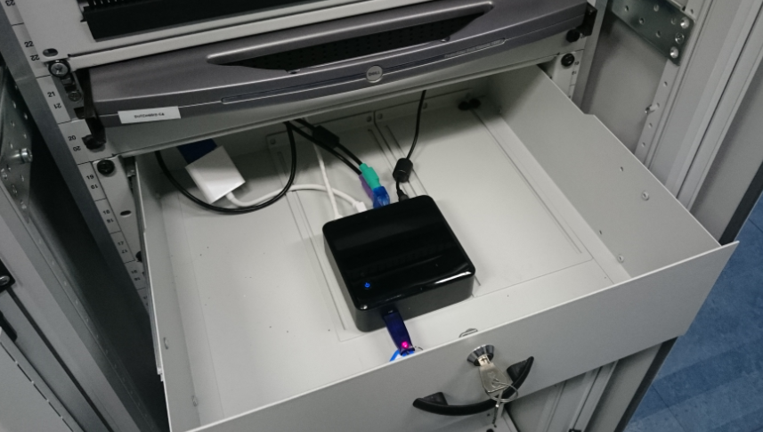
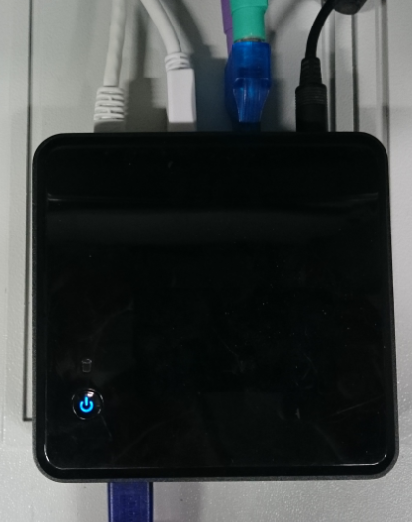
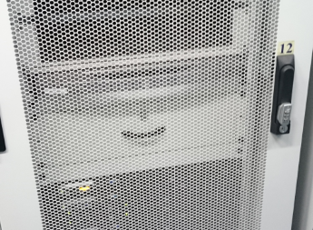
More pretty pictures

Slide 11
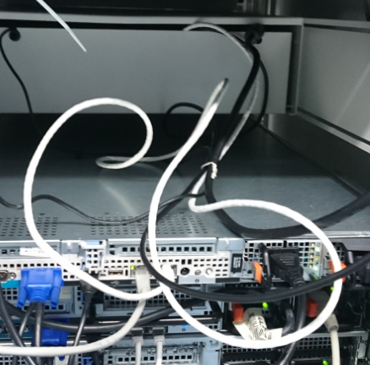
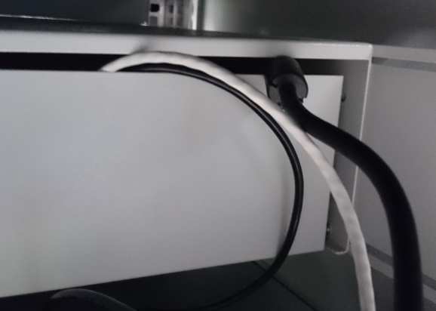

Slightly more ugly pictures …

Slide 12
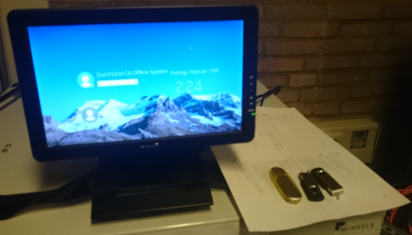
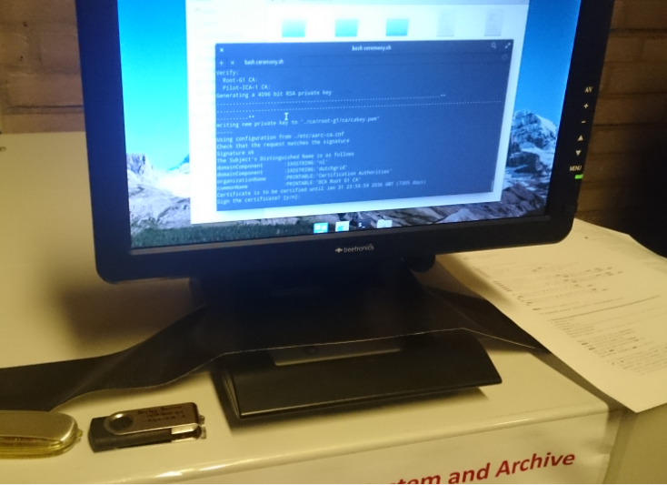
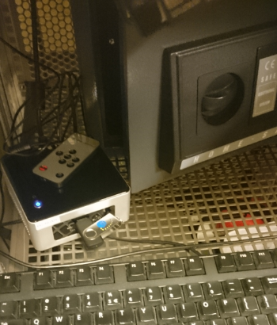
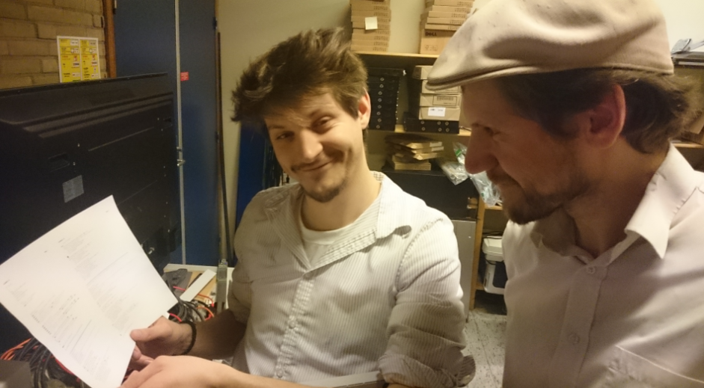
Key generation ceremony
In a single ceremony session generated both the off-line DCA Root and the RCauth.eu ICA
Prepared a script that would generate the key pairs,
self-sign the Root, and with the Root sign the RCauth ICA
Reviewed script with experts and operators for RCauth
Stored print-out of the script in the archive
Created copies on USB sticks and on the same day
deposited in off-site safe

Slide 13
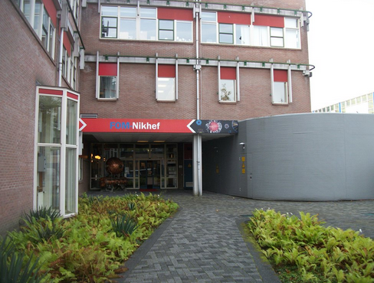
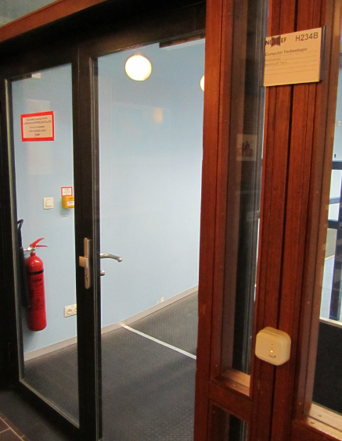
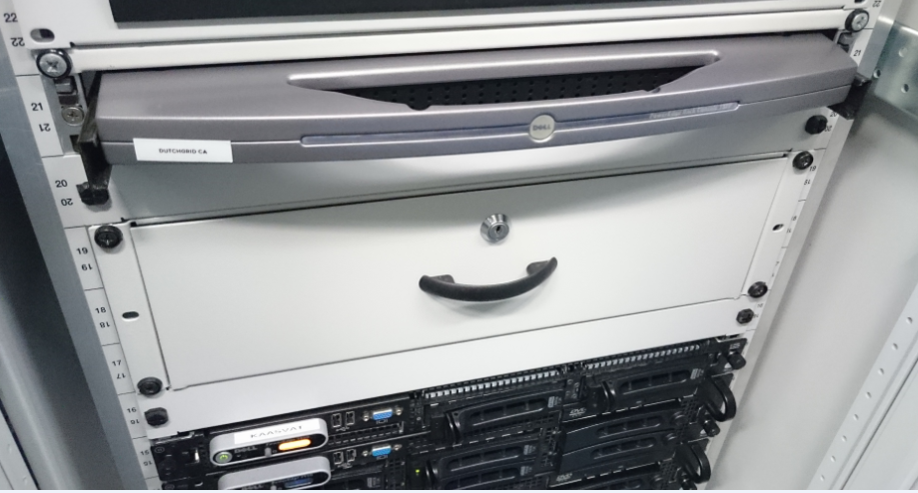
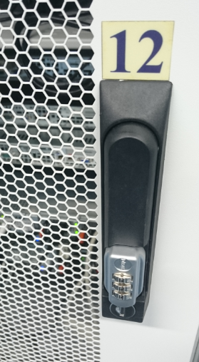
Physical controls are quite OK ☺
Located at Nikhef, Amsterdam, NL
Nikhef-specific part of the DC Housing Facilities
Room capacity 400kW, total ~ 2MW, 2N+ no-break
ID based access control, 24hr guard on-site, 2nd floor (above see-level)
CA and security systems in locked dedicated cabinet.
On-line CA signing system in locked drawer
CA signing system
Delegation Server

Slide 14


Deployment and (financial) sustainability models
VO portals
High volatility of services and platforms – best left to user groups and (sub) communities
Light-weight linkage – technically OIDC, with need to connect explicitly with an MP (MP will distribute user credentials, and has some responsibility for trust) – frequent communications between VO portal and MP operators foreseen
Suggest to keep with users and (sub) communities
VO membership services: assume unchanged from today
Master Portal & Credential Store (plus CLI token acquisition)
More costly: runs specific glue software (maintenance cost), needs to have some secure infra
Needs to gain trust from users (for which it manages credentials), VO portals, and the TTS ICA
Some distribution options – but it needs professional hosting and management
operational capabilities & usability: not too many WAYFs or consent screens

Slide 15
MP operating options
At home institutions and research labs
  Easy to gain user trust: they ‘know’ the operator. With a small per-institutional user base not likely to get traction
  As soon as use of the service extends to VO portals outside the home org, branding (and trust) conflicts emerge
At generic e-Infrastructures (EGI, EUDAT, GEANT, …)
  Close to relying parties, so easier to gain trust, and connected to managed data centres that do secure hosting
  Pretty remote from the typical researchers, so unlikely to ‘know’ the many connecting VO portals
  VO portal builders/operators may not easily find a ‘generic e-Infra’ that is beyond their research domain
  Yet may work well for largish VOs, and for VOs whose management service is already outsourced to centres that are closely linked to a generic e-Infrastructure
At the (ESFRI) Research Infrastructures (like ELIXIR, …)
  Usually have a good IT (and trust) capability
  Are logically close to the VO portals and may feel ‘dutybound’ to support community portals in their research domain
  Are few enough in number so that the negotiation with a (single) back-end TTS ICA remains feasible
Outsourcing this as “SAAS” by the RIS
  can work – but outsourcing the management of connecting VO portals defeats the purpose – and needs a multi-tenant MP management implementation
Scale is important: if master portal is down, dependent VO portals may not work. Scope (#users), available service agreements, and (implicit) expectations may drive relationship between end-users (portals) and the MP operators.
operational capabilities & usability: not too many WAYFs or consent screens

Slide 16

DS/TTS back-end ICA options
Delegation service (with the ‘filtering proxy WAYF’) and the ICA are a joint trust enclave
Must jointly be run under the same policy management controls
Maintains the ultimate trust link to the generic relying parties (through IGTF accreditation)
Visible to end-user since user must knowingly permit transfer of the tokens to the MP store
May also become visible to the user if it has to present a WAYF
Has to establish relationships with the MPs and the upstream IdPs/federations
WAYF redirection may be primary factor to decide between single or multiple instances:
widest possible user base – and not steering user away from her or his only working IdP
operational capabilities & usability: not too many WAYFs or consent screens

Slide 17
DS/TTS back-end ICA options (I)
At ‘natural home’ organisation of the user or of the VO operator: not feasible trust-wise
At the generic e-Infrastructures (EGI, EUDAT, GEANT, …)
  They will have participating centres that can do secure hosting, and operational link eases trust
  May be unlikely to agree on a single one, so the WAYF problem emerges and creates silo’s
  Potential for ‘lock-in’ between the TTS and specific relying parties only within same infrastructure
  … if global accreditation is bypassed in favour of instantaneous easy satisfaction
  Cost may be prohibitive for even some of these entities, but they all have cost recuperation systems in place
At the (ESFRI) Research Infrastructures (like ELIXIR, …)
  The RIs also have access to capable participating hosting centres and could do it (or outsource it!)
  Same issue in creating silos, easy rapid bypasses, and lock-in
  There are even more RIs than there are generic e-Infras: scalability issues emerge stronger
  Smaller user base makes for higher per-user costs, but operational need may make it easier to bear
A single one for Europe
A single one for the world: great!

Slide 18
DS/TTS back-end ICA options (II)
At the generic e-Infrastructures (EGI, EUDAT, GEANT, …)
At the (ESFRI) Research Infrastructures (like ELIXIR, …)
A single one for Europe
  prevents silos and does away with any fronting-WAYF issues
  – but the fact that it needs to ask user to trust the master portal leads to branding questions ☹
  cost per user is lower due to scale, so recuperation could be easier – yet it has to be independent and thus has to hunt for funding through either fees (per user, per MP, per authentication?) or through contracts with e-Infra s or RIs
  lack of clear ‘ownership’ leaves it vulnerable to vendor longevity – too few subscribers give spiraling costs
  can maybe go through joint procurement (e.g. TCS has option for ‘enterprise-specific TA’ hosting)
  each e-Infra wants to be the exclusive provider of the back-end IdP, to provide the uniqueID
  – and certainly not allow the user to ‘escape out’ of the e-Infra/RI silo (can be done with entityID forwarding)
A single one for the world: great!
  but: legal issues in DP from the EU
  needs extremely high reliability, and probably regional distribution anyway for acceptable latency and 24x7 support

Slide 19
Costing the services
Highly depends!
What is ‘the service’? Delegation Service & WAYF? Master Portals?
Technical elements only, or operational service implementation?
Desired service level (support & availability)
Extent of the service (number of users, communities, …)
Recuperation model very much a business decision as well
Base fee plus additional costing on demand (per-connected portal, per master portal)?
Flat-fee for technical and operational implementation?
Fee per transaction? Back-channel via the RIs (free at point-of-use), or …?
Including or excluding support services?
Can be anywhere between a few kEur to well over 100+kEur cost per year (for >3year service)

Slide 20
Open Questions!
Do we want to push for a particular distribution model?
If so: how firm should we push for a single TTS back-end service?
Should this always be neutral? Each e-Infra already pushing for the ‘exclusively’ linked IdP …
What is ‘neutral’ anyway?
The pilot contains some bits of software glue – how should ‘we’ fund the maintenance effort? Or should we push some specific bits also ‘upstream’?
Nikhef, as part of the Dutch National e-Infrastructure coordinated by SURF, supports
the pilot operations for now – once it is to transition, which process should we follow?
Is that something we need to worry about here, what of an open and transparent selection,
or are you happy it leave the selection process it all up to ‘SURF’?
What are your expectations for scale, expected A/R, and service support level
if the CILogon-like TTS Pilot is indeed used by RIs and e-Infras? In 2017? And in 2020?

Slide 21
References
https://wiki.geant.org/display/AARC/Models+for+the+CILogon-like+TTS+Pilot

Slide 22
davidg@nikhef.nl

