Slide 1
Sustainability for the AARC CILogin-like TTS Pilot
Distribution and models for the CILogon-like TTS Pilot
for the European Open Science Cloud and
the Dutch National e-Infrastructure coordinated by SURF
David Groep
NA3 coordinator
Nikhef PDP (Advanced Computing Research) group
AARC I2GS session, EGI ENGAGE Conference
April, May 2017

Slide 2
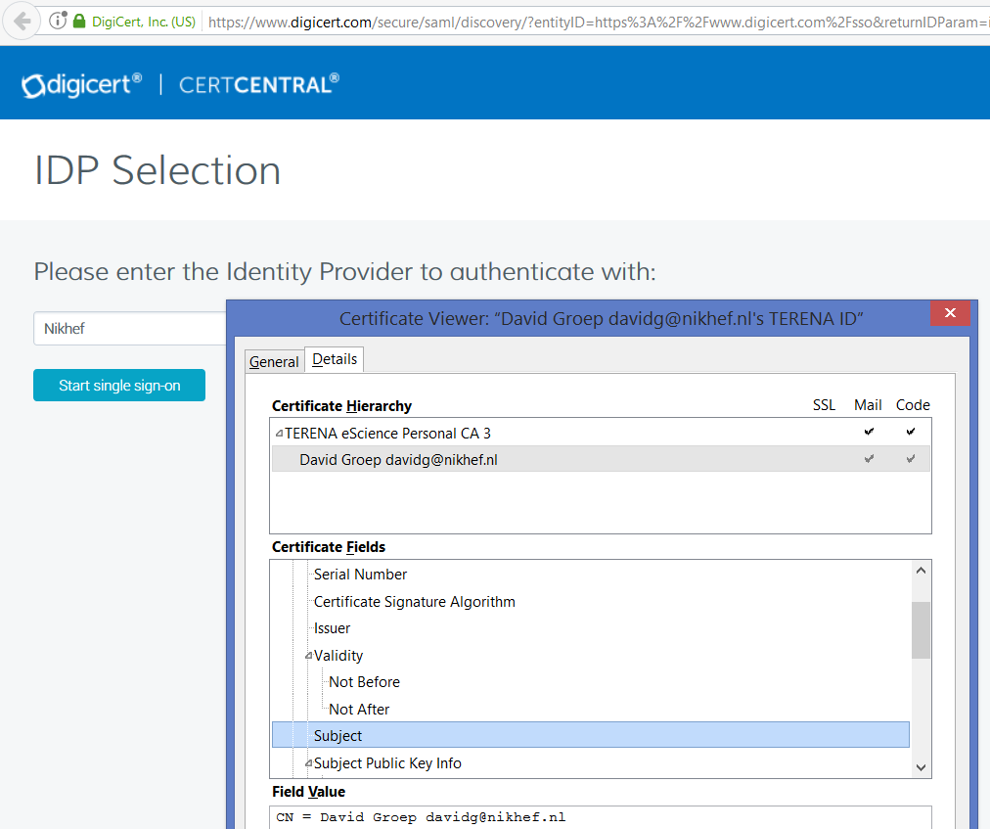
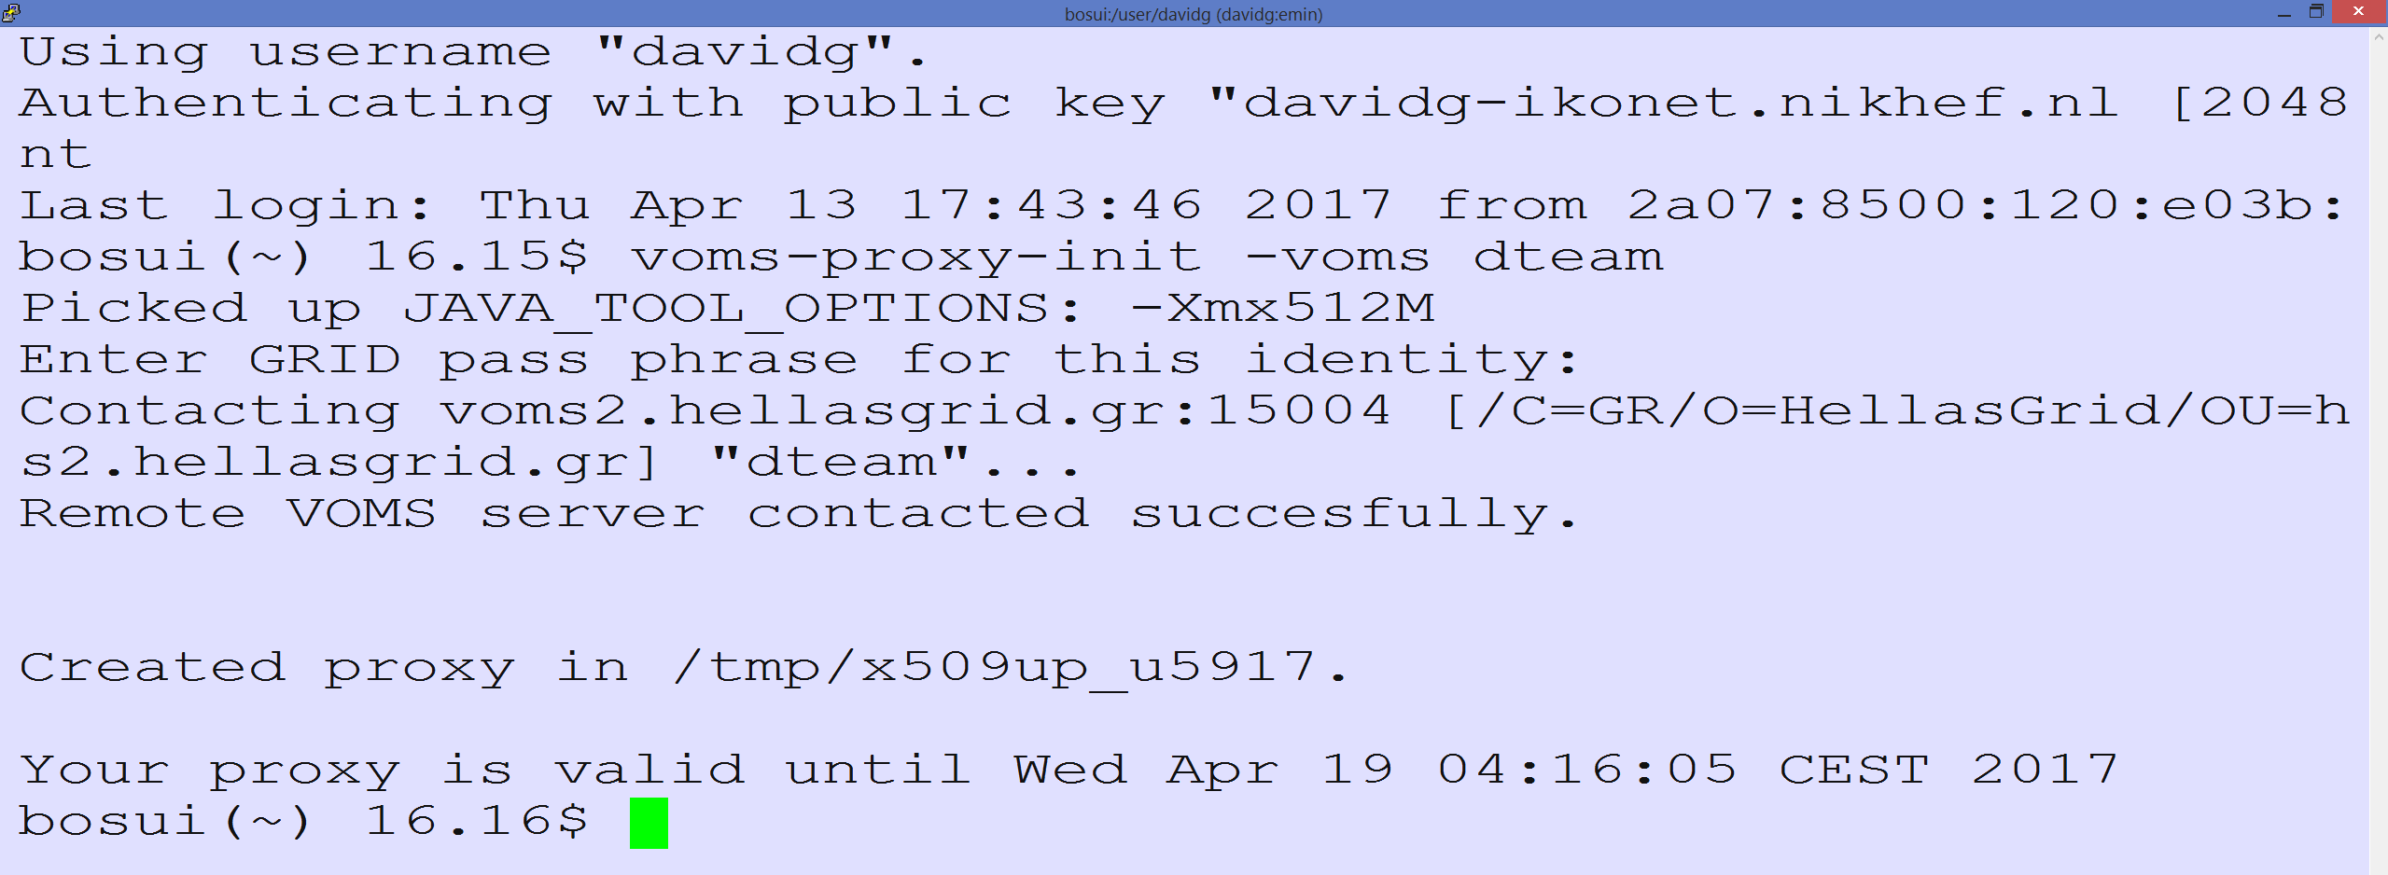
Seamless (eduGAIN) Access to (non-Web) Resources using PKIX?
Traditional workflow – using a client-held credential
Works great provided the user understand the technology – and we may have found all users that know how to manage ☹

Slide 3
Seamless (eduGAIN) Access via the CILogon-like TTS Pilot: aims
Ability to serve a large pan-European user base without national restrictions
  without having to rely on specific national participation exclusively for this service
  serving the needs of cross-national user communities that have a large but sparsely distributed user base
Use existing resources and e-Infrastructure services
  without the needs for security model changes at the resource centre or national level
Allow integration of this system in science gateways and portals with minimal effort
  only light-weight industry-standard protocols, limit security expertise (and exposure)
Permit the use of the VOMS community membership service
  attributes for group and role management in attribute certificates
  also for portals and science gateways access the e-Infrastructure
Concentrate service elements that require significant operational expertise
  not burden research communities with the need to care for security-sensitive service components
  keep a secure credential management model
  coordinate compliance and accreditation – and help meet EU privacy stuff in just one place to ease adoption
Optional elements: ability to obtain CLI tokens (via ssh agent or even U/P); implicit AuthZ

Slide 4
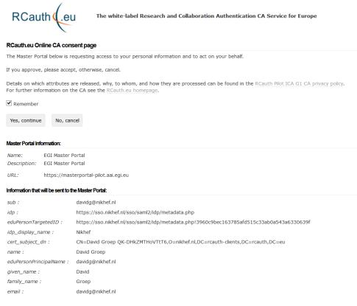
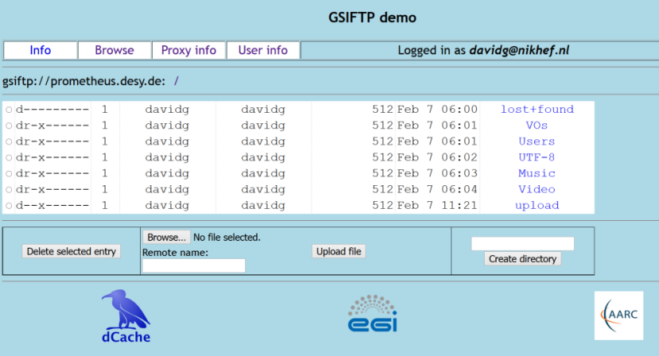
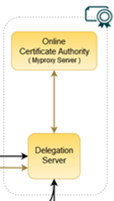
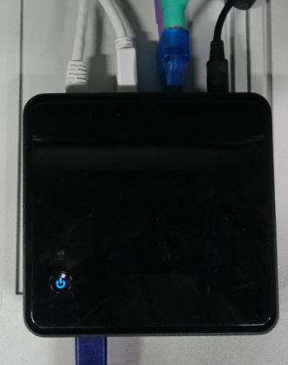

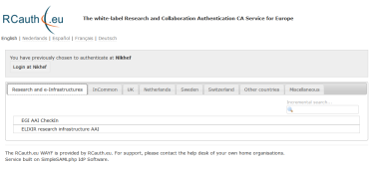


Flow for RCauth-like scenarios
Community Science Portal
Accredited
PKIX Authority
Infrastructure Master
Portal Credential Store
REFEDS R&S
Sirtfi Trust
User Home Org
or Infrastructure IdP
Policy Filtering WAYF / eduGAIN
Built on CILogon and MyProxy!
www.cilogon.org
see also https://rcdemo.nikhef.nl/
4
Notes:
VO portal can be anything even a simple shell
Certs stored only for 11 days
Master portal can add attributes via VOMS (or others in the future)

Slide 5
DEMO
https://rcdemo.nikhef.nl/
https://rcdemo.nikhef.nl/getproxy
you can do most things except access the Prometheus dCache pool right now
that last elements needs your credential to be added to the permitted list

Slide 6
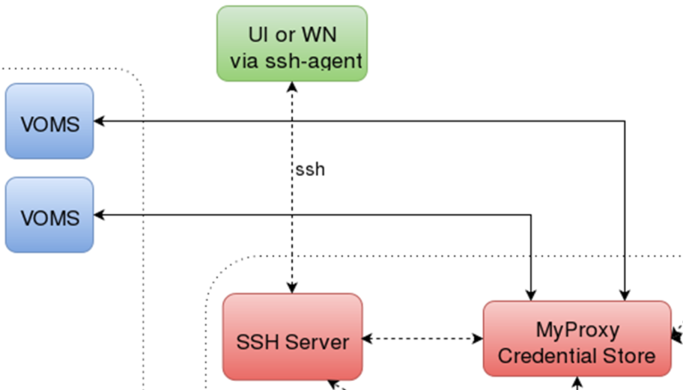
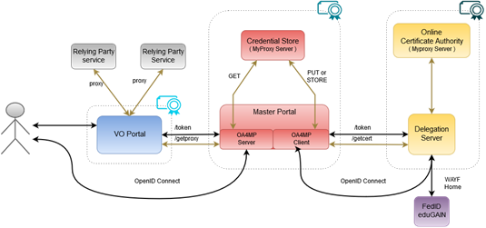
CILogon-like TTS Pilot - distributable elements

Slide 7
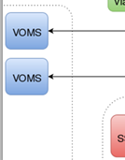
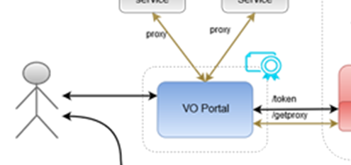
Blue: VO services and resources
Are around today, either self-managed or hosted, in most communities
Science gateways, portals, e.g. HADDOCK, Galaxy, LifeRay (generic), WebFTS, …
Omnipresent (and has unfortunately proven to be an easily compromised target)
Will have to get credentials from the MPs, but should be able to
do so only for authenticated users
Downtime will impact its’ own users, but there will be
many of these (same service by different sites?)
Considerations:
Operated as today by the communities
Bound slightly stronger to the community via the Master Portal

Slide 8
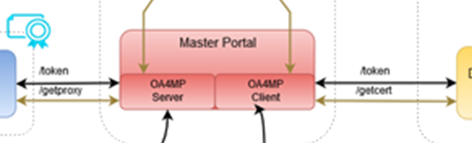
Red: the Master Portal (MP) and Credential Repository
Needs to be a trusted element (to permit credential storage by the TTS)
Requires some operational and security expertise (managed data centre, locked racks, access controls, ability to designate infrastructure for security operations, trained staff)
Connects to (many) workflow-specific VO portals
Connects to a single Delegation Service/TTS – and can give IdP hints
Downtime of an MP disables resource access for connected VO portals
Considerations:
One per Research or e-Infrastructure
Should be highly available (database sync)
Infrastructures can also build their own (e.g. in WaTTS, Unity, …)

Slide 9
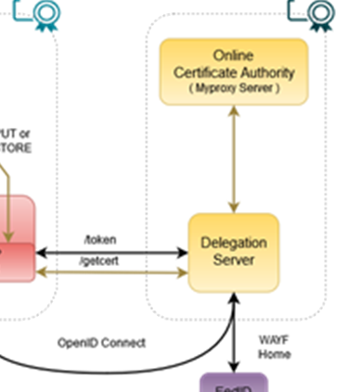
Yellow: the Token Translator/OA4MP/CA service
Needs security and policy expertise – and ability to maintain accreditation
Needs operational and technical capabilities: hardware security modules,
managed data centres, off-line and on-line secure areas, ROBAB-proof trained
personnel, ability to designate infrastructure for security operations
Connects to (a few, we hope) Master Portals (MPs) with explicit agreements
to take care of user credential protection and compliance
Connects (many, we hope scalably) federations, IdPs and (few) SP-IdP-Proxies
May have to present a WAYF, if the VO portal does not pass IdP entityID
Considerations:
Trust and compliance, with IGTF accreditation
Single logical instance, with HA built in for production
Managed by a consortium: in Europe agreed by at least EGI, EUDAT, GÉANT, ELIXIR, and SURF

Slide 10







Potential RCauth.eu management model
shared governance through a
Policy Management Authority
non-discriminatory policy and practices
joint PMA authoritative
for policy and operations
Stakeholders
EGI, EUDAT, SURF,
GÉANT, ELIXIR, …
in-kind or explicit contributions
of services, kit, and operators
trust by any and all
global relying parties
Infrastructure-specific Master Portals
and Credential Repository
user contact service by
specific stakeholder

Slide 11
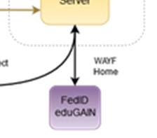
Purple: connected federations and IdPs (proxies)
In the generic case (conventionsl R&E federations) only limited control possible
Infrastructure-managed IdPs will provide more specific capabilities, e.g., uniqueness
Connects to many services, of which the DS/TTS is just one
Build on common technology (keep with SAML, no OIDC here)
Shared policy compliance: REFEDS R&S, Sirtfi
Negotiate only when needed (but a TTS must serve all users to prevent fragmentation!)
Cope with heterogeneity (i.e.: use a ‘filtering WAYF/entity filter proxy’)
Considerations:
eduGAIN registration, Sirtfi adoption, REFEDS R&S, filtering capability
Needs a friendly registrar, but is otherwise ‘just another SP’

Slide 12
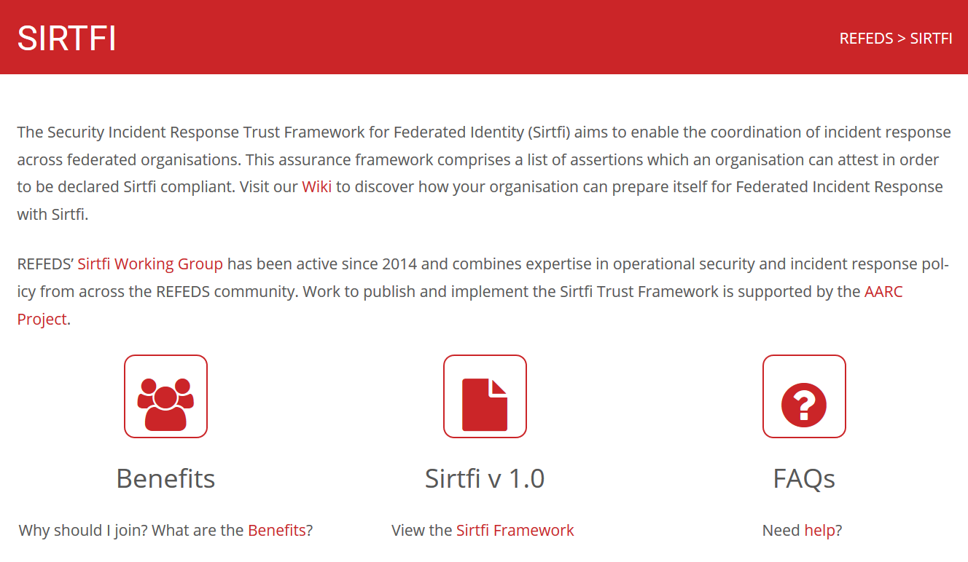
Sirtfi and R&S – policy needs for trust in identity providers and federations
REFEDS and federation focused FAQ
Definition of the global Security Contact
meta-data profile for use in eduGAIN
Namespace for Sirtfi Assurance at IANA
Used in cyber ops roleplay exercises
Promoted at I2TechX,
FIM4R, Kantara, and TF-CSIRT
Ingredient to the ‘CILogon pilot’
combination of
REFEDS “Research and Scholarship”
and
Sirfti v1.0
meets assurance requirements for RIs and EIs according to the IGTF “assured identifier trust”
https://refeds.org/SIRTFI
✓
Mar 17th 137 IdPs ineduGAIN
that support Sirtfi
12

Slide 13
Where are we now?
Several pre-production instances deployed, for EGI and ELIXIR (all managed by Nikhef)
A ‘production demonstrator’ instance of the TTS set up in conceptually the ‘right way’:
  Dedicated servers, secure environment, FIPS 140 level 3 approved HSM, anchored in a stable way
  Policy and practices accredited (under the ‘unique-identifier-only’ profile) at the IGTF – which is good enough for some infrastuctures, and is expected to be good enough in EGI in combination with managed communities
  Scalable negotiation model based on Sirtfi and REFEDS R&S section 6
  Model requirements on attached MPs defined (for key protection)
  Trust anchors in production (RCauth.eu and its “DCAROOT” HLCA)
Last updates to the software ongoing: policy-filtering ‘proxy-WAYF’ to link to eduGAIN & more
But it’s a production demonstrator, not production, without an SLA, and with limited capacity
… and it’s a bit a ‘Heath Robinson’ service, using mostly pre-available hardware

Slide 14
Costing the services
Highly depends!
What is ‘the service’? Delegation Service & WAYF? Master Portals?
Technical elements only, or operational service implementation?
Desired service level (support & availability)
Extent of the service (number of users, communities, …)
Can be anywhere between a few kEur to well over 100+kEur cost per year ☺
Recuperation model appears to converge
Master Portals (Credential Management) on a per-Infrastructure basis, from own funding
Delegation Service/RCauth.eu: free at point of use
Funded via in-kind contributions by the major e-Infrastructures
Distributed H/A setup, leveraging existing capabilities and some additional person effort

Slide 15
References
https://wiki.geant.org/display/AARC/Models+for+the+CILogon-like+TTS+Pilot

Slide 16
davidg@nikhef.nl

