Slide 1
Policy and Best Practice Harmonisation
facilitating research and collaboration
David Groep
NA3 Activity Lead
TNC2016 – AARC Workshop
16 June, 2016
Prague

Slide 2
The Policy Puzzle
Many groups and (proposed) policies, but leaving many open issues
AARC is tackling a sub-set of these
  “Levels of Assurance” – a minimally-useful level and a differentiated set, for ID and attributes
  “Incident Response” – encouraging ‘expression’ of engagement by (federation) partners
  and a common understanding on operational security
  “Sustainability models and Guest IdPs” – how can a service be offered in the long run?
  “Scalable policy negotiation” – beyond bilateral discussion
  “Protection of (accounting) data privacy” – aggregation of personal data in operating
  collaborative infrastructures
Strategy is to support and extend established and emergent groups so as to
leverage their support base (and ‘multiply’ the effect of policy investments from AARC)
IGTF
FIM4R
REFEDS
SCI
GN4
AARC
. . .
SIRTFI

Slide 3
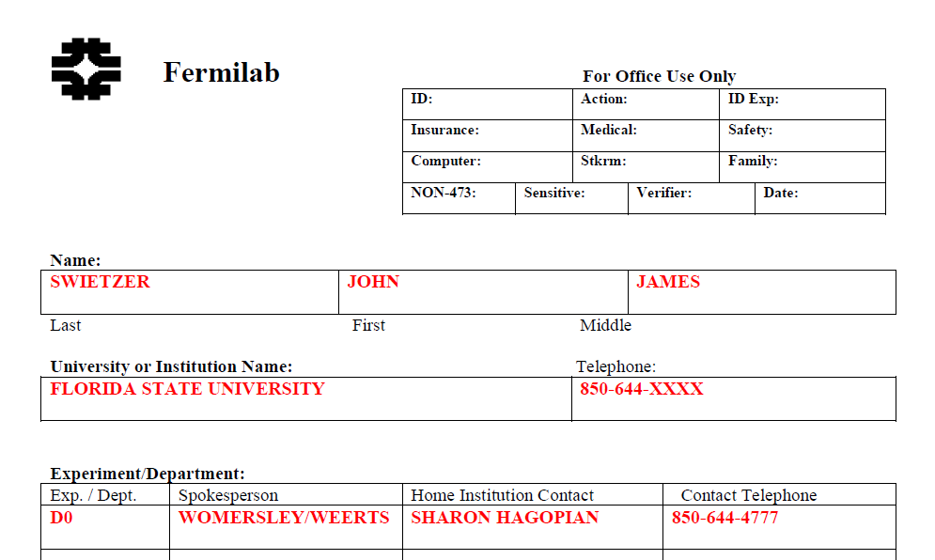
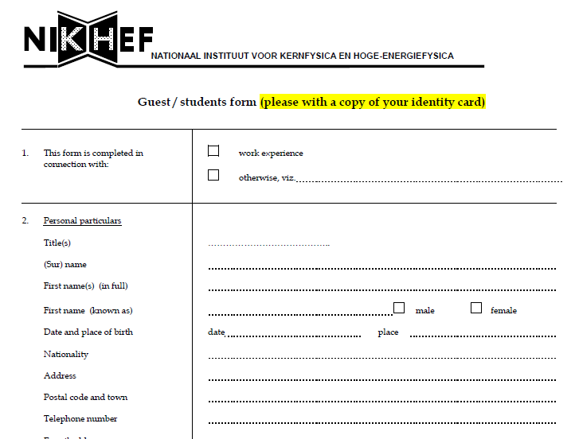
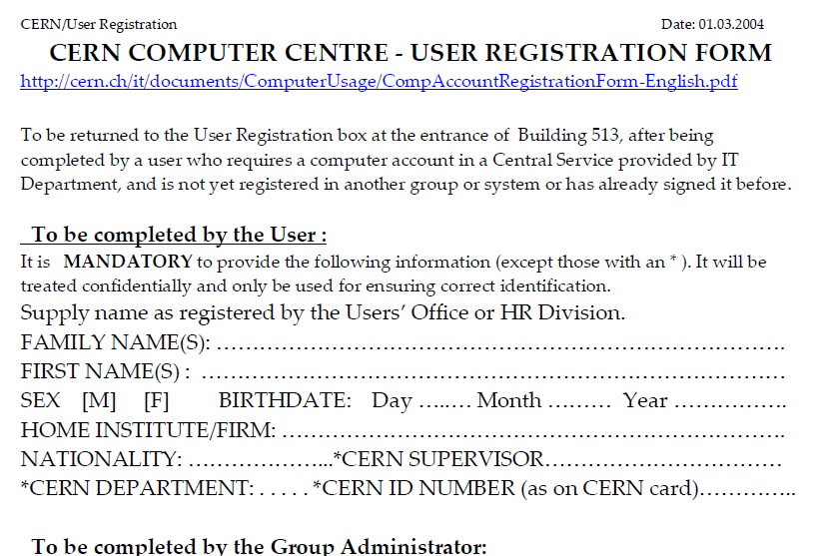
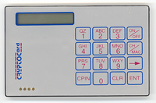
Policy and Best Practices Harmonisation
Task 1
Development of best practices for Levels of Assurance

Slide 4
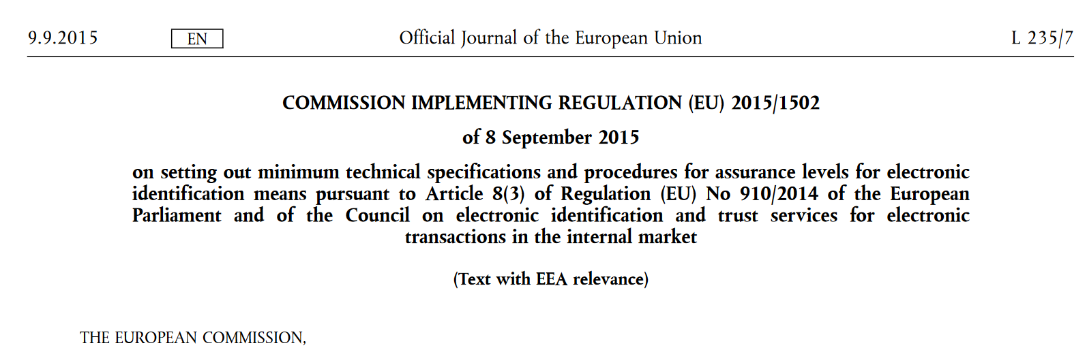
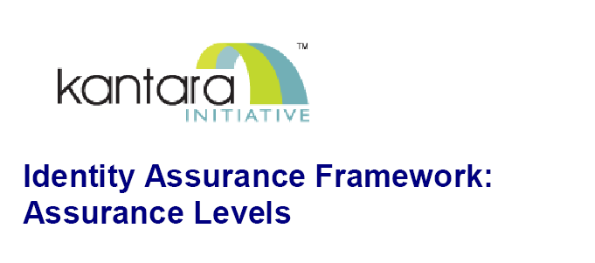
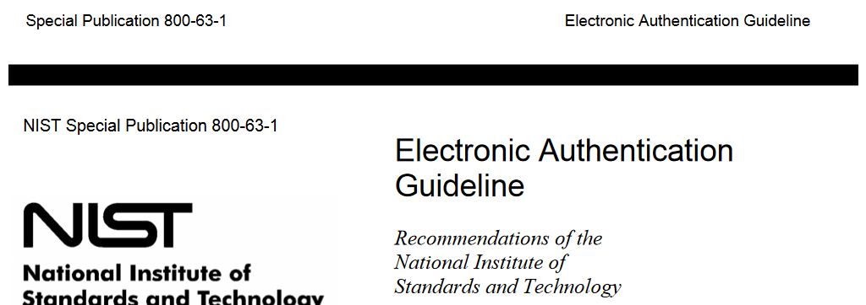
Assurance Profiles and ‘differentiated’ levels of assurance
Many layered models (3-4 layers)
but: specific levels don’t match needs
of Research- and e-Infrastructures:
Specific combination
‘authenticator’ and ‘vetting’ assurance
doesn’t match research risk profiles
Disregards existing trust model
between federated R&E organisations
Cannot accommodate
distributed responsibilities
As a result, in R&E today there is in practice hardly any documented
and agreed assurance level

Slide 5









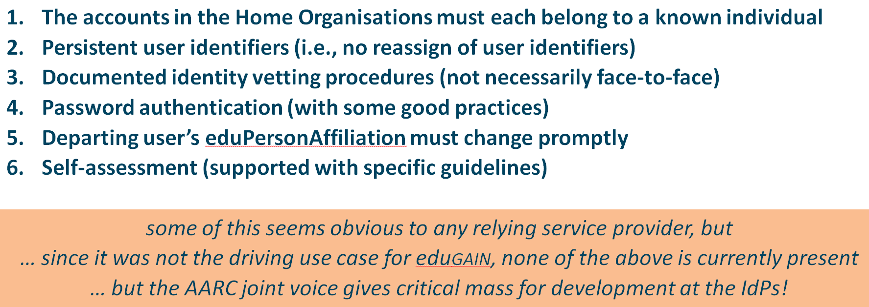
Assurance Profile development in AARC
✓
REFEDS group on
baseline assurance
European ‘baseline’ use case
requirements from RIs and EIs
✓
depth interviews
Global REFEDS consultation process
Baseline requirements for low-risk use cases
✓
R&E Federation
Assurance
Capabilities
GEANT4-1
Self-assessment tool requirements
MNA3.1 “baseline
LoA” document
GEANT4-2 or
community work
TNA3.2 “Sirtfi”

Slide 6




PY2: Assurance Profile development in AARC
– collaborative and differentiated assurance
✓
REFEDS group on
baseline assurance
Collaborative
community
trust policies
European ‘baseline’ use case
requirements from RIs and EIs
✓
depth interviews
Global REFEDS consultation process
Baseline requirements for low-risk use cases
Differentiated Assurance Profiles for RIs and e-Infra’s
NIST SP800-63 v3, IETF VoT, eIDAS
✓
R&E Federation
Assurance
Capabilities
GEANT4-1
Self-assessment tool requirements
3 BMS
scenarios
low, med,
and high
DNA3.1
Differentiated
Assurance Recommendations
MNA3.1 “baseline
LoA” document
GEANT4-2 or
community work
TNA3.2 “Sirtfi”

Slide 7
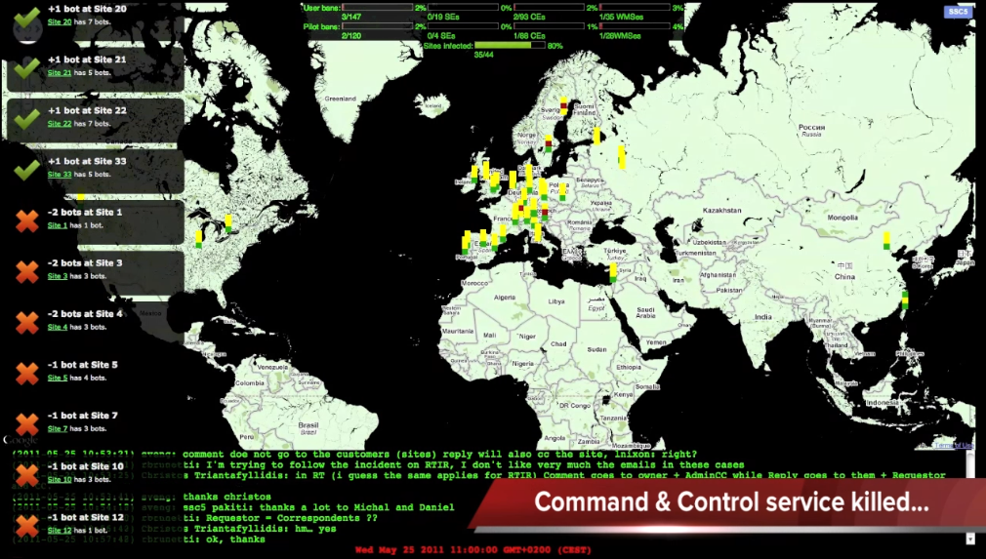
Policy and Best Practices Harmonisation
Task 2
Security Incident Response

Slide 8
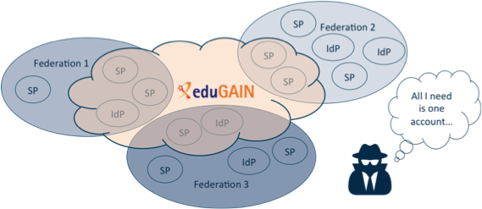
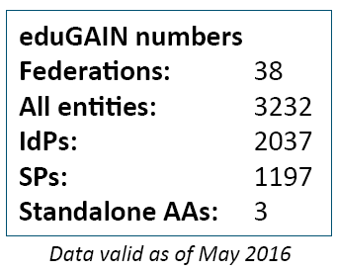
Security Incident Response in the Federated World
How could we determine the scale of the incident?
  Do useful logs exist?
  Could logs be shared?
Who should take responsibility for resolving
the incident?
How could we alert the identity providers
and service providers involved?
Could we ensure that information is shared confidentially, and reputations protected?
Security Incident Response Trust Framework for Federated Identity
Sirtfi – based on Security for Collaborating Infrastructures (SCI) & FIM4R Recommendations

Slide 9
A Security Incident Response Trust Framework – Sirtfi summary
Operational Security
Incident Response
Traceability
Require that a security incident response capability exists with sufficient authority
to mitigate, contain the spread of, and remediate the effects of an incident.
Assure confidentiality of information exchanged
Identify trusted contacts
Guarantee a response during collaboration
Participant Responsibilities
Improve the usefulness of logs
Ensure logs are kept in accordance with policy
Confirm that end users are aware of an appropriate AUP

Slide 10
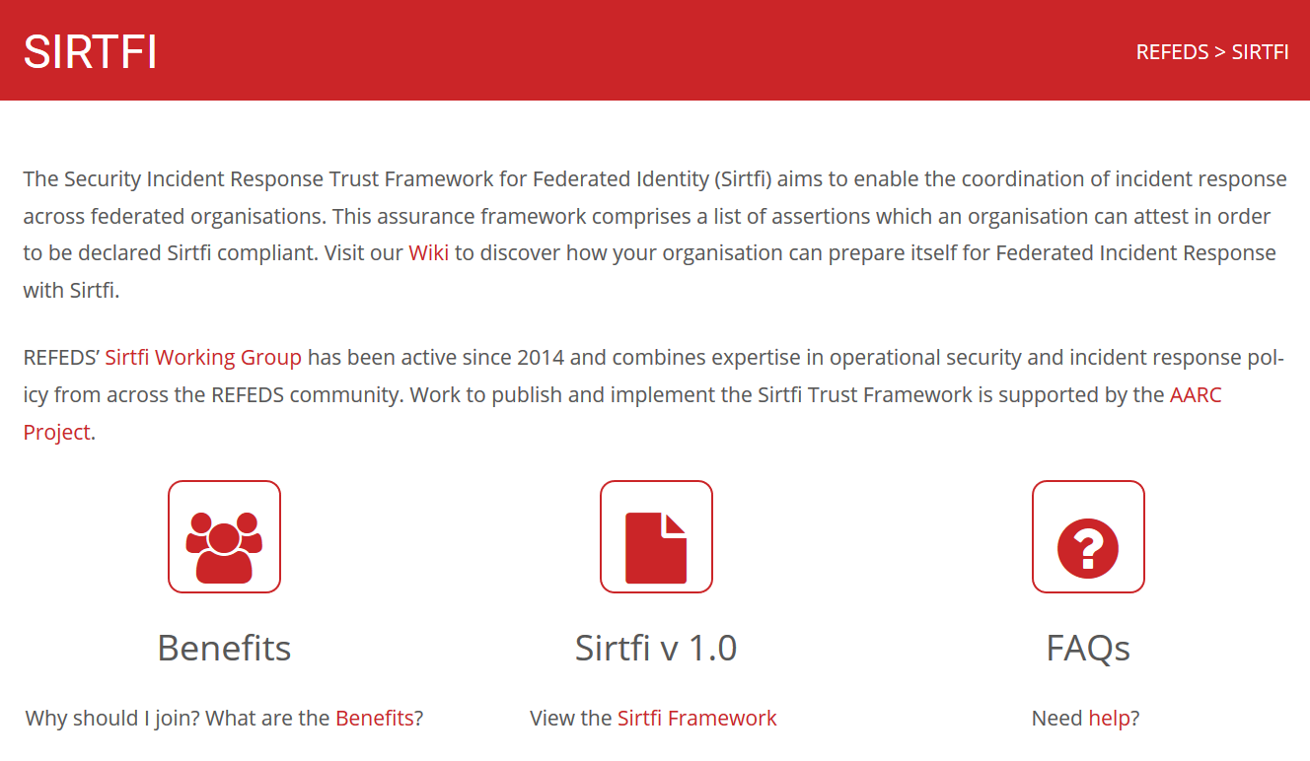
Sirtfi Training and Outreach
REFEDS and federation focused FAQ
Definition of the global Security Contact
meta-data profile for use in eduGAIN
Namespace for Sirtfi Assurance at IANA
Used in cyber ops roleplay exercises
Promoted at I2TechX,
FIM4R, Kantara, and TF-CSIRT
Ingredient to the CILogon pilot
combination of
REFEDS “Research and Scholarship”
and
Sirfti v1.0
meets assurance requirements for RIs and EIs according to the IGTF “assured identifier trust”
https://refeds.org/SIRTFI

Slide 11
Incident response – adoption process and impact
✓
✓
January 2016: Sirtfi document globally agreed (v1.0) and published
Description of incident response contact in eduGAIN
March,April 2016: extended adoption process to bulk-approve IdPs in ‘tight’ federations
May 2016: agreed adoption model with SURFconext and SWITCHaai,
interest from WAYF-DK, CSC/FUNET, DFN, and UK AMF
✓
June 3rd: 87 IdP in eduGAIN that support Sirtfi
✓

Slide 12
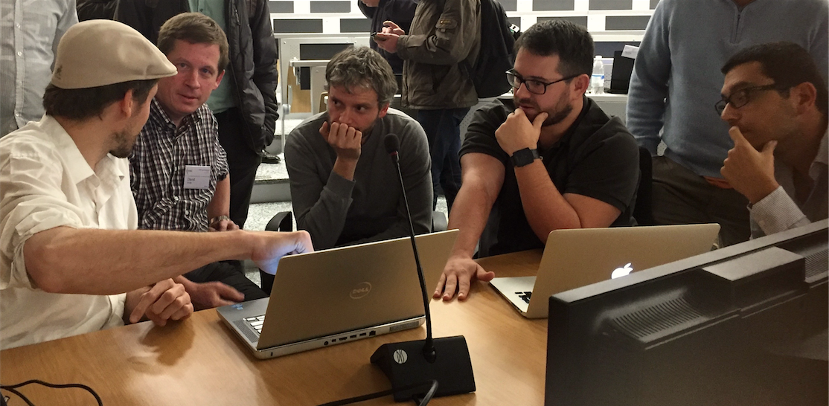
Policy and Best Practices Harmonisation
Task 3
Recommendation for service operational models
for enabling cross-domain sustainable services

Slide 13
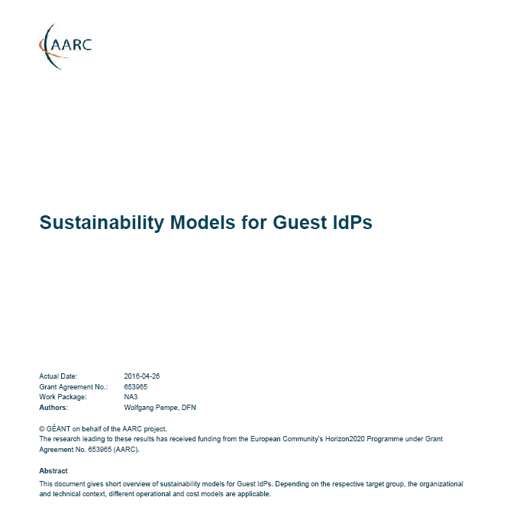
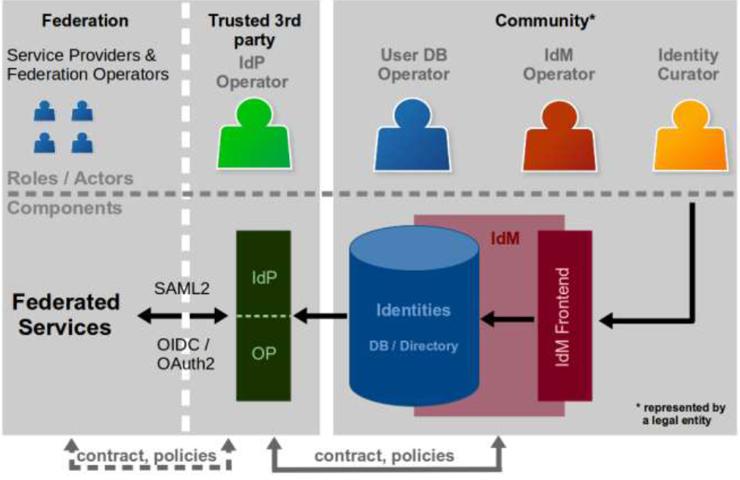
Sustianability models for ‘guest’ IdPs – serving users beyond academia
Guest IdPs are critical to almost all collaboration use cases
Collaboration does not end at the door of the university !
PY1 work:
Model study – too often ‘guest’ IdPs have faded
or become less usable for research collaborations
Identify sustainable IdP models based on experience
PY2 plans:
based on use of guest IdPs in the Blueprint
Leverage work of GEANT4 on COPaaS
Review feasibility of ‘paid’ & ‘external’ IdPs services
which may or may not be free at point of use
https://wiki.geant.org/display/AARC/Sustainability+models+for+Guest+IdPs

Slide 14
Federation operations – alignment recommendations for use in Pilots
Combined desk study (based on automated meta-data) and interviews (DFN AAI, SURFconext)
Differences | care level offered to participants collective acceptance and provisioning of services
 | national funding model and adequacy, federation structure
Alignment | acceptance policy for service providers and IdPs – intent is all the same
 | charging models: IdP connected without additional cost, SPs are ‘free’
 | entity categories for grouping ‘alike’ services and IdPs is supported
Alignment | eduGAIN participation is still opt-in (needs convincing of each IdP)
In PY2 focus on obvious differences, such as:
support for catch-all ‘guest’ IdPs in all federations
support of attribute authorities: is either complicated or easy depending on federation structure
https://wiki.geant.org/display/AARC/Federations+Current+Policies+and+Practices

Slide 15

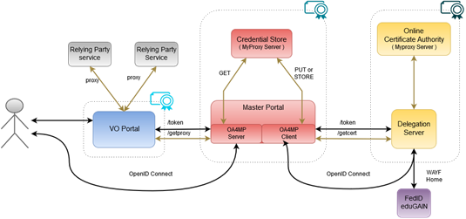
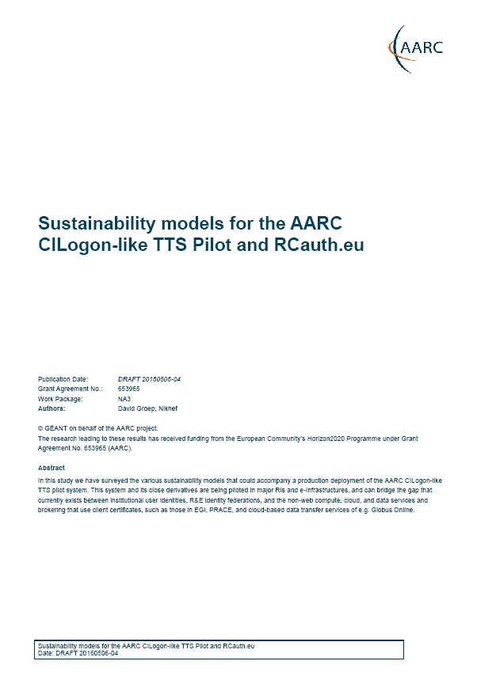

AARC Pilot sustainability
PY1 completed:
Sustainability models
Integration with EIs/RIs
Funding schemes
Transition negotiations
Intentionally ‘white label’
CILogon-like TTS Service
connecting SAML to Community
Portals and existing e-Infrastructures
PY2 schedule:
Collabora Productivity
Develop business model
and demonstrate feasibility
On-premise or SaaS trusted collaboration
using LibreOffice Online and OwnCloud
with integration of eduGAIN IdPs

Slide 16
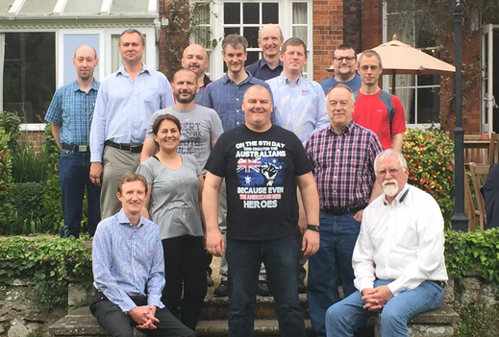
Policy and Best Practices Harmonisation
Task 4
Development of scalable policy negotiation mechanisms

Slide 17
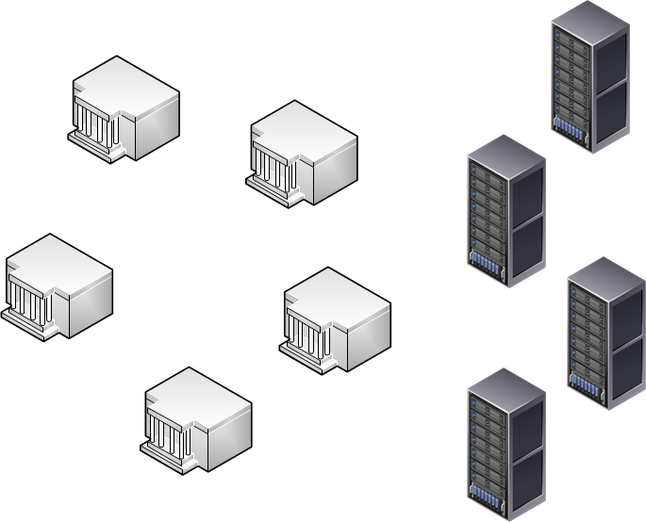
Full mesh policy negotiation does not scale – we cannot afford it!
Collaborations by design have their services distributed
and
not that many collaborations are a legal entity
or are not ‘authoritative’ for constituent services
‘n x m’
IdP
Home
Institute
IdPs and Home Institutes
do not have the effort to evaluate services
that only impact a couple of their people
are – in academia – in general very risk-averse
SP
Collaborative
Resource
or SIte
Group entities to easy negotiation process

Slide 18
Grouping of entities – PY1 results
eduGAIN ‘SAML’
Entity Categories Review
Entity Category
Experiment using Sirtfi
Use of
proxy bridging components
adoption survey
granularity of categories
traditionally pushed by IdPs, with requirements on SPs,
but that is changing!
‘REFEDS R&S’, ‘DP CoCo’,
but also
‘CLARIN’, ‘SWAMID AL1’, …
Evolving results: AARC Wiki*
Sirtfi compliance via ECs
self-assessment facilitates adoption – but does it show in eduGAIN publication?
Unexpectedly rapid adoption:
87 Sirtfi entities in 4 month
R&S: 284 in ~ 3 yr
CoCo: 157 in ~ 2 yr
Conclude: time is ‘ripe’ for it
how much of eduGAIN can we connect to current EI resources
based on entity categories
leverage Sirtfi and ‘R&S’
proxying is bi-directional
Use ‘CILogon-like TTS’ pilot
can we get the back-end CA accredited⁺ to the IGTF
and thus have instant global acceptance for some ECs?
* https://wiki.geant.org/display/AARC/Current+Status+of+SAML+Entity+Categories+Adoption
+ http://www.rcauth.eu/ and see the SA1 presentation tomorrow

Slide 19
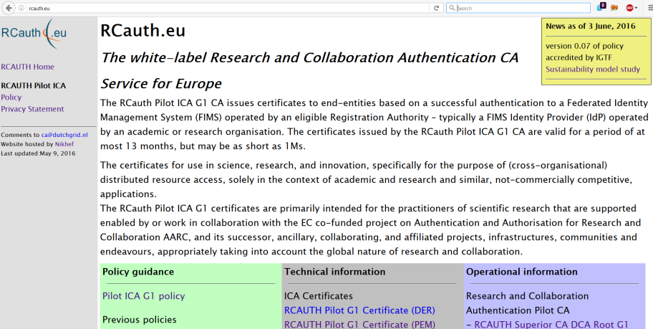
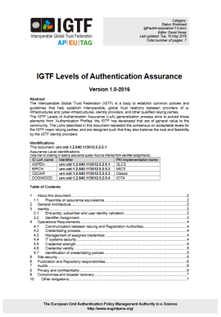



RCauth.eu – supporting the CILogon Token Translation Pilot
Head side of the coin
Entity categories to identify qualifying IdPs, so that the collaborative services can trust what comes out of the federated Identity Providers
Privacy Policy, Data
Protection, CP/CPS
REFEDS R&S ‘section 6’ –
non-reassigned identifiers for users
meets IGTF ‘Identifier Trust Assurance’ requirements profile
Sirtfi incident response –
traceability for users at time of issuance
SP-based heuristic resolution
of Federated IdP inconsistencies
* pending foreseen revision of applicable EGI policy – planned for early EGI PY2 (Q3 2016)

Slide 20
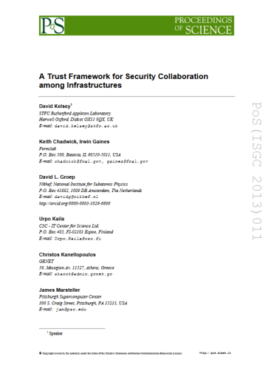
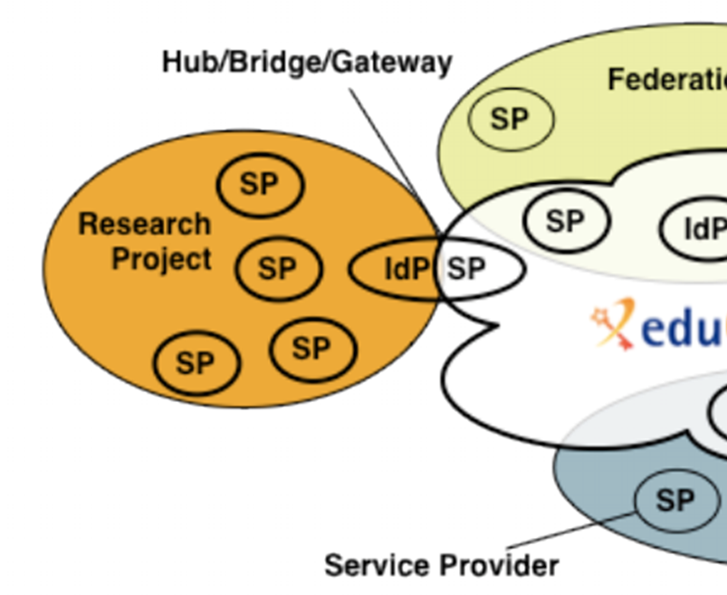
PY2: Developing scalable policy models in light of the Blueprint
✓
allow proxy operators to assert CoCo and R&S based on known SP properties
✓
Develop framework recommendations for RIs for coherent policy sets
evaluate with the SP-IdP-Proxies in pilots,
based on the Blueprint (DNA3.4)
Collaborate in WISE & FIM4R
to gain global endorsement
Tail side of the coin
Policy frameworks for collective service providers, so they can – via Entity Categories – convince IdPs of their joint compliance
Graphics inset: Ann Harding, SWITCH

Slide 21
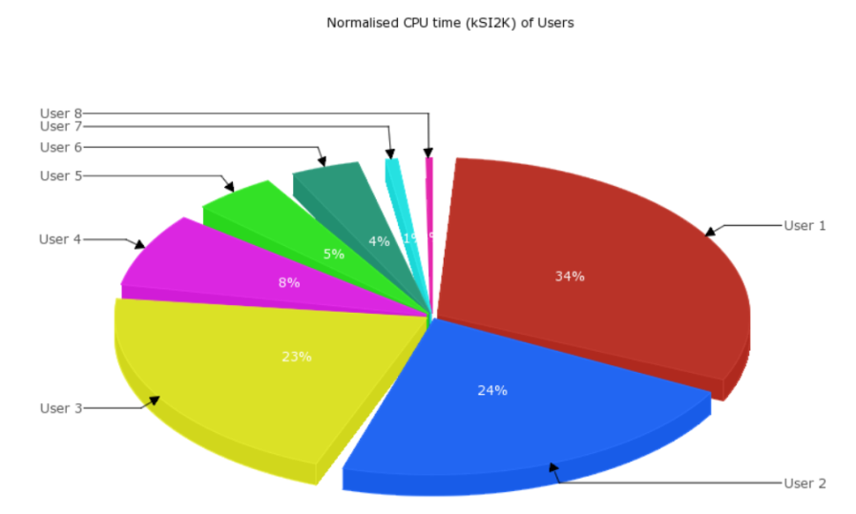
Policy and Best Practices Harmonisation
Task 5
Accounting and the processing of data

Slide 22
Scope of the AARC Accounting and Processing of Data task
Protection of personal data in research data
User attribute release by federated organisations
Personal data processing in accounting & collaboration
patient records
survey data collation
big data analytics
research data combination
Research Infrastructures
Institutional
Ethical Committees
ESFRI Cluster Projects
institutional IdP attributes
GEANT DP CoCo*
minimal release in eduGAIN
REFEDS
Research & Scholarship
REFEDS, GEANT4
community management
Joint RIs, EIs and AARC work
collection of usage data
in RIs and e-Infrastructures
correlating resource usage
to people and groups
collate usage data across countries and continents
personal data used for incident response
AARC “TNA3.5” – this task
* GEANT Data Protection Code of Conduct – see
http://geant3plus.archive.geant.net//uri/dataprotection-code-of-conduct/v1/Pages/default.aspx

Slide 23
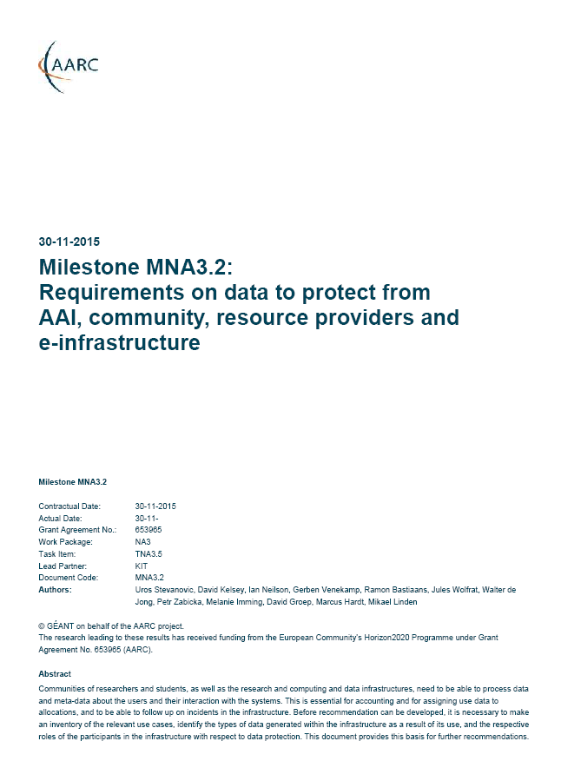
What data needs to be protected, and who has a role in it?
Survey of distinct cross-national infrastructure use-cases: EGI, PRACE, and DARIAH
Data collection necessary for ‘legitimate interests’
Accounting and justification of global resource use:
personal data (name, unique ID, roles, attributes, rights, …)
kept for up to 18 months after use because of yearly reporting cycle
Operational purposes: fault finding, researcher support
Incident response and security operations
MNA3.2 drafted under challenging conditions
at delivery in November 2015 the GDPR was still an (advanced) draft
full implementation of the GDPR will outlive the AARC project
different organisational awareness of EU-US data transfers
… even if Safe Harbour never worked for research anyway …

Slide 24
Identified needs and structure – now towards PY2 recommendations
Global view needed for accounting data
Policy coherency as enabler – model policies
Security Incident Response – data exchange
exchange of personal data is imperative – both for EIs and Research Collaboration funding
put in place policies on retention, permissible use, secure exchange, purpose limitation
add as permissible purpose, but leave its scope to Sirtfi and existing forums
‘binding’ - in the sense that a party can only remain in the club if it’s compliant
policy suite identified by Security for Collaborating Infrastructures (SCI) group
roles are defined to limit access to personally identifiable data
PY2 plans
Recommendations for RIs, EIs & proxies based on developing coherent and binding policy set: in open, transparent, yet creative way interpret principles of Binding Corporate Rules

Slide 25
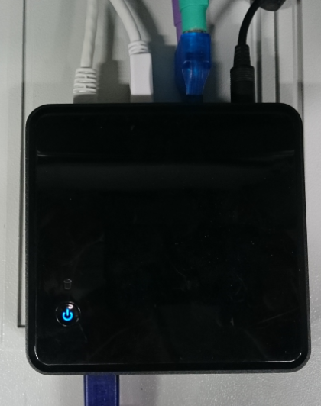
Policy and Best Practices Harmonisation
Integrated approach – an example:
RCauth.eu Token Service and the ‘European CILogon’

Slide 26

CILogon-for-Europe TTS in PY1: ‘of the Pilot, the Blueprint, and the Policy’
JRA1 - Blueprint Architecture
Task 4 – scalable policy
Demonstrates the use of credential translation to connect infrastructures
Task 3 – sustainability
Use of ECs in IdP-SP-proxy to bridge policy domains
Global Collaboration
Sustainability model study
to enable EGI, ELIXIR, etc, to decide business model
Joint work+coordination
with CTSC and CILogon
Operational guarantee for RCauth.eu
by Dutch National e-Infrastructure (SURF) at Nikhef as long as needed
What Makes the
CILogon - for - Europe an Integrated Pilot?
Task 4 – scalable policy
Accreditation to the IGTF pilots sufficiency of Sirtfi and R&S entity categories
Task 2 – Incident Response
Task 1 – assurance levels
Reference implementation of traceable non-reassigned identifiers using R&S + Sirtfi
SA1 - Pilots with communities
Implements the Baseline;
Introduces collaborative assurance basis for federated identity in EIs
Enabled the SA1 Pilot to demonstrate with ELIXIR on production EGI infra*
* pending foreseen revision of applicable EGI policy – planned for early EGI PY2 (Q3 2016)

Slide 27
Conclusions
Baseline Assurance Profile set and moved to REFEDS for implementation
Sirtfi v1.0 approved and already implemented by 87 IdPs in eduGAIN
Joint Sirtfi and Assurance self-assessment tool requirements set
Alignment of federation operations shows improvement
Sustainability model study for CILogon-for-Europe TTS picked up
by EGI, ELIXIR and others to adopt the service for production use
RCauth.eu – backend to CILogon – accredited for use in RIs and EIs
Accounting data exchange found viable route option by
binding to “BCR-like” infrastructure policy sets
But now for an exciting second year … with … You!

Slide 28
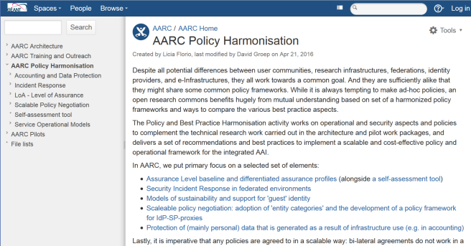
https://aarc-project.eu/workpackages/policy-harmonisation/
https://wiki.geant.org/display/AARC/AARC+Policy+Harmonisation
Thanks to all P&BP collaborators
from CSC, CERN, DAASI, RAL/STFC,
KIT, GRNET, DFN, Renater,
SURFsara, LIBER, and Nikhef,
and to Jim Basney of
NCSA, CTSC and CILogon
davidg@nikhef.nl

