Slide 1
WP3: Policy and Best Practice Harmonisation
addressing the research communities’ requirements
David Groep
NA3 Activity Coordinator
Nikhef
AARC EC Review
27-28 June, 2017
Brussels
version 20170517-03 DRAFT DO NOT USE FOR REAL PURPOSES

Slide 2
Agenda
Structure and administrative matters
  Team – tasks, task leaders, and partners
  Resources – budget and effort utilisation
Objectives
Achievements
  Differentiating Assurance Profiles for Research with Distinct Risk Levels
  Trusted Security Incident Response for Federations
  Sustainable Services: Models and Mechanisms
  Enabling Infrastructures to Collaborate by Permitting Sharing of User Data
  Building Agreements on Policy in a Scalable Fashion
Conclusions

Slide 3















Activity Structure
  T1
  T2
  T3
  T4
  T5
Activity Lead
Assurance Profiles
Incident Response Trust
Service Models & Sustainability
Scalable Policy Mechanisms
Accounting and Data Processing
  David Groep
  Nikhef (FOM)
  Mikael Linden
  CSC
  Hannah Short
  CERN
  Peter Gietz
  DAASI GmbH
  David Kelsey
  STFC-RAL
  Uros Stevanovic
  KIT
Partners

Slide 4
Policy and best practice activity high-level objectives
✓
Provide an assurance profile (LoA) framework meeting the requirements of the resource providers (RIs and EIs) that is feasible to achieve by the identity providers in eduGAIN
✓
Identify a (distributed) approach to handling security incidents in a federated environment
✓
Investigate terms of for delivering services – recommendations and sustainability models
✓
Specify scalable policy negotiation mechanisms between identity providers,
attribute providers and service providers to facilitate access to resource providers
✓
Develop guidelines to facilitate the exchange of accounting and usage data **
** as defined in the work plan section 3.1 – was accidentally not reiterated in the NA3 WP objectives table

Slide 5
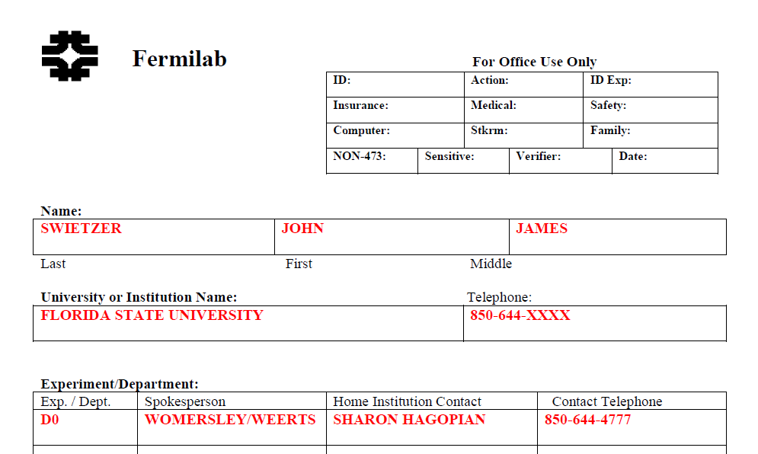
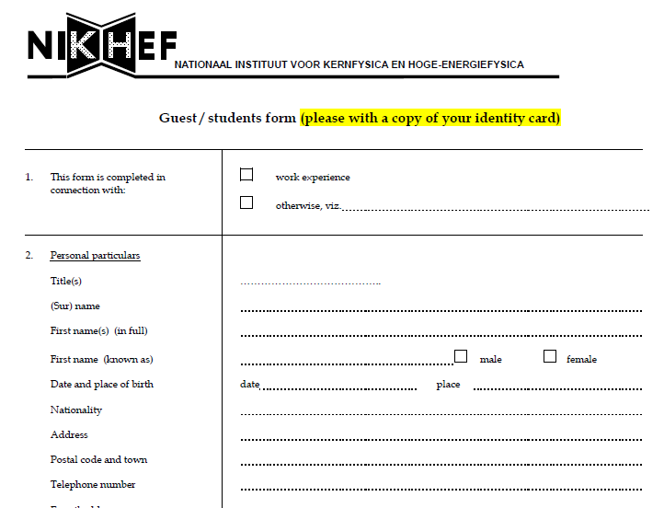
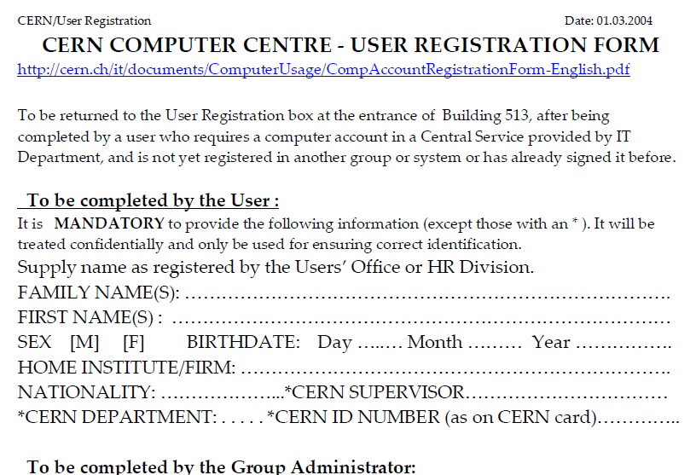
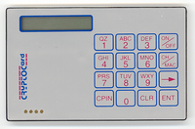
Policy and Best Practices Harmonisation
Task 1
Development of best practices for Levels of Assurance

Slide 6
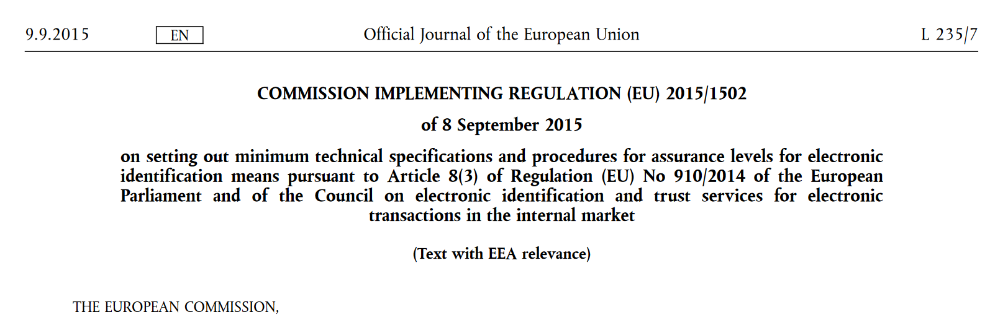
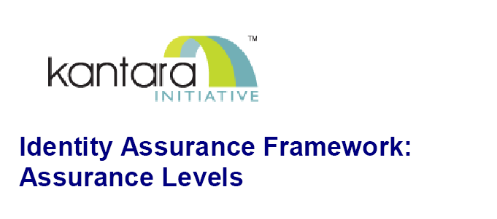
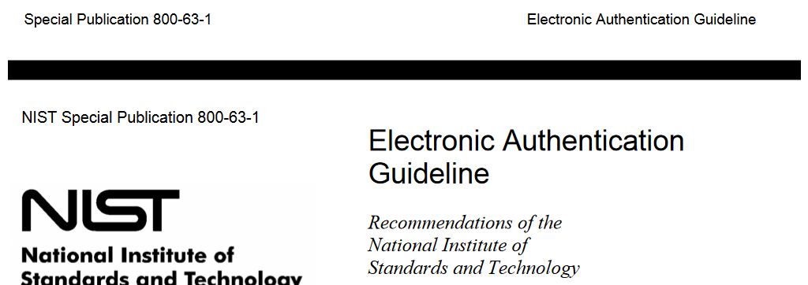
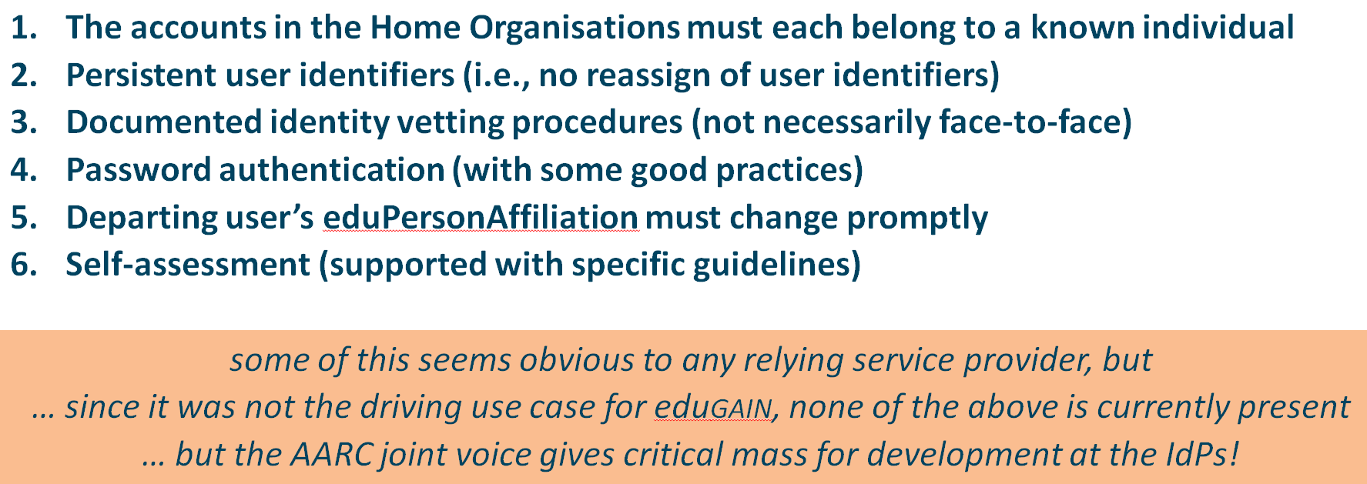
Assurance Profiles and ‘differentiated’ levels of assurance
Many layered models (3-4 layers)
but: specific levels don’t match needs
of Research- and e-Infrastructures:
Specific combination
‘authenticator’ and ‘vetting’ assurance
doesn’t match research risk profiles
Disregards existing trust model
between federated R&E organisations
Cannot accommodate
distributed responsibilities
As a result, in R&E there was
in practice hardly any documented
and agreed assurance level
Last year:
baseline assurance for research use cases

Slide 7



Differentiated assurance from an Infrastructure viewpoint
‘low-risk’ use cases
few unalienable expectations by research and collaborative services
generic
e-Infrastructure services
access to common compute and data services that do not hold sensitive personal data
protection of sensitive
resources
access to data of real people, where positive ID of researchers and 2-factor authentication is needed
Baseline Assurance
known individual
Persistent identifiers
Documented vetting
Password authenticator
Fresh status attribute
Self-assessment
Slice includes:
assumed ID vetting
‘Kantara LoA2’, ‘eIDAS low’, or ‘IGTF BIRCH’
Good entropy passwords
Affiliation freshness
better than 1 month
Slice includes:
Verified ID vetting
‘eIDAS substantial’, ‘Kantara LoA3’
Multi-factor authenticator

Slide 8
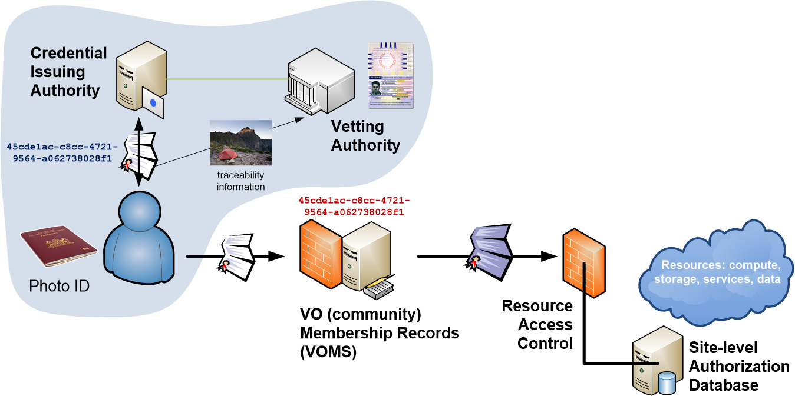
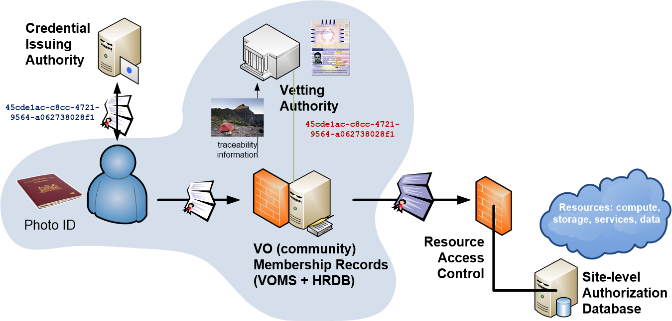
An example from EGI: beyond a single baseline with differentiated assurance?
e-Infra
example
managed identity information
real names, unique identifier
user-level traceability through the IdP
managed credential expiration or revocation
IGTF ‘Birch’ traditional assurance from IdP
Limited vetting requirements on community
unique identifier based on some process
not necessarily face-to-face
credential expiration set at issuance only
IGTF ‘Dogwood’ identifier-only assurance from IdP
Traceability requirements added on community
  https://documents.egi.eu/document/2930

Slide 9
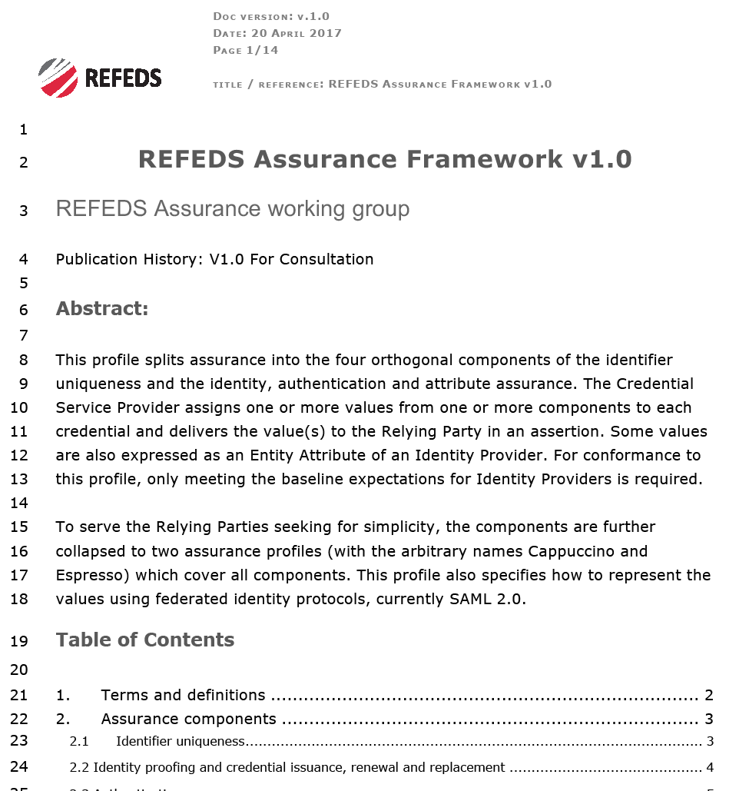
Gaining global adoption: REFEDS Assurance Framework
Why a REFEDS process?
open forum – AARC does not have all stakeholders inside
international forum – a Europe-only approach not helpful
link to identity federations –
adoption needs IdP to act and federations to communicate
re-enforces complementary work – on the REFEDS MFA profile
Expression and technical adoption
leads to new eduGAIN metadata and new attributes for IdPs
Definite implementation guidance in normative form helps
Facilitate evaluation and peer review by kick-starting a self-assessment tool

Slide 10
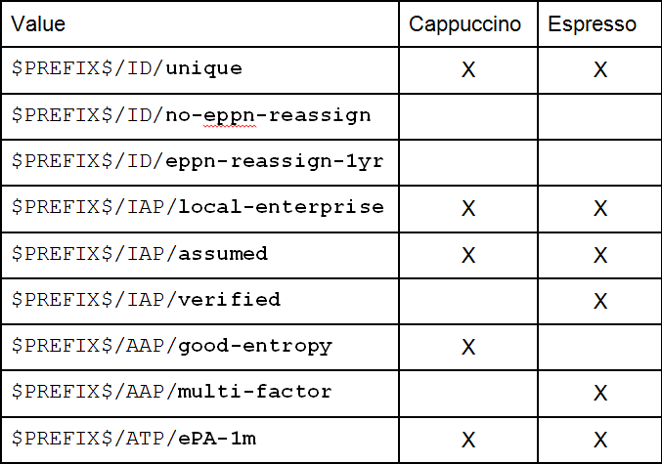
Differentiated Assurance Profile – in eduGAIN, REFEDS, and beyond
Specific definitive guidance to IdPs and federations
Logical grouping and profiles for the Infrastructures
Uniqueness at least ePUID or ePTID/NameID
ID proofing: ‘local enterprise’, ‘assumed’ (Kantara LoA2, IGTF BIRCH, eIDAS low), or ‘verified (LoA3, eIDAS substantial)
Authenticator: follow REFEDS MFA
‘good-entropy’ or ‘multi-factor’
Freshness: better than 1 month
Any and all assurance profiles
organisational-level authority, also used locally for ‘real work’, good security practices
… and simplicity for all – mandatory expression of profiles
https://wiki.refeds.org/display/CON/Consultation%3A+REFEDS+Assurance+Framework

Slide 11
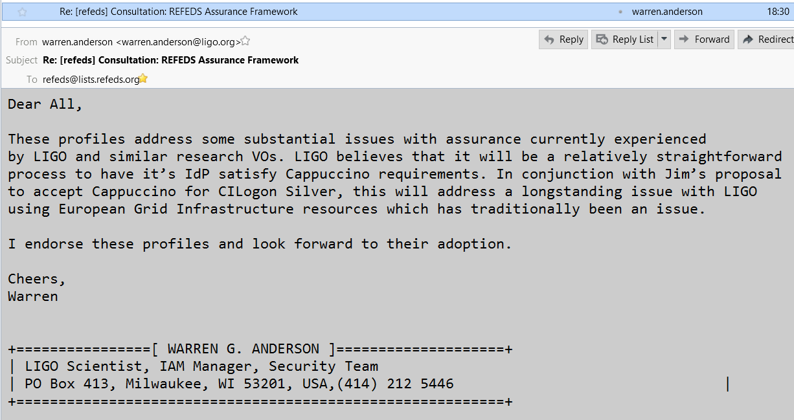
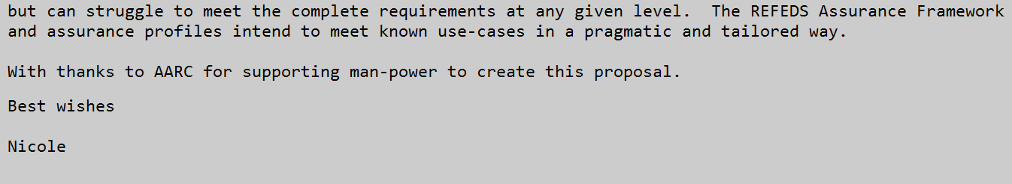
Assurance with global impact
– LIGO Gravitational Waves Observatory response (REFEDS list, May 16th)

Slide 12
Main achievements in assurance profile development
Infrastructure interviews and FIM4R analysis | ➔ | Baseline assurance requirements aligned with REFEDS R&S + Sirtfi
Analysis of assurance mechanisms IETF VoT and SP800-63v3 – balanced to relying party needs | ➔ | Proposed Assurance Profiles, not levels, aligned with community needs
IdPs and federations need specific implementation guidance | ➔ | Decomposition of assurance in 4 independently assessable components
Relying parties need actionable assertions | ➔ | Profiles linked to concrete cases: baseline (IGTF identifier-only), ‘cappuccino’ (e-Infrastructures, IGTF Birch), and ‘espresso’ (biological, medical use cases)

Slide 13
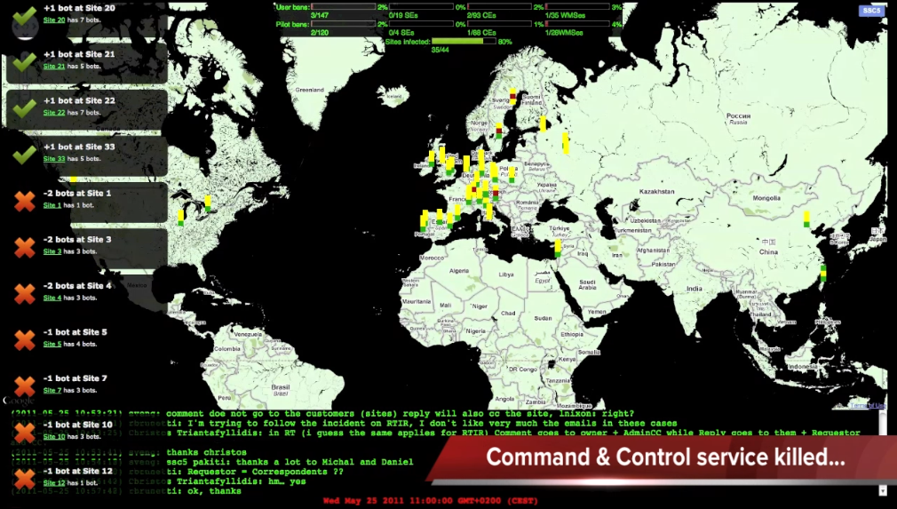
Policy and Best Practices Harmonisation
Task 2
Security Incident Response

Slide 14
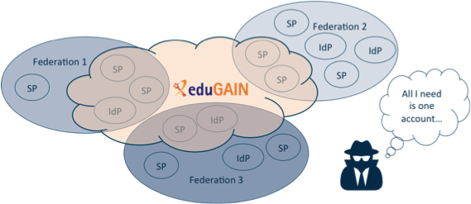
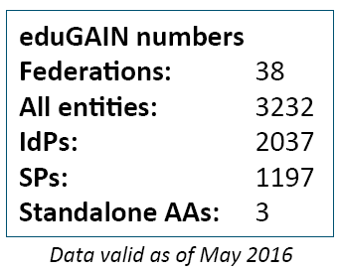
Security Incident Response in the Federated World
How could we determine the scale of the incident?
  Do useful logs exist?
  Could logs be shared?
Who should take responsibility for resolving
the incident?
How could we alert the identity providers
and service providers involved?
Could we ensure that information is shared confidentially, and reputations protected?
Security Incident Response Trust Framework for Federated Identity
Sirtfi – based on Security for Collaborating Infrastructures (SCI) & FIM4R Recommendations

Slide 15
A Security Incident Response Trust Framework – Sirtfi summary
Operational Security
Incident Response
Traceability
Require that a security incident response capability exists with sufficient authority
to mitigate, contain the spread of, and remediate the effects of an incident.
Assure confidentiality of information exchanged
Identify trusted contacts
Guarantee a response during collaboration
Participant Responsibilities
Improve the usefulness of logs
Ensure logs are kept in accordance with policy
Confirm that end users are aware of an appropriate AUP

Slide 16
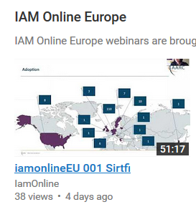
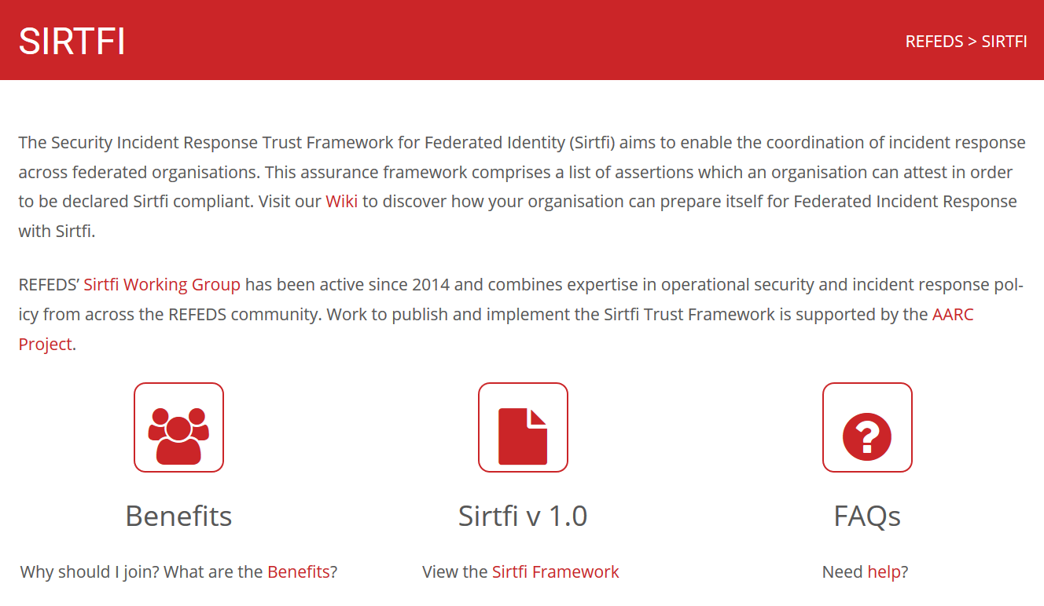
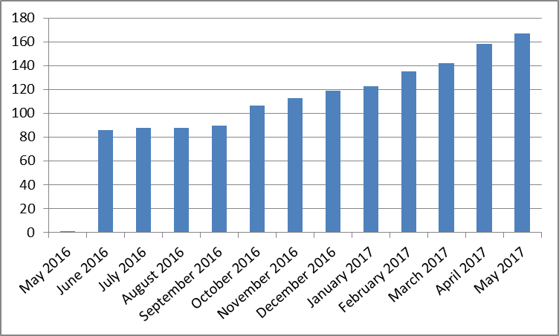
Sirtfi adoption in eduGAIN
https://refeds.org/SIRTFI
Promotional activities successful
REFEDS, Internet2 TechX, ISGC Taipei, TNC,
TF-CSIRT, FIM4R, Kantara webinars, …
Used in CyberOps role play exercises
167 entities
bulk
model
Adds security contact meta-data in eduGAIN
namespace for Sirtfi Assurance at IANA
with R&S specification:
meets baseline assurance requirements
and IGTF “assured identifier trust”
Compare: 376 REFEDS R&S after 3+ yrs

Slide 17
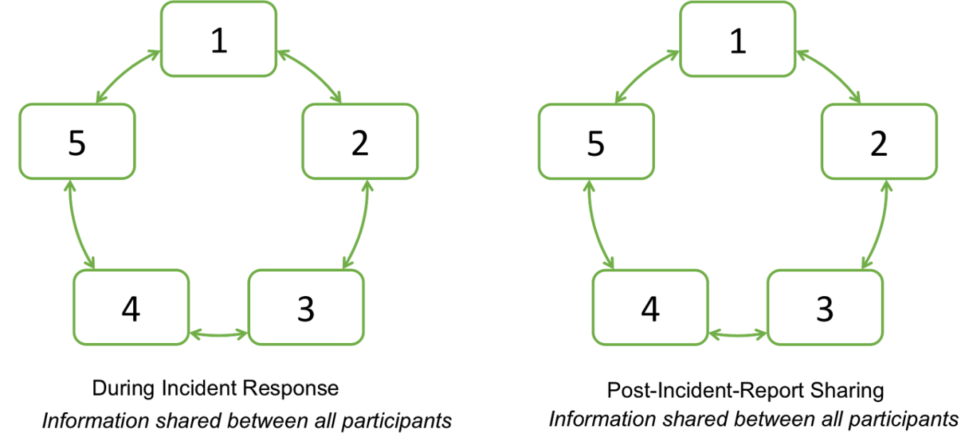
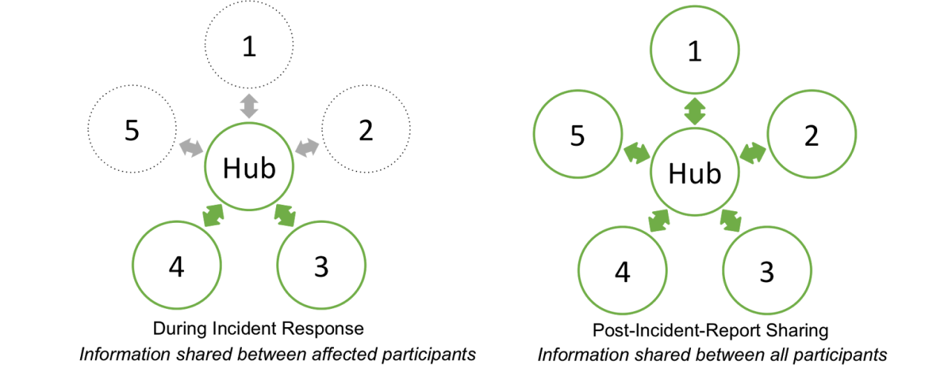
Beyond Sirtfi: streamlining the response process
trust relationships: allow information to flow rapidly to all that need to know
Infrastructure sharing model: PRACE, XSEDE, …
Infrastructure sharing model: EGI, WLCG, …

Slide 18
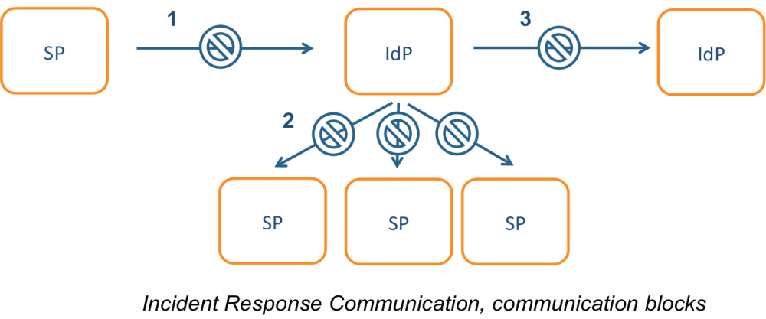
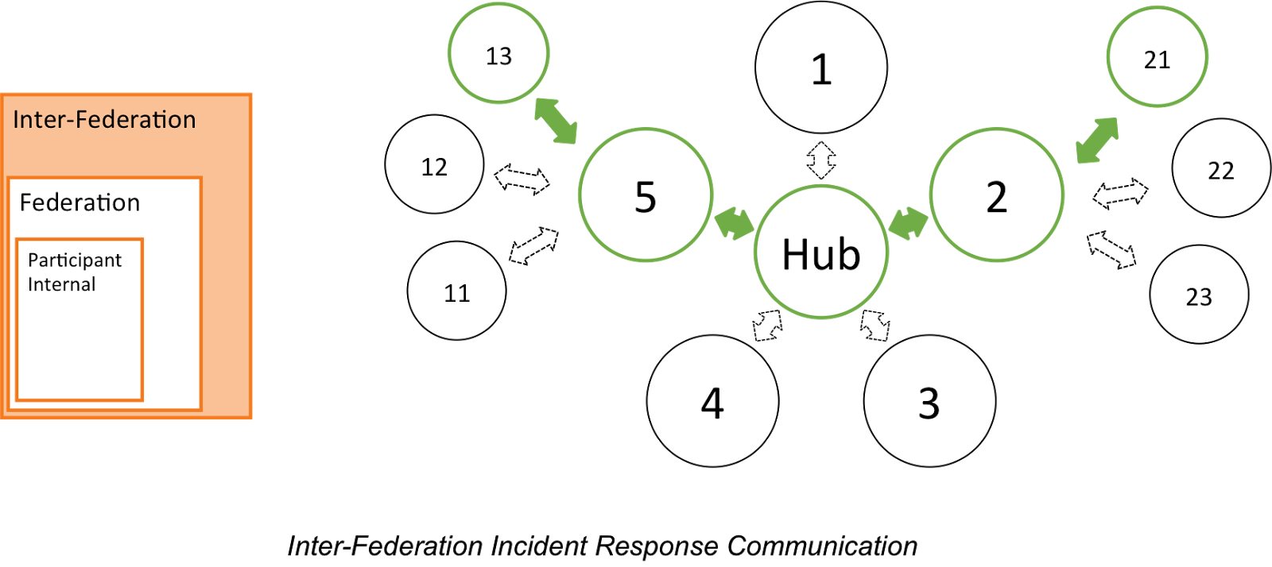
Incident response process evolution in federations
Proposed solutions
Stronger role for federation operators, as
they are known to both SPs and IdPs
Add hub capability centrally (@ eduGAIN)
Challenges
IdP appears outside the service’
security mandate
Lack of contact, or lack of trust
in IdP which is an unknown party
IdP fails to inform other affected
SPs, for fear of leaking data or reputation
No established channels of communication

Slide 19
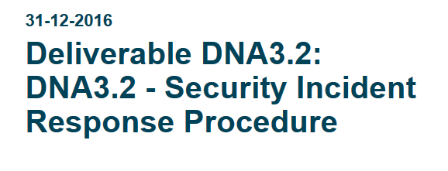
Addressing Security Incidents – a Joint Effort
Each federation should
provide a federation security contact point which is well-known
appoint a Security Coordinator when notified about a potential incident and help out
The eduGAIN inter-federation should
coordinate the incident response process and communications until it is resolved
produce and share a report of the incident with all Sirtfi-compliant organisations
Template procedure – in DNA3.2:
Closely co-developed with GEANT “The Project” and eduGAIN
the new eduGAIN support desk will take on the coordination role and act as last resort
✓
Infrastructures
Appear as a single SP towards the federations (its SP-IdP Proxy)
Leverage existing global trust relationships and detection capabilities and intelligence
Now also interact with their federation partners

Slide 20
Main achievements in federated incident response
Sirtfi defined and achieved global consensus | ➔ | Federation participants can identify trustworthy peers and self-assert compliance
Entity category defined in REFEDS | ➔ | eduGAIN now carries contact data alongside R&S used in scalable access control
Multiple deployment models: both per-entity and per federation | ➔ | > 167 IdPs in eduGAIN are Sirtfi’d today
Incident response procedure agreed | ➔ | Prevent spreading of incidents and increase confidence within R&E federation
eduGAIN support pilot takes on security coordination | ➔ | Information sharing between affected parties improved, reducing misunderstanding

Slide 21
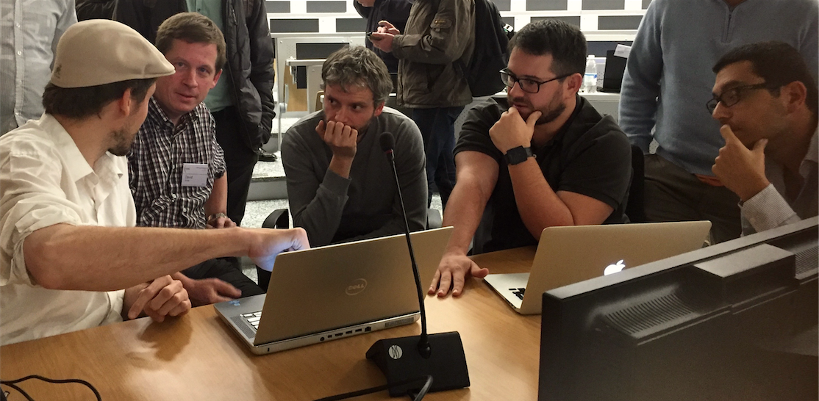
Policy and Best Practices Harmonisation
Task 3
Recommendation for sustainable services and models

Slide 22
Recommendations for
Research and e-Infrastructures to Build Sustainable Services
‘Investigate terms of (AAI) usage for delivering services’
˃
Making services sustainable – beyond funding cycles and across domains
Guidelines, templates, and how to apply them to the AARC pilots
˃
Mitigating heterogeneity in Infrastructure and Federation policies and practices
Recommendations for future federation development in line with FIM4R
˃
Identity providers ‘of last resort’, by the Infrastructure or the community
Strategies and risks in staring a guest identity provider

Slide 23
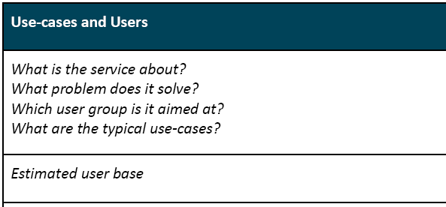
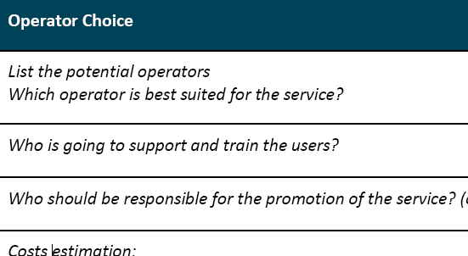
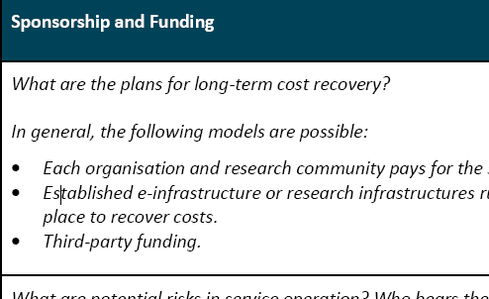
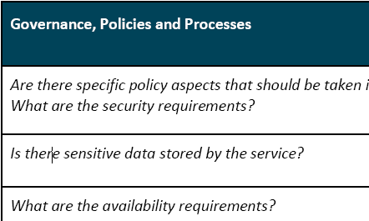
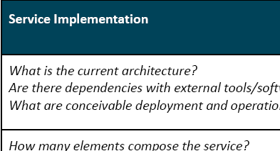
Promoting sustainability through recommended templates
Common analysis
Initial focus usually on ‘use cases’ and ‘service implementation’
this misses the long-term sustainability
Only few pilots have yet addressed full set
Template approach encourages focus ☺
AARC SA1 Pilots with a sustainability plan
RCauth.eu*
DARIAH Guest IdP
Social IDs to SAML
WaTTS

Slide 24








Example: planned RCauth.eu management model
From
AAI-TCB
shared governance through a
Policy Management Authority
non-discriminatory policy and practices
joint PMA authoritative
for policy and operations
Stakeholders
EGI, EUDAT, SURF,
GÉANT, ELIXIR, …
in-kind or explicit contributions
of services, kit, and operators
trust by any and all
global relying parties
Infrastructure-specific Master Portals
and Credential Repository
user contact service by
specific stakeholder

Slide 25
Planned RCauth.eu: operator distribution and support plans
From
AAI-TCB
Beyond just the ‘Nikhef Best Effort™’ service
what is ‘the service’ in this context: Delegation Service & WAYF
can be anywhere between a few kEur to well over 100+kEur cost per year …
Recuperation model
Credential Management services from other (non-RCauth) sources, per-Infrastructure
Delegation Service and RCauth.eu: free at point of use
funded via in-kind contributions by the major e-Infrastructures
distributed H/A setup, leveraging existing capabilities and some additional person effort
EOSC Hub Consortium picked middle ground
contribute effort and some hardware resources to the joint pan-European pool
help steer the development through joint, independent, management body (PMA)
partners with existing security operations expertise: GRNET, STFC, FZJ + SURF/Nikhef

Slide 26
Collect Recommendations in one place – for Infrastructures & Federations
For Research and generic e-Infrastructures
Following the AARC BluePrint and the intent of the FIM4R group – make it easier for users
Support GEANT DP CoCo when possible + R&S – ease the liability on IdPs to give you data
Joint Sirtfi – and help the R&E security stance
Apply homogeneous policy mapping frameworks inside your Infrastructure: ‘Snctfi’!
For Federations, REFEDS, and eduGAIN
Support an omnidirectional, non-reassigned ID for users that is standard everywhere
Don’t filter authentication to only services you know about: allow meta-data to flow
Support attribute release through R&S, and collaborate in Sirtfi
Help eduGAIN operate a support desk to help international research and collaboration
Recommendations go to REFEDS, eduGAIN – and the Infrastructures through FIM4R & IGTF

Slide 27
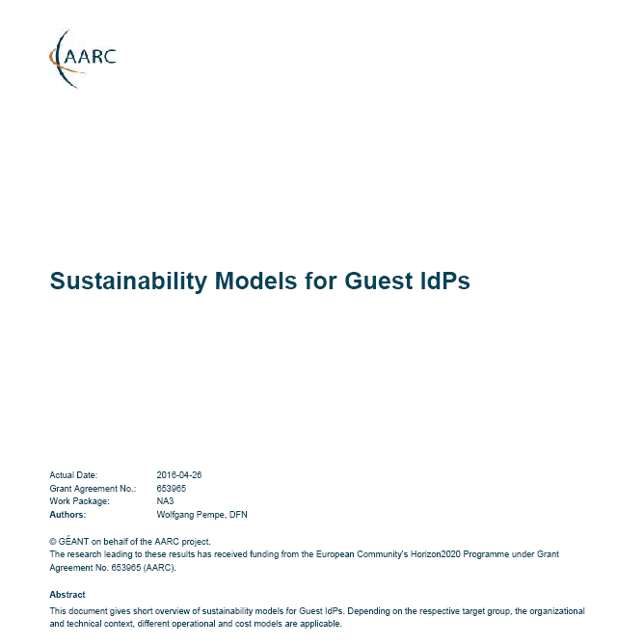
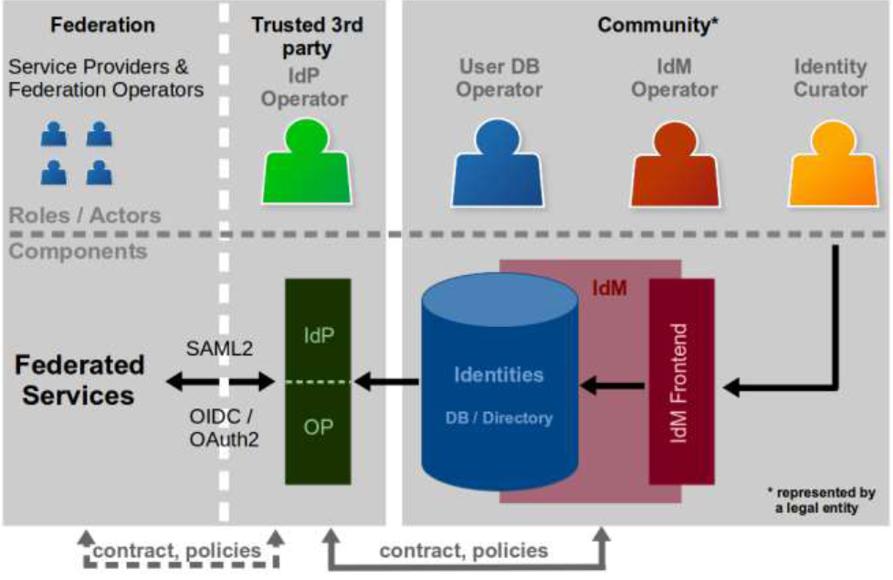
Models for ‘guest’ IdPs – serving users beyond academia
Guest IdPs are critical to almost all collaboration use cases
Collaboration does not end at the door of the university!
Model study: too often ‘guest’ IdPs have faded –
sustainable elements extracted:
Use established, long-lived, institutional partners
Ensure funding beyond projects
Framework needed for ‘non-trivial’ communities
As collaboration moves to meeting at least baseline assurance, cheap-and-cheerful guest IdPs will fail
https://wiki.geant.org/display/AARC/Sustainability+models+for+Guest+IdPs

Slide 28
Main achievements in sustainability development
Template for sustainability analysis | ➔ | Concrete future plans for SA1 pilot results
RCauth sustainability model | ➔ | Adoption as baseline service by major Research and e-Infrastructures
Recommendations for Infrastructures | ➔ | Better attribute release by federations and increased usability by researchers
Recommendations for federations | ➔ | Increased adoption of R&S and Sirtfi allows research SPs like CERN and EGI to join
Model study for guest IdPs | ➔ | Improve planning and expectations of ‘cheap-and-cheerful’ project-based IdPs

Slide 29
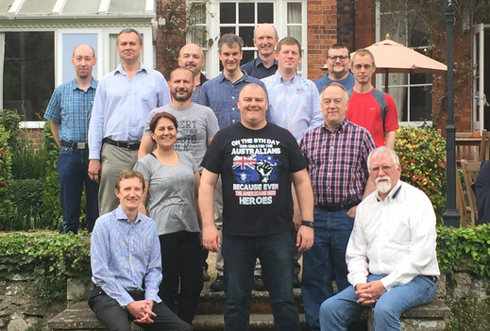
Policy and Best Practices Harmonisation
Task 4
Development of scalable policy negotiation mechanisms

Slide 30
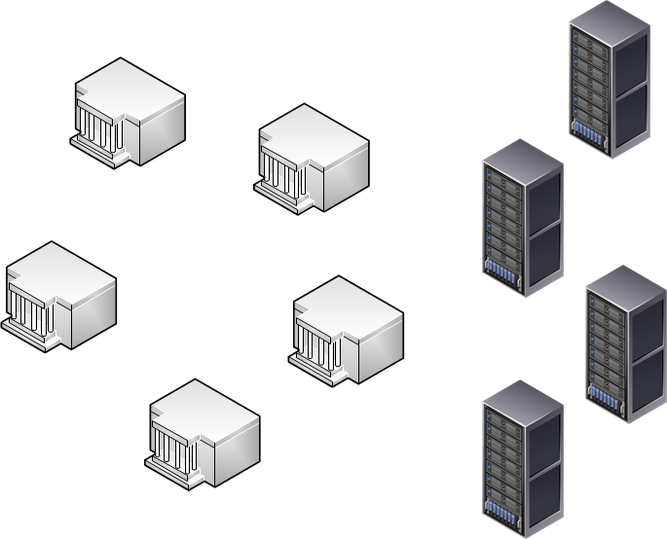
Getting agreements in a distributed world: scalable policy mechanisms
Group entities to ease agreements with federations
Collaborations by design have their services distributed
and
not that many collaborations are a legal entity
or are not ‘authoritative’ for constituent services
Aim: improve attribute release by IdPs & Federations
Entity Category mechanism: ‘R&S’, DP CoCo, Sirtfi, …
Define trust framework for Infrastructures – SPs-to-IdPs
Framework for Infrastructures to assess back-end SPs
Permit Gateway to assert entity categories with confidence
Readiness survey for services evaluated with HNSciCloud PCP
‘n x m’
IdP
Home
Institute
SP
Collaborative
Resource
or SIte
Develop policies models for SP-IdP Proxy – IdPs to SPs
Model for service providers that ‘hide’ complexity of all R&E
Through concrete (RCauth.eu) use case & with global review

Slide 31
Entity Category adoption – R&S and Sirtfi
eduGAIN ‘SAML’
Entity Categories Review
Entity Category
Experiment using Sirtfi
Continuous monitoring
adoption survey
granularity of categories
traditionally pushed by IdPs, with requirements on SPs,
but that is changing!
‘REFEDS R&S’, ‘DP CoCo’,
but also
‘CLARIN’, ‘SWAMID AL1’, …
Sirtfi compliance via ECs
self-assessment facilitates adoption – but does it show in eduGAIN publication?
GEANT and eduGAIN
technical.edugain.org
Unexpectedly rapid adoption:
Sirtfi: 167 entities / ~1 yr
R&S: 284 → 646 entities/1yr
Both grow together now!
Thus: time is ‘ripe’ for EC ☺

Slide 32
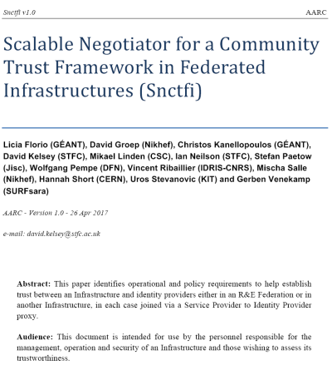
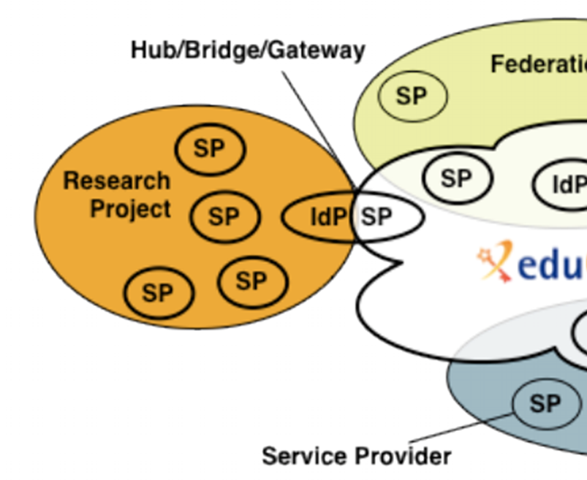
Snctfi: aiding Infrastructures achieve policy coherency
✓
allow SPIdP Proxies to assert ‘qualities’, categories, based on assessable trust
✓
Develop recommendations for an Infrastructure’s coherent policy set
Snctfi
Scalable Negotiator for a Community Trust Framework in Federated Infrastructures
Derived from SCI, the framework on Security for Collaboration among Infrastructures
Complements Sirtfi with requirements on internal consistent policy sets for Infrastructures
Aids Infrastructures to assert existing categories to IdPs
REFEDS R&S, Sirtfi, DPCoCo, …
Graphics inset: Ann Harding and Lukas Hammerle, GEANT and SWITCH

Slide 33
Snctfi infrastructure requirements, a summary
Operational Security
User Responsibilities
Protection and Processing of Personal Data
State common security requirements: AAI, security, incident and vulnerability handling
Awareness: users and communities need to know there are policies
Have a data protection policy that binds the infrastructure together, e.g. AARCs recommendations or DP CoCo
Ensure constituents comply: through MoUs, SLA, OLA, policies, or even contracts, &c
Have an AUP covering the usual
Community registration and membership should be managed
Have a way of identifying both individuals and communities
Define the common aims and purposes (that really helps for data protection …)
Make sure every ‘back-end’ provider has a visible and accessible Privacy Policy

Slide 34
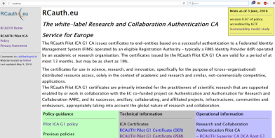
Model scalable policies for SP-IdP Proxies – the RCauth.eu example
How can a SP-IdP proxy leverage federation policies?
What are useful design criteria for a scalable service?
Focus on permitting individual access, engaging both federations and Infrastructures
Avoid an opt-in model, or a scheme where specific countries can opt-out or block access
Allow infrastructures explicitly to operate an IdP of last resort, and recognise its qualities
Meet your (target) infrastructure needs
For cross-infrastructure services, peer review and accreditation significantly helps adoption
Leverage entity categories and assurance profiles
Don’t ask IdPs to do something special just for your gateway
Be ready to deal with a complex, multi-national, and multi-federation reality
Incidental non-compliance needs to be mitigated in your service – use Sirtfi & eduGAIN support

Slide 35
Main achievements in scalable policy models
Status of Entity Category adoption in eduGAIN | ➔ | Identifying entities speeds adoption done very successfully for Sirtfi
Snctfi policy coherency for Infrastructures | ➔ | Document endorsed by infrastructure reps will be homed long-term by IGTF (or FIM4R)
RCauth.eu policy reference implementation | ➔ | Accredited gateway service with global reach enabling federated access to resources in EGI, OSG, XSEDE, ELIXIR, and others
HelixNebula Science Cloud recommendations | ➔ | Easy checklist to push to new (commercial) providers that we want to be federated

Slide 36
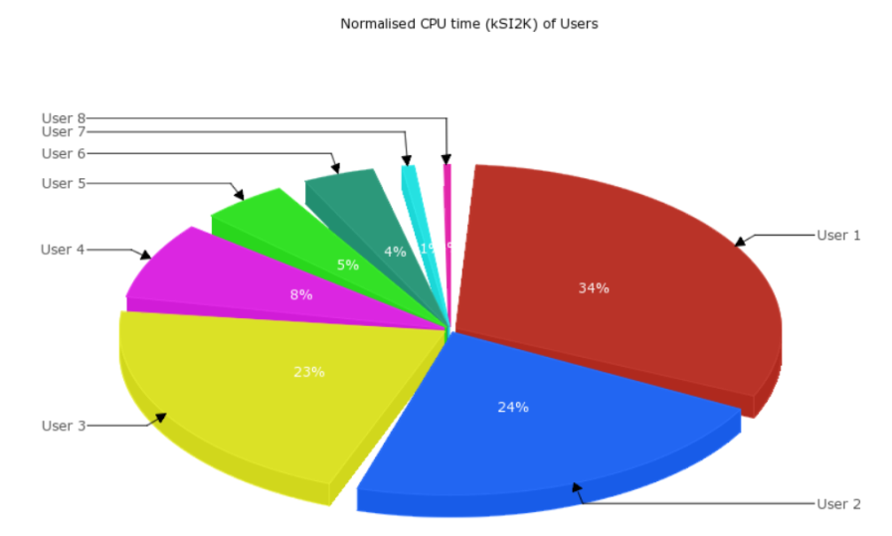
Policy and Best Practices Harmonisation
Task 5
Accounting and the processing of data

Slide 37
Scope of the AARC Accounting and Processing of Data task
Protection of personal data in research data
User attribute release by federated organisations
Personal data processing in accounting & collaboration
patient records
survey data collation
big data analytics
research data combination
Research Infrastructures
Institutional
Ethical Committees
ESFRI Cluster Projects
institutional IdP attributes
GEANT DP CoCo*
minimal release in eduGAIN
REFEDS
Research & Scholarship
REFEDS, GEANT4
community management
Joint RIs, EIs and AARC work
collection of usage data
in RIs and e-Infrastructures
correlating resource usage
to people and groups
collate usage data across countries and continents
personal data used for incident response
AARC “TNA3.5” – this task
* GEANT Data Protection Code of Conduct – see
http://geant3plus.archive.geant.net//uri/dataprotection-code-of-conduct/v1/Pages/default.aspx

Slide 38
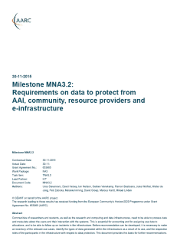
Identified needs and structure – MNA3.2 as basis for recommendations
Data collection necessary for ‘legitimate interests’ for Research and e-Infra
Justification of global resource use, with infrastructures collecting data collaboratively
Operational purposes: fault finding, researcher support, Incident response
Global view needed for accounting data
Policy coherency as enabler – model policies
Security Incident Response – data exchange
exchange of personal data is imperative – both for EIs and Research Collaboration funding
put in place policies on retention, permissible use, secure exchange, purpose limitation
add as permissible purpose, but leave its scope to Sirtfi and existing forums
‘binding’ - in the sense that a party can only remain in the club if it’s compliant
policy suite identified by Security for Collaborating Infrastructures (SCI) group
roles are defined to limit access to personally identifiable data

Slide 39
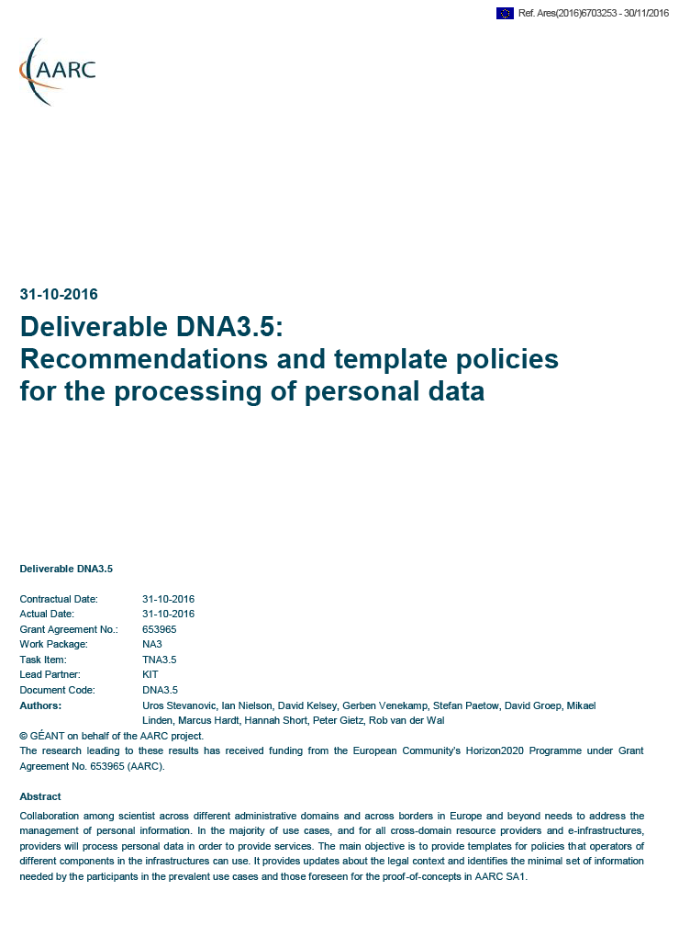
Three community models – three Recommendations?
GDPR-style Code of Conduct – a new way?
Model Clauses
BCR-inspired model (“Binding Corporate Rules”-like)
Global sharing in controlled communities appears attractive
Only works for tightly and ‘legal document’ controlled communities
Note that this is not formally BCR, so requires acceptance of some risk
Uncertainly about requirements (governing body) and
timing (> Mar 2018) are not helpful for adoption today … just yet
Ongoing work: text needs to allow for (community) attribute authorities
Puts legal and contract onus on the SP-IdP Proxy (as per our Blueprint)
Research and Collaboration lack both mechanism and time to do this
Collaborations (e.g. based around Snctfi) with control mechanisms benefit
“Say what you do, and do as you say” – transparency and openness
is our real benefit towards the person whose data is being handled

Slide 40
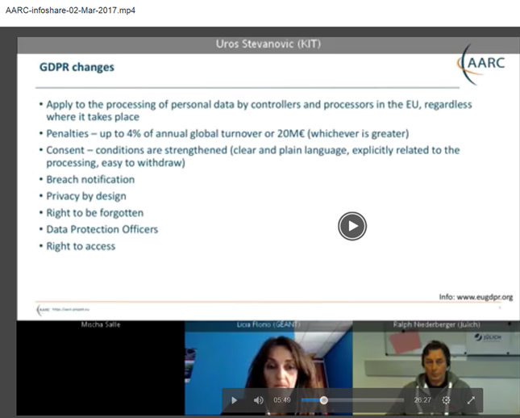
AARC InfoShare on data related to accounting, monitoring and logging
Talk and present the accounting data protection recommendations everywhere!
Especially since most researchers actually don’t care about this
(and frankly don’t understand the fuss we make about their personal data …)
Uros Stevanovic (KIT), March 2017
https://aarc-project.eu/aarc-infoshare/

Slide 41
Main achievements in infrastructure & accounting data protection
Survey of requirements for AAI data protection | ➔ | Infrastructures collect similar kinds of data, and do not need sensitive personal data for accounting: common guidance is realistic
 | ➔ | Global exchange of this data is essential
Review of GDPR changes | ➔ | Identified BCR-like model as basis for data processing in Infrastructures
 | ➔ | GDPR-style Codes of Conduct attractive, but uncertainty about need governing body
 | ➔ | No straightforward legal basis exists for scalable global research collaboration ☹

Slide 42
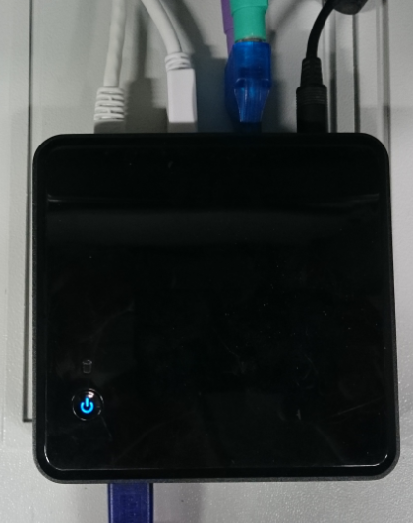
Policy and Best Practices Harmonisation
Pulling it all together

Slide 43
Our Achievements
Bridged need for specific guidance and actionable assurance with infrastructure-driven profiles
Developed via REFEDS to get global adoption and federation acceptance
Sirtfi approved and rapidly implemented: strong growth in eduGAIN with already 167 entities
Practical process for addressing global incidents, in close collaboration with eduGAIN Support
Concrete recommendations for Infrastructures and Federation to drive FIM4R and eduGAIN
Ensure the result will live: sustainability templates lead to successful long-lived services
Snctfi aids Infrastructures presenting coherent qualities towards federations with confidence
Accounting Data Protection recommendations help Infrastructures provide services jointly

Slide 44
Primary Open Challenges – for AARC2 and the Community
Snctfi is ‘just a framework’ – now apply it to interoperate
Policy baselines – beyond mapping to harmonisation
Security Incident Response
Provide best practices and give recommendations to infrastructures on how to address responsibilities, security, and trust mechanisms to enable interoperation
Extend the Assurance Baseline and differentiated Profiles to other areas: traceability and logging, differentiates views on accounting and user data, evolution of the GDPR,
Communities and research infrastructures hold the key to mitigating user-centric incidents: involve attribute authorities and involve SP-IdP Proxies in the mitigation process
‘Cross-silo’ trust between Research Infrastructures, and with generic e-Infrastructures
Create – through the AARC2 Competence Centre – a global consensus: IGTF, FIM4R, &c
Promote organisational & individual trust groups within the eduGAIN constituency: WISE, eduGAIN
Standards for sharing incident response notifications and reports
Encourage joint trust in acceptable use policies, attribute management, and identity assurance

Slide 45
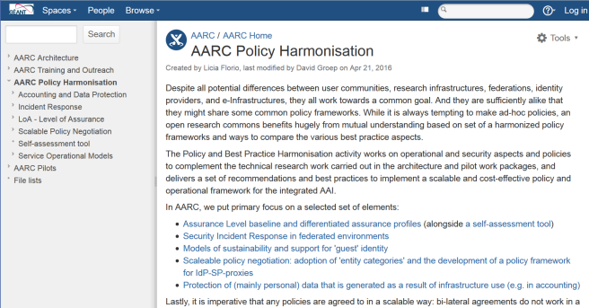
https://aarc-project.eu/workpackages/policy-harmonisation/
https://wiki.geant.org/display/AARC/AARC+Policy+Harmonisation
Thanks to all P&BP collaborators
from CSC, CERN, DAASI, RAL/STFC,
KIT, GRNET, DFN, Renater,
SURFsara, LIBER, and Nikhef,
and to Jim Basney of
NCSA, CTSC and CILogon
davidg@nikhef.nl

