Slide 1

Federated Incident Response
Authentication and Authorisation for Research and Collaboration
David Groep (borrowing heavily from Hannah Short, CERN)
Policy and Best Practice activity coordination
Nikhef
ISGC Security Workshop Taipei
Mach 31, 2019
Security Workshop 2019
co-supported by EOSC-HUB

Slide 2
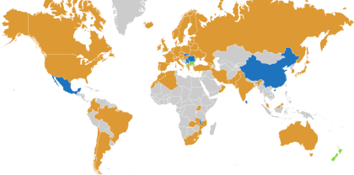
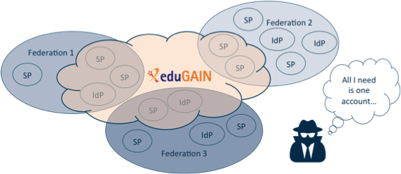













R&E federation and eduGAIN – what you may know already
eduGAIN – many countries & economic regions with an R&E identity federation
… yet incident response has to be global (since the miscreants certainly are ☹) …
full of valuable resources (data, network, services)
graphics sources: map technical.edugain.org; federation drawing: Hannah Short, CERN; Infrastructure logos: AARC Pilot use cases

Slide 3
But what appears trivial
SP
IdP
SP notices suspicious jobs executed by a handful of users from an IdP
Notifies IdP
IdP identifies over 1000 compromised identities
IdP identifies all SPs accessed
Notifies SPs
SP
SP
SP
graphics source: Hannah Short, CERN

Slide 4
… may not be so …
SP
Small IdP may not have capability to block users, or trace their usage
IdP
SP notices suspicious jobs executed by a handful of users from an IdP
Notifies IdP
X
IdP identifies over 1000 compromised identities
!
IdP identifies all SPs accessed
!
Large SP does not share details of compromise, for fear of damage to reputation
X
X
Notifies SPs
X
SPs are not bound to abide by confidentiality protocol and disclose sensitive information
SP
SP
No security contact details!
!
!
SP
graphics source: Hannah Short, CERN

Slide 5

A Security Incident Response Trust Framework – Sirtfi summary
Operational Security
Incident Response
Traceability
Require that a security incident response capability exists with sufficient authority
to mitigate, contain the spread of, and remediate the effects of an incident.
Assure confidentiality of information exchanged
Identify trusted contacts
Guarantee a response during collaboration
Participant Responsibilities
Improve the usefulness of logs
Ensure logs are kept in accordance with policy
Confirm that end users are aware of an appropriate AUP

Slide 6
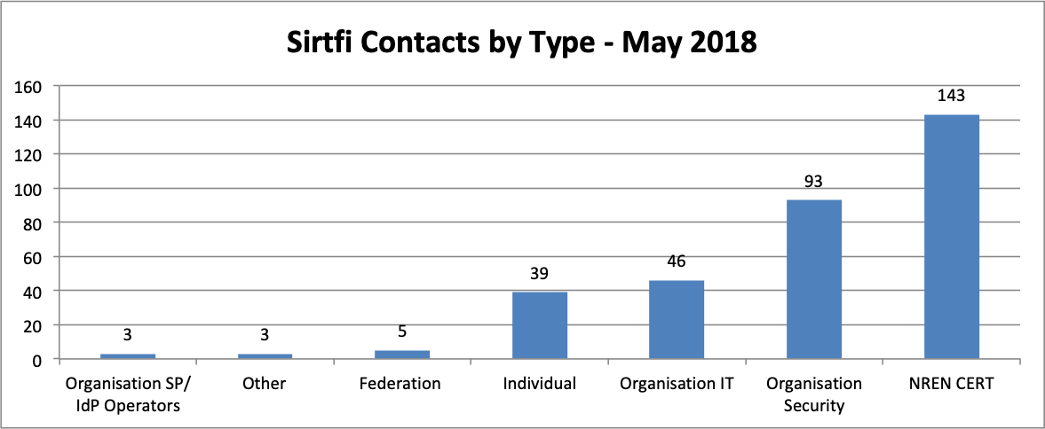
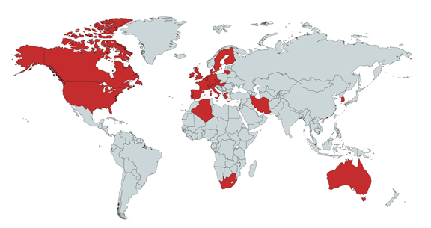
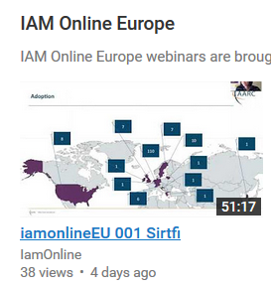
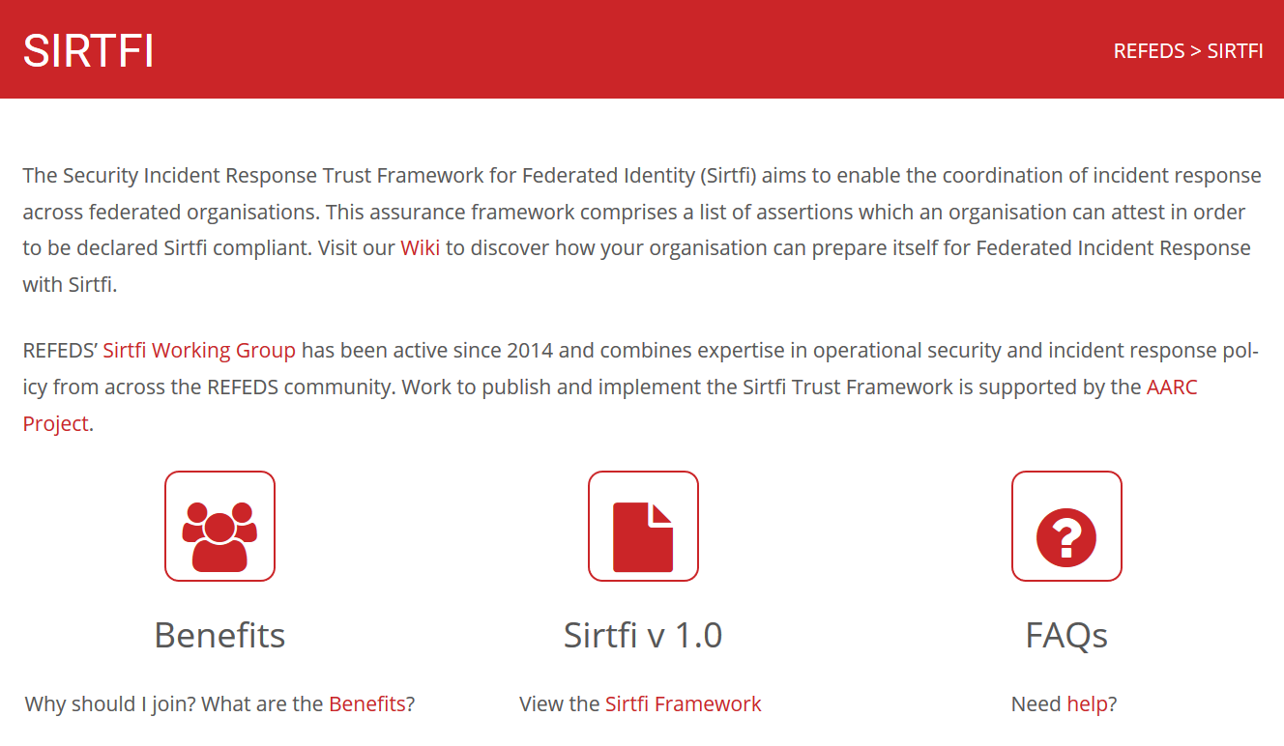
Sirtfi today
https://refeds.org/SIRTFI
countries with at least one Sirtfi entity
graphics source: AARC2 DNA3.2 Report on Incident Response in FIM; data: technical.edugain.org

Slide 7
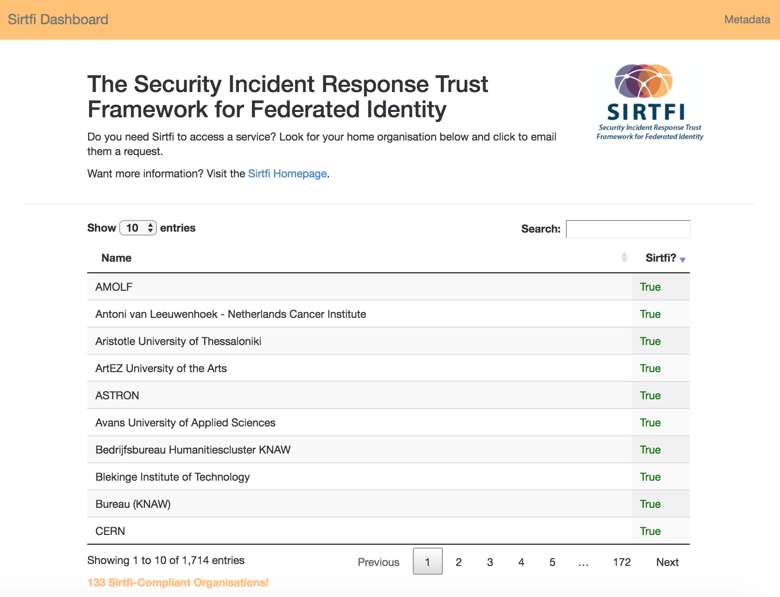
Want to check?
http://sirtfi.cern.ch/
graphics source: Hannah Short, CERN

Slide 8
Response: Prepare, Act, and Report
Before the incident
support and implement Sirtfi – see https://refeds.org/sirtfi
infrastructure (proxies) should adopt interoperable policies - http://wise-community.org/sci/
identity federations should adopt common incident response procedures
– through the new eduGAIN support function
leverage templated emails to ensure proper information sharing – AARC-I051
establish communications channels in advance
During an incident
follow the latest procedures – from your infrastructure, federation, eduGAIN, or (NREN) CERT
initial procedures available at https://aarc-project.eu/guidelines/aarc-i051/
https://wiki.geant.org/display/AARC/Operational+Security+and+Incident+Response

Slide 9
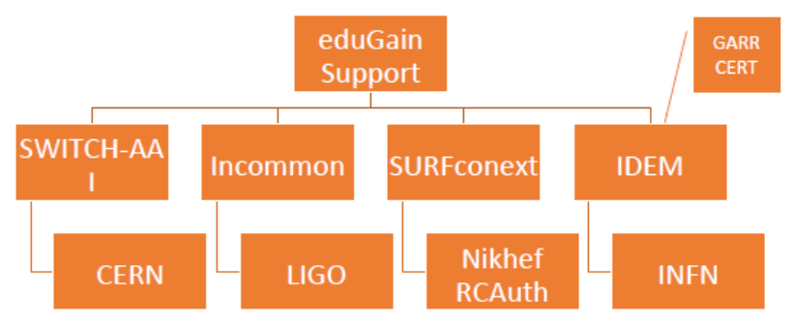
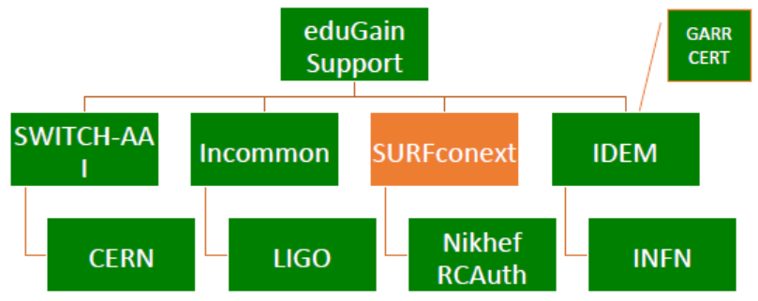
Exercising the processes with mock incidents
eduGAIN
Federation1
Federation2
Federation3
Federation4
IdP1
SP1
SP2
SP3
Identity1 from IdP1 accesses the 3 SPs
Informant notices malicious activity at SP1 and informs them
Exercise date | Report | URL
March 2018 | Incident Simulation #1 Report | https://aarc-project.eu/wp-content/uploads/2018/04/20180326-Incident-Simulation-Report.pdf
November 2018 | Incident Simulation #2 Report | https://aarc-project.eu/wp-content/uploads/2018/11/Incident-Response-Test-Model-for-Organisations-Simulation-2.pdf

Slide 10
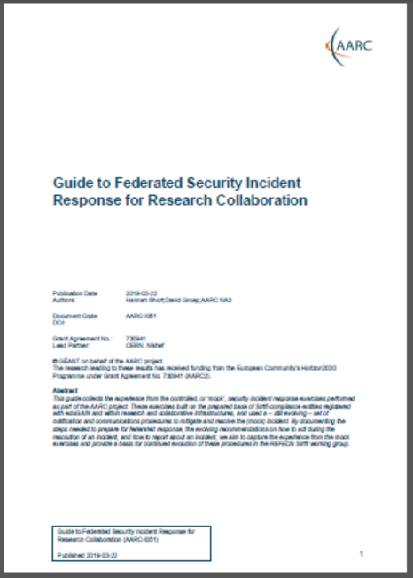
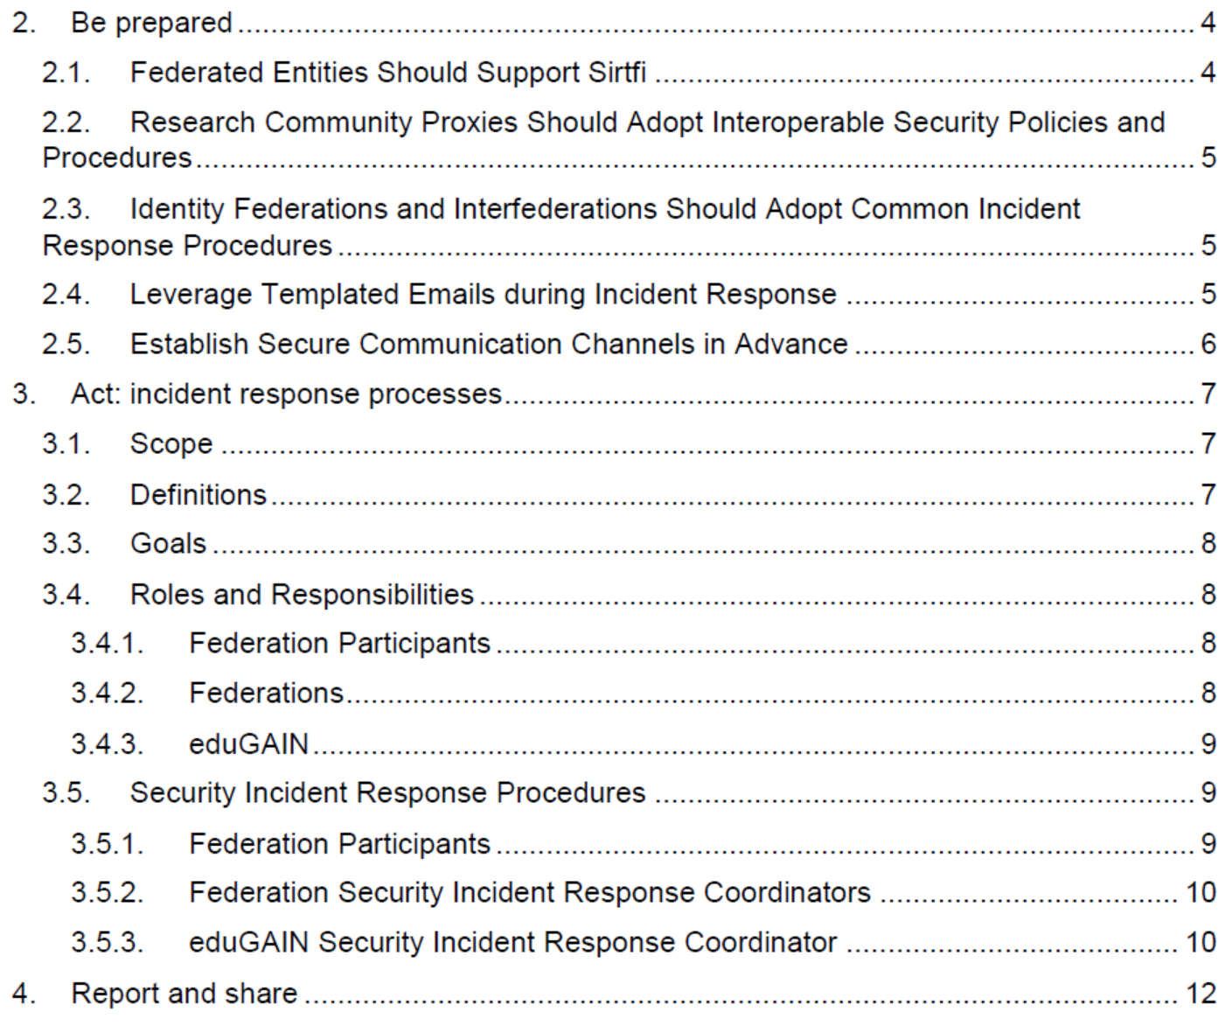
AARC-I051 – the current best practice (and evolution)

Slide 11
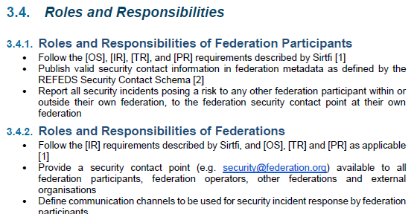
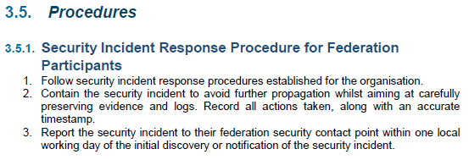
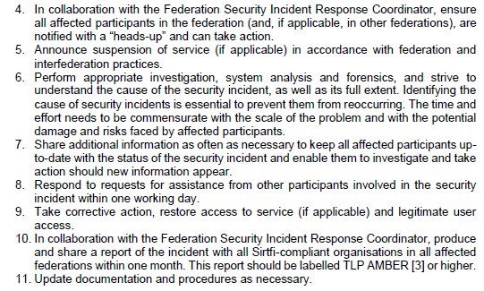
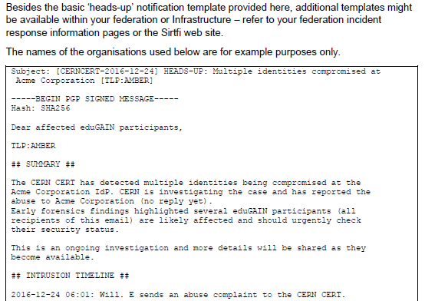
How to be effective during an incident?
AARC-I051 – https://aarc-project.eu/guidelines/aarc-i051/

Slide 12
Summary and what to do today (OK: and also tomorrow …)
Prepare
support and implement Sirtfi - https://refeds.org/sirtfi
adopt interoperable policies - http://wise-community.org/sci/
adopt common incident response procedures – AARC-I051
leverage templated emails for proper information sharing
establish communications channels in advance
and be plugged-in … share, with the support of your infrastructure CERT/CSIRT teams
Access to security contacts
Access to threat intelligence
Access to vulnerability reports
Access to expertise for advanced incident investigation,
e.g. forensics
Fostering of trust between members
Trusted Introducer
eduGAIN security
nren-CERT
EGI-CSIRT
REN-ISAC
FIRST

Slide 13

Planned progress on “SCC Coordination”
More exercises, coordinated via WISE
Improve available tooling
Promote sharing of trust resulting from exercises
davidg@nikhef.nl

Slide 14

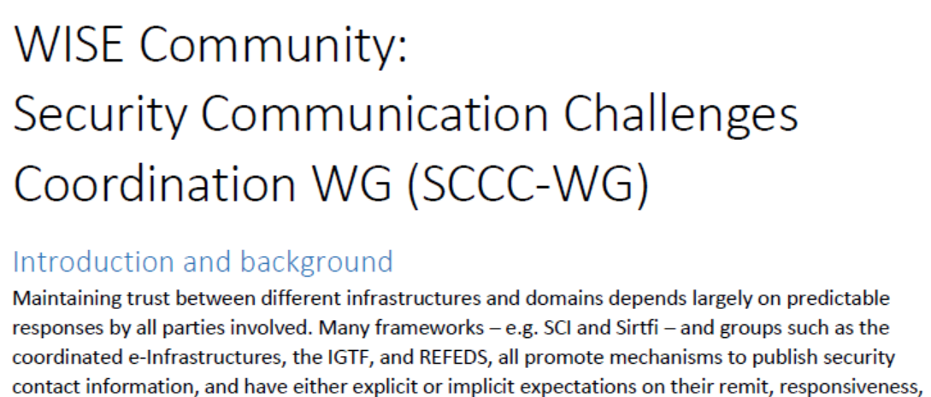
WISE SCCC WG
Shameless plug: WISE & SIGISM Kaunas meeting
https://wise-community.org/events/
https://eventr.geant.org/events/3044

