Slide 1
Trust framework for proxies and Snctfi research services
AARC-I082, AARC TREE D2.1
David Groep
Policy Area
Nikhef and Maastricht University
PMA+, AARC Policy, EnCo Joint Meeting Prague
May 2025

Slide 2
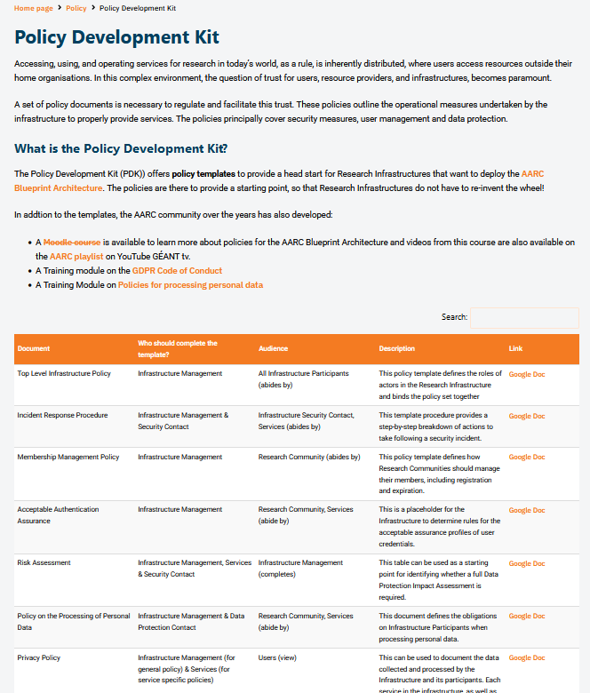
Developing the Trust framework, guidelines and best practice for BPA proxies and interaction with research services
minimise the number of divergent policies empower identity providers, service providers, user communities to rely on interoperable policies
From the old PDK to a new Policy, Process, and Procedure Development Kit (‘P3DK’)
Simplify!
comprehensive review of the existing policy suite
input from national research infrastructures and nodes
not only in Europe but e.g. also Australia
leverage the works we co-created with REFEDS and EOSC
https://aarc-community.org/policies/policy-development-kit/

Slide 3
Specific aims
Analyse issues with PDK v1
mixing policy and procedures
cross-border terminology issues
audience ‘challenges’
Leverage the possibility for ‘offloading’ AAI proxy tasks to provides
especially for small/midsize communities
New structure of the PDK – but not the content itself, this is the framework
New BPA2025 components: identity proxy, site-local proxy
common pitfall for AAI design when governance is not clear

Slide 4
Trust beyond AARC PDK version 1 and the ‘2019’ BPA
“The Trust framework identifies the smallest set of distinct guidelines (policies, good practices, procedures) necessary to cover trust, security, and operational interaction of proxies in composite-proxy scenarios beyond the community-and-infrastructure proxy doublet of AARC-G045.
Some elements may already be in place, such as the attribute authority operations security guidance AARC-G071, others have only been identified as needed but have not yet been described in sufficient detail to formulate policy of good practice.
The aim of this paper is to identify the smallest set of distinct guidelines, practices, and procedures needed.”

Slide 5
Why Loops Should Be Forbidden (BPA2025)

Slide 6
Proxies and more proxies

Slide 7
Proposed trust framework (and hence PDKv2)

Slide 8
Snctfi
20250220 consensus: Snctfi will be the set of guidelines that define the trust in the proxy itself, that a proxy operator can control and assert. This means: Sirtfi, Security Operational Baseline, GEANT DPCoCov2, AAOPS, and the Notice Management guidelines. This makes Sntfi into a ‘verifiable’ set that can be ‘checked’ when a (community) looks for a provider of proxy/aai services. Most communities will not be running their own.
Snctfi also affects ‘southbound’ entities (other proxies and SPs) in a similar way that NIS2.0 does it, unless there is a clear way that the proxy itself can absorb the whole issue. This in particular applies to the Security operational baseline, but also DPCOCO. For Sirtfi incident response, the proxy might implement local controls to mitigate the impact form downstream services not doing Sirtfi correctly?
There are hence parts of the PDK that are not included in Snctfi, such as the Community Membership Management (since the community cannot request that from the proxy they are procuring), not the user-level purpose binding and SLAs.

Slide 9
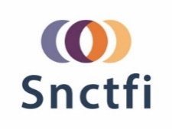
The Snctfi ‘offloadable’ platform aspects of the PDKv2

Slide 10
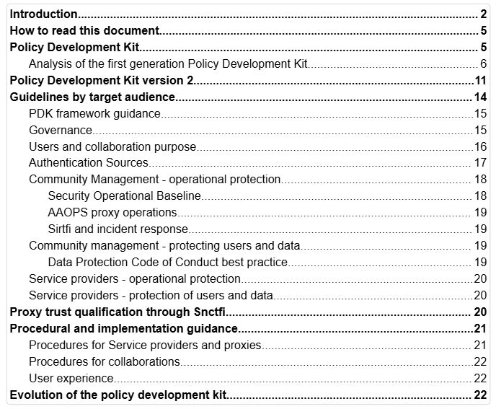
AARC I082 ‘informational’ guidance

Slide 11
Review of AARC I082
Informational pages
https://wiki.geant.org/display/AARC/AARC-I082+Trust+framework+for+proxies+and+Snctfi+research+services
Direct document link
https://edu.nl/uu3qt

