Slide 1
AARC G084 – Security Baseline
evolving operations security in EOSC and the PDK
David Groep
AARC Policy Area
Nikhef & Maastricht University
EUGridPMA+ 64 AARC, IGTF, and EnCo joint meeting
October 2025, Karlsruhe

Slide 2
AARC TREE - Operational Trust for Community and (Infrastructure) Proxies
“Baselining trust and security has proven an effective way to align multi-domain infrastructures. Both in the R&E identity provider space […] as well as for service providers in the EOSC Interoperability Framework and for the EOSC Nodes […], this has enabled secure interworking of providers across organisational, jurisdiction, and sectoral domains.
However, for the research infrastructure proxy services in the AARC BPA (the membership management services in attribute authorities, and in the central proxy components), operational trust and security guidance is lacking.
And even for the EOSC Federation, generalized guidance for a Security Operational Baseline was missing
what was available comes either from projects that could not be considered, or
from specific infrastructures, rather than being cross-sectoral and organization-agnostic

Slide 3
An open ecosystem of providers, across many layers
Founded on subsidiarity, this translates to
primum non nocere: do no harm to interests & assets of others, including users
not expose other service providers in the EOSC ecosystem to enlarged risk as a result of their participation in EOSC
be transparent about infosec maturity and risk to its customers and suppliers

Slide 4
Expected concrete result
A set of (one or more) guidelines that represent
a widely agreed and jointly-developed operational trust baseline for infrastructure membership management and proxy components. This is
supplemented by policy model guidance on how to connect sectoral federations that have more specific policies to this baseline. These guidelines are
based on the dialogue between AARC policy experts, the current (EOSC and sectoral) provider federations, and the research infrastructure community,
through FIM4R and WISE
Making a Security Operational Baseline part of the AARC PDK will address this outcome

Slide 5
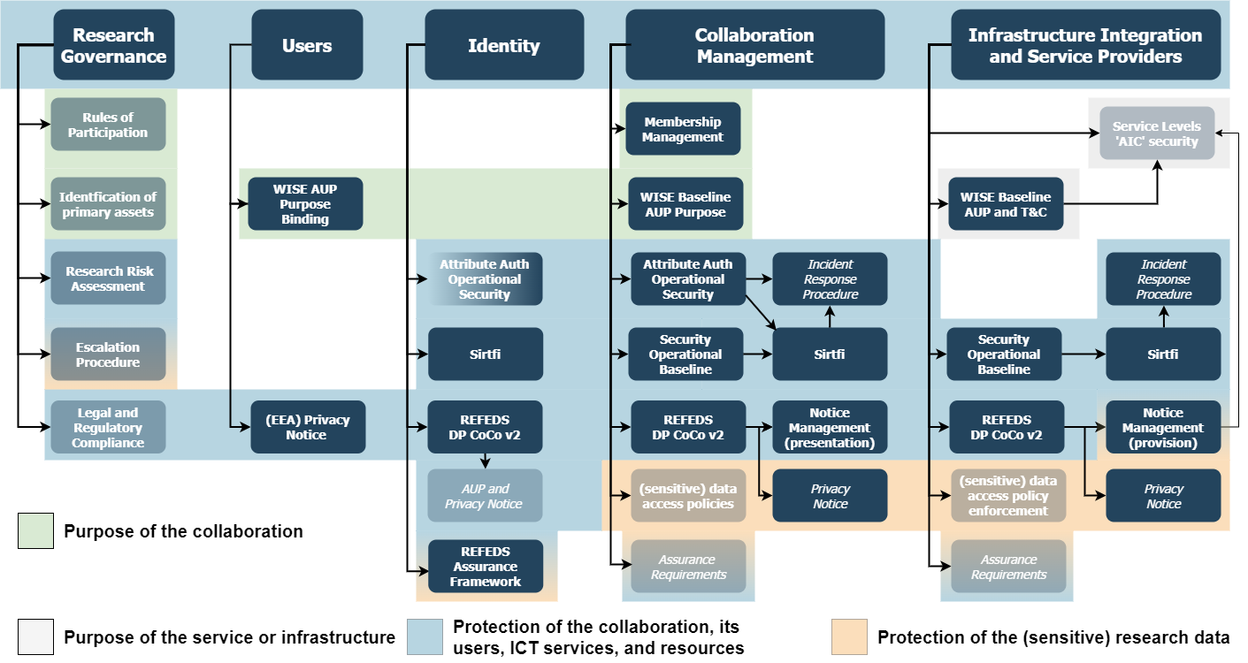

Slide 6
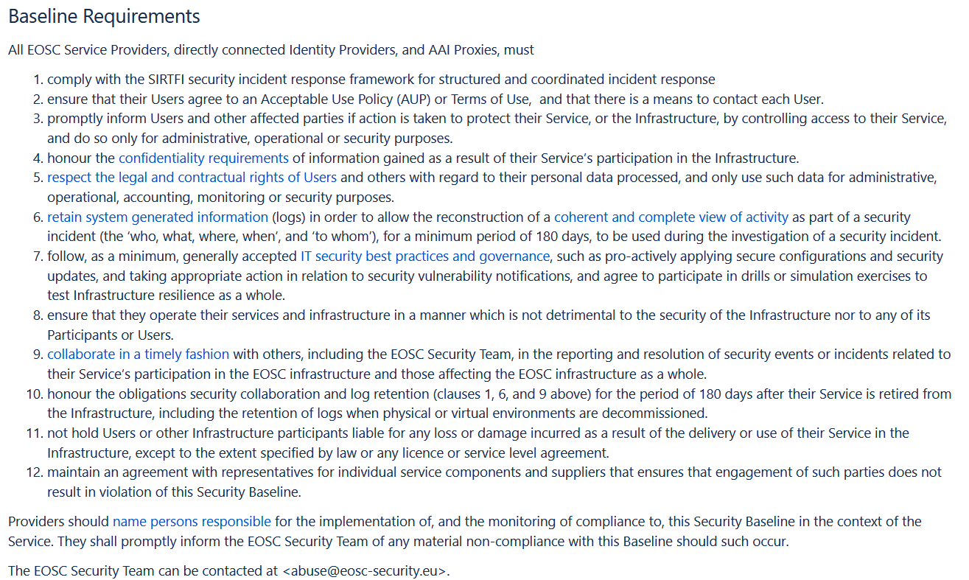
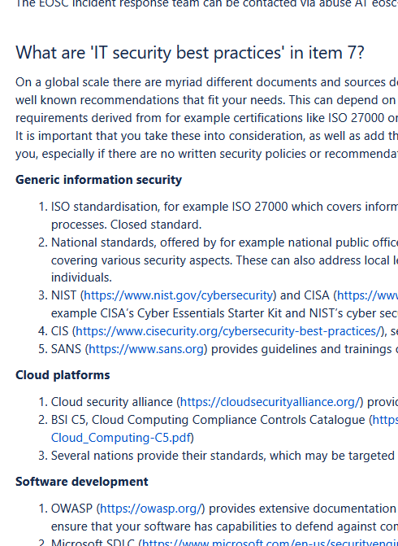
A good starting point …
evolved from the Site Operations, UK-IRIS, EOSC Security Ops Baseline, now generalised

Slide 7
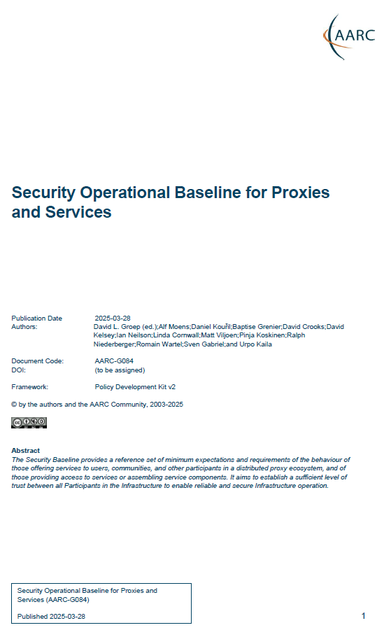
AARC G084
The Security Baseline provides a reference set of minimum expectations and requirements of the behaviour of those offering services to users, communities, and other participants in a distributed proxy ecosystem, and of those providing access to services or assembling service components.
It aims to establish a sufficient level of trust between all Participants in the Infrastructure to enable reliable and secure Infrastructure operation
“Adherence to the Security Operational Baseline implies that you, as a service provider, proxy operator, identity provider must: …”

Slide 8
The 12 points
1. comply with the SIRTFI security incident response framework for structured and coordinated incident response
2. ensure that their Users agree to an Acceptable Use Policy (AUP) or Terms of Use, and that there is a means to contact each User.
3. promptly inform Users and other affected parties if action is taken to protect their Service, or the Infrastructure, by controlling access to their Service, and do so only for administrative, operational or security purposes.
4. honour the confidentiality requirements of information gained as a result of their Service’s participation in the Infrastructure.
5. respect the legal and contractual rights of Users and others with regard to their personal data processed, and only use such data for administrative, operational, accounting, monitoring or security purposes.
6. retain system generated information (logs) in order to allow the reconstruction of a coherent and complete view of activity as part of a security incident (the ‘who, what, where, when’, and ‘to whom’), for a minimum period of 180 days, to be used during the investigation of a security incident.
7. follow, as a minimum, generally accepted IT security best practices and governance, such as pro-actively applying secure configurations and security updates, and taking appropriate action in relation to security vulnerability notifications, and agree to participate in drills or simulation exercises to test Infrastructure resilience as a whole.
8. operate services and infrastructure in a manner which is not detrimental to the security of the Infrastructure nor to any of its Participants or Users.
9. collaborate in a timely fashion with others, specifically those with which there is a direct AAI trust relationship, in the reporting and resolution of security events or incidents related to their participation in the infrastructure and those affecting the infrastructure as a whole.
10. honour the obligations security collaboration and log retention (clauses 1, 6, and 9 above) for the period of 180 days after their Service is retired from the Infrastructure, including the retention of logs when physical or virtual environments are decommissioned.
11. not hold Users or other Infrastructure participants liable for any loss or damage incurred as a result of the delivery or use of the Service in the Infrastructure, except to the extent specified by law or any licence or service level agreement.
12. maintain an agreement with representatives for individual service components and suppliers that ensures that engagement of such parties does not result in violation of this Security Baseline.

Slide 9
Concluding remarks
Providers should name persons responsible for the implementation of, and the monitoring of compliance to, this Security Baseline in the context of the Service. They shall promptly inform all security teams of infrastructures with which they have an AAI trust relationship of any material non-compliance with this Baseline should such occur.
Security teams of infrastructures that act as aggregators and incident response coordination centres must publish one of more contact addresses and inform partners about those.

Slide 10
What to do with the background guidance – AARC Wiki?
The guidance we have is (was?) on the EOSCF Wiki, which is both inaccessible for updates and not ‘AARC-blessed-and-branded’
Migrate to AARC Wiki?
How to integrate with the Compendium?

