Slide 1
AARC G084 – Security Operational Baseline
Strengthening operations security, evolving the PDK
David Groep
AARC Policy Area
Nikhef & Maastricht University
AEGIS meeting
November 2025

Slide 2
AARC TREE - Operational Trust for Community and (Infrastructure) Proxies
“Baselining trust and security has proven an effective way to align multi-domain infrastructures. […and] this has enabled secure interworking of providers across organisational, jurisdiction, and sectoral domains.
However: for the research infrastructure proxy services in the AARC BPA (the membership management services in attribute authorities, and in the central proxy components), operational trust and security guidance is lacking.
And even for the EOSC Federation, generalized guidance for a Security Operational Baseline was missing
what was available comes either from projects that could not be considered, or
from specific infrastructures, rather than being cross-sectoral and organization-agnostic

Slide 3
An open ecosystem of providers, across many layers
Founded on subsidiarity, this translates to
primum non nocere: do no harm to interests & assets of others, including users
not expose other service providers in the ecosystem to enlarged risk
as a result of their participation in an infrastructure community
be transparent about ‘infosec’ maturity and risk to its customers and suppliers

Slide 4
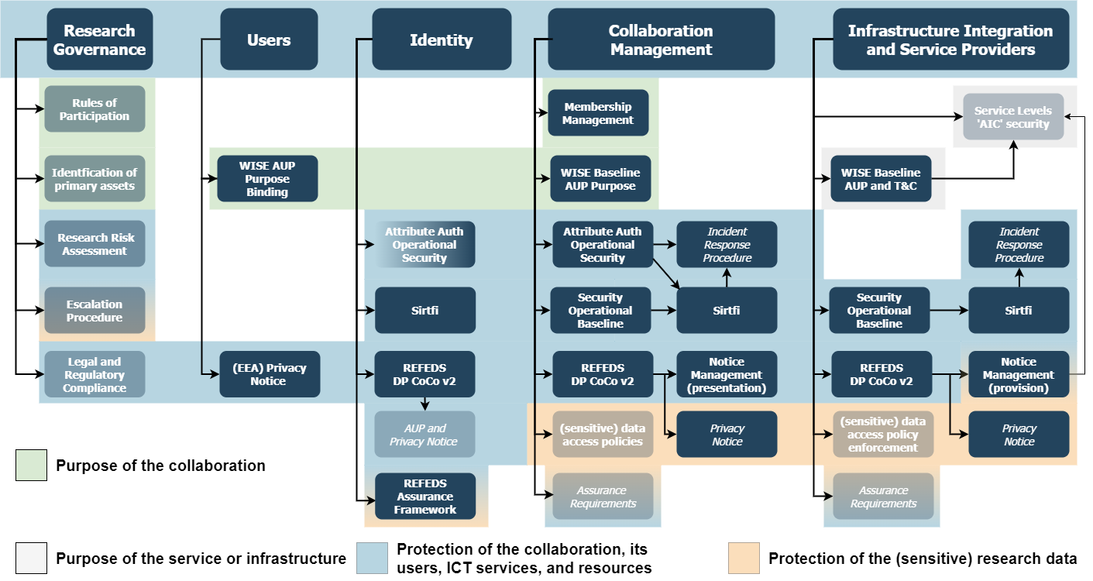
AARC PDK version 2

Slide 5
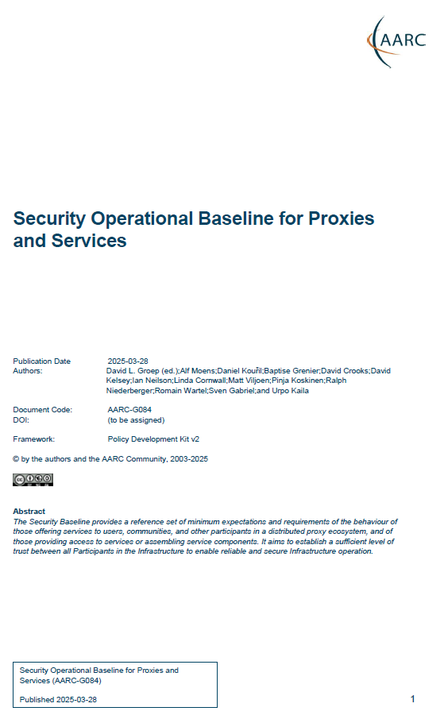
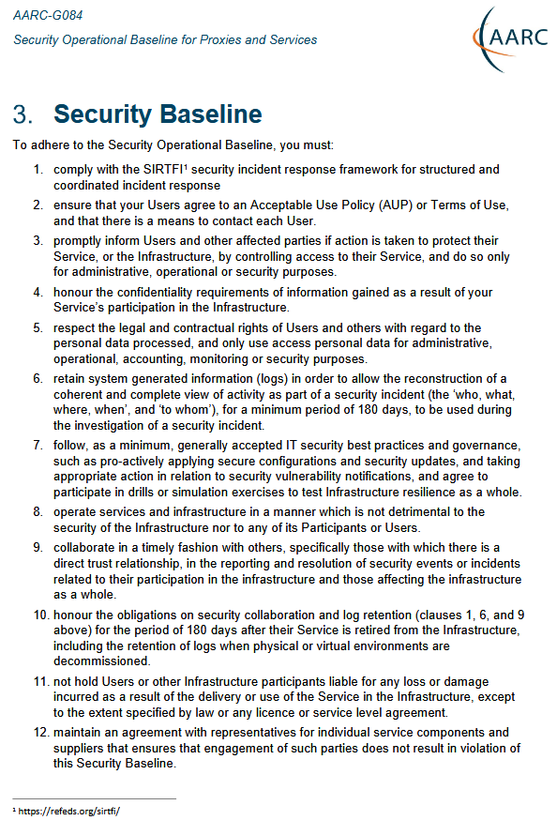
AARC G084 – a one-pager
The Security Operational Baseline codified current community good practice for protecting authentication providers, AAI proxies, and identity providers, participating in an AAI Federation.
It is RECOMMENDED that all service providers follow these Baseline Requirements to achieve a sufficient level of security.
These requirements augment but do not replace applicable security policies and obligations, or more specific security arrangements and service level agreements that may exist between participants
“To adhere to the Security Operational Baseline, you must: …”
Evolved from PDKv1, UK-IRIS, and earlier baselines … now generalised

Slide 6
The 12 points
comply with the SIRTFI security incident response framework for structured and coordinated incident response [ref to SIRTFI]
ensure that your Users agree to an Acceptable Use Policy (AUP) or Terms of Use, and that there is a means to contact each User.
promptly inform Users and other affected parties if action is taken to protect their Service, or the Infrastructure, by controlling access to their Service, and do so only for administrative, operational or security purposes.
honour the confidentiality requirements of information gained as a result of your Service’s participation in the Infrastructure.
respect the legal and contractual rights of Users and others with regard to the personal data processed, and only use access personal data for administrative, operational, accounting, monitoring or security purposes.
retain system generated information (logs) in order to allow the reconstruction of a coherent and complete view of activity as part of a security incident (the ‘who, what, where, when’, and ‘to whom’), for a minimum period of 180 days, to be used during the investigation of a security incident.
follow, as a minimum, generally accepted IT security best practices and governance, such as pro-actively applying secure configurations and security updates, and taking appropriate action in relation to security vulnerability notifications, and agree to participate in drills or simulation exercises to test Infrastructure resilience as a whole.
operate services and infrastructure in a manner which is not detrimental to the security of the Infrastructure nor to any of its Participants or Users.
collaborate in a timely fashion with others, specifically those with which there is a direct trust relationship, in the reporting and resolution of security events or incidents related to their participation in the infrastructure and those affecting the infrastructure as a whole.
honour the obligations on security collaboration and log retention (clauses 1, 6, and 9 above) for the period of 180 days after their Service is retired from the Infrastructure, including the retention of logs when physical or virtual environments are decommissioned.
not hold Users or other Infrastructure participants liable for any loss or damage incurred as a result of the delivery or use of the Service in the Infrastructure, except to the extent specified by law or any licence or service level agreement.
maintain an agreement with representatives for individual service components and suppliers that ensures that engagement of such parties does not result in violation of this Security Baseline

Slide 7
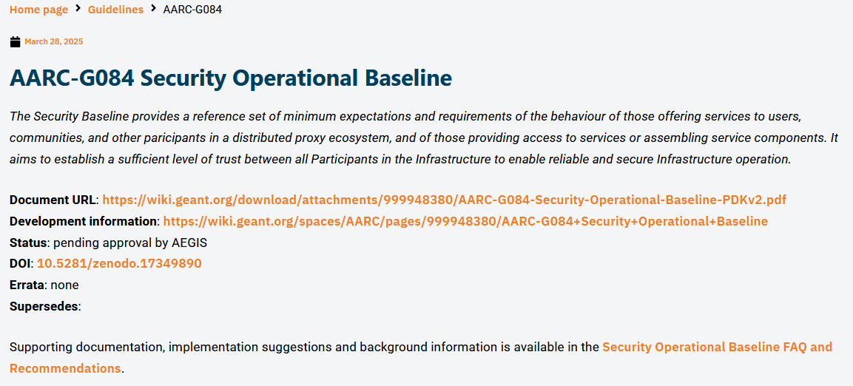
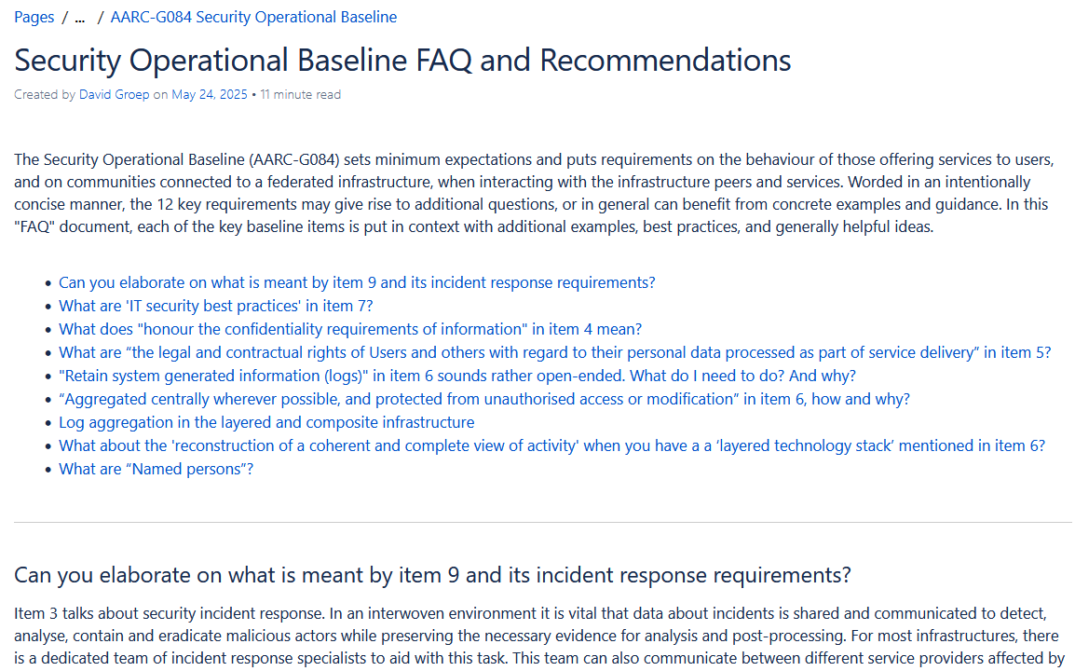
FAQ and implementation guidance
https://wiki.geant.org/spaces/AARC/pages/1049624759/view

Slide 8
From today?
G084 will be published as 10.5281/zenodo.17349890 once endorsed
Guidance and implementation hints are on the AARC Wiki,
which is both inaccessible for updates and not ‘AARC-blessed-and-branded’
Linked to the Compendium via the Policy Development Kit

Slide 9
davidg@nikhef.nl

