Slide 1
Boosting AAI for research and collaboration
David Groep
NA3 – Policy Harmonisation and Best Practice coordinator
Nikhef
10th FIM4R Meeting
Vienna, 20-21 February 2017

Slide 2
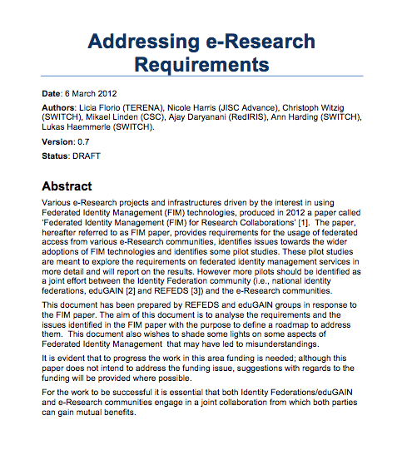

Starting Point: Identified Requirements
Attribute Release
Attribute Aggregation
User
Friendliness
SP
Friendliness
User Managed Information
Persistent Unique Id
Credential translation
Credential Delegation
Levels of Assurance
Guest
users
Step-up AuthN
Non-web-browser
Community based AuthZ
Best
Practices
Social & e-Gov IDs
Incident Response

Slide 3
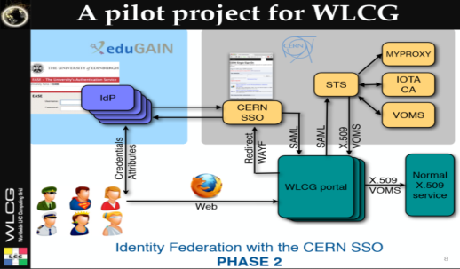
















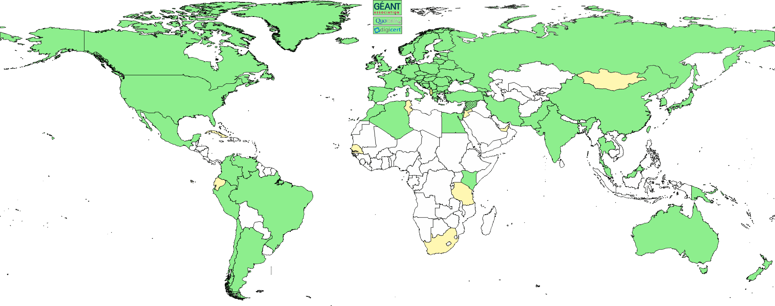





















3

Slide 5

Common Scenario
The scenario:
  There is a technical architect of a research community
  Her community is distributed internationally
  Increasing number of services need authentication and authorization
  She wants to focus on research and not reinvent the wheel
  She starts googling and asking around
So, there are some solutions available, but…

Slide 6
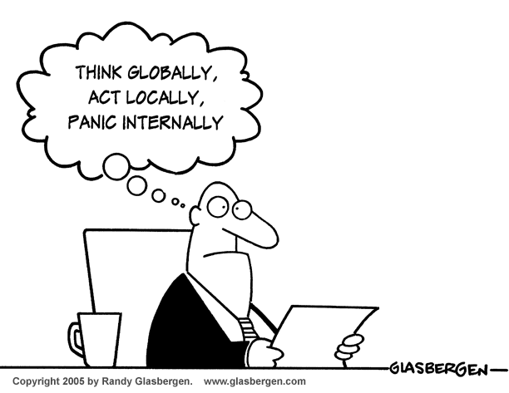
Think Global: the AARC project
  Bring federated access to eResearch
  Avoid a future in which new research collaborations develop independent AAIs
  Build on existing tools and framework

Slide 7

What AARC does want to change and how
Improve usage of FIM – Promote usage of FIM and organise training to leverage identity providers outside the academic boundaries
Address Research requirements – Design
a technical Blueprint Architecture that builds
on top of eduGAIN to add components required
Offer support for global policies – Sponsor the development of key policy frameworks that aim to add additional ‘flavours’ to eduGAIN.
Sustainability – Ensure that operations of components of the blueprint architecture and deployment of assurance, security and policy frameworks rest with r/e-infrastructures

Slide 8
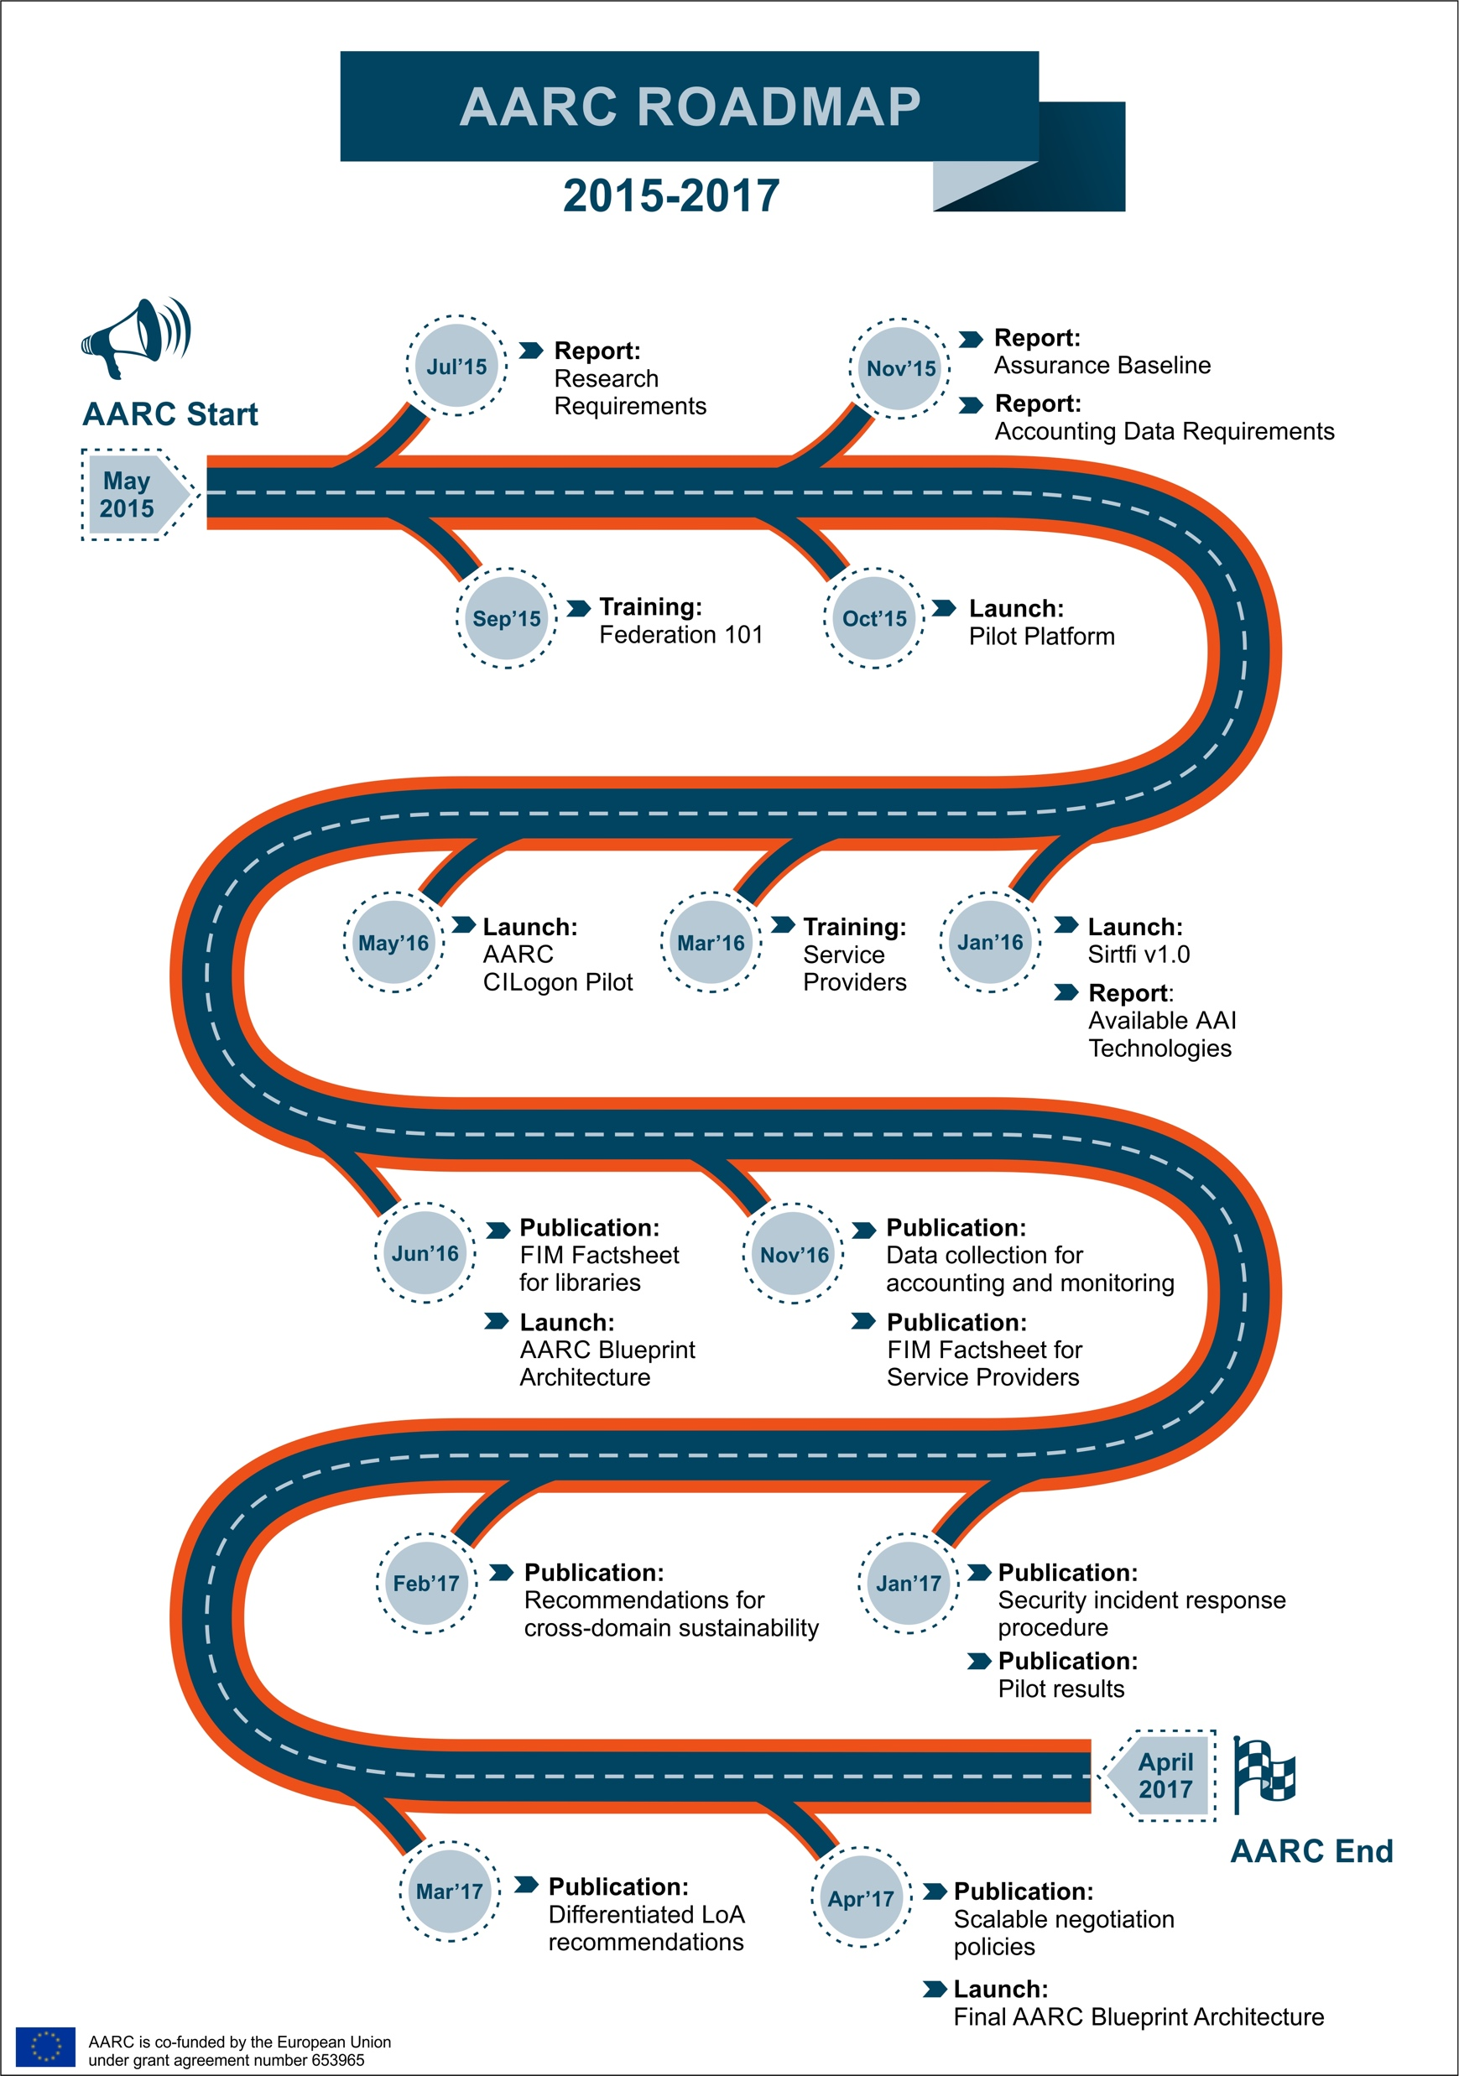
https://aarc-project.eu/achievements/

Slide 9
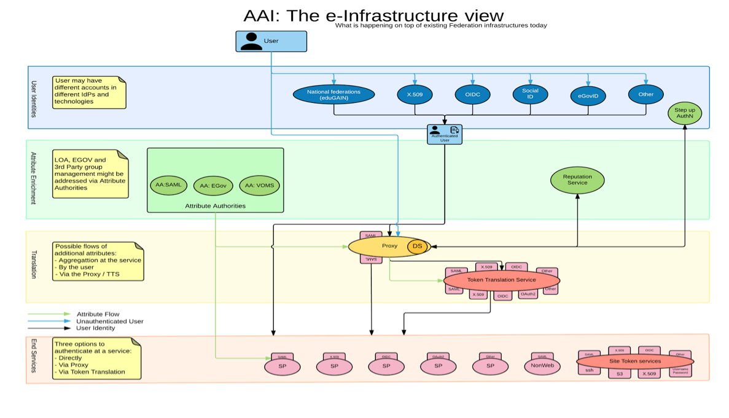

AARC Blueprint Architecture & eduGAIN
Research & e-Infrastructures
  Implement the AARC blueprint
AARC
  set of building blocks - both technical and policy,
  leveraging eduGAIN,
  for International Research Collaboration
eduGAIN and the Identity Federations
  A solid foundation for federated
  access in R&E

Slide 10
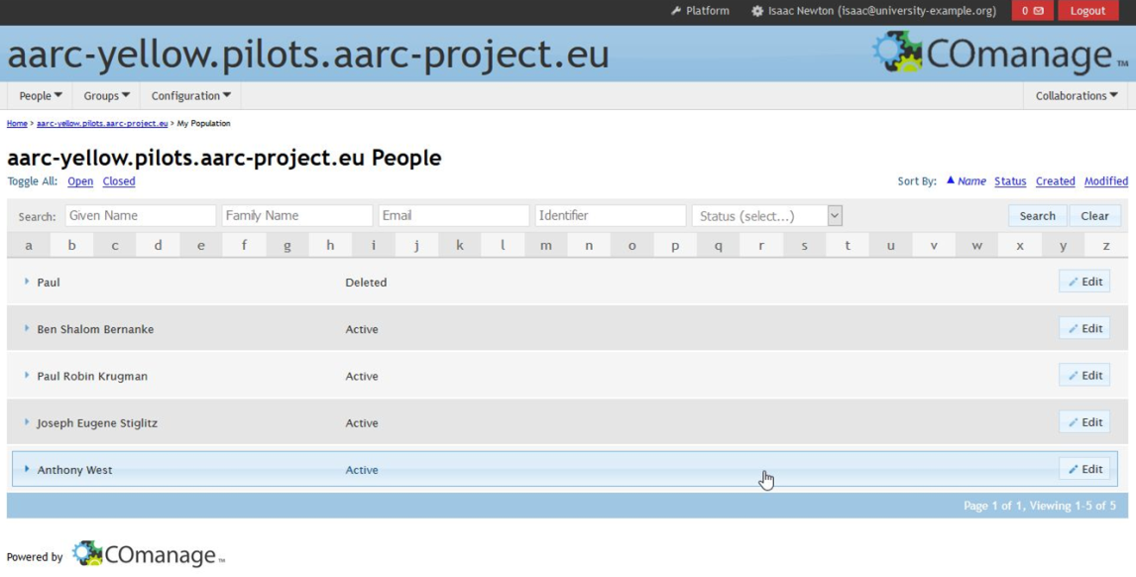
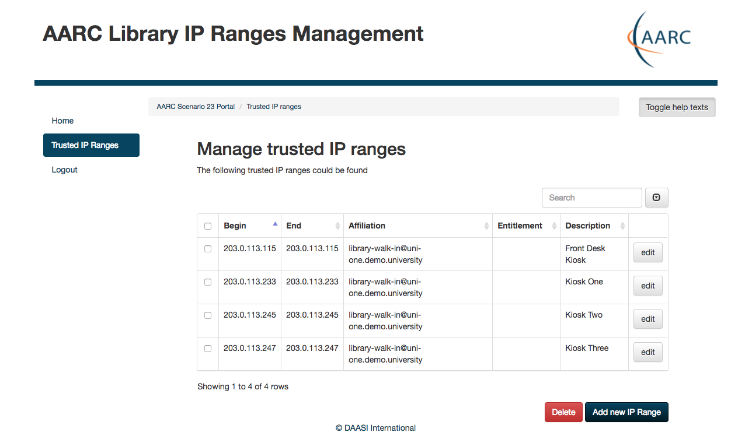
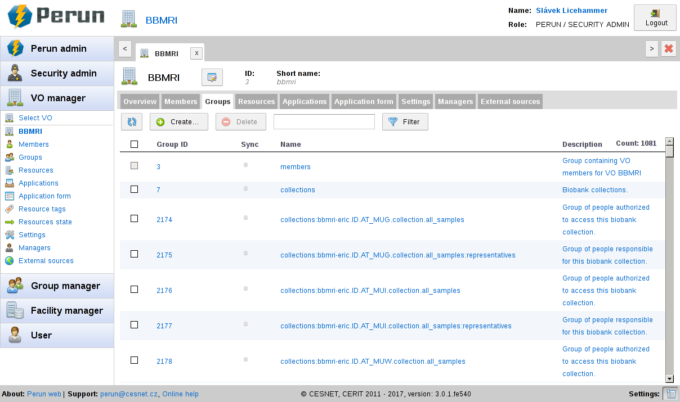
Pilots and demonstrators
AttributeManagementPilot
AuthX509toSAMLDemo
BBMRIAAIPilot
CILogon-like pilot
COmanageORCIDPilot
COmanageSSHPilot
LibrariesCockpitPanelConsortiumProxy
LibrariesCockpitPanelEZproxy
LibrariesCockpitPanelWalkInUsersPortal
ORCIDpilotCockpitPanel
PerunVOMSCILogonPilot
SocialIDCockpitPanel
https://wiki.geant.org/display/AARC/Pilot+results+and+demos

Slide 11

AARC CILogon Pilot: A Token Translations Service for Europe
Use-cases:
Hide PKIX complexity from the users
Federated Access to web and non-web resources
Support different type of credentials and delegation
Enables access to different resource via portal
Benefits:
Allows for VO services, ie. VOMS
Offered to research communities as service
Managed security-sensitive components
Built on CILogon and MyProxy! www.cilogon.org

Slide 12
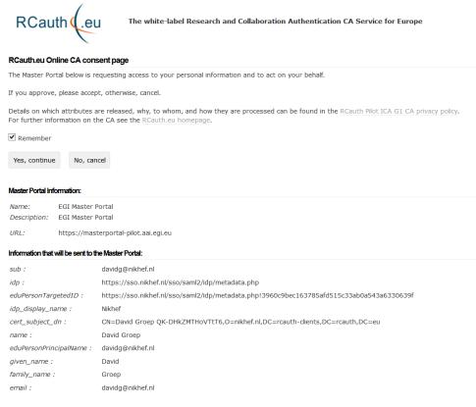
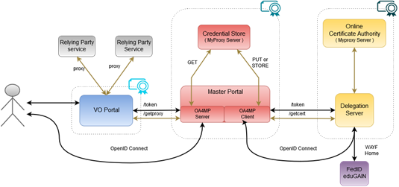

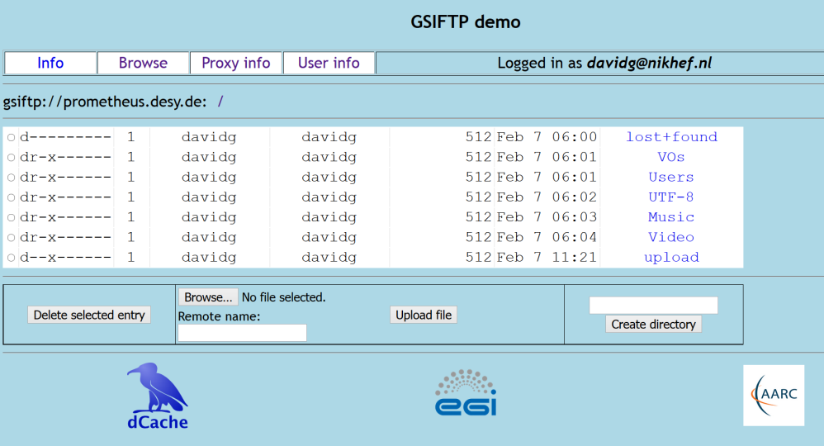
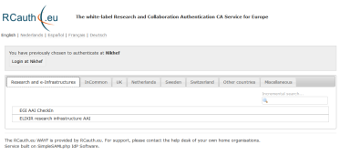
Flow for RCauth-like scenarios
Sirtfi
REFEDS “R&S”
Built on CILogon and MyProxy!
www.cilogon.org
see also https://rcdemo.nikhef.nl/
12
Notes:
VO portal can be anything even a simple shell
Certs stored only for 11 days
Master portal can add attributes via VOMS (or others in the future)

Slide 13
First e-Infrastructure implementations for BPA & pilots
EGI CheckIn Service
https://wiki.egi.eu/wiki/AAI
ELIXIR AAI
https://www.elixir-europe.org/services/compute/aai
EUDAT B2ACCESS
https://www.eudat.eu/services/b2access
GÉANT eduTEAMS
https://www.eduteams.org

Slide 14
Solving the Policy Puzzle
Pushing forward best practices and like policies across many participants
  “Levels of Assurance” – baseline and differentiated profiles, capabilities and grouping
  “Incident Response” – beyond Sirtfi: a common understanding on operational security
  “Sustainability, Guest IdPs, use models” – how can a service be offered in the long run?
  “Scalable policy negotiation” – helping SPs move beyond bilateral discussion
  “Protection of (accounting) data privacy” – necessary aggregation without breaking
  the law too much
Strategy
to support and extend established and emergent groups
leverage their support base - and ‘multiply’ the effect of policy work from AARC
IGTF
FIM4R
REFEDS
WISE
GN4
AARC
. . .
SIRTFI

Slide 15
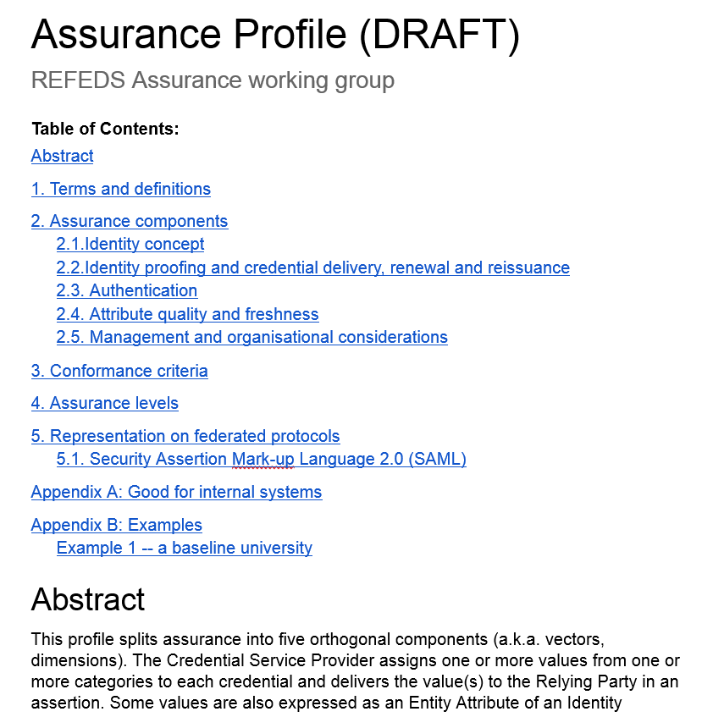
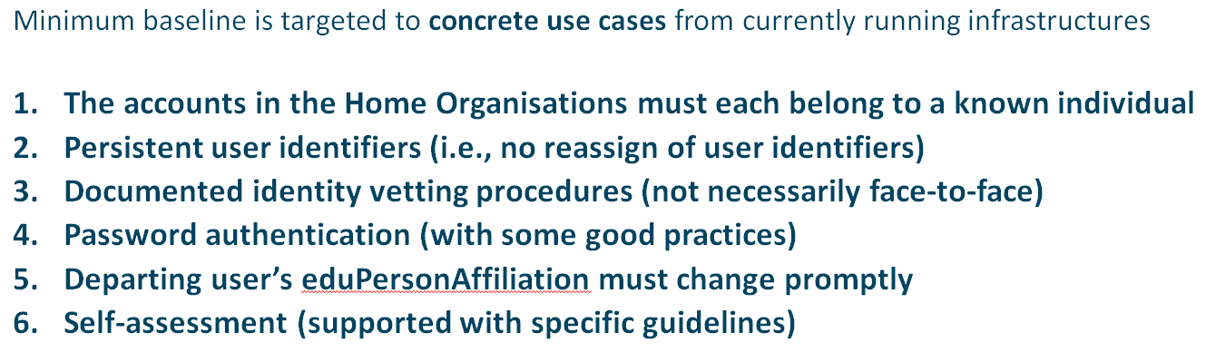
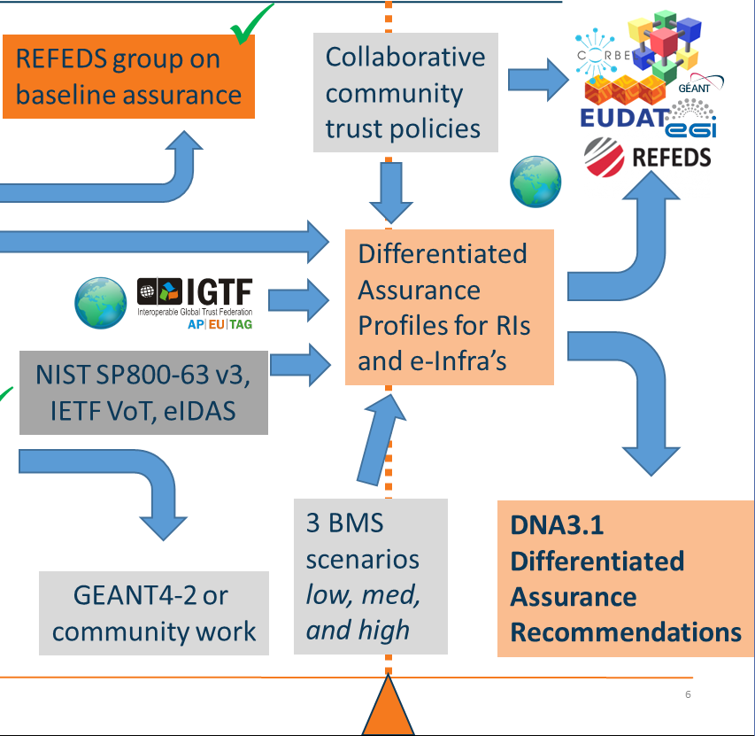
From Baseline to Differentiated Assurance
REFEDS WG based on capabilities (‘vectors’ mainly for IdPs)
Grouping of capabilities with our SPs into profiles
Different profiles and
joint alignment of assurance
between e-Infras ongoing …
@REFEDS: Assurance Components consultation early 2017 – simple structure
@FIM4R: useful grouping in assurance profiles – see Mikael’s talk
https://docs.google.com/document/d/15v65wJvRwTSQKViep_gGuEvxLl3UJbaOX5o9eLtsyBI

Slide 16
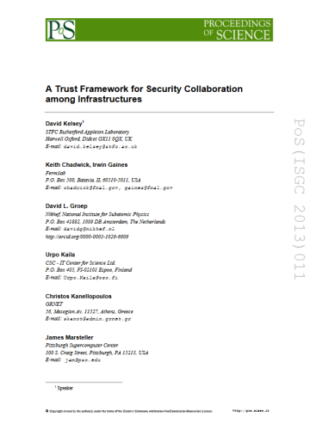
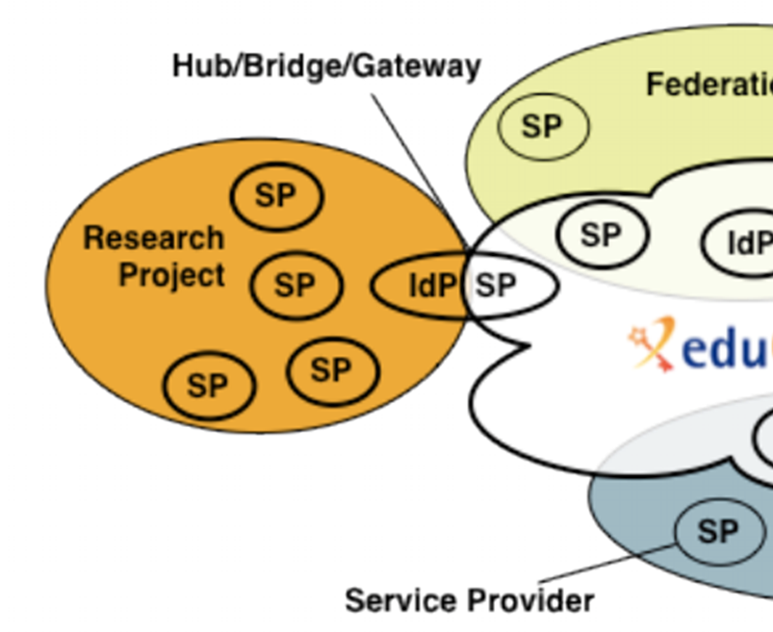
Developing scalable policy models in light of the Blueprint: Snctfi
✓
allow proxy operators to assert ‘trust marks’ based on known SP properties
✓
Develop framework recommendations for RIs for coherent policy sets
evaluate with the SP-IdP-Proxies in pilots
based on the Blueprint Architecture
Collaborate in WISE, IGTF &
FIM4R to get endorsement
Many SPs are alike
Policy frameworks for collective service providers Shared use of and collaboration on reputation services, together in FIM4R
Complementary work:
Accounting Data Exchange Protection for Infrastructures
Graphics inset: Ann Harding, SWITCH
Proxying IdPs to SPs is part of the BPA, with e.g. the RCauth CPS as policy example

Slide 17

Inconsistency as our gravest risk? – towards AARC2
Reflected in updated AARC2 structure
Operational security capabilities and Incident response in federations – beyond Sirtfi v1
Service-centric policies: traceability & accounting, privacy, gateway operations & proxies
e-Researcher-centric policies: alignment of AUPs and templates,
authentication assurance, community attribute management models
and provisioning
Policy Engagement and Coordination:
contributes to Community Engagement, provision of
policy expertise to the Competence Centre, promotion of
best practices globally (WISE, FIM4R, IGTF, REFEDS),
easing end-to-end coordination across the chain
Structuring the exchange of information amongst SP groups

Slide 18
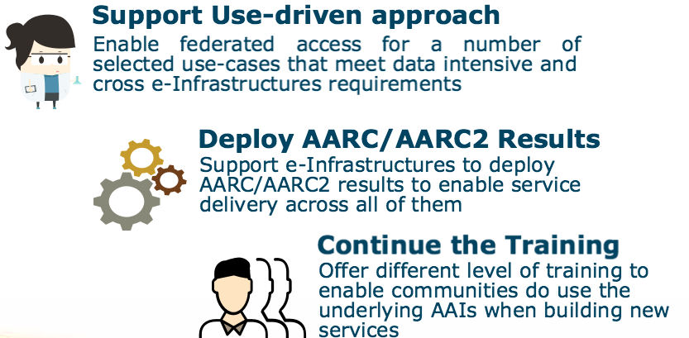
AARC2 In three bullets
Notes:
Starts 1st of May 2017

Slide 19

AARC2 Focus on Pilots and eScience Engagement
8 Pilots with research communities:
  CTA, EPOS, EISCAT_3D, LIGO, LifeWatch, WLCG,
  Biomedical Science Research, HNSciCloud
Pilots to support interoperability
among research & e-Infrastructures

Slide 20
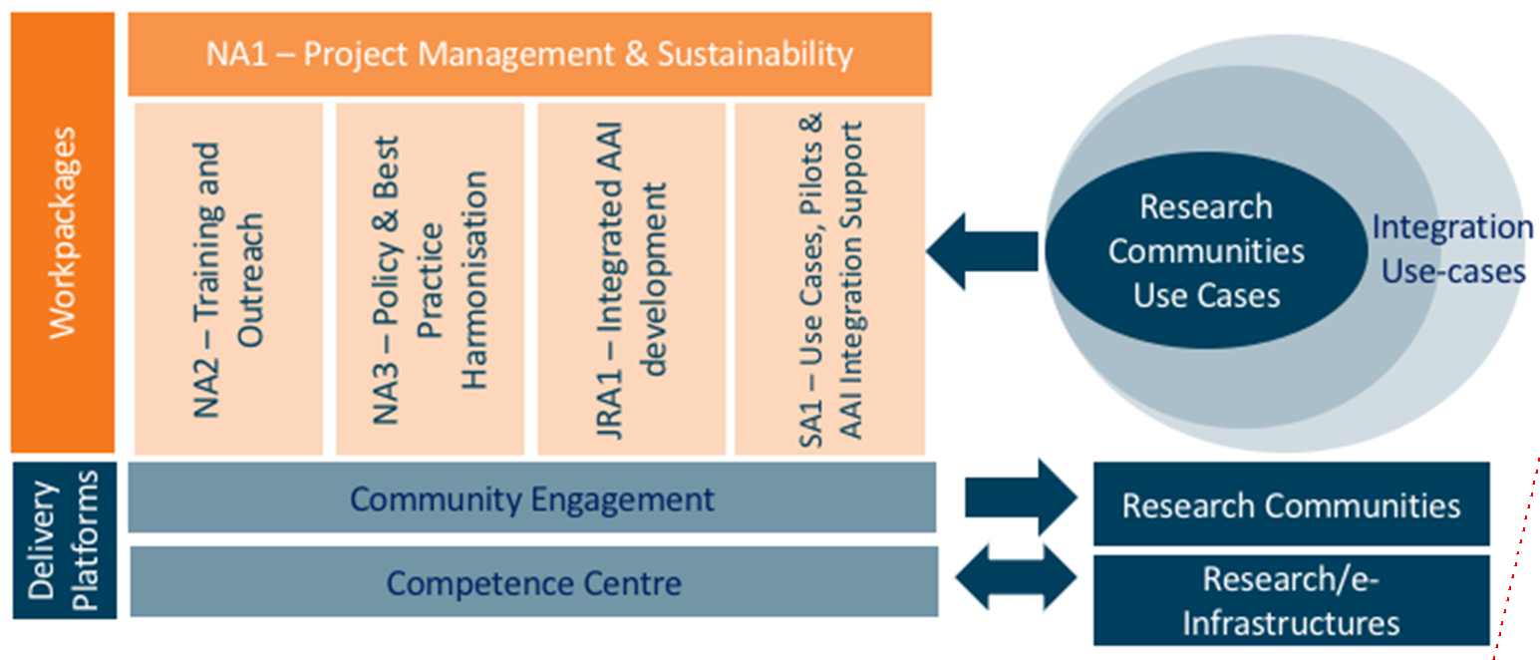
Two new engagement mechanisms

Slide 21

What AARC can do for you?
AARC/2 support for Research & e-Infrastructure collaborations
FIM4R as a community forum for AARC/2 work and pilots
including bilateral meetings as needed
Create a forum for Infrastructures: the competence centre
facilitate the exchange of information of every (AAI, security) sort
Check the AARC blog for the latest information
https://aarc-project.eu/news-blog/
Get in touch: aarc-contacts@lists.geant.org

Slide 22
davidg@nikhef.nl

