Slide 1
The AARC ‘CILogon-like’ Pilot
The Research and Collaboration Authentication Service CA
David Groep
AARC NA3 Activity Lead
Nikhef, Physics Data Processing Group
APgridPMA 2016 Taipei meeting
14 March 2016

Slide 2
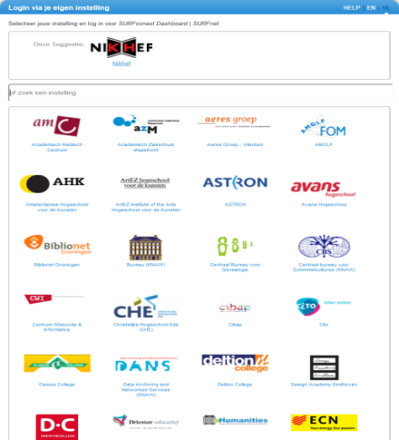
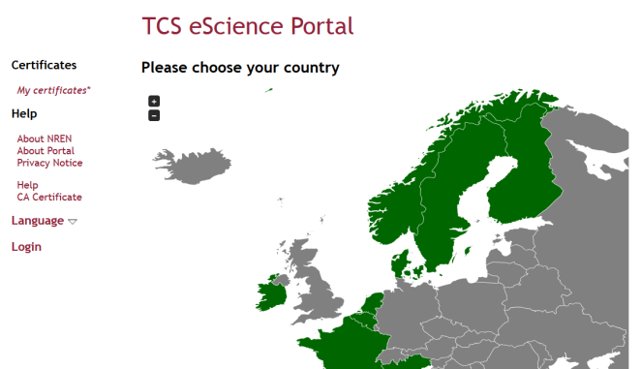
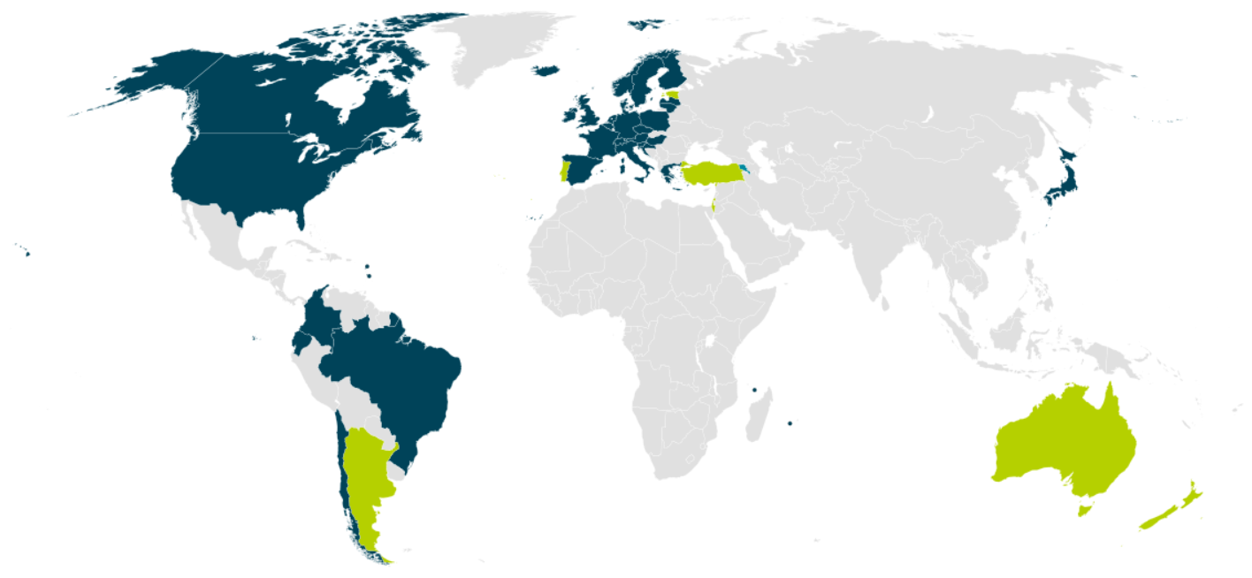


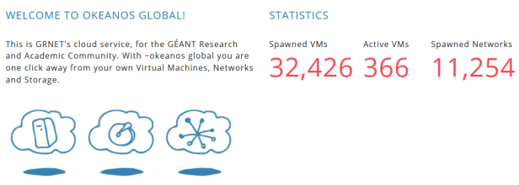

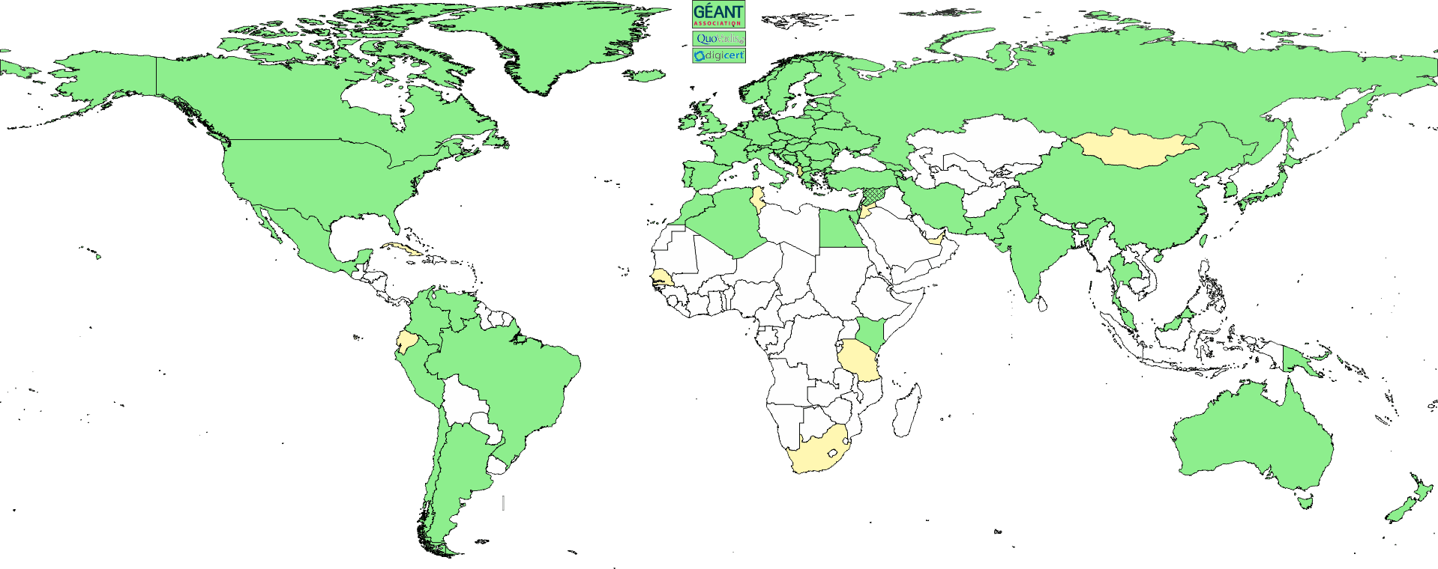
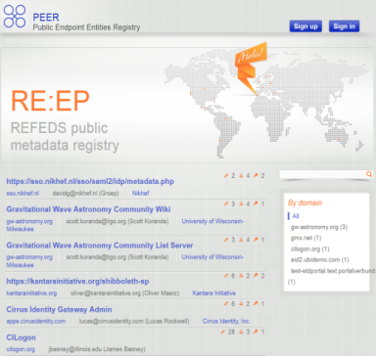
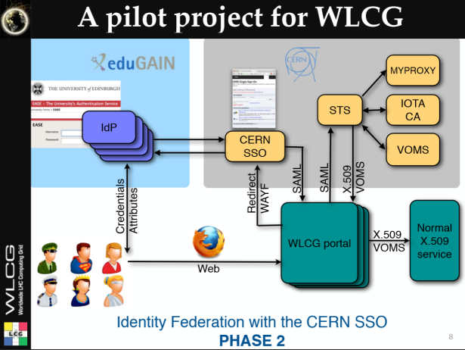

We live in a federated world …
wLCG FIM4R pilot
background: eduGAIN connected federations as of November 2014, and others – Brook Schofield, TERENA

Slide 3
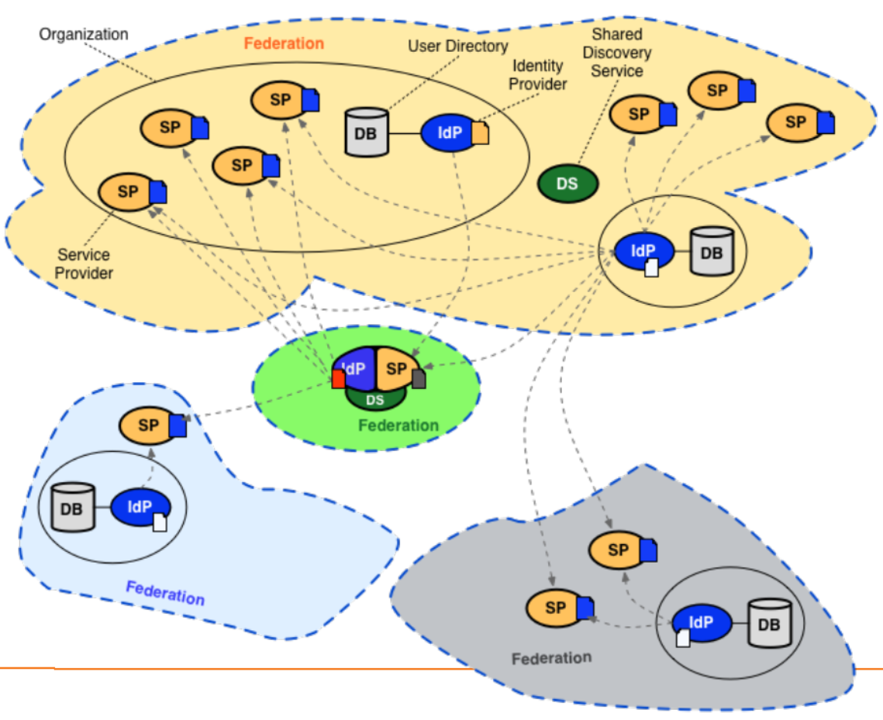
Conventional R&E federations (web-only, selected services only)

Slide 4
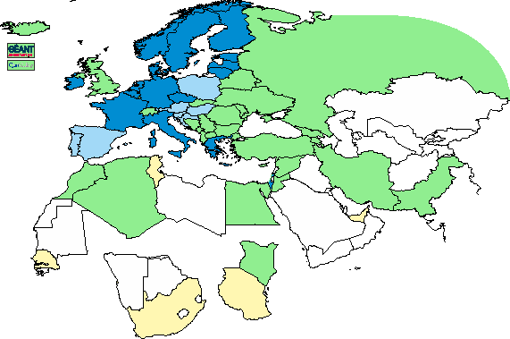
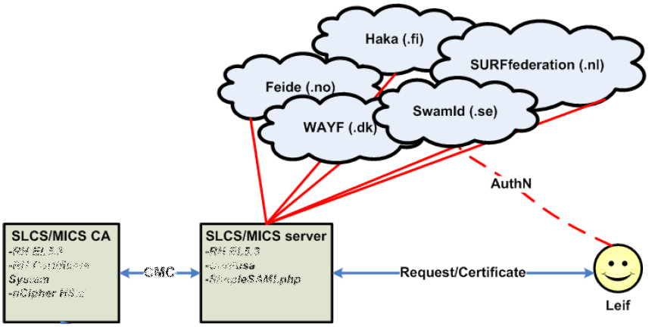
Leveraging R&E federations: TCS, DFN SLCS, CILogon … - with extended LoA
Bridging conventional R&E federated organisations to the trusted e-Infra world requires more
Release of relevant attributes, unique non-reassigned ID, higher assurance profile via contracts
Graphic: IGTF 2015
Graphic from: Jan Meijer, UNINETT

Slide 5
The AAI evolution of e-Infrastructures and Research Infrastructures
Most infrastructures move to completely hiding PKIX from the end-user
  Less credentials to manage, appearing ‘simpler’ to the user, but …
  EEPKI + RFC3820 proxies did solve both the CLI and delegation use case rather nicely!
Bridging and translation is the pragmatic approach
  Does not require major technical changes in existing R&E federations
  Allows for community-centric identities-of-last-resort (or first resort, for that matter!)
  Time line is more predictable, because fewer entities are involved –
  and those entities have a stake in and the benefits off the results
Emerging as a pattern in many Research Infrastructures that use CLI or brokerage
  ELIXIR, UMBRELLA, WLCG, INDIGO DC
  SAML->OIDC, SAML->X509, X509->OIDC, X509->SAML, OIDC->X509, …

Slide 6
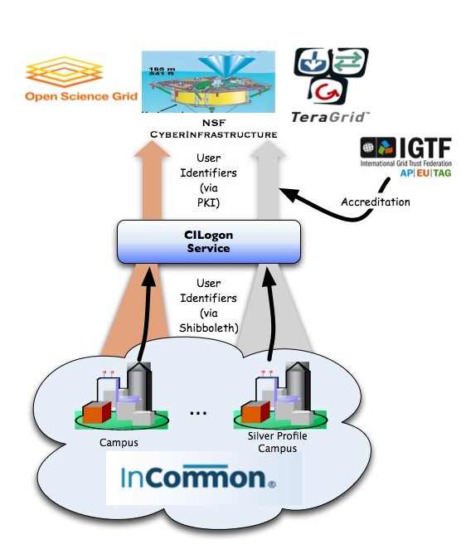
CILogon service and project (Jim Basney et al.)
Enable campus logon to CyberInfrastructure (CI)
  Use researchers’ existing security credentials at their home institution
  Ease credential management for researchers and CI providers
Multiple interfaces
SAML/OpenID Web Browser SSO
  PKCS12 certificate download
  Certificate issuance via OAuth
  OpenID Connect token issuance
  SAML ECP for CLI issuance
Slide content: Jim Basney, based on http://www.cilogon.org/docs/201106-cilogon-cern.pptx?attredirects=0&d=1
and http://www.cilogon.org/docs/20141030-basney-cilogon.pdf?attredirects=0&d=1

Slide 7
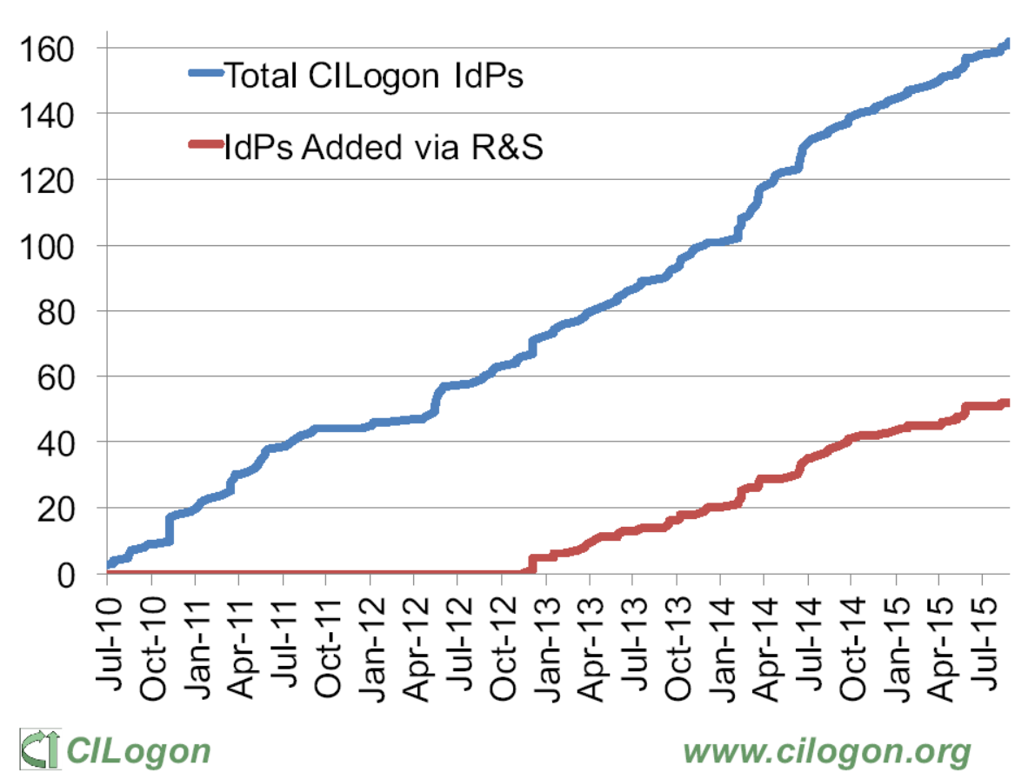
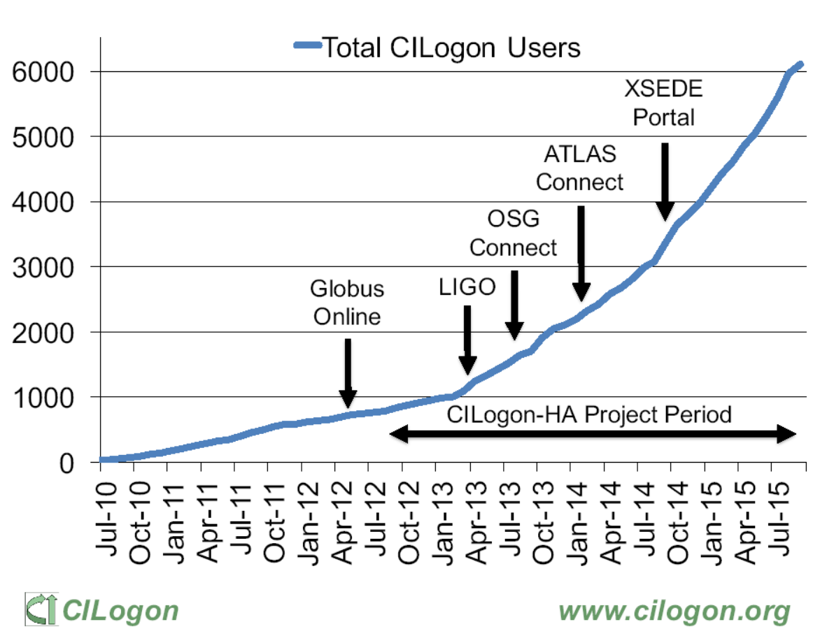
CILogon adoption in the US/InCommon
http://www.cilogon.org/docs/2015-09-cilogon-ha.pdf?attredirects=0&d=1

Slide 8
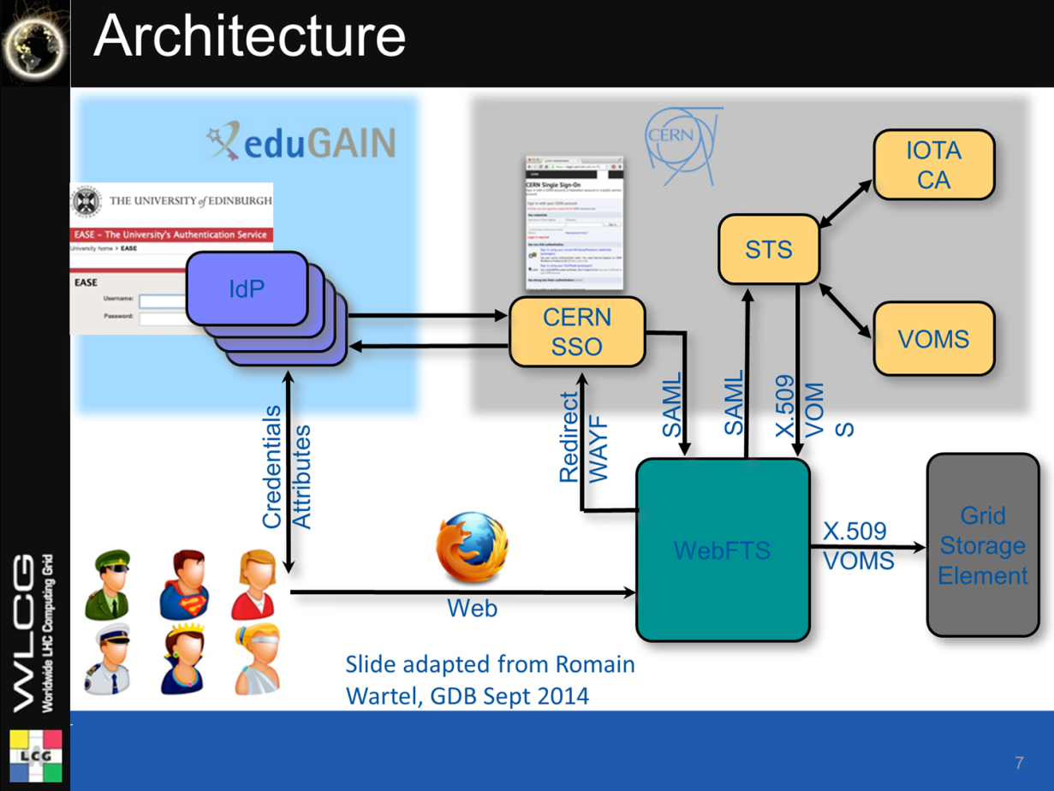
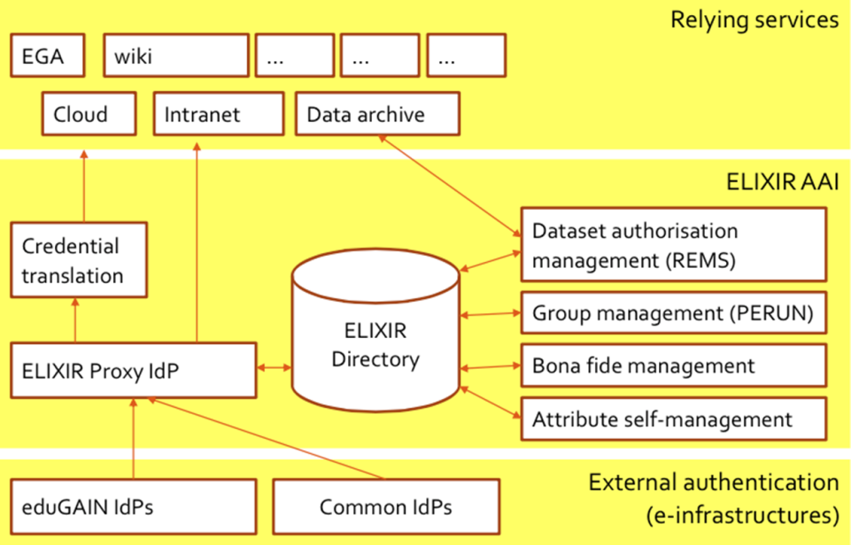
Not enough for RIs and e-Infrastrucutures
WebFTS ‘FIM4R’ in wLCG
Romain Wartel
ELIXIR reference architecture
Mikael Linden et al.

Slide 9
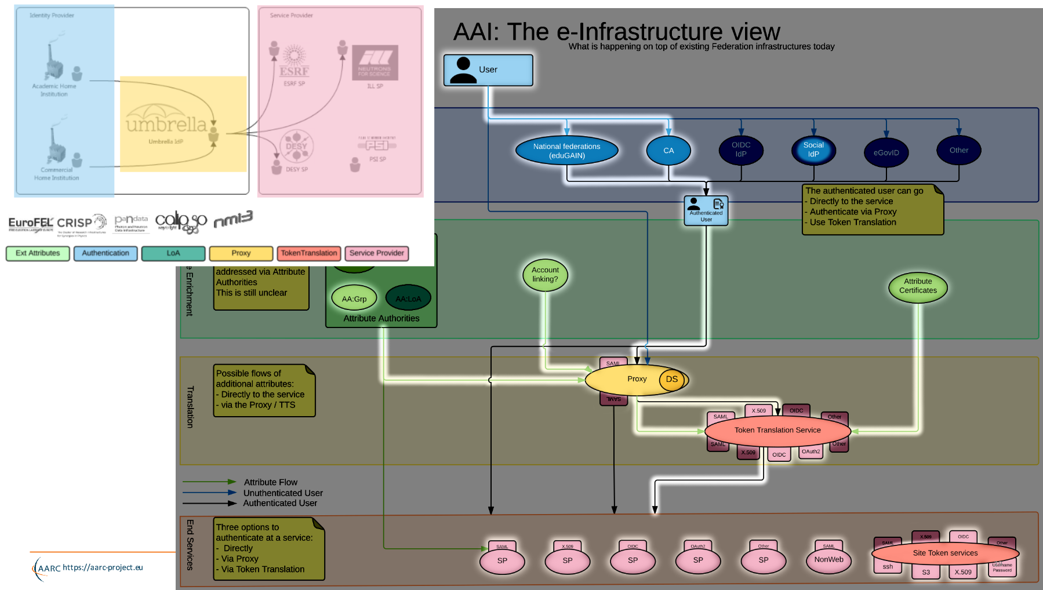
Example:
Umbrella
Marcus Hardt, KIT and AARC
https://aarc-project.eu/wp-content/uploads/2015/11/20151102-JRA1.2-Blueprint-Status-Hardt.pdf

Slide 10
AARC Vision and Objectives
Improve federated access by addressing current challenges
Integrate existing R&E AAIs to create a highway for identities
  Avoid the creation of project-specific AAIs by enabling researchers to use their existing credentials to access different resources
Harmonise policies among e-Infrastructures to ease service delivery
Define a training package for institutions and services to support federated access

Slide 11
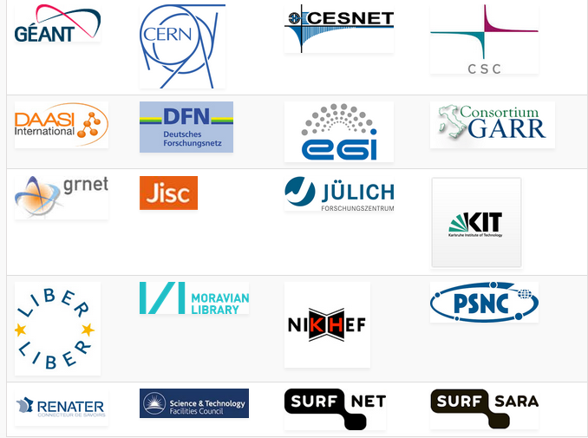
Some AARC Facts
Authentication and Authorisation
for Research and Collaboration
Two-year EC-funded project
20 partners
  NRENs, e-Infrastructure providers and Libraries as equal partners
About 3M euro budget
Starting date 1st May, 2015
https://aarc-project.eu/

Slide 12
Issues hindering the adoption of FedAuth
Although many production federations are pretty good, and quite a few IdPs have good processes …
public documentation, self-assessment and peer-review are missing
it’s not consistent across IdPs
and processes are not designed for collaboration use cases
re-use of identifiers occurs (also an issue for social IdPs)
the identity providers provide no identity … or it’s non-consistent
identifiers generated are specific to each SP (defeating brokering)
and may not provide traceability needed for valuable resources
some allow users to change their own data (including e.g. their email address and all contact data), or do not collaborate in case of issues

Slide 13
But many elements are coming together now!
E-Infrastructure & IGTF differentiated assurance profiles: DOGWOOD (IOTA), CEDAR/BIRCH (Classic, MICS)
Research communities establishing themselves higher-quality attribute stores
Attribute release conventions and scalable methodologies like REFEDS R&S
Higher awareness of multi-actor AAI and ‘VOs’ within the traditional R&E federation world
Better community management and more structured user communities
“Operationalizing” federations, e.g. through traceability and incident response (Sirtfi)
Software evolution for non-web use cases (OIDC – OAuth2, SAML ECP, MyProxy, …)

Slide 14
Assurance profiles as charted by the IGTF
So many production federations and IdPs are pretty good, but …
they are all different, and the lowest common denominator is quite low
… so IGTF for ‘conventional’ assurances requires additional per-user controls
… and the (‘uniqueified’) AP ‘DOGWOOD’ (IOTA) leaves an assurance gap
…3,4
LoA 2: 1, 2-factor vetting, verified traceability, externally audited as matter of course
2
Assurance profiles BIRCH, CEDAR (MICS, Classic):
identified naming, traceability, longer-term, limited auditing
Kantara-like
Assurance
Scale
ASPEN (SLCS): identified naming, point-in-time traceability, time-limited
RP task
DOGWOOD (IOTA): unique identification, no identity , limited traceability
1
LoA 1: verified email address with mail-back
* somewhat
my personal
view …
sorry for bias
LoA 0: ‘like conventional unsigned email’

Slide 15
IOTA in the e.g. EGI context
EGI – by design - supports loose and flexible user collaboration
300+ communities
Many established ‘bottom-up’ with fairly light-weight processes
Membership management policy* is deliberately light-weight
Most VO managers rely on naming in credentials to enroll colleagues
Only a few VOs are ‘special’
LHC VOs: enrolment is based on the users’ entry in a special (CERN-managed) HR database, based on a separate face-to-face vetting process and eligibility checks, including government photo ID + institutional attestations
Only properly registered and active people can be listed in VOMS
ELIXIR directory and bona-fide management
…
*) https://documents.egi.eu/document/79

Slide 16
Software support for DiffLoA
What is needed it for the infrastructures (resource centres) to differentiate between ‘light-weight VOs’ and ‘heavily-managed VOs’
Preferably on a per-VO basis
Allowing IdPs with a lower assurance profile to be used for heavily-managed VOs’
Whilst ensuring light-weight VOs can continue to enjoy airiness since they’re combined with higher-assurance IdPs (CAs)
Logic foreseen for such a decision
( VO:/pvier && CA:IGTF-Classic,IGTF-MICS,”NL-eInfra-Zero-CA” ) ||
( VO:/atlas && CA:IGTF-Classic,IGTF-MICS,IGTF-SLCS,IGTF-IOTA ) ||
( VO:/* && CA:IGTF-Classic,IGTF-MICS,IGTF-SLCS )

Slide 17





Attribute Release evolving towards REFEDS Research & Scholarship
Release models
All kinds of attributes
- user approval based
- usually no real ID info
what you would like to see …
what you get
If you offer a carrot
REFEDS R&S
- implicit release of basic
attributes, likely true
- scales well, but ‘slow’
adoption
- works globally if it does!
Attributes when you Ask
- 1-on-1 attribute release
- Both in mesh and H&S
- Scalability issues
Authenticator only
- no useful ID
- for risk-averse IdPs
what your users
will ask for …
. . .
. . .
“R&S Service Providers MUST resolve issues of non-compliance within a reasonable period of time from when they become aware of the issue. Failure to do so MUST result in revocation of the entity’s membership in the R&S category.” – and hope federations check IdPs
Research and Scholarship Attribute Set
displayName or (givenName and sn)
mail
eduPersonPrincipalName
eduPersonTargetedID
eduPersonScopedAffiliation
[https://refeds.org/category/research-and-scholarship]

Slide 18
Sirtfi – security incident response and traceability capability in federations
defines basic security incident response capabilities
to which member organizations can self-assert compliance
initial draft intended to be a simplified framework – approved now by REFEDS to stimulate adoption by IdPs and promotion via federations (but the framework is general)
Based on SCI grouping of capabilities
Self-assertion is a rather newish concept in conventional R&E federations, but fits the RIs and e-Infrastructures for the prevalent use cases – the IGTF does peer-review supported self-audits
To scale self-assertion to 10k+ entities (IdPs, SPs, attribute authorities) needs automation
EWTI working group on the self-assessment tool collected initial requirements (Mikael, Hannah)

Slide 19
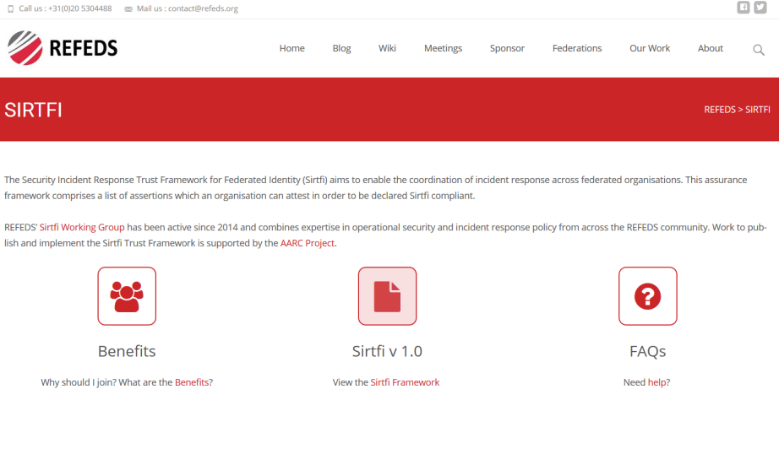
Sirtfi Framework for Incident Response Collaboration
Asserting Sirtfi compliance by an IdP or SP (e.g. via SAML meta-data) means concretely
Operational Security
  Managed vulnerability patching and processes, some intrusion detection,
  account management, contact information available, CSIRT established
Incident Response
  Provide contact information, timely response to assistance requests, willing to collaborate,
  respect privacy and TLP classifications
Traceability
  Logs are timestamped, retained, and available; and there is a policy governing its retention
Participant Responsibilities
  There is an AUP for participants, users are made aware of it and agree to abide by it
Some, not all, federation agreements actually cover some of this (e.g. an AUP in SURFconext)
https://refeds.org/SIRTFI

Slide 20
Sirtfi – the road ahead!
Phase I: develop the SIRTFI Trust Framework specification, defining
basic security incident response capabilities - organizations can self-assert compliance
  Define meta-data schema for security contacts
  Entity category definition and registration
Phase II: means for member organisations in R&E federations to indicate their compliance
  Training and communication
  Implement contact and category definitions in production federations (and keep it up to date)
Phase III: means for proactive notification of account compromise along the chain
  Automated mechanisms for incident notification in the federation chain
  Look e.g. at initiatives like Confyrm – incidents mostly spread based on commons user across SPs and IdPs
  Tooling is needed, but maintaining privacy is always a challenge …

Slide 21
Sirtfi in practice – Security Contact Meta-data in federations
Security Contact Data in the meta-data specification
Extends InCommon contactType (and will likely be renamed):
<ContactPerson contactType="other" xmlns:icmd="http://id.incommon.org/metadata" icmd:contactType=
"http://id.incommon.org/metadata/contactType/security">
Who to expect there?
Somebody in the entity organisation security team who knows about TLP and confidentiality
Promptly (within one business day) acknowledge receipt of the security incident report.
As soon as circumstances allow, investigate incident reports regarding resources, services, or identities for which they are responsible.
Respond to the incident reporter and any other impacted parties when the incident is resolved.

Slide 22
All the elements in place: Credential Translation & Management

Slide 23


Translation services – an overview
NCSA (IL,USA) operated service and project
InCommon backed MICS and IOTA
Generic ‘opaque’ certificate in Europe
Helps with PII data protection and integration with ESFRIs and e-Infrastructure
CERN wLCG IOTA CA
eduGAIN backed with added
CERN HR DB controls
GEANT Trusted Certificate Service TCS
could be turned into a translation service, when each subscriber would enable that since it has a subscriber-centric validation model

Slide 24
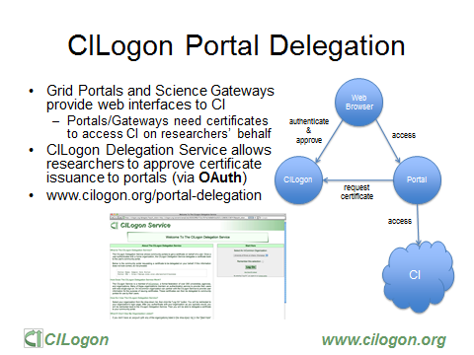
Slide: Jim Basney,
NCSA and CILogon

Slide 25
AARC SA1 “CIlogon-like Pre-Pilot”
Establish a CILogon (like) service in Europe
Integrated closely with R&E federation landscape (with all of full-mesh, H&S, mixed-models)
Integration with user community services and attribute services
Close co-operation with the CILogon Project (Jim Basney et al.)
Pre-pilot work, so based on pre-AARC requirements gathering
FIM4R requests, alignment with known user communities (EGI evolution, ELIXIR)
Potential to support the EGI ENGAGE community ‘competence centre’ work
Leveraging existing components and services: CIlogon + ‘OAuth4MyProxy’ components, VOMS Attribute Certificate service, OIDC libraries, …
Try to fit first in the existing policy framework: Approved Robots (and “PUSPs”), Trusted Credential Stores, PKP Guidelines, IGTF ‘DOGWOOD’ – unless the pilot runs aground …

Slide 26
Desired features set
Certificate or proxy retrieval possible for federatively-authenticated end-user
inside a community (VO) portal or science gateway
Work with the existing (SAML2) R&E federations
Credential repository feature: manage credentials on behalf of the user
Provide – on the user’s request – delegated credentials to science gateways
Make end-user facing science gateways really light-weight: VOs should not need to know about protecting long-term secrets (and need a way to authenticate users)
Support both certificate and non-certificate science gateway use cases in the same way
Provide simple way for users to obtain ‘opaque’ CLI credentials (proxies) on their own system
Constraints:
No new software components (only limited glue)
Deployable in a scalable way – with a sustainability model behind it
As few CAs as possible (preferably: just one)

Slide 27
End-user credential hiding in the AARC CILogon-like Pilot
Do not assume any changes in the IdPs: no ECP, no new policies, no nothing (reality, sorry!)
Assume no major changes in the e-Infrastructures: interfaces remain a mix of Web and PKIX, policies remain mostly as-is
Should show results ‘fairly soon’ (i.e. in a few months work) for a broad audience
Leverage existing CILogon and MyProxy, thanks to the collaboration of AARC-CTSC/MyProxy
Beyond CILogon
CILogon assumes the e-Infrastructures (CIs) build the portals and interfaces
CILogon assumes that users in the end might retrieve certificates explicitly
Larger RIs and e-Infra in Europe could do it, but not the large number of small communities
So the AARC Pilots adds additional control elements: credential management, light-weight portal interfacing, (VOMS) attribute management, optional: opaque credential retrieval

Slide 28
Components
http://wiki.nikhef.nl/grid/CILogon_Pre-Pilot_Work

Slide 29
Authorization at the VO level
The VO light-weight portals (gateways) can re-use this system for both AuthN and AuthZ
Can be used besides a conventional (SAML) login to science gateway when a proxy is needed
Or even …
User ability to complete the OIDC login to the VO web portal (each time) does AuthN
Ability of the portal to successfully request VOMS attributes for an AuthZ/membership check
Successful authN and failed AuthZ? Suggest enrolment or auto-enrol members!
VO portal must be on a trusted list of the Master Portal
  Needs to be able to do OIDC in a trusted way
  Using a VO portal client ID + client secret (but there are server certs as well for the web site itself)
  User must be able to trust that the Master Portal will only relinquish user credentials to intended places
  OIDC consent mechanism informs the user of where the user credentials are sent

Slide 30
What do the VO portals (science gateways) get?
Basic service elements
Authentication and a persistent non-reassigned ID
Check on membership in a VO – since they get the VOMS attributes
Implicit ‘Where Are You From’ because of the Delegation Service redirect
Credential repository service and refresh model
Simple OIDC interface
Additional elements
Option to add auto-enrolment in the VOMS server
Option to add a generic ‘opaque access token’ (proxy) service via an SSH interface
Implicit SSH user-public key repository at the master portal

Slide 31
Towards a CILogon CA for Europe
As a first phase, Jim may actually just open up the existing CILogon to ‘eduGAIN’
Once InCommon has also technically joined eduGAIN
For qualified entities in eduGAIN: R&S + SirTFi
Uniqueness enforced by the CILogon CA itself (as long as there’s no true ‘ePUniqueID’)
Aim for (a single) IOTA CA in Europe (EU/EEA) to back the Master Portals
This would be a generic IOTA CA, but it can be modeled closely on existing ones
Model yet to be worked out (extend CERN’s IOTA CA? A new one?)
Support as many (European) eduGAIN IdP as feasible
Potentially including qualified IdPs of last resort operated by RI/e-Infrastructures, or qualified proxy services like the VOPaaS IdP gateway (with LoA support)
Having it issue only short-lived credentials would make things like DPCoCo compliance easier

Slide 32
Access to a CILogon service from ‘all of eduGAIN’ - requirements
eduGAIN is a policy-neutral interfederation exchange mechanism – so it has no single policy
To make it trustworthy and usable, it is wise to consider requiring e.g.
R&S attribute release, so that the service gets
eduPersonPrincipalName, mail, and (displayName OR (givenName AND sn))
also gets a non-reassigned identifier. This may be ePPN, but could be the (pretty useless but at least unique eduPersonTargetedID or NameID)
Aligned with the SirTFi Framework
remains to be seen if this is actually sufficient for accrediting it …

Slide 33
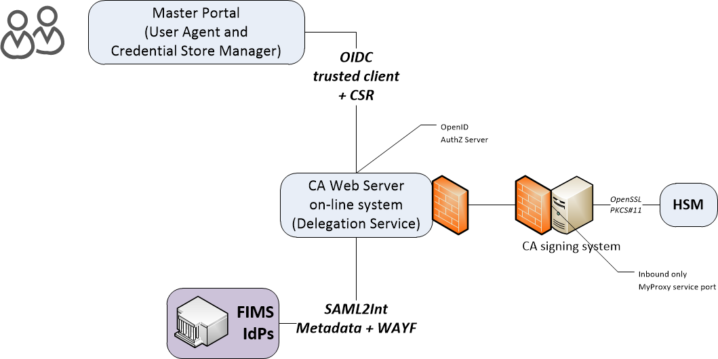

Slide 34
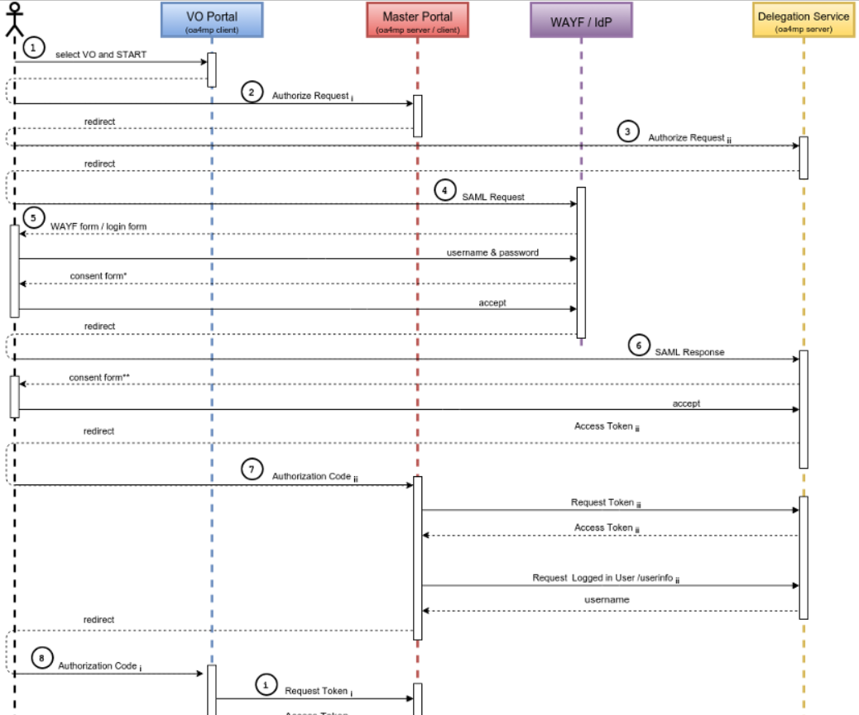
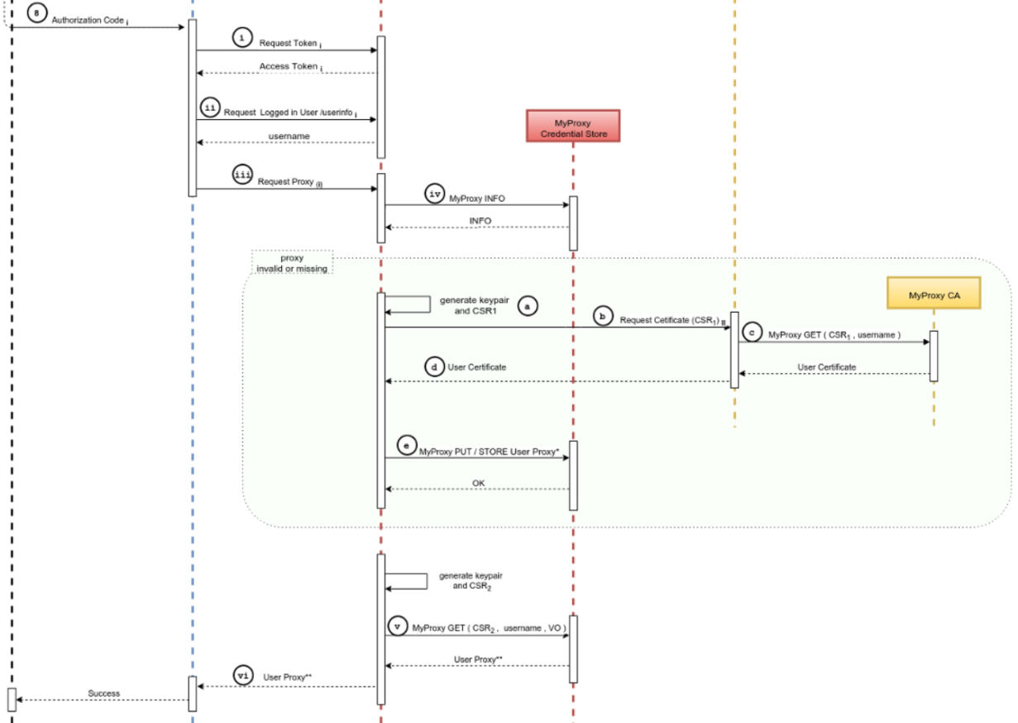
It’s a complex flow … because of a double OIDC + SAML + Online CA

Slide 35
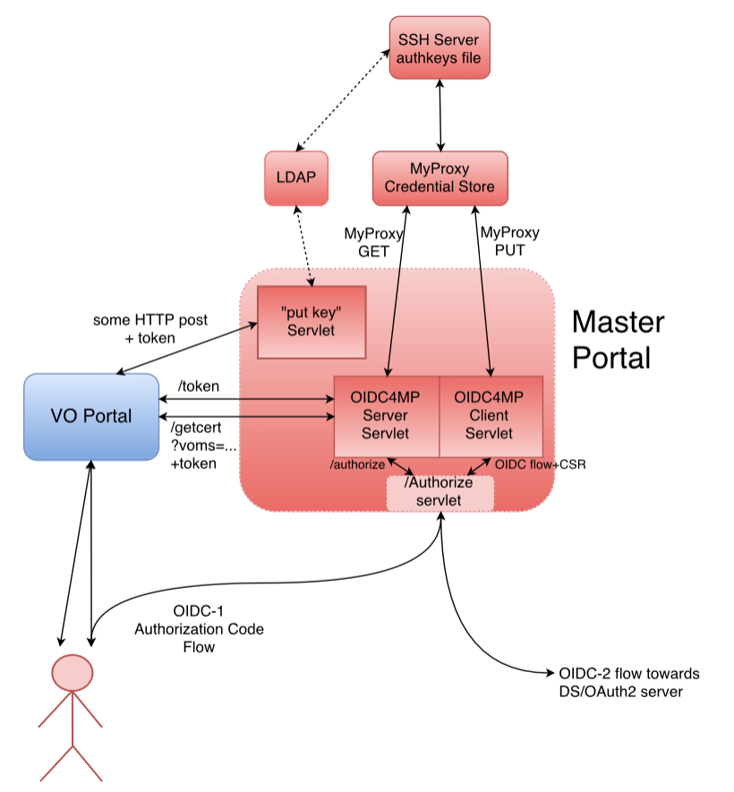
Master portal is a rather critical service
This is the component that – with a credential store and an (OIDC) authentication interface –takes care of the user credential management
The back-end CA provides
  Identifier uniqueness
  Revocation capability
but not much more!
It is a highly trusted component, of which there should not be many
But it may still be better then end-user managed keys – for authentication, that is …

Slide 36
An AARC ‘CILogon-like’ CA and the IGTF Policy Suite

Slide 37
Relevant IGTF policies
IOTA AP: LoA DOGWOOD and PKI Technology Guidelines
  https://www.igtf.net/ap/iota
  https://www.igtf.net/ap/loa
  https://wiki.eugridpma.org/Main/PKITechnologyGuidelines
Guidelines on the Operation of Credential Stores (draft)
  https://www.eugridpma.org/guidelines/trustedstores/
PKP Guidelines
  https://www.eugridpma.org/guidelines/pkp

Slide 38
Protecting credentials, CS Operators
http://wiki.eugridpma.org/Main/CredStoreOperationsGuideline
data needed to activate and use credential material must not be held by the system on persistent storage, and must not be held by the system administrators. These must only be present in the system as a result of a user action, and only for as long as the user is using the system.
The activation data and any plain text private keys should be removed as soon as the user stops using the service, and should not be kept past 24 hours of inactivity exclusive use of confidential, integrity protected, and authenticated channels for the transfer of activation data and any private key material.
The keys used to protect the channel must have a strength equivalent to or better than an 2048 bit RSA key.
The keys must be suitably protected by the operating system or an HSM, and must only be accessible by the service and trained personnel with procedural controls.

Slide 39
PKP Guidelines
Section: Generation of private keys
A system SHOULD NOT persistently keep pass phrases or plain text private keys for longer than 24 hours, unless the key pair is used solely as a basis for Short Lived credentials, i.e. the certificate has a total validity of less than 1 Ms.
  “This text is written such that it allows for a portal to request a certificate on the user’s behalf (e.g. by redirecting the users to a, potentially federated, SLCS service) and keep the key material in the portal. To off-set the risk of keeping unencrypted private keys on disk for long periods of time, the mechanism as used by, e.g., the ssh-agent system is intended to be used for protection: The portal can itself encrypt it with some other pass phrase and store the key on disk, but keep the (portal-private) activation data to re-read the private key only in-memory (so that it becomes a lot harder to sniff in case the box is broken, in the same way that ssh-agent does it and for the same reasons).”

Slide 40
PKP Guidelines
But in the “Storage of key material” section …
Data needed to decrypt or use the private key MUST not be held by the system on persistent storage, and MUST not be held by the system administrators. It MUST only be present in the system as a result of a user action, and only for as long as the user is using the system. The activation data and any plain text private keys SHOULD be removed as soon as the user stops using the service, and MUST NOT be kept past 24 hours of inactivity.
  “This text specifically allows for long-running and multi-step work flows to continue in the absence of physical user presence at the portal. The word 'inactivity' should be interpreted as “if a user logs in and starts a long work flow at 3PM, leaves the portal and goes home at 5 PM, but the work flow completes only 48 hours after that, it is perfectly legitimate for this third-party system to hang on to the private key activation data in memory for 56 hours”. If we were to limit the caching of activation data to just 6 (or 24) hours after the user as stopped clicking on the portal (i.e. at 11PM), we would never get any real work done. But if the portal gets rebooted, the activation data is lost and the work flow will terminate once the pending proxies expire (after ~ 12-24 hrs). The 6 or 24-hour period is somewhat arbitrary, and should be synchronised to the characteristic ‘session expiration’ period for most portal applications.”

Slide 41
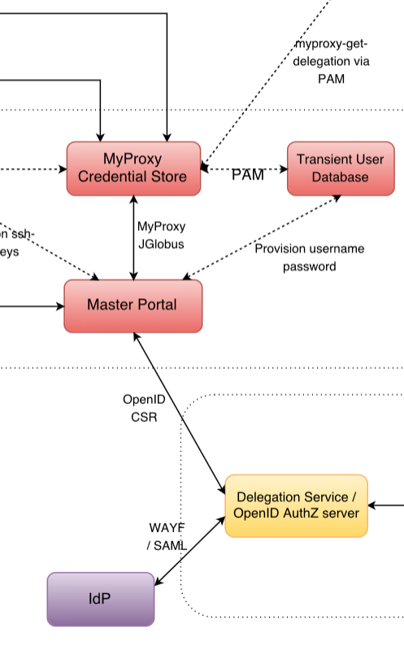
PKP Guidelines – the Challenge
The PKP Guidelines assume the user is present – somewhere in the
workflow – to provide a unique secret (activation data) with which
to protect the user’s credential
But:
in the entire federated workflow, there is no such secret to be found
the SAML assertion, the OIDC access tokens, the authorization codes:
all are generated by servers
the one unique user secret is hidden
– rightfully and only ever exposed to the federated IdP
the only place from which to get
a unique bit of private data close to the credential store
… is a single common place: the Master Portal ☹

Slide 42
Building the Pilot
The AARC CILogon-like Pilot works around this in the ‘trivial’ way
It requests a certificate when the user logs in via the portal (OIDC->OIDC->SAML/R&E)
Generates a unique key pair in the Master Portal memory, making a CSR on behalf of the user
OK, since “Key material MUST only be generated in the system as a result of a user action”
It then delegates a proxy to the Master Credential Store (a protected MyProxy)
And securely deletes the key pair in memory
By storing only a proxy in the Master Credential Repository it can leverage PKP and CS guidelines

Slide 43
What is the ‘right’ way of doing this? Considerations
Can the user – with duly informed consent – actually delegate credential management?
Pros
Good for usability and recoverability of user credentials (no separate passwords)
Custodianship is clearly identified (at the master portal operator)
Users are quite fed up with credential management and use any solution, so why not this?
Short life time can help limit the risks
Cons
Custodianship is clearly identified – who will want to run the master portal and take the risks?
Master portal operator can act as the user –
Short life time impairs the user for long-running jobs – automatic credential renewal is
non-trivial since you need the user in the loop every time
… and the master portal does not know the workflow

Slide 44
Short-lived credentials?
Use of credentials with a life time < 1Ms (11days) does allow unencrypted storage
So the master portal could ‘just’ hold them
Towards a mixed model:
The work flow may run for longer than 11 days
the responsibility for renewal is with the science gateway
involving the user at the VO portal
Science workflow directs user to the master portal
The CA allows for both VO-based portal and direct use:
13 months* where possible, 11 days where necessary

Slide 45
RCauth.eu – accreditation and implementation

Slide 46
AARC engagement process: operational pilots
AARC will not operate any long-term services (that’s for GEANT, EGI, PRACE, EUDAT …)
But will pilot actual technology combinations that are useful to (research) communities
Proposal-identified pre-pilot: certificate-less access to existing services with “CILogon for Europe”
Driven by Mischa Sallé and Tamas Balogh (Nikhef)
Aligned with the EGI “JRA1” activity around the evolution of the AAI technology (ChristosK)
Using actual use cases from EGI competence centres and AARC communities
“It’s always a challenge to pilot something with a real community – the expectations are usually much higher than what can be provided in a pilot …”

Slide 47
Operating an generic European IOTA CA
It is a SPOF, so needs a high service level
Should be within the EU to ease transfer of personal data
Needs a sustainability model
Candidates to run this?
joint e-Infrastructure operation?
source it to a dedicated company under a strong SLA + PII protection?
‘Worst case’ would be to get one per country … and we still need a business model
In AARC DAASI is tasked to research possible sustainability & operating models

Slide 48
Distribution of Roles in a Sustainable Model
VO Portal (Science GW)
One per application
Many deployed throughout
Reduced policy and compliance burden
Master Portal
One per country, ESFRI
Must be well-managed
Can be managed because there are few
CA and Delegation Service
As few as possible: just one!

Slide 49
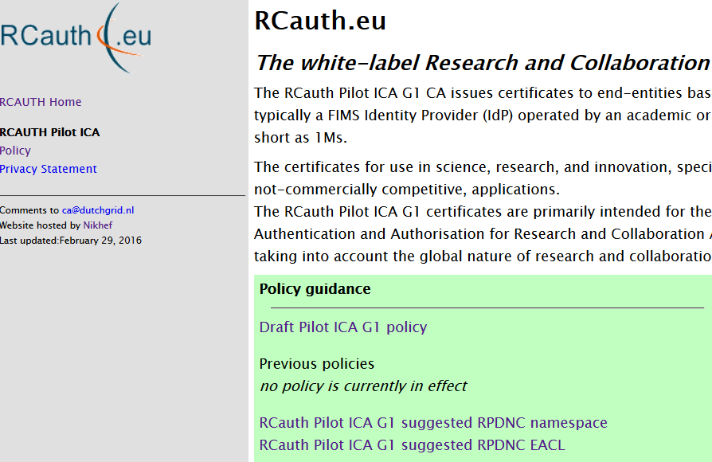
RCauth.eu – a white label IOTA CA for Europe
Move pilot towards a complete accredited IOTA CA
Allows to find policy issues and compliance bottlenecks in the review process
Tests applicability of ‘Sirtfi’ and REFEDS R&S with our relying parties
And in practice
Actually supports AARC and e-Infrastructure use cases (ELIXIR, EGI CC)
Potential to collaborate closely with the WLCG IOTA CA
Is white-label so that it (politically) can be used by anyone
Hosted for now under the DutchGrid CA Service umbrella
On-line “model A” on-line HSM CA with an off-line root
But no guaranteed service level – that’s for another entity
to take over once we have a business model working
https://www.rcauth.eu/

Slide 50
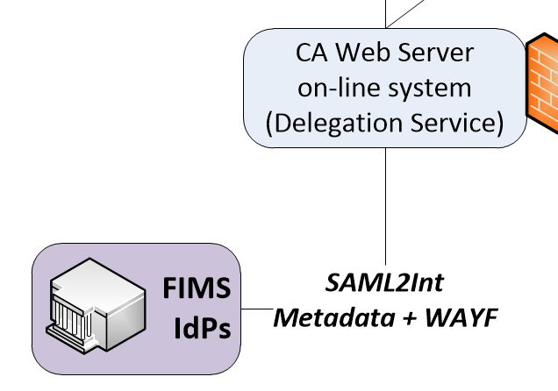
Policy challenges beyond CILogon?
Jim’s CILogon is a single CA, serving a single controlled federation (InCommon)
RCauth.eu tries to take this one step further, by leveraging eduGAIN + additional policies
But in IOTA:
“Any such third parties must have a documented and verifiable relationship
with the issuing authority, and through this relationship the issuing authority
must have documented, verifiable and auditable means to ensure the
requirements of this authentication profile are met.”
And we have
eduGAIN + REFEDS R&S (uniqueness) + Sirtfi (traceability and incident response)
The eduGAIN declaration and a signed meta-data file – is that ‘documented and verifiable’?

Slide 51
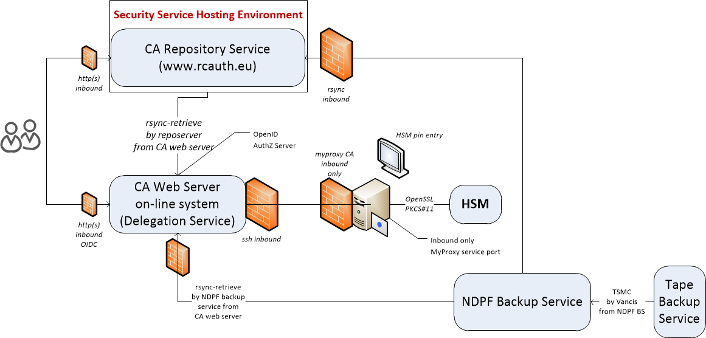
RCauth.eu – online CA setup
Gemalto SafeNet eToken Pro 72k HD

Slide 52
RCauth deployment schedule
CP/CPS for both the off-line root and the RCauth Pilot ICA completed drafts
Call for reviewers went out on March 2nd, 2016
Because of the nature of the RCauth operator, it needs external moderation in EUGridPMA …
Still looking for more reviewers … who are not ‘compromised’ by AARC …
Aim to complete the process at the Ankara May meeting
Needs reviews to complete (and not find major blocking issues)
Needs SURFconext to agree to the privacy policy (or we could not do incident response)
… or RCauth to find the most suitable federation in eduGAIN to hook up to
Some remaining programming effort to implement EU privacy constraints
The draft trust anchors are added as experimental CAs for testing

Slide 53
Thanks to all AARC folk whose slides and work I used in here –
esp. Mischa Sallé, Tamas Balogh, Jim Basney, Paul van Dijk
davidg@nikhef.nl

