Slide 1

Interoperable AAI: blueprint, technology, policy
in an interconnected world
David Groep
AARC Policy and Best Practice Activity Lead
APGridPMA IGTF Spring meeting at ISGC
In collaboration with and
co-supported by EOSC-HUB
March 2018
Taipei, TW
Supported by the Dutch National
e-Infrastructure coordinated by SURF

Slide 2
Research Communities
How researchers collaborate varies
significantly from community to community
Ability to access and share resources is
crucial for the success of any collaboration
research -and education- depends on IT Infrastructure
AAI becomes more diverse: different authentication, authorization, and community management models
With user-managed, home-institute-, and social IDs
Notes:
The way researchers collaborate within scientific communities can vary significantly from community to community. On the one hand, there are highly structured communities with thousands of researchers who can be virtually anywhere in the world. Typically, these communities have been working together for a long time, they want to share and have access to a wide range of resources. On the other hand, one finds a diverse number of smaller research communities working within specific or across scientific disciplines. Typically, these are either nascent communities being established around new scientific domains, or they are communities in specific domains that did not require wide spread and close collaboration among the researchers. And of course, in between these two extremes, there are many scientific communities of varying size, structure, history etc.
Regardless, if we are talking about large-scale, well-structured collaborations or about loosely coupled collaborations centred around the individual researcher, they all need to share and access resources. The ability to access and share resources is crucial for the every day research. Advanced research needs equally advanced IT services.

Slide 3
About the tour
Federated identity and the research infrastructure: proxies in the AARC Blueprint Architecture
Bridging policy across the proxy: assurance profiles and assessment and operational trust
Translating tokens and credentials: TCS and RCauth.eu - on uniqueness and ‘trust marks’ in FIM
Supporting connected services: scalable trust in OIDC

Slide 4















Identified common challenges
Communities / e-infrastructures surveyed in AARC
Homeless
users
User
friendliness
PII Data Protection
Community
based AuthZ
SP
friendliness
Credential
translation
Bridging Communities
Engaging
SPs
Notes:
So we identified a large number of requirements and common challenges across (14) research communities and e-infrastructures. (based on FIM4R)
Balancing the interest of all the different communities
The input we needed to commence our pilots
Attribute aggregation: Most federated identity management systems are limited by users' ability to choose only one identity provider per service session. There should be a linking service that lets users securely link their various identity provider (IdP) accounts without having to authenticate separately to each IdP.
User friendliness: The tools that support the FIM framework should be simple and intuitive and integrate with the many other IT tools used in daily life. Multiple redirection problem, standardise (shib loging, institutional login).
Credential translation: Converting credentials to different formats enables interaction between services using different authentication technologies
Level of insurance: 1. level of assurance as to whether someone or something is who or what it claims to be in a digital environment. 2. The way you login. How safe is the digital way to login you are using (password? Crappy. Token? Super safe) 3. How much do I trust your infrastructure (your admin? Your network?)
Bridging communities. FIM is important and it’s becoming even more. Bridging between the various communities is a central issue with an efficient mapping of the respective attributes.
non-browser federated access. Non-browser based interfaces are essential to support machine-machine interactions in secured workflows.

Slide 5

AARC Blueprint Process
  Guidelines and supporting documents
  reference architecture
  conventions and community standards
  best policy practices
  implementation hints
  training for ‘FIM’ communities
https://aarc-project.eu/architecture/
https://aarc-project.eu/guidelines/

Slide 6
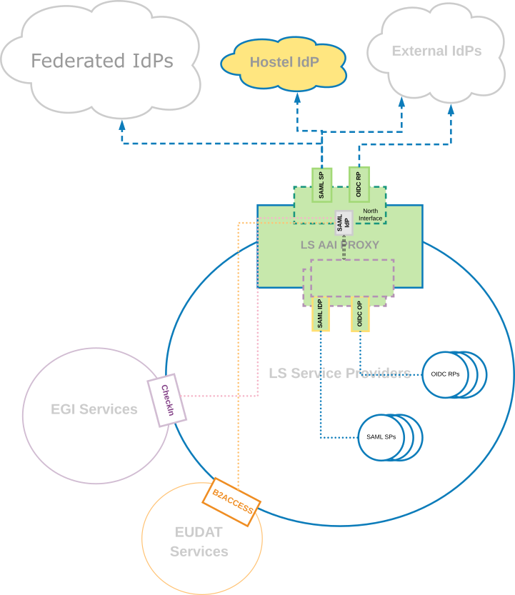
The IdP-SP-Proxy Design Pattern
  Challenges addressed by the proxy model
  attribute release, identity provider heterogeneity, and pervasiveness
  attribute aggregation, community based authorization, & persistent unique identifiers
  guest users, social, and eGov ID
  assurance aggregation and ‘step-up’
  user friendliness and WAYF
  token translation, non-web, and delegation
  provider-friendliness and connection options
example from the LS AAI

Slide 7
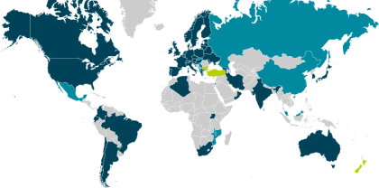
Identity providers – eduGAIN, social, eGov, …
  49 members – many different models?
  architecture (hub-and-spoke vs mesh)
  baseline policies present or absent
  non-reassigned id and attributes:
  ‘by default’, optional, or sometimes discouraged(!)
  tagging of entities and IdPs (‘categories’):
  open, limited, or needs implementation repeatedly
  constituency: including or excluding e.g. private R&D
  paid option or part of nren base services package
  support available for organisational IdP software (e.g. ADFS)
  and then there is social ID for (citizen) science, eGov IDs &c
Federations in eduGAIN
Members | 49
Voting-only | 6
Candidates | 13
Entities in eduGAIN
All | 4538
IdPs | 2654
SPs | 1888
Standalone AAs | 5
data: technical.edugain.org as of 11 March 2018

Slide 8
Harmonisation at the proxy – the technical bits user identity layer and attribute services
To harmonise incoming attributes, the proxy will need state
Long term state
assignment of infrastructure-specific unique identifier
current recommendation: eduPersonUniqueID or sub (type: public)
heuristics to determine ‘unexpected’ changes in source IdPs
even SAML NameID and eduPersonTargetedId may be suspect,
and ePPN is not guaranteed
– see REFEDS R&S spec and also LIGO for algorithm
account linking
Ephemeral state
SSO caching
optional step-up authentication done for this session
assurance profile based on linked authentications
https://aarc-project.eu/guidelines/#architecture

Slide 9
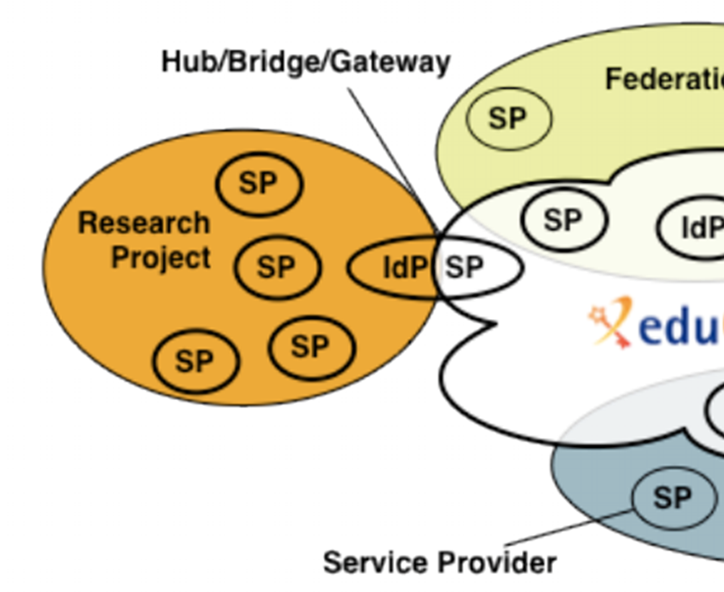
Bridging more than just protocol and technology
Baseline capabilities in the IdPs
Incident response collaboration
Assurance
non-reassignment of an identifier
minimal release of attributes for collaboration
Baseline capabilities in the Infrastructure
Protection of Personal Data (“PII”) and Acceptable Use
Define purpose and scope of attribute use
User and community management
Risk assessment and assurance needs
https://aarc-project.eu/guidelines/#policy
Graphics inset: Ann Harding and Lukas Hammerle, GEANT and SWITCH

Slide 10
Assurance: from federation to infrastructure

Slide 11
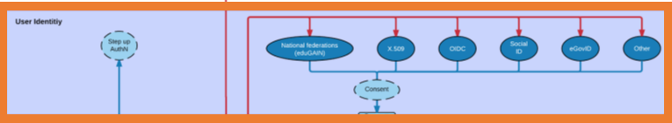
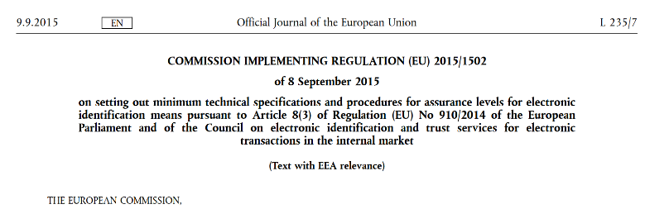
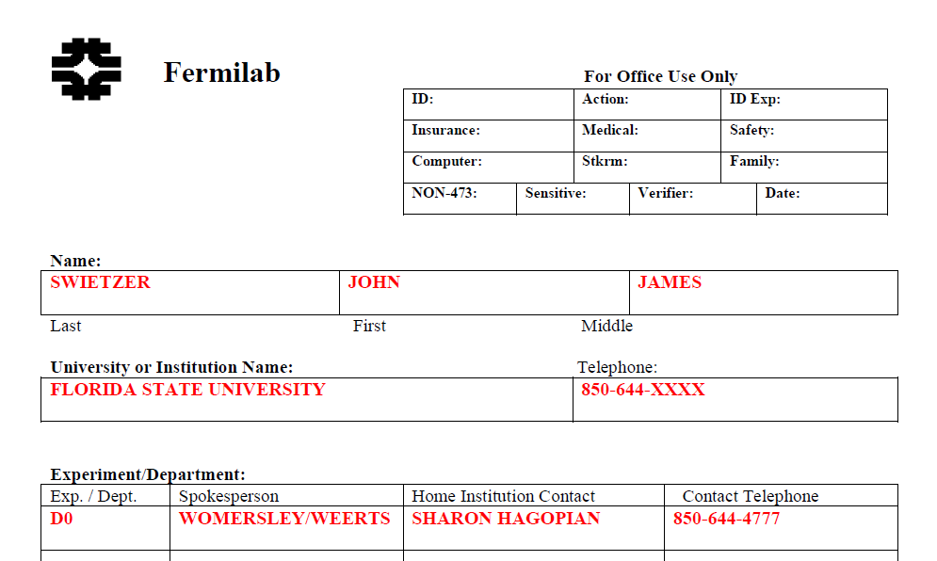
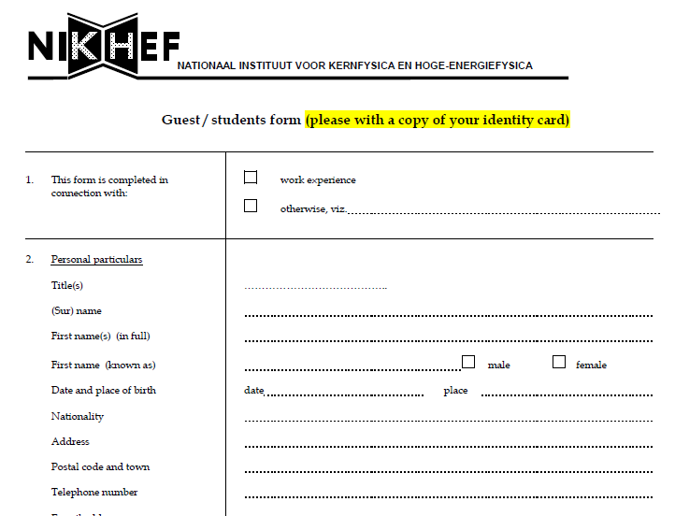
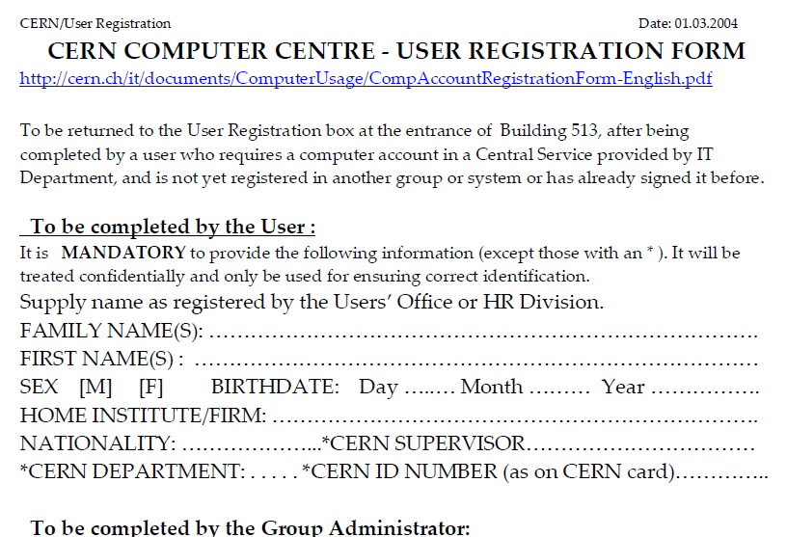
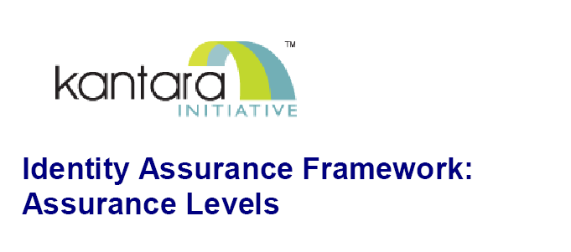
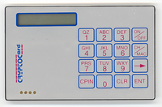
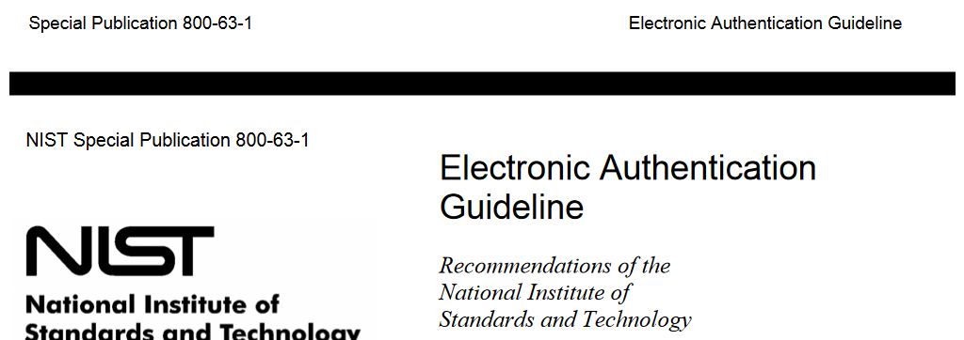
Trusting the User’s Authentication
Many layered models (3-4 layers)
but: specific levels don’t match needs
of Research- and e-Infrastructures:
Specific combination
‘authenticator’ and ‘vetting’ assurance
doesn’t match research risk profiles
Disregards existing trust model
between federated R&E organisations
Cannot accommodate
distributed responsibilities
As a result, in R&E federation there was
in practice hardly any
documented and agreed assurance level
Beyond uncontrolled identifiers:
baseline assurance for research use cases
11

Slide 12
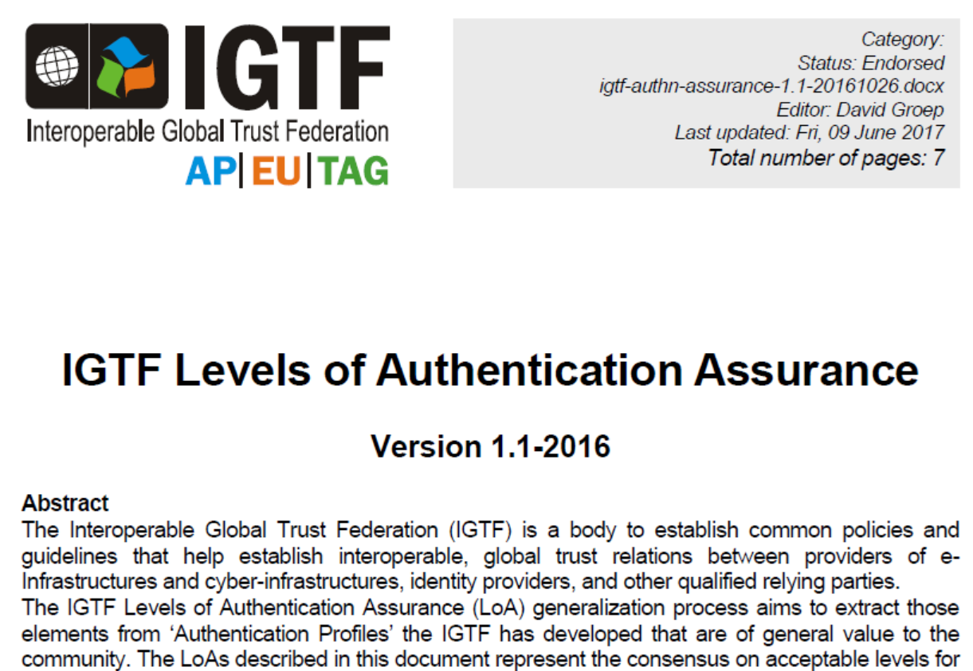
The need for guidance

Slide 13
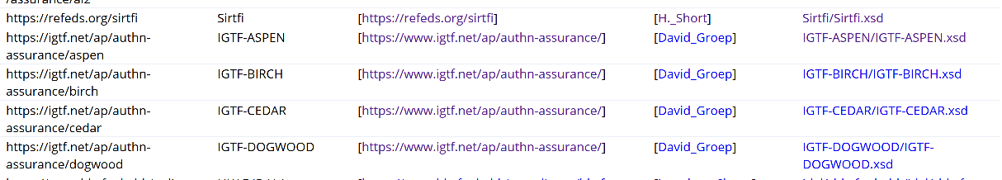
IGTF Assurance Levels: ASPEN to DOGWOOD
specifically targeted at the risk profile of the e-Infrastructures
https://www.iana.org/assignments/loa-profiles/

Slide 14
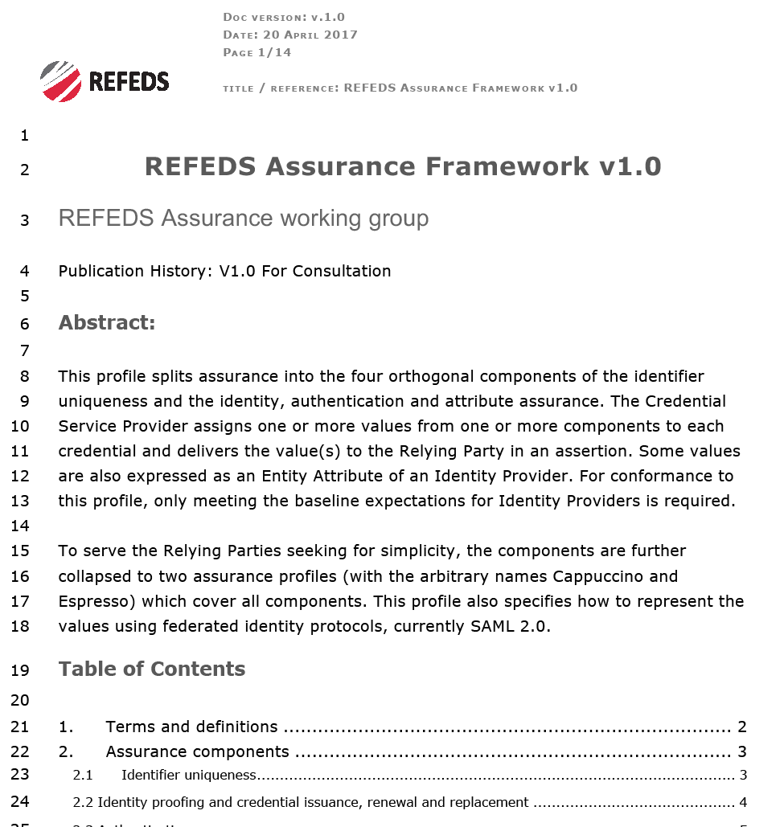
Gaining global federation adoption: REFEDS Assurance Framework
https://wiki.refeds.org/display/GROUPS/Assurance+Working+Group
open, international forum for R&E FIM federations (and a few IdPs)
has links to identity federations –
adoption needs IdP to act and federations to communicate
add new eduGAIN metadata and new attributes for IdPs
implementation guidance in normative form helps
Focus on federation and identity provider feasibility
leveraging REFEDS single* and multi-factor authentication specs
component-based approach allows much flexibility for IdPs to express what they can do
… but - by account linking or Infrastructure specification - assurance profiles can be more powerful

Slide 15
Assurance between Infrastructure AAI Proxies
Assurance derived from several sources
R&E federation IdPs
linked (social) IDs
user-managed credentials
community registry processes
Prevent recomputation of assurance when crossing infrastructures, or
when connecting to pre-arranges groupings of services (‘infrastructure services’)
share common use cases and their risk assessment, so assurance profiles can take precedence
ease flow of information between infrastructures, where more detail is often superfluous
augment the basic REFEDS RAF profiles with infrastructure-specific profiles
-> effective assurance level

Slide 16
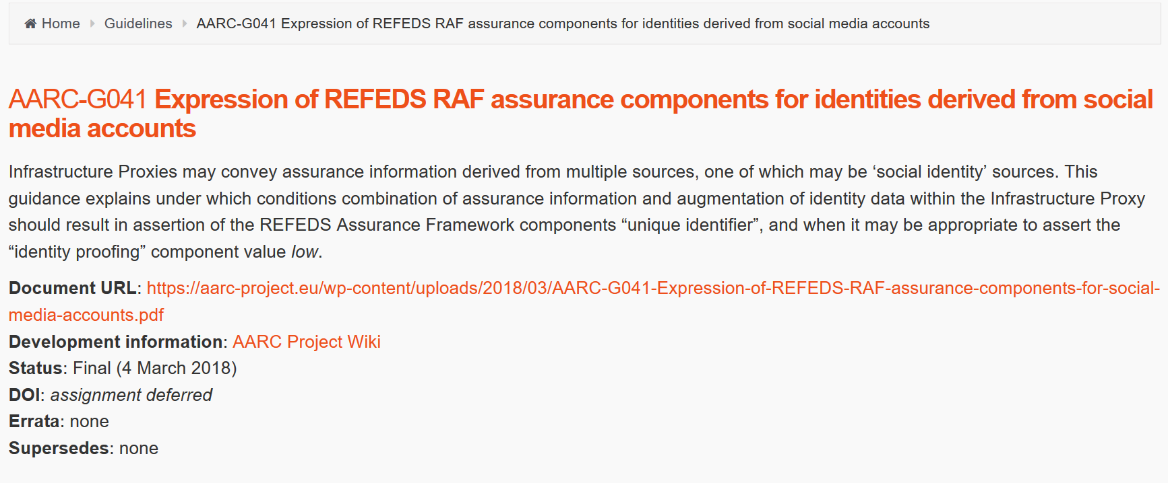
Five Profiles: two imported from REFEDS RAF, two from IGTF, one new
Name | REFEDS RAF Assurance Profile Cappuccino
SAML Identifier | https://refeds.org/assurance/profile/cappuccino
Other identifier(s) | -
Description | has a unique identifier, identity proofing and credential qualifies substantially to Kantara LoA 2, IGTF BIRCH or CEDAR, or eIDAS low, and can be attained with single-factor authentication according to REFEDS SFA without further constraints. Affiliation information is not older than one month.
Name | REFEDS RAF Assurance Profile Espresso
SAML Identifier | https://refeds.org/assurance/profile/espresso
Other identifier(s) | -
Description | has a unique identifier, identity proofing and credential qualifies substantially to Kantara LoA 3 or eIDAS substantial, and must be attained with multi-factor authentication according to REFEDS MFA, where the multi-factor credential cannot be derived solely from a single-factor. Affiliation information is not older than one month.
Name | IGTF BIRCH
SAML Identifier | https://igtf.net/ap/authn-assurance/birch
Other identifier(s) | IGTF-BIRCH urn:oid:1.2.840.113612.5.2.5.2
Description | Persistent non-reassigned identifier, identity proofing based on in-person appearance (current or past), remote vetting with compensatory controls, or Kantara LoA 2 or better. Includes a reasonable verified representation of the real name of the entity, and is secure with a best common practice (27-bit entropy as per NIST SP800-63v2, 2004) single factor or multi-factor authenticator. Identity and authenticator are managed by the CSP.
Name | IGTF DOGWOOD
SAML Identifier | https://igtf.net/ap/authn-assurance/dogwood
Other identifier(s) | IGTF-DOGWOOD urn:oid:1.2.840.113612.5.2.5.4
Description | Persistent non-reassigned identifier, identity proofing sufficient to ensure non-reassignment of the identifier for the lifetime of the CSP. May contain marginally-verified real name resemblance or identifiers clearly identifiable as pseudonyms. No anonymous credentials permitted and issuance is traceable at time of issuance. Authenticator is secured according to best common practice (27-bit entropy as per NIST SP800-63v2, 2004) single factor or multi-factor authenticator, or compensatory controls on credential validity period are in place. Identity and authenticator are managed by the CSP.
Name | AARC Assam
SAML Identifier | https://aarc-project.eu/policy/authn-assurance/assam
Other identifier(s) | AARC-Assam
Description | Identity substantially derived from social media or self-signup identity providers (outside the R&E community) on which no further policy controls or qualities are placed. Identity proofing and authenticator are substantially derived from upstream CSPs that are not under the control of the Infrastructure. The Infrastructure ensures uniqueness on the identifiers based on proprietary heuristics.
this is a challenging profile, since many of its qualities are
outside the control of the Infrastructure Proxy
See AARC-G041
for considerations on “ID/unique” compliance
AARC-G021
Exchange of specific assurance information between Infrastructures
https://aarc-project.eu/guidelines/aarc-g021/ and https://doi.org/10.5281/zenodo.1173558

Slide 17
Combined assurance: EGI example
EGI – by design - supports loose and flexible user collaboration
300+ communities
Many established ‘bottom-up’ with fairly light-weight processes
Membership management policy* is deliberately light-weight
Most VO managers rely on naming in credentials to enroll colleagues
Only a few VOs are ‘special’
LHC VOs: enrolment is based on the users’ entry in a special (CERN-managed) HR database, based on a separate face-to-face vetting process and eligibility checks, including government photo ID + institutional attestations
Only properly registered and active people can be listed in VOMS

Slide 18
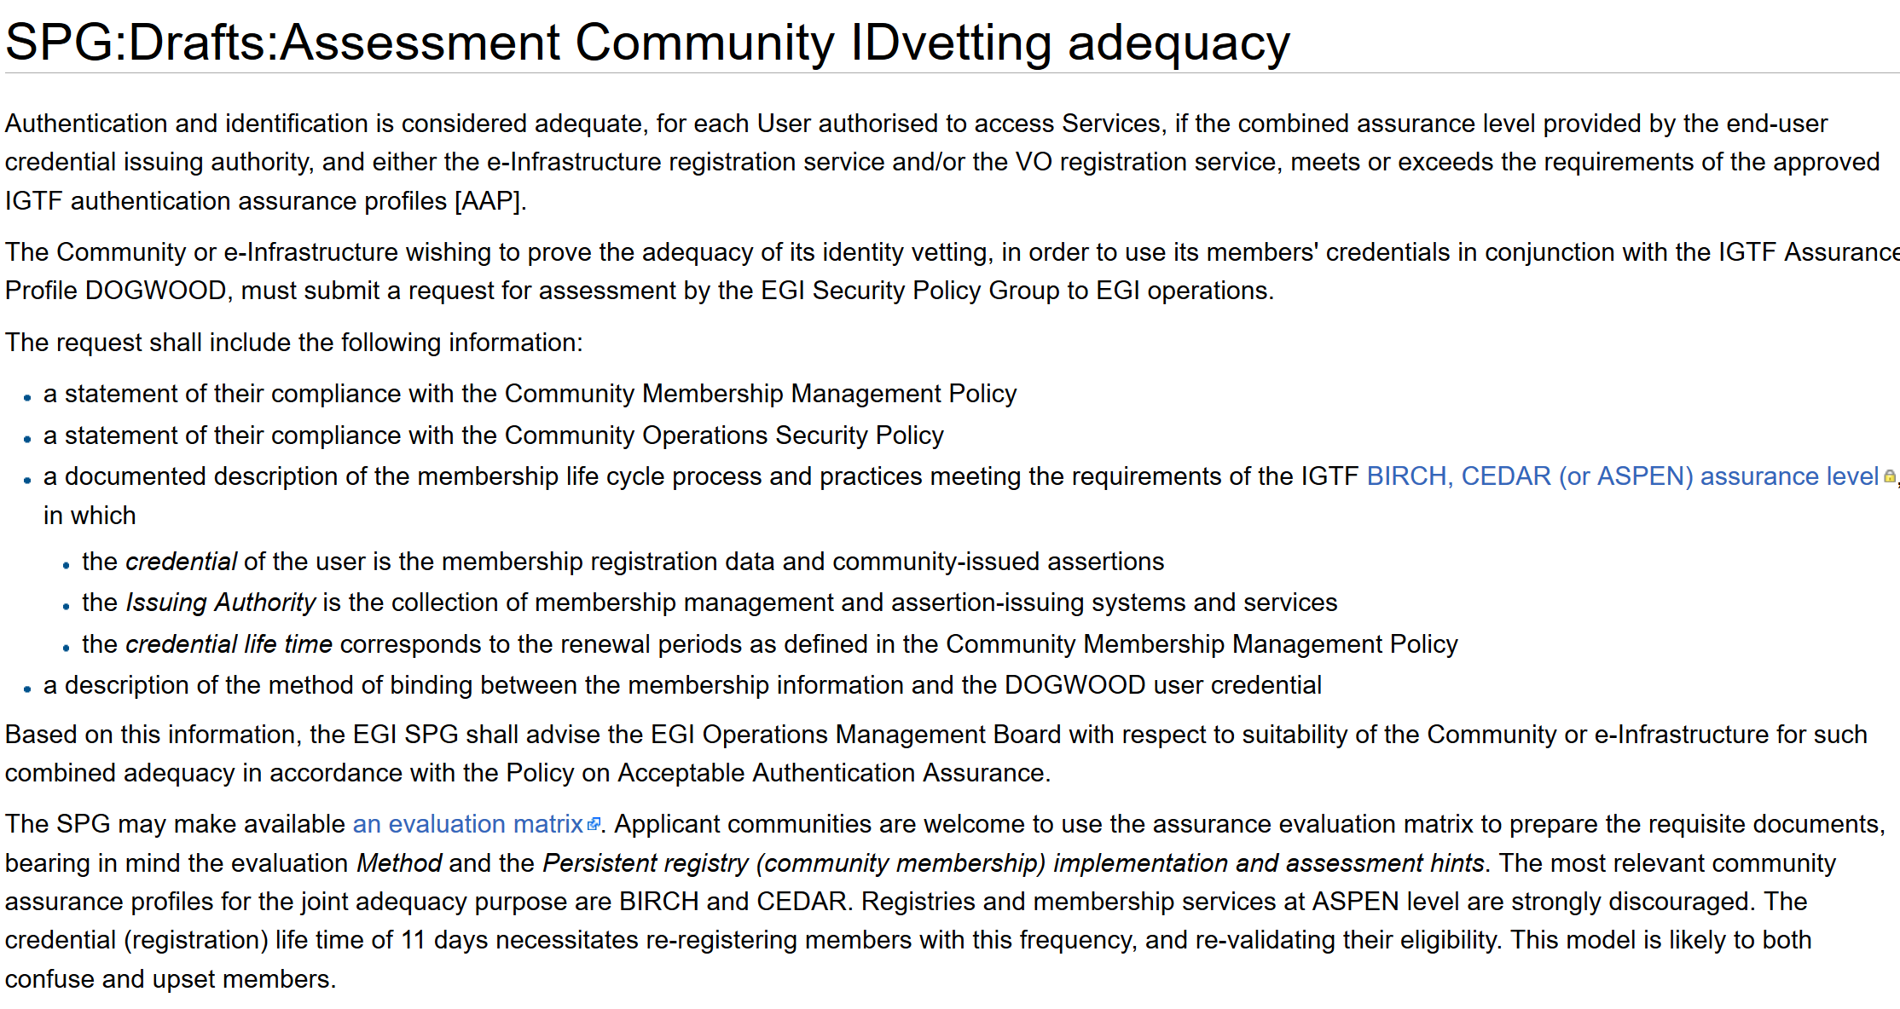
Developing an assessment framework
https://wiki.egi.eu/wiki/SPG:Drafts:Assessment_Community_IDvetting_adequacy

Slide 19
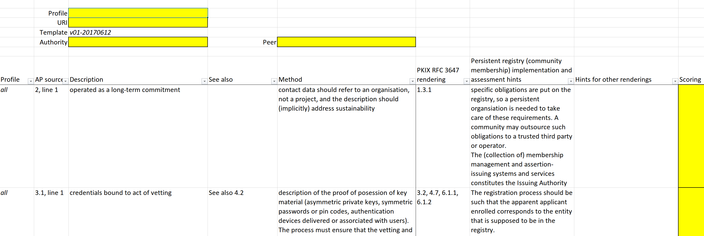
Assessment Matrix
Mapping for PKIX/RFC3647 is trivial
How to apply out BIRCH/CEDAR guidance to community registries?
Relevant for COmanage & VOMS communities, and potentially much wider
https://wiki.eugridpma.org/Main/AssuranceAssessment

Slide 20
Trusted Operational Security and Incident Response

Slide 21
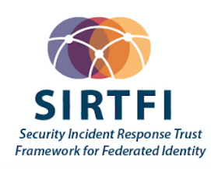
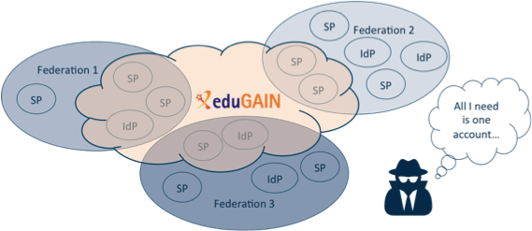
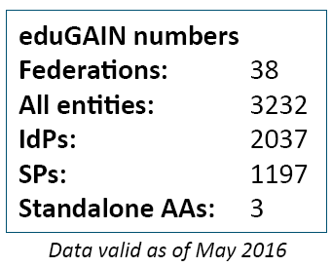
Security Incident Response in the Federated World
How could we determine the scale of the incident?
  Do useful logs exist?
  Could logs be shared?
Who should take responsibility for resolving
the incident?
How could we alert the identity providers
and service providers involved?
Could we ensure that information is shared confidentially, and reputations protected?
Security Incident Response Trust Framework for Federated Identity
Sirtfi – based on Security for Collaborating Infrastructures (SCI) & FIM4R Recommendations

Slide 22

A Security Incident Response Trust Framework – Sirtfi summary
Operational Security
Incident Response
Traceability
Require that a security incident response capability exists with sufficient authority
to mitigate, contain the spread of, and remediate the effects of an incident.
Assure confidentiality of information exchanged
Identify trusted contacts
Guarantee a response during collaboration
Participant Responsibilities
Improve the usefulness of logs
Ensure logs are kept in accordance with policy
Confirm that end users are aware of an appropriate AUP

Slide 23
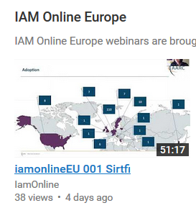
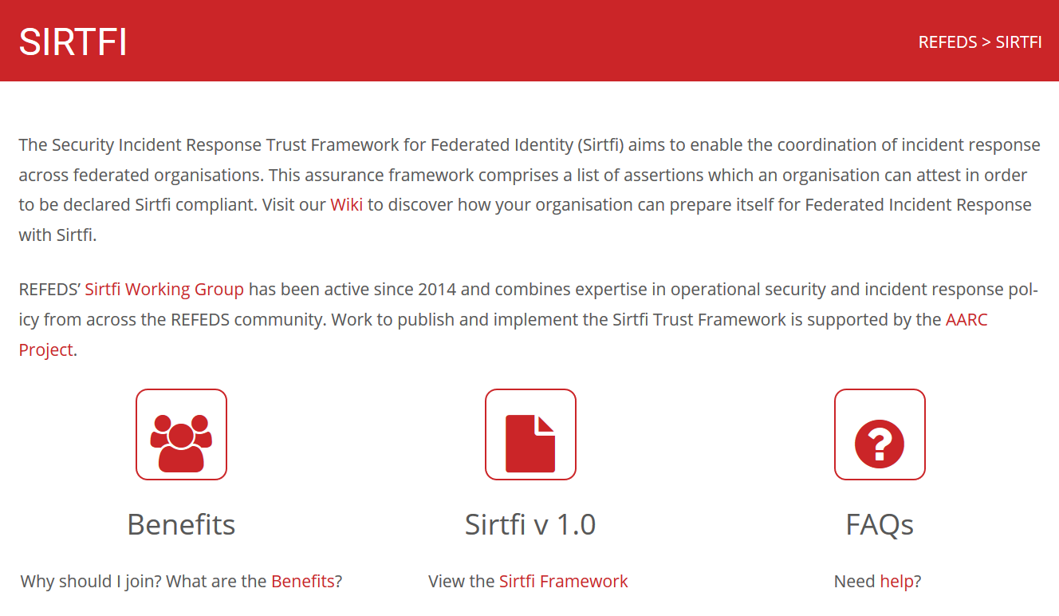
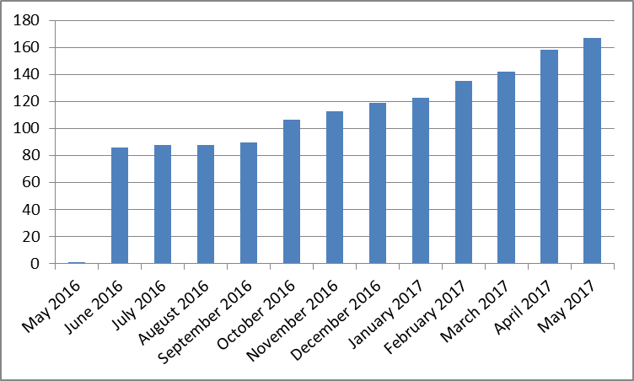
Sirtfi adoption by authentication providers and services
https://refeds.org/SIRTFI
Used for filtering (with R&S) by proxies & services
EGI operational services, RCauth.eu bridge,
CERN SSO, CILogon Basic services, …
>170 entities
adds security contact meta-data in eduGAIN
with R&S meets baseline assurance and
IGTF “assured identifier” profile
… IGTF-to-eduGAIN bridge asserts R&S+Sirtfi
Combine with 407 REFEDS R&S IdPs (May ’17)

Slide 24
Linking FIM AAI to PKIX technology: TCS and RCauth

Slide 25
The AAI evolution of e-Infrastructures and Research Infrastructures
Most infrastructures move to completely hiding PKIX from the end-user
  Less credentials to manage, appearing ‘simpler’ to the user, but …
  EEPKI + RFC3820 proxies did solve both the CLI and delegation use case rather nicely!
Bridging and translation is the pragmatic approach
  Does not require major technical changes in existing R&E federations
  Allows for community-centric identities-of-last-resort (or first resort, for that matter!)
  Time line is more predictable, because fewer entities are involved –
  and those entities have a stake in and the benefits off the results
Emerging as a pattern in many Research Infrastructures that use CLI or brokerage
  ELIXIR, UMBRELLA, WLCG, INDIGO DC
  SAML->OIDC, SAML->X509, X509->OIDC, X509->SAML, OIDC->X509, …

Slide 26
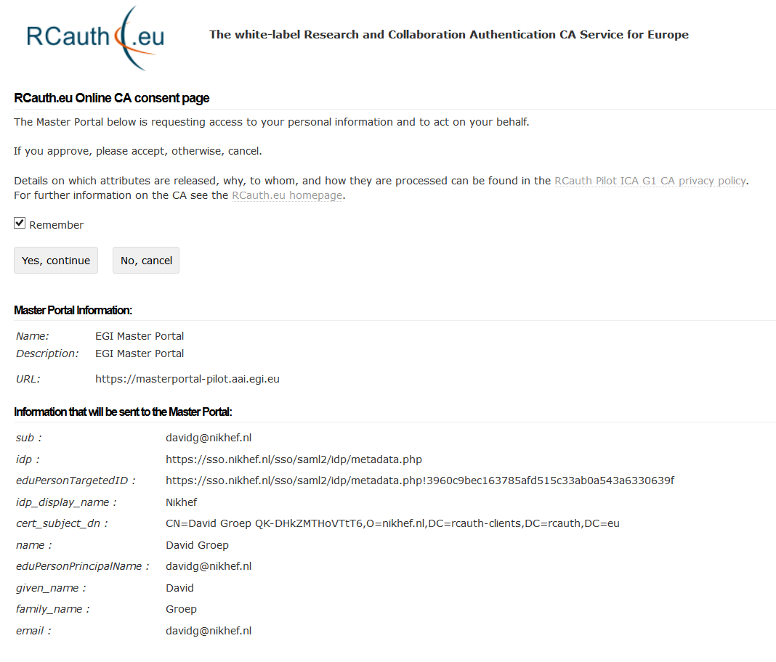
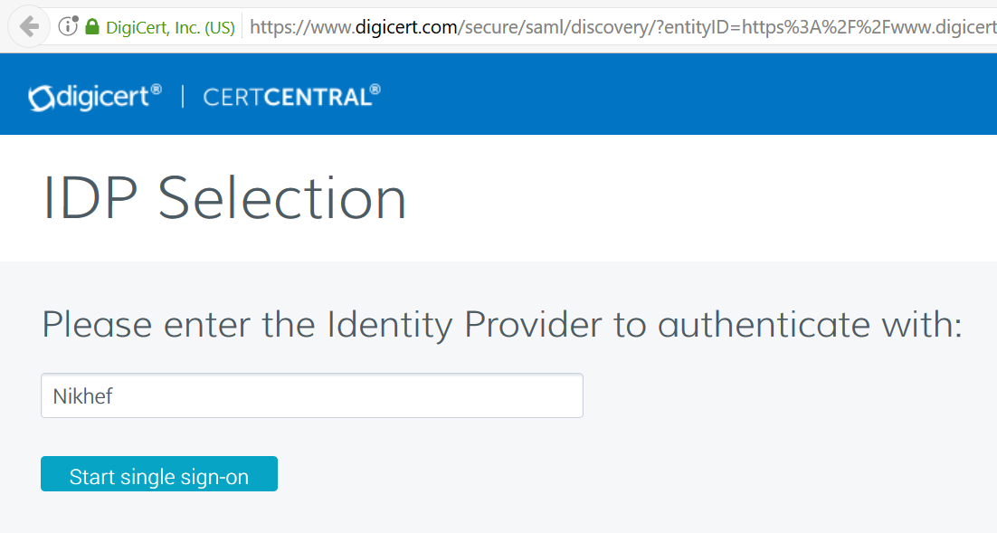
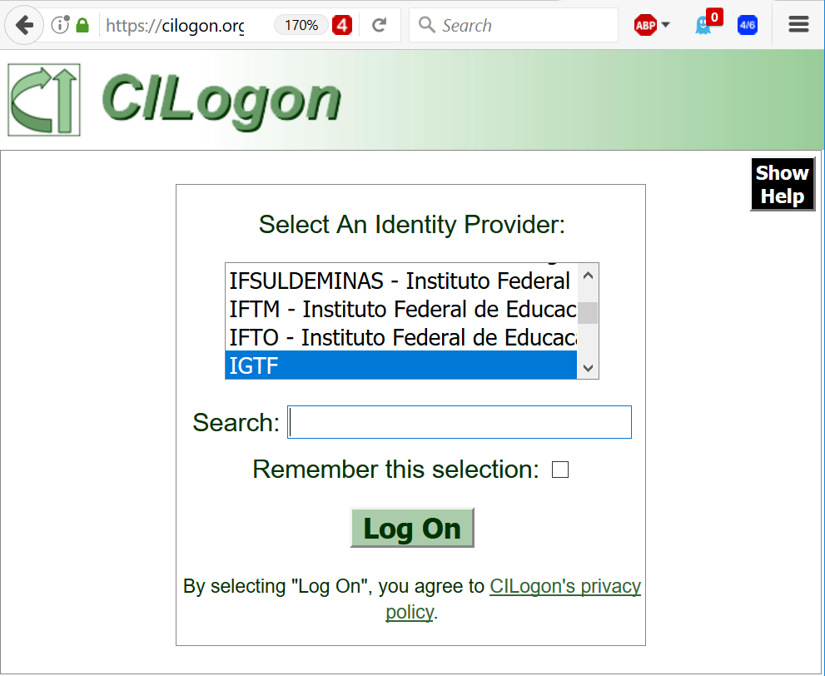
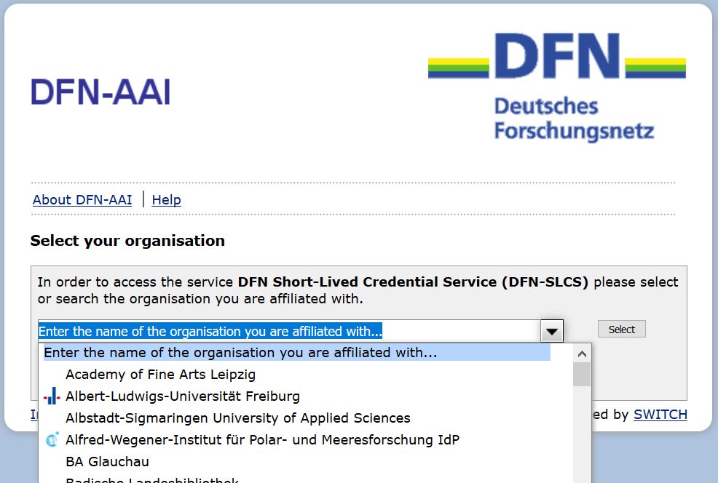
Bridges everywhere: TCS – CILogon – DFN SLCS – RCauth.eu

Slide 27
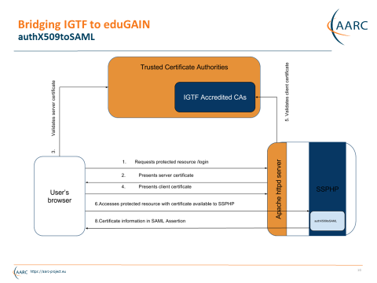
IGTF to eduGAIN bridge
https://edugain-proxy.igtf.net/
Work by Ioannis Kakavas and Nicolas Liampotis (GRNET) for the AARC project

Slide 28
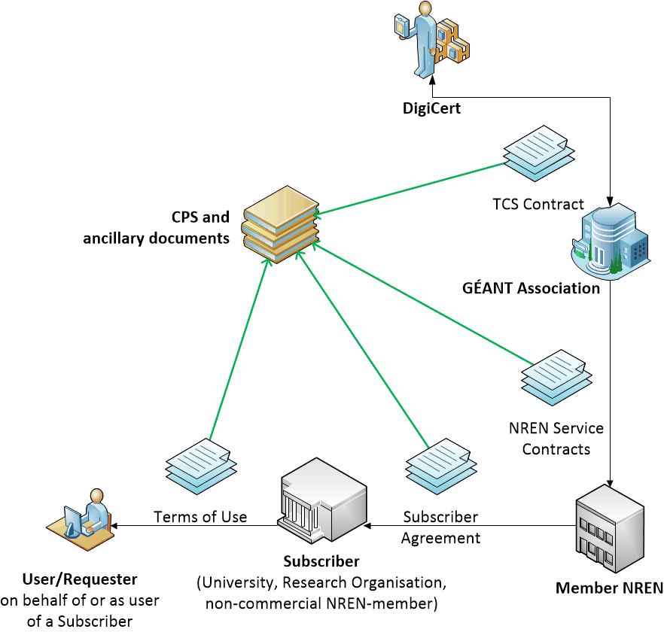

TCS: Responsibility is built using contracts
scales well to large numbers of organisations and users
assurance requirements on subscribers ensure quality ID
bound through legal contracts
listed in specific document and in the CPS
assurance target: BIRCH

Slide 29
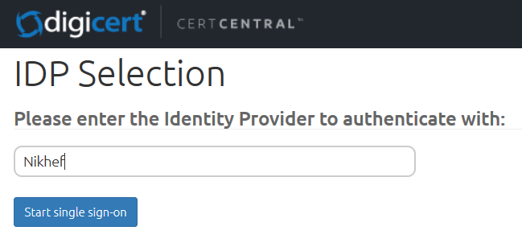
SSO SAML portal now natively hosted by DigiCert
Scope: client certificates (and client certificates only, sorry!)
Assurance profile target BIRCH and public trust (S/MIME)
DigiCert itself is now a ‘SAML2Int’ Service Provider
<md:EntityDescriptor entityID="https://www.digicert.com/sso">
visible to Federations and IdPs via the eduGAIN meta-data
DigiCert will know about all IdPs in eduGAIN (via eduID.at)

Slide 30
Some scaling issues
Service is based on subscription – both by the NREN and the user’s home institution
impossible to connect non-NREN members, members outside GEANT scope, SMEs, &c
sometimes entire countries opt out, for political or other reasons
Single, publicly-trusted, assurance level does not reflect current risk diversity
all TCS trust anchors today are also publicly trusted
works great for browser and S/MIME trust, but cannot address assurance composition by the Infrastructures and Proxies
Requires active work by the home organization for either FIM eligibility or specific enrolment
and the specific enrolment options are not always clear, and technically more complex
Needs the user to keep managing credentials – an apparent obstacle for many communities

Slide 31

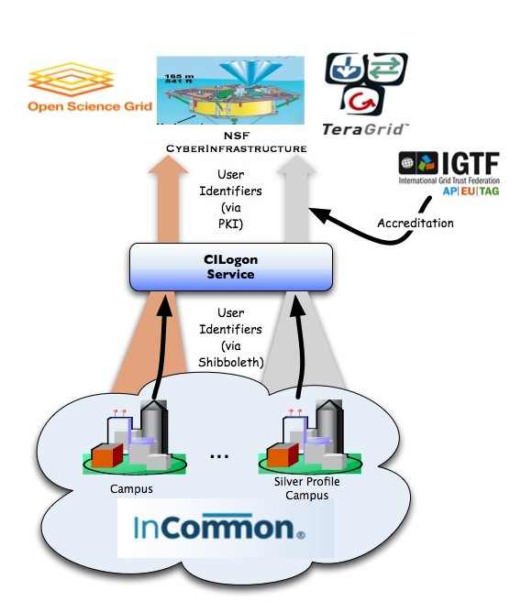
CILogon service and project (Jim Basney et al.)
Enable campus logon to CyberInfrastructure (CI)
  Use researchers’ existing security credentials at their home institution
  Ease credential management for researchers and CI providers
Multiple interfaces
SAML/OpenID Web Browser SSO
  PKCS12 certificate download
  Certificate issuance via OAuth
  OpenID Connect token issuance
  SAML ECP for CLI issuance
Slide content: Jim Basney, based on http://www.cilogon.org/docs/201106-cilogon-cern.pptx?attredirects=0&d=1
and http://www.cilogon.org/docs/20141030-basney-cilogon.pdf?attredirects=0&d=1

Slide 32
A CILogon-like Token Translations Service for Europe – RCauth.eu
Ability to serve a large pan-European user base without national restrictions
  without having to rely on specific national participation exclusively for this service
  serving the needs of cross-national user communities that have a large but sparsely distributed user base
Use existing resources and e-Infrastructure services
  without the needs for security model changes at the resource centre or national level
Allow integration of this system in science gateways and portals with minimal effort
  only light-weight industry-standard protocols
Permit the use of the (VOMS) community membership service
  attributes for group and role management in attribute certificates
  also for portals and science gateways access the e-Infrastructure
Concentrate service elements that require significant operational expertise
  not burden research communities with the need to care for security-sensitive service components
  keep a secure credential management model
  coordinate compliance and accreditation
assurance target: DOGWOOD

Slide 33
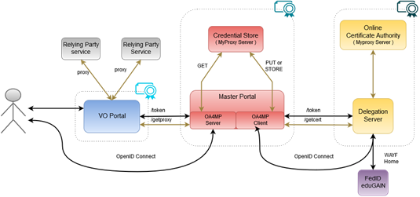

AARC CILogon-like TTS Pilot components

Slide 34
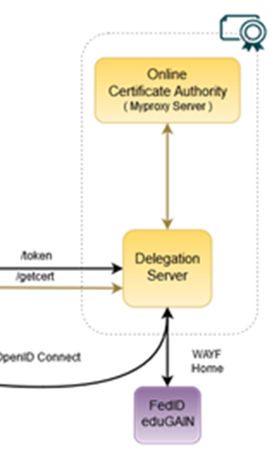
RCauth.eu – a white-label IOTA CA in Europe
Cover as much as R&E Federated Europe as possible
Scoped to research and collaborative use cases
In a scalable and sustainable deployment model
In the AARC Pilot we build a production-worthy pilot service
which will operate for as long as necessary and useful
supported by the Dutch National e-Infrastructure & Nikhef
… and that will in the subsequent phase be:
taken up by sustained infrastructures (part supported by EOSC-HUB)
a replicated redundant instance
migrated to a new managing entity

Slide 35
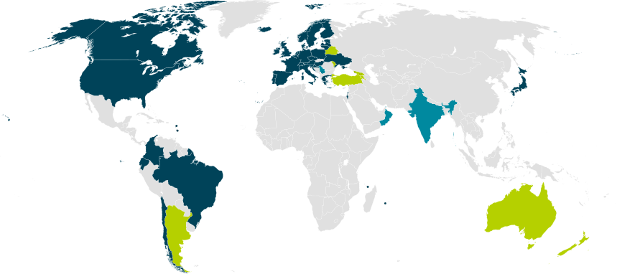
Our Registration Authorities: all qualified Federated IdPs [1.3.2]
RAs are the eligible IdPs connected through a
Federated Identity Management System (FIMS)
primarily: ensemble of IdPs in eduGAIN that
meet the policy requirements of this CA
Eligible applicants are all affiliated to an RA
Three eligibility models
Direct relationship CA-IdP, with agreement declaration
Rest of eduGAIN: – “Sirtfi” security incident response and OpSec capabilities plus
– REFEDS “R&S section 6” non-reassigned identifiers and applicant name
are required, and tested via statement in ‘meta-data’ and
by releasing the proper attributes
within the Netherlands: SURFconext Annex IX* compliance for all IdPs
“IdPs within eduGAIN are deemed to have entered materially into an agreement with the CA”

Slide 36
Building RCauth - technically

Slide 37
Name uniqueness [3.1]
Federations, with their distributed responsibility model, always face a consistency challenge
  Release of any identifier associated with a individual person (‘privacy concerns’)
  Guaranteeing non-reassignment of an identifier - has not played a major role inside any single org till now
  Agreeing on how to name the name (attribute) of the authenticated user is different
  Ability to trace an identifier to a person – and how to find the person at all
We have to rely on the RAs (institutions) to provide an identifier that we can use - even if the institution itself does not consider RCauth.eu on its own worthy of specific attention
We can leverage grander schemes and agreements
eduPerson schema – almost all federations use this, and most require specs compliance
REFEDS Research and Scholarship (“R&S”) specification – aligns attribute release (and federation registrars check for minimal compliance
Sirtfi – new standard to harmonize incident response and opsec capabilities and processes

Slide 38
Constructing a non-reassigned subjectName
/DC=eu/DC=rcauth/DC=rcauth-clients/O=orgdisplayname/CN=commonName
All the uniqueness will be in the commonName – that will “contain sufficient information such that an enquiry via the issuer allows unique identification of the vetted entity”
The orgdisplayname is used to “identify the identity management system via which the identity of this person was vetted” [IOTA 3.2]
So if – over time – the orgdisplayname may conflict, be re-used, or is ambiguous, we don’t need it: we will use the commonName to trace and ensure non-reassignment!

Slide 39
CommonName – the big challenge
Requirements
Contain a representation of the real name of the applicant as asserted by the IdP
the opaque option is not very friendly to downstream services
Must be unique and non-reassigned
Allow – via the issuer – unique identification of the entity in the stated IdP
So we construct it out of 2, but sometimes even 3, elements
Readable name of the applicant (max. 40 characters)
Unique Shortened Representation of the identifier provided by the IdP (16 characters)
Optional: ensured-uniqueness sequence number (max. 3 digits)

Slide 40
From eduGAIN IdPs, you can expect anything … rightfully!
$ java -cp icu4j-59_1.jar:. transliterate2 [...]
"Jőzsi Bácsi" "Guðrún Ósvífursdóttir" "Χρηστος Κανελλοπουλος"
"簡禎儀"
Input: Jőzsi Bácsi
Output: Jozsi Bacsi
Input: Guðrún Ósvífursdóttir
Output: Gudrun Osvifursdottir
Input: Χρηστος Κανελλοπουλος
Output: Christos Kanellopoulos
Input: 簡禎儀
Output: jian zhen yi
Try yourself?
https://github.com/rcauth-eu/aarc-delegation-server/blob/master/delegation-server/src/main/java/org/delegserver/oauth2/generator/DNGenerator.java
But Unicode e.g. does not distinguish the diaeresis and the umlaut
Paul Mühl → Paul Muhl is wrong, should have been ‘Paul Muehl’
reünie → reunie is good, you definitely don’t want ‘reuenie’
As the so for stability, we keep Any-Latin here and treat all as a diaeresis

Slide 41
commonName – USR of the IdP identifier
Provides for issuer-assisted traceability of people. We pick and record the attribute used, preferring:
eduPersonUniqueID attribute (scoped) from the IdP (the ‘perfect’ attribute, available nowhere)
eduPersonPrincipalName (scoped) attribute from the IdP (a good attribute, OK 97% of the time)
eduPersonTargetedID constructed from IdP entityID and IdP-local (but targeted) opaque value
This is then pushed through the “Unique Shortened Representation”:
first 16 characters of the base-64 encoded binary representation of the SHA-256 hash of the value, with any SOLIDUS (“/”) characters replaced by HYPHEN-MINUS (“-“) characters
This mapping leaves 96 bits of entropy of the hash and thus a mean collision probability <10 ^{– 14}
If the IdP gives | USR in CN RDN
40ea621a0a7355cf4fb1ca8d4f22a53d@nikhef.nl | uXmc85peL+35ONPO
davidg@nikhef.nl | Kydx8KT6xc1CHjD1
https://sso.nikhef.nl/sso/saml2/idp/metadata.php!02f7dfbb9605cf549e874bce55bfe0de030e9140 | Wgt0ltSuF7BAA7FM

Slide 42
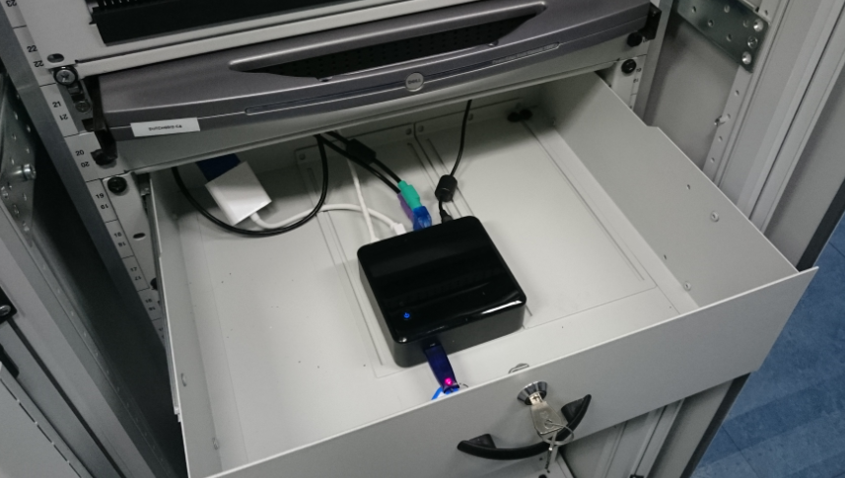
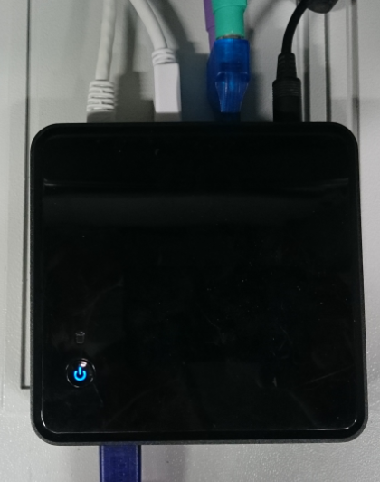

RCauth.eu Pilot ICA G1 – its initial single-site deployment
try some services at
https://rcdemo.nikhef.nl/
or use Project MinE, or ELIXIR, or …

Slide 43

Considerations
Part of the operations will be sustainably funded
by EOSC-HUB through its partners for the technical ops
by SURF DNI for both support and operations
in-kind for trusted network connectivity by GÉANT
and those who put in resources have a rightful say in where the resources go … up to a point
Core values and principles of RCauth.eu are beyond just those contributing stakeholders
must be open to anyone for any acceptable work – we don’t want a fragmented community
nobody to be ‘left out of the rain’ (unlike to TCS which depends on NREN policy and sign-up)
usefulness to research and collaboration is paramount and must be the deciding factor

Slide 44
RCauth.eu Governance
Governance Board
RCauth PMA
Ops Coordination Team
Representatives (and one alternate) from
each Materially Contributing Stakeholder
EGI.eu, EUDAT (ETFC), GÉANT, Nikhef (SURF)
Individuals drawn from the wide community […]
experts in the field of identity management
for research and collaboration,
PKI technology and identity bridging
STFC
GRNET
Nikhef
Operations people from each of the hosting partners with a (copy of) the RCauth.eu signing key,
and those partners otherwise involved in OPS

Slide 45
How to manage distribution: two options
Most consistent external view – closest internal coordination and trust
  Single RCauth.eu signing key
  Securely distributed to each operational partner
  Fully owned and managed by the PMA
  Requires partners to accept stringent controls by the PMA to ensure trust
  Fully transparent to users and external RPs
Most distributed and resilient view – with global user and RP impact on usability
  Each partner gets a different RCauth.eu signing key
  These will show up as independent ICAs in the IGTF distribution
  Same Subject DN namespace, but different issuer names in parallel and simultaneously
  Partners can join and leave, validity of ICA controlled through the CRL of upstream root
  Allows PMA to control a leaving party without such party’s co-operation and without special measures
  Floods IGTF distribution with multiple ICAs, and persistently exposes CA internal to VOMS and RPs

Slide 46

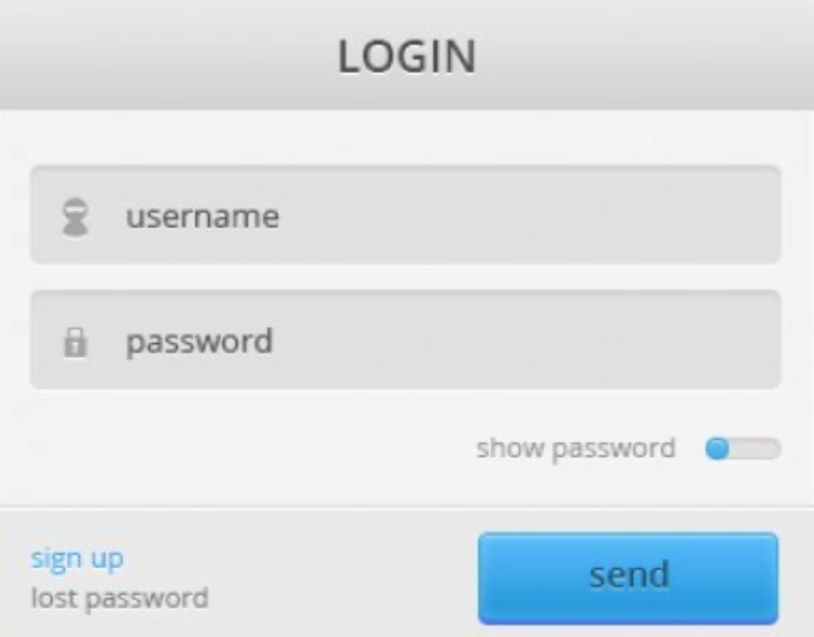

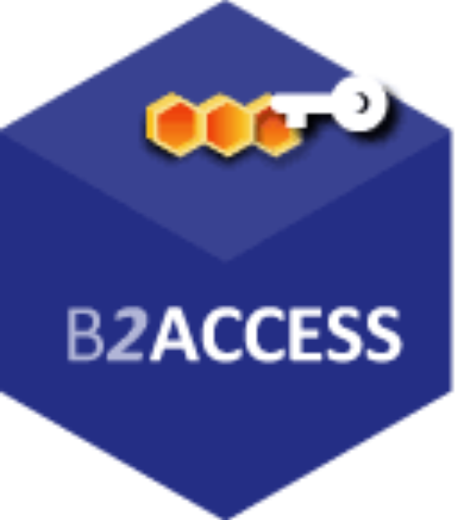




Everything meshed together … look for your favourite loop …
…
…
and many more hubs and bridges, apologies if your logo is not here …

Slide 47
Supporting the Infrastructures beyond PKIX & SAML
OIDC technology
OIDC Federation
IGTF OIDCfed AARC Pilot

Slide 48
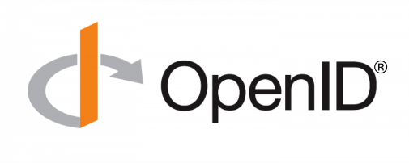
OpenID Connect
Web- and mobile-friendly (REST/JSON) identity layer on top of OAuth2
OAuth2 authentication flow
Claims REST interface for identity information
Probably known to you already
many social logins: Google, Linked-In, MSFT, …
part of many identity solutions products: Ping, NRI, …
and one very .well-known from our own community: ORCID

Slide 49


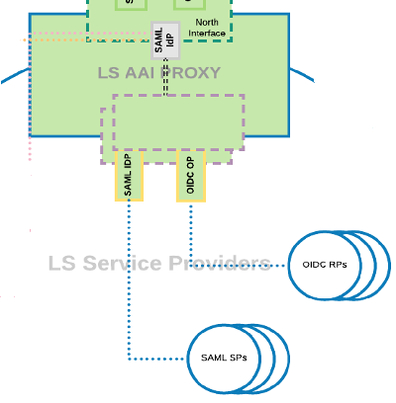

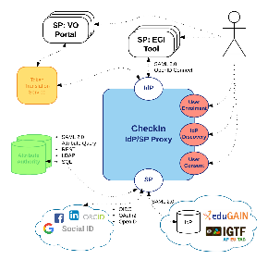
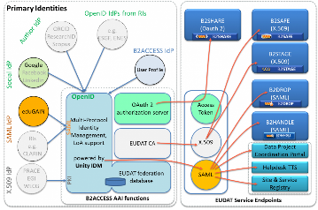
Building conections: Client ID and Client Secret
https://www.eugridpma.org/meetings/2018-01/summary-eugridpma-2018-01-prague.txt
Planning for Globus migration from X.509 to Globus Auth
Maintain credential assurance for XSEDE users and systems
Continue to benefit from IGTF trust community
WaTTS service
EGI MasterPortal
MinE Credential Hosting
… B2ACCESS, …
ELIXIR and LSAAI services
e-Infra connections
Master
Portal
SSH Proxy CLI
Prometheus WebDAV portal
mkProxy service
…
EGI CheckIn
B2ACCESS
EOSC-HUB AAI
Today < O(50) clients;
next year O(100-1000)?
both technical trust (trust anchors) and aligned policies needed to make this scale

Slide 50
Assurance and trust frameworks
Identity Assurance Profiles for R/E-Infra risk scenarios (https://igtf.net/ap/loa/)
“BIRCH” - good quality (federated) identity,
“DOGWOOD” - identifier-only, but with traceability (R&S+Sirtfi+a few bits)
RFC 6711 Registry: https://iana.org/assignments/loa-profiles
technology-specific ‘trust anchor’ distribution services
Policy framework for Relying Parties (‘SP-IdPs-Proxies’)
Snctfi - Community Trust Framework in Federated Infras
https://igtf.net/snctfi
How can we help support RI and e-Infrastructure use cases?
technology bridges: TCS, RCauth.eu, IGTF-eduGAIN bridge, …
behind the Infrastructure Proxies for research & collaboration, OIDC gains prominence

Slide 51
OIDC mechanics
thanks to Davide Vaghetti (GARR) whose REFEDS Linz slide content I re-used

Slide 52
OIDC Actors
The User who wants to access a protected resource, either by himself or through an application.
The Relying Party (often called the Client) is the entity that will request and use an access token.
The OIDC Provider (OP) is the entity that will release the access token.
slide content thanks to Davide Vaghetti, GARR, for GN4-2-JRA3-T3.1.A

Slide 53
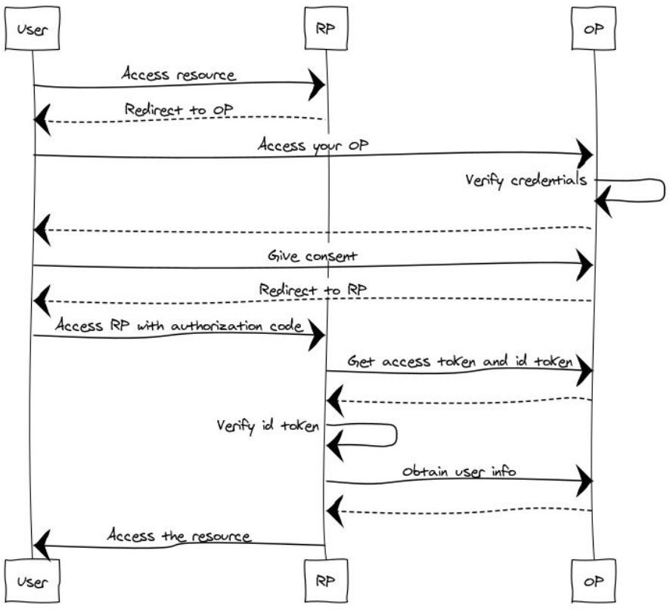
OIDC: OP and RP needs to know about each other
RP redirect the user to the OP’s
authorization_endpoint
OP redirect the user to the RP’s redirect_uri
RP exchange the code for an access_token at the token_endpoint (and authenticate…)
RP requests user claims at the OP’s
userinfo_endpoint
slide content thanks to Davide Vaghetti, GARR, for GN4-2-JRA3-T3.1.A

Slide 54
OpenID Connect –
Discovery and Dynamic Client Registration
http://openid.net/specs/openid-connect-discovery-1_0.html
a mechanism for an OpenID Connect Relying Party to discover the End-User's OpenID Provider and obtain information needed to interact with it, including its OAuth 2.0 endpoint locations
http://openid.net/specs/openid-connect-registration-1_0.html
defines how an OpenID Connect Relying Party can dynamically register with the End-User's OpenID Provider, providing information about itself to the OpenID Provider, and obtaining information needed to use it, including the OAuth 2.0 Client ID for this
Relying Party
slide content thanks to Davide Vaghetti, GARR, for GN4-2-JRA3-T3.1.A

Slide 55
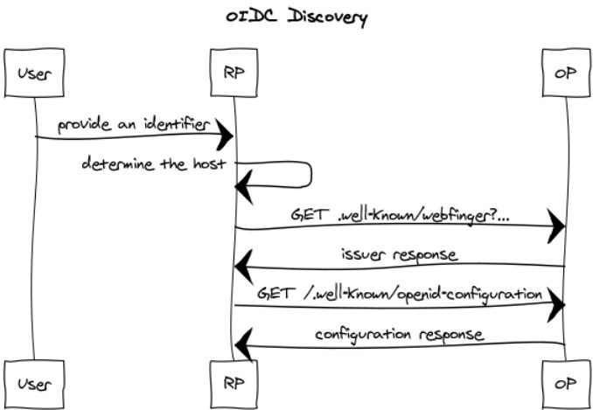
OpenID Connect Discovery 1.0
The RP receives and consumes the OP metadata
(provider configuration).
No trust information is provided.
slide content thanks to Davide Vaghetti, GARR, for GN4-2-JRA3-T3.1.A

Slide 56
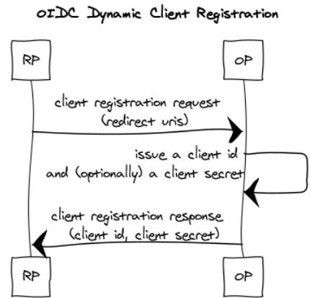
OpenID Connect Dynamic Client Registration 1.0
The OP receives a client registration request from the RP.
No trust information is provided.
The OP sends a client registration response to the RP.
No trust information is provided.
slide content thanks to Davide Vaghetti, GARR, for GN4-2-JRA3-T3.1.A

Slide 57
OIDC Federation
Slides on general OIDC Fed work: Roland Hedberg, Ioannis Kakavas, Maarten Kremers

Slide 58
OIDC Identity Federations – The Specification
Governing principals
Allow dynamic discovery and registration without losing trust
Enforcement of federation and organisation policies
Allow delegation of entity registration
Metadata transport and origin independent
Self-contained metadata
Slides content: Roland Hedberg, Ioannis Kakavas, Maarten Kremers

Slide 59
OIDC Identity Federations – The Specification
Building blocks
Trusted 3rd party
Chain of verifiable claims
Compounded metadata
Slides content: Roland Hedberg, Ioannis Kakavas, Maarten Kremers

Slide 60
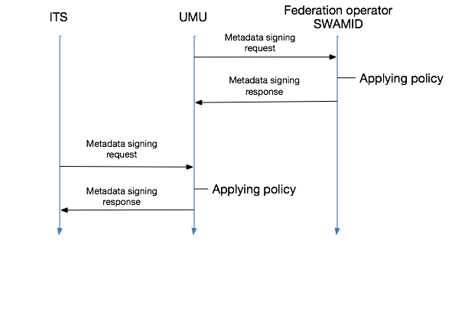
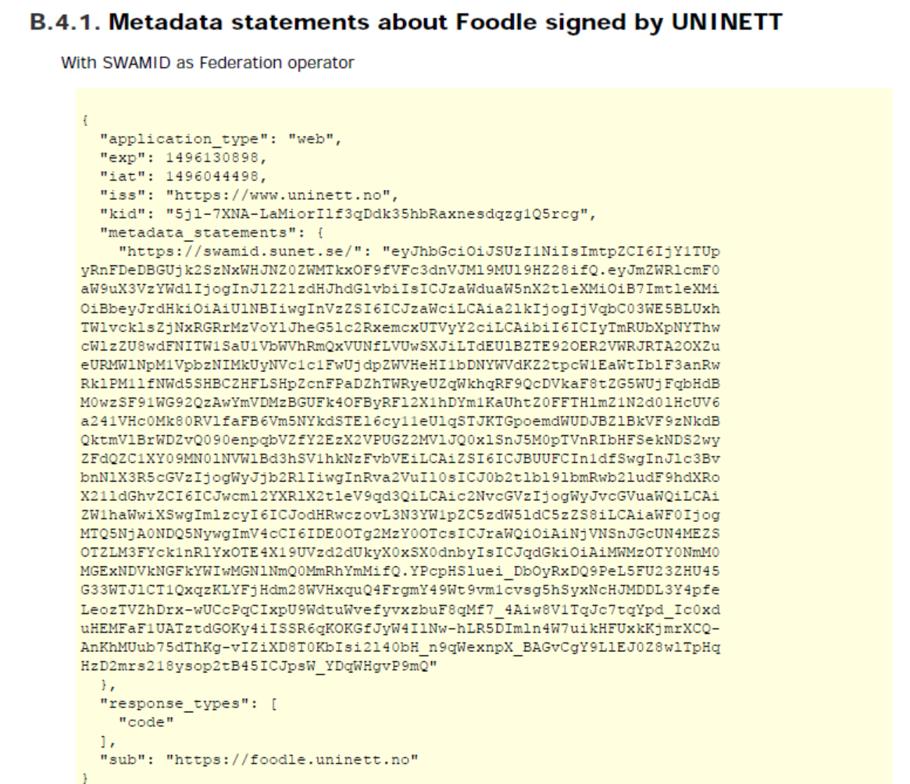
OIDC Identity Federations – The Specification
Metadata construction
Slides content: Roland Hedberg, Ioannis Kakavas, Maarten Kremers

Slide 61
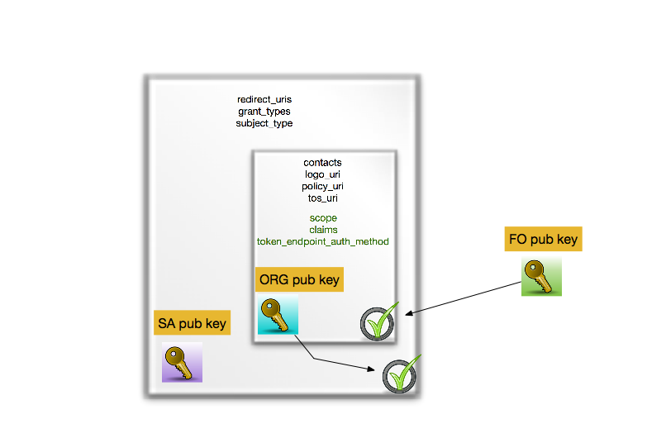
OIDC Identity Federations – The Specification
Compounded metadata statement
Slides content: Roland Hedberg, Ioannis Kakavas, Maarten Kremers

Slide 62
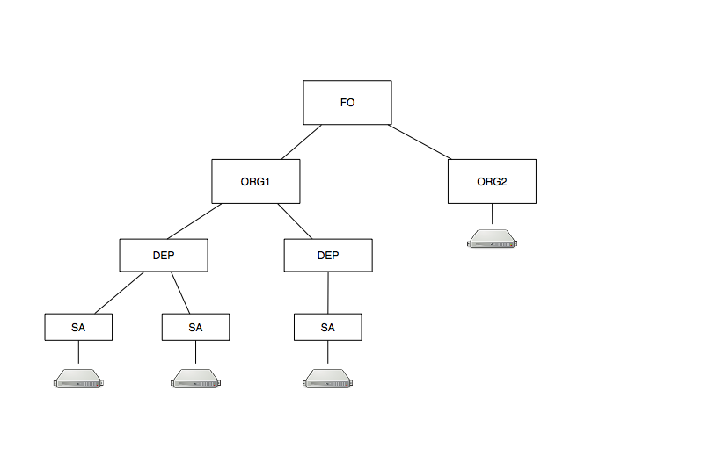
OIDC Identity Federations – The Specification
Depth
Slides content: Roland Hedberg, Ioannis Kakavas, Maarten Kremers

Slide 63
OIDC Identity Federations – Implementations & Tools
Reference Implementation in Python
https://github.com/OpenIDC/fedoidc
Federation aware OpenID Connect Provider
Federation aware Relying Party
Support for Federation Operator related functionality
Slides content: Roland Hedberg, Ioannis Kakavas, Maarten Kremers

Slide 64
OIDC RP Federation Pilot

Slide 65
OIDC Fed ‘policy’
IGTF “RP oriented” OIDC Fed can leverage existing framework
connect RPs from infrastructures that are IGTF members
(EGI, HPCI, OSG, WLCG, GEANT, PRAGMA, PRACE, XSEDE, …)
and new IGTF RP members can join of course!
Accreditation process and membership guidelines in place
OPs in the federation (RI/EI IdP-SP-Proxies) use IGTF APs
and Snctfi framework where needed
RPs in the federation become the responsibility of their member representatives
regional (‘national’) RP groups via their existing authority member
for RP trust (more than today) re-use Sirtfi, WISE, and trust groups

Slide 66
Scoping and model discussions
ACAMP session nodes (see Wiki)
  do not over-complicate the initial set-up
  retain dynamics in the system by leveraging existing trust
  stick to OIDC core attributes makes life easier
  discovery – leave this for the RPs, but make our data available
  allow overlapping federations and be complementary (COIs)
  Don’t boil the ocean
  scope to the expected O (100) organisations
  leverage existing trust and current operational mechanisms
http://wiki.eugridpma.org/Main/OIDCFed

Slide 67
IGTF OIDC Federation Task Force
The IGTF task force for OIDC Federation will
identify specific objectives – I2 TechEx
scope needs and requirements for R/E infrastructure OIDC Fed – Prague EUGridPMA 42
verify compatibility of IGTF Assurance Profile framework
for ‘technology-agnosticity’ with OpenID Providers (proxies) and RPs
test an OIDCFed scenario
e.g. starting with use cases: WLCG, RCauth.eu, ELIXIR/LS, EGI CheckIn, …
assess structure and needed meta-data in a ‘trust anchor service’,
  how to address RPDNC
  links it with (dynamic) client registration
liaise with OIDC Fed efforts in AARC and GN*-*, and Roland Hedberg

Slide 68
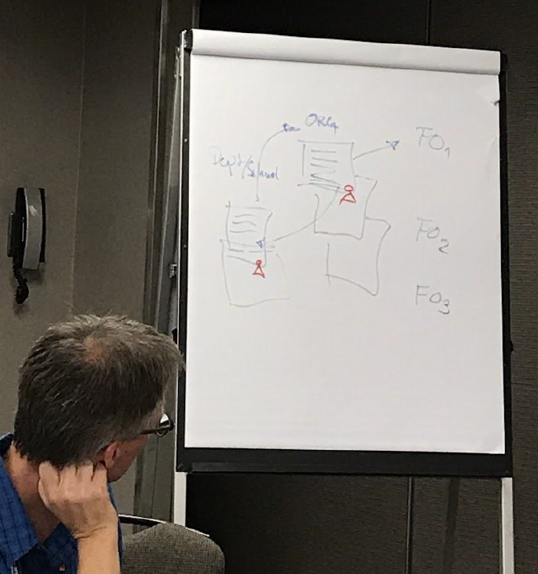
OIDC Fed pilots
Based on the spec by Roland Hedberg
scoped to the RP + Proxy
case is not very complex, actually
Infrastructures can use trusty shortcuts that would be too costly at the general R&E scale
leverage existing policy and trust framework
‘pilot’ RPs and proxies will be using scripting and glue to get integration with existing services, based on assessed trust framework
we can leverage existing trust

Slide 69
Can we do without a single one to rule them all?
today the RIs and EIs trust the IGTF trust anchors and
may (but do rarely) add their own
Can the ‘federation’ be the community and import a commonly trusted set?
Can the IGTF allow devolved registration provided that the trusted organisations implement the same policy controls Snctfi and the proper Assurance Profiles?
i.e. the IGTF runs an MDSS
for the RPs and Proxies

Slide 70
For the benefit of Research Infras …
IGTF membership process and Snctfi jointly give you the trust of Infra SPs (RPs)
use peer-reviewed (self-)assessment as foundation of the ‘scientific process’ of trust
technical details on how the IGTF FedOp will sign and distribute meta-data statements – subject to discussion at TIIME, AARC, and IGTF meetings
new communities and (proxy) operators can join IGTF any time
  there is no fee or something like that
  but we request participation in the peer-review and assessment process …

Slide 71
Information sharing
Keeping in touch
http://wiki.eugridpma.org/Main/OIDCFed
oidcfed@igtf.net
(https://igtf.net/mailman/oidcfed)
but don’t forget everyone else!
REFEDS, GEANT
TIIME, TNC, TechEx, …

Slide 72

https://aarc-project.eu/policies/
components of this work have been co-supported by:
the Dutch National e-Infrastructure coordinated by SURF,
EOSC-HUB – EOSC-hub receives funding from the European Union’s Horizon 2020 research and innovation programme under grant agreement No 777536
AARC (2) – which has received funding from the European Union’s Horizon 2020 research and innovation programme under Grant Agreement No. 730941 (AARC2)
davidg@nikhef.nl
for slides not otherwise
credited to third parties

