Slide 1
Linking research and infrastructures to federation –
technology, policy, deployment
David Groep
AARC Policy and Best Practice Activity Lead
RDA FIM IG
September 2017
Montréal, QC, CA

Slide 2
Research Communities
The way researchers collaborate within scientific communities can vary significantly from community to community
The ability to access and share resources is crucial for the success of any collaboration
Research and Education (R&E) ICT
there also to support collaboration
Re-using existing identity management fabrics
Notes:
The way researchers collaborate within scientific communities can vary significantly from community to community. On the one hand, there are highly structured communities with thousands of researchers who can be virtually anywhere in the world. Typically, these communities have been working together for a long time, they want to share and have access to a wide range of resources. On the other hand, one finds a diverse number of smaller research communities working within specific or across scientific disciplines. Typically, these are either nascent communities being established around new scientific domains, or they are communities in specific domains that did not require wide spread and close collaboration among the researchers. And of course, in between these two extremes, there are many scientific communities of varying size, structure, history etc.
Regardless, if we are talking about large-scale, well-structured collaborations or about loosely coupled collaborations centred around the individual researcher, they all need to share and access resources. The ability to access and share resources is crucial for the every day research. Advanced research needs equally advanced IT services.

Slide 3
Federated Identity Management for Research
Access services using identities from their Home Organizations when available.
Secure integration of guest identity solutions and support for stronger authentication mechanisms when needed.
Access to the various services should be granted based on the role(s) the users have in the collaboration.
Users should have one persistent identity across all community services when needed.
Ease of use for users and service providers. The complexity of multiple IdPs/Federations/Attribute Authorities/ - technologies should be hidden.
Notes:
Of course, you can understand how compelling such a service is to the research community. Leveraging eduGAIN, researchers can rely on the institutional accounts in order to access and share services. No more need for certificates, no need to operate costly infrastructures just to offer and manage user accounts so that researchers can collaborate. But eduGAIN and the Identity Federations do not come without their own limitations.
Indeed, using eduGAIN is not just a switch that can be flipped. In most of the cases, although the identity network is there, the home institutions acting as identity providers, require that they approve the connection of each and every new service provider. Things look quite OK for local services, but what about international Service Providers? How the research community can benefit from this service?
In 2012, many scientific communities come together, forming a working group called Federated Identity Management for Research, which investigate the current state FIM and its potential within their domains. After a series of workshops, they published the FIM4R paper, which highlights the importance of eduGAIN and the identity federations and the role they can play.

Slide 4















Identified common challenges – beyond the ‘corporate IT’ stuff
Communities / e-infrastructures surveyed in AARC
Homeless
user Home
User
friendliness
Attribute Aggregation
Community
based AuthZ
Non-Web Access
Credential
translation
Bridging Communities
Identity Assurance
Persistent non-reassigned ID
Notes:
So we identified a large number of requirements and common challenges across (14) research communities and e-infrastructures. (based on FIM4R)
Balancing the interest of all the different communities
The input we needed to commence our pilots
Attribute aggregation: Most federated identity management systems are limited by users' ability to choose only one identity provider per service session. There should be a linking service that lets users securely link their various identity provider (IdP) accounts without having to authenticate separately to each IdP.
User friendliness: The tools that support the FIM framework should be simple and intuitive and integrate with the many other IT tools used in daily life. Multiple redirection problem, standardise (shib loging, institutional login).
Credential translation: Converting credentials to different formats enables interaction between services using different authentication technologies
Level of insurance: 1. level of assurance as to whether someone or something is who or what it claims to be in a digital environment. 2. The way you login. How safe is the digital way to login you are using (password? Crappy. Token? Super safe) 3. How much do I trust your infrastructure (your admin? Your network?)
Bridging communities. FIM is important and it’s becoming even more. Bridging between the various communities is a central issue with an efficient mapping of the respective attributes.
non-browser federated access. Non-browser based interfaces are essential to support machine-machine interactions in secured workflows.

Slide 5
AARC: making federation work (also) for Research and e-Infrastructures
https://aarc-project.eu/infrastructures/
https://aarc-project.eu/pilots/piloted-solutions/
https://aarc-project.eu/training/

Slide 6
AARC Blueprint Architecture - Enabling an ecosystem of solution on top of eduGAIN
A Blueprint Architecture for authentication and authorization
  A set of architectural and policy building blocks on top of eduGAIN
eduGAIN and the Identity Federations
  A solid foundation for federated access in Research and Education

Slide 7

AARC Blueprint Architecture
  Guidelines and support documents
  Best practices for managing authorisation
  Expressing group membership and role information
  Scalable attribute aggregation
  Implementation of token TTS
  Credential delegation
  Non-web access
  Social media IdPs
  Use cases for account linking
  Use cases for LoA elevation via step-up authentication
https://aarc-project.eu/blueprint-architecture/

Slide 8
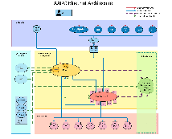
and over 20 pilots with user communities and Infrastructures

Slide 9
Easing linking of research to infrastructure services with good practice
‘Researcher (user)-centric’ policy
Identify the source of your identity, will your provider stand by that identifier, and will it be yours forever?
The Blueprint SP-IdP Proxy as key component,
also policy-wise:
Filtering function for policy and assurance
Present harmonized view to existing federations to get ‘useful’ data from them
Service Infrastructure
Incident response
“Sirtfi adoption will be critical”
“A” baseline “LoA” will be critical, (demonstrable but not necessary by audit)
Basically: your, FIM4R, requirements!

Slide 10
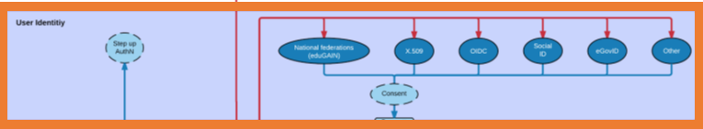

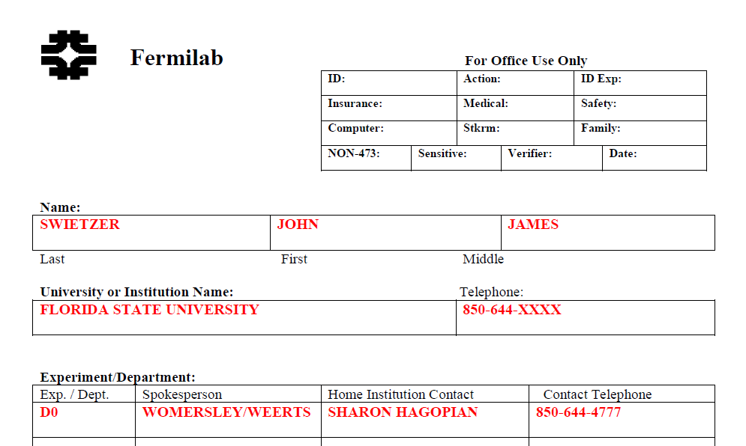
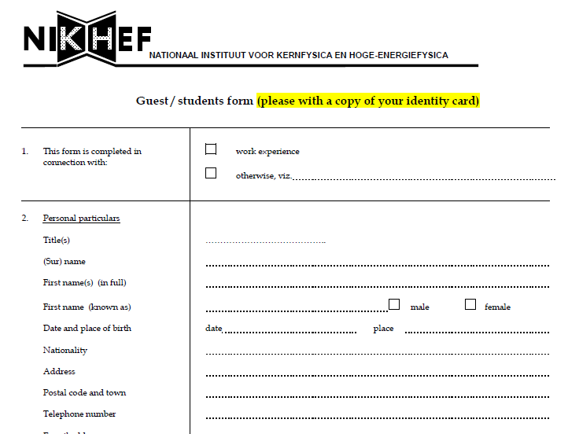
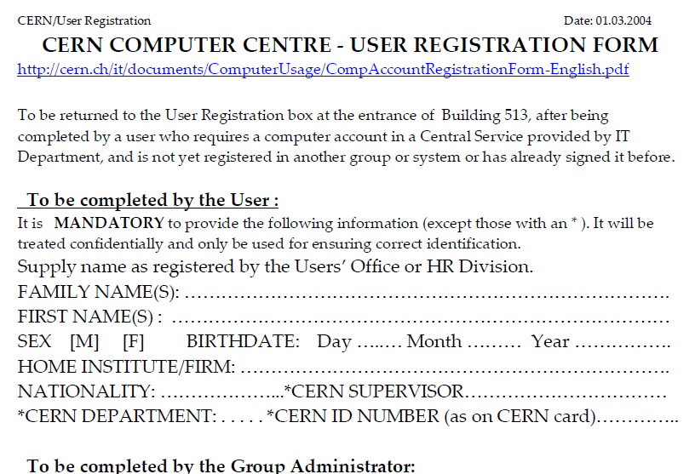
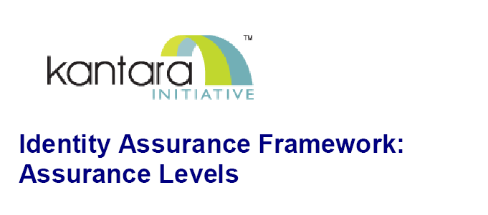
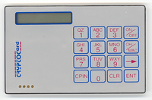
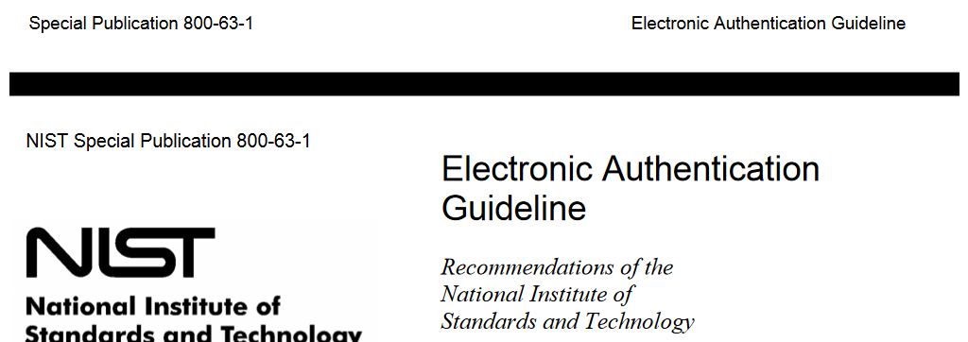
Trusting the User’s Authentication
Many layered models (3-4 layers)
but: specific levels don’t match needs
of Research- and e-Infrastructures:
Specific combination
‘authenticator’ and ‘vetting’ assurance
doesn’t match research risk profiles
Disregards existing trust model
between federated R&E organisations
Cannot accommodate
distributed responsibilities
but also national (eduGAIN) R&E federations lacked a documented, agreed assurance level
Beyond uncontrolled identifiers:
baseline assurance for research use cases
10

Slide 11



Differentiated assurance from a (Research) Infrastructure viewpoint
‘low-risk’ use cases
few unalienable expectations by research and collaborative services
generic
e-Infrastructure services
access to common compute and data services that do not hold sensitive personal data
protection of sensitive
resources
access to data of real people, where positive ID of researchers and 2-factor authentication is needed
Baseline Assurance
known individual
Persistent identifiers
Documented vetting
Password authenticator
Fresh status attribute
Self-assessment
Slice includes:
assumed ID vetting
‘Kantara LoA2’, ‘eIDAS low’, or ‘IGTF BIRCH’
Good entropy passwords
Affiliation freshness
better than 1 month
Slice includes:
Verified ID vetting
‘eIDAS substantial’, ‘Kantara LoA3’
Multi-factor authenticator

Slide 12

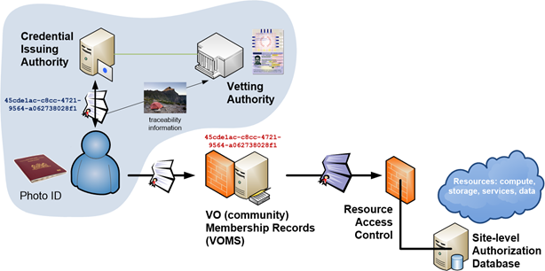
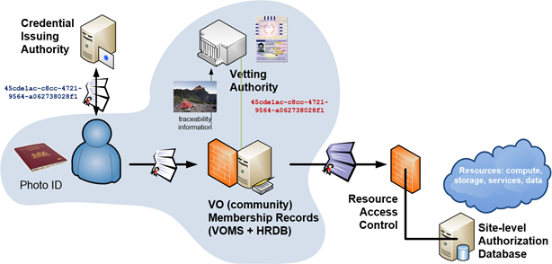
Using Assurance in practice: “Espresso” for sensitive data
Identifiers ID proofing Authentication Attributes
ID is unique, personal and traceable
Good enough for institution’s local systems
Good entropy passwords
Accurate and fresh affiliation information
ePPN is unique, personal and traceable
Assumed
(e.g. postal credential delivery)
Multi-factor authentication
Verified
(e.g. F2F)
Assurance can come from a single source …
… or be a combined/collaborative assurance
by identifier source and vetting attributes

Slide 13
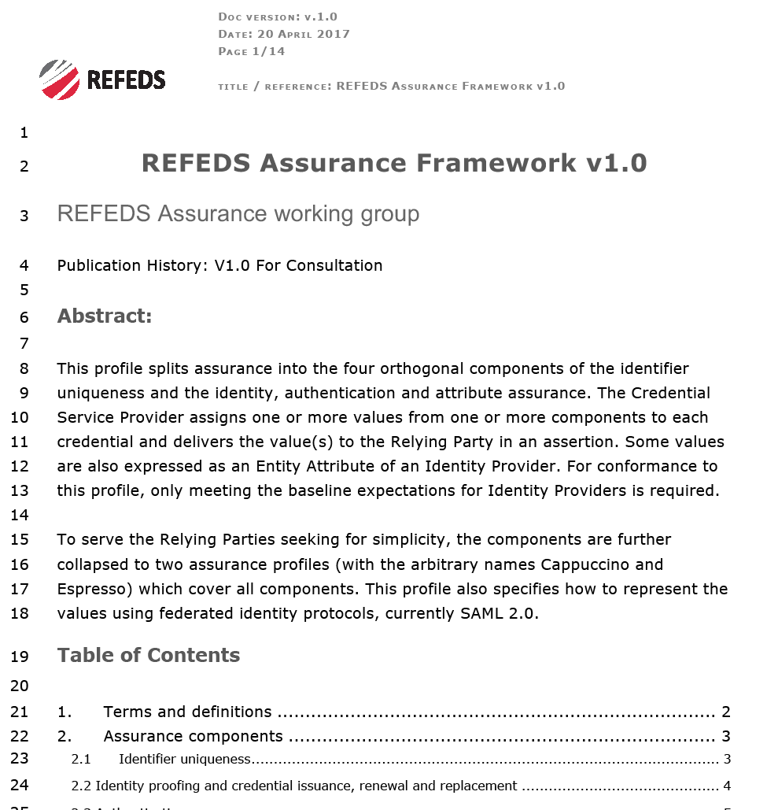
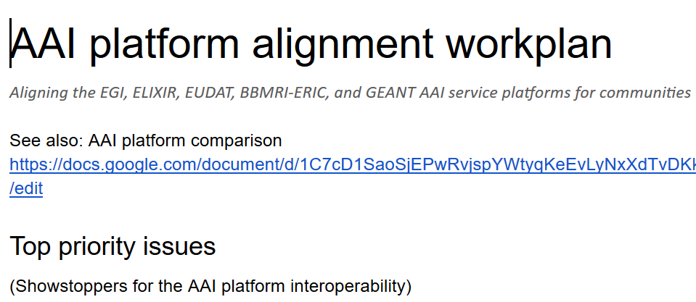
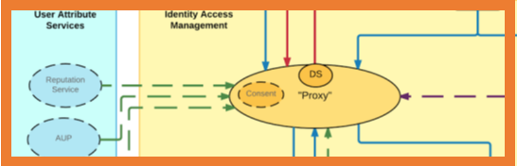
Gaining global adoption: REFEDS Assurance Framework
https://wiki.refeds.org/display/GROUPS/Assurance+Working+Group
open, international forum (gave us R&S spec with ‘some’ UniqueID)
link to identity federations –
adoption needs IdP to act and federations to communicate
Add new eduGAIN metadata and new attributes for IdPs
implementation guidance in normative form helps
Also used to align the e-Infrastructure providers
so that you can move between proxied infrastructures
… and now: how to apply it to attribute provenance?

Slide 14
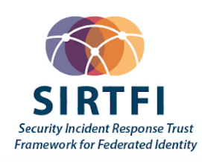
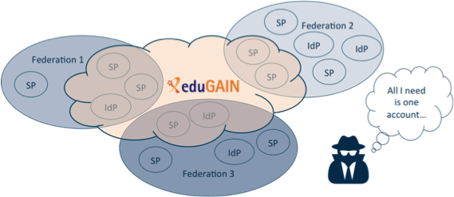
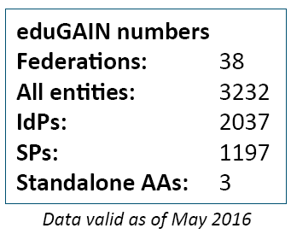
Security Incident Response in the Federated World
How could we determine the scale of the incident?
  Do useful logs exist?
  Could logs be shared?
Who should take responsibility for resolving
the incident?
How could we alert the identity providers
and service providers involved?
Could we ensure that information is shared confidentially, and reputations protected?
Security Incident Response Trust Framework for Federated Identity
Sirtfi – based on Security for Collaborating Infrastructures (SCI) & FIM4R Recommendations

Slide 15

A Security Incident Response Trust Framework – Sirtfi summary
Operational Security
Incident Response
Traceability
Require that a security incident response capability exists with sufficient authority
to mitigate, contain the spread of, and remediate the effects of an incident.
Assure confidentiality of information exchanged
Identify trusted contacts
Guarantee a response during collaboration
Participant Responsibilities
Improve the usefulness of logs
Ensure logs are kept in accordance with policy
Confirm that end users are aware of an appropriate AUP

Slide 16
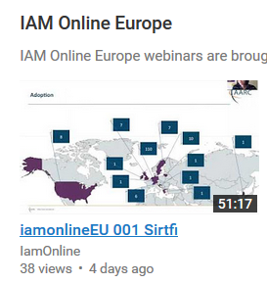
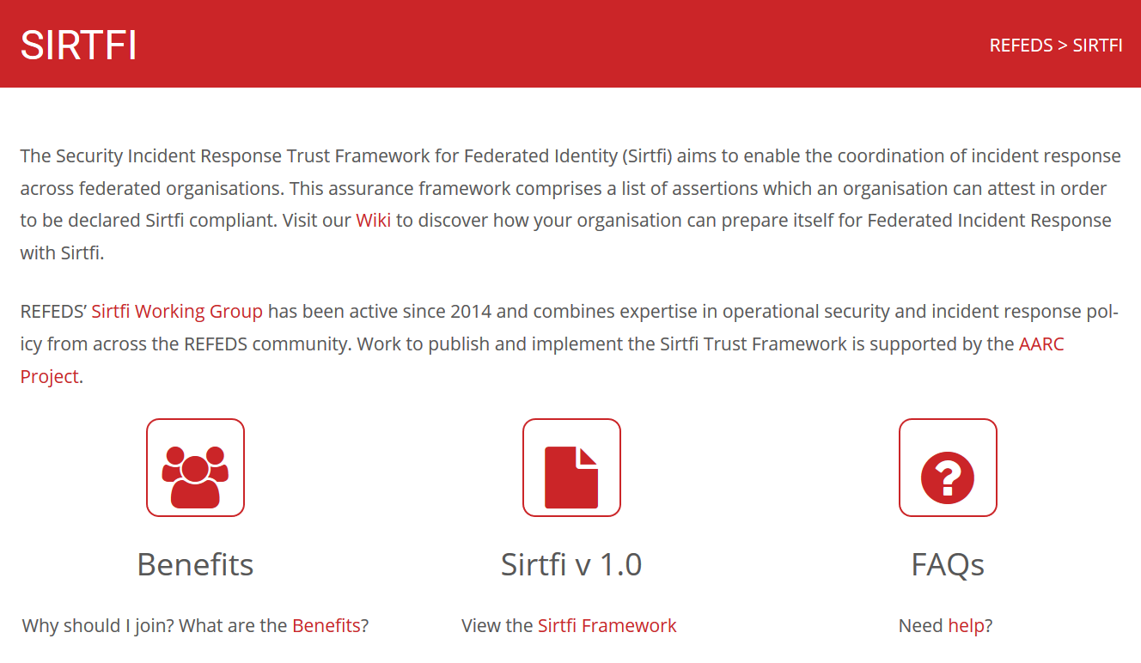
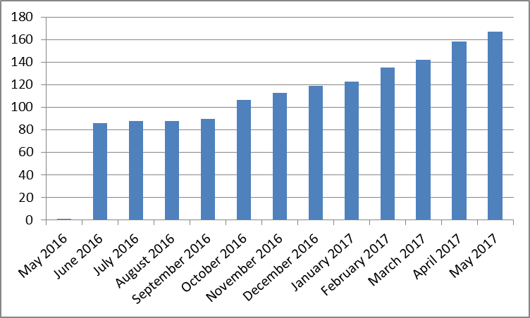
Sirtfi adoption by authentication providers and services
https://refeds.org/SIRTFI
Used for filtering (with R&S) by proxies & services
EGI operational services, RCauth.eu bridge,
CERN SSO, CILogon Basic services, …
>170 entities
adds security contact meta-data in eduGAIN
with R&S meets baseline assurance and
IGTF “assured identifier” profile
… IGTF-to-eduGAIN bridge asserts R&S+Sirtfi
Combine with 407 REFEDS R&S IdPs (May ’17)

Slide 17

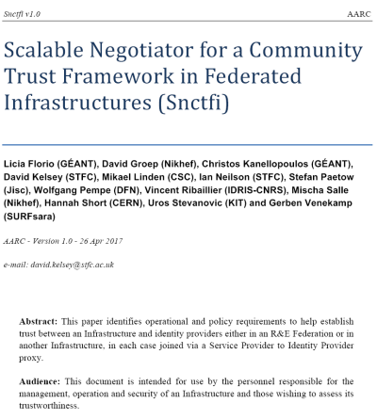
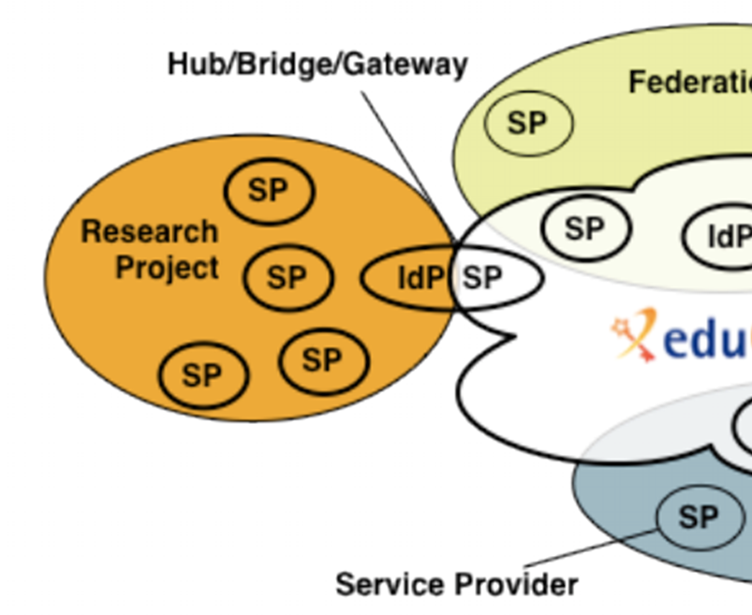
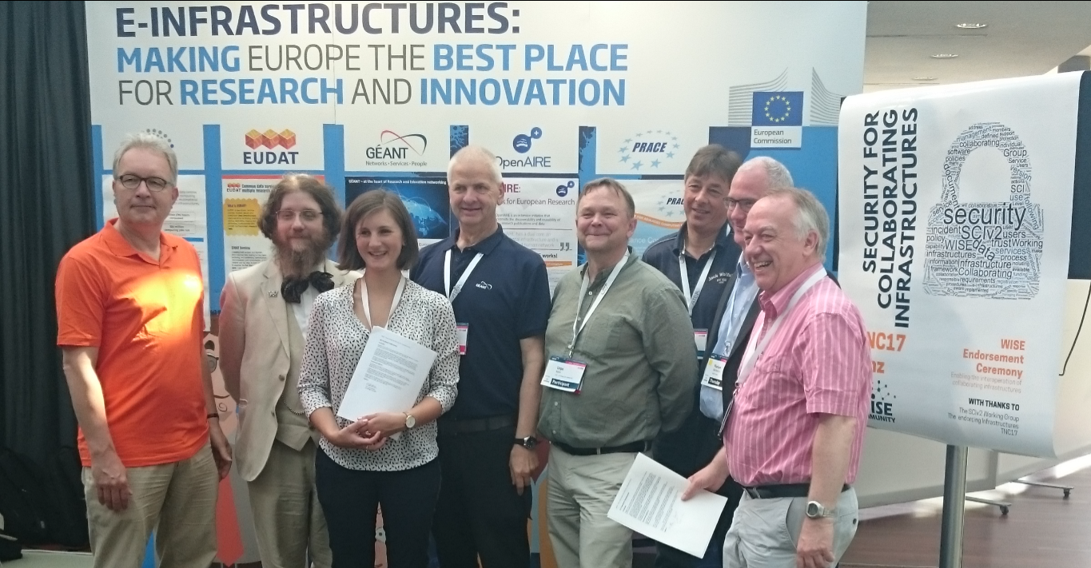
Snctfi: aiding Infrastructures achieve policy coherency
✓
allow SPIdP Proxies to assert ‘qualities’, categories, based on assessable trust
✓
Develop recommendations for an Infrastructure’s coherent policy set
Snctfi
Scalable Negotiator for a Community Trust Framework in Federated Infrastructures
Derived from SCI, the framework on
Security for Collaboration among Infrastructures
Complements Sirtfi with requirements on internal consistent policy sets for Infrastructures
Aids Infrastructures to assert existing categories to
IdPs: REFEDS R&S, Sirtfi, DPCoCo, …
See FIM4R presentation by David Kelsey!
Graphics inset: Ann Harding and Lukas Hammerle, GEANT and SWITCH

Slide 18
Snctfi infrastructure requirements, a summary
Operational Security
User Responsibilities
Protection and Processing of Personal Data
State common security requirements: AAI, security, incident and vulnerability handling
Awareness: users and communities need to know there are policies
Have a data protection policy that binds the infrastructure together, e.g. AARCs recommendations or DP CoCo
Ensure constituents comply: through MoUs, SLA, OLA, policies, or even contracts, &c
Have an AUP covering the usual
Community registration and membership should be managed
Have a way of identifying both individuals and communities
Define the common aims and purposes (that really helps for data protection …)
Make sure every ‘back-end’ provider has a visible and accessible Privacy Policy
https://igtf.net/snctfi

Slide 19
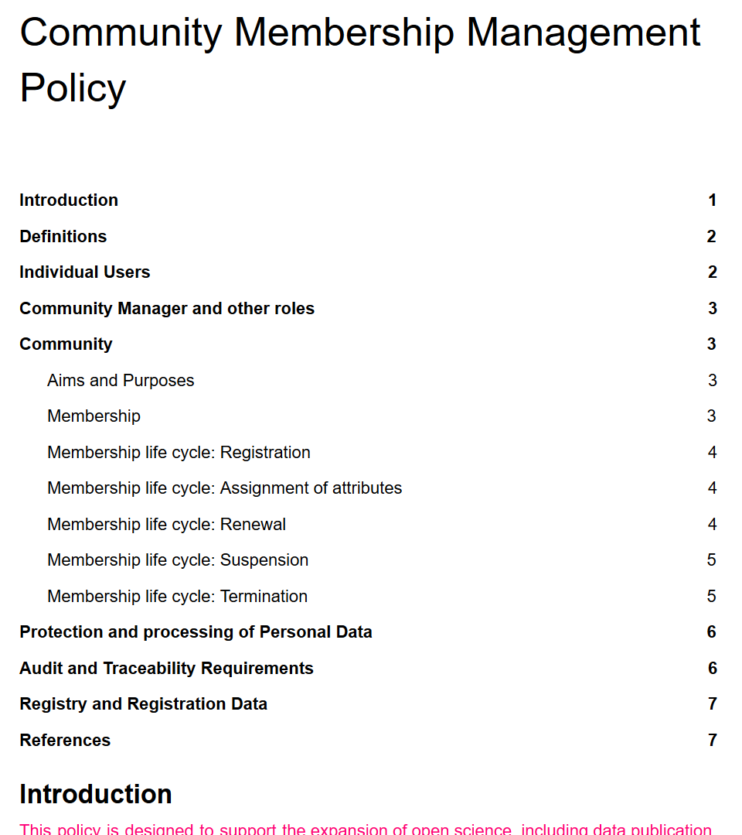
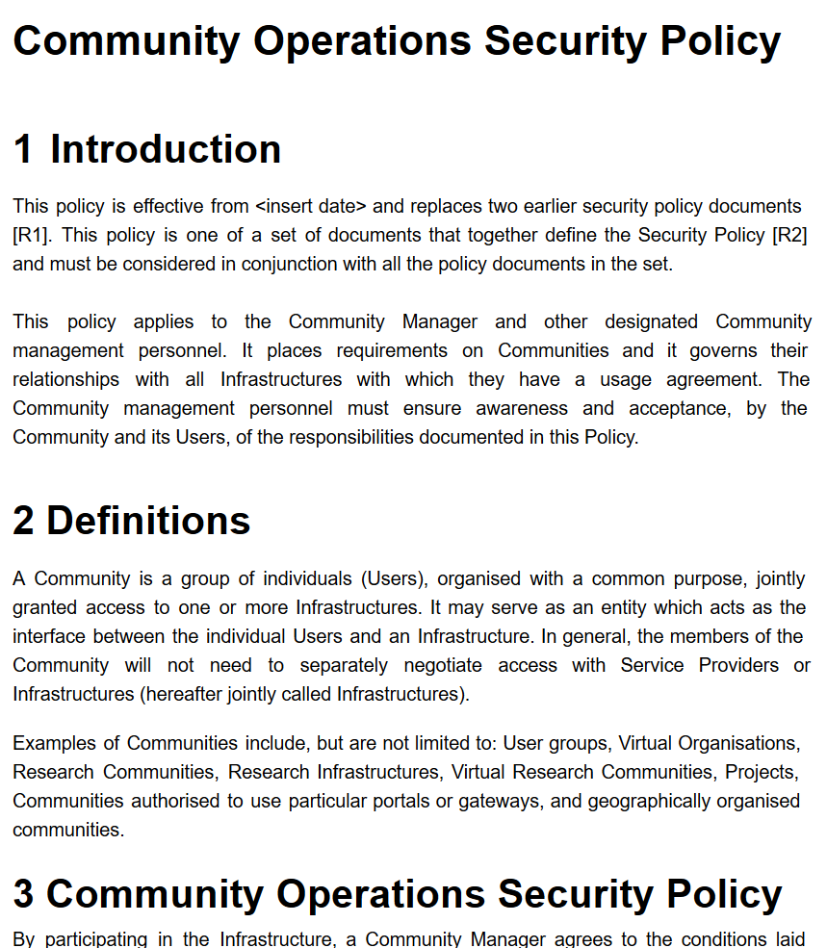
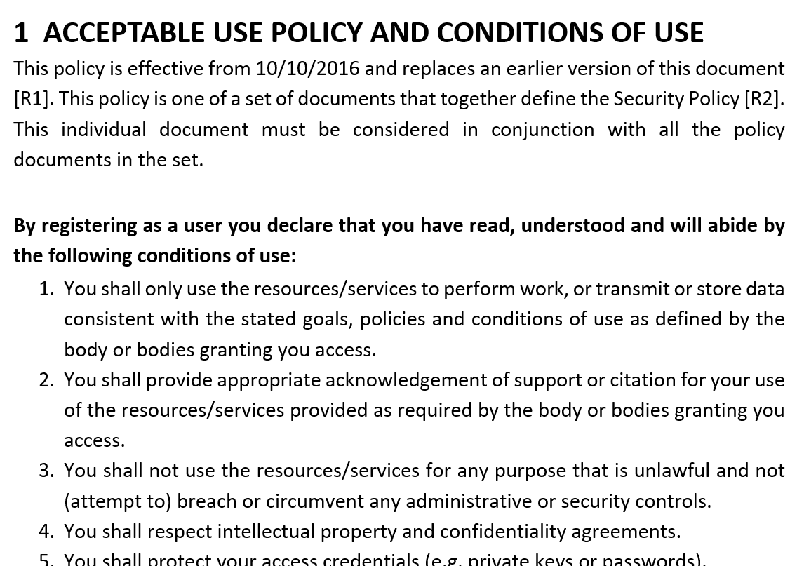
Evolving the Policy Development Kit for communities around Snctfi
…
https://wiki.geant.org/display/AARC/Policy+Engagement+and+Coordination

Slide 20

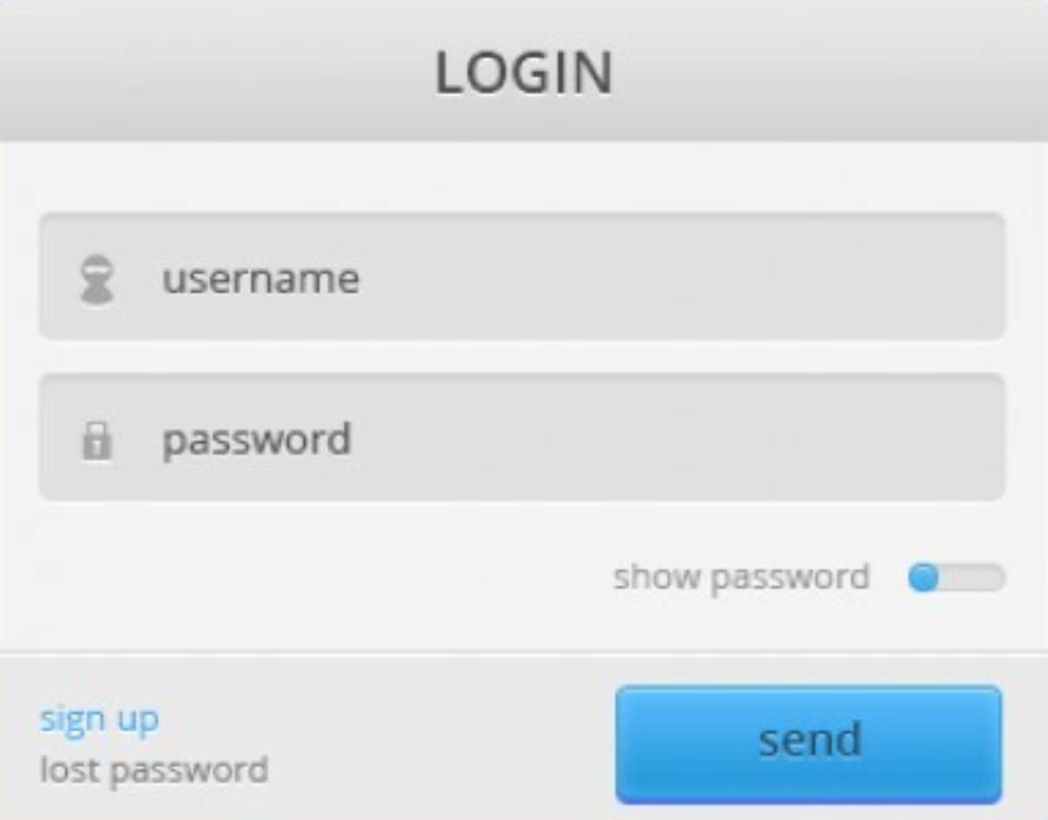

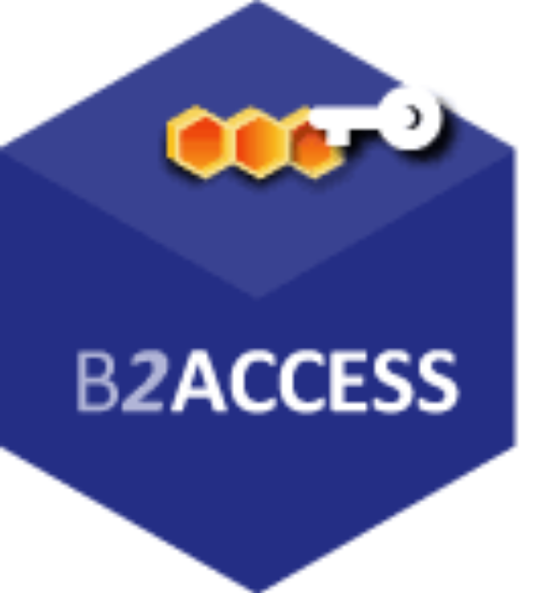




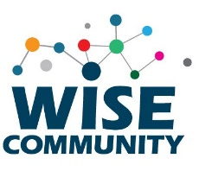
Everything can be meshed together …
…
…
&
and many more hubs and bridges, apologies if your logo is not here …

Slide 21

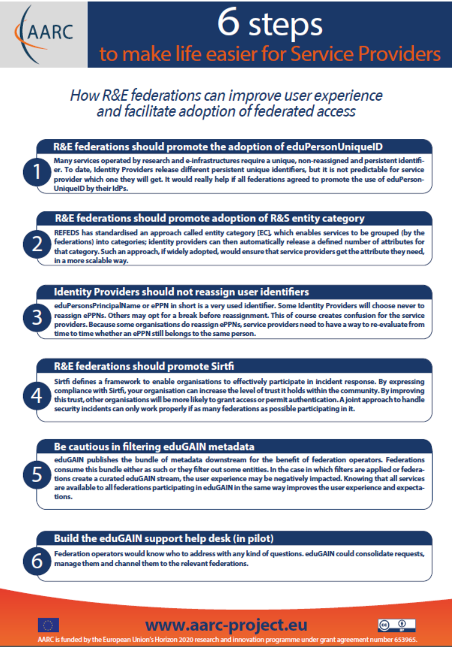
Collect Recommendations – both for Infrastructures & Federations
For your Research and generic e-Infrastructures
Following AARC Blue Print Architecture and the recommendations – makes it easier for you
Support Personal Data Protection (EU) + tag R&S – IdPs could giving you useable identifiers
Assess if Sirtfi + R&S is sufficient for access. Or add a REFEDS Assurance Profile.
Apply policy frameworks inside your Infrastructure, ‘Snctfi’, or re-use the policy kit
For Federations, REFEDS, and eduGAIN
Support an omnidirectional, non-reassigned ID for users that is standard everywhere
Don’t filter authentication to only services you know about: allow meta-data to flow
Support attribute release through R&S, and collaborate in Sirtfi
Help eduGAIN operate a support desk to help international research and collaboration
Recommendations go to REFEDS, eduGAIN – and the Infrastructures through FIM4R & IGTF

Slide 22

We have a lot to do still … ENGAGE through FIM4R, IGTF, REFEDS, WISE!
Operational Security and Incident Response
Evolve beyond Sirtfi by adding automated (volume) sharing of data and indicators of compromise
Cross-domain trust groups spanning Infrastructures (and the eduGAIN Support Desk)
Supporting Research Service Providers and Infrastructures: Service-centric guidance
Adoption of Snctfi, helping communities and infrastructure to express trust
Accounting data in complex communities, access control to accounting data in Infrastructures?
Movement of people and collaboration: e-Researcher-centric guidance
Align attribute management practices & provenance for self-hosting and managed communities
Beyond Espresso: review complex Assurance Profile cases – in light of the GDPR and beyond
Policy Development Engagement and Coordination
Guidance for communities: policy development and engagement ‘kit’
SCIv3: aligning Snctfi, Sirtfi, and Recommendations through WISE, IGTF, and FIM4R & FIMIG

Slide 23

And if I want to get to AARC?
A bilateral channel to:
  Report on AARC recommendations and pilots with research collaborations in AARC
  Get feedback on AARC solutions from the wider FIM4R community
Explore possibility to pilot solutions more widely
Effectively supporting FIM4R
  AARC supports participation of AARC research collaborations at FIM4R

Slide 24
https://aarc-project.eu/policies/
davidg@nikhef.nl

