Slide 1
Policy and Best Practice … in practice
David Groep
P&BP activity lead
AARC All Hands meeting Milano
2015-11-03

Slide 2
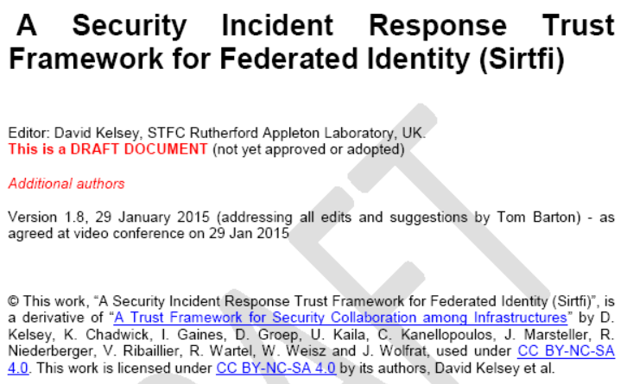
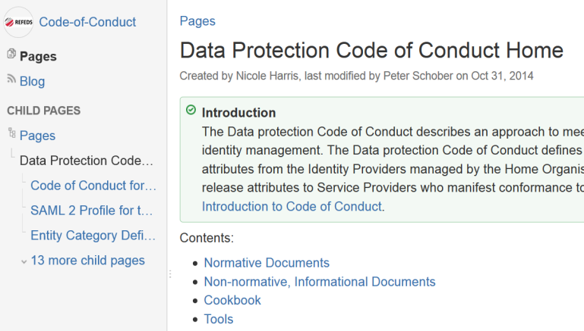
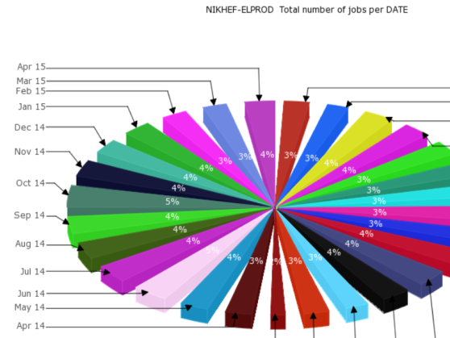
Policy and best practice development
What does assurance mean? And to whom?
How much differentiation of LoA can people handle?
How can we address incidents that
propagate through the federated space?
Can we get policy coordination to scale?
What is the place of third-party
commercial and eGov providers?
How does that help guest identity?
What’s a sustainable distribution of
responsibilities amongst AAI participants?
How can we share necessary accounting?

Slide 3
Agenda for this morning
Some words on policy coordination in AARC (~15min)
Introduction to and discussion of each of the current key areas
~ 15 min of introduction presentation, opening on to ~20min of discussion each
Assurance baseline
Incident response
Sustainability models
coffee break
Scalable negotiation mechanisms
Accounting and logging data privacy
Open policy questions needing attention in 2017+ (~20min)

Slide 4
Objectives
Develop recommendations for best practice in the areas of identity and attribute assurance, and identify the minimal set of policies and best practices that permits grouping of identity and attribute providers.
Objectives
provide a level of assurance (LoA) framework that meets the requirements of resource providers and can at the same time be supported by institutions (identity providers);
identify a distributed approach to handling security incidents in a federated environment;
specify scalable policy negotiation mechanisms between identity providers, attribute providers and service providers to facilitate resource providers;
investigate terms of usage for delivering commercial services.
To reach the objectives, also policy development will need to be tested & piloted ;-)

Slide 5
Assurance – Mikael Linden
MNA3.1:
“Recommendation on minimal assurance level relevant for low-risk research use cases”
Based on an interview approach, reaching both communities and RIs
Baseline is expected to be ‘feasible’ for IdPs
Due by M7 (end of this month)
Evolution of the assurance work in AARC
Differentiated LoA recommendation is planned for the next stage
Also includes evolution of the current requirements

Slide 6
Security Incident Response for Federations (SIRTFI) – Hannah Short
First version of the SirTFi document is now ready and going through REFEDS consultation
A phased approach permits gradual engagement by federations and IdPs
Final deliverable is at the end of the project, but intermediate progress is very promising
although much will depend on take-up in the federations, for which dissemination is essential

Slide 7
Sustainabilty models and guest IdPs – Peter Gietz (& Martin Haase)
Sustainability models need to be developed for many stakeholders
Interviews with federation operators to evaluate federation models – there are many, and recommendations esp. for new federations are needed
Especially interesting for (semi?) federations around RIs – the issues might be quite similar
Models (for federations and also Guest IdPs) are technology agnostic
Needs much input: here and based on interview (you as a federation will be asked ;-)
Sustainability also involves the development of business models and (possibly?) a market
User-centric identity in an identity market place (will users pay for their attributes and authenticator to be managed? Why? How much?)
Split of authenticator and attribute stores, turning our ‘current IdPs’ into attribute providers as well

Slide 8
Scalable policy negotiation – Dave Kelsey
What is the current take-up of mechanisms?
Entity Categories seen as a key element in expressing policies in federation
Initial survey (by RENATER) showed increasing but still limited take-up – how can this be promoted?
Policies in common design patterns?
There are new opportunities and issues with scaling policy compliance or expression
in ‘proxying’ SP communities – which are appearing as a key design principle
Should all hidden services behind an SP proxy be R&S to make the proxy R&S?
What happens to (commercial) services used by communities inside their infrastructure (and behind their SP proxy)?
Can we define a template policy that communities can sign up to, making it a ‘policy proxy’?

Slide 9
Accounting and logging data protection – Uros Stevanovic & Marcus Hardt
We need to know what to protect now, in order to scope the policy recommendations
The inventory is a M7 (end of this month) milestone
Based on a wide survey of both infrastructure as well as community requirements
Includes needs for incident response, accounting, and metering
A (set of) accounting data protection policies is due by the end of AARC

Slide 10
Policy challenges that are likely to remain open?
Community attribute authority operations best practice (“AA operations guidelines”)?
Recommendations on resource value and sensitivity with respect to appropriate assurance?
Incident response within distributed user communities, engagement of the “VOs”?
Policy composition and precedence – expressed in access control system implementations?
Significant amounts of outreach, preaching, and training on the adoption of best practices
… and you will have more ideas: let’s feed them into AARC2
We come back to this at the end of the morning!

Slide 11
davidg@nikhef.nl

Slide 12
OQSD: Open Questions for Stimulating Discussion
how to pilot the LoA floor in SA1, and if we can use production federations for that ... ?
how step-up authentication - for the later phase if communities need that - would fit in the blueprint architecture?
how can policy be effectively disseminated by training to the IdPs?
How can we engage federations in that?
How can we pilot new entity categories via SA1? Can we do that in production (I think we must!)?
Does the (blueprint) architecture generate state in AAI systems with personal data that then needs to be protected?
Can training help in promoting EC adoption for scalable policy?
Should we try this for attribute authorities as well in SA1?
The guest IdPs developed in JRA1 and SA1 (there are several), how do they map on the foreseen sustainability model?
Is there a commercial market for IdPs? Are folks willing to pay?
An amalgamated IdP with LoA?
In there collective experience in the AARC consortium to provide input to any sustainability model?
Which existing federations and relying party consortia provide role models for sustainability? What is the spread?

