Slide 1

64th EUGridPMA,
AARC, IGTF, and GN5 EnCo
Prague meeting
May 2025
David Groep

Slide 2
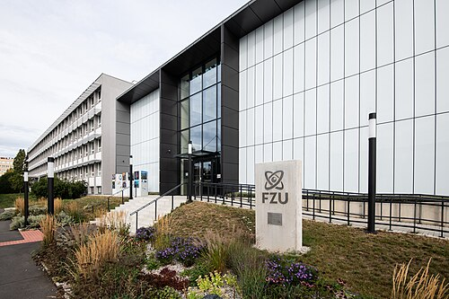
Great to be here …. in-person – or remote!
Thanks to Jiri Chuboda and FZU and Daniel Kouril!

Slide 3
Part of a series
Today (Wednesday) morning: membership, self-assessments, PKIX fabric issues
  Agenda building
  State of the IGTF Trust Fabric
  GEANT TCS updates
  ELM, DCVOTA and updates from our global peers
Thursday: A Global View, Trust, trust mechanisms, wallets
  Trust framework and snctfi research services (AARC I082)
  Token updates
  Wallets, Verifiable credentials, and eID assurance
Friday (until ~ 15.00)
  AARC PDK evolution
  GEANT Trust and Identity – enabling communities
and although some of you are remote …
let it not be a series of presentations, but raise your (virtual) hand, engage, comment,
engage in violent agreement, add or shorten, &c!

Slide 4
Logistics
Upload presentations to the agenda page
https://eugridpma.org/agenda/64
you should have a login, or invite email
For the benefit of those on-line-only, also connect to zoom (without audio please!), and share your screen when presenting/editing
https://eugridpma.org/z/64

Slide 5
Building a global trust fabric
Questions?

