Slide 1
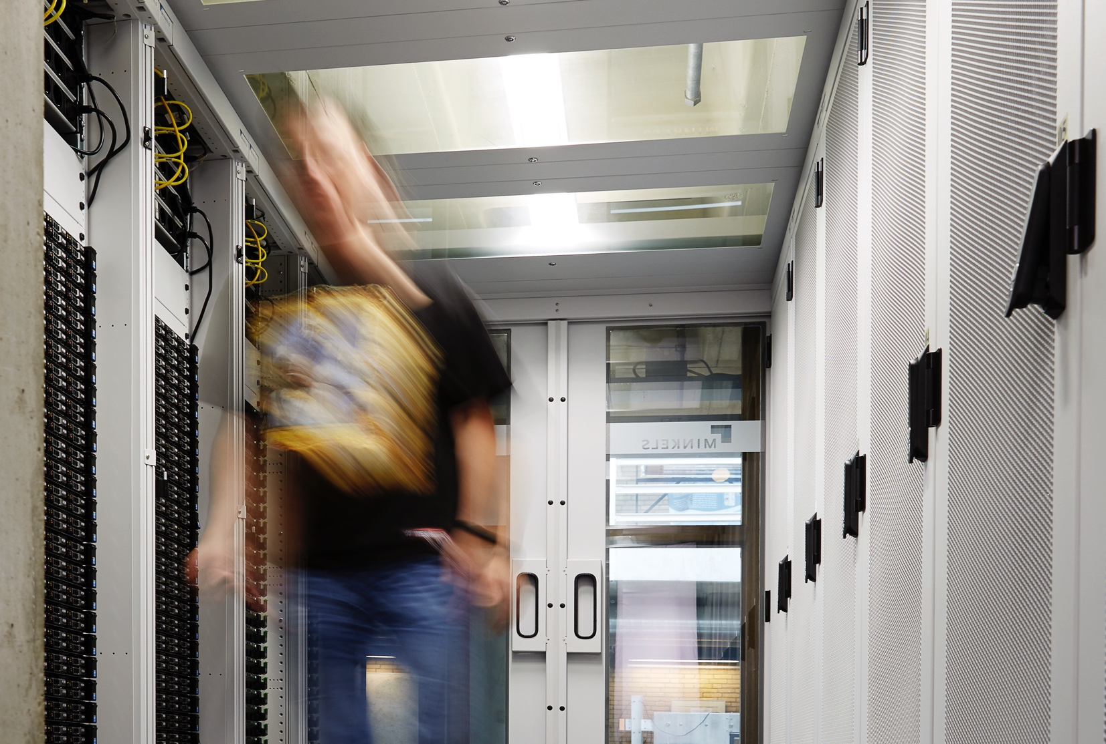

Welcome to Nikhef
  AARC2 2. All Hands Meeting
David Groep
About Nikhef
About the meeting
About dinner
November 2017

Slide 2
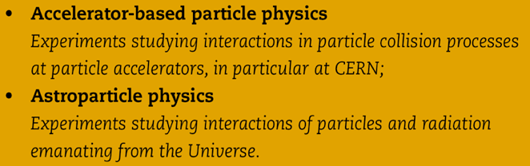
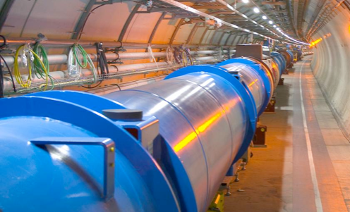
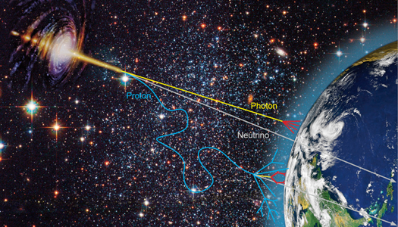


What is Nikhef
Phenomenology
Collider physics
Astroparticle physics

Slide 3

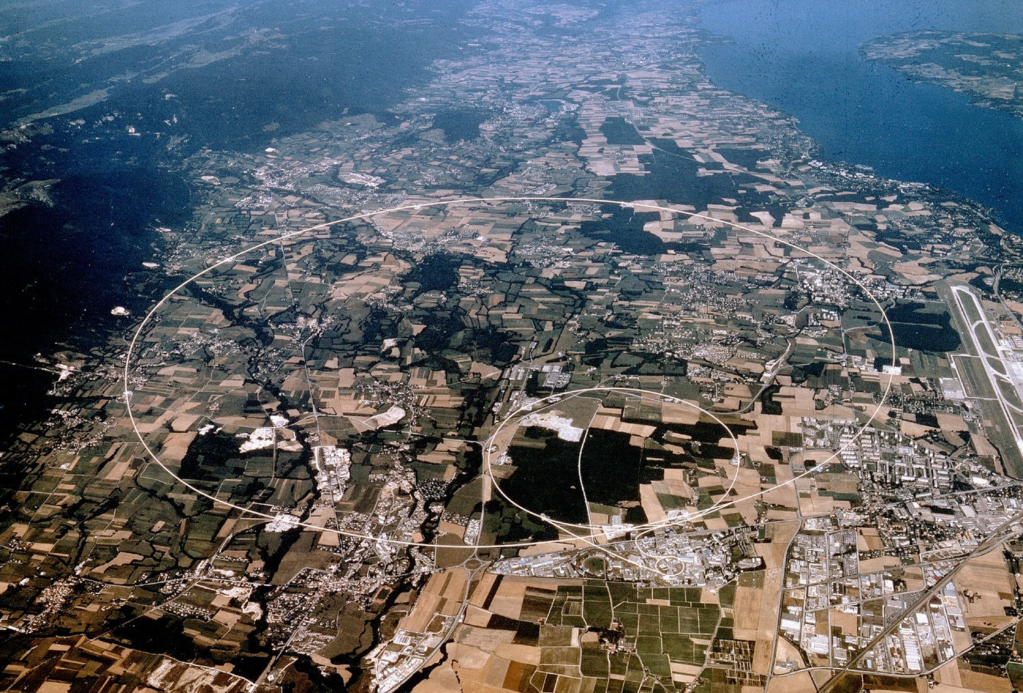
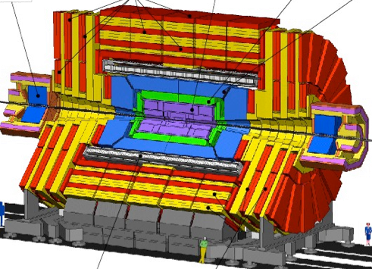



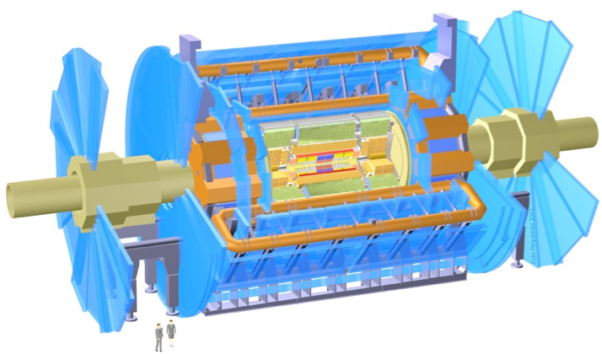

Large Hadron Collider
Imagery: CERN
protons
Atlas
Nikhef participates in the Atlas, LHCb, and Alice experiments

Slide 4
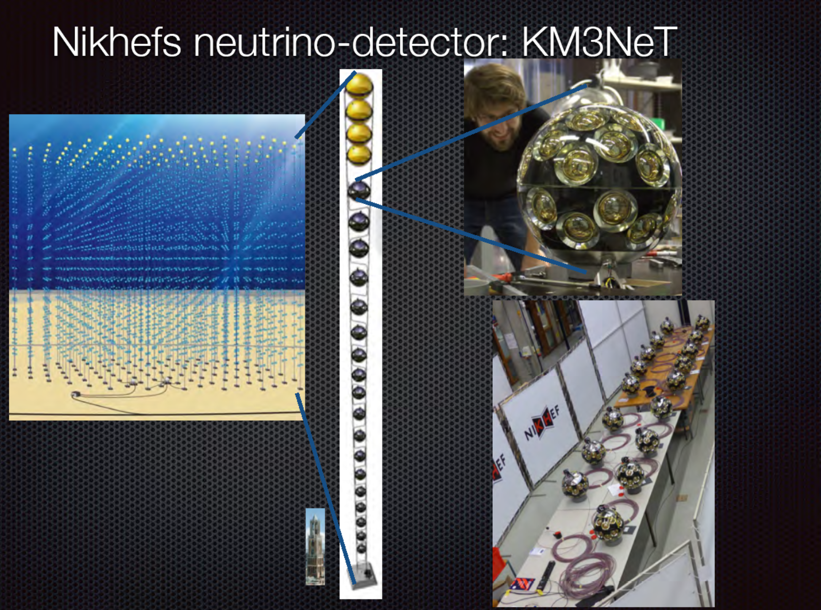
Neutrinos at Nikhef: KM3Net
Nikhef participates in the Atlas, LHCb, and Alice experiments

Slide 5
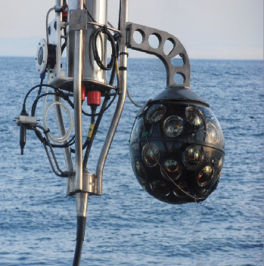
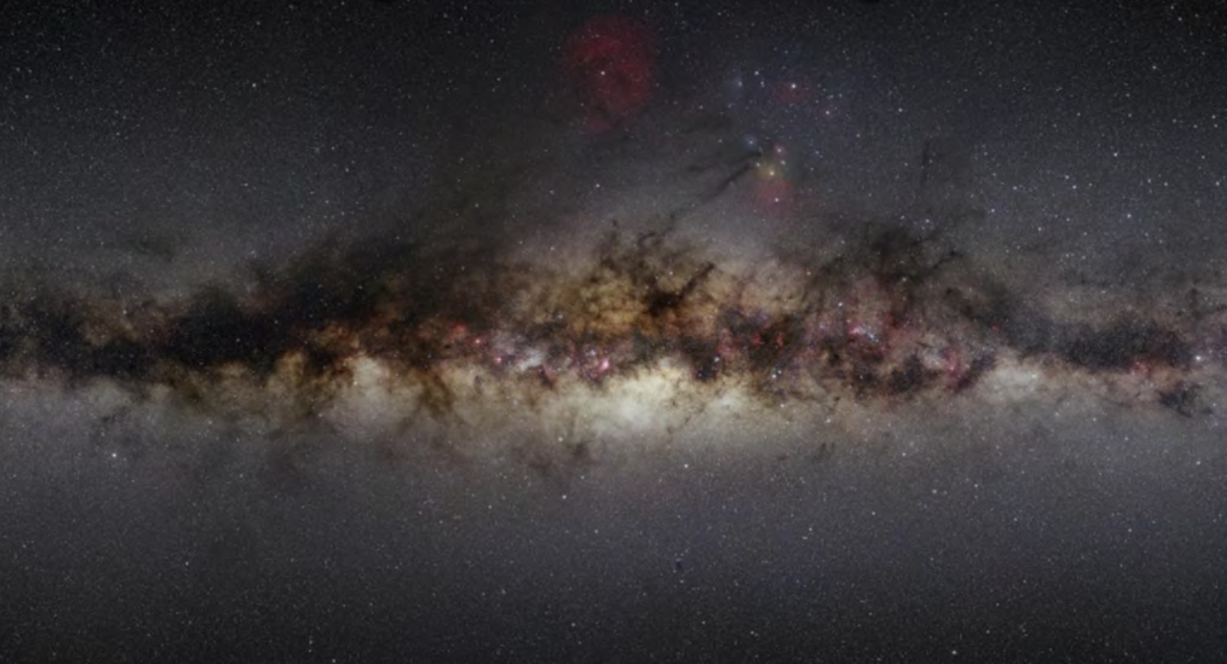
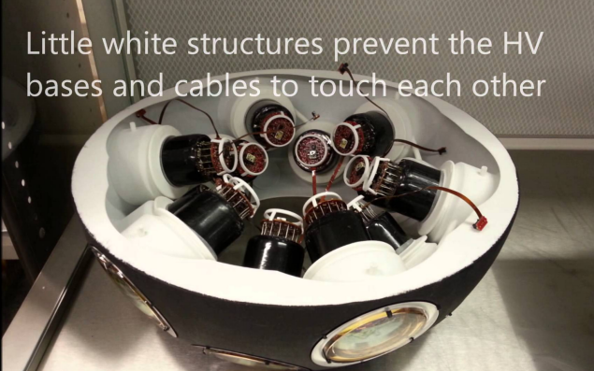
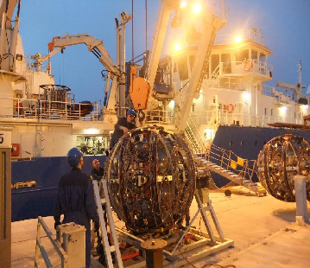
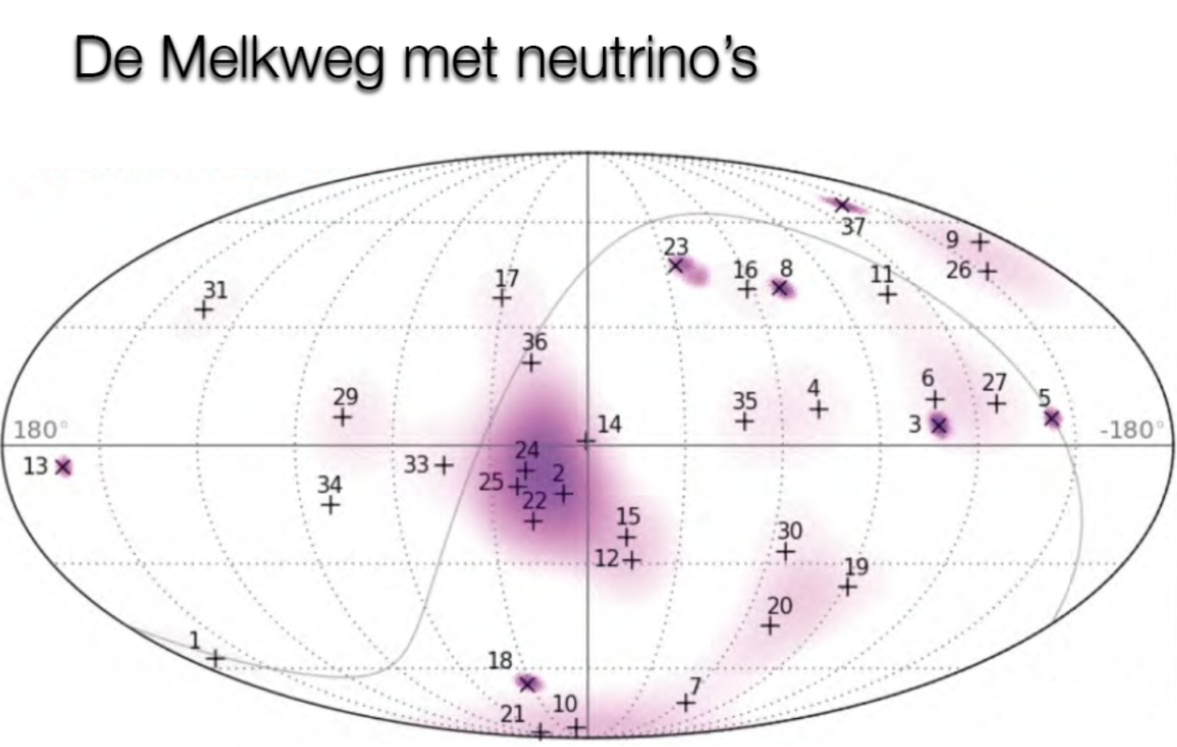
Neutrino at nikhef: KM3Net
Nikhef participates in the Atlas, LHCb, and Alice experiments
5

Slide 6
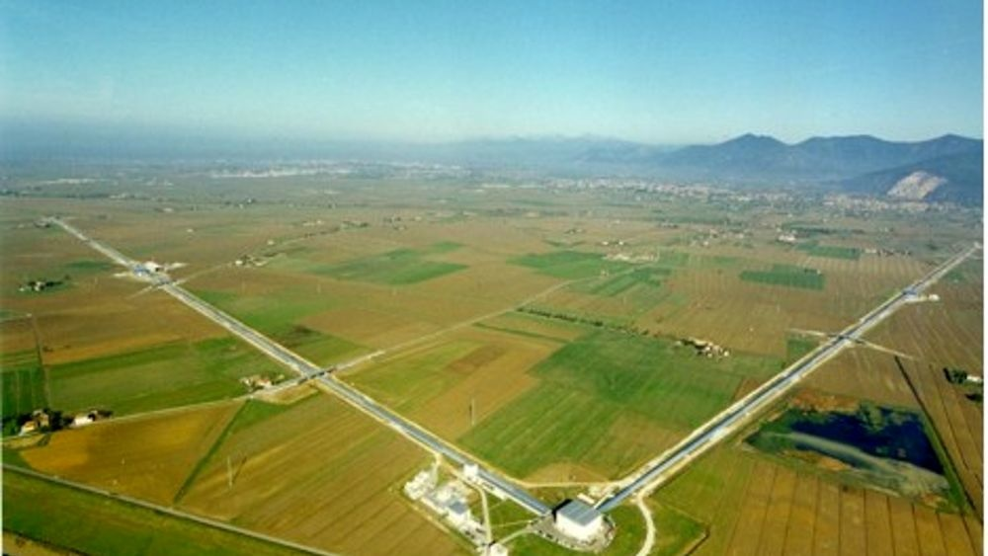
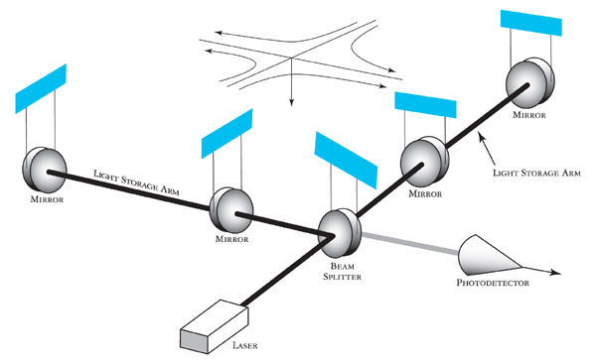
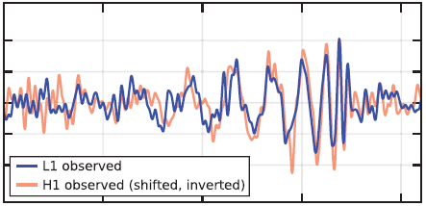

Virgo & LIGO GW astronomy
Imagery: gw-astronomy collaborations, LSC

Slide 7
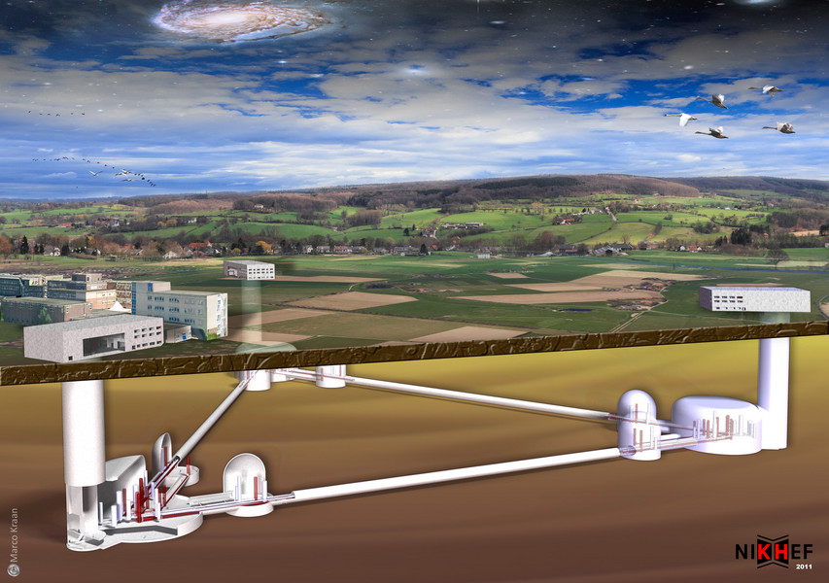
GW Astronomy: ET
Einstein Telescope – projected onto Heuvelland Limburg, NL

Slide 8
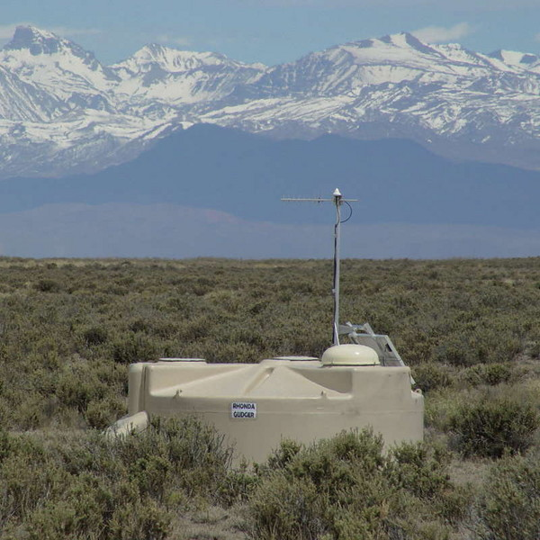
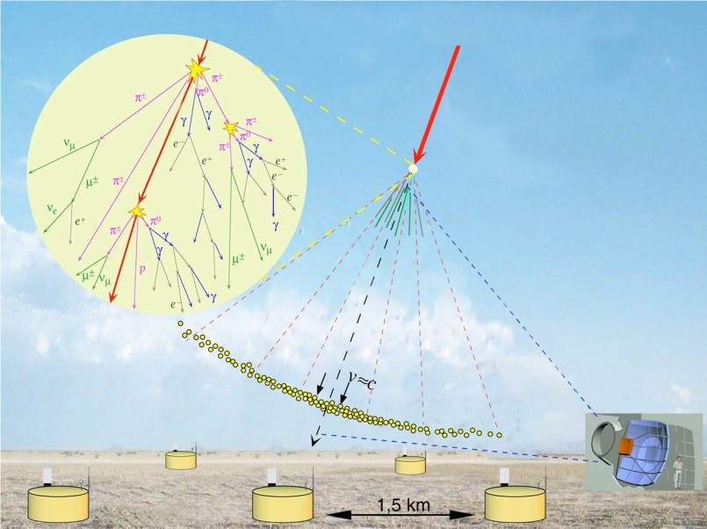
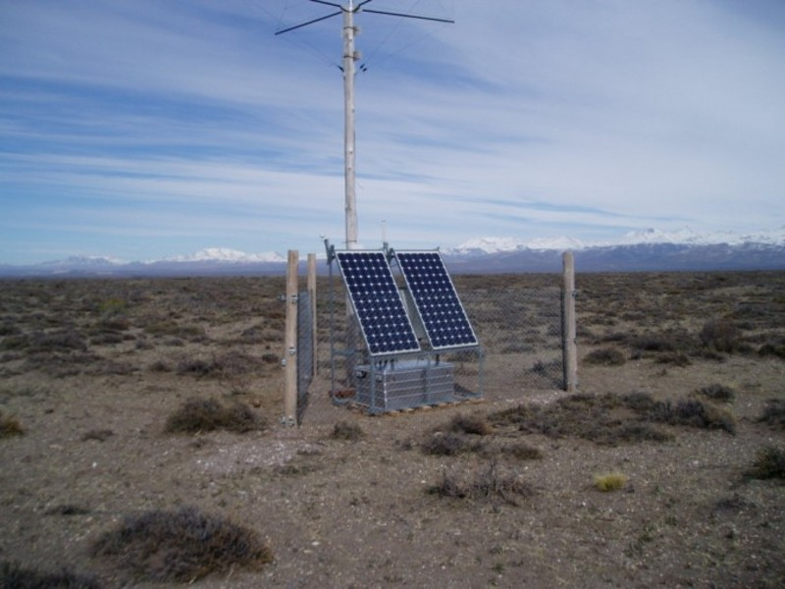
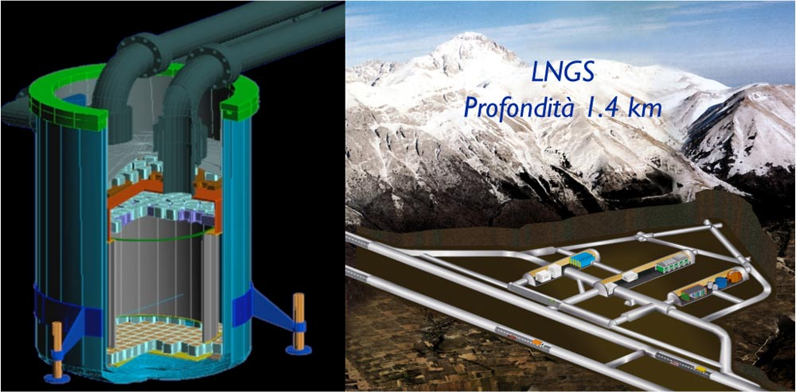
Astroparticle Physics
Image sources:
LNGS/INFN,
Xenon collaboration;
Pierre Auger collaboration;
Nikhef

Slide 9
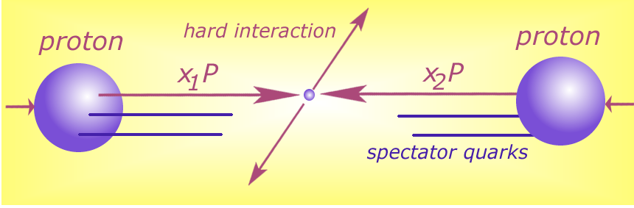
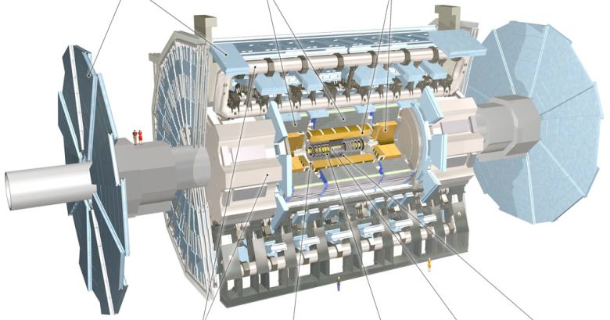





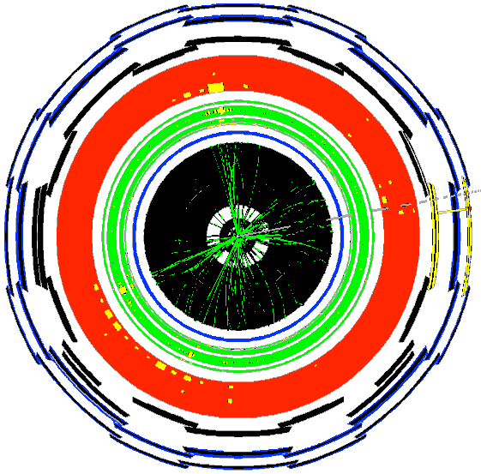

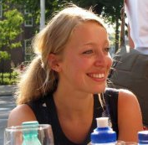

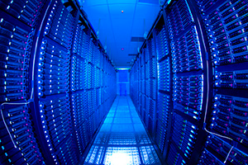



Detector to Doctor ...
and processing
40 miljoen / seconde
Analysis of collision data by PhD students
Trigger systeem selecteert 600 Hz ~ 1 GB/s data
Data distribution in
EGI, OSG, … through WLCG

Slide 10
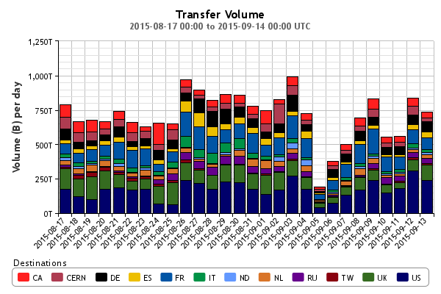
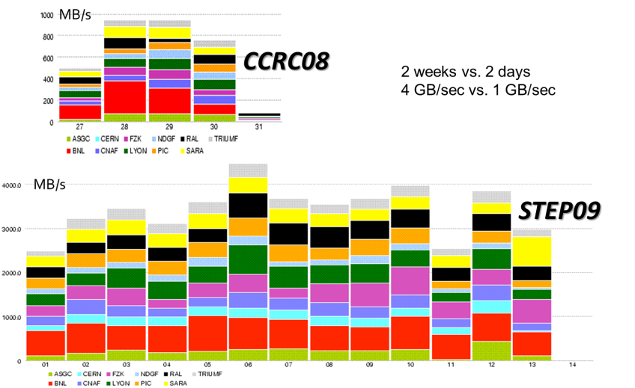
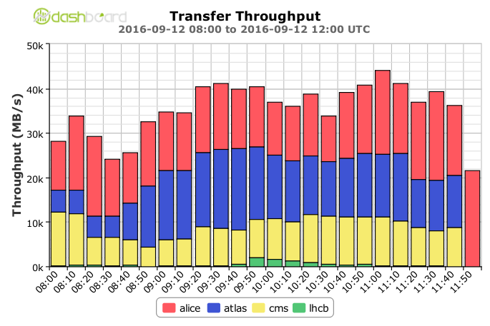
Prepare early, test often
Global transfer rates now > 40 GB/s –
acquisition:10 PB/mo (~x2 derived data)
STEP09 : Jamie Shiers, CERN IT/GS; Throughput 2016: WLCG Workshop 2016, Ian Bird, CERN

Slide 11
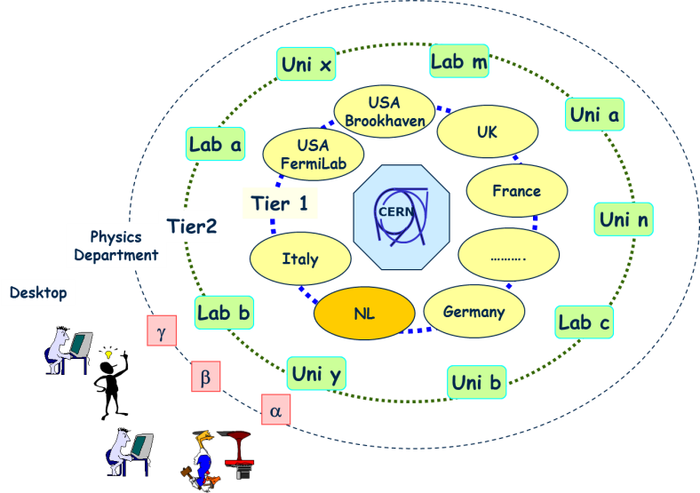
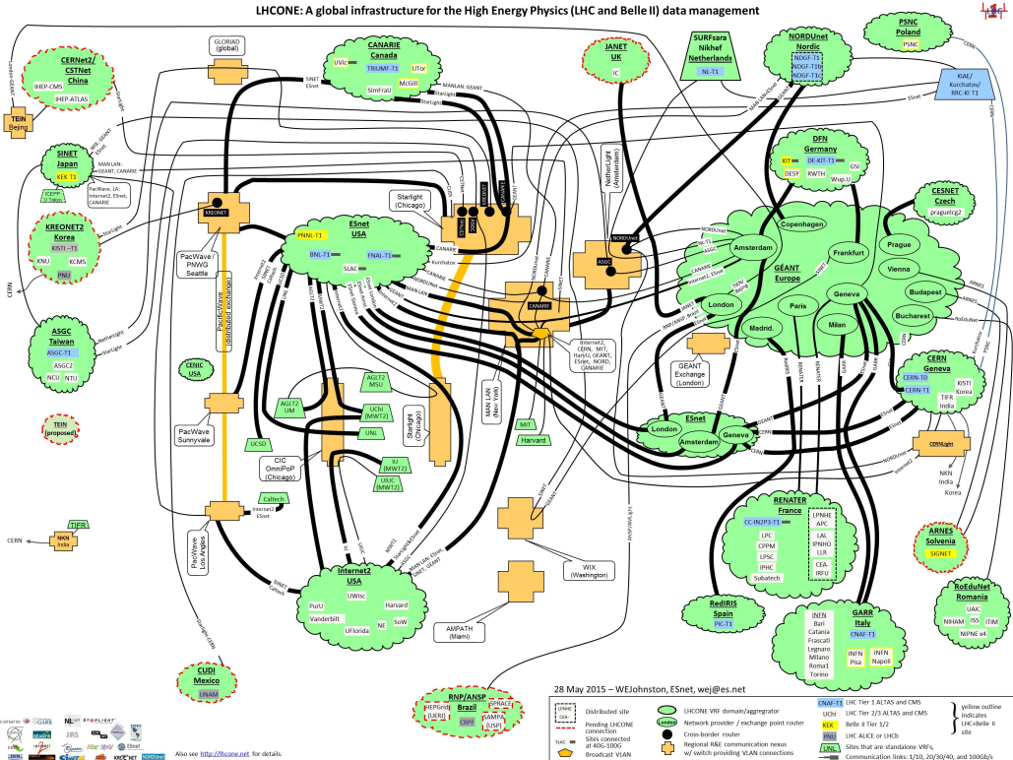
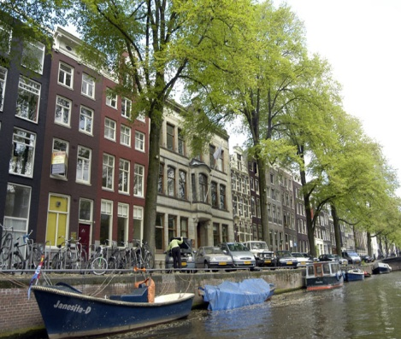
A global system of systems
From hierarchical data distribution to
a full mesh and dynamic data placement

Slide 12
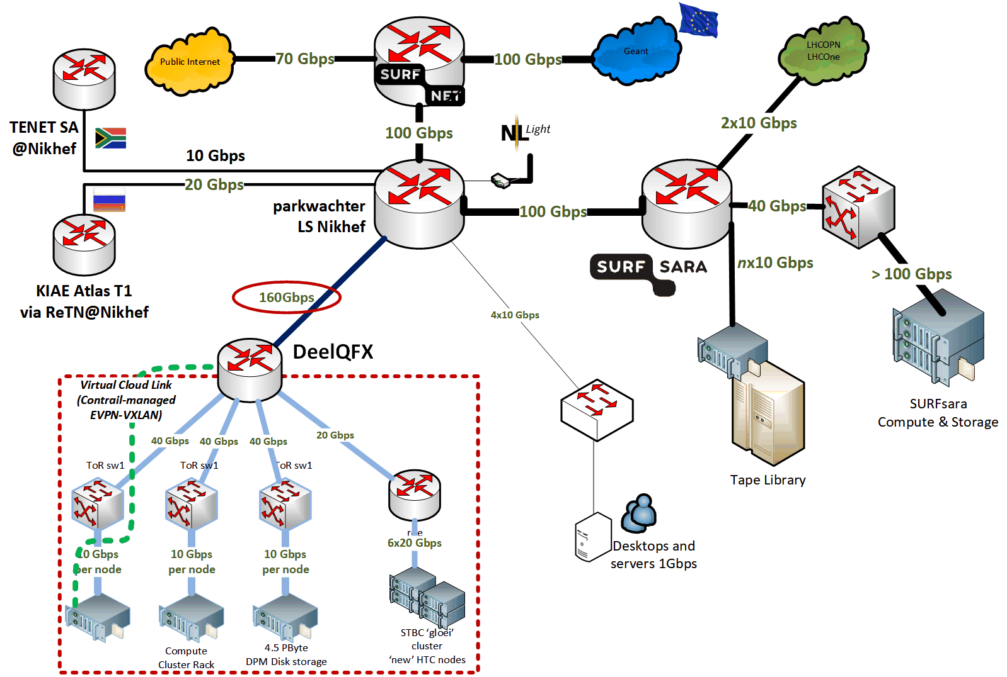
Nikhef and the World
Design basis
data intensive compute
guaranteed I/O rate per data volume
PaaS/IaaS dynamic function assignment
open peering policy
reliable hosting at AMS-IX certified DC
Key figures
1.2Tbps compute and data backbone
330 Gbps wide-area interconnect
4.5 PByte disk storage DPM
1.2 PByte disk storage dCache
5500 compute cores
dedicated hosting security services
Experimental ‘playground’ facilities
for trials with network, CPU and
storage vendors, and Nikhef capabilities

Slide 13
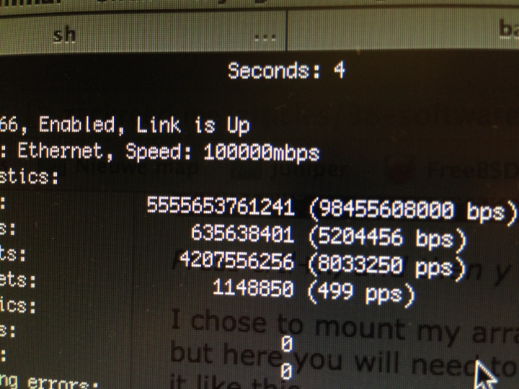
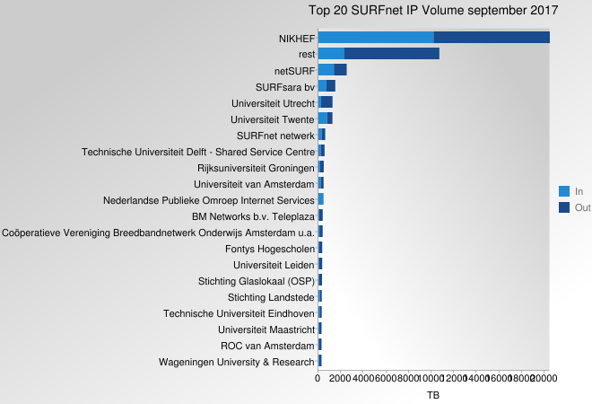
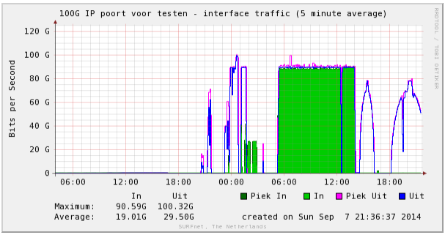
just do it ...
Nikhef fraction of total SURFnet (NL Academic) traffic, September 2017
20 PByte/mo
Nikhef → SURFnet → RUG-CIT||UvA – validation in 2015

Slide 14
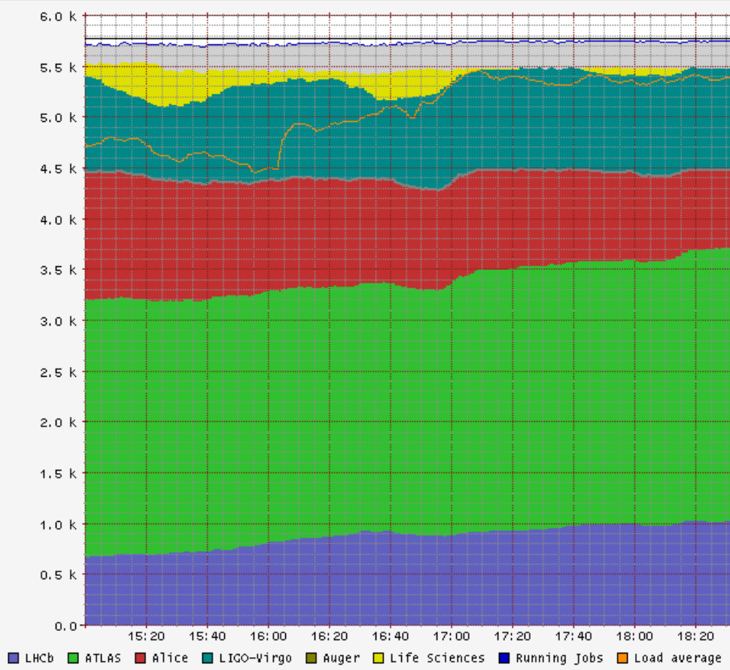
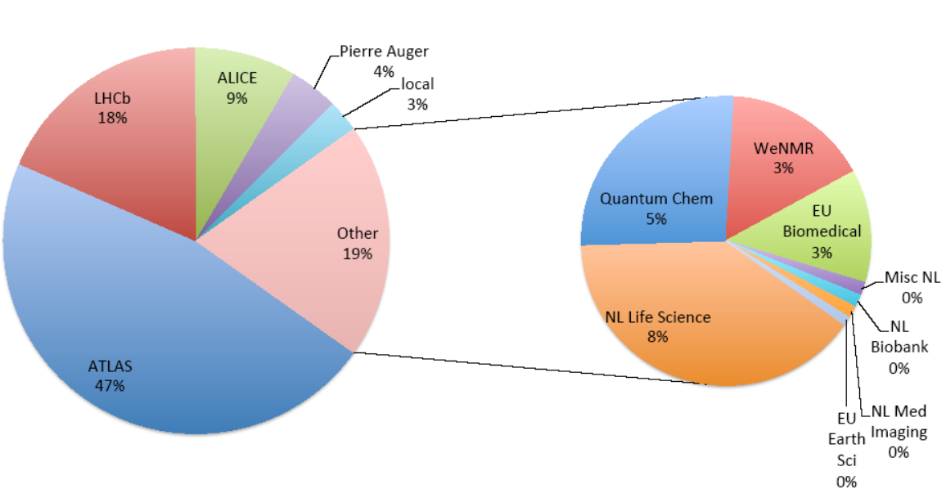
and keep it efficient by joining up
>98% utilisation, >90% efficiency
NL: WeNMR
EGI biomedical
LIGO/Virgo gravitational waves
LHC Alice
LHC Atlas
LHCb
Right:: NIKHEF-ELPROD facility, Friday, Dec 9th, 2016
Left: annual usage distribution 2013-2014

Slide 15
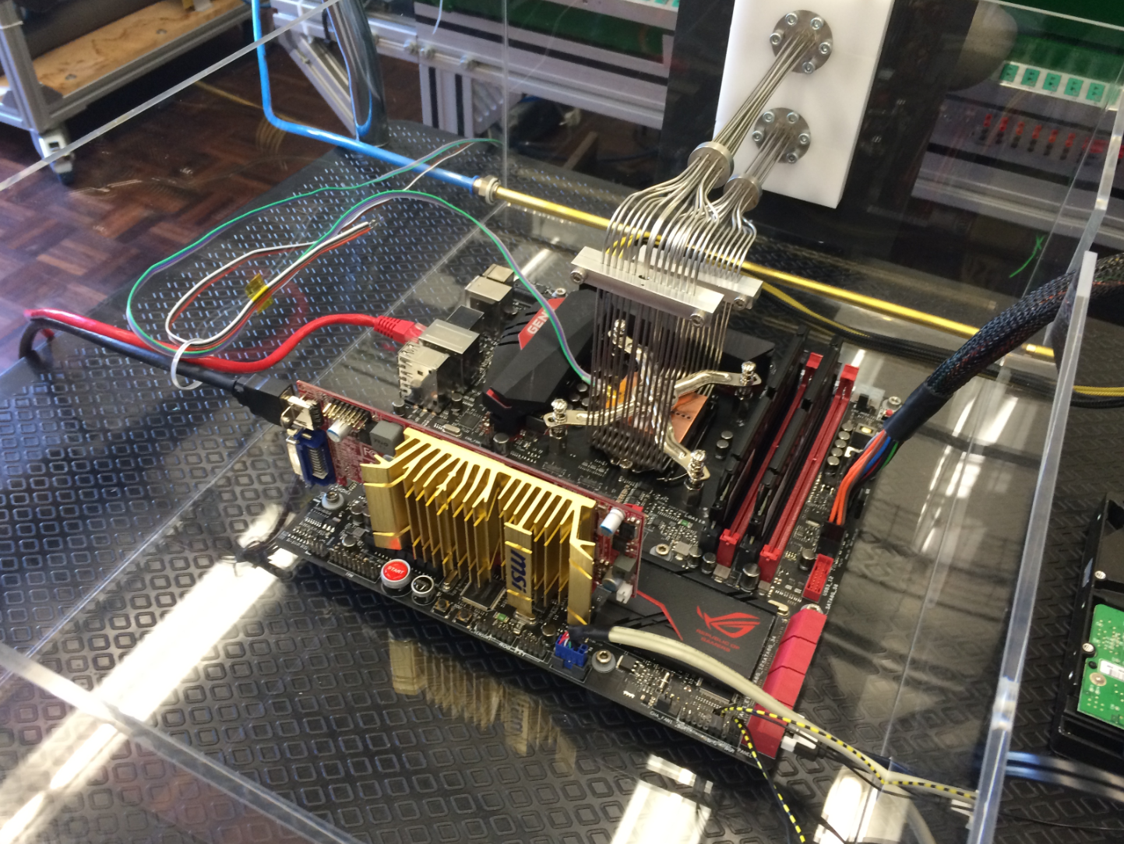
Because something are fun
... but not the long-term solution!

Slide 16
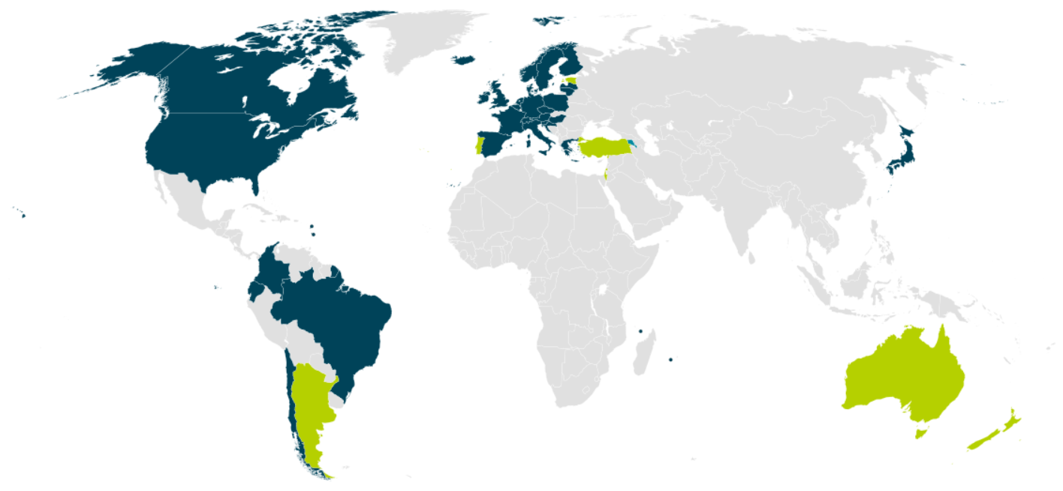


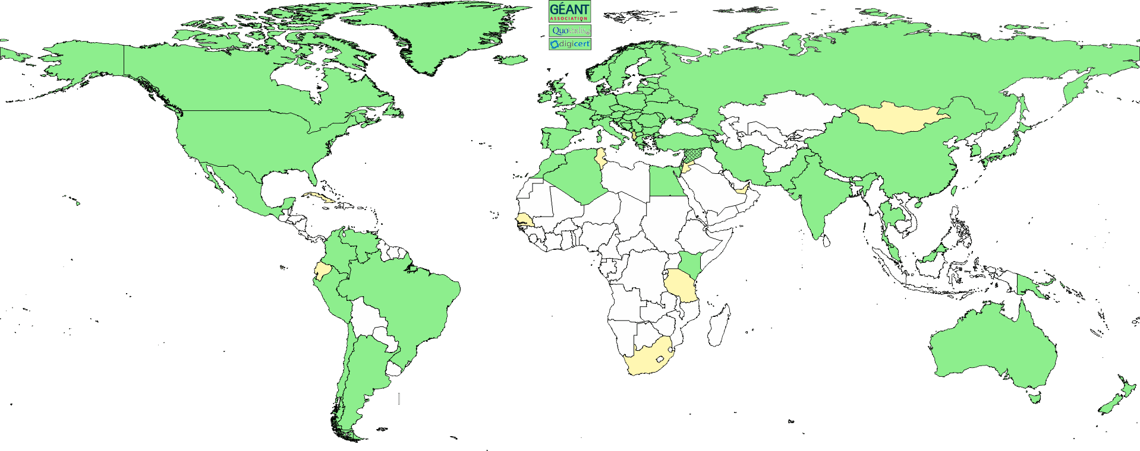

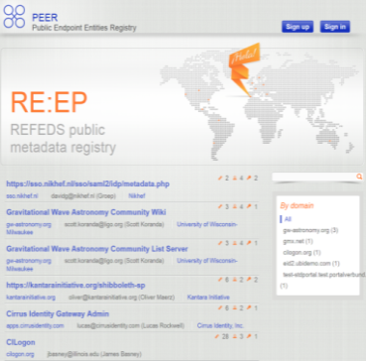
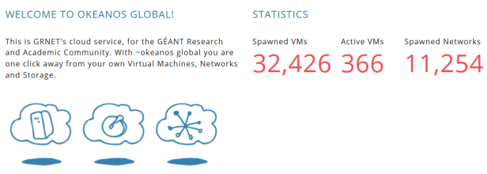

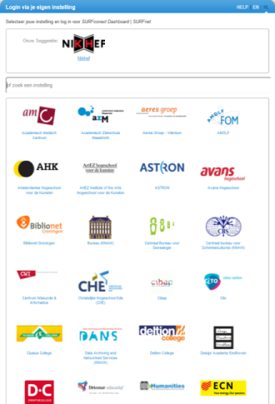
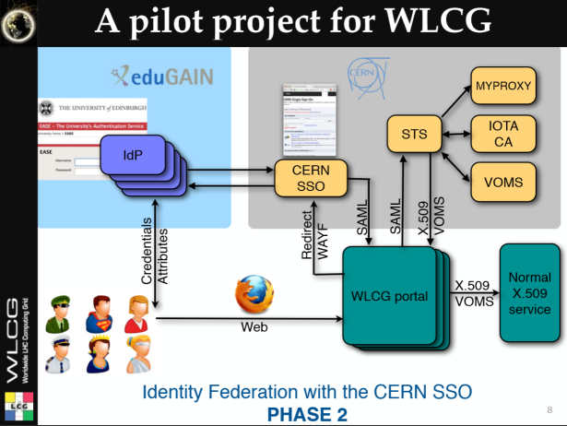
So we need to work together
wLCG FIM4R pilot

Slide 17
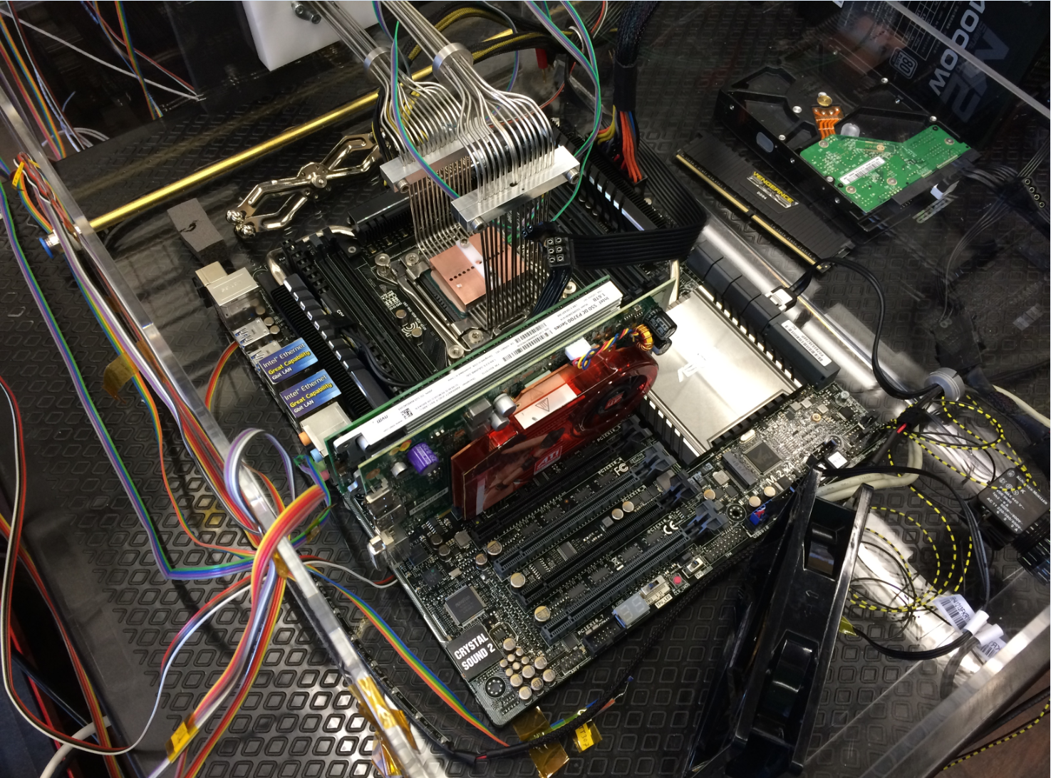
Fun, but not the solution to single-core performance …
Collaboration of Intel™ and Nikhef PDP & MT (Krista de Roo) “CO2 Inside”

