Slide 1
Nuclear energy
FEW course
Jo van den Brand
www.nikhef.nl/~jo/ne
May 11, 2011
Week 6, jo@nikhef.nl

Slide 2
Inhoud
Jo van den Brand
Email: jo@nikhef.nl URL: www.nikhef.nl/~jo
0620 539 484 / 020 598 7900, Kamer T2.69
Book
Elmer E. Lewis, Fundamentals of Nuclear Reactor Physics
Week 1 Nuclear reactions, neutron interactions
Week 2 Neutron distributions in energy
Week 3 Reactor core
Week 4 Reactor kinetics
Week 5 Neutron diffusion, distribution in reactors
Week 6 Impact, risks, etc.
Week 7 Reactivity feedback, long-term core behavior
Website: www.nikhef.nl/~jo/ne
Werkcollege
Woensdag, Mark Beker (mbeker@nikhef.nl)
Tentamen
23 mei 2011, 8:45 – 10:45 in HG-10A05, 2 uur
Herkansing: 22 augustus 2011, 8:45 – 10:45
Beoordeling: huiswerk 20%, tentamen 80% (alles > 5)

Slide 3
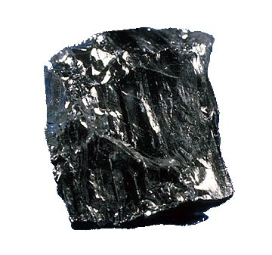
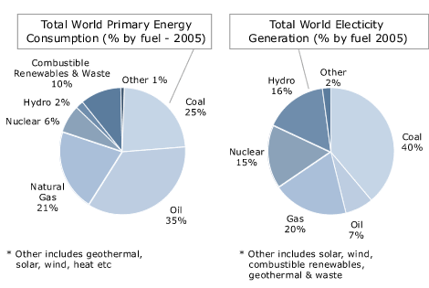
Mining accidents
Fatalities and injuries for mining in USA
Year | Average Annual Deaths | Average Annual Injuries
1936-1940 | 1,546 | 81,342
1941-1945 | 1,592 | 82,825
1946-1950 | 1,054 | 63,367
1951-1955 | 690 | 38,510
1956-1960 | 550 | 28,805
1961-1965 | 449 | 23,204
1966-1970 | 426 | 22,435
1971-1975 | 322 | 33,963
1976-1980 | 254 | 41,220
1981-1985 | 174 | 24,290
1986-1990 | 122 | 27,524
1991-1995 | 99 | 24,201
1996-2000 | 86 | 17,500
2001-2005 | 62 | 12,952
2006-2007 | 69 | 11,800
PR China | 2482Mt | Russia | 233Mt
USA | 990Mt | Indonesia | 169Mt
India | 427Mt | Poland | 95Mt
Australia | 309Mt | Kazakhstan | 92Mt
South Africa | 244Mt | Colombia | 64Mt
deadliest year in U.S. coal mining history was 1907, with 3,242 deaths
Benxihu (Honkeiko) Colliery (本溪湖媒礦), located at Benxi, Liaoning, China. On April 26, 1942, a gas and coal-dust explosion in the mine killed 1,549, 34% of the miners working that day.

Slide 4
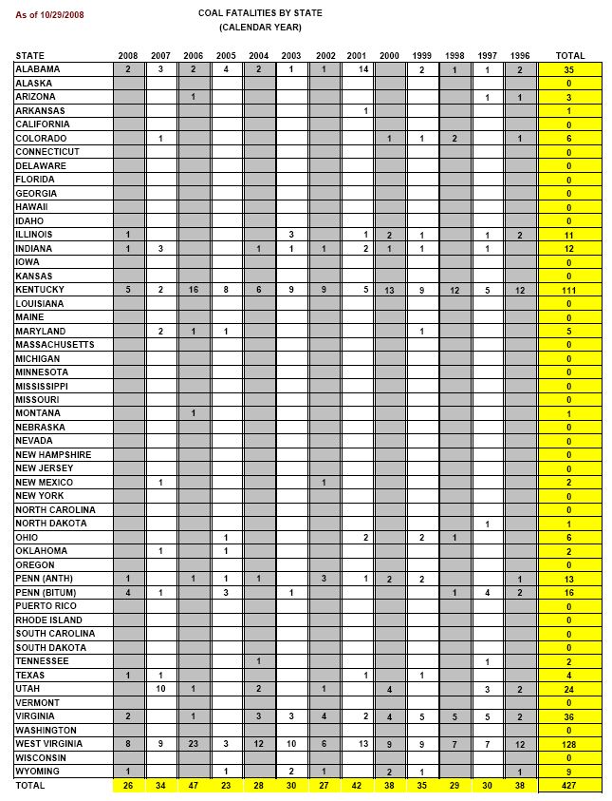
Coal mining accidents: USA and China
Source: State Administration of Work Safety
Year | Total number of coal mine accidents | Total number of deaths
2000 | 2,863 | 5,798
2001 | 3,082 | 5,670
2002 | 4,344 | 6,995
2003 | 4,143 | 6,434
2004 | 3,639 | 6,027
2005 | 3,341 | 5,986
In 2004: China official statistics: 6,027 deaths
USA reported 28 deaths in the same year
Coal production in China is twice that of the USA, while the number of coal miners is around 50 times that of the USA
Thus, deaths in coal mines in China are
4 times as common per worker
108 times as common per unit output
as in the USA.

Slide 5
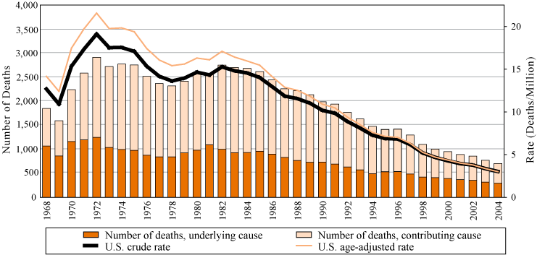
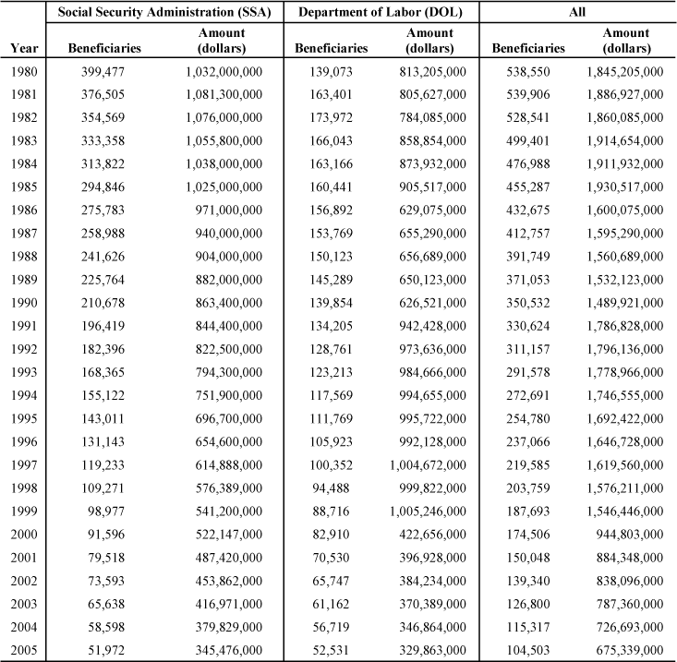
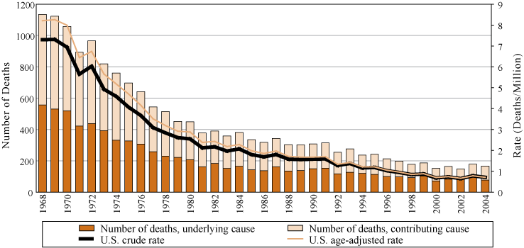
Work-Related Lung Disease (WoRLD) Surveillance System
Pneumoconiosis
42,252 underground miners (2000)
10,000 deaths last 10 years
http://www.cdc.gov/
US residents, age 15 and over, 1968 - 2004
Federal Black Lung Program:
Silicosis
Federal Black Lung Program:
4000 new cases of black lung every year in the USA (4% of workers annually)
10 000 new cases every year reported in China (0.2% of workers).

Slide 6
Black lung disease in China
Black lung disease claims 140,000 lives in China
The black lung disease has claimed 140,000 lives in the Chinese mainland since the occupational disease report system was founded in 1950s, revealed vice Health Minister Jiang Zuojun at a televised conference for prevention and treatment of occupational diseases held in Beijing March 17, 2005. A total of 580,000 black lung cases have been reported in China so far, and there are 440,000 people suffering from black lung disease at present. The number of black lung case is increasing roughly 10,000 annually. In addition, China reports nearly 30,000 poison cases relating to occupation and use of pesticide in production. About 1,500 people die from poison. Jiang acknowledged the occupational disease has grown so rampant in some areas that "black lung village" and "poison village" have emerged. Many laborers have become impoverished due to the disease. Moreover inappropriate settlement of disputes over occupational diseases has led to incidents that influence social harmony and stability, including blockade of road, strike, demonstration, and group appeal to higher authority for help. Occupational disease has become a grave problem that harms public health and social stability. To strengthen prevention and treatment of occupational diseases, the Chinese government has adopted occupational health review system for construction projects; imposed strict approval for aptitude of service departments for occupational health; rectified diagnosis and appraisal for occupational disease. The Health Ministry has decided to launch a publicity week with feature "Safeguard laborer's health by prevention of occupational diseases", in which consultation regarding prevention and treatment of occupational disease will be offered to laborers free of charge. By People's Daily Online

Slide 7
Radiation exposure of coal
Science 8 December 1978: Vol. 202. no. 4372, pp. 1045 – 1050 DOI: 10.1126/science.202.4372.1045
 | Articles Radiological Impact of Airborne Effluents of Coal and Nuclear Plants J. P. McBride ¹, R. E. Moore ², J. P. Witherspoon ², and R. E. Blanco ³ ¹ Research staff member of the Chemical Technology Division, Oak Ridge, Tennessee 37830 ² Research staff members of the Health and Safety Research Division, Oak Ridge, Tennessee 37830 ³ Manager of Radioactive Waste Management Research and Development Programs at Oak Ridge National Laboratory, Oak Ridge, Tennessee 37830 Radiation doses from airborne effluents of model coal-fired and nuclear power plants (1000 megawatts electric) are compared. Assuming a 1 percent ash release to the atmosphere (Environmental Protection Agency regulation) and 1 part per million of uranium and 2 parts per million of thorium in the coal (approximately the U.S. average), population doses from the coal plant are typically higher than those from pressurized-water or boiling-water reactors that meet government regulations. Higher radionuclide contents and ash releases are common and would result in increased doses from the coal plant. The study does not assess the impact of non-radiological pollutants or the total radiological impacts of a coal versus a nuclear economy.
The extremely high standards of the nuclear industry result in a regimen of care and containment
NCRP Report No. 95, Radiation Exposure of the U.S. Population from Consumer Products and Miscellaneous Sources
NCRP Report No. 95 is another of the assessment series of reports. This Report recognizes that there are many consumer products available which emit ionizing radiation, in some cases as an essential element of the proper performance of the device and in other cases as incidental or extraneous to the purpose for which the product was designed. The Report evaluates the exposures from all of these types of products. Treated are electronic products such as television receivers and airport luggage inspection systems; radioactive materials such as radioluminous products, building materials, glass and ceramics; and miscellaneous exposure sources such as high voltage vacuum electronic units. Also covered are exposures resulting from disposal of radioactive surplus items and transport of radioactive materials. Recommendations for dose reduction are also provided in the Report

Slide 8
Unclean Fuels Kill 1.5 Million People Per Year - UN
GENEVA - Half the world's population burns wood, coal, dung and other solid fuels to cook food and heat their homes, exposing them to dangerous smoke that kills 1.5 million people a year, the UN health agency said on Thursday.
The World Health Organisation (WHO) said women and children in Africa and Asia were especially vulnerable to indoor air pollution from open fires and poorly ventilated stoves.
Children make up 800,000 of the 1.5 million people who die each year from polluting household fuels, women account for 500,000 deaths and the remaining 200,000 are men.
"Day in day out, and for hours at a time, women and their small children breathe in amounts of smoke equivalent to consuming two packs of cigarettes per day," the WHO said.
Yet in a report entitled "Fuel For Life: Household Energy and Health," the Geneva-based agency said it could cost as little as US$6 per family to install better-insulated and fuel efficient stoves in developing countries.
"Making cleaner fuels and improved stoves available to millions of poor people in developing countries will reduce child mortality and improve women's health," WHO Director General Lee Jong-wook said.
Inhaling indoor smoke doubles a child's risk of pneumonia and makes adults three times as likely to suffer chronic pulmonary disease than those who cook with electricity, gas and other clean-burning fuels, it said.
Halving the 3 billion people worldwide cooking with solid fuels by 2015 would cost between US$13 billion to US$43 billion a year depending on the new energy source used, WHO said. Using liquefied petroleum gas would be cheaper than ethanol.
But it would save up to US$91 billion a year over 10 years due to health care savings, less illness, fewer deaths, and higher productivity due to less time-intensive fuel collection and cooking.
"With more time available, children would do better at school, while their mothers could engage in child care, agriculture or other income-generating activities," it said.
Making better-ventilated stoves available to half of those currently using inefficient cookers could save US$34 billion in fuel expenditure each year, it said.
Story Date: 5/5/2006

Slide 9
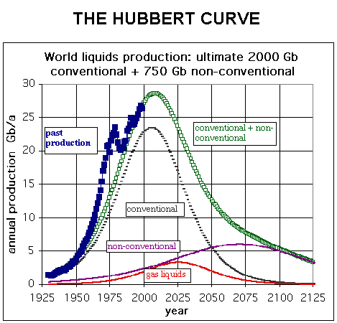
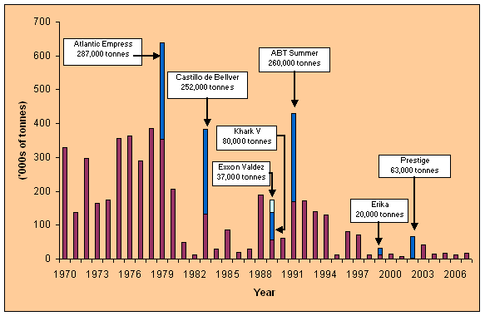
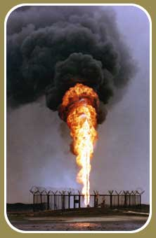
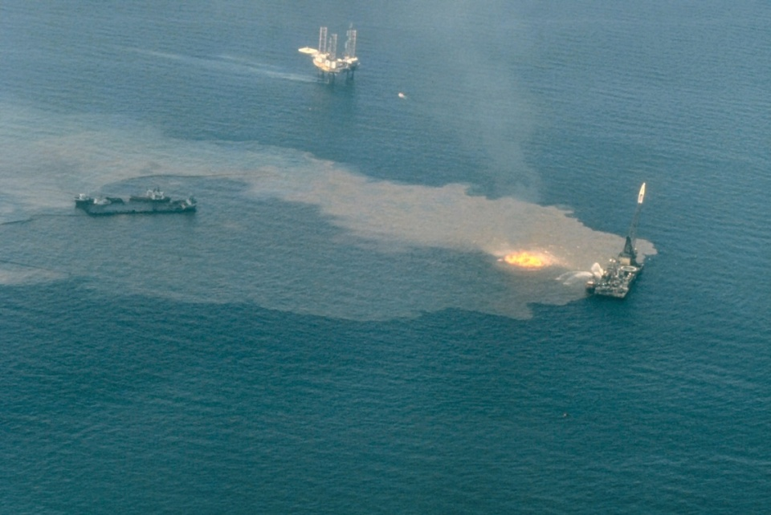
Oil spills
Gulf war oil spill, 1991, 0.8 - 1.5Gt
IXTOC I oil well blowout
1979, Gulf of Mexico, 480Mt

Slide 10
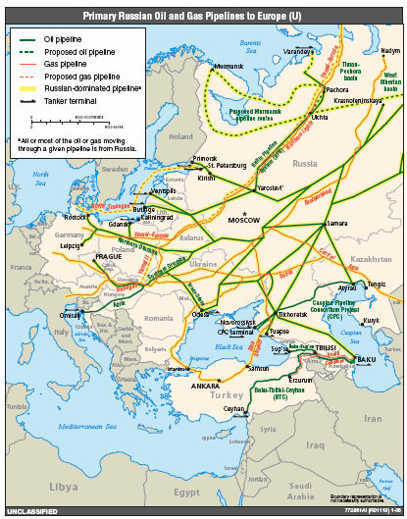
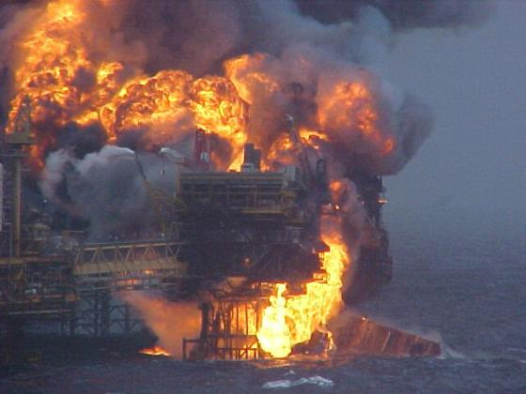
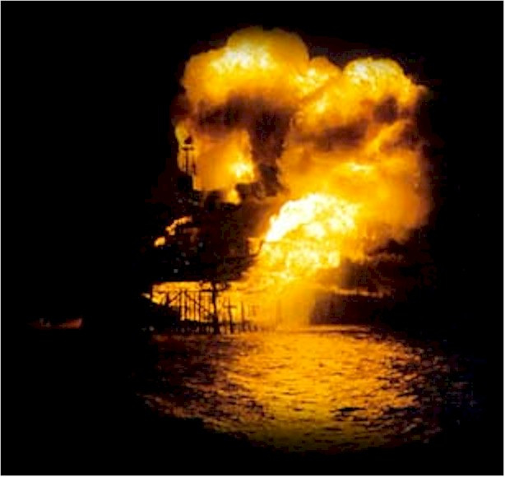
Oil: pipeline ruptures, platform accidents
Piper Alpha was a North Sea oil production platform operated by Occidental Petroleum (Caledonia) Ltd. The platform began production in 1976, first as an oil platform and then later converted to gas production. An explosion and resulting fire destroyed it on July 6, 1988, killing 167 men. Total insured loss was about US$ 3.4 billion.

Slide 11
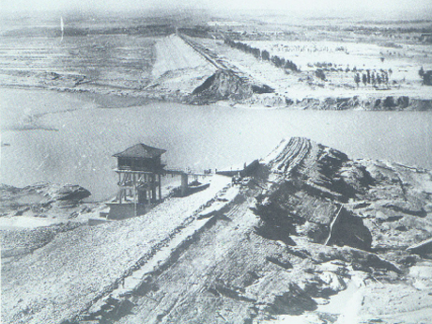
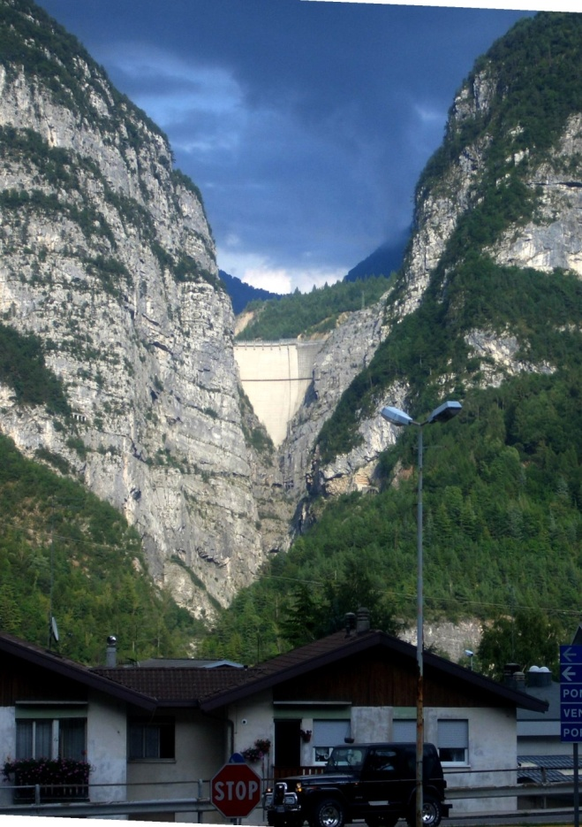
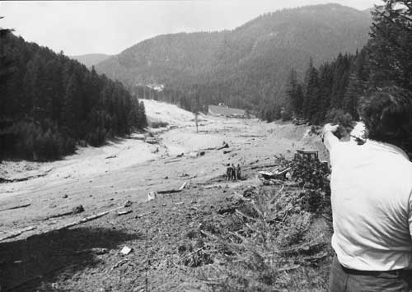
Dam disasters
Banqiao dam failure – 1975
According to the Hydrology Department of Henan Province, in the province, approximately 86,000 people died from flooding and another 145,000 died during subsequent epidemics and famine. In addition, about 5,960,000 buildings collapsed, and 11 million residents were affected.
Val di Stava dam disaster – 1985
268 deaths
Vajont dam disaster – 1963
One of the highest dams in the world measuring 262 metres
Its 1963 failure during initial filling was caused by geological instability
Total of 1910 casualties

Slide 12
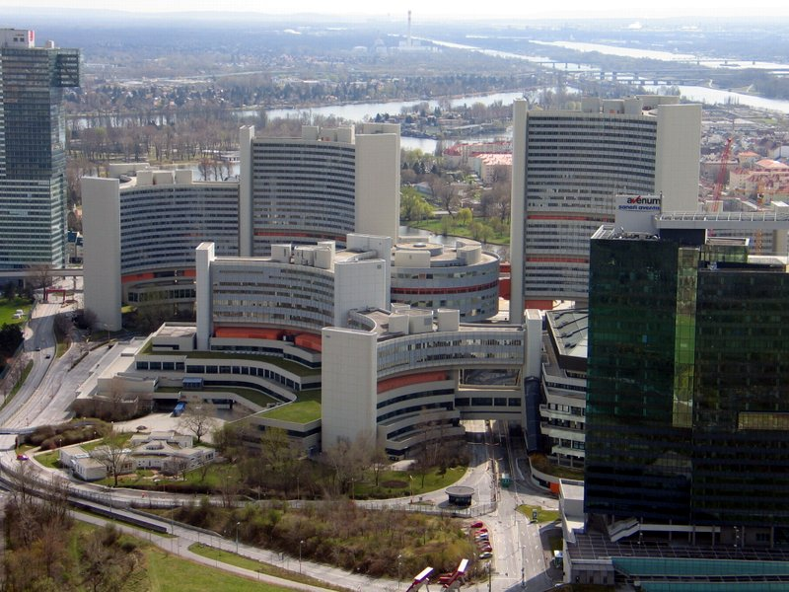
International Nuclear Event Scale
International Atomic Energy Agency
Level 7: Major accident | Chernobyl | Large off-site impact
Level 6: Serious accident | Mayak | Significant off-site release
Level 5: Accident with wider consequences | Windskale, Three mile island | Severe reactor damage, limited off-site release
Level 4: Accident with local consequences | Sellafield, Saint-Laurent, Tokaimura | Public exposure (near limits), fatal exposure
Level 3: Serious incident | Thorp Sellafield, Paks | Public exposure (below limits), near accident
Level 2: Incident | Asco, Forsmark | No off-site impact, overexposure of worker
Level 1: Anomaly | Tricastin | Anomaly (water leak, contamination)

Slide 13
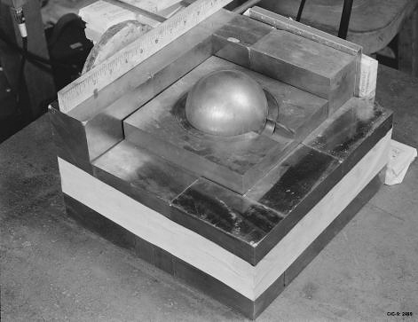
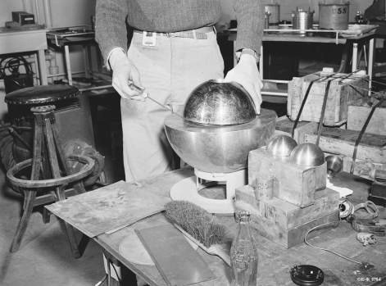
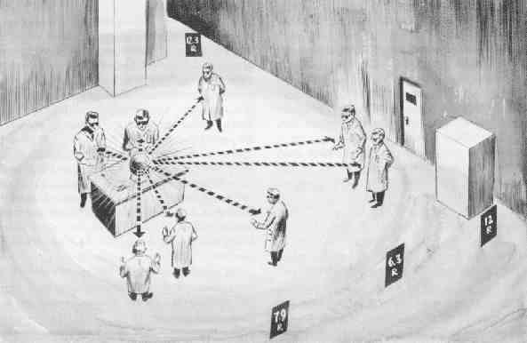
First nuclear accidents
Harry K. Daghlian, Jr., (1921 – September 15, 1945)
Physicist of Armenian descent with the Manhattan Project who accidentally irradiated himself on August 21, 1945 during a critical mass experiment at the remote Omega Site facility at Los Alamos National Laboratory in New Mexico, resulting in his death 21 days later.
Daghlian was irradiated as a result of a criticality accident that occurred when he accidentally dropped a small tungsten carbide brick onto a 6.2 kg delta phase plutonium bomb core.
This core was later nicknamed the "Demon core”
Louis Alexander Slotin (December 1, 1910 – May 30, 1946)
Canadian physicist and chemist who took part in the Manhattan Project.
Performed experiments with uranium and plutonium cores to determine their critical mass values. After World War II, Slotin continued his research at Los Alamos National Laboratory.
On May 21, 1946, Slotin accidentally began a fission reaction, which released a burst of hard radiation. He was rushed to hospital, and died nine days later.

Slide 14
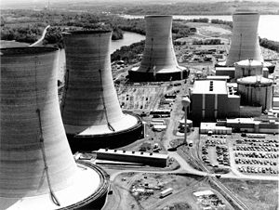
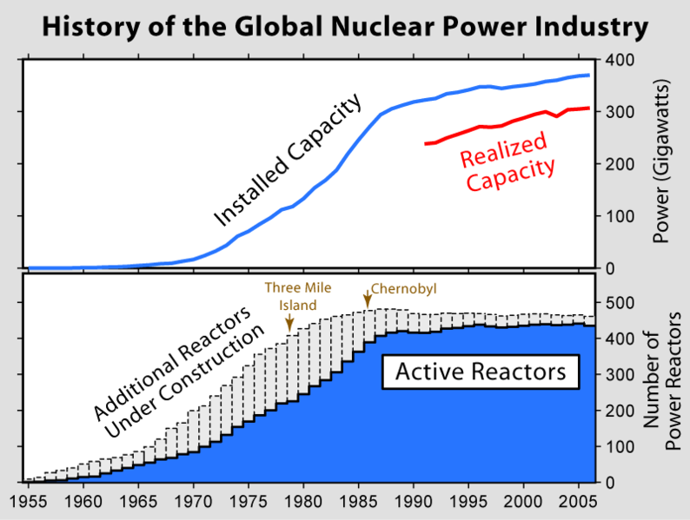
Three Mile Island – TMI-2
Release few weeks before accident
TMI-2: PWR (Babcock & Wilcox)
March 28, 1979. Biggest nuclear accident in USA. Pump of secondary non-nuclear cooling fails. Turbine and reactor are shutdown (normal procedure).
Temperature and pressure in reactor rise (normal). Relief valve of pressurizer (PORV) opens.
PORV should close, but fails to do so (not noticed by operators). Pressure keeps dropping, cooling water pours out of PORV. Reactor core overheats.
Backup system failed since after tests prior to accident people forgot to open valves (human error). Half of the core melted. All contained. Radioactive noble gases (~43 kCi krypton) were vented (<20 Ci of I-131).
Average dose to people within ten miles was 8 mrem. Nobody received more than 100 mrem (power plant workers norm: < 5 rem per year. Estimate of additional cancers <~ 1.

Slide 15
Mayak – Russian nuclear fuel reprocessing plant
Mayak plant
Built in 1945 – 48 in total secrecy for Soviets Union’s nuclear weapon program. Five nuclear reactors were built.
On 29 September 1957, when the failure of the cooling system for a tank storing tens of thousands of tons of dissolved nuclear waste resulted in a non-nuclear explosion having a force estimated at about 75 tons of TNT (310 gigajoules), which released some 20 MCi (740 peta-becquerels) of radioactivity.
At least 200 people died of radiation sickness, 10,000 people were evacuated from their homes, and 470,000 people were exposed to radiation.

Slide 16
Nuclear power – October 2008
The world total annual energy consumptions amount to 14 billion coal equivalent.
Reactor type | In operation |  |  | Under construction
 | Number | net capacity MWe |  | Number | net capacity MWe
PWR | 265 | 243,295 |  | 27 | 24,195
BWR | 94 | 85.287 |  | 3 | 3,925
AGR, GGR | 18 | 9,034 |  | - | -
CANDU/D₂O-PWR | 44 | 22,390 |  | 4 | 1,298
RBMK | 16 | 11,404 |  | 1 | 925
SNR | 2 | 690 |  | 2 | 1.220
total | 439 | 372,100 |  | 34 | 31,563

Slide 17
Energy reserves – 2006
Natural gas | 235 billion t coal equivalent
Mineral oil/shales/liquid gas | 232 billion t coal equivalent
Natural uranium | 27 billion t coal equivalent
Coal (all forms) | 726 billion t coal equivalent.
The world total annual energy consumptions amount to 14 billion coal equivalent.

Slide 18
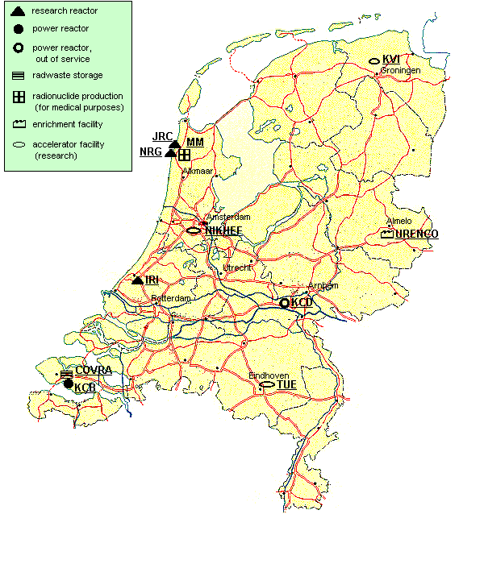
Nuclear installations in The Netherlands

