Slide 1
Inflation
Jo van den Brand, Chris Van Den Broeck, Tjonnie Li
Nikhef: April 23, 2010

Slide 2
Limitations of standard cosmology
Horizon problem, flatness problem, missing exotic particles
Horizon: largest distance over which influences can have travelled in order to reach an observer: visible Universe of this observer
Thermal equilibrium between different parts of the Universe established by exchange of photons (radiation)
Photons decouple about 100,000 years A.B. and then the horizon was much smaller than at present
Observer today
System 1 and its lightcone
System 2 and its lightcone
One expect that regions with about the same temperature are relatively small, but this is not the case
no time for signals
Big Bang, t = 0
Inflation: one starts with a small Universe which is in thermal equilibrium and inflates this with an enormous factor. Increasingly more of this Universe is now entering our horizon.

Slide 3
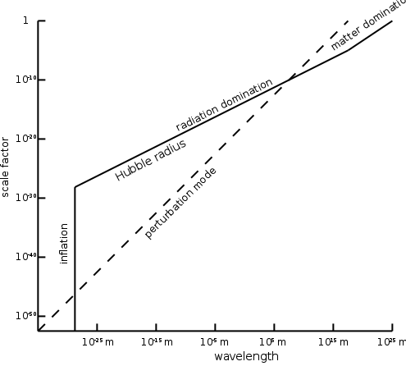
Flatness problem and exotic particles
Experiments show: Universe now has a nearly flat Robertson – Walker metric
In order to explain the present flatness, the metric of the early Universe needs to resemble even more a perfectly flat RWM
Flatness problem: which mechanism brought the earliest flatness so close to the flat RW metric?
If you assume that the Universe was always perfectly flat, then the Universe started with exactly the critical density. Why?
Classical Standard Model of Cosmology provides no answers
Modern particle physics predicts exotic particles: supersymmetric particles, monopoles, …
Inflation

Slide 4
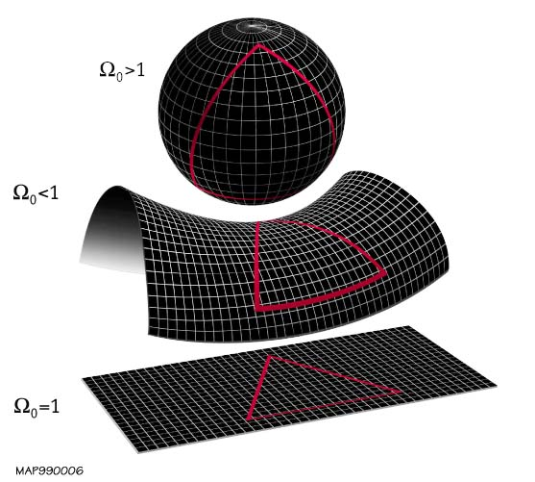
Friedmann equations
Previously: flat Robertson – Walker metric (k = 0). In general one hast
Einstein equations give Friedmann equations
Without cosmological constant, FV – 1 becomes
Critical density: for given H the density for which k = 0
10⁻²⁶ kg m⁻³
Density / critical density: Ω

Slide 5
Friedmann equations
Friedmann equation 1 can be re-written as
On the right only constants. During expansion, density decreases (~a³)
Since Planck era, ra² decreased by a factor 10⁶⁰
Thus, (Ω⁻¹ – 1 ) must have increased by a factor 10⁶⁰
WMAP and Sloan Digital Sky Survey set Ω₀ at 1 within 1%
Then | Ω⁻¹ - 1 | < 0.01 and at Planck era smaller than 10⁻⁶²
Flatness problem: why was the initial density of the Universe so close to the critical density?
Solutions: Anthropic principle or inflation (ra² rapidly increases in short time)

Slide 6
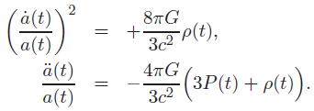
Dynamics of cosmological inflation
Inflation occurs when the right part of FV – 2 is positive, so for n < -1/3.
A cosmological constant will do, but inflation works differently
Take scalar field which only depends on time (cosmological principle)
Langrangian – density
Note: Minkowski-metric yields the Klein Gordon equation
Action
Euler – Lagrange equations yield equations of motion
Details of evolution depend on the potential energy V

Slide 7
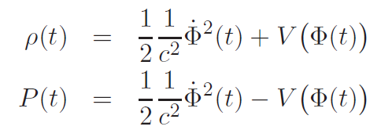
Dynamics of cosmological inflation
Energy – momentum tensor (T + V) for Lagrangian density (T – V)
Insert Lagrangian and metric, and compare with T for Friedmann fluid
Total energy density of the scalar field
Kinetic energy density of the scalar field
Potential energy density of the scalar field
During inflation: the inflaton – field is dominant
Inflation equations:
Cosmology: choose potential energy density and determine scale factor a(t) and inflaton field

Slide 8
Simplified inflation equations
Assume slow evolution of the scalar field (Slow Roll Condition)
Equation of state with n = -1
This leads to inflation, independent on details of inflaton field
Furthermore, assume that the kinetic energy density stays small for a long time (this prevents inflations from terminating too soon)
Simplified inflation equations (SIE)
SIE are valid when

Slide 9
Inflation parameters
Use first SIE to re-write
Inflation parameter: measures slope of V (V should be flat)
Inflation parameter
From SIE
Then guarantees that inflation will occur
Furthermore
parameter
Determines the rate of change for the slope of V. We want V to remain flat for a long time.

Slide 10
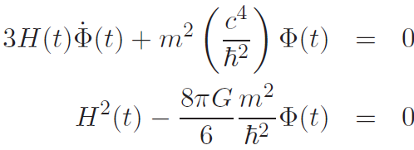
An inflation model
Massive inflaton field: quantum field of particles with mass m
SIE become
Potential energy density
Two coupled DE: take rote of SIE - 2
Insert in SIE – 1:
Solving yields
Amplitude inflaton field on t = 0
Insert inflaton field in SIE – 2. This yields
Expanding Universe: use + sign
Solve with and this yields

Slide 11
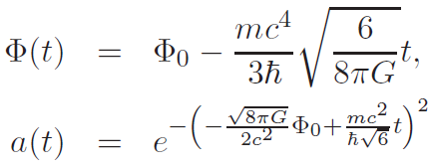
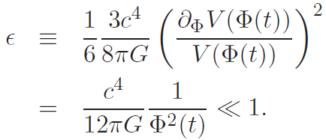
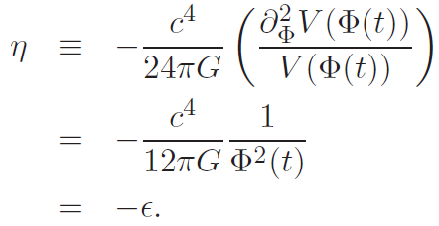
An inflation model
As solutions we find
Interpretation: inflaton field decays in time
Inflation parameter
When one parameter is small, the other is too
Inserting the inflaton field in the expression for the inflation parameter yields
Inflation continuous to this time, and stops at
Scale factor obeys
Inflation occurs!
Specific model:

Slide 12
End of inflation: reheating phase
Inflaton field decays to new particles (this results in radiation)
The potential energy density V has somewhere a deep and steep dip
Inflation parameter not small anymore: inflation breaks off
Inflation equations
Add dissipation term
Add radiation
Second Friedmann equation
These equations tell us
how inflatons are transferred into radiation,
how the inflaton field decreases,
how the scale factor evolves during this process
Give G, V and n(t) and everything is fixed

Slide 13
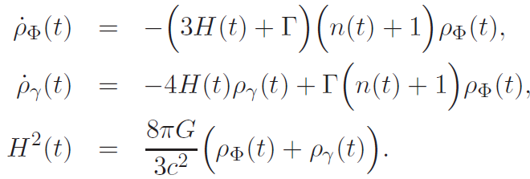
Re-heating equations
Eliminate the inflaton field
One has
Insert in
Also use
Differentiate FV – 1 and use FV – 2 to eliminate
Re-heating equations are three coupled differential equations
Give G, V and n(t) and all is fixed
After inflation the Universe is dominated by radiation (and we can employ relativistic cosmology to describe the evolution)

