Slide 1
General Relativity
a summary
Jo van den Brand, Chris Van Den Broeck, Tjonnie Li
Nikhef: April 9, 2010
jo@nikhef.nl

Slide 2
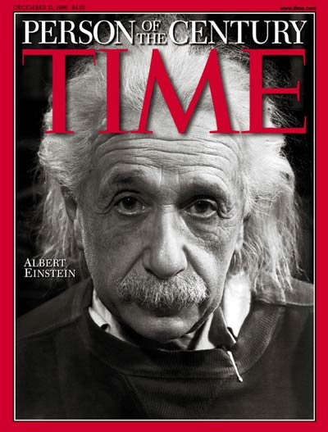
Motivation
Einstein gravity :
Gravity as a geometry
Space and time are physical objects
Most beautiful physical theory
Gravitation
Least understood interaction
Large world-wide intellectual activity
Theoretical: ART + QM, black holes, cosmology
Experimental: Interferometers on Earth and in space, gravimagnetism (Gravity Probe B)
Gravitational waves
Dynamical part of gravitation, all space is filled with GW
Ideal information carrier, almost no scattering or attenuation
The entire universe has been transparent for GWs, all the way back to the Big Bang
Notes:
Gravitatie is de minst begrepen fundamentele wisselwerking.
De allerbeste fysici zijn nodig geweest om gravitatie te brengen, waar het nu is: Newton en Einstein
De theorie voorspelt dat het Universum gevuld is met gravitatiegolven.

Slide 3
Newtonian gravity
Newton’s Law:
m_{i}
[m]=kg
r_{i}
P
m
Discrete:
m_{i}
[m]=kg
r_{i}
P
Continuous:
[ρ]=kg/m³
r
P
ρ dv

Slide 4
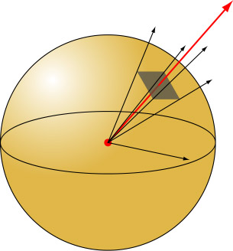
Gravitational flux
Mass M in center of sphere
do
Flux F_{g} through surface of sphere:
M
R
In essense:
- g ∝ 1/r²
- surface area ∝ r²
F_{g} =-4πGM holds for every closed surface; not only for that of a sphere with M at center!

Slide 5
Gauss law
Mass M enclosed by sphere
M
Mass M enclosed by arbitrary surface
M
Mass m outside arbitrary surface
m

Slide 6
Gauss law – example
Volume sphere:
Mass distribution: ρ kg/m³
g
symmetry: g ⊥ sphere, g(r)
“Gauss box”: small sphere
ρ
r
g
R
R
r
g
Sphere

Slide 7
Gauss law – mathematics
Consider locally (Gauss):
g(x+dx,y,z)
dz
dy
g(x,y,z)
dx
Compact notation: use “divergence”:
Thus

Slide 8
Gravitational potential – Poisson equation
Law of gravity:
m_{i}
[m]=kg
r_{i}
P
m
[ρ]=kg/m³
r
P
ρ dv

Slide 9
General relativity
Einstein’s gravitation
Spacetime is a curved pseudo-Riemannian manifold with a metric of signature (-,+,+,+)
The relationship between matter and the curvature of spacetime is given by the Einstein equations
Units: c = 1 and often G = 1
Notes:
Gravitatie is de minst begrepen fundamentele wisselwerking.
De allerbeste fysici zijn nodig geweest om gravitatie te brengen, waar het nu is: Newton en Einstein
De theorie voorspelt dat het Universum gevuld is met gravitatiegolven.

Slide 10
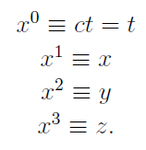
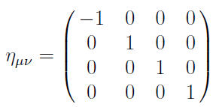
Special relativity
Consider speed of light as invariant in all reference frames
Coordinates of spacetime
denote as
superscripts
Cartesian coordinates
spacetime indices: greek
space indices: latin
SR lives in special four dimensional manifold: Minkowski spacetime (Minkowski space)
Coordinates are
Elements are events
Vectors are always fixed at an event; four vectors
Abstractly
Metric on Minkowski space
as matrix
Inner product of two vectors (summation convention)
Spacetime interval
Often called `the metric’
Signature: +2
Proper time
Measured on travelling clock
Notes:
Gravitatie is de minst begrepen fundamentele wisselwerking.
De allerbeste fysici zijn nodig geweest om gravitatie te brengen, waar het nu is: Newton en Einstein
De theorie voorspelt dat het Universum gevuld is met gravitatiegolven.

Slide 11
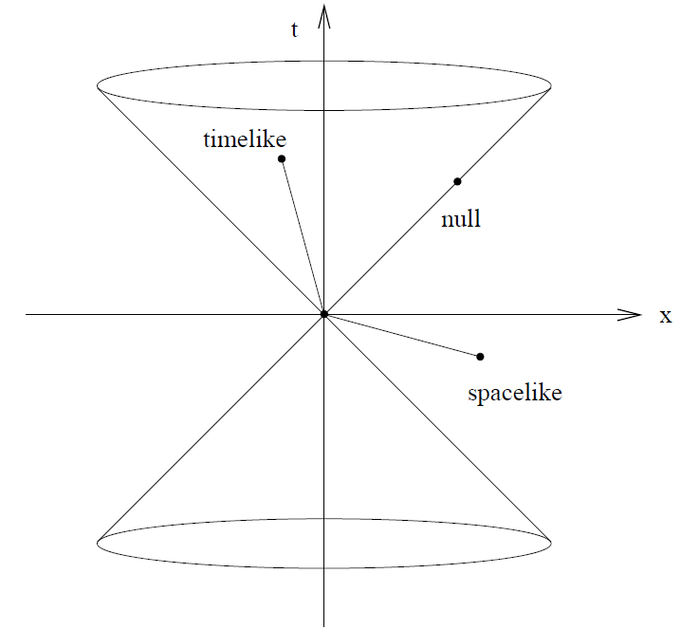
Special relativity
Spacetime diagram
Points are spacelike, timelike or nulllike separated from the origin
Vector with negative norm is timelike
Path through spacetime
Path is parameterized
Path is characterized by its tangent vector as spacelike, timelike or null
For timelike paths: use proper time as parameter
Calculate as
Tangent vector
Four-velocity
Normalized
Momentum four-vector
Mass
Energy is time-component
Particle rest frame
Moving frame for particle with three-velocity along x-axis
Small v
Notes:
Gravitatie is de minst begrepen fundamentele wisselwerking.
De allerbeste fysici zijn nodig geweest om gravitatie te brengen, waar het nu is: Newton en Einstein
De theorie voorspelt dat het Universum gevuld is met gravitatiegolven.

Slide 12
Inertia of pressure
SRT: when pressure of a gas increases, it is more difficult to accelerate the gas (inertia increases)
Exert force F, accelerate to velocity v << c
Volume V
Density r
Pressure P
SRT: Lorentz contraction shortens box
v
Energy needed to accelerate gas
additional inertia of gas pressure

Slide 13
Energy – momentum tensor: `dust’
Energy needed to accelerate gas
Dependent on reference system
0 – component of four-momentum
Consider `dust’
Collection of particles that are at rest wrt each other
Constant four-velocity field
Flux four-vector
Rest system
n and m are 0-components of four-vectors
Particle density in rest system
Mass density in rest system
Energy density in rest system
Moving system
N⁰ is particle density
N^{i} particle flux in x^{i} – direction
is the component of tensor
The gas is pressureless!

Slide 14
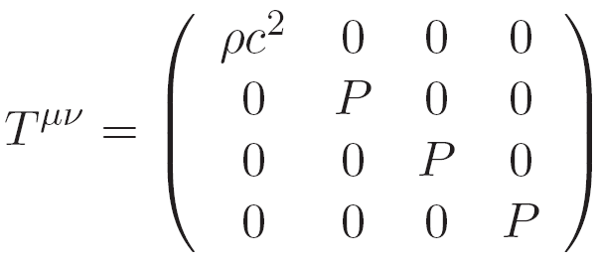
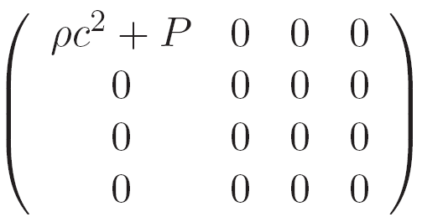
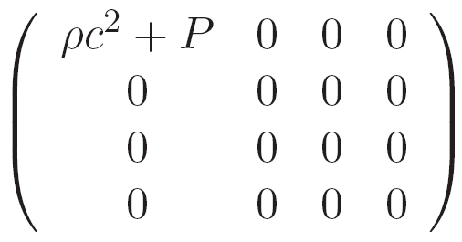
Energy – momentum: perfect fluid
Perfect fluid (in rest system)
Energy density
Isotropic pressure P
diagonal, with
In rest system
Tensor expression (valid in all systems)
We had
Try
We find
In addition
Components of are the flux of the momentum component in the direction
In GR there is no global notion of energy conservation
Einstein’s equations extent Newtonian gravity:

Slide 15
Tensors – coordinate invariant description of GR
Linear space – a set L is called a linear space when
Addition of elements is defined is element of L
Multiplication of elements with a real number is defined
L contains 0
General rules from algebra are valid
Linear space L is n-dimensional when
Define vector basis Notation:
Each element (vector) of L can be expressed as or
Components are the real numbers
Linear independent: none of the can be expressed this way
Notation: vector component: upper index; basis vectors lower index
Change of basis
L has infinitely many bases
If is basis in L, then is also a basis in L. One has and
Matrix G is inverse of
In other basis, components of vector change to
Vector is geometric object and does not change!
i
contravariant
covariant

Slide 16
1-forms and dual spaces
1-form
GR works with geometric (basis-independent) objects
Vector is an example
Other example: real-valued function of vectors
Imagine this as a machine with a single slot to insert vectors: real numbers result
Dual space
Imagine set of all 1-form in L
This set also obeys all rules for a linear space, dual space. Denote as L*
When L is n-dimensional, also L* is n-dimensional
For 1-form and vector we have
Numbers are components of 1-form
Basis in dual space
Given basis in L, define 1-form basis in L* (called dual basis) by
Can write 1-form as , with real numbers
We now have
Mathematically, looks like inner product of two vectors. However, in different spaces
Change of basis yields and (change covariant!)
Index notation by Schouten
Dual of dual space: L** = L

Slide 17
Tensors
Tensors
So far, two geometric objects: vectors and 1-forms
Tensor: linear function of n vectors and m 1-forms (picture machine again)
Imagine (n,m) tensor T
Where live in L and in L*
Expand objects in corresponding spaces: and
Insert into T yields
with tensor components
In a new basis
Mathematics to construct tensors from tensors: tensor product, contraction. This will be discussed when needed

Slide 18
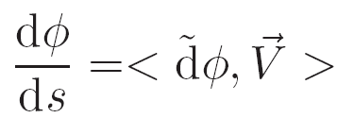
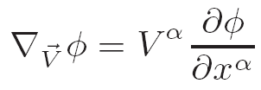
Curvilinear coordinates
t
Derivate of scalar field
f(t₂)
2
f(t₁)
1
tangent vector
Magnitude of derivative of f in direction of
Derivative of scalar field along tangent vector

Slide 19
Example
Transformation
Position vector
Base vectors
Natural basis
Metric is known
Non orthonormal
Inverse transformation
Dual basis

Slide 20
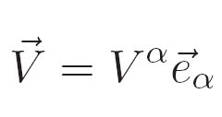
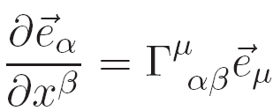
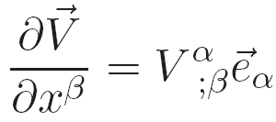
Tensor calculus
Derivative of a vector
a is 0 - 3
Set b to 0
Notation
Covariant derivative
with components

Slide 21
Polar coordinates
Calculate
Calculate Christoffel symbols
Divergence and Laplace operators

Slide 22
Christoffel symbols and metric
Covariant derivatives
In cartesian coordinates and Euclidian space
This tensor equation is valid for all coordinates
Take covariant derivative of
Directly follows from in cartesian coordinates!
The components of the same tensor for arbitrary coordinates are
Exercise: proof the following
Connection coefficients contain derivatives of the metric

Slide 23
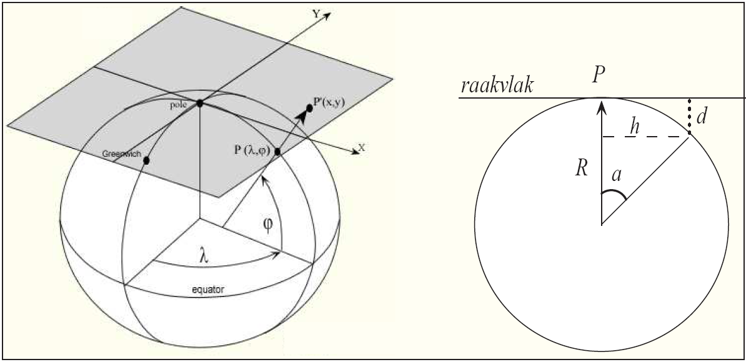
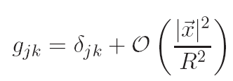
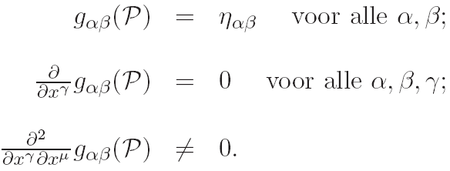
Local Lorentz frame – LLF
Next,we discuss curved spacetime
At each event P in spacetime we can choose a LLF:
- we are free-falling (no gravity effects according to equivalence principle (EP))
- in LLF one has Minkowski metric
Locally Euclidian
LLF in curved spacetime
At each point tangent space is flat

Slide 24
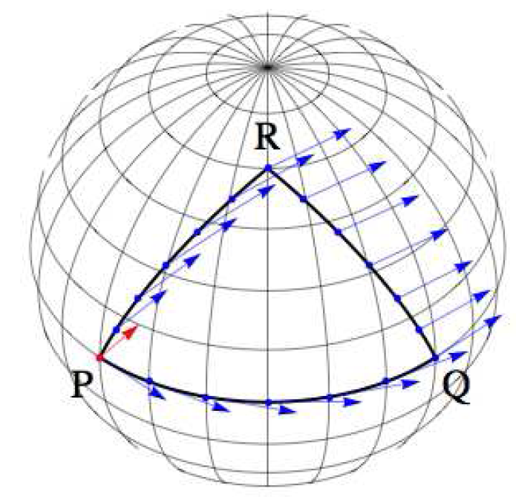
Curvature and parallel transport
Parallel lines can intersect in a curved space (Euclidian fifth postulate is invalid)
Parallel transport of a vector
- project vector after each step to local tangent plane
- rotation depends on curve and size of loop
Mathematical description
- interval PQ is curve with parameter
- vector field exists on this curve
- vector tangent to the curve is
- we demand that in a LLF its components
must be constant
Parallel transport

Slide 25
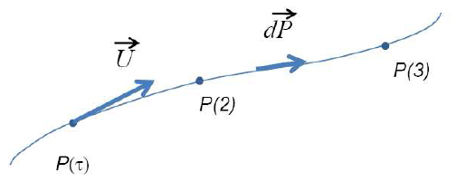
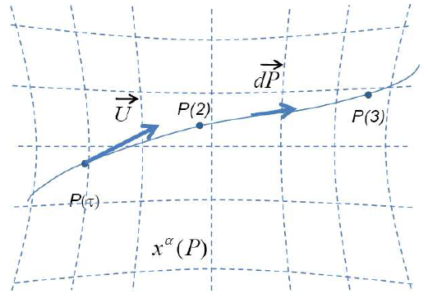
Geodesics
Parallel transport
Geodesic: line, as straight as possible
Components of four-velocity
Geodesic equation
Four ordinary second-order differential equations for the coordinates and
Coupled through the connection coefficients
Two boundary conditions
Spacetime determines the motion of matter

Slide 26
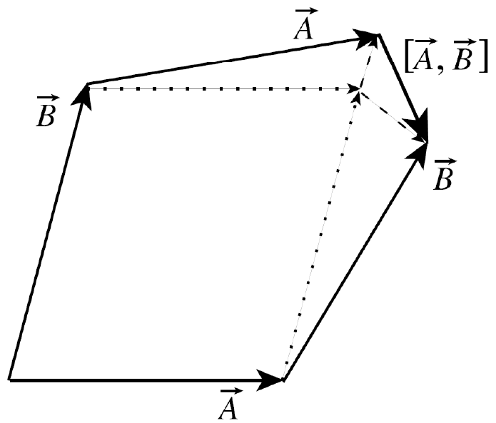
Riemann tensor
Consider vector fields and
Transport along
Vector changes by
Transport along
Components of the commutator
Commutator is a measure for non-closure
Curvature tensor of Riemann measures the non-closure of double gradients
Consider vector field

Slide 27
Riemann tensor – properties
Metric tensor contains all information about intrinsic curvature
Properties Riemann tensor
Antisymmetry
Symmetry
Bianchi identities
Independent components: 20
Curvature tensor of Ricci
Ricci curvature (scalar)
Exercise: demonstrate all this for the description of the surface of a sphere

Slide 28
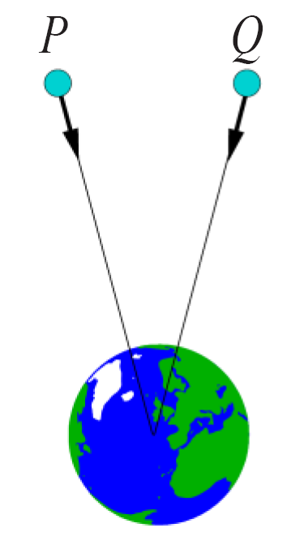
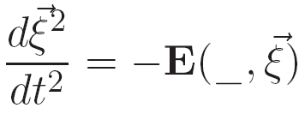
Tidal forces
Drop a test particle. Observer in LLF: no sign of gravity
Drop two test particles. Observer in LLF: differential gravitational acceleration: tidal force
According to Newton
Define
Gravitational tidal tensor

Slide 29
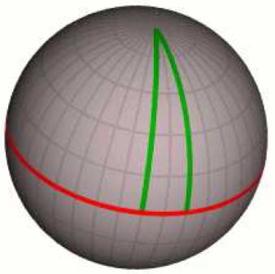
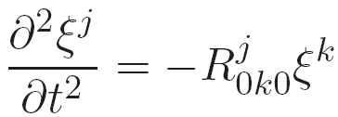
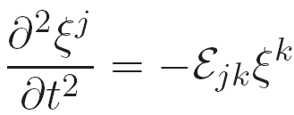
Einstein equations
Two test particles move initially parallel
t
Spacetime curvature causes them to move towards each other
Initially at rest
At one has
Second-order derivative does not vanish because of curvature
P
Q
x
One has
Follows from
Describes relative acceleration
Newton

Slide 30
Einstein equations
Perhaps we expect
However, not a tensor equation (valid in LLF)
Perhaps one has
Einstein 1912 – wrong
tensor
scalar
Set of 10 p.d.e. for 10 components of
Problem:
Free choice:
Einstein tensor
Bianchi identities
Energy – momentum tensor
Einstein equations
Matter tells spacetime how to curve

Slide 31
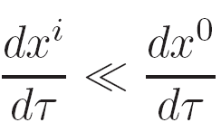
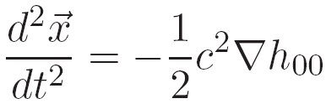
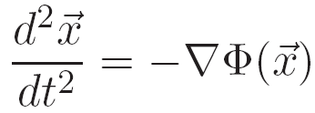
Weak gravitational fields
GR becomes SRT in a LLF
Without gravitation one has Minkowski metric
For weak gravitational fields one has
Assume a stationary metric
Assume a slow moving particle
Worldline of free-falling particle
Christoffel symbol
Stationary metric
Newtonian limit of GR
Newton
Earth
Sun
White dwarf

Slide 32
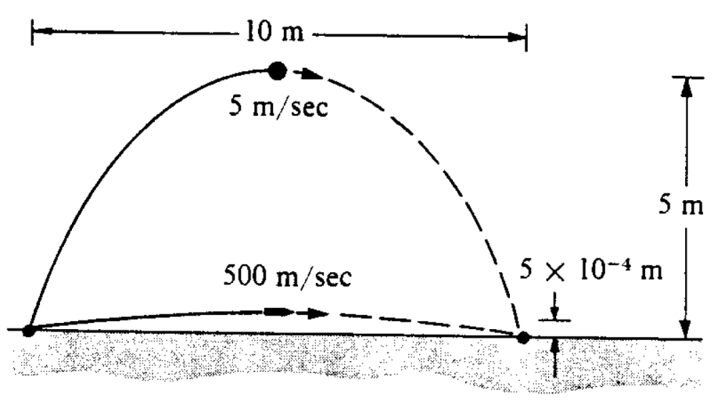
Curvature of time
Spacetime curvature involves curvature of time
Clock at rest
Time interval between two ticks
Spacetime interval
Describes trajectories of particles in spacetime
Trajectories of ball and bullet
Spatial curvature is very different

Slide 33
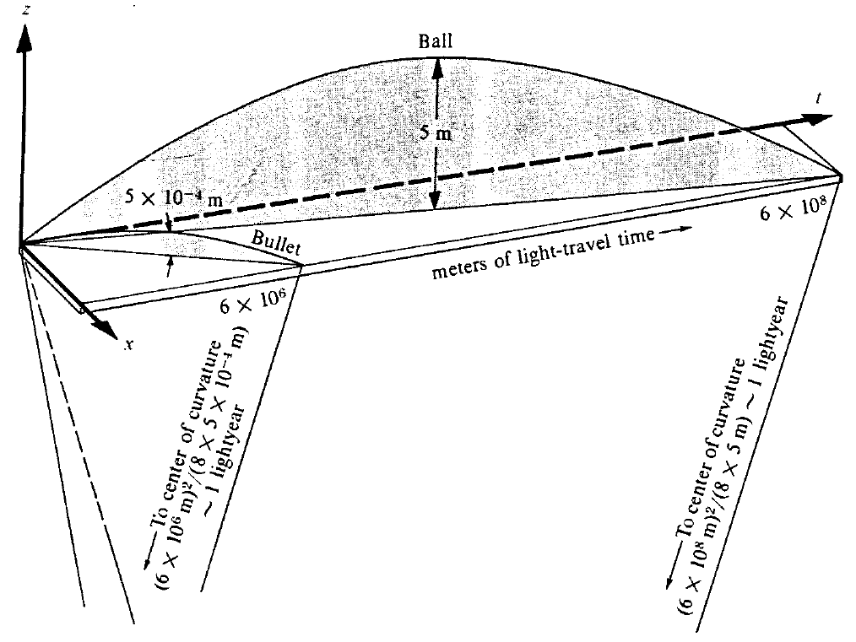
Curvature in spacetime
In reality, the trajectories (geodesics) are completely straight, but spacetime is curved

