Slide 1
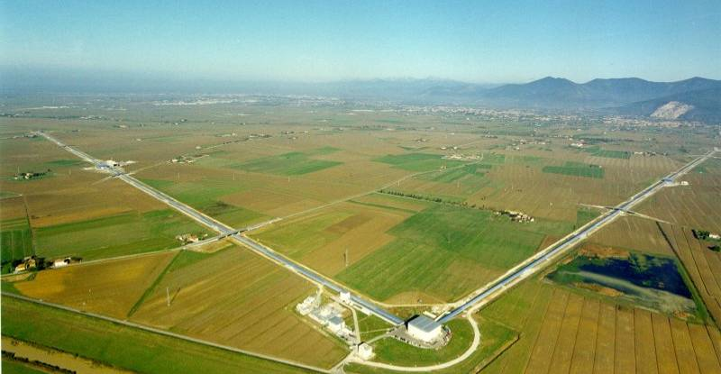
Search for gravitational waves
Jo van den Brand

Slide 2
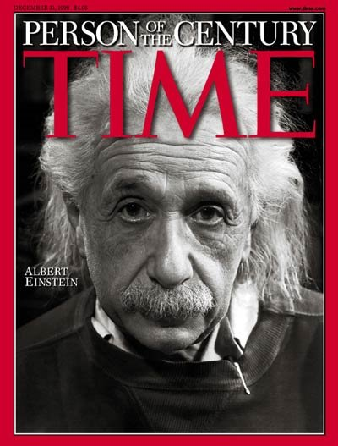
Introduction
Einstein gravity :
Gravity as a geometry
Space and time are physical objects
Gravitational waves
Dynamical part of gravitation, all space is filled
Very large energy, almost no interaction
Ideal information carrier, almost no scattering or attenuation
The entire universe has been transparent for GWs, all the way back to the Big Bang

Slide 3
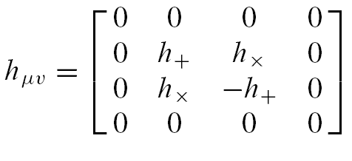
Gravitational waves `squeeze’ space: small effects
Proper distance between x^{μ} and x^{μ} +dx^{μ}
Define
Wave equation
Plane GW propagating in z-direction

Slide 4
Gravitational waves
Predicted by general relativity
GW = space-time metric wave
  Distance variation
  Strain amplitude h:
GW
L-
Δ
L
L+
Δ
L
time
GW produced by mass acceleration
  d = source distance
  Q = quadrupole moment
Small coupling factor → astrophysical sources
L=20 m, d = 2 m, 27 rad/s
Earth-sun: 313 W

Slide 5
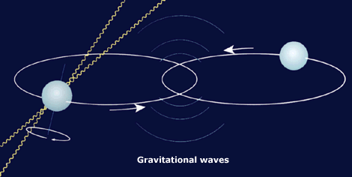
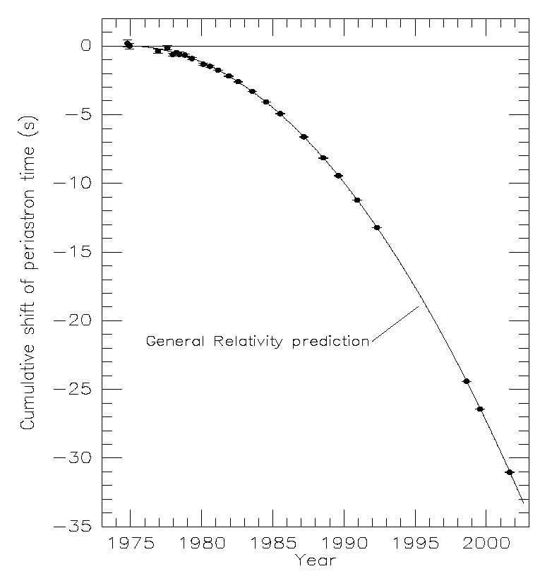
Evidence for gravitational waves
PSR 1913+16
  R. Hulse, J. Taylor (1974)
  Binary pulsar (T = 7.75 hr)
  1 pulsar (17 rev/s) → get the orbital parameters
  Orbital period decreases
    Energy loss due to GW emission (~10²⁵ W)
    Good agreement with GR
    Inspiral lifetime about 300 Myears (3.5 m/yr)
    Expected strain, h~10⁻²⁶ m

Slide 6
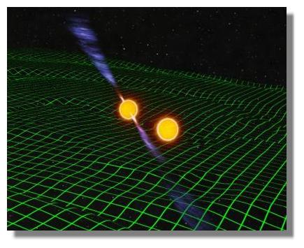
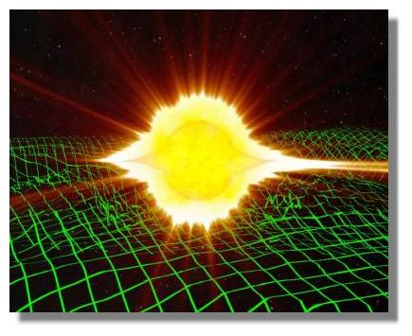
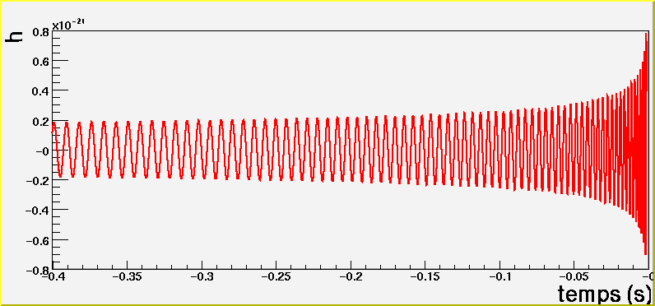
GW source: coalescing binary
End of the life of compact binary systems
  Neutron stars, systems have been observed
Rare events
  ~ 0.1 event/year (@20Mpc) ±1 order of magnitude
Typical amplitude (NS-NS): h ~ 10⁻²² @ 20 Mpc
“Known” waveform
  Search with matched filtering
  General relativity tests
  Standard candles: get the distance from the waveform
    Coincidence with short gamma ray burst?
    GRB070201, M31, No NSNS or BHBH.

Slide 7
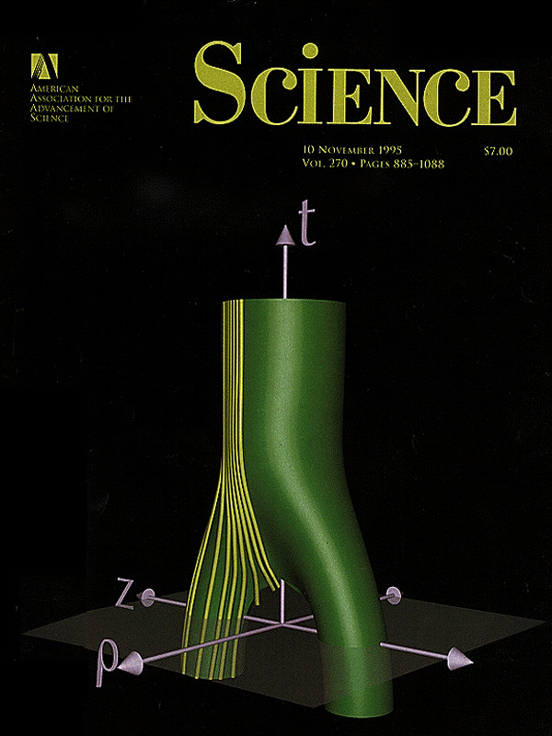
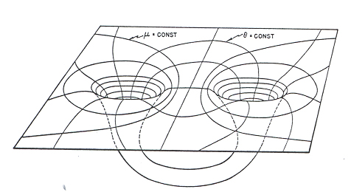
Collision of two black holes
Two-body problem in general relativity
Numerical solution of Einstein equations required
Problem solution started 40 years ago (1963 Hahn & Lindquist, IBM 7090)
Wave forms critical for gravitational wave detectors
A PetaFLOPS-class grand challenge
Oct. 10, 1995
Matzner, Seidel, Shapiro, Smarr, Suen, Teukolsky, Winicuor

Slide 8
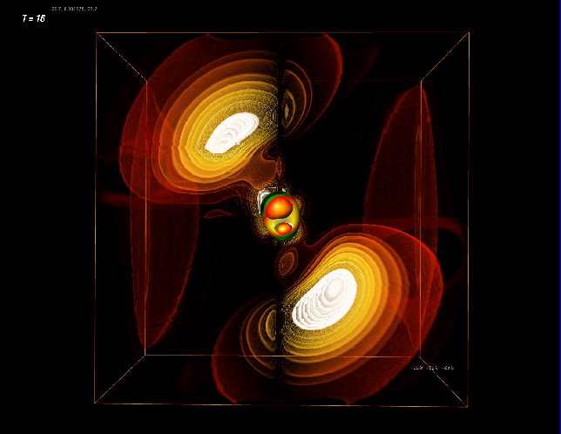
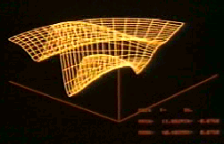
Numerical relativity
1977
Eppley & Smarr
CDC 7600
One processor
Each 35 Mflops
5 hours
1999
Seidel & Suen, et al.
SGI Origin
256 processors
Each 500 Mflops
40 hours
300X
30,000X

Slide 9
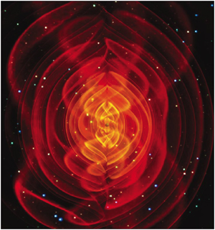
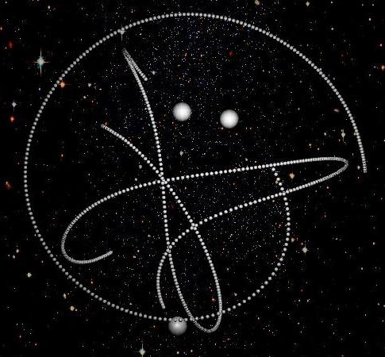
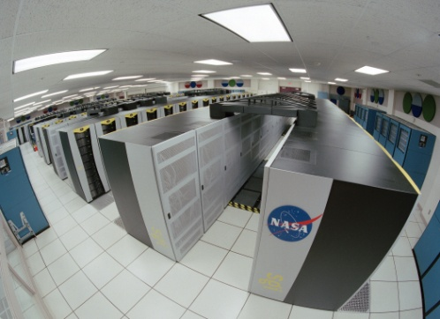
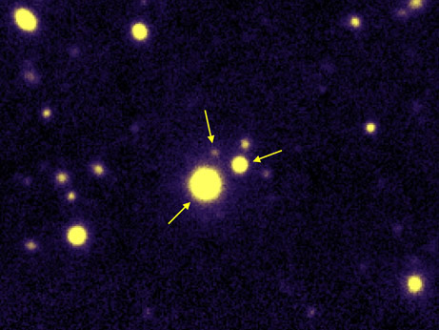
Numerical relativity
First merger of three black holes simulated on a supercomputer
ScienceDaily (Apr. 12, 2008)
Manuela Campanelli, Carlos Lousto and Yosef Zlochower—Rochester Institute of Technology Center for Computational Relativity and Gravitation
Triple quasar (10.8 Gly)
S. G. Djorgovski et al.,
Caltech, EPFL (Jan. 2007)

Slide 10
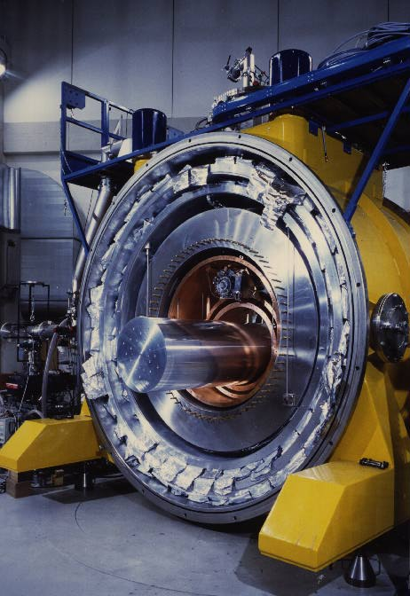
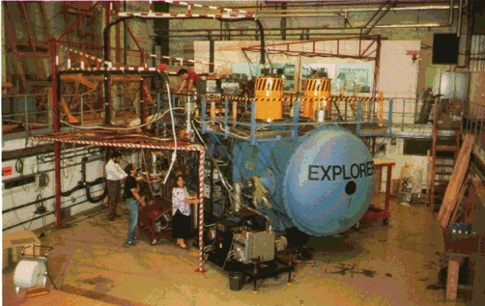
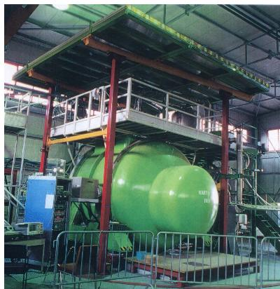
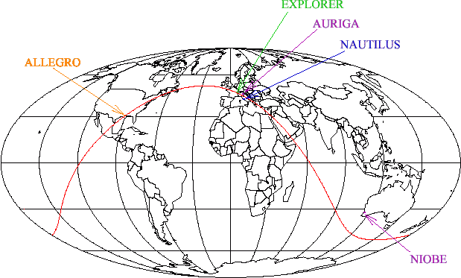
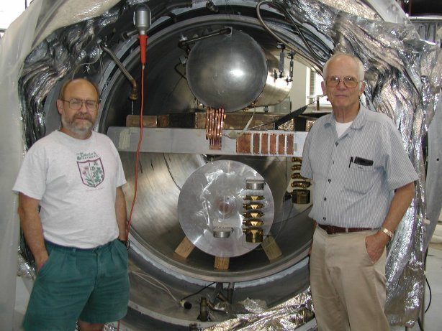
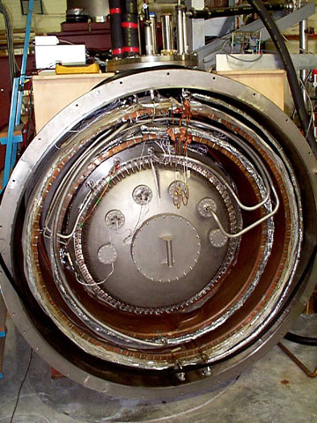


Bar detectors: IGEC collaboration
  Built to detect gravitational waves from compact objects

Slide 11
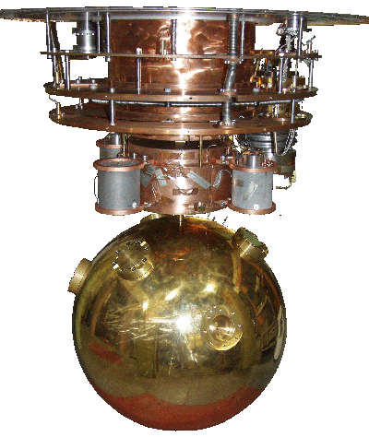
Mini-GRAIL: a spherical `bar’ in Leiden

Slide 12
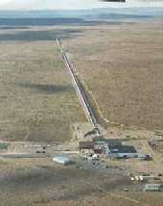
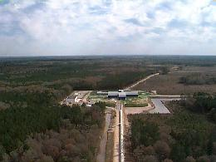
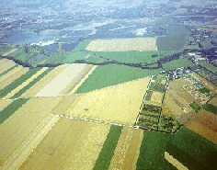
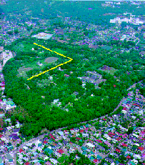
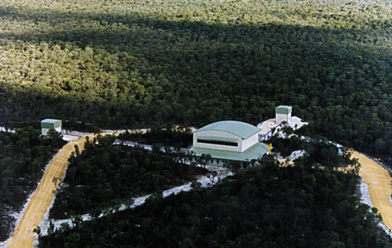
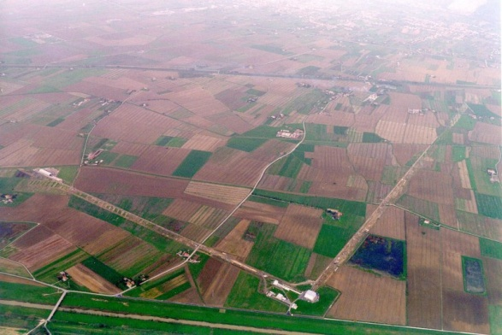
Interferometric detectors: an international dream
GEO600 (British-German)
Hanover, Germany
LIGO (USA)
Hanford, WA and Livingston, LA
TAMA300 (Japan)
Mitaka
AIGO (Australia),
Wallingup Plain, 85km north of Perth
VIRGO (French-Italian)
Cascina, Italy

Slide 13
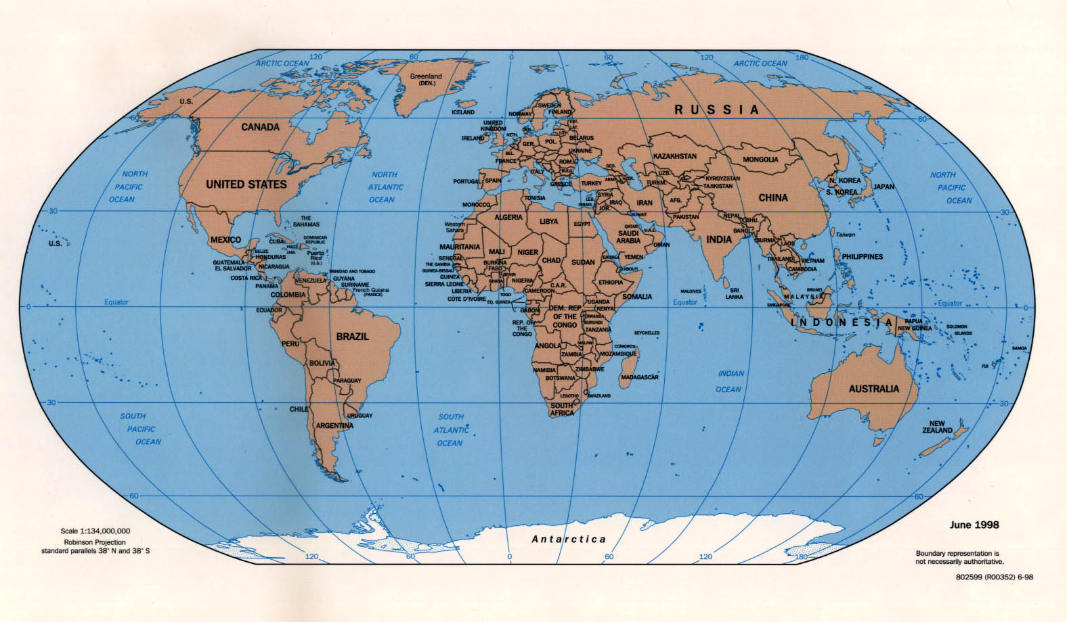
Network of Interferometers
LIGO
GEO
Virgo
TAMA
AIGO
decompose the polarization of gravitational waves
detection confidence
locate the sources

Slide 14
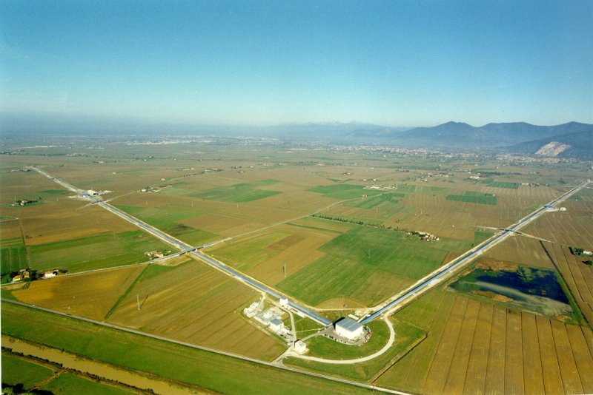
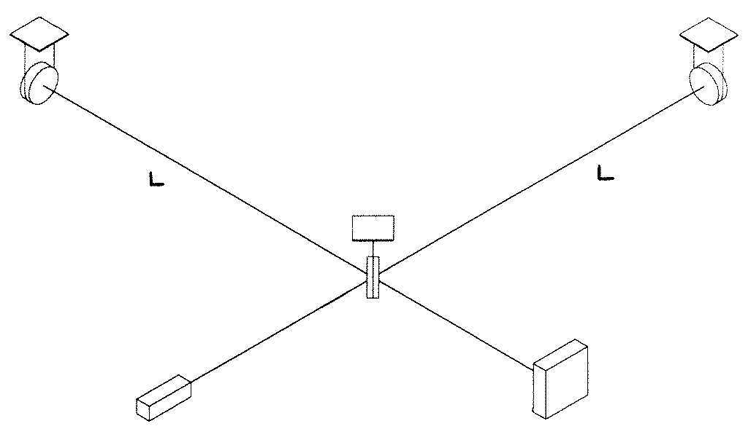
Interferometer as GW detector
Principle: Measure distances between free test masses
  Michelson interferometer
  Test masses = interferometer mirrors
  Sensitivity: h = ΔL/L
    We need large interferometer
    For Virgo L = 3 km
Virgo: CNRS+INFN
(ESPCI-Paris, INFN-Firenze/Urbino, INFN-Napoli, INFN-Perugia, INFN-Pisa, INFN-Roma,LAL-Orsay, LAPP-Annecy, LMA-Lyon, OCA-Nice)
+ NIKHEF joined 2007
First science run: May – September 2007
Suspended
mirror
Suspended
mirror
Beam splitter
Light
Detection
LASER

Slide 15
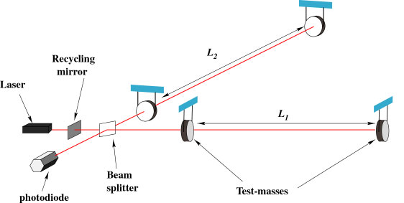
Interferometer Concept
…causing the interference pattern to change at the photodiode
As a wave passes, the arm lengths change in different ways….
Suspended
Masses

Slide 16
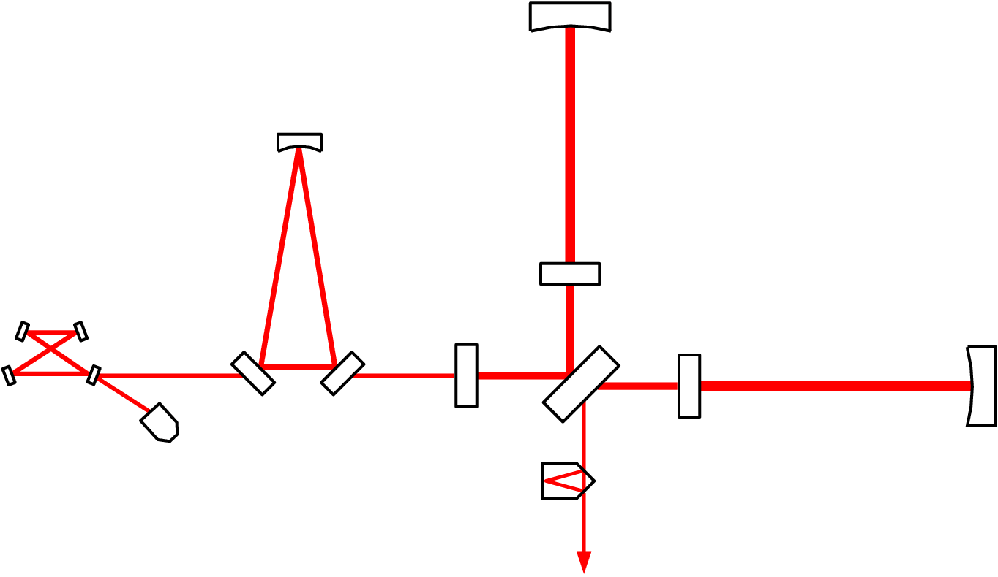
VIRGO Optical Scheme
Input Mode Cleaner (144 m)
3 km long Fabry-Perot
Cavities
Laser 20 W
Power
Recycling
Output Mode
Cleaner (4 cm)

Slide 17
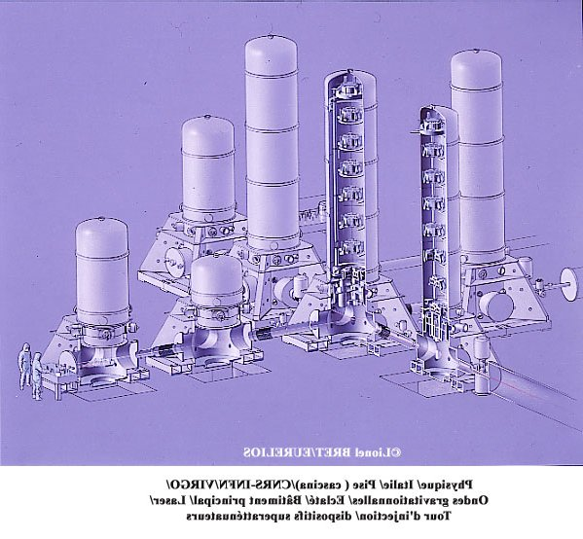
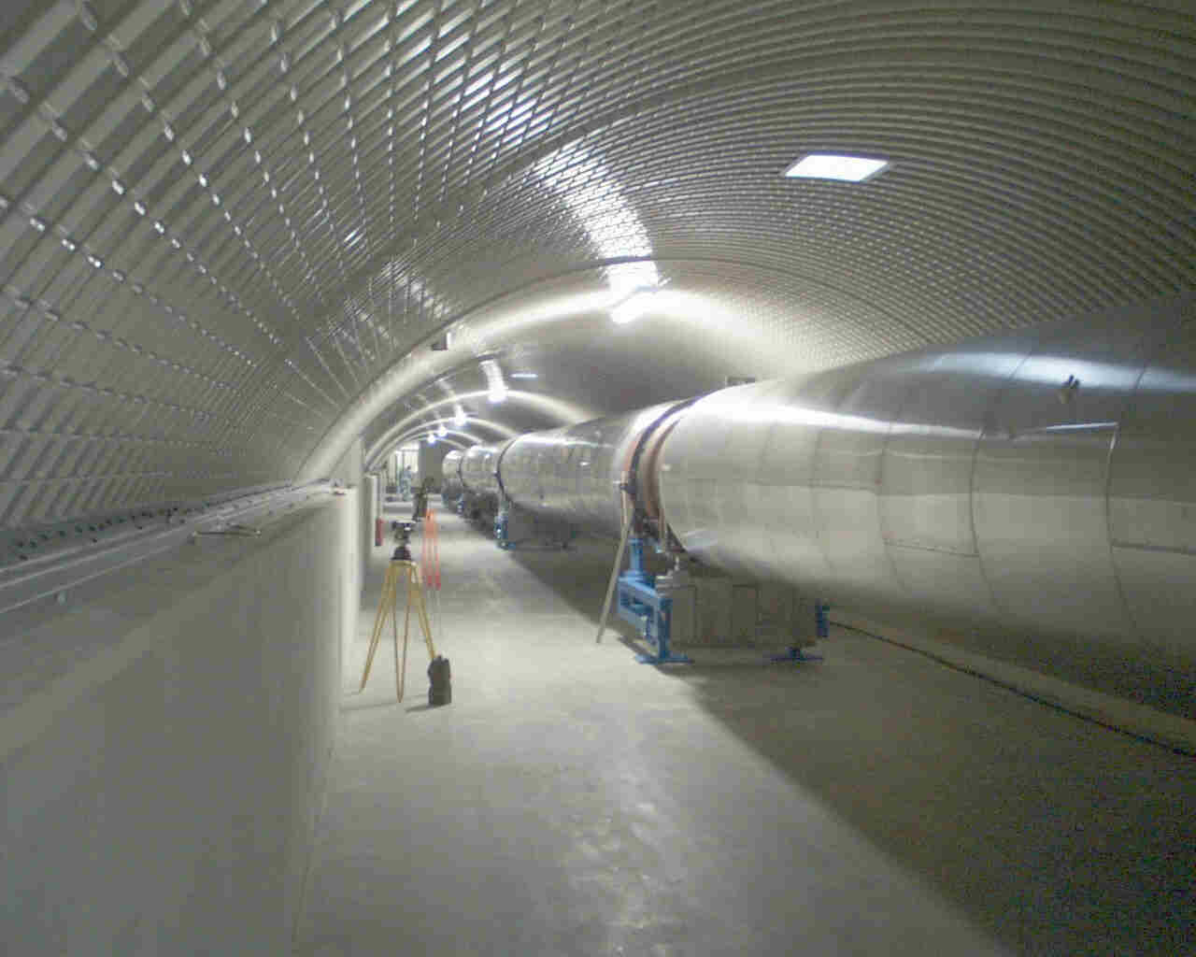
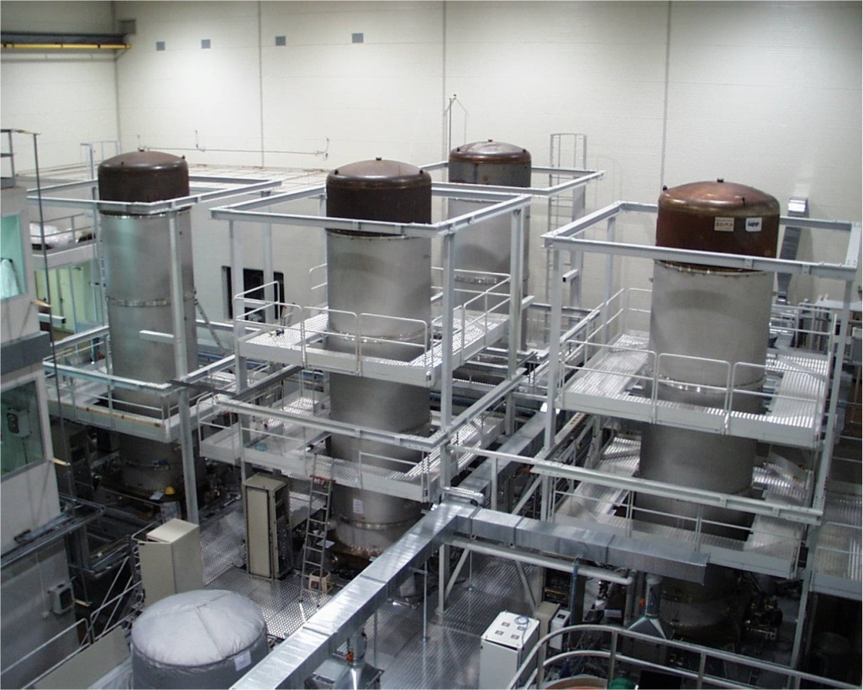
Vacuum system
UHV

Slide 18
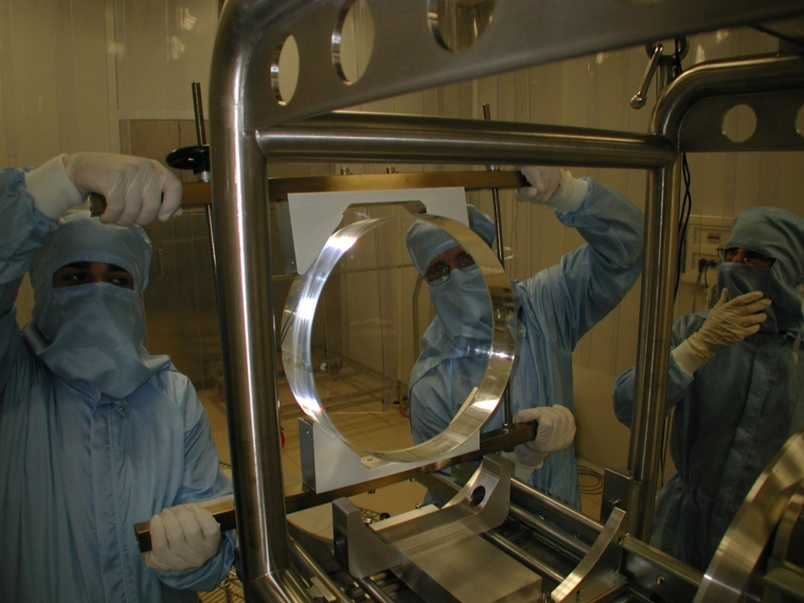
Mirrors
High quality fused silica mirrors
  35 cm diameter, 10 cm thickness, 21 kg mass
  Substrate losses ~1 ppm
  Coating losses <5 ppm
  Surface deformation ~l/100
Quantum Non-demolition Measurements

Slide 19
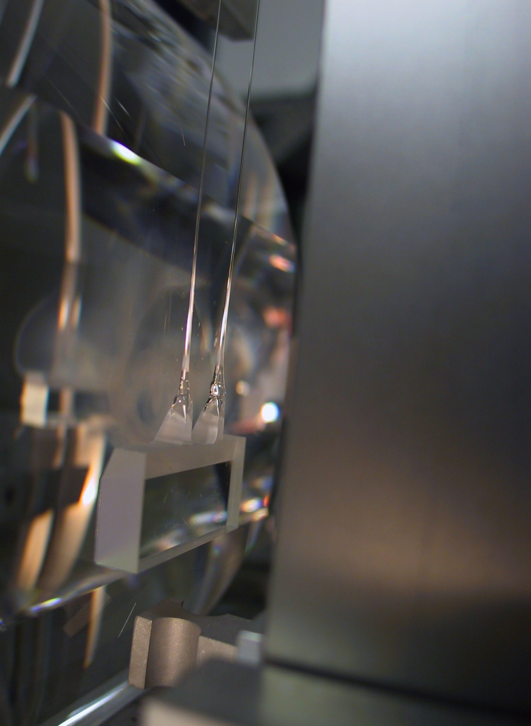
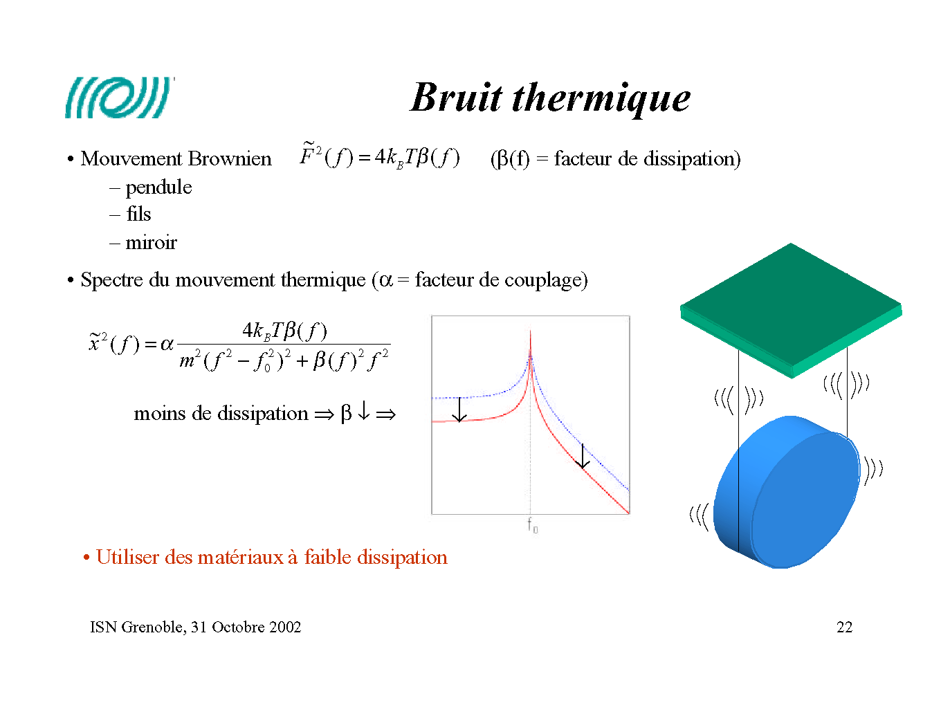
Thermal noise
Mechanical modes are in thermal equilibrium
  Modes:
    Pendulum mode
    Wire vibration
    Mirror internal modes
    Coating surface
  Energy associate: k_{B}T
Thermal motion spectrum:
Strategy:
  use low dissipative materials:
  → concentrate the motion at the resonance frequency

Slide 20
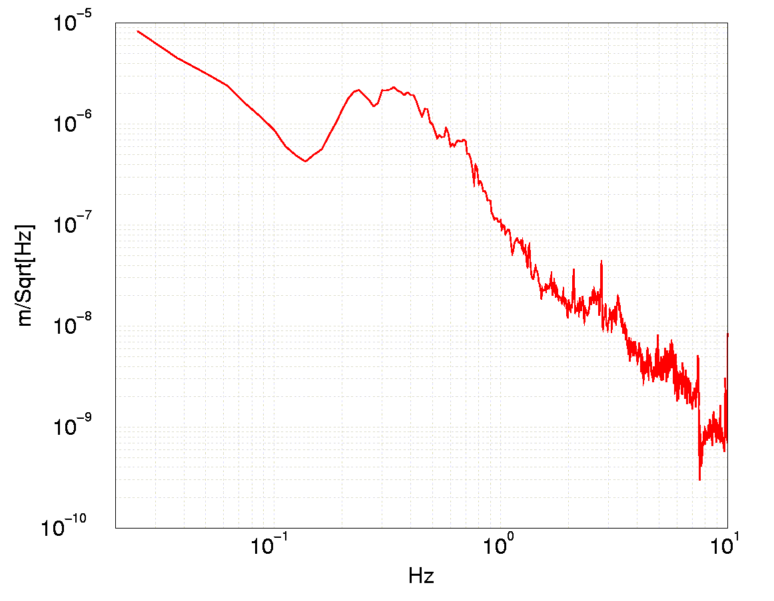
The seismic noise challenge
Noise spectrum:
Goal:
  More than 10 orders of magnitude above 4Hz
Vertical to horizontal coupling > 2 ×10⁻⁴
  Need to filter vertical motions!
3 km
6400 km

Slide 21
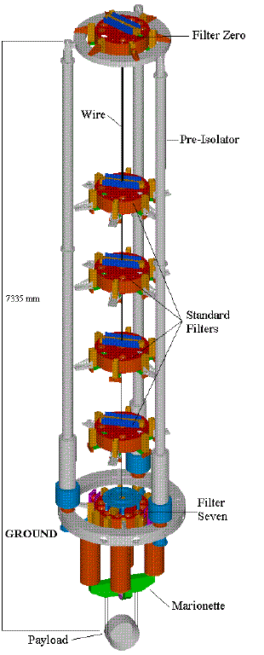
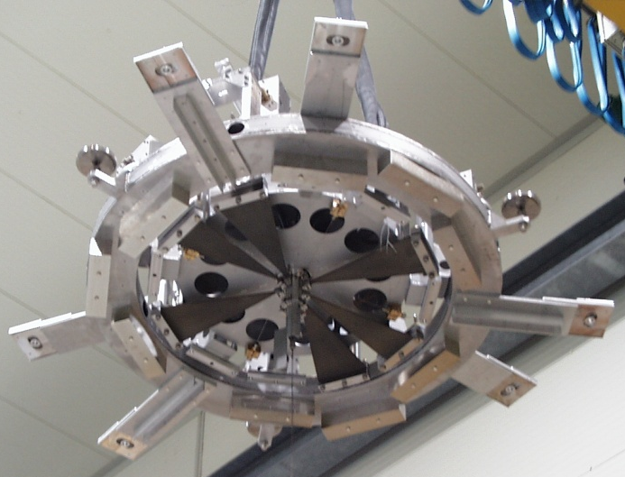
VIRGO super attenuator
Solution:
  Chain of filters
Passive device
  Combine:
    blades (vertical)
    wires (pendulum)
6 seismic filter (in all DOFs)
Inverted pendulum for low freq. control
2 Control stages:
  Marionetta (longitudinal-angular)
  reference mass (longitudinal)
Expected attenuation: 10¹⁴ @ 10 Hz
Various control strategies

Slide 22
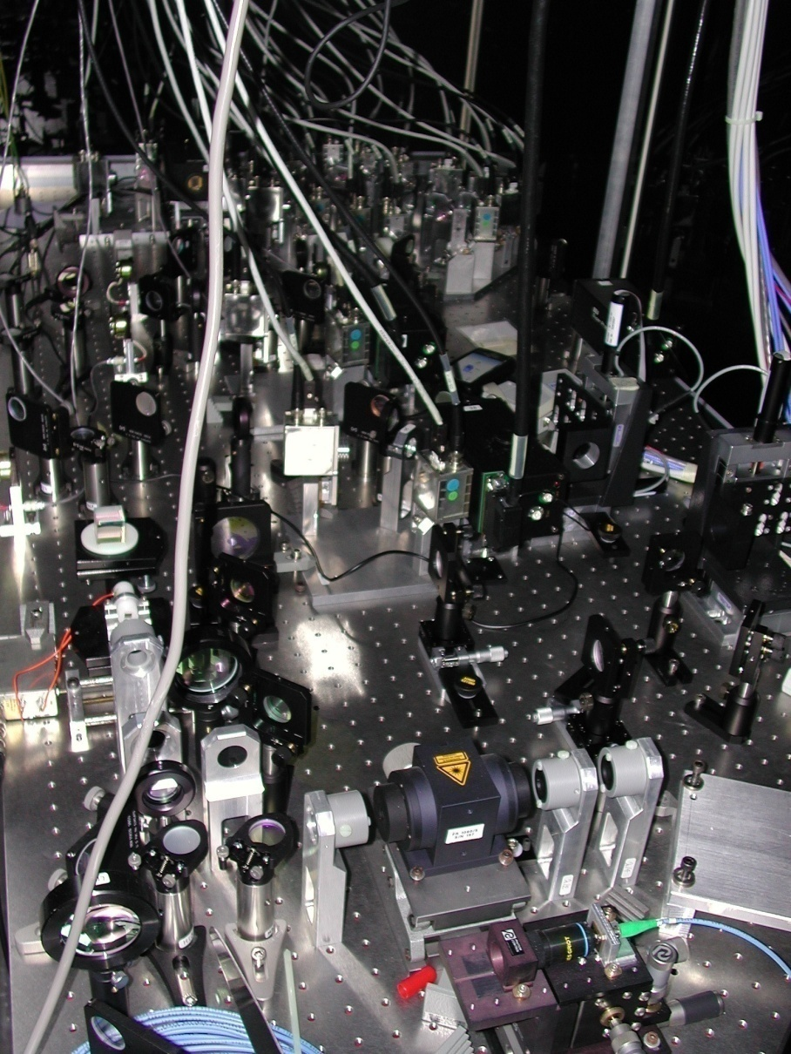
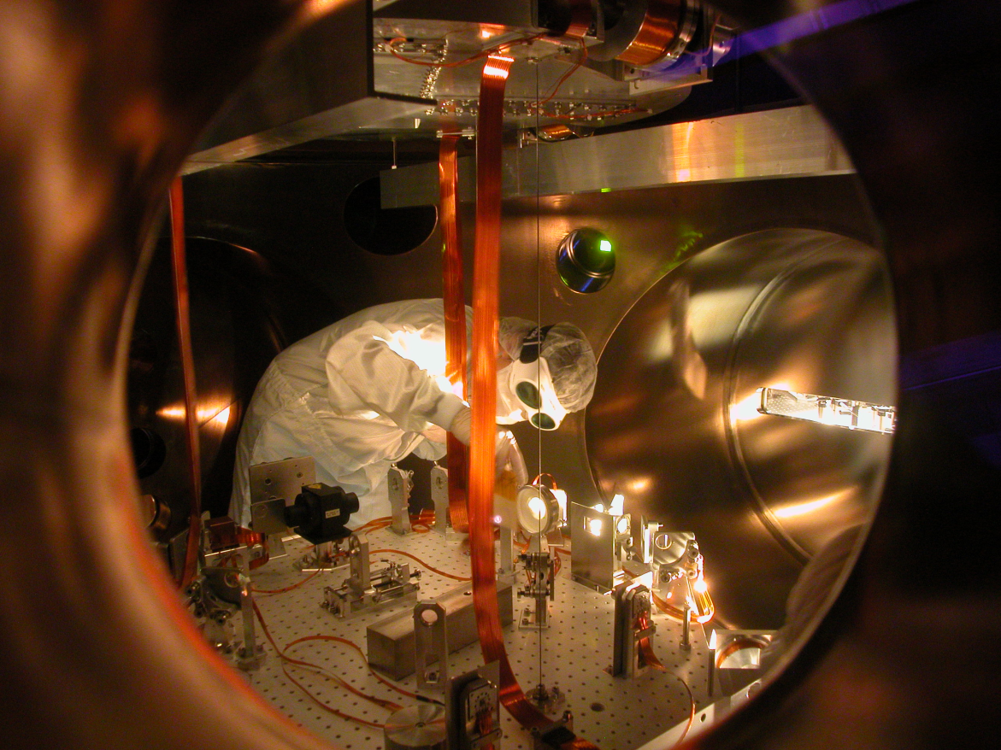
Detection system
Theory:
  One photodiode
Reality
  Multiple beams, multiple photodiodes, mod/demodulation electronics, camera, DAQ,…
  > 1400 « ADC channels »
  18 Mbytes/s of raw data

Slide 23
NIKHEF activities

Slide 24
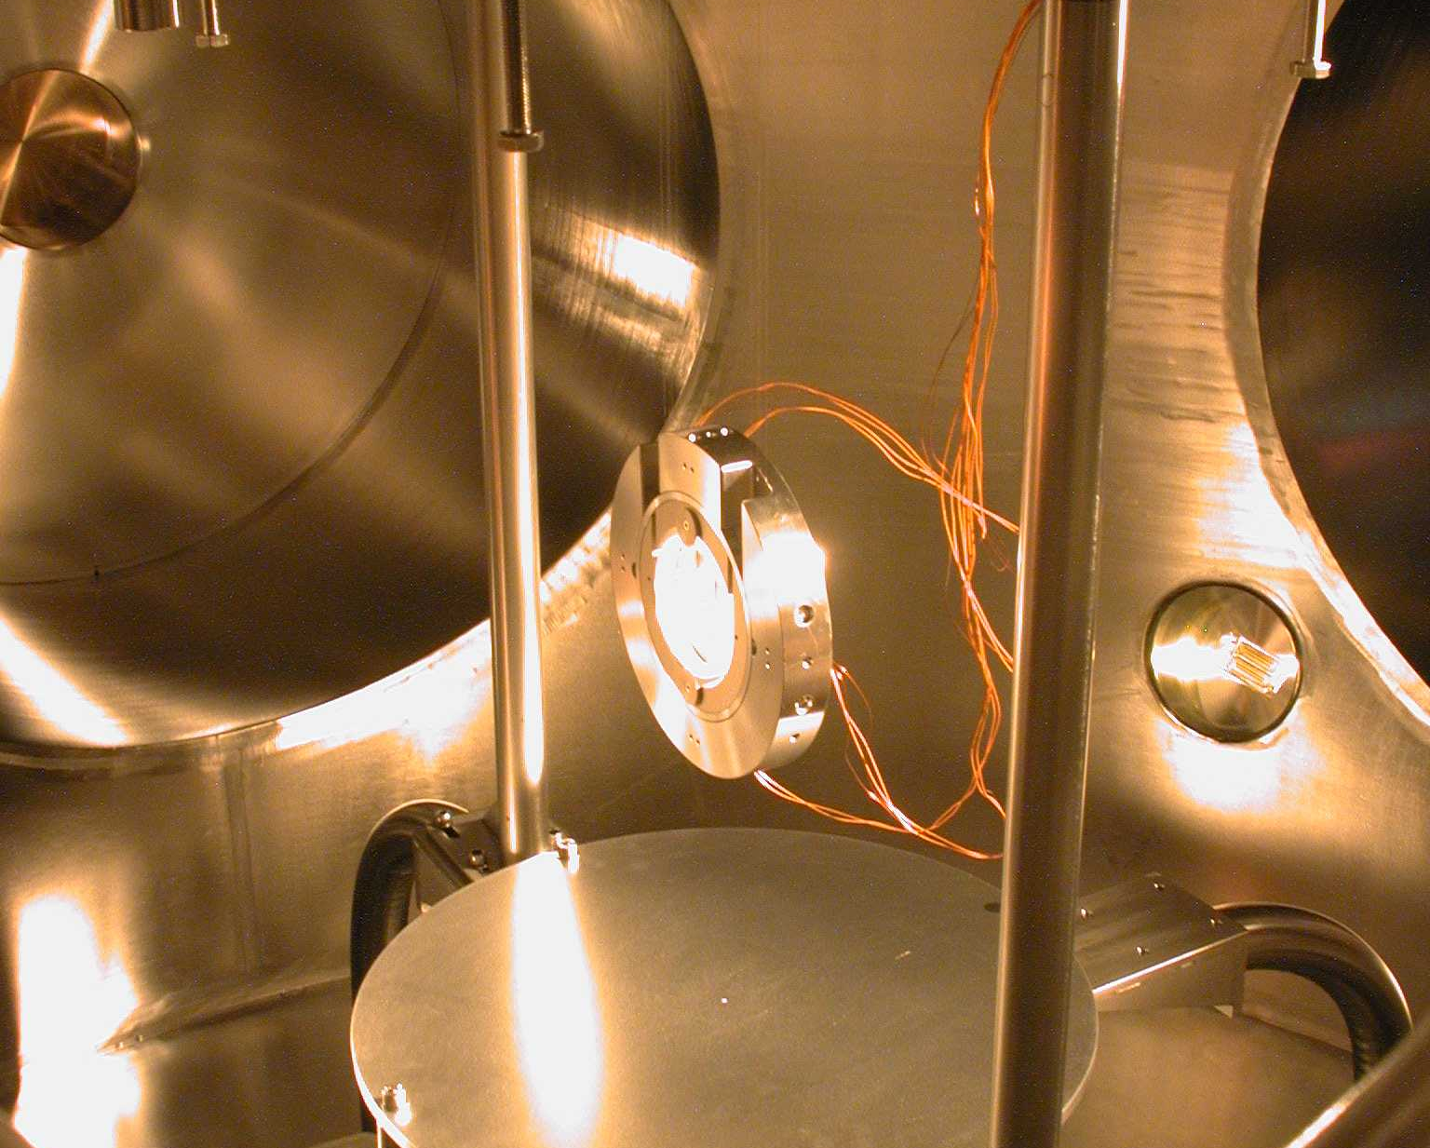
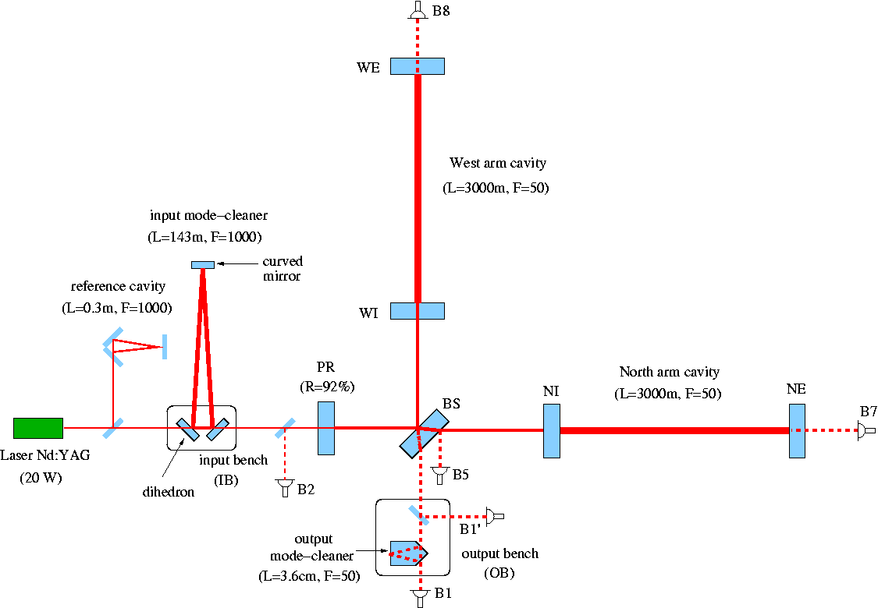
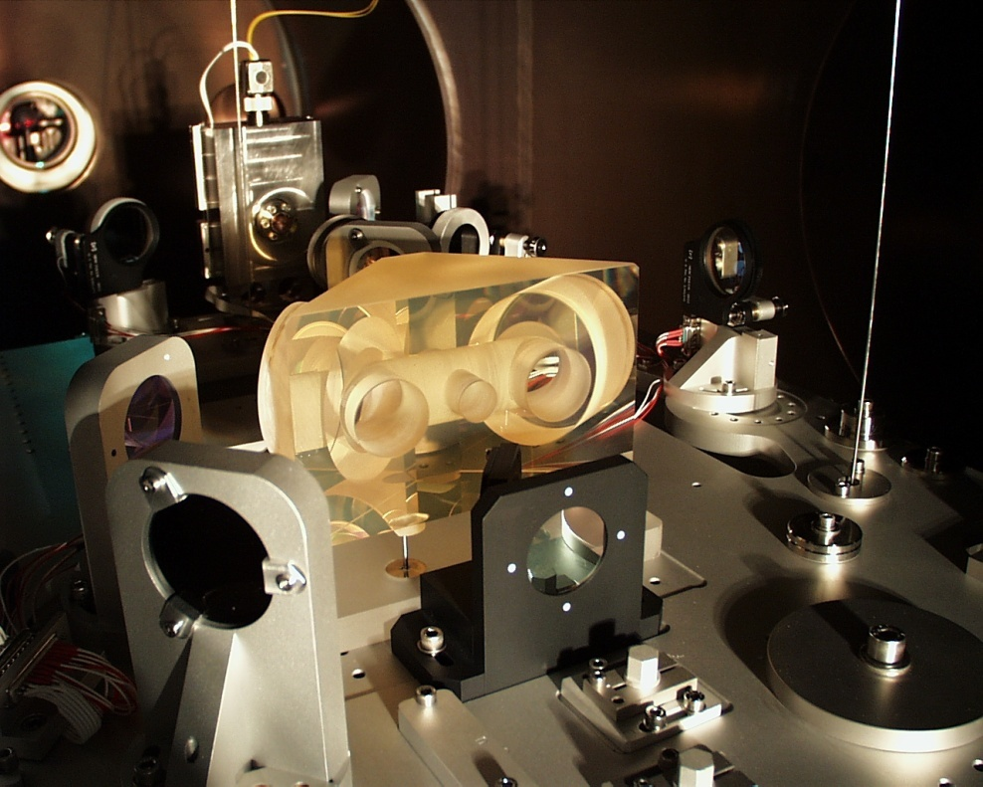
Input mode cleaner
Mode cleaner cavity: filters laser noise, select TEM00 mode
Input beam
Transm. beam
Refl. beam

Slide 25
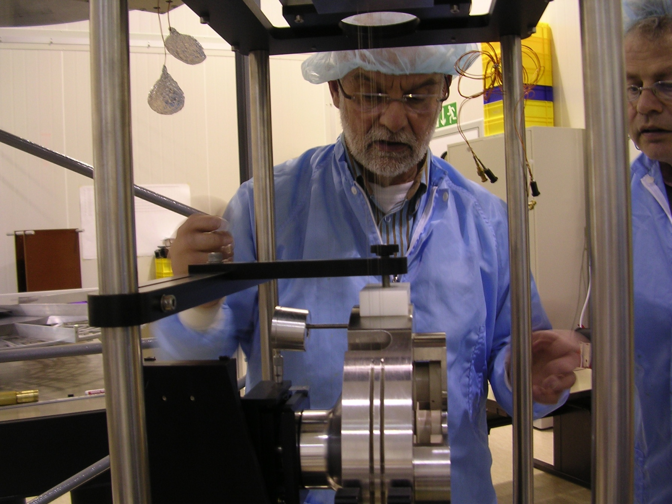
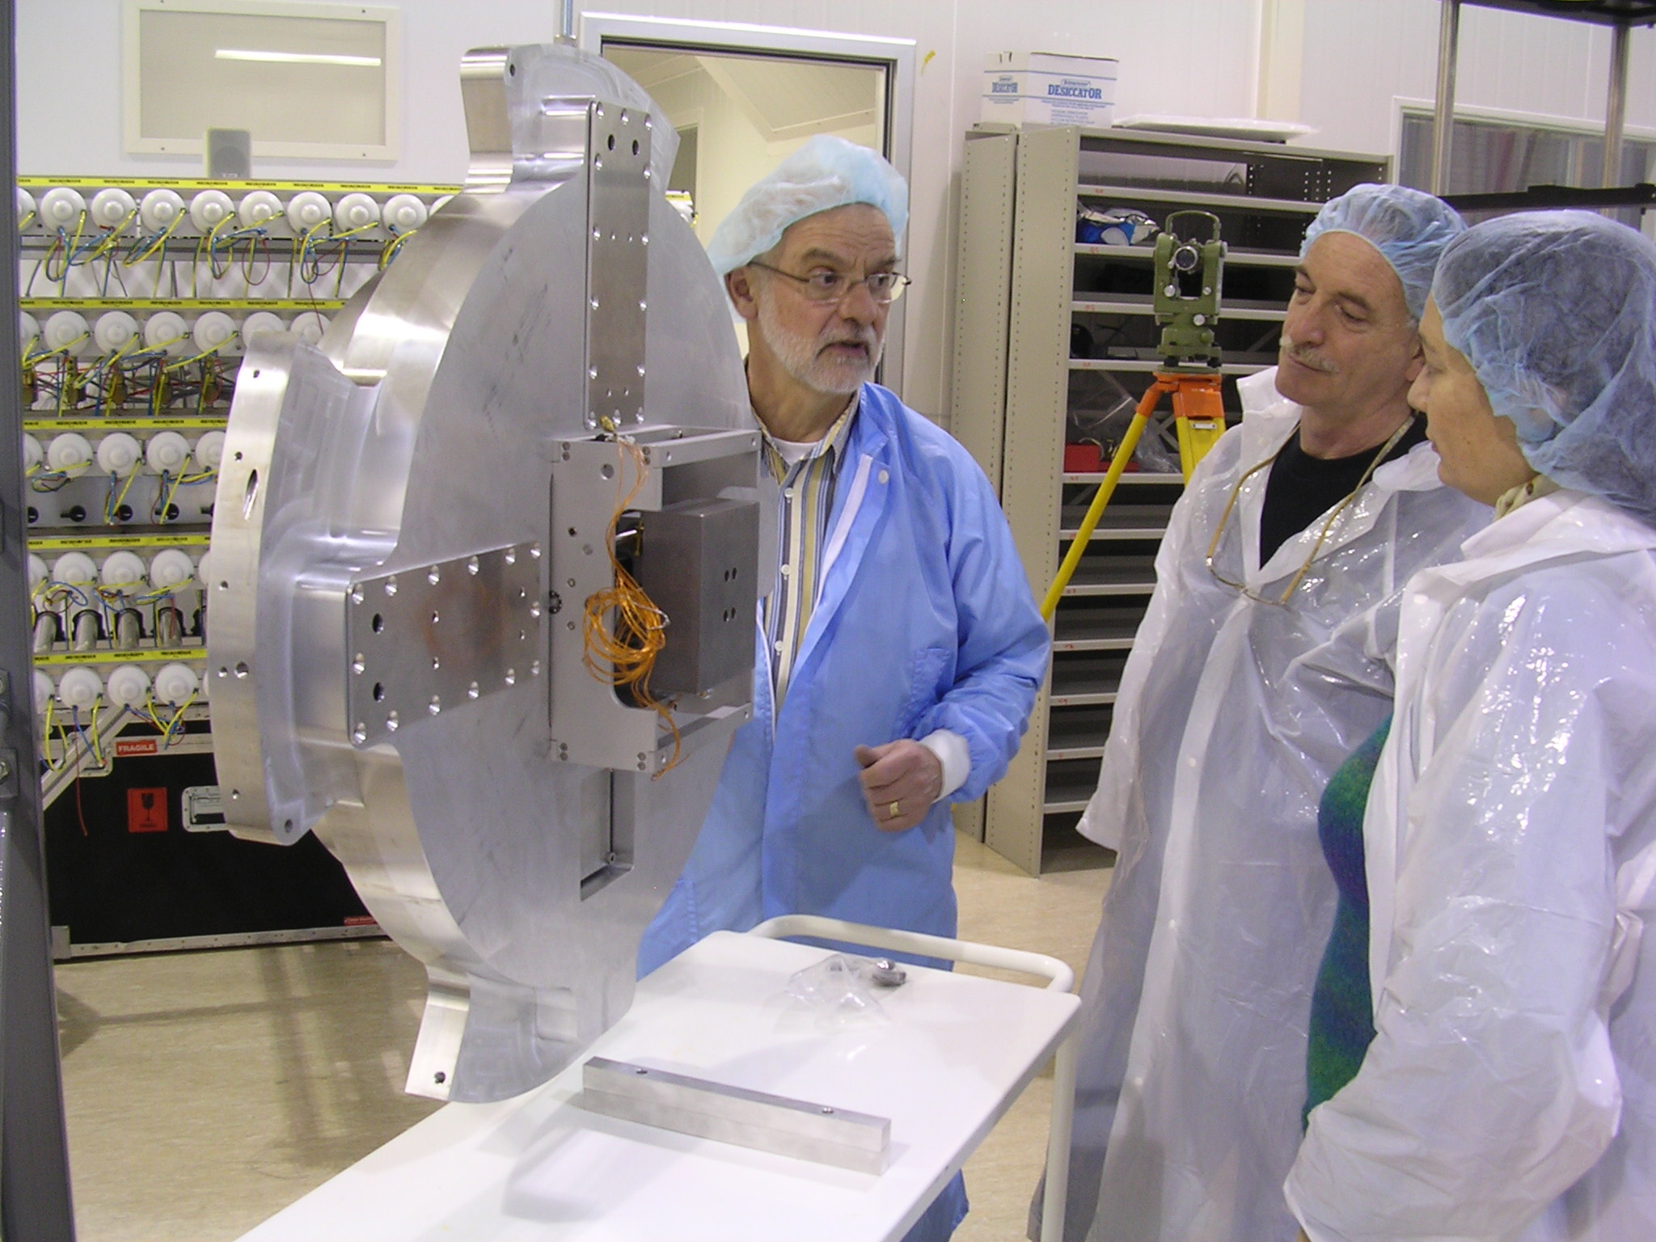
Input mode cleaner end-mirror

Slide 26

NIKHEF: Linear alignment of VIRGO
Phase modulation of input beam
Demodulation of photodiode signals at different output beams
  => longitudinal error signals
Quadrant diodes in output beams
  => Alignment information
  (differential wavefront sensing)
Anderson-Giordano technique
  2 quadrant diodes after arm cavities
W
N
EOM

Slide 27

VIRGO design sensitivity
Shot noise
Seismic noise
Thermal noise
Shot noise
1

Slide 28
Virgo Status
& Commissioning

Slide 29
A short summary
1993
  Virgo approved by CNRS & INFN
1996
  Start construction at the Site
2001-02
  Central Interferometer commissioning
July 2003:
  Inauguration;
  Start the full Virgo commissioning
February 2004:
  First Lock in recombined mode
October 2004:
  First lock in recycled mode
September 2006
  First lock at high power
2001: CITF
Autumn 2003: single cavity
Feb. 2004: recombined
Oct. 2004: recycled

Slide 30

Sensitivity evolution

Slide 31


Sensitivity today
Hardware Limit

Slide 32
Sensitivity today
Length Control
Hardware Limit

Slide 33
Sensitivity today
Angular Control
Length Control
Hardware Limit

Slide 34
Sensitivity today
Acoustics
Angular Control
Length Control
Hardware Limit

Slide 35

Virgo sensitivity compared to LIGO and GEO600
March 8
Inspiral range 5.5 Mpc
  The horizon (best orientation) for a binary system of two 10 solar mass black holes is 63 Mpc

Slide 36

Virgo joint analyses
Virgo – Bars joint analysis
Burst events and stochastic signals
Bars, GEO600 and 2km Hanford in Astrowatch
Virgo – LIGO collaboration
Working group for burst, inspiral events, stochastic and periodic sources
Formal MoU
Publish together
  Virgo now at 1e-22 / rtHz

Slide 37
Virgo analysis at NIKHEF

Slide 38




Radiation from rotating neutron stars
“Mountain” on neutron star
Wobbling neutron star
Accreting neutron star
R-modes

Slide 39


Pointing at known neutron stars
Targeted search of GWs from known isolated radio pulsars
S1analysis: upper-limit (95% confidence) on PSR J1939+2134:
  h₀ < 1.4 x 10⁻²² (e < 2.9 x 10⁻⁴) Phys Rev D 69, 082004 (2004)
S2 analysis: 28 pulsars (all the ones above 50 Hz for which search parameters are “exactly” known)

Slide 40



Periodic sources – all sky search – Roma / NIKHEF
Doppler shifts
  Frequency modulation: due to Earth’s motion
  Amplitude modulation: due to the detector’s antenna pattern.
Assume original frequency is 100 Hz and the maximum variation fraction is of the order of 0.0001
Note the daily variations
After FFT: energy not in a single bin, so the SNR is highly reduced
Bin in galactic coordinates
Re-sampling
Short FFTs
Hough maps
Include binary systems
ALL SKY SEARCH
enormous computing challenge
(Sipho van der Putten, Henk Jan Bulten, Sander Klous)

Slide 41


Binary pulsars
Include binary system in analysis

Slide 42
The future?
Supernovae – with present detector only sensitive to Milky Way
Coalescent binaries – with present detector

Slide 43
LIGO and VIRGO: scientific evolution
At present hundreds of galaxies in range for 1.4 M_{o} NS-NS binaries
Enhanced program
  In 2009 about 10 times more galaxies in range
Advanced detectors
  About 1000 times more galaxies in range
  In 2014 expect 1 signal per day or week
  Start of gravitational astrophysics
  Numerical relativity will provide templates for interpreting signals

Slide 44



Creation of Adam - Michelangelo
Design Study Proposal approved by EU within FP7
Large part of the European GW community involved EGO, INFN, MPI, CNRS, NIKHEF, Univ. Birmingham, Cardiff, Glasgow
Recommended in Aspera / Appec roadmap

Slide 45



Experience: underground interferometers
LISM: 20 m Fabry-Perot interferometer, R&D for LCGT, moved from Mitaka (ground based) to Kamioka (underground)
Seismic noise much lower:
Operation becomes easier
  10² overall gain
  10³ at 4 Hz

Slide 46




Gravity gradient noise
Gravity gradient noise
  Time varying contributions to Newtonian background driven by seismic compression waves, ground-water variations, slow-gravity drifts, weather, cultural noise
  Determines low-frequency cut-off
  Cannot be shielded against
Counter measures
  Network of seismometers and development of data correction algorithms
    Analytical studies: G. Cella
    Numerical studies: E. Hennes
Figure: M.Lorenzini

Slide 47


Site selection: Einstein Telescope and the Netherlands
Discussion with Earth scientists
  VU, Delft, TNO
  KNMI: microseismic activity
Coal mines in Limburg

Slide 48

NS - NS INSPIRAL RANGE
GRB050509B
1ST GENERATION
2ND
GENERATION
3RD GENERATION
INTERFEROMETER
Credit G.Cagnoli

Slide 49


Gravitational wave antenna in space - LISA
  3 spacecraft in Earth-trailing solar orbit separated by 5 x10⁶ km.
  Measure changes in distance between fiducial masses in each spacecraft
  Partnership between NASA and ESA
  Launch date ~2016+

Slide 50

Complementarity of Space- & Ground-Based Detectors
Difference of 10⁴ in wavelength:
Like difference between X-rays and IR!
Rotating
Neutron Stars
LISA
VIRGO
LISA will see all the compact white-dwarf and neutron-star binaries in the Galaxy (Schutz)
Notes:
Advanced LIGO (from White Book)

Slide 51


LISA interferometry
“LISA is essentially a Michelson Interferometer in Space”
However
  No beam splitter
  No end mirrors
  Arm lengths are not equal
  Arm lengths change continuously
  Light travel time ~17 seconds
  Constellation is rotating and translating in space

Slide 52


LOI to ESA – LISA analysis
Nikhef, VU, RUN and SRON
Netherlands: Bulten/Nelemans

Slide 53


Beyond Einstein is the umbrella program for a series of NASA/ESA missions linked by powerful new technologies and common science goals to answer the questions:
    What powered the Big Bang?
Gravitational Waves Can Escape from Earliest Moments of the Big Bang
Inflation
(Big Bang plus
10⁻³⁴ Seconds)
light
Big Bang plus 300,000 Years
Now
gravitational waves
Big Bang plus
14 Billion Years

Slide 54




Beyond Einstein is the umbrella program for a series of NASA/ESA missions linked by powerful new technologies and common science goals to answer the questions:
    What happens at the edge of a Black Hole?
Chandra - Each point of x-ray
light is a Black Hole!
Is Einstein’s theory still right in these conditions of extreme gravity? Or is new physics awaiting us?
Notes:
54

Slide 55


Beyond Einstein is the umbrella program for a series of NASA/ESA missions linked by powerful new technologies and common science goals to answer the questions:
    What is the mysterious Dark Energy pulling the Universe apart?
We do not know what 95% of the universe is made of!
September 6, 2007: Committee on NASA's Einstein Program: An Architecture for Implementation, National Research Council
Finding 4. LISA is an extraordinarily original and technically bold mission concept. LISA will open up an entirely new way of observing the universe, with immense potential to enlarge our understanding of physics and astronomy in unforeseen ways. LISA, in the committee’s view, should be the flagship mission of a long-term program addressing Beyond Einstein goals.
Dark energy and matter interact through gravity
Notes:
55

Slide 56


Slide 57

Summary
Gravitational wave physics
  Dutch Astroparticle Physics initiative
  Exciting new physics program
    Important questions are addressed
    Long-term scientific perspective
VIRGO and LIGO
  Sensitivity is improving fast
  First science run underway
  MOU between LIGO and Virgo
NIKHEF commitment
  Modest at this moment
  Expand to FOM research program

