Slide 1


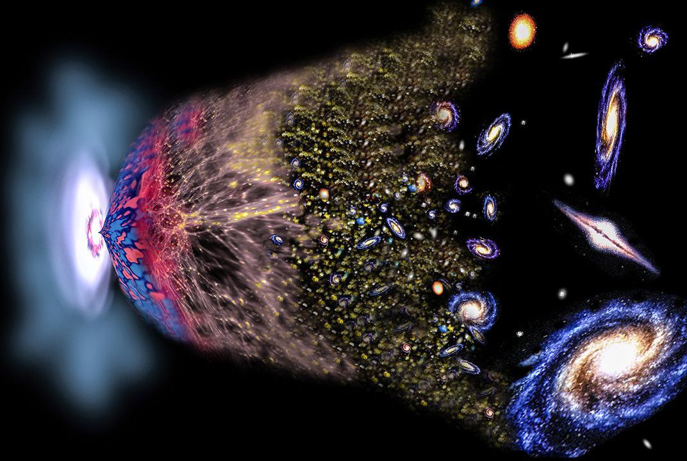
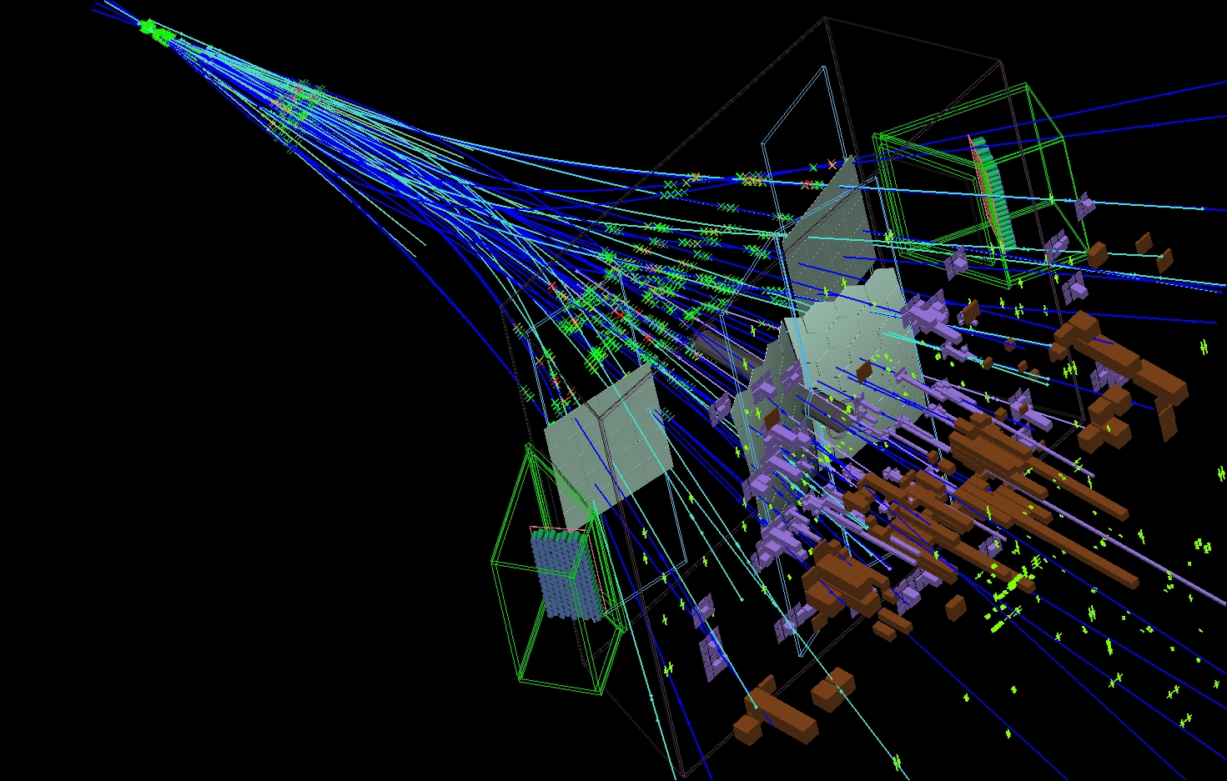
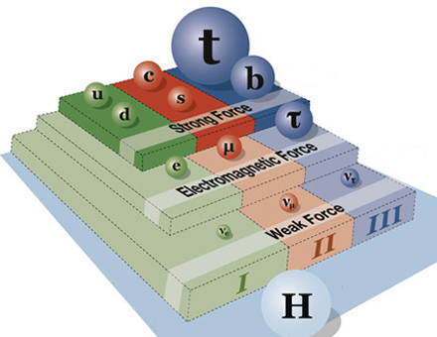
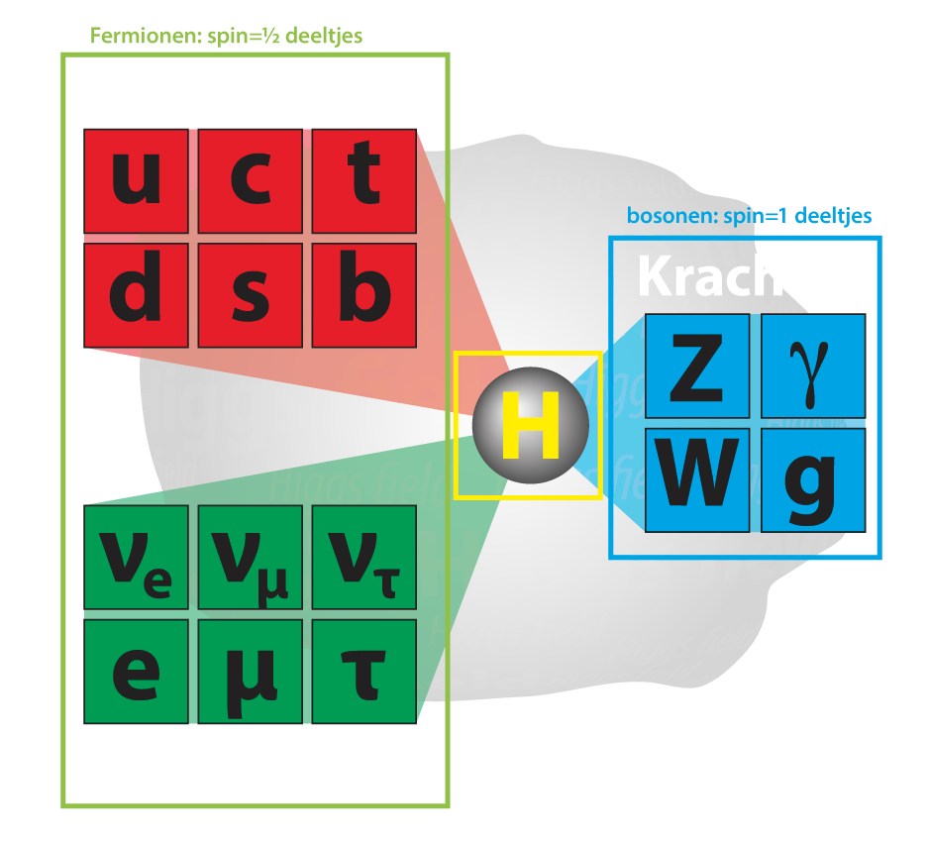
Why 3 ?
Marcel Merk
Maastricht
1-7-2024
1
2
3
Why three generations of particles?
Why is there no antimatter?
Why this particle mass hierarchy?
Notes:
Fundamental particles: Standard Model
Matter particles:
3 generations: only 1-st one stable matter
Fundamental laws symmetric matter antimatter
What determines the hierarchy of particle masses?

Slide 2






Z-boson physics: Electroweak force
$$q^{2}=s$$
Z resonance lineshape
$$\frac{1}{q^{2}}$$
Resonance:
$$q^{2}=s$$
$$M_{z}=91 GeV$$
Z
$$\frac{1}{M_{Z}^{2}−q^{2}}$$
$$q^{2}=s= {\left(E_{1}+E_{2}\right)}^{2}$$

Slide 3
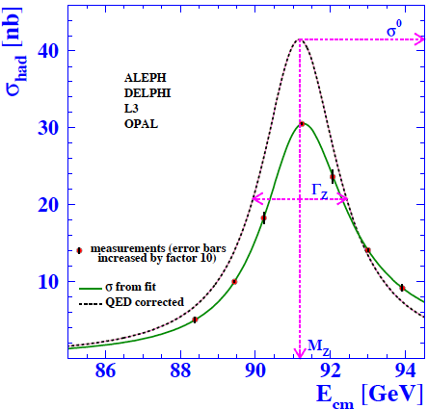
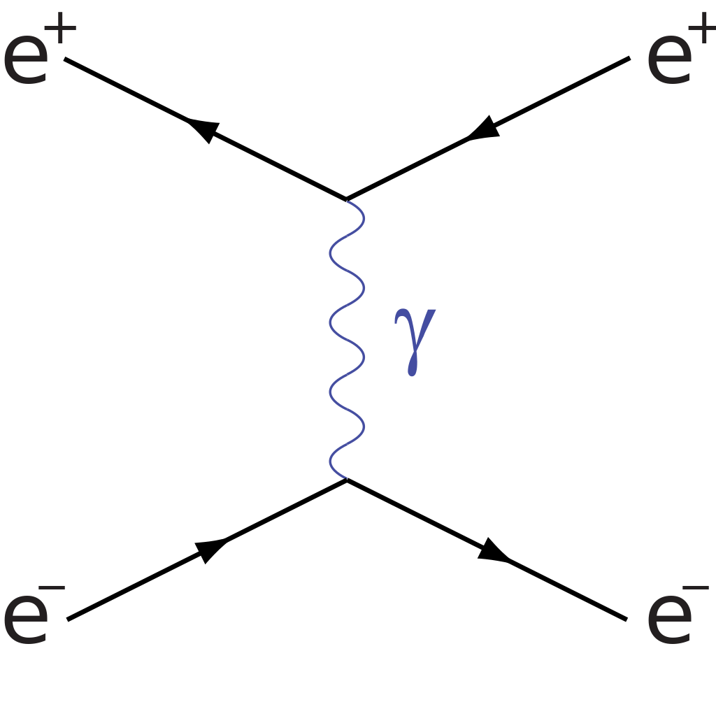


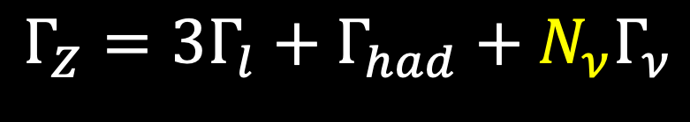





Measurement of the Z-lineshape
Z-lineshape:
$$σ_{Z}$$
$$σ_{z}=\frac{12πΓ_{ee}Γ_{ff}}{M_{z}^{2}} \frac{s}{{\left(s−M_{Z}^{2}\right)}^{2}+M_{Z}^{2}Γ_{Z}^{2}}$$
Measure it in each point:
$$σ_{z}=\frac{N_{z}}{ℒ}$$
• Z-cross section:
• Luminosity $ℒ$ = beam collision intensity
Use a well known (QED) process:
$$ℒ=\frac{N_{Bhabha}}{σ_{Bhabha}}$$
➔Determine $Γ_{ff}$
Number of Neutrinos:
$\sqrt{S}$ $=$
$$Γ_{Z}=3Γ_{l}+Γ_{had}+N_{ν}Γ_{ν}$$
Notes:
Fundamental particles: Standard Model
Matter particles:
3 generations: only 1-st one stable matter
Fundamental laws symmetric matter antimatter
What determines the hierarchy of particle masses?

Slide 4
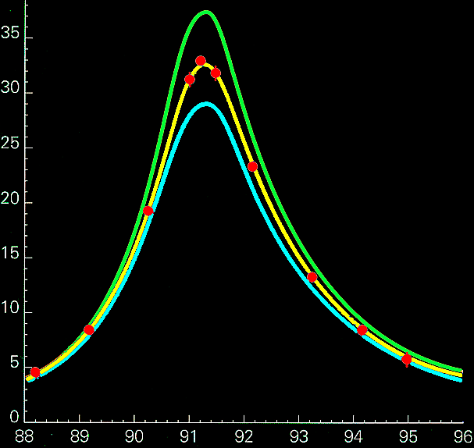
Measurement of the Z-lineshape
LEP
Z-lineshape:
$$σ_{Z}$$
$$σ_{z}=\frac{12πΓ_{ee}Γ_{ff}}{M_{z}^{2}} \frac{s}{{\left(s−M_{Z}^{2}\right)}^{2}+M_{Z}^{2}Γ_{Z}^{2}}$$
4 neutrinos
Measure it in each point:
3 neutrinos
$$σ_{z}=\frac{N_{z}}{ℒ}$$
• Z-cross section:
Number of events
2 neutrinos
• Luminosity $ℒ$ = beam collision intensity
Use a well known (QED) process:
$$ℒ=\frac{N_{Bhabha}}{σ_{Bhabha}}$$
➔Determine $Γ_{ff}$
measurements
Number of Neutrinos:
Collision Energy (GeV)
$$Γ_{Z}=3Γ_{l}+Γ_{had}+N_{ν}Γ_{ν}$$
Notes:
Fundamental particles: Standard Model
Matter particles:
3 generations: only 1-st one stable matter
Fundamental laws symmetric matter antimatter
What determines the hierarchy of particle masses?

Slide 5
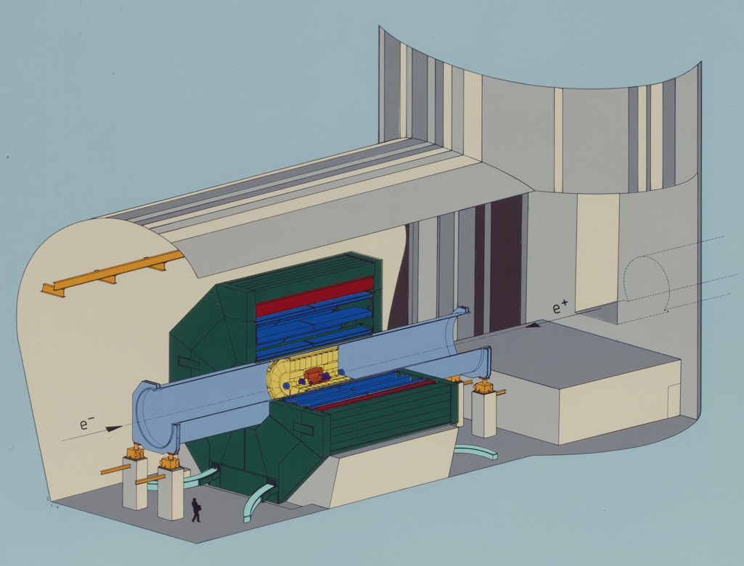
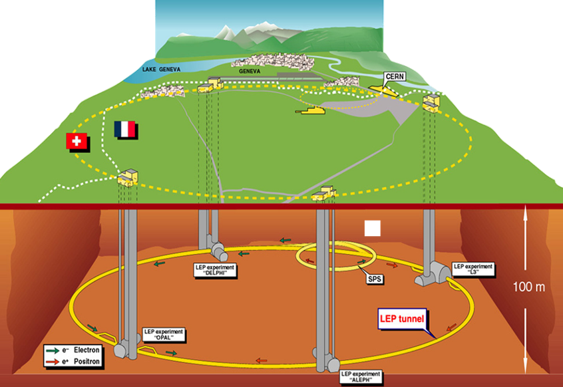
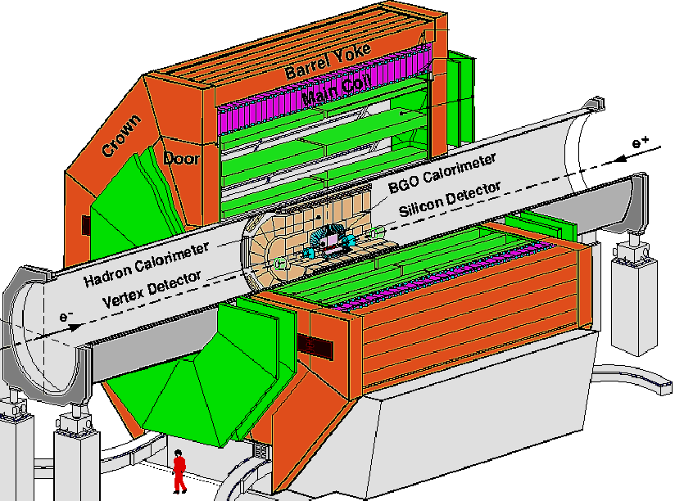
LEP-1 & L3: 1989 - 1995
Notes:
Fundamental particles: Standard Model
Matter particles:
3 generations: only 1-st one stable matter
Fundamental laws symmetric matter antimatter
What determines the hierarchy of particle masses?

Slide 6
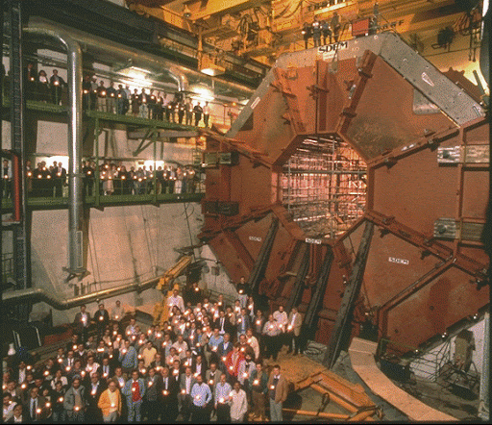
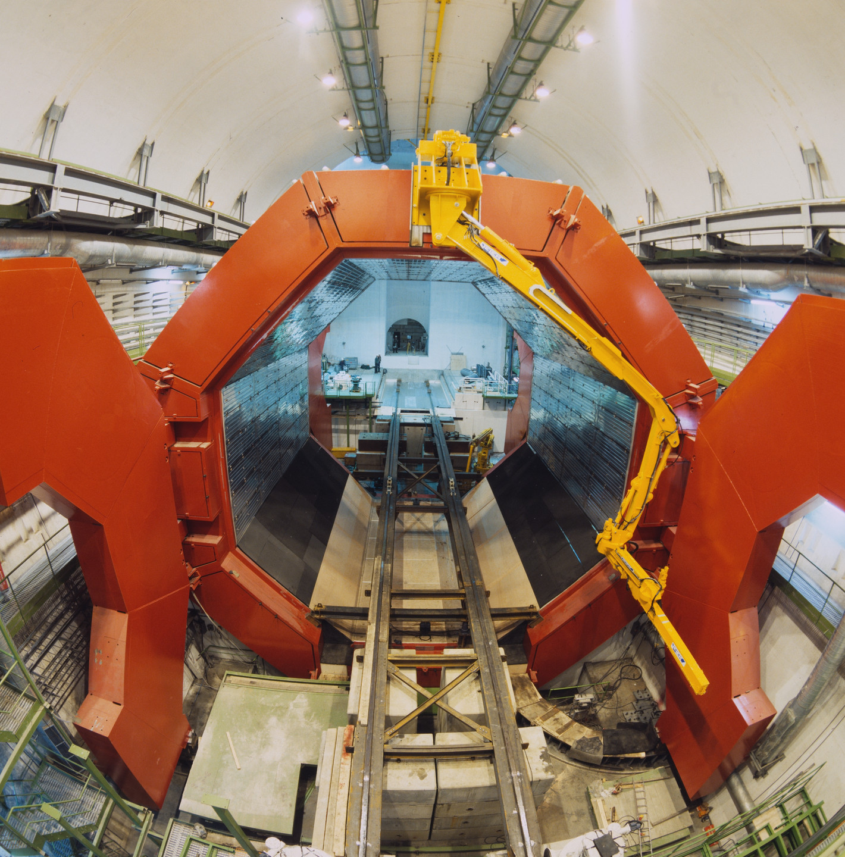
Construction of L3 experiment
Notes:
Fundamental particles: Standard Model
Matter particles:
3 generations: only 1-st one stable matter
Fundamental laws symmetric matter antimatter
What determines the hierarchy of particle masses?

Slide 7
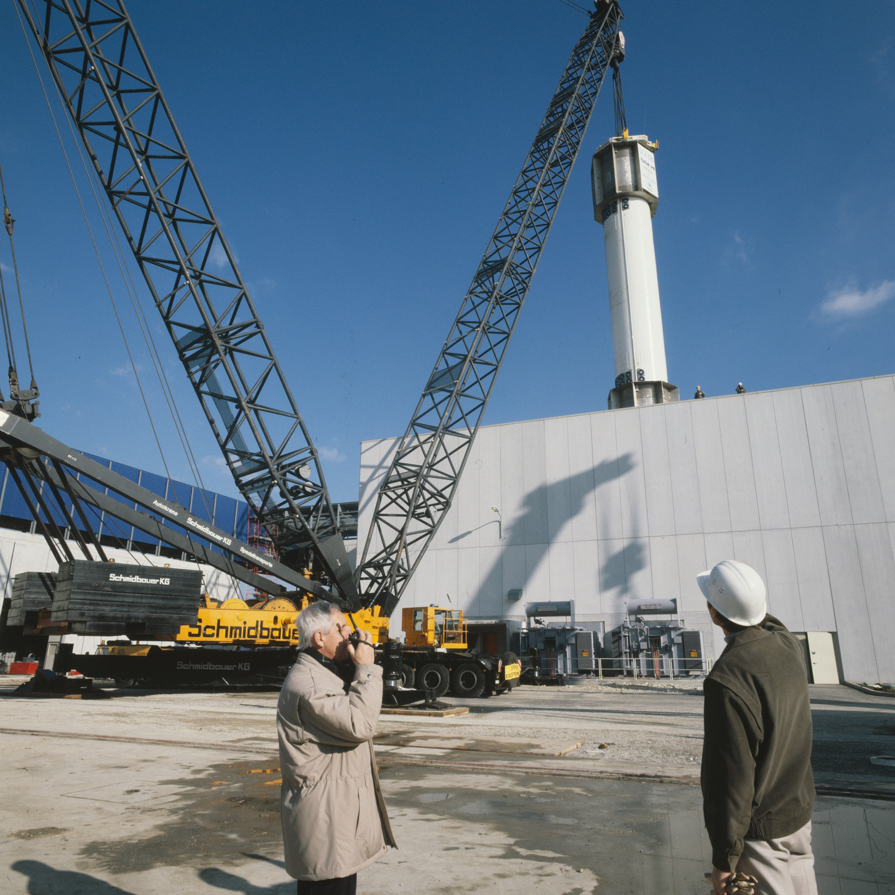
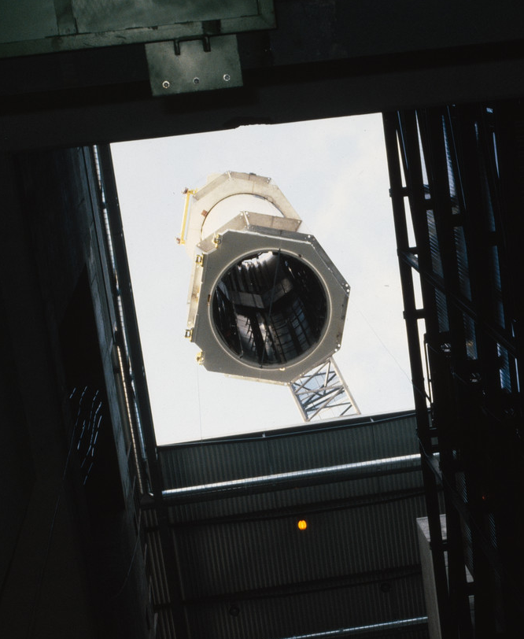
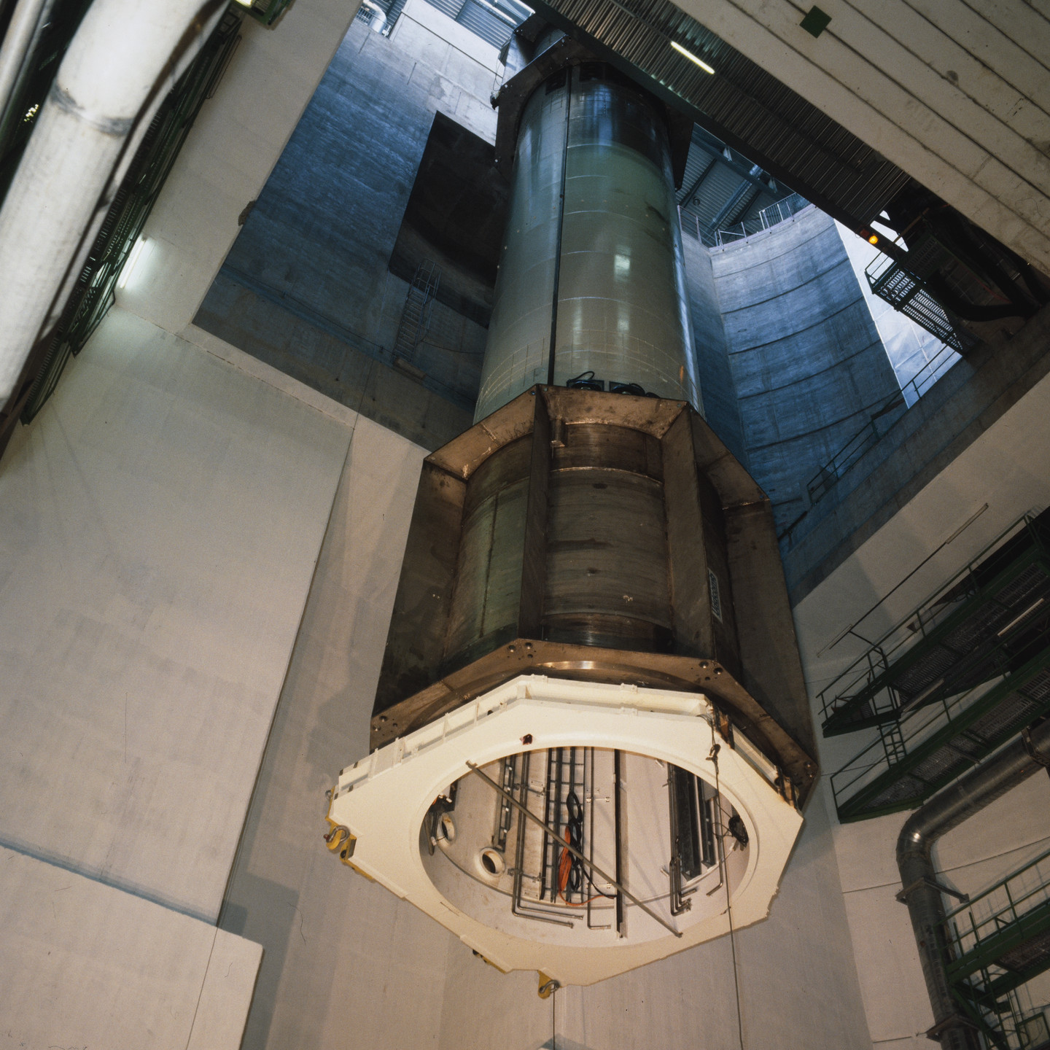
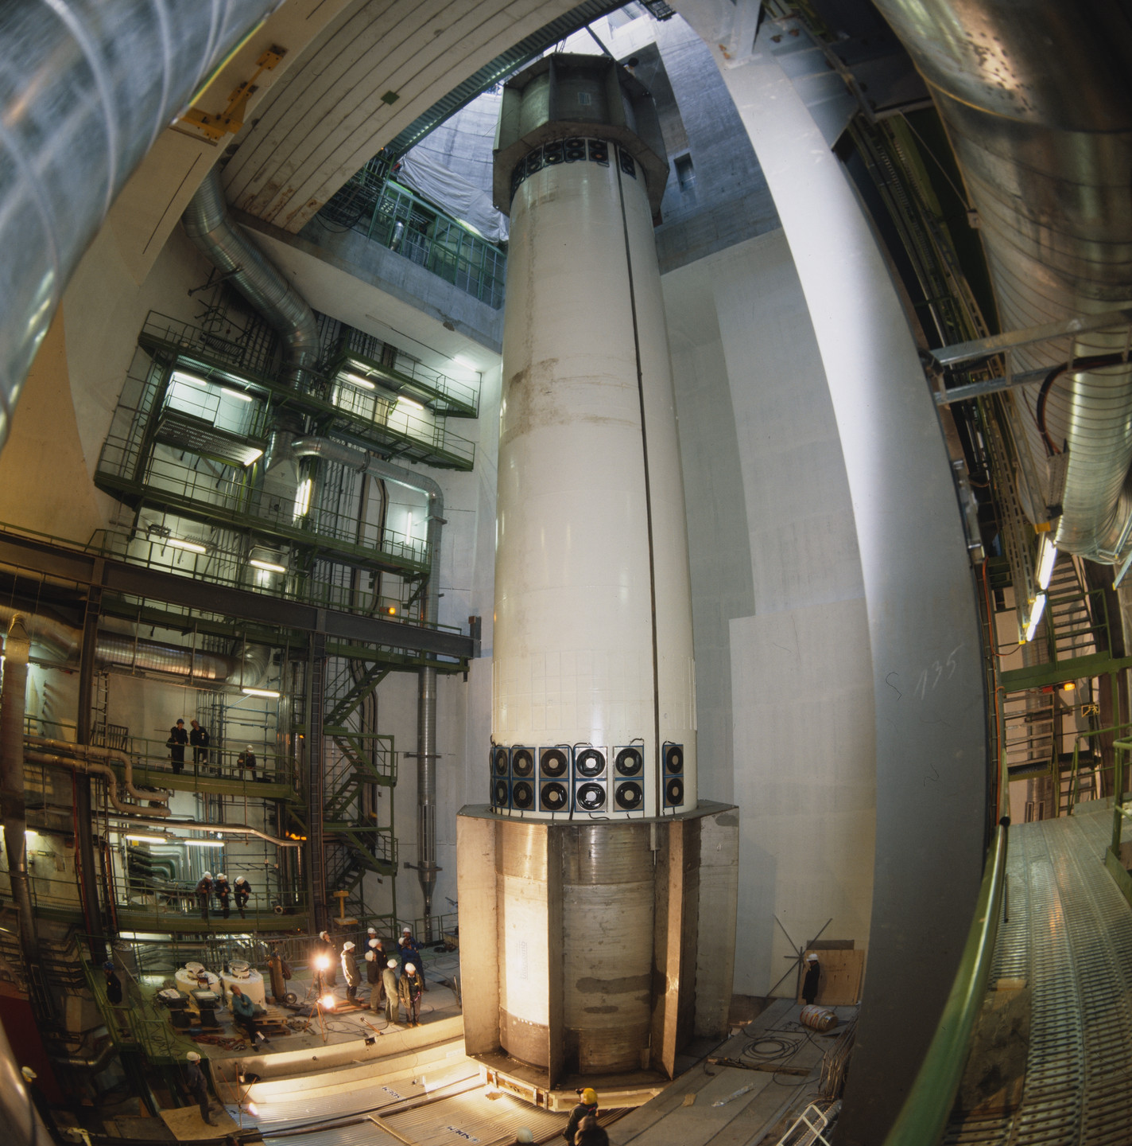
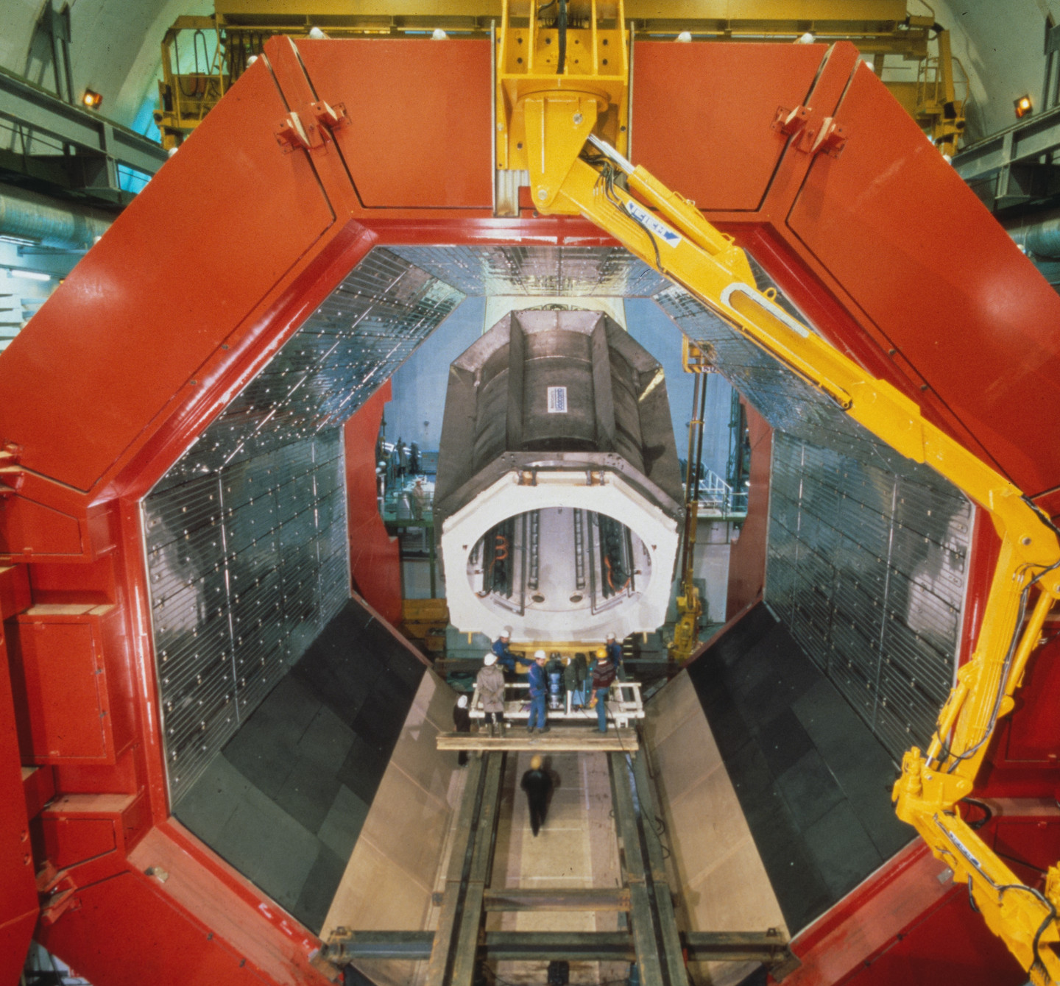
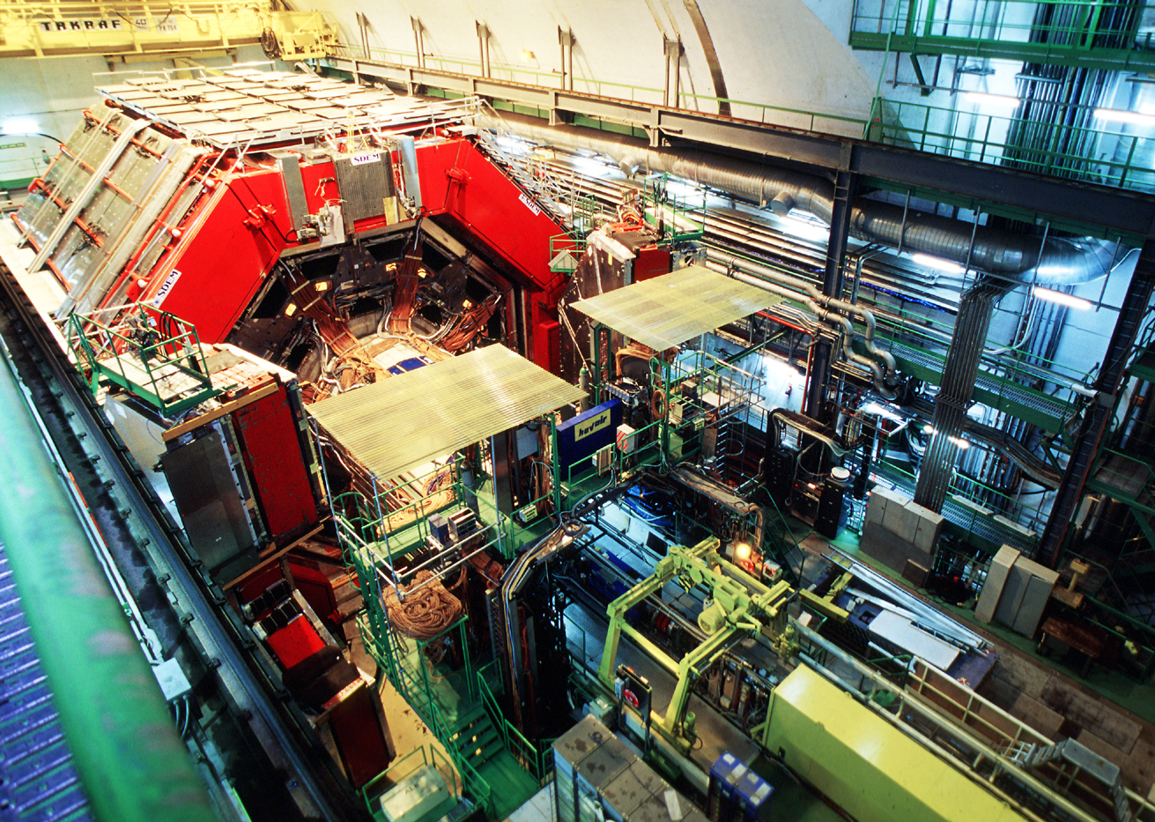
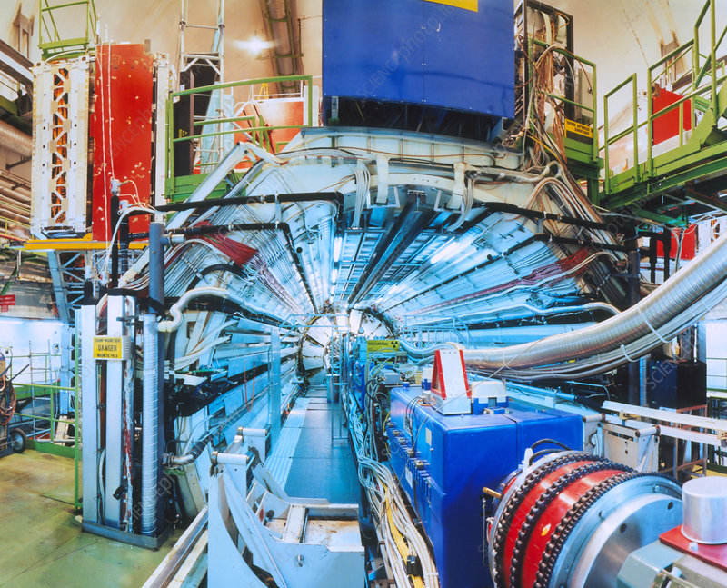
Construction of L3 experiment
Notes:
Fundamental particles: Standard Model
Matter particles:
3 generations: only 1-st one stable matter
Fundamental laws symmetric matter antimatter
What determines the hierarchy of particle masses?

Slide 8
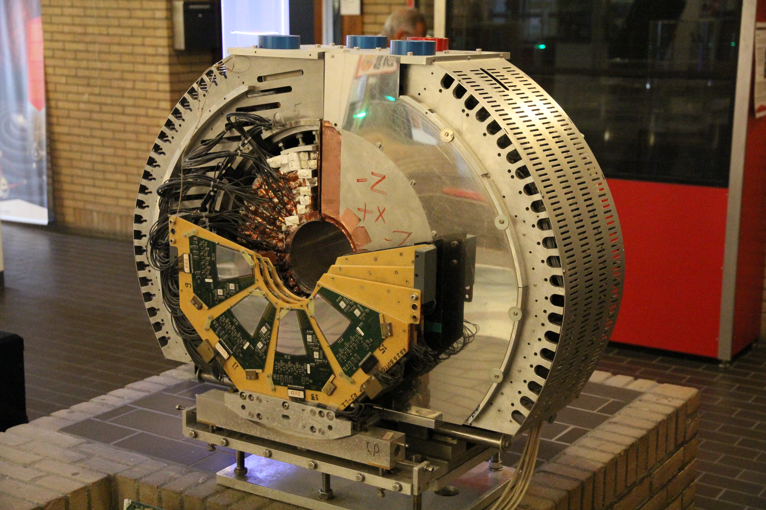





Measurement of the Z-lineshape
$$N_{Z}$$
LEP
$$σ_{z}$$
4 neutrinos
3 neutrinos
$$=$$
$$⇒$$
Number of events
2 neutrinos
$$ℒ$$
measurements
Collision Energy (GeV)
Notes:
Fundamental particles: Standard Model
Matter particles:
3 generations: only 1-st one stable matter
Fundamental laws symmetric matter antimatter
What determines the hierarchy of particle masses?

Slide 9
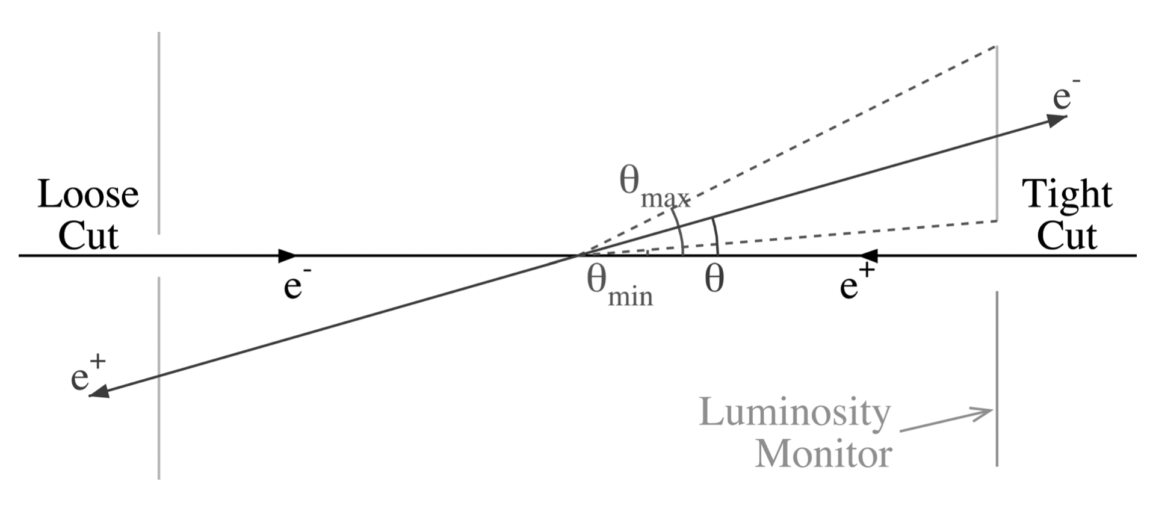
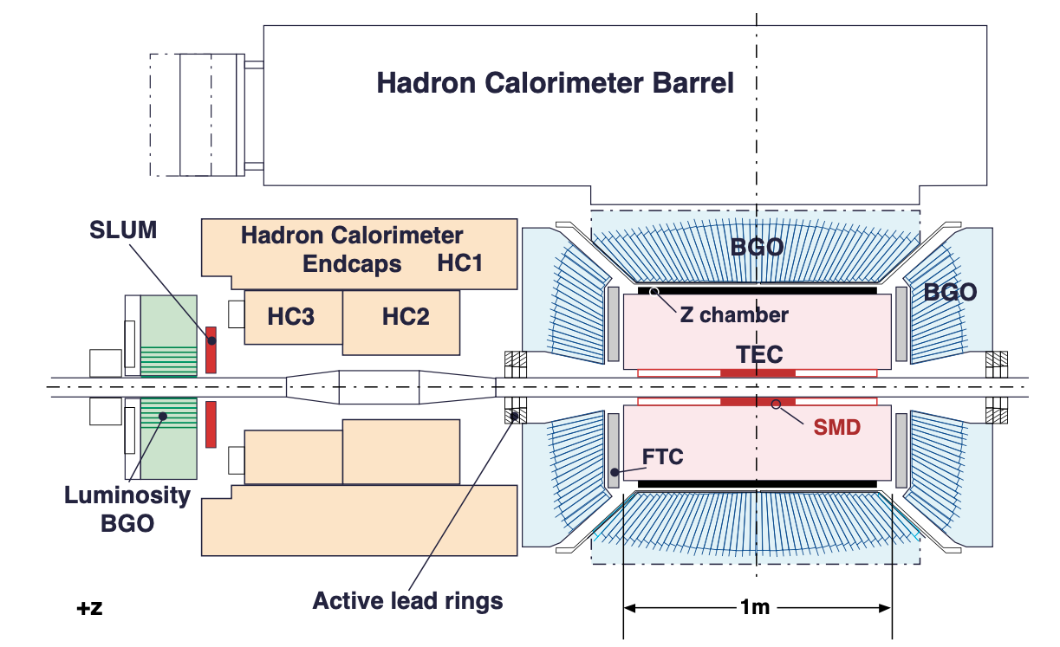
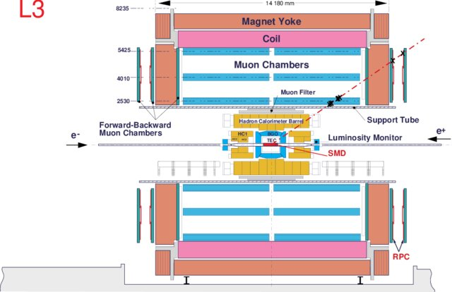

Luminosity: a sub-experiment in L3
Bhabha: $e^{+}e^{−}→e^{+}e^{−}$
304
BGO
crystals
e⁺
e─
304
BGO
crystals
θ
IP
Notes:
Fundamental particles: Standard Model
Matter particles:
3 generations: only 1-st one stable matter
Fundamental laws symmetric matter antimatter
What determines the hierarchy of particle masses?

Slide 10
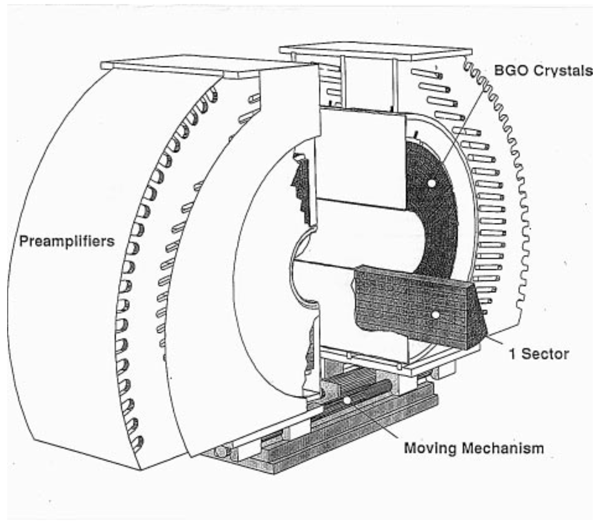
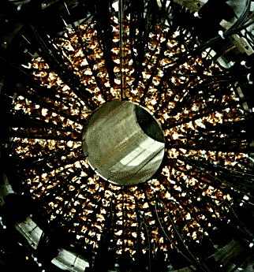
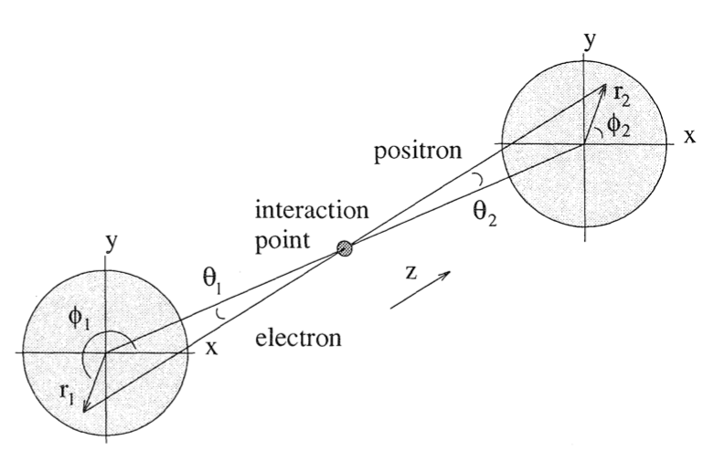
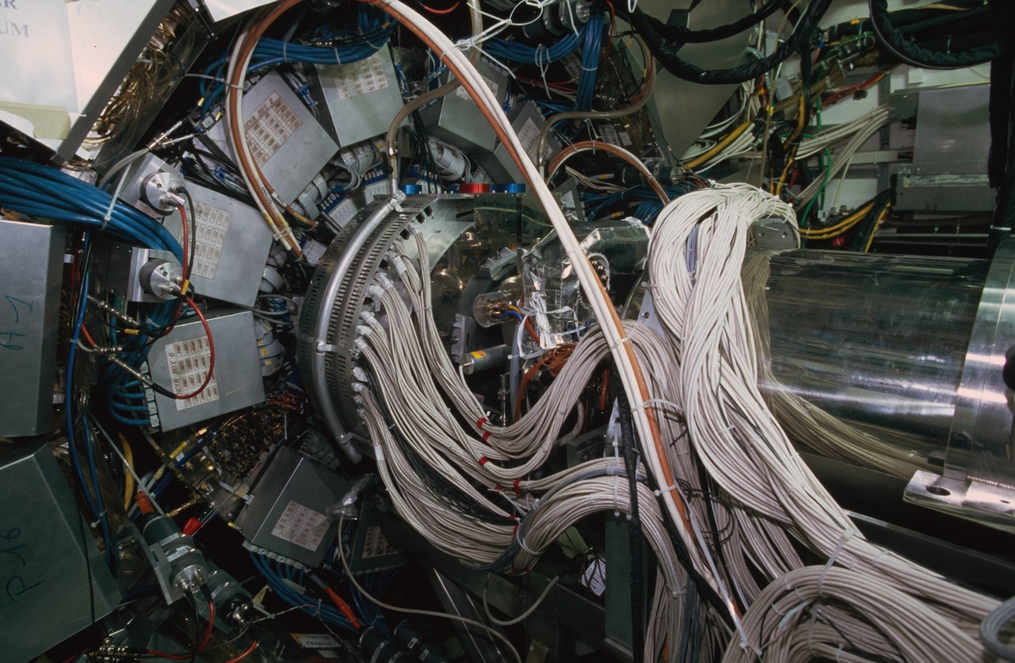
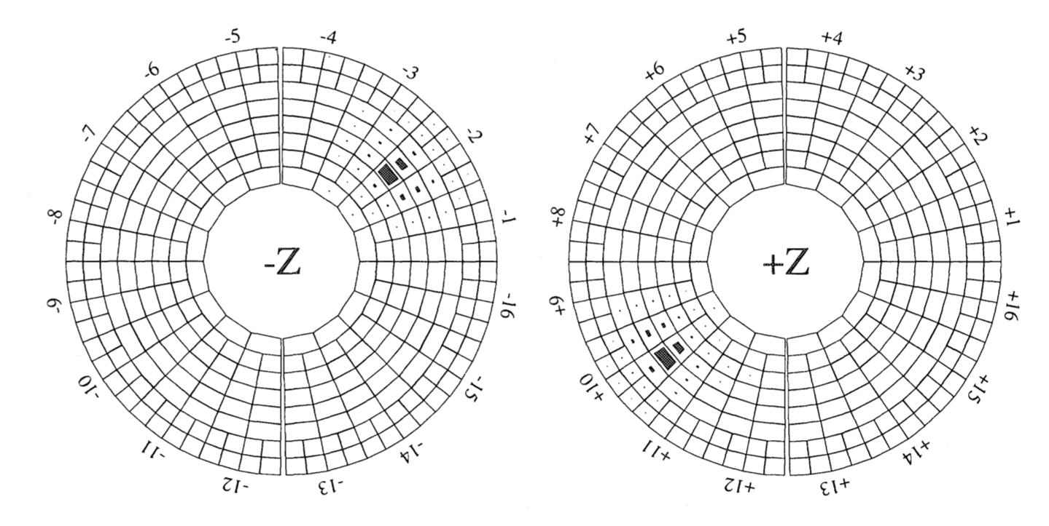
A BGO crystal calorimeter to detect electrons
Notes:
Fundamental particles: Standard Model
Matter particles:
3 generations: only 1-st one stable matter
Fundamental laws symmetric matter antimatter
What determines the hierarchy of particle masses?

Slide 11
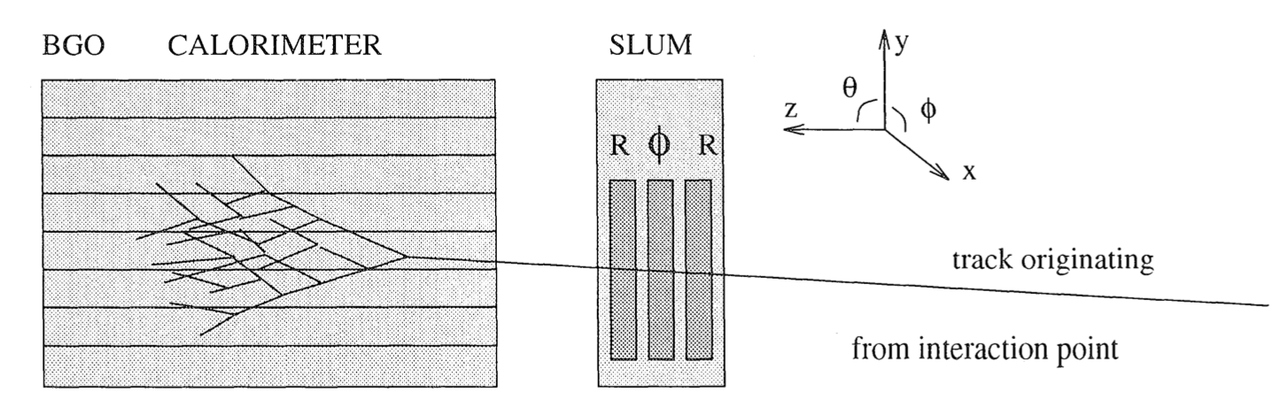
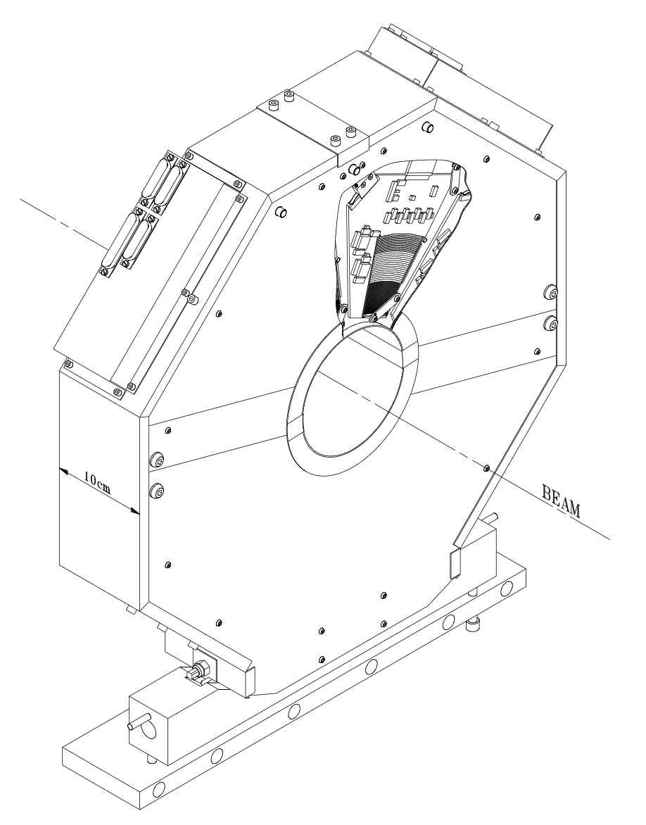
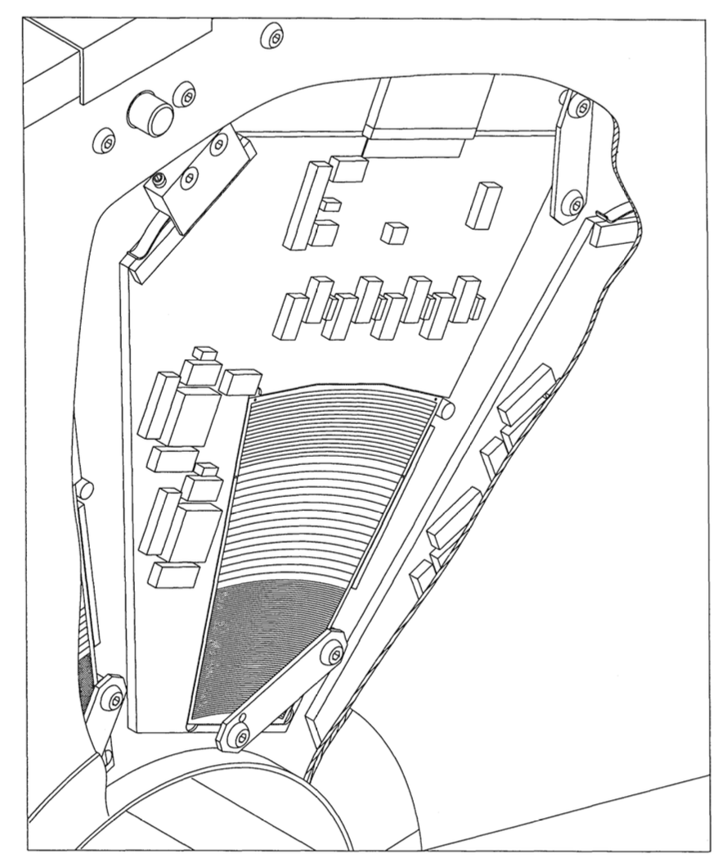
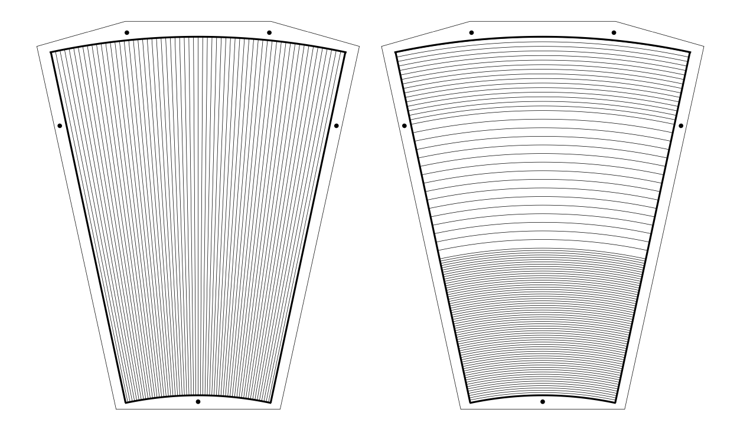



The Silicon LUMi upgrade: SLUM
Concept: improve the knowledge of fiducal volume with a silicon detector
$$e$$
$R$ wafer
$φ$ wafer
SLUM
High precision survey marks
Notes:
Fundamental particles: Standard Model
Matter particles:
3 generations: only 1-st one stable matter
Fundamental laws symmetric matter antimatter
What determines the hierarchy of particle masses?

Slide 12
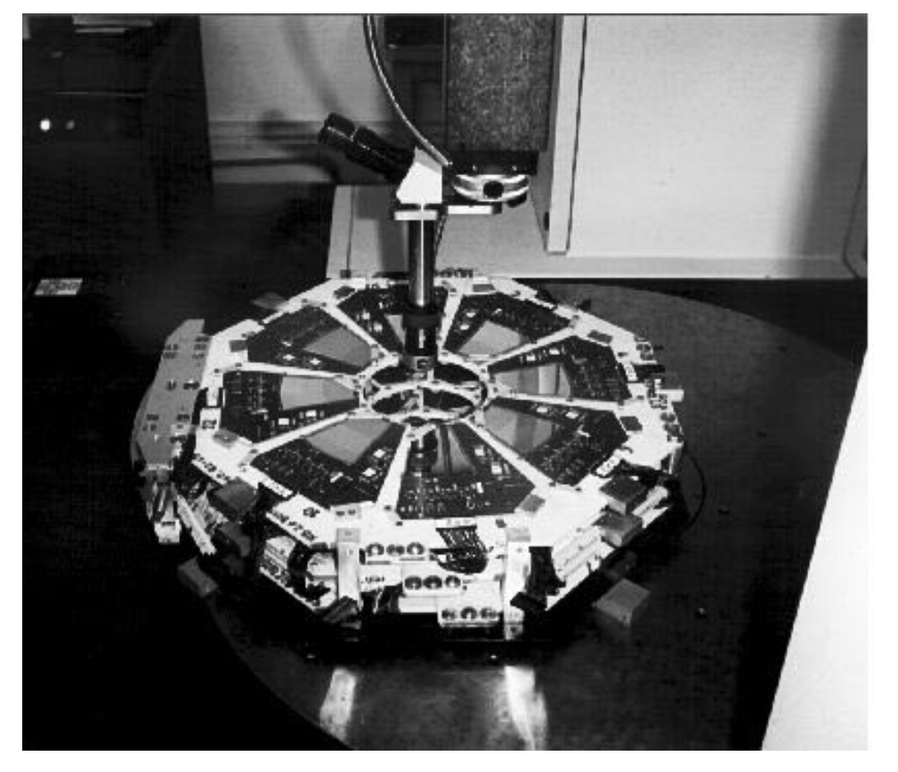
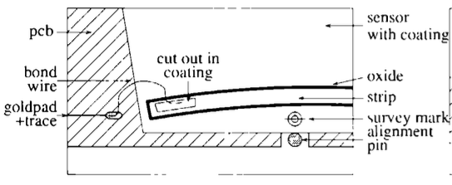
High Precision Mechanics
Performing geometrical Survey
Notes:
Fundamental particles: Standard Model
Matter particles:
3 generations: only 1-st one stable matter
Fundamental laws symmetric matter antimatter
What determines the hierarchy of particle masses?

Slide 13
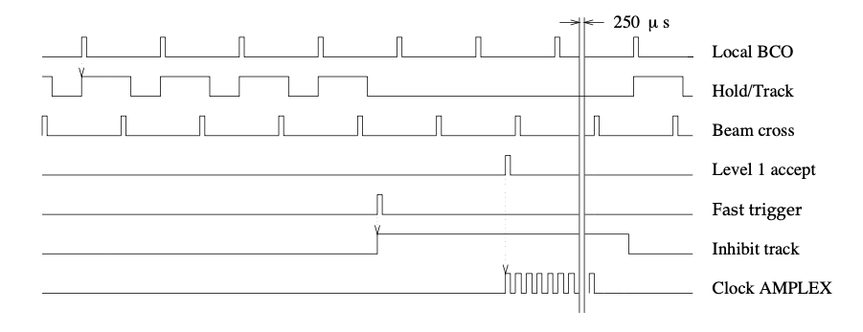
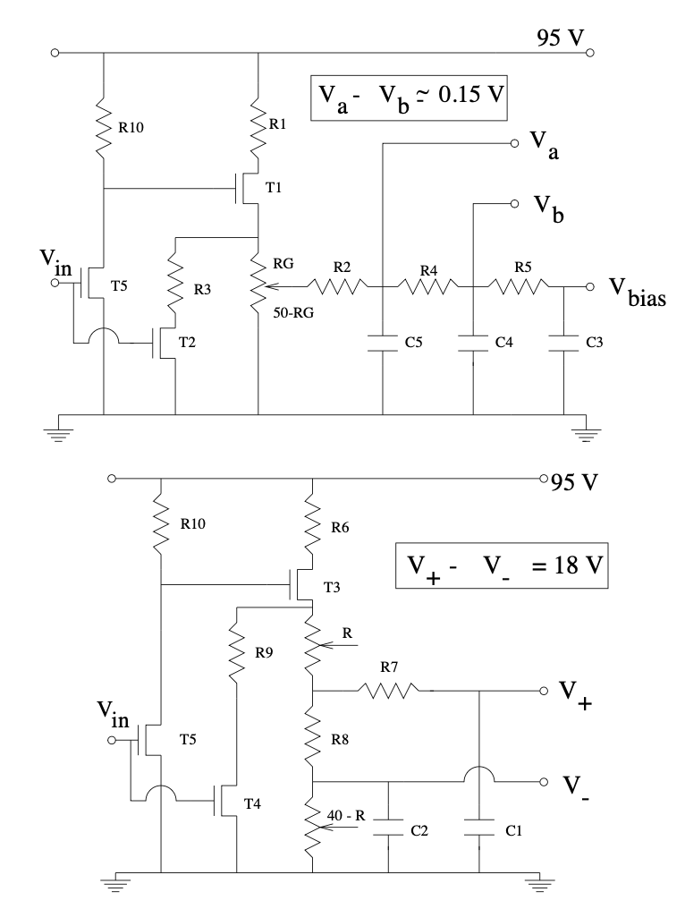
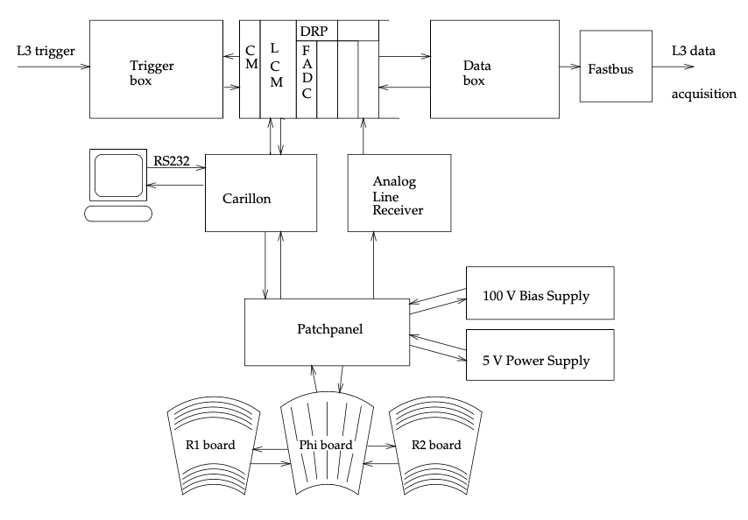
Electronics
Timing
Analog
Digital
Notes:
Fundamental particles: Standard Model
Matter particles:
3 generations: only 1-st one stable matter
Fundamental laws symmetric matter antimatter
What determines the hierarchy of particle masses?

Slide 14
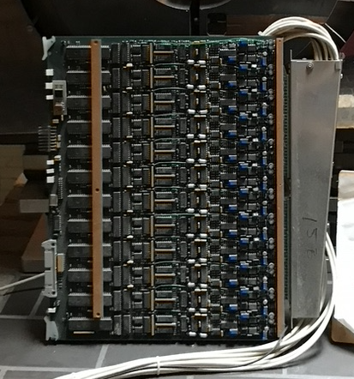
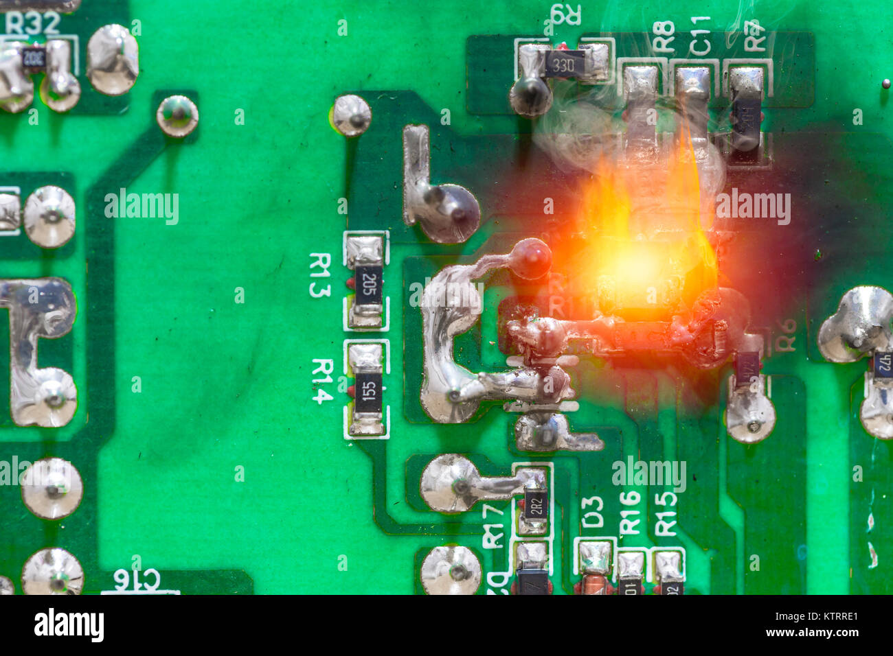
Electronics
Powering up Level-1 crate in the presence of Sam Ting
My colleague Ian (very calm): ‘That does not look good…’
Indeed: cost a weekend to repair!
BGO ADC cards
Notes:
Fundamental particles: Standard Model
Matter particles:
3 generations: only 1-st one stable matter
Fundamental laws symmetric matter antimatter
What determines the hierarchy of particle masses?

Slide 15
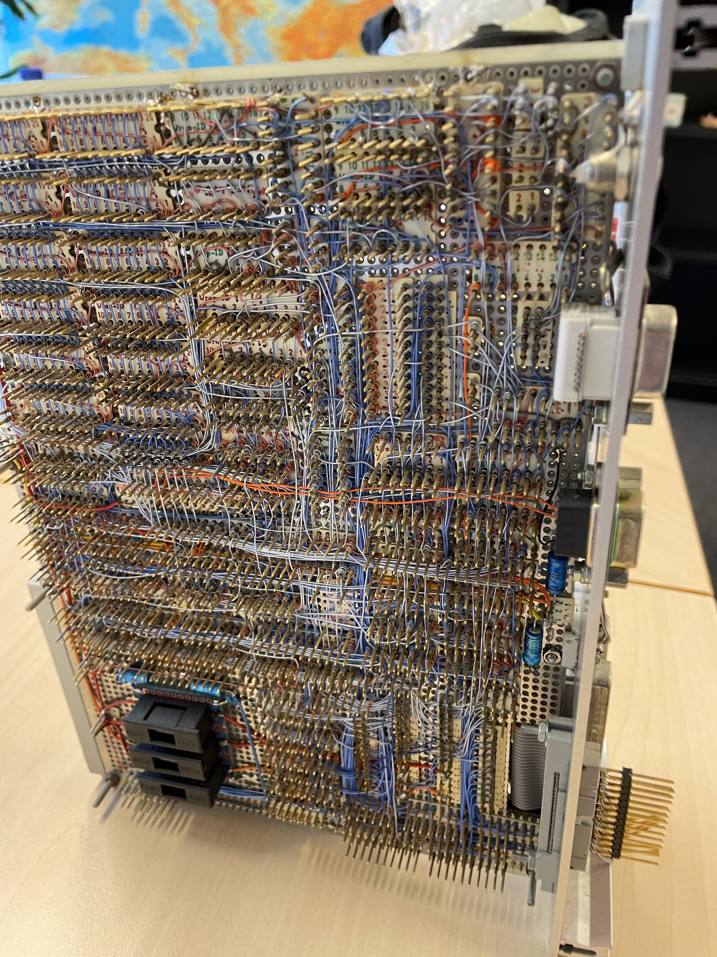
Electronics
BGO ADC cards
Notes:
Fundamental particles: Standard Model
Matter particles:
3 generations: only 1-st one stable matter
Fundamental laws symmetric matter antimatter
What determines the hierarchy of particle masses?

Slide 16
The detector in situ
Notes:
Fundamental particles: Standard Model
Matter particles:
3 generations: only 1-st one stable matter
Fundamental laws symmetric matter antimatter
What determines the hierarchy of particle masses?

Slide 17
The detector afterwards at Nikhef
Notes:
Fundamental particles: Standard Model
Matter particles:
3 generations: only 1-st one stable matter
Fundamental laws symmetric matter antimatter
What determines the hierarchy of particle masses?

Slide 18
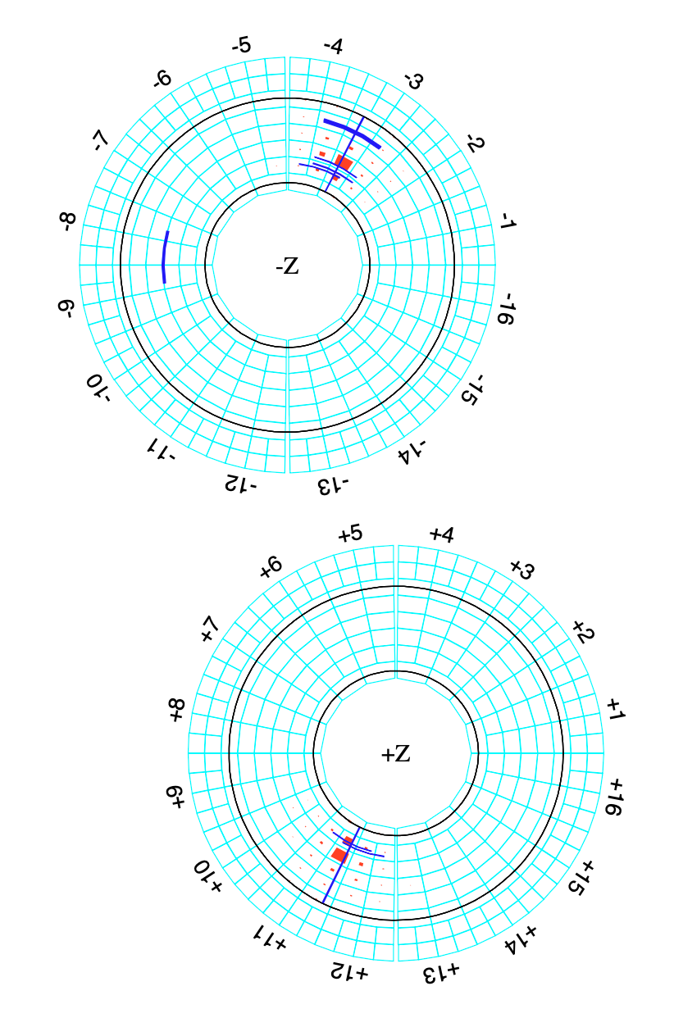
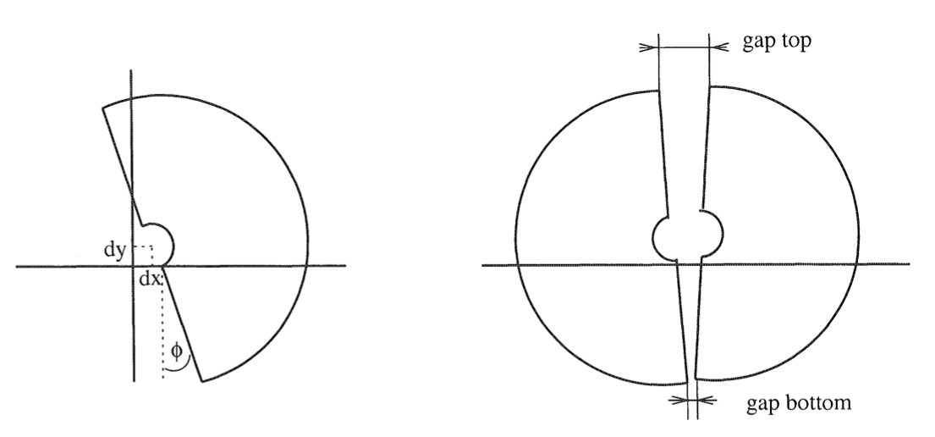
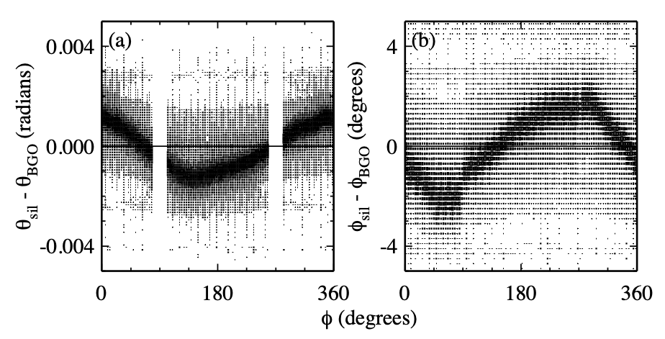
Data: Silicon– BGO Alignment
Notes:
Fundamental particles: Standard Model
Matter particles:
3 generations: only 1-st one stable matter
Fundamental laws symmetric matter antimatter
What determines the hierarchy of particle masses?

Slide 19
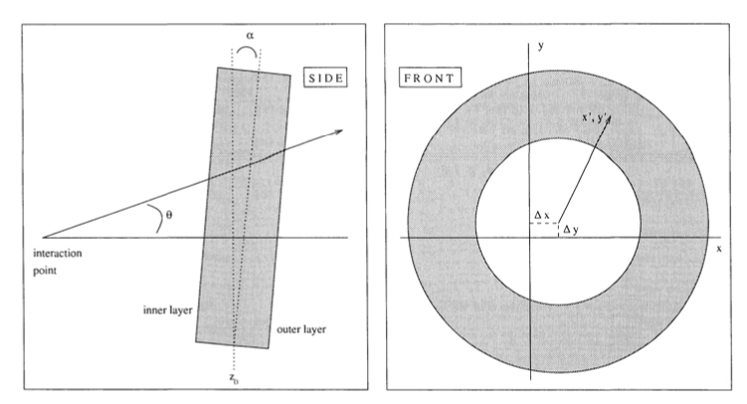
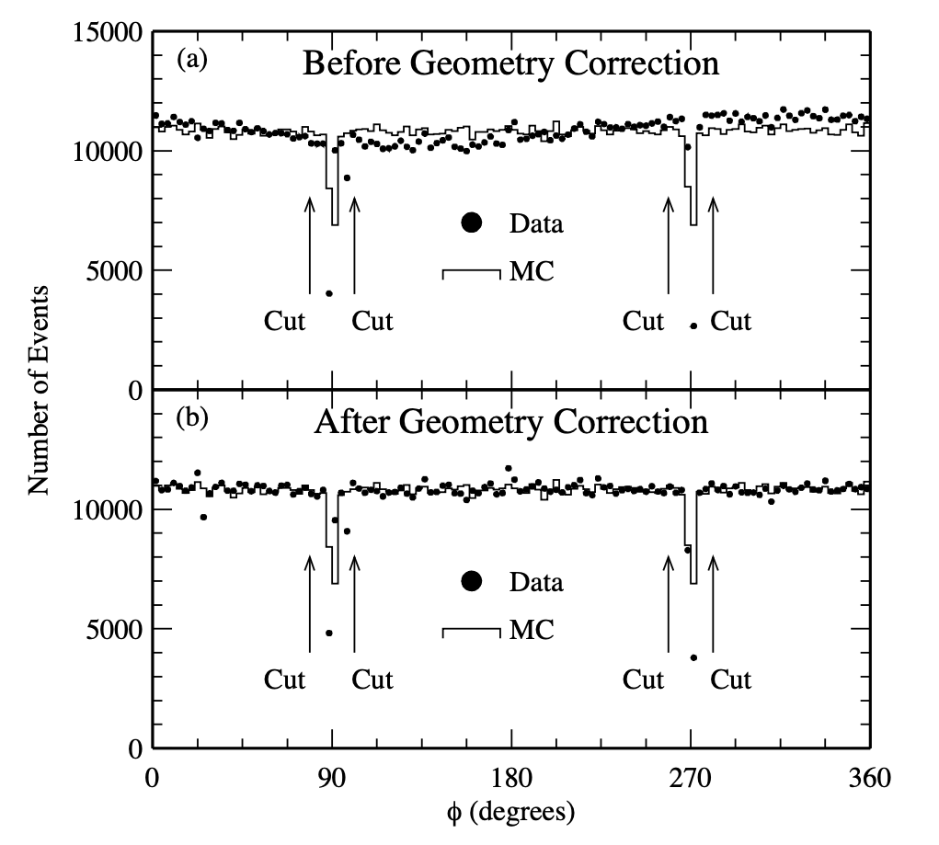
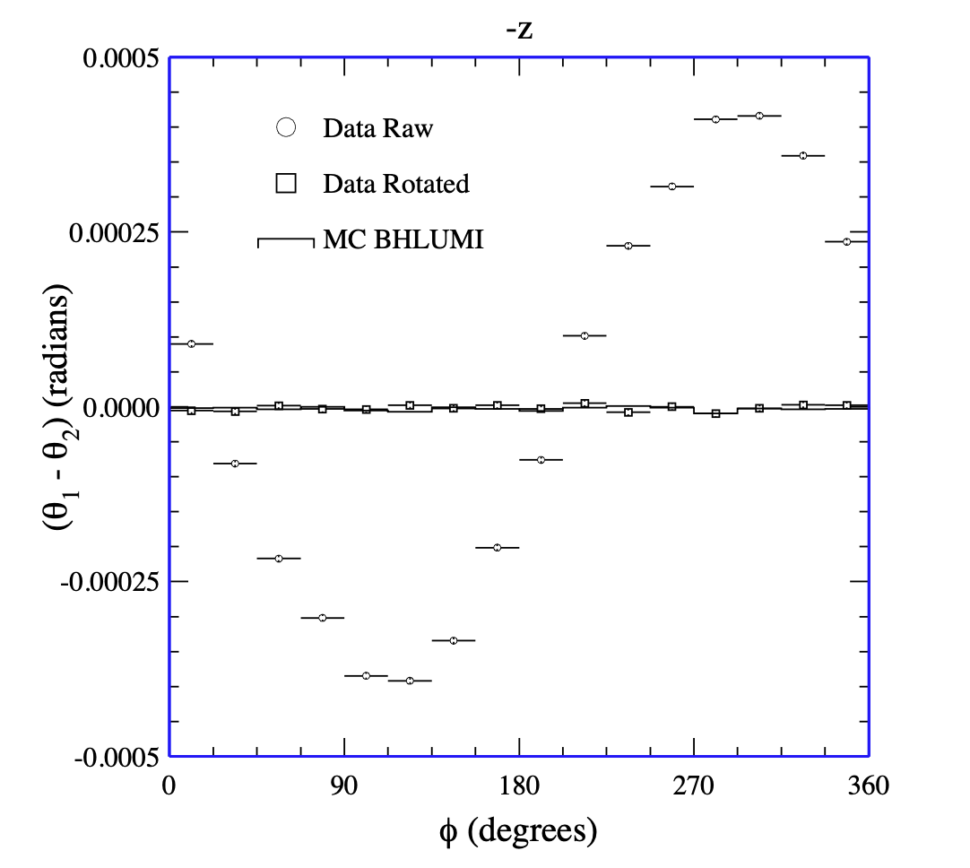
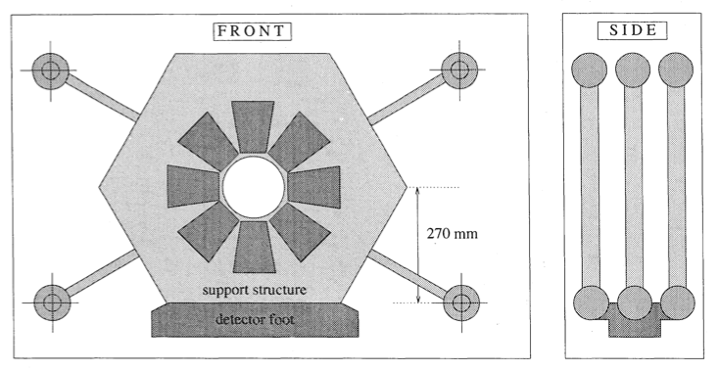

Absolute Rotation & Offsets
Bhabha: $e^{+}e^{−}→e^{+}e^{−}$
304
BGO
crystals
e⁺
e─
304
BGO
crystals
θ
IP
2) Offset from Azimuthal Event rate
3) Rotation $θ$ (use double $R$)
1) External Survey
Notes:
Fundamental particles: Standard Model
Matter particles:
3 generations: only 1-st one stable matter
Fundamental laws symmetric matter antimatter
What determines the hierarchy of particle masses?

Slide 20
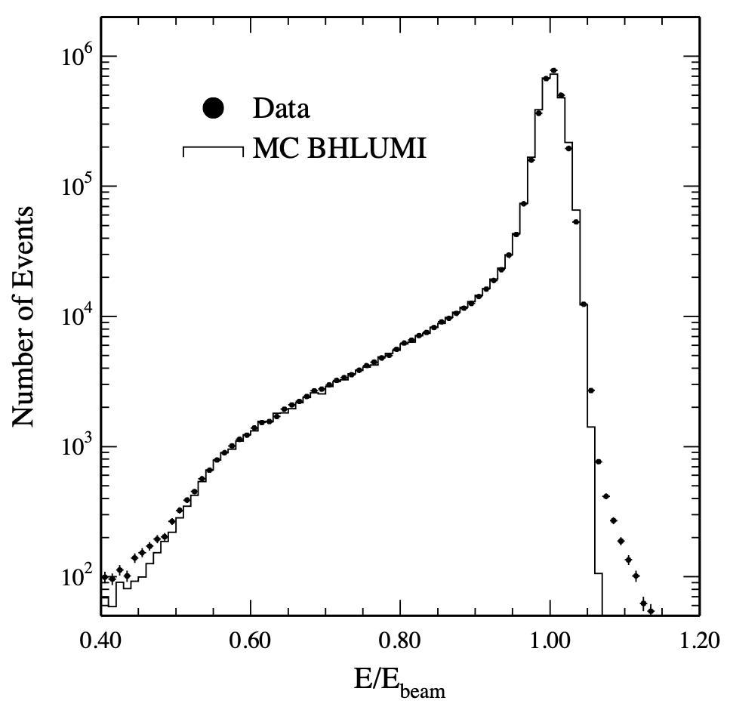



The Precision of the Luminosity Measurement
Asymmetric Cuts to allow radiative events:
• Electron energy: $E_{tight}>0.8 E_{beam}$
$E_{loose}>0.4 E_{beam}$
• Acoplanarity: $\left|Δφ−{180}^{o}\right|<{10}^{o}$
• Polar acceptance: $32<θ_{tight}<54 mrad$
$27<θ_{loose}<65 mrad$
Polar angle
Electron Energy
Acoplanarity

Slide 21




Main Systematics of the Luminosity Measurement
Results: Lumi precision
1993: ${Δℒ}/{ℒ=0.08\%}$
1994: ${Δℒ}/{ℒ=0.05\%}$
A lumi measurement for each of the four $R$-planes

Slide 22





Measuring Z-decays

Slide 23

Measurement of the Z-lineshape
$$N_{Z}$$
$$σ_{z}$$
$$+$$
$$=$$
$$ℒ$$
Notes:
Fundamental particles: Standard Model
Matter particles:
3 generations: only 1-st one stable matter
Fundamental laws symmetric matter antimatter
What determines the hierarchy of particle masses?

Slide 24


Number of Neutrino generations
LEP
$$Γ_{Z}=3Γ_{l}+Γ_{had}+N_{ν}Γ_{ν}$$
4 neutrinos
3 neutrinos
Number of events
2 neutrinos
Combined result from ALEPH, DELPHI, L3 and OPAL:
$$N_{ν}=2.984±0.008$$
measurements
The most important result of LEP1:
➔ 3 light neutrino generations
Collision Energy (GeV)

Slide 25



1) LEP: The Z-boson decays into 3 light neutrino generations
$$f$$
LEP
4 neutrinos
3 neutrinos
$$\overline{f}$$
Number of events
2 neutrinos
measurements
=3
Collision Energy (GeV)
  No additional weakly interacting light fermion generations.

Slide 26


2) LHC: Higgs production
Loop diagram is proportional to the mass of the heaviest fermion.
$$H→γγ$$
$$H→4μ$$
Quarks
3
  Top is the heaviest fermion
  3 Flavour generations
i = 1, 2, 3
Leptons

Slide 27











The CKM matrix $V_{CKM}$ - 3 Generations vs 2 Generations
$V_{CKM}$:
$d$ $s$ $b$
$V_{CKM}$:
$$u$$
$$c$$
$$t$$
$$\left(\begin{matrix}V_{ud} & V_{us} & V_{ub} \\ V_{cd} & V_{cs} & V_{cb} \\ V_{td} & V_{ts} & V_{tb}\end{matrix}\right)$$
$$\left(\begin{matrix}V_{ud} & V_{us} \\ V_{cd} & V_{cs}\end{matrix}\right)$$
$$u$$
$$c$$
Wolfenstein parametrization:
$$\left(\begin{matrix}1−1/2λ^{2} & λ & Aλ^{3}\left(ρ−iη\right) \\ −λ & 1−1/2λ^{2} & Aλ^{2} \\ Aλ^{3}\left(1−ρ−iη\right) & −Aλ^{2} & 1\end{matrix}\right)$$
$$\left(\begin{matrix}1−1/2λ^{2} & λ \\ −λ & 1−1/2λ^{2}\end{matrix}\right)$$
$➔$ 1 CP violating parameter
$➔$No CP violation!
3 generations is the minimal particle content to generate CP violation (In Standard Model).

Slide 28




The Baryogenesis Puzzle – Electroweak Baryogenesis?
Sacharov Conditions: all present in S.M.
Baryon Number Violation
C and CP Violation
Thermal non-equilibrium
‘t Hooft, PRL
37 (1976) 8
V
Axial Anomaly:
f
f
tunnel
f
1st order
φ
Sphaleron Transitions
Weak Interaction
Higgs Phase Transition
Baryogenesis from Higgs symmetry breaking?
symmetric phase
broken phase
expanding bubble (Higgs condensates)

Slide 29

The Baryogenesis Puzzle – Electroweak Baryogenesis?
Sacharov Conditions: all present in S.M. , but not sufficient
Baryon Number Violation
C and CP Violation
Thermal non-equilibrium
‘t Hooft, PRL
37 (1976) 8
V
Axial Anomaly:
f
f
f
2nd order
φ
Sphaleron Transitions
Weak Interaction
Higgs Phase Transition
Baryogenesis from Higgs symmetry breaking?
symmetric phase
broken phase
expanding bubble (Higgs condensates)

Slide 30






How large is CP violation?
To explain the absence of antimatter in the universe requires a primordial baryon asymmetry of: $\frac{Δn_{B}}{n_{γ}}≈{10}^{−10}$
Large CP violation requires large mixing and large phases in the CKM matrix.
  Surface of unitarity triangle : $J$
Jarlskog criterion (1987) for amount of CP violation:
det$\left[M_{u}M_{u}^{†} , M_{d}M_{d}^{†}\right]=2 i J \left(m_{t}^{2}−m_{c}^{2}\right)\left(m_{c}^{2}−m_{u}^{2}\right)\left(m_{u}^{2}−m_{t}^{2}\right)$
$× \left(m_{b}^{2}−m_{s}^{2}\right)\left(m_{s}^{2}−m_{d}^{2}\right)\left(m_{d}^{2}−m_{b}^{2}\right)$
  From CKM: ${A_{CP}}/{T_{c}^{12}}≈{10}^{−20 }$
→ Too small
Explanation requires existence of new massive particles.
Cecila Jarlskog

Slide 31

The central role of Mass

Slide 32


The central role of Mass
Mass & Higgs
Higgs mechanism as origin of particle mass
The Higgs potential as a portal to BSM physics
Electroweak symmetry breaking

Slide 33


The central role of Mass
Mass & QCD
Chiral symmetry as origin of Hadron masses
QGP in heavy ions and in neutron stars
Chiral symmetry breaking

Slide 34


The central role of Mass
Mass & CP-violation
Quark and lepton masses as origin of CP violation
Origin of neutrino masses

Slide 35


The central role of Mass
Mass & Dark Matter
Invisible source of mass
Caused by weakly interacting particles?

Slide 36


The central role of Mass
Mass & GW
Mass as the source of space-time deformations
Primordial grav waves from phase transition?
http://dx.doi.org/10.1098/rsta.2017.0126
Notes:
http://dx.doi.org/10.1098/rsta.2017.0126

