Slide 1
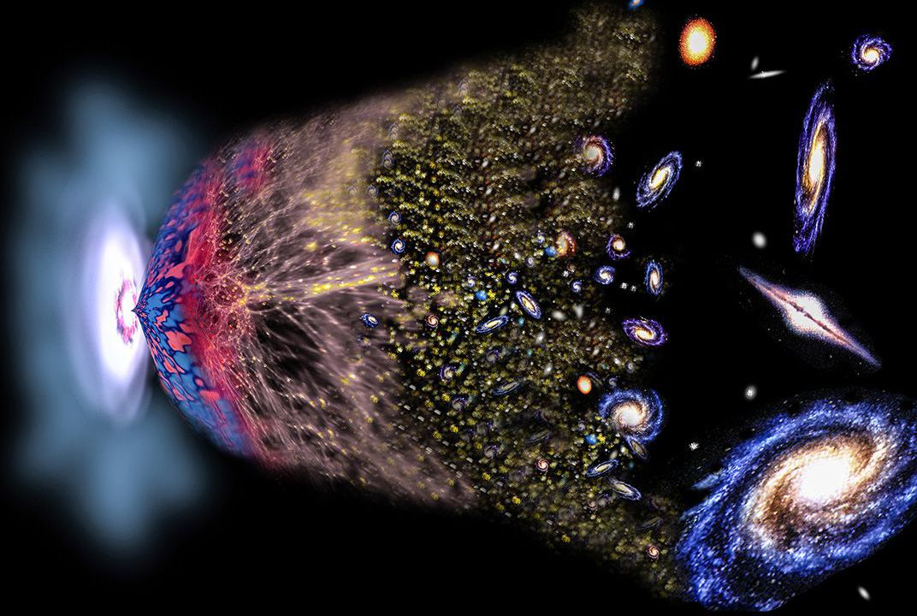
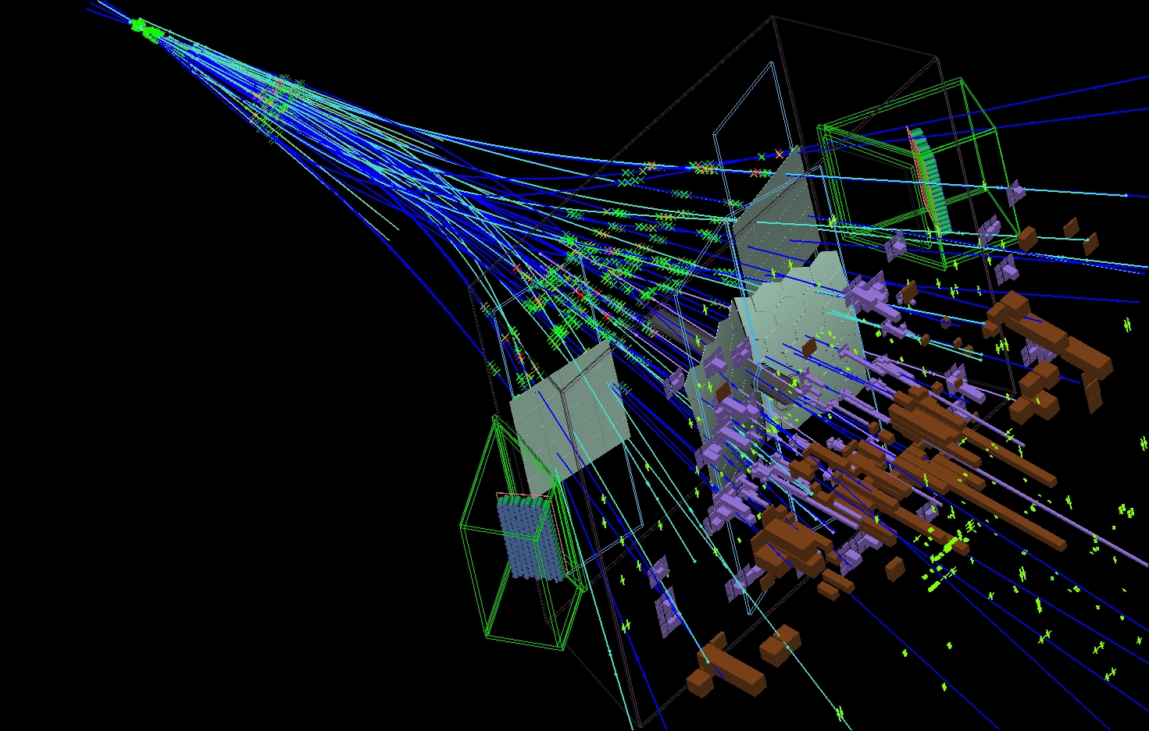
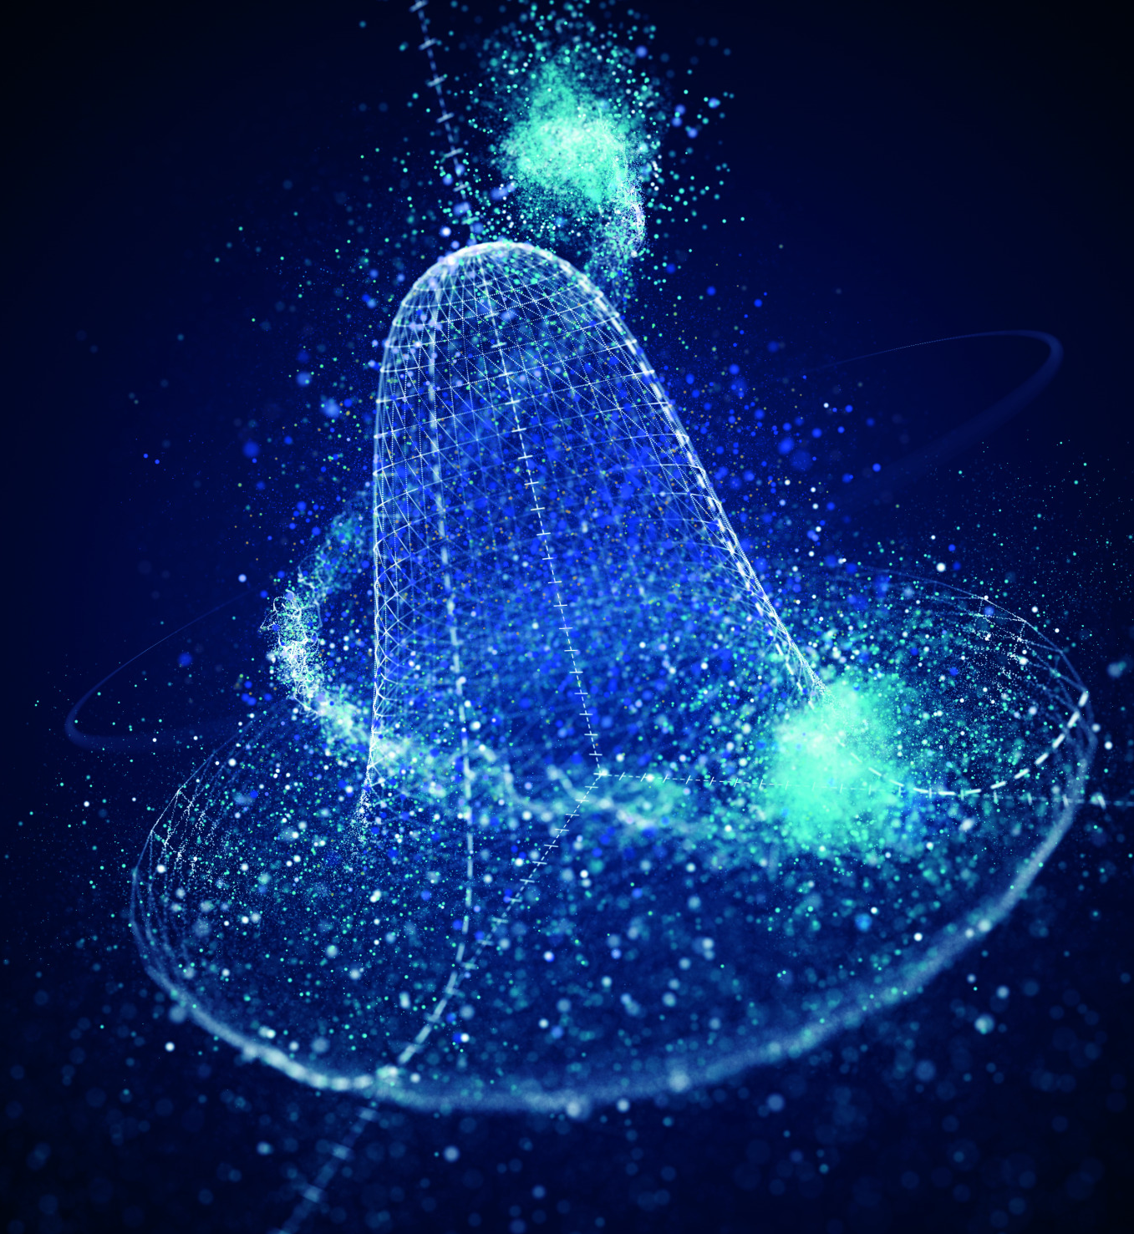
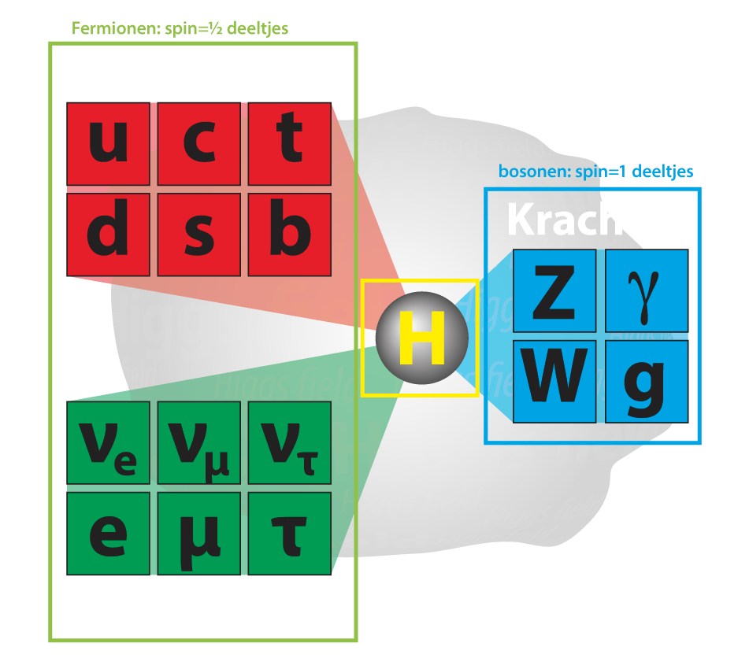
Flavour Physics and CP Violation
Marcel Merk
1
2
3
Why three generations of particles?
Why is there no antimatter?
What is the role of EWSB?
Notes:
Fundamental particles: Standard Model
Matter particles:
3 generations: only 1-st one stable matter
Fundamental laws symmetric matter antimatter
Why is an atom neutral: charge proton=-electron?

Slide 2
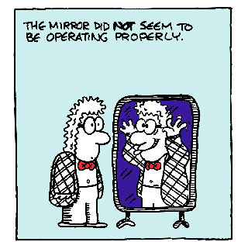
Introduction to CP Violation
1
Contents:
Discrete Symmetries C, P and CP
CP violation in the weak force
How can we measure it?
The matter – antimatter asymmetry

Slide 3
Introduction to CP Violation
1
Contents:
Discrete Symmetries C, P and CP
CP violation in the weak force
How can we measure it?
The matter – antimatter asymmetry

Slide 4
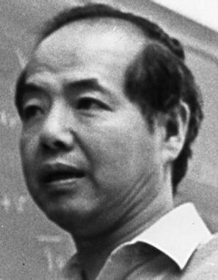
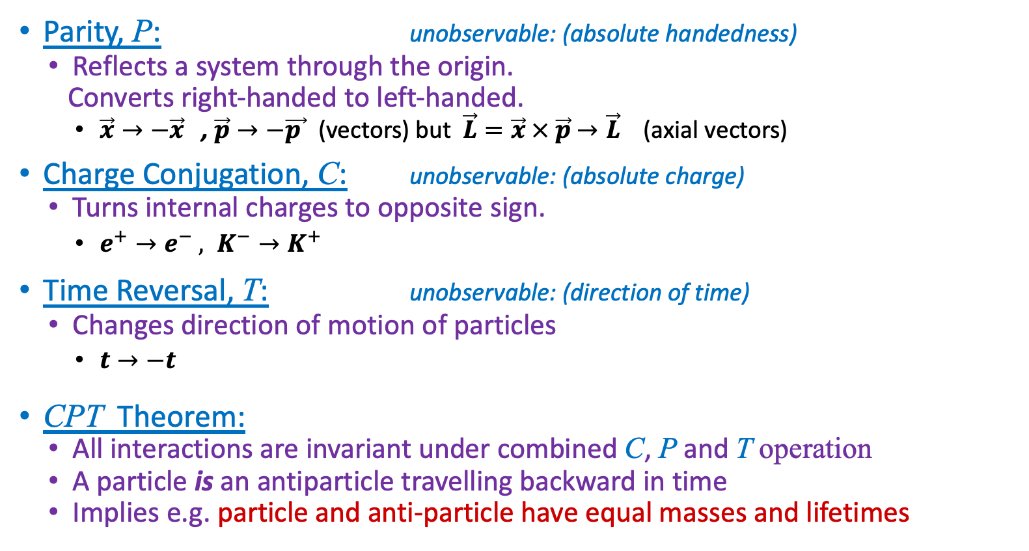
C, P, T Discrete Symmetries
5
T.D.Lee: “The root to all symmetry principles lies in the assumption that it is impossible to observe certain basic quantities; the non-observables”
Parity, P: unobservable: (absolute handedness)
Reflects a system through the origin.
Converts right-handed to left-handed.
$\vec{x}→−\vec{x}$ , $\vec{p}→−\vec{p }$ (vectors) but $\vec{L}=\vec{x} × \vec{p}$ $→\vec{L}$ (axial vectors)
Charge Conjugation, C: unobservable: (absolute charge)
Turns internal charges to opposite sign.
$e^{+}→e^{−} , K^{−}→K^{+ }$
Time Reversal, T: unobservable: (direction of time)
Changes direction of motion of particles
$t→−t$
CPT Theorem:
All interactions are invariant under combined C, P and T operation
A particle is an antiparticle travelling backward in time
Implies e.g. particle and anti-particle have equal masses and lifetimes
+
−
Notes:
Unobservables:
Absolute spatial position or direction: p and angular p, absolute velocity, wave function phase,…
CPT → Lagrangian is Hermitian L(x)=>L-dagger(-x)

Slide 5
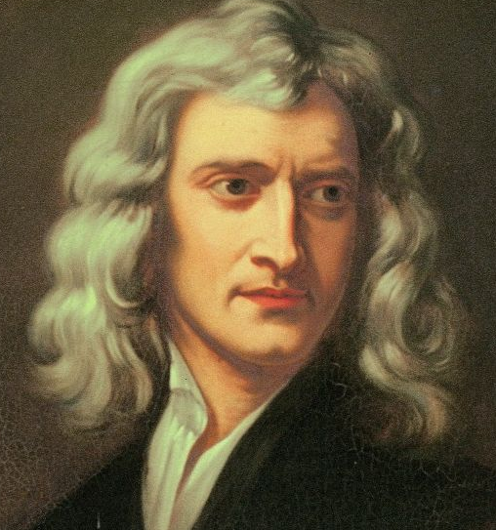
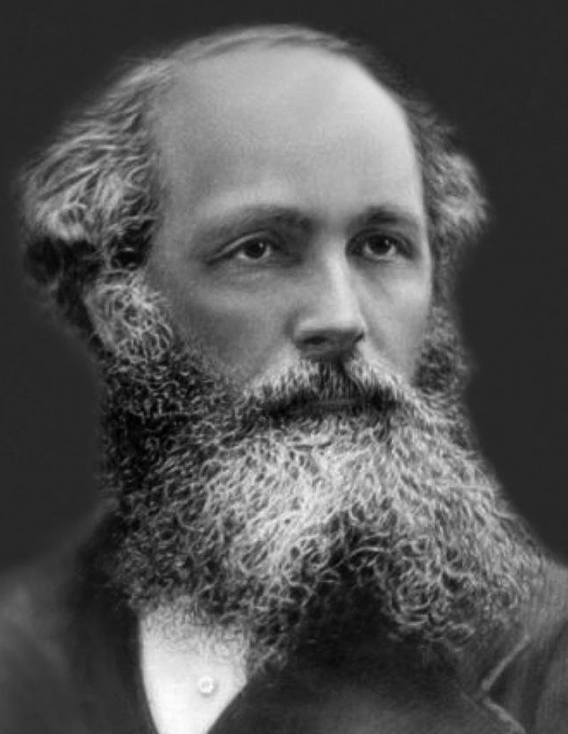
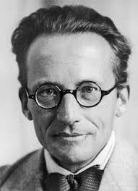
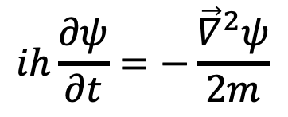
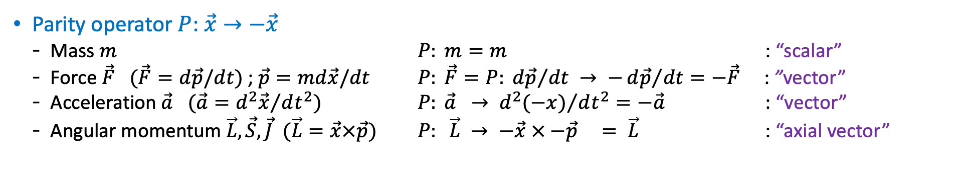
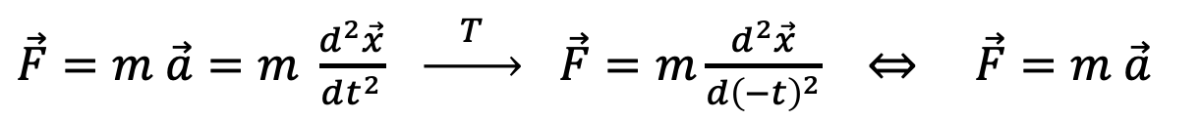
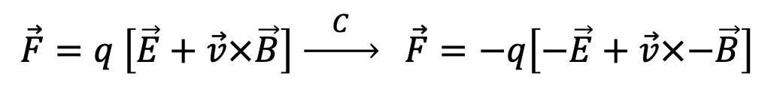
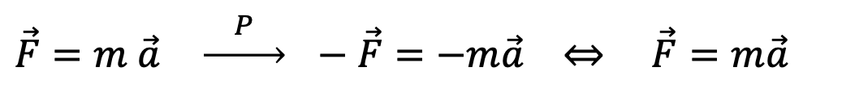
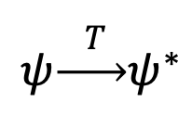
Classical Mirror Worlds
→ Invariant!
3
Parity operator $P$: $\vec{x}→−\vec{x}$
Mass $m$ $P: m=m$ : “scalar”
Force $\vec{F}$ $(\vec{F}=d\vec{p}/dt)$; $\vec{p}=md\vec{x}/dt$ $P: \vec{F}=P: {d\vec{p}}/{dt} → −{d\vec{p}}/{dt=−\vec{F}}$ : ”vector”
Acceleration $\vec{a}$ $(\vec{a}={d^{2}\vec{x}}/{dt^{2})}$ $P: \vec{a} → {d^{2}(−x)}/{dt^{2}}=−\vec{a}$ : “vector”
Angular momentum $\vec{L}, \vec{S}, \vec{J}$ $(\vec{L}=\vec{x}×\vec{p})$ $P: \vec{L} → −\vec{x} × −\vec{p} = \vec{L}$ : “axial vector”
Parity: Newton’s law is invariant under P-operation (i.e. the same in the mirror world):
$\vec{F}=m \vec{a} \underset{→}{ P } −\vec{F}=−m\vec{a} ⇔ \vec{F}=m\vec{a}$
Charge: Lorentz Force in the C-mirror world is invariant:
$$\vec{F}=q \left[\vec{E}+\vec{v}×\vec{B}\right] \underset{→}{ C } \vec{F}=−q\left[−\vec{E}+\vec{v}×−\vec{B}\right]$$
✓
✓
Time: laws of physics are also invariant unchanged under T-reversal, since:
$\vec{F}=m \vec{a}=m \frac{d^{2}\vec{x}}{dt^{2}} \underset{→}{ T } \vec{F}=m\frac{d^{2}\vec{x}}{d{\left(−t\right)}^{2}} ⇔ \vec{F}=m \vec{a}$
$$ih\frac{∂ψ}{∂t}=−\frac{{\vec{∇}}^{2}ψ}{2m}$$
QM: Consider Schrodinger’s equation $(t→−t$) :
?
Complex conjugation of the equation is required to stay invariant:
$$ψ\underset{→}{ T }ψ^{∗}$$
Notes:
Unitary U^dagger U = 1 or U ^dagger = U^-1.
Eigenvalues of unitary matrices are orthogonal, but not necessarily real (like Hermitean matrices).
P\psi(r) = e^iphi/2 \psi(-r) , since an overall phase is unobservable.

Slide 6

C-, P-, T- Symmetry
4
Classical Theory is invariant under C, P, T operations; i.e. they conserve C, P, T symmetry
Newton mechanics, Maxwell electrodynamics.
Suppose we watch some physical event. Can we determine unambiguously whether:
We are watching the event where all charges are reversed or not?
We are watching the event in a mirror or not?
Macroscopic biological asymmetries are considered accidents of evolution rather than fundamental asymmetry in the laws of physics.
We are watching the event in a film running backwards or not?
The arrow of time is due to thermodynamics: i.e. the realization of a macroscopic final state is statistically more probable than the initial state.
Notes:
Macroscopic: human body, left handed molecules etc.
Second law of thermodynamics

Slide 7
Parity Violation
9
Before 1956 physicists were convinced that the laws of nature were left-right symmetric. Strange?
A “gedanken” experiment: consider two perfectly mirror symmetric cars:
Gas pedal
Gas pedal
driver
driver
“L” and “R” are fully symmetric,
Each nut, bolt, molecule etc.
However the engine is a black box
“L”
“R”
Person “L” gets in, starts, ….. 60 km/h
Person “R” gets in, starts, ….. What happens?
Phrased in another way: can you tell whether you are looking directly at the car or via a mirror?

Slide 8

Parity Violation
6
Can you tell whether you are looking directly at the right-side car or via a mirror?
If No :Parity conservation, if Yes: Parity violation

Slide 9
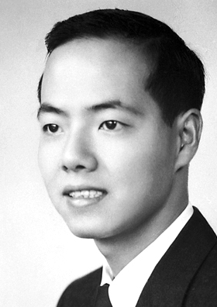
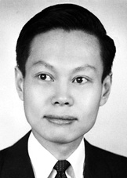
Parity Violation
9
Before 1956 physicists were convinced that the laws of nature were left-right symmetric. Strange?
A “gedanken” experiment: consider two perfectly mirror symmetric cars:
Gas pedal
Gas pedal
driver
driver
T.D. Lee
C.N. Yang
“L” and “R” are fully symmetric,
Each nut, bolt, molecule etc.
However the engine is a black box
“L”
“R”
Person “L” gets in, starts, ….. 60 km/h
Person “R” gets in, starts, ….. What happens?
Phrased in another way: can you tell whether you are looking directly at the car or via a mirror?
What happens in case the ignition mechanism uses, say, Co⁶⁰ β decay?

Slide 10
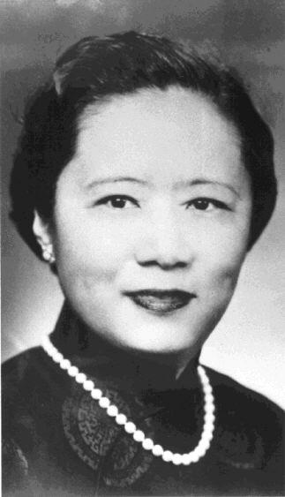
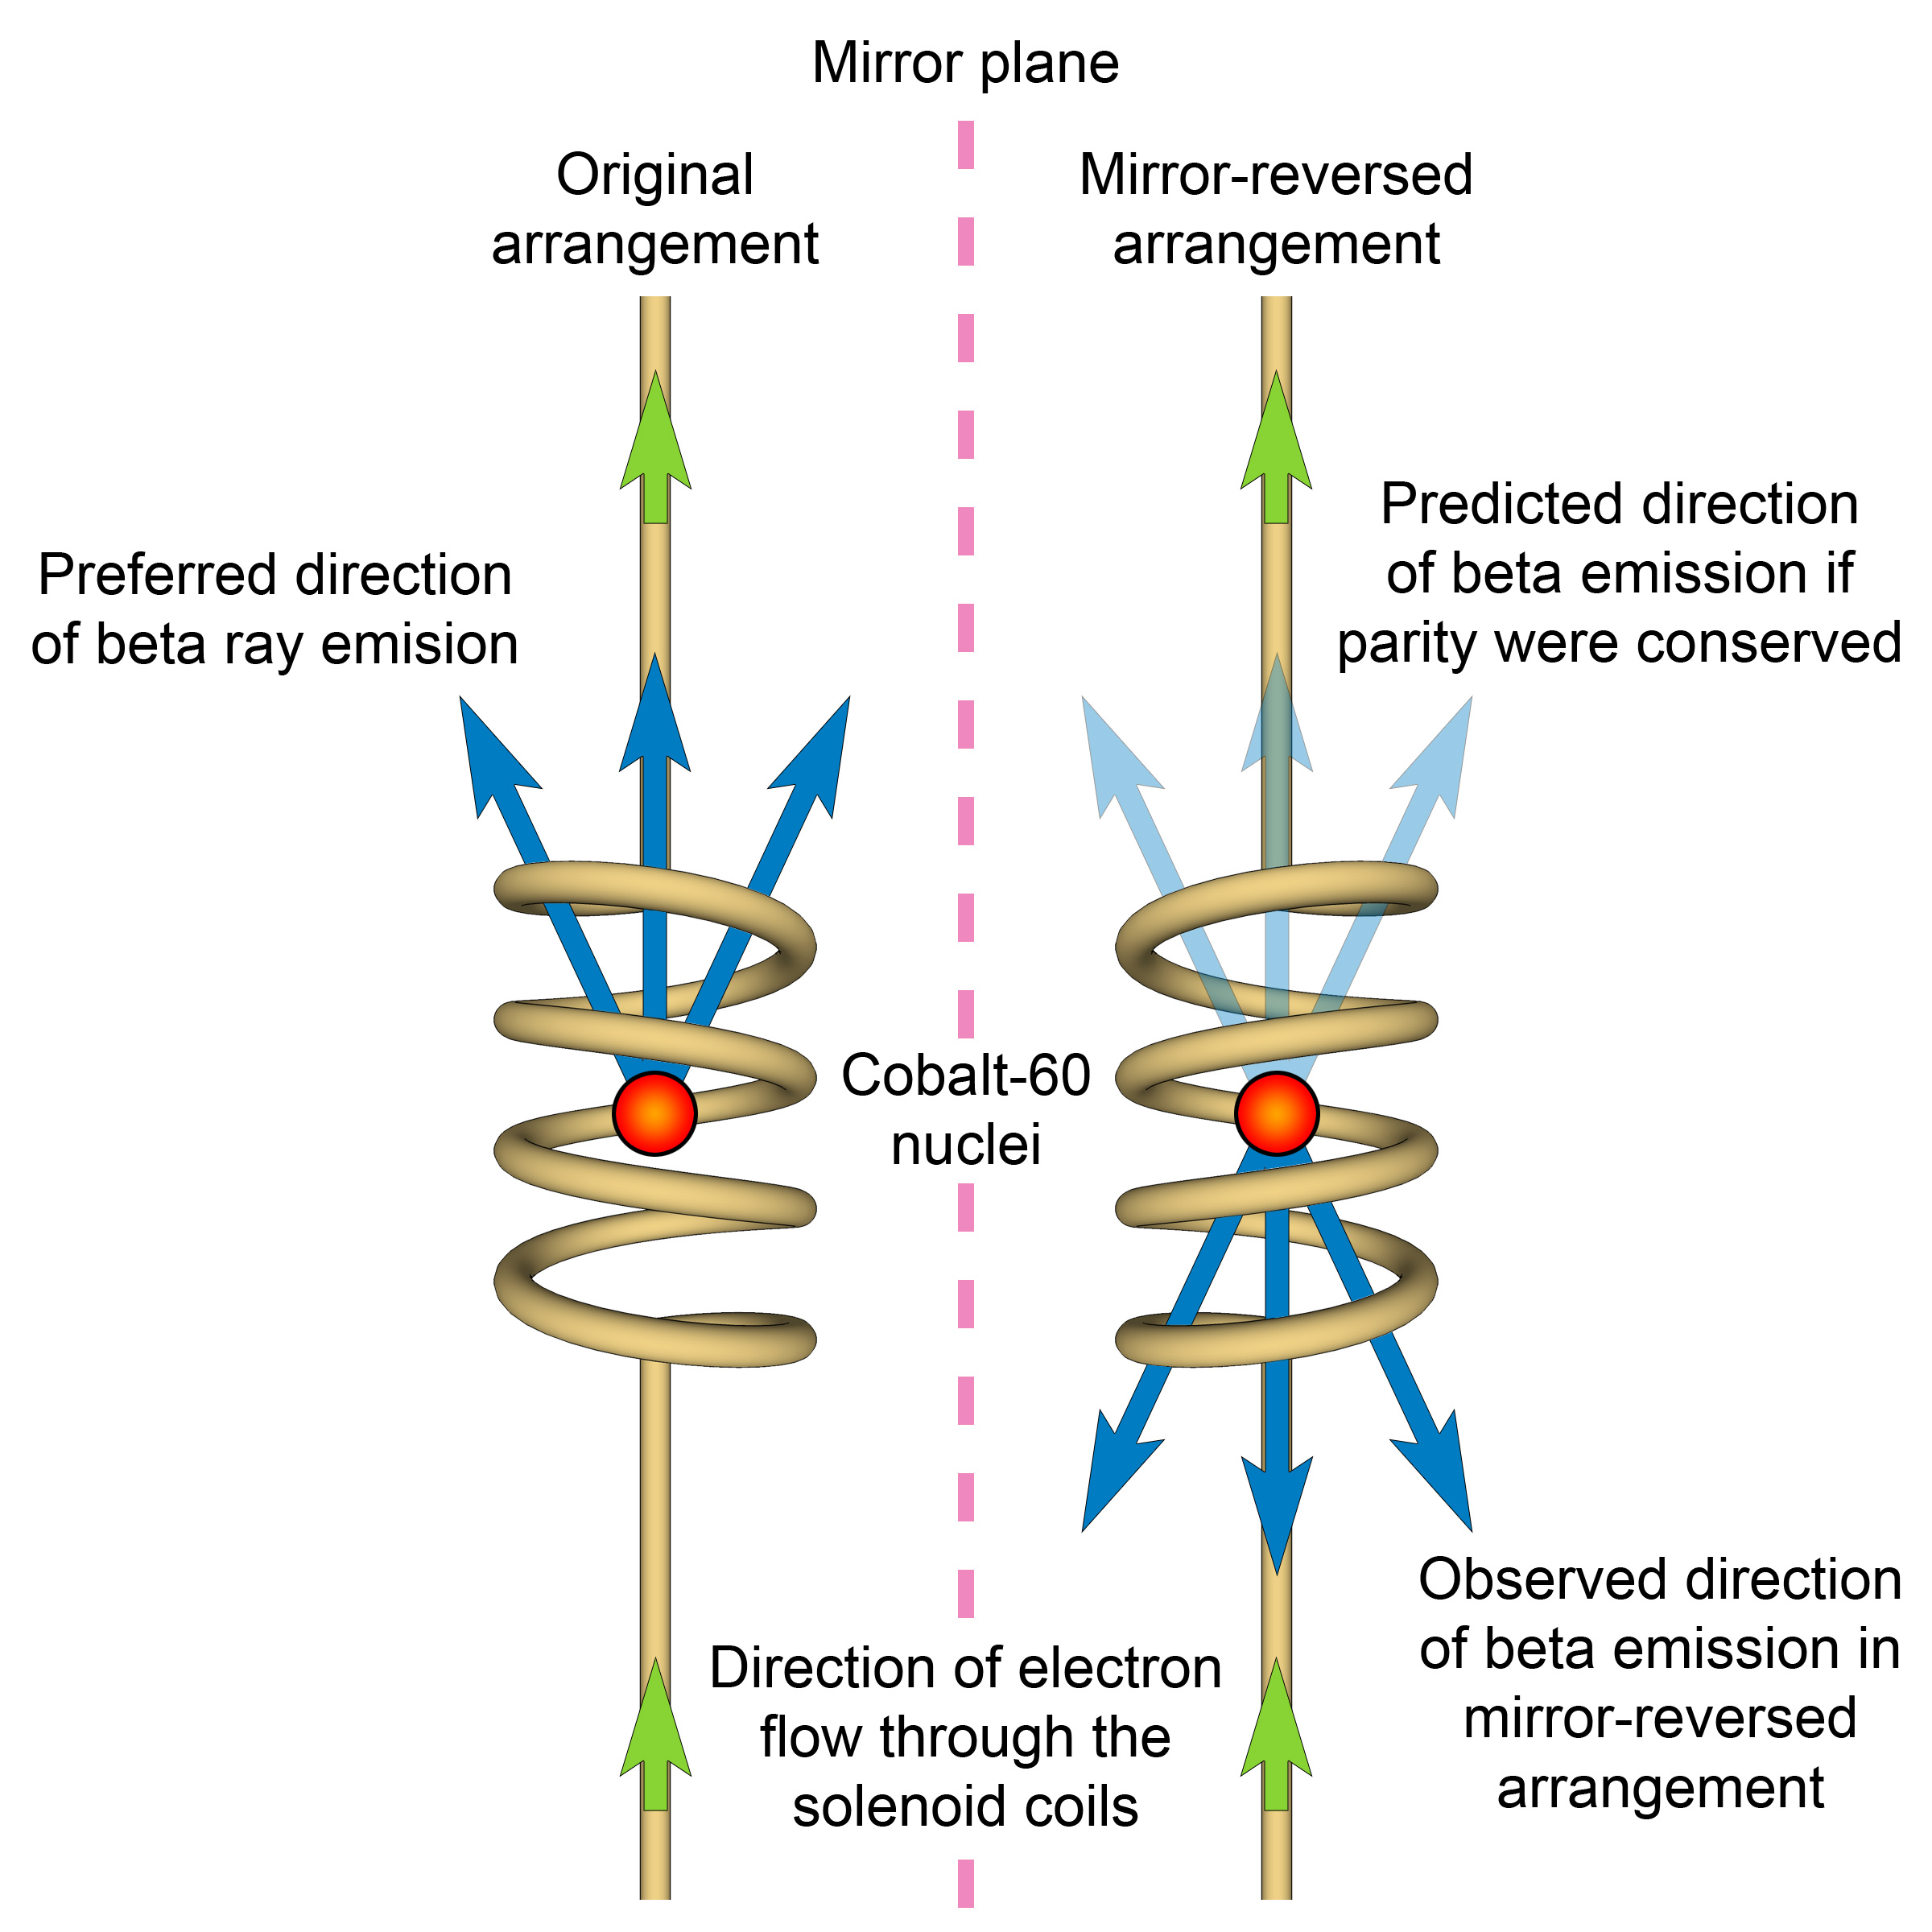
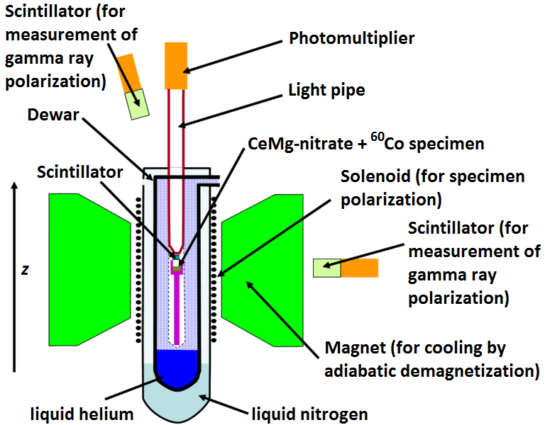
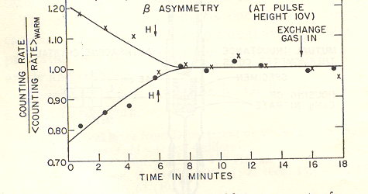



Discovery of Parity Violation
8
Spin is pseudoscalar, P: $\vec{S}→\vec{S}$
C.S. Wu
Parity
B-field
$${}_{27}^{60}{Co}→{}_{28}^{60}{Ni}+e^{−}+\overline{ν_{e}}$$
Preferred
S: 5 4 ½ ½
Symmetric?
Mag down
Is physics is parity invariant?
Only if electron decay rate is symmetric wrt spin direction!
Mag up
B
More electrons emitted opposite the $\vec{S}$ direction
Not equal → Parity violation!
Notes:
60Co -> 60Ni* + e- + v. 60Co has J=5, 60Ni has J=4, so J=1. Temperature 0.01 K, the nuclei are aligned in the magnetic field. Measure the electron intensity along the polarization. Spin of the electron must be in the direction of the B field.
The essence is that vec(J) . Vec(p) is a pseudoscalar (changes sign under Parity) variable has a non-zero expectation value!

Slide 11
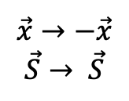
$P$ violation in pion decay
9
Wu’s experiment was shortly followed by another clever experiment by L. Lederman: Look at decay π⁺ → μ⁺ ν_{μ}
Pion has spin 0, while μ,ν_{μ} both have spin ½ → spin of decay products must be oppositely aligned
μ⁺
π⁺
ν_{μ}
P
Do these happen at the same rate?
$$\vec{x}→−\vec{x}$$
$$\vec{S}→ \vec{S}$$
ν_{μ}
π⁺
μ⁺

Slide 12
$P$ violation in pion decay
9
Wu’s experiment was shortly followed by another clever experiment by L. Lederman: Look at decay π⁺ → μ⁺ ν_{μ}
Pion has spin 0, while μ,ν_{μ} both have spin ½ → spin of decay products must be oppositely aligned
μ⁺
π⁺
ν_{μ}
OK
Does not happen!
P
$$\vec{x}→−\vec{x}$$
$$\vec{S}→ \vec{S}$$
OK
ν_{μ}
π⁺
μ⁺
Ledermans result: All neutrinos are left-handed
P symmetry is maximally violated

Slide 13
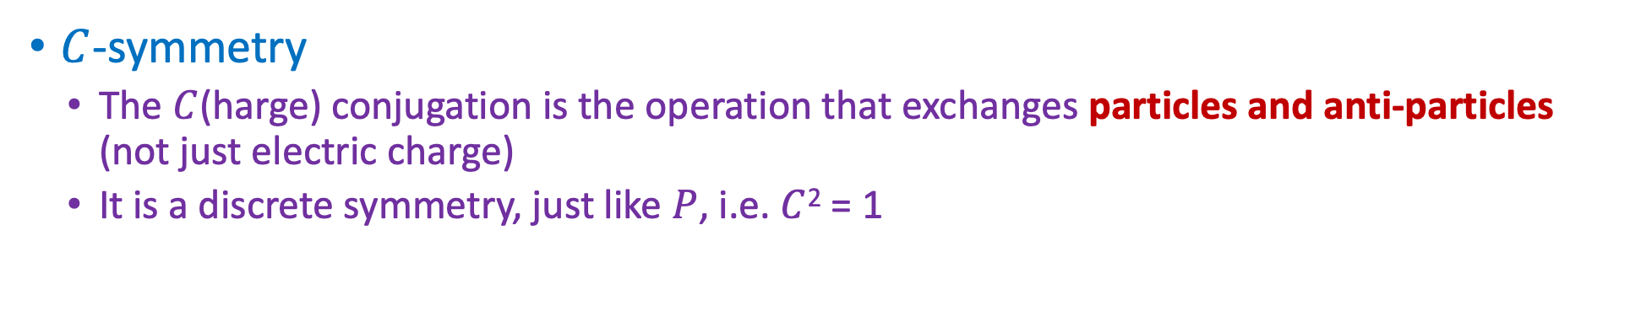
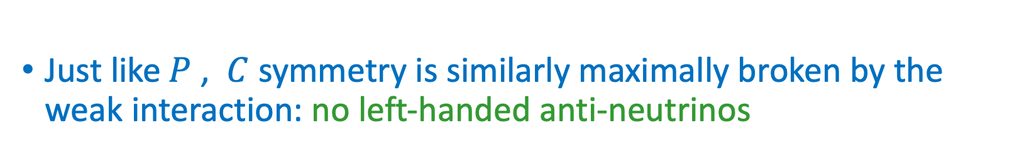
Charge conjugation symmetry?
10
$C$-symmetry
The $C$(harge) conjugation is the operation that exchanges particles and anti-particles (not just electric charge)
It is a discrete symmetry, just like $P$, i.e. $C$² = 1
μ⁺
π⁺
ν_{μ}(LH)
OK
C
μ⁻
π⁻
ν_{μ}(LH)
OK
Just like$P$ , $C$ symmetry is similarly maximally broken by the weak interaction: no left-handed anti-neutrinos
C symmetry is maximally violated

Slide 14
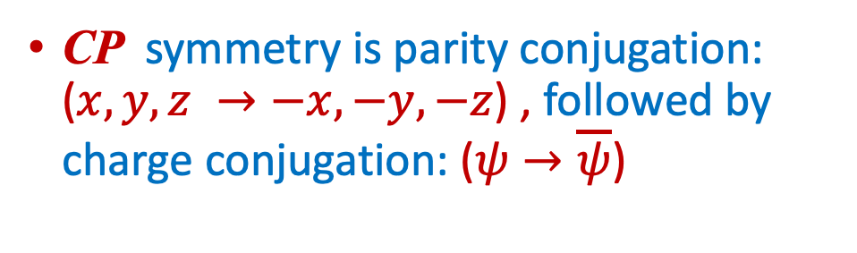
The Weak force and $C$, $P$ and $CP$ conjugation
11
ν_{μ}
μ⁺
μ⁻
Intrinsic
spin
C
e⁺_{R}
e⁻_{R}
P
C
W⁺
W⁻
π⁺
π⁺
π⁻
ν_{L}
ν_{L}
e⁺_{L}
e⁻_{L}
P
W⁺
W⁻
μ⁺
ν_{μ}
ν_{μ}
CP
ν_{R}
ν_{R}
CP symmetry is parity conjugation: ($x,y,z →−x,−y,−z$) , followed by charge conjugation: ($ψ→\overline{ψ}$)
CP symmetry appears to be preserved in the weak interaction
But in 1964 looking at kaons…

Slide 15
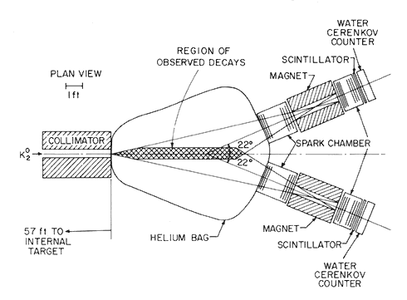
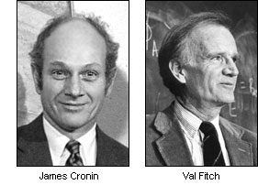
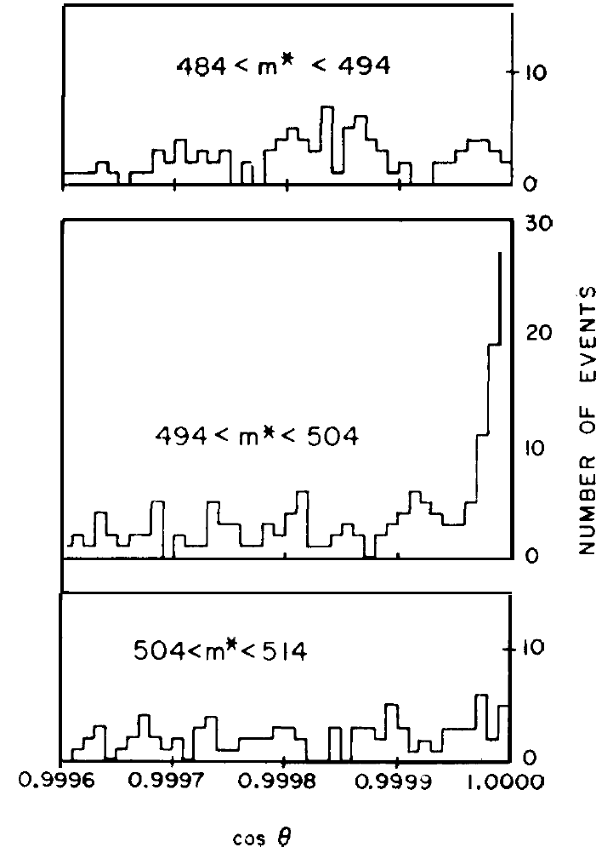


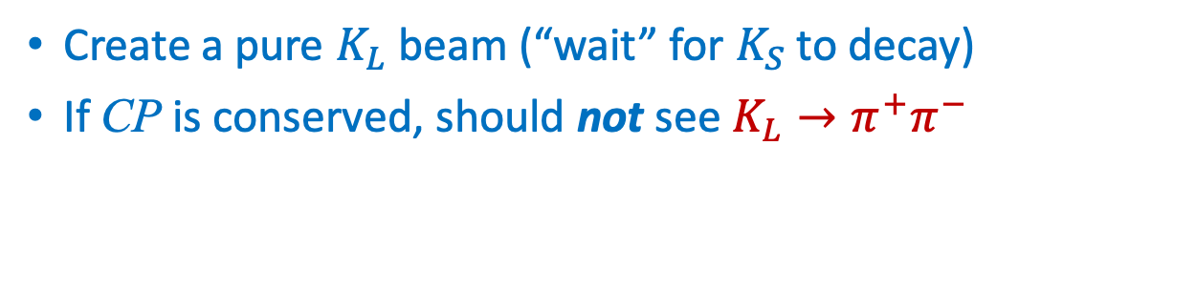
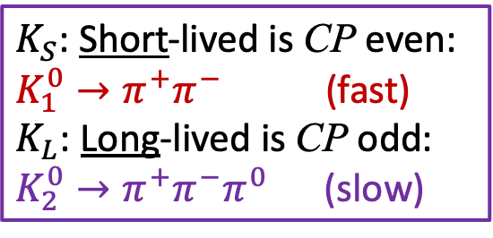




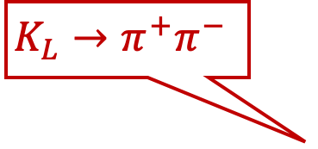


Discovery of CP-Violation with $K^{0}$ decays
15
$K_{S}$: Short-lived is CP even:
$K_{1}^{0}→π^{+}π^{−}$ (fast)
$K_{L}$: Long-lived is CP odd:
$K_{2}^{0}→π^{+}π^{−}π^{0}$ (slow)
Create a pure $K_{L}$ beam (“wait” for $K_{S}$ to decay)
If CP is conserved, should not see $K_{L}→π^{+}π^{−}$
$$π^{+}$$
$$K_{L}^{0}$$
$$π^{−}$$
$$K_{L}→π^{+}π^{−}$$
James Cronin
Val Fitch
Effect is tiny:
about 2/1000
CP: -1 1
mass, $θ$
CP violating Signal: $K_{L}→π^{+}π^{−}$
CP: -1 -1
$$M_{K_{S}}=498 MeV$$
Background: $K_{L}→π^{+}π^{−}π^{0}$
θ
$π^{0}$ remains undetected
cos θ
Notes:
Christenson, Cronin, Fitch, Turlay
Pion parity=-1. Signal will appear in Kaon mass window and zero theta angle.

Slide 16
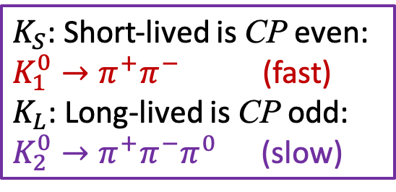


Discovery of CP-Violation with $K^{0}$ decays
15
$K_{S}$: Short-lived is CP even:
$K_{1}^{0}→π^{+}π^{−}$ (fast)
$K_{L}$: Long-lived is CP odd:
$K_{2}^{0}→π^{+}π^{−}π^{0}$ (slow)
Create a pure $K_{L}$ beam (“wait” for $K_{S}$ to decay)
If CP is conserved, should not see $K_{L}→π^{+}π^{−}$
$$K^{0}$$
$$K_{L}→π^{+}π^{−}$$
James Cronin
Val Fitch
Effect is tiny:
about 2/1000
mass, $θ$
CP violating Signal: $K_{L}→π^{+}π^{−}$
$$M_{K_{S}}=498 MeV$$
Background: $K_{L}→π^{+}π^{−}π^{0}$
θ
$π^{0}$ remains undetected
cos θ
Notes:
Christenson, Cronin, Fitch, Turlay
Pion parity=-1. Signal will appear in Kaon mass window and zero theta angle.

Slide 17
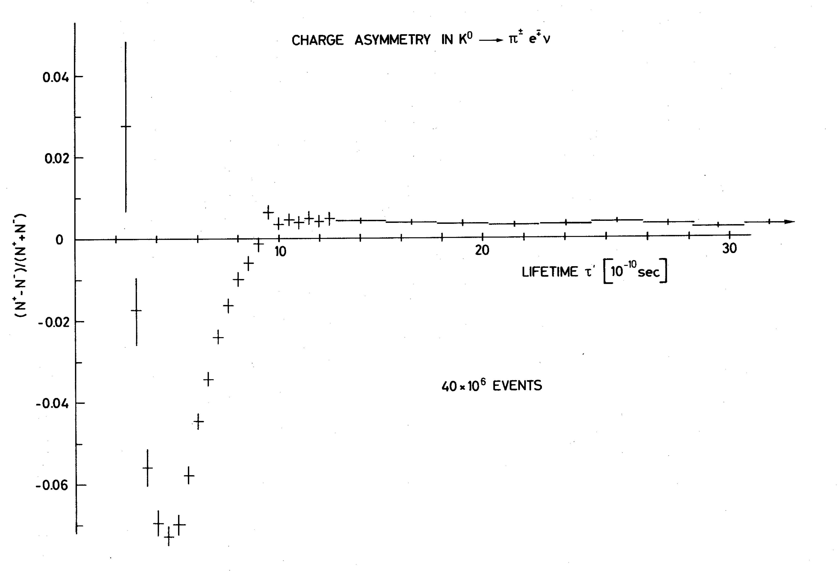
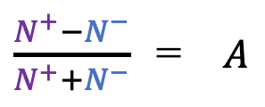


Alternative: Charge Asymmetry in $K^{0}$ decays
13
Measure $A= \frac{N^{+}−N^{−}}{N^{+}+N^{−}}$ with $\begin{matrix}N^{+}=K^{0}→π^{−}e^{+}ν \\ N^{−}= \overline{K^{0}}→π^{+}e^{−}\overline{ν}\end{matrix}$ vs the $K^{0}$ decay time
$\frac{N^{+}−N^{−}}{N^{+}+N^{−}}$ = $A$
Thesis Vera Luth, CERN 1974
$$K_{S}$$
$$K_{L}$$
time
CP violation in meson mixing.
$K_{L}^{0}$ decays with long lifetime decay slightly more to $e^{+}$ than to $e^{−}$
Notes:
Create K0, particles, after time K_s has decayed and K_L remains. CPV in mixing. Thesis work at Heidelberg/CERN!
Parity quark and antiquark are opposite.

Slide 18
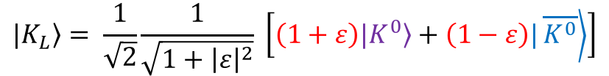
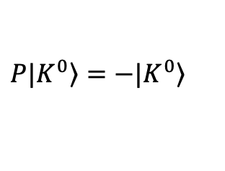
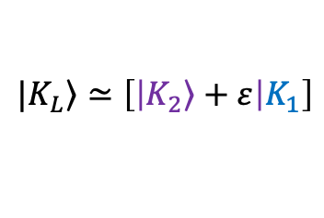
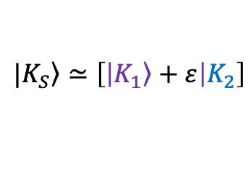

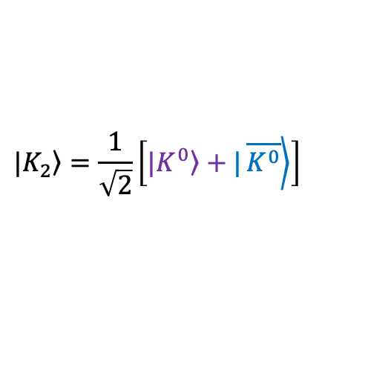

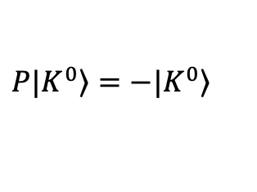

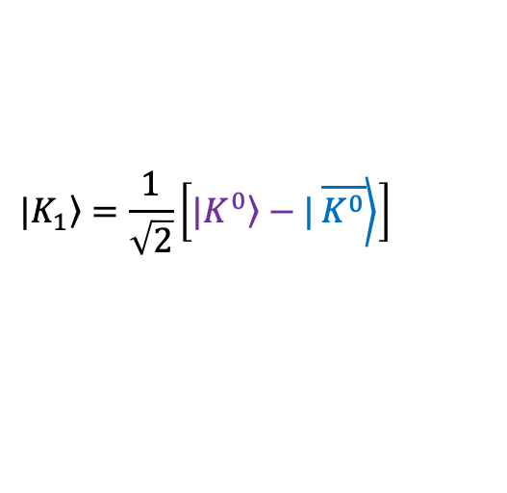
Alternative: Charge Asymmetry in $K^{0}$ decays
13
Measure $A= \frac{N^{+}−N^{−}}{N^{+}+N^{−}}$ with $\begin{matrix}N^{+}=K^{0}→π^{−}e^{+}ν \\ N^{−}= \overline{K^{0}}→π^{+}e^{−}\overline{ν}\end{matrix}$ vs the $K^{0}$ decay time
$\frac{N^{+}−N^{−}}{N^{+}+N^{−}}$ = $A$
Thesis Vera Luth, CERN 1974
Kaon has $J^{P}=0^{−}$:
$$\left.P|K^{0}\right\rangle =−\left.|K^{0}\right\rangle$$
$$K_{S}$$
$$K_{L}$$
$$\left.P|K^{0}\right\rangle =−\left.|K^{0}\right\rangle$$
Two CP states:
$$\left.|K_{1}\right\rangle =\frac{1}{\sqrt{2}}\left[|\left.K^{0}\right\rangle −|\left.\overline{K^{0}}\right\rangle \right]$$
time
$$\left.|K_{2}\right\rangle =\frac{1}{\sqrt{2}}\left[|\left.K^{0}\right\rangle +|\left.\overline{K^{0}}\right\rangle \right]$$
CP violation in meson mixing.
Two particles:
$$\left.|K_{L}\right\rangle = \frac{1}{\sqrt{2}}\frac{1}{\sqrt{1+{\left|ε\right|}^{2}}} \left[\left(1+ε\right)|\left.K^{0}\right\rangle +\left(1−ε\right)|\left.\overline{K^{0}}\right\rangle \right]$$
$$\left.|K_{S}\right\rangle ≃\left[\left|\left.K_{1}\right\rangle +ε\right|K_{2}\right]$$
$→π^{−}e^{+}ν$
$$→π^{+}e^{−}\overline{ν}$$
$$\left.|K_{L}\right\rangle ≃\left[\left|\left.K_{2}\right\rangle +ε\right|K_{1}\right]$$
$K_{L}^{0}$ decays with long lifetime decay slightly more to $e^{+}$ than to $e^{−}$
Notes:
Create K0, particles, after time K_s has decayed and K_L remains. CPV in mixing. Thesis work at Heidelberg/CERN!
Parity quark and antiquark are opposite.

Slide 19
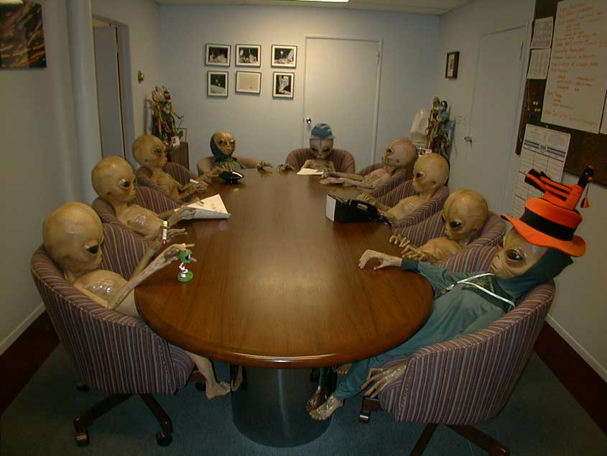

Contact with Aliens !
14
Are they made of matter or anti-matter?

Slide 20

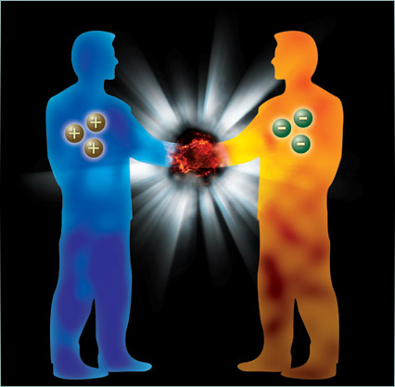

Contact with Aliens !
14
Are they made of matter or anti-matter?
Compare $K_{L}^{0}→π^{+}e^{−}\overline{ν}$ to $K_{L}^{0}→π^{−}e^{+}ν$
Compare the charge of the most abundantly produced electron with that of the electrons in your body:
If opposite: matter If equal: anti-matter

Slide 21
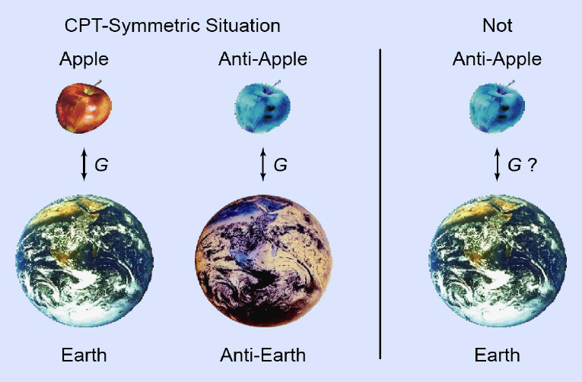
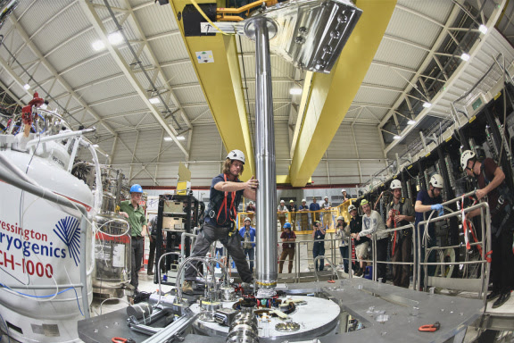
Alpha experiment: does antimatter fall down?
15
See: CERN news
News on 27 Sept 2023:
Several thousands of antimatter hydrogen atoms were dropped in the gravitational field
Antimatter falls “down” to earth in the same way as matter does

Slide 22
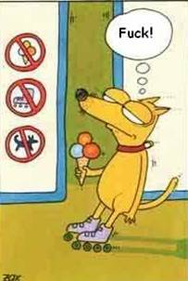
CPT Violation…
16
CPT symmetry implies that an antiparticle is identical to a particle travelling backwards in time.

Slide 23
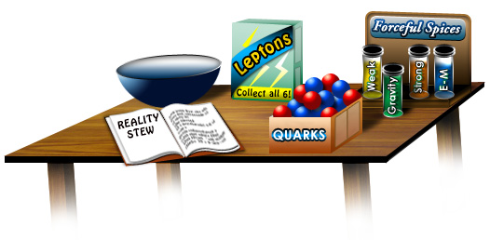
Introduction to CP Violation
17
Contents:
Discrete Symmetries C, P and CP
CP violation in the Weak Force
How can we measure it?
The matter – antimatter asymmetry

Slide 24
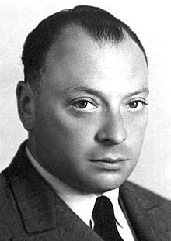



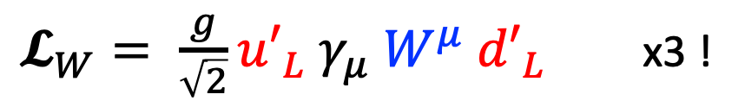









Weak interaction in three Flavour Generations
18
Weak Interaction is 100% parity violating.
Wolfgang Pauli: “I cannot believe God is a weak left-hander.”
Implement an SU(2)_{L} symmetry for massless particles:
$𝓛_{W}= \frac{g}{\sqrt{2}}{u′}_{L} γ_{μ} W^{μ} {d′}_{L}$ x3 !
Note:
$$ψ_{L}=\frac{1}{2}\left(1−γ^{5}\right)ψ$$
Wolfgang Pauli
Flavour universality: identical interactions in three generations.
In fact: how to distinguish a massless $d^{′}$quark from $s^{′}$quark?
$$d′$$
$$s′$$
$$b′$$
$$u′$$
$$W^{+}$$
$$c′$$
$$W^{+}$$
$$W^{+}$$
$$t′$$
There is no CP violation in these massless interactions
What happens when particles acquire mass after symmetry breaking?
Notes:
Note the quotes: massless particles

Slide 25









































Charged current after symmetry breaking
19
After symmetry breaking the massless flavour states mix into mass states:
$u_{i}={\left(V^{u}\right)}_{ij} u_{j}^{′}$
and
$d_{i}={\left(V^{d}\right)}_{ij} d_{j}^{′}$
$$i,j=1,2,3$$
$$V_{CKM}=V^{u†} V^{d}$$
$𝓛_{W}= \frac{g}{\sqrt{2}}{u′}_{L} γ_{μ} W^{μ} {d′}_{L}$
$𝓛_{W}= \frac{g}{\sqrt{2}} V_{CKM} u_{L} γ_{μ} W^{μ} d_{L}$
$$s$$
$$b$$
$$V_{ub}$$
$$d$$
$$V_{ud}$$
$$V_{us}$$
$$W^{+}$$
$$u$$
$$W^{+}$$
$$u$$
$$W^{+}$$
$$u$$
$$d$$
$$s$$
$$V_{cs}$$
$$b$$
$$V_{cb}$$
$$V_{cd}$$
$$c$$
$$W^{+}$$
$$c$$
$$W^{+}$$
$$c$$
$$W^{+}$$
$$d$$
$$s$$
$$V_{ts}$$
$$b$$
$$V_{tb}$$
$$V_{td}$$
$$t$$
$$W^{+}$$
$$t$$
$$W^{+}$$
$$t$$
$$W^{+}$$

Slide 26
Flavour Changing Quark Interactions
20
Flavour changing currents
3
2
1

Slide 27
Flavour Changing Quark Interactions
20
Flavour changing currents
3
2
1

Slide 28
Flavour Changing Quark Interactions
20
Flavour changing currents
3
2
1

Slide 29
Flavour Changing Quark Interactions
20
Flavour changing currents
3
2
1

Slide 30
Flavour Changing Quark Interactions – CP Violation
20
Flavour changing currents
3
2
Complex coupling constants are the source of CP viol.
1
Particle and antiparticle interactions have complex conjugated coupling constants
The complex coupling is a requirement to observe CP violation
Notes:
Why complex? See Dirac slide. Also T is Initial->Final – complex conjugation.

Slide 31

Introduction to CP Violation
21
Measurement of CP Violation
Contents:
Discrete Symmetries C, P and CP
CP violation in the weak force
How can we measure it?
The matter – antimatter asymmetry

Slide 32





How to observe CP violation?
22
Consider a “matter process”:
$$B_{s}^{0}→π^{+}K^{−}$$
And the “antimatter process”:
$${\overline{B}}_{s}^{0}→π^{−}K^{+}$$
”Matter”:
”Antimatter”:
?
=
${Prob=\left|\overline{A}\right|}^{2}={\left|Ae^{−iφ}\right|}^{2}=A^{2}e^{−iφ}e^{iφ}$
${Prob=\left|A\right|}^{2}={\left|Ae^{iφ}\right|}^{2}=A^{2}e^{iφ}e^{−iφ}$
Even with complex clouplings the decay rates are expected the same?!

Slide 33




How to observe CP violation? A quantum interference experiment
23
”Matter”:
${\left|A\right|}^{2}={\left|A_{1}\right|}^{2}+{\left|A_{2}\right|}^{2}+$
$A_{1}A_{2}\left(e^{iφ}e^{iδ}+e^{−iφ}e^{−iδ}\right)$
$$A = A_{1 } + A_{2}e^{iφ}e^{iδ}$$
”Antimatter”:
$$\overline{A} ={ A}_{1} + A_{2}e^{−iφ}e^{iδ}$$
$${\left|\overline{A}\right|}^{2}={\left|A_{1}\right|}^{2}+{\left|A_{2}\right|}^{2}+$$
$$A_{1}A_{2}\left(e^{−iφ}e^{iδ}+e^{iφ}e^{−iδ}\right)$$
CP Asymmetry: ${\left|A\right|}^{2}−{\left|\overline{A}\right|}^{2}=4 A_{1}A_{2}\sin{φ}\sin{δ }≠0$
CP violation!

Slide 34










How to measure CP violation? A quantum interference experiment
23
”Matter”:
${\left|A\right|}^{2}={\left|A_{1}\right|}^{2}+{\left|A_{2}\right|}^{2}+$
$A_{1}A_{2}\left(e^{iφ}e^{iδ}+e^{−iφ}e^{−iδ}\right)$
$$A = A_{1 } + A_{2}e^{iφ}e^{iδ}$$
$$A_{1}$$
$$π^{+}$$
$$B_{s}^{0}$$
$$A_{2}$$
$$K^{−}$$
$$\overline{A_{1}}$$
$$π^{−}$$
$${\overline{B}}_{s}^{0}$$
$$K^{+}$$
$$\overline{A_{2}}$$
”Antimatter”:
$$\overline{A} ={ A}_{1} + A_{2}e^{−iφ}e^{iδ}$$
$${\left|\overline{A}\right|}^{2}={\left|A_{1}\right|}^{2}+{\left|A_{2}\right|}^{2}+$$
$$A_{1}A_{2}\left(e^{−iφ}e^{iδ}+e^{iφ}e^{−iδ}\right)$$
CP Asymmetry: ${\left|A\right|}^{2}−{\left|\overline{A}\right|}^{2}=4 A_{1}A_{2}\sin{φ}\sin{δ }≠0$
CP violation!

Slide 35

CP violation and Interference
24
Feynman: “In the end all quantum phenomena are manifestations of the double slit experiment.”
Thought: Assuming CPT symmetry, CP violation implies a quantum arrow of time
Quantum interference ←→ arrow of time?

Slide 36

Introduction to CP Violation
25
Contents:
Discrete Symmetries C, P and CP
CP violation in the weak force
How can we measure it?
The matter – antimatter asymmetry

Slide 37




The Baryogenesis Puzzle – Electroweak Baryogenesis?
26
1. Baryon asymmetry
2. Matter - antimatter asymmetry
3. Non - reversal
Sacharov Conditions
All present in S.M.
✓ Baryon Number Violation
✓ C and CP Violation
✓ Thermal non-equilibrium
Adler-Bell-
Jackiw
1st order
‘t Hooft, PRL
37 (1976) 8
V
Axial Anomaly:
$\left(B−L\right)=0$
$ΔB=3$
$ΔL=3$
f
f
tunnel
f
Quantum anomaly
Weak Interaction
φ
Higgs Phase Transition
Baryogenesis from Higgs symmetry breaking?
symmetric phase
broken phase
expanding bubble (Higgs condensates)
Notes:
Adler_Bell_Jacqiw quantum anomaly. Non conserved axial current that leads to baryon/lepton number violation B-L constant.

Slide 38
The Baryogenesis Puzzle – Electroweak Baryogenesis?
27
Expanding bubbles of broken phase
In a medium of symmetric phase
Baryon production in
front of bubble wall
Was the phase transition in the early universe of 1st order?
Higgs potential?
If new physics is abundant in thermal plasma of early universe:
➔ Likely to be of TeV energy scale.
Notes:
Excess of left handed particle in front of the bubble wall. Baryon # violating sphalerons are in thermal equilibrium and restore chiral symmetry converting it into a baryon asymmetry. These baryons are absorbed by the bubble. For sphalerons to be out of equilibrium, need v > 1.1 T

Slide 39
The Baryogenesis Puzzle – Electroweak Baryogenesis?
26
1. Baryon asymmetry
2. Matter - antimatter asymmetry
3. Non - reversal
Sacharov Conditions
All present in S.M.
✓ Baryon Number Violation
✓ C and CP Violation
✓ Thermal non-equilibrium
Adler-Bell-
Jackiw
1st order
‘t Hooft, PRL
37 (1976) 8
V
Axial Anomaly:
$\left(B−L\right)=0$
$ΔB=3$
$ΔL=3$
f
f
tunnel
f
Quantum anomaly
Weak Interaction
φ
Higgs Phase Transition
Notes:
Adler_Bell_Jacqiw quantum anomaly. Non conserved axial current that leads to baryon/lepton number violation B-L constant.

Slide 40



The Baryogenesis Puzzle – Electroweak Baryogenesis?
28
1. Baryon asymmetry
2. Matter - antimatter asymmetry
3. Non - reversal
Sacharov Conditions
All present in S.M.
Not Enough?
✓ Baryon Number Violation
✘ C and CP Violation
✘ Thermal non-equilibrium
1st order
Adler-Bell-
Jackiw
‘t Hooft, PRL
37 (1976) 8
2nd order
SM
V
V
Axial Anomaly:
$\left(B−L\right)=0$
$ΔB=3$
$ΔL=3$
f
f
tunnel
f
Quantum anomaly
Weak Interaction
φ
Higgs Phase Transition
✓ Sphalerons
✘ 1st order?
• SM: M_{H} < ~70 GeV
• THDM: M_{H} ~ 125 OK
✘ CPV from CKM
− BAU: $\frac{Δn_{B}}{n_{γ}}≈{10}^{−10}$
− $A_{CP}=J_{inv} × \left(m_{t}^{2}−m_{c}^{2}\right)\left(m_{c}^{2}−m_{u}^{2}\right)\left(m_{u}^{2}−m_{t}^{2}\right)$
$×\left(m_{b}^{2}−m_{s}^{2}\right)\left(m_{s}^{2}−m_{d}^{2}\right)\left(m_{d}^{2}−m_{b}^{2}\right)$
From CKM: ${A_{CP}}/{T_{c}^{12}}≈{10}^{−20 }$ → Too small
Used $T_{c}∼100$ GeV

Slide 41
The Baryogenesis Puzzle – Electroweak Baryogenesis?
28
1. Baryon asymmetry
2. Matter - antimatter asymmetry
3. Non - reversal
Sacharov Conditions
All present in S.M.
Not Enough?
✓ Baryon Number Violation
✘ C and CP Violation
✘ Thermal non-equilibrium
1st order
Adler-Bell-
Jackiw
‘t Hooft, PRL
37 (1976) 8
2nd order
SM
V
V
Axial Anomaly:
f
f
tunnel
Electroweak Baryogenesis:
Search for manifestations of CP violation from physics beyond the Standard Model at the TeV scale
f
Quantum anomaly
Weak Interaction
φ
Higgs Phase Transition
✓ Sphalerons
✘ 1st order?
• SM: M_{H} < ~70 GeV
• THDM: M_{H} ~ 125 OK
✘ CPV from CKM
− BAU: $\frac{Δn_{B}}{n_{γ}}≈{10}^{−10}$
− $A_{CP}=J_{inv} × \left(m_{t}^{2}−m_{c}^{2}\right)\left(m_{c}^{2}−m_{u}^{2}\right)\left(m_{u}^{2}−m_{t}^{2}\right)$
$×\left(m_{b}^{2}−m_{s}^{2}\right)\left(m_{s}^{2}−m_{d}^{2}\right)\left(m_{d}^{2}−m_{b}^{2}\right)$
From CKM: ${A_{CP}}/{T_{c}^{12}}≈{10}^{−20 }$ → Too small
Used $T_{c}∼100$ GeV

Slide 42

Alternative Explanation…
29

Slide 43

Introduction to CP Violation
30

Slide 44
Extra

Slide 45

3 Generations of particles – How do we know?
31
LEP: The heavy Z boson decays into 3 light neutrino types.
LEP @ CERN:
1989-2000
No additional weakly interacting light fermion generations.

Slide 46


3 Generations of particles – How do we know?
32
LEP: The heavy Z boson decays into 3 light neutrino types.
LEP
4 neutrinos
3 neutrinos
Number of events
2 neutrinos
measurements
=3
Collision Energy (GeV)
No additional weakly interacting light fermion generations.

Slide 47
3 Generations of particles – How do we know?
33
LHC: Higgs production:
Loop diagram is proportional to the mass of the heaviest fermion.
$$H→γγ$$
$$H→4μ$$
3
i = 1, 2, 3
Top is the heaviest fermion flavour.
3 Flavour generations

Slide 48






How about leptons?
34
Equivalent of CKM-Matrix $V_{CKM}$ for leptons is PMNS-Matrix
Pontecorvo-Maki-Nakagawa-Sakata matrix: $U_{PMNS}$
Neutrinos: $U_{PMNS}$ • Quarks: $V_{CKM}$
$$\left(\begin{matrix}ν_{e} \\ ν_{μ} \\ ν_{τ}\end{matrix}\right)=\left(\begin{matrix}U_{e1} & U_{e2} & U_{e3} \\ U_{μ1} & U_{μ2} & U_{μ3} \\ U_{τ1} & U_{τ2 } & U_{τ3}\end{matrix}\right)\left(\begin{matrix}ν_{1} \\ ν_{2} \\ ν_{3 }\end{matrix}\right)$$
$$\left(\begin{matrix}d′ \\ s′ \\ b^{′}\end{matrix}\right)=\left(\begin{matrix}V_{ud} & V_{us} & V_{ub} \\ V_{cd} & V_{cs} & V_{cb} \\ V_{td} & V_{ts } & V_{tb}\end{matrix}\right)\left(\begin{matrix}d \\ s \\ b\end{matrix}\right)$$
?
ν₁
ν₂
ν₃
d
s
b
Completely different hiearchy

