Slide 1
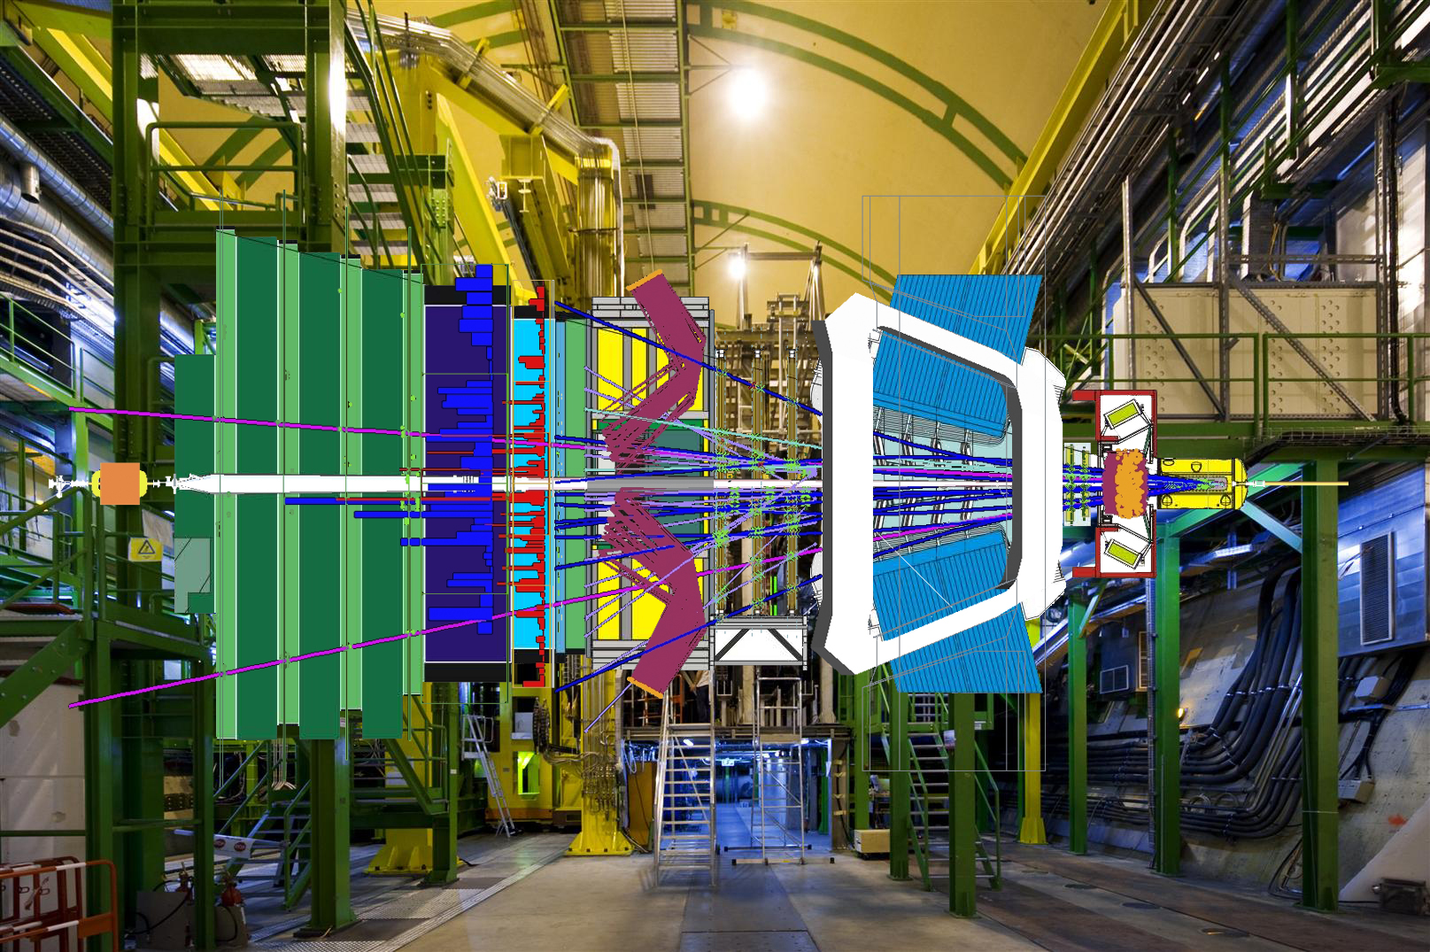
B-physics: LHCb
SAC report 2017 – M.Merk
1) Group 2) Velo 3) Main Tracker 4) HLT 5) Physics
Notes:
Long term involvements Velo, Main tracker, HLT. Project leadership OT, HLT and Velo in the past. Significant investments upgrade. Physics active: physics coordinator. Probably run coordinator coming two years. Central role in collab. Profit from collab with Nikhef flavour theory.

Slide 2
B-physics: LHCb
SAC report 2017 – M.Merk
Motivation and Vision:
• Nikhef joined LHCb to make large impact in LHC experiment.
– Focus on tracking: detector, reconstruction, analyses.
• LHCb is sensitive to physics (far) above LHC energy.
– Detector works very well.
• Group members work on both detector and analysis.
• Students have good possibilities to publish their own analysis.
1) Group 2) Velo 3) Main Tracker 4) HLT 5) Physics
Notes:
Long term involvements Velo, Main tracker, HLT. Project leadership OT, HLT and Velo in the past. Significant investments upgrade. Physics active: physics coordinator. Probably run coordinator coming two years. Central role in collab. Profit from collab with Nikhef flavour theory.

Slide 3
B-physics: LHCb
SAC report 2017 – M.Merk
Conclusions:
• Wide physics program with tantalising flavor results.
• Detector ready for 2017 run.
• Upgrade projects critical phase; senior manpower re-inforcement.
• Ask Nikhef management for help to revive Groningen position.
• Funding successes for Postdoc & PhD manpower.
1) Group 2) Velo 3) Main Tracker 4) HLT 5) Physics
Notes:
Long term involvements Velo, Main tracker, HLT. Project leadership OT, HLT and Velo in the past. Significant investments upgrade. Physics active: physics coordinator. Probably run coordinator coming two years. Central role in collab. Profit from collab with Nikhef flavour theory.

Slide 4
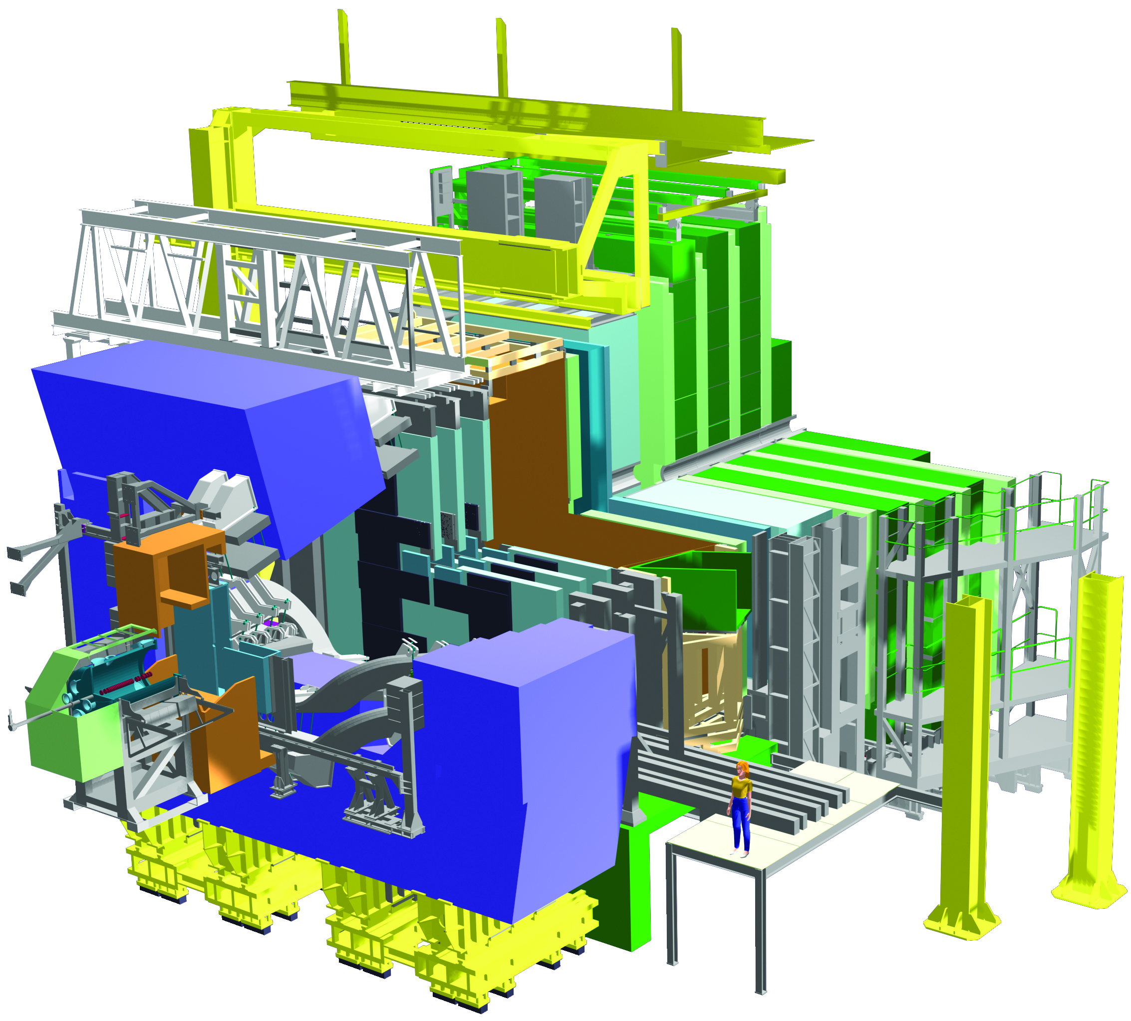
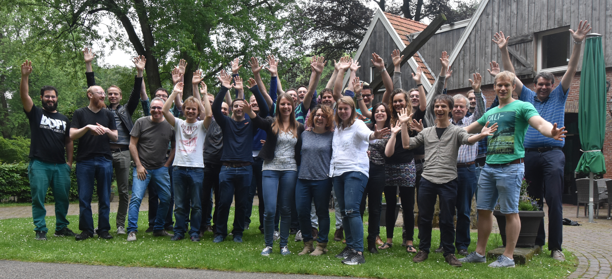
1) LHCb group @ Nikhef: Phase-1 & Phase-2
Analyses:
• Tracking
• CP violation
• Rare Decays
Detectors:
• Velo, OT, HLT
LHCb Programme-1:
1999-2014
Group composition:
10 staff, 3 postdoc, 9 PhD.
University partner: VU
Investment in LHCb:
4.950 M€ (9% LHCb)
Additional Funding:
2 Vidi’s, 1 FOM/v, 2 Project
LHCb Programme-2:
2015-2021
Group composition:
”8–” staff, 2+ postdoc, 7+ PhD.
University partner: VU, RuG
Investment in LHCb:
3.2 M€ (7% LHCb)
Additional Funding:
2 Vici, 1 Vidi, 1 Infieri, 1 Project
Notes:
Structural funding (Staff + FOM programme reducing at 25% level), even though new group (RuG Van Swinderen Institute) joined.
Also overall investement in LHCb upgrade reduced proportionally).
Many funding attempts but very little success in additional (personal funding schemes) – main worry!

Slide 5
LHCb Schedule and long term plan
Long Term Plan: make large steps in Lumi:
Run I + II : L = 4 x 10³² cm⁻² s⁻¹ : collect 3+5 fb⁻¹
On schedule
Run III + IV : L = 2 x 10³³ cm⁻² s⁻¹ : collect 50 fb⁻¹
Phase-1 Upgrade fully funded
Run V : L = 2 x 10³⁴ cm⁻² s⁻¹ : collect 300 fb⁻¹
Phase-2 upgrade “EoI” prepared for next LHCC
2019 | 2020 |  | 2021 | 2022 | 2023 | 2024 | 2025 | 2026 |  | 2027 | 2028 | 2029 | 2030 | 2031 | 2032 | 203+
 |  |  | Run III |  |  |  |  |  | Run IV |  |  |  |  |  | Run V
LS2 |  |  |  |  |  |  | LS3 |  |  |  |  |  | LS4
LHCb 40 MHz UPGRADE |  |  | L = 2 x 10³³ |  |  | LHCb Consolidation |  |  |  | L = 2 x 10³³ 50 fb⁻¹ |  |  | LHCb Ph II UPGRADE |  | L = 2 x 10³⁴ 300 fb⁻¹
ATLAS Phase I Upgr |  |  | L = 2 x 10³⁴ |  |  | ATLAS Phase II UPGRADE |  |  |  | HL-LHC L = 5 x 10³⁴ |  |  | ATLAS |  | HL-LHC L = 5 x 10³⁴
CMS Phase I Upgr |  |  | 300 fb⁻¹ |  |  | CMS Phase II UPGRADE |  |  |  |  |  |  | CMS |  | 3000 fb⁻¹
Belle II |  |  | 5 ab⁻¹ | L = 8 x 10³⁵ |  | 50 ab⁻¹
LHC schedule: Frederick Bordry, Jun 2015

Slide 6
LHCb Upgrade Investment: Velo, SciFi and HLT
Cost: 57 MCHF; MoU Nikhef: 1920 kCHF (Scifi) + 1320 kCHF(Velo) + 676 kCHF (CF)
Notes:
4 MEuro investment fund 80% committed.

Slide 7
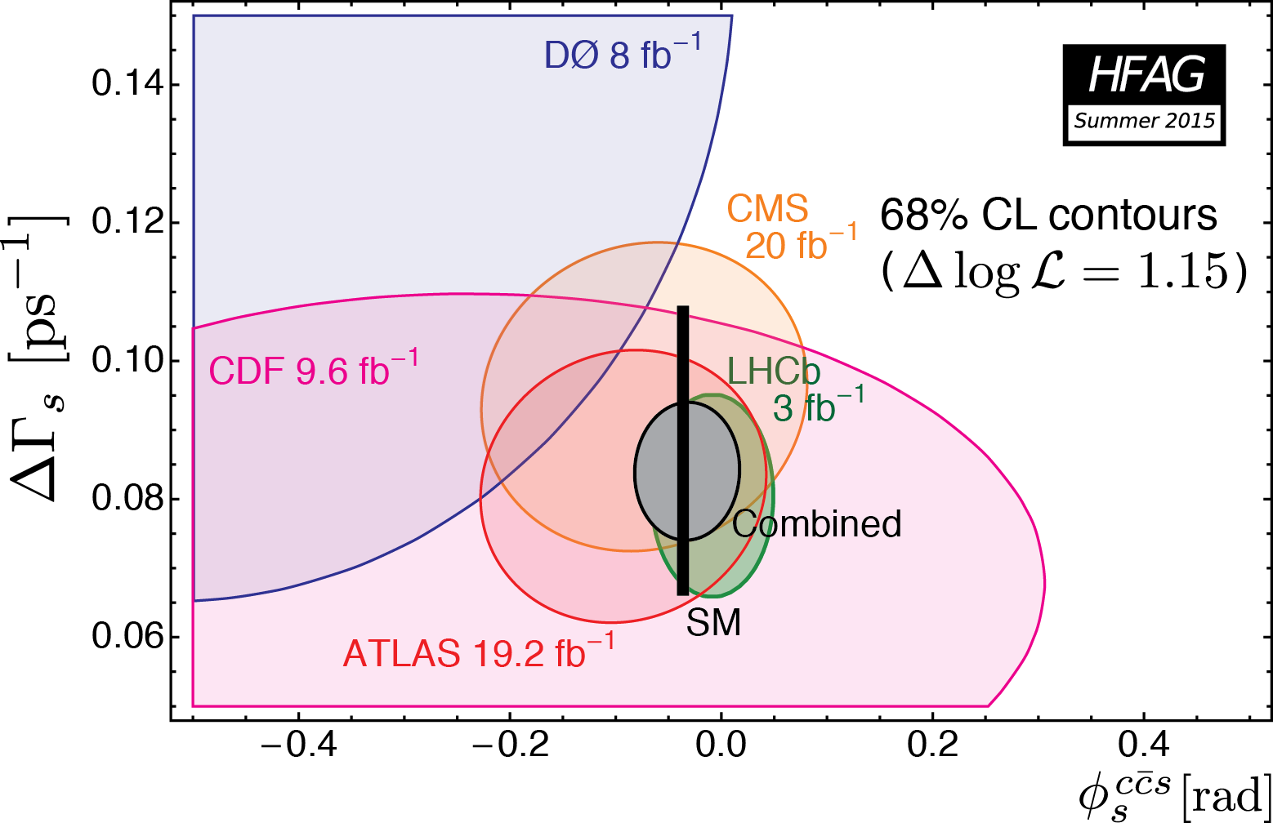
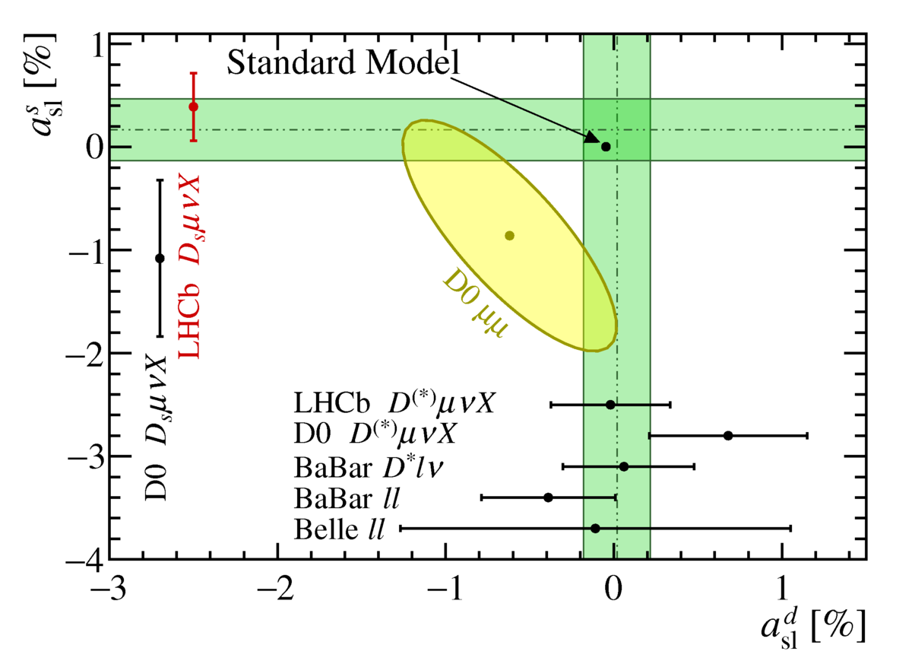
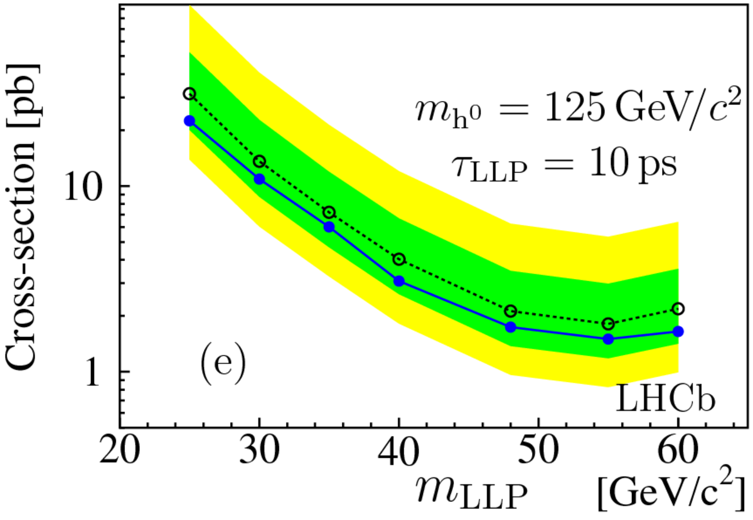
Nikhef Group Activities
Rare Decays: B_{s,d}→μμ, LFV:
A. Pellegrino, G. Onderwater, F. Archilli,
M. Mulder, M. v. Veghel
CP violation(angle φ_{s}): B_{s}→J/ψφ, J/ψK_{s}, φφ:
G. Raven, P. Koppenburg, S. Benson,
V. Syropoulos, K. Govorkova
CP violation (angle γ): B→D_{s}K:
N. Tuning, M. Merk, L. Bel
Semi-leptonic decays: a_{sl}^{d}, a_{sl}^{s}, R_{D*} :
J. v. Tilburg, H. Wilschut, G. Ciezarek, J. de Vries, L. Dufour
Long-lived particles:
W. Hulsbergen, E. Dall’Occo
Vertex Detector:
W. Hulsbergen, M. v. Beuzekom, E. Jans, P.Koppenburg, F. Archilli, E. Dall’Occo
Main Tracker:
A. Pellegrino, N.Tuning, J. v. Tilburg, G.Ciezarek, J. de Vries, L. Dufour, L Bel, M. Mulder
High Level Trigger:
G.Raven, S. Benson, V. Syropoulos, M.v.Veghel
4σ

Slide 8
Good News and Worries
Funding PhD’s & Postdocs:
Reduced resources of previous years recovered by new grants:
Vici Hulsbergen : “Long-lived massive particles”
Vici Tuning : “Time dependent CP Violation”
Projectruimte Fleischer & Merk : “B_{(s)} → 𝜇⁺𝜇–”
Marie Curie Benson : “Trigger & B decays to neutrals”
Notes:
Vici Tuning: 1) Bs→Ds Ds (phi_s) 2) Bs→Dsh (gamma and Afs) 3) 4)SciFi + SiPM
Vici Hulsbergen: 1) long-lived→jets 2) l.l. →(same sign) muon+jets 3) l.l. →di-muons 4) Velo upgrade
Structural funding (Staff + FOM programme reducing at 25% level), even though new group (RuG Van Swinderen Institute) joined.
Also overall investement in LHCb upgrade reduced proportionally).
Many funding attempts but very little success in additional (personal funding schemes) – main worry!

Slide 9
Good News and Worries
Detector Projects:
SciFi: A.P. (also OT running, Very Rare decays)
VeloPix Mechanics: W.H. (also Velo running, Vici)
VeloPix Electronics: M.v.B. (also Grav waves, R&D)
HLT upgrade: G.R. (also computing, LepCol)
Running OT: N.T. (also Run coordinator, Vici)
Running Velo: P.K. (also physics), W.H.
Running HLT: G.R. & G.O. (also LFV,)
Senior staff LHCb group reduced:
Retired: E.J., T.K., H.W.
Changes: J.vT., H.S., G.R. (0.6), MvB (0.x)
Notes:
Hans Wlischut
Vici Tuning: 1) Bs→Ds Ds (phi_s) 2) Bs→Dsh (gamma and Afs) 3) 4)SciFi + SiPM
Vici Hulsbergen: 1) long-lived→jets 2) l.l. →(same sign) muon+jets 3) l.l. →di-muons 4) Velo upgrade
Structural funding (Staff + FOM programme reducing at 25% level), even though new group (RuG Van Swinderen Institute) joined.
Also overall investement in LHCb upgrade reduced proportionally).

Slide 10
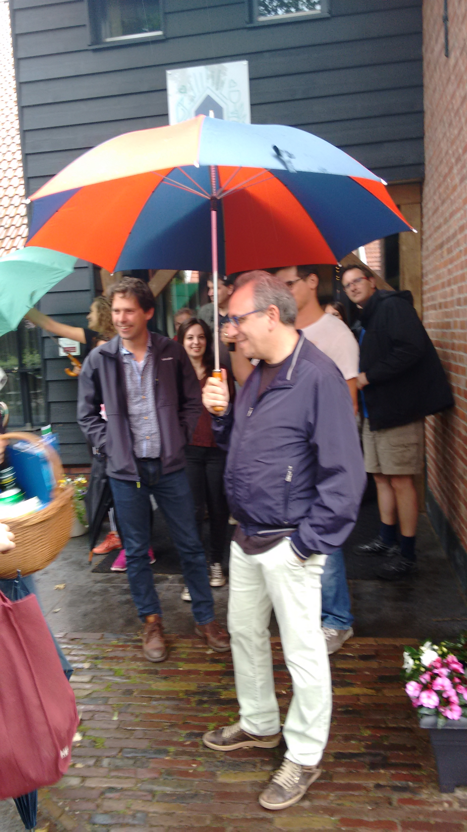
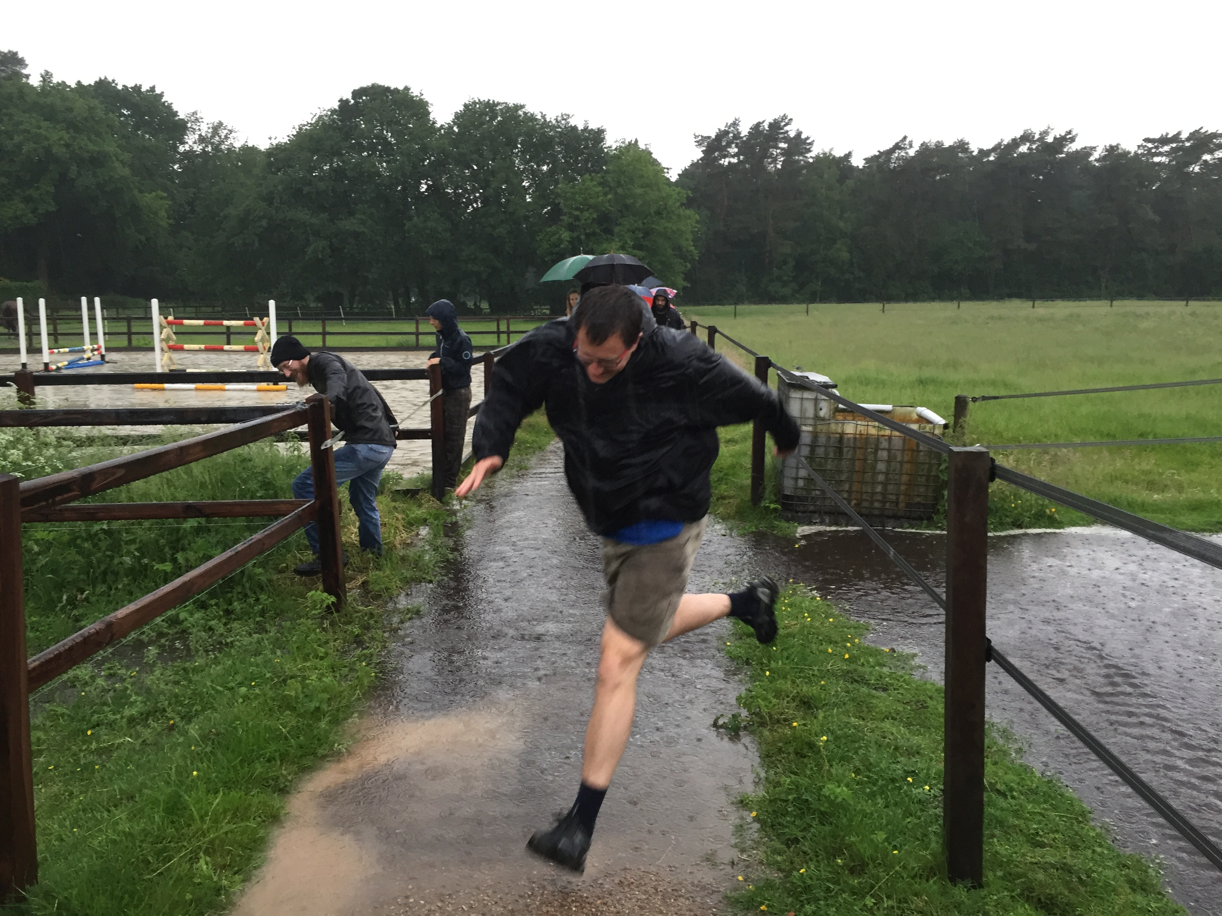
Good News and Worries
Detector Projects:
SciFi: A.P. (also OT running, Very Rare decays)
VeloPix Mechanics: W.H. (also Velo running, Vici)
VeloPix Electronics: M.v.B. (also Grav waves, R&D)
HLT upgrade: G.R. (also computing, LepCol)
Running OT: N.T. (also Run coordinator, Vici)
Running Velo: P.K. (also physics), W.H.
Running HLT: G.R. & G.O. (also LFV,)
Senior staff LHCb group reduced:
Retired: E.J., T.K., H.W.
Changes: J.vT., H.S., G.R. (0.6), MvB (0.x)
Upgrade projects under tension:
➔Ask for help during 2017 - 2021
Groningen group sub-critical:
➔Try to revive Groningen position
All senior group members contribute to hardware.
Notes:
Vici Tuning: 1) Bs→Ds Ds (phi_s) 2) Bs→Dsh (gamma and Afs) 3) 4)SciFi + SiPM
Vici Hulsbergen: 1) long-lived→jets 2) l.l. →(same sign) muon+jets 3) l.l. →di-muons 4) Velo upgrade
Structural funding (Staff + FOM programme reducing at 25% level), even though new group (RuG Van Swinderen Institute) joined.
Also overall investement in LHCb upgrade reduced proportionally).

Slide 11
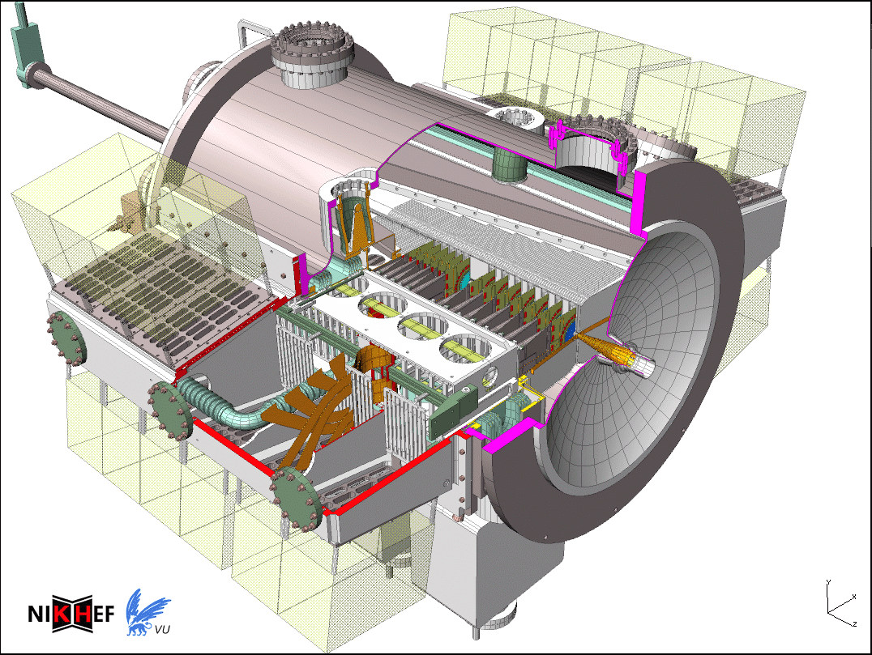
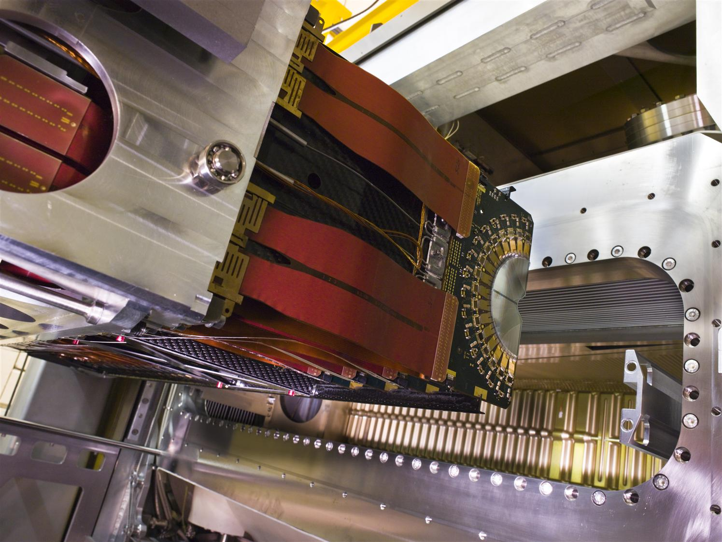
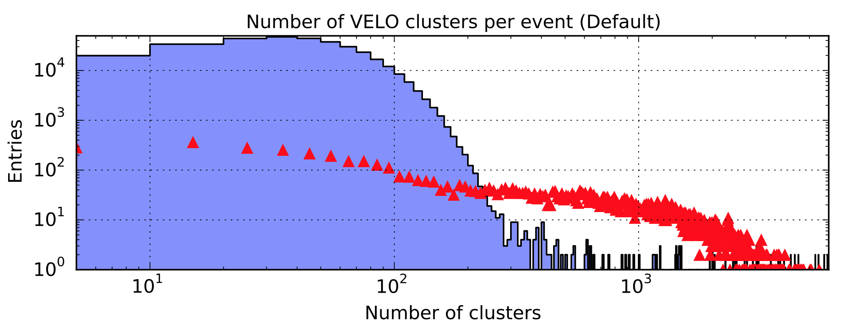
2) Velo: Run-1 & Run-2
Nikhef contributions:
Vessel mechanics & vacuum control
Cooling & maintenance
Vacuum encapsulation: “RF box”
Detector Open-Close system
Electronics: Beetle chip
PileUp detectors (40 MHz)
p – p
Pb-Pb
• 99% channels work
• σ_{PV}(x,y)=10μm, σ_{PV}(z)=60μm
• Radiation damage as expected…
Notes:
Nikhef large contrbutions. Velo operating well. Even working well in Pb-Pb data taking.

Slide 12
Velo Radiation damage
• LHCb sensors most irradiated Si at LHC
• Monitor Depletion Voltage with HV scan
MPV ADC count
Voltage
Effective depletion voltage [V]
fluence
• Observed efficiency loss inner region. ➔ Raise HV to 300 V.
Notes:
What is the maximum HV, 500 V?

Slide 13
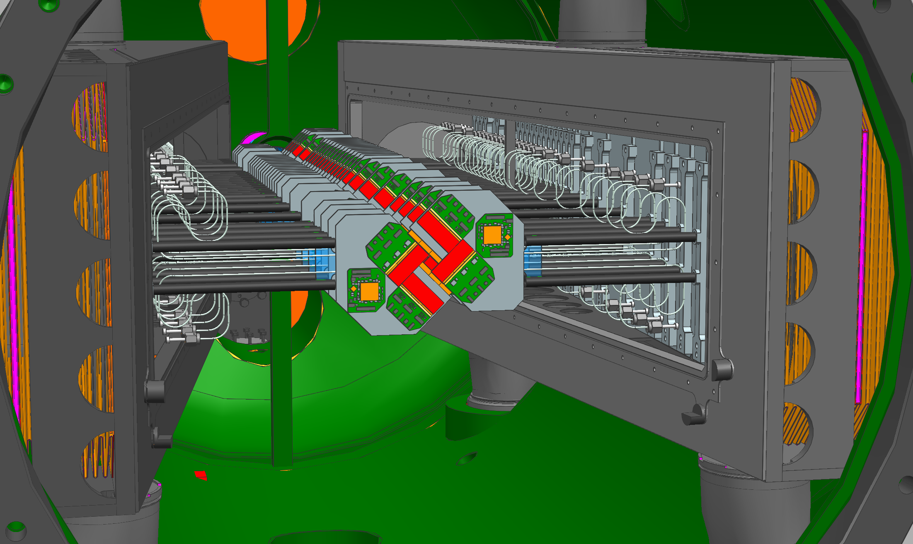
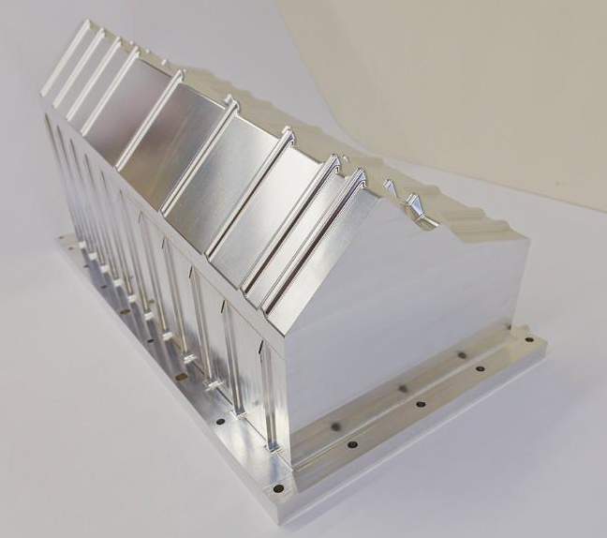
Velo Upgrade
Upgrade:
• Pixel Detector
• Closer to beam
A) Module design & construction
B) Electronics: VeloPix chip
C) Vacuum Envelope (“RF-box”)
Dropped responsibilities:
• CO₂ cooling
• Vacuum control
Notes:
Upgrade is from strip to pixel, closer to beam. RF foil at 3.5 mm, Si at 5 mm, now 8 mm). Major projects: module (with Manchester), VeloPix (with CERN), RF-box (with CERN).
VeloPix chip submission “now”, Module – temperature/deformations measurements, RF-box having fun.
Some activities ended.

Slide 14
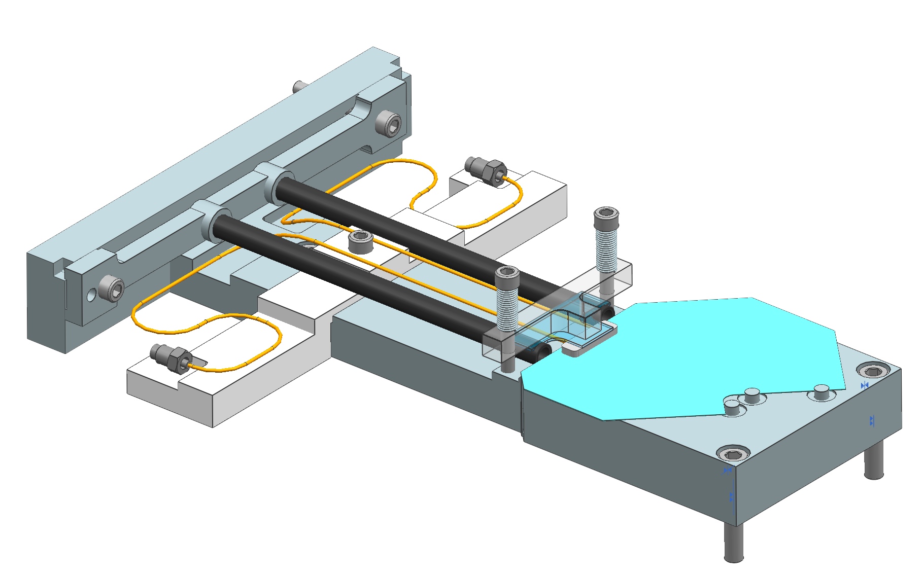
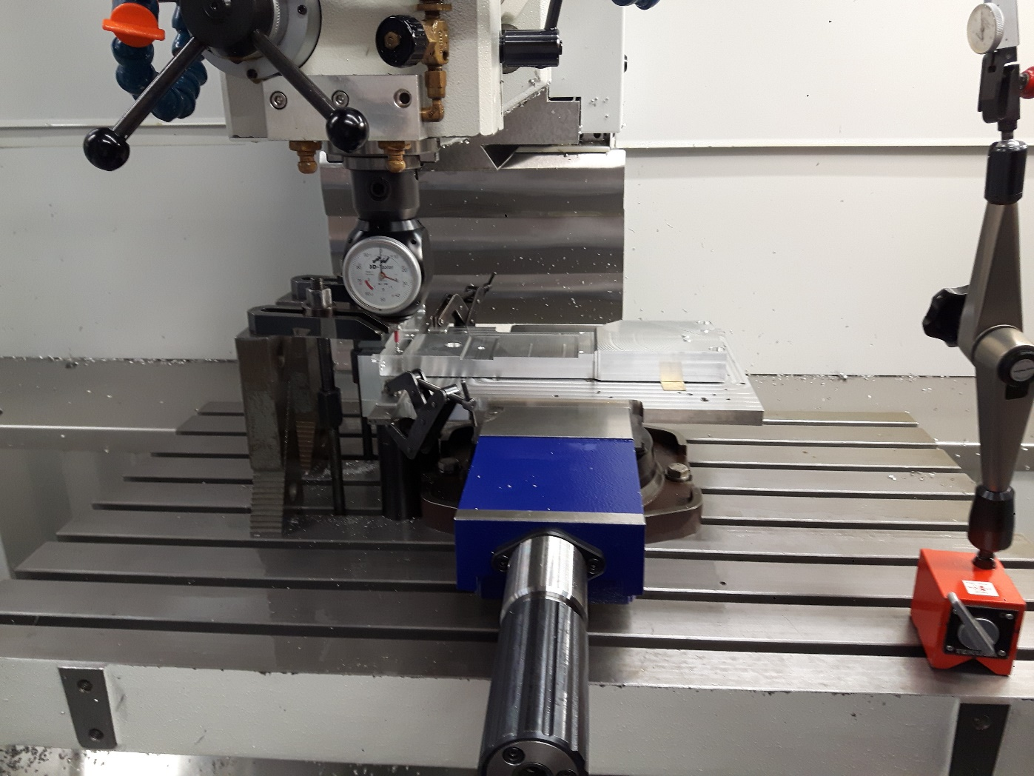
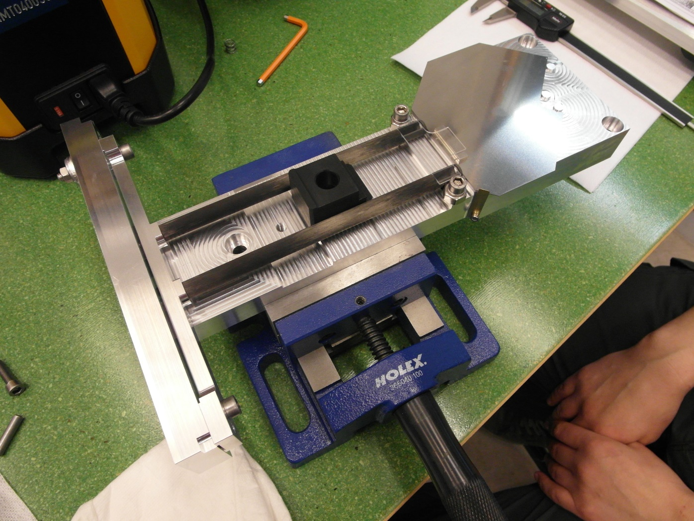
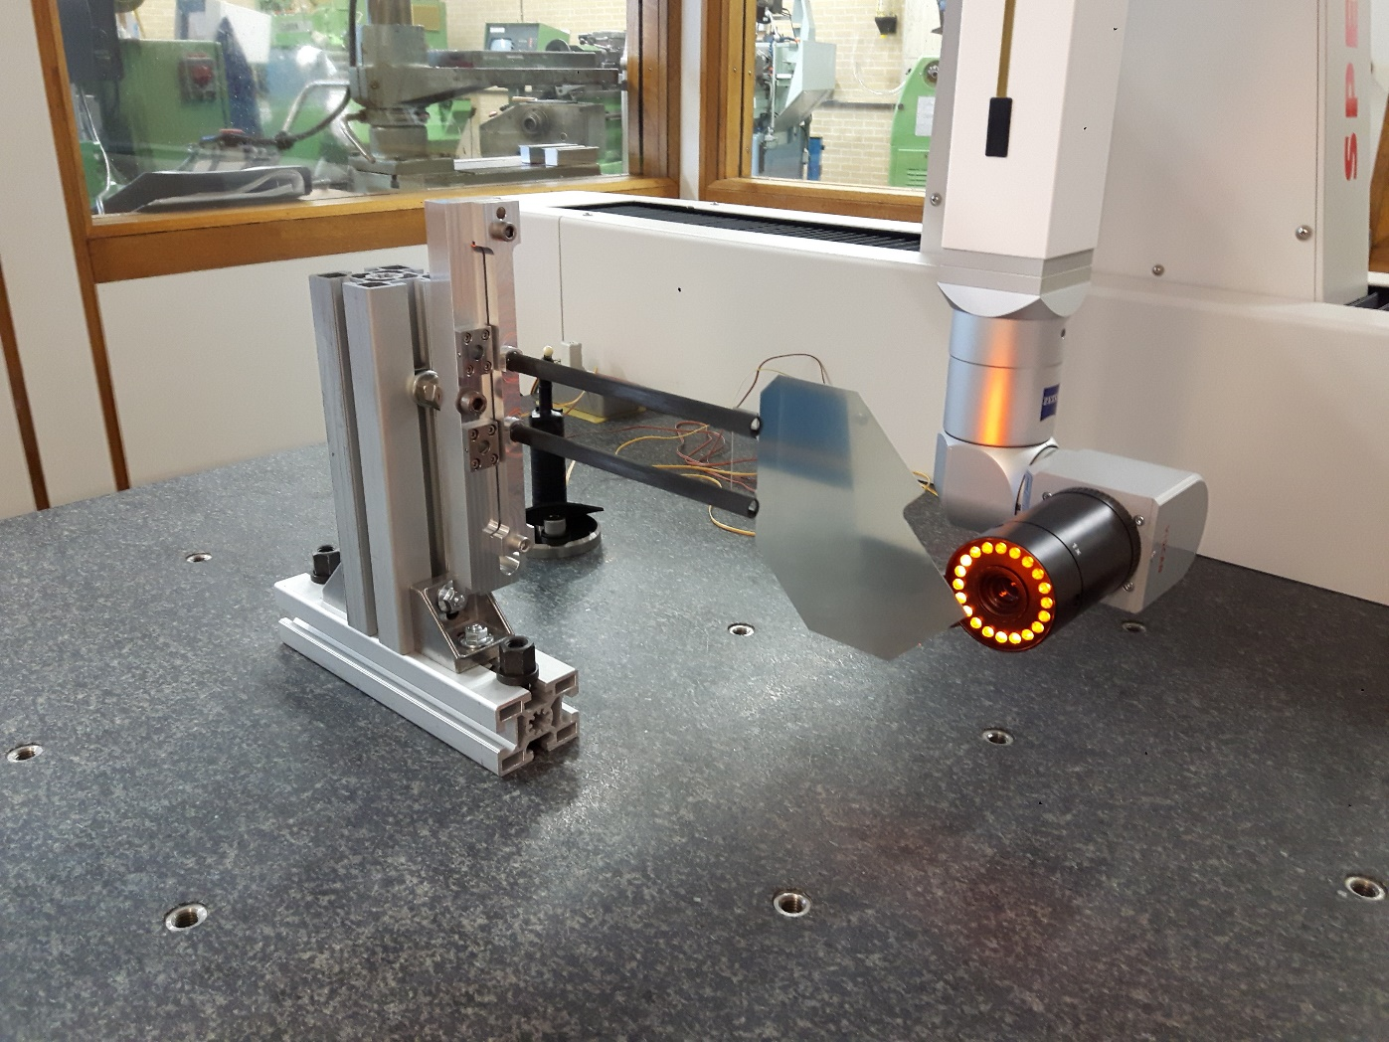
Module Production
Bare module jig
jig production
J. v. Dongen, W. Hulsbergen, M. v. Overbeek, E. Jans, K. de Roo, E. Roeland, F. Sanders
Module production
Mechanical validation
Notes:
Machine for module being used from in-house equipment. Gluing dispenser bought.

Slide 15
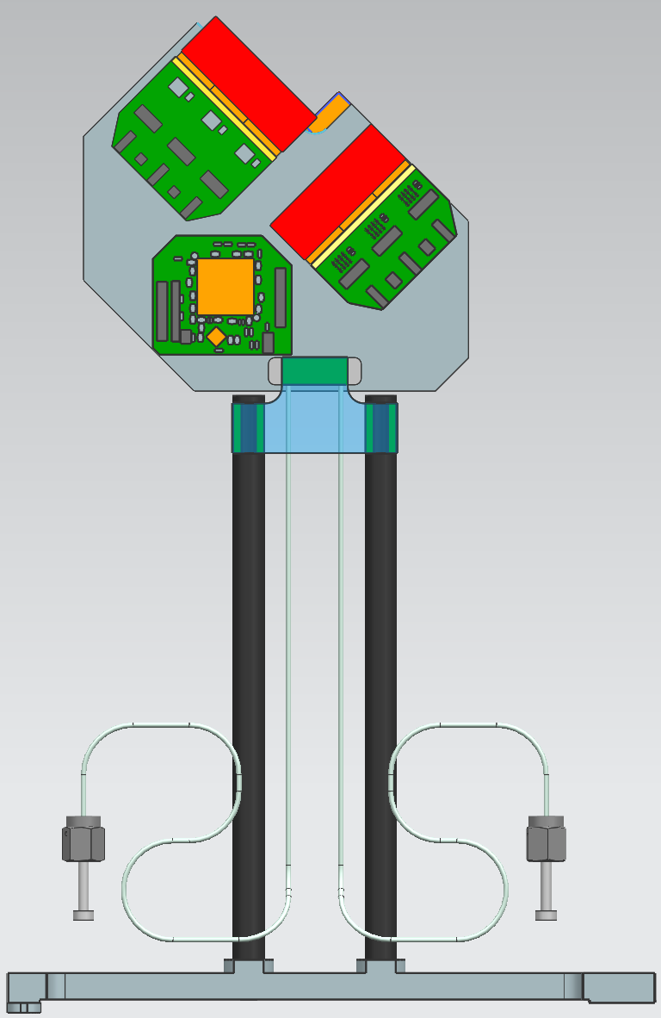
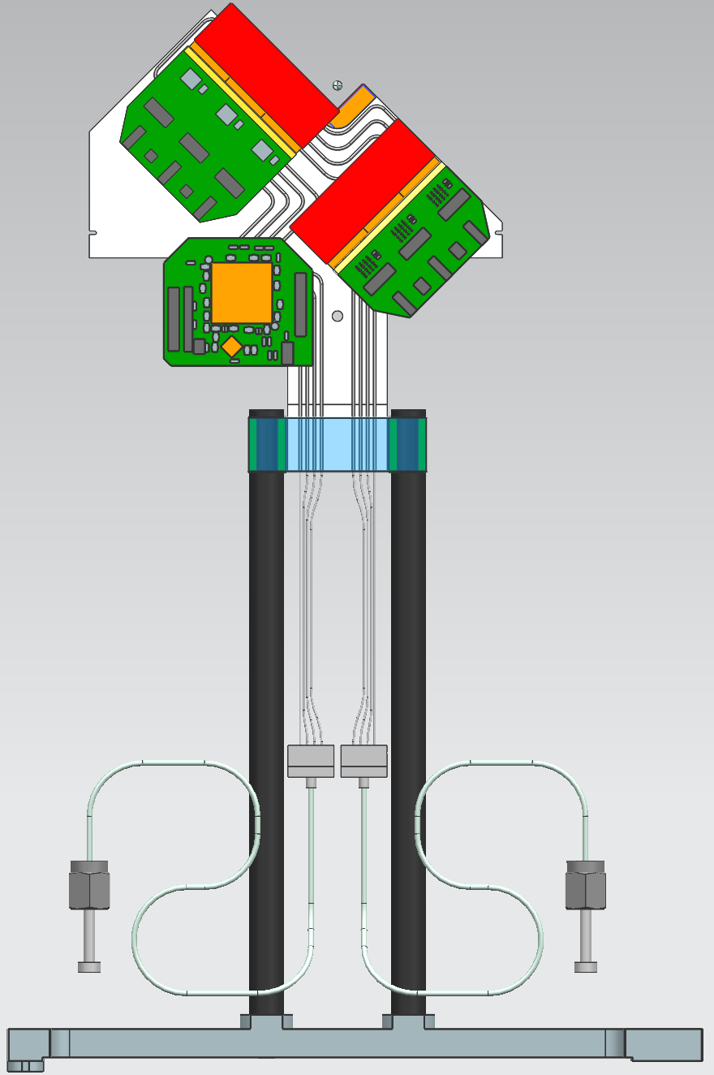
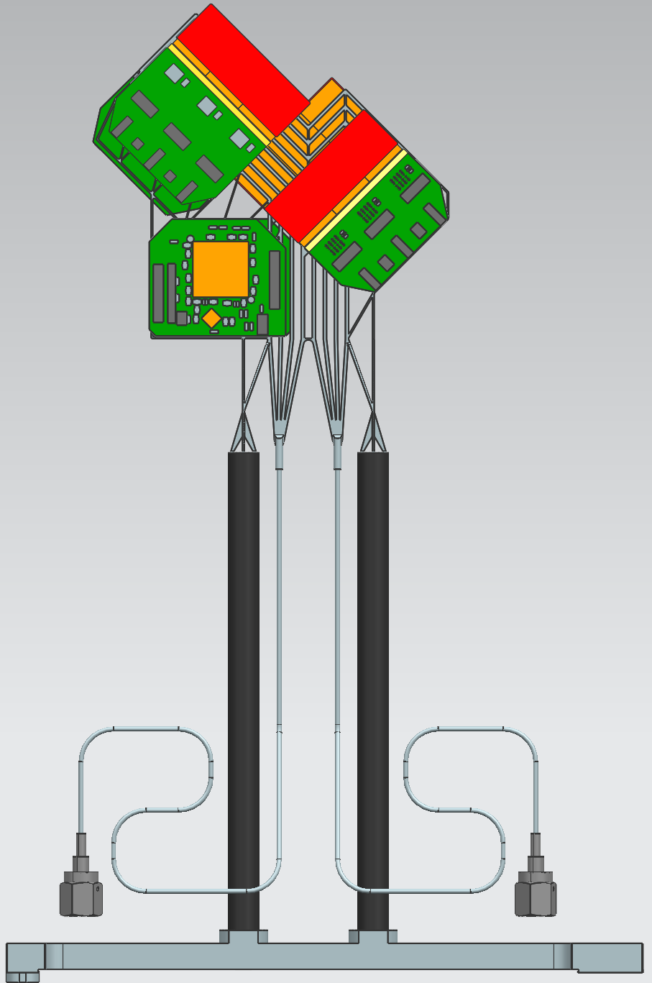
Module Issue: Cooling Substrate
“Plan A”
“Plan B”
“Plan Z”
• 500 μm Si substrate with
microchannel cooling
• Least material
• Best cooling performance
• Delicate handling
• Expensive
• 1 mm ceramic with
0.65mm st. steel tubes
• More material
• Gluing tubes in grooves?
• Less handling risks
• Cheap
• 3d-printed Titanium
with 500 μm channels
• No insulating midplate:
material budget ~ plan A
• Unproven cooling perf.
• Cheap, easy handling

Slide 16
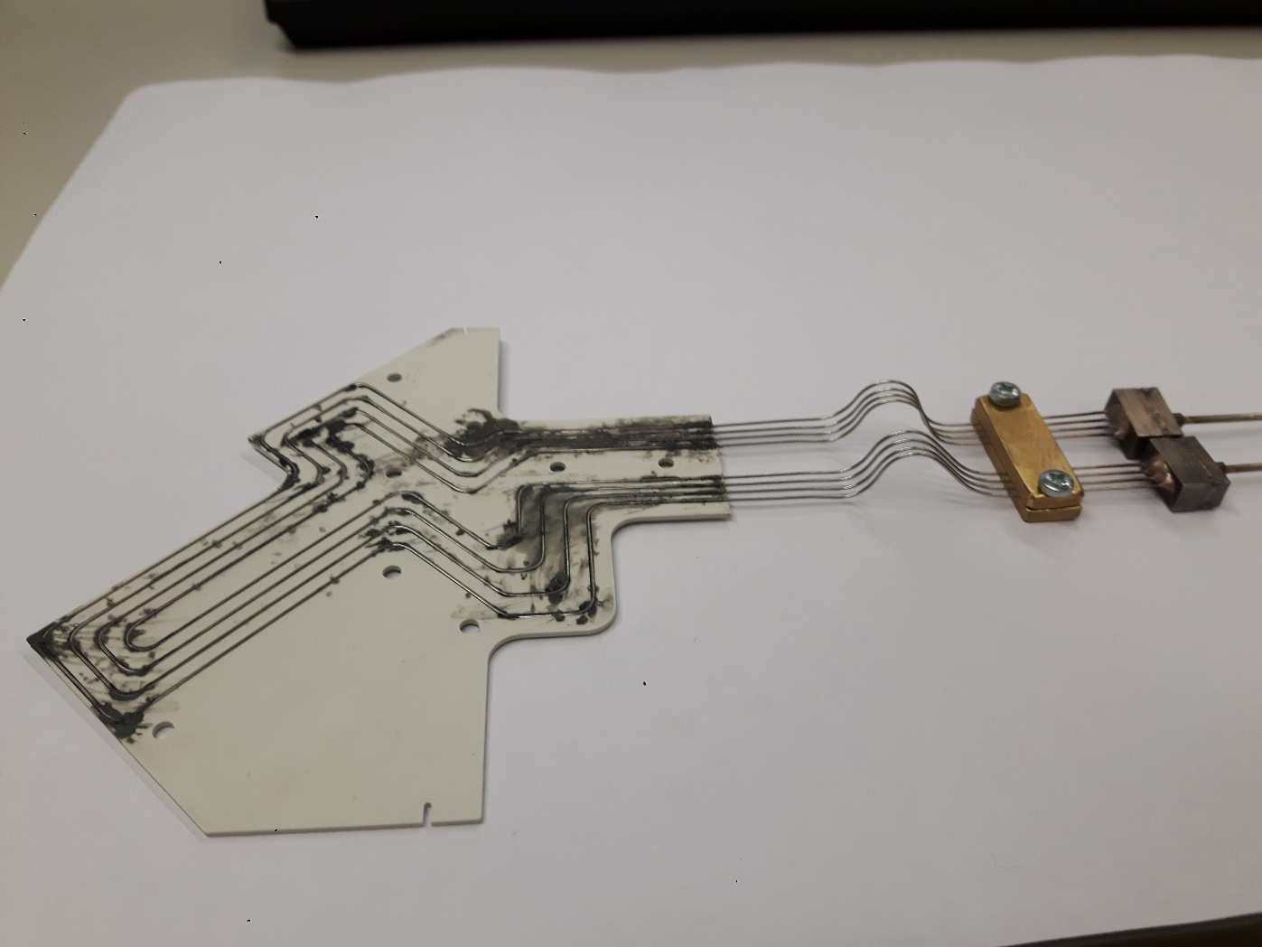
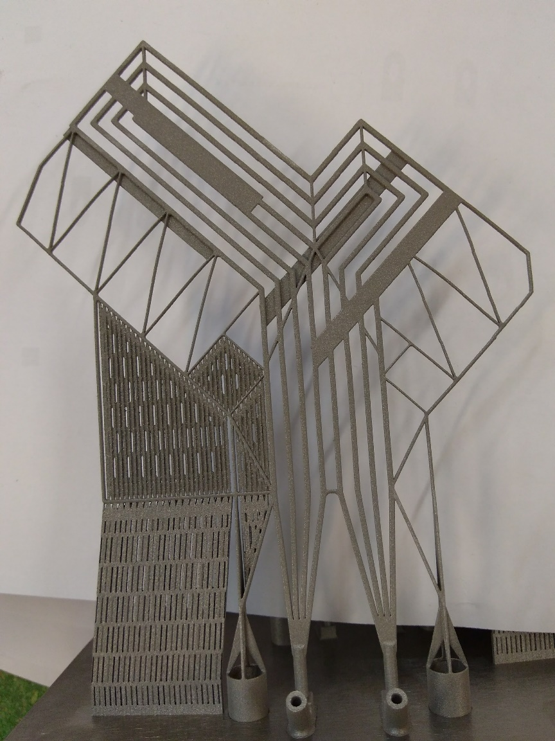
Alternatives for microchannel cooling
“Plan B” : Oxford
“Plan Z” : Nikhef
Both options still require some R&D:
• Cooling and Mechanical behaviour
Need to converge urgently
Module production schedule very tight

Slide 17
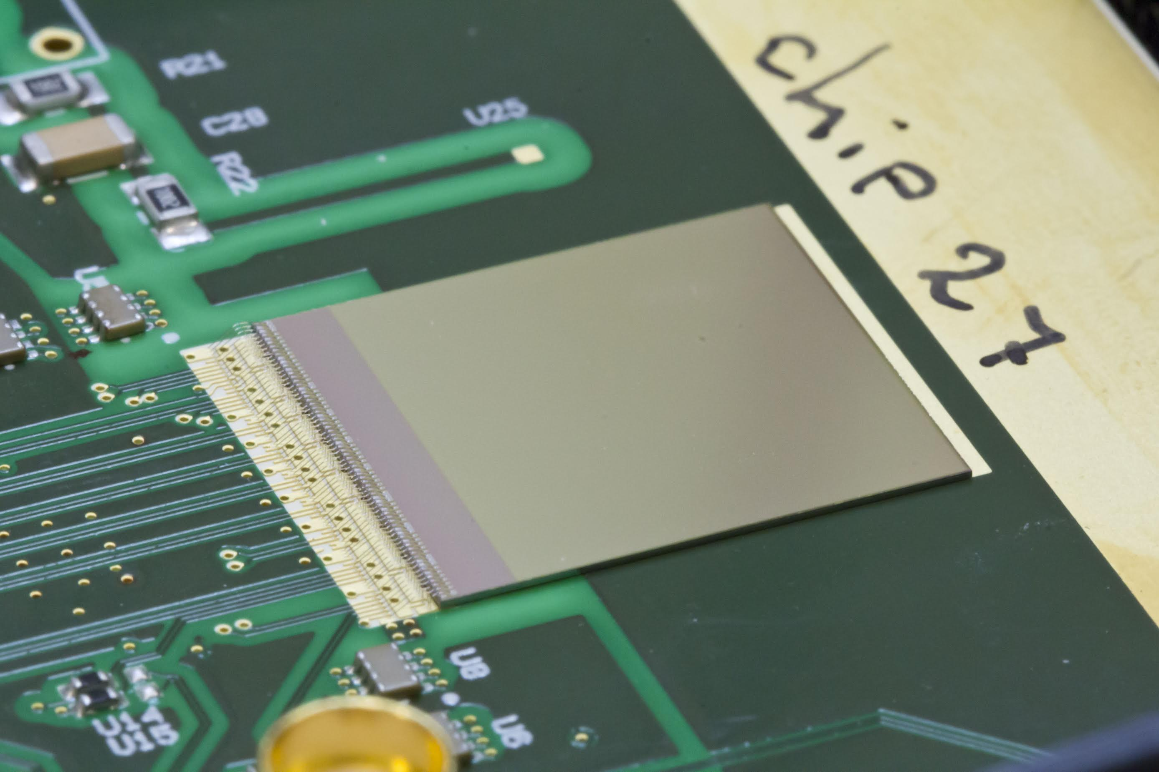
VeloPix Chip
Specs | TimePix3 | VeloPix
Readout | ToT | binary
Power | < 1 W cm⁻² | < 1.5 W cm⁻²
Pixel | 55 x 55 μm² | 55 x 55 μm²
Rad hard | ? | 400 MRad
Hit Rate | 80 Mhits/s/ASIC | 900 Mhits/s/ASIC
Technoloy | 130 nm CMOS | 130 nm CMOS
M. v. Beuzekom, E. Dall’Occo,
B. v.d. Heijden, H. Boterenbrood, F. Schreuder, G. Visser
• VeloPix characterization going well:
– Chip so-far meets requirements
– Radiation hardness is sufficient
• Second submit scheduled in July:
– Fix single event upsets
– Jitter in high speed transmission
– Clean up clock signals

Slide 18
Sensor Characterization with Beamtests
M. v. Beuzekom, E. Dall’Occo,
H. Snoek, P. Tsopelas
• Beamtests:
– TimePix3: Extensive tests at CERN:
➢ Charge collection
➢ High Voltage tolerance
➢ Resolution
➢ Efficiency
➢ Irradiation
– VeloPix: High speed tests at Fermilab
currently ongoing.
Efficiency
Notes:
Lots of studies with prototype pixel detectors using TimePix3 chip. 200 micron chip.
Radiation effects. Hamamatsu vs Micron.

Slide 19
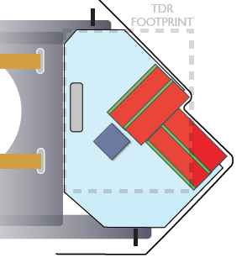
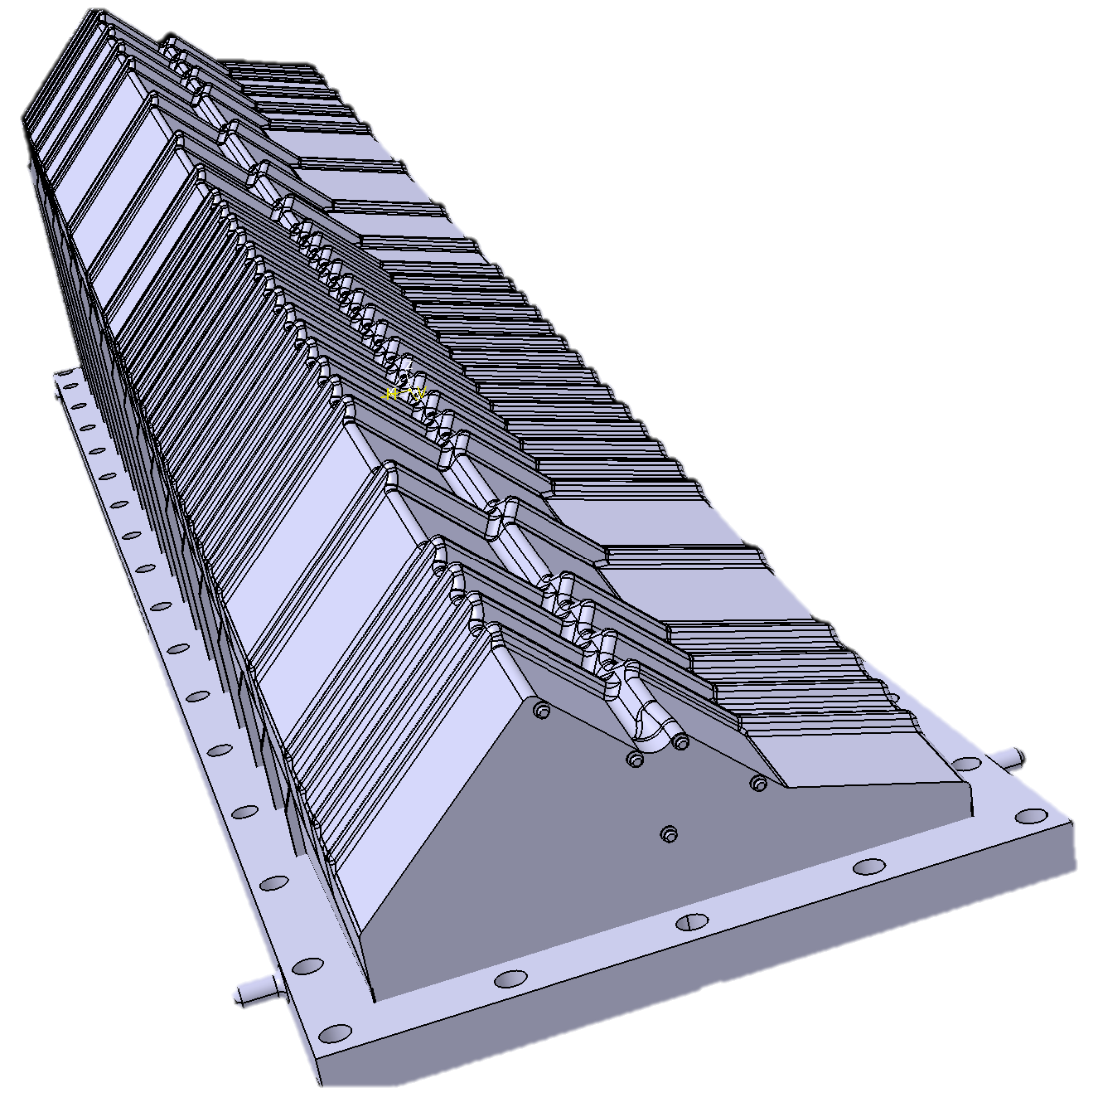
Vacuum Envelope “RF-Box”
M. Doets, W. Hulsbergen, T. Ketel, B. Munneke, K. de Roo, W. Kuilman, J. Kos
VELO
vessel
primary
vacuum
secondary
vacuum
RF box
Vacuum Envelope:
• Complicated shape (minimize mult.scat.)
• Milled from massive AlMg alloy block
• Close to beam: 3.5 mm
• Vacuum tight
• RF-wake fields
• Thickness: two step procedure:
– First 0.5 mm, then 0.25 mm box
Notes:
RF box.

Slide 20
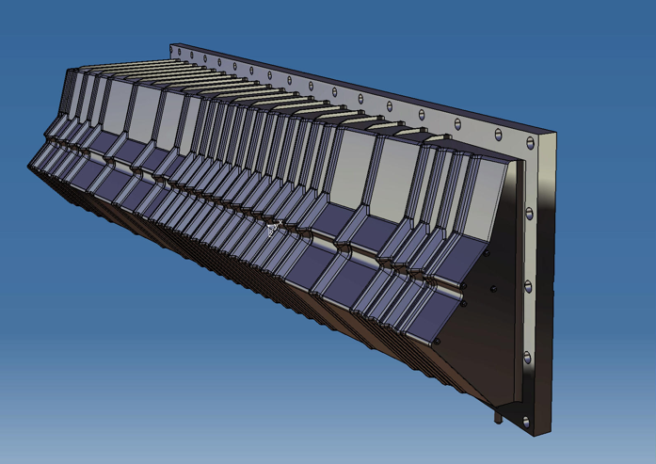
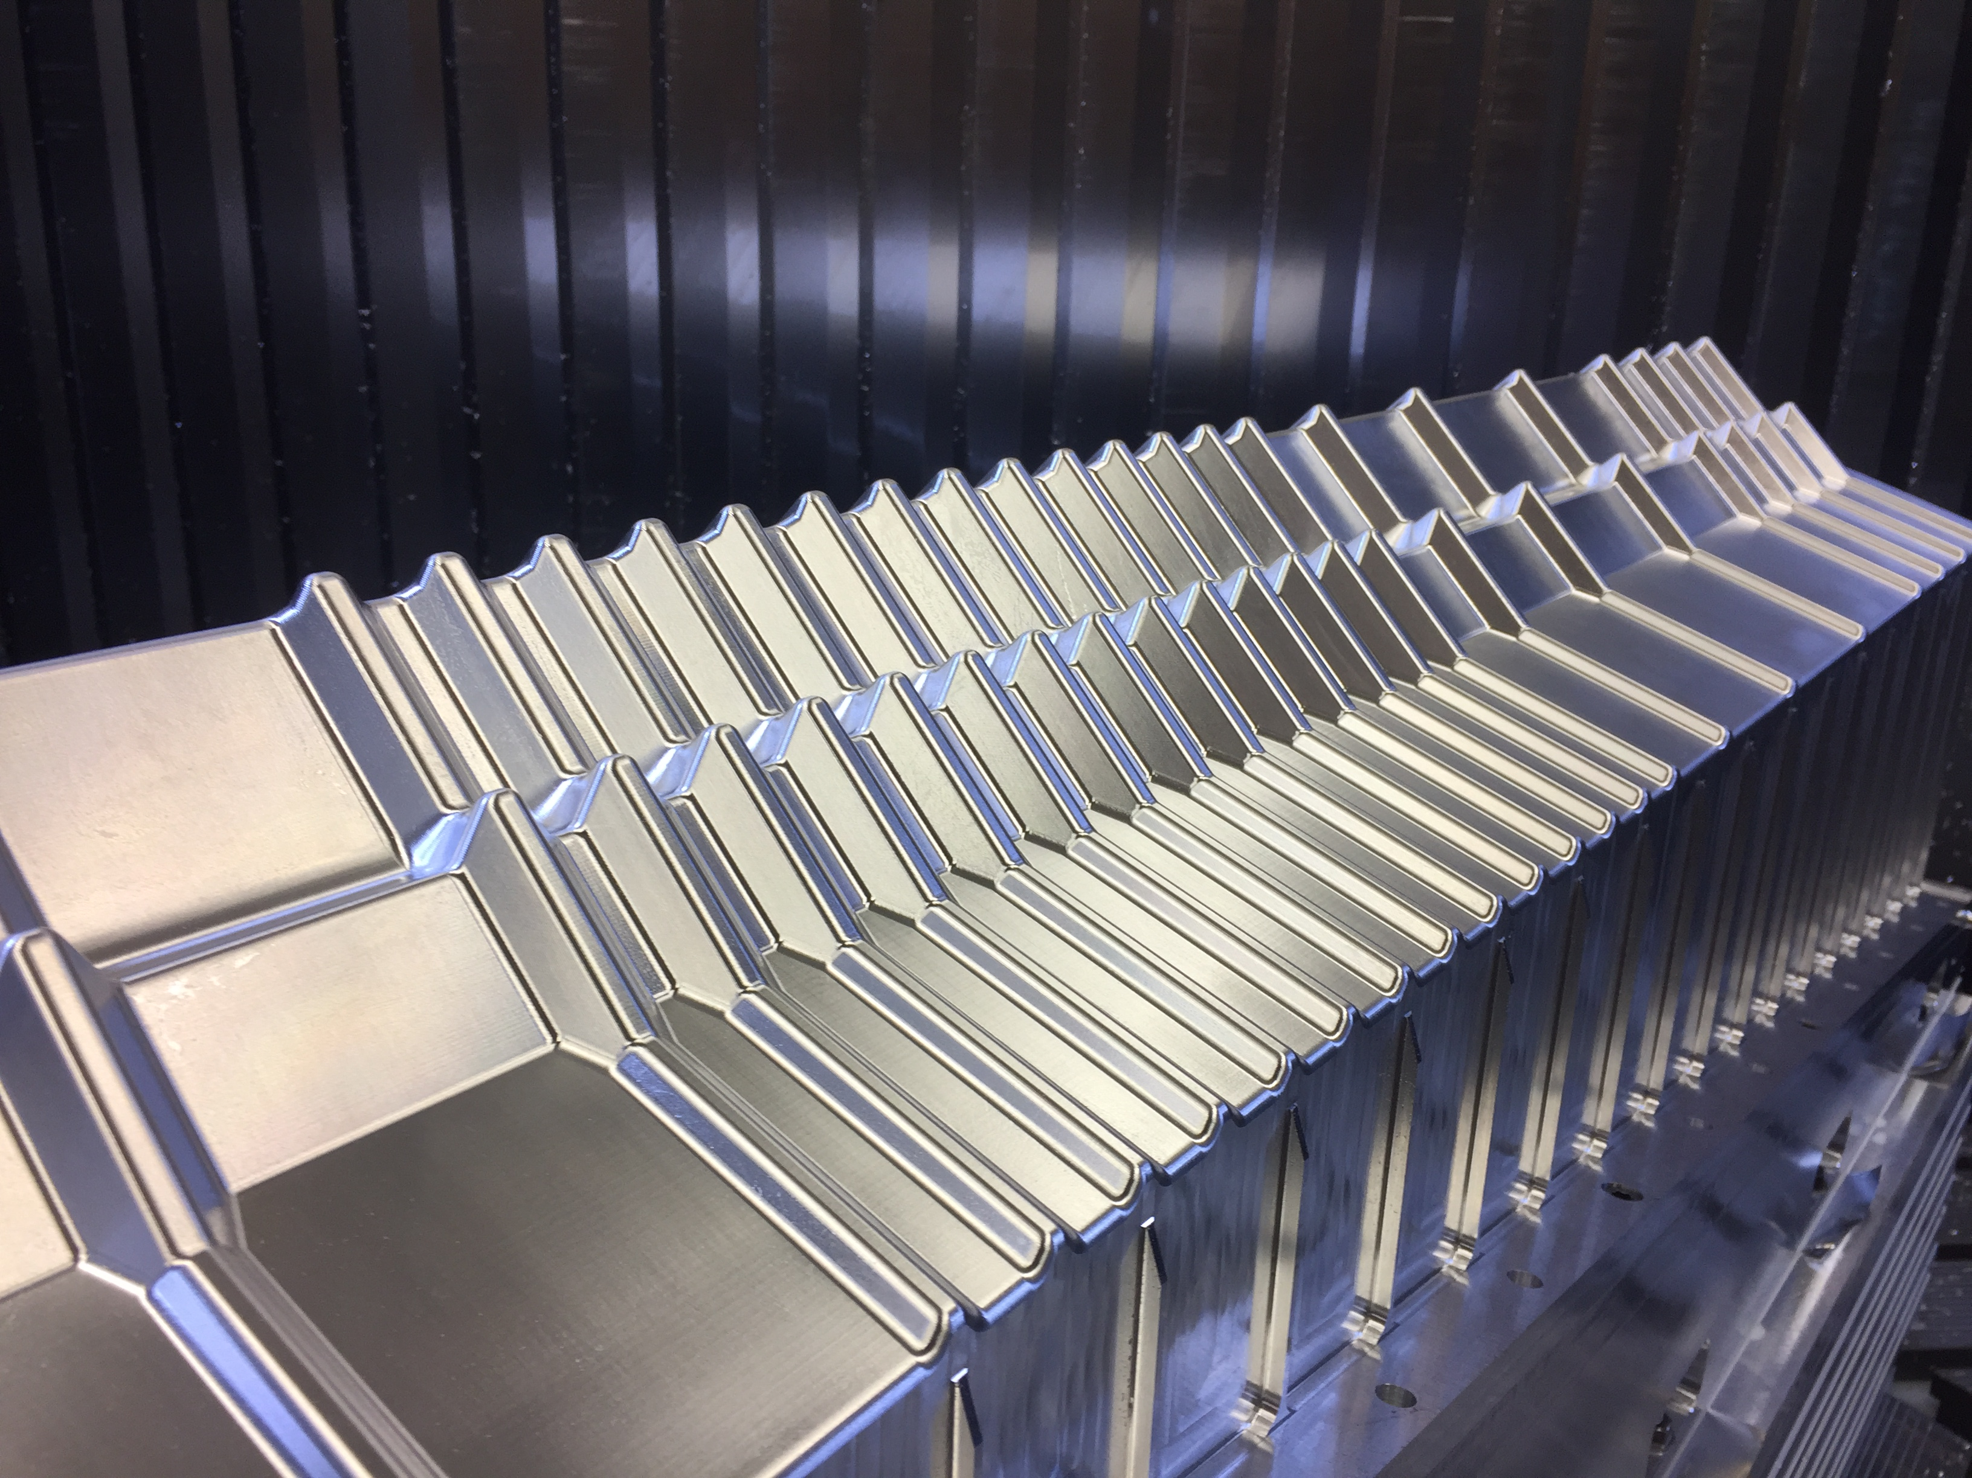
Vacuum Envelope “RF-Box”
W. Hulsbergen, T. Ketel,
W. Kuilman, J. Kos
Design
First 0.5 mm box
Vacuum Envelope:
• Complicated shape (minimize mult.scat.)
• Milled from massive AlMg alloy block
• Close to beam: 3.5 mm
• Vacuum tight
• RF-wake fields
• Thickness: two step procedure:
– First 0.5 mm, then 0.25 mm box

Slide 21
Velo Project Status
Module construction:
• Preparations ongoing at Nikhef, very tight time-schedule
• Cooling substrate decision urgently required
• Module EDR June 2017(?), Module PRR Dec 2017
VeloPix ASIC:
• Submit-2 in June 2017
• Close to critical time-path
RF-box:
• 0.5 mm box completed
• proceed to 0.25 mm box

Slide 22
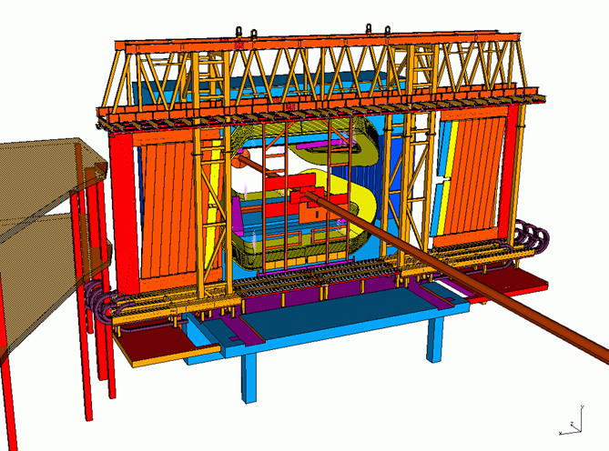
3) Outer Tracker: Run-1 & Run-2
Nikhef Contributions:
Long term Project leadership
Frames and Modules construction
Electronics
Installation, commissioning, monitoring
  RT & online T0 calibrations
Resolution studies
Irradiation studies and ageing tests
• 99.98% channels work
• Hit resolution < 200 μm
• No radiation damage (!)
Tracking efficiency
resolution
Occupancy
Online t₀
calibration
2011 Data
2012 Data
2015 Data
p_{T} (GeV)
Drift time residual (ns)
# channels
Notes:
Large involvement in OT straws. So far ageing does not occur. Detector works very well. Pb-Pb occupancy up to 100%.

Slide 23
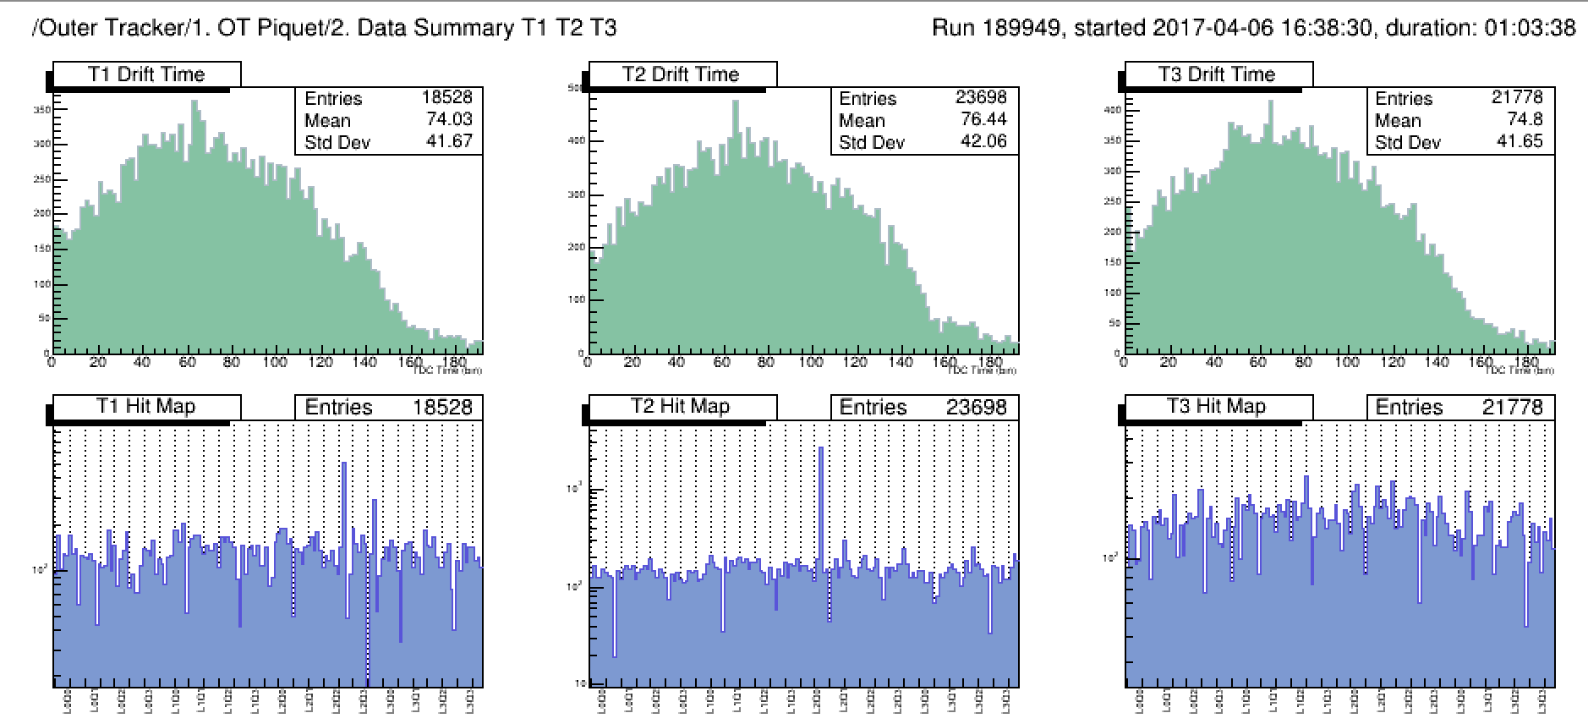
Outer Tracker status
N. Tuning, J. de Vries, L. Dufour, A. Pellegrino, G Ciezarek
Hit resolution within specs:
σ_{x}=170 µm (σ_{t}=2.4 ns)
➔Perhaps sensitivity for T.o.F. PID for
low p tracks (σ_{tof}=0.6 ns) ?
PID?
Ready for 2017 run (from cosmics):
• Clean drift time spectrum
• 50 out 53460 straws have noise > 1%
T.o.F.
T1 TDC
spectrum
T2 TDC
spectrum
T3 TDC
spectrum
T1 hitmap
T2 hitmap
T3 hitmap
Notes:
Questions:
Protons are more energetic than pions!
Pione from D*?
Momentum spetra?

Slide 24
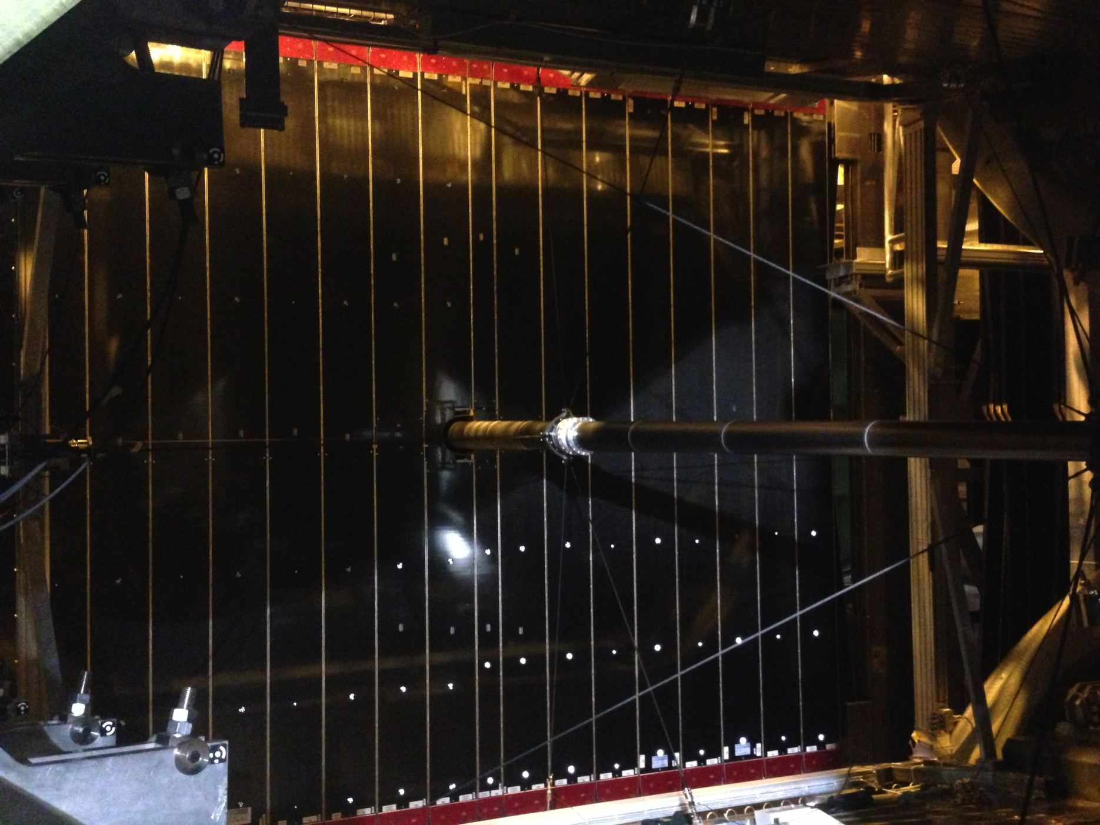
The OT without IT in front

Slide 25
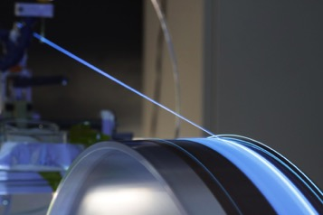
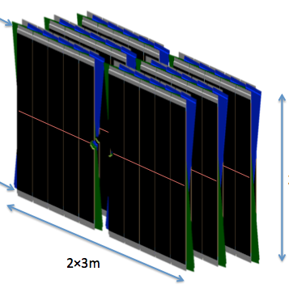
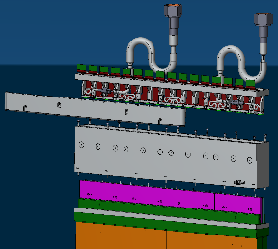
SciFi Upgrade Tracker .
1 Module:
1 Detector:
= 11.000 km fibres
= 128 modules
= 600 k SiPM channels
= 8 fibre mats
1 module
= 2 x 16 SiPM
2 x 2.5 m
= 2 x 32 Pacific ASICs
= 2 Cold Boxes

Slide 26
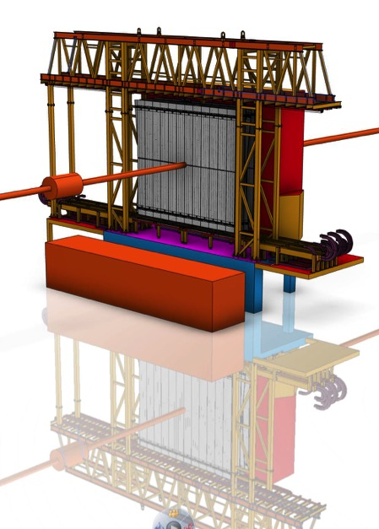
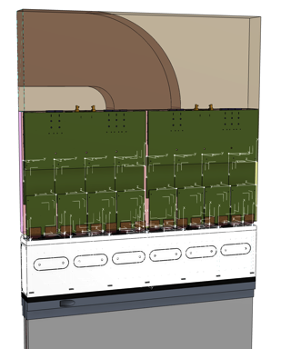
Tracker Upgrade: Scintillating Fiber Tracker
Nikhef Projects:
Electronics
Cold Box (-50º C)
Modules (20%)
C-Frame & cabling
Digitization software
Elect: A. Berkien, W. Gotink, H Verkooijen, C. Ietswaard,
M. van der Kraats, W. Vink
Mech: R. Walet, M. Jaspers, L. Veldt, H. Kok, H. Band, R. Buis, F. Kayzel, B. Munneke, M. v. Overbeek
Soft: F. Schimmel, J. de Vries
5 [m]
Cabling,
piping etc.
FE
Electronics
Coldbox
Module
Notes:
Scintillating Fibre Tracker, 2.5 m long fibres read out by silicon photomultipliers at the edge of the acceptance.
SiPM’s hamamatsu. Fibers Kururai. Fiber thickness fluctuations acceptable.
Our projects: FE-Electronics: master board and (Clermont Ferrand cluster board).
Coldbox to keep the SiPMs at -50ºC. Central modules = 20%

Slide 27
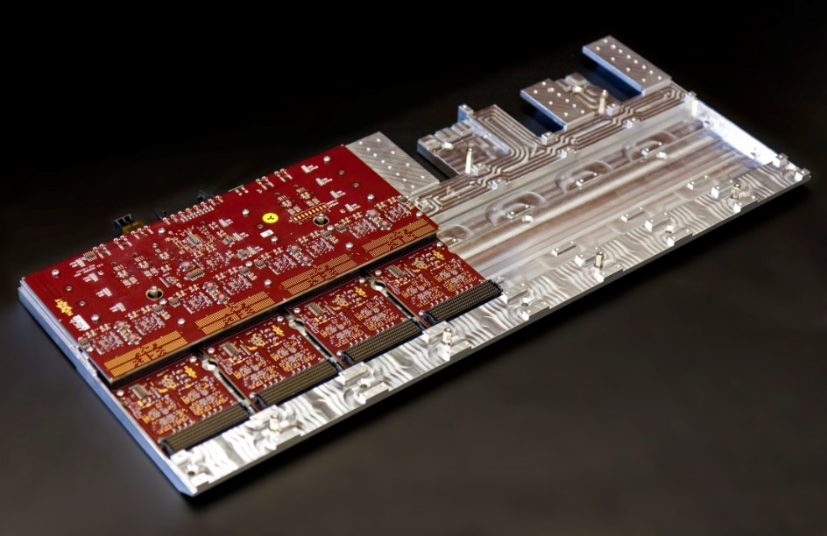
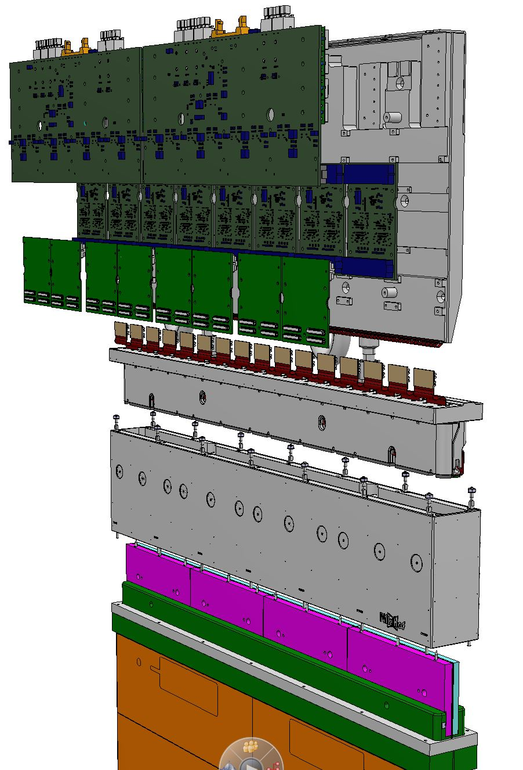
Module End = Frontend + Coldbox
Behind schedule
Master
Clusterization
Pacific
SiPM & Flex cables
Tight schedule
Cold box

Slide 28
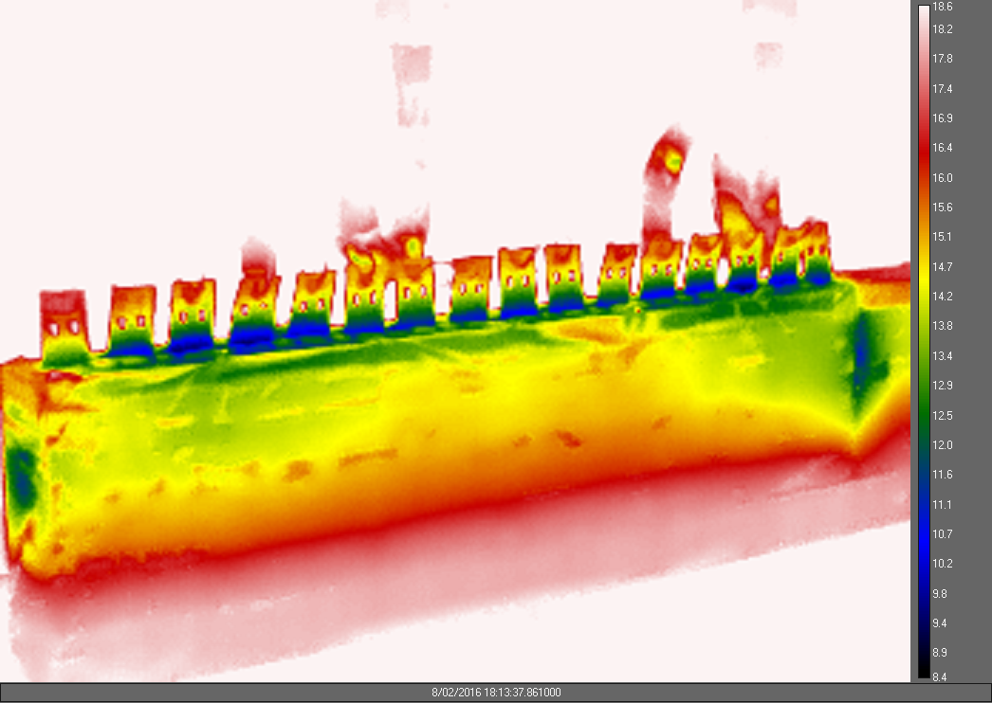
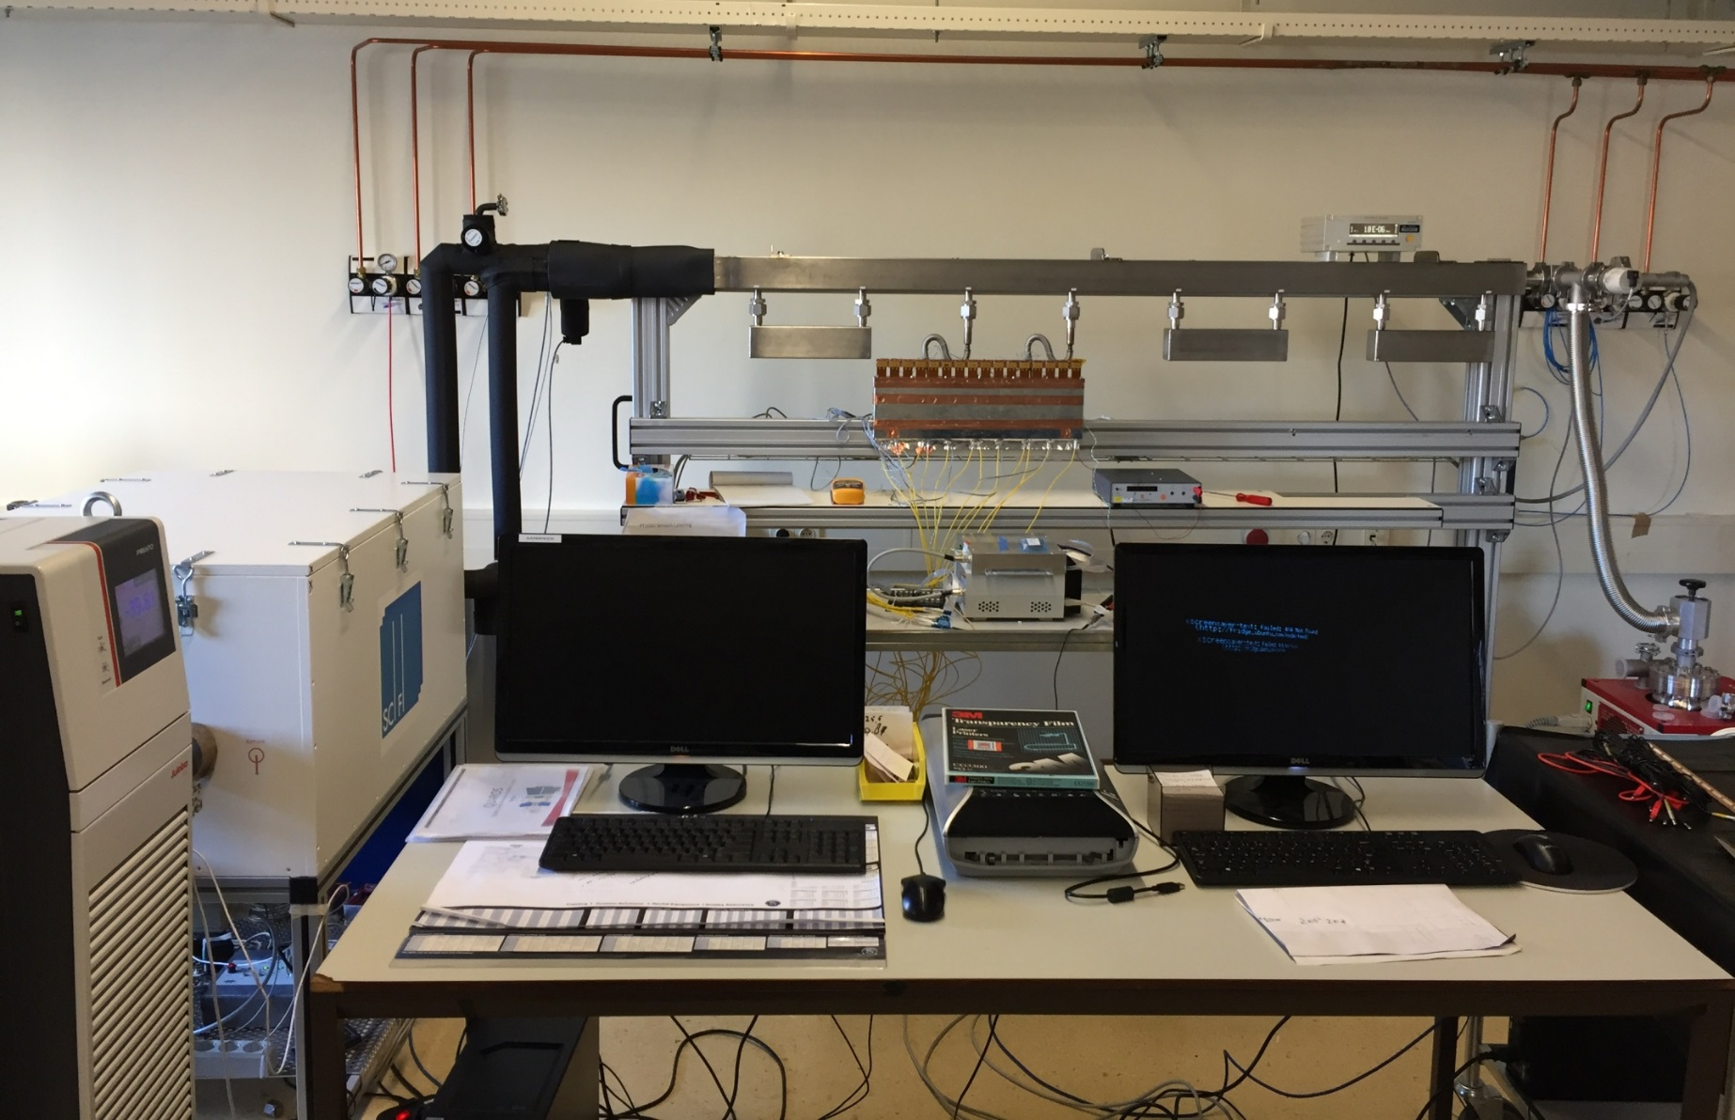
Cold box tests .
T_{set} value controlled here
Vacuum Manifold (~10⁻⁶)
ColdBox
Novec Loop
Cooling Control
QuarosControl
Vacuum Pump
Julabo Chiller
Do we need humidity management inside coldbox?

Slide 29
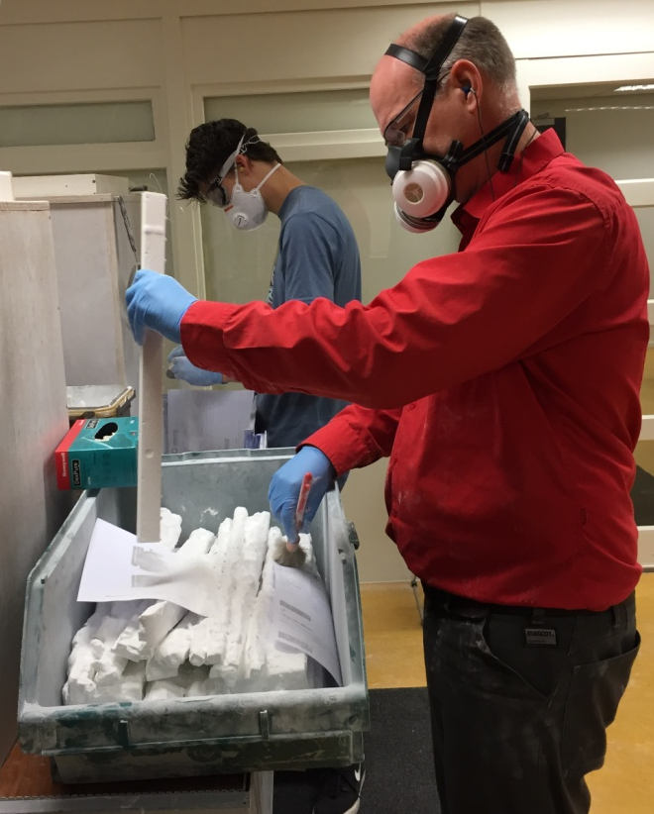
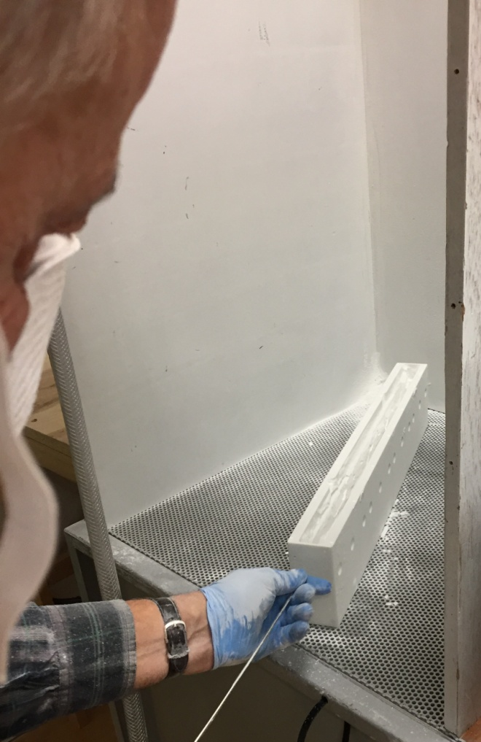
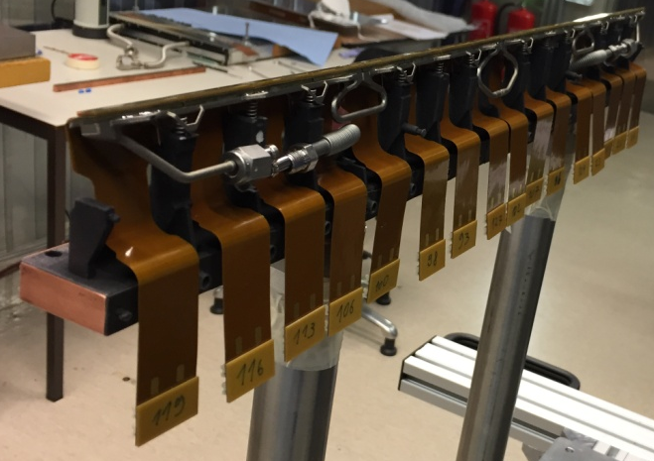
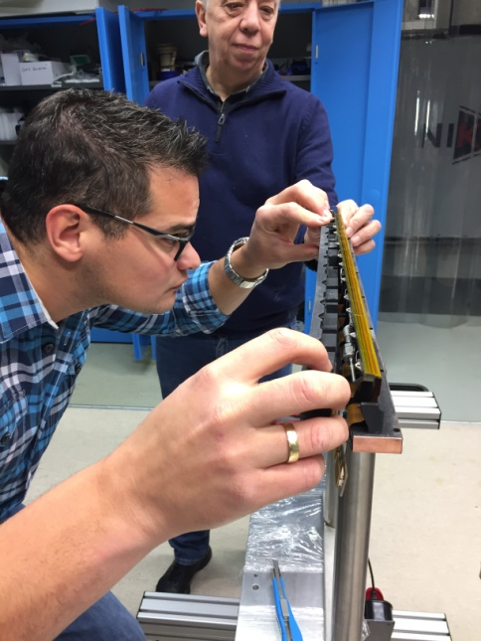
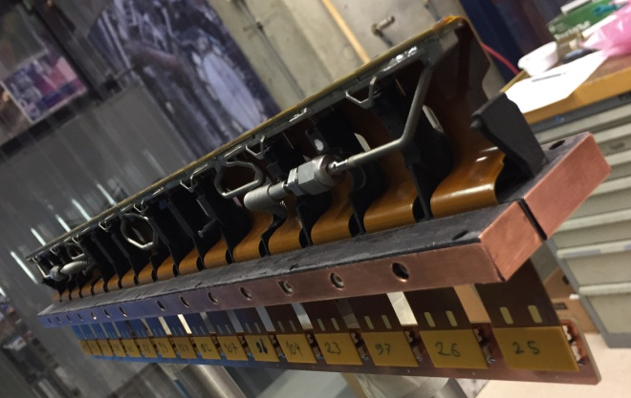
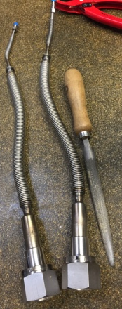
Some Impressions from Pre-Series Production

Slide 30
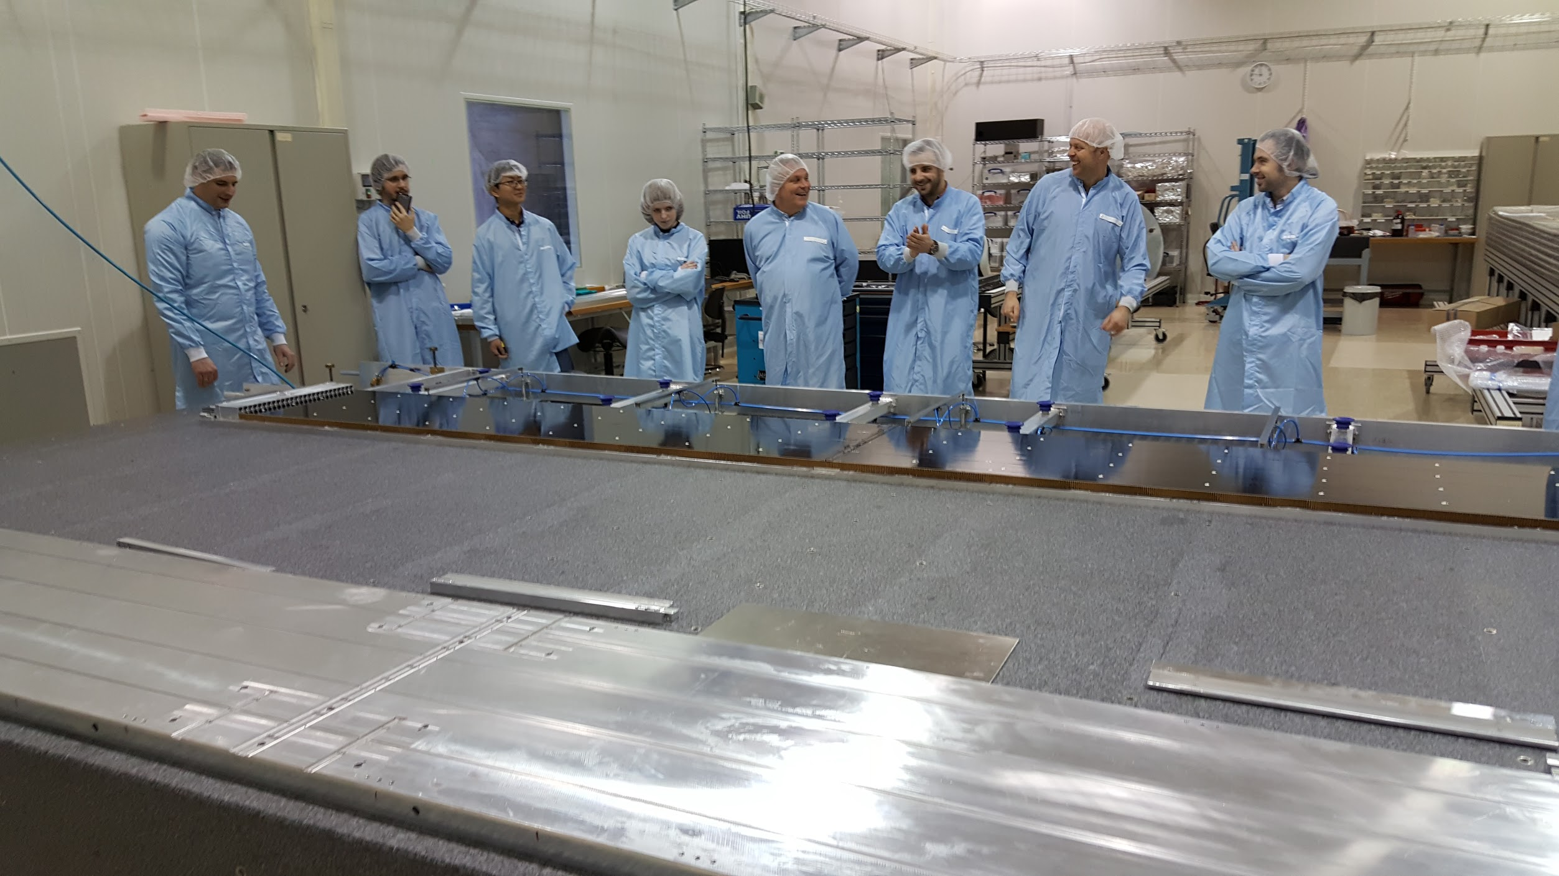
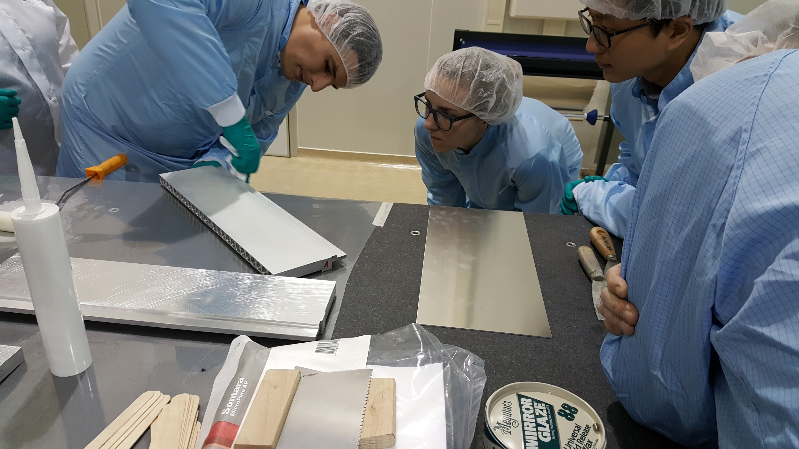
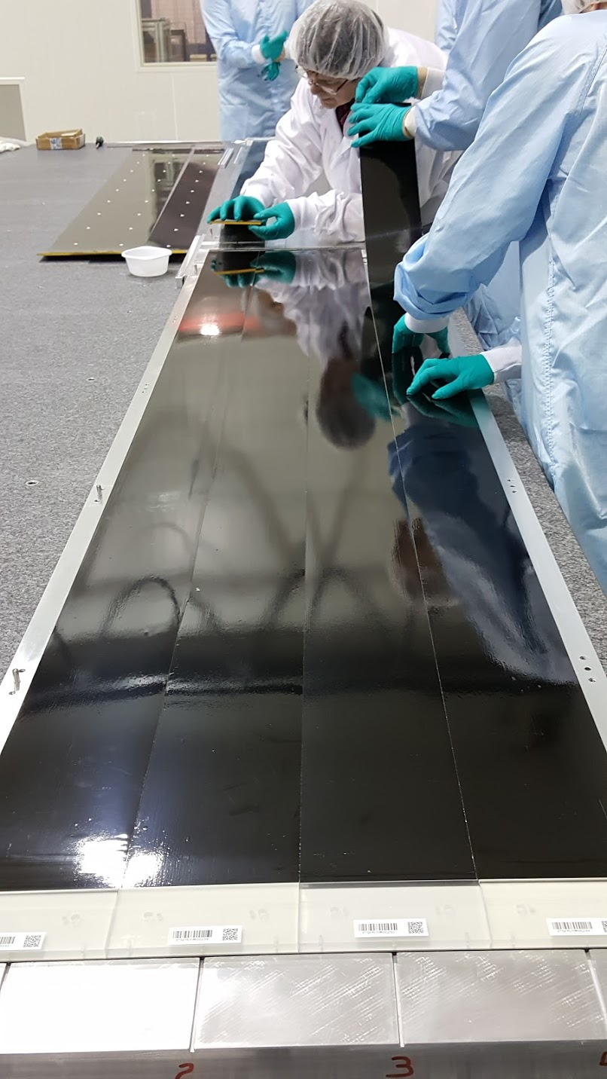
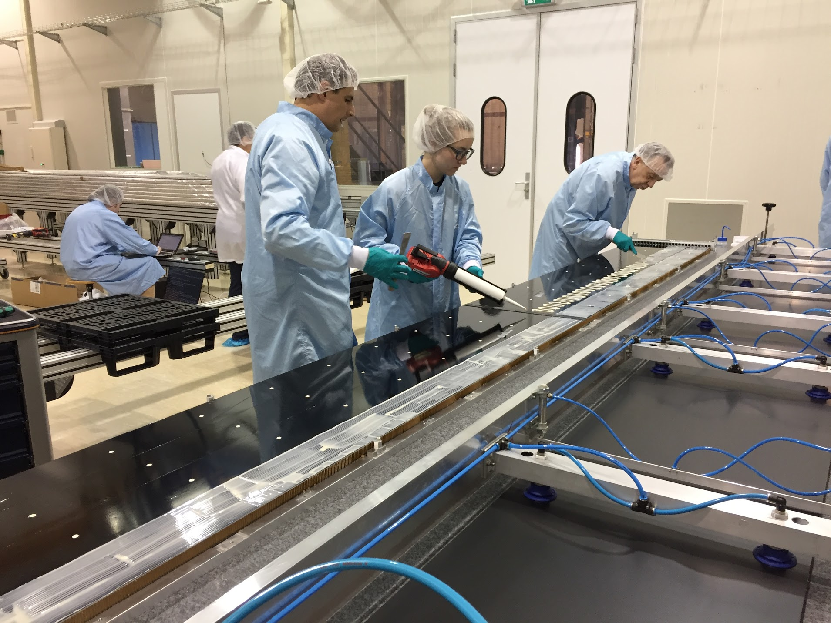
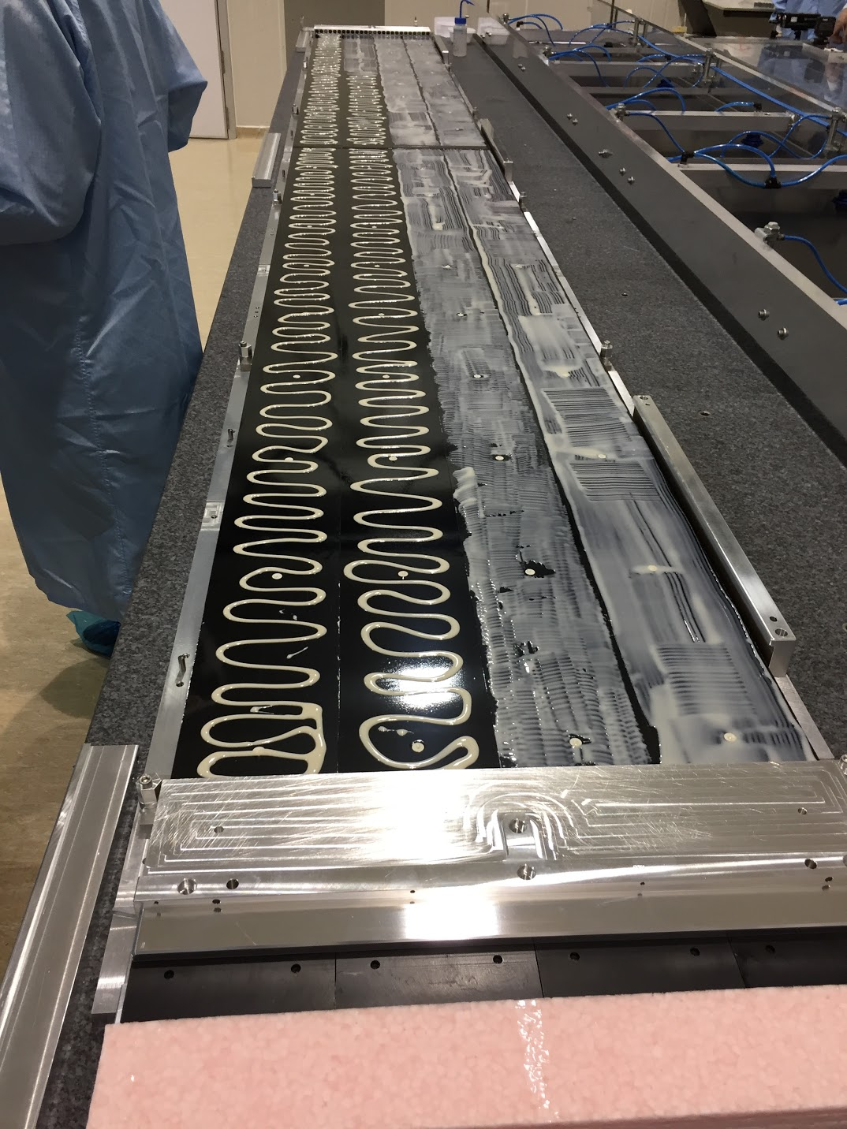
Module production preparation
Nikhef site being prepared for production of the center modules (20%)

Slide 31
Overall SciFi project status
 | R&D | proto | pre-series | series | On schedule
Fibres |  |  |  |  | ☑
Mats |  |  |  |  | ☑
Modules (N) |  |  |  |  | ☑
SiPM |  |  |  |  | ☑
Flex cable |  |  |  |  | ☑
Cold box (N) |  |  |  |  | ☑
Pacific ASIC |  |  |  |  | ☑
FEE (N) |  |  |  |  | ☑
Frames (N) |  |  |  |  | ☑
50%
25%
10%
• Very tight schedule with several delays.

Slide 32
4) High Level Trigger: Run-2 and Upgrade
LHCb Run II
HLT @ 1 MHZ
LHCb Upgrade 2021
HLT @ 30 MHZ
Notes:
From run-1 to run-2 prepare the software HLT. Include online calib. 5kHz→12.5 kHz. Work on framework, implementaion of algorithms and a lot of optimizations. Gerhard’s quote of saving money.

Slide 33



High Level Trigger: Toward Upgrade
Run-1:
Run-2:
Run-3:
Nikhef Contributions:
• “Turbo” trigger lines:
– Save only signal tracks to disk; no re-reconstruction
– About 50% triggers in turbo (e.g. charm program not possible without turbo)
• Code optimization and parallelization:
– Gaudi::Functional framework
K. Govorkova, S. Benson, G. Raven
Notes:
From run-1 to run-2 prepare the software HLT. Include online calib. 5kHz→12.5 kHz. Work on framework, implementaion of algorithms and a lot of optimizations. Gerhard’s quote of saving money.

Slide 34
4) High Level Trigger: Toward Upgrade
Upgrade preparations (collaborate with PDP group):
Run-3:
Multi-thread
Multi-job (memory!!)
Reconstruction program
being implemented and
tested
34
Nikhef Contributions:
• “Turbo” trigger lines:
– Save only signal tracks to disk; no re-reconstruction
– About 50% triggers in turbo (e.g. charm program not possible without turbo)
• Code optimization and parallelization:
– Gaudi::Functional framework
K. Govorkova, S. Benson, G. Raven
Notes:
From run-1 to run-2 prepare the software HLT. Include online calib. 5kHz→12.5 kHz. Work on framework, implementaion of algorithms and a lot of optimizations. Gerhard’s quote of saving money.

Slide 35
5) Physics Exploitation: Run-1
angle γ
angle φ_{s}
a_{sl}^{s} and a_{sl}^{d}
LHCb sees “flavour puzzles”.
Nikhef large involvement in Run-1
Good students can play major role!
Excited about Run-2
Well positioned with expertise
Postdoc & PhD funding established
B_{d,s}⁰ → μ⁺μ⁻
v-pion search
B→D*τν/B→D*μν
Notes:
Well positioned in time-dependent CP violation: phi_s mixing phase and angle gamma (DsK). Large involvement with B→mumu, also in comb paper with CMS. Our students were involved in normalisation and in combination PDF. B→D*tau nu our postdoc. A_sl^s done, our student comm author.

Slide 36
Plan for Run-2 Physics Projects
Each project: 1-2 staff, 1-2 postdocs, 3-4 PhD’s
See backup slides for details
Time dependent CP Violation
Trees: B_{s}→D_{s}K (CKM angle 𝛾)
Box: B_{s}→J/𝜓𝜙, B_{(s)}→D_{(s)}D_{(s}) (phase φ_{s})
Penguins: B_{s}→ 𝜑𝜑 (SM=0)
Funding: Program + Vici
Very Rare decays
B_{(s)}→µ⁺µ– (B_{d}/B_{s} ratio)
B_{(s)}→e⁺e– (enhanced (pseudo)scalars)
B_{(s)}→eµ, ... (Lepton Flavor Violation)
Funding: Program + projectruimte
Long-lived particles in Higgs decays
l.l.→jets (Hidden Valley)
l.l.→ µ + jets (SUSY, R.H. neutrinos)
l.l.→ µ⁺µ– (dark photons)
Funding: Vici
Semileptonics
a_{SL}^{s}, a_{SL}^{d} (CPV in mixing)
RD*, RD (Lepton Universality)
Double-double ratios R(DK) (Lep Univ)
Funding: Vidi
➔ Continue to exploit collaboration with Nikhef flavor theory.
Under group discussion - maintaining focus and expertise on tracking:
(Re-) invest in track reconstruction tasks for Run-2 analysis to improve performance?
➔Momentum reconstruction, Electron reconstruction, Magnet field extrapolation
Notes:
Note that some sub-projects are long term (collect statistics) and don’t require continuous 100% FTE.

Slide 37
Excitement in Flavor: Rare Decays: b → s μ⁺μ–
JHEP 06 (2014) 133
JHEP 06 (2014) 133
JHEP 06 (2014) 133
JHEP 11 (2016) 47
JHEP 09 (2015) 179
JHEP 06 (2015) 115
Branching fractions related to b → s μ⁺μ– transition consistently lower than predicted.

Slide 38
In addition P5’, RD, RD*, RK, RK* → LFNU?
P’₅
4σ
2.8 σ, 3.0 σ from SM
2.6 σ
2.3 σ
2.5 σ

Slide 39
B-physics: LHCb
SAC report 2017 – M.Merk
Conclusions:
• Wide physics program with tantalising flavor results.
• Detector ready for 2017 run.
• Upgrade projects critical phase; senior manpower re-inforcement.
• Ask Nikhef management for help to revive Groningen position.
• Funding successes for Postdoc & PhD manpower.
1) Group 2) Velo 3) Main Tracker 4) HLT 5) Physics
Notes:
Long term involvements Velo, Main tracker, HLT. Project leadership OT, HLT and Velo in the past. Significant investments upgrade. Physics active: physics coordinator. Probably run coordinator coming two years. Central role in collab. Profit from collab with Nikhef flavour theory.

Slide 40
Backup Information
Physics Projects

Slide 41

CPV-1: Bs mixing and CKM angle γ with B_{s}→D_{s}π/K
B_{s} mixing frequency with B_{s}→D_{s}π :
L. Bel,
M. Merk,
M. Mulder,
N. Tuning
CPV in Tree:
γ
CP angle γ with B_{s}→D_{s}K :
Notes:
Angle gamma via tim-depandent analysis of Bs→Ds K

Slide 42


CPV-2: Bs Mixing Phase ϕ_{s} with B_{s}→J/ψ φ
CPV in Box:
ϕ_{s}
Mass spectrum
Penguin control
S. Benson, K. Govorkova, P. Koppenburg,
G. Raven, V. Syropoulos,
2011 + 2012 data: 3 fb⁻¹
Notes:
Phi_s mixing phase and penguin control via Bs→J/psi Ks

Slide 43
CPV-3: Semileptonic Asymmetries
G. Ciezarek, L. Dufour, J.v.Tilburg, J.de Vries
a_{sl}^{s}
D_{s}⁻→K⁻K⁺π⁻
D⁻→K⁻K⁺π⁻
a_{sl}^{d}
+ Test for CPT violation:
M.v.Veghel,
J. v. Tilburg
M(KKπ) MeV
Notes:
CP violation in mixing a_sl^d and a_sl^s. Also tests for Lorentz violation from mixing B-mixing.

Slide 44
Semileptonics RD* : LFNU?
Eg. LFNU:
Upcoming:
• D in additon to D*
• Hadronic tau decays
• Double-double R_{DK}?
B→D*𝜏𝜈
B→D*𝜇𝜈

Slide 45
Very rare decays: B_{s,d} → μ⁺μ⁻

Slide 46
Very rare decays: B_{s,d} → μ⁺μ⁻
F. Archille, M. Mulder,
G. Onderwater, A. Pellegrino,
M. v Veghel, m. Merk
Run 1:
• BR Normalisation using
fragmentation ratio f_{s}/f_{d}
• Background Model
• CMS & LHCb combination
Run 2:
• B⁰→μ⁺μ⁻ / B_{s}⁰→ μ⁺μ⁻
• Effective lifetime
• Groningen: LFV: B_{(s)}→eμ
• Benson: B→𝛾𝛾
• Considering: B_{(s)}→e⁺e–

Slide 47

Long-lived particle search: v-pions and Majorana neutrino’s
i) Limit for “v-pions” with low mass and short lifetime
Displaced vertices
P. David, V. Heijne, W. Hulsbergen
ii) Search for 5 – 50 GeV neutrinos in decay of real W
GeV scale Majoranas: two same sign muons and a jet
μ
μ
W
W. Hulsbergen. E. Dall’Occo
ν_{μ}
N
ν_{μ}
q
q’
Veto backgrounds from conversions

Slide 48
LHCb and Vista25

Slide 49
Flavour Physics
Flavour Puzzles:
• Why are there three particle generations?
• What explains masses and interaction strengths?
• New particles and sources of CP Violation?
➔LHCb: Studies physics beyond TeV scale.
Track record of indirect discoveries:
K⁰→μμ: charm prediction GIM
CPV K_{L}⁰→ππ: 3rd generation
B-mixing: large top-mass
EW Z-physics: H mass prediction

Slide 50
The Precision Frontier
Large potential to study Beyond SM physics: B-physics, Charm, EDM’s, Kaons, g-2, …
W. Altmannshofer
Coll. Aspen, 2014
Nikhef + VU + RuG have unique opportunity for coherent precision flavour program!

Slide 51
LHCb Schedule and long term plans
2019 | 2020 |  | 2021 | 2022 | 2023 | 2024 | 2025 | 2026 |  | 2027 | 2028 | 2029 | 2030 | 2031 | 2032 | 203+
 |  |  | Run III |  |  |  |  |  | Run IV |  |  |  |  |  | Run V
LS2 |  |  |  |  |  |  | LS3 |  |  |  |  |  | LS4
LHCb 40 MHz UPGRADE |  |  | L = 2 x 10³³ |  |  | LHCb Consolidation |  |  |  | L = 2 x 10³³ 50 fb⁻¹ |  |  | LHCb Ph II UPGRADE |  | L = 2 x 10³⁴ 300 fb⁻¹
ATLAS Phase I Upgr |  |  | L = 2 x 10³⁴ |  |  | ATLAS Phase II UPGRADE |  |  |  | HL-LHC L = 5 x 10³⁴ |  |  | ATLAS |  | HL-LHC L = 5 x 10³⁴
CMS Phase I Upgr |  |  | 300 fb⁻¹ |  |  | CMS Phase II UPGRADE |  |  |  |  |  |  | CMS |  | 3000 fb⁻¹
Belle II |  |  | 5 ab⁻¹ | L = 8 x 10³⁵ |  | 50 ab⁻¹
LHC schedule: Frederick Bordry, Jun 2015
Long Term Plan: make large steps in Lumi:
Run I + II : L = 4 x 10³² cm⁻² s⁻¹ : collect 3+5 fb⁻¹
On schedule
Run III + IV : L = 2 x 10³³ cm⁻² s⁻¹ : collect 50 fb⁻¹
Phase-1 Upgrade fully funded
Consolidation plans becoming concrete
Run V : L = 2 x 10³⁴ cm⁻² s⁻¹ : collect 300 fb⁻¹
Phase-2 upgrade “EoI” prepared for next LHCC

Slide 52
LHCb’s “No-lose Theorem” for Future
LHCb will provide order of magnitude improvements in:
Precision measurements on fundamental couplings,
Mass range for searches for new particles or forces beyond LHC energy scale.
LHCb complements B-physics with:
Charm and Strange physics
Electroweak (W,Z physics)
Central Exclusion Production physics
Spectroscopy and Quarkonia (tetra-q/penta-q)
Heavy Ion Physics
LHCb will:
Publish 50++ publications/year
Give high visibility for students: ~ 2 publications+conf’s for our PhD students.
LHCb will continue to develop state-of-the-art technology
Upgrade: 40 MHz event-rec, VeloPix μ-channel cooling, SciFi with SiPM at -40ºC,
Allowing students to work on challenging hardware and analysis.

