Slide 1
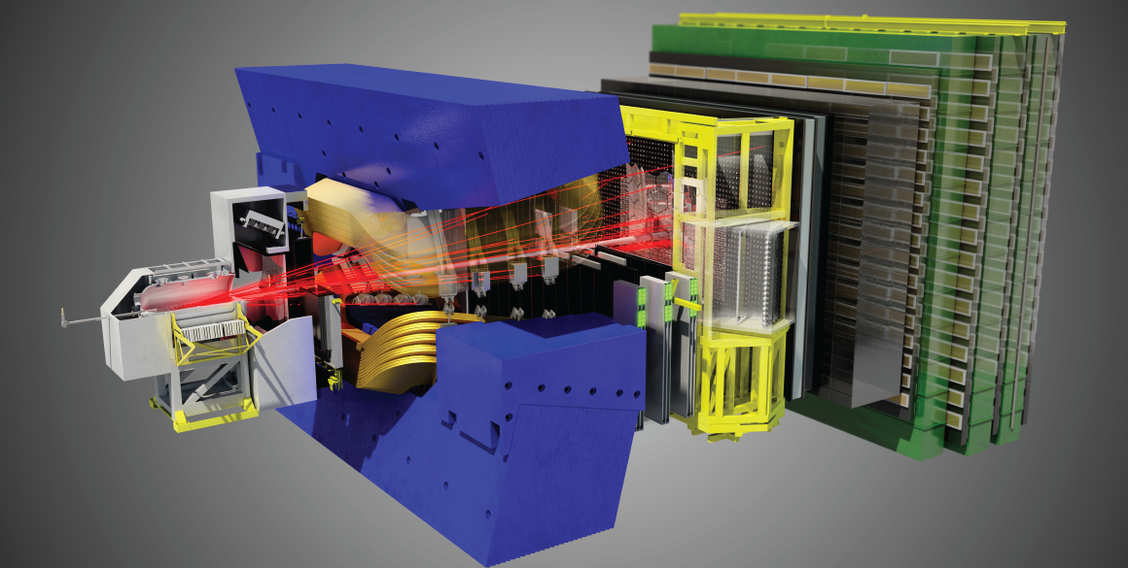
LHCb program
Nikhef SAC Review 2013
Marcel Merk for the LHCb group

Slide 2
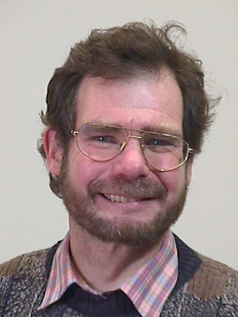
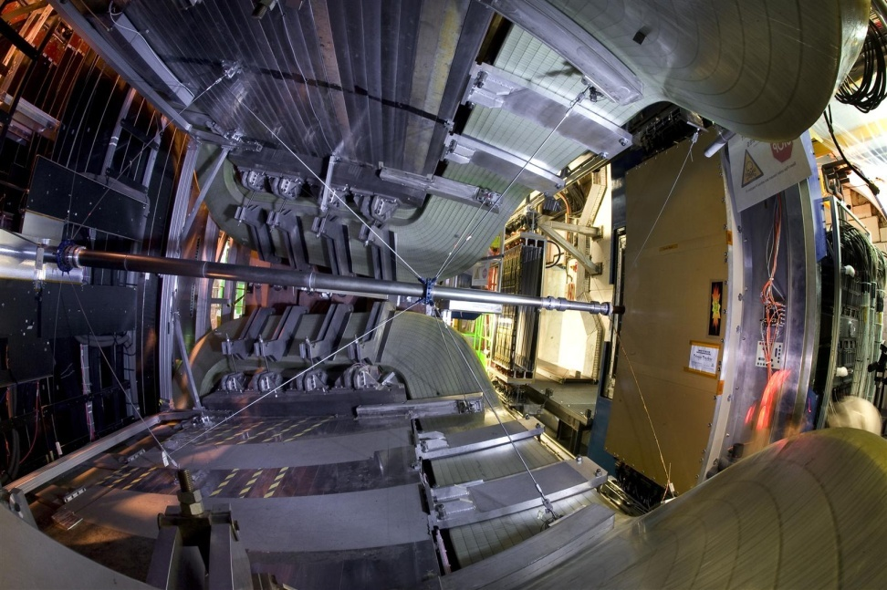
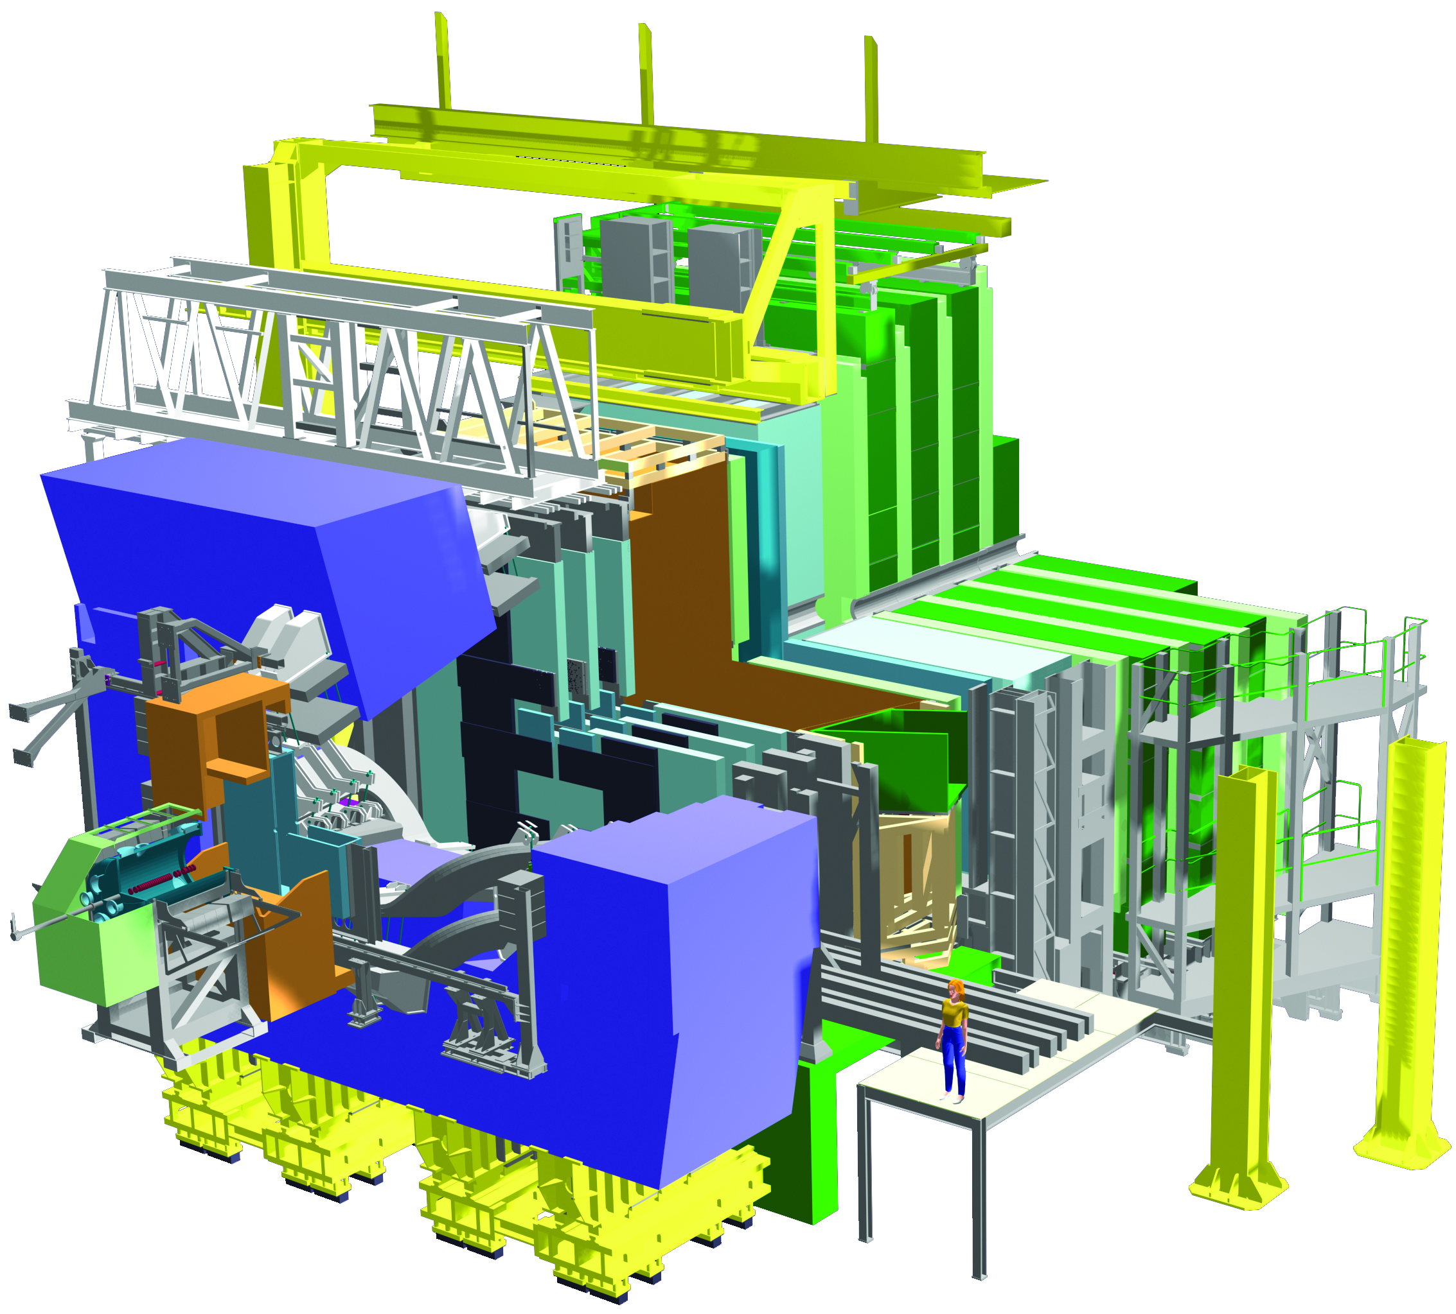

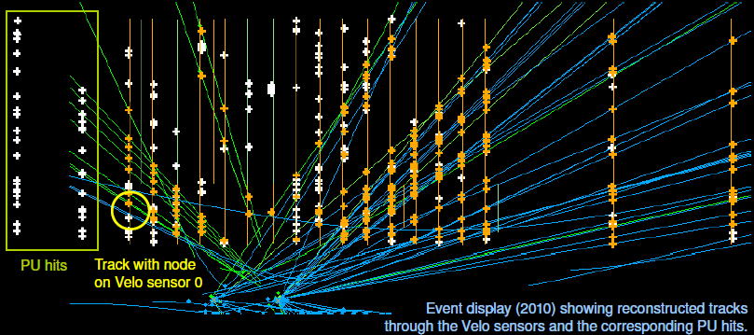
LHCb Program
Form a relatively large group in LHCb with corresponding responsibilities in both hardware and physics (Werner Ruckstuhl)
VELO, Pile Up (MT, ET, CT)
OT (MT, ET, CT)

Slide 3
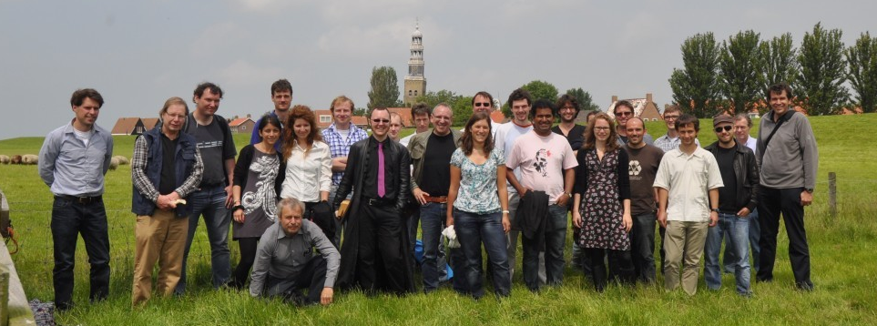
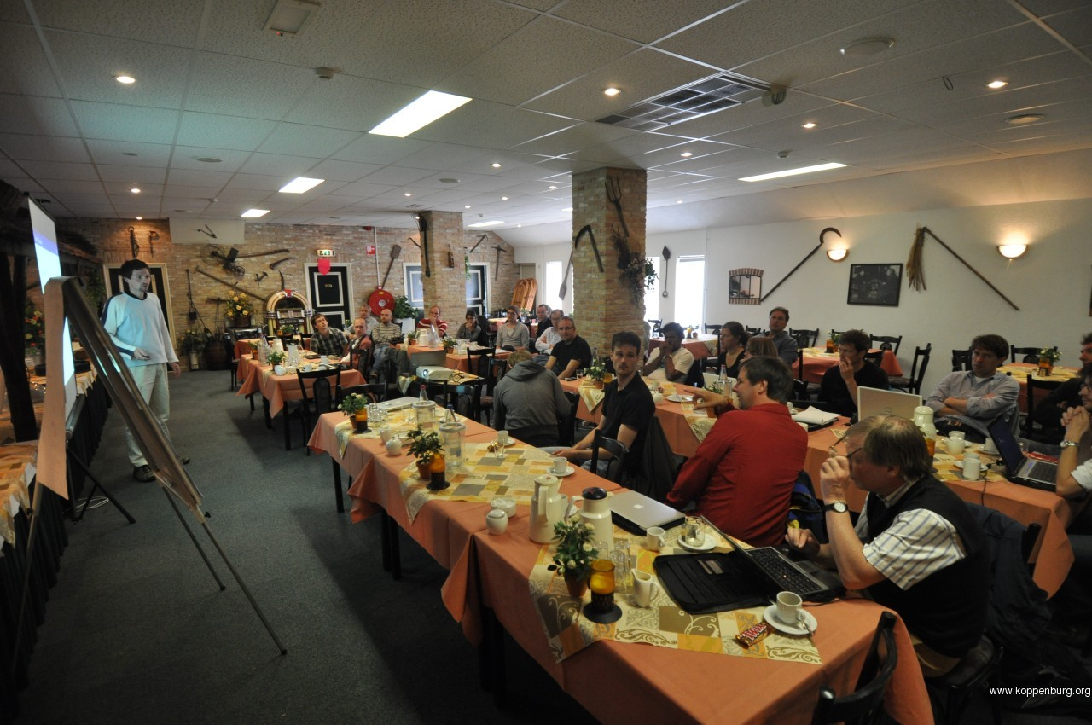
The “Bfys” team
Group Composition (Current):
10 staff, 5 Postdocs, 12 PhD’s
(second group in LHCb after CERN)
University Partner: VU + RuG
Investement in LHCb: 4.950 kE (9% LHCb)
Additional grants:
2 Vidi, 2 Projectruimtes, 1 FOM/v

Slide 4
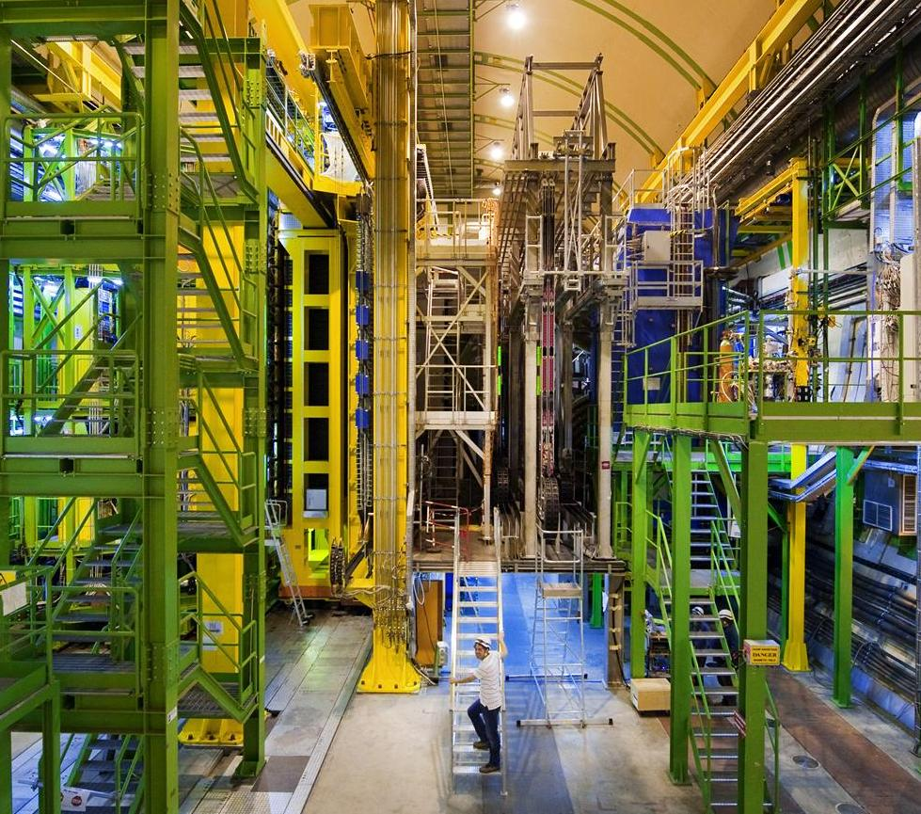
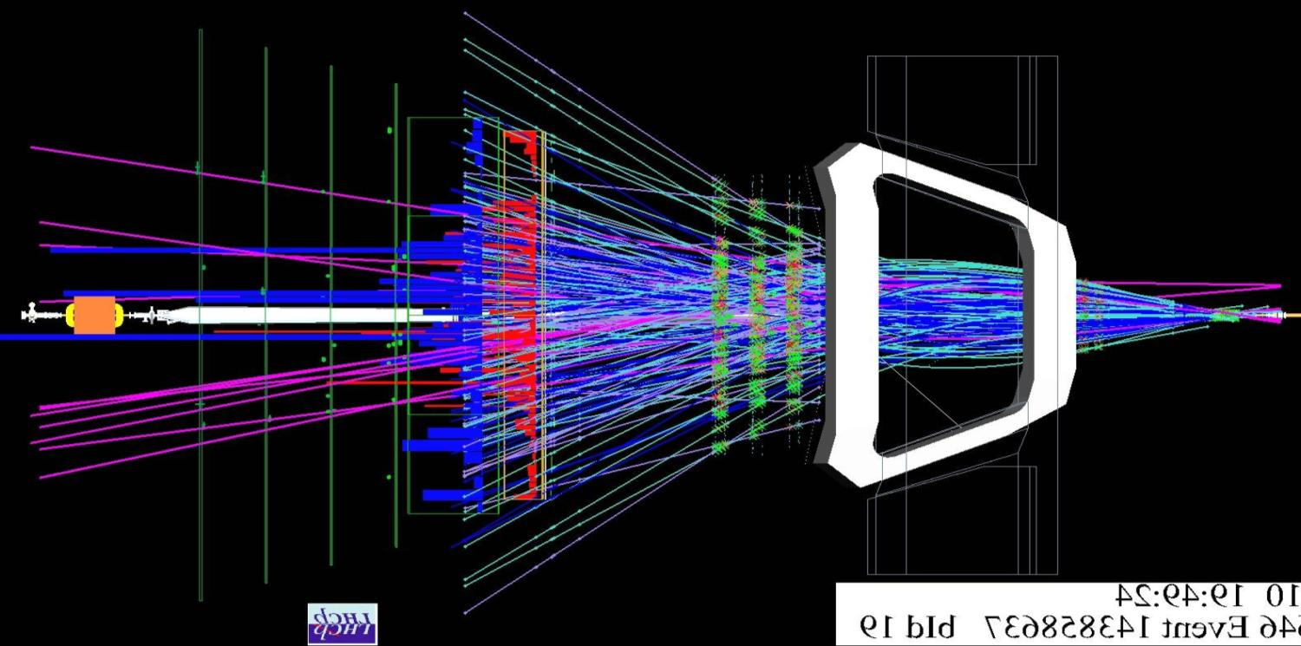
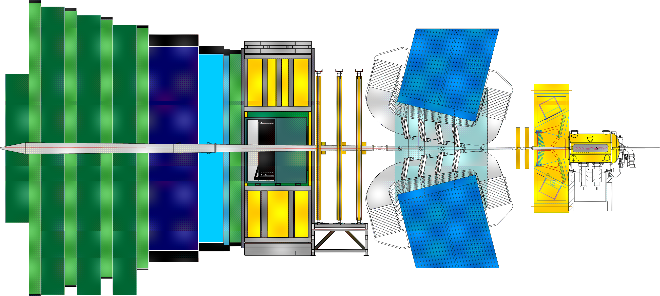
The LHCb Detector
23 sep 2010 19:49:24
Run 79646 Event 143858637
4

Slide 5
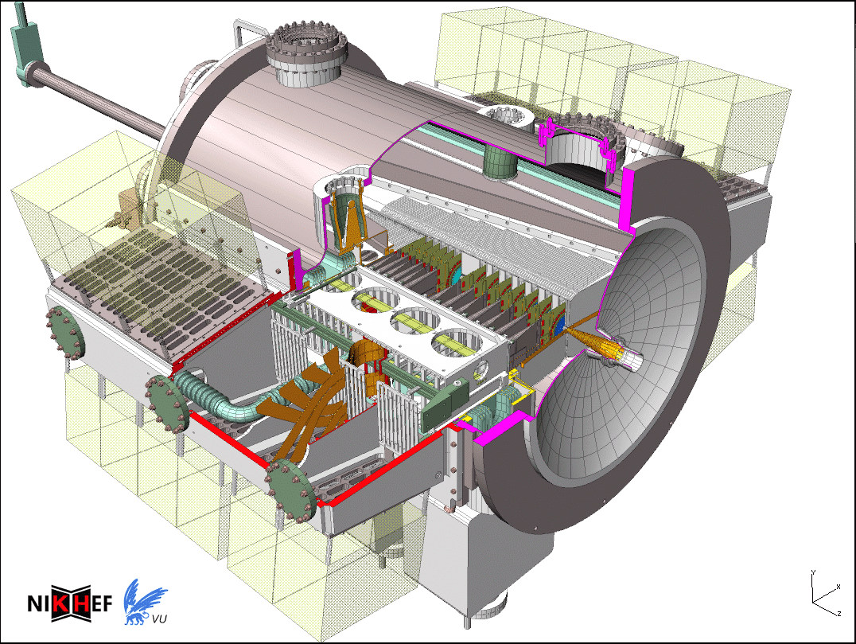
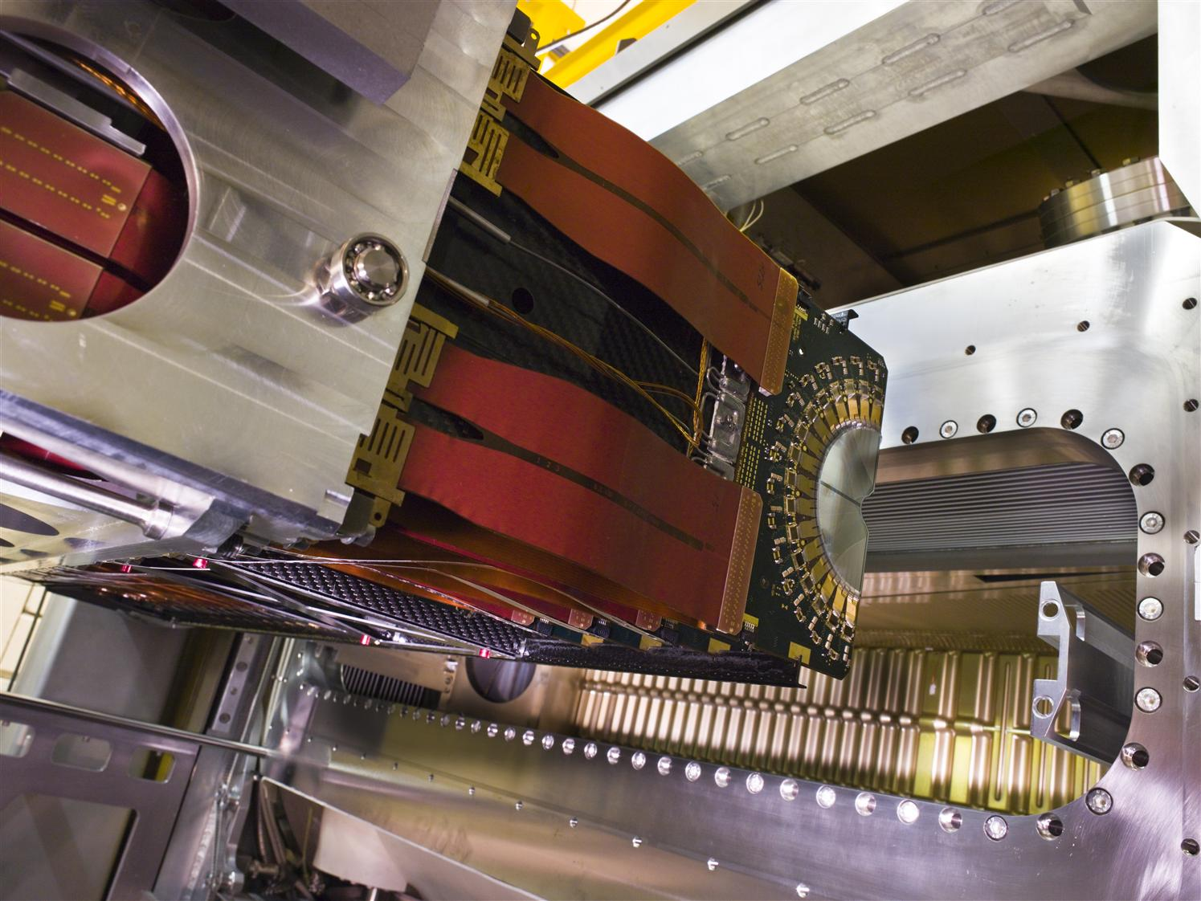
Vertex Locator (Velo)
Nikhef Hardware contributions:
Velo vessel mechanics
Vacuum Control
CO2 cooling
RF box
Detector Open-Close system
Electronics: Beetle chip
Nikhef Activities:
(Deputy) Project leadership until 2012
Installation and commissioning
  Time alignment
Quality control and monitoring
  Operation
  Data quality
Vertexing

Slide 6
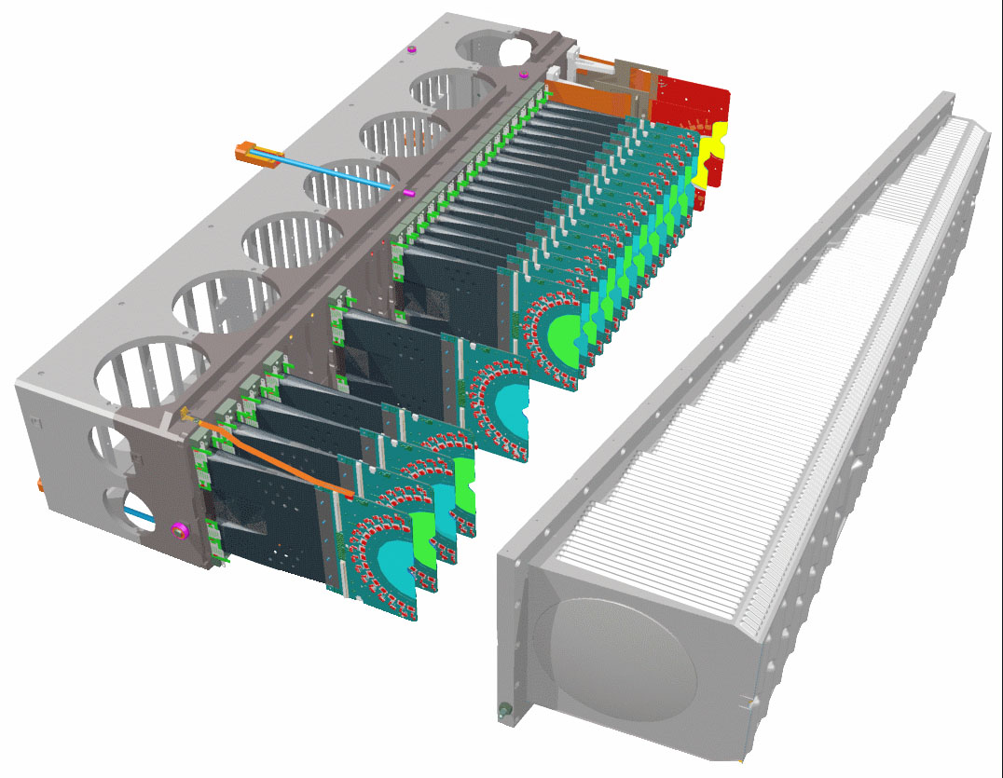
Vertex Locator (Velo)
Nikhef Hardware contributions:
Velo vessel mechanics
Vacuum Control
CO2 cooling
RF box
Detector Open-Close system
Electronics: Beetle chip
Nikhef Activities:
(Deputy) Project leadership until 2012
Installation and commisioning
  Time alignment
Quality control and monitoring
  Operation
  Data quality
Vertexing

Slide 7
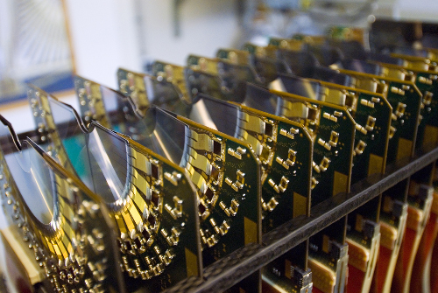
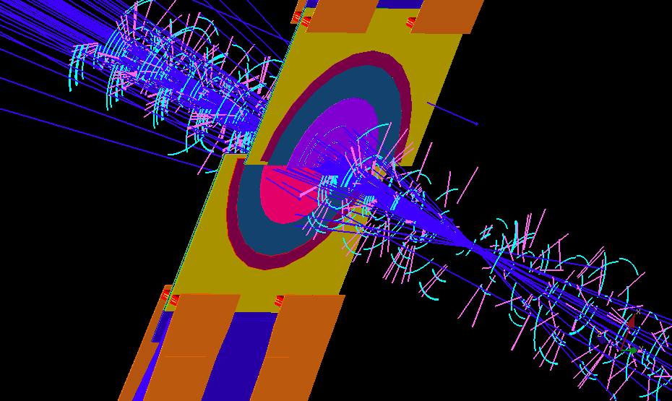
Vertex Locator
99.4% cluster
efficiency

Slide 8
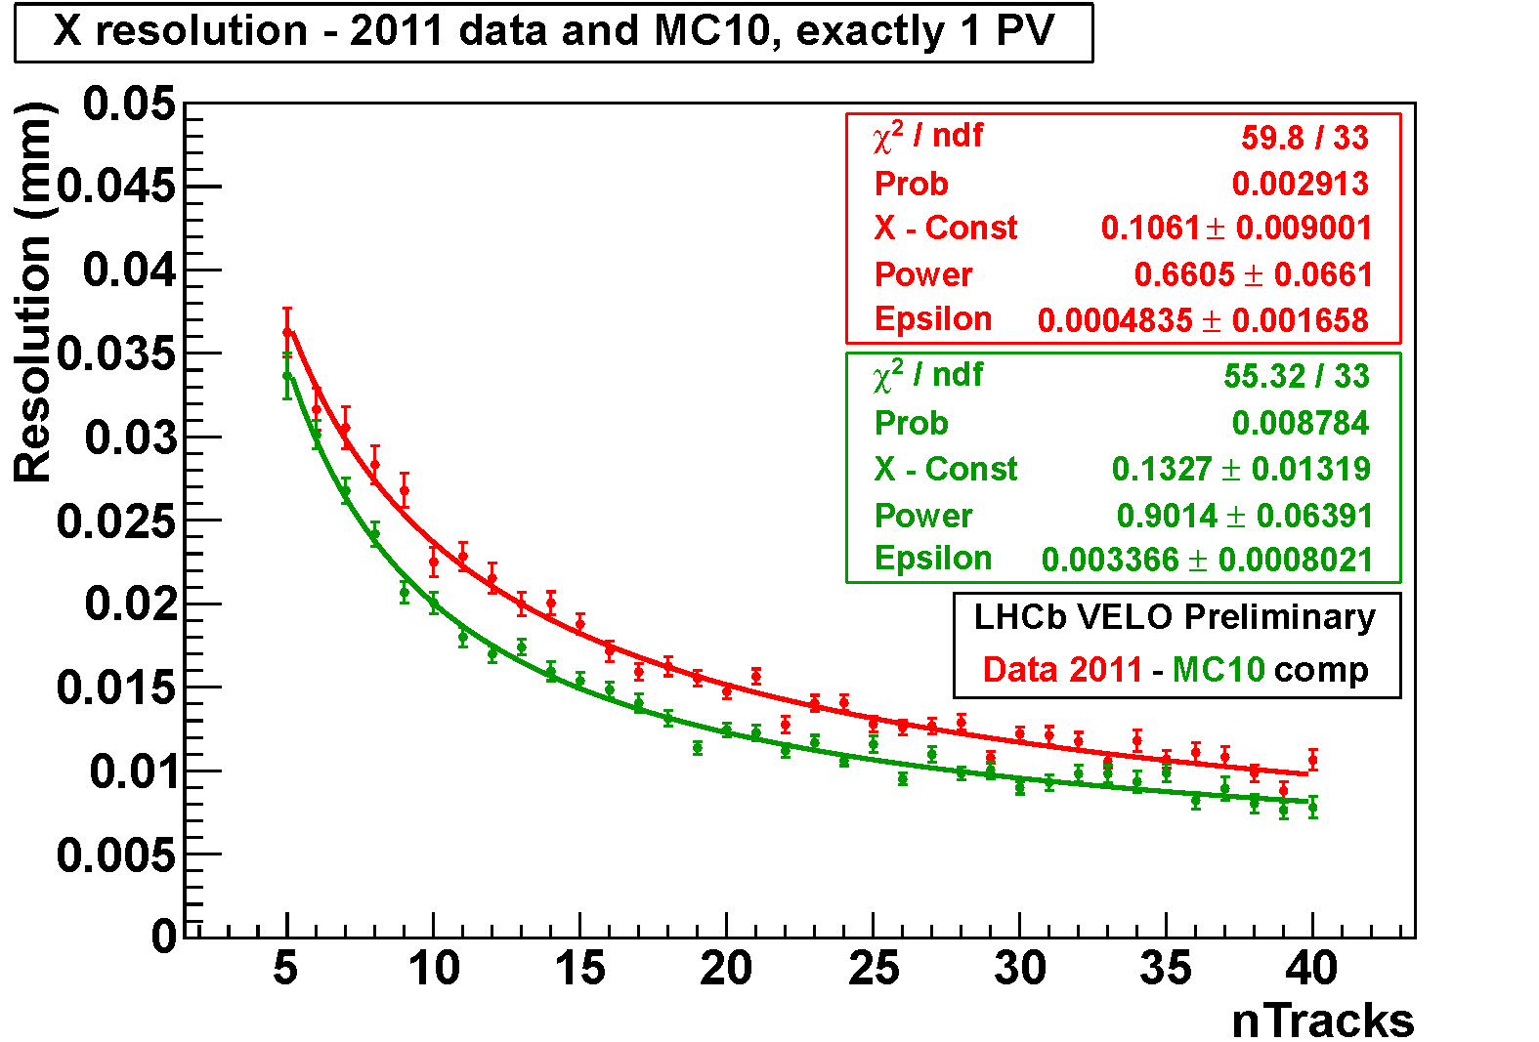
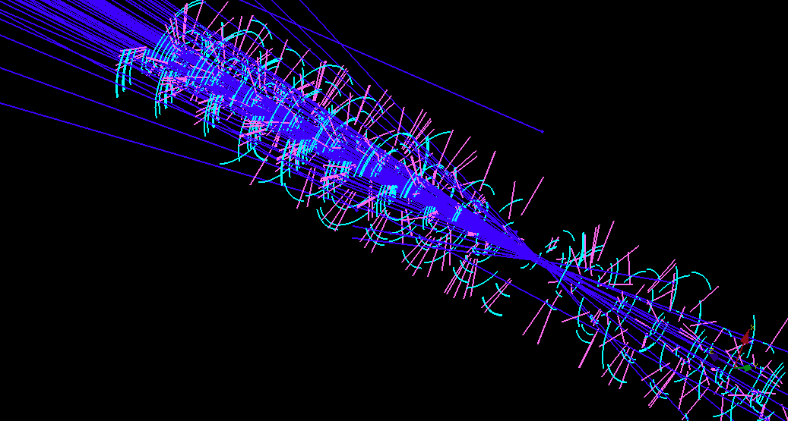
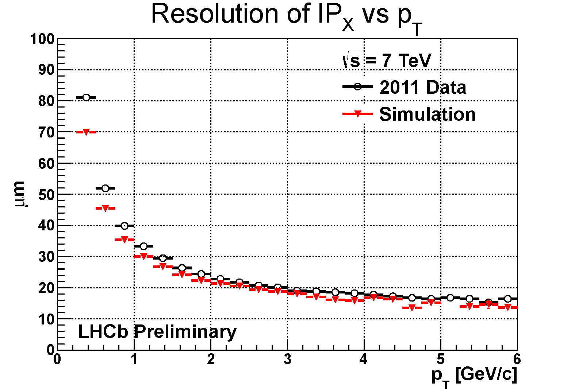
Vertex Locator
Primary
Secondary

Slide 9
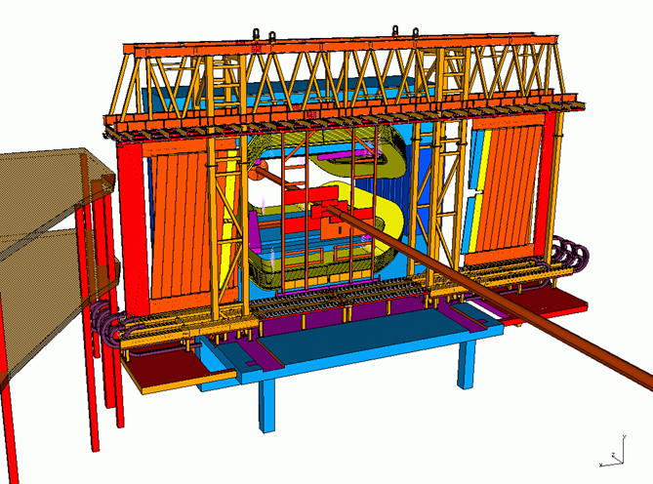
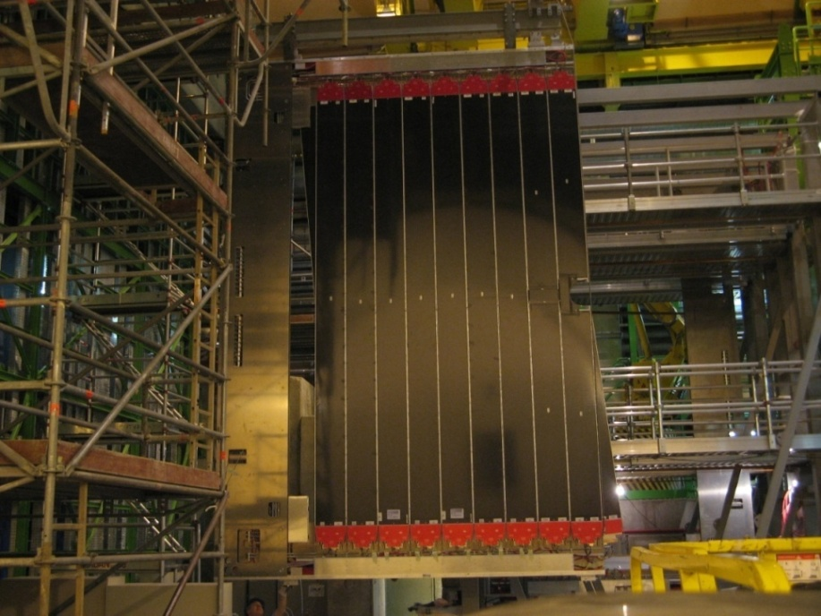
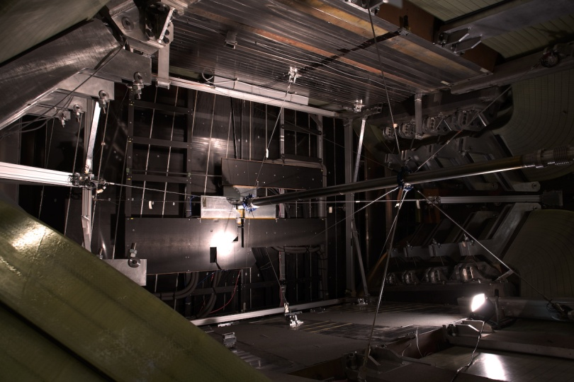
Outer Tracker
Nikhef Activities:
Project leadership
Frame and Module construction
Electronics testing
Installation, commissioning, monitoring
  RT & T0 calibrations
Resolution studies
Irradiation studies and ageing tests

Slide 10
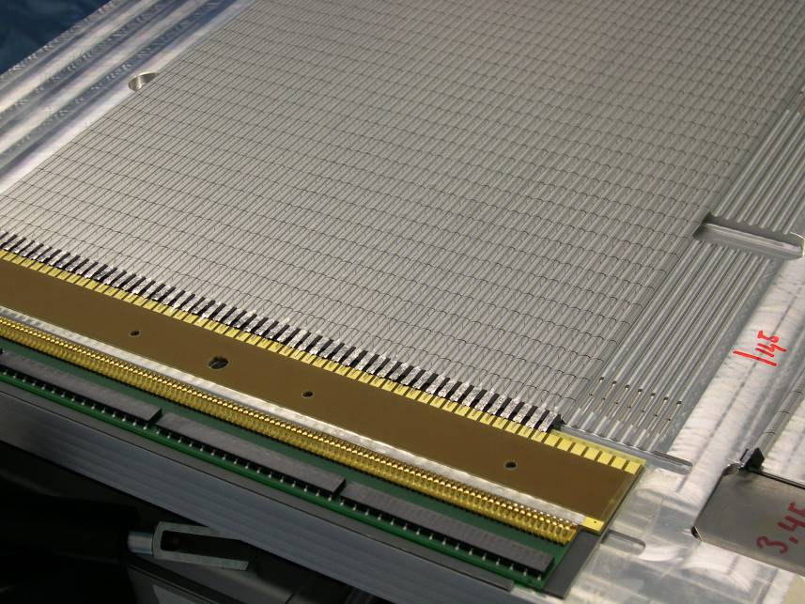
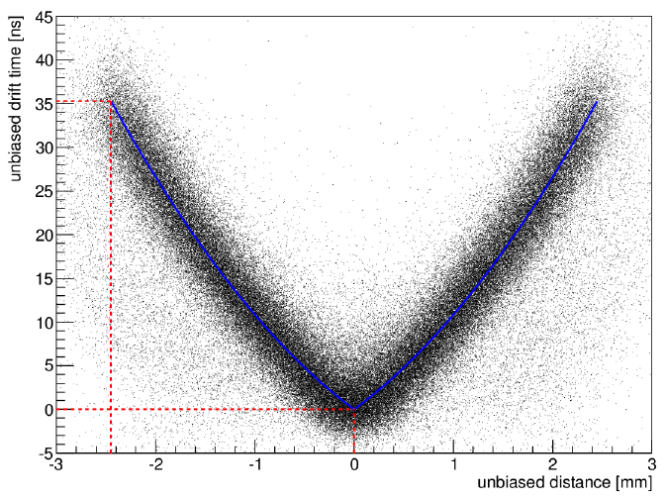
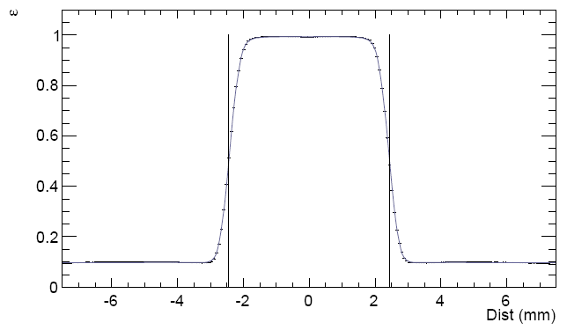
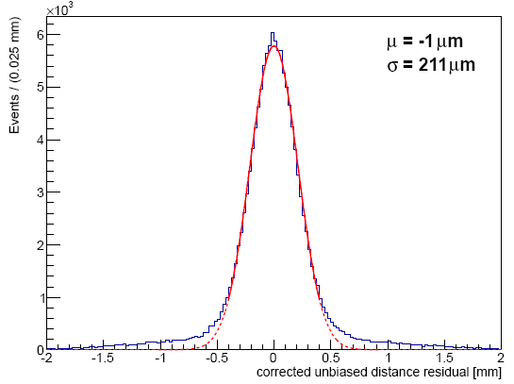
Outer Tracker
rt-relation:
Efficiency profile:
hit resolution:
Plateau:
ε = 99.5%
σ = 211 μm

Slide 11
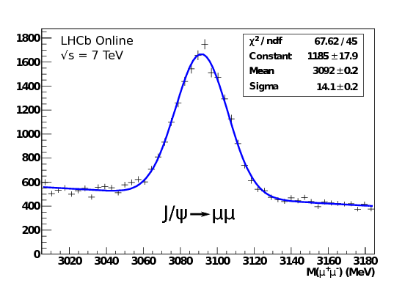
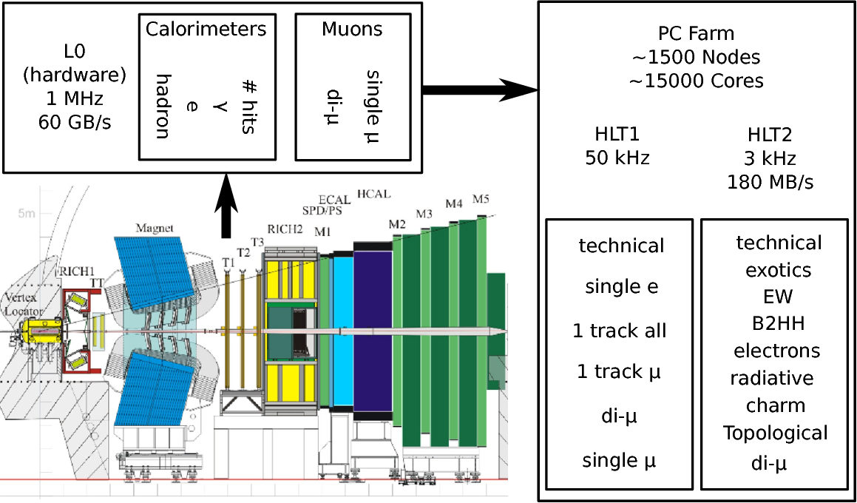
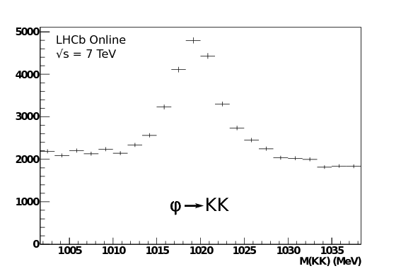
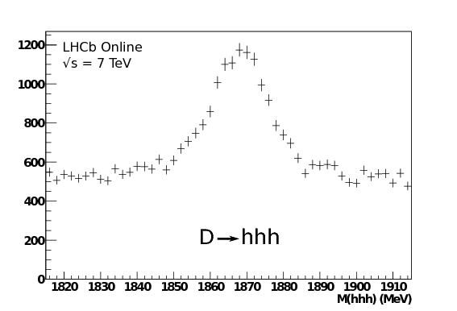
The Trigger
Nikhef Trigger contributions
L0 Hardware
  Pile-Up detector
HLT Software
  Framework authors
  Contributions to algorithms
Trigger project leader from 2012
11

Slide 12
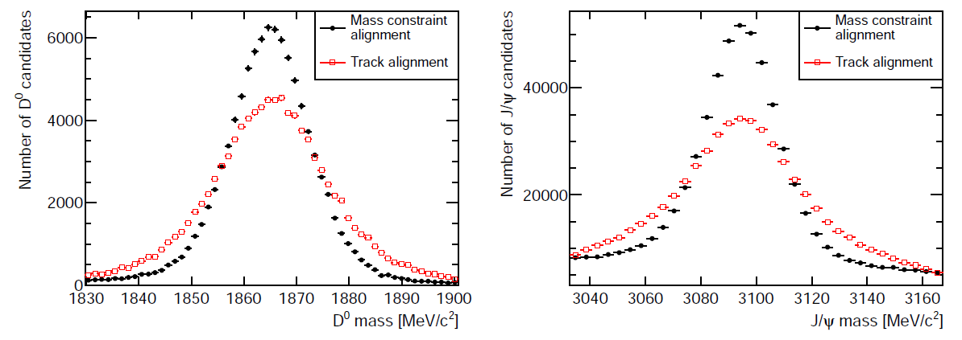
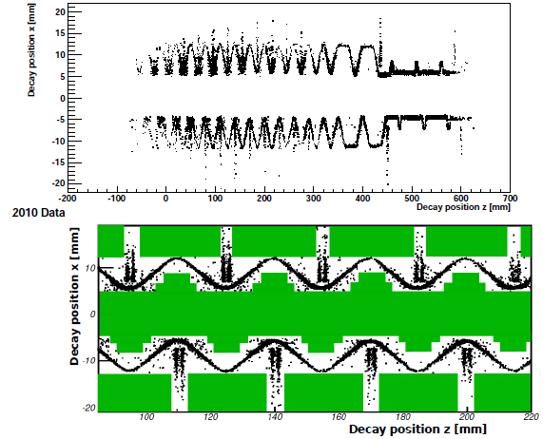
Reconstruction
Offline & Trigger Track Reconstruction:
  Kalman filter using hits of all tracking sub-det’s
Track based Alignment:
  Allows to include mass constraint from any clean resonance
  Precise mass reconstruction
Convenors Reconstruction and Alignment
regions with material
are vetoed in analysis
red: without D0 mass constraint in alignment
black: with D0 mass constraint in alignment
Online Displaced Vertex determination:
  Used for Exotic particle searches

Slide 13
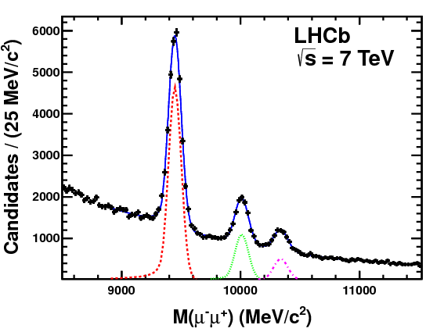
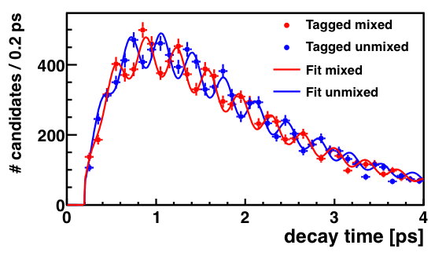
LHCb vs Atlas/CMS
LHCb Forward Geometry; comparison to 4π general purpose experiments:
Pro’s:
  Mass Resolution due to long lever arm
  Vertex Resolution due to Velo in vacuum
  RICH PID
  Online reconstruction capabilities
Con’s:
  Limited acceptance for high Pt -physics
  Limited pileup (Luminosity) capability
Mass Resolution – Upsilon spectrum:
Decay-time Resolution – B_{s} mixing:

Slide 14


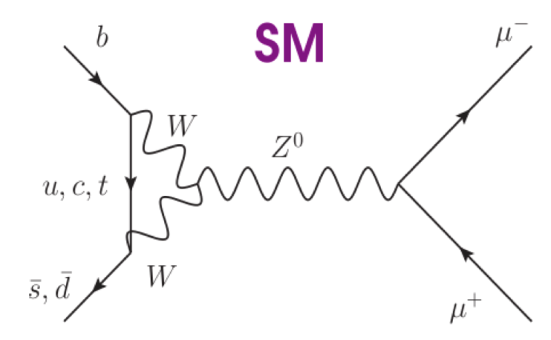

LHCb – Flavour Physics
Testing the deep quantum structure of Nature by looking at quantum loops via trees, boxes, penguins:

Slide 15
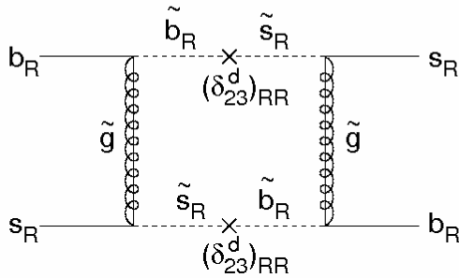
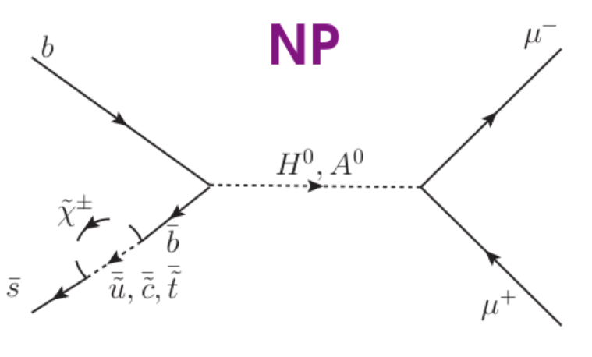
LHCb – Flavour Physics
Testing the deep quantum structure of Nature by looking at quantum loops via trees, boxes, penguins:
SM
NP

Slide 16
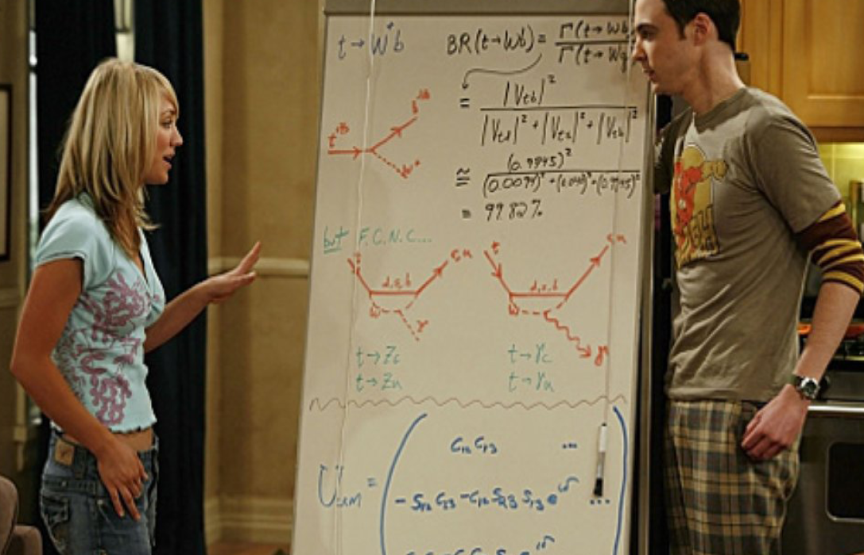
Explaining Flavour Physics…
Notes:
The Big Bang Theory: Sheldon and Penny

Slide 17
Papers by Nikhef Bfys group members
Physics Papers:
Measurement of the effective B_{s}→J/ψ K_{s} lifetime, Nucl. Phys. B (2013)
Measurement of CP violation and the B_{s}⁰ meson decay width difference with B_{s}⁰→J/ψ K⁺K⁻ and B_{s}⁰→J/ψ π⁺π⁻ decays, Phys. Rev. D (2013)
Prompt charm production in pp collisions at √s = 7 TeV, Nucl Phys B (2013).
Measurement of the fragmentation fraction ratio f_{s}/f_{d} and its dependence on B meson kinematics”, JHEP (2013)
Measurement of the time-dependent CP asymmetry in B→ J/ψ K_{s} decays, Phys. Lett. B (2013).
First evidence of the B_{s}→μ⁺μ⁻ decay”, Phys. Rev. Lett. (2013)
Search for the rare decays K_{s}→μ⁺μ⁻, Phys. Rev. Lett. (2013)
Measurement of the B_{s}→J/ψ K_{s} branching fraction, Phys. Lett. B (2012)
Measurement of the branching fractions of the decays B_{s}→D_{s}K and B_{s}→D_{s}π, JHEP (2012)
Strong constraints on the rare decays B_{s}→μ⁺μ⁻ and B⁰→μ⁺μ⁻, Phys. Rev. Lett (2012)
Measurement of the CP violating phase ϕ_{s} in the decay B_{s}→J/ψ φ
Search for Higgs-like bosons decaying into long-lived exotic particles, CONF note (2012)
Determination of f_{s}/f_{d} for 7 TeV pp collisions and a measurement of the branching fraction for the decay B⁰→D⁻K⁺, Phys. Rev. Lett. (2011)
Search for the rare decays B_{s}→μ⁺μ⁻ and B⁰→μ⁺μ⁻, Phys. Lett. B (2011)
Detector Papers:
Radiation hardness of the LHCb Outer Tracker, NIM (2012)
Radiation damage in the LHCb Vertex Locator, NIM (2012)
The LHCb Trigger and its Performance, NIM (2012)
Application of vertex and mass constraints in track based alignment, NIM (2012)
Letter of Intent for the LHCb Upgrade, CERN-LHCC-2011-011
Ageing in the LHCb Outer Tracker: Aromatic hydrocarbons and wire cleaning, NIM (2011)
Ageing in the LHCb Outer Tracker: Phenomenon, culprit and effect of oxygen, NIM (2011)

Slide 18
Papers by Nikhef Bfys & Theory group members
Exploring B_{s}→D_{s}⁽*^{)±}K± Decays in the Presence of a Sizeable Width Difference ΔΓ_{s}
  K. De Bruyn, R. Fleischer, R. Knegjens, M. Merk, M. Schiller, N. Tuning, Nucl.Phys.B, 2012
  Method used in angle gamma analysis.
Probing New Physics via B_{s}→μ⁺μ⁻ Effective Lifetime
  K.De Bruyn, R. Fleischer, R. Knegjens, P. Koppenburg, M. Merk, A. Pellegrino, N. Tuning, Phys.Rev.Lett, 2012
  Strategy to be applied in upgrade
Branching Ratio Measurements of B_{s} Decays
  K. De Bruyn, R. Fleischer, R. Knegjens, M. Merk, N. Tuning, Phys.Rev.D, 2012
  Distinguish “Theoretical” vs “Experimental” Branching Ratio definition.
Tests of Factorization and SU(3) Relations in B Decays into Heavy-Light Final States
  R. Fleischer, N. Serra, N. Tuning, Phys.Rev.D, 2011
  Used in fs/fd paper by Nikhef
Extracting Gamma and Penguin Topologies through CP Violation from B_{s}→J/Ψ K_{s}
  K. De Bruyn, R. Fleischer, P. Koppenburg, Eur.Phys.J., 2010
  B_{s}→J/Ψ K_{s} Branching ratio paper
A New Strategy for B_{s} Branching Ratio Measurements and the Search for New Physics in B_{s}→μ⁺μ⁻
  R. Fleischer, N. Serra, N. Tuning, Phys.Rev.D., 2010
  Used in fs/fd paper and B_{s}→μ⁺μ⁻

Slide 19
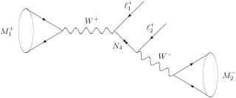
Analyses: current and future
“Time dependent CP Violation”:
B→J/ψ K_{s} (sin 2β)
B_{s}→J/ψ K_{s} (Penguin)
B_{s}→J/ψ ϕ (Mixing phase φ_{s})
B_{s}→D_{s} K (Angle γ with trees)
➔ Ongoing
“Very Rare B decays”:
K_{s}→μ⁺μ⁻
B_{s}→μ⁺μ⁻
➔Ongoing, add B→eμ
“Exotics”:
Long lived particles
Jet Reconstruction for Higgs
➔New: LFV, LNV
“Normalisations”:
D & D* production cross section
Branch. Ratio: B_{s}→D_{s}π & B_{s}→D_{s}K
f_{s}/f_{d} fragmentation
➔ Finished

Slide 20
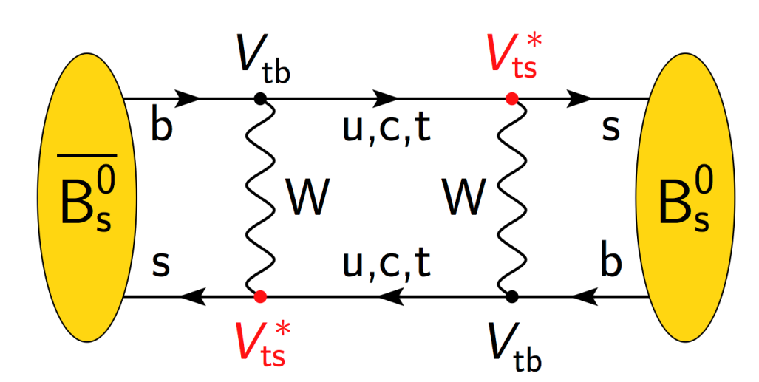
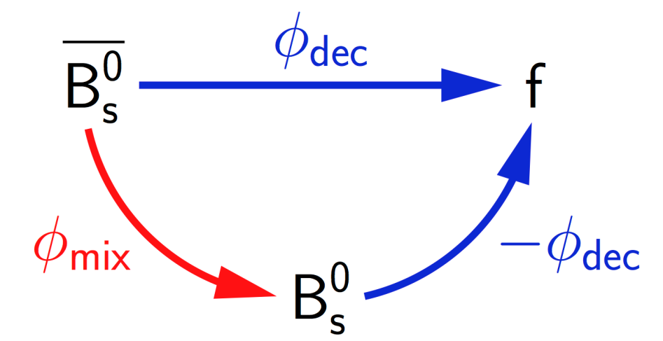
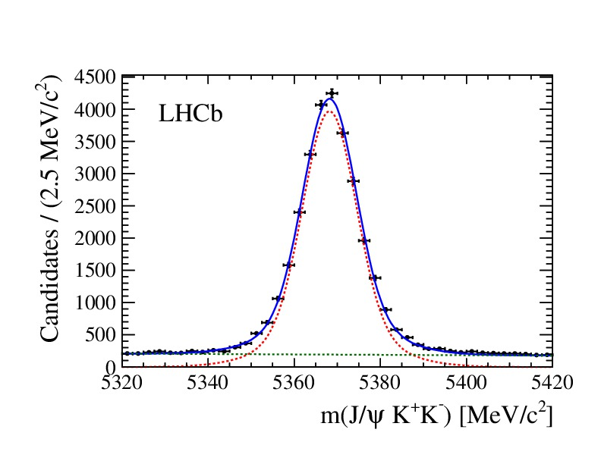
Ex. 1) CP Violation in B_{s} mixing: B_{s}→J/ψ ϕ
Nikhef:
  Angular and decay time fitting formalism + constraint of penguin pollution (1 postdoc)
  Signal selection and background subtraction (1 PhD)
  (Trigger) Decay-time acceptance (1 PhD)
  Angular acceptance (1 PhD)

Slide 21
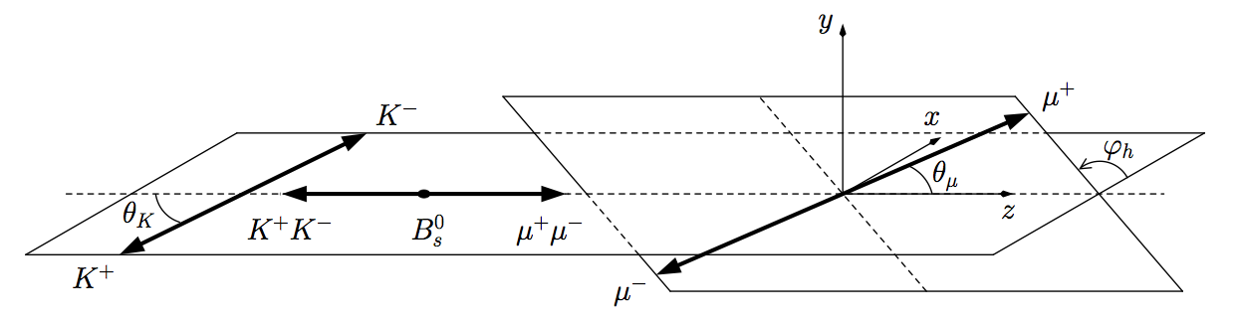
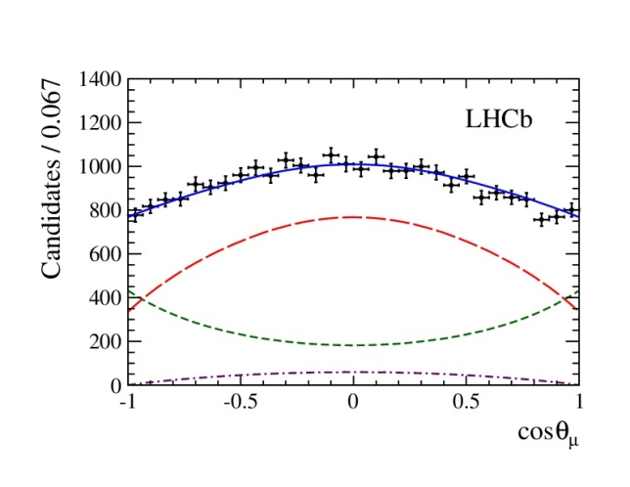
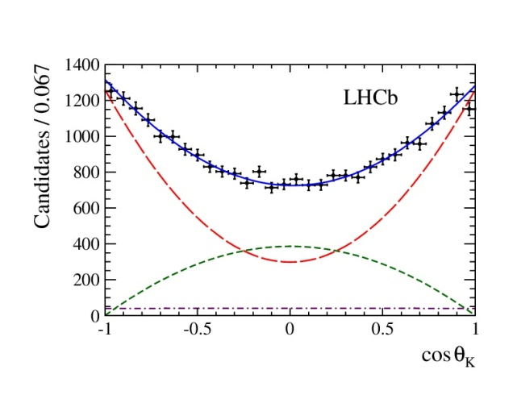
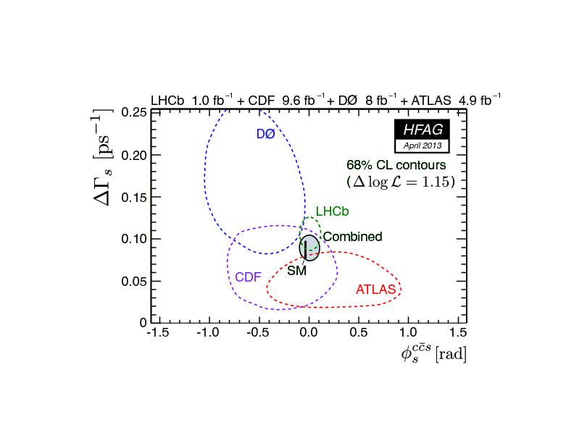
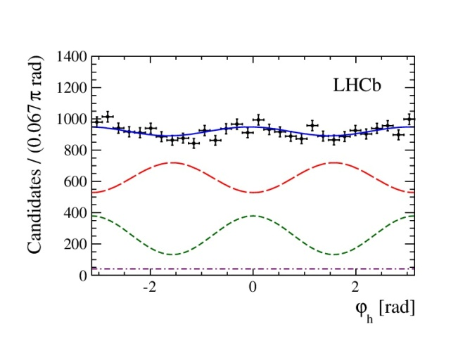
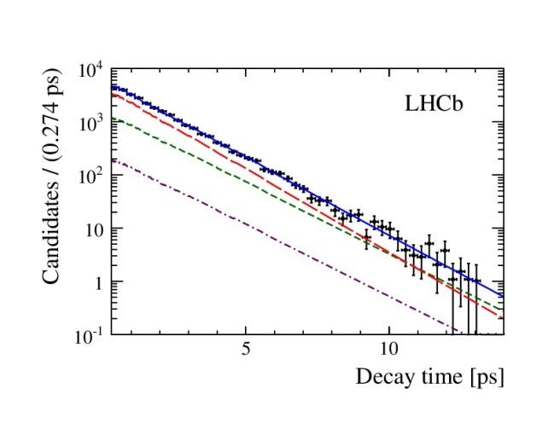
Ex. 1) CP Violation in B_{s} mixing: B_{s}→J/ψ ϕ
Combined angular and decay time analysis:
First direct observation of a non-zero ΔΓ_{s} value
φ_{s} result compatible with Standard Model

Slide 22
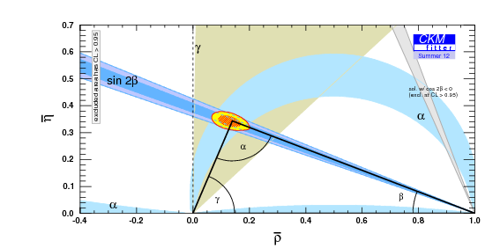
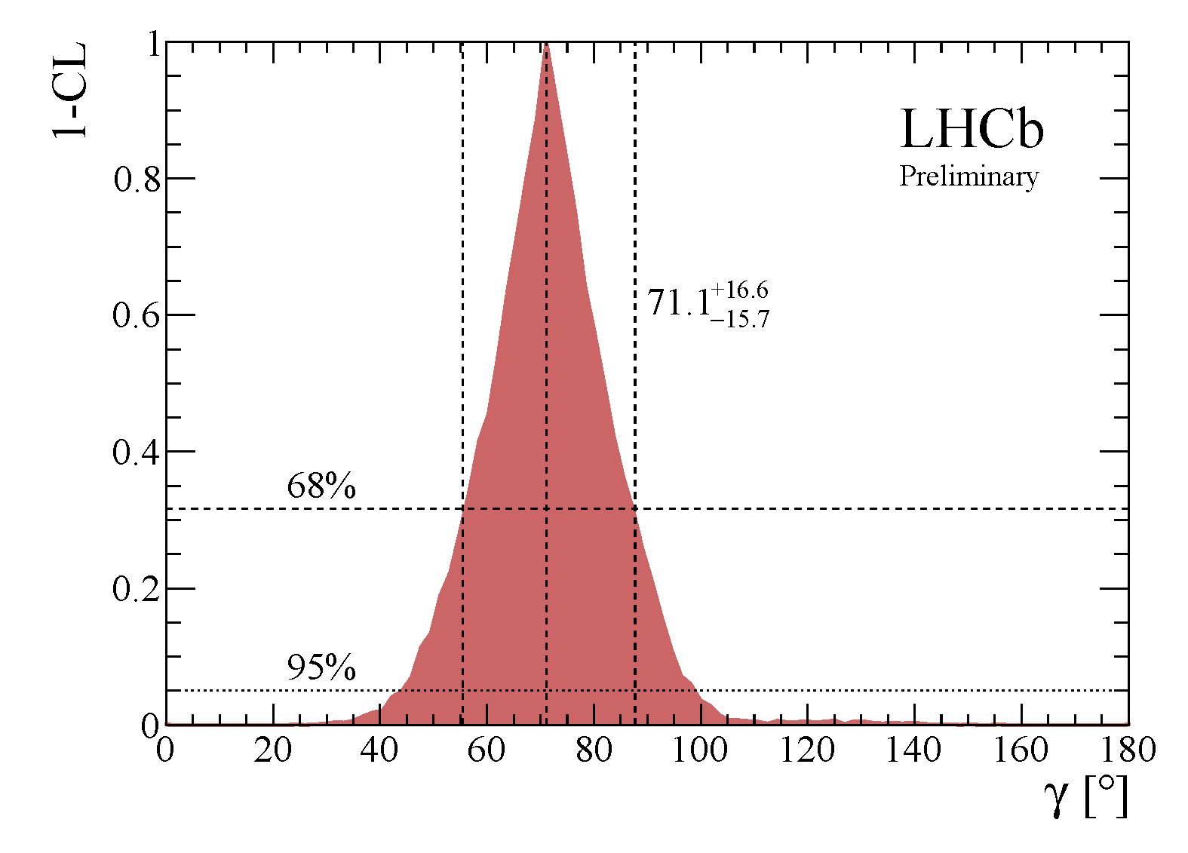
Ex 2) CKM Angle γ “with trees”
First LHCb measurement on angle γ using time-integrated methods
Nikhef main contributor to time-dependent method
  B_{s}→D_{s}K
Nikhef:
  Likelihood fitting in mass and decay time (1 postdoc)
  Acceptance determination (1 PhD)
  Decay time resolution determination (1 PhD)
  Tagging dilution determination (1 PhD)

Slide 23
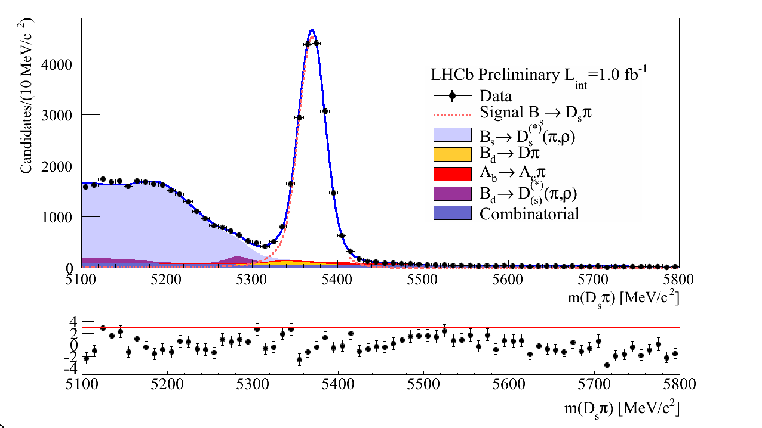


Ex 2) CKM Angle γ “with trees”
Bs Mixing!
B_{s}→D_{s} π
Oscillations…?
B_{s}→D_{s} K

Slide 24


Ex 3) B_{s}→ μ⁺μ⁻
Very rare decay:
BR(SM) = (3.5 ± 0.3) x 10⁻⁹

Slide 25



Ex 3) B_{s}→ μ⁺μ⁻
Nikhef:
  B.R. normalisation (1 PhD)
  f_{s}/f_{d} (1 PhD)
  Specific background identification (1PhD)
  Confidence level calculation (1 Postdoc)
With Nikhef Theory group:
  Branching Ratio definition:
    “Time integrated” (exp) vs ”Time=0” (theory)
  New observables in time dependence
    (requires upgrade)

Slide 26


LHCb Upgrade
Phase-1 (2010 – 2017) : ~ 5 fb⁻¹ with 1 MHz read-out
Upgrade (2019 – 2029) : ~ 50 fb⁻¹ with 40 MHz read-out. Nikhef involvements:
2013 – 2014 : Technology choices and Upgrade TDRs
2015 – 2018 : Construction & Installation
2019 – … : Phase-II Physics
Upgrade LoI and Framework
TDR positively received by LHCC
“Strong Science Case”
CERN Workshop 2012:
“Implications of LHCb Measurements and Future Prospects”
Submitted Eur.Phys.J.C., 2012

Slide 27

Detector Upgrade to 40 MHz R/O
VELO
Si strips
(replace all)
Silicon Tracker
Si strips
(replace all)
Outer Tracker
Straw tubes
(replace R/O)
Muon MWPC
(almost compatible)
RICH
HPDs
(replace HPD & R/O)
Calo
PMTs (reduce PMT gain, replace R/O)
Estimated cost: 52 MCHF

Slide 28




Nikhef: Velo Upgrade
Velo Pixel detector
  55 by 55 μm
R&D for TimePix3→Velopix
R&D for detector cooling
High speed data transmission
Testbeam

Slide 29




Upgrade RF Box
Mill from a solid Al box:
Prototype VU

Slide 30




Outer Tracker Upgrade
Modules: Technology choice in 2013: Straws vs Scintillating Fibers
“S” type (two pieces)
S
M
M
M
M
New electronics for 40 MHz readout of straw modules:
M

Slide 31
Sensitivities to key quarks flavour channels

Slide 32
FOM Program Funding Request
Project 1. “CP Violation”
Staff: P. Koppenburg, M.Merk, G. Raven, N. Tuning
A. CP Violation in tree-decays: 1 postdoc, 2 PhD students
B. CP Violation in loop decays: 1 postdoc, 2 PhD students
Project 2. “Rare Decays”
Staff: A. Pellegrino, W.Hulsbergen, G. Onderwater, H. Wilschut
A. Very rare B decays (B→μμ): 1 postdoc, 2 PhD students
B. Lepton Flavour Violation (B→eμ, τ→3μ): 0.5 postdoc, 2 PhD students
C. Lepton number violation: 0.5 postdoc, 2 PhD students
New Group joined LHCb:
RuG/KVI
Project 3. “Detector Upgrade”
Staff: M. v. Beuzekom, W. Hulsbergen, E. Jans, E. Koffeman, M.Merk
G. Onderwater, A. Pellegrino
A. Detector R&D: 0.5 postdoc, 1.5 PhD students
B. Trigger R&D: 0.5 postdoc, 1.5 PhD students
Total: 5 postdocs (x3 years), 13 PhD’s (x4 years) over 7 years:
➔ average group size: 2.1 postdoc , 7.4 PhD

Slide 33

Compare to 2000 - 2011
Program 2000 – 2011
Average per year:
9.3 PhDs and 4.3 postdocs
Current program request
Average per year:
7.4 PhDs and 2.1 postdocs
Program 2000 – 2011
Average per year:
717 kE/y + 409 kE/y = 1126 kE/y
Current program request
Average per year:
5541 kE over 7 years = 792 kE/y
(Reduction of 30%)
Will try to seek additional funding
(As of last week: 1 FOM/v postdoc)

Slide 34
Additional Material
(Backup Slides)

Slide 35
PhD’s and Theses
HERA-B (5)
  Wouter Hulsbergen (2002), Maarten Bruinsma(2002), Maaijke Mevius(2003), Hernan Wahlberg(2005), Antonelli Sbrizzi(2006)
Babar (2)
  Max Baak (2009), Hella Snoek(2009)
LHCb (18 + 3 unfinished)
  Nikolai Zaitsev (L0+PA 2000), Rutger van der Eijk (OT+TR 2002), Rutger Hierck(TR 2003), Niels van Bakel (VL 2004), Sander Klous (VL 2005), Jeroen van Tilburg (TR 2005), Bart Hommels (OT 2006), Jacopo Nardulli (OT+PA 2007), Peter Vankov (OT 2008), Aras Papadelis (VL 2009), Edwin Bos (TR 2010), Gabriel Ybeles Smit (PA 2010), Eduard Simioni (OT 2010), Tristan du Pree (PA 2010), Jan Amoraal (TR 2011), Fabian Jansen (OT+PA 2011), Barbara Storaci (OT+PA,2012), Daan van Eijk (OT+PA 2012), Alexandr Kozlinskiy (OT+PA, 2013)
Current PhD Students – LHCb (12)
  Chiara Farinelli (VL), Serena Oggero (L0+PA), Roel Aaij (HLT), Jeroen van Leerdam (PA), Veerle Heijne (PA), Rose Koopman (PA), Kristof de Bruyn (TH+PA), Suvayu Ali (PA), Pieter David (PA), Siim Tolk (PA), Panos Tsopelas (VL), Vasilis Syropoulos (PA)
VL = Velo, OT= OTR, L0=Level 0, HLT=High Level Trig, TR=Track Rec, PA=Phys Anal, TH=Theory

Slide 36







Indirect Searches – Proven to work!
B⁰ mixing pointed to the top quark mass
K⁰→ μμ pointed to the charm quark
ARGUS Coll, Phys.Lett.B192:245,1987
GIM, Phys.Rev.D2,1285,1970
…
…
…
b
d
d
s
d
b
μ
μ

Slide 37


Luminosity & Efficiency

Slide 38


Lumi Levelling & Deferred Trigger
Luminosity levelling:
Automatic beam steering to keep lumi at maximum during fill: 4 x 10³² cm⁻² s⁻¹
Deferred Trigger:
When event builder detects that HLT cannot keep up, it stores events on disks in the farm nodes.
Events are processed inbetween fills.
~20% gain in CPU
End of Fill
End of Fill
Disk usage
time

Slide 39

Time Dependent CP Violation with B_{d}⁰
“Golden mode” B⁰→J/Ψ K_{s}
  S = 0.73 ± 0.07 ± 0.04
  C = 0.03 ± 0.09 ± 0.01

Slide 40


Physics (2): Penguin control with B⁰→J/ψK_{s}
With LHCb's increasing precision, penguin contributions to e.g. B→J/ψKs become relevant.
  Is this the reason for the tension in sin2β?
Study U-spin partners, both theoretically (R.Fleischer et al) and experimentally.
Observation of B⁰→J/ψK_{s} with 0.37 pb⁻¹.
More channels in the pipeline.

Slide 41




Nikhef: Outer Tracker Upgrade
Outer Tracker 40 MHz electronics R&D “halfway”
ASDBLRs
40MHz TDC implemented in Actel FPGA
Stratix IV (readout and GBT emulator)
Outer Tracker requires shorter straw-modules in central region
# Outer Tracker hits in trigger:
Without spillover
With spillover
Notes:
The OT is currently operating at limit with pileUp. Plot show multiplicity cuts that we make in the HLT to be able to deal with the events (real data) selecting spills.
Readout of Sci Fi is Silicon Photomultipliers SiPM (20 p.e. per mip) – radiation protection. Alternative MAPMT a la RICH – same readout.

Slide 42






Velo Upgrade
Detector at smaller inner radius
Pixel vs Strips
(technology choice 2013)
New 3.5mm
CO₂
Current 5.5mm
.
Module-0 design
CO2 cooling
capillaries
#Particles/chip/BX
Electronics: huge data rates: 500 Mhits/s per chip

Slide 43
Velo Upgrade
Velo module: Technology choice Strips vs Pixels on May 1, 2013
  Possible to realize in current situation:
    Prototype thermal module
  Not Possible to realize in current situation:
    Module-0 concept, required by review committee for technology choice
    Thermal simulations: comparison with measurement and alternative variants
    FEA-simulations and measurements mechanical behaviour during cooling/heating
    Measurement of EMI-effect of orbital welding
  VeloPix variant seriously in danger.
VeloPix chip design
  Current 1 FTE instead of 2FTE will lead to delay in submission date VeloPix chip (2014).
  Expect that this can be corrected: 1.5 FTE in 1st half 2013, 2 FTE in 2nd half 2013
TimePix3 readout SPIDR
  Not specific LHCb, used for TimePix3 characterization and correlated with VeloPix submissions
  Should have 1 FTE ET for firmware and 0.4 FTE CT software but lately received little
    Problematic for beamtests and TimePix characterization
  Current situation would lead to serious delay VeloPix. On critical path.
Velo Mechanics:
  Upgrade: R&D Milling with 5-axial technique, material selection, thinning
    For the moment mainly done at the VU, expect use of Nikhef facilities in 2013

Slide 44
Velo Upgrade
Velo module: Technology choice Strips vs Pixels on May 1, 2013
  Possible to realize in current situation:
    Prototype thermal module
  Not Possible to realize in current situation:
    Module-0 concept, required by review committee for technology choice
    Thermal simulations: comparison with measurement and alternative variants
    FEA-simulations and measurements mechanical behaviour during cooling/heating
    Measurement of EMI-effect of orbital welding
  VeloPix variant seriously in danger.
VeloPix chip design
  Current 1 FTE instead of 2FTE will lead to delay in submission date VeloPix chip (2014).
  Expect that this can be corrected: 1.5 FTE in 1st half 2013, 2 FTE in 2nd half 2013
TimePix3 readout SPIDR
  Not specific LHCb, used for TimePix3 characterization and correlated with VeloPix submissions
  Should have 1 FTE ET for firmware and 0.4 FTE CT software but lately received little
    Problematic for beamtests and TimePix characterization
  Current situation would lead to serious delay VeloPix. On critical path.
Velo Mechanics:
  Upgrade: R&D Milling with 5-axial technique, material selection, thinning
    For the moment mainly done at the VU, expect use of Nikhef facilities in 2013
Pixels vs Strips:
Pixel has more (online) potential then strip detector for upgrade.
Choice for Strips occurs if Pixel option is lacking behind.
Big blow for Nikhef (and for LHCb).

Slide 45

Velo

Slide 46

Velo X-ray

Slide 47

Velo X-ray

Slide 48

Velo X-ray

Slide 49

Scientific Output
LHCb: ± 100 Papers & 700 Talks
# International conference talks
date
In addition papers individual Bfys members in collaboration with Nikhef Theory group

Slide 50


Upgrade Motivation
Lumi dependence of L0 trigger yields:
  Muon trigger profits from higher lumi
  E_{T} trigger channels fill up bandwidth; higher E_{T} cuts cost efficiency
40 MHz
Level -0
L0
e, γ
L0
had
L0
μ
≤1 MHz
HLT1
High p_{T} track with non-zero Impact Parameter
High-Level Trigger
30 kHz
Global reconstruction
Inclusive selections
μ, μ+track, μμ, topological, charm, ϕ
HLT2
& Exclusive selections
Solution:
  Increase the bandwidth for L0 or remove completely
  Requires new front end electronics
~3 kHz
Storage: “nominal” event size ~35kB

Slide 51




Upgrade of LHCb
flexible software trigger with up to 40 MHz input rate and 20 kHz output rate
run at ~ 5-10 times nominal LHCb luminosity → L ~ 1-2 ∙ 10³³ cm⁻² s⁻¹
big gain in signal efficiency (up to x7 for hadron modes)
upgrade electronics & DAQ architecture
collect ≥ 5/fb per year and ~ 50/fb in 10 years
LLT custom electronics
CPU Event Filter Farm

Slide 52
Sensitivities to key quark flavour channels
LHCb
Upgrade

Slide 53



Radiation Damage in the Velo
n⁺-on-n sensors at -28ºC
Innermost fluence: 6x10¹³ 1 MeV n_{eq}/cm² per fb⁻¹
Leakage current closely monitored
Velo replacement detector being assembled
LHCb Velo Preliminary
Leakage current vs time
Detector heated
in shutdown
time
Effective depletion voltage ratio different detector zones.
ratio = V_{dep}(@160 pb⁻¹ )/V_{dep}(@ 0 pb⁻¹)
Effective depletion voltage vs R for various integrated Lumi’s:

Slide 54

Velo Upgrade
L-shape pixel modules, 4 sensors with 3 pixel readout chips each
VELOPix chip will be based on Timepix3, design ongoing, submission expected Q3-2012
Big challenges in heat transport, cooling interfaces
  Hybrid with either diamond or TPG core
High speed data transmission
Radiation hardness: 400 Mrad TID, 10¹⁶ 1 MeV n_{eq} / cm²

Slide 55

VeloPix
Matrix of 256x256 pixels of 55x55 um²
  Active chip area 14x14 mm²
  < 2 mm inactive periphery
Each pixel measures time-of-arrival (25 ns resolution)
and charge (0.5 - 1ke- resolution) of hits
No trigger, prompt transmission of zero-suppressed hit data
~ 500 Million hits per chip in hottest region
  5.8 tracks / bunch crossing, 2-3 hits/track
Grouping of hits in 4x4 super-pixel packets
  to reduce (redundant) address and ToA information
  to simplify clustering of hits offline
Output bandwidth ~ 12 Gbit/s per chip
Power consumption < 3 Watts
Chip development collaboration: Nikhef & CERN
Based on Timepix3, 130 nm (or 65) technology
14.1
2.0
17-02-2012

Slide 56
Other Activities
Testbeam analysis (timepix, radiation hard sensors)
Geant4 simulations
Slim edge sensor characterisation/design (if FP7 proposal is granted)
Readout for TPX3 (called SPIDR)
Contributions to TPX3/VELOPix telescope (trigger, DAQ)

Slide 57


Auto-imaging of the Velo

Slide 58
Scientific Output
LHCb: ± 100 Papers & 700 Talks
# International conference talks
date
In addition papers individual Bfys members in collaboration with Nikhef Theory group

